Slide 2
LHC Injectors Upgrade Workshop
Montreux, 13-15 February 2019

Slide 3
Timeline and requirements for beam commissioning across the ion chain
Draft
Reyes Alemany on behalf of the ion team

Slide 4
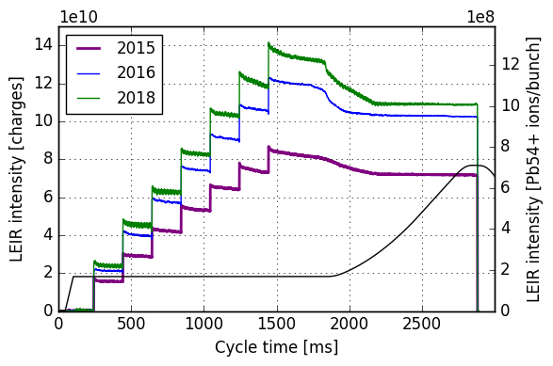
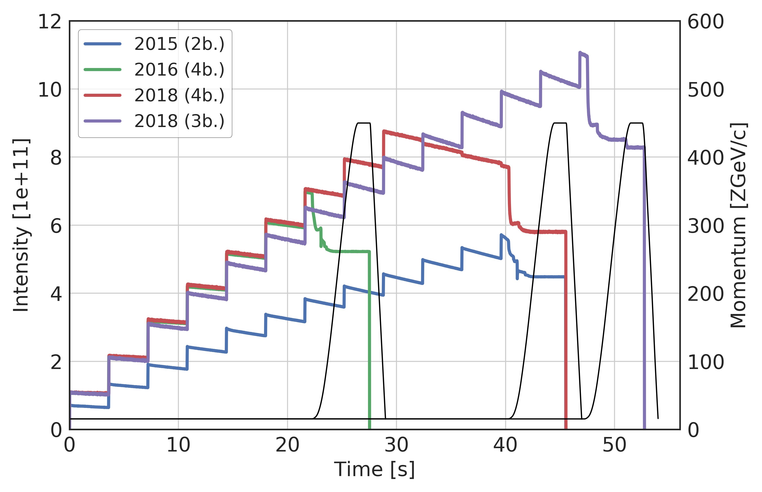
Beam commissioning: beam parameters pre-LS2 performance
Beam | Mean (e10 c) | Typical (e10 c) | LIU (e10 c)
4 b – 100 ns | 9.4 | 9.7 | 8.8
3 b – 75 ns | 9.1 | 9.4
2018
LEIR
2016
2015
LEIR extracted intensity from LHC luminosity production fills in 2018
2018 (3b)
SPS
Pre-LS2 performance will have to be achieved up to the exit of PS with “almost” untouched machines
Pre-LS2 performance will have to be achieved up to the exit of SPS with a new (LL)RF system
The SPS will commission a completely new beam “SLIP STACKING BEAM” with LIU performance in 2021
2018 (4b)
2016 (4b)
2015 (2b)

Slide 5
New systems to commission with beam
Need to prepare a detailed plan, discussions with RF team on going
LINAC3:
  RF amplifiers (5kW) & LLRF systems for the buncher, the debuncher and the ramping cavities
    3 months of HWC: new devices, new controls, logging, high level software
    3 months of “intermittent” BC in 2020 (when beam available from source)
TRANSFER LINE LINAC3 to LEIR:
    New acquisition electronics for BPMs
    One vertical slice tested and debugged in 2018 ➔ very good results and under specifications
LEIR:
    Upgrade of some PC controls to FGCs
SPS new LLRF:
  Fixed frequency acceleration for EARLY (NA) and multi-bunch 100 ns & 75 ns:
  Slip stacking
Reliability/stability items to keep performance!!
Need to prepare a detailed commissioning plan, discussions with RF team on going
Beam performance improvement!!

Slide 6
Overall hardware and beam commissioning DRAFT planning
2020
May
Jun
Jul
Aug
Sep
Oct
Nov
Dec
LINAC3 ventilation commissioning
ITH/LBS etc HWC
TL Polarity checks
(Technical services needed in the TL)
Source HWC
Source BC (test mode)
When beam available from source
Needs careful planning
Goal: LINAC3 (new) RF fully commissioned before 2021
LINAC3 RF & New LLRF HWC
LINAC3 RF & New LLRF BC
LINAC3 HWC (1)
PS Switch Yard closes
TL HWC
LINAC3 RF light(2) maintenance starts
Hardware commissioning (HWC)
Stripper foils characterization
Beam commissioning (BC)
(1) Everything else
(2) No new installations
Full LINAC3 set up and characterization up to LBE&LBS
40% beam time to TL for BC + new BPMs BC
LBE/LBS tests with ions, including controls aspects, foreseen in 2019 LBE run and end 2020

Slide 7
Overall hardware and beam commissioning DRAFT planning across the ion injector chain
2021
Jan
Mar
Oct
Apr
Jun
Jul
Aug
Sep
May
Feb
Source BC
LINAC3 BC
Demonstrate 2018 LEIR performance with 100 & 75 ns
Note: LEIR commissioning under responsibility of SPS ➔ shared manpower for both machines
Source in final configuration
LEIR
IST
HWC
TL BC
RBC
Beam to LEIR W16
PS
Source start up
End LINAC3 RF & light maintenance
Beam to PS W18
SPS
1,2-injections
Sep, Oct, Nov
Beam to SPS W23
4b-100 ns, 3b –75 ns, NA61
New LLRF: Fixed Frequency Acceleration (FFA)
New LLRF: transition crossing stability + SPS Slip Stacking
SPS ion commissioning: blocks of “x days”/week (with highest priority w.r.t. other MD or commissioning activities) in parallel to NA & LHC physics. “x” will be defined as soon as we get a commissioning plan from RF team.
Dedicated MDs (1,2) needed to achieve pre-LS2 performance for 3 b – 75 ns with all injections before LHC ion run
EARLY
4b – 100 ns
3b – 75 ns

Slide 8
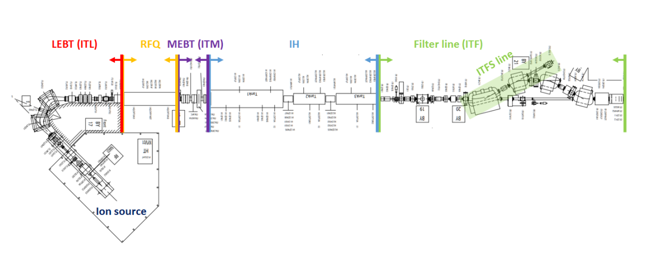
Beam commissioning time line: Pb source (final configuration)
M1: source start-up
M2: source conditioning to full performance
2021
W1 | W2 | W3 | W4 | W5 | W6 | W7 | W8 | W9 | W10 | W11 | W12 | W13 | W14 | W15
Source
Activity | Related tasks | Tools | Time | Groups
Start-up | Test source sub-components Plasma conditioning HT conditioning | LEBT | 1 week | ABP
Source conditioning to full performance | LEBT tuning | LEBT RFQ | 3 week | ABP
Note: ion commissioning takes place during working hours and mostly driven by experts, i.e. 1 week = 5 working days

Slide 9
Beam commissioning time line: LINAC 3
M3: first beam down LINAC3 + measurements
2021
W1 | W2 | W3 | W4 | W5 | W6 | W7 | W8 | W9 | W10 | W11 | W12 | W13 | W14 | W15
Source
Activity | Related tasks | Remarks | Tool requirements | Time | Group
RFQ and buncher phase amplitude to ITFS | First beam transfer to ITFS line |  | All magnets. Scanning scripts SEMGrids | 2d | ABP
MEBT Emittance |  |  | Emittance measurement tool SEMGrids | 3d | ABP
CAV1/2/3 phase amplitude to ITFS |  |  | All magnets. Scanning scripts SEMGrids | 2d | ABP
Stripper Measurements |  | If not done or completed in 2020 | Stripper controls, slits, BCTs | 2d | ABP

Slide 10
Beam commissioning time line: LINAC 3
M4: complete measurements
2021
W1 | W2 | W3 | W4 | W5 | W6 | W7 | W8 | W9 | W10 | W11 | W12 | W13 | W14 | W15
Source
Linac3
Activity | Related tasks | Tool requirements | Time | Group
Ramping cavity phase scan |  | SEMGrids | 1d | ABP
LBS Test |  | Master Slave Line controls working. LBS working. | 2d | ABP
Debucher phase scan |  | LBS | 1d | ABP
ITH Emittance Scan |  | Quad Scan application | 1d | ABP

Slide 11
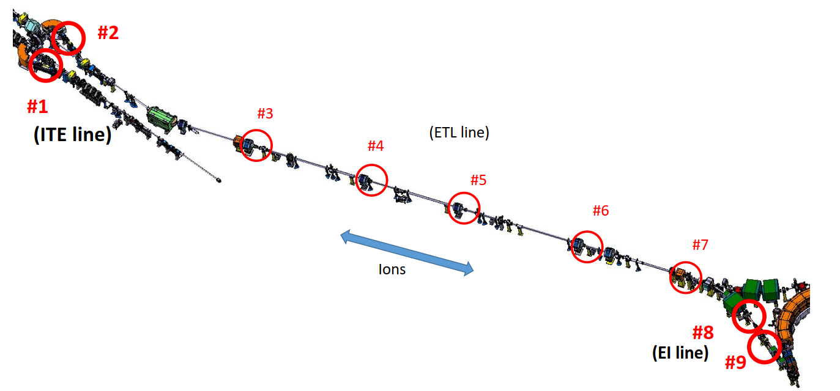
Beam commissioning time line: TRANSFER LINE (TL)
M5: TL beam commissioning + new BPMs
2021
W1 | W2 | W3 | W4 | W5 | W6 | W7 | W8 | W9 | W10 | W11 | W12 | W13 | W14 | W15
Source
Linac3
TL
(ETL line)
New TL injection BPMs
LINAC3
Activity | Related tasks | Tool requirements | Remarks | Time | Groups
TL BC | Beam steering | BTVs, Sem GRIDs, new BPMs | Partly done in 2020 | 2W | OP, BI, ABP
 | New BPM commissioning | new BPMs
 | Beam instrumentation commissioning | BTVs, Sem GRIDs, BCTs
 | Optics measurements | new BPMs
LEIR

Slide 12
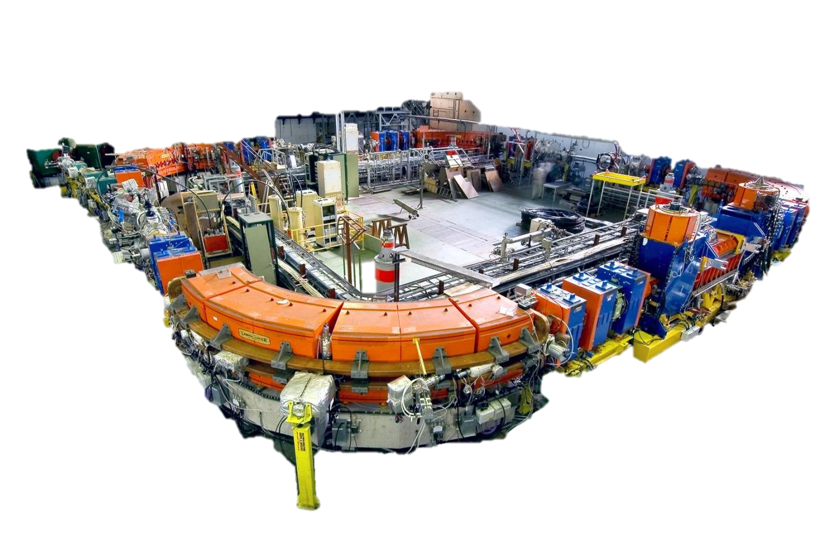
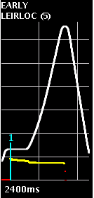
Beam commissioning time line: LEIR - EARLY
M6: EARLY beam (1 injection) ready for PS
2021
W1 | W2 | W3 | W4 | W5 | W6 | W7 | W8 | W9 | W10 | W11 | W12 | W13 | W14 | W15
Source
Linac3
TL
LEIR
Activity | Related tasks | Tool requirements | Group | Time
Transfer line steering and injection | Beam steering and kick response First injection optimization | BTV, BPM, BCT, YASP | OP, BI, ABP | 2 d
Establish circulating beam, RING BI beam commissioning | E-cooler optimization, orbit correction, Q&Q’ correction, kick response, injection optimization, BI commissioning | e-cooler, Schottky monitor, BPM, BCT YASP, Q&Q’ app, automatic injection optimization app | OP, BI, ABP | 2 d
Set up RF capture and acceleration | Commissioning of isoadiabatic capture h=1, loops commissioning, extraction synchro loop | Longitudinal Schottky, tomoscope | OP,RF | 3 d
Orbit, Q&Q’ correction through the cycle | Orbit, Q&Q’ correction through the cycle Kick response | YASP, Q&Q’ app | OP, ABP | 1 d
Setting up extraction | Extraction bump optimization, TL steering to PS, LEIR to PS synchronization | BPM, YASP, BCTs properly gated | OP, ABP | 2 d

Slide 13
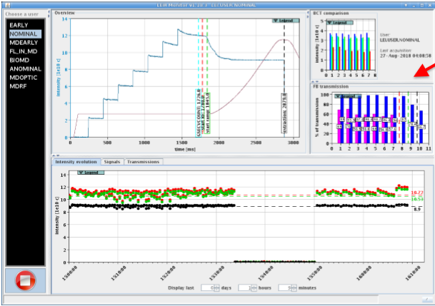
Beam commissioning time line: LEIR - NOMINAL 4b – 100 ns
M7: 4b – 100 ns beam (7 injection) ready for PS
2021
W1 | W2 | W3 | W4 | W5 | W6 | W7 | W8 | W9 | W10 | W11 | W12 | W13 | W14 | W15
Source
Linac3
TL
LEIR
Activity | Related tasks | Tool requirements | Groups | Time
Orbit correction at injection | Orbit correction at injection (exclude injection bump, 1 injection) | BTV, BPM, BCT, YASP | OP, ABP | 3 d
Maximize momentum acceptance | Match capture fRF with frev Set injected beam +1º/_{oo} off frev Set stack beam -1º/_{oo} off frev Optimize capture Flat orbit at radial pickups | e-cooler, Schottky monitor, BPM, BCT | OP, ABP
Optimize injection efficiency | Run injection optimization: injection bumps, e-cooler bumps, etc | Automatic injection optimization app | OP, ABP
RF capture with frequency modulation | First RF capture with frequency modulation | Schottky monitor, tomoscope, BCT | OP, RF, ABP
Orbit, Q&Q’ correction at through cycle | Orbit, Q&Q’ correction through the cycle Kick response | YASP, Q&Q’ app | OP, ABP | 2 d
Single injection

Slide 14
Beam commissioning time line: LEIR - NOMINAL 4b – 100 ns
Draft
M7: 4b – 100 ns beam (7 injection) ready for PS
2021
W1 | W2 | W3 | W4 | W5 | W6 | W7 | W8 | W9 | W10 | W11 | W12 | W13 | W14 | W15
Source
Linac3
TL
LEIR
Multiple injection
Activity | Related tasks | Tool requirements | Groups | Time
Orbit bump in SS4 | Orbit bump in SS4 at injection to minimize vacuum pressure | YASP, vacuum profiles, BCT | OP, ABP | 1 d
Three injections | Optimize e-cooler | Schottky monitor, IPM, BPM, BCT, YASP | OP, ABP
Seven injections | Optimize e-cooler Transverse damper commissioning | e-cooler, Schottky monitor, IPM, BPM, BCT, YASP, TFB | OP, ABP
Orbit, Q&Q’ correction through the cycle | Orbit, Q&Q’ correction through the cycle Kick response | YASP, Q&Q’ app | OP, ABP

Slide 15
Beam commissioning time line: LEIR - NOMINAL 4b – 100 ns
Draft
M7: 4b – 100 ns beam (7 injection) ready for PS
2021
W1 | W2 | W3 | W4 | W5 | W6 | W7 | W8 | W9 | W10 | W11 | W12 | W13 | W14 | W15
Source
Linac3
TL
LEIR
Activity | Related tasks | Tool requirements | Groups | Time
RF capture with frequency modulation | Optimize RF capture with frequency modulation for high intensity | Schottky monitor, tomoscope, BCT | OP, RF, ABP | 2 d
E-cooler current optimization | Optimize e-cooler gun current Optimize e-cooler bump | e-cooler, Schottky monitor, BPM, BCT YASP | OP, ABP | 1 d
B field decay measurement and correction | B field decay measurement Optimize accumulation | New implementation of the decay in LSA, Longitudinal Schottky, YASP, BCT | OP, ABP
Q 2.75 during capture | Bring Q towards 2.75 during capture | YASP, Q&Q’ app | OP, ABP
Extraction setting up | Match extraction settings to EARLY | BPM, YASP, BCTs properly gated | OP, ABP | 1 d
Multiple injection

Slide 16
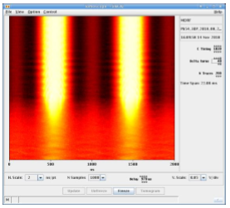
Beam commissioning time line: LEIR - NOMINAL 3b – 75 ns
M8: 3b – 75 ns beam (7 injections)
2021
W1 | W2 | W3 | W4 | W5 | W6 | W7 | W8 | W9 | W10 | W11 | W12 | W13 | W14 | W15
Source
Linac3
TL
LEIR
Activity | Related tasks | Tool requirements | Groups | Time
Clone 4b – 100 ns cycle to 3b – 75 ns cycle | Clone cycle Commission new cycle with beam at injection | All | OP, ABP | 2 d
RF capture with frequency modulation | Optimize RF capture with frequency modulation | Schottky monitor, tomoscope, BCT | OP, RF, ABP | 2 d
Extraction setting up | Match extraction settings to EARLY | BPM, YASP, BCTs properly gated | OP, BI, ABP | 1 d
W15: Contingency week: need to accommodate oven refills
1
2
3
Note: ion commissioning takes place during working hours and mostly driven by experts, i.e. 1 week = 5 working days, LEIR expert manpower considerably reduced

Slide 17
SPS (slip-stacking) ion beam commissioning
Three major milestones:
  Recover pre-LS2 performance of “3 b – 75 ns” with new LLRF ➔ mitigation beam for LHC 2021 ion run (June – August)
  Commissioning of slip-stacking functionality of LLRF with beam (September – November)
  “In parallel” ➔ Ensure ion beam stability throughout transition crossing and beyond ➔ proposed tools: controlled emittance blow up and 800 MHz (September – November)

Slide 18
Risks and mitigations
Risk: Source tests destabilize performance
Mitigation: Early restart for these tests, and time to rollback to 2018 set-up ready for LEIR restart
Risk: LINAC3 RF modifications
Mitigation: Early test of performance in 2020, well in advance of LEIR restart.
Risk: LEIR in shut down for 2 years ➔ LEIR vacuum
Mitigation: Ask for surveillance of the LEIR vacuum “critical item for ions” during LS2 by VSC
Risk: LEIR “expert” operation manpower considerably reduced
Mitigation: early commissioning start, thorough documentation, automatic tools

Slide 19
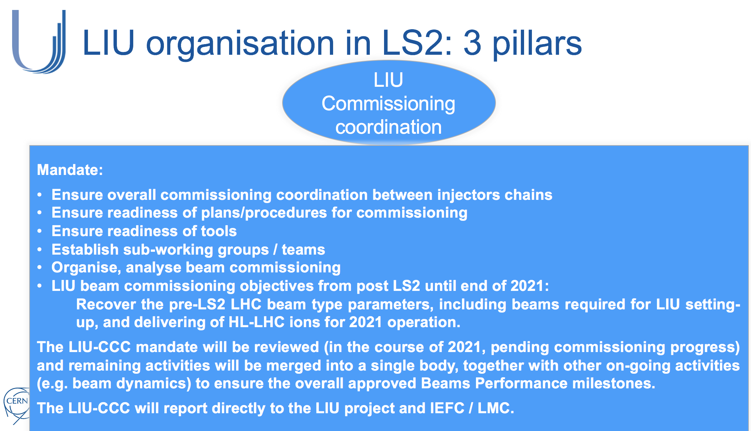
Risks and mitigations
Risk: New SPS (LL)RF system which needs the completely new slip-stacking mechanism to deliver HL-LHC ion beam to LHC in 2021
Mitigation: 3 b – 75 ns beam to LHC in 2021 with 2018 performance ➔ 70% of HL-LHC requirement

Slide 20
Summary
Linac3:
  Will have a significant 2020 test period and RF commissioning. 2021 restart is then fast.
LEIR:
  Planning for beam commissioning is optimized, clear and tight.
SPS ion beam commissioning: three well defined milestones:
  Mitigation beam: 3 b – 75 ns with 2018 performance (with new LLRF)
  Slip-stacking
  Systematic studies/cure transition crossing instabilities
Next steps:
  Circulate this schedule to relevant parties for comments
  Clarify services requirements for hardware testing of transfer line elements in May 2020
  Elaborate a more detailed RF commissioning plan (Linac3 and SPS)

