Slide 2
LHC Injectors Upgrade Workshop
Montreux, 13-15 February 2019

Slide 3
Wrap-up
A. Huschauer, V. Kain

Slide 4
Milestone for commissioning of Injectors: beam availability for the LHC
4th of March, 2021: injection of LHCPROBE beam into the LHC

Slide 5
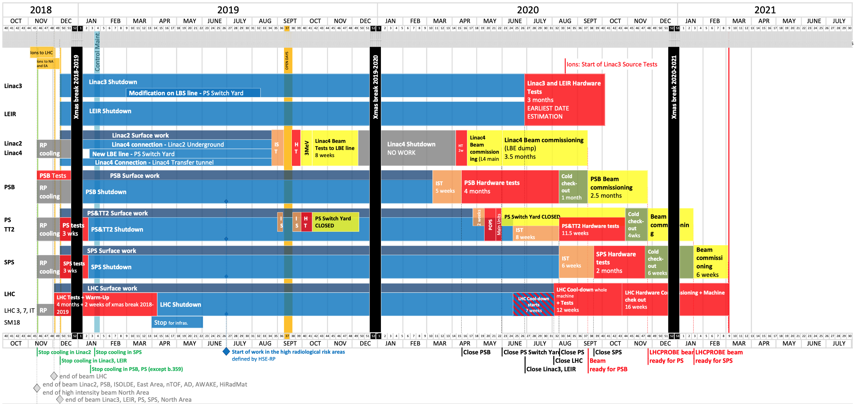
Status of , and
IST
HWC
BC
Strategy and organization defined
  Global effort across the complex
First solid versions of beam commissioning planning available
  Main focus so far on p+ for LHC
Details for IST, HWC and check-out to come
  Needs definition of all operational scenarios
Milestone for end of 2019: IST, HWC planning to be worked out in sub-working groups
  IST identification, planning/coordination and risk analysis
  Including safety aspects and resources
shutdown
run 3

Slide 6
Hot topics I
Cross-machine coordination is crucial → definition of priorities
  Same equipment experts (POPS - POPS-B, beam instrumentation), same OP teams (LINAC4 – PSB, LEIR – SPS,…)
  Piquet/expert shifts during commissioning?
  Switch yard open/closed/open/closed
  Procedures, documentation, ...
Christmas shutdown 2020 – how to minimise the time lost?

Slide 7
Hot topics II
Startup of fixed target physics
Performance tracking and online analysis
  Beam rather than machine centric
  Indispensable considering the HL-LHC requirements presented by Rogelio (fill length, bunch-by-bunch variations, ...)
Establishment of a forum to discuss operational aspects

Slide 8
Software and tools
The invisible block in the master schedule
  Development pursued in parallel to the shutdown activities
Only starting to review processes across machines
  → Injector settings management working group
  Is this enough?
More efficient machine operation:
  Optimization/machine learning algorithms
  enough priority and man power allocated?

