Slide 2
LHC Injectors Upgrade Workshop
Montreux, 13-15 February 2019

Slide 3
Linac4 and LBE Line Commissioning
B. Mikulec for the Linac4 team

Slide 4
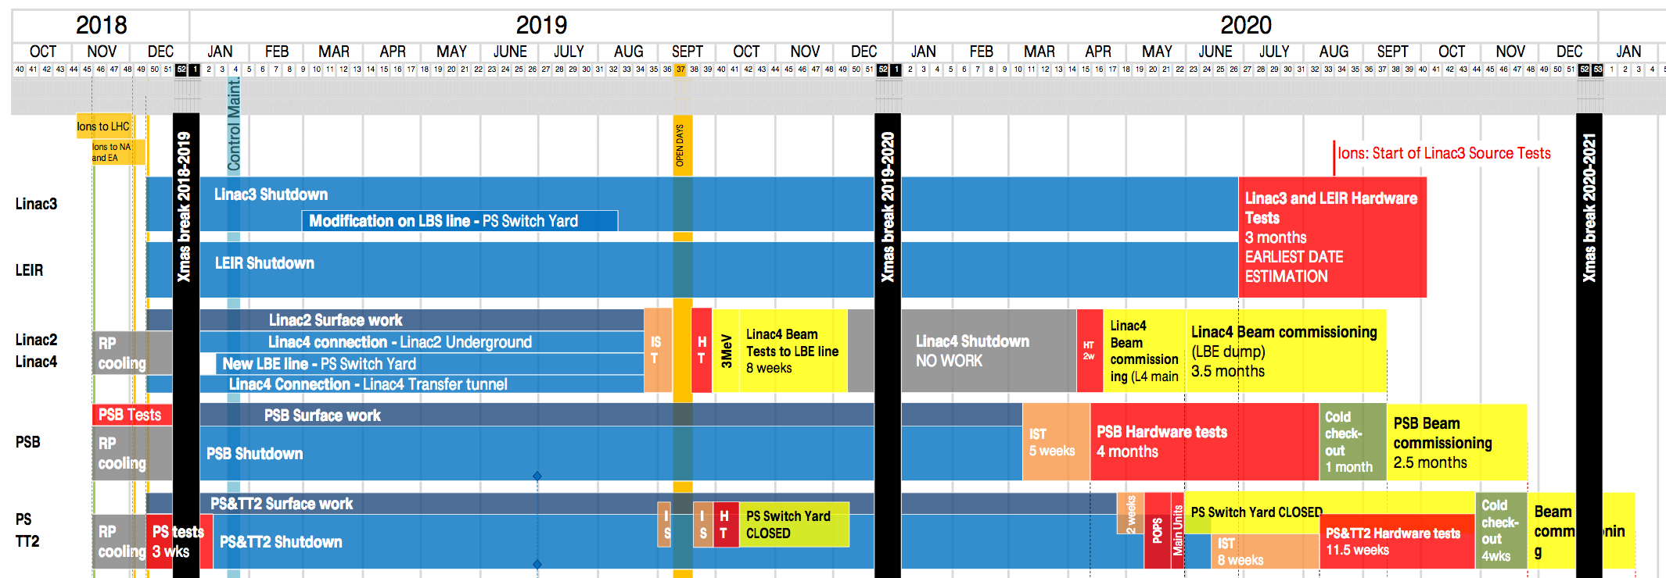
LS2 Master Schedule
For Linac4 commissioning, beam to LBE line most relevant, although difficult to arrange (blocks access to PS Switchyard)
First LBE line run September - December 2019 to mitigate risks for post-LS2 restart
  Second level
    Third level
      Fourth level
        Fifth level
We are here!

Slide 5
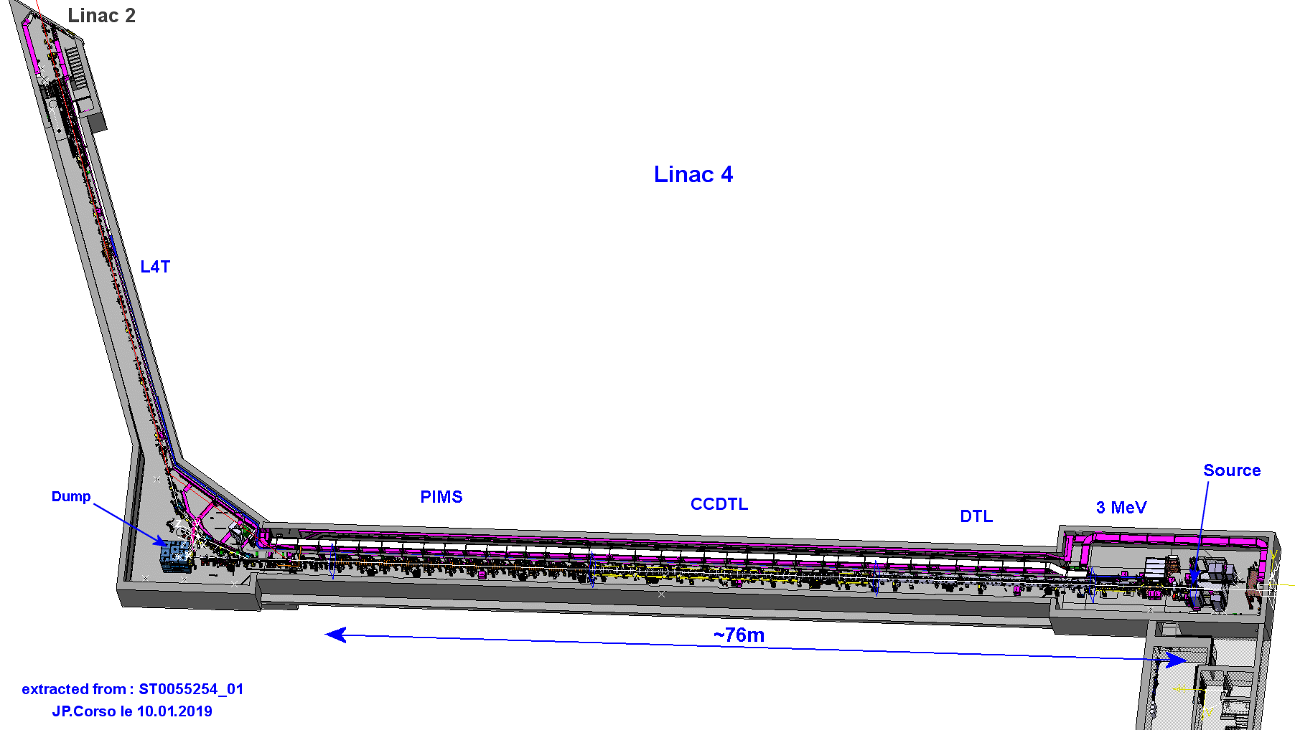
LINAC4 - layout
Vertical step to connect to LT, LTB and BI lines
in Linac2/PS tunnel
Pre-injector
3 MeV
Source(s) @ 45 kV
2 solenoids
RFQ (1 Klystron)
11 EMQ
3 Buncher Cavities
2 Chopper units
+ dump
Debuncher
Cell-Coupled Drift Tube Linac
100 MeV
7 Modules
6 Klystrons
7 EMQ
7 steerers
14 PMQ
25 m
Π-mode Structure
160 MeV
12 Modules
6 Klystrons
12 EMQ
12 steerers
23 m
Drift Tube Linac
50 MeV
3 Tanks
3 Klystrons
1 EMQ
2 steerers
114 PMQ
19 m

Slide 6
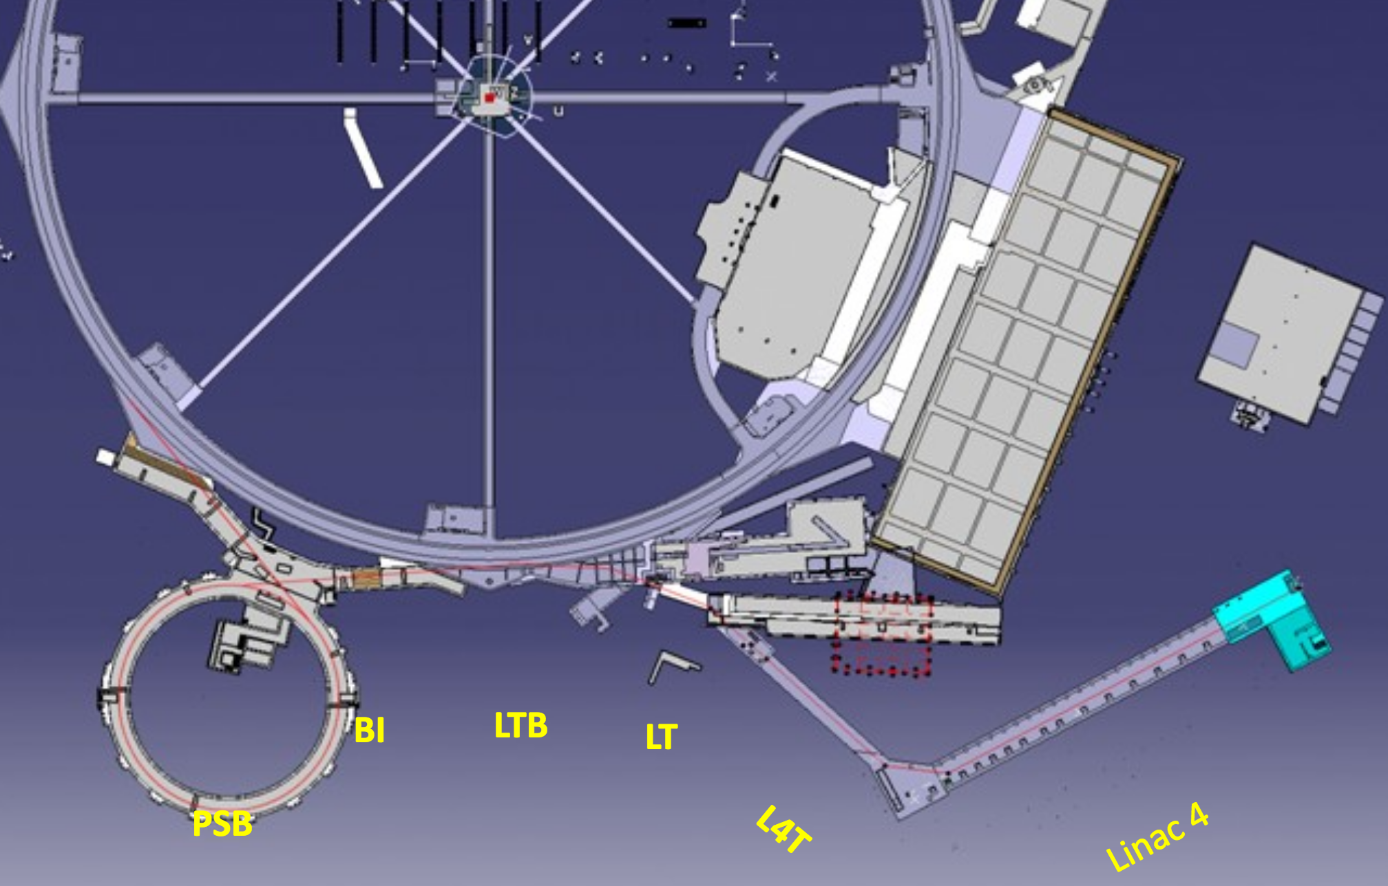
Transfer Lines
LBE
~177 m from PIMS exit to PSB foil: L4T ~70 m (to LT.BHZ20) and LT/LTB/BI lines ~107 m
Commissioning of ~170 m of transfer lines (half of L4T, LT, LTB and the LBE emittance measurement line) in 2019 run with >50 active elements
  In addition 5 horizontal and 2 vertical bending magnets → dispersion control in both planes essential

Slide 7
2019 LBE Line Run

Slide 8
2019 LBE Run Goal
* https://edms.cern.ch/document/1898179/1.1
Approach specified* beam quality as closely as possible before LS2 commissioning and identify potential remaining issues → risk mitigation for provision of post-LS2 beams in time and within specifications
  Many important parameters could not be tested before (not possible with Linac4 in stand-alone)
  Various modifications during LS2:
    Renewed transfer lines and LBE line → new equipment
    Cabling/decabling campaigns (in particular in PS)
    Controls changes (LS2 baseline, new FESA3 version and 64-bit OS, Linac4 → PSB timing domain, MTG…)
    Interlock changes
    Important new features for LL-RF: feedback and feedforward algorithms, energy/phase ramping, 600 μs pulse length compatibility…
    New applications
    Test bed for important new features for future operation like ‘upgraded’ checklists, transactional settings, SIS, power converter interlocks, reinforcement learning…
  Transfer lines with several bending magnets → need to control dispersion and explore matching phase space
  Transverse and longitudinal beam characterisation near PSB injection point

Slide 9
The 12 Top Ingredients of the 2019 LBE Line Run
In 2019:
4 weeks of beam tests to LBE (excluding HW + beam commissioning)
Test principles and identify issues
Not sufficient time to go into all details
Notes:
4 weeks of beam for important last 2 points + debuncher + LLRF FB/FF

Slide 10
2020 Linac4 Restart

Slide 11
2020 Linac4 Restart - Goals
Timely provision of all requested beams to the PSB with pre-LS2 specifications
  For commissioning of PSB and all downstream machines
  First physics beams
In theory no modifications planned after 2019 LBE line run, BUT
  Might need to test potential LL-RF modifications (as a result of the 2019 LBE line run) in case cavity beam loading could not be sufficiently compensated by new proposed algorithms
  Will need to go into more detail for optimisations of LL-RF algorithms, longitudinal painting + chopping, optics
  Increased functionality of source Autopilot and evaluation of steering/matching automatization algorithms
    No source modifications planned after 2019 LBE line run → should have ~26 mA at LBE
Set up and test all operational beams
  Optimise all cycle-dependent settings, including interlocks/watchdogs/BLM thresholds
  Evaluate under final conditions full ppm operation (e.g. for debuncher and long. painting)
Notes:
In case of a source current increase, might have to exchange some klystrons (at their power limit) and would need adaptations for RF and BI.

Slide 12
2020 Linac4 Restart – Additional Remarks
OP will invest in this period to evaluate for future reference the minimum Linac4 restart time after periods with only minor modifications (like after a YETS)
  Deploy the usual shift arrangement for this period (M/A shifts during HW commissioning, full MAN during basic beam commissioning to the Linac4 dump)
  Remark: the PSB will also restart HW commissioning in April 2020 (same team of operators)
  For a representative evaluation there should be a piquet service available for the BC phase (tbd)
Start in current LS2 Master Schedule: w15 2020 with HW commissioning (2 weeks)
  Plan to start actually with 1 week of IST, followed by 2 weeks of HW commissioning (2 weeks from summer 2018 experience where HW commissioning was under OP responsibility) → total: 3 weeks
Continue with beam commissioning to the Linac4 dump with aggressive schedule
  OP will gain experience with Linac4 beam commissioning during 2019 LBE line run (until then, BC was under ABP responsibility) – this will help refining the 2020 beam commissioning planning
  Current estimate for this phase: 2.5 weeks (was 1 month after summer 2018); beam commissioning running in parallel with RF setup, which requires 2 weeks from RFQ to the last PIMS cavities; half a week for final equipment tests at 160 MeV and longitudinal + transverse beam characterisation
  Will adapt ‘online’ according to advancement

Slide 13
Milestones for Pre-Requisites
2019:
End June 2019: CO Linac4 LS2 baseline deployed, FESA classes ready
End July 2019: settings management/LSA changes implemented for LBE line run
End August 2019: most applications ready (with very few agreed exceptions)
Successful 2019 LBE line run and clear identification of all remaining open issues
2020:
13th January 2020: final CO LS2 baseline release for injectors
February 2020: update of checklists finished; release of online planning (ASM)
End March 2020: all services available, settings management/LSA changes (incl. optics) implemented for PSB connection, DB logging reviewed; all applications ready
DSO tests and HW/beam permits OK in time for start of IST/HW commissioning

Slide 14
2020 Basic Beam Commissioning to Linac4 Dump (Phase 1)
Start source
IST finished
HW comm. finished
Basic beam comm. finished
Week 1 | Week 2 | Week 3 | Week 4 | Week 5 | Week 6 (1st)
For beam commissioning:
Activity | Related tasks | Tool requirements | Remarks | Estimated duration
Start-up of Linac4 source | Check source stability, e⁻ dump current etc. Partial verification of source Autopilot | Faraday Cup, BCT, Semgrid applications; pre-chopper; correctors; source BIC; Autopilot | ABP specialists | 3 weeks
Start-up of Linac4 RF systems | LLRF setup of all cavities (excl. debuncher) | Inspector | RF + EPC specialists | 2 weeks
LEBT/MEBT tuning, phasing in linac Recommissioning of instrumentation | RFQ transmission Pulse flatness Chopping efficiency Beam loading and ToF | Trajectories, ToF, BSM1… (full set of beam instruments and related applications) | Could profit from optimisation algorithms for transm./flatness | 2 weeks
Beam Characterisation | Long. + transv. measurements Steering to dump | Emittance meas. application | Check new optics (vert. emitt. meas.) | 0.5 weeks

Slide 15
2020 Beam Studies to Linac4 Dump
Stripping foil tests etc.
Beam tests to Linac4 dump in parallel to 2020 LBE line tests
Week 6 (2nd) | Week 7 | Week 8 | Week 9 | Week 10 | …
These activities could mostly run in parallel to beam being sent to LBE:
Activity | Related tasks | Tool requirements | Remarks | Estimated duration
Stripping foil tests | Test graphene foil for 1 new manufacturer Test another GSI amorphous C foil |  | Incompatible with beam operation to LBE and other measurements | 2 days
Tuning of source Autopilot | Source stability along pulse and pulse-to-pulse Check transmission and pulse flatness Continuous caesiation | Autopilot, BCTs, Timber | In parallel; reserve one cycle for this task | 4 weeks
Optimisation of LL-RF feed-back and feed-forward algorithms | Check compensation for cavity beam loading at each transition (R4!) | BSM, RF monitoring with Inspector | Small part can be done with beam to L4 dump, but then beam to LBE is needed. | Tbd based on experience from LBE line run

Slide 16
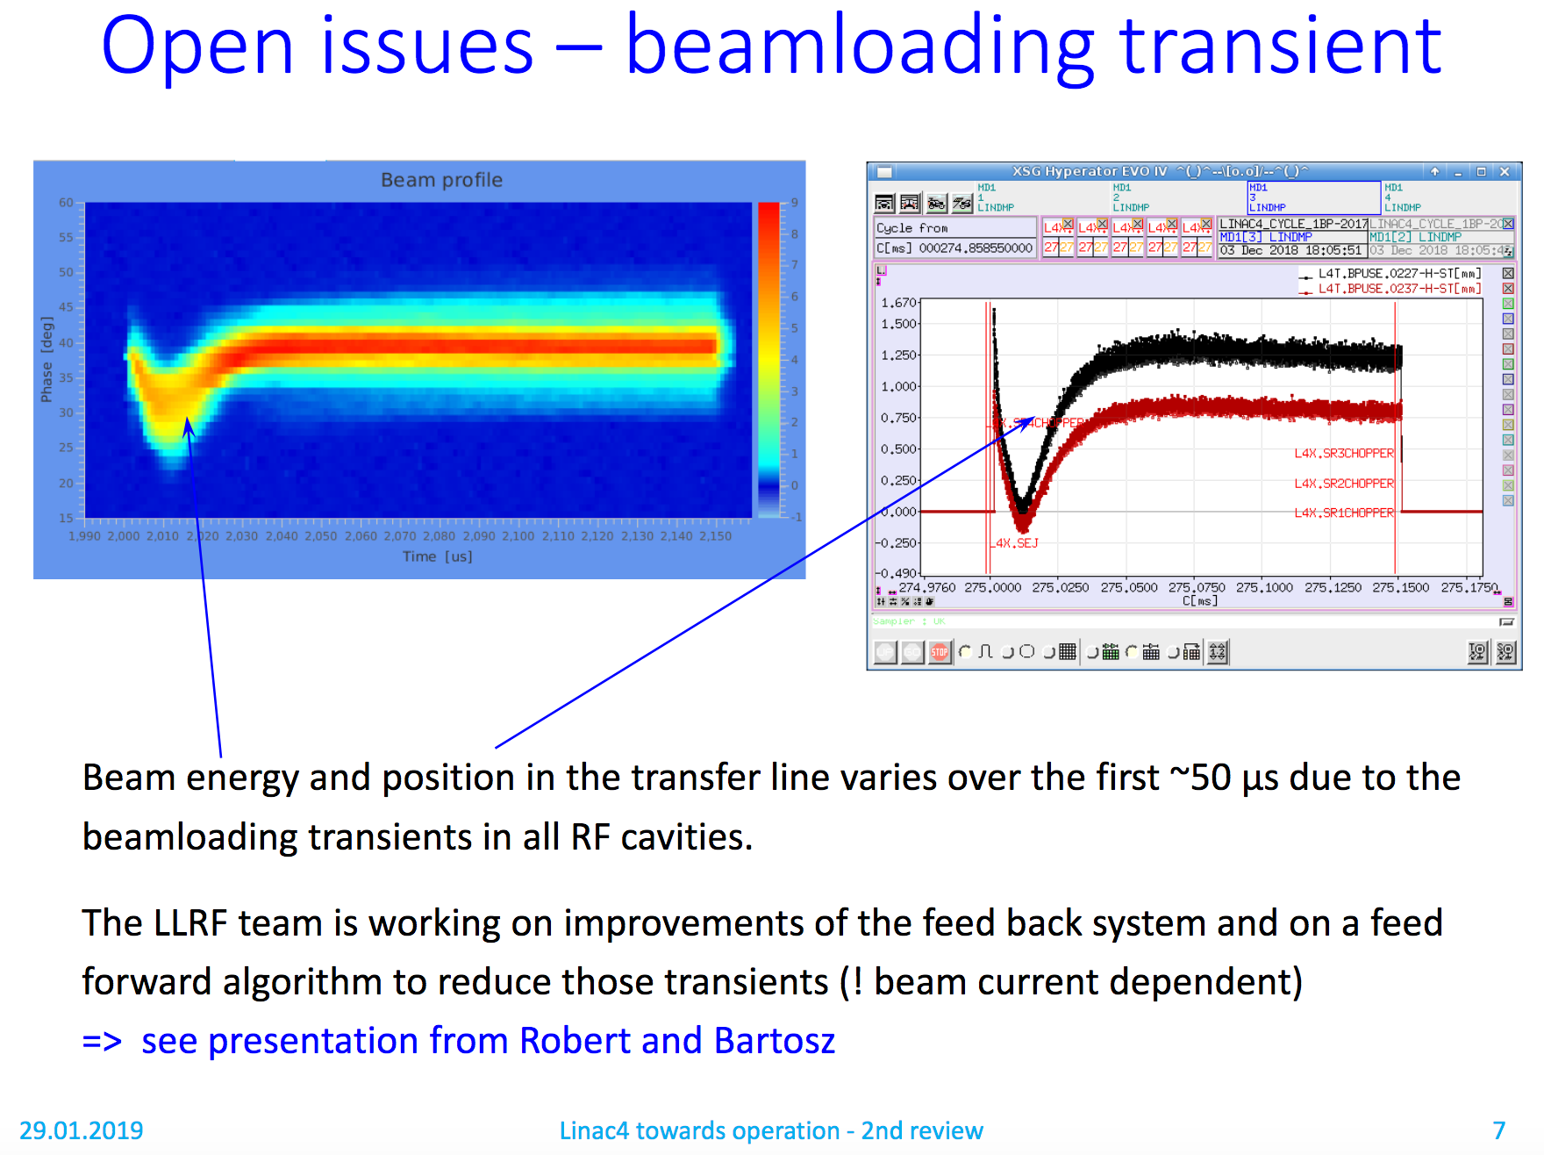
Effects of Cavity Beam Loading
‘Risk’ item, as no experience yet at Linac4 with compensation algorithms
First evaluation possible during 2019 LBE line run
Affects injection position/angle at PSB injection → degradation of transverse emittance
  Appears always for Ring 4 and at any abrupt transition in beam current (if longer than ~a few μs)
See slide R. Wegner @
2nd Linac4 towards Operation Review
https://indico.cern.ch/event/778856/

Slide 17
Phase 2: 2020 Beam to LBE
Most important part of Linac4 beam commissioning (debuncher in TL, dispersion…) starting beg. of June 2020 (w23)
Last chance to solve outstanding issues; final beam preparation and characterisation before injection into PSB
Operators back to M/A shift (have to handle in parallel PSB HW commissioning)
Co-activity issues: will certainly have to cede some beam time to PS/PSB/LEIR?
  IST and HW commissioning in parallel in PS Switchyard (PS and LEIR?) → in case of access need to stop beam to LBE
  HW commissioning in parallel in PSB → in case of access need to stop beam to LBE (new sectorisation)
  Need cross-machine optimisation of access requests; maybe slot in some optional access periods into Linac4 planning?
Question: piquet service during beam commissioning? Training of piquets?

Slide 18
2020 Beam to Linac4 LBE Line
TLs + LBE
re-commissioned
All beams ready
for PSB
Week 7 | Week 8 | Week 9 | Week 10 | … | Week 18
Activity | Related tasks | Remarks
Recommissioning of transfer lines and LBE | Magnet/power converter checks Interlock checks Instrumentation checks | Estimate: 0.5 weeks
Further optimisation of LL-RF feed-back and feed-forward algorithms | Have to include tests with by-ring interlocks | Highest risk item; duration will depend on outcome of 2019 LBE line run
Further optimisation for longitudinal painting (PIMS11/12, debuncher, chopper, controls, by-ring interlocks) |  | Detailed studies (not possible during 2019); use all cycles due to low duty cycle
Steering/matching studies for all use-cases
Work on final details to improve machine availability
Final optimisation of Autopilot, including continuous caesiation in view of PSB beam quality
Set up all commissioning and operational beams | Take transv. & long. reference measurements | ½ day per beam
Continuous running with concentrated MDs on the
individual subjects co-ordinated with specialist availability
Notes:
Beam time effectively reduced due to: Beam comm. during summer, access in SWY/PSB, low duty cycle, specialist availability might be reduced due to other LS2 activities

Slide 19
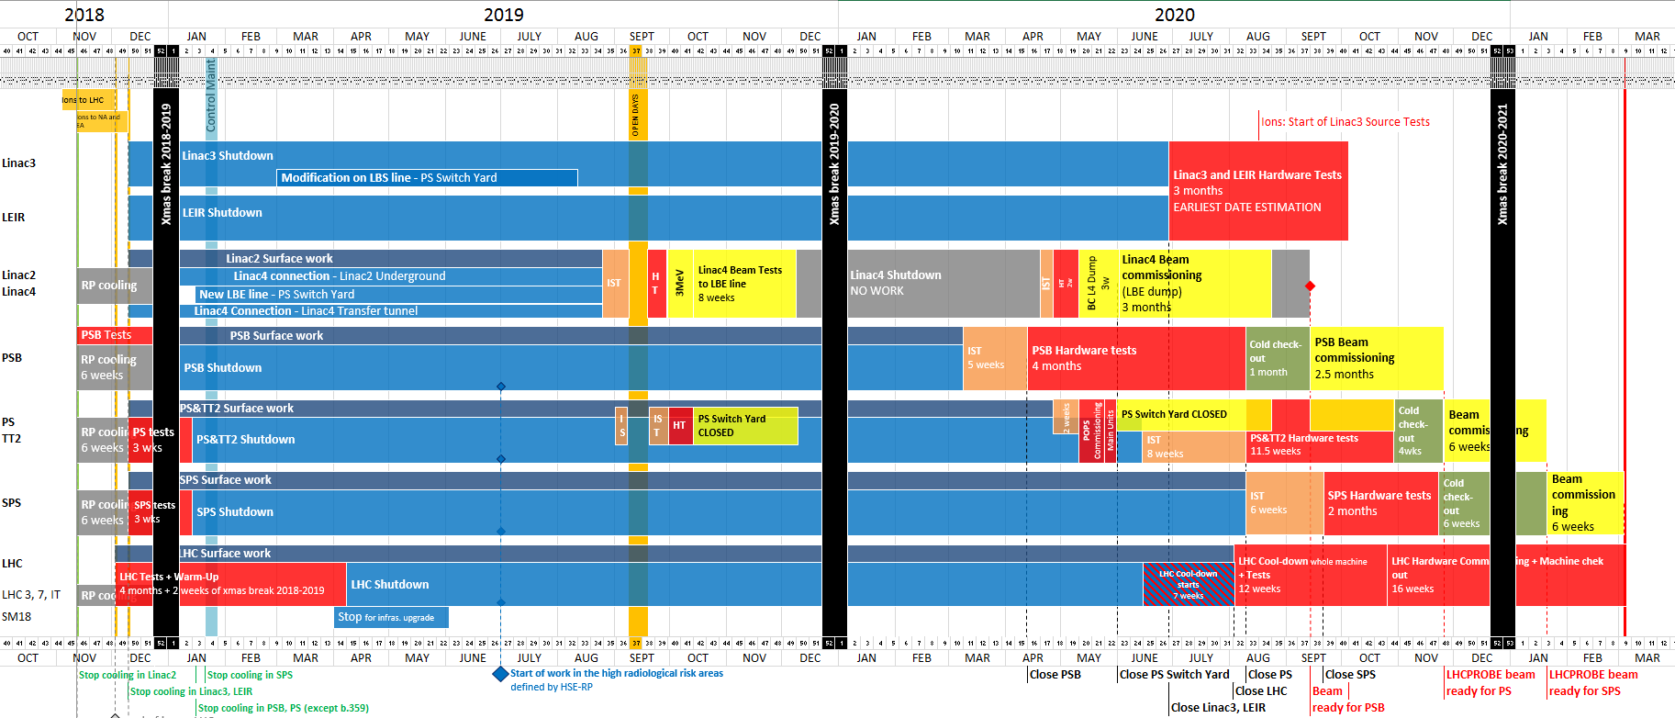
Proposed Modification to LS2 Master Plan
Courtesy J. Coupard

Slide 20
Summary
All beams necessary for the first few months will be prepared during the Linac4 beam commissioning to be ready for the PSB beam commissioning start
Simulation of min. start-up time for Linac4 after a YETS
Longitudinal painting is lower priority → could gain 4 weeks and delay Linac4 commissioning planning (gain time for PS SWY activities)
  Long. painting foreseen for highest intensity beams only (ISOLDE, TOF) → would mean to live without long. painting until ~2022 (might require dedicated MD time - tbc)
Proposed changes to LS2 Master Schedule: start with Linac4 commissioning 2 weeks later with 1 week of IST and target end of beam commissioning 3 weeks earlier than originally foreseen (mainly to free manpower)
  BUT: should keep this margin in case of issues with LL-RF algorithms (highest risk item)
  Could help in case PSB HW commissioning could be finished a few days earlier…
  Might need to delay whole block by ~1 week (tbc with PS and LEIR HW commissioning and POPS/POPS-B tests)
Proposal to re-assess the final planning in January 2020 once the LBE line run results are known → opportunity to optimise the planning across accelerator complex

Slide 21


