Slide 1


Accurate event localisation for pixelated direct electron detection using neural networks
Paul van Schayck
The Maastricht Multimodal Molecular Imaging Institute (M4I)
Division of Nanoscopy
Maastricht University, The Netherlands
iWORID 2019
2019-07-07
Notes:
Instructions:
Title has to fit in the white part
Your name has to follow the template: W.N. NAME
MEETING: name of the conference
Place: place where the meeting takes place
Date format: up to you

Slide 2
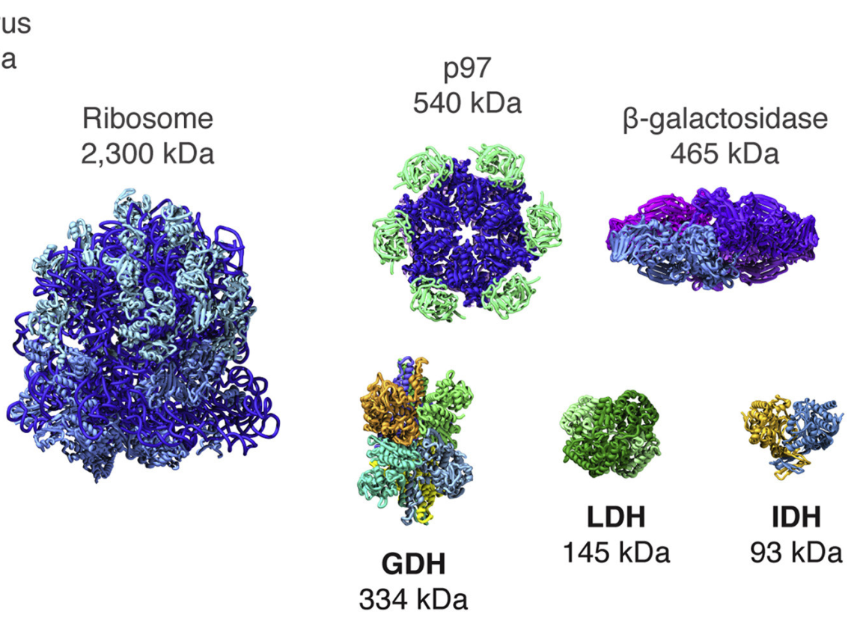
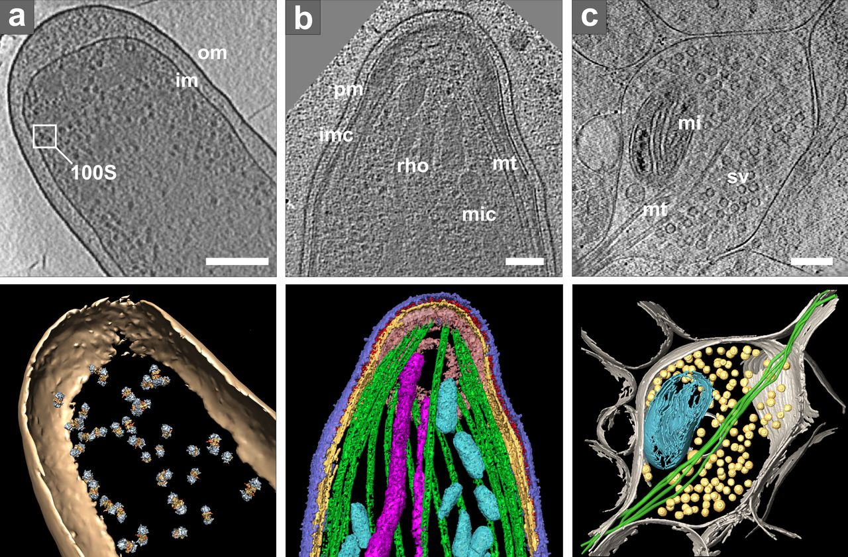
Structural biology has a new tool: cryogenic-electron microscopy
Resolving macro molecular structures using
Single Particle Analysis (SPA)
In situ structure determination using electron tomography of thin lamellae
J Cell Biol Aug 2013, 202 (3) 407-419;
Cell June 2016 165, 7, 1698-1707
Notes:
SPA:
No crystals required
In native conditions
No synchotron
ET:
Native conditions

Slide 3
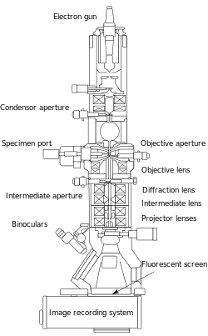
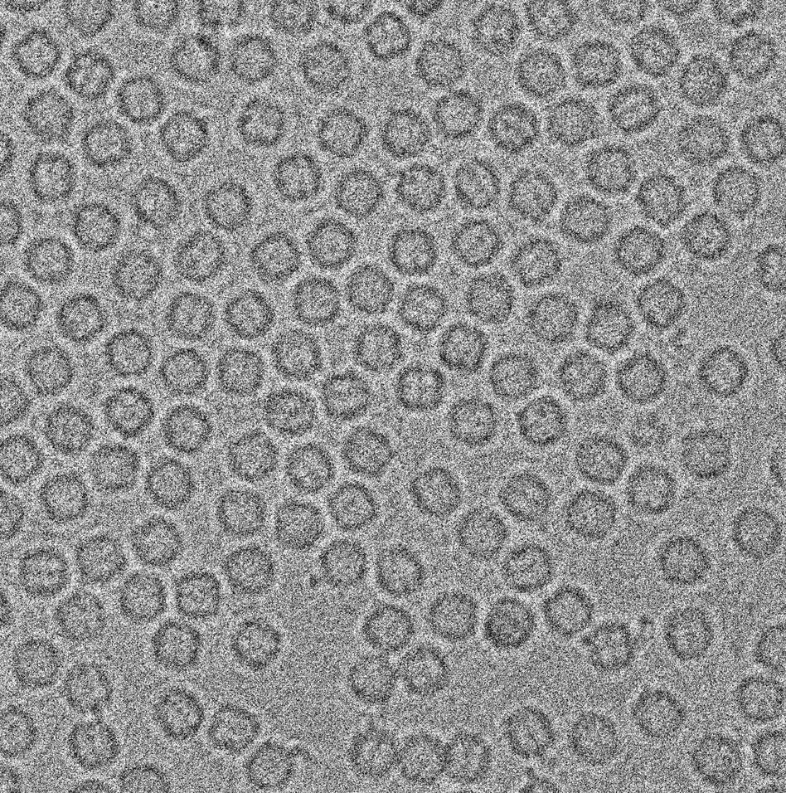
Biological samples are weak phase-contrast objects for EM
Micrograph of vitrified Apoferritin proteins
Micrograph of vitrified cellular structures
J Cell Biol Aug 2013, 202 (3) 407-419;
Cell June 2016 165, 7, 1698-1707
Notes:
No… they are increased contrast
Minimize noise added by the detector
Possible to identify side chains of amino acids
Possible to identify the individual subunits of the microtubuli

Slide 4
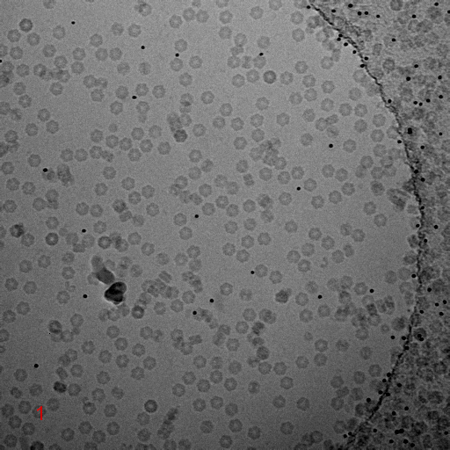
Biological samples are radiation sensitive
Radiation damage is an important limiting factor in cryo-EM
Only about 40 e⁻/Å² are possible
Corresponds to about 40-80 counts per pixel
Therefore: Every electron counts!
Karuppasamy et al., J. Synchrotron Rad. (2011). 18, 398-412

Slide 5
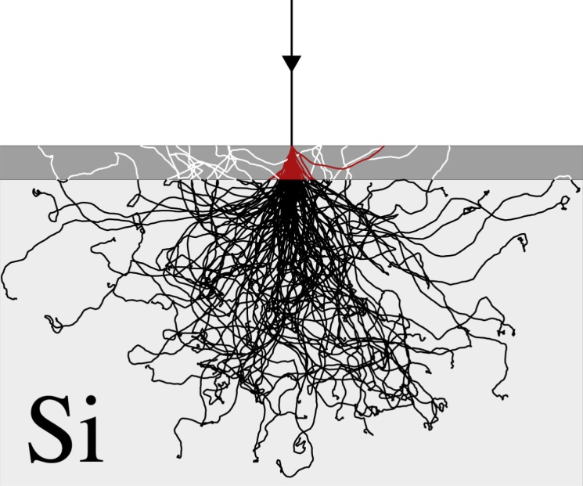
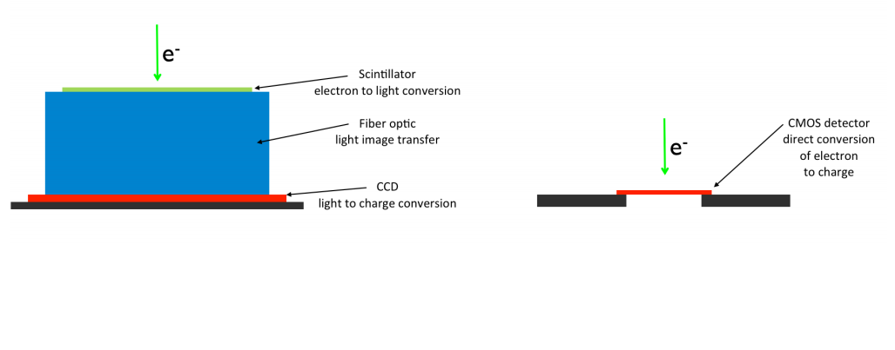
The advance of the direct electron detector
Monolithic Active Pixel Sensor
(MAPS)
Sensor back thinning to 30 µm to improve PSF
Notes:
Electrons are tricky!
Back thinning

Slide 6
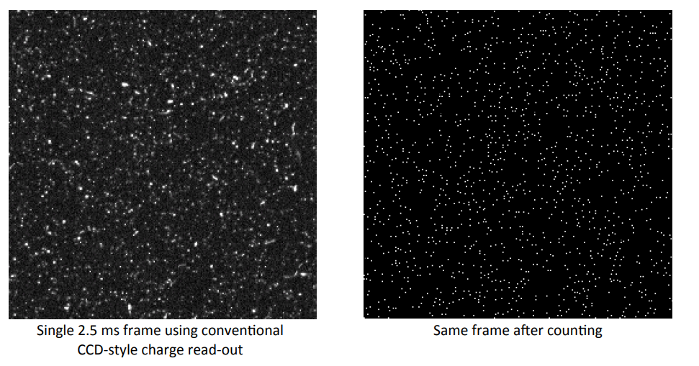
MAPS based direct electron detectors implement a digital counting mode
electron counting mode
Exposure times up to 60 seconds!
Problems:
Throughput
Drift

Slide 7
Electron detectors
Monolithic Active Pixel Sensor
(MAPS)
Timepix3
Hybrid Pixel Detector
Sensor layer separated from per-pixel electronics by bump bonds.
Integration and frame based
Low throughput
Works best at 300 kV
True counting detector
Sparse output
Throughput: 1 second
(High Dynamic Range)
(Radiation hardness)

Slide 8
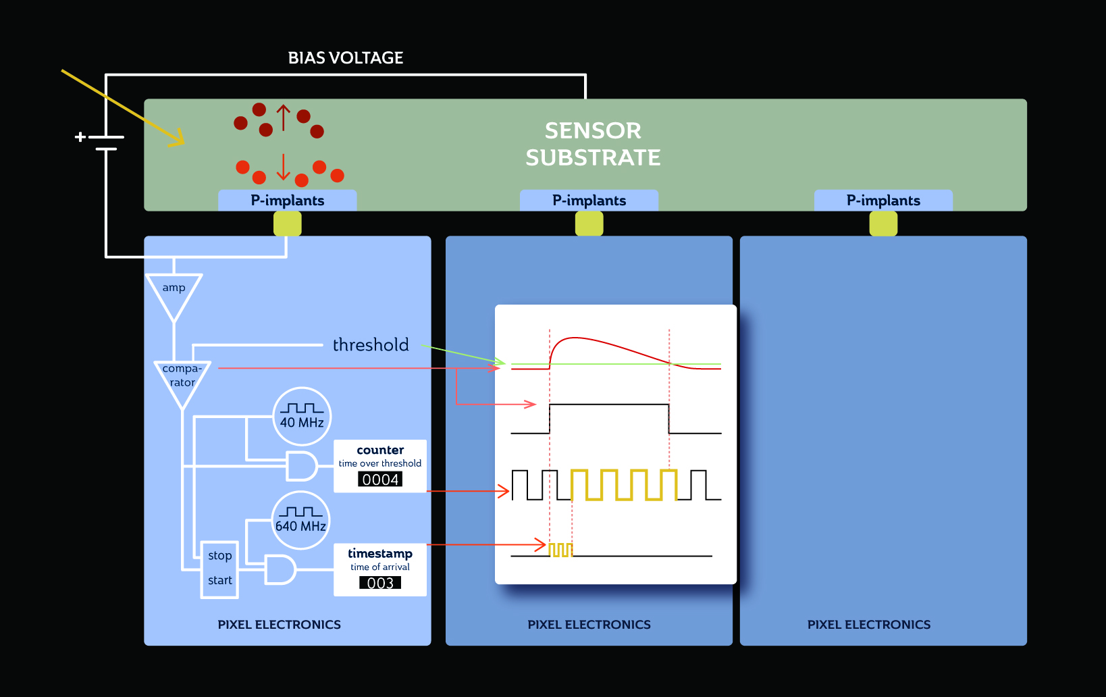
Timepix3: Hybrid Pixel Detector ASIC
Simultaneous ToT (energy) and ToA (timing)
Timing: 1.56 ns
Sparse readout
120 Mhit/s (for quad)

Slide 9
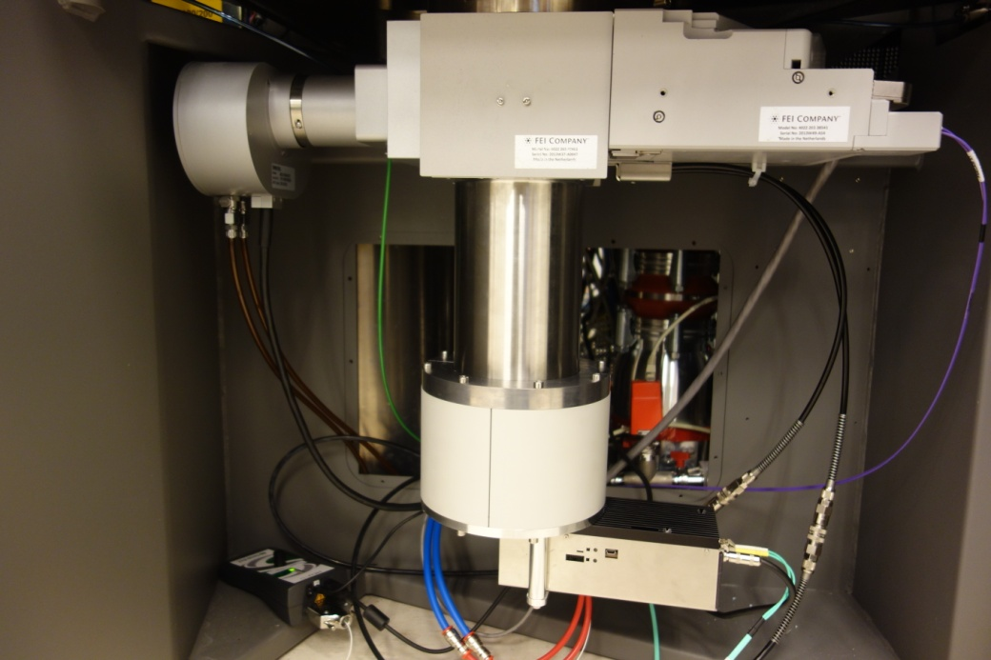
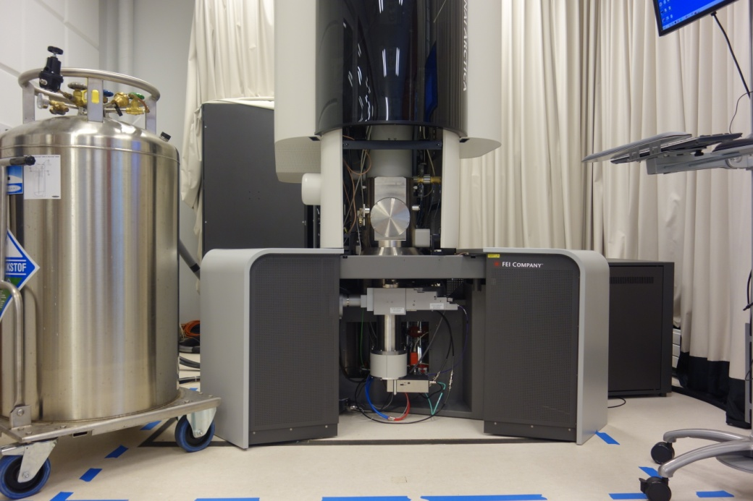


Timepix3 installed at 200 kV FEI Tecnai Arctica and 300 kV FEI Polara

Slide 10
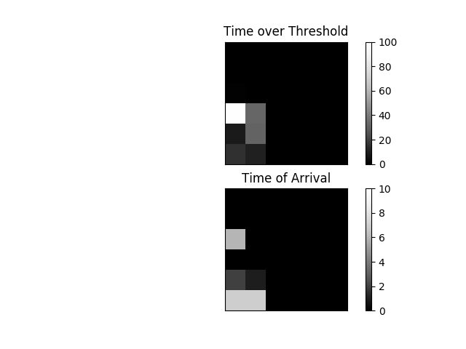

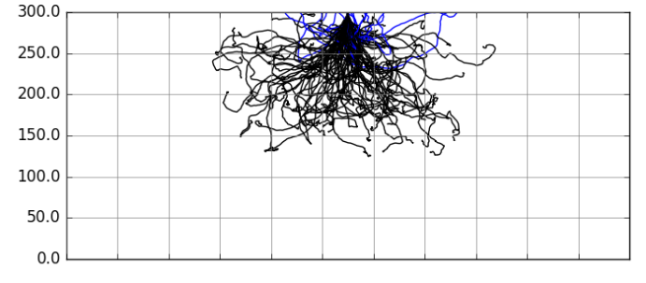
Timepix3 example output with 200 kV electrons
200 keV
e⁻
300 µm silicon
Can we resolve the impact point of the electron?

Slide 11
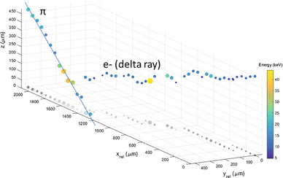
Time of Arrival contains 3D information of track in sensor layer
Bergmann, B., Pichotka, M., Pospisil, S. et al. Eur. Phys. J. C (2017) 77: 421. https://doi.org/10.1140/epjc/s10052-017-4993-4

Slide 12
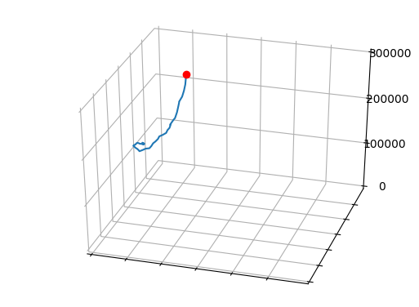
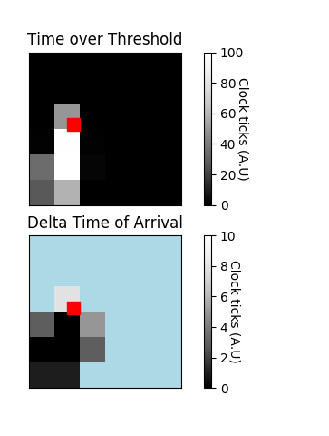
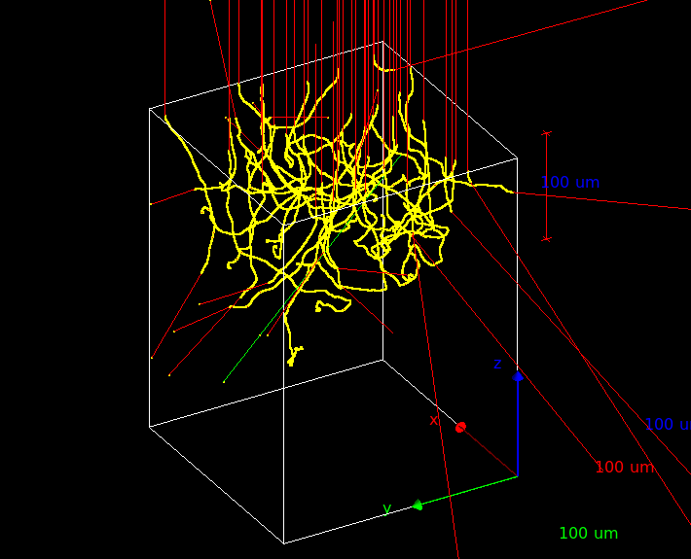
Using machine learning for electron event localisation
1. Simulation
2. Convolutional neural network (CNN)
Target incident
position
Neural network including connections (called weights) between neurons
Compare
Simulated
detector output
Adjust weights
Geant4Medipix
n = 50000
Schübel A. et al., IEEE Transactions on Nuclear Science (2014)

Slide 13
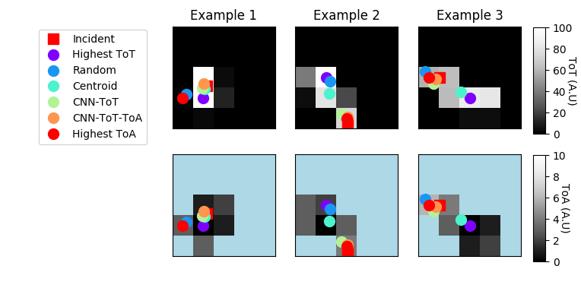
Event localisation using different methods. Example plots

Slide 14
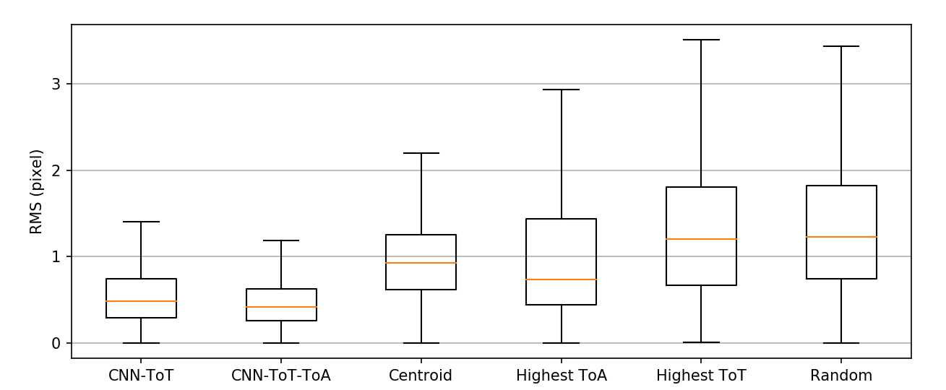
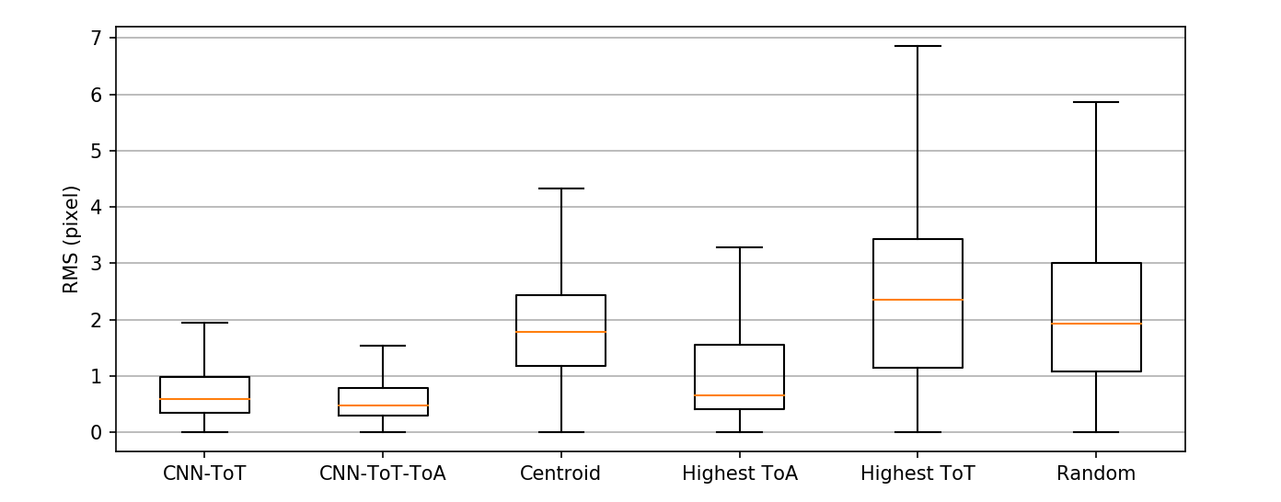
Results: Event localisation using neural network compared to other methods
0.41
200 keV
300 keV
0.48
Box represents Q1-Q3. Orange line is median.

Slide 15
Validation: Applying event localisation on experimental data
Event localisation (CNN-ToT)
Event localisation (CNN-ToT)
Without
With
Without
With
Vitreous apoferrin proteins at 200 kV
Image of UltrAU grid foil (225x) at 300 kV

Slide 16
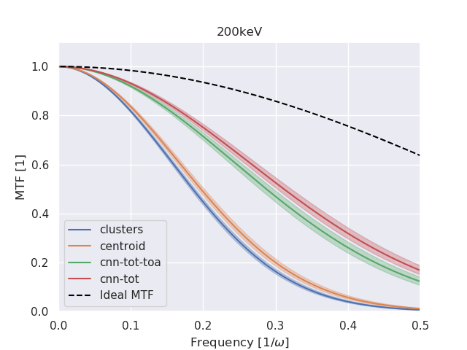
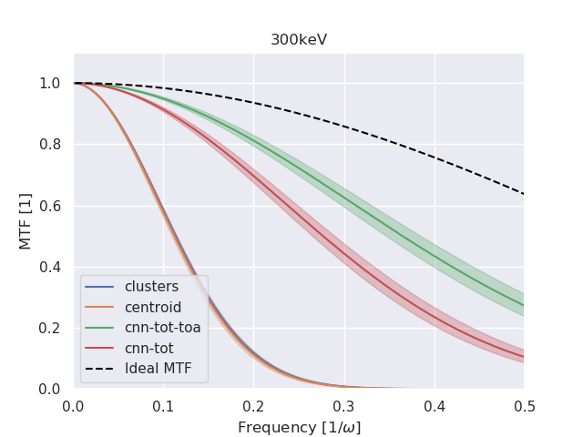
Validation: Knife edge method to calculate MTF
0.70
0.65
0.30
0.05
Erik Fröjdh
Method: Tinti, G. et al.,(2018). IUCrJ.

Slide 17
Processing: From raw data to micrographs
Filter
CNN
Convert data
Find clusters
Localise
events
Fill image matrix
Split over time
Processing
Raw
stream
Hits
Clusters
Events
Frame
Movie
Step
Correction
Chip
edges
ToT/ToA
Super resolution
Threshold
Notes:
One hour to process 70 mhit

Slide 18
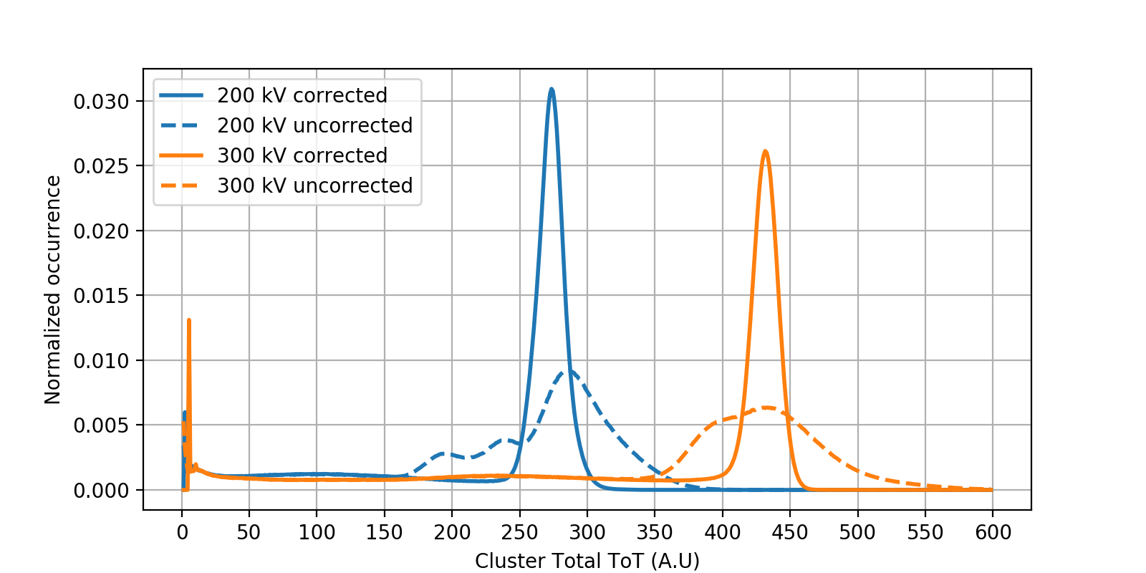
ToT correction
300 kV
FWHM=20 kV
200 kV
FWHM=16 kV
Notes:
Can we make use of the energy resolution?

Slide 19
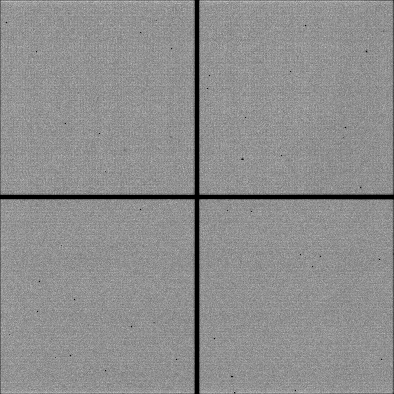
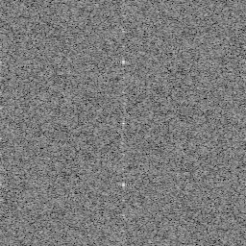
Systematic row pattern seen after CNN-ToT-ToA event localisation
Power spectrum (FFT)
200 kV flat beam, with CNN-ToT-ToA event localisation
Notes:
Also very much visible when we use highest-ToA

Slide 20
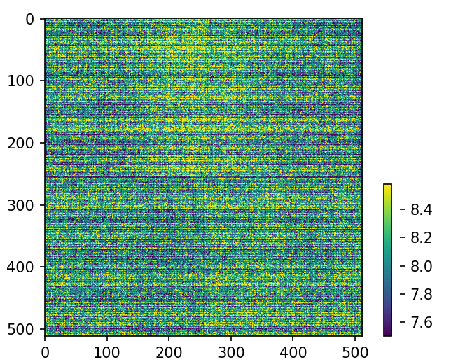
Systematic row pattern seen after CNN-ToT-ToA event localisation
Average fine-ToA value

Slide 21
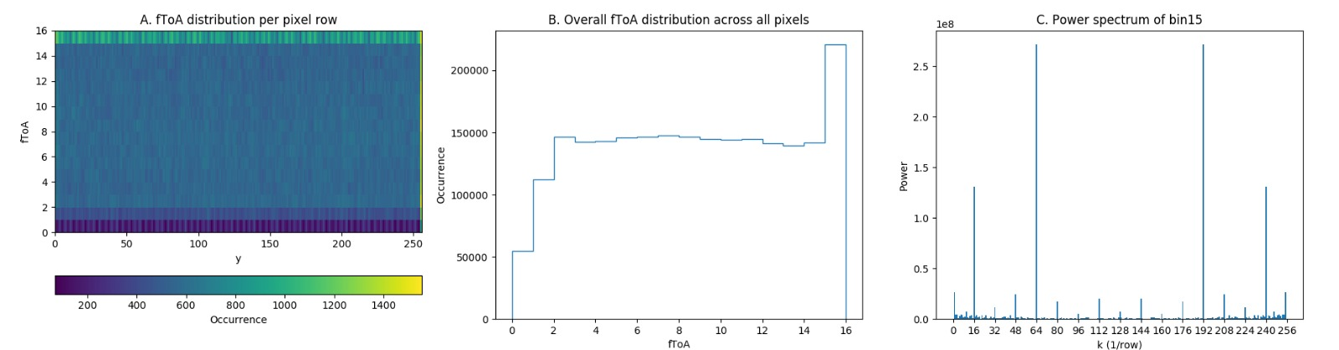
Pattern seen in fine-ToA timer of Timepix3
fToA distribution for each row
Overall fToA distribution
FFT of bin15 across the rows
Due to phasing setting of the fine-ToA signal?

Slide 22
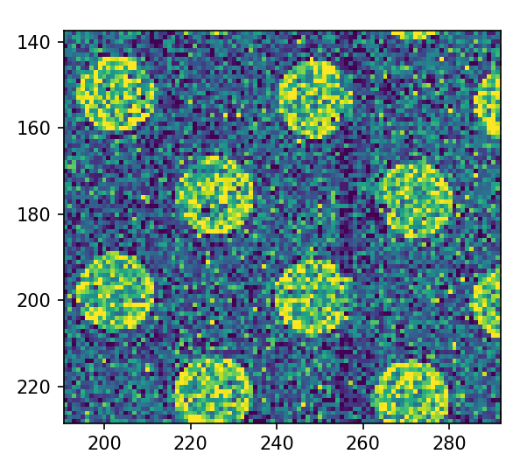
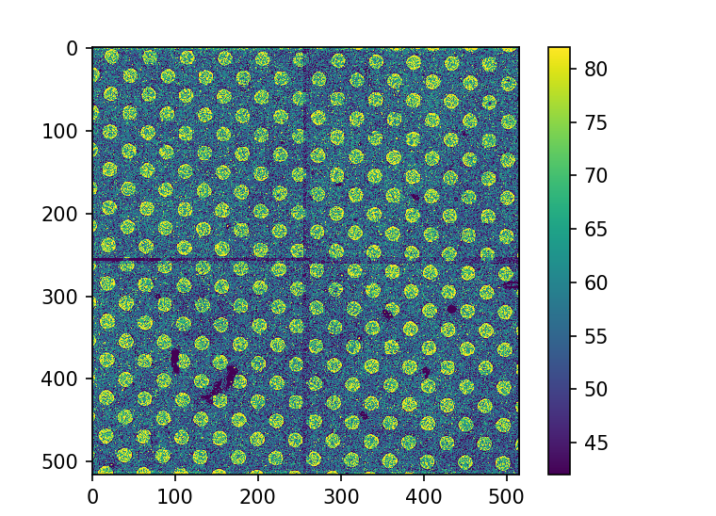
Chip edge correction
Chip 2
255x255
Chip 1
255x255
Chip 3
255x255
Chip 0
255x255
Edge pixels are triple the size → 6 pixel to correct

Slide 23
Summary and outlook
Accurate event localisation of 200 and 300 kV electrons using ToT (and ToA) data using a convolutional neural network
MTF improvement (at ½ Nyquist):
  200 kV: 0.30 → 0.65
  300 kV: 0.05 → 0.70
Timepix3 is a tricky detector for imaging
  Corrections needed for irregularities in counting, ToT and (both) ToA clocks
Outlook:
Record full Single Particle Analysis dataset
  Detector-Microscope integration
Make use of the Timepix3 timing for electrons
  Beam-induced motion correction
Notes:
Why is ToT only already working so well?

Slide 24




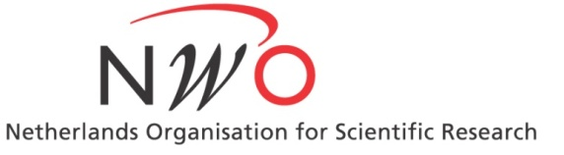
Acknowledgements
Raimond Ravelli
Peter Peters
Hugo Boulanger
Lucas Roussel
Dirk Bongers
Erik Maddox
Bram Bouwens
Hans Brouwer
Dmitry Byelov
Igor Nederlof
Hans Roeland Poolman
Matthijs van Raaij
Steven Tan
Eric van Genderen
Erik Fröjdh
Jan Pieter Abrahams
This research has been made possible with the support of the Dutch Province of Limburg
This research received funding from the Netherlands Organisation for Scientific Research (NWO) in the framework of the Fund New Chemical Innovations.

Slide 25
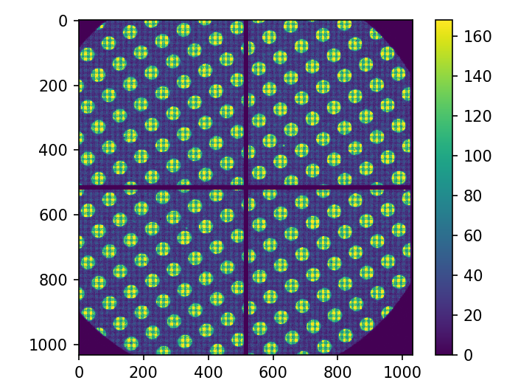
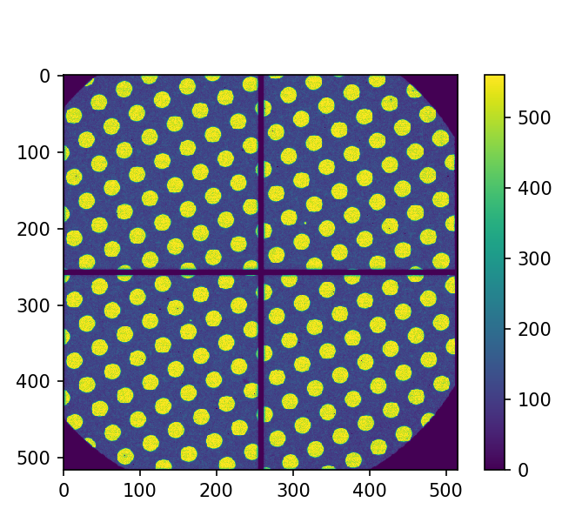
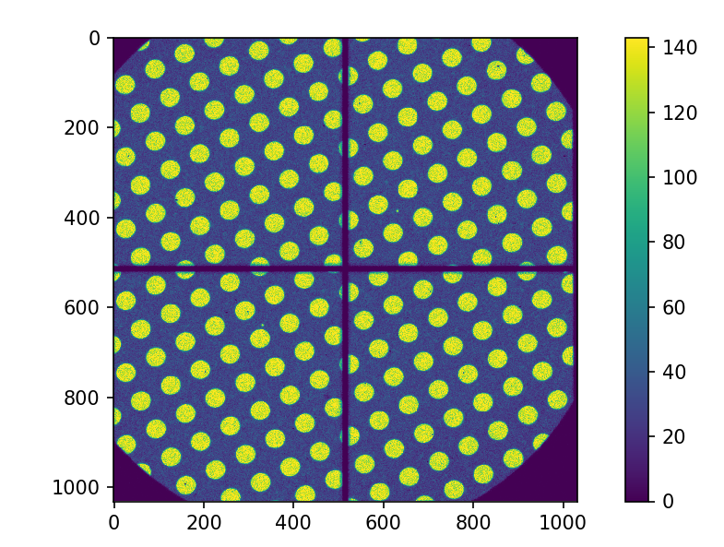
Super resolution (2x)
uncorrected
corrected

Slide 26
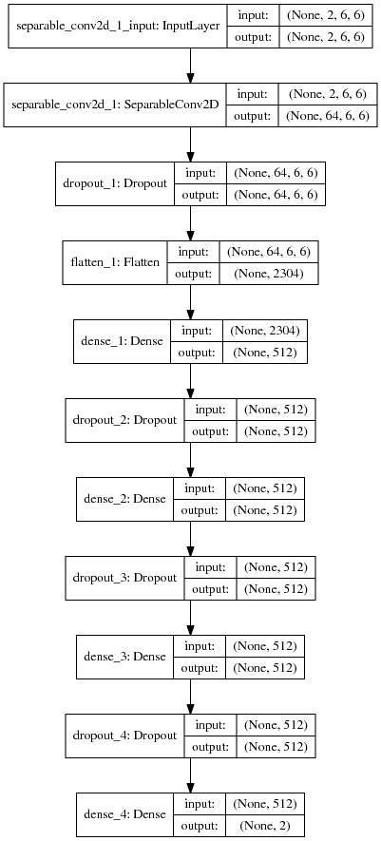
Design of the network
10 x 10 x 2 input
Separable 2D convolution
3 x Dropout+Dense layer
Adam optimizer
ReLU activation
200 epochs
Keras 2.1
TensorFlow 1.4

Slide 27
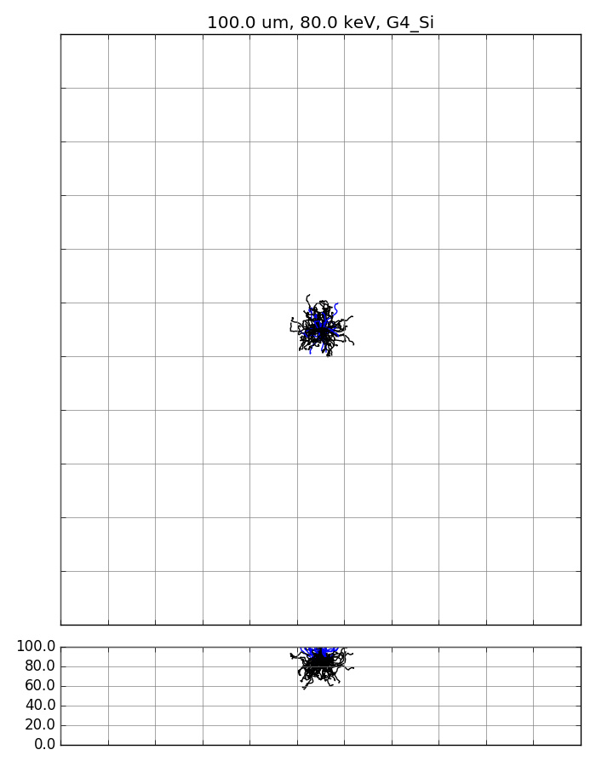
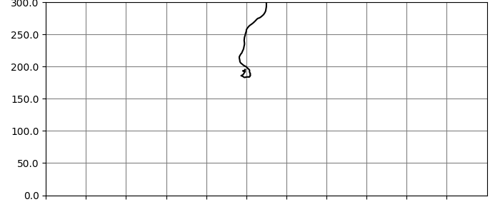
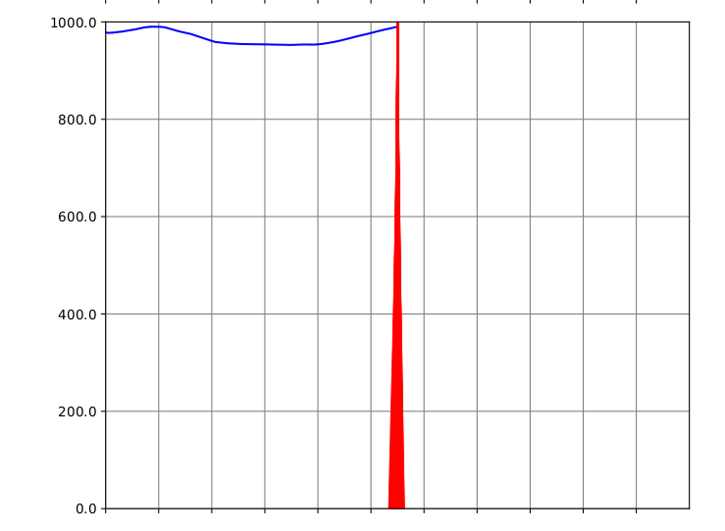
The challenge of detecting electrons
Increasing energy of the electron
100 keV
200 keV
200 MeV
e⁻
e⁻
e⁻
300 µm silicon
Gray lines represent 55 um pitch
Notes:
Lateral scattering
So why not change energy?
Low energy: Not enough to pass through matter
High energy: Too much, vaporizes your sample

Slide 28
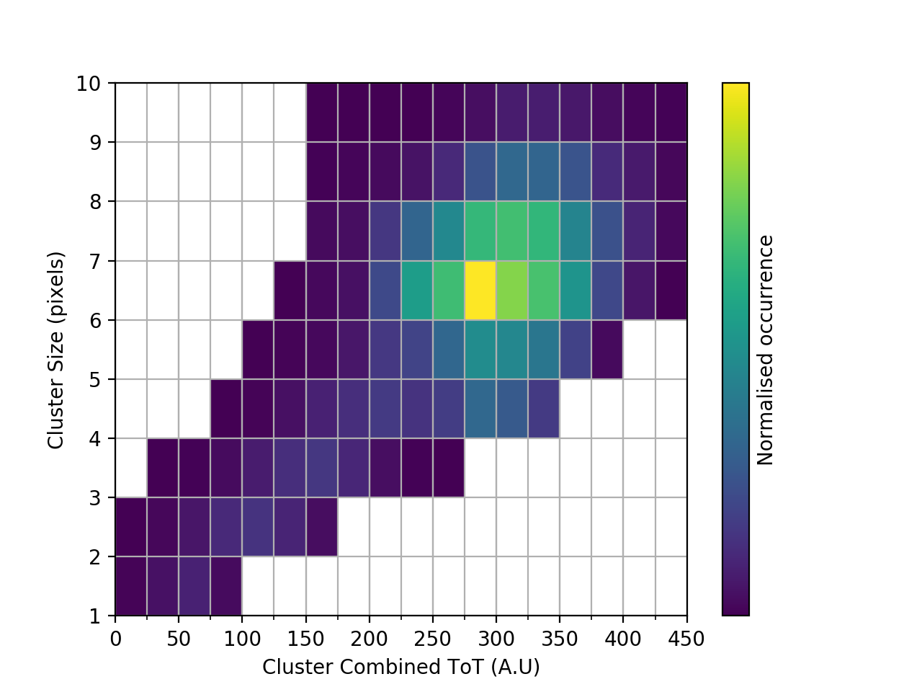
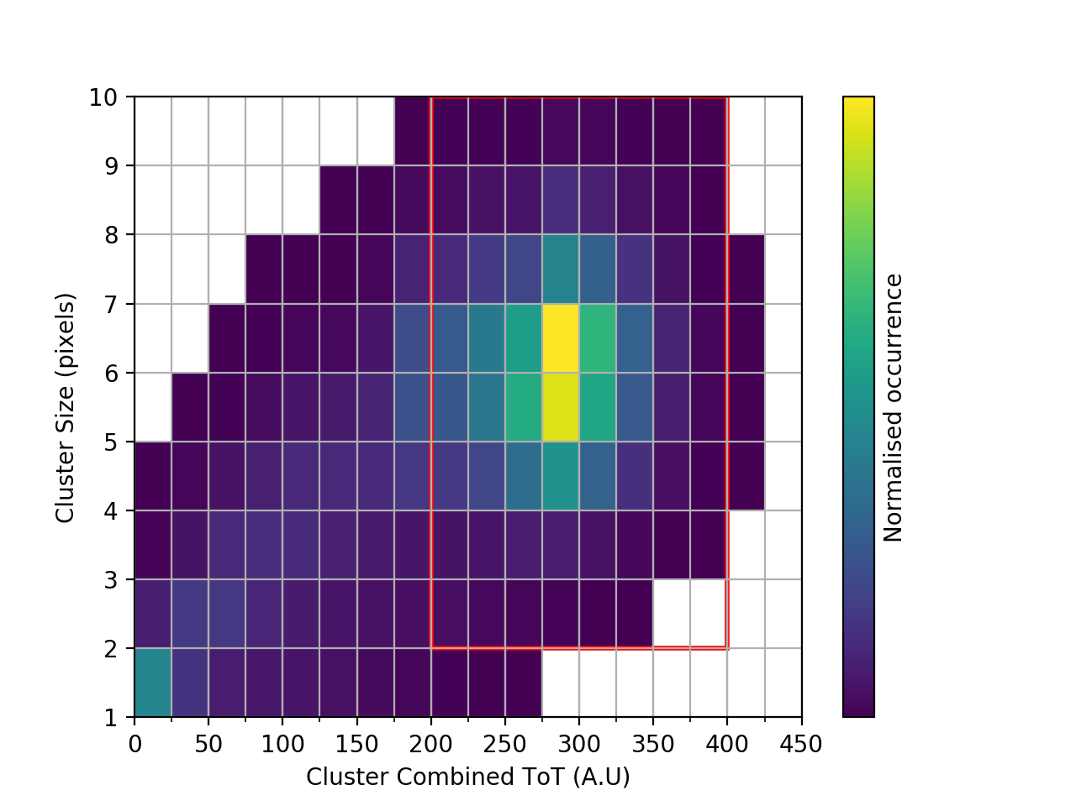
200 kV
Simulated
Experimental

Slide 29
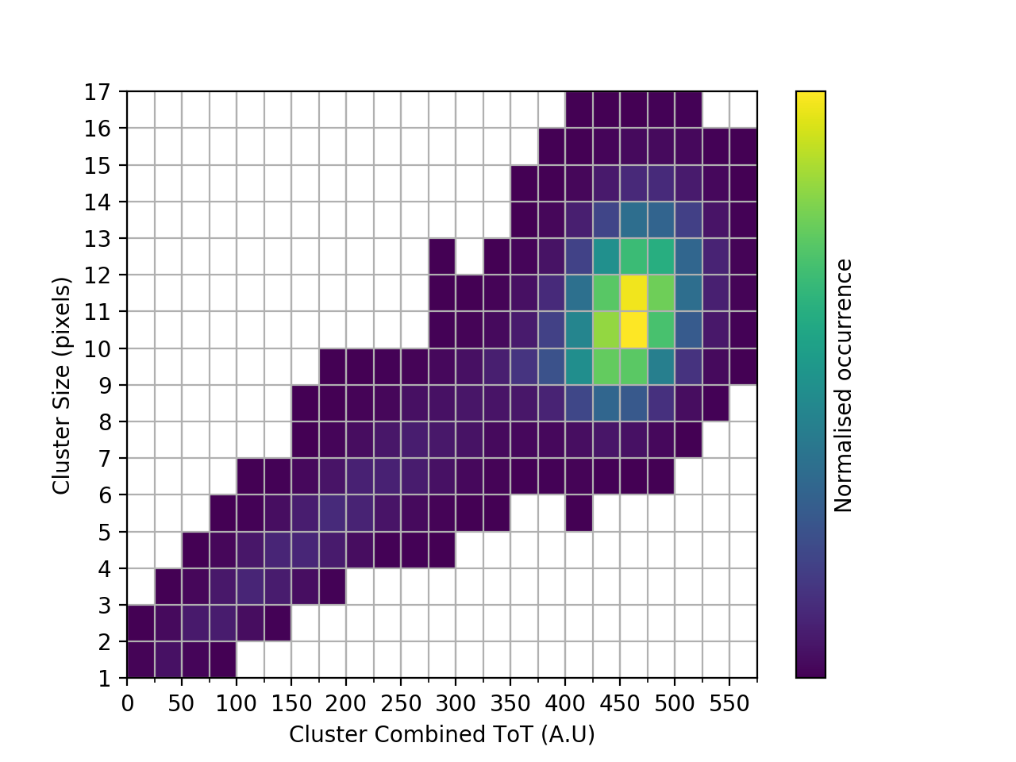
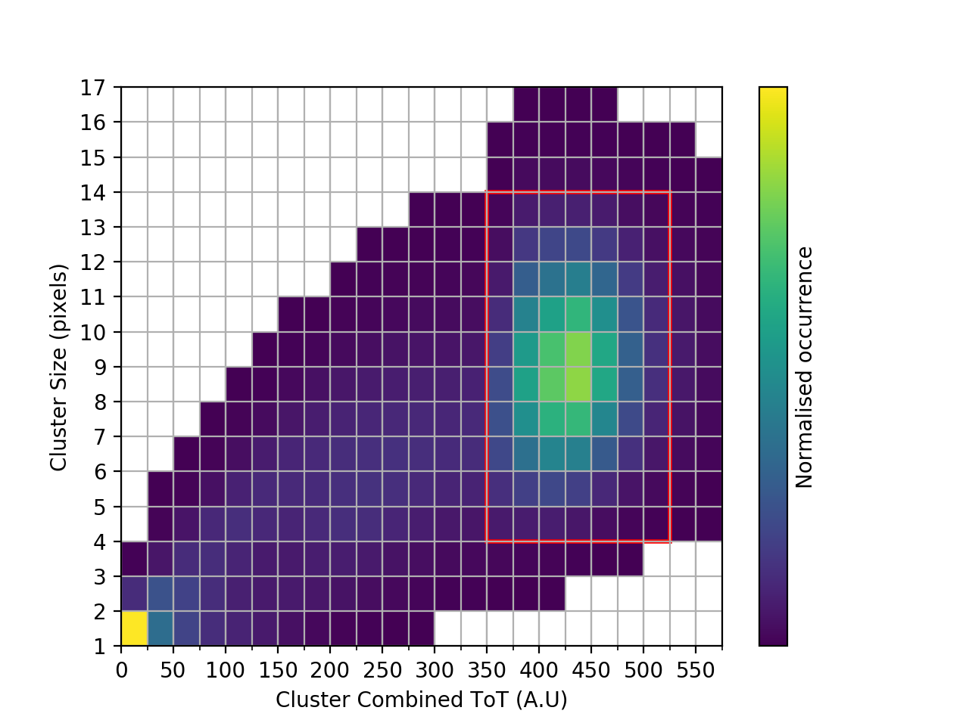
300 kV
Simulated
Experimental

