Slide 1
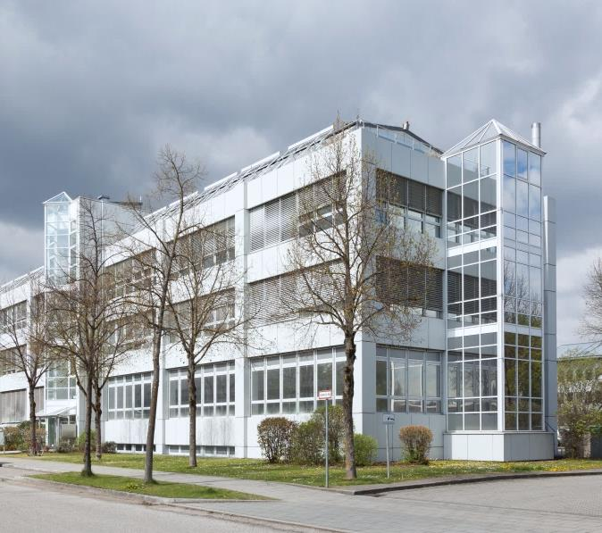

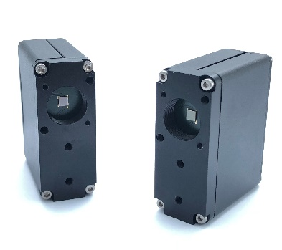
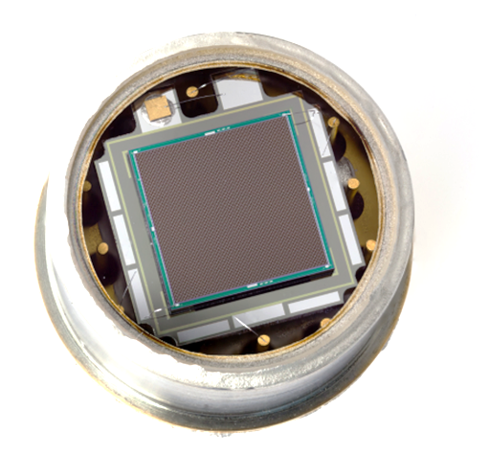

Latest Developments in KETEK’s Silicon Photomultiplier Solutions
Tobias Eggert, Wolfgang Gebauer, Florian Wiest

Slide 2
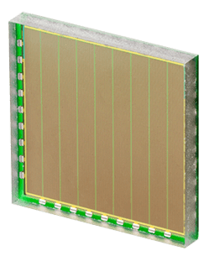
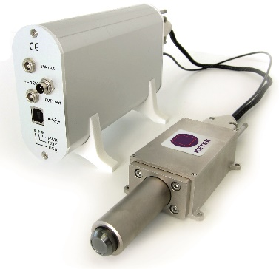
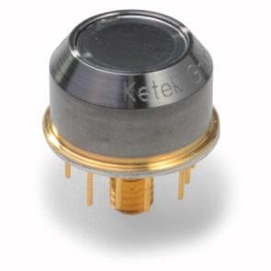

KETEK at a Glance
SiPM
SiPM
SiPM
Family-owned enterprise, founded in 1989 by Dr. Josef Kemmer
100 employees. Headquarter: Munich, Germany
Major product lines:
- SDD modules, detector electronics and complete systems
- Silicon Photomultipliers (SiPM)
Quality Management certified according to ISO 9001:2015

Slide 3
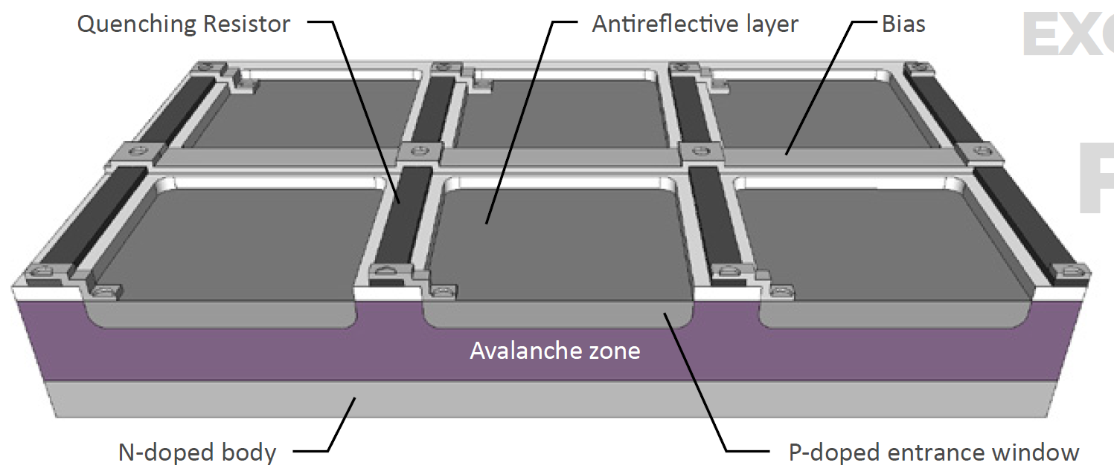



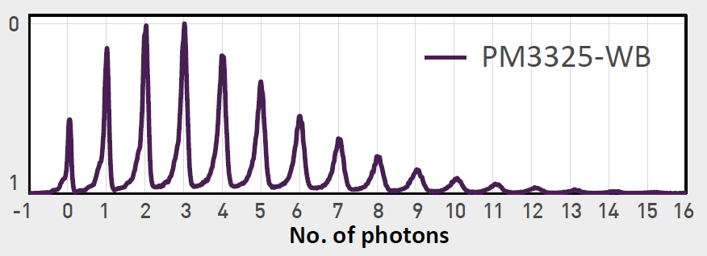
SiPM Working Principle
V-High
…
…
V-Low
Histogram of the response to a pulsed laser source
Break Down
Working Point
ON
OFF

Slide 4
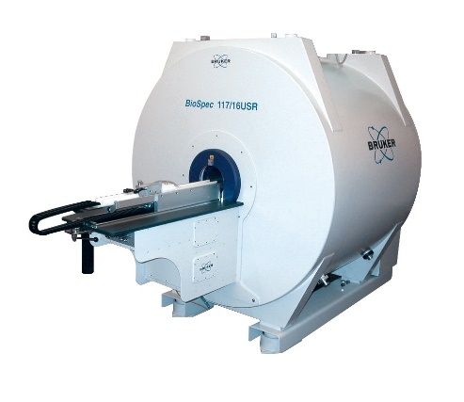
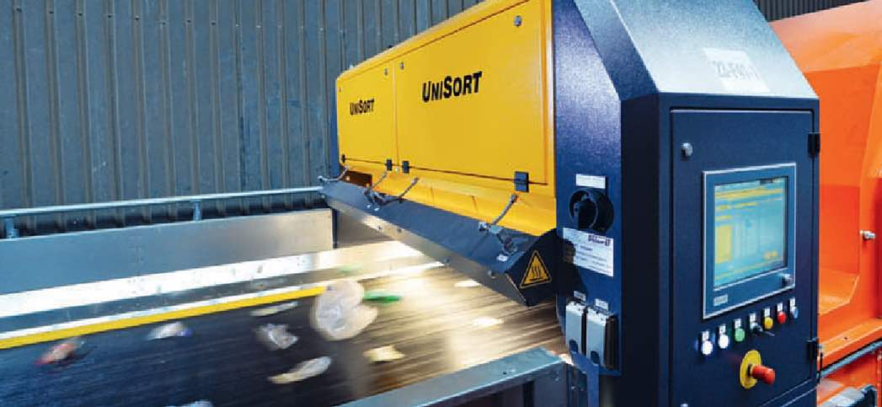
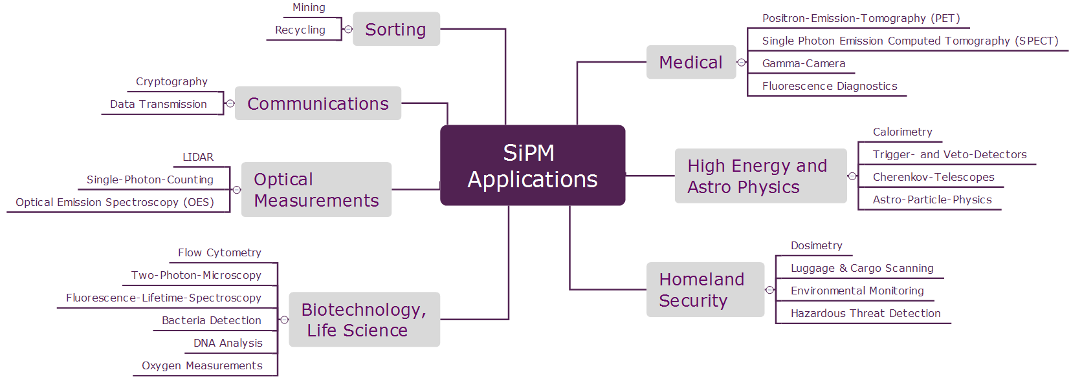
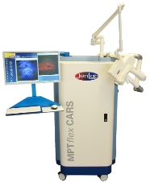

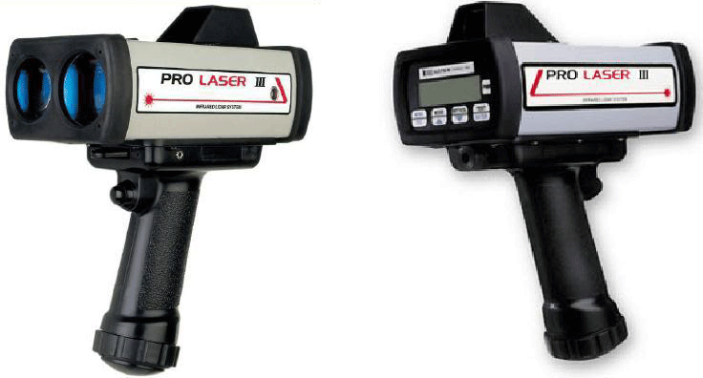
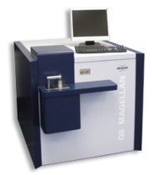
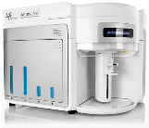
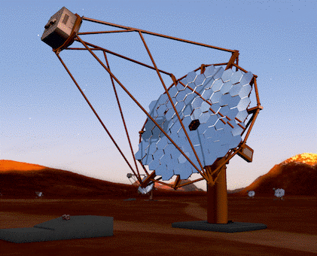
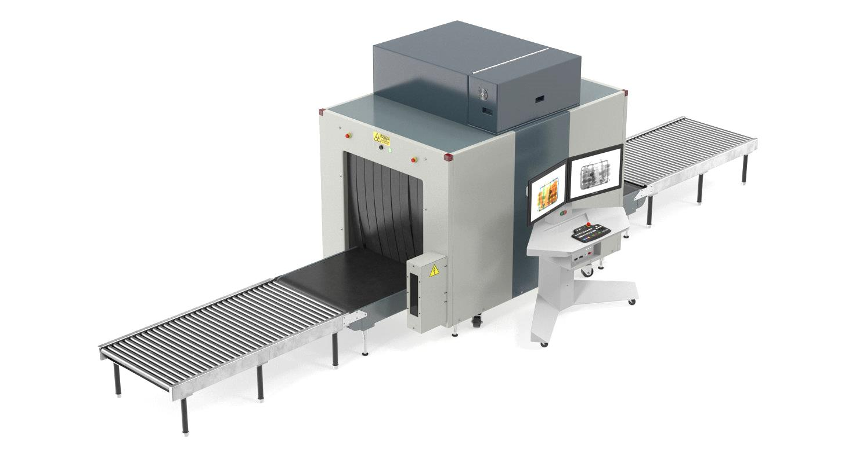

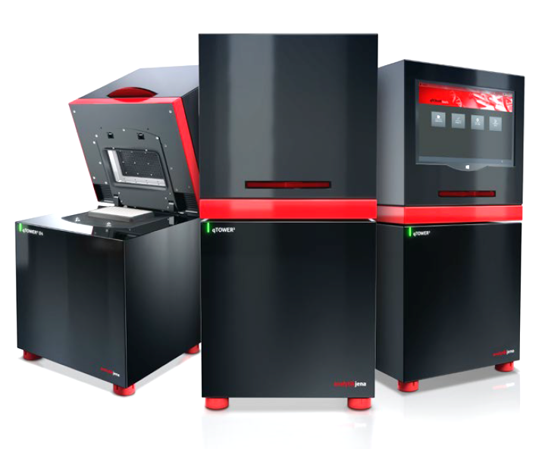
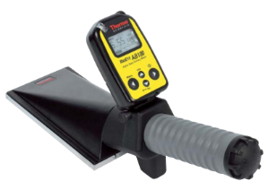
SiPM Applications

Slide 5
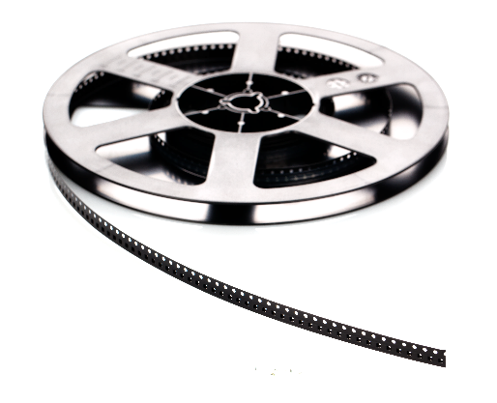
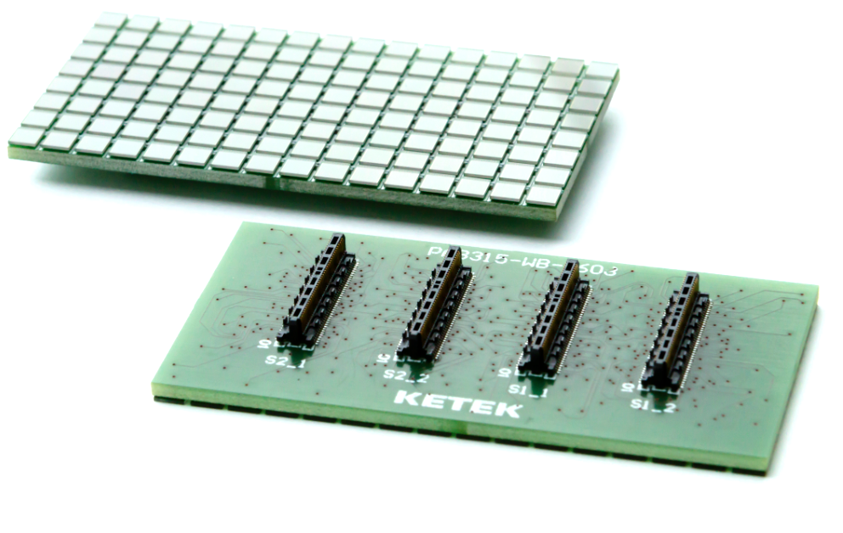
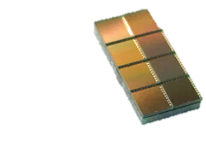
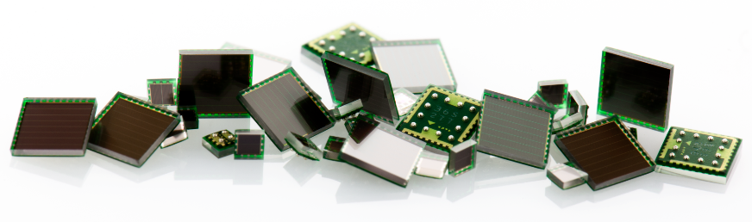
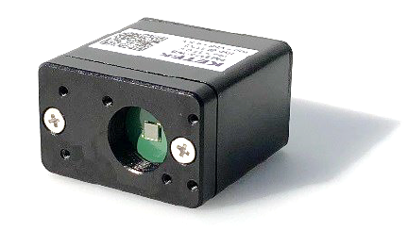
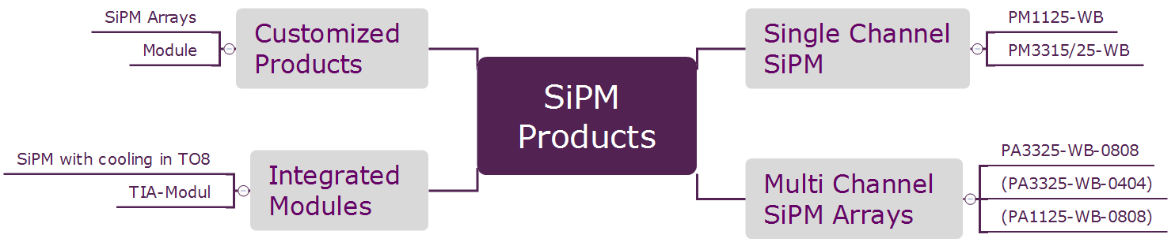
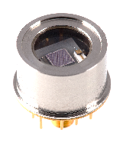
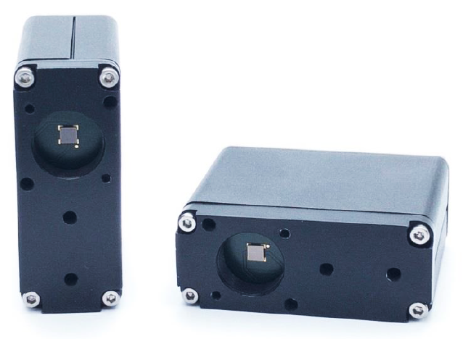
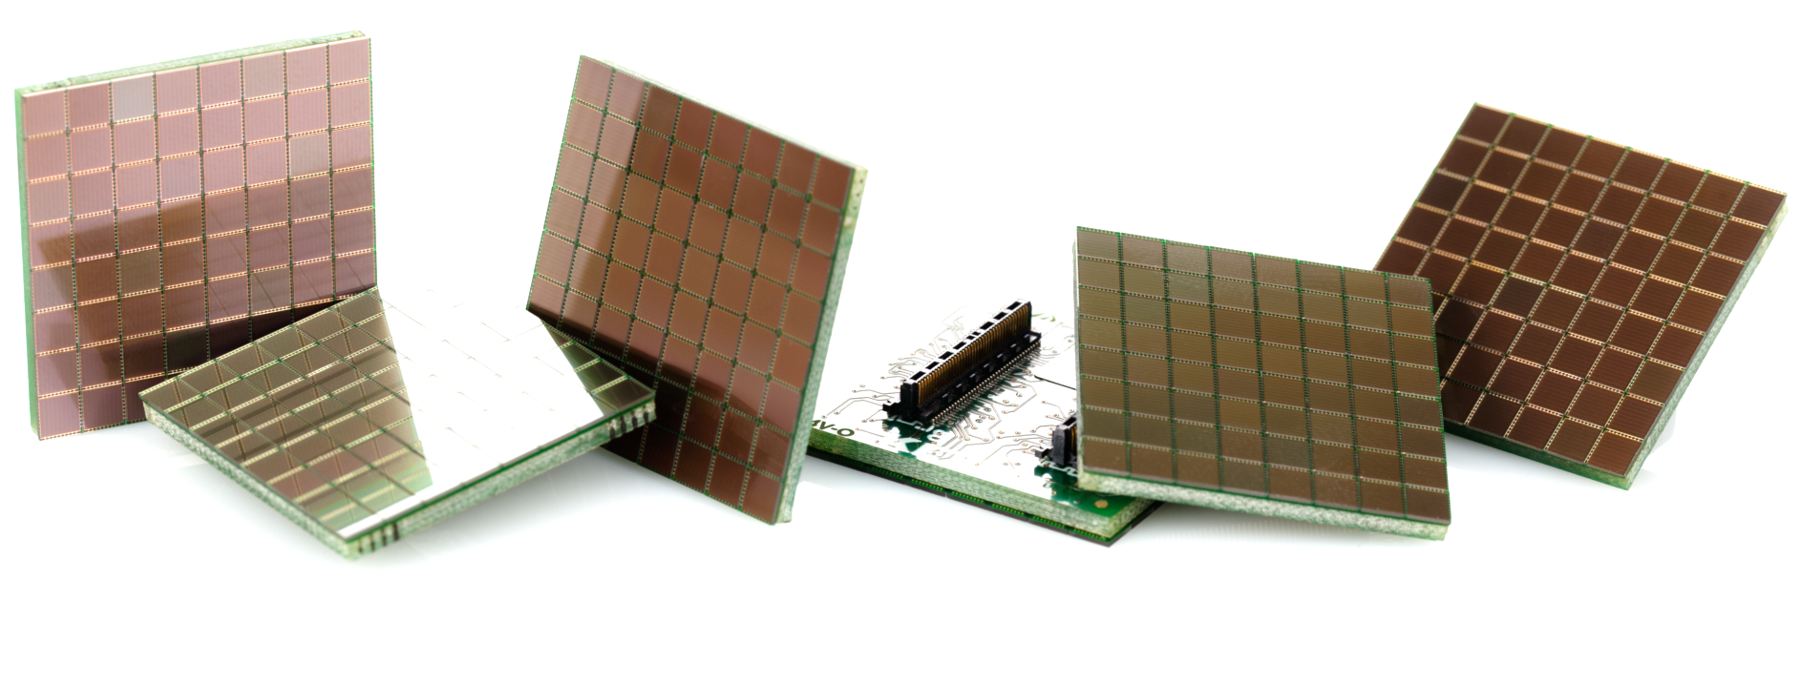
KETEK SiPM Products

Slide 6
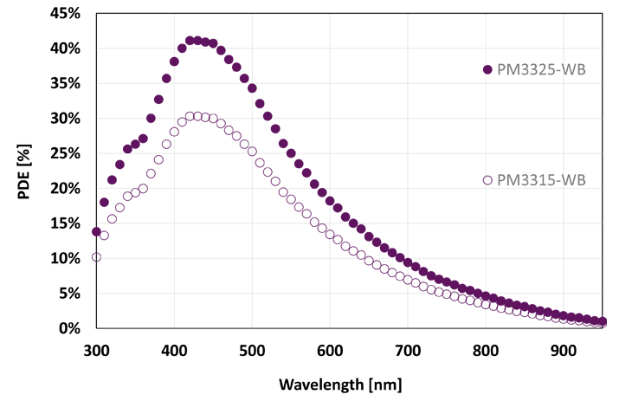
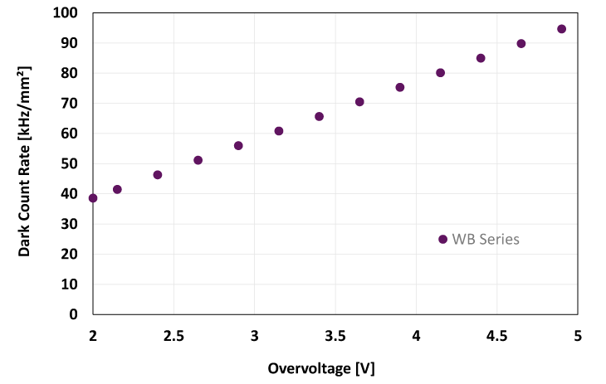
KETEK SiPM WB-Series
Photo detection efficiency of the WB Series SiPMs versus photon wavelength. The peak PDE is at ca. 430 nm.
Excellent PDE to cell size ratio.
PM3325:
43 % @ 430 nm
PM3325-WB
PM3315-WB
QE Quantum Efficiency
ε Geiger/Breakdown Efficiency
GE Geometrical Efficiency (active area)
λ Wavelength
V Bias
Typical Dark Count Rate (DCR) of the WB Series versus overvoltage.
DCR greatly improved
Dark pulses = pulses not being excited by incoming light
Dark pulses are triggered by thermally generated electrons
WB-Series

Slide 7
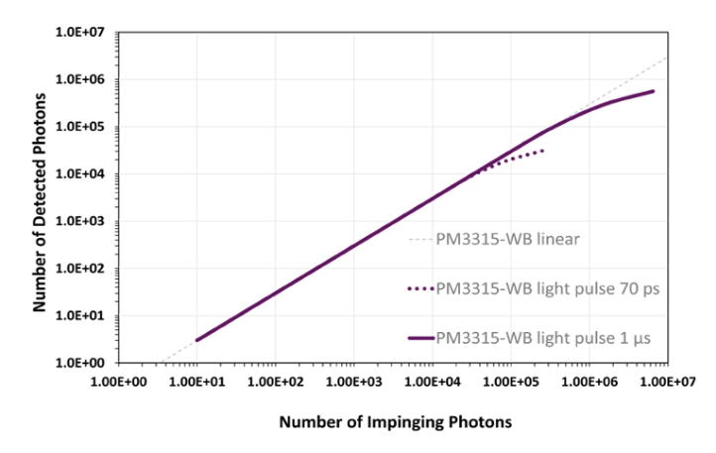
Dynamic Range of SiPM
The dynamic range is limited by the recovery time and the number of micropixels
PM3315-WB Recovery Time: 13ns
Number of pixels: 39k
N_{Pixel-fired} Number of fired Cells
N_{Cell} Total Number of Cells
PDE Photon Detection Area
N_{Ph} Number of incident Photons

Slide 8
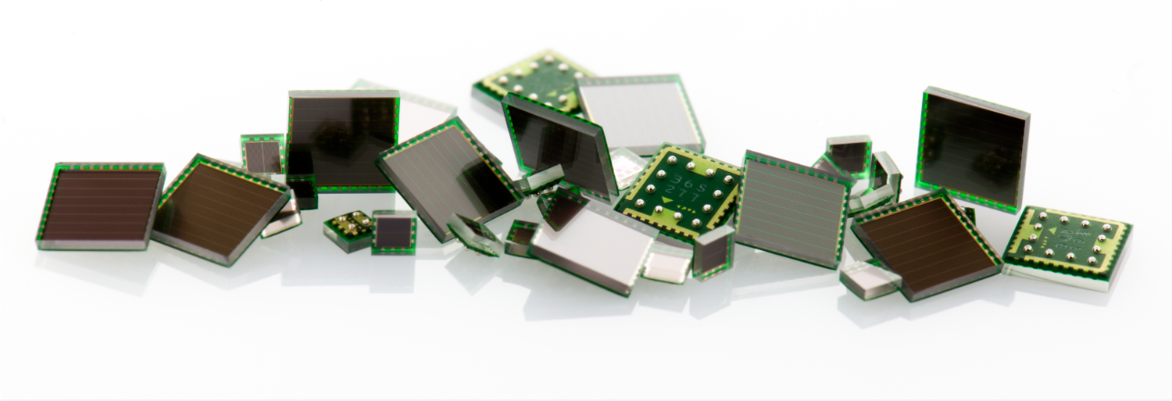
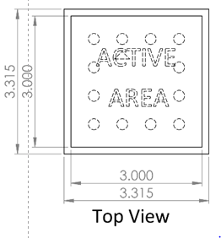
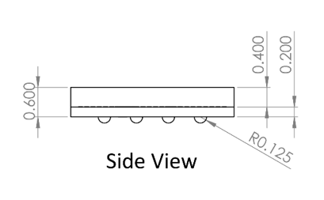
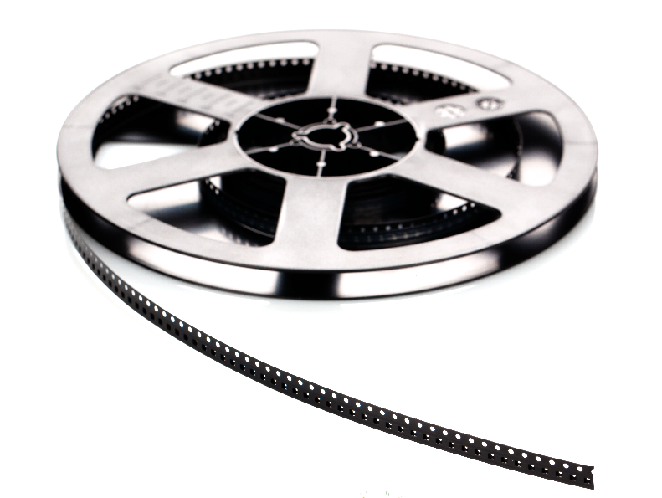
KETEK WB Series: Reliable and Cost Efficient
Wafer Level Package
Cost efficient
High volume production
Robust and reliable
Insensitive to high magnetic fields
PM11
1x1 mm² active area
1.315 x 1.315mm² lateral size
Ideal for high resolution arrays
PM33
High shearing forces (~30N/device)
Excellent package fill factor
Tape and Reel Delivery
Notes:
WLP
- robust
reliable
cost efficient
high volume capabiltiy
MR compatible

Slide 9
WB Series - Reliability Test Procedure
Test | JEDEC Test Method | Test Conditions
PC | Pre-conditioning / MSL classification according to J-STD-020 | MSL1: Moisture Sensitivity Level 1 Temp.-Cycle: 5 x -40°C / +60°C Bake: 24h at 125°C Soak: 168h at 85°C / 85% R.H. Reflow: 3 x Peak 255°C – 260°C
TC | Temperature Cycling according to JESD22-A104 | 1000 cycles @ -55°C/125°C without bias
H³TS | High Humidity High Temperature Storage according to JESD22-A101 | 1000h @ 85°C/85% RH without bias
HTS | High Temperature Storage according to JESD22-A103 | 1000h @ 125°C without bias
Reliability Testing
MSL1: 45pcs
TC: 15pcs
H³TS: 15pcs
HTS: 15pcs
45 devices of each batch are picked
for reliability testing
10 devices for ESD test (3kV HBM)
Additional reliability tests with applied bias voltage have been successfully completed (HTRB + H³TRB)
Moisture sensitivity level
J-STD-020: Components must be mounted and reflowed within
MSL 3 – 168 hours
MSL 2 – 1 year
MSL 1 – Unlimited
“floor life out of the bag”
Notes:
9
9

Slide 10
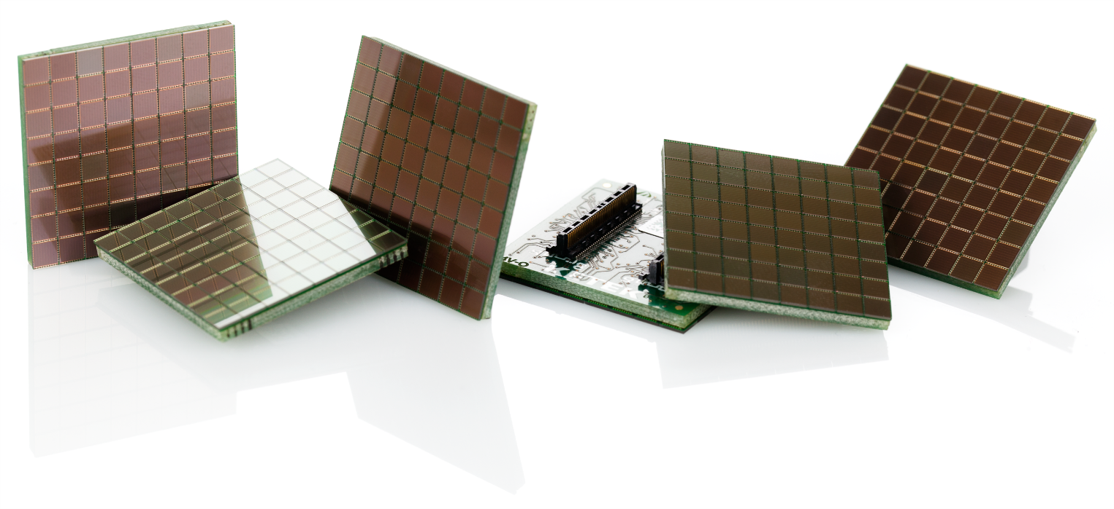
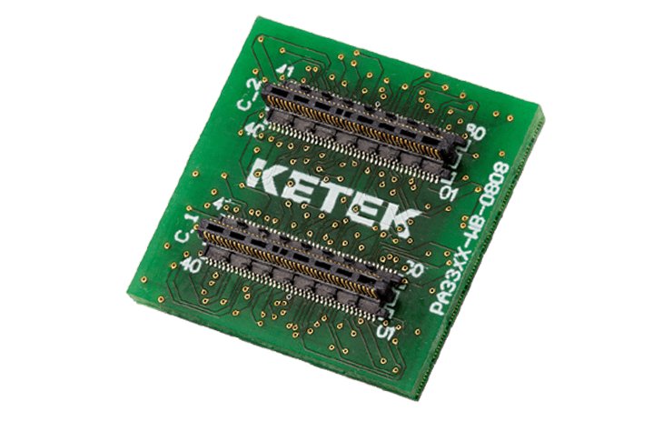
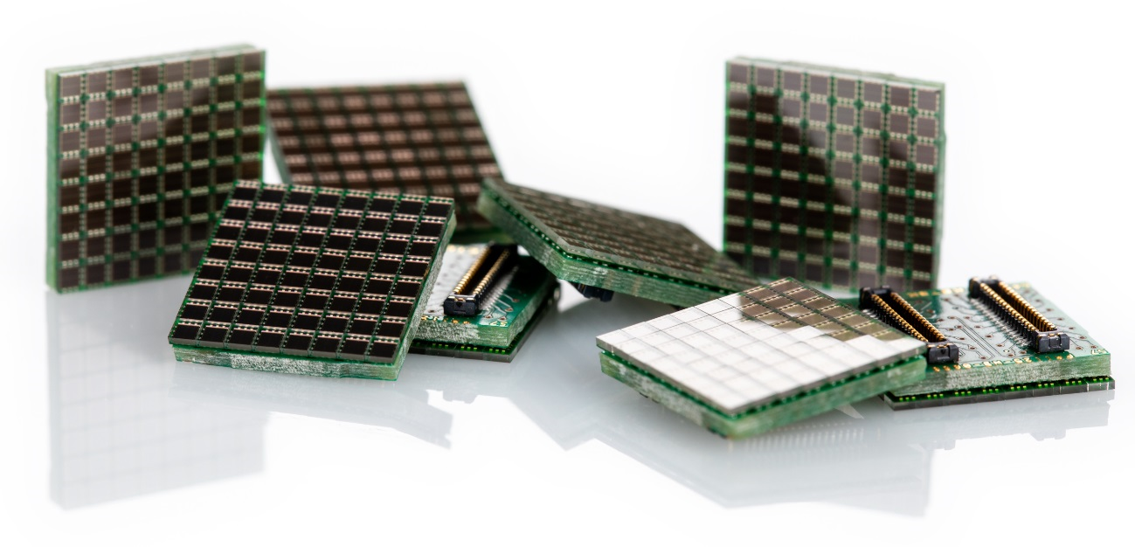
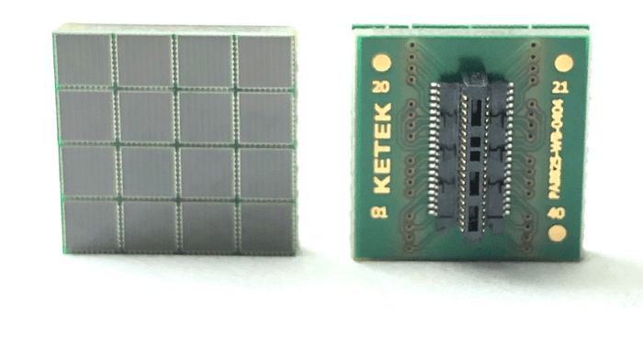
SiPM Arrays off the shelf
PA33xx-WB-0808
64 channel array with 80% fill factor
New PA1125-WB-0808
High resolution SiPM array
PA3325-WB-0404
16 channel array with 80% fill factor
Notes:
WLP
- robust
reliable
cost efficient
high volume capabiltiy
MR compatible

Slide 11

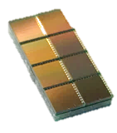
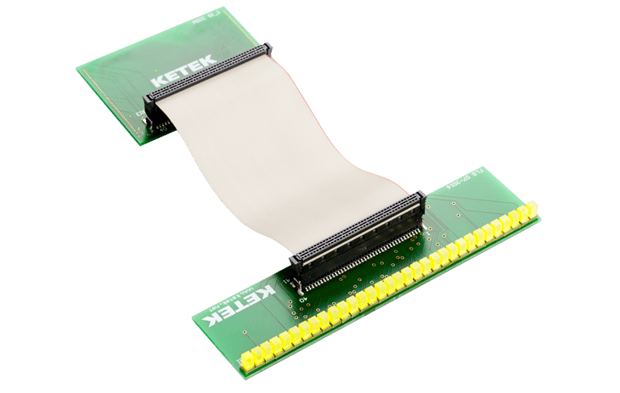
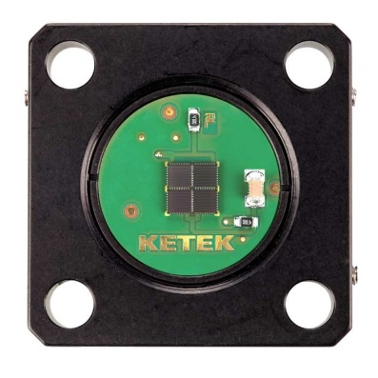
Custom SiPM solutions
SiPM module with integrated cooling in TO8 housing
Custom arrays based on SiPM WB series
4x PM3325-WB on evaluation PCB for optical bench applications

Slide 12
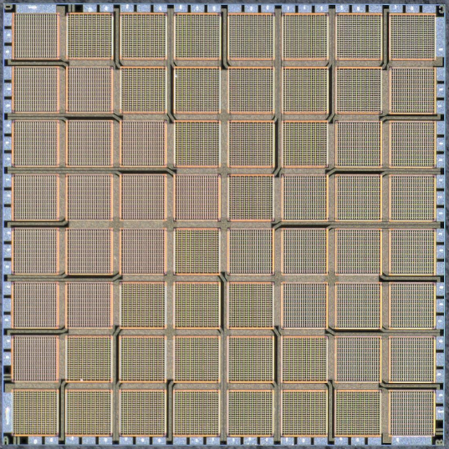
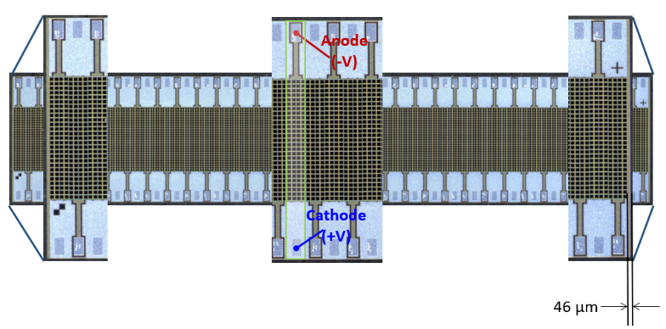
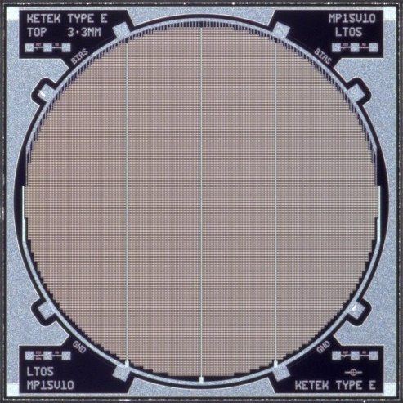
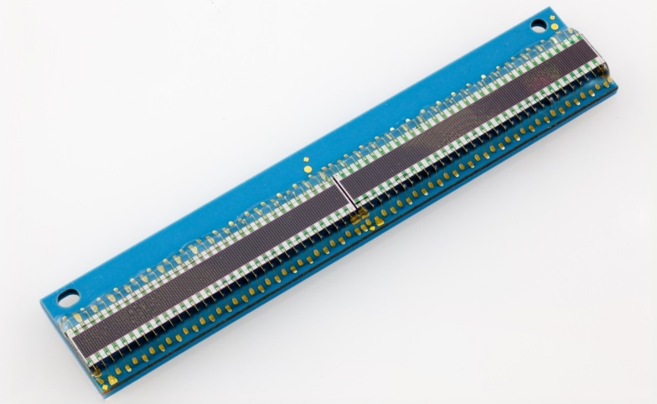
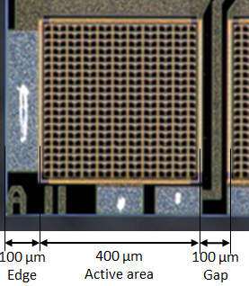
Customized SiPM Chips
Monolithic 64-channel-array
for the University of Tokyo
Linear 64-channel SiPM chip for CERN LHCb experiment
Round-shaped high dynamic range SiPM for CERN CMS
64x0.16mm² active area
64x400 cells / 20µm pitch
8.6mm² active area
38158 cells / 15µm pitch

Slide 13
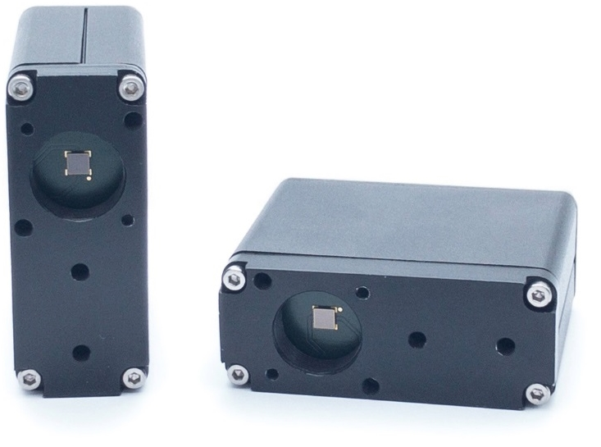
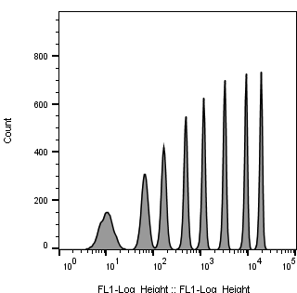
KETEK SiPM TIA Module
SiPM Module successfully tested and evaluated at MoFlo (Beckman Coulter cell sorter)
PM3315-WB SiPM based
Integrated Transimpedance Amplifier (TIA)
Plug and Play Solution for Cytometry
Control Input for SiPM Bias Voltage
15WB 488nm 510-550 Vctrl 530mV
Compatible with Thorlabs® SM05 Optics and Hamamatsu® PMT mounts
TIA Module output signal directly can be fed into DAQ without further preprocessing
Highly cost effective solution compared to PMT
Energy [a.u.]
Data courtesy of Dr. Malte Paulsen (EMBL, Heidelberg)

Slide 14
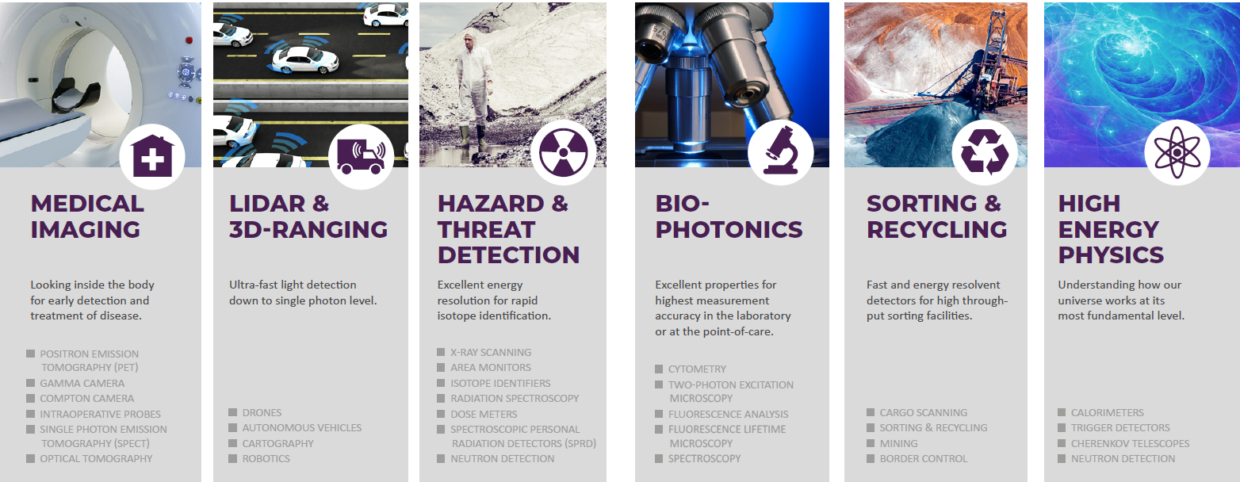
Conclusion
KETEK SiPM combine high fill factor with large dynamic range
Highly reliable and robust chip-size package
Customized as well as off-the-shelf array solutions
Customized electronics and cooled SiPM modules
Flexible partner for industrial and scientific projects

Slide 15

30
YEARS
1989 - 2019
THANK
Y O U

Slide 16
Backup

Slide 17



Silicon drift detectors for X-Rays
KETEK’s VITUS Silicon Drift Detectors (SDD) are the state-of-
the-art X-ray detectors for 0.05 keV - 50 keV energy range
Applications such as EDS, XRF, μXRF and TXRF
Patented graphene window
Tailored electronics solutions for unprecedented
performance
Modern production facilities in Munich
VITUS SDD on Mars rovers „Spirit“, „Opportunity“, „Curiosity“
and on NASA/JPL PIXL experiment for „Mars 2020“ rover

Slide 18

Quality Everywhere
Quality in focus: First Certification of ISO 9001:2000 in March 2008
First Certification according ISO 9001:2015 in April 2017
Successful Re-Certification according ISO 9001:2015 in March 2018
Quality Policy
  Quality is the basis of all activities at KETEK, and every employee contributes significantly to quality.
  It is our ultimate goal to gain and maintain satisfied and convinced customers. This is achieved through in-time and precise products and services and by competent and friendly cooperation with our customer's staff. These goals require commitment, expertise, and personal responsibility of all employees.
  The production of the detector and electronics systems is monitored by methods of statistical process control and optimized for quality and cost. Highest yield, on-time delivery, and a zero-defect quality are the objectives of all processes, products, and services. Moreover, they are essential to ensure the company's future.
  Close cooperation with key customers allows KETEK an on-time development and production of customized detector solutions with a high value creation. This leads to close customer loyalty and ensures the quality characteristics of KETEK’s products and systems in the market.
  Full commitment to quality during their work and active contribution to the continuous improvement to the quality of KETEK’s products, processes, and services are expected from every employee in order to improve the quality continually.
April 2019
Confidential

Slide 19

Scientific Satellite Mission with KETEK SiPM
AFIS-P experiment TU Munich E18. 900x PM3350T
Images courtesy of T. Pöschl, E18
confidential, reproduction only with permission

Slide 20

NEW KETEK SiPM WB-Series
Typical Dark Count Rate (DCR)
over Temperature
DCR greatly improved

Slide 21





Flow Cytometry with KETEK SiPM TIA Module
Comparison of PMT vs. SiPM TIA Module – 8 peaks Rainbow Calibration Particle
setup parameters: 488nm 200mW laser power 530-40
PMT
520 V
SiPM PM3315-WB
Vctrl 520 mV
Data courtesy of Dr. Malte Paulsen (EMBL, Heidelberg)

Slide 22




Positron Emission Tomography
PET: Medical Imaging for Cancer Diagnostics
SiPM is the ideal detector
Demand for high SiPM volumes
Eingrenzung durch ToF
[1] J. Karp, University of Pennsylvania
[2] gehealthcare.com

Slide 23




Multichannel Readout of Block Detector
5 x 5 SiPM array with 25 pcs PM6660 (6 x 6 mm² active area, 60 µm cell size)
  15 x 15 LYSO crystal array, each crystal 1.5 x 1.5 x 10 mm³, pitch 1.55 mm, 3M ESR reflector, Saint Gobain BC 630 optical grease, light guide 2.7 mm
Read out by Multichannel Readout System
+
+
FLS

Slide 24

Waste Sorting Application – First Prototypes
Line Array Prototype with 32 PM3350 and GAGG scintillators
  Read out by PETsys Electronics
FLS

Slide 25



Environmental Surveillance: Fukushima
Compton Camera with our SiPMs (PM66)
  Radiation Monitoring and Surveillance
Kenji Shimazoe
http://dx.doi.org/10.1080/00223131.2015.1089796
THG
Notes:
25

Slide 26

X-Ray Transmission Spectroscopy

Slide 27
XRF-Measurement with SiPM + Scintillator
PM1150-EB with 1.2x1.2x4 mm³ LYSO
50 keV X-Ray Source
No Pre-amplification
Charge Integration at 50 Ohm with Oscilloscope
ΔE/E~50-60%
for all energies
THG

Slide 28


X-Ray Counting – Radiation Monitoring
SiPM in combination with a scintillator can be used for X-Ray counting
  Limited energy resolution
  Lower limit currently reached: 5.9 keV, dE/E = 50% FWHM (3keV)
  Energy range of detection complimentary to SDD
KETEK PM6660 coupled to GAGG scintillator
Counting the interactions of Fe-55 (5.9 keV)
50% FWHM energy resolution
THG

Slide 29

Single Photon Spectrum with PM3325-WB
(1 kV/A Module)
Single Photon Spectrum measured by use of a short pulsed laser (<100ps pulse width)

Slide 30



WB Series – PM33XX
Wafer Level Package
cost efficient
high volume production
robust & reliable
MR compatible
Tape and Reel Delivery
Notes:
WLP
- robust
reliable
cost efficient
high volume capabiltiy
MR compatible

Slide 31


NEW PM11XX-WB
- Smallest 1x1 mm² device
- Ideal for high resolution arrays
Tape and Reel Delivery
Notes:
WLP
- robust
reliable
cost efficient
high volume capabiltiy
MR compatible

