Slide 1
Quantitative analysis on electric field variation in SiPMs for scintillation detection applications
KAIST
Kyung Taek Lim
Crete – July 10th, 2019

Slide 2
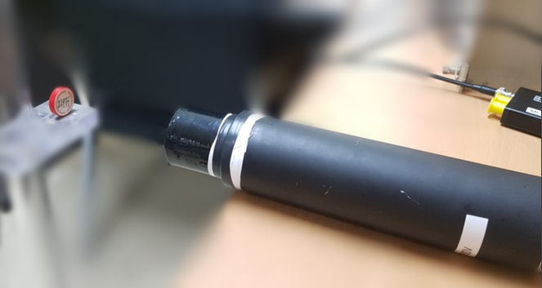
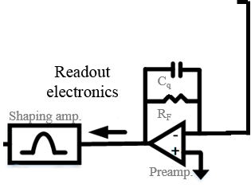
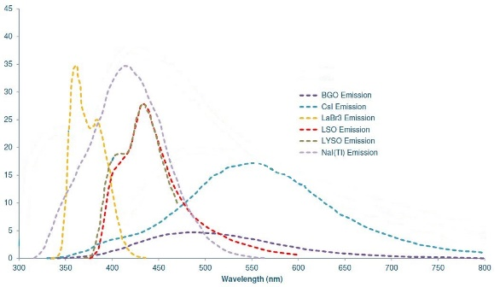
Scintillation detection
Introduction
Scintillation detection:
Scintillator + Photodetector (e.g., PMT, SiPD)
Scintillators (organic or inorganic) emit photons after interacting with ionizing radiation, e.g., x-rays and γ-rays
Scintillator specific variables:
Emission wavelength
Light yield
Decay time
Attenuation length
Source
Scintillator
Photodetector
Output
pulse
Spectral response in various scintillators
 | Peak emission (nm) | Light yield (ph/MeV)
BGO | 480 | 9,000
LYSO | 420 | 30,000
LaBr3 | 380 | 60,000
CsI(Tl) | 540 | 65,000
NaI(Tl) | 415 | 38,000
Plastic | 380-420 | 10,000
Light yield in common scintillators
J. Murphy, “SensL Technology Update,” 2013

Slide 3
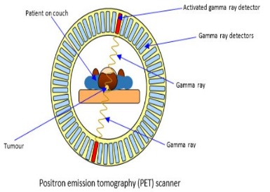
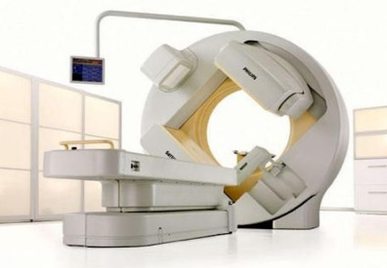
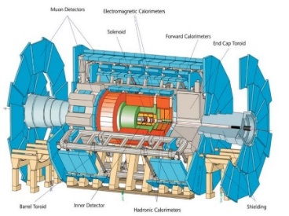
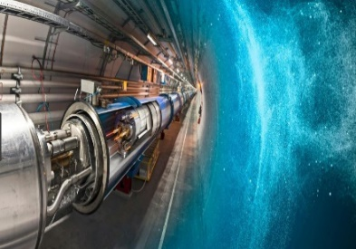
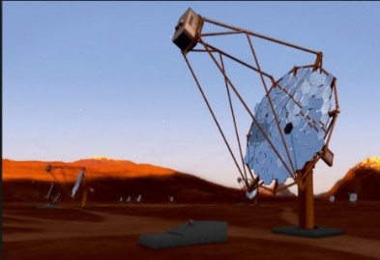
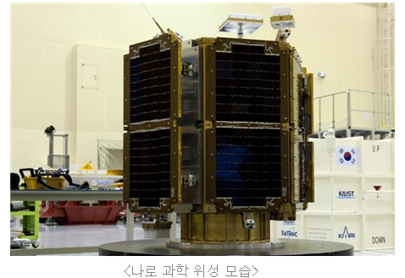

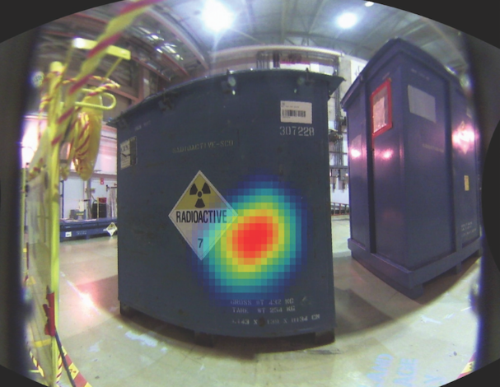
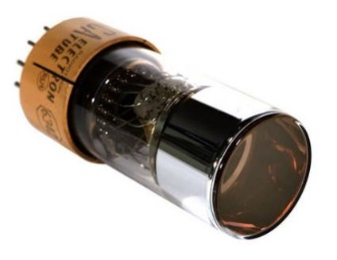
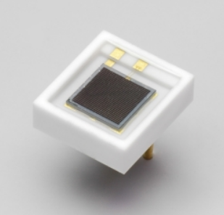
Scintillation detection applications
Introduction
Nuclear Medicine
PET/CT, PET/MRI, SPECT
High Energy Physics
CALIC AHCAL, CMS HCAL
Astrophysics
Cherenkov telescope, Neutrino detectors
Hazard and Threat Detection
Gamma camera, RPM, Dosimeter
Vacuum tube technology
Bulky size
High voltage (~ 10³ V)
Sensitive to magnetic field
FireflySci
Solid state technology
Robust & compact
Low voltage (< 100 V)
Insensitive to magnetic field
Hamamatsu
Photomultiplier tube (PMT)
Silicon photomultiplier (SiPM)

Slide 4
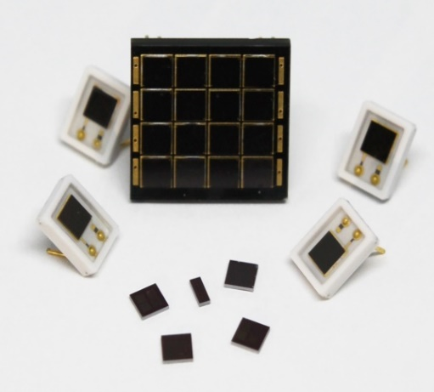
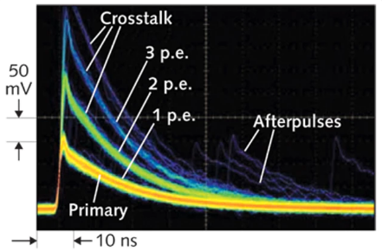
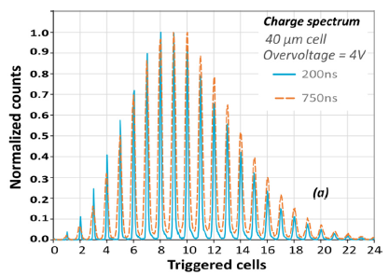
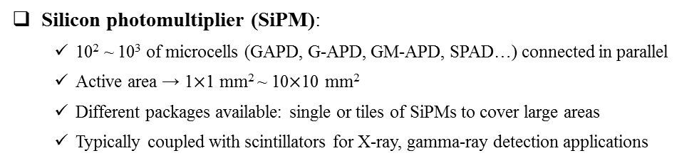
Silicon photomultiplier (SiPM)
Introduction
Single pixel SiPM at KAIST-NNFC
~ 10⁵
Avalanche
breakdown
in a GAPD
A cross-section of a GAPD with a passive quenching resistor
Silicon photomultiplier (SiPM):
  10² ~ 10³ of microcells (GAPD, G-APD, GM-APD, SPAD…) connected in parallel
Active area → 1$×$1 mm² ~ 10$×$10 mm²
Different packages available: single or tiles of SiPMs to cover large areas
Typically coupled with scintillators for X-ray, gamma-ray detection applications
Micrograph of microcell arrays
(x100 zoom)
E. Hergert and S. Piatek, Testing Detectors: Understanding key parameters of silicon photomultipliers, 2014
F. Acerbi and S. Gundacker, NIMA 926, 16–35 (2019)

Slide 5
SiPM-based system parameters
Introduction
SiPM structure parameters
SiPM characteristics
Target application
considerations
Gain
Photon number resolving capability
Epitaxial layer
Dark Count Rate
Well structure
(p/n junction)
Dynamic Range
Timing capability
Guard ring
Photon detection efficiency
Breakdown voltage
Quenching resistor (R_{q})
Power consumption
Signal shape
ARC layer
Temperature dependencies
and other considerations such as large dynamic range, large-area systems, and so on…
  Well structure (p/n junction) determines the electric field profile in a GAPD
Trade-offs between the DCR and PDE with respect to the electric field in the depletion region.

Slide 6
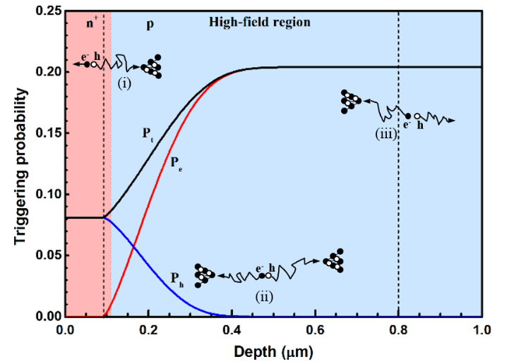
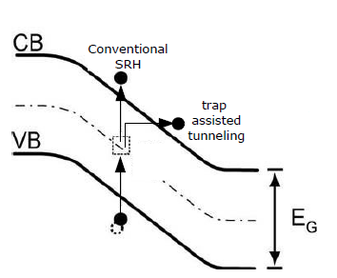
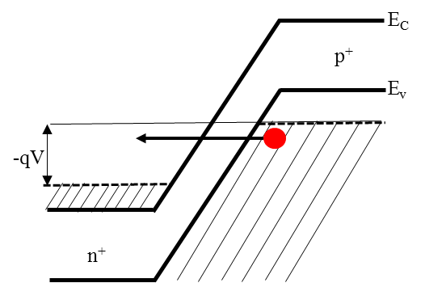



Trade-offs between DCR and PDE
Motivation
Factors influencing PDE
  $PDE=QE \left(λ\right)× P_{t} (α_{e,h})×FF$
  ${\text{α}}_{e}$, ${\text{α}}_{h}$: impact ionization rate of e, h $∝$ (E)
h⁺
Trivial solutions for enhancing PDE:
Increase fill factor → Device geometry optimization
Increase quantum efficiency → ARC optimization
Increase electric field strength → Well structure
e⁻
  An example of P_{t} calculation
Factors influencing DCR
DCR = DCR_{diff} + DCR_{SRH} + DCR_{tunnel}
$${\text{DCR}}_{\text{SRH}}\text{ ≈ }\text{A}∙{\text{P}}_{\text{t}}∙\frac{{\text{n}}_{\text{i}}\text{W}(1+Γ)}{{\text{τ}}_{\text{g}0}}$$
Trivial solutions for reducing DCR:
Reduce impurity concentration → Wafer & fabrication technology
Increase detection threshold → Readout circuit design
Decrease electric field strength → Well structure
Band–to–band
tunneling
Field enhanced Shockley–Read–Hall generation
  Design and fabricate SiPMs with different E-field profiles
  Evaluate Δ E on SiPM performance through photon-number resolving capability (R_{SiPM})

Slide 7
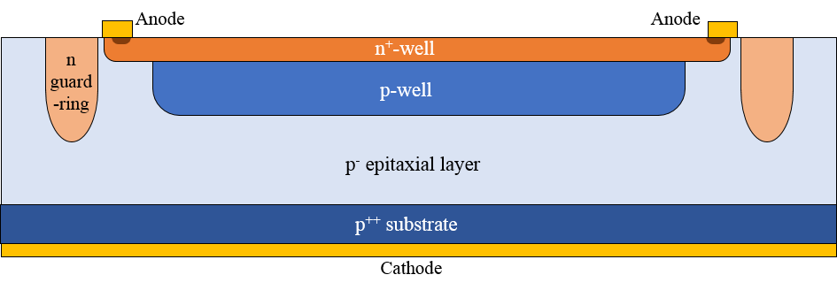
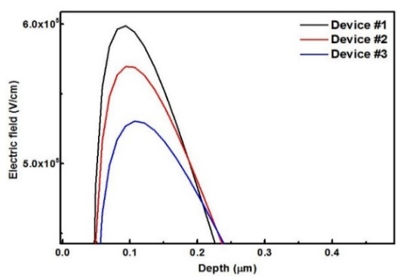
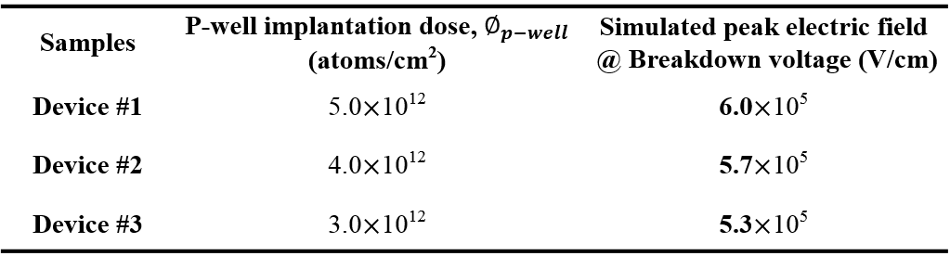
Device Structure & Simulation
Materials & Methods
n-on-p
Structure
E-field
Distribution
  Cross-sectional diagram of a GAPD
Depth
(μm)
  Simulated 1D E-field profiles as a function of depletion depth (μm)
  n-on-p SiPMs with three peak E-field strengths
  2D TCAD simulation
  Three p-well implantation doses and their corresponding simulated peak electric field

Slide 8
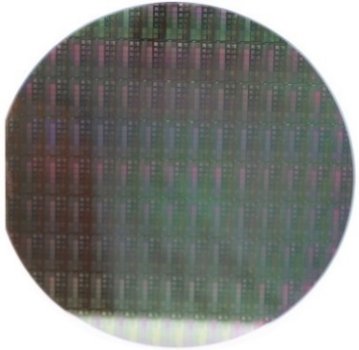
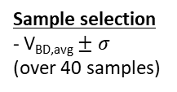
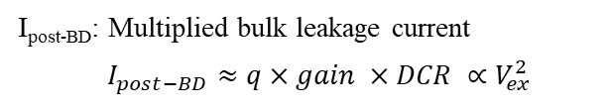
Reverse I–V Curves
Result & Discussion
  Reverse I–V of single types with three ϕ_{p-well} conditions
  Reverse I–V of single types as a function of V_{ex}
I_{post-BD}
I_{pre-BD}
Measurement setup
- Voltage range: 0 – 70 V
- Cell type: 65-μm single microcell
- Wafer–level I–V measurements
Sample selection
- V_{BD,avg} $± σ$
(over 40 samples)
  I_{post-BD}: Multiplied bulk leakage current
  $$I_{post−BD}≈q×gain ×DCR ∝V_{ex}^{2}$$
  Tape-out wafer @ NNFC
  Samples on ceramic packaging

Slide 9
Dark Count Rate (DCR)
Result & Discussion
  DCR of fabricated samples with three ϕ_{p-well} conditions
  Temperature dependency of DCR in fabricated samples
V_{ex} = 2.0 V
  Arrhenius plot of fabricated samples with three ϕ_{p-well} conditions
  Δ Activation energy (E_{A}) vs. E-field
    0.43 eV → 0.46 eV → 0.51 eV (approaches E_{g,Si}/2)
    Increase in the effective band energy seen by the carrier
    Less influence of field-enhanced mechanisms on SRH generation of carriers
    → Larger effective carrier lifetime, τ_{g.}
V_{ex} = 2.0 V

Slide 10
Photon detection efficiency (PDE)
Result & Discussion
Shift in peak sensitivity
  PDE of fabricated samples with three ϕ_{p-well} conditions
Enhanced E-field in the “extended” depletion region in Device #3

Slide 11
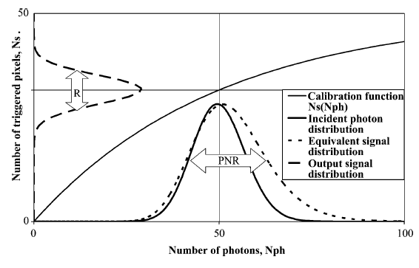
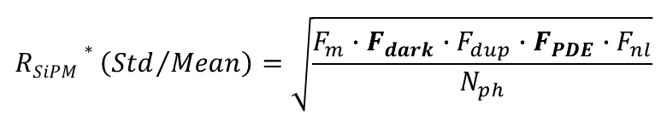
Photon number resolving capability
Result & Discussion
Concept of photon-number-resolution*
*S. Vinogradov, et al., Trans. Nucl. Sci, 58, 9-16, (2011)
  $$RSiPM∗\left({Std}/{Mean}\right)=\sqrt{\frac{F_{m}∙F_{dark}∙F_{dup}∙F_{PDE}∙F_{nl}}{N_{ph}}}$$
    F_{m}: Avalanche multiplication
    F_{dark}: Dark count rate
    F_{dup}: Correlated noise
    F_{PDE}: Photon detection efficiency
    F_{nl}: Non-linearity
N_{ph} = 5000
N_{ph} = 20000
N_{ph} = 50000
  R_{SiPM} of GAPDs with three ϕ_{p-well} conditions for N_{ph} = 5000, 20000, and 50000 photons (V_{ex} = 2.0 V)

Slide 12
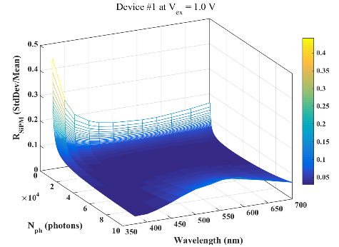
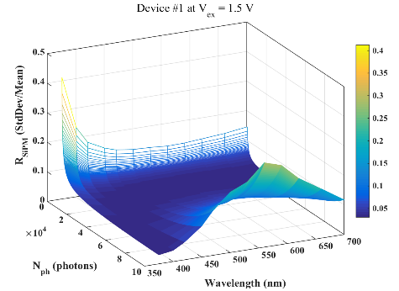
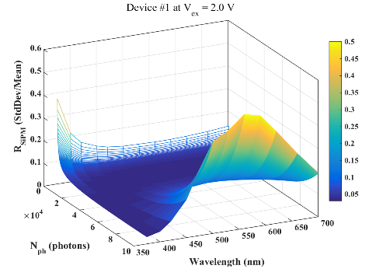
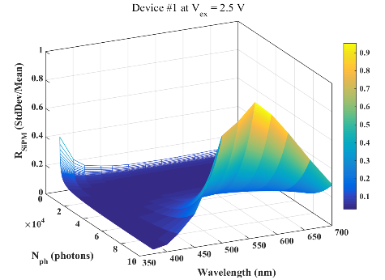
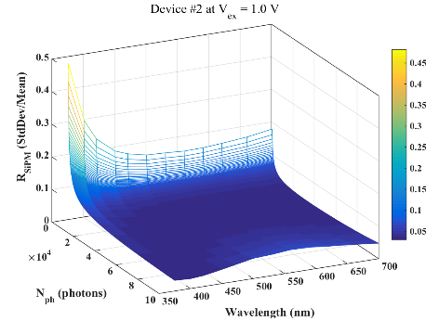
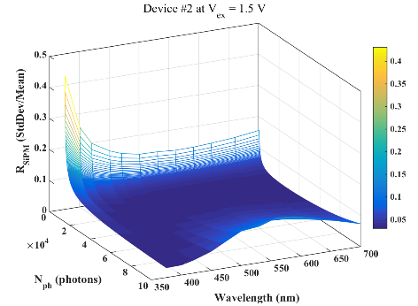
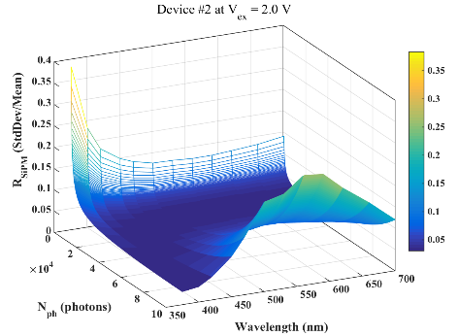
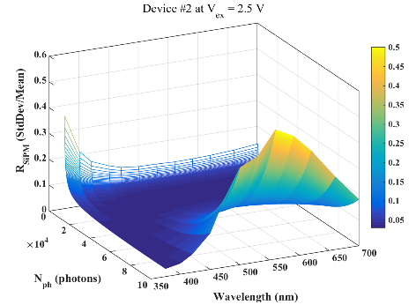
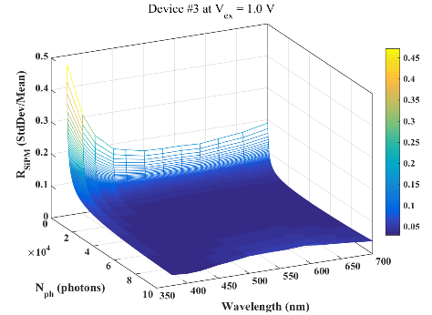
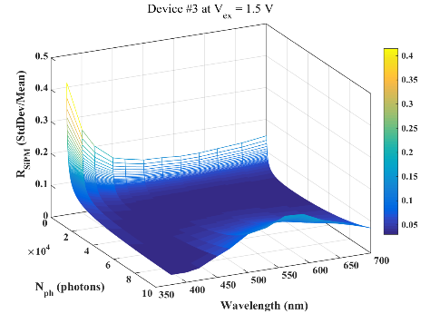
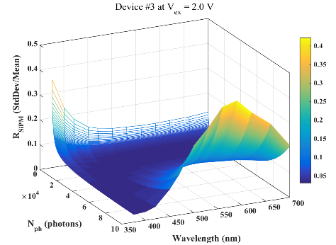
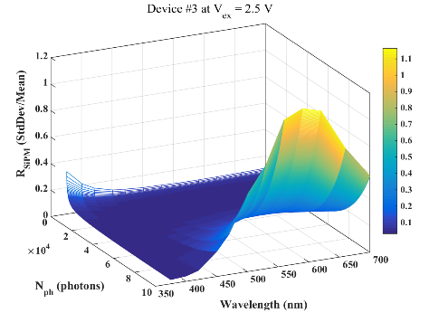
R_{SiPM} mapping (N_{ph}, λ)
Result & Discussion
Input range
- N_{ph}: 5.0x10² ~ 10x10⁴ photons
- λ: 375 ~ 700 nm
1.0 V
1.5 V
2.0 V
2.5 V
Device #1
R_{SiPM}
λ
N_{ph}
Device #2
Device #3

Slide 13



R_{SiPM} mapping (N_{ph}, λ)
Result & Discussion
Device #1 at V_{ex} = 2.5 V
Device #2 at V_{ex} = 2.5 V
N_{ph} (photons)
Wavelength (nm)
N_{ph} (photons)
Wavelength (nm)
Device #3 at V_{ex} = 2.5 V
  Δ R_{SiPM} vs. E-field @ λ = 530 nm, V_{ex} = 2.5 V
    ΔR_{SiPM} is negligible at low N_{ph} (< 10000 photons)
    ΔR_{SiPM} becomes noticeable when N_{ph} > 20000 photons
    At higher N_{ph} (> 20000 photons), Device #2 has the best R_{SiPM} while Device #3 has the worst R_{SiPM} for all V_{ex}
N_{ph} (photons)
Wavelength (nm)

Slide 14
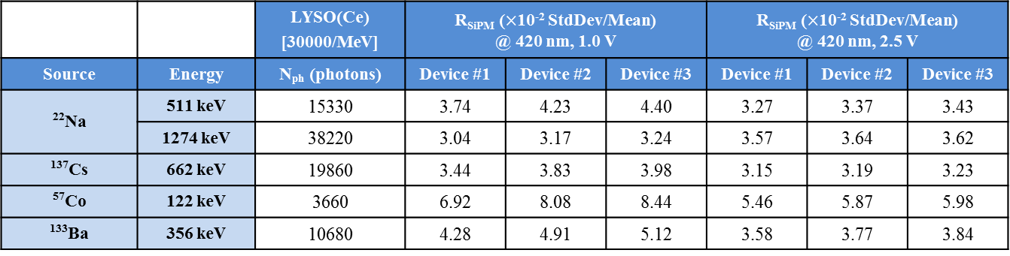
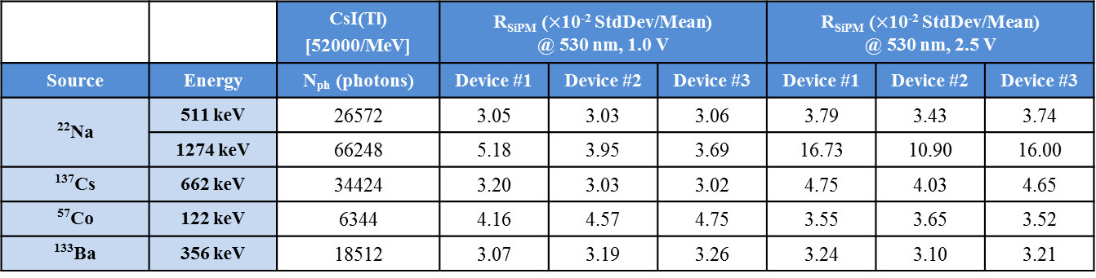
R_{SiPM} comparison
Result & Discussion
SiPM specification: n-on-p/ 65-μm micro-cell/ 2.95x2.95 mm²
    Decrease E-field (but not too much) for scintillation detection applications with high N_{ph}
    Increase E-field for scintillation detection applications with moderate or low N_{ph}

Slide 15
Conclusion
Demonstrated the trade-offs between DCR and PDE with respect to ΔE:
  SiPM performance quite sensitive to ΔE in the depletion region
  Evaluated R_{SiPM} (N_{ph}, λ) of SiPMs with three E-field profiles for scintillation detection applications:
  Overall, R_{SiPM} is strongly driven by the PDE
  Non-linearity becomes significant with increasing N_{ph} due to the limited N_{cell}
Lower E-field (but not too low) could be favorable for high N_{ph}, e.g., CsI(Tl) or LaBr₃
Higher E-field could be a better choice for moderate or low N_{ph}, e.g., LYSO or plastic
What about non-scintillation detection applications such as fluorescence spectroscopy or Light Detection and Ranging (LiDAR)?

Slide 16
Thank you for your attention
Crete – July 10th, 2019

Slide 17
Gain & Crosstalk
  Gain of fabricated samples with three ϕ_{p-well} conditions (3$×$3 array)
  Crosstalk probability of 3x3 types with three ϕ_{p-well} conditions
  Δ Gain vs. E-field
    3.3$×$10⁶ → 2.6$×$10⁶ → 1.9$×$10⁶ at V_{ex} = 2.5 V
    Lower ϕ_{p-well} results in a wider depletion width → Smaller C_{d} → Reduction in the cell gain
  Δ Crosstalk probability (P_{CT}) vs. E-field
    Optical photons generated during the avalanche multiplication and triggering probability → proportional to V_{ex.}
    P_{CT} is proportional to gain → Reduction in the P_{CT} with decreasing electric field.

Slide 18
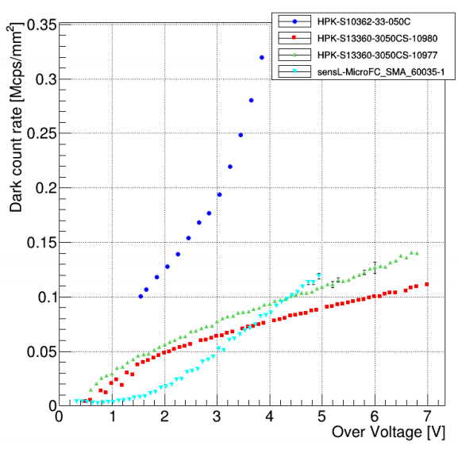
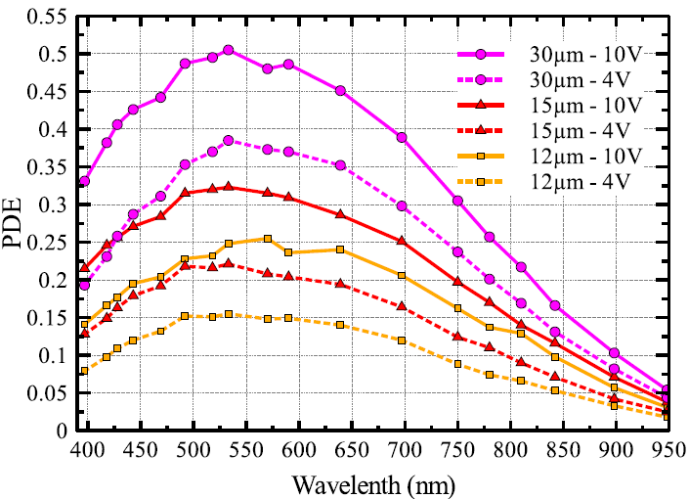
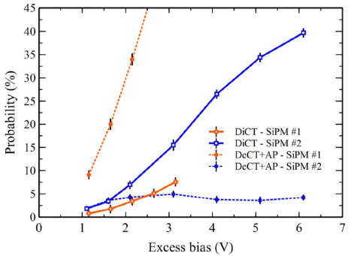
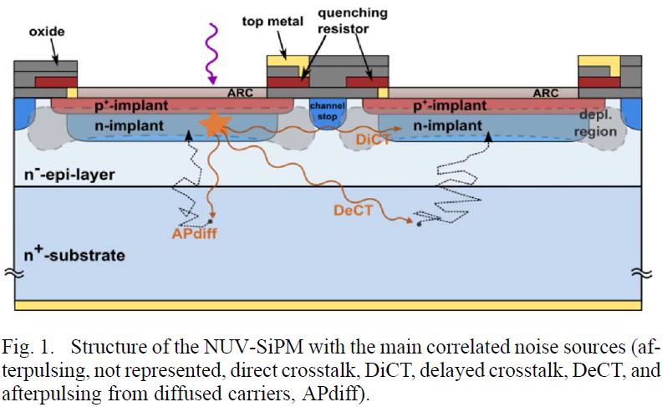
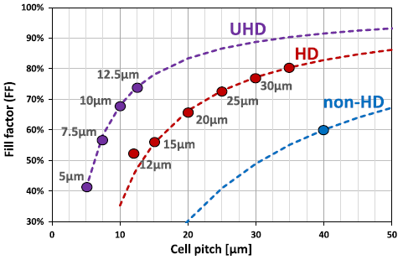
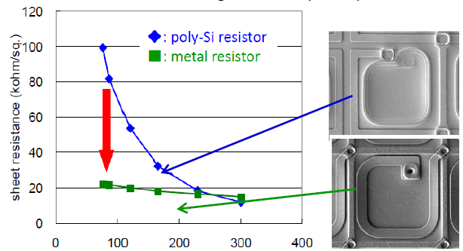
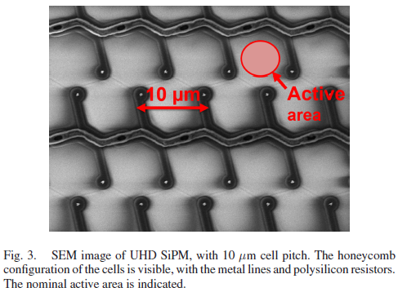
Progress in SiPM technology
Improvement in DCR
Improvement in PDE
Improvement in CT and AP
n-on-p
C. Betancourt et al., Siena Workshop, 2016
F. Acerbi et al., IEEE J. Quant. Elec., 54 (2018)
F. Acerbi et al., IEEE Trans. Nucl. Sci., 62 (2015) 1318-1325
Improvement in DR
Improvement in R_{q}
 | 2007 | 2013 | 2017
PDE (%) | ~ 10 | ~ 40 | ~ 55
DCR (MHz/mm²) | ~ 10 | ~ 0.1 | ~ 0.05
CT (%) | > 20 | < 10 | < 1
AP (%) | > 20 | < 10 | < 3
N. Otte, “A review of silicon photomultipliers,” 2017
F. Acerbi et al., IEEE J. Sel. Top. Quantum Electron, 62 (2018) 1318-1325
T. Nagano, IEEE NSS 2013

