Slide 1
Implementation of Earned Value Management (EVM) in HLLHC Project
R. Martins
12/12/2018

Slide 2
Goal of HL-LHC as fixed in 2010
From FP7 HiLumi LHC Design Study application
The main objective of HiLumi LHC Design Study is to determine a hardware configuration and a set of beam parameters that will allow the LHC to reach the following targets:
A peak luminosity of L_{peak} = 5×10³⁴ cm⁻²s⁻¹ with levelling, allowing:
An integrated luminosity of 250 fb⁻¹ per year, enabling the goal of L_{int} = 3000 fb⁻¹ twelve years after the upgrade.
This luminosity is more than ten times the luminosity reach of the first 10 years of the LHC lifetime.
Ultimate performance established 2015-2016: with same hardware
and same beam parameters: use of engineering margins:
L_{peak ult} ≅ 7.5 10³⁴ cm⁻²s⁻¹ and Ultimate Integrated L_{int ult} ∼ 4000 fb⁻¹
LHC should not be the limit, would Physics require more…
Project approved by CERN Council in June 2016

Slide 3
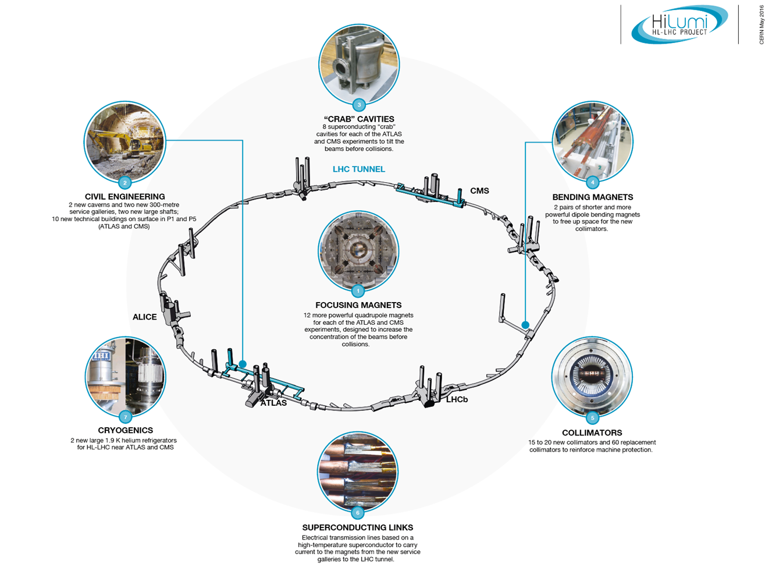
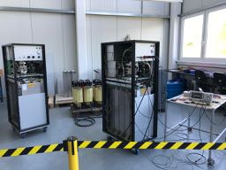
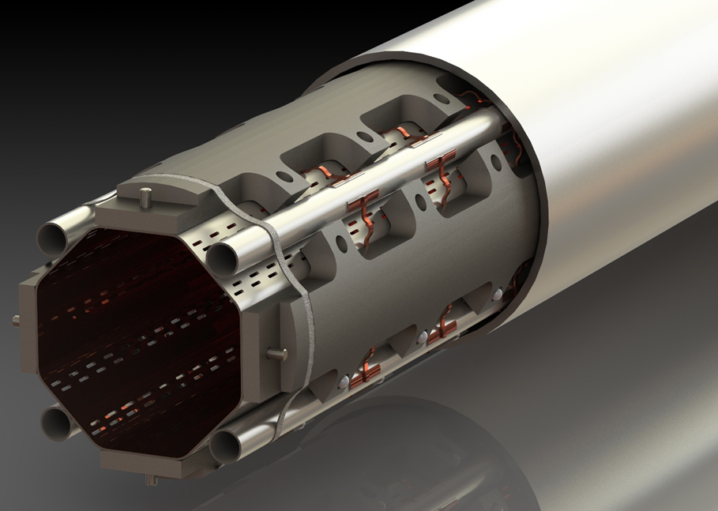
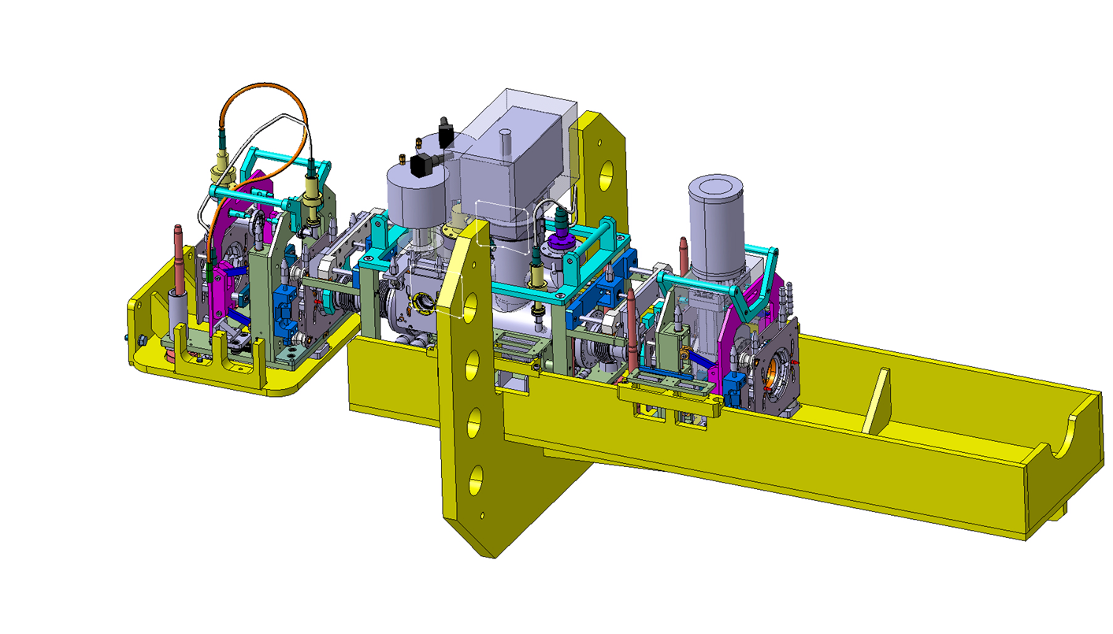
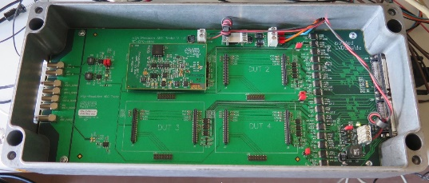
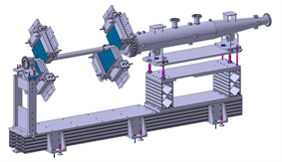
Technology landmarks

Slide 4
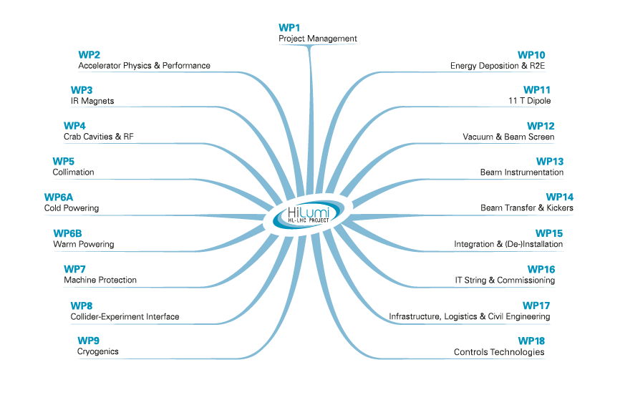
Core Activities of Accelerator and Technology sector

Slide 5
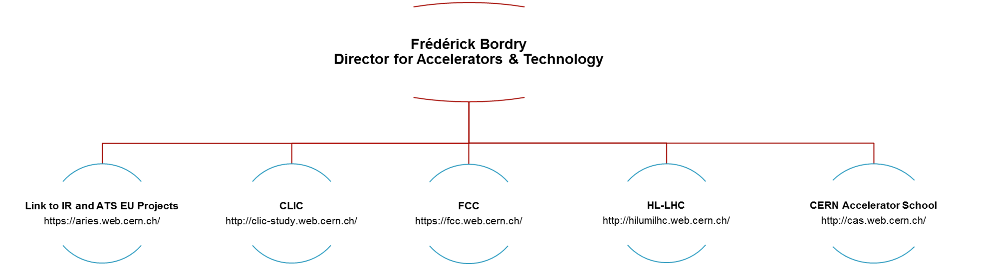
Accelerator and Technology Sector Directorate Office (ATS-DO)
Director for Accelerators & Technology
ATS DO Unit
BE Department
EN Department
TE Department
Unit of the Accelerator and Technology (A&T) sector
Staffed by persons working on main projects or studies such as HL-LHC, FCC, CLIC and EU Activities.
No hierarchical functions within the departments of the A&T sector.
Project and Study leaders report directly to the Director for Accelerators and Technology.
Source
https://espace.cern.ch/acc-tec-sector/mandate.aspx

Slide 6
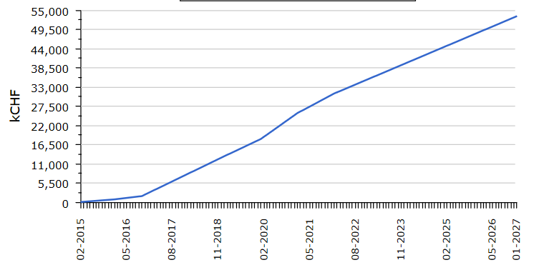
EVM Guidelines
Organization
(5 criteria)
Planning / Schedule / budgeting
(10 criteria)
EVM Analysis / Reports
(6 criteria)
Revision / data maintenance
(5 criteria)
Accounting Considerations
(6 criteria)
(PV) planned value
(BAC) Budget at completion
Approved budget for the work scheduled to be completed by a specif date
Total amount of money originally planned to spend on the project.
BAC
Reporting Progress
Accouting System
$
(EV) Earned value
(AC) Actual Cost
Quantification of the “worth”
of the work done to date by Project Engineers
Costs Actually incurred
for the work completed
by a specific date
EIA – 748 Standard for Earned Value Management
(32 criteria)

Slide 7


EVM Guidelines
Analyzes and Management reports
EAC
CHF
PV
Baseline
BAC
AC
SV – Schedule variance
CV – Cost variance
AC – Actual cost
PV – Planned value
BAC – Budget at Completion
SV
CV
EV
$
?
Time
?
Am I spending more than I expected?
Am I on schedule?
$$CV=EV−AC$$
$$SV=EV−PV$$
EV < AC | EV = AC | EV > AC
(-) CV | (0) CV | (+) CV
Over | On | Under
EV < PV | EV = PV | EV > PV
(-) SV | (0) SV | (+) SV
Behind | On | Ahead

Slide 8
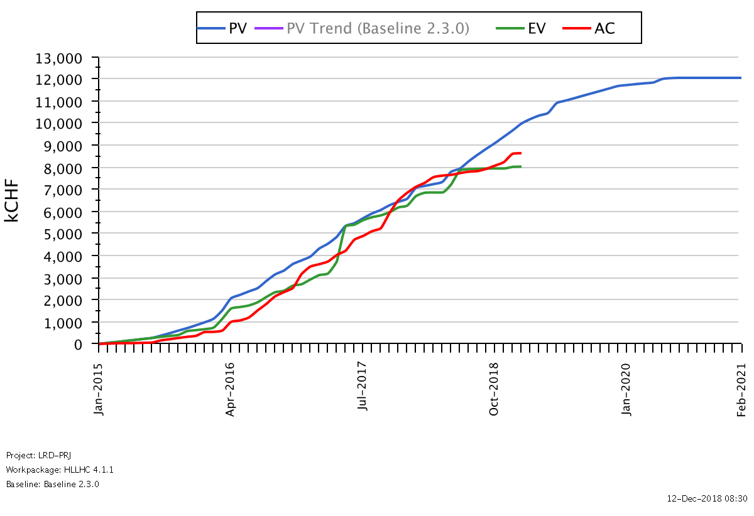
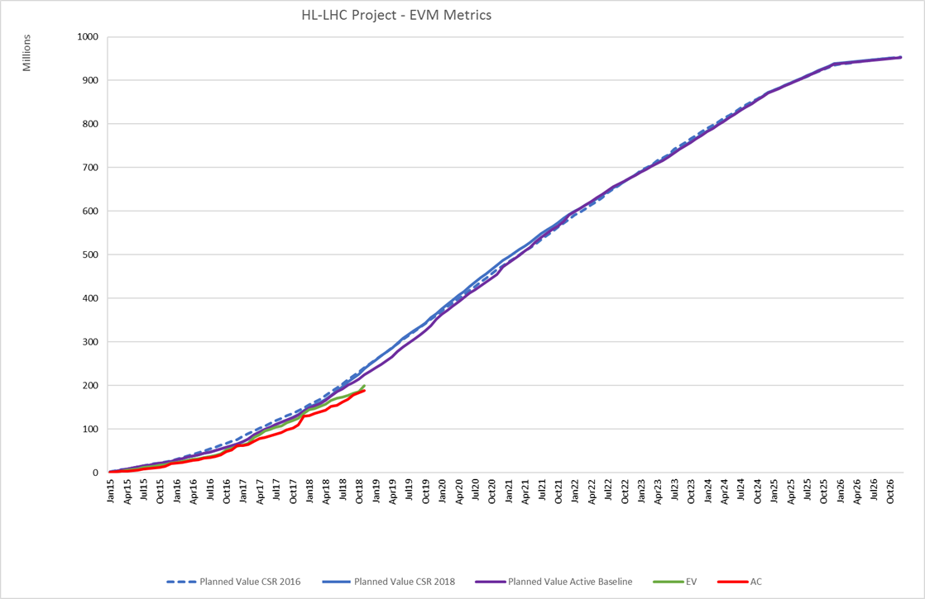
EVM & Planned value evolution since 2016
950 MCHF (Material)
HL-LHC has passed the cap of
180 MCHF in expenditure
>350 MCHF in commitment.

Slide 9
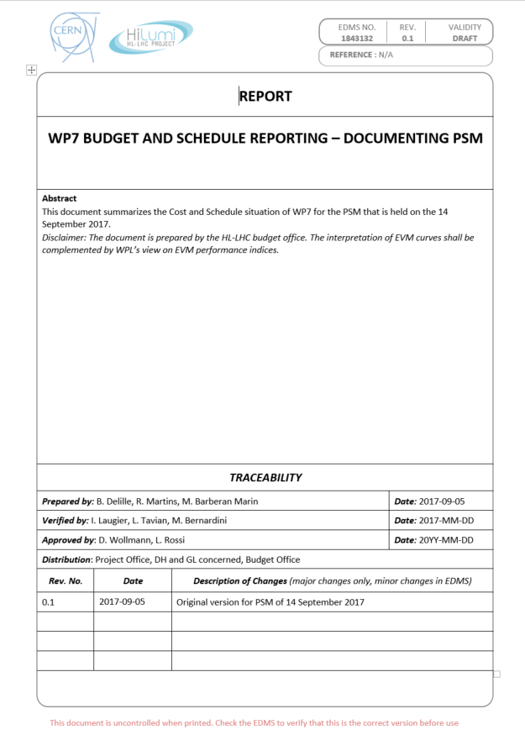
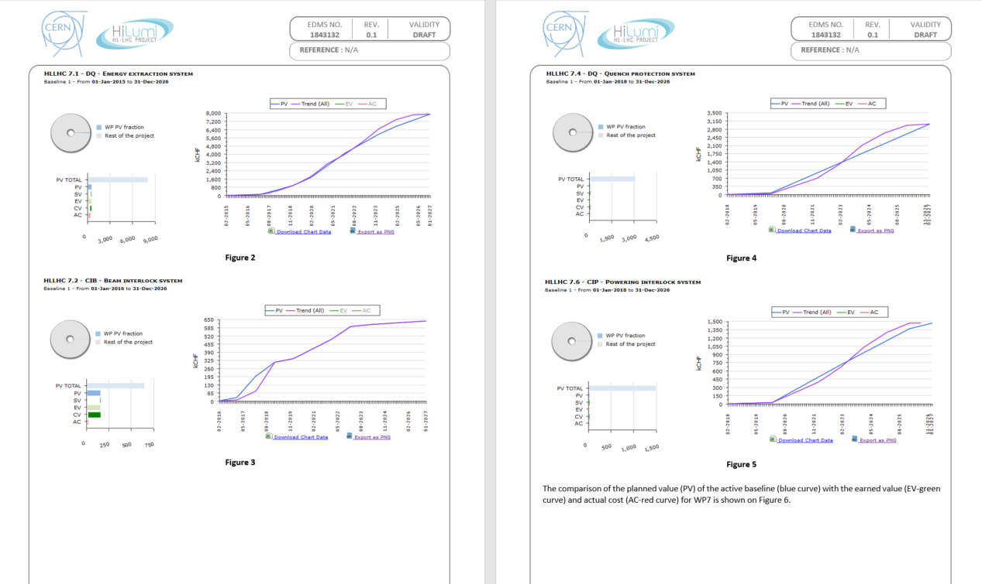
EVM in the context of the HL-LHC project
Providing input to
In general weekly
Technical updates
WP Progress monitoring
WP management process
Project Steering Meetings
HL-LHC Project C&S Reviews
Financial Reporting to CERN Committees
Project Reporting to CERN Committees
Committees every 3 months
Project Progress reporting
C&S Update
Baseline changes reporting
In general 3x a year
WP Progress monitoring
C&S Update
Savings/Loss monitoring
Every 18 months
Project Progress reporting
C&S Update
Savings/Loss reporting
Baseline changes proposal

Slide 10

Training
PMI Project Management course
2 French courses
AXEL course

Slide 11
Thank you!

