Slide 1


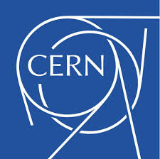
EP-4022
Rui Vizinho de Oliveira

Slide 2
Discussion topics
HGCAL
Dry-out
Modelling & Design

Slide 3
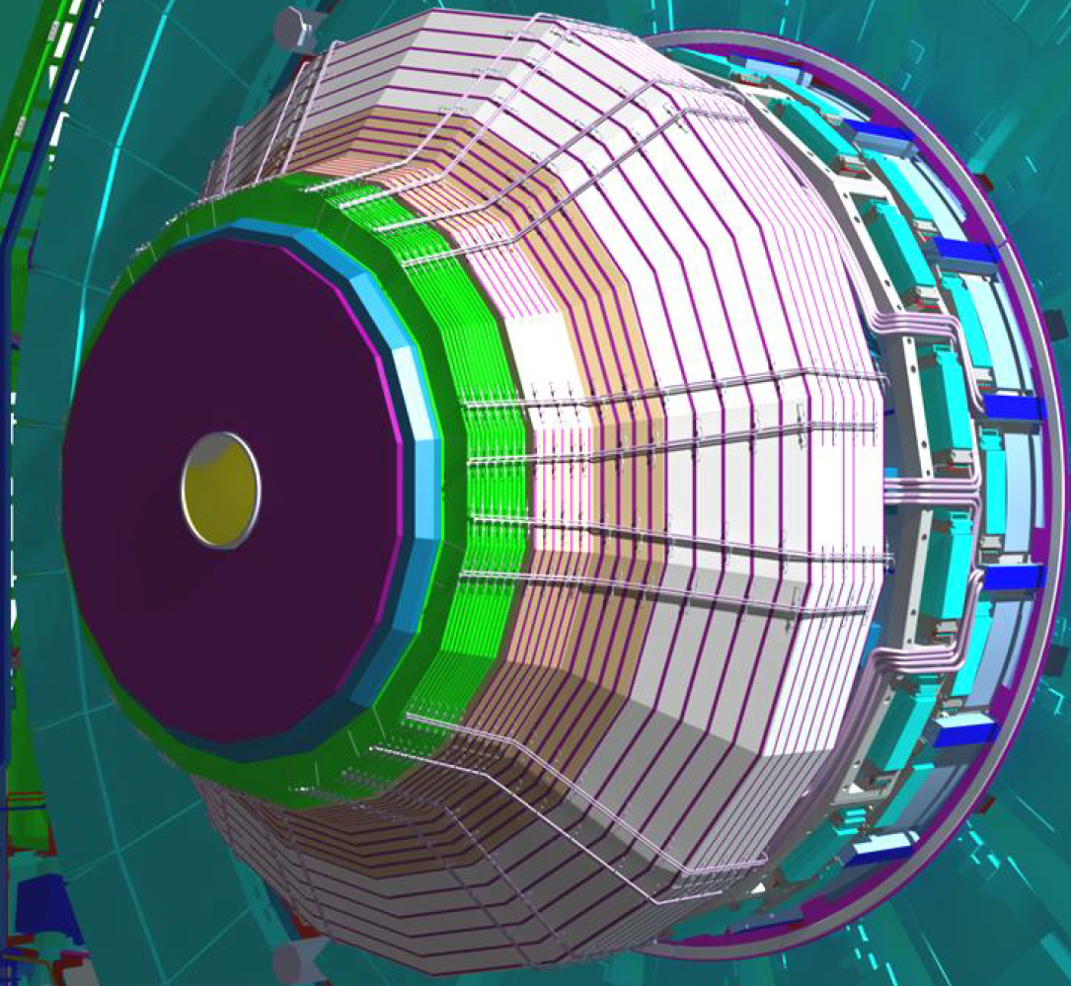
HGCAL
High Granularity Calorimeter

Slide 4
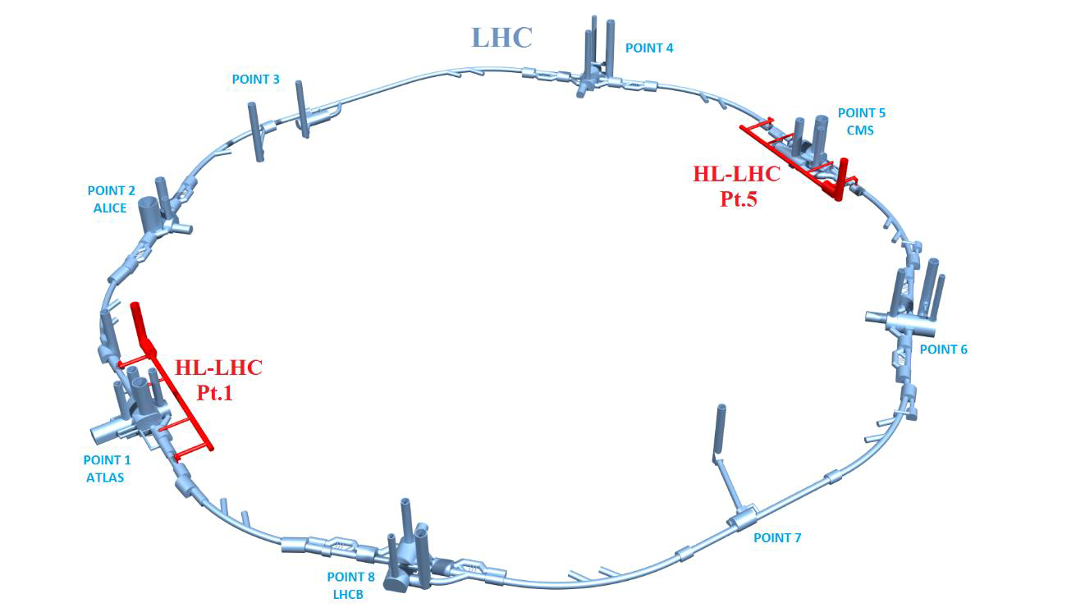
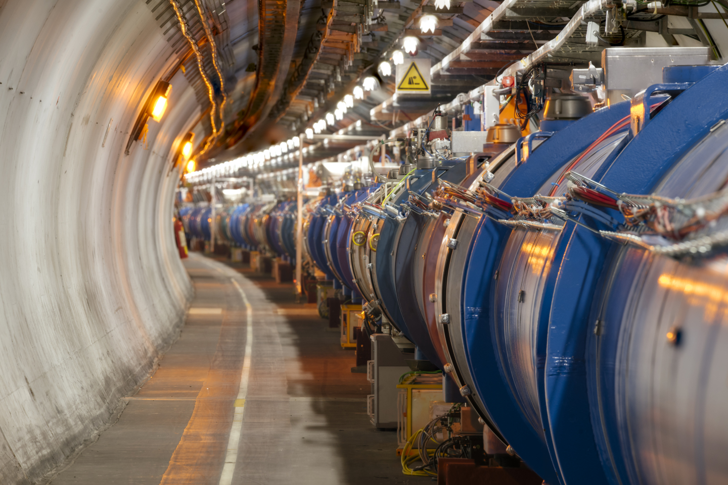
HGCAL
HL-LHC 10X more luminosity
11-12 Tesla superconducting magnets,
new technology for beam collimation,
loss-less superconducting links
compact superconducting crab cavities with ultra-precise phase control for beam rotation,
high-power…

Slide 5
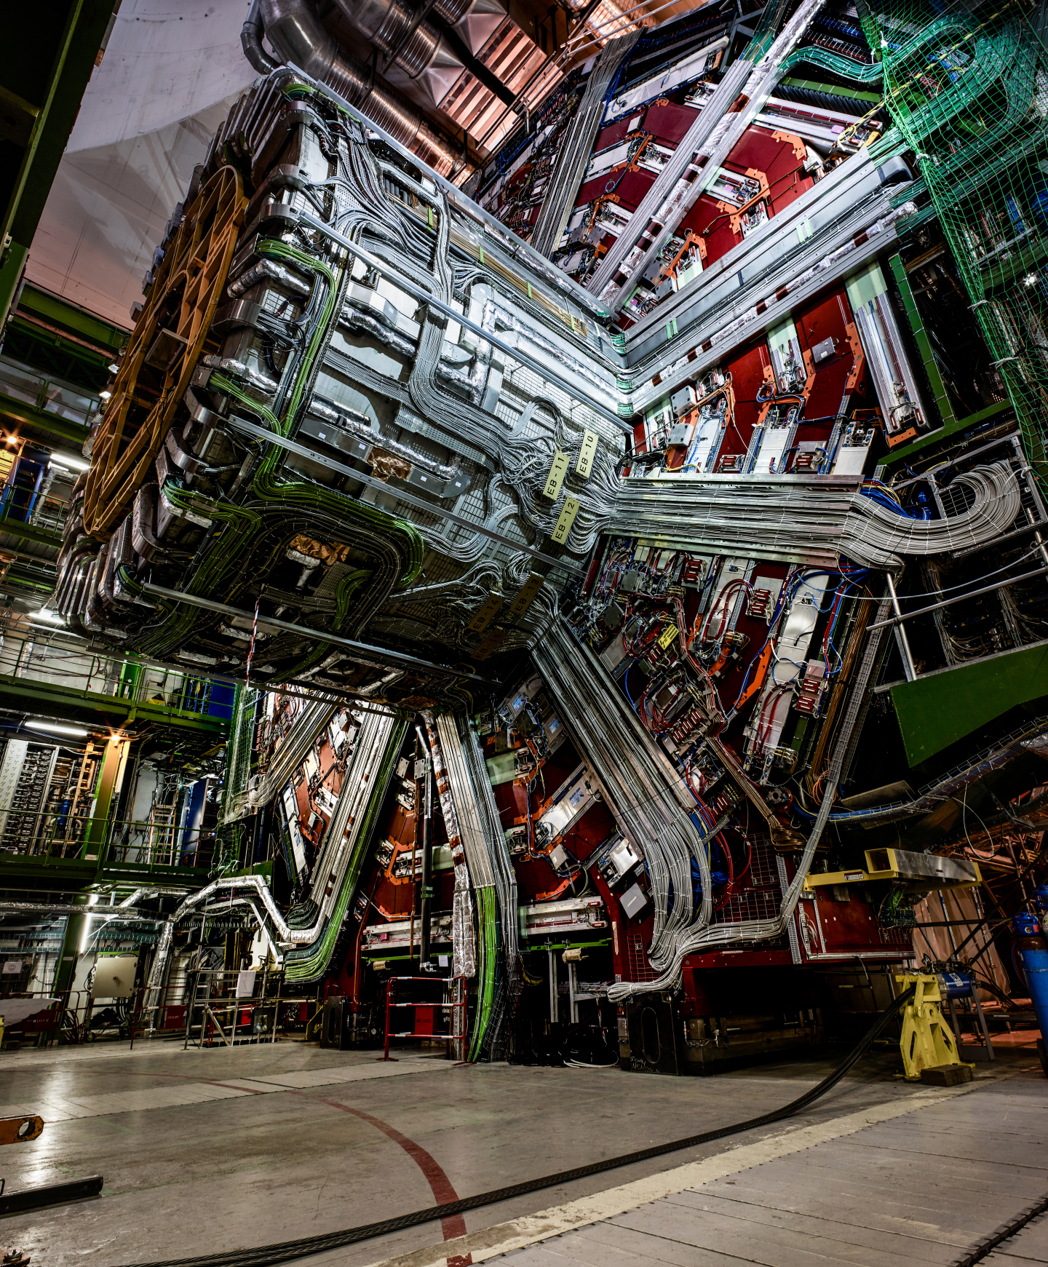
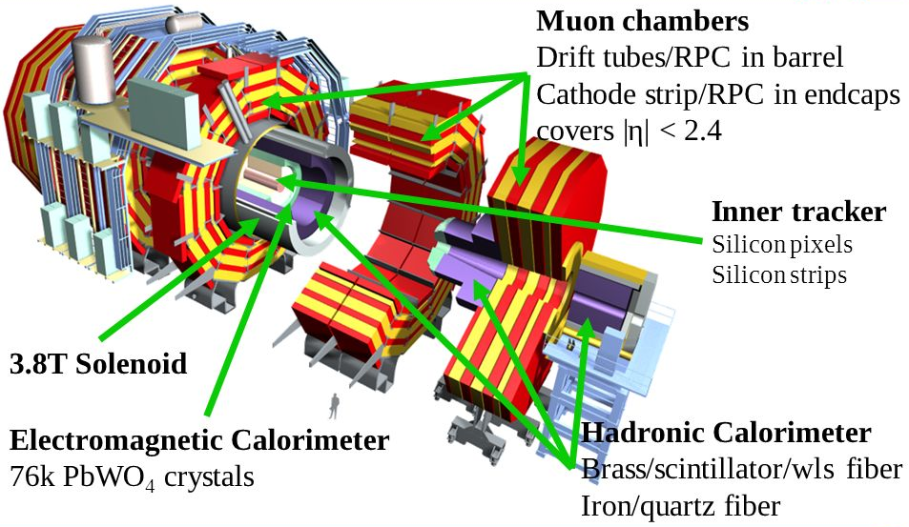
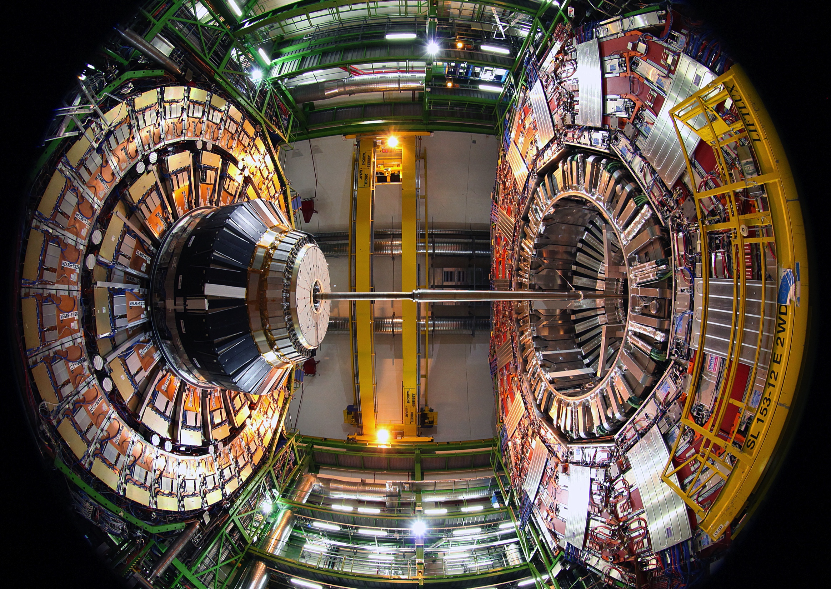
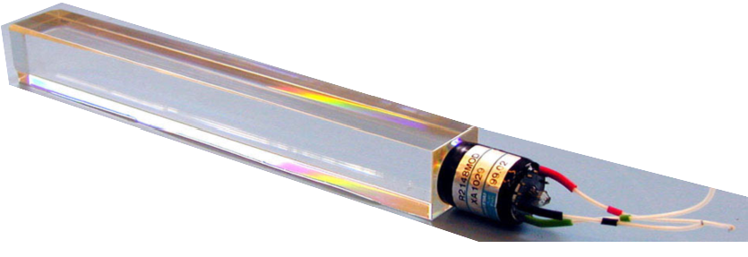
HGCAL
Current calorimeters fail above 500 fb⁻¹ (L_{int})
Made of PbWO₄ crystals

Slide 6
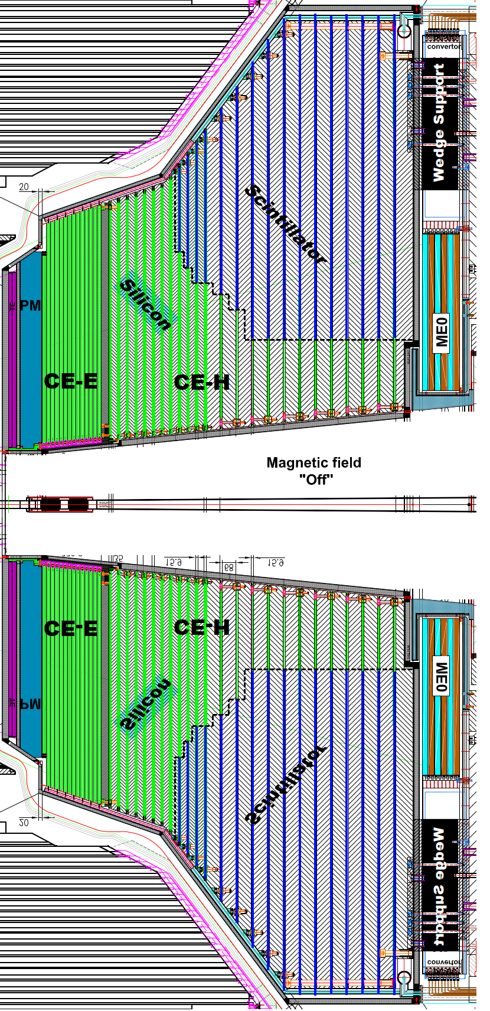
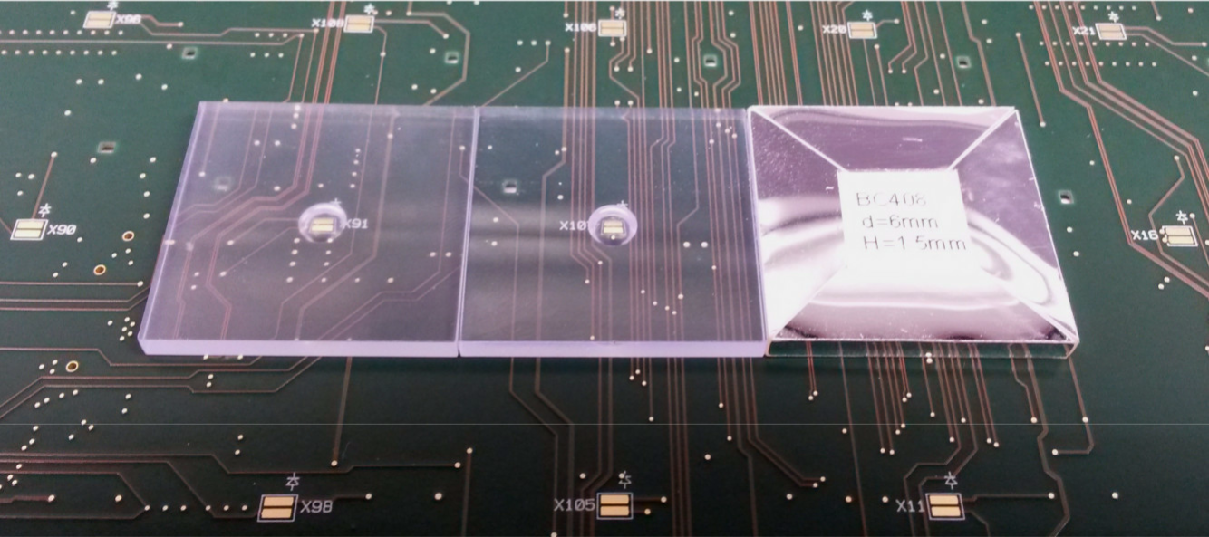
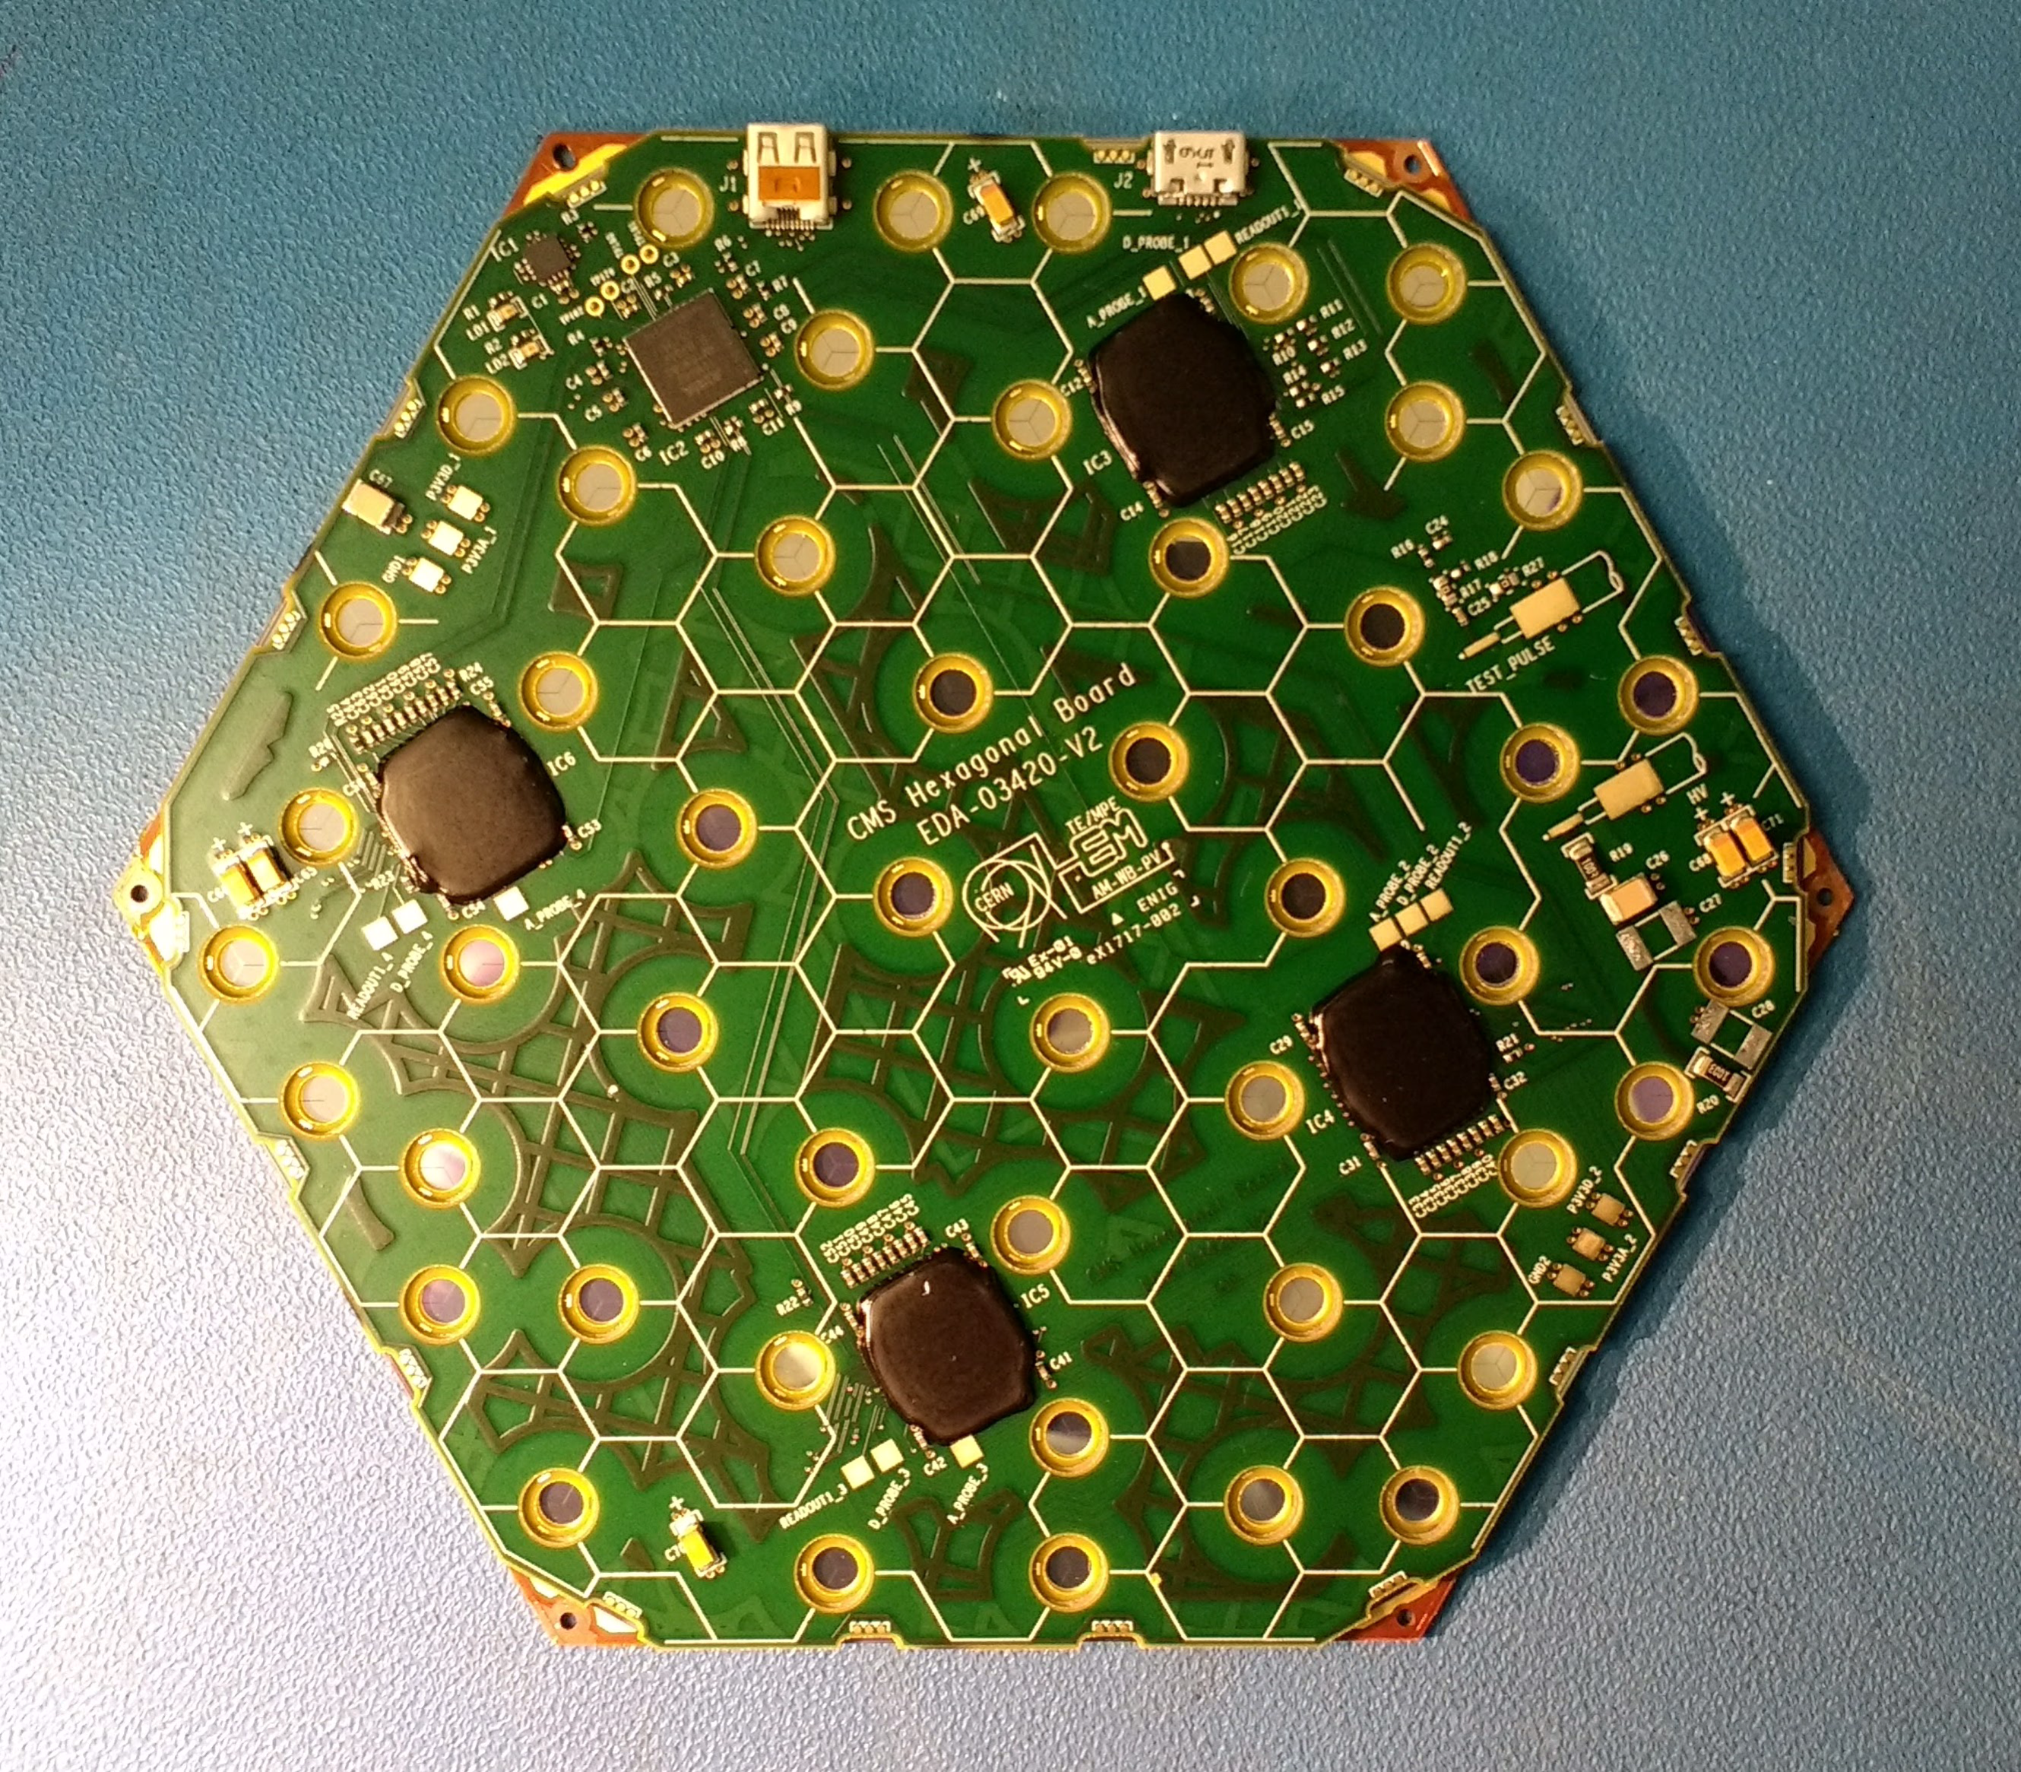
HGCAL
New calorimeters operate at 3000 fb⁻¹ (L_{int})
Made of Silicon sensors
&
Scintillation tiles with SiPM photodetectors

Slide 7
HGCAL
Silicon sensors withstand more than 3000 fb⁻¹
-30 degrees Celsius during operation

Slide 8
HGCAL
Dew-point control
Condensation/ice formation
Electrical faults

Slide 9
Dry-out
Nitrogen gas
Dry air

Slide 10
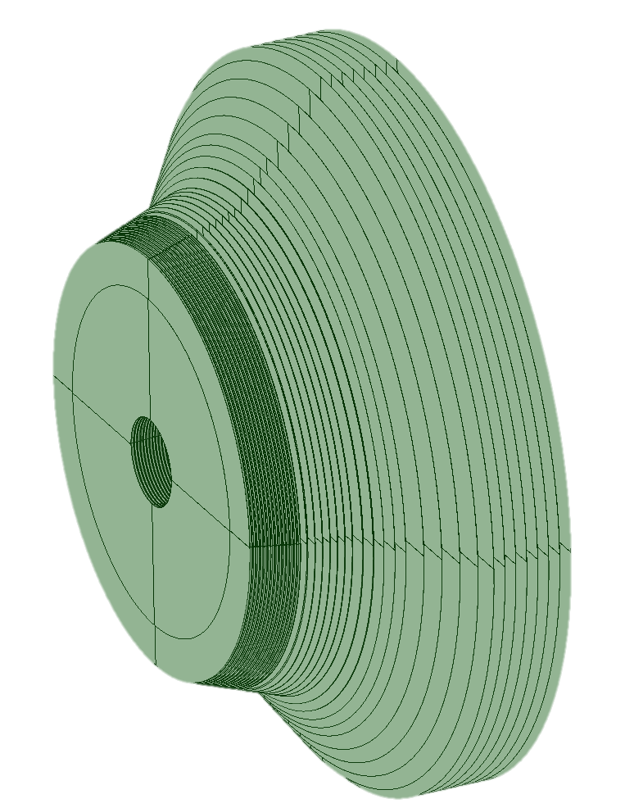
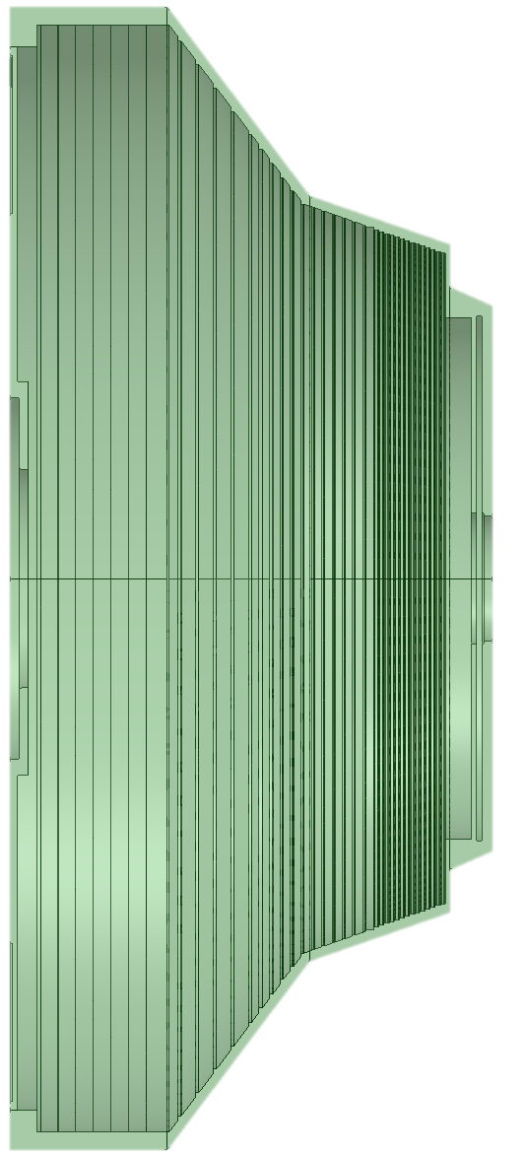
Dry-out
Flush/fluid regions
Thermal shield
Thin disk regions

Slide 11
Modelling & Design

Slide 12
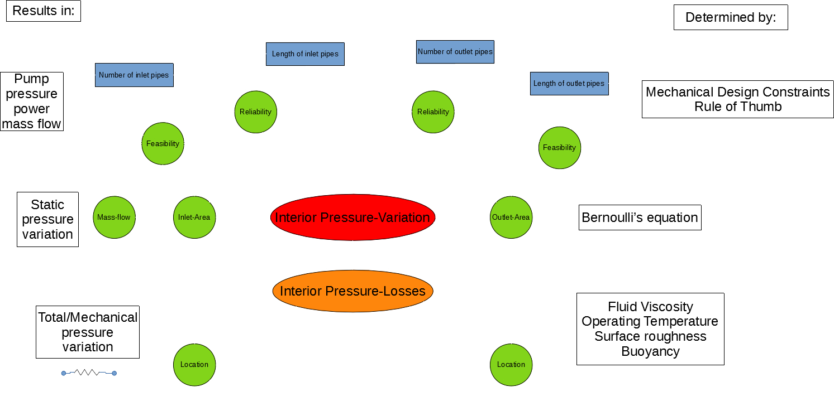

Slide 13
Modelling & Design
Challenges
Service Cables
74 thin disk regions (3 to 0.2 mm thick)
Thermal Shield

Slide 14
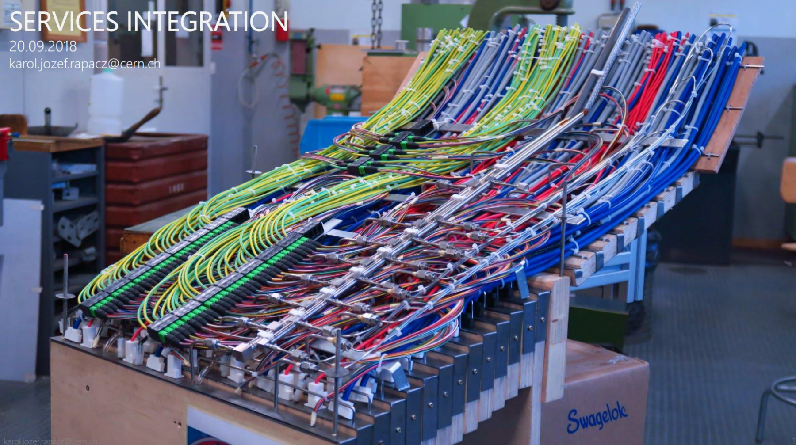
Modelling & Design
Service Cables

Slide 15
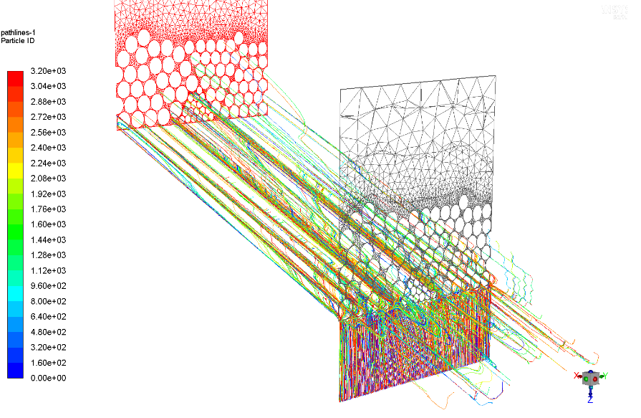
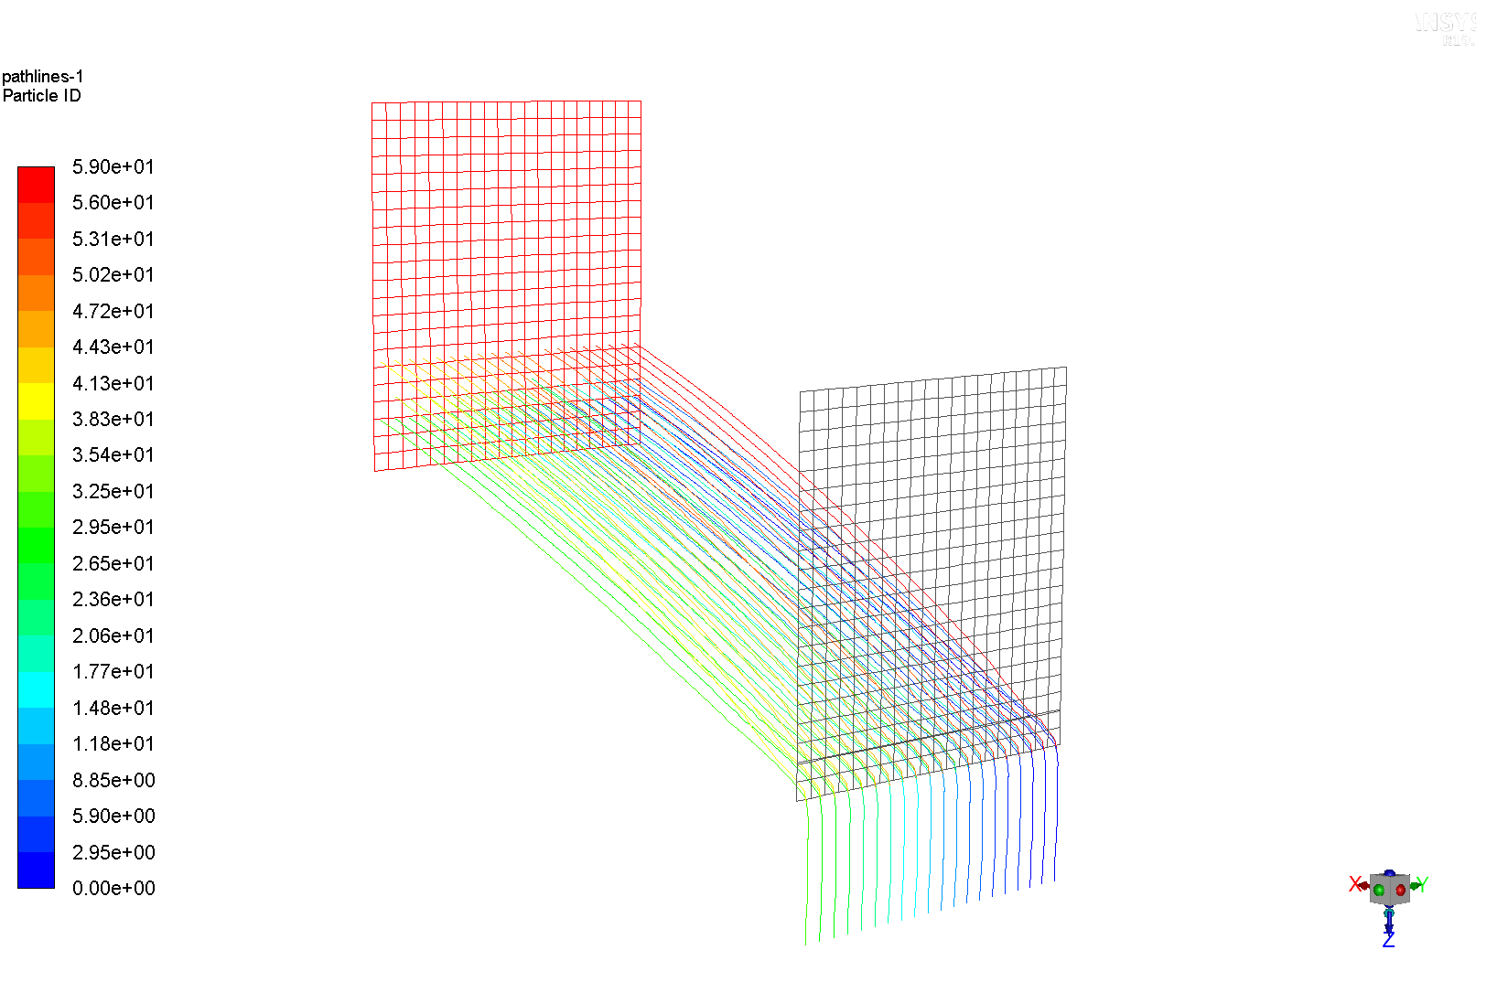
Modelling & Design
Service Cables Porous Media

Slide 16
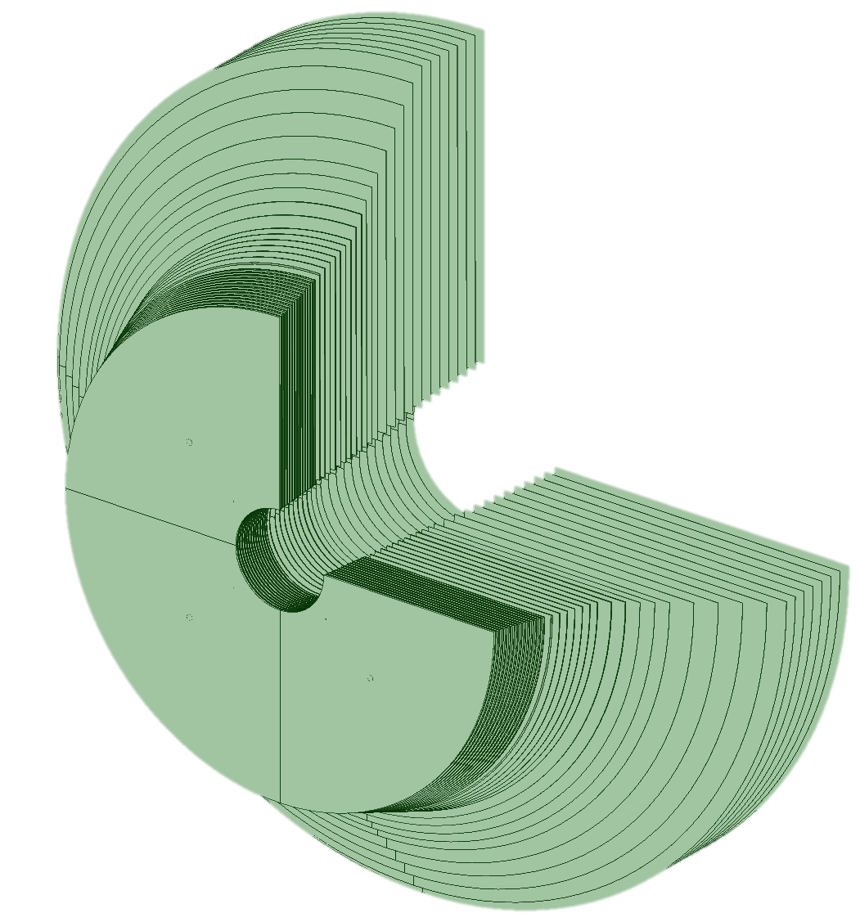
Modelling & Design
74 thin disk regions (3 to 0.2 mm thick)

Slide 17
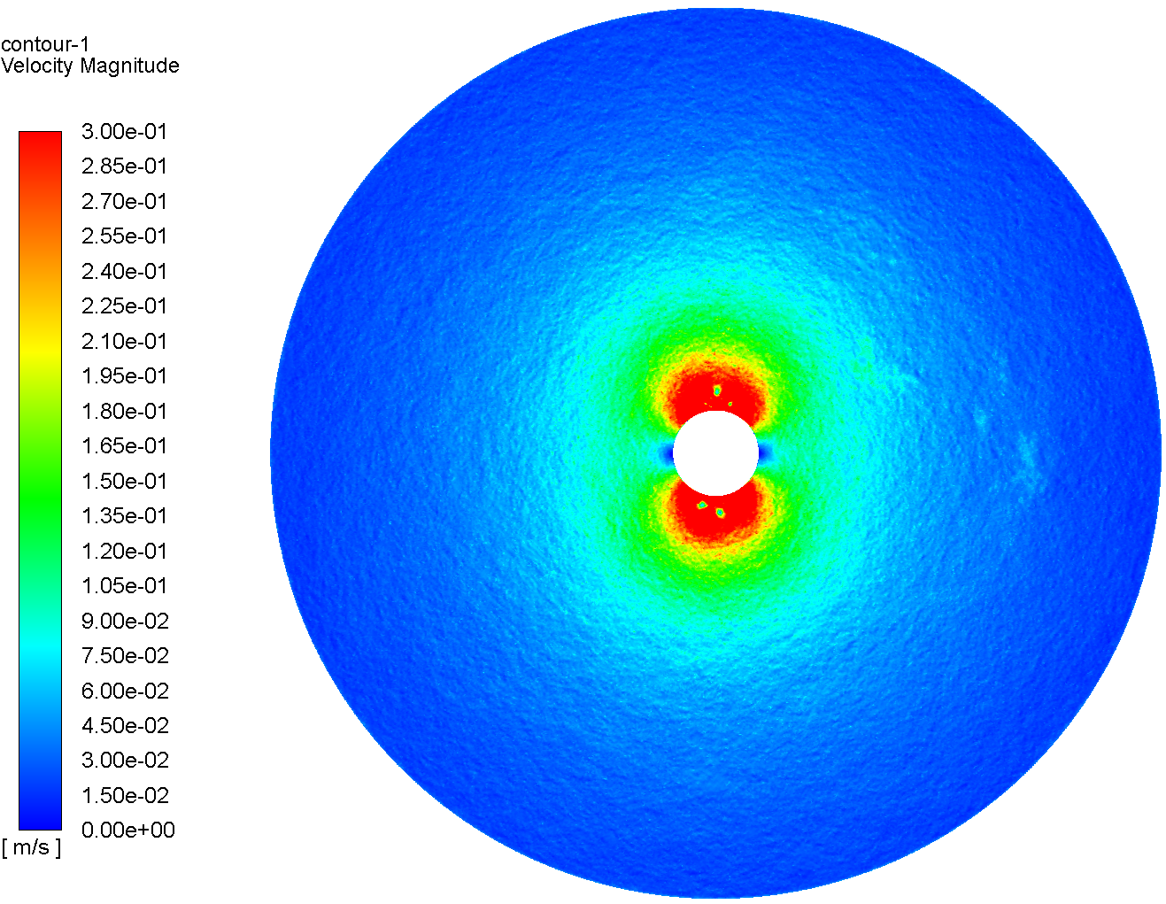
Modelling & Design
74 thin disk regions (3 to 0.2 mm thick)
Single disk simulation and parameterization

Slide 18
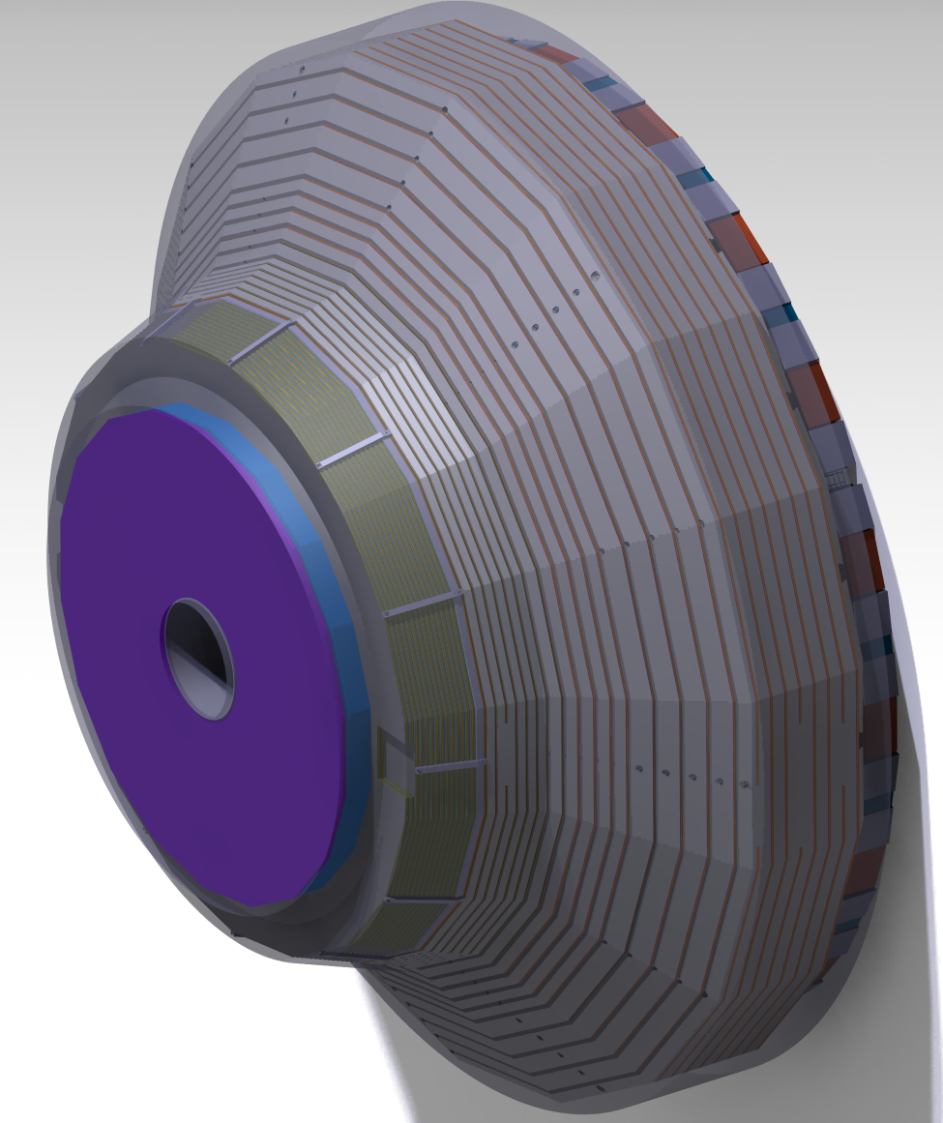
Modelling & Design
Thermal shield

Slide 19
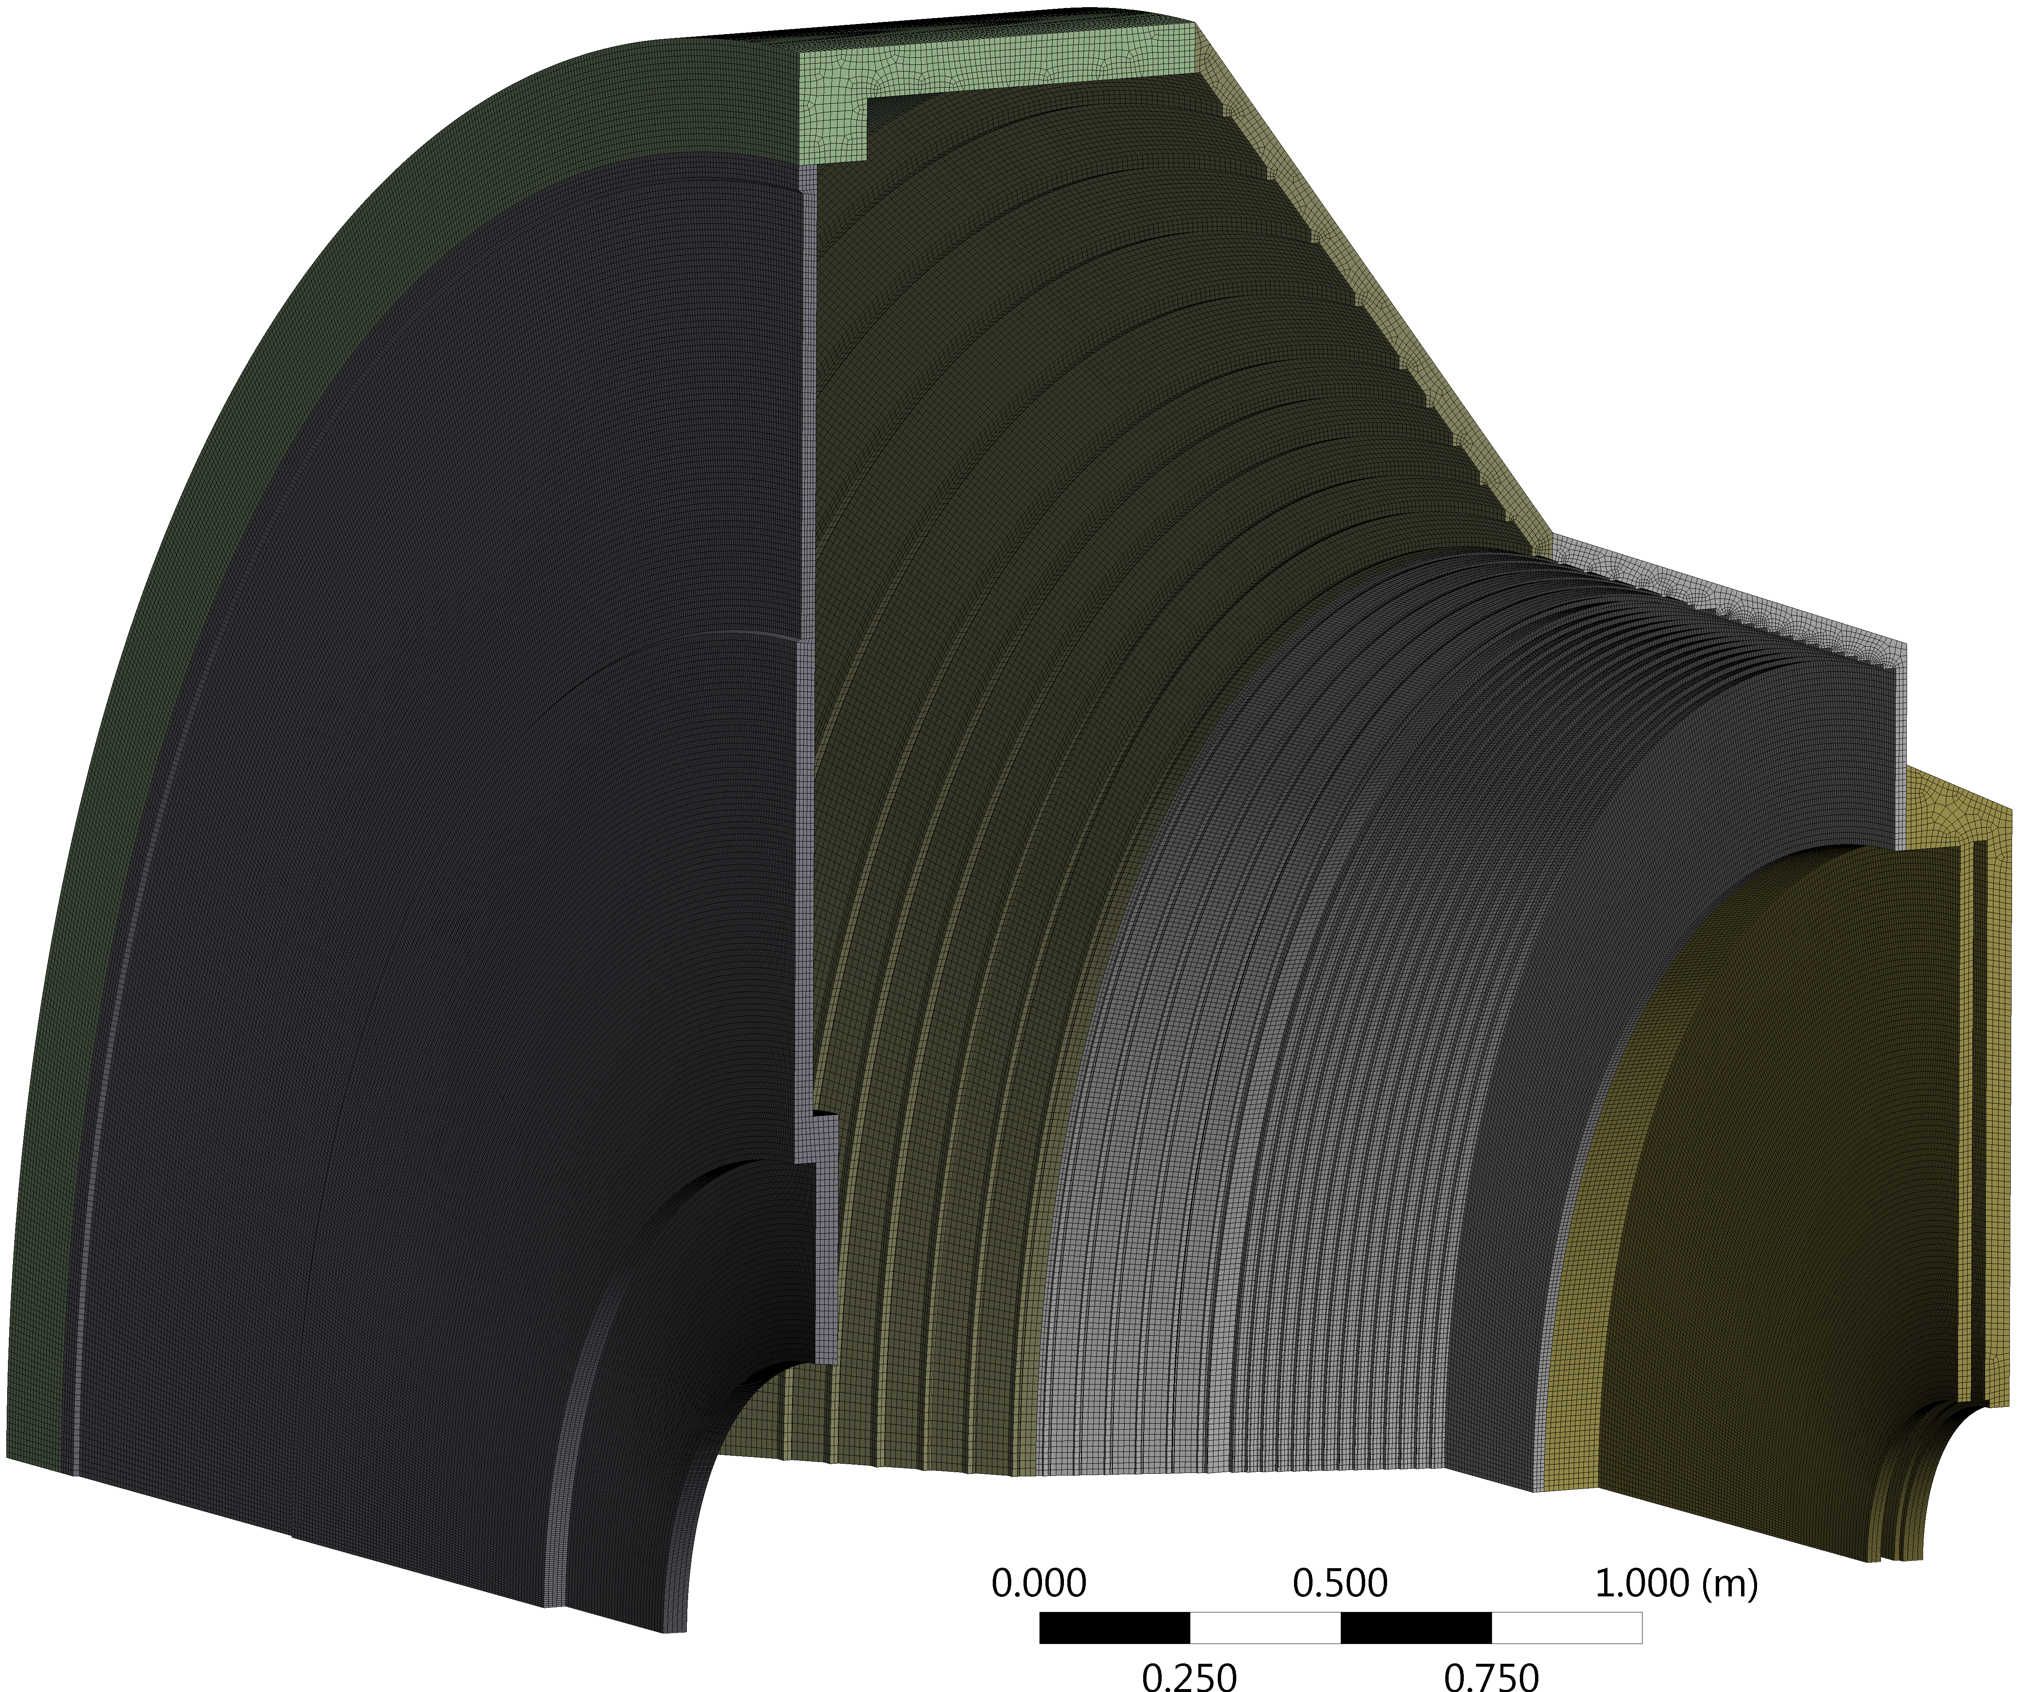
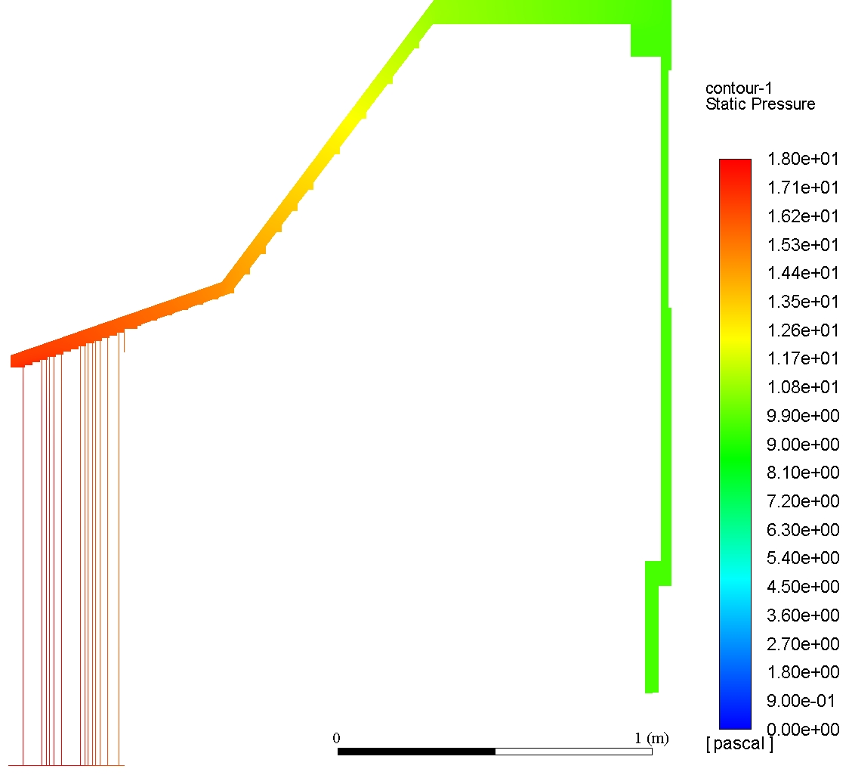
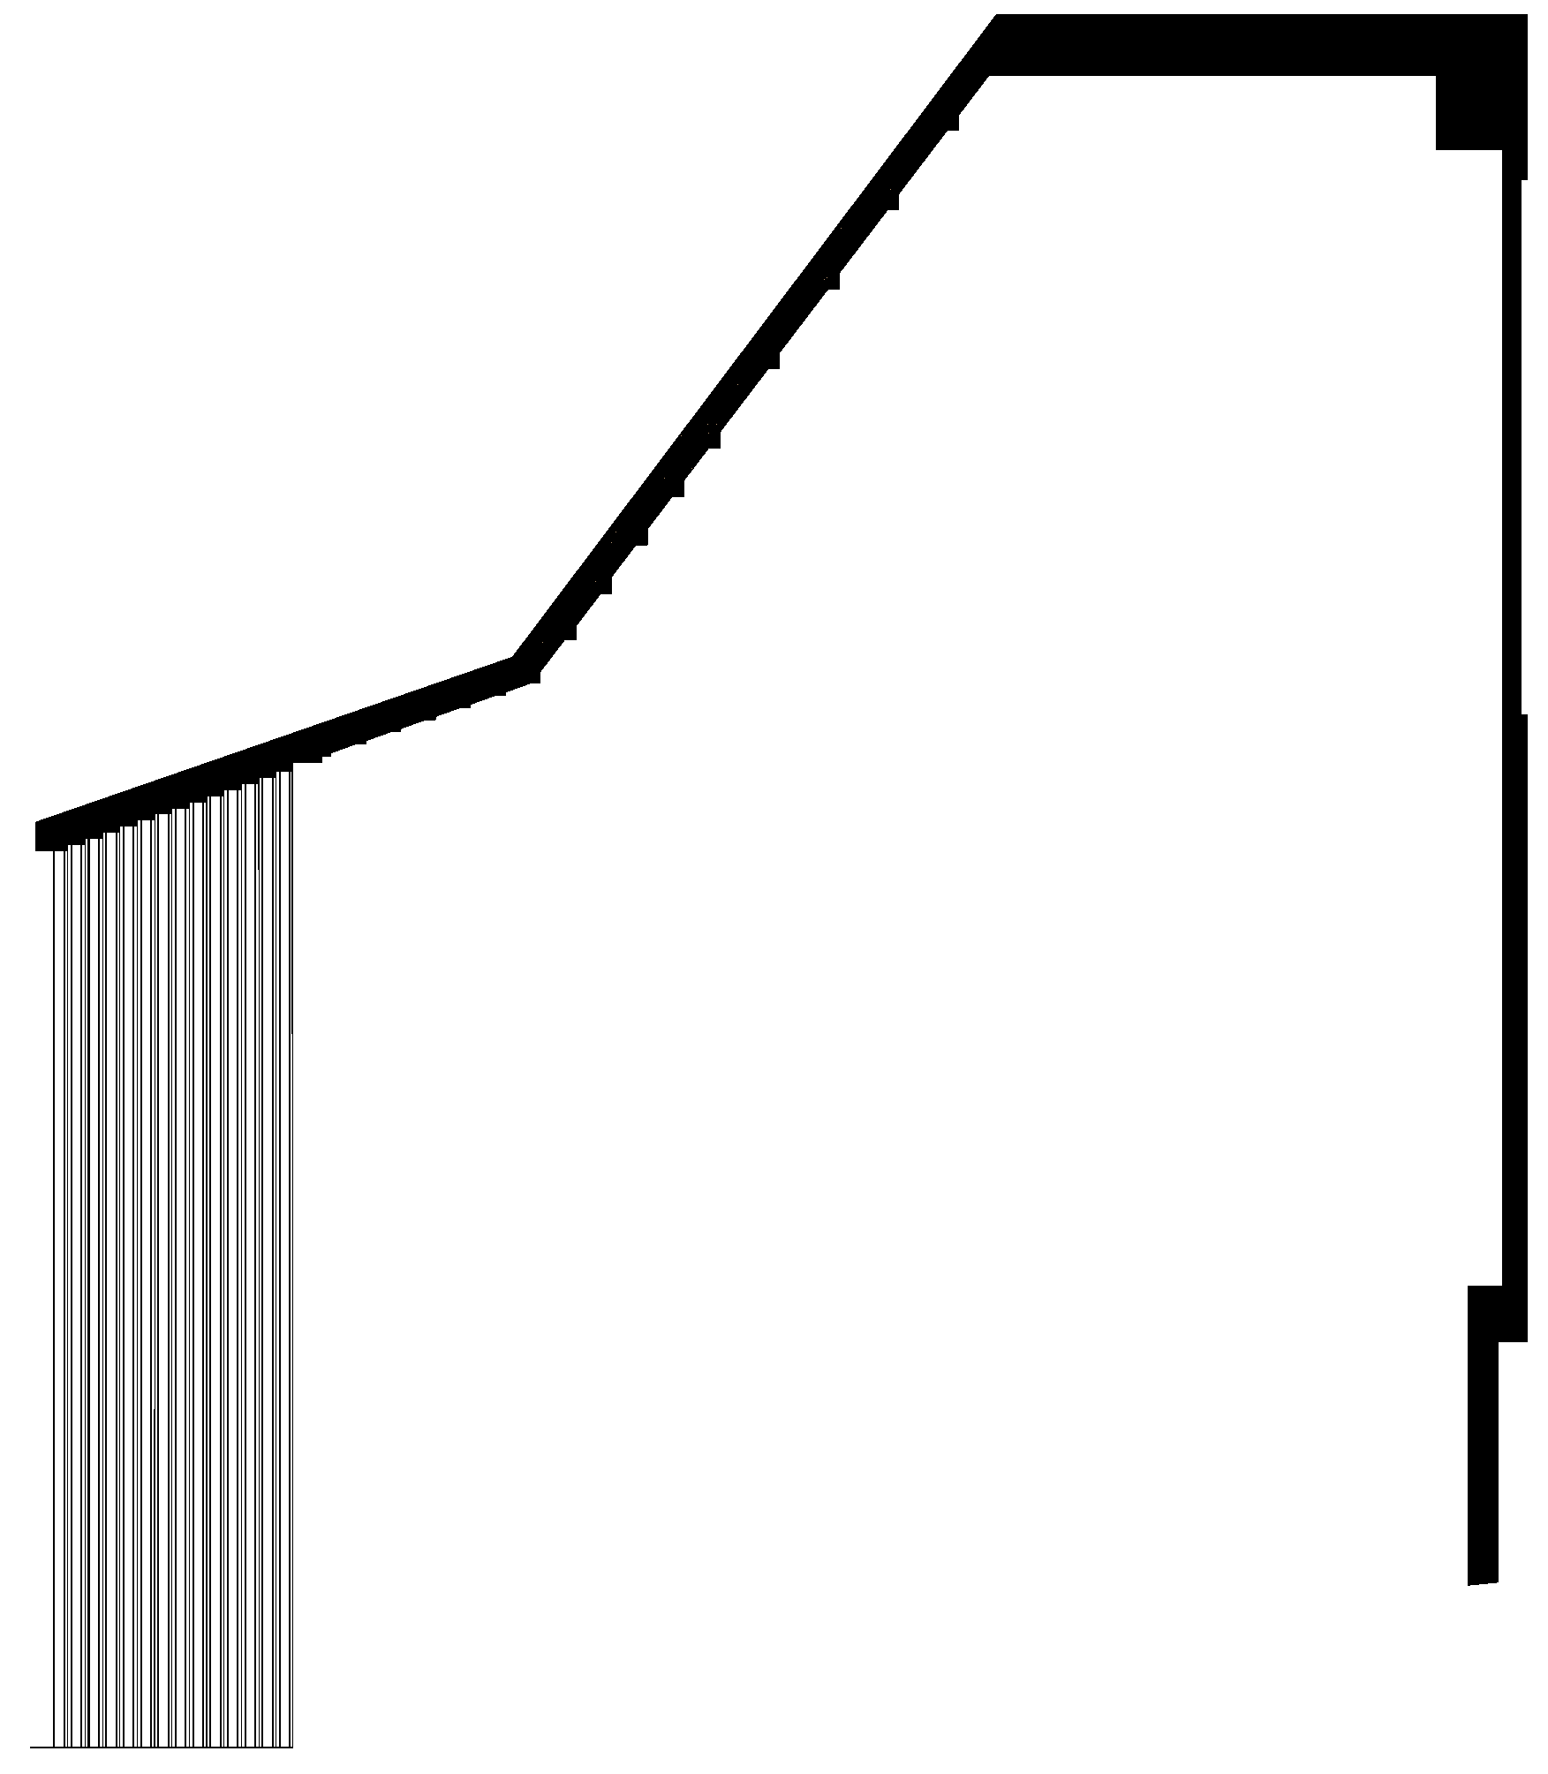
Modelling & Design
Thermal shield
2D axisymmetric
&
3D half and quarter simulations

Slide 20
Q&a
Thank you for your time.

