Slide 1


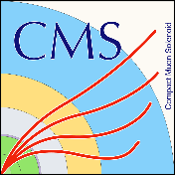
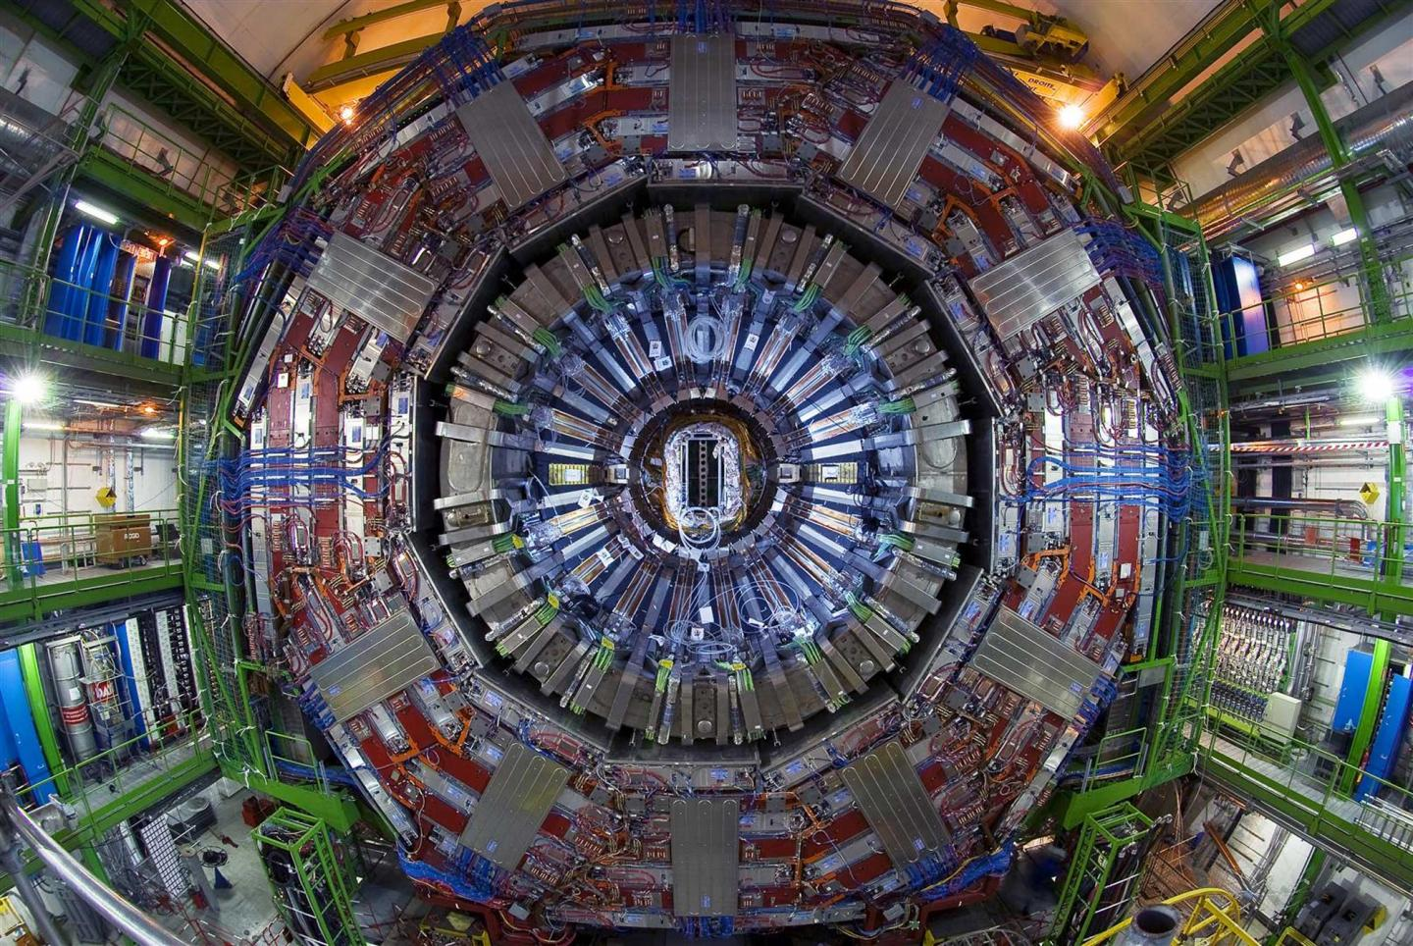
Thermal analysis and testing of the electronical package for the new High Granularity Calorimeter (HGCAL) for the CMS detector
Trainee: GOMES, Ricardo
Supervisor: MOCCIA, Stefano
EP-CMX-EI

Slide 2
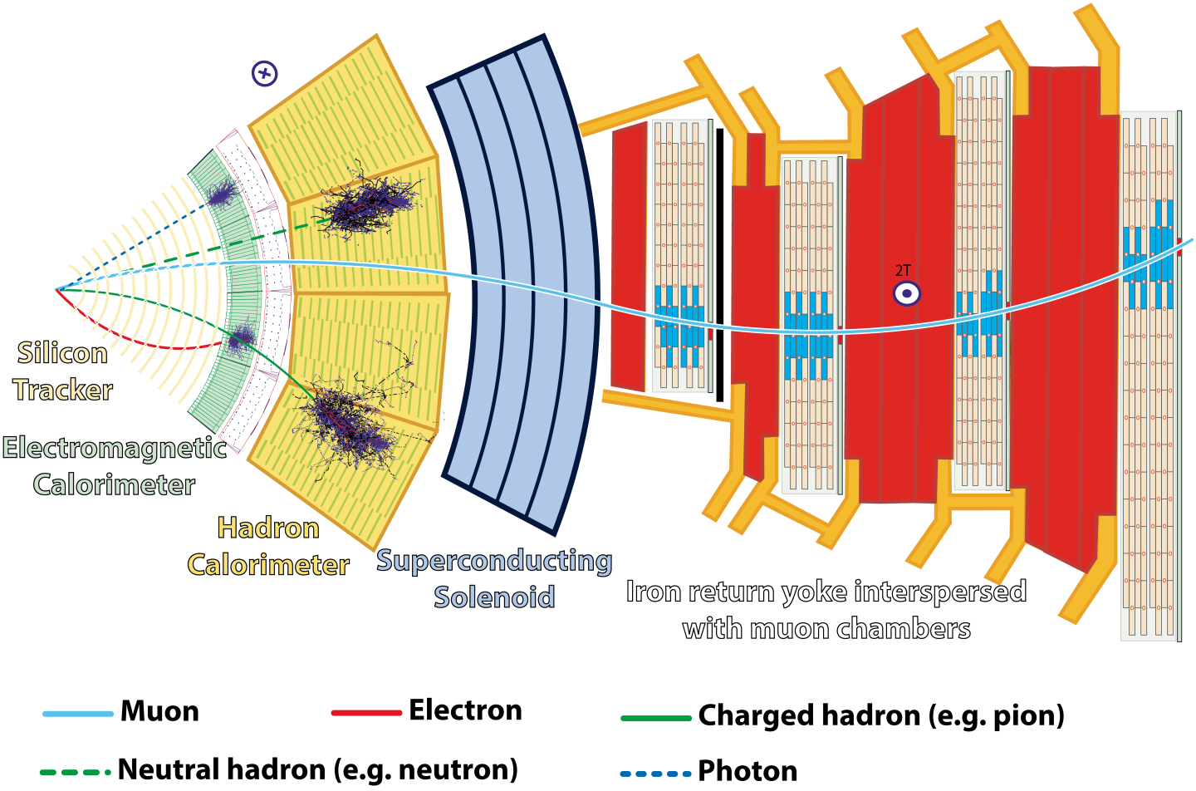
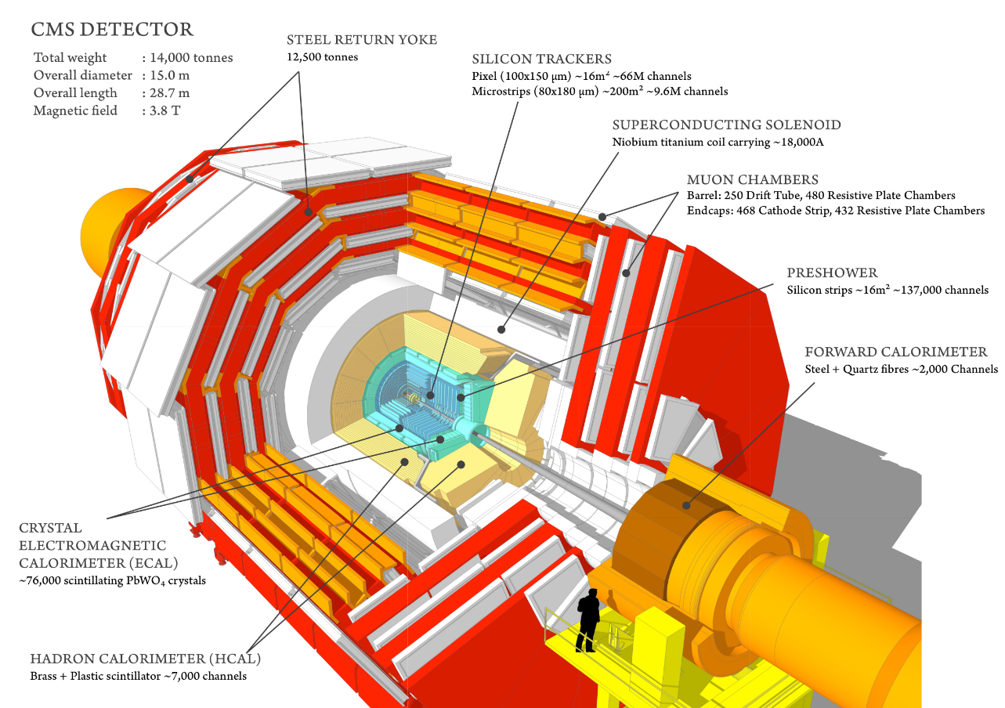
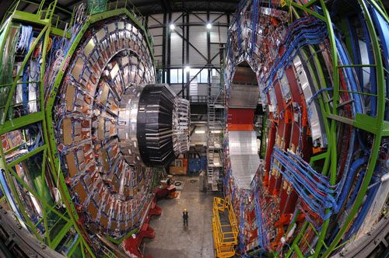

Context
What is the CMS?
CMS detector – 3D model
CMS detector – cavern photo
For the High Luminosity operation of the LHC, CMS will replace the endcap calorimeters with a new High Granularity Calorimeter.
12/12/2018
1/14

Slide 3
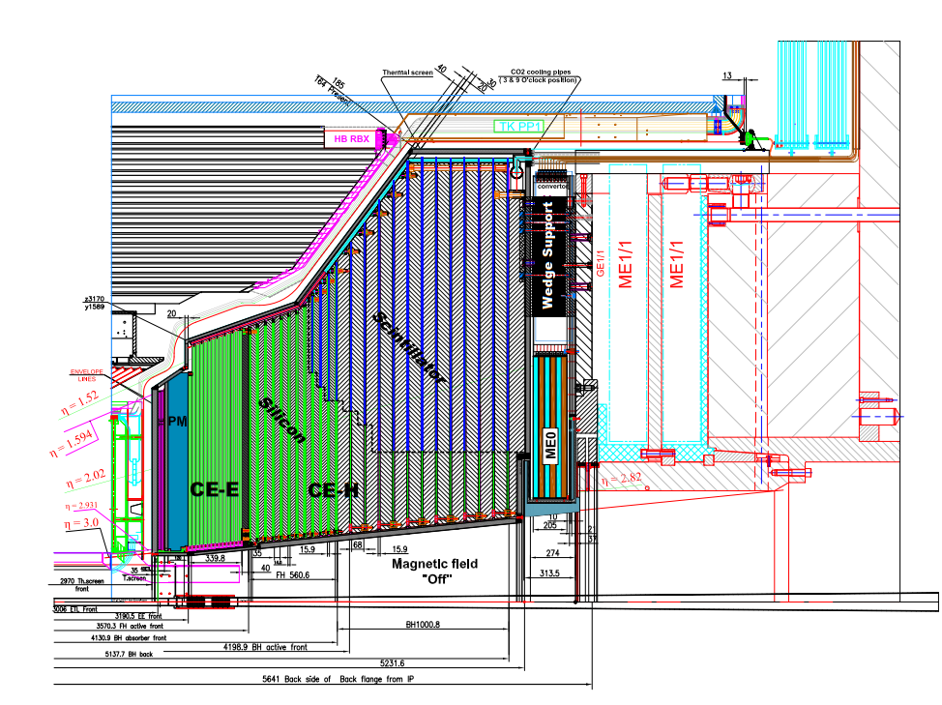
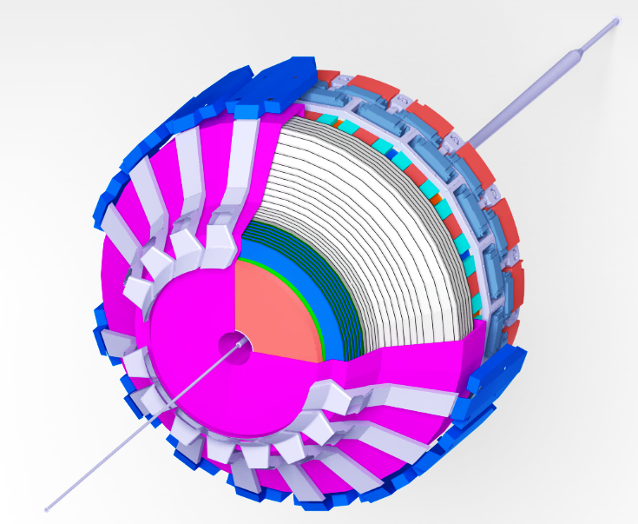
Context
High Luminosity & High Granularity Calorimeter
HGCAL Slice drawing
HGCAL 3D Model
Initial focus will be on the Electromagnetic (CE-E)
12/12/2018
2/14

Slide 4
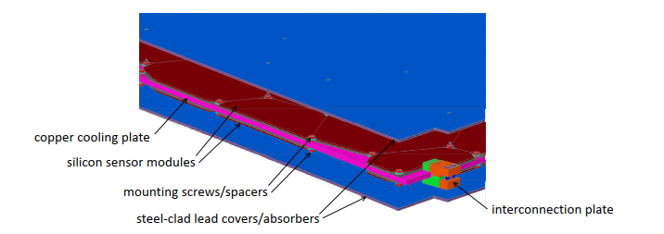
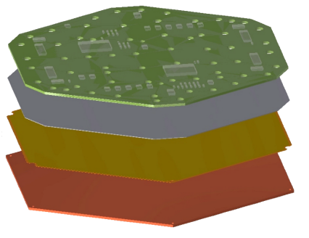
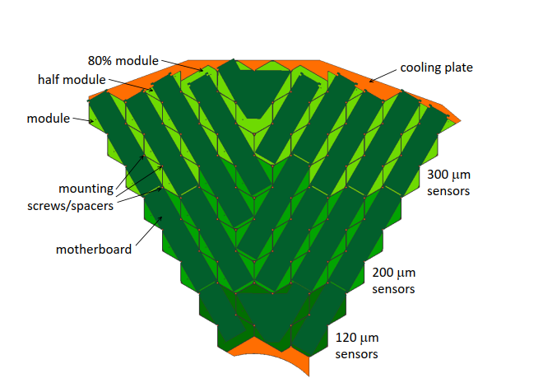
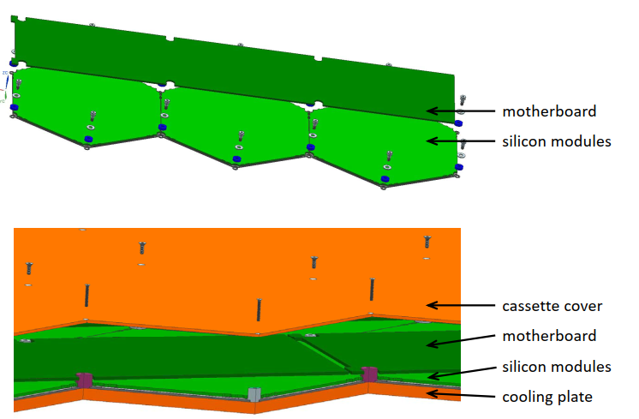
Context
Outer edge of a CE-E cassette – 3D model
Hexaboard
Silicon Sensor
Glue
Cu and CU/W base plate
Hexaboard layers
Cassette Layout?
Exploded diagram of a motherboard and three silicon modules on a cooling plate (at -30˚ C)
Schematic Layout of a CE-E Cassette
First analysis will be focused on a small section of the cassette composed by three modules (Silicon sensor, CU-W baseplate, Hexaboard), the cooling plate, motherboard and lead steel cover.
12/12/2018
3/14

Slide 5
Internship objectives
Thermal analysis of the Hexaboard-Motherboard (HB-MB) package
Experimental setup and analysis to validate results
Understand and propose new design solutions based on the obtained results
Proposal to improve the Thermal performance of the HB-MB configuration
Thermal-mechanical model of the full cassette
12/12/2018
4/14

Slide 6
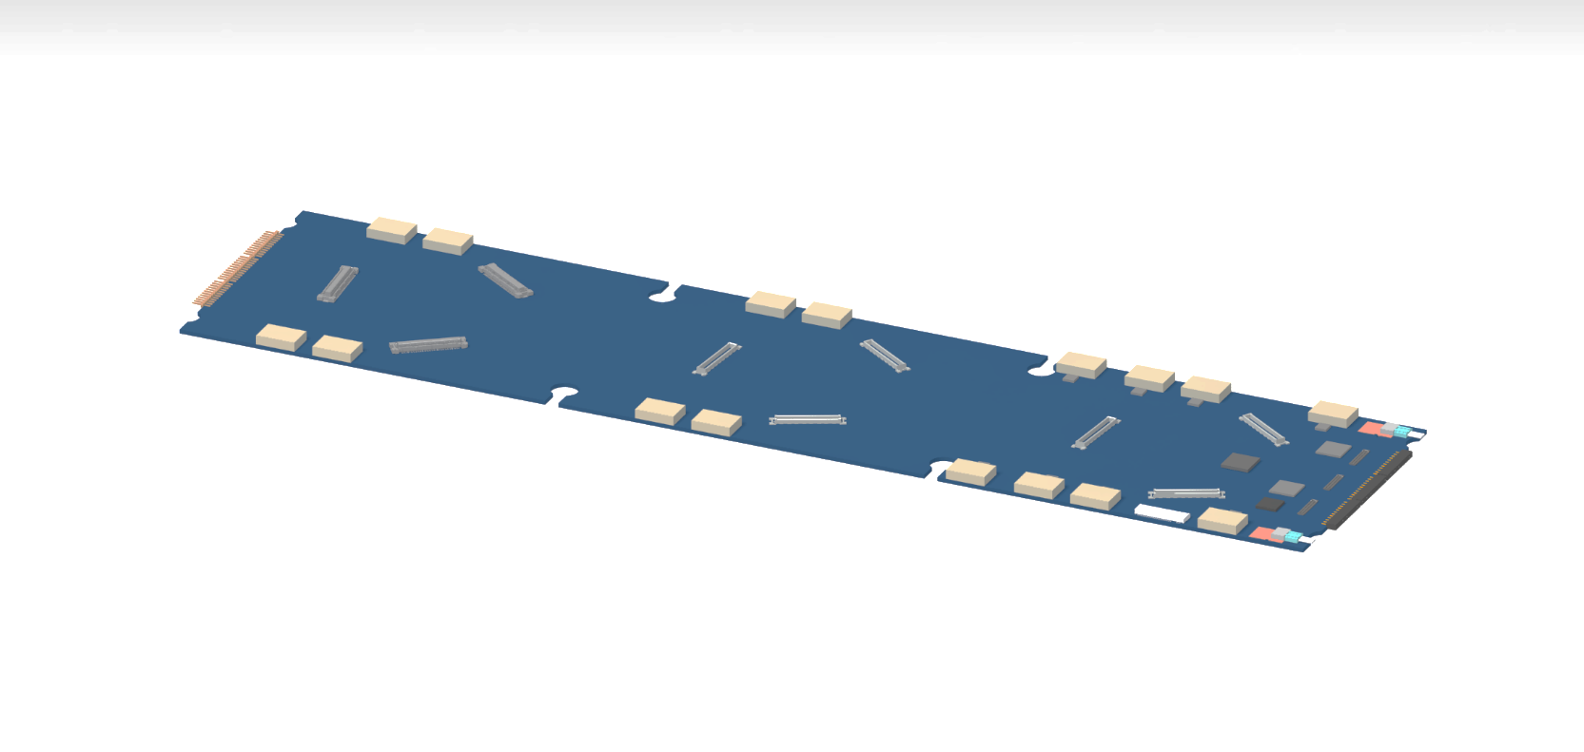
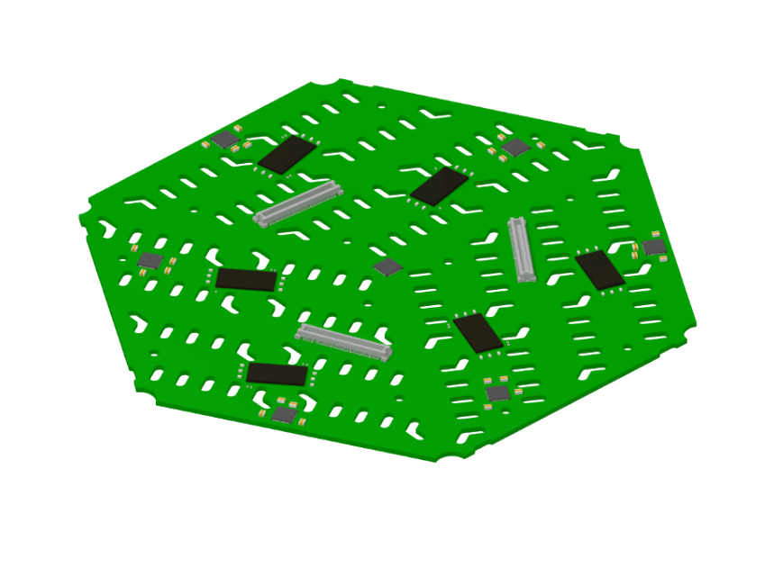
MB-HB Baseline
Most recent models and heat loads provided by P. Rubinov (HGCAL Electronics Coordinator);
Detailed electronic components with pin connections to the boards;
Detailed plastic connectors between both boards;
P. Rubinov also provided the heat loads of each one of the electronic components
Max. Allowable operating temperature for the chips is 60° C.
491 mm
189 mm
Detailed 3D model of the Hexaboard
Detailed 3D model of the Motherboard
A simplified model shall be made (necessary for the thermal analysis)
12/12/2018
5/14

Slide 7
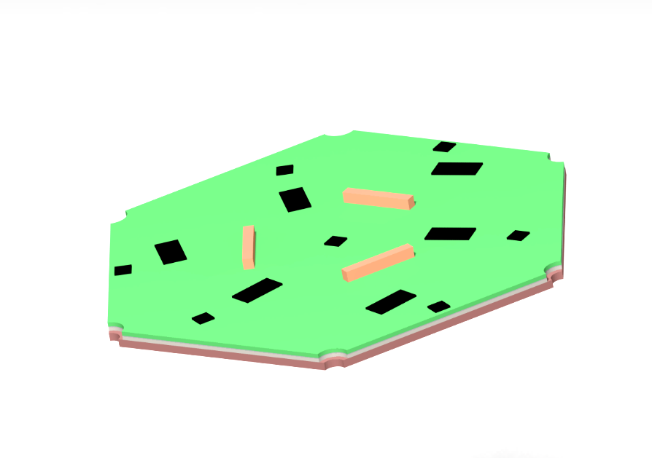
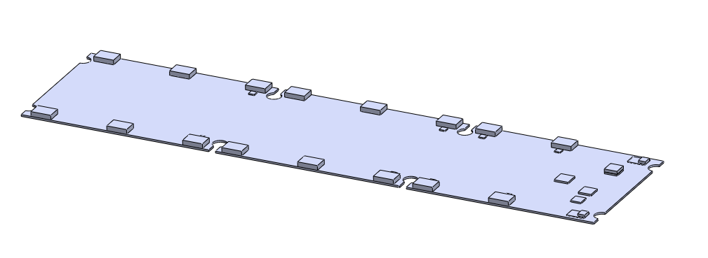
MB-HB Model
Electronic components cannot be moved due to motherboard design;
Each electronic component is considered to be a silicon block with a specific internal heat generation;
CLK_MUX
HGCROC
DCDC conv
eConD
Connector
VTRX+OM
LDO
eConD
SCA
lpGBT
Motherboard- 3D model
Hexaboard – 3D Model
Hexaboard components and specs
Motherboard components and specs
12/12/2018
6/14

Slide 8
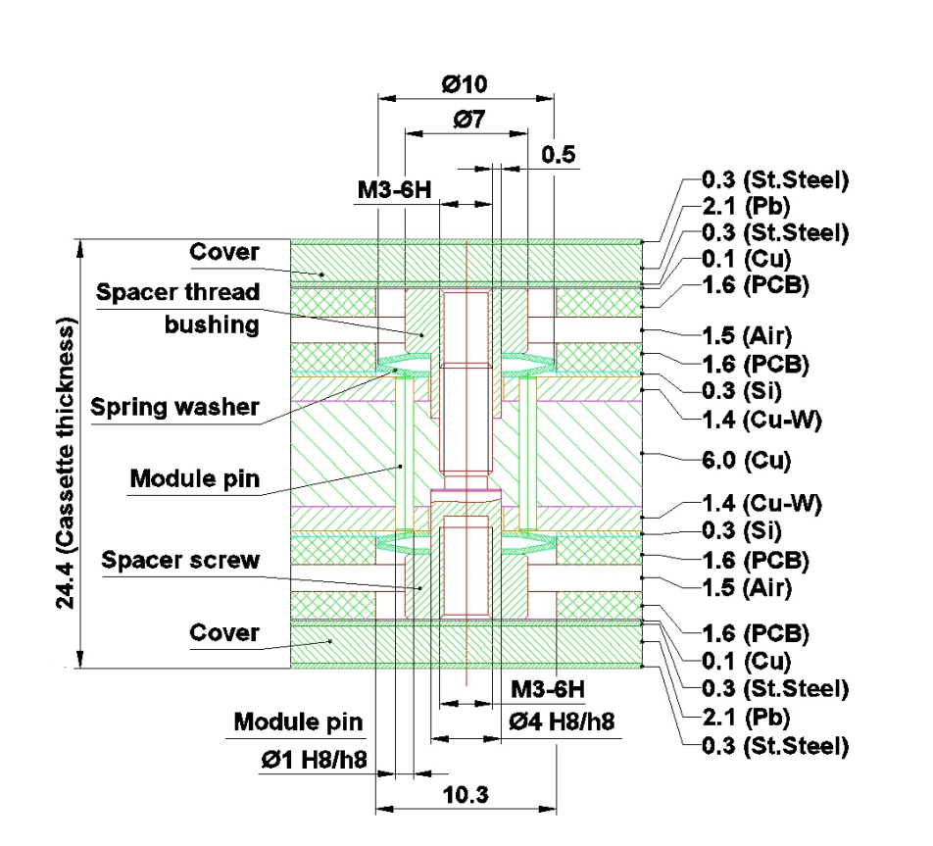
MB-HB Model
Cover
MotherBoard
HexaBoard
Partial CE-E Cassette - 3D simplified model
Equivalent Thermal Contact Conductance (TCC) is going to be considered to simplify the model (no errors are introduced);
Posts connect the copper layer to the lead-steel cover;
No contact between the posts and the HB-MB;
Cross section through the thickness of a cassette
Materials and layers of the cassette
12/12/2018
7/14

Slide 9
Major assumptions
Simplified model using equivalent Thermal Contact Conduction (TCC);
Cooling plate at -30 ˚C;
Vacuum between Hexaboard and Motherboard (no difference by adding static air);
Perfect connection between the posts, copper plate and the lead-steel cover;
Perfect connection between each electronic components and the boards;
Only conduction is considered (neither convection or radiation)
Adiabatic system;
Steady-state;
12/12/2018
8/14

Slide 10
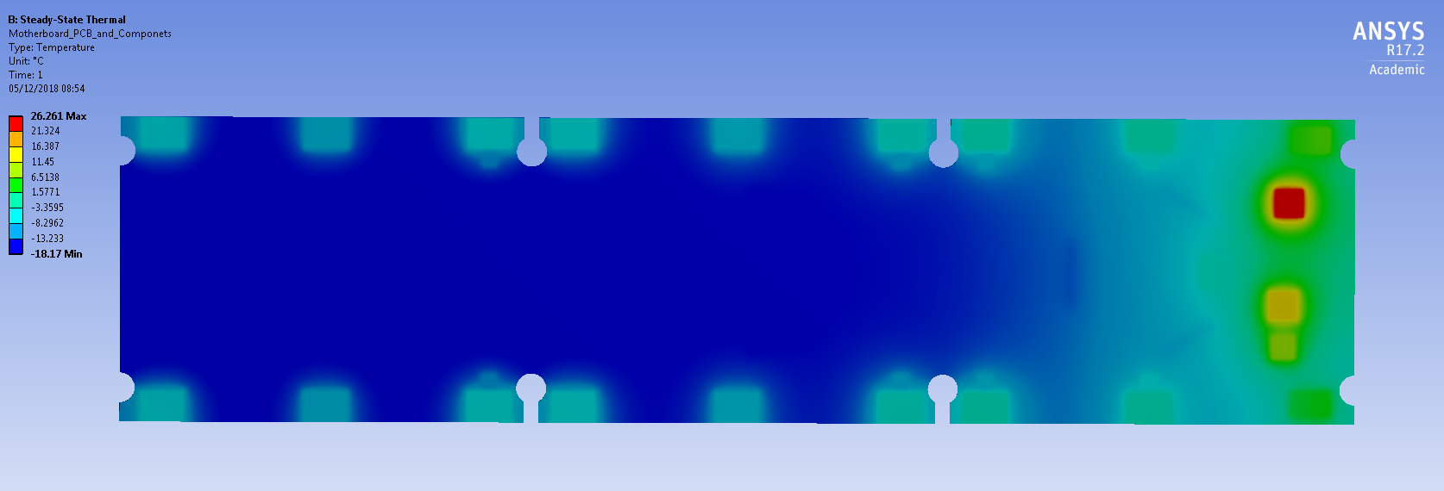
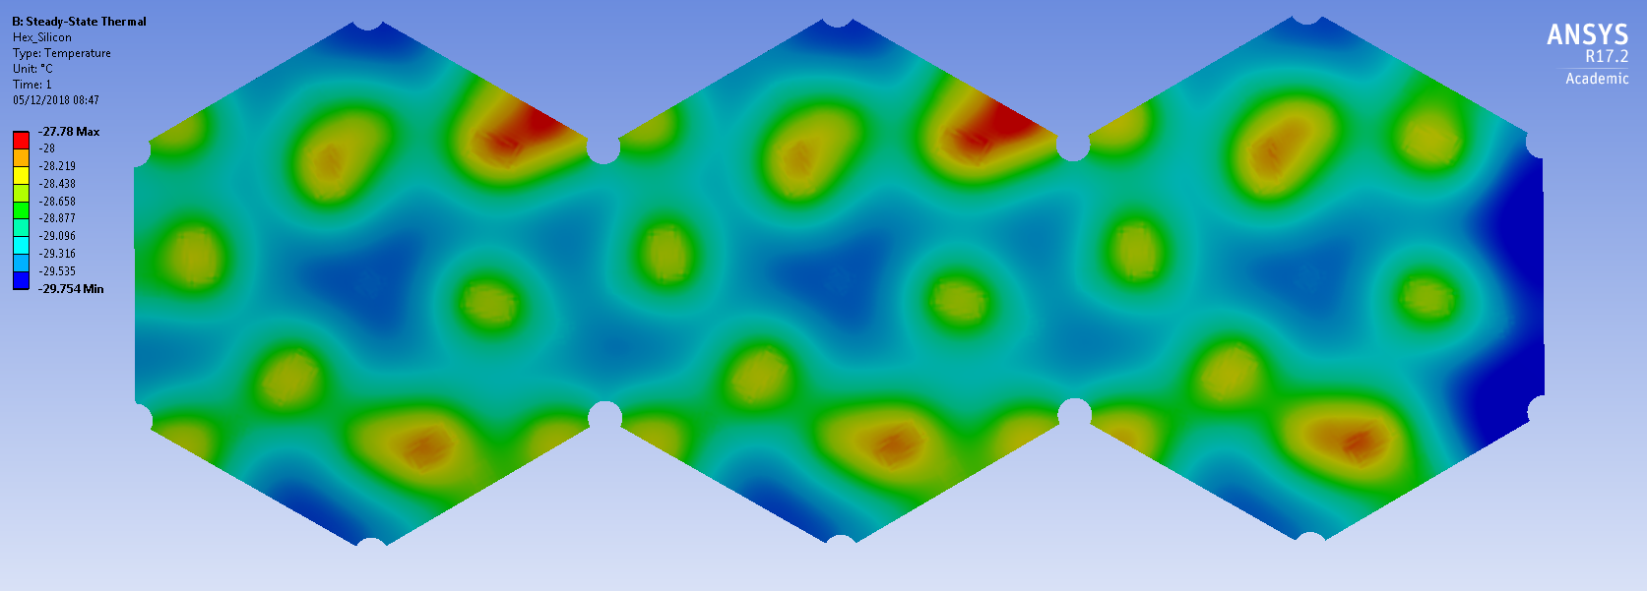
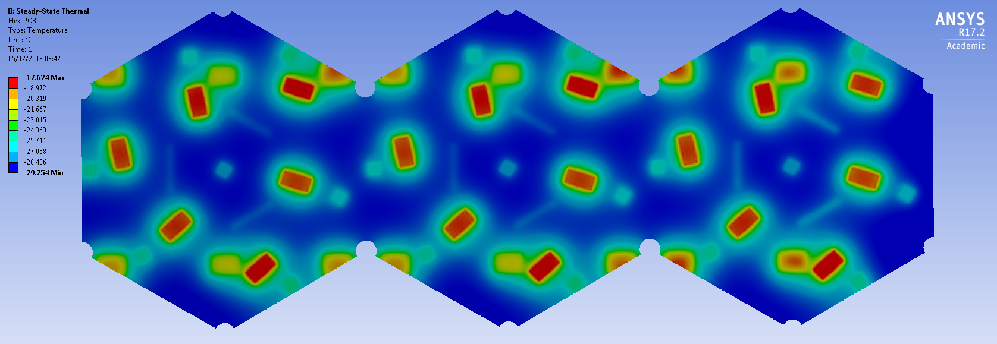
Baseline results
eConT
Baseline Model temperature - Motherboard
Baseline Model temperature – Silicon layer
Results:
eConT is the hottest electronic componet: 26.2 ˚C;
Maximum temperature reached by the sillicon layer is -27.8 ˚C;
PCB does not contribute to the heat dissipation (as expected);
Baseline Model temperature – PCB of Hexaboard
The eConT temperature ΔT with respect to the cooling plate is about 56 ˚C.
This would represent a problem for the foreseen testing period with cooling plate at 15 ˚C
12/12/2018
9/14

Slide 11
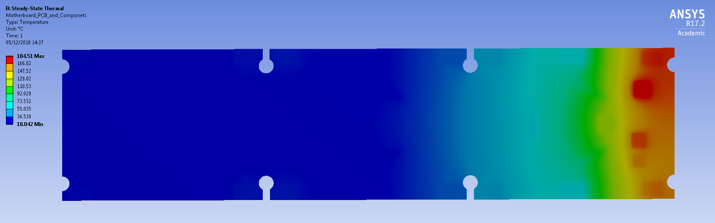
Importance of the cover
Without lead-steel cover temperatures will rise umpredictably;
Almost no heat transfer through the plastic connectors;
Motherboard temperature – Standard model with no lead-steel cover
Good contact must be ensured between
the posts, lead-steel cover and the cooling plate
12/12/2018
10/14

Slide 12
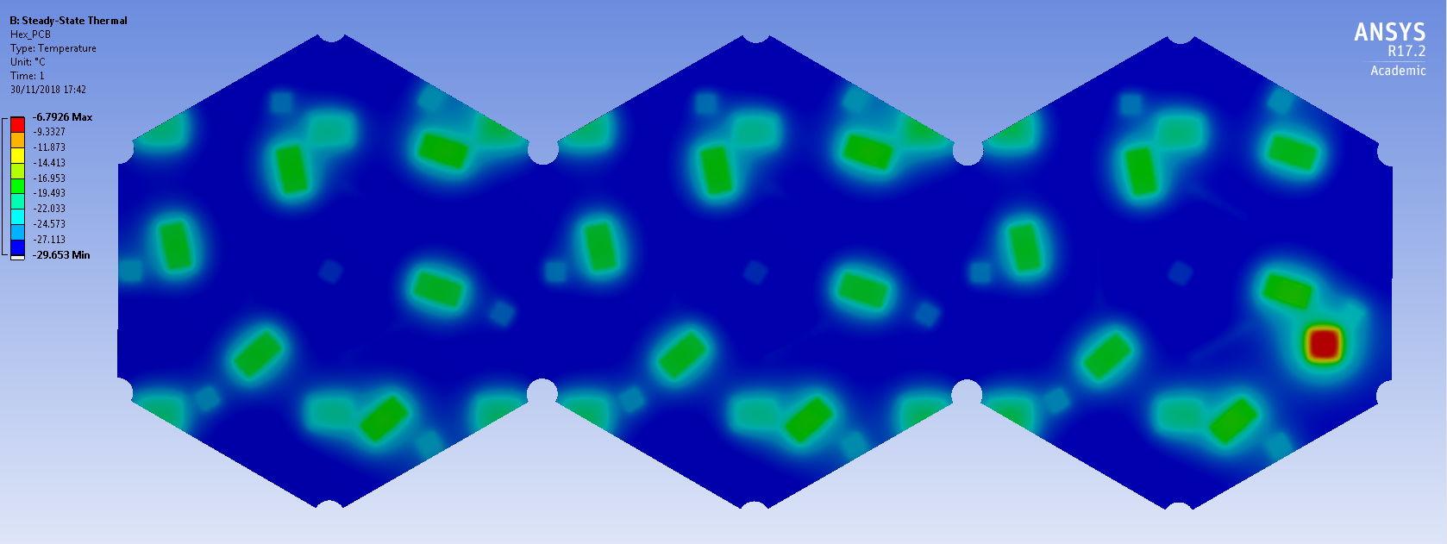
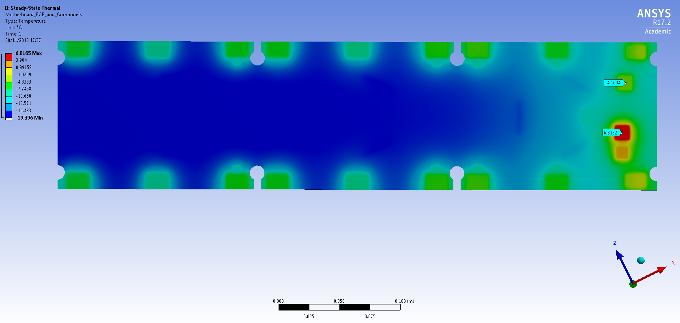
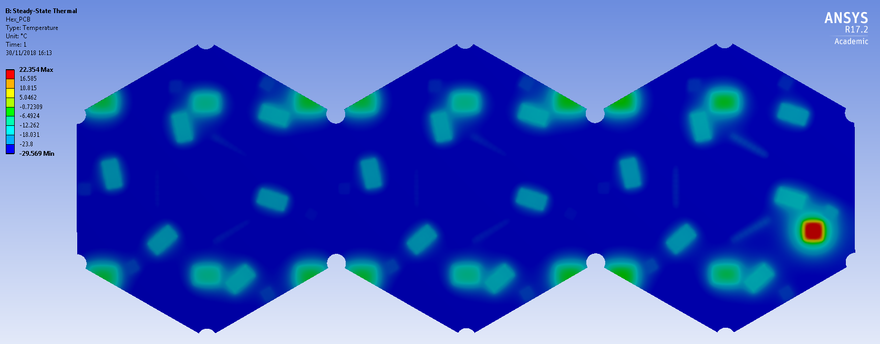
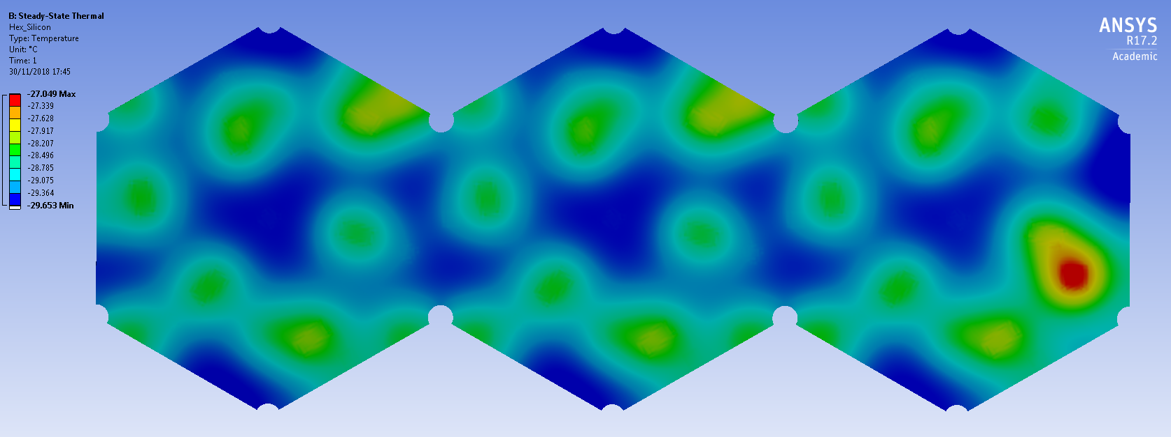
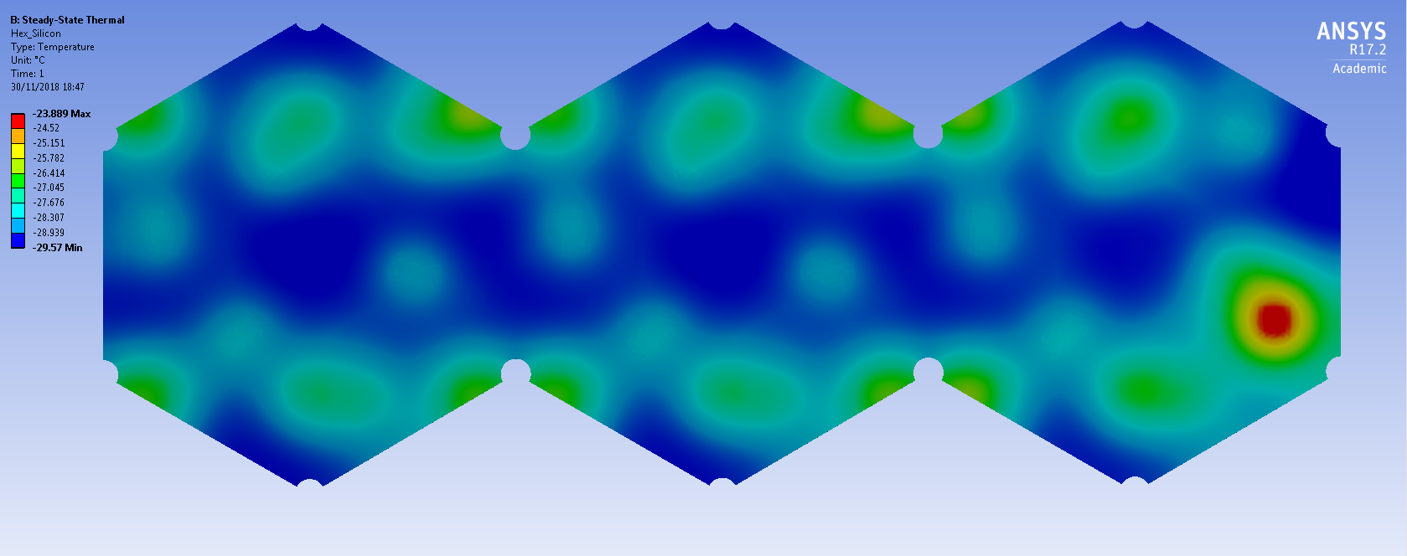
Most promising solution
Possible solution could be the application of a thermal pad (10 W/m K) on eConT to the Hexaboard;
Robustness of this solution to be evaluated;
 | Baseline | Thermal pad on eConT
eConT | 26.2 ˚C | -4.2 ˚C
eConD | 15.3 ˚C | 6.8 ˚C
Motherboard temperature considering a thermal pad
Results:
Hottest electronic component is now eConD at 6.8 ˚C;
Local increase of the temperature on the silicon layer to -27.0 ˚C;
Lead-Steel cover has an extreme importance on the cooling of the motherboard;
Silicon temperature considering a thermal pad
12/12/2018
11/14
eConT decreases to -4˚C and Max. Temp. is reached by eConD: 6 ˚C

Slide 13
Summary
Lead-Steel cover has a significant impact on the motherboard cooling;
High heat generation on several electronic components, specially on eConT – hottest component;
The use of a thermal pad seems to be a promissing solution (allowing thermal testing at room temperature);
Convection has no influence on the results;
Given the harsh environment (i.e. radiation, cooling cycles) degradation of the thermal pad material must be considered;
12/12/2018
12/14

Slide 14
Challenges for 2019
Improve the thermal contact modeling of the different considered parts (electronic components; cover; cooling plate and posts)
Collaborative work with the cassete and electronic design engineers to optimize the thermal performance of the HB-MB package;
Validate the obtained results (with experimental tests);
Expand the thermal-mechanical analysis to the all cassette;
12/12/2018
13/14

Slide 15
Questions?
References
[1] CMS Collaboration, “The Phase 2 Upgrade of the CMS endcap calorimeter”, Technical design report, 9 April 2018, ISBN 978-92-9083-459-5
12/12/2018
14/14

