Slide 1

How we manage 40K machines in the CERN Computer centre
Zhechka Toteva, SIMEON TSVETANKOV (CERN/IT)
CERN – 03/10/2019

Slide 2
Outline
CERN Computer Centre (CC) in numbers
Overview of the CERN network and data storage
Overview of electricity and cooling
WLCG in a couple of numbers
Configuration management at CERN IT
CERNMegabus@CERN
  Architecture
  Overview of major implemented use cases
  CERN Computer Centre (CC) power cut management

Slide 3
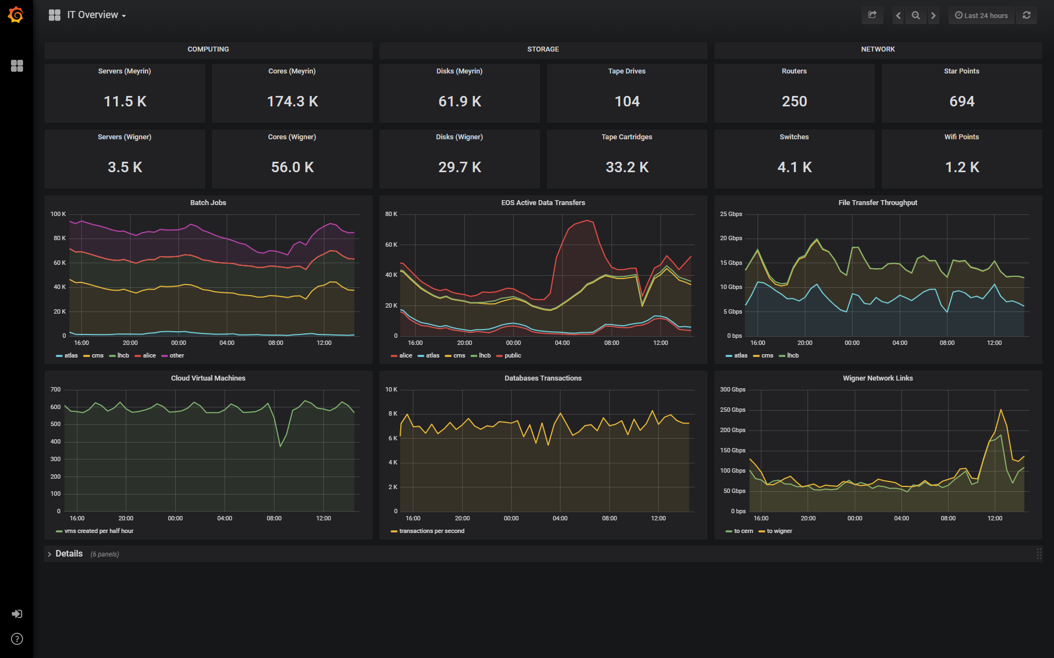
CERN Computer Centre (CC) in numbers
Oct’18

Slide 4
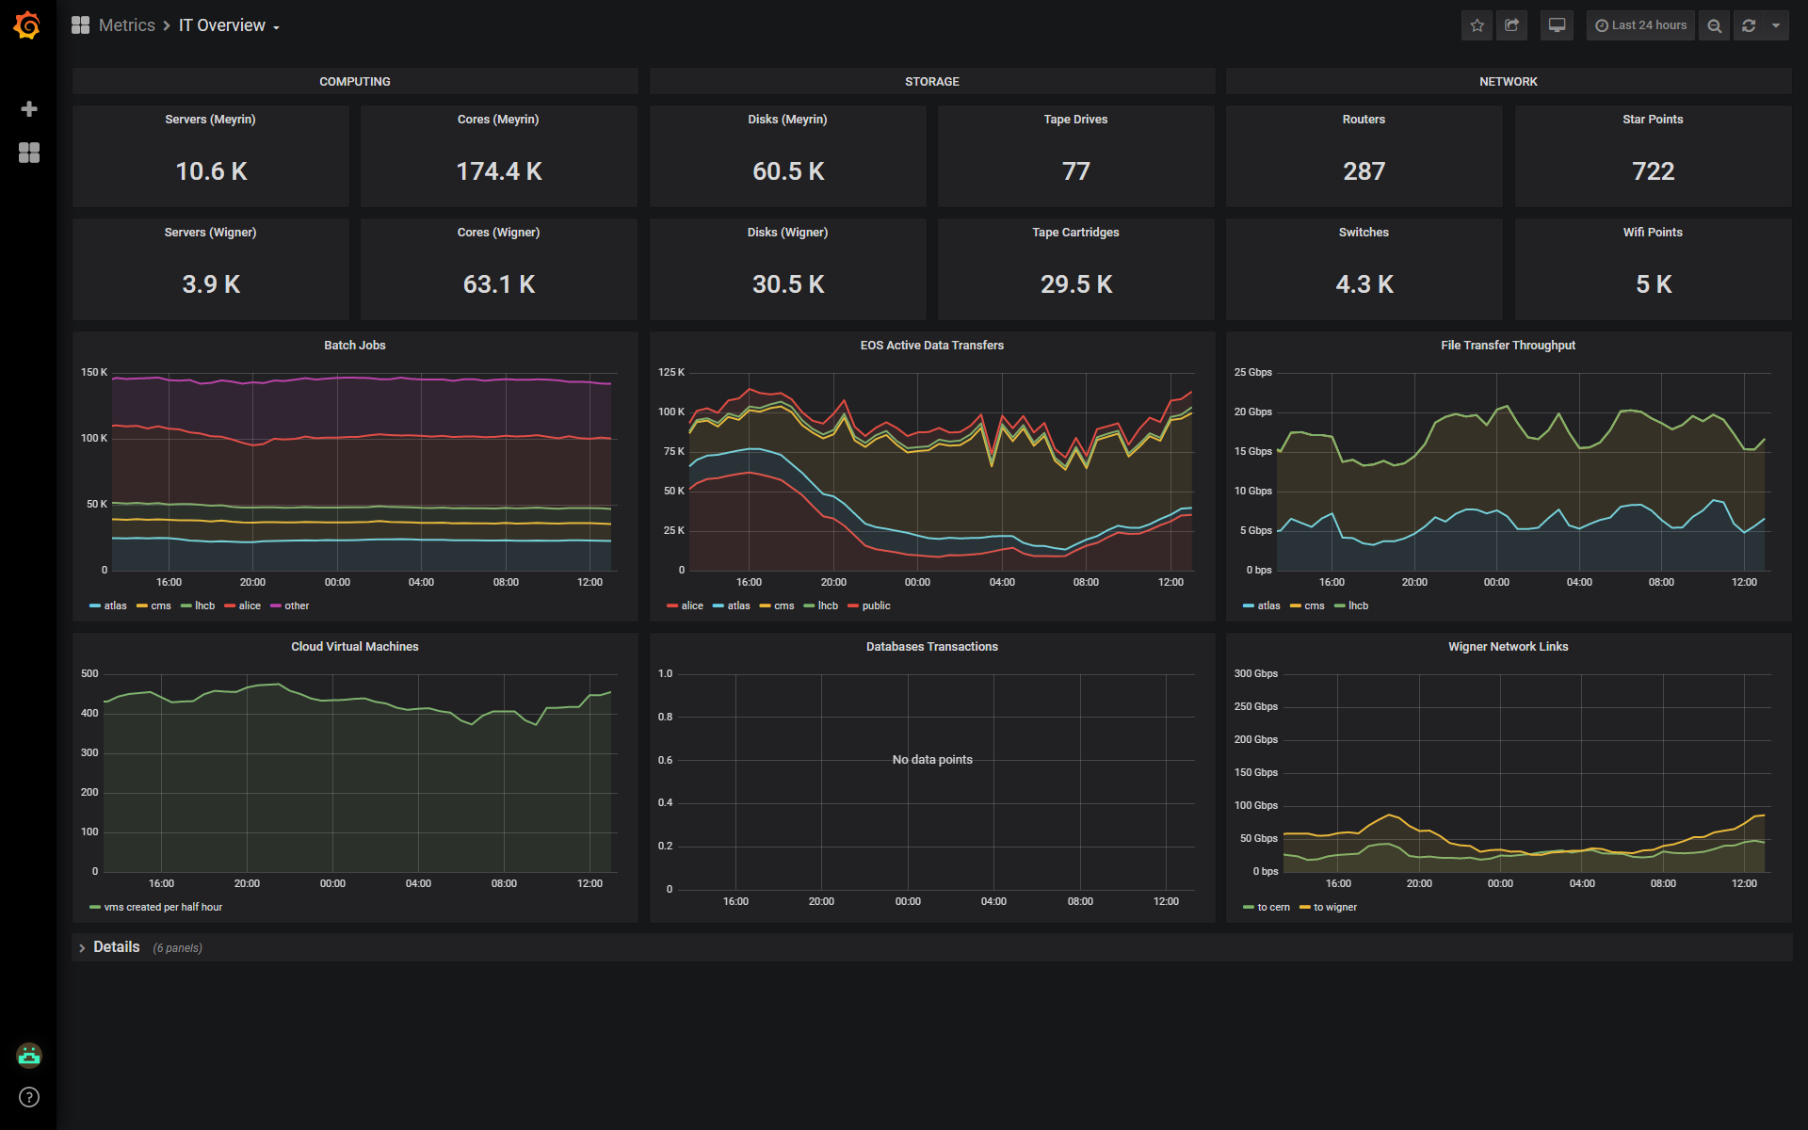
CERN Computer Centre (CC) in numbers
Oct’19

Slide 5
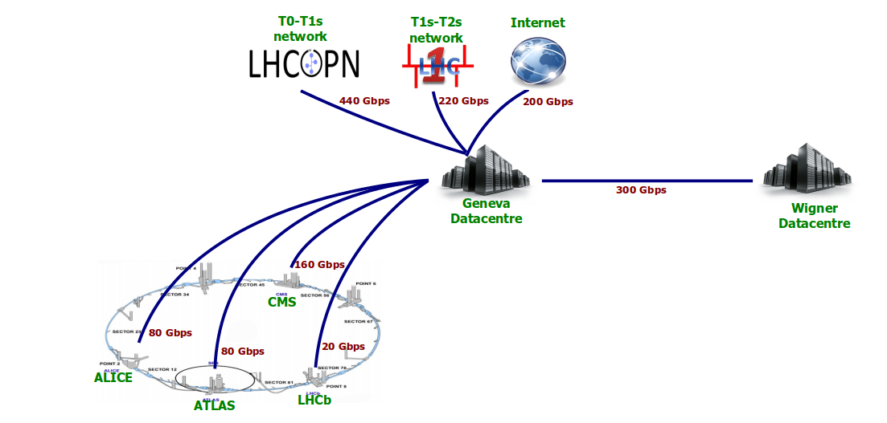
Computing network
250 routers, 4100 switches, 5000 Wi-Fi points
Over 50,000 km of optical fibre providing network connectivity throughout the CERN sites.
Wigner Data centre in Hungary
  1200 km distance
  with three 100 Gb/s

Slide 6
Data storage
50 Pbytes / year from LHC
  + 25 Pbytes / year from non-LHC experiments
RECORD: November 2018: 15.8 petabytes of data (from all sources) were written on tape that month (13.47 PB of LHC data alone)
  More than 2 PB read/write daily
Tape drives faster than disks; but slower in mounting (latency)
  90 K disk drives (of which 10-15% are SSD, providing less than 10% capacity)
  SSDs are 5-10 times more expensive than spinning disks
www.cern.ch/eos
www.cern.ch/castor

Slide 7
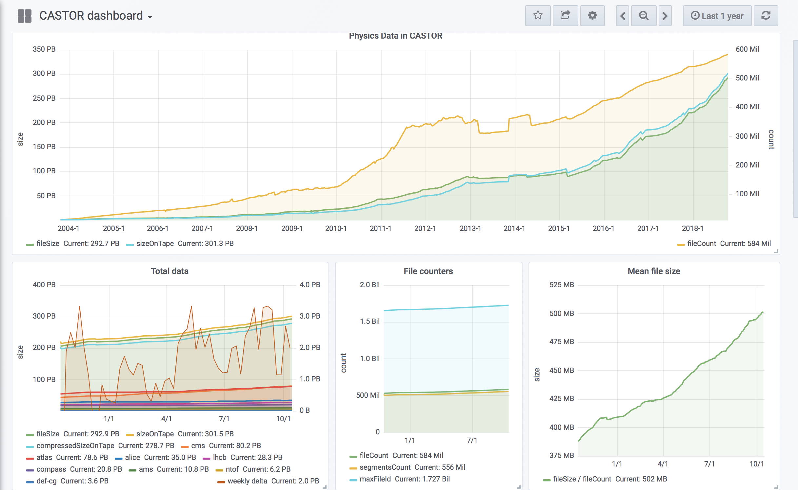
https://filer‐carbon.cern.ch/grafana/dashboard/db/castor‐dashboard?orgId=1

Slide 8
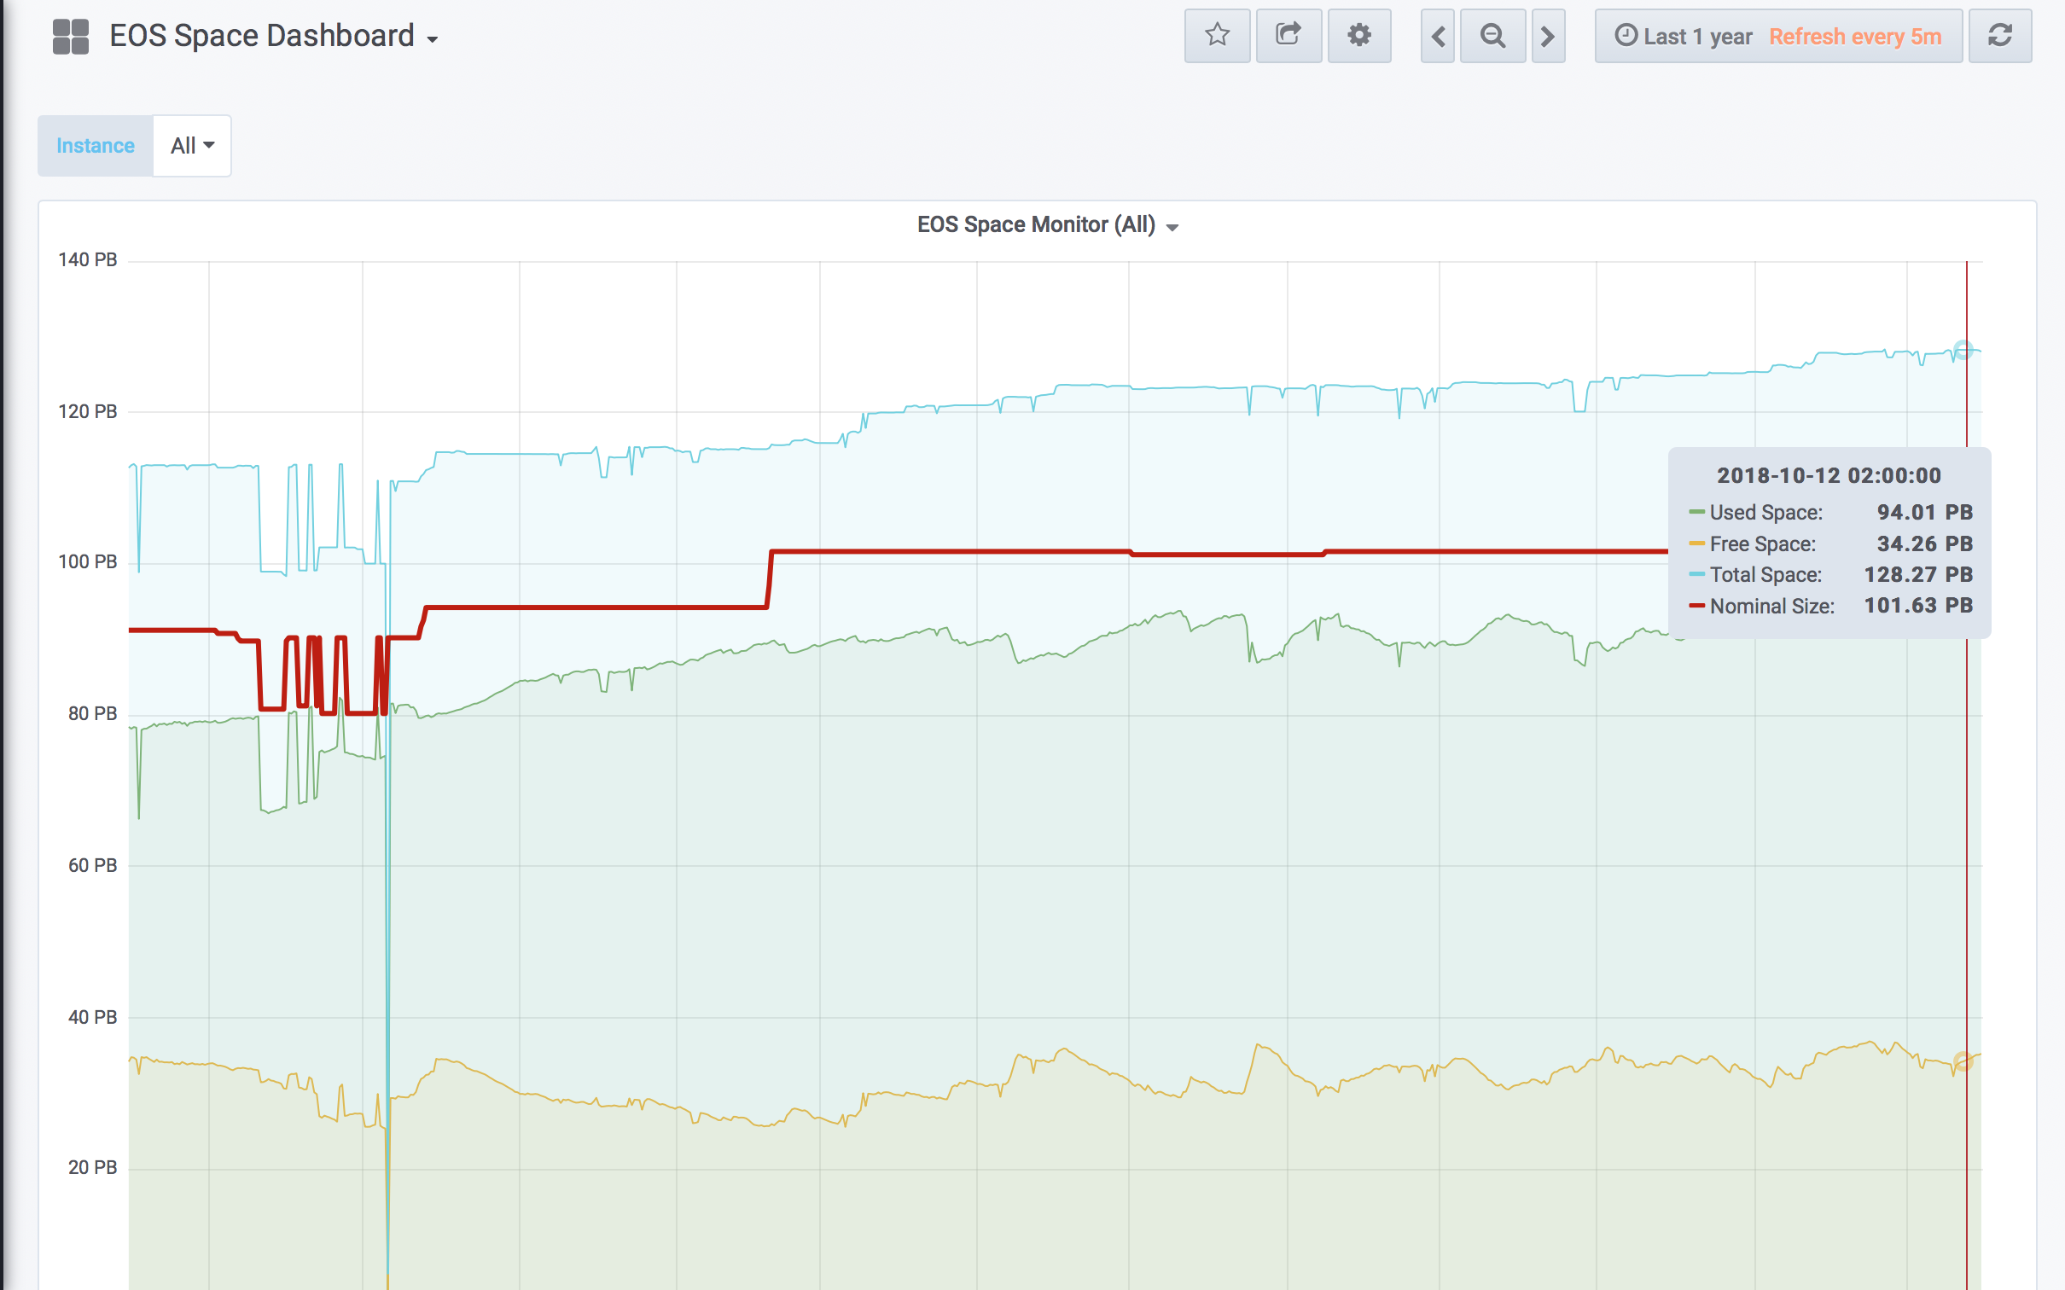

Slide 9
Electricity and cooling
2.7 MW consumption (+ ~ 1 MW cooling) from maximum 3.5 MW
  480 KW diesel generators
Protected by UPS
  Enough to start the diesel generators
  Enough to shut down non-critical machines*
Cooling
  Chilled air via silver ducts enters the false floor and the into the closed server aisles
  Water-cooled racks in the vault in the basement

Slide 10
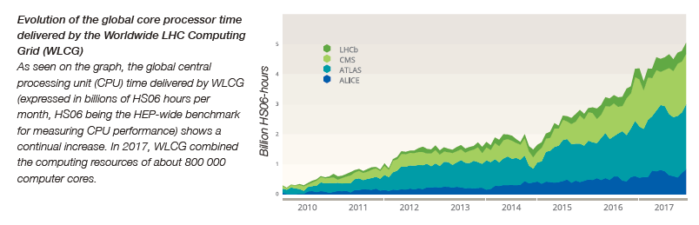
WLCG – Worldwide LHC computing grid
More than 170 data centres in 42 countries with about 900,000 CPU cores
  CERN provides about 20% of the WLCG resources
  Allows more than 12,000 physicists to access LHC data
  >300,000 jobs run concurrently on the Grid
  Storage is about 500 PB disk and 800 PB of tape globally
  In 2018, global transfer rates have regularly exceeded 60GB/s
Key facts and numbers (http://information-technology.web.cern.ch)
www.cern.ch/wlcg
www.cern.ch/wlcg-public

Slide 11







Configuration management at CERN IT
Certification Manager
CERNMegabus
43 000 Puppet managed machines
TEIGI Tool suite
…
AI-TOOLS

Slide 12
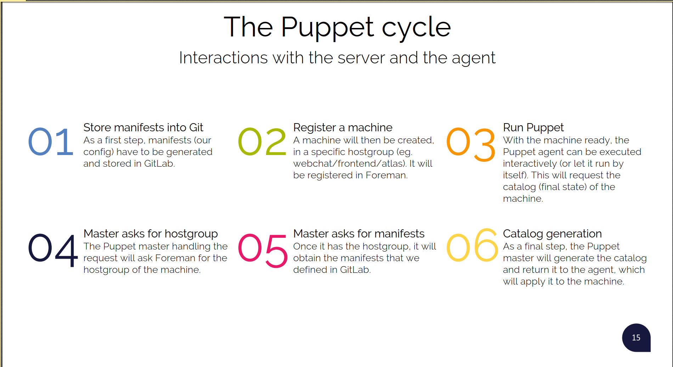
Thanks to the Config team for the slide

Slide 13
CERNMegabus at CERN IT
A service that provides for instant communication between services
CERNMegabus
The CERNMegabus architecture is based on the publisher-consumer model and utilises the CERN IT messaging infrastructure
The publisher and the consumer services comprises of building blocks
  configured with Puppet
  to use the CERNMegabus python libraries
Installed on all Puppet managed machines in the CERN CC

Slide 14
CERNMegabus architecture
1. Subscribe for message
Central CERN IT ActiveMQ brokers
Change service ”A”
2. Publish message
Affected service “B”
3. New message
The CERNMegabus architecture is based on the publisher-consumer model and utilises the CERN IT messaging infrastructure
4. Execute reactive actions
External program

Slide 15

Already our clients
CASTOR
BATCH
EOS
CERNMegabus
43 000 Puppet managed machines
CLOUD
TEIGI Tool suite
(roger)
DNS Load Balancing
IT Monitoring
CERN Computer Centre Power Cut Management

Slide 16
From roger to EOS/CASTOR/Puppet HAProxy
Subscribe for topic /topic/roger.**group.castor and hostgroup selector in message
Central CERN IT ActiveMQ brokers
Set roger state of castor-lhcb-disknode-X to disabled
2. Publish message to /topic/roger.**group.castor
castor-lhcb-headnode-Y
3. Message de-queued
4. Execute `modifydiskserver Disab castor-lhcb-disknode-X `
hostgroup header: `castor-lhcb-diskservers`
{"new": {"update_time": "1538633786", "updated_by": “blueuser", "hostname": “castor-lhcb-disknode-X", …, "appstate": "disabled"}, "old": {"update_time": "1538633774", "updated_by": “somebody", "hostname": "castor-lhcb-disknode-X “, …, "appstate": “production"}
In practice - I
Set castor-lhcb-disknode-X in read-only mode
~1 sec

Slide 17

CERN CC Power Cut event
1. Preserve data
Electrical grid
UPS
Power back
~ 20 min
Shutdown
(all machines which we can)
t

Slide 18
CERN CC Power cut event detection
ccpcoX programmatically detects power cut/power back event

Slide 19
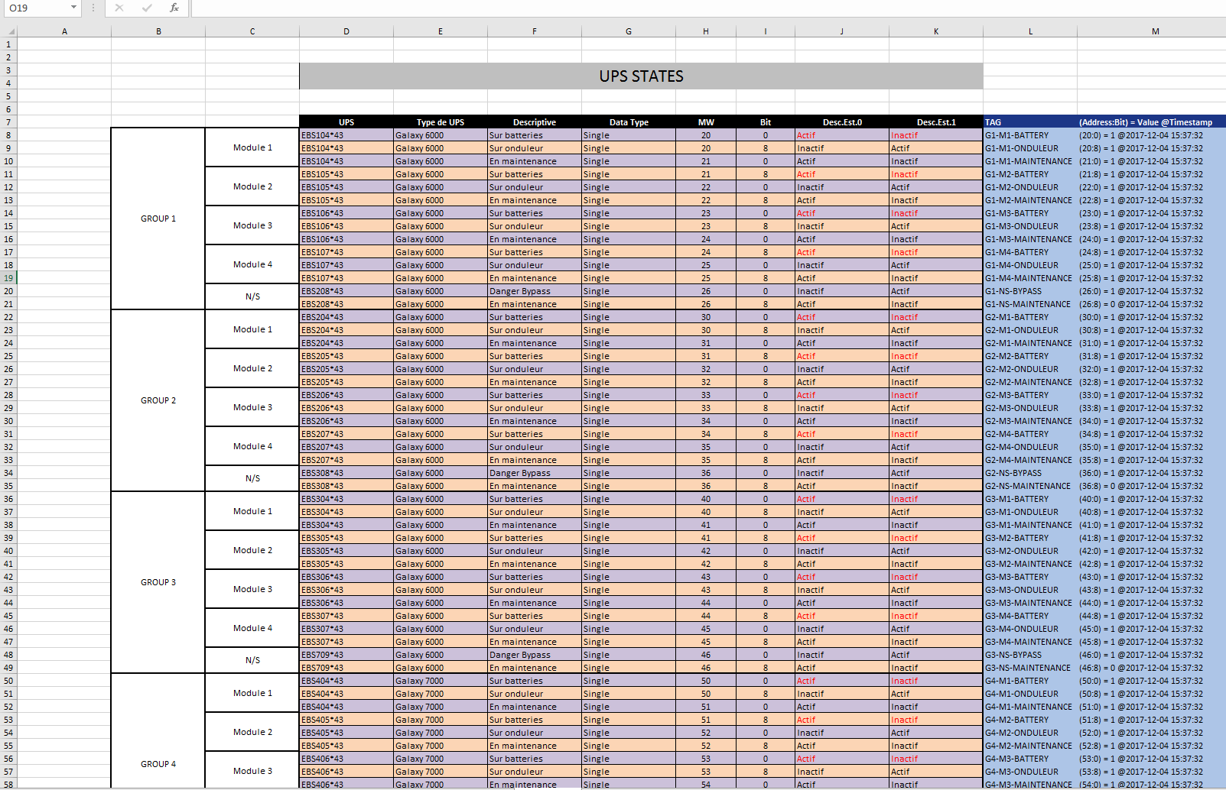
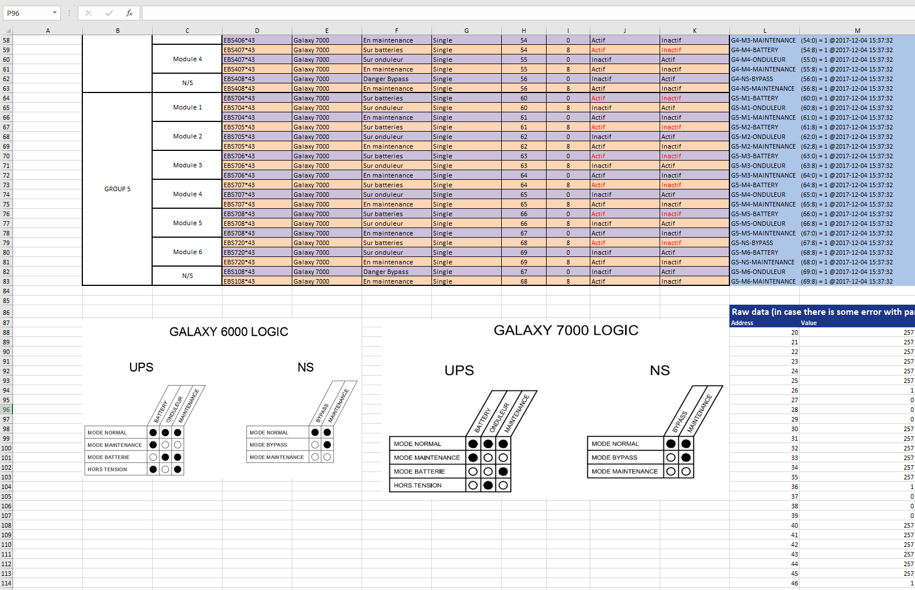
UPS and PLC

Slide 20
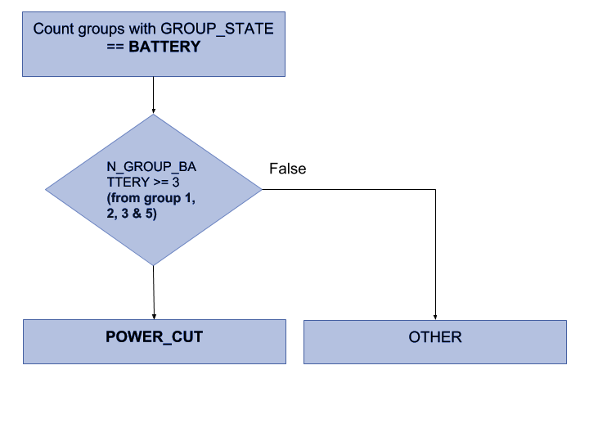
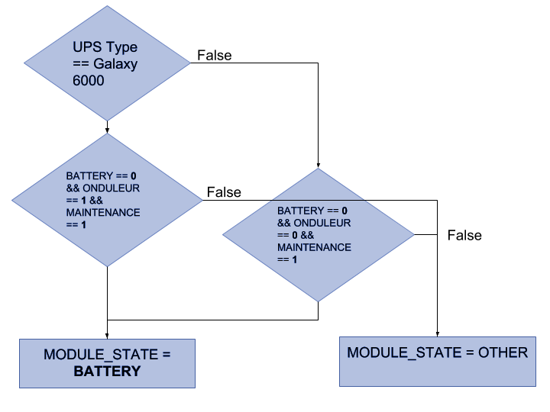
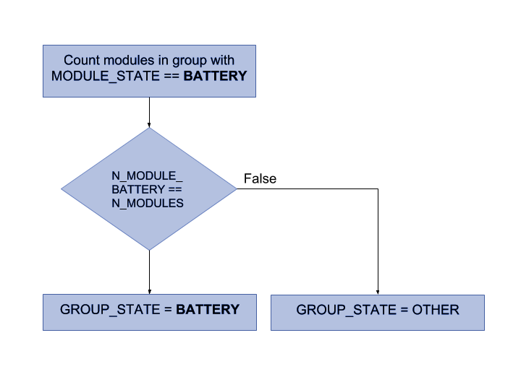
CERN CC Power cut event detection algorithm
module1
UPS 1
0
1 0
1
1
1
0
01
0
1
0
1
..
module2
...
module5
UPS 2
Modbus
...
PLC
...
UPS 3
...
UPS 4
...
UPS 5
Decision making algorithm
Data collection

Slide 21
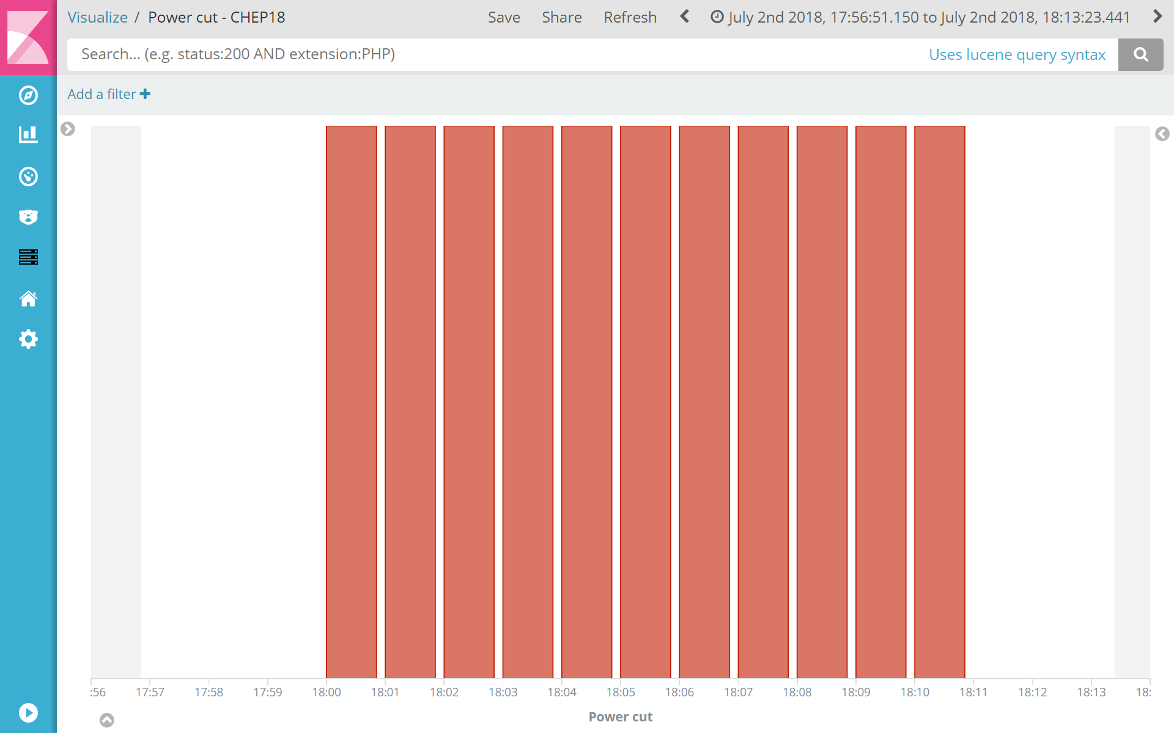
CERN CC Power cut tests
During mid-annual power cut test on the 2nd of July, 2018
  Detected power cut
  Notified the subscribed machines
  Shutdown the machines, which had been predefined to be shutdown
  Detected the power back
  Notified the machines, which had been predefined to wait
Presented at CHEP’18

Slide 22
From CERN CC UPS PLC to CERN CC shutdown
Central CERN IT ActiveMQ brokers
1. /topic/ccco.notif
ccpcoX programmatically detects power cut/back event
2. Publish message to /topic/ccco.notif
Any Puppet managed machine in CC*
3. Message de-queued
2 mins after detection!
4. Execute
`std_log --path=XYZ`
message = {'powercut_now': True, 'elapsed_time': 0, 'simulation': False}
In practice - IV
Log power cut events in /var/log/powercut.log
~2 min*

Slide 23

Thanks
THANKS for listening and ENJOY your visit at CERN
Zhechka & Simeon

