Slide 1

Particle Sources
Dr. Scott Lawrie
Ion Source Section Leader
ISIS Pulsed Spallation Neutron & Muon Facility
Rutherford Appleton Laboratory

Slide 2
Many Many Particle Sources
Species
Technique
Filament
Photocathode
Arc Plasma
Laser
Microwave
RF
Cyclotron-Resonance
Duopigatron
Duoplasmatron
…
Electron
Proton
Light Ion
Heavy Ion
Negative Ion
High Charge State
Radioactive
Spin-Polarised
Neutral
Muon
Exotic
1+
4+
34+

Slide 3
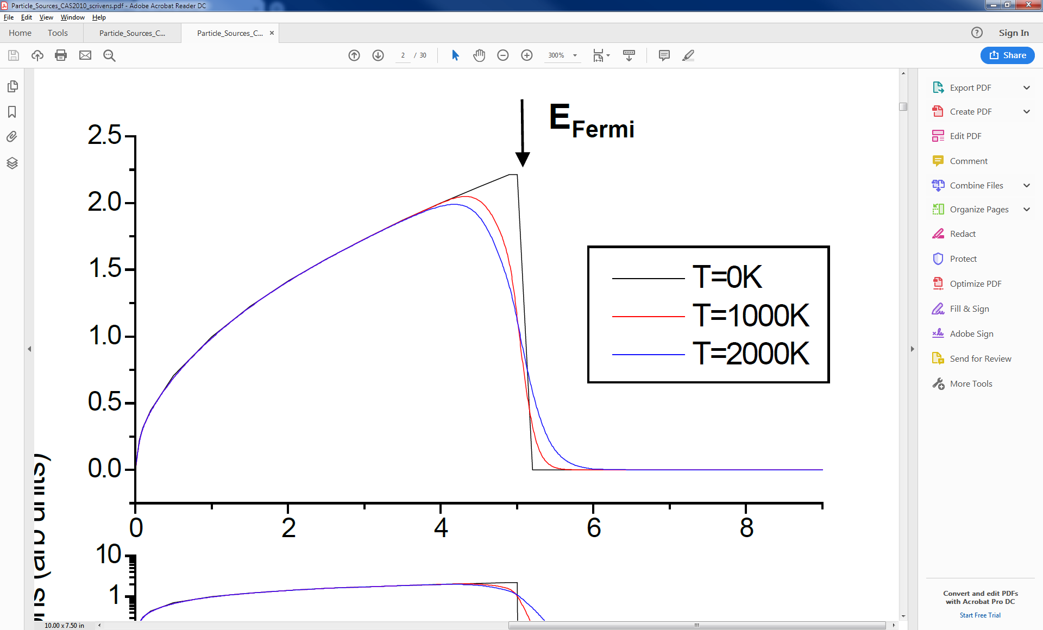


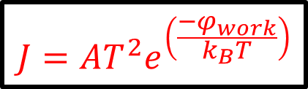
Fermi-Stats. & Work Function
Fermi level, E_{Fermi} is kinetic energy of electron in highest occupied state
Work-function, φ_{work} is energy input to release an electron from the surface (basis of photoelectric effect)
Higher temperature, T smears out the Fermi level
Some electrons may cross work-function and escape
Integrating the number of available released electrons gives current density, J
To get a lot of current, need high T and a material with a high A and low φ_{work}
$$\overline{n_{i}}$$
E_{Fermi}
φ_{work}
$$eV$$
$$J=AT^{2}e^{\left(\frac{−φ_{work}}{k_{B}T}\right)}$$
Richardson-Dushmann equation

Slide 4
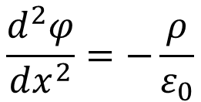
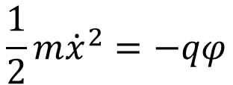
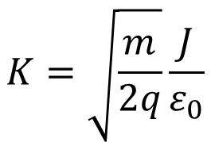
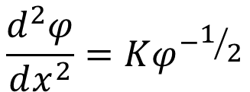

Child-Langmuir Law
Want the released particles to go somewhere
Apply potential difference to accelerate into a beam
E-field of already-emitted particles shields the cathode from the accelerating E-field: space-charge-limited flow
Cannot accelerate an arbitrarily high number of particles
Can calculate the extractable current density:
J
V
d
Continuity eqn.
Kinetic energy
Poisson eqn.
$$\frac{1}{2}m{\dot{x}}^{2}=−qφ$$
$$\frac{d^{2}φ}{dx^{2}}=−\frac{ρ}{ε_{0}}$$
$$J=ρ\dot{x}$$
$$\frac{d^{2}φ}{dx^{2}}=Kφ^{−1/2}$$
$$K=\sqrt{\frac{m}{2q}}\frac{J}{ε_{0}}$$
where:

Slide 5
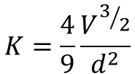

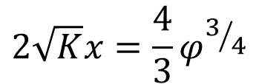
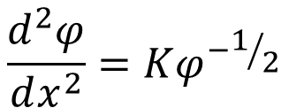
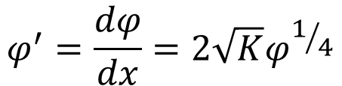
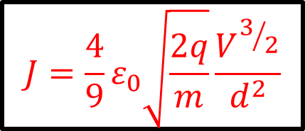

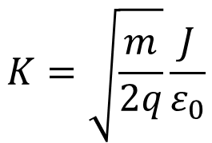


Child-Langmuir Law (cont’d.)
$$\frac{d^{2}φ}{dx^{2}}=Kφ^{−1/2}$$
$$φ^{′}=\frac{dφ}{dx}$$
Substitute:
Then:
$$φ^{′}dφ′=Kφ^{−1/2}dφ$$
$${φ′}^{2}=4Kφ^{1/2}$$
$$φ^{′}=\frac{dφ}{dx}=2\sqrt{K}φ^{1/4}$$
Integration gives:
So:
Rearrange and integrate again:
$$φ_{\left(x=d\right)}=V$$
$$2\sqrt{K}x=\frac{4}{3}φ^{3/4}$$
Bound. cond.:
So:
$$K=\frac{4}{9}\frac{V^{3/2}}{d^{2}}$$
But from the previous slide:
$$K=\sqrt{\frac{m}{2q}}\frac{J}{ε_{0}}$$
$$J=\frac{4}{9}ε_{0}\sqrt{\frac{2q}{m}}\frac{V^{3/2}}{d^{2}}$$
Therefore:
This Child-Langmuir “V^{3/2}” Law says that the extractable current
density of a particle source depends ONLY on
the voltage and electrode gap

Slide 6

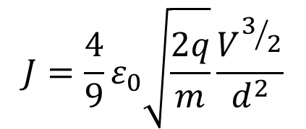

Child-Langmuir Law (cont’d.)
$$J=\frac{4}{9}ε_{0}\sqrt{\frac{2q}{m}}\frac{V^{3/2}}{d^{2}}$$
Total extracted current, I from
an area, A is thus:
$$I=JA=PV^{\frac{3}{2}}$$
Space-
charge
limited
$$P=\frac{4}{9}ε_{0}\sqrt{\frac{2q}{m}}\frac{A}{d^{2}}$$
I [mA]
Production
limited
where:
V [kV]
This P is the perveance: depends only on source geometry
Real measured beam perveance always lower than this
Assumes infinite, thin, plane electrodes (usually not true)
Assumes particles starting with zero velocity
V^{3/2} law only holds if particle source can deliver the current

Slide 7
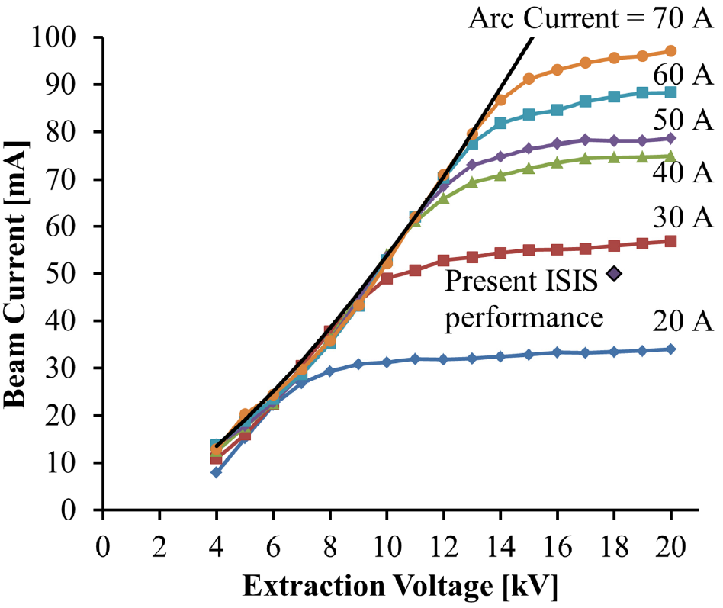
Perveance Measurement
Ideal Child-Langmuir
perveance
= 1.96 mA kV^{-3/2}
Measured perveance
= 1.7 mA kV^{-3/2}

Slide 8

Emittance
Quality of beam just as important as quantity
  Emittance affects machine luminosity and beam-loss
  Want beam emittance < machine acceptance
Particles occupy 6-dimensional phase space
Practical measurements use position-angle (‘trace’) space
Emittance scan can tell immediately how a beam is focused
Also shows up important aberrations (not just pure ellipses)
$$\left(x,P_{x},y,P_{y},z,P_{z}\right)$$
y’ [mrad]
y
z
y [mm]

Slide 9
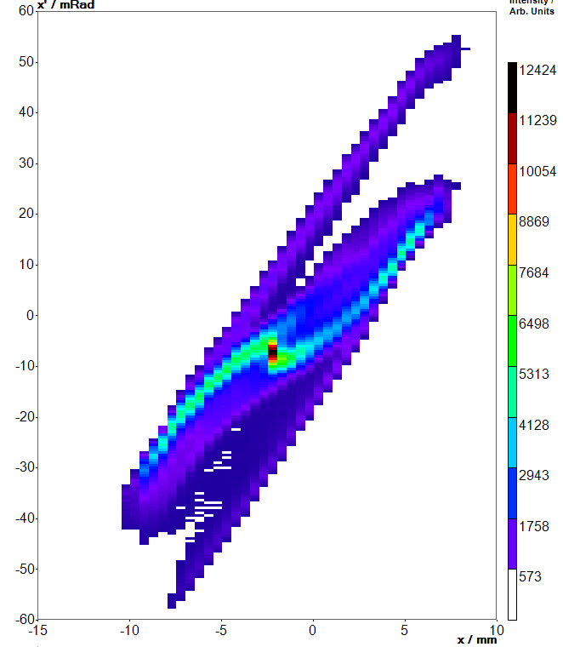



Emittance Ellipses
and Pitfalls
Ellipse defined by:
What is the best fit ellipse?
$$γx^{2}+2αxx^{′}+β{x′}^{2}=ε_{x}$$
where:
$$βγ−α^{2}=1$$
Do we use RMS or 4.RMS?
are the Twiss parameters
For real, non-elliptical
data sets, calculate 4.RMS
emittance statistically:
$$ε_{4.rms}=4\sqrt{\left\langle x^{2}\right\rangle \left\langle {x′}^{2}\right\rangle −{\left\langle xx′\right\rangle }^{2}}$$
Units usually given in
[π mm mrad], but varies
What units? Watch out for π!

Slide 10
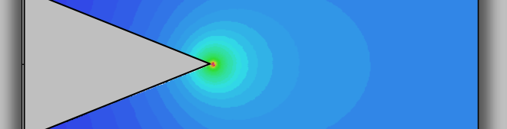
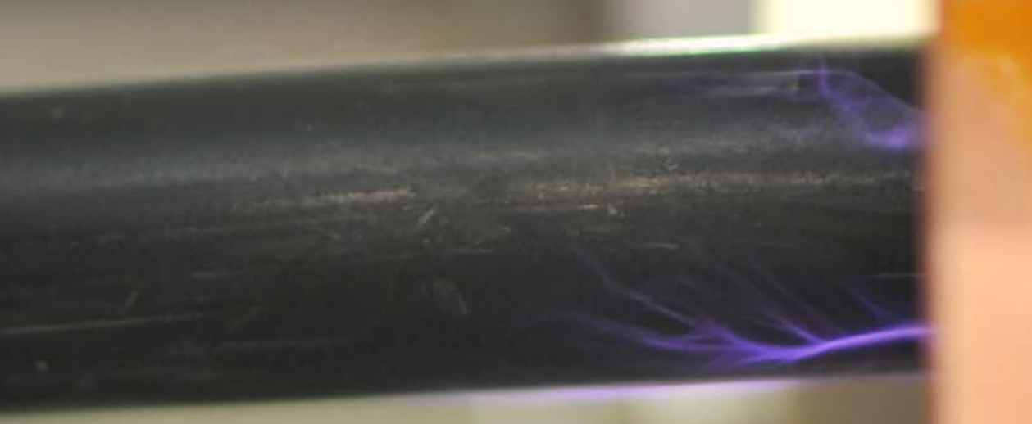

High Voltage Considerations
$$F=q\left(E+v×B\right)$$
Particle sources have
very low beam energy:
Magnetic focusing
Magnetic deflection
RF acceleration
Relativistic
Ample space
High space-charge
Dirty vacuum
Sensitive diagnostics
HV is the only option, BUT:
Must protect insulator triple junctions
Must avoid points in E-field regions
Must ensure proper cable terminations

Slide 11
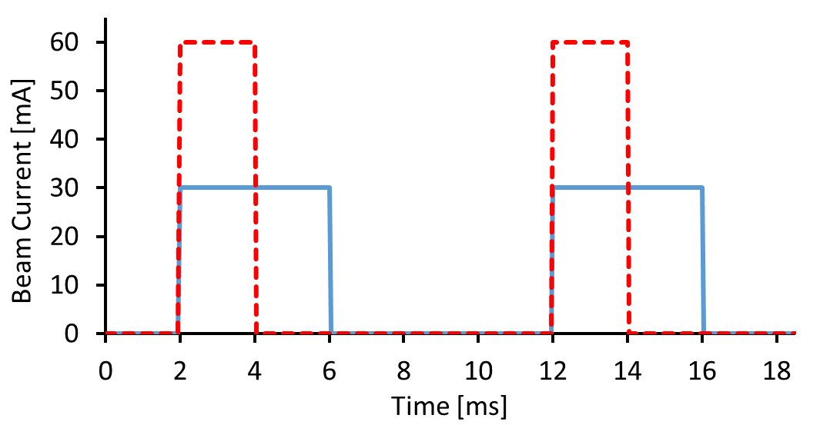
Timing in Pulsed Sources
Usually only need beam a fraction of the time
However, more difficult to make pulsed power supplies
Different D.F.%
but same total
integrated charge
Duty Factor = Pulse Length x Repetition Rate
e.g. ISIS: 200 µs x 50 Hz = 1% Duty Factor

Slide 12
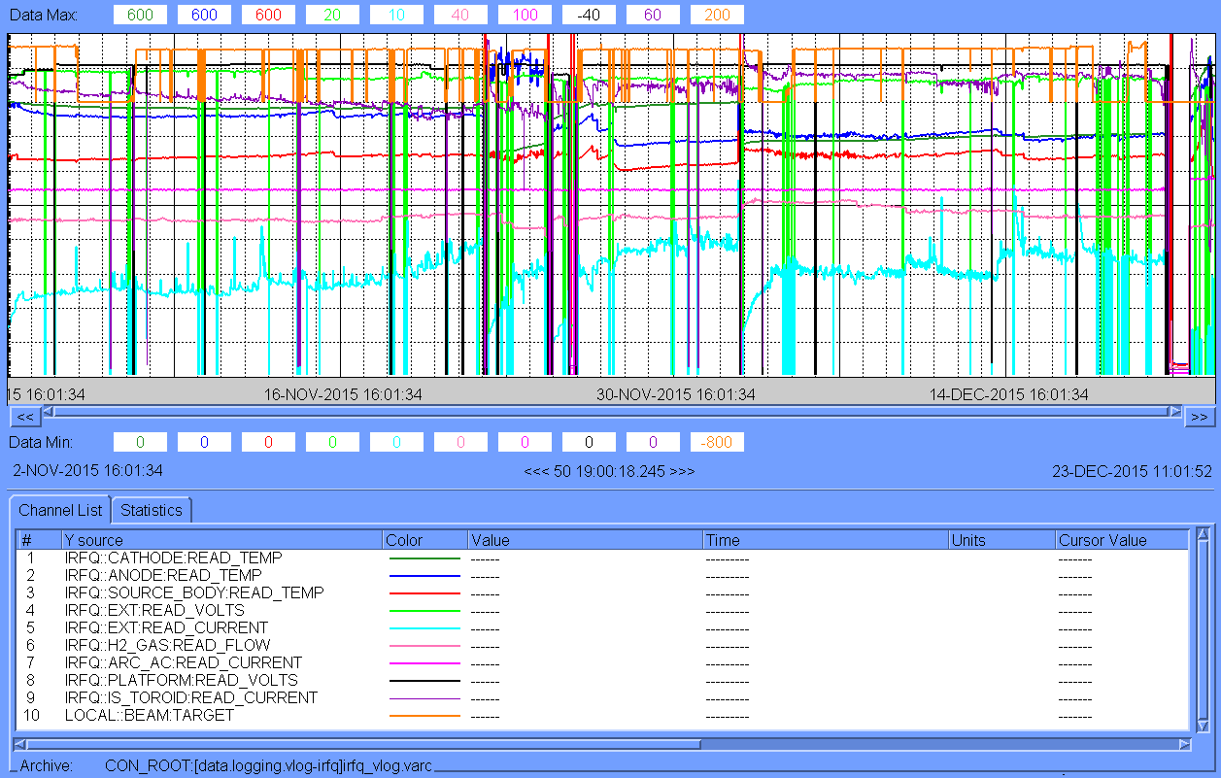
Reliability and Stability
Seven week log

Slide 13
Summary of Fundamentals
Electrons released from hot surfaces
Lower work-function materials release more electrons
Space-charge limit to amount of extractable current
Extraction systems described by their perveance
Particle beams described by their emittance
Many ways to define emittance and its units: be careful
Must consider high voltage engineering requirements
Usually need specialist pulsed power supplies
Reliability dominates all other performance goals
Now we can move onto real particle sources…

Slide 14
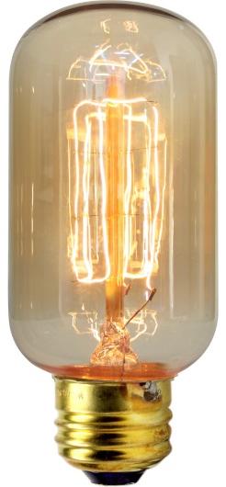
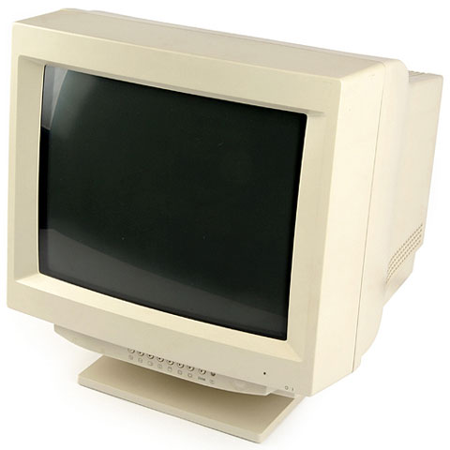
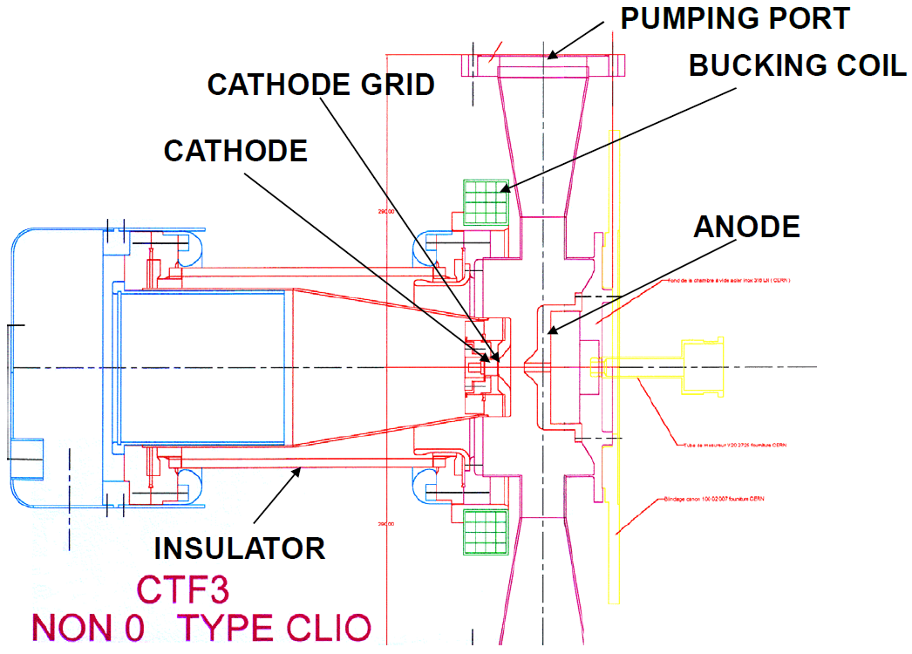
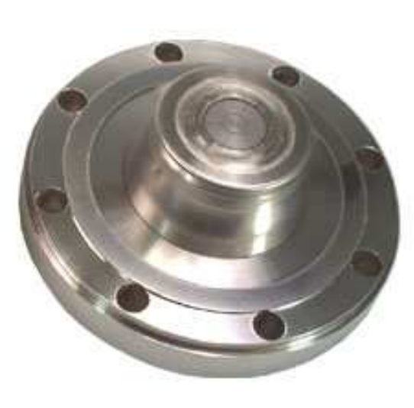
Thermionic Electron Gun
W dispenser cathode
with impregnated
BaO:CaO:Al2O3

Slide 15
Photocathode Electron Guns
Anode
Electron
Beam
Material | Type | (E_{gap} + E_{Aff}) * or ϕ_{work} [eV] | λ [nm] | Q.E. $
W | Metal | 4.5 | 375 | 10⁻⁶
W:Th | Metal | 2.6 | 477 | 10⁻⁵
Cs | Metal | 1.81 | 685 | 10⁻³
LaB₆ | Ceramic | 2.6 | 477 | 10⁻⁶
GaAs:Cs | Semi-cond. | 2.3 | 532 | ~0.10 &
Cs₂Te | Semi-cond. | 3.5 | 350 | 0.12
K₂CsSb | Semi-cond. | 2.1 | 590 | 0.29
Photo-
cathode
Laser
Beam
Use low work function cathode
Raise temperature
Fire laser onto it
Accelerate e-beam
Bunch timing set by laser pulses
* In semi-conductors, the equivalent to work
function ϕ_{work} is (band-gap + electron affinity)
$ Q.E. = Quantum efficiency = Electrons/Photon
& Vacuum-dependent

Slide 16
DC Photocathode Gun
ALICE @ DL
350 kV DC, 80 pC bunch, GaAs:Cs

Slide 17
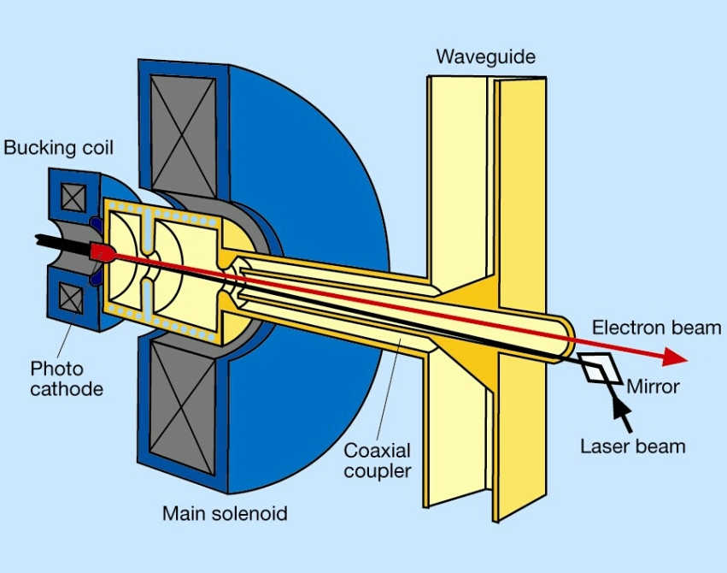
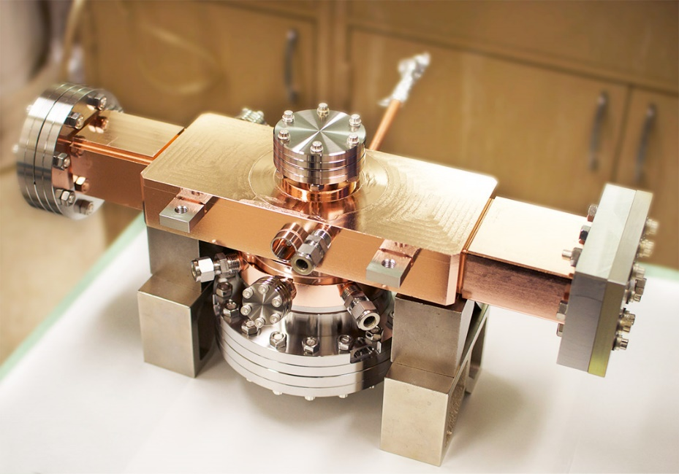
RF Photocathode Gun
FERMI2 @ Trieste
3 GHz RF
50 Hz laser
Q.E. ~3x10⁻⁵
500 pC bunch
5.1 MeV beam

Slide 18
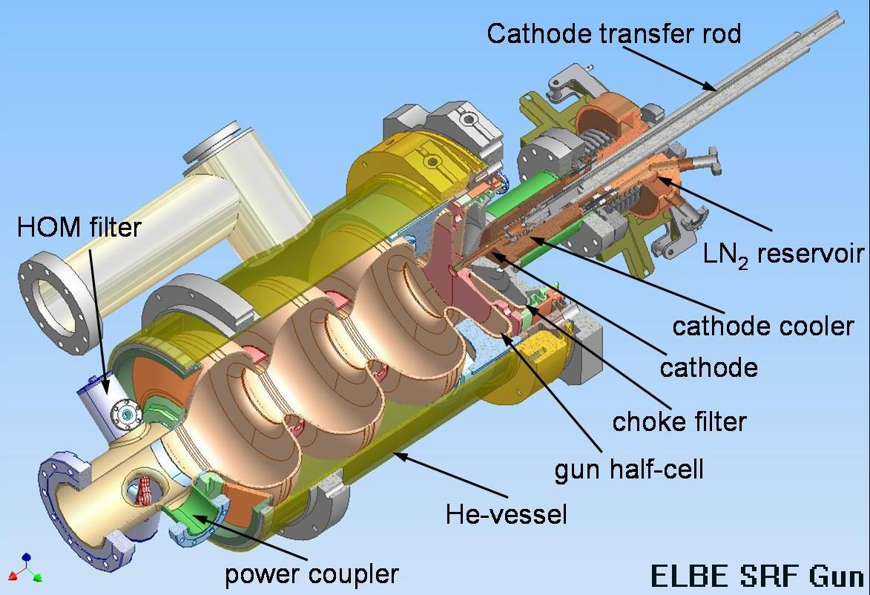
Superconducting RF Gun
SRF2 @ ELBE
Cs₂Te cathode
1.3 GHz CW RF
13 MHz UV laser
200 pC bunch
4.5 MeV beam
Main issue with
all photoinjectors
using Cs₂Te
cathodes is the
need to replace
the cathode after
~100 hours

Slide 19
Most are Plasma-Based Sources
Species
Technique
Filament
Photocathode
Arc Plasma
Laser
Microwave
RF
Cyclotron-Resonance
Duopigatron
Duoplasmatron
…
Electron
Proton
Light Ion
Heavy Ion
Negative Ion
High Charge State
Radioactive
Spin-Polarised
Neutral
Muon
Exotic
1+
4+
34+

Slide 20
Plasma Parameters
Air
Sun Centre
10²⁴
10²²
10²⁰
10¹⁸
10¹⁶
10¹⁴
10¹²
10¹⁰
10⁸
10⁶
Fusion Reactor
Ion
sources
Solar Corona
Plasma Density [particles per m³]
Iono-sphere
Van Allen Belts
Solar
Wind
Interstellar Gas
Intergalactic
10⁻² 10⁻¹ 10⁰ 10¹ 10² 10³ 10⁴ 10⁵
Plasma Temperature [eV]
1 eV ≈ 11,600 K

Slide 21
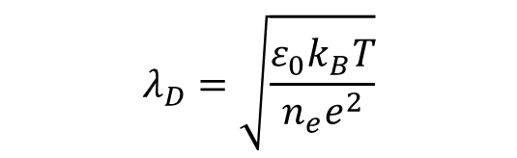
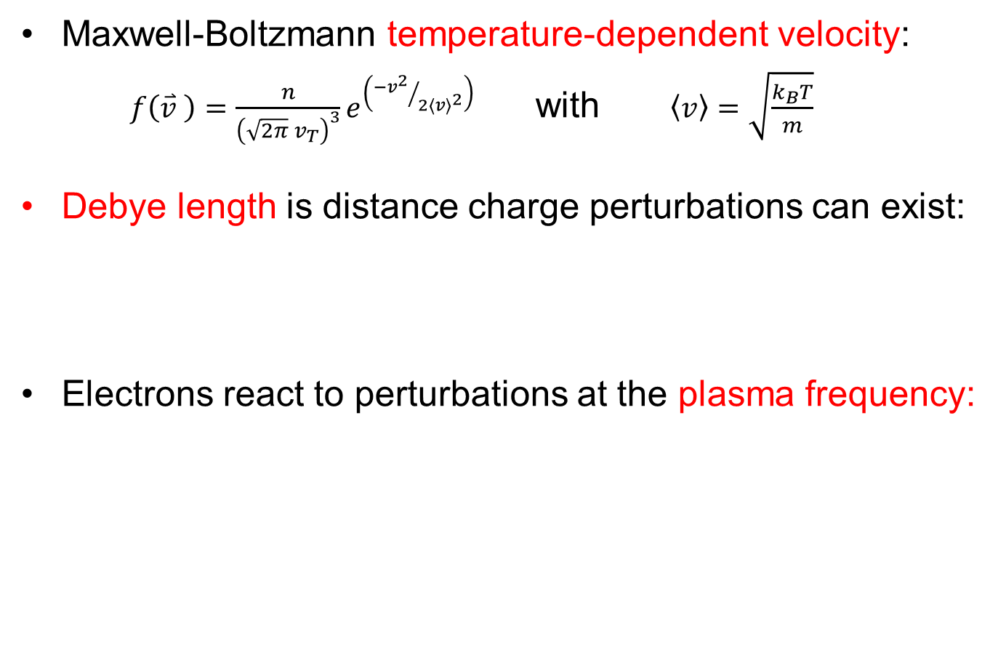
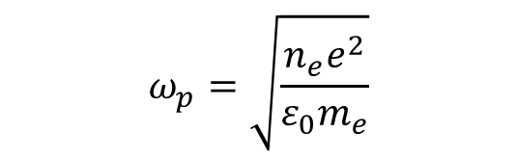
Plasma Fundamentals
Maxwell-Boltzmann temperature-dependent velocity:
$f\left(\overset{⃑}{v} \right)=\frac{n}{{\left(\sqrt{2π} v_{T}\right)}^{3}}e^{\left({−v^{2}}/{2{\left\langle v\right\rangle }^{2}}\right)}$ with $\left\langle v\right\rangle =\sqrt{\frac{k_{B}T}{m}}$
Debye length is distance charge perturbations can exist:
Electrons react to perturbations at the plasma frequency:
$$λ_{D}=\sqrt{\frac{ε_{0}k_{B}T}{n_{e}e^{2}}}$$
$$ω_{p}=\sqrt{\frac{n_{e}e^{2}}{ε_{0}m_{e}}}$$

Slide 22


Plasma Fundamentals
Particle collision frequency depends on cross-section:
With a mean free path between collisions:
Electron impact ionisation examples:
  e– + He⁰ → He¹⁺ + 2e– then e– + He¹⁺ → He²⁺ + 2e–
  e– + H₂ → H₂* then e– + H₂* → H– + H⁰
To ionise efficiently, need plasma confinement, usually in the form of magnetic fields
$$\left\langle ω_{en}\right\rangle =2π n_{n}σ_{en}\left\langle v_{e}\right\rangle$$
$$λ_{f}=\frac{1}{n_{n}σ_{en}}$$

Slide 23





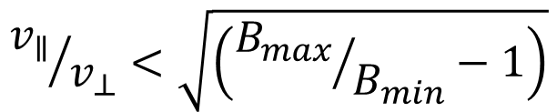

Plasma Fundamentals
Charged particles confined transversely in a uniform B-field
If particles also have $v_{∥}$ and B-field is increasing into screen, get longitudinal magnetic mirror confinement with:
Mirror both ends → magnetic bottle
Also ExB, gradB, curvature & diffusion drifts
Ions
$$ω_{L}=\frac{eB}{m}$$
Larmor frequency:
(a.k.a. cyclotron)
Electrons
$$r_{L}=\frac{v_{⊥}}{ω_{L}}$$
Larmor radius:
$$v_{⊥}$$
$${v_{∥}}/{v_{⊥}}<\sqrt{\left({B_{max}}/{B_{min}}−1\right)}$$
Loss
cone
Loss
cone
$${−v}_{∥}$$
$${+v}_{∥}$$

Slide 24
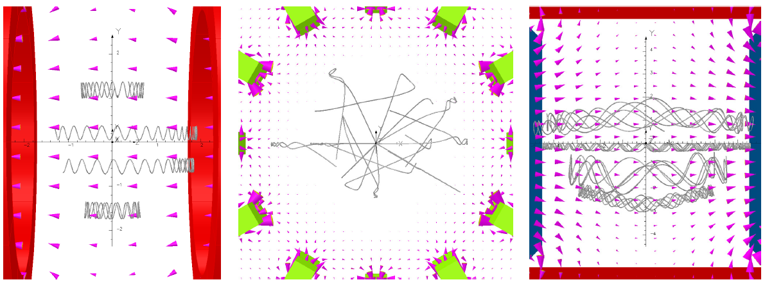
Plasma Confinement Techniques
Solenoid bottle
(often combined with
hexapole cusp)
Multicusp ‘bucket’
of dipoles in
checkerboard pattern
Dipole magnet,
parallel cathodes
and anode ‘window’

Slide 25
The Typical Ion Source
Every ion source basically consists of two parts:
Ion production inside a plasma
Beam extraction from the plasma
Confinement Magnet
Plasma
chamber
Plasma
Emission
Aperture
Power Feed
Particle Beam
Gas Feed
Confinement Magnet
Extraction
Electrodes

Slide 26
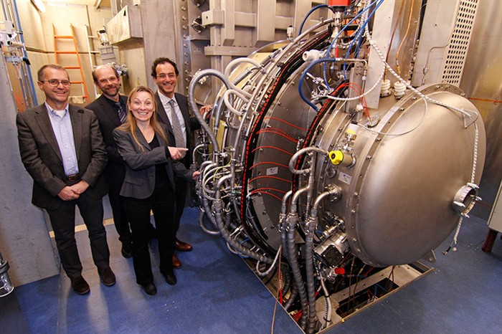
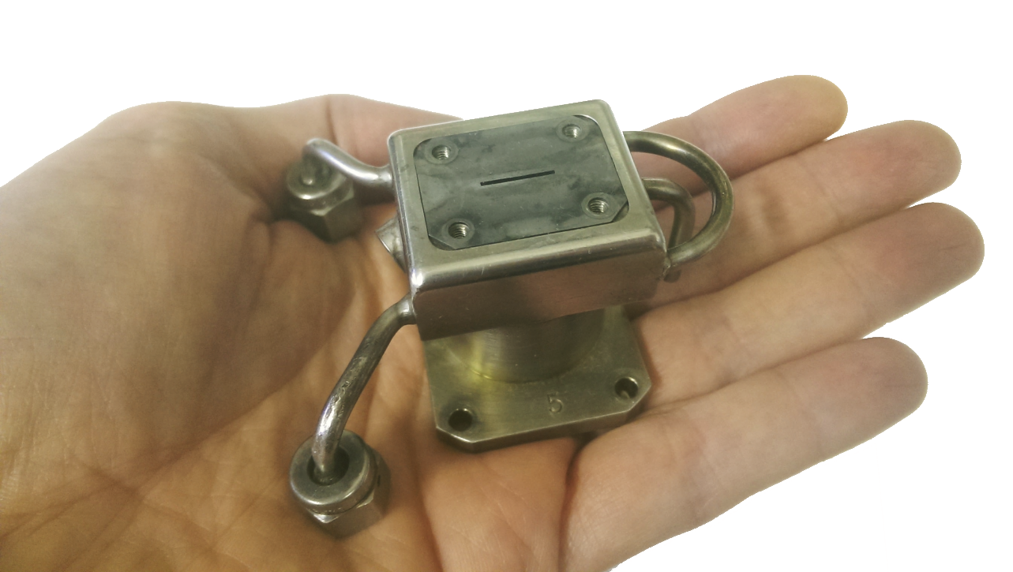
No ‘Typical’ Ion Sources!
‘ELISE’ ITER
Demonstration
H– Source
ISIS
H– Source

Slide 27
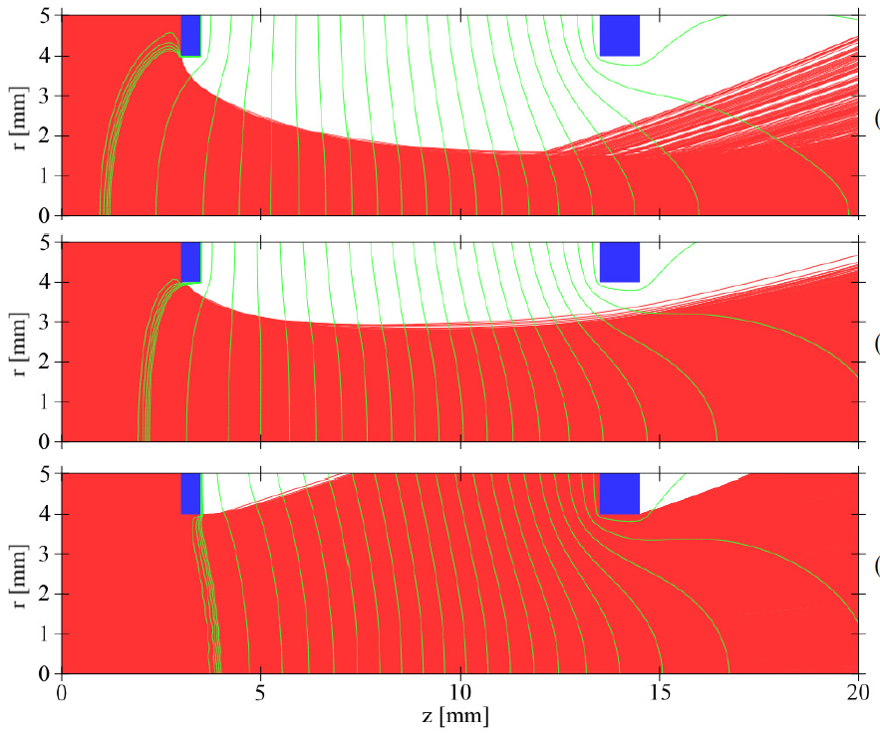
Beam Extraction
Particle dynamics at emission aperture defines the beam performance throughout entire accelerator: crucial!
Plasma meniscus is notional ‘boundary’ where beam originates
Meniscus sets beam current, emittance and focussing. Shape varied by plasma density, extraction voltage and electrode geometry
Under-dense plasma:
beam cross-over & aberrations
Meniscus
Perveance match:
parallel beam
Over-dense plasma:
very divergent beam

Slide 28
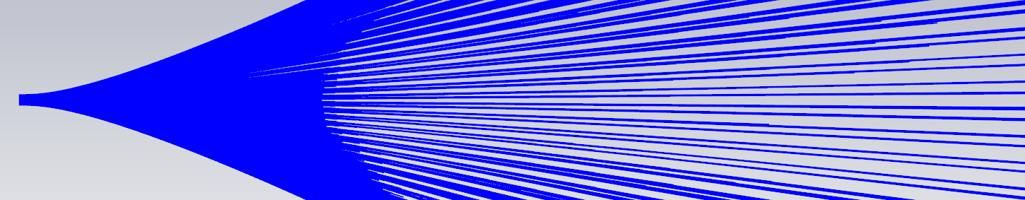
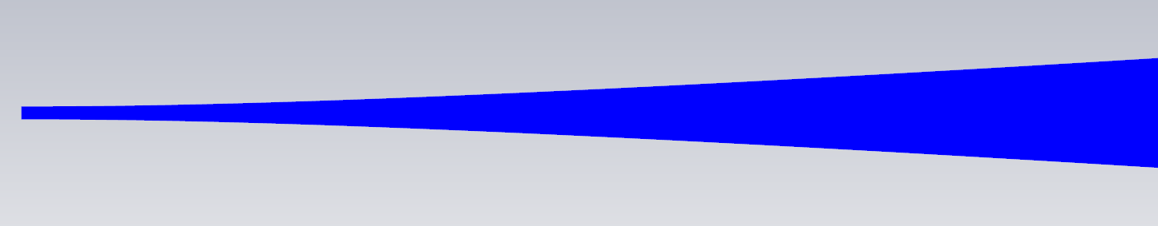
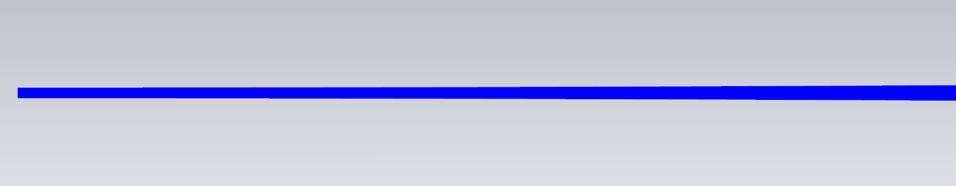
Space Charge
50mA proton beam, 5mm initial radius, drifting 1m
10 keV beam
100 keV beam
1 MeV beam
CONCLUSION: Need to focus and accelerate low energy beams hard

Slide 29
Space Charge Compensation
Space charge increases beam size
Beam ionises residual gas and traps
electrons in beam potential: Space charge compensation. Takes ~50 µs, depending on vacuum pressure.

Slide 30
Summary of Fundamentals (2)
Most ion sources involve plasma
Lots of parameters to describe a plasma
Plasmas confined with various topology magnetic fields
After plasma is the beam extraction region
Plasma meniscus defines initial beam focussing
Space charge affects low energy, high mass beams
Often attempt deliberate space charge compensation
Now we can move onto real examples of ion sources…

Slide 31
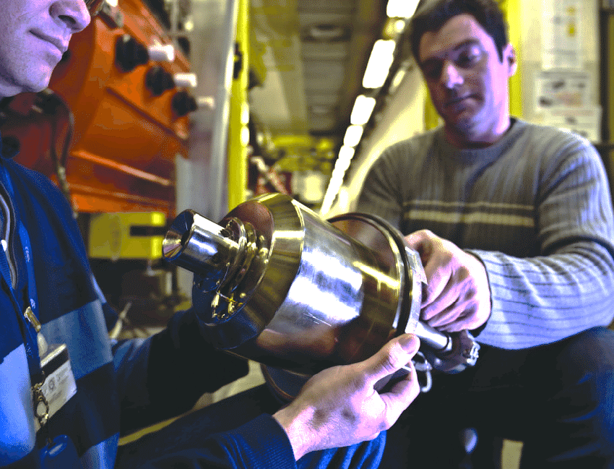
Proton Sources
Duo
plasmatron
CERN Linac2 1956
300 mA protons
150 µs, 1 Hz
Anode
Solenoid
Expansion cup
Intermediate electrode
Cathode filament
Extraction
electrode
Steel yoke

Slide 32
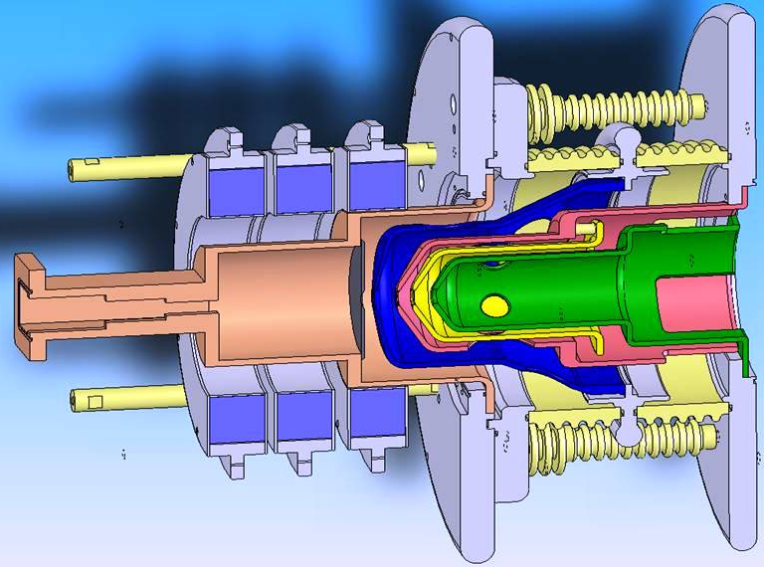
Proton Sources
2.45 GHz ECR
SILHI @ CEA, INFN, ESS…
120 mA protons
All duty factors up to 100%
RF cavity immersed in
axial solenoid field
Select RF frequency to match Larmor frequency
Electrons gain energy
Increases ionisation rate
Electrons
E-field
Electron Cyclotron Resonance (ECR)

Slide 33
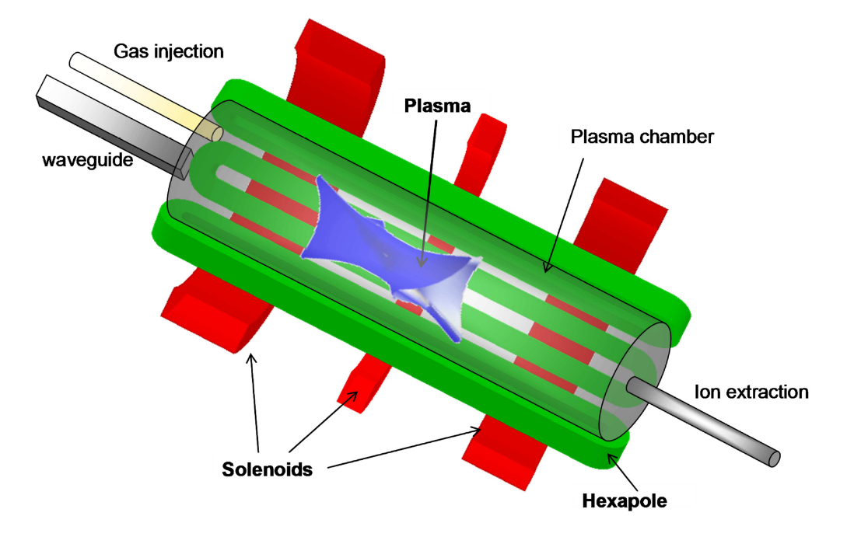
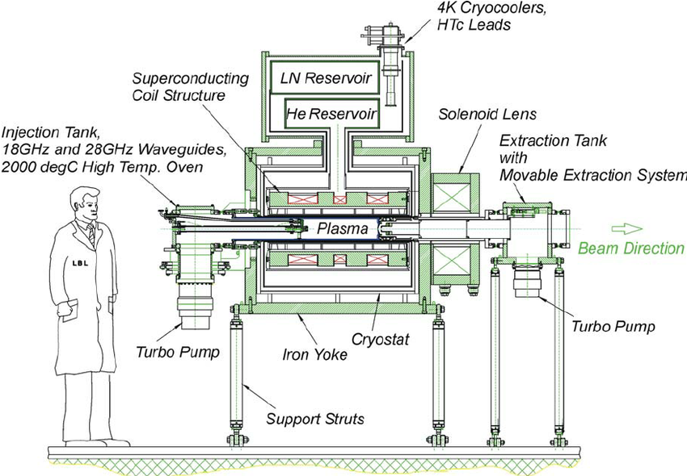
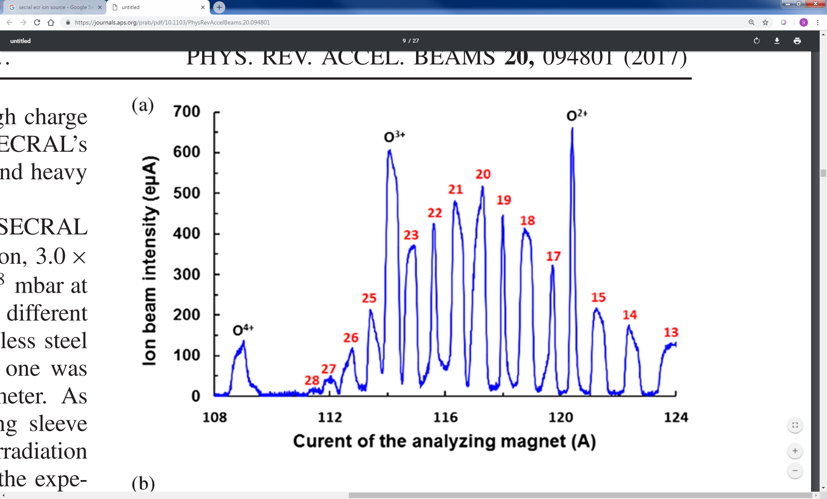
High Charge State Sources
Hexapole transverse confinement
Higher frequency → stronger B
Superconducting magnets
Large and very expensive!
SECRAL & VENUS 28 GHz ECRs
High currents of Bi²⁰⁺, Pb³⁴⁺…

Slide 34
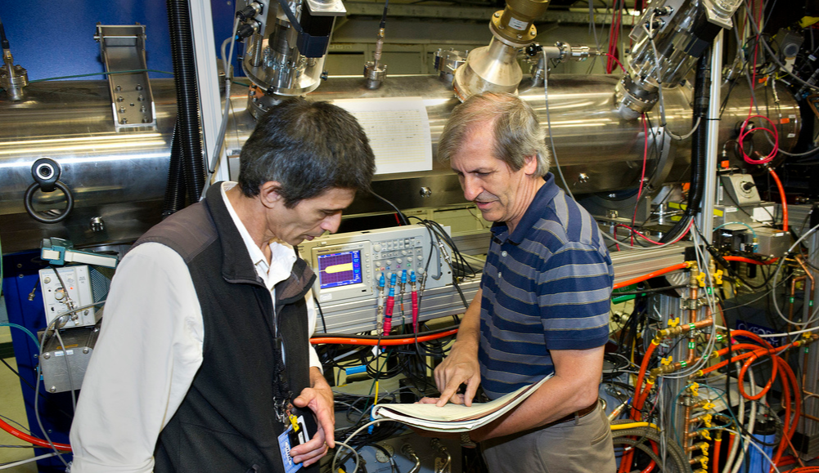
High Charge State Sources
High power electron beam ionises gas
Ions trapped and undergo step-wise ionisation
Remove trapping voltage to release ions
Superconducting Solenoid
Drift tubes
Electron Gun
Electron Beam Ion Source
EBIS @ RHIC
10 A electron gun
5 T, 1.9 m ion trap
Au³²⁺, U³⁹⁺…
10 µs, 5 Hz pulses

Slide 35
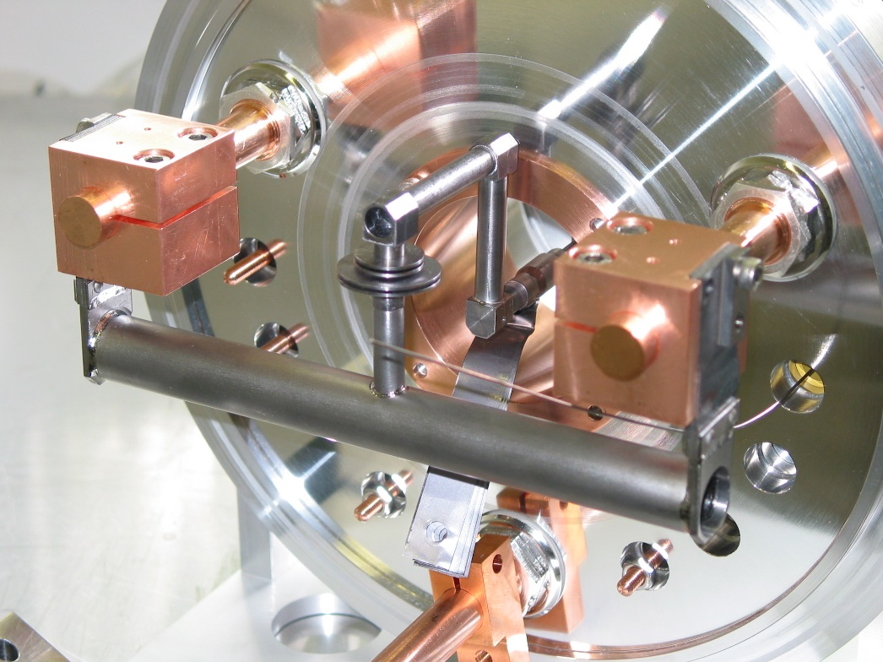
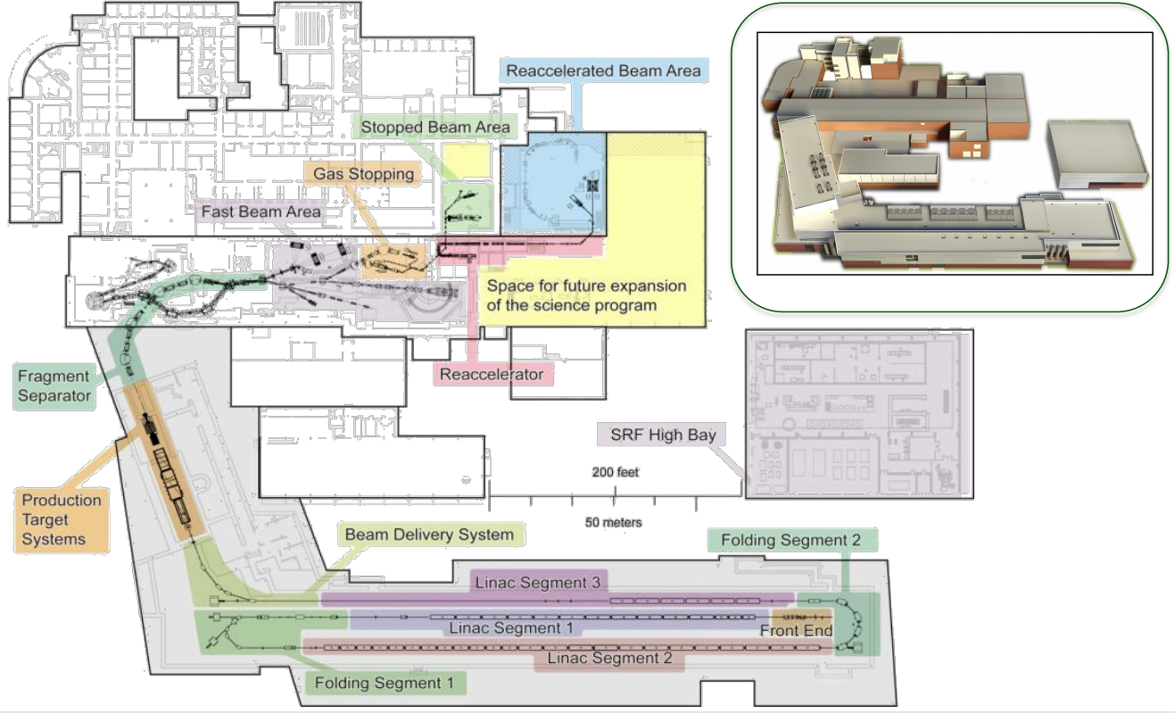
Charge Breeders
& ISOL
(Isotope
Separation
On-Line)
Impact protons onto target
Radioactive ions emerge
Further ionisation in plasma
Extract and (quickly!) accelerate and analyse
Study very exotic nuclei
ISOLDE @ CERN
10⁷ ¹³²Sn per second
Soon in USA:
FRIB

Slide 36
Negative Ion Sources
+0 MV
+2 MV
+4 MV
H–
0 MeV H–
8 MeV H⁺
H⁺
Tandem
Cyclotron
Synchrotron
50 MW H–
H⁰
H⁺
H–
Tokamak

Slide 37


H– Ion Production Methods
Volume Production (H– beams $≲4$0 mA)
Surface Production
(H– beams $≳4$0 mA)
e_{fast} + H₂
= H₂* + e_{slow}
Low φ_{work} metals release electrons
Alternatively, energetic atoms
hitting surface can take a free
electron, creating H–
e_{slow} + H₂*
= H– + H⁰

Slide 38

Caesium: a Blessing and a Curse
Good Points | Bad Points
Allows copious H– production Reduces co-extracted e– current Allows high current plasma arc Stabilises plasma Nothing else as effective | Increases rate of HV sparking Makes vacuum vessel messy Highly explosive AND toxic Hard to work with and expensive Reduces ion source lifetime
Moral:
Only use ‘JUST ENOUGH’
caesium for acceptable
ion source performance!

Slide 39

ISIS Penning Surface H– Source
Machined molybdenum, ceramic, stainless & copper
High temperature and magnetic & electric fields
Microscope alignment of extraction electrode
Hydrogen & caesium feeds into the vacuum
Welded 1/8” air & water cooling pipes
Bolts torqued for good thermal contact
> 2 kW of power damages components
Lasts 3-4 weeks → have 10 ready to go
55 mA H– at 250 µs, 50 Hz
Wear after 35 days

Slide 40

ISIS RF Volume H– Source

Slide 41
Final Thoughts
Accelerator designers always want more from the particle source!
More current
Higher charge states
Higher duty factor
Lower emittance
Longer lifetime
More stability
Squarer pulse shape
More Gaussian Profile
Quicker start-up
Better vacuum
Very active & exciting career, always in need of more minds

Slide 42
Thank you for listening!
Feel free to contact me if you’re interested in this subject.
Please email homework answers to me by 22/03/2019.
scott.lawrie@stfc.ac.uk
Notes:
Questions?

Slide 43

Homework Questions
Use the ideal gas law to calculate the particle number density inside a room-temperature vacuum vessel at a (somewhat poor) pressure of
10⁻⁴ mbar. Assuming $σ_{en}$ = 6x10⁻¹⁹ m⁻², calculate the mean free path. If the vessel is 0.5 m long, is the pressure high enough to be collisional?
You want to make an electron gun which can operate at 1 kHz, with an extracted charge of 500 pC/bunch. Your photocathode has Q.E. = 1x10⁻⁴. What power laser would you need if it operated at a wavelength of 532 nm?
You want to make an H– ion source with an output beam current of 40 mA at 45 kV extraction voltage operating at 50 Hz for the scSPS project.
  Discuss whether you would use caesium in this ion source.
  What are the benefits and drawbacks of altering the geometry terms
  A and d² to reach a suitable perveance?
  Write a list and brief justification of the physics simulations you would need to perform to design this ion source.

