Slide 1
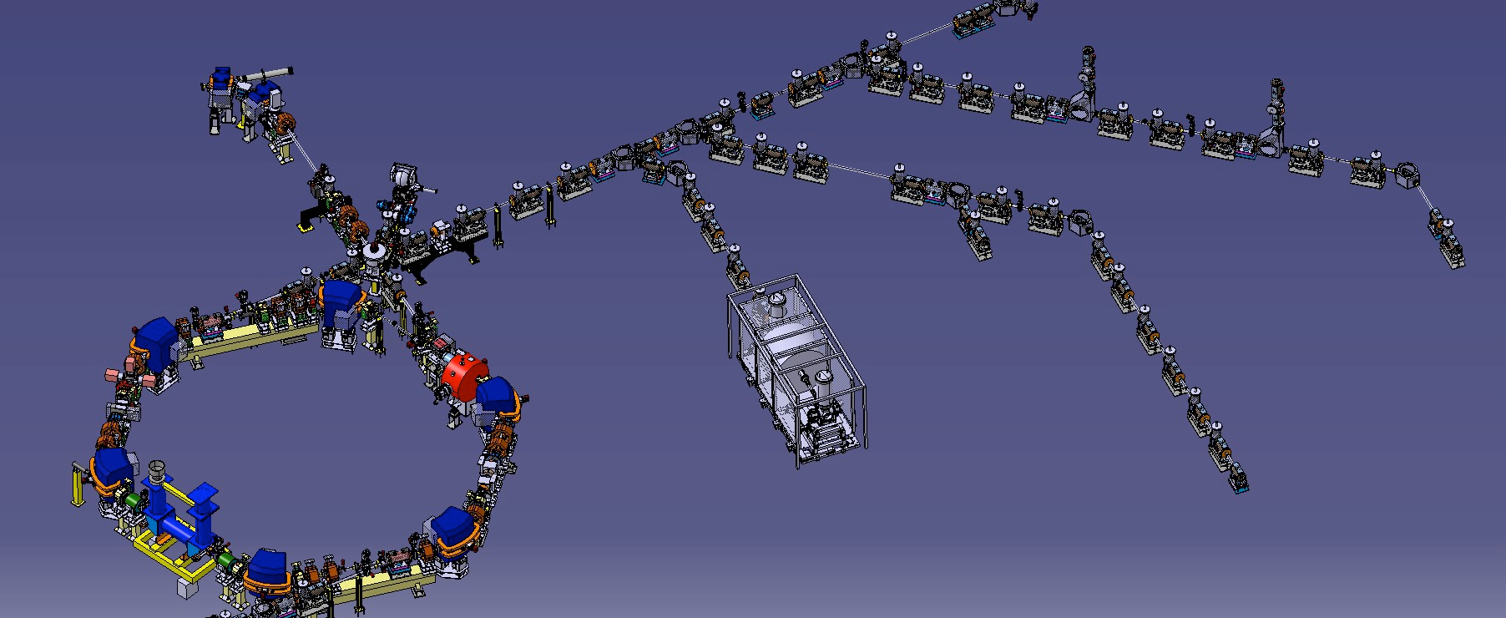
Experience with e-cooler at ELENA and requirements for optimisation of future applications
D. Gamba on behalf of the AD/ELENA teams BE-ABP/BE-BI Joint Meeting 10th Jan 2019
ELENA layout and beam status at the end of the run (9 Nov 2018)
Hints about e-cooling performance
Desiderata for future optimisation
Conclusions
Experience with e-cooler at ELENA BE-ABP/BE-BI Joint Meeting 10th Jan 2019

Slide 2
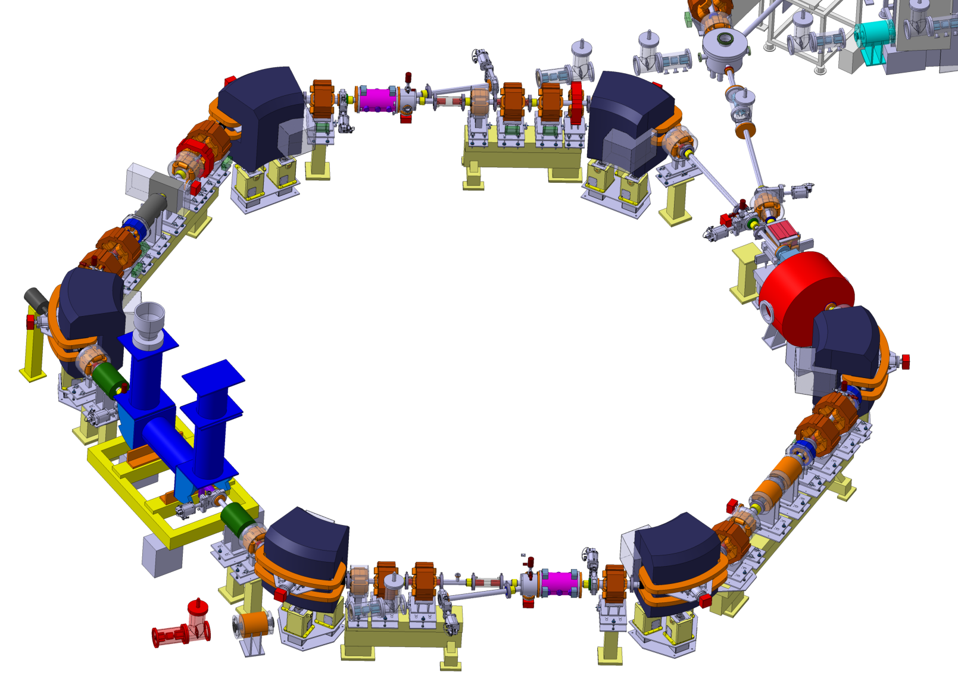
ELENA Overview and Layout
Extraction towards existing experiments
(with fast electrostatic deflector)
Line from H⁻ and proton
source for commissioning
Wideband RF cavity
Injection with
magnetic septum (≈300 mrad)
and kicker (84 mrad)
Scraper to measure
emittances
(destructive)
Quadrupoles
High sensitivity magnetic
pick-up for Schottky diagnostic
(intensity) and LLRF
Electron Cooler and
compensation solenoids
Extraction towards new exp. zone
Deceleration of antiprotons from 5.3 MeV to 100 keV to improve efficiency of experiments
Circumference 30.4 m (1/6 the size of the AD)
  Fits in available space in AD hall and allows installing all equipment without particular efforts
  Lowest average field (beam rigidity over average radius) Bρ/R = 94 G (smaller than for AD 115 G)
Experience with e-cooler at ELENA BE-ABP/BE-BI Joint Meeting 10th Jan 2019

Slide 3
Status End of Run 2018
Intensity estimate from LLRF
Almost nominal cycle:
  Injection 100 MeV/c
  Deceleration to 35 MeV/c (h = 1)
  De-bunching and e-cooling
  Deceleration to 13.7 MeV/c (h=4)
  De-bunching and e-cooling
  Re-bunching (with e-cooler on) on h=4 and extraction to experiment
    GBAR only user so far.
If we trust LLRF intensity estimate we have about 50% deceleration efficiency
Still quite some losses at the end of second ramp
  Still to be understood…
Bunched beam
e-cooling
Most “difficult” losses
e-cooling
Magnetic cycle
Position pick-up sum signal,
proportional also to intensity
2 s/div
(Almost) Ready and looking forward to send beam to
all other AD experiments after LS2!
Experience with e-cooler at ELENA BE-ABP/BE-BI Joint Meeting 10th Jan 2019

Slide 4
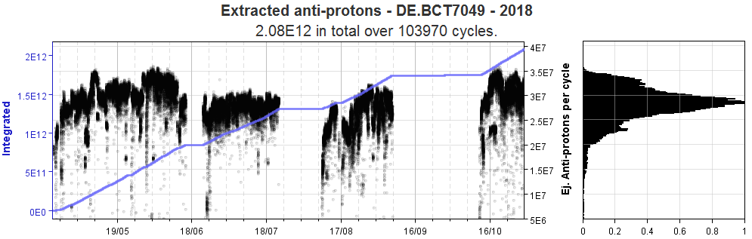
Important Facts: beam time
E-cooler studies (so far) only possible with pbars
  Unavailability of p beam from source; limited attempts with H-
AD cycle length ~110 s; MD shift of 8 h
  About 33 shots/hour; 260 shots/MD shift
  Typically 2/3 MDs per week ≈ 10% of time
  Unfortunate year for AD (about 62% availability = 4400h)
    i.e. about 15000 shots (upper boundary) for ELENA MDs in 2018
Courtesy T. Eriksson (link)
Experience with e-cooler at ELENA BE-ABP/BE-BI Joint Meeting 10th Jan 2019

Slide 5
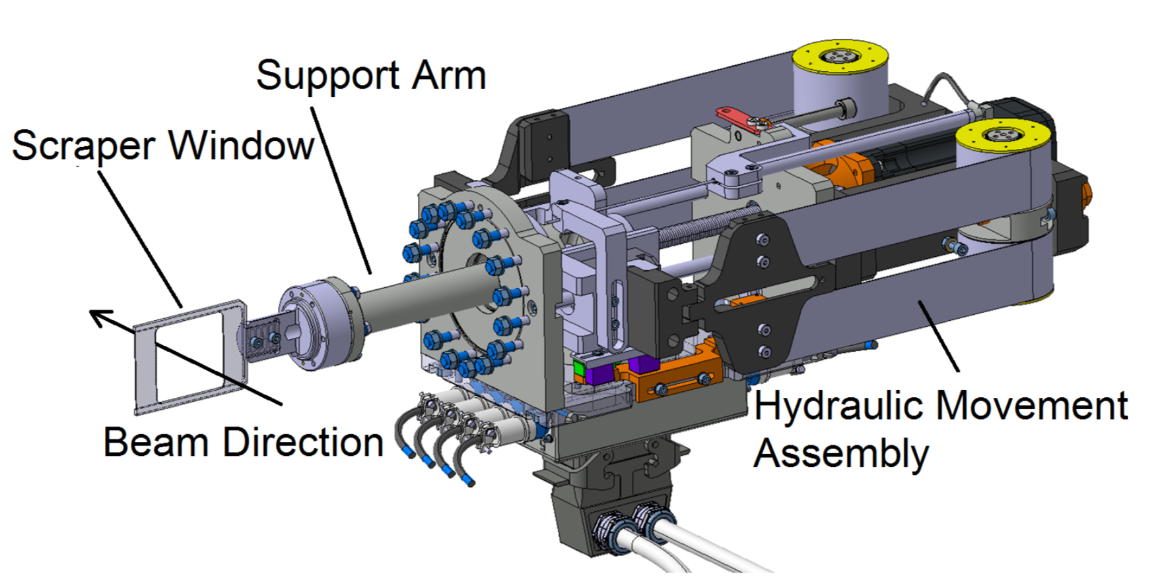
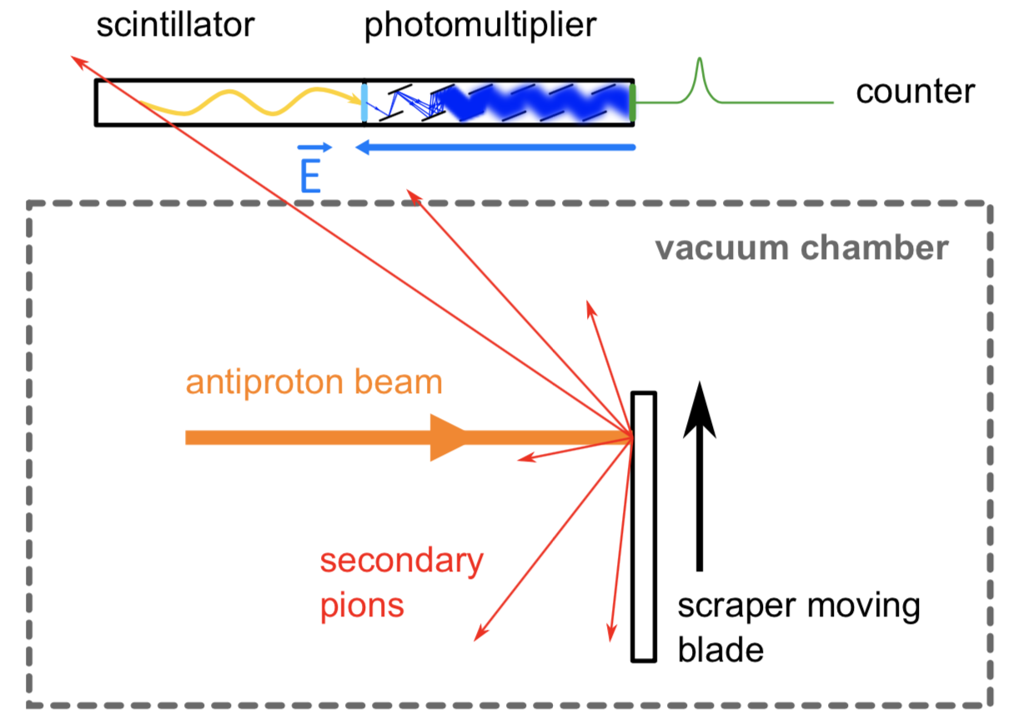
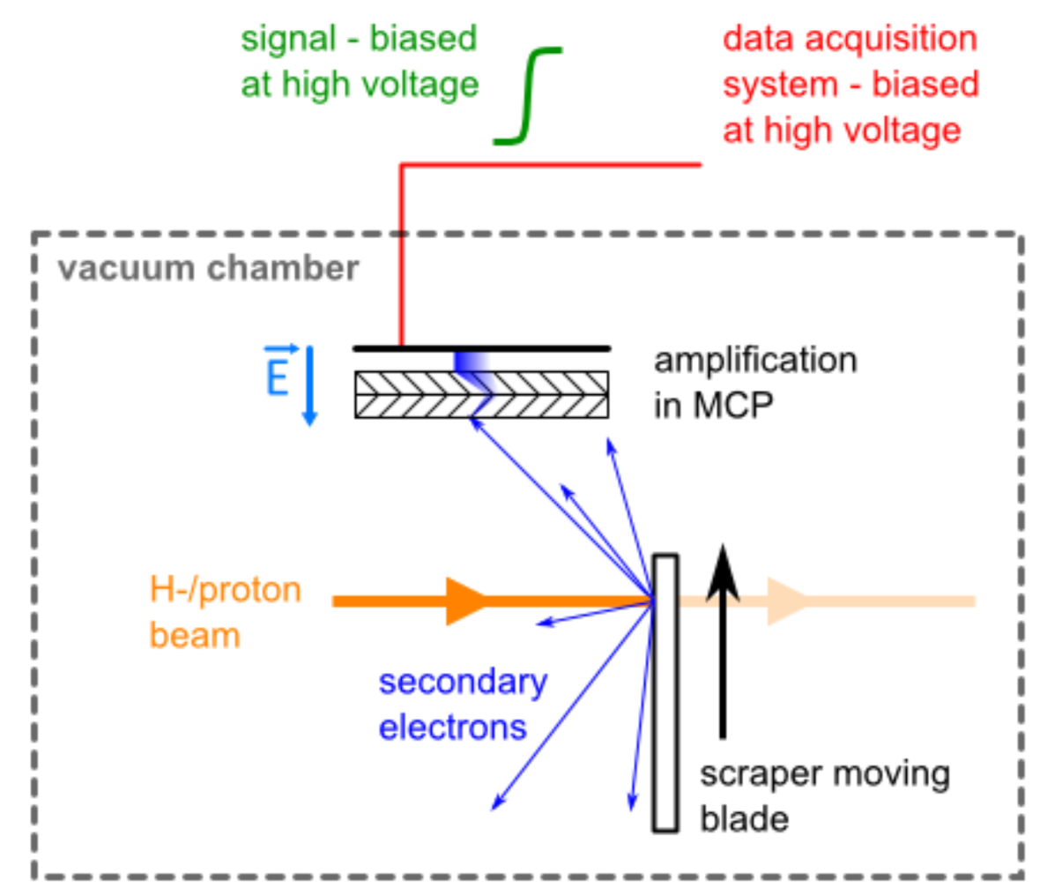
Important Facts: Beam Instrumentation
Scraper measurement
  Destructive
  Integrated in control system
Schottky diagnostic (LPU or TPU)
  Non-destructive
  Not fully integrated in CO
Courtesy P. Grandemange (link)
Also available:
2 BPMs in e-cooler section, but only used to measure ions (no tests with e-, isn’t it?)
Recombination Monitor only for e- beam optimisation with H- and p (not exploited)
Experience with e-cooler at ELENA BE-ABP/BE-BI Joint Meeting 10th Jan 2019

Slide 6
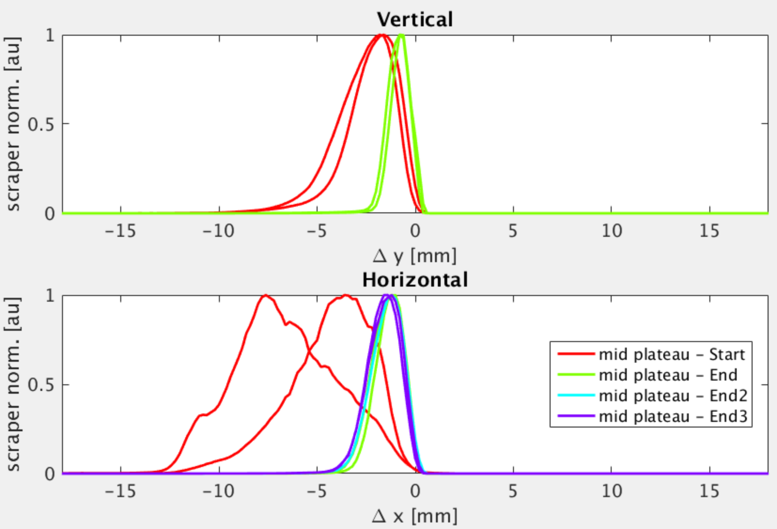
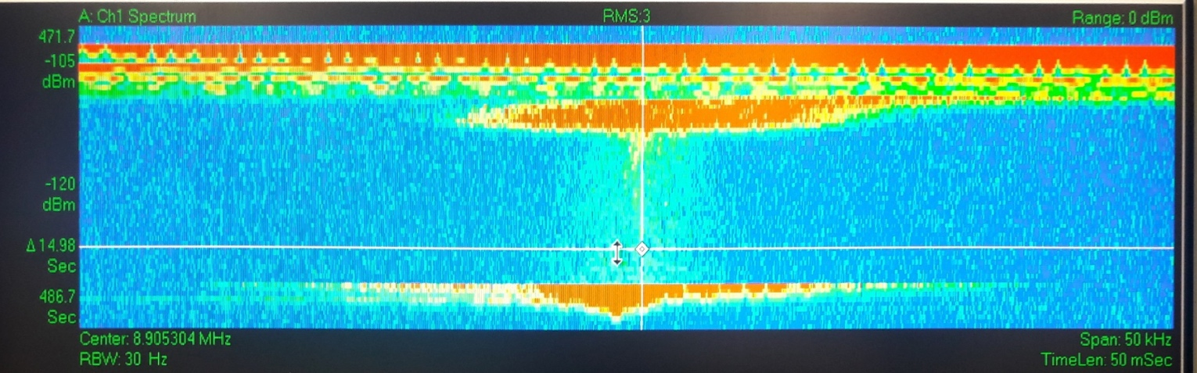
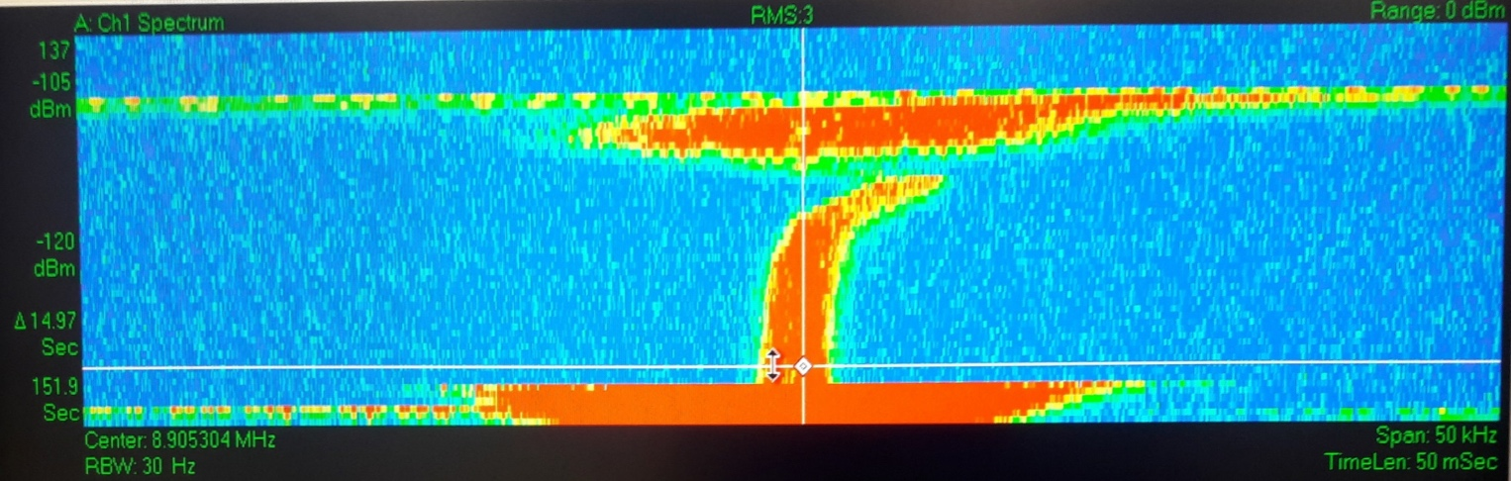
E-cooler in action - 35 MeV/c plateau
~half profile measured with “scraper”
Schottky signal
E-cooler off
E-cooler on
Courtesy G.Tranquille
Clear transverse and longitudinal emittances reduction observed
Only limited amount of time on systematic optimization of cooling (lack of time)
  Some optimisation with orbit bumps/angles in e-cooler
  Surely(?) margin for improvements
Experience with e-cooler at ELENA BE-ABP/BE-BI Joint Meeting 10th Jan 2019

Slide 7
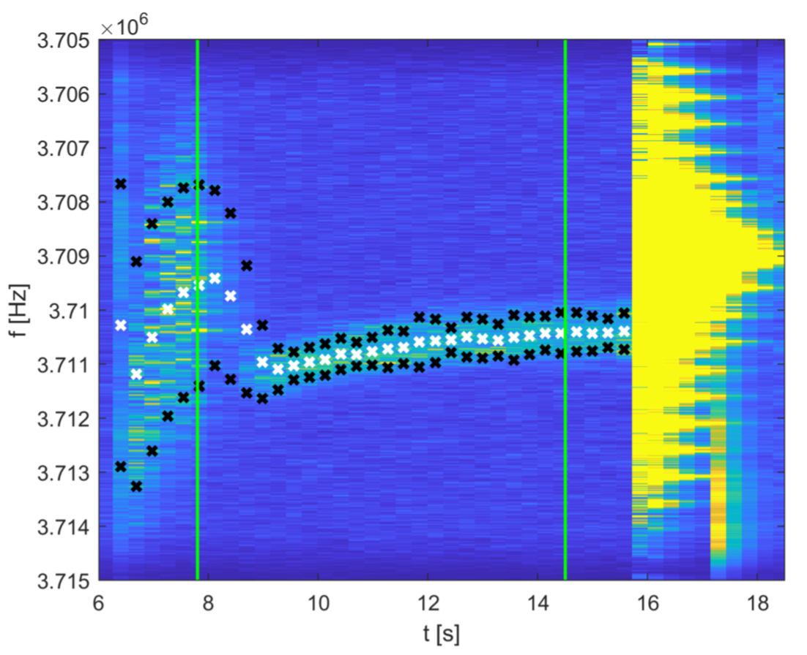
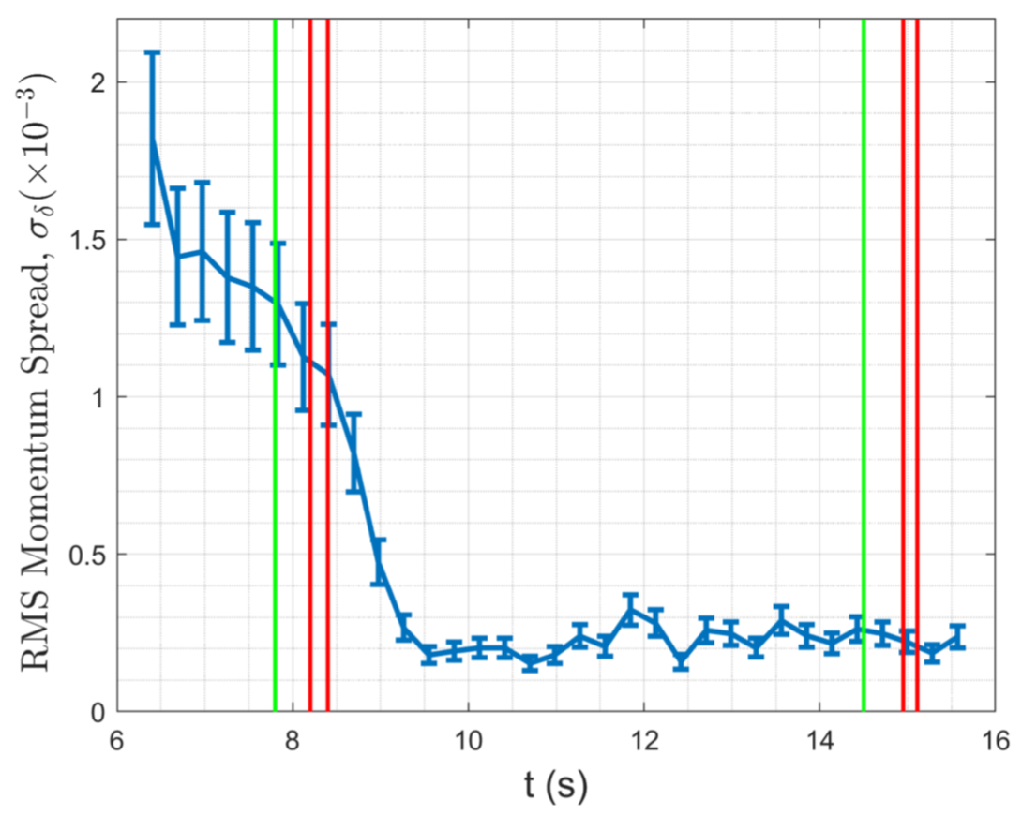
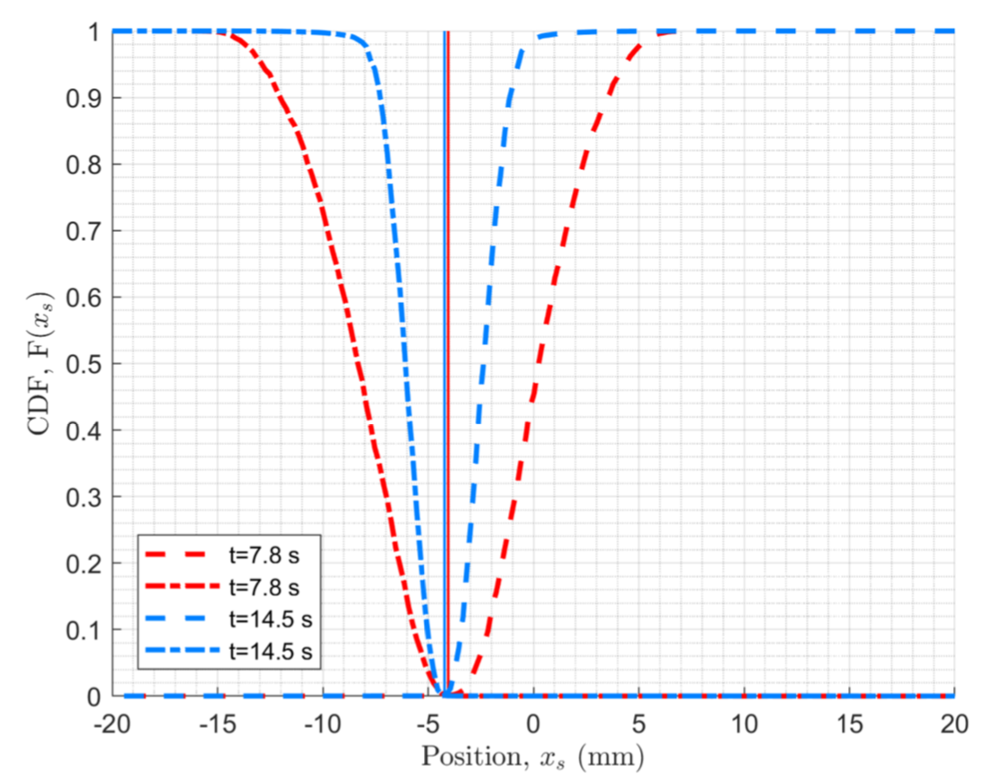
Some details by J.Hunt
Schottky signal @h=10
Analysis of Schottky signal
De-bunching
(unclear time)
Re-bunching
Longit. cooling time of the order of 1 s
  Momentum spread ~2.5e-4 compatible with expectations
Clear reduction of transverse beam size
Some drift of mean energy
  e- beam energy drift?
No sizable variation of beam mean transverse position
Cumulative Distribution Functions from Left/Right scrapings
Experience with e-cooler at ELENA BE-ABP/BE-BI Joint Meeting 10th Jan 2019

Slide 8
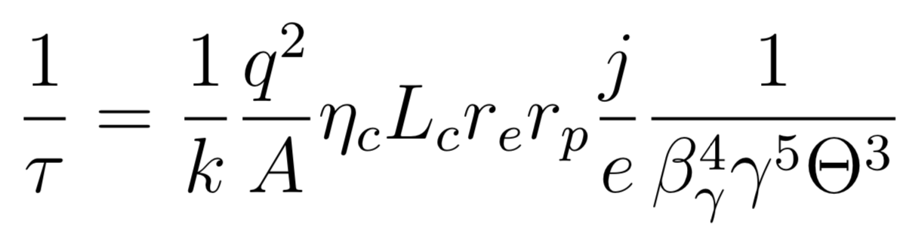
Cooling time
k = 0.16(?)
L_{C} = Coulomb logarithm
≈ 10 typically
j = e⁻ current density
r.m.s. ion/electron “angular” spread
Q = -1; A = 1 for ELENA
from: ELENA Design Report (CERN-2014-002)
Putting everything together, to be expected cooling time of τ < 1 s
  Compatible with observations.
Experience with e-cooler at ELENA BE-ABP/BE-BI Joint Meeting 10th Jan 2019
Notes:
\eta_c = \frac{L_{cool}}{L_{ring}} \approx 0.023
r_e &= 2.8 \times 10^{-15}\\
r_p &= 1.54 \times 10^{-18}
\gamma &\approx 1 \\
\beta_\gamma &\approx 0.038 - 0.015
N_e = \frac{j}{\beta_\gamma\,c\,e}= \frac{I_{e_{beam}}}{\beta_\gamma\,c\,e\, r_{e_{beam}}^2 \pi}
j &= N_e \beta_\gamma\,c\,e \\
N_e &\approx 1.4 \times 10^{12} [m^{-3}]
BetaTwiss = 2 m; emittance = 4 um
\Theta_{\parallel} &\approx \Delta p_{ion} / p_{ion} \approx 2\times10^{-3}\\
\Theta_{\bot} &\approx \sqrt{\epsilon \gamma_{Twiss}} \approx \sqrt{\epsilon /\beta_{Twiss}} \approx 1.4\times10^{-3}\\

Slide 9
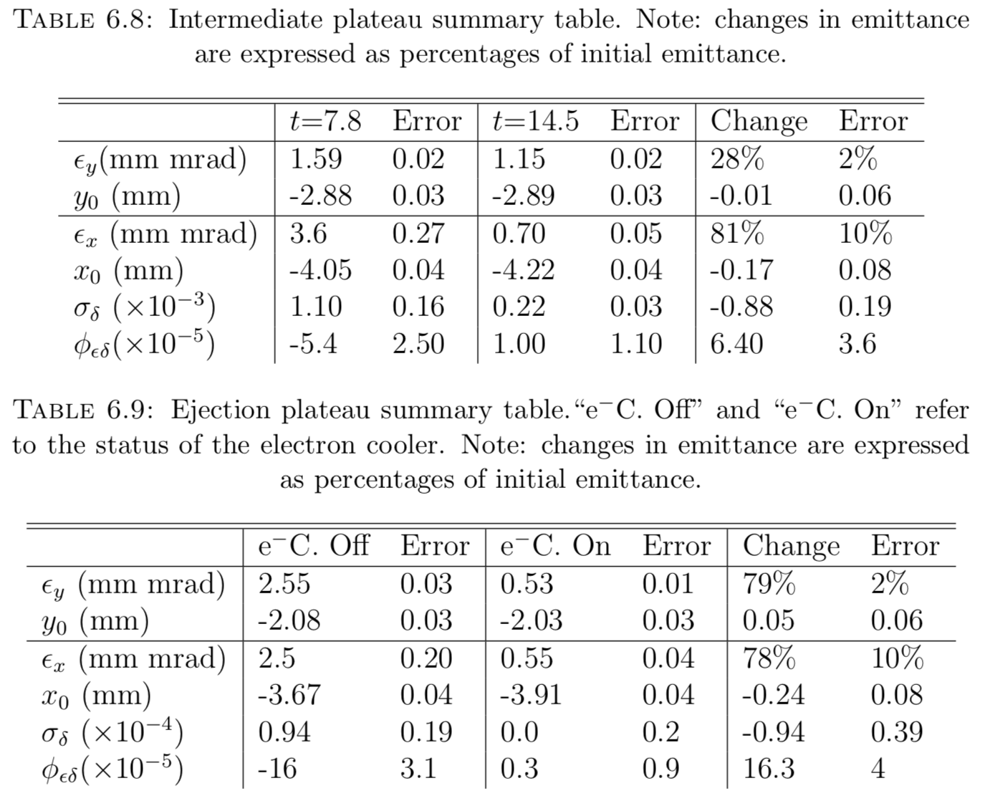
Transverse performance by J.Hunt
still, about x2 worst than design values (0.3/0.2 μm)
Great emit. improvement
Experience with e-cooler at ELENA BE-ABP/BE-BI Joint Meeting 10th Jan 2019

Slide 10
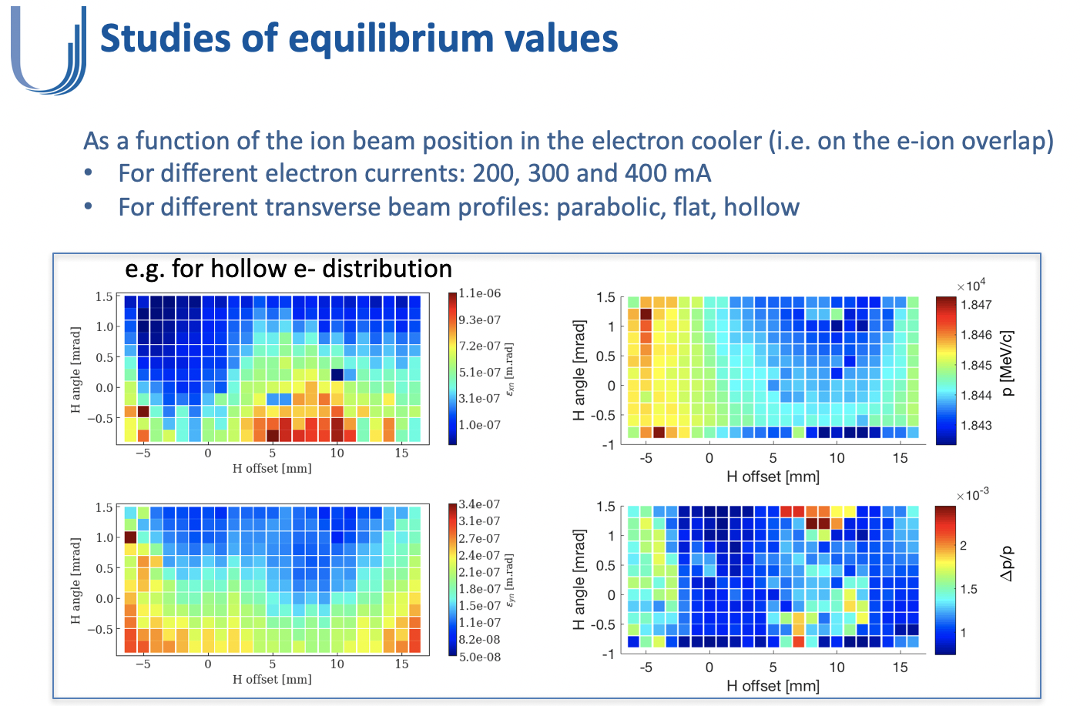
Desiderata: looking at LEIR
from: A.Saa Hernandez (indico)
Each scan contains about 260 points = 1 ELENA pbar MD shift
Only destructive emittance measurement in ELENA
Experience with e-cooler at ELENA BE-ABP/BE-BI Joint Meeting 10th Jan 2019

Slide 11
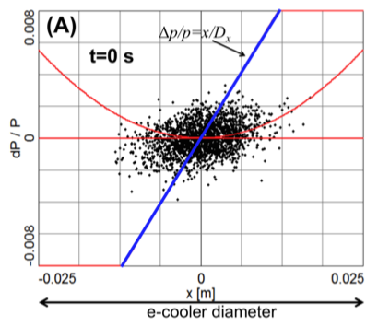
Scan using a single cycle?
We can profit of space-charge effect on e- beam energy distribution:
To the right, a quick test at LEIR
  Requires new tooling/flexibility of ELENA control system
Best alignment?
frequency
time
Ion beam intensity
e- energy offset
wrt transverse position
from: J. Resta-López et al 2015 JINST 10 P05012 (link)
Hor. ion offset bump in the cooler
Experience with e-cooler at ELENA BE-ABP/BE-BI Joint Meeting 10th Jan 2019

Slide 12
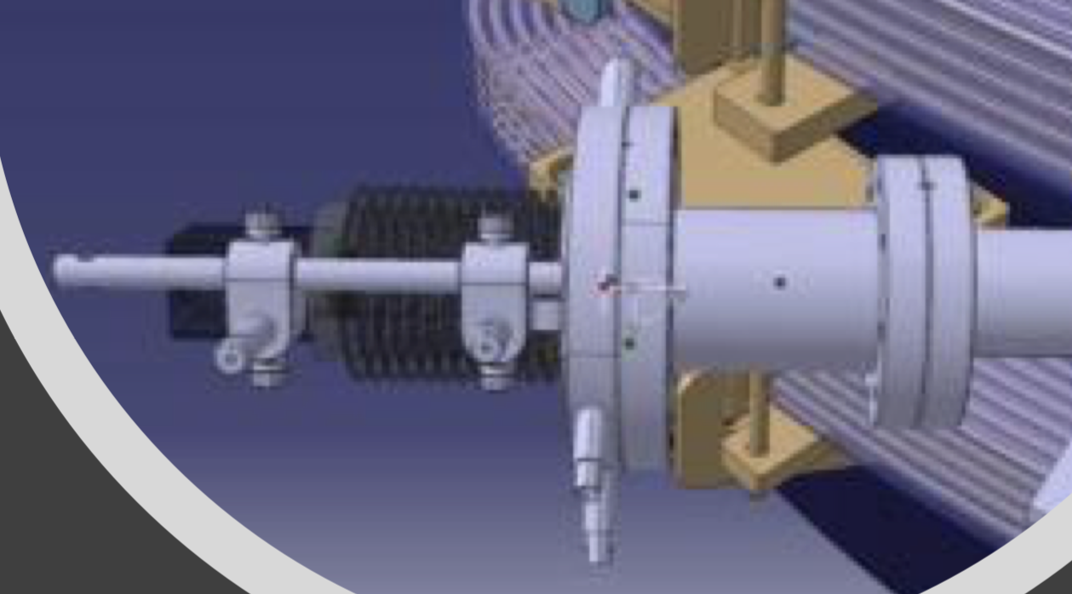
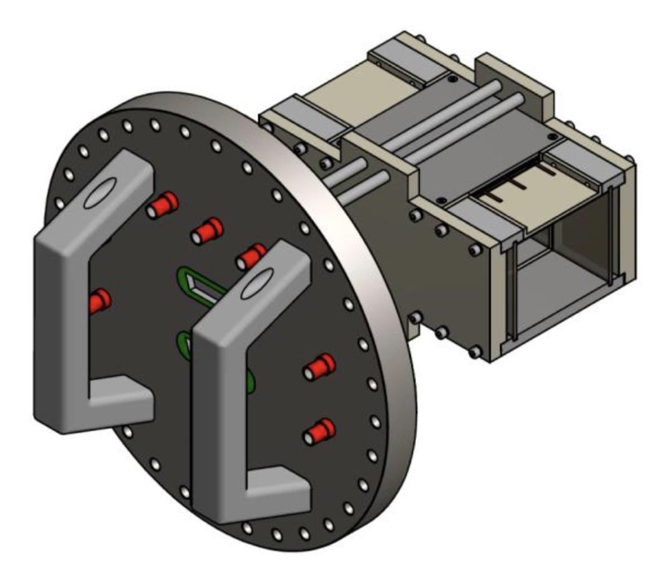
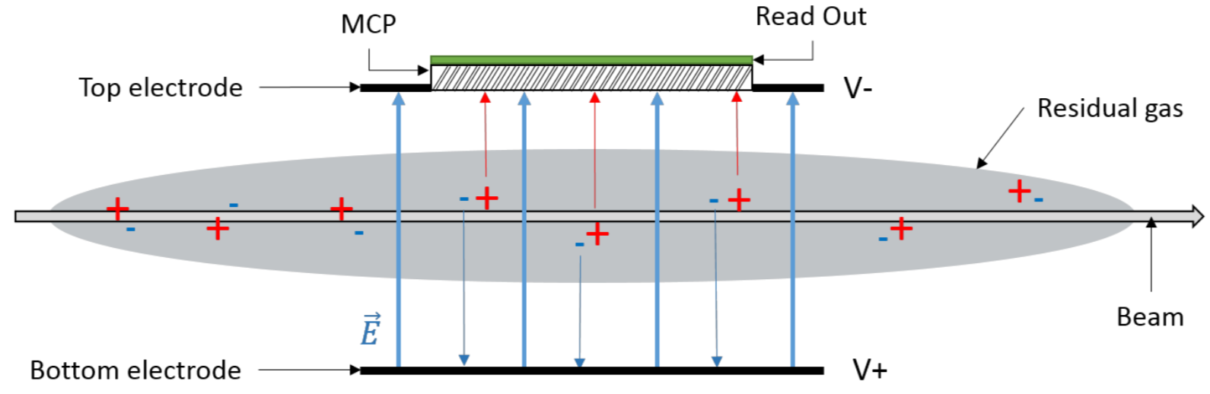
Overcome scraper limitation
Use of available recombination monitor
  Only for H-/p operation
  Still to be exploited
  How to translate information to pbar operations?
Use of Transverse Resonant Schottky Pickup to estimate emittances
  Previous attempts in AD not successful (?)
Installation of dedicate IPM
  Proposal available (e.g. EDMS #1754985)
  Impact on vacuum and beam dynamics
  still to be fully evaluated (?)
  No short term plans (?)
MCP
CO₂
E
beam
Experience with e-cooler at ELENA BE-ABP/BE-BI Joint Meeting 10th Jan 2019

Slide 13
Conclusions
2018 a very fruitful year for ELENA commissioning
  Many sub-systems (RF, BI, e-cooler) (almost) fully commissioned
  Nominal beam performance (almost) established
E-cooling is doing what it has promised
  Emittance reductions of ~80% down to ~0.5 μm (nominal ~0.3 μm)
  Results obtained with limited-empirical studies “by hand”
Could not fully profit of the H⁻/p source => being fixed
  Use of p beam envisaged for e-cooling studies (higher rep rate)
After LS2 all pbars will need to go through ELENA
  More pbar “shots” available, eventually for parasitic observations
  Hopefully, more time for well-thought, systematic measurements
Still, limited emittance-measurement capabilities
  We probably need to discuss what are the options (e.g. IPM?)
Thanks for your attention, comments and questions …

Slide 14
Backup

Slide 15
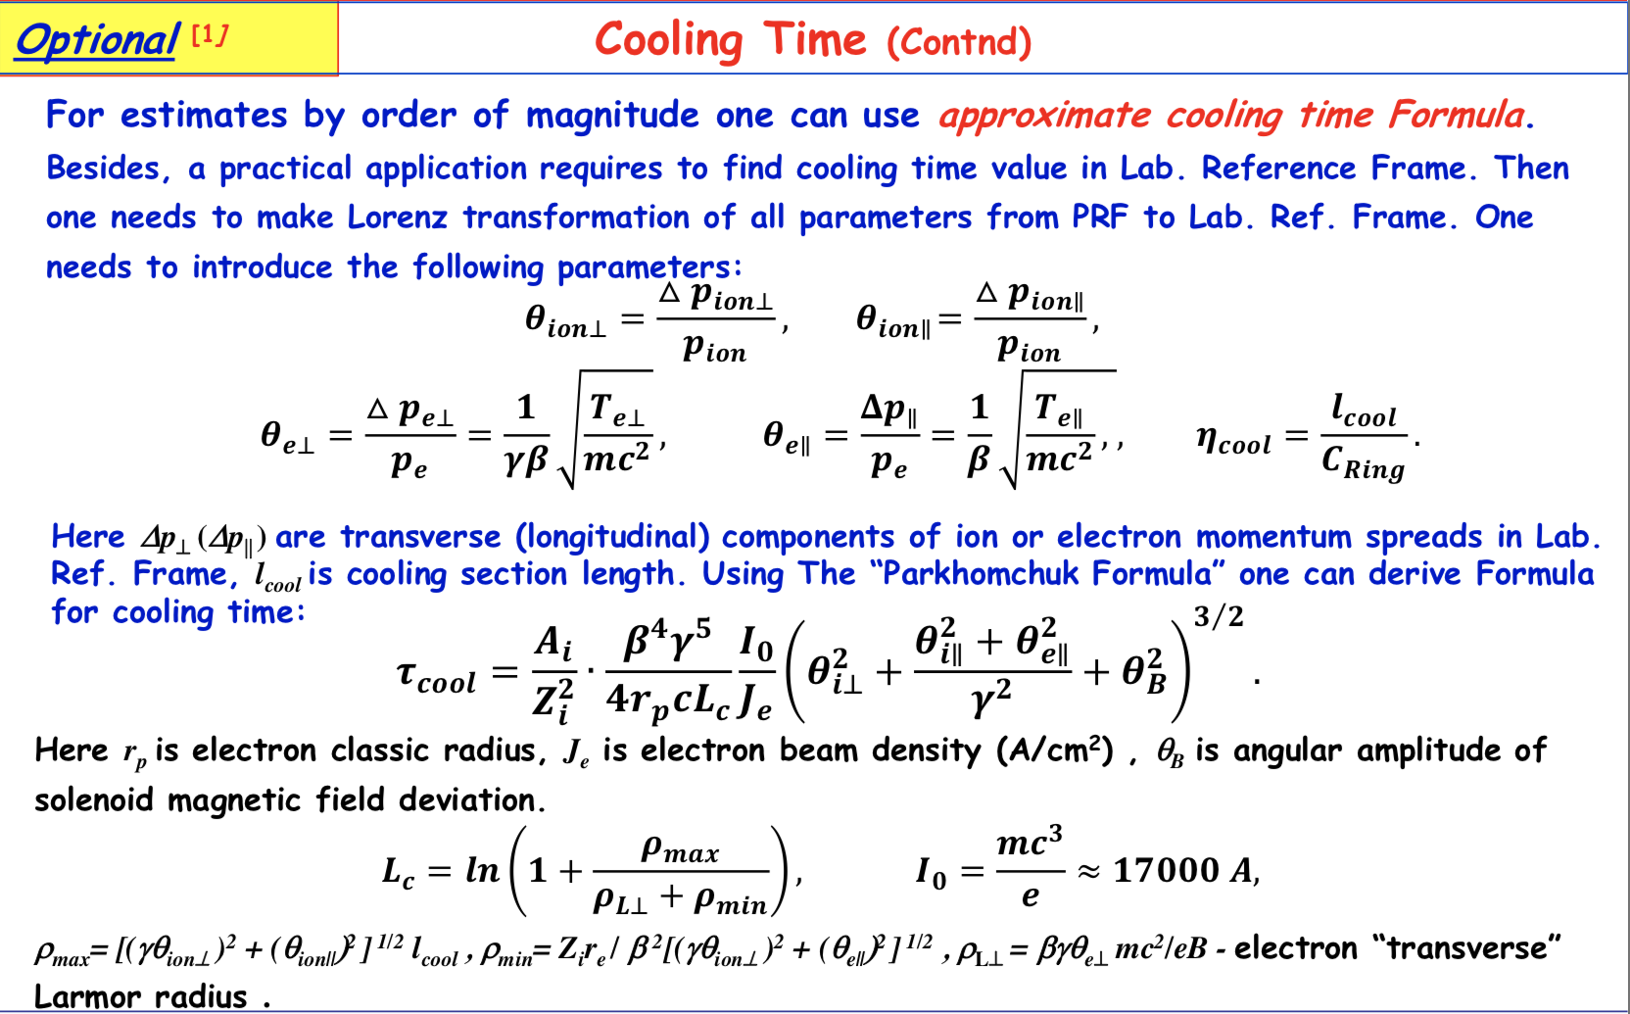
Cooling time
from: Beam Cooling Techniques – I. Meshkov (indico)

Slide 16
Some interesting slides from A.Saa Hernandez (indico):
Overview of 2018 MD studies in LEIR

Slide 17
Can we capture at a higher momentum?
Linac3 could not inject at a higher energy, so we would need to accelerate the ions without RF during the (no-longer) flat bottom by means of the Ecooler
We do indeed accelerate the ion beam
And could afterwards capture and ramp with minor modifications (adjust RF at capture and correct ramp)
revolution frequency
reduce dp/p with cooling
injection
h=101
drag ion beam
harmonic 100
Longitudinal
Schottky
h=102
h=103
h=104
time
h=105
However:
same emittance blow-up for different final momentum
Electron
Cooler

Slide 18
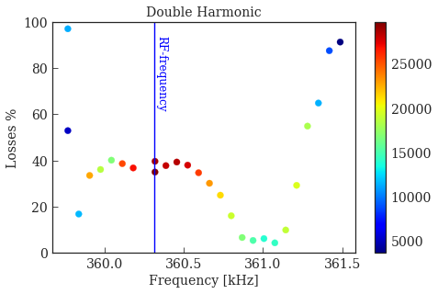
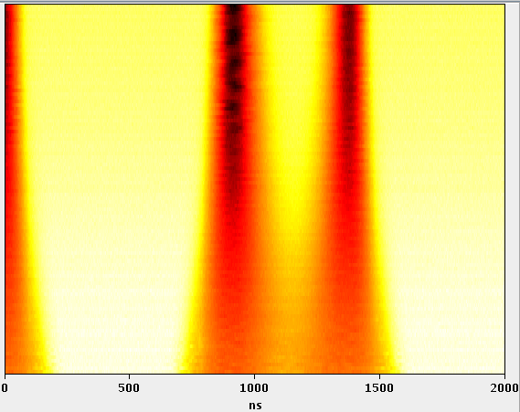
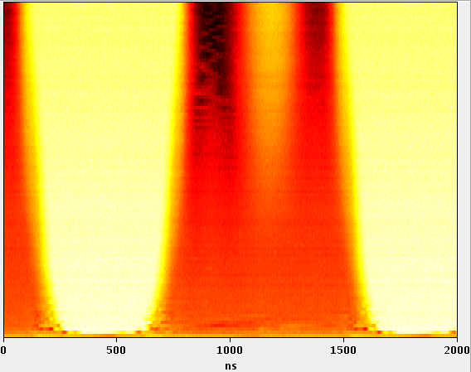
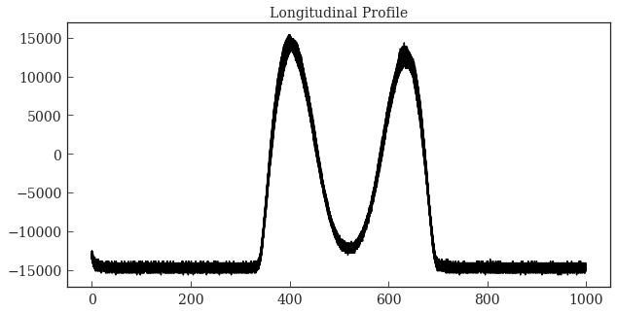
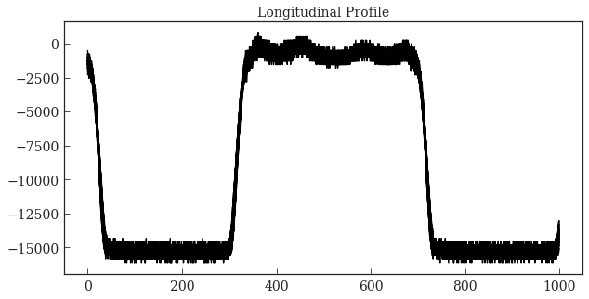
And if we cool a bunched beam?
At capture, losses and a emittance blow-up associated to SC and IBS always observed
What if we extend cooling time to after RF capture?
  Beam damped in all 3 planes
  By adjusting the electron cooler gun voltage, we drag ion beam to a frequency which has an offset with the RF frequency, creating hollow/flat distributions
h
h

Slide 19
Heating processes: dominated by IBS or Space Charge?
Similar nature: Coulomb force
IBS: particle collisions as they perform betatron and synchrotron oscillations → redistribution of momenta within the bunch → increase emittances
Space charge: derived from the E-field generated by the distribution of charged particles, creates tune shift and can excite resonance → increase emittances
What happens here?
Depends on intensity? On WP? On resonance excitation? Does it cause losses?
Simulations ongoing for both IBS and space charge, separately. Qualitative agreements found, we needed to get lots of data for further understanding

Slide 20
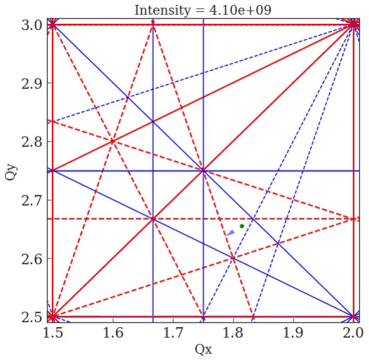

Equilibrium emittance vs Intensity vs Qy
For IBS dominated regime ε ~ I^{n} (with n ~ 0.6 for ions of Ti²²⁺, Kr³⁶⁺, Xe⁵⁴⁺, Au⁷⁹⁺, U⁹²⁺ measured at GSI)…
but then emittance blow up and losses should be similar for all tunes and we had already observed that was not the case
Look further: emittance dependence on WP, above a threshold intensity!
→ Space charge dominates for certain tunes and intensities (ongoing studies)

Slide 21
Can we compensate this resonance?
Yes, if excited by the magnetic errors, it should be possible by means of a pair of skew sextupoles with a phase advance 3ΔQ_{y} = 90◦ → Only XSF41 and XSF42 available, with 3ΔQ_{y} = 133◦
do a dynamic resonance crossing as a function of the current in the sextupoles and measure losses
Sextupole settings found that compensate losses up to 90%
when crossing the resonance dynamically
Measurements for beams with low and high intensity, compensating on flat bottom and during ramp. Studies also for static (nominal) WP.

Slide 22
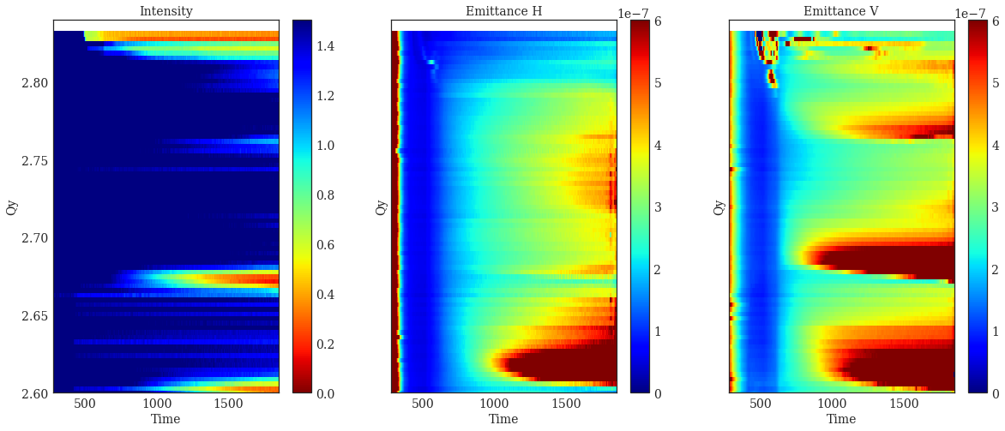
Tune Scan: compensated vs. uncompensated
1D vertical scan
cycle evolution for different Qy
Qx = 2.75
Qx = 2.66
No compensation of resonance at Qy=2.66
With compensation of resonance at Qy=2.66 using skew sextupoles

