Slide 1
Simulation of electron guns
for electron cooler
Alexander Pikin, Hannes Pahl, Adriana Rossi, Gerard Tranquille

Slide 2
Requirements:
Magnetic field on the cathode: 2.4 kGs
Cathode diameter: 25 mm
Nominal operating electron current is I_{el} =3.5 A.
Electron beam energy E_{el}=60 keV (110 MeV for protons)
The electron beam will expand in interaction region with magnetic field 600 Gs
Model:
Uniform magnetic field 2 kGs< B<3 kGs
Electron energy E_{el}=60.0 keV
Electron current range: 0.1 A < I_{e} < 5.0 A
Accelerating gap to 60 kV has width 60 mm.
The electron transverse energy was measured in the same magnetic field after acceleration in uniform magnetic and electrostatic fields at fixed electron energy of 60 keV.

Slide 3
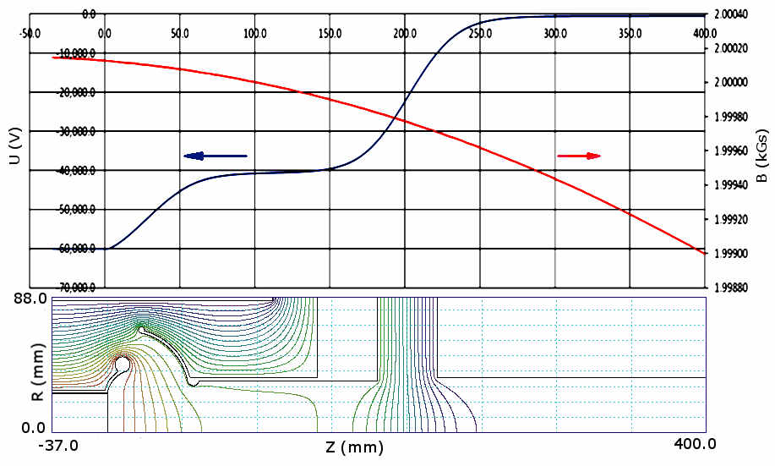
Model
Drift tube
Anode
Wehnelt electrode
Range of measurements
Cathode

Slide 4
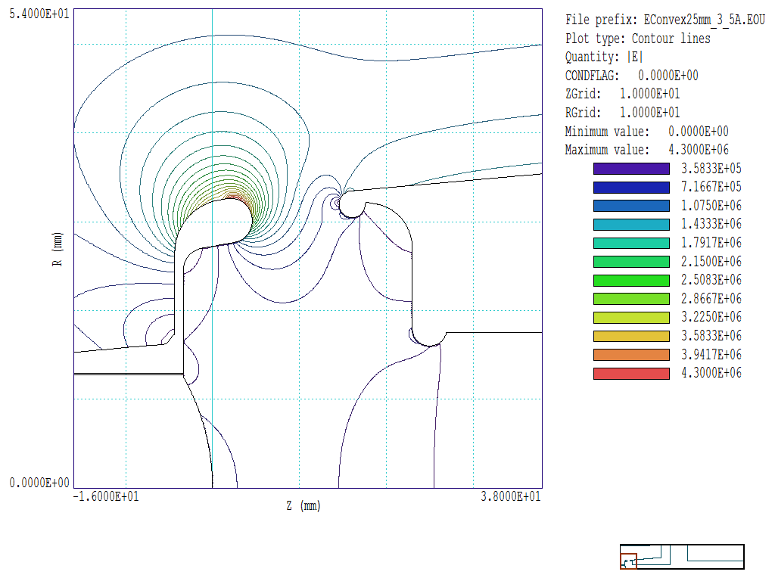
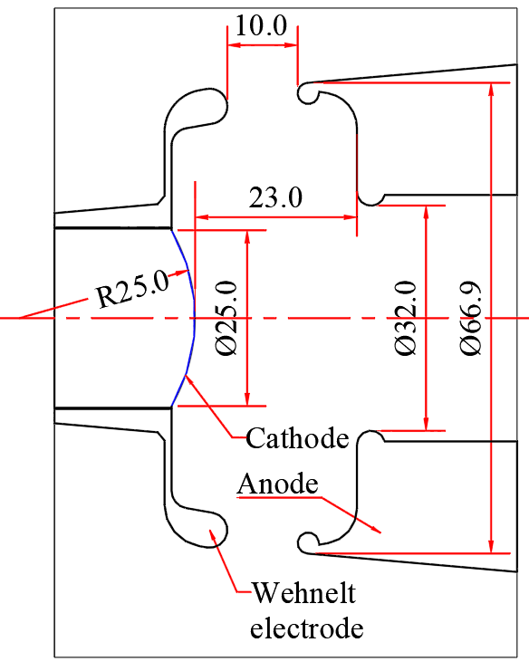
Electric field strength distribution in the cathode-anode gap of electron gun with convex cathode for electron current I_{el}=3.5 A and anode voltage U_{an} 11.25 kV
1. Convex cathode with flat electrodes:
Geometry of the gun:
Perveance = 2.93 A/V^{1.5}
Kilpatrick safety factor (3.5 A and 11.2 kV) =4.54

Slide 5
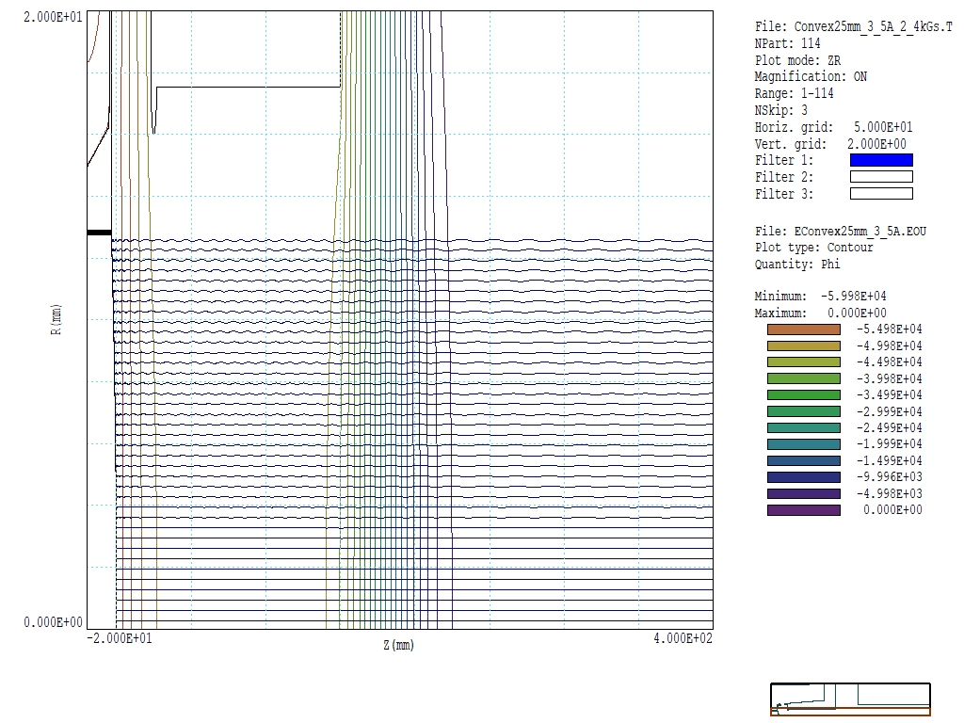
Electron trajectories in uniform magnetic field B=2.4 kGs from electron gun with convex cathode.
I_{el}=3.5 A, U_{an}=11254 V, E_{final}=60 keV.

Slide 6
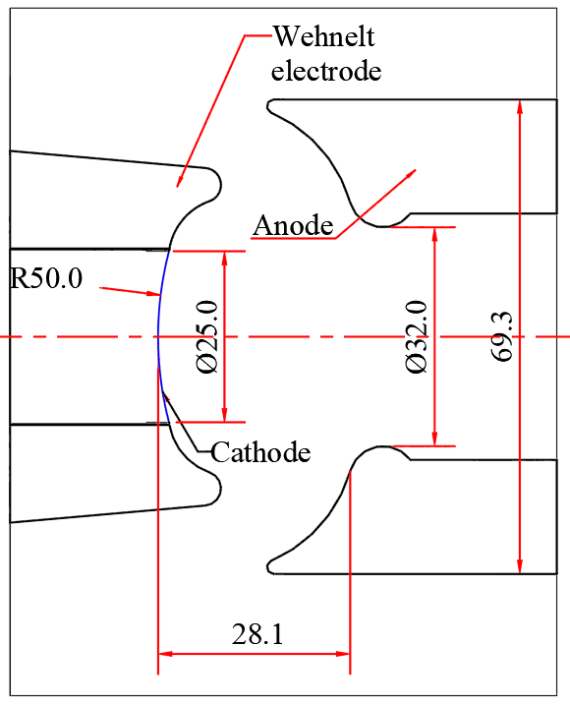
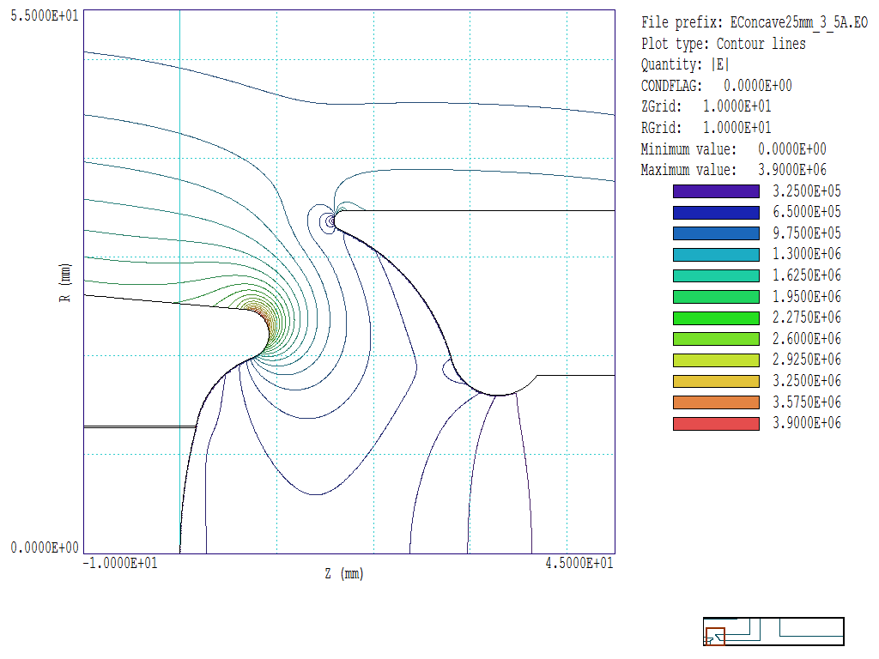
2. Concave cathode
Electric field strength distribution in the cathode-anode gap of electron gun with concave cathode for electron current I_{el}=3.5 A and anode voltage 11.25 kV
Geometry of the gun:
Perveance = 1.38E6 A/V^{1.5}
Kilpatrick safety factor (I_{el}=3.5 A and U_{an} =18.6 kV) = 4.22

Slide 7

Electron trajectories in uniform magnetic field B=2.4 kGs from electron gun with concave cathode.
I_{el}=3.5 A, U_{an}=18605 V, E_{final}=60 keV.

Slide 8
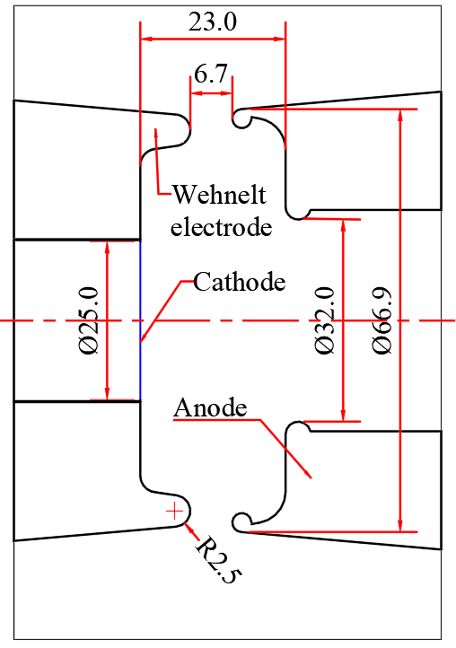
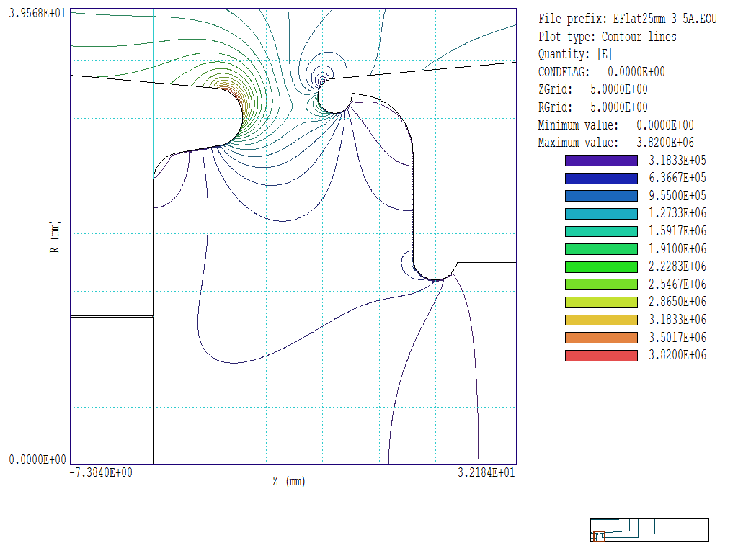
3. Flat cathode and flat electrodes
Electric field strength distribution in the cathode-anode gap of electron gun with flat cathode for electron current I_{el}=3.5 A and anode voltage 12.15 kV
Geometry of the gun:
Perveance = 2.613E6 A/V^{1.5}
Kilpatrick safety factor (I_{el}=3.5 A and U_{an} =12.15 kV) = 4.98

Slide 9

Electron trajectories from electron gun with flat cathode (R_{sph}=25 mm) in uniform magnetic field 2.4 kGs for electron current I_{el}= 3.5 A, and final energy E_{el}=60 keV

Slide 10
Comparison of electron guns with different geometry with fixed electron current

Slide 13
Comparison of the transverse electron energy for the gun with concave cathode for two different accelerating gaps: 40 mm and 60 mm.

Slide 14

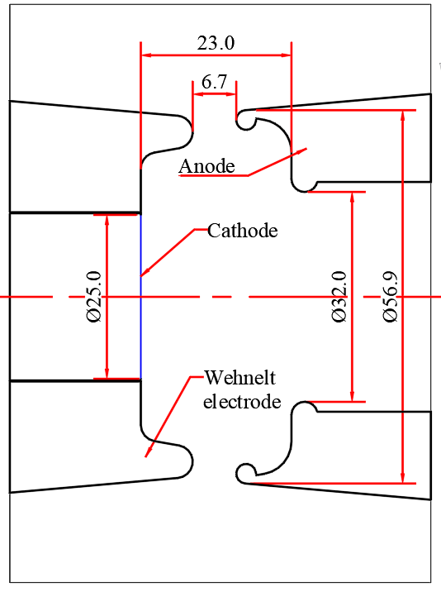
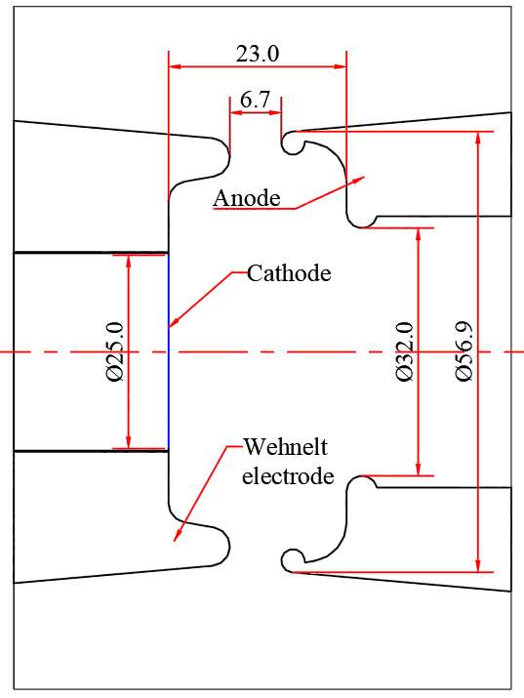
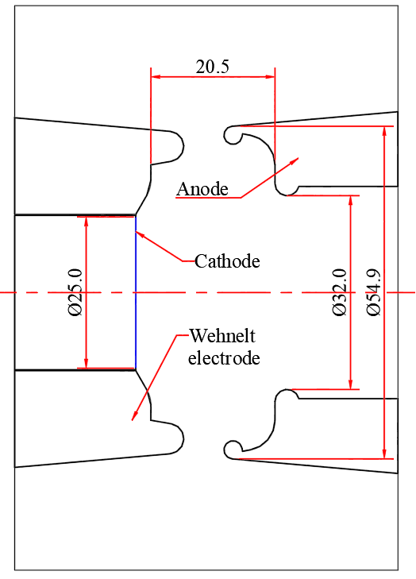
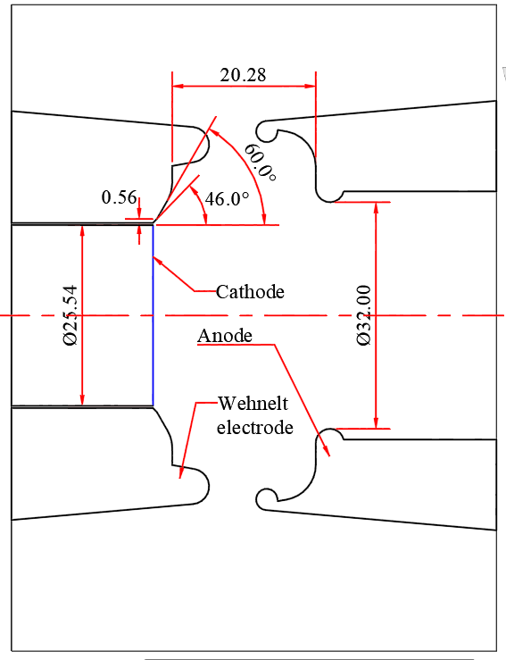
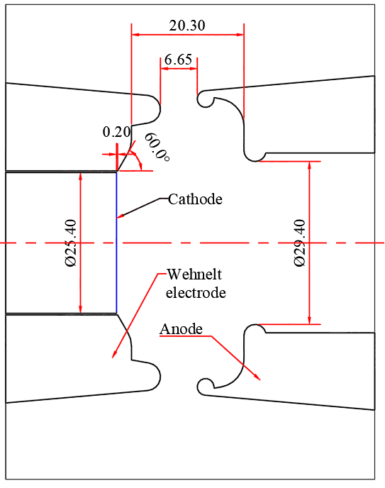
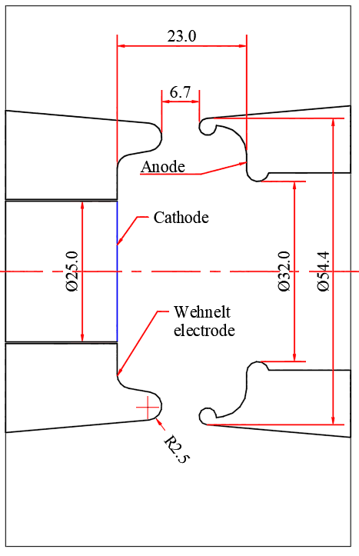
7 geometries of gun with flat cathode and flat electrodes has been tested:
1
2
3
4
5
6
7

Slide 15
Performance comparison of electron guns with flat cathodes and different geometries with current 3.5 A

Slide 16
Similar:
Flat cathode + flat electrodes, Version 7- effect of control electrode negative bias: effect and price.

Slide 17
Simulated maximum electron beam temperature for special regimes 0.1 A and 3 keV) and (2.5 A and 27 keV):

Slide 18
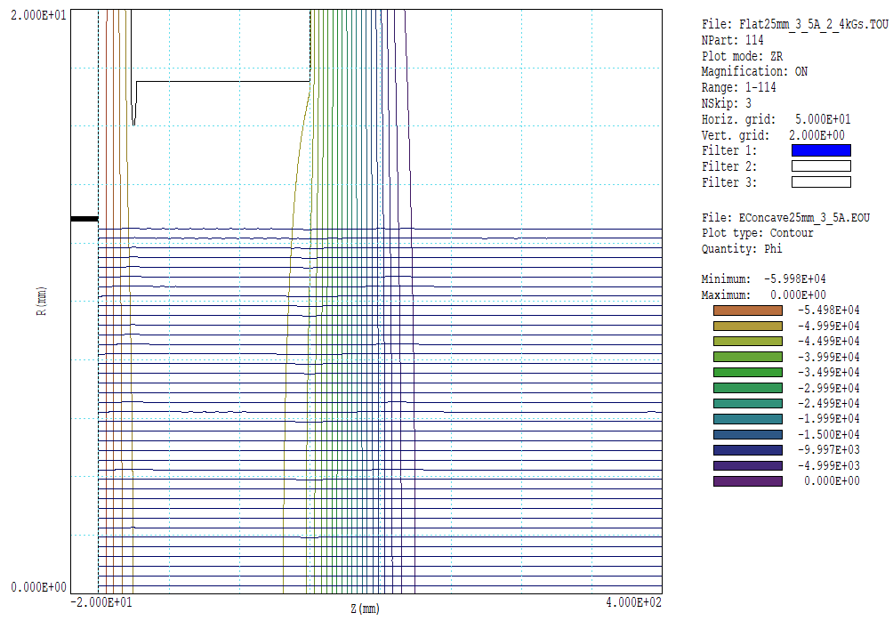
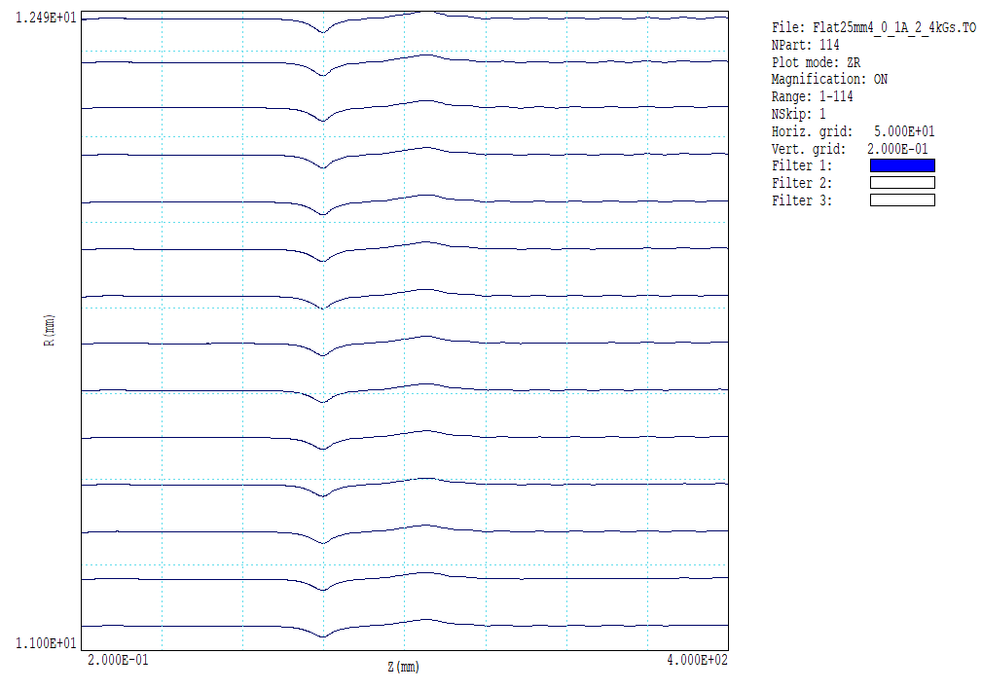
Electron trajectories for gun with flat electrodes (Version 1) at I_{el} =3.5 A

Slide 19
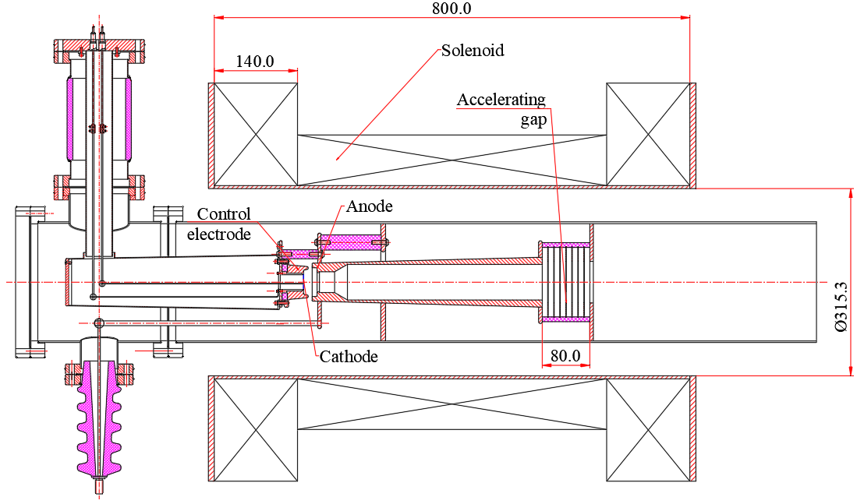
Schematic design of the cooler gun side version with open side flange:

Slide 20
Axial magnetic field distribution of the gun solenoid: L=800 mm, ID=315 mm
Pancake structure of coils
Conductor: 6.35x6.35 mm, water channel 3.5 mm
For 2.4 kGs I=120 A, U=160 V,
Power consumption approx. 20 kWatt
Water consumption: 16 L/min,
Water pressure approx. 0.3 Bar,
Water temperature rise 20⁰

Slide 21
Conclusion:
Out of three simulated electron gun geometries the electron gun with flat cathode and flat electrodes provides the smallest transverse electron energy in all tested ranges of the electron current (0.1-5.0 A) and magnetic field (2.0 – 3.0 kGs). The convex electron gun has the largest perveance and the most uniform distribution of the electron current density across the beam. The electron guns with concave and flat cathodes have some elevation of the current density on the periphery.
Electrostatically all gun geometries are spark-safe for the anode voltage holdoff: at 3.5 A the Kilpatrick safety factor is larger than 3.9 for all guns.
The pattern of minima and maxima of the transverse energy as a function of the magnetic field depends on the accelerating gap: it can move with varying the gap.
Of all tested concepts the lowest transverse energy provides electron gun with flat cathode and flat electrodes. It is easy and safe to control the emission density distribution on the cathode by changing the Wehnelt bias.
For different geometries of guns with flat cathode the transvers energy variations as a function of the magnetic field for a fixed electron current stay within the same “corridor”. Analysis of different gun geometries with flat cathode and flat electrodes demonstrated that with small variations of transverse energy these guns generate beams with different radial distribution of current density depending on the shape of the Wehnelt electrode.
With electron current I00 mA and the beam energy of 3 keV the transverse electron energy remains lower than 1 eV up to magnetic field of 300 Gs.

