Slide 1
Status and ideas for primary beam instrumentation
Kick-off meeting EABI-WG
29-Nov-2018
F.Roncarolo BE-BI

Slide 2
Introduction
This WG mandate implies addressing the present status, needs and plans for the instrumentation monitoring the primary beams upstream of the targets/experiments
  PS -> EAST area (most instrumentation included/affected by LS2 E.A. CONS)
  PS -> AD (not covered at all by me today…)
  SPS to North Area
  Future SPS for physics beyond colliders
Today:
  List PS → EA diagnostics (for reference) and mention few issues/plans
  List SPS → NA diagnostics and give status + short summary of last two years discussions /requests

Slide 3
PS → E.A. Primary beam diagnostics (I)
BCGAA ( aka LSD)
  Spill longitudinal structure
  Very old. Maintenance/optimization tricky
  2018 issues:
    old amplifier, replaced in summer → better sensitivity
    50 Hz noise under study
  displaced in LS2 (EA cons) , will change HV PS, study 50 Hz noise
Secondary Emission Chambers
  XSEC: metal foils + bias/collecting electrodes
  XION: metal foils in tank filled with gas, for ion beams
F61.BCTF023 used for XSEC calib
Cherenkov Counters

Slide 4
PS → E.A. Primary beam diagnostics (II)
BCSAA (aka Telescope XTEL)
  Scintillator + PMT
  Placed above targets. Intensity of secondaries backscattered from the target proportional to primary beam intensity
BTVs
  Old ‘marguerites’ replaced with ‘standard’ BTV systems, ‘chromox’ screens
Scintillating fiber monitors (XBPF)
  New generation of detectors
  For profile, position, intensity
  Replacing gaseous wire chambers (XDWC)
BLMs
  Request for BLMs along primary lines (F61, F62, T08) ongoing. Func. Specs being clarified (e.g. interlock or not)
  Deployment not possible during LS2
  Would be good to pull cables

Slide 5
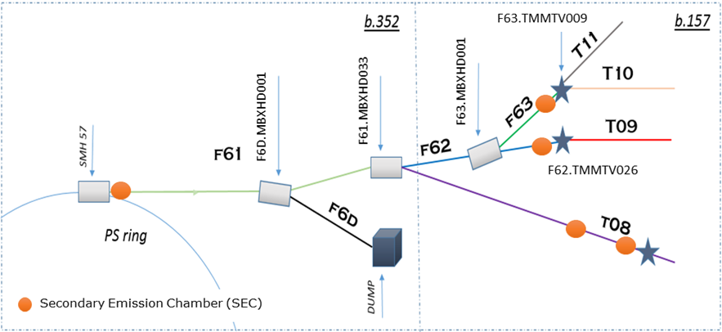
PS -> EAST Area - XSEC
Cross calibrated to FBCT
After LS2 layout

Slide 6
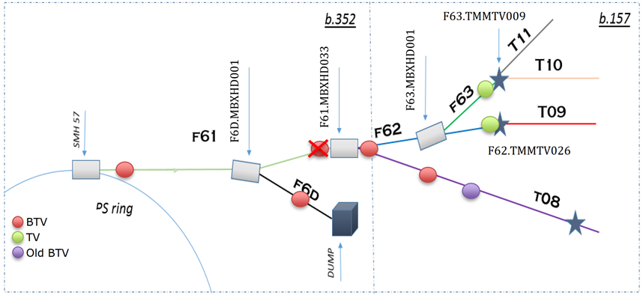
E.A. - BTV after LS2

Slide 7
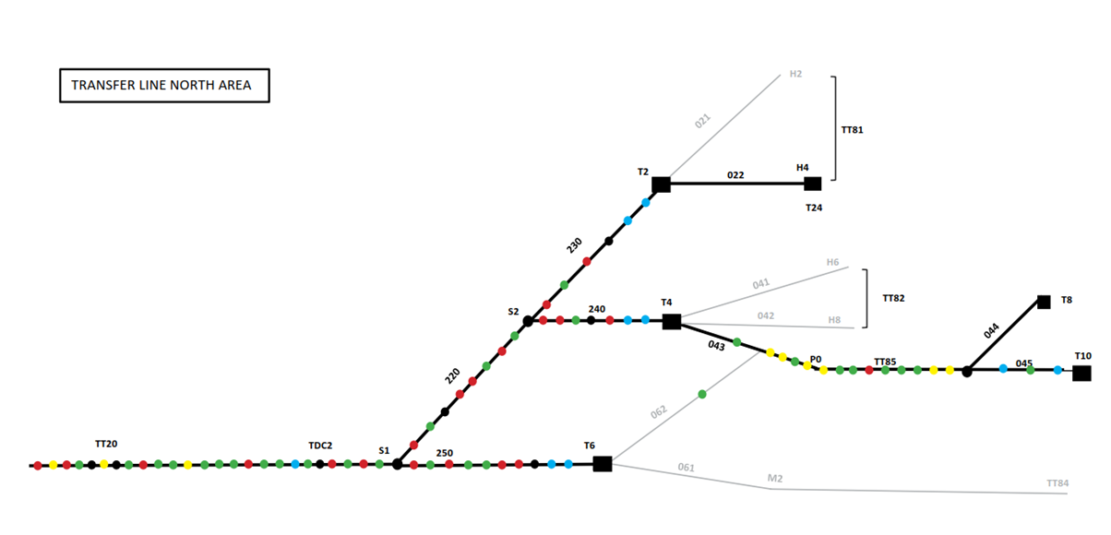
SPS → N.A. Primary beam diagnostics
Each dot is an instrument or a diagnostics box with more than 1 instrument…

Slide 8
SPS → N.A. Primary beam diagnostics (SEM)
Un-bunched beam (no ‘classical BCTs’ / BPMs suitable)
Various types of Secondary Emission Monitors (SEM) as only tool so far BSG : grid with typically 16 strips (width 0.5-2.5 mm).
  BSP : 2 (1/2) foils to measure the position (compare Left/Right resp Top/Bottom foil signals).
  BSM : same as BSP, but on a step motor.
  BBS : thin movable strip (0.2 mm) to scan across the beam.
  BSI : a single foil to measure beam intensity.

Slide 9
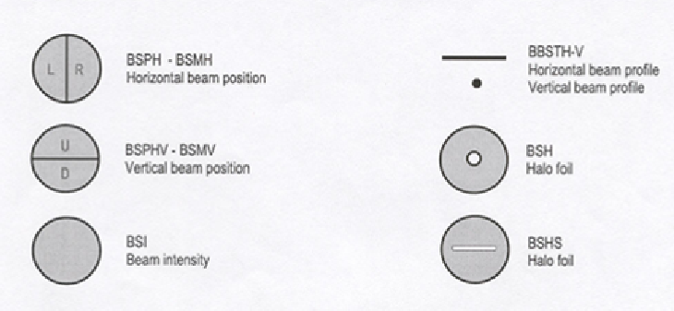
SPS N.A. SEM types
Steering is performed with BSPs and BSGs.
Profiles are obtained with BSGs and BBSs (extraction channel & targets).

Slide 10
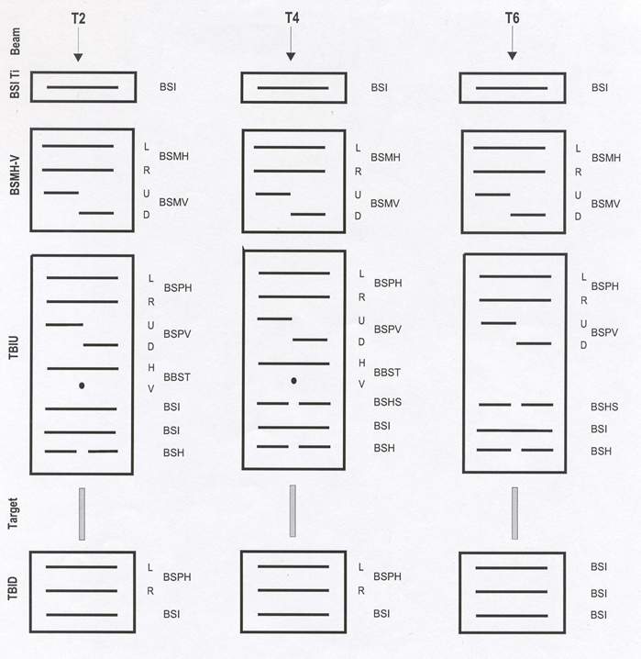
SPS N.A. target ‘boxes’
High activation
Spares available

Slide 11
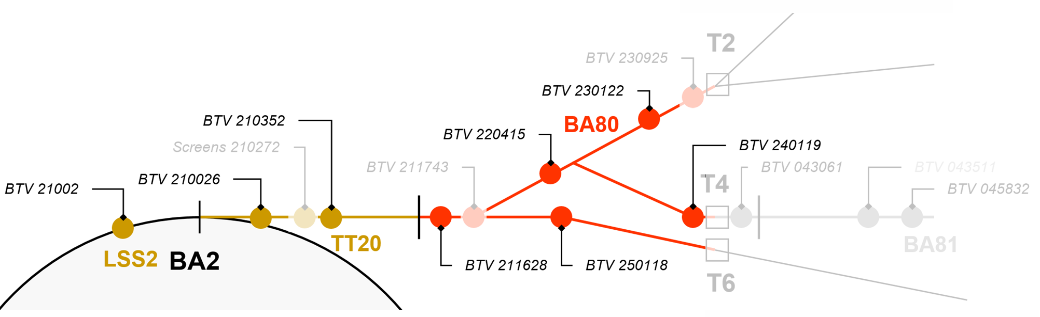
N.A. BTVs
LSS2 (BA2) BTVs renovated during LS1
TT20 (BA80) renovation postponed to LS2

Slide 12
SPS - N.A. issues/plans
New SEM electronics (CONS) featuring integrator mode (like today) and spill sampling at least partially implemented in LS2
Ageing is a concern for both SEM and BTV systems
  This includes cables ageing and radiation damage
  For LS2 hard to negotiate a partial cable refurbishment in TT20
Various meetings/discussions in the last two years about
  issues with present diagnostics and need for new monitors
  New requests for Physics Beyond Colliders (e.g. BDF, SHiP)
    E.G. Issues/plans, discussed in SLAWG (a dedicated one on Nov 2016 …) and BI TB
Could not check the status of the various open points for today
  next slides == my present understanding (+ potential for agendas of this WG ?)

Slide 13
SPS -- N.A. diagnostics issues/discussions
1
BSI calibration for absolute P.O.T.
  SEY dependence on vacuum history/conditioning and dose
Steering via BSPs tricky, inaccurate (e.g. when beam not Gaussian, when beam only on half plate, optimization not possible)
  Grids would be better
BI EXPERTS:
M.Duraffourg , F.Roncarolo et. al

Slide 14
SPS -- N.A. diagnostics issues/discussions
2
Precision BPMs in LSS2 during spill (de-bunched)... interesting candidates discussed such as BGI and BSRT
Screens (or pixel detectors) (at ZS??) with high dynamic range to replace the mini-scanners, to get better resolution and acquisition in only one shot.
BI EXPERTS:
J.Story, G.Trad, E.Bravin, S.Burger et al.

Slide 15
SPS -- N.A. diagnostics issues/discussions
3
Dedicated fast detector in TT20 for monitoring spill quality up to 200 MHz
  Some work-discussion on-going, need feedback (servo-spill) or only monitoring?
BI EXPERTS:
E.Effinger, C.Zamantzas, M.Duraffourg et al.

Slide 16
SPS -- N.A. diagnostics issues/discussions
4
Fast interlocking on BLMs in the LSS2 extraction region (diamonds installed, not interlocked)
2 LHC type BLMs in BA2 before and after diffuser
BLMs at all TT20 quads → 6 BLMs installed, SPS type
Lots of MDs in 2018, F.Velotti et al.
Existing TDC2 BLMs with old cables (failure in 2018). Can’t touch cables during LS2. Will install new cables in LS2 and have old and new in parallel
BI EXPERTS:
E.Effinger, C.Zamantzas,

Slide 17
SPS -- N.A. diagnostics issues/discussions
5
Non-interceptive intensity measurements in TT20 (DC-BCT) with < % level calibration accuracy... CCC-type devices discussed.
SPS ring before extraction: Beam momentum spread measurements: bunch length measurements on a turn-by-turn basis: hardware is available, software missing, it should be tested in MDs whether tomography is possible within a reasonable time.
BI EXPERTS:
J.Tan, P.Odier, M.Wendt et al.

Slide 18
Conclusion – Outlook
Concerning primary beams diagnostics:
Anything missing w.r.t. what you expected today? AD? nTOF?
What are the main subjects/systems than can/should be addressed by this W.G. ?
How should we prioritize?

Slide 19
SPARES

Slide 20
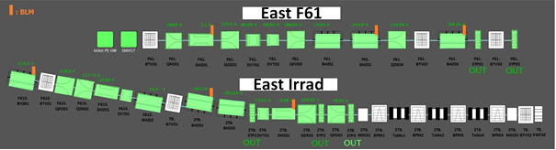

Slide 21
