Slide 1
Longitudinal stability measurements with different rf cavity configurations
s
LIU-PS Beam Dynamics Working Group
23/11/2018
A. Lasheen, H. Damerau
Acknowledgements: G. Favia

Slide 2
Outline
Introduction
Identification of guilty impedance sources from the impedance model
Measurements of quadrupolar instability for different rf cavity configurations
Conclusions

Slide 3
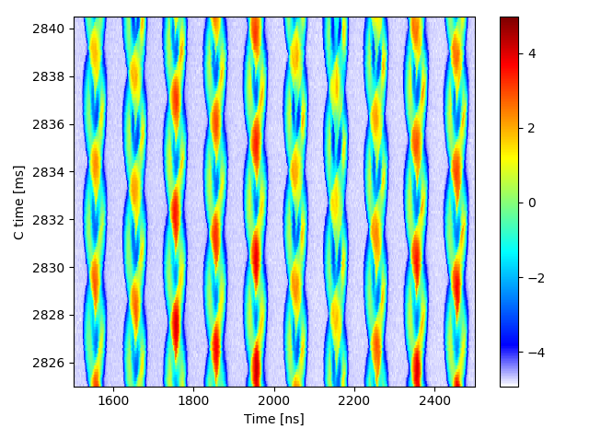
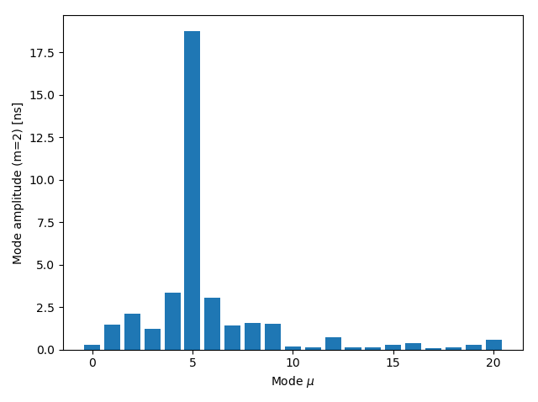
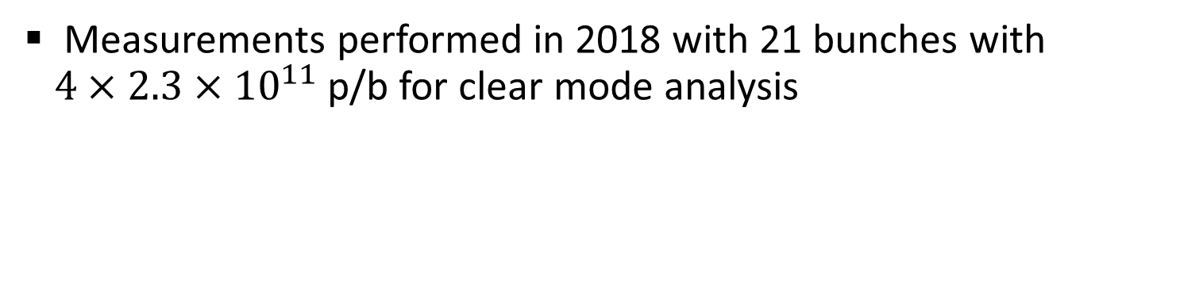
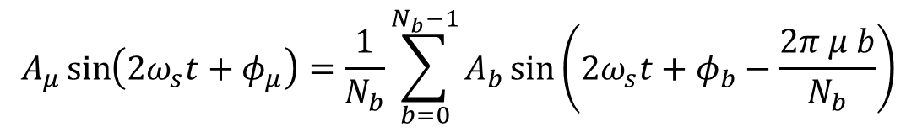
Quadrupolar coupled bunch instability with 21b
Measurements performed in 2018 with 21 bunches with
$4×2.3×{10}^{11}$ p/b for clear mode analysis
$$A_{μ}\sin\left(2ω_{s}t+φ_{μ}\right)=\frac{1}{N_{b}}\sum_{b=0}^{N_{b}−1}{A_{b}\sin\left(2ω_{s}t+φ_{b}−\frac{2π μ b}{N_{b}}\right)}$$

Slide 4
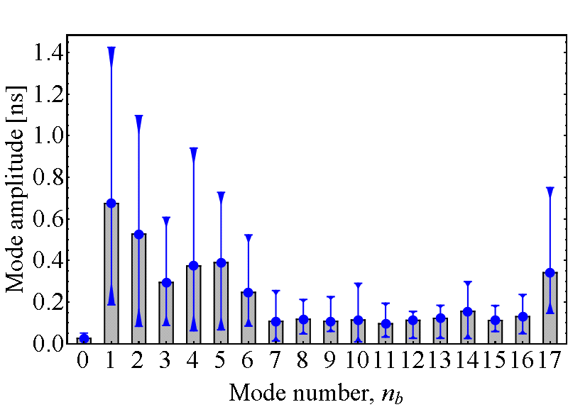
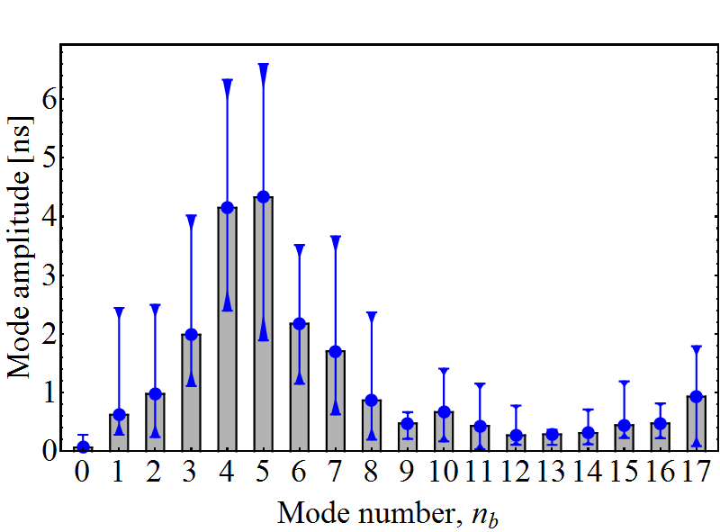
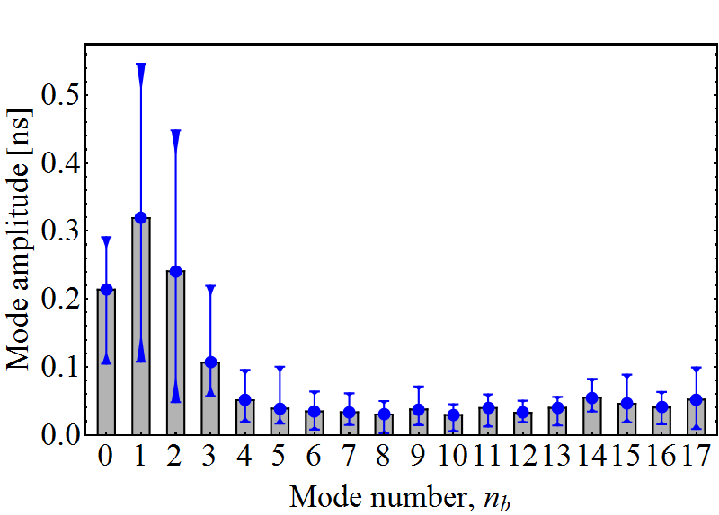
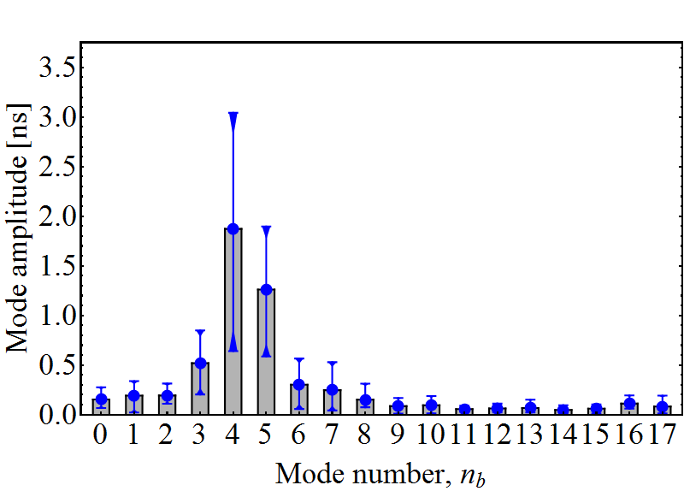
Mode pattern – previous years
 | Acceleration | Flat-top
Dipole (2013/2016 data)
Quadrupole (2017 data)
Measurements of coupled-mode spectra with 18 bunches reproducible over years
Mode pattern changes when arriving to top energy

Slide 5
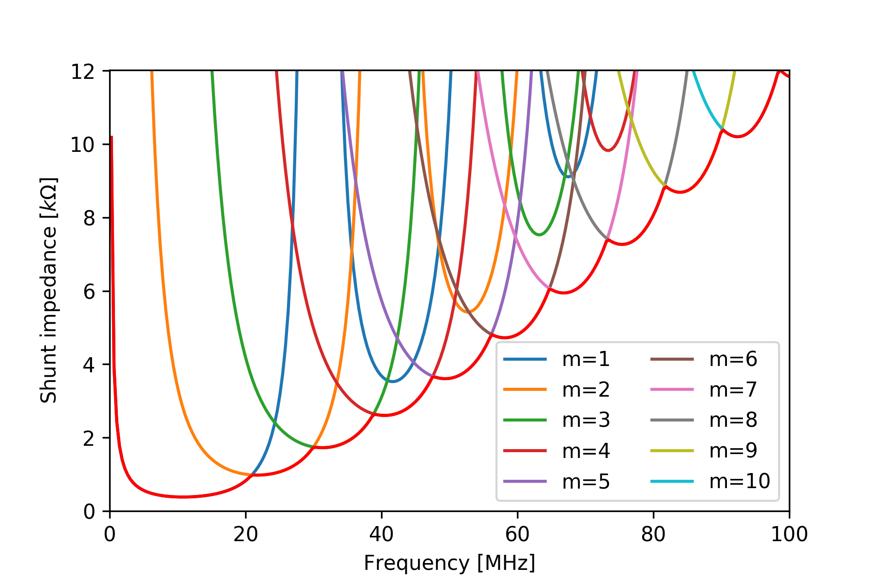
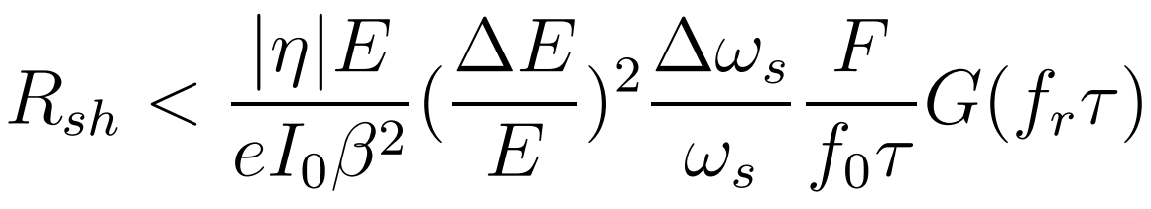


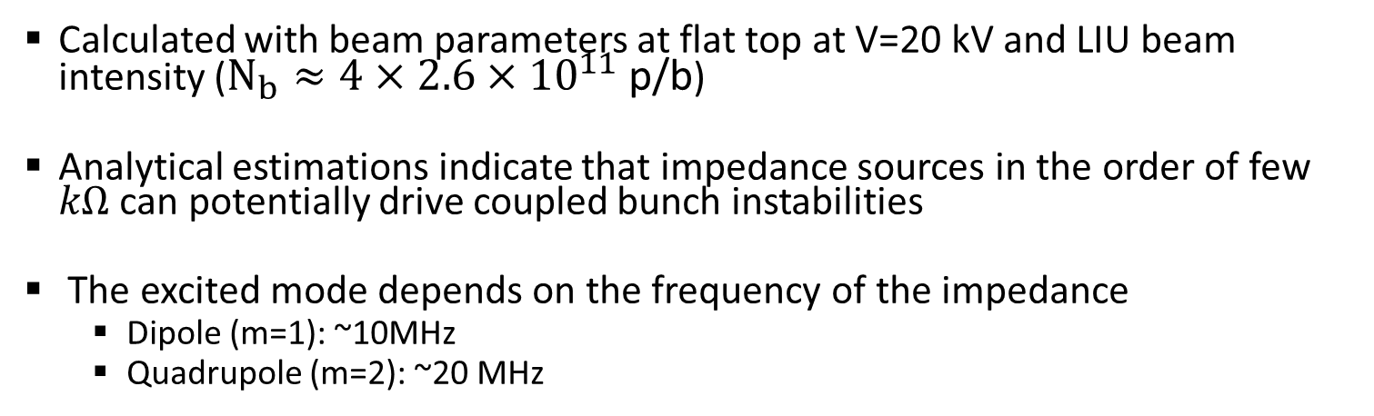
Shunt impedance for coupled-bunch instability
Coupled bunch instability threshold (narrow-band impedance source)
E. Shaposhnikova,
http://cds.cern.ch/record/691957/
Calculated with beam parameters at flat top at V=20 kV and LIU beam intensity ($N_{b}≈4×2.6×{10}^{11}$ p/b)
Analytical estimations indicate that impedance sources in the order of few $kΩ$ can potentially drive coupled bunch instabilities
The excited mode depends on the frequency of the impedance
  Dipole (m=1): ~10MHz
  Quadrupole (m=2): ~20 MHz

Slide 6
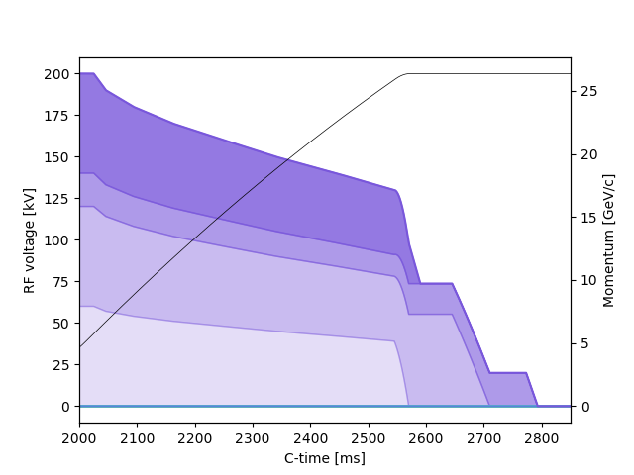
10 MHz cavities RF program (h=21)
(V group) Closure of gap relay
(H group) Parking
V group, H group | 10 MHz cavities
3, A | C10-36, C10-46, C10-51
2, B | C10-56, C10-66, C10-76
1, B | C10-81
4, C | C10-86, C10-91, C10-96
Spare | C10-11 (always closed)
(4)
(C)
(3)
(2)
(1)
(A)
(B)
At arrival to flat-top, the rf voltage is reduced and cavity gaps are short-circuited by gap relays to minimize the induced voltage.
The impedance of the 10 MHz cavities short circuited is small, but not 0
Longitudinal emittance is measured at C=2595 ms and coupled bunch instabilities are measured at C=2825, with the splittings disabled and rf voltage kept to 20 kV using only C10-81.

Slide 7
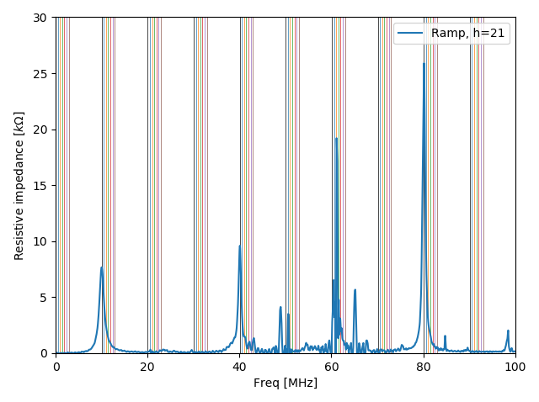
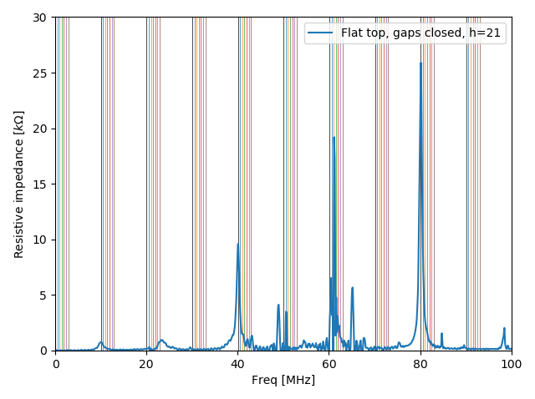
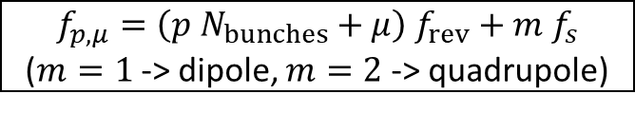
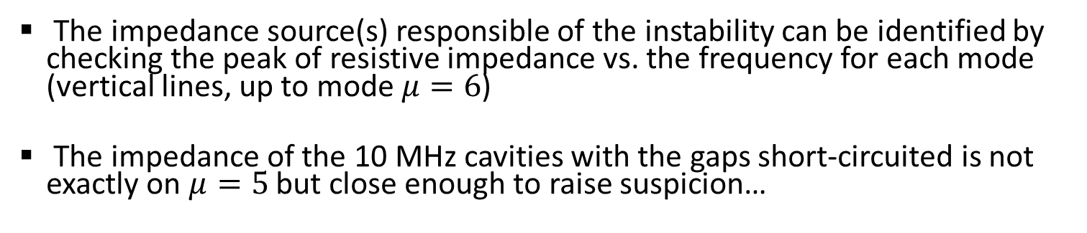
Impedance and coupled-bunch modes
Kicker resonance to be checked…
Impedance gap relay closed *
$f_{p,μ}=\left(p N_{bunches}+μ\right) f_{rev}+m f_{s}$
($m=1$ -> dipole, $m=2$ -> quadrupole)
* G. Favia, based on C10-11 measurements, https://cds.cern.ch/record/2286835/
The impedance source(s) responsible of the instability can be identified by checking the peak of resistive impedance vs. the frequency for each mode (vertical lines, up to mode $μ=6$)
The impedance of the 10 MHz cavities with the gaps short-circuited is not exactly on $μ=5$ but close enough to raise suspicion…

Slide 8
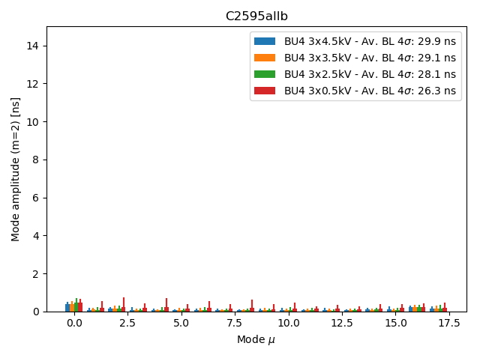
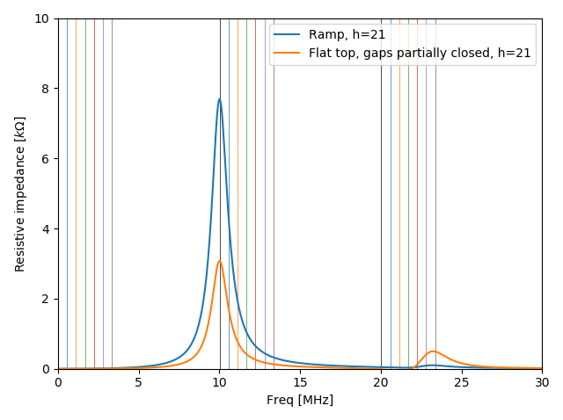
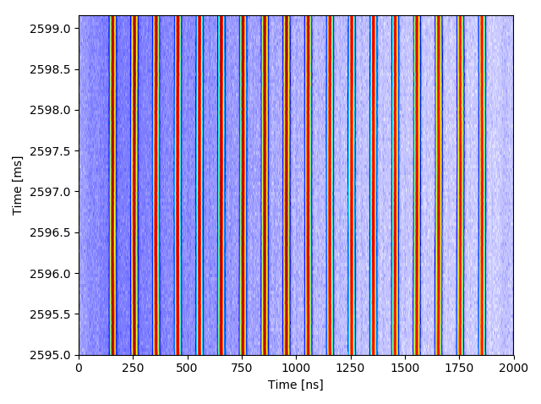
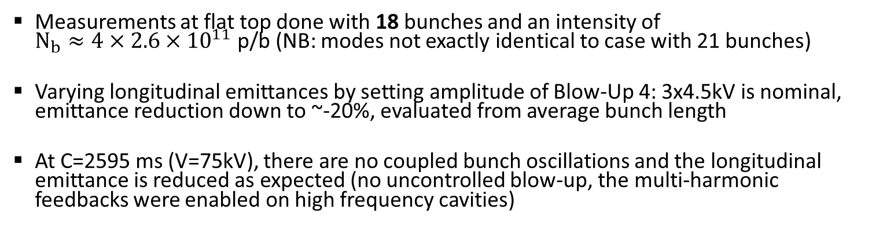
Normal operation at C=2595 ms
Measurements at flat top done with 18 bunches and an intensity of
$N_{b}≈4×2.6×{10}^{11}$ p/b (NB: modes not exactly identical to case with 21 bunches)
Varying longitudinal emittances by setting amplitude of Blow-Up 4: 3x4.5kV is nominal, emittance reduction down to ~-20%, evaluated from average bunch length
At C=2595 ms (V=75kV), there are no coupled bunch oscillations and the longitudinal emittance is reduced as expected (no uncontrolled blow-up, the multi-harmonic feedbacks were enabled on high frequency cavities)

Slide 9
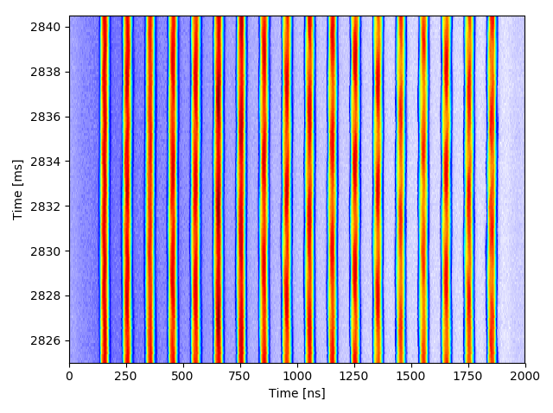
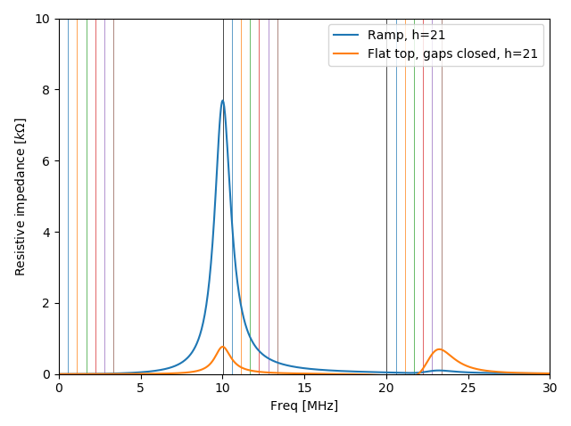
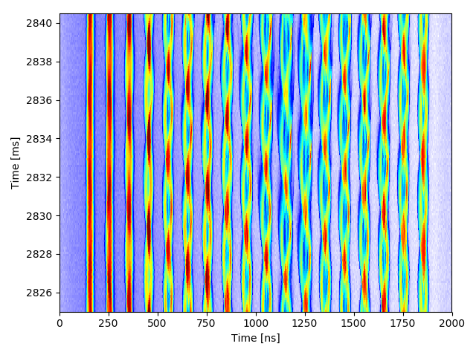
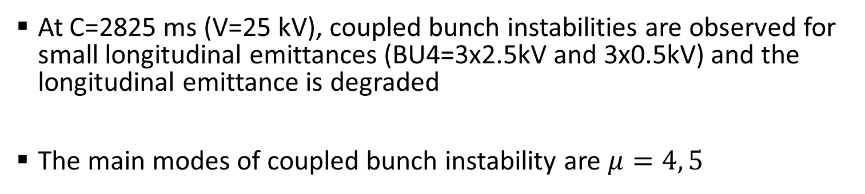
Normal operation at C=2825 ms
Longitudinal emittance
-20%
At C=2825 ms (V=25 kV), coupled bunch instabilities are observed for small longitudinal emittances (BU4=3x2.5kV and 3x0.5kV) and the longitudinal emittance is degraded
The main modes of coupled bunch instability are $μ=4, 5$

Slide 10
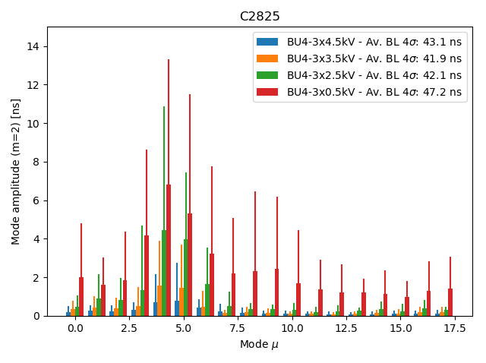
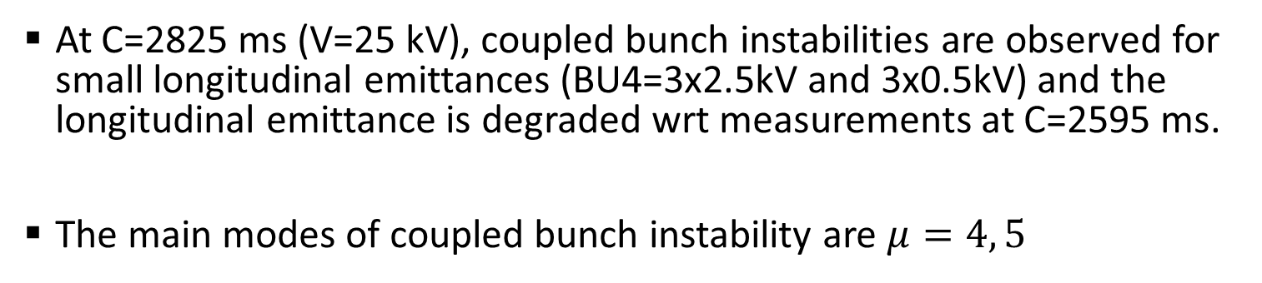
Normal operation at C=2825 ms
Errorbars: max of 10 shots
At C=2825 ms (V=25 kV), coupled bunch instabilities are observed for small longitudinal emittances (BU4=3x2.5kV and 3x0.5kV) and the longitudinal emittance is degraded wrt measurements at C=2595 ms.
The main modes of coupled bunch instability are $μ=4, 5$

Slide 11
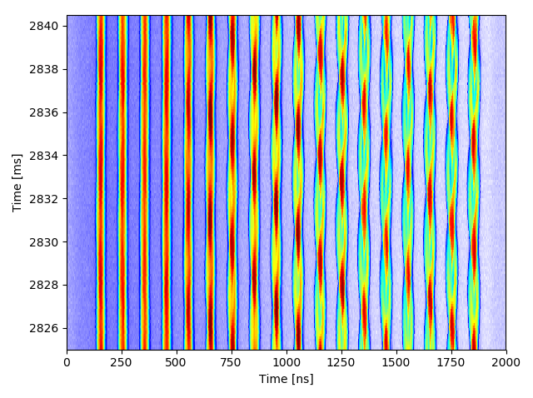
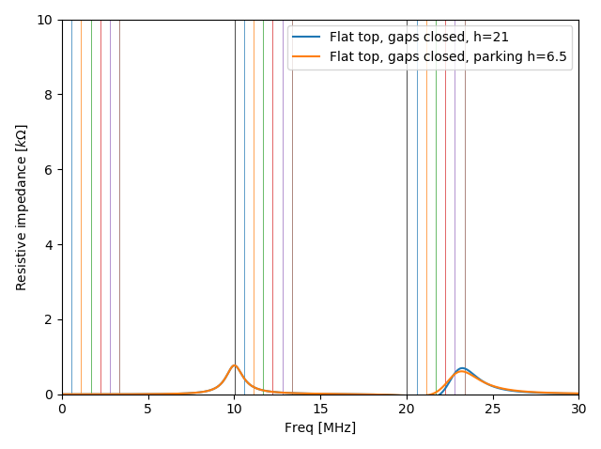
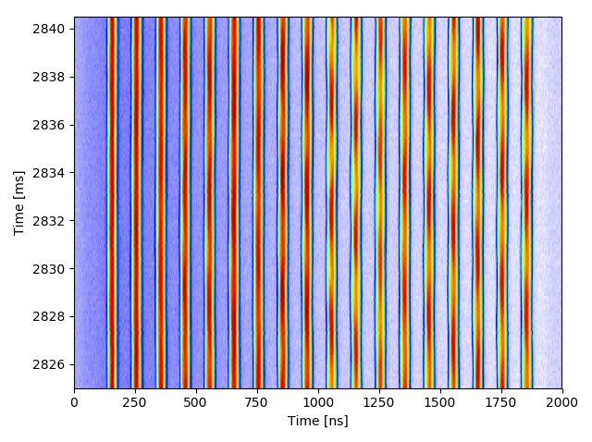
Parking short-circuited cavities at C=2825 ms
Parking
The 10 MHz cavities can be “parked” by tuning the cavity at the low harmonic h=6.5
The tuning of the cavity is dominated by the gap relay and the frequency of the short-circuited cavities does not change. The shunt impedance is slightly reduced.
The gain is small but visible especially for small emittance (BU4=3x3.5kV)

Slide 12
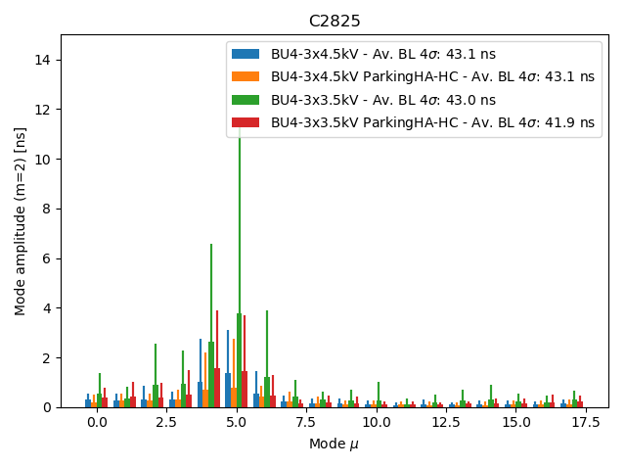
Parking short-circuited cavities at C=2825 ms
Errorbars: max of 10 shots
The 10 MHz cavities can be “parked” by tuning the cavity at the low harmonic h=6.5
The tuning of the cavity is dominated by the gap relay and the frequency of the short-circuited cavities does not change. The shunt impedance is slightly reduced.
The gain is small but visible especially for small emittance (BU4=3x3.5kV)

Slide 13
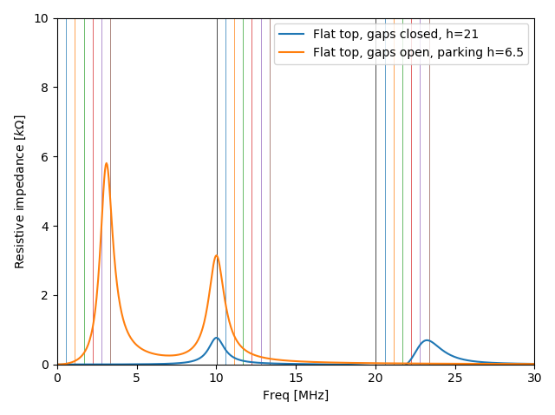
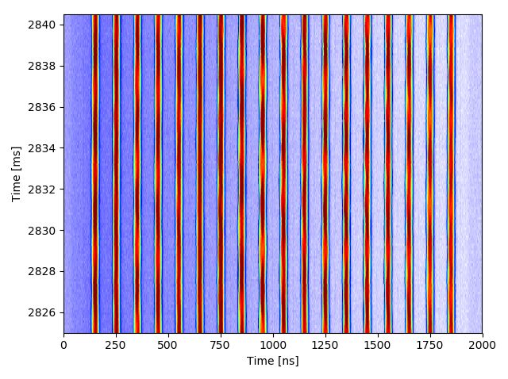
Parking and open gap relay at C=2825 ms
NB: smallest long. emittance
See Slide 5, the impedance may be in the very low frequency region, where coupled-bunch instability threshold m=1 increase a lot
Parking + open gap
The gap relay of the unused cavities can be left open (right gap, left gap, or both) while parking to tune the cavities at low frequency
The impedance is large, but in a frequency region far from the one expected for quadrupolar instability (~20 MHz).
NB: dipolar instability still damped by the coupled bunch feedback

Slide 14
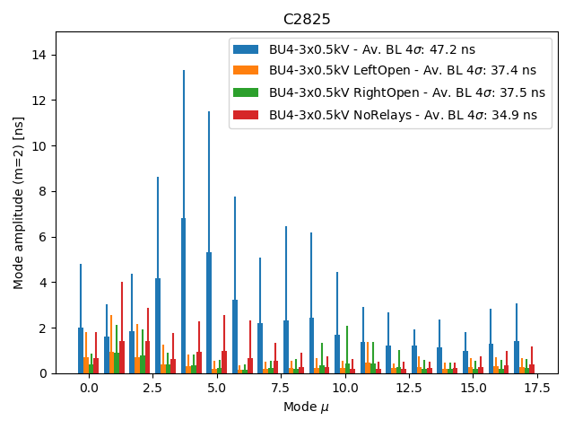
Parking and open gap relay at C=2825 ms
Errorbars: max of 10 shots
See Slide 5, the impedance may be in the very low frequency region, where coupled-bunch instability threshold m=1 increase a lot
Measurements done with the lowest emittance setting, the quadrupolar oscillations are greatly reduced
The longitudinal emittance is not blown-up when the gap relays are left open (see Slide 9)
The impedance of the 10 MHz cavities is a clear contributor to the quadrupolar instability

Slide 15
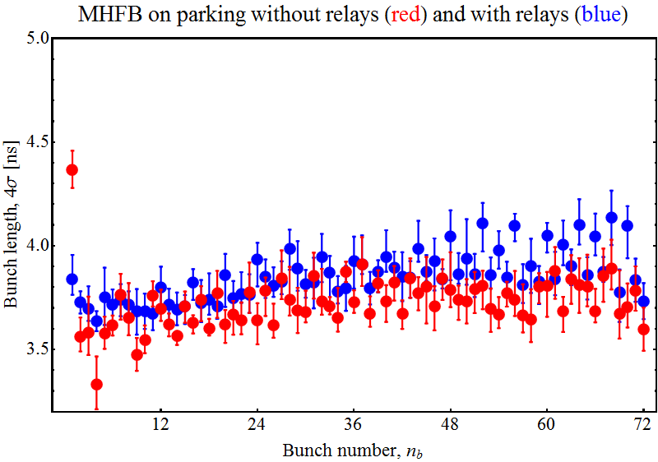
Extracted bunch length with parking + open gaps
Keeping the gaps open with parking allowed to understand the source of instability but may not be an operational solution
The extracted bunch length is shorter on average, but some bunches are completely degraded
Need to better understand the status of the rf cavities in that configuration

Slide 16
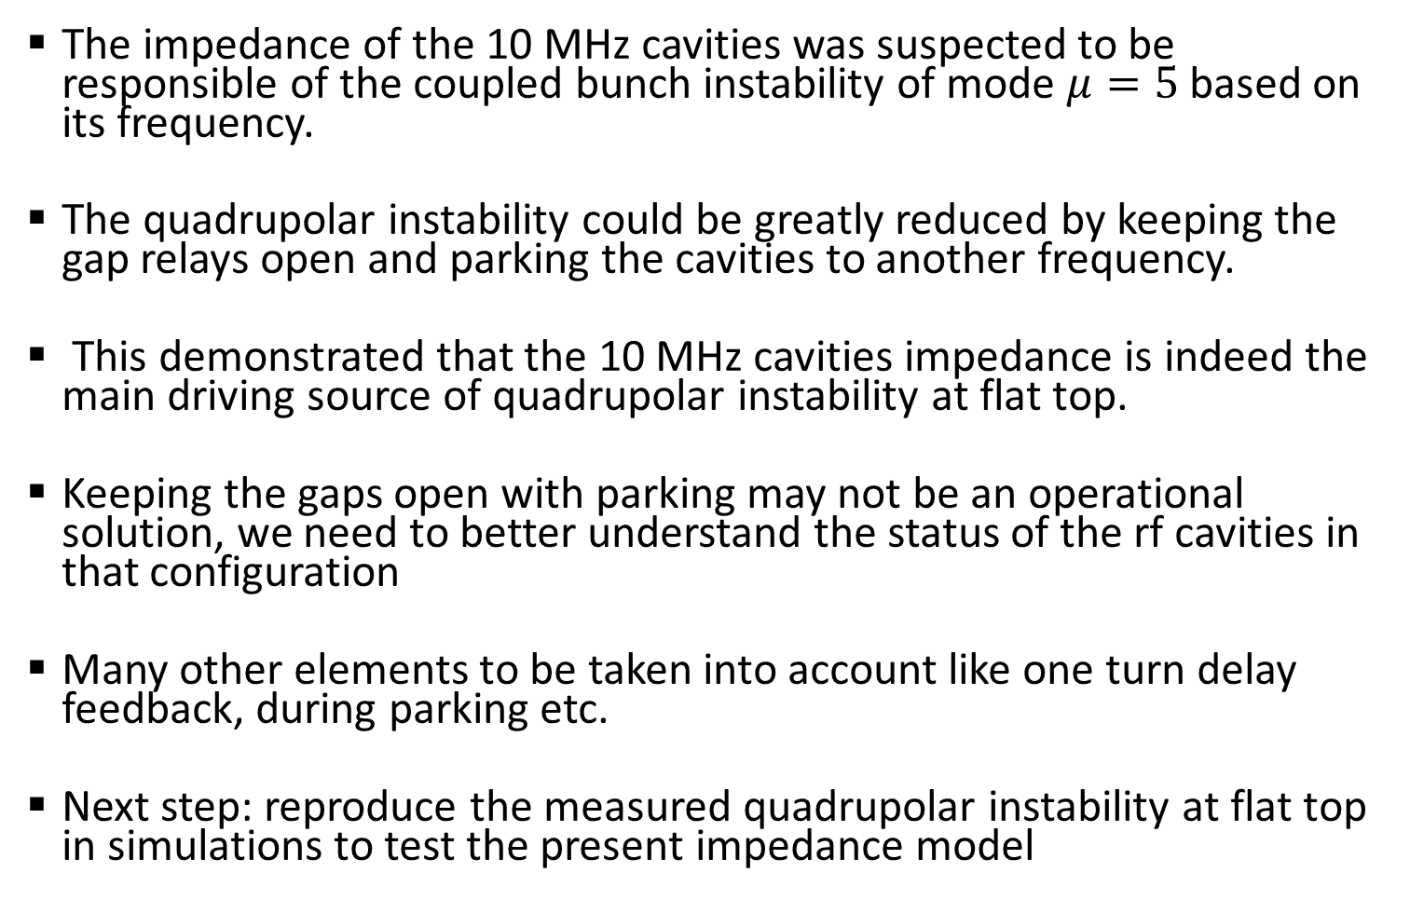
Conclusions
The impedance of the 10 MHz cavities was suspected to be responsible of the coupled bunch instability of mode $μ=5$ based on its frequency.
The quadrupolar instability could be greatly reduced by keeping the gap relays open and parking the cavities to another frequency.
This demonstrated that the 10 MHz cavities impedance is indeed the main driving source of quadrupolar instability at flat top.
Keeping the gaps open with parking may not be an operational solution, we need to better understand the status of the rf cavities in that configuration
Many other elements to be taken into account like one turn delay feedback, during parking etc.
Next step: reproduce the measured quadrupolar instability at flat top in simulations to test the present impedance model

