Slide 2
Update on turn-by-turn SEM grid measurements
LIU PS BD Meeting
23 November 2018
V. Forte, G.P. Di Giovanni, M. Fraser, A. Guerrero Ollacarizqueta, A. Huschauer, F. Roncarolo, E. Senes, F. Tecker
Acknowledgements: F. Antoniou, C. Carli, A. Oeftiger, P. Skowronski

Slide 3
Talk overview
This presentation directly follows the last one at PS BD WG #23
NEW: <2 hours of dedicated MD on November 7th 2018
    Operational vs PPM-rematched optics
Data treatment: Gaussian and statistical RMS fits
Brightness comparison with WS results
Deliberated mismatch by changing BT.QNO10 (PPM-rematched optics)
Vertical measurements by moving the tune far from Qy=6.25
Conclusions and next steps

Slide 4
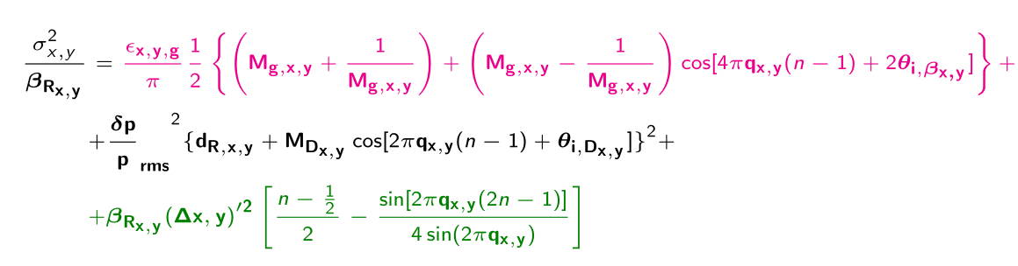
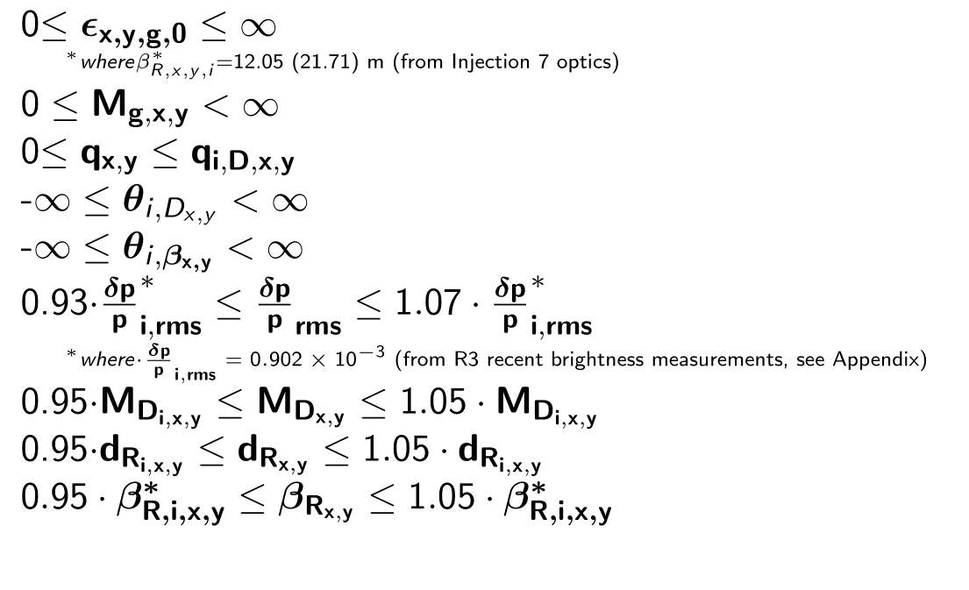
Constraints for total beam size fit parameters
Method as in M. Benedikt, C. Carli et al., here
betatronic
dispersive
scattering
Boundaries are derived from systematics
1
We decided to separate betatron and dispersive tune due to space charge considerations

Slide 5
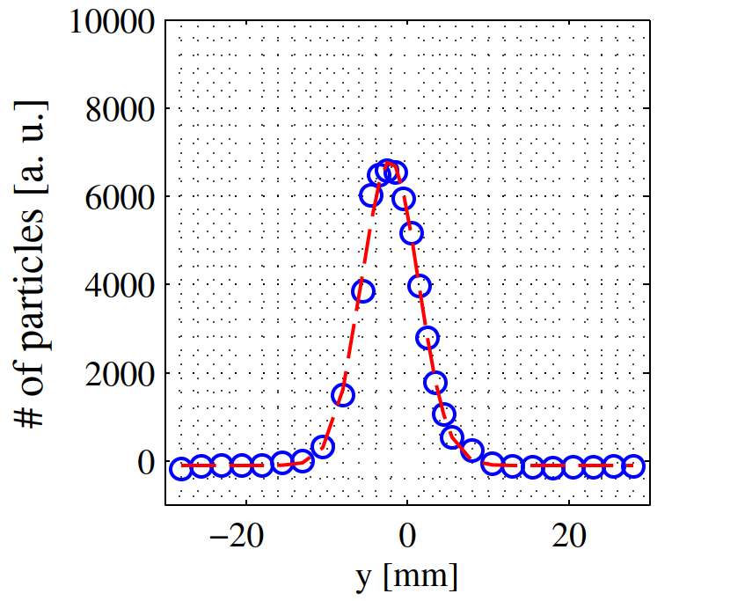
Beam data treatment
We started by performing Gaussian fit of the total profile and then subtracting dispersive contribution to the Gaussian beam size in quadrature
  Analysis similar to previous one
x

Slide 6
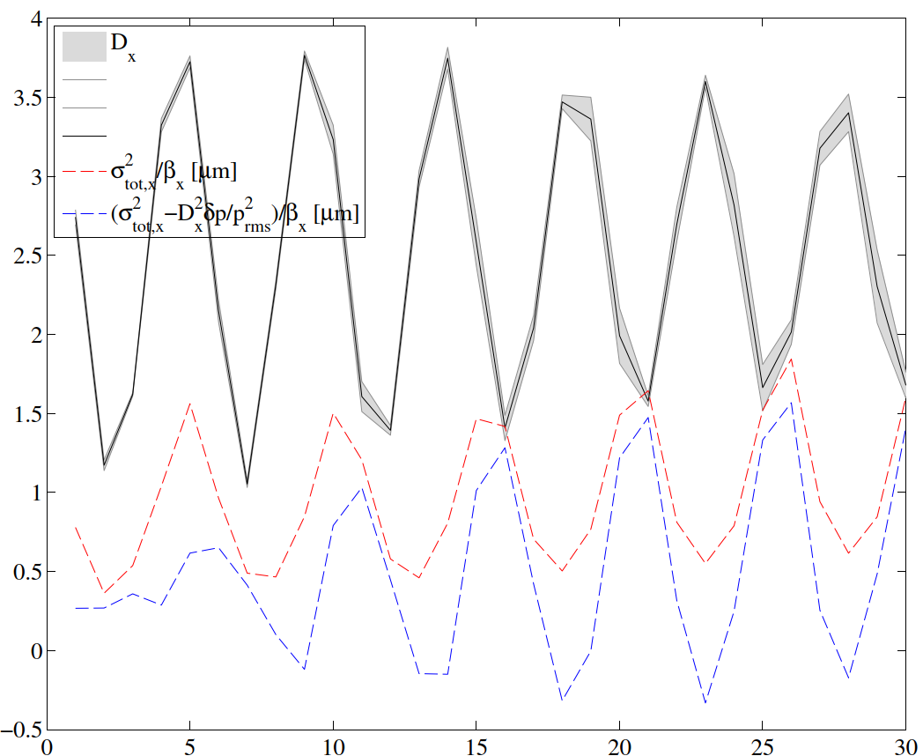
Beam data treatment: results with Gaussian fit
Then we noticed that some “unphysical” effect was happening…
  For OP optics, where dispersion beating is larger, during subtraction in quadrature of dispersive contribution, the derived betatron beam size was going to negative values !!
    It mightbe due to a relevant error in dp/p rms, however it looked a bit large to me…
OP optics
!?

Slide 7
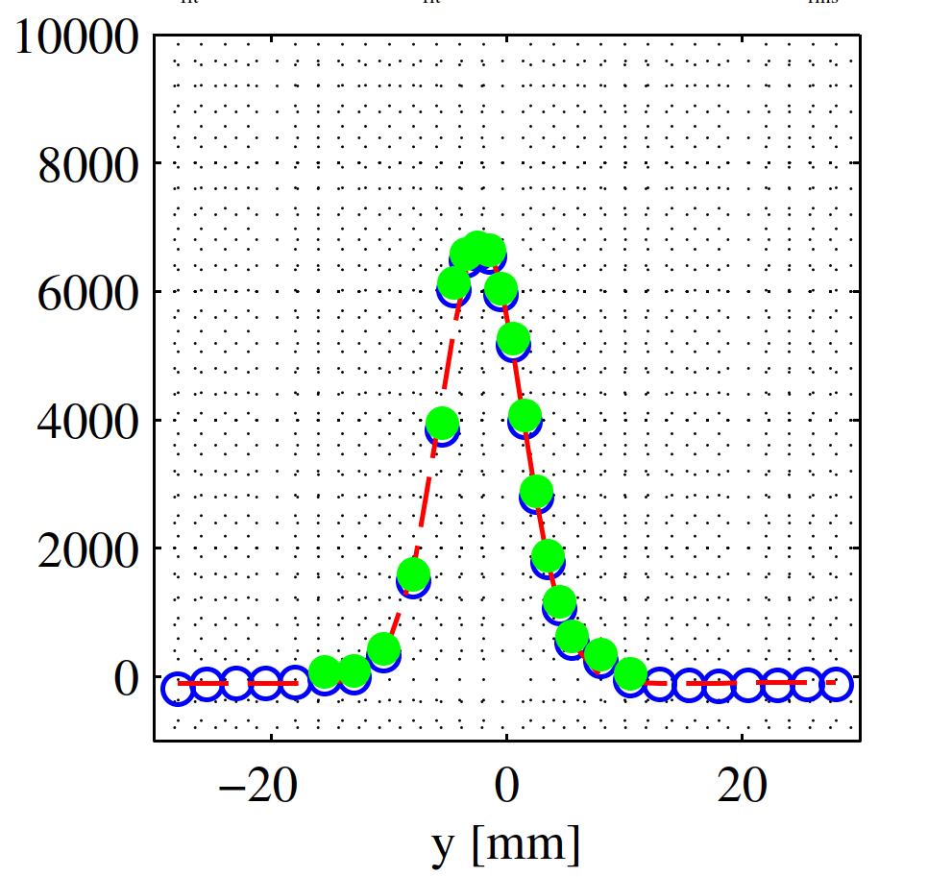
Beam data treatment
Then we noticed that some “unphysical” effect was happening…
  For OP optics, where dispersion beating is larger, during subtraction in quadrature of dispersive contribution, the derived betatron beam size was going to negative values !!
  Probably numerical artefact ➔ usage of rms statistical evaluation of beam size (thanks to clean S/N from SEM grids signals)
    5p Gaussian fit
    Selection of +/- 4 Gaussian sigma around the (Gaussian) fitted centre
    Shift SEMgrid signal by baseline and slope of 5p Gaussian fit
    Selection of bins with positive density (see filled green markers ) to exclude biasing of electronics
    Statistical computation of beam centroid and RMS emittance
    Advantage is that this method is statistical, thus subtraction in quadrature of dispersive profile is exact
x

Slide 8
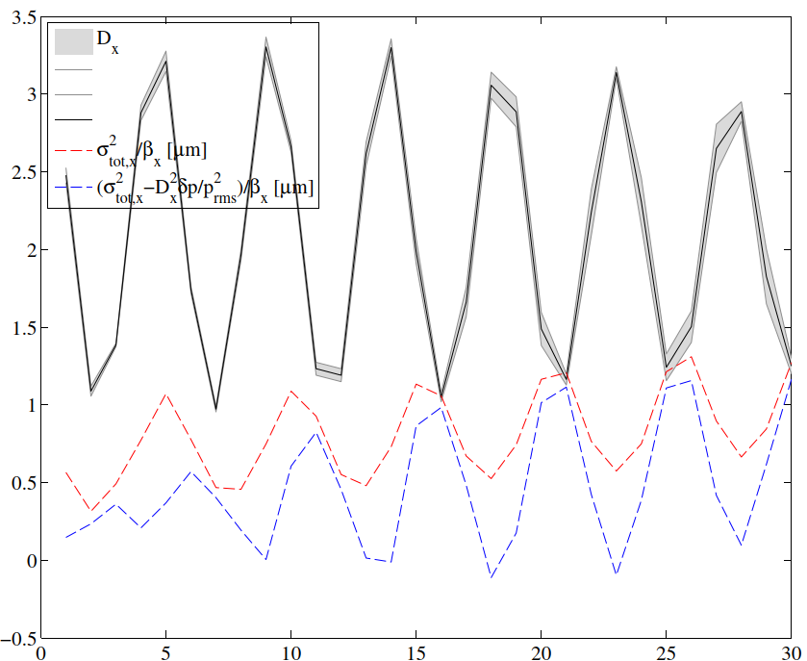
Beam data treatment: results with statistical rms
Total beam size beating is reduced
Negative (unphysical) emittance reduced
OP optics ~50e10 ppb

Slide 9
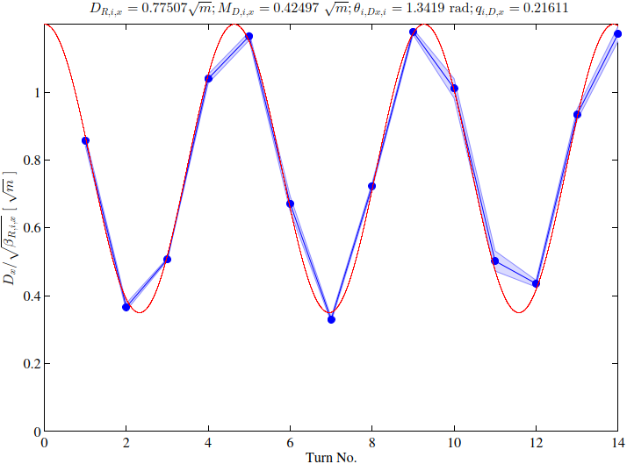
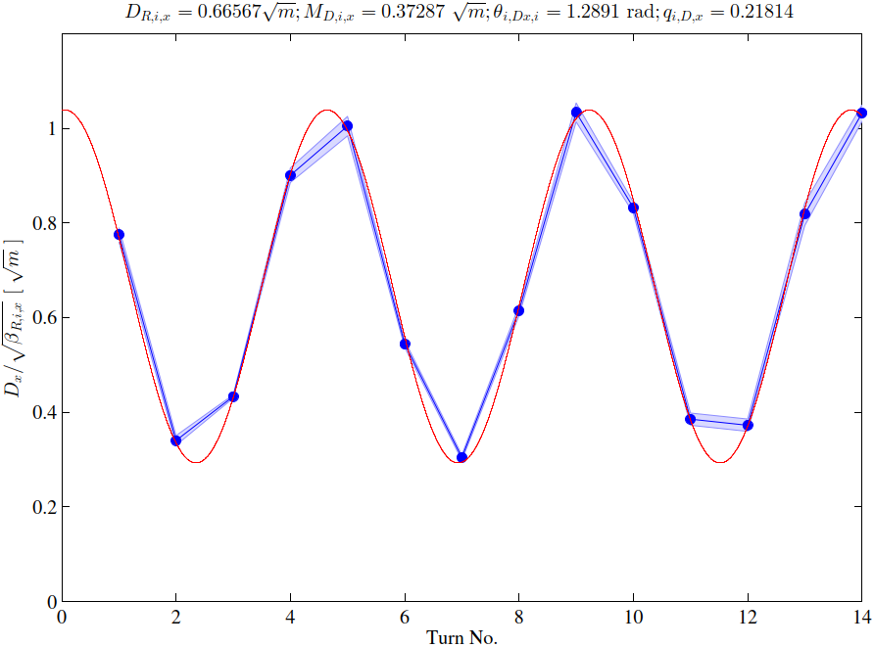
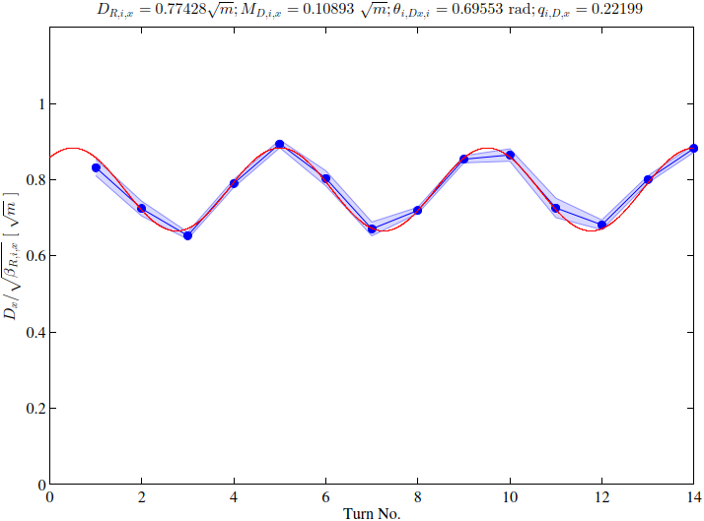
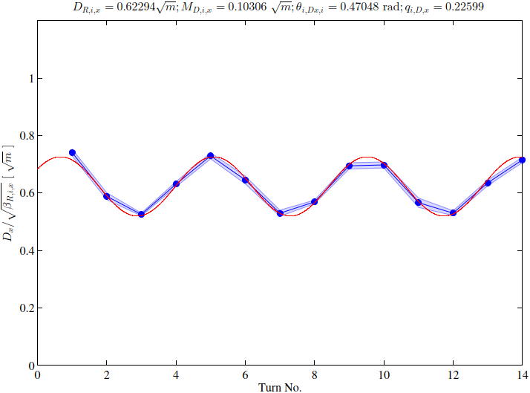

Beam data treatment: Gaussian vs statistical mean
Dispersive closed solution reduced by changing beam centroid evaluation
  Statistical evaluation can cause fluctuation of the closed solution (due to SEMs resolution, however this method is used for self-consistency)
  Nominal MadX dispersion is 2.4/sqrt(10.22)~0.75 $√m$
  OP optics
By using RMS centroid from 5p Gaussian fit
By using statistical RMS centroid
  Fluctuation of closed solution
  PPM-rematched optics
By using RMS centroid from 5p Gaussian fit
By using statistical RMS centroid

Slide 10
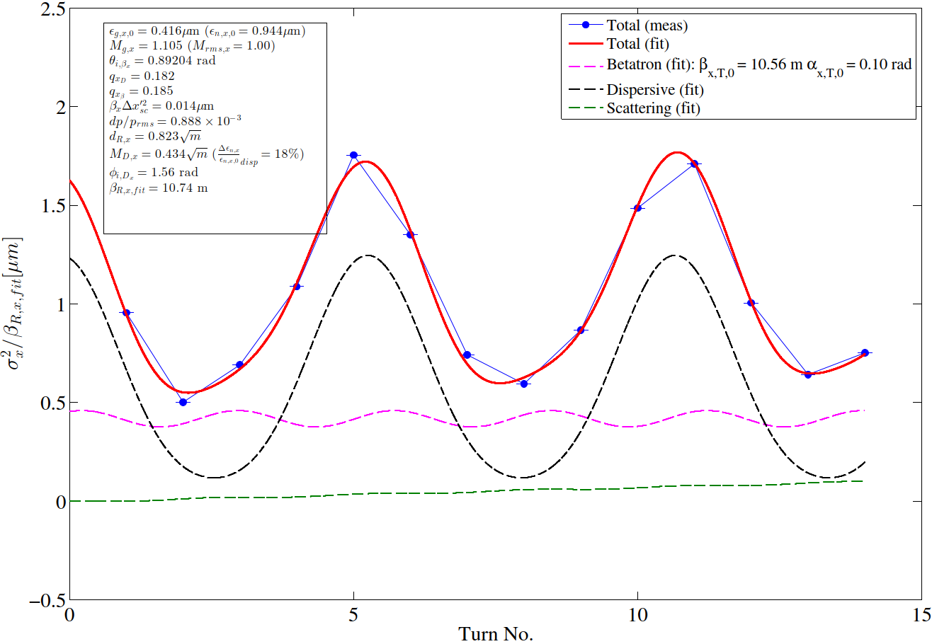
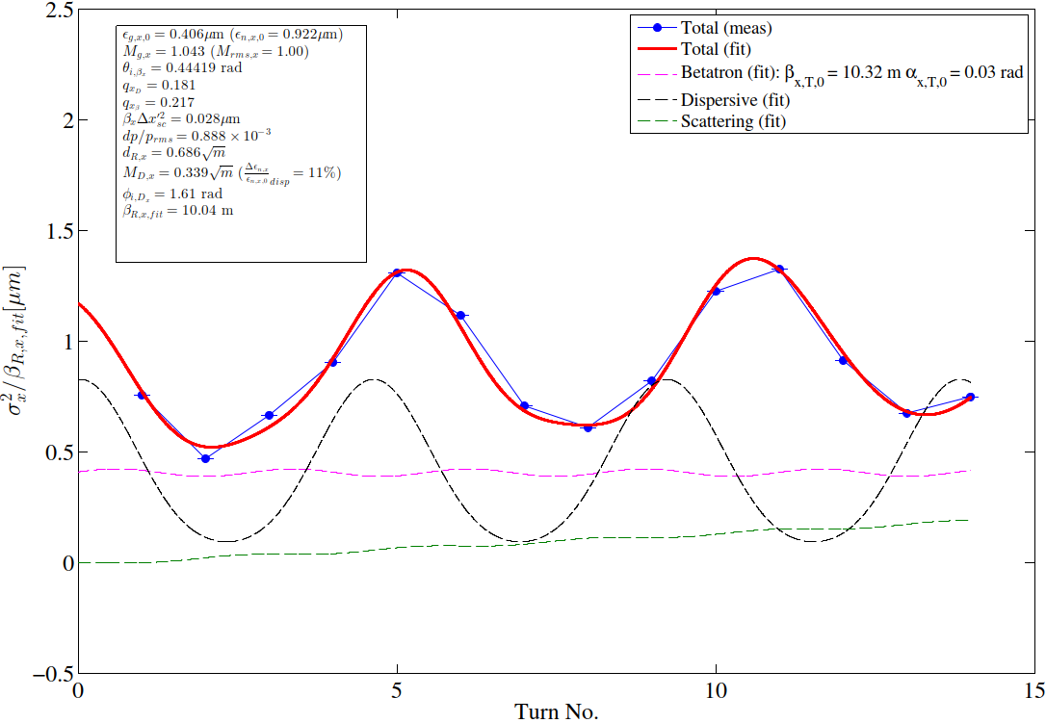
Final fit – OP optics: Gaussian vs statistical mean
RMS beam size from 5p Gaussian fit
RMS beam size from statistical analysis

Slide 11
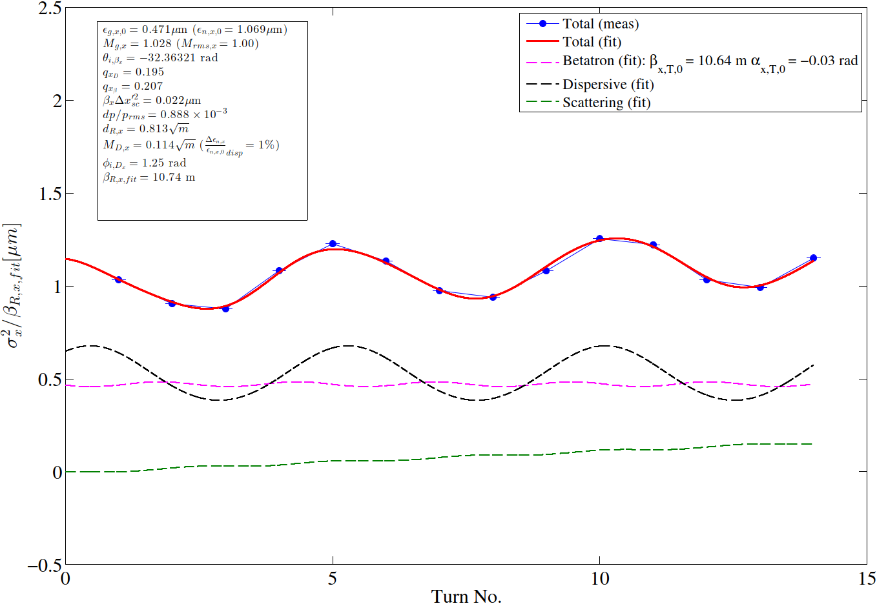
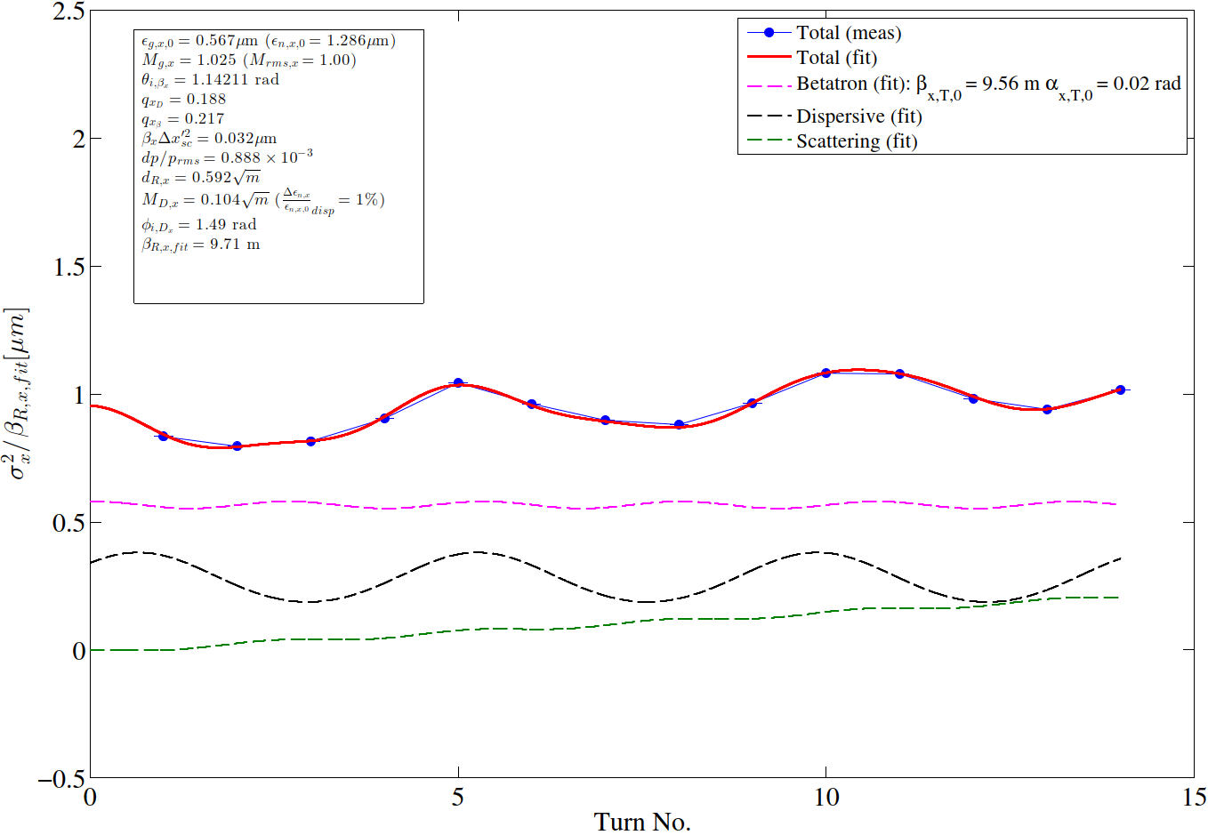
Final fit – PPM-rematched optics: Gaussian vs statistical mean
Beam size beating amplitude (i.e. total mismatch) even more attenuated with statistical rms
RMS beam size from 5p Gaussian fit
RMS beam size from statistical analysis
RMS beam size from 5p Gaussian fit

Slide 12
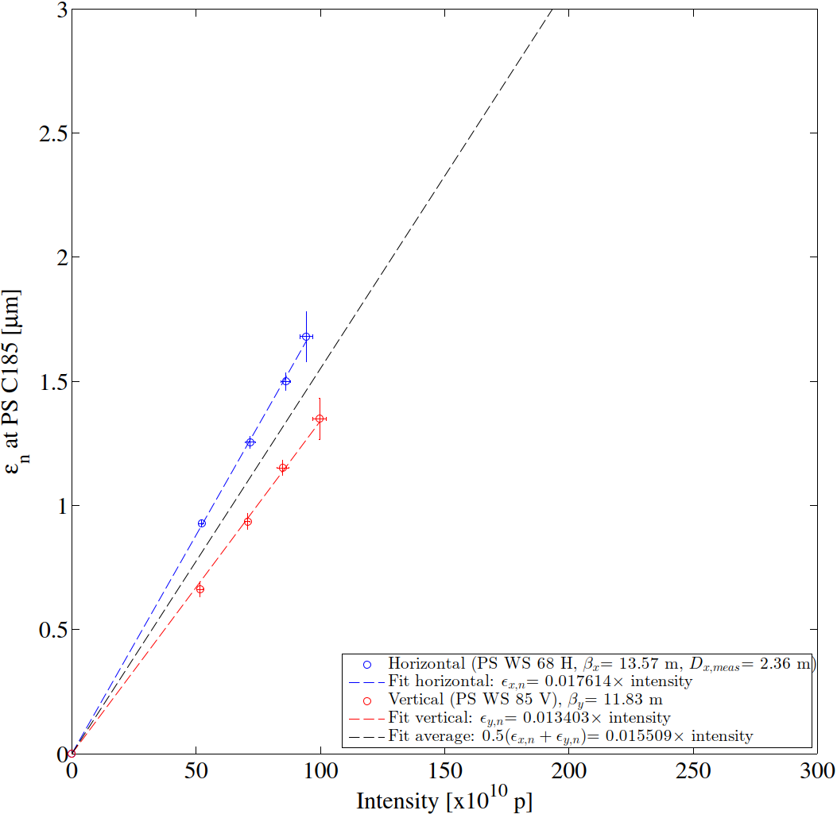
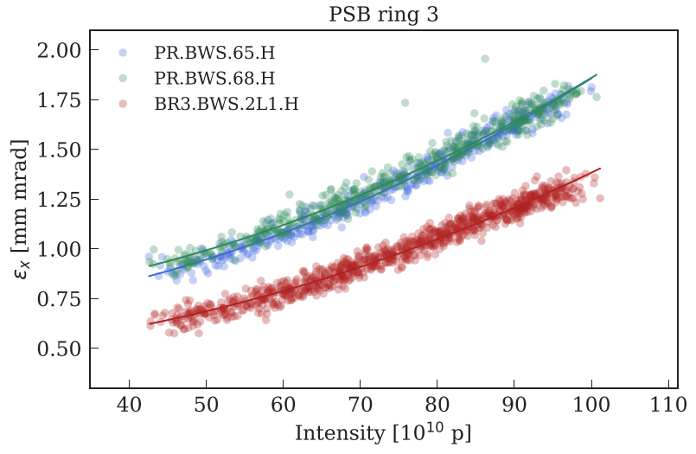
Horizontal brightness with the two optics:
Brightness measurement points taken on PPM-rematched optics are similar to the measurements performed by AlexH and Fanouria (thanks!)
  As far as I understand PSB quantities (with measured optics) are not far too… looking forward to see them…
  Nota bene! WS still evaluated with conventional method
ε_{x}/Intensity ~0.016/0.017
(not very orthodox fit, but I am confident)
  PPM-rematched optics BCMS 0.9 eVs
  Fixed dp/p_{rms}=0.888e-3 (in this plot)
Courtesy AlexH and Fanouria

Slide 13
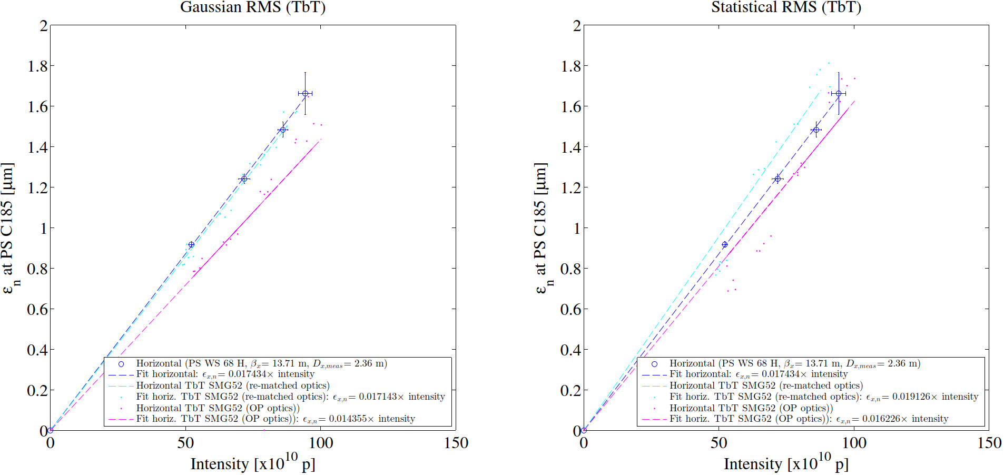
Horizontal brightness with the two optics:
Brightness of the incoming beam for PPM-rematched optics beam is very close to the brightness measured with the PS WS 68H (with Gaussian fit evaluation of total beam size)
  In the case of statistical rms evaluation it even exceeds the WS brightness ➔ numerical artefact?
Brightness of Optics A beam gets closer to the WS one with statistical evaluation
  The statistical RMS beam size helps the proper deconvolution of the longitudinal profile

Slide 14
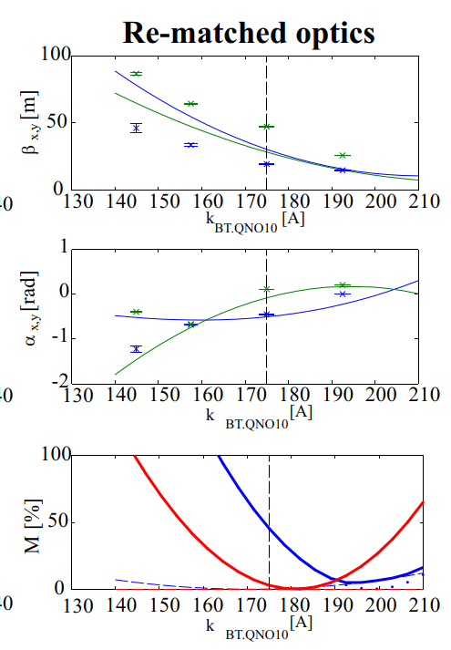
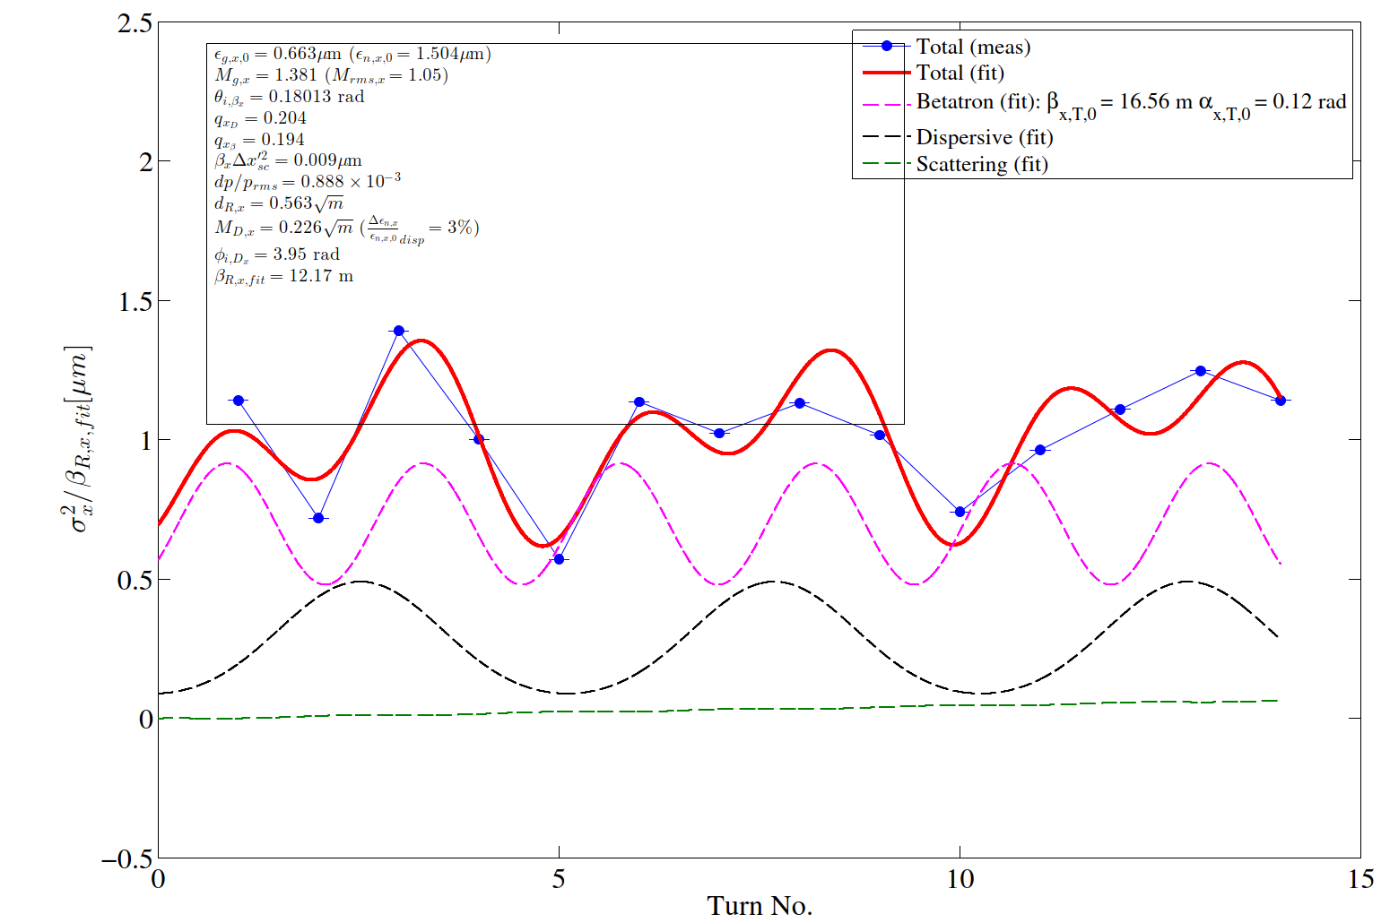

Preliminary: a mismatched case -
PPM-rematched optics and BT.QNO10 at 150 A
Betatron amplitude increases but not as expected (M_{g} =1.38 instead of ~2.5)
  Fit more complicated and not optimal (large residuals) ➔Tuning of fit to be followed up
  Tune (6.21,6.33)
HB2018 –WEP2P006

Slide 15
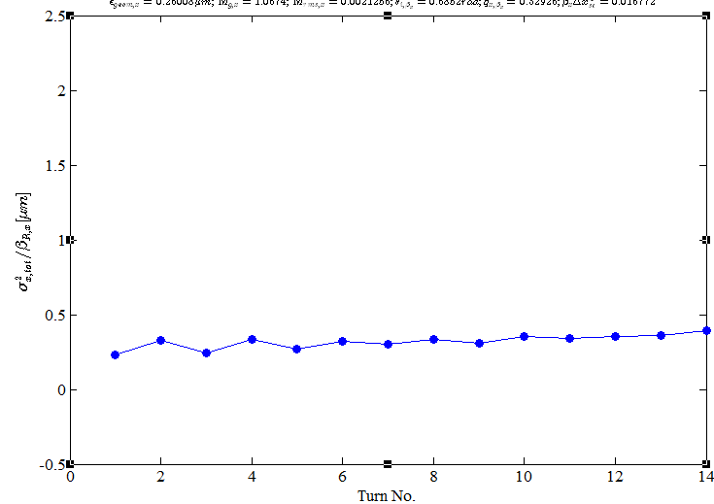
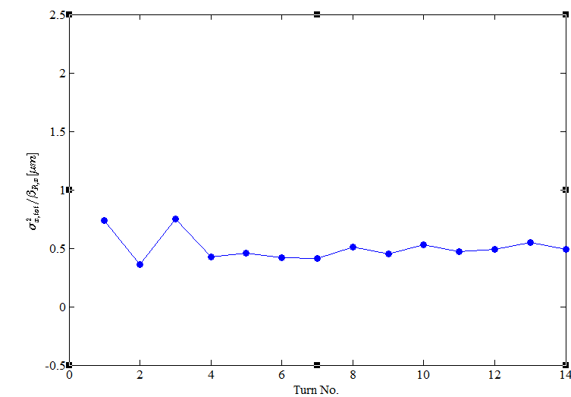
Preliminary: vertical PPM-rematched optics
Tune moved to Qy=6.33 to have better phase advance
Analysis to be refined
Matched case
Mismatched case

Slide 16
Conclusions
TbT SEMgrids profiles were acquired in another (longer) dedicated MD on 7th November
  Data at different settings of the PSB vertical shavers were taken for BCMS OP beams with OP and PPM-rematched optics
  Results are consistent with previous MD in terms of mismatch
Gaussian and statistical RMS beam size evaluations have been used
  Main reason: to better disentangle dispersive contribution in OP optics (large dispersive mismatch
Brightness curve (from TbT SEMs) shows that incoming beam has same (or very similar) horizontal brightness of beam measured with WS at C185
  Looking forward for final analysis
  I will try to fix some parameters in the fit (e.g. dispersive mismatch)
Horizontal TbT has been applied to mismatched beam
  Betatron component arises, thus smaller than expected ➔ to be followed up
Analysis of data in vertical plane on-going
  Betatron component arises, thus smaller than expected ➔ to be followed up
Analysis of bunch lengthening through tomoscope data on-going
  Useful to correlate rms bunch lengthening with rms momentum spread

Slide 17
Thanks
☺

Slide 18
Appendix

Slide 19
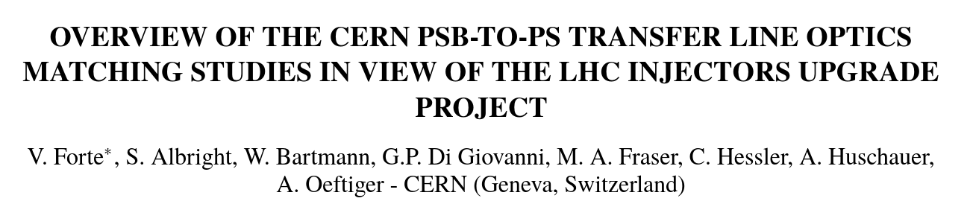
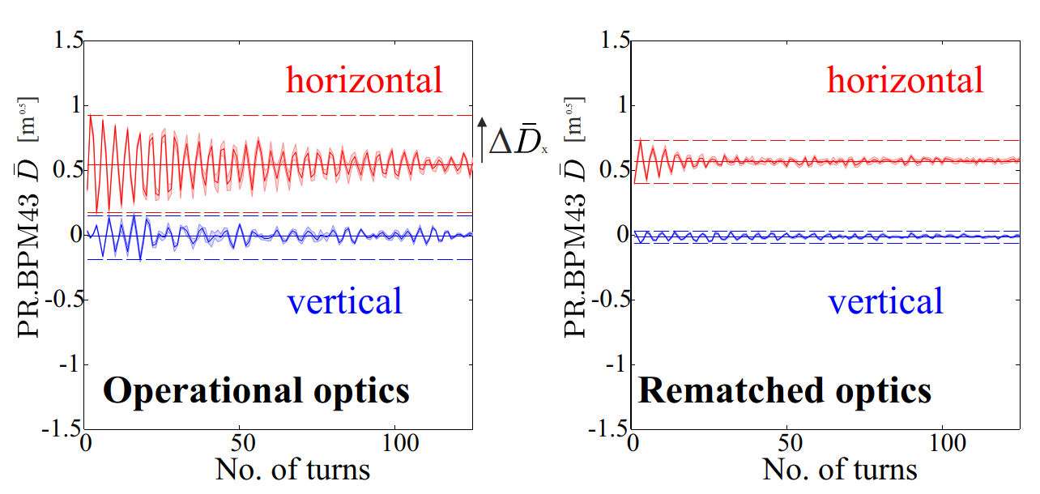
TbT dispersion from BPMs

Slide 20
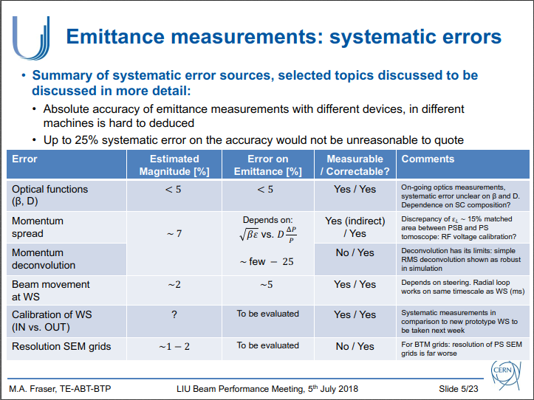
PSB extracted dp-p_{rms}
Extracted from M. Fraser - LIU Beam Performance Meeting, 5th July 2018

Slide 21
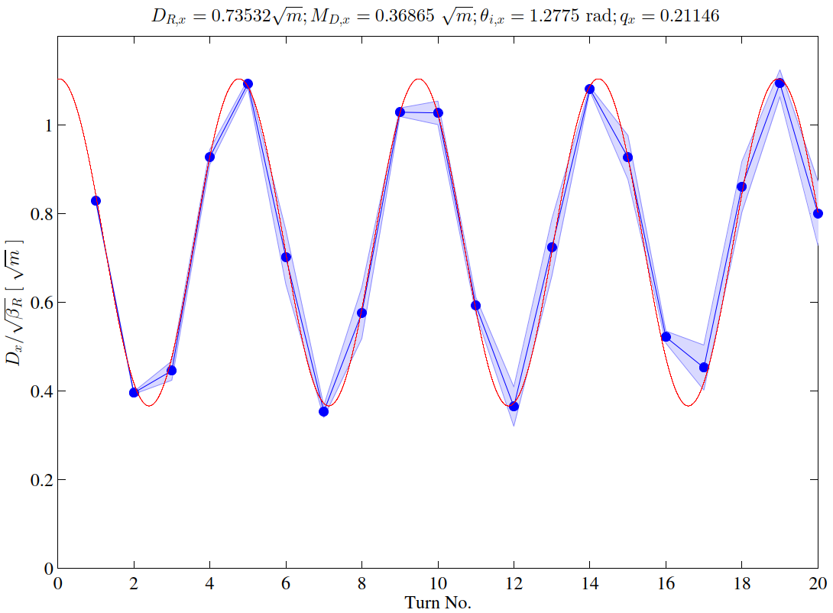
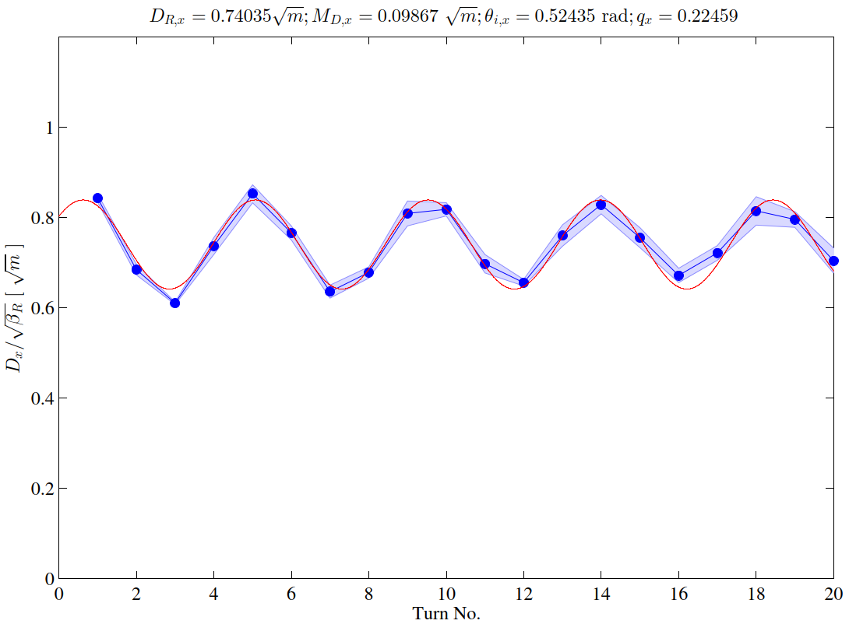

Horizontal dispersion vs. turns
RF OFF (check RF ON):
  Consistent periodic dispersion from fit D_{R,x} = 0.73-0.74 $\sqrt{m}$** (~2.57 m)
  M_{D,x} improved in re-matched optics: from 0.37 to 0.1 $\sqrt{m}$**
    Fully consistent with dispersion from BPMs (see Appendix)
    Related analytical Δε/ε₀ = 14% (operational optics) ; 1% (PPM-rematched optics)
      considering ε_{0,norm}=1.1 um and dp/p_{rms}=0.9e-3
Operational optics
PPM-rematched optics
**β_{R,x} = 12.05 m at SMG52 (From “Injection 7” optics)

Slide 22
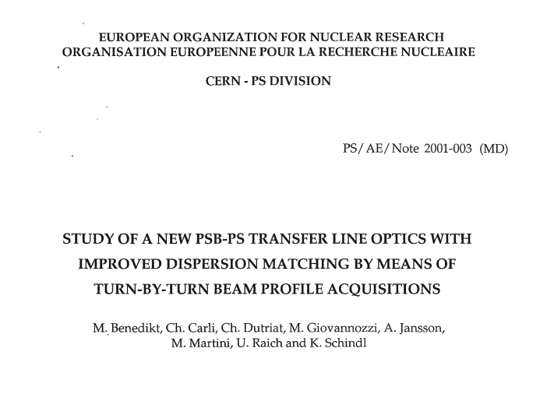
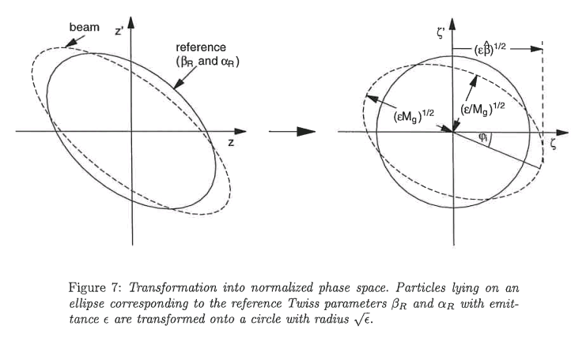
PDF here

Slide 23
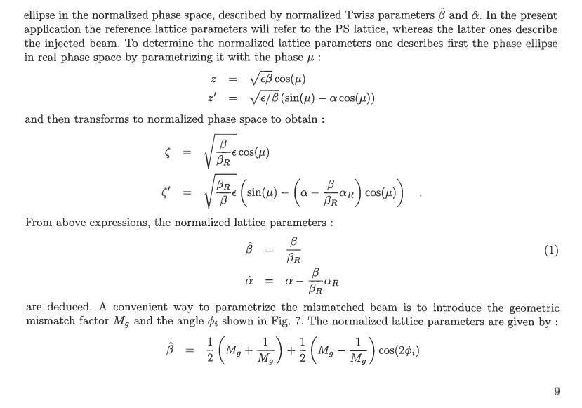
PDF here

Slide 24
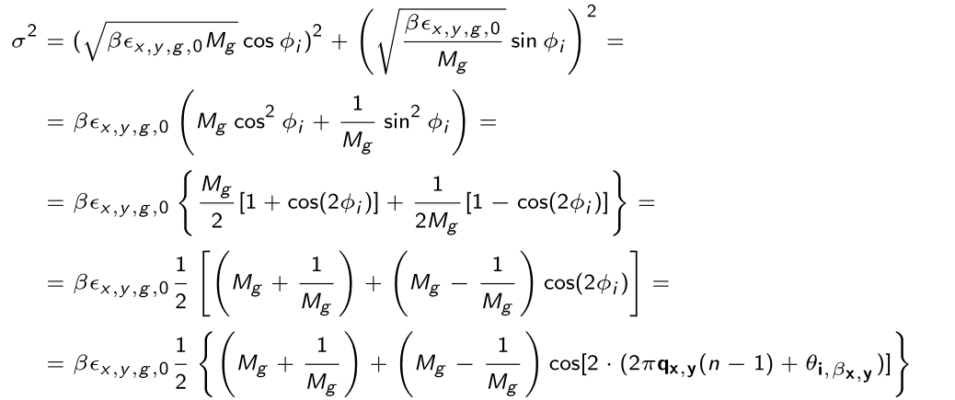
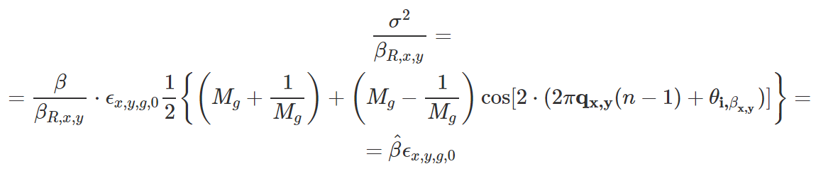
The incoming beam with σ=sqrt(βε)
Going to normalized rms (by dividing by the β_{R} of the ring)…
Thanks C. Carli

Slide 25
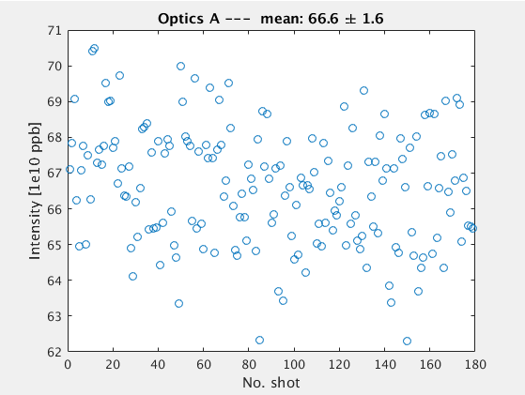
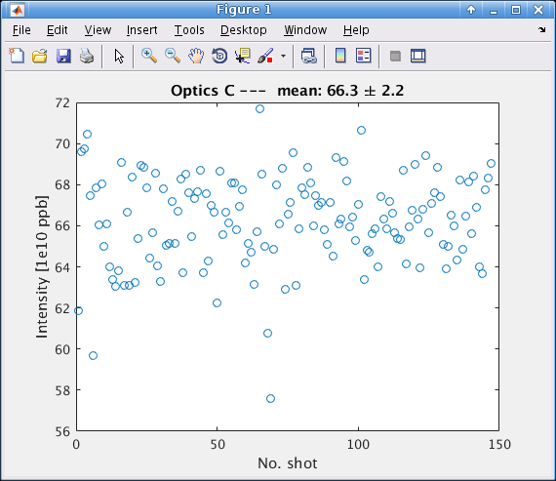
Intensities

Slide 26
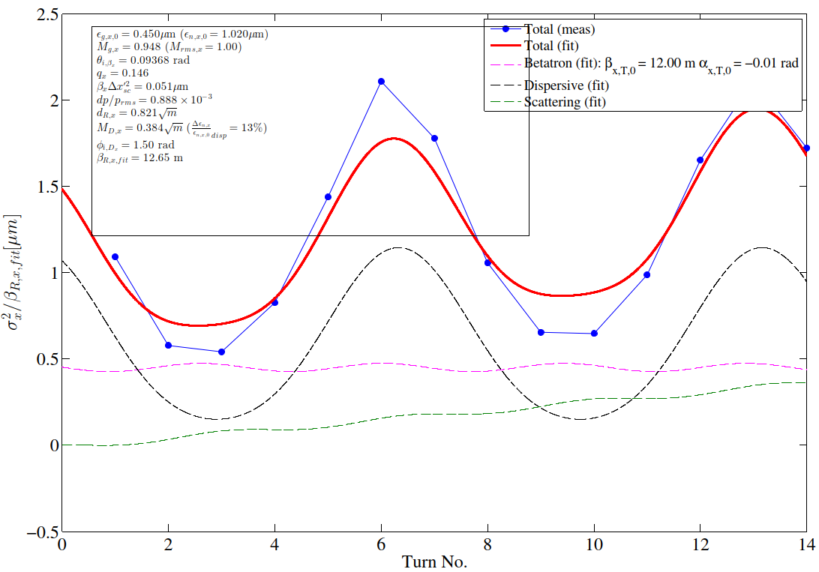
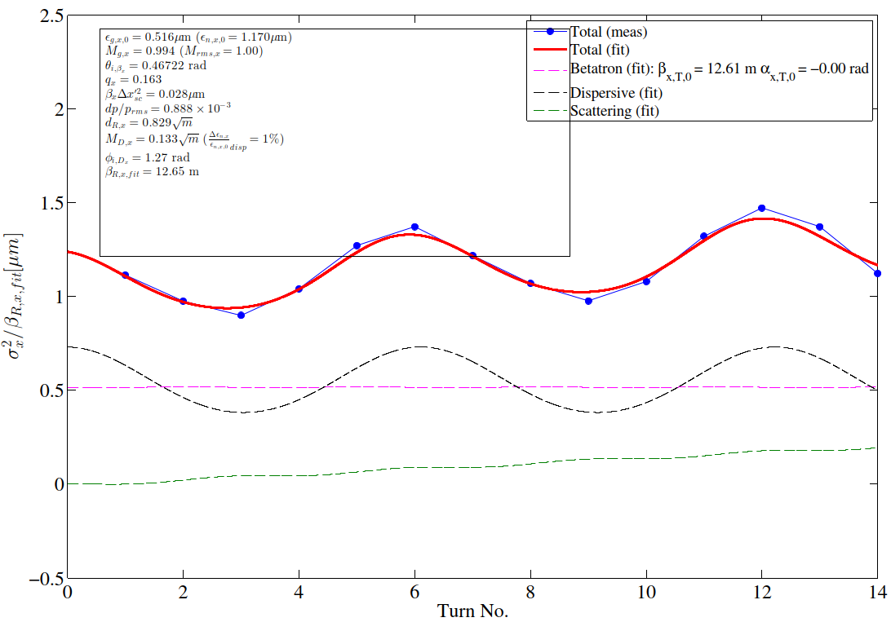
RF ON – tune 6.17-6.24
Optics A
Optics C

Slide 27
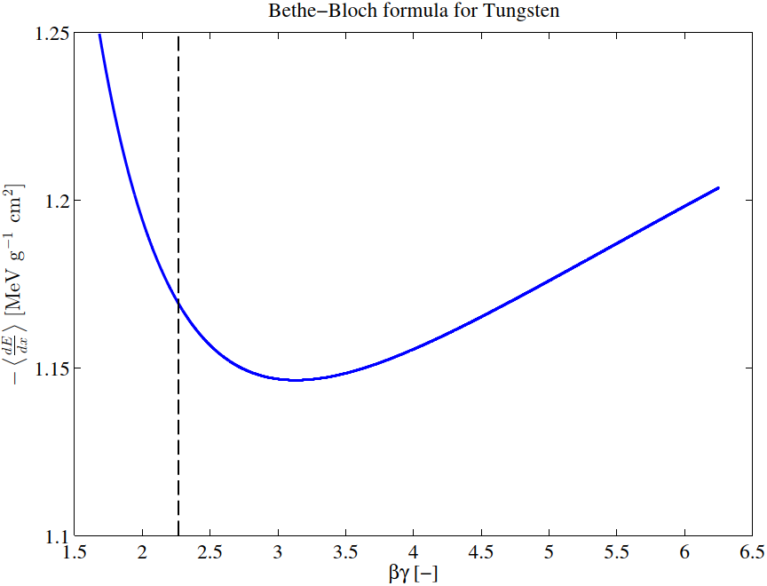

Energy loss: Bethe-Bloch formula
Energy loss per turn per particle:
1.17 [MeV·g⁻¹·cm²] x 40e-4 [cm] x 19.3 [g·cm⁻³] = 0.09 MeV / turn
  Density ρ = 19.3 g/cm³
  Wire diameter d_{wire}= 40 μm = 40e-4 cm
Relative Emittance growth due to energy loss

Slide 28
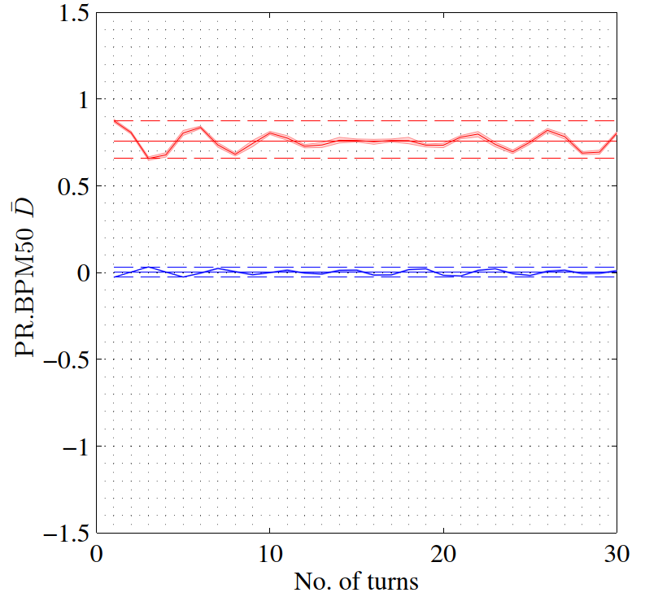
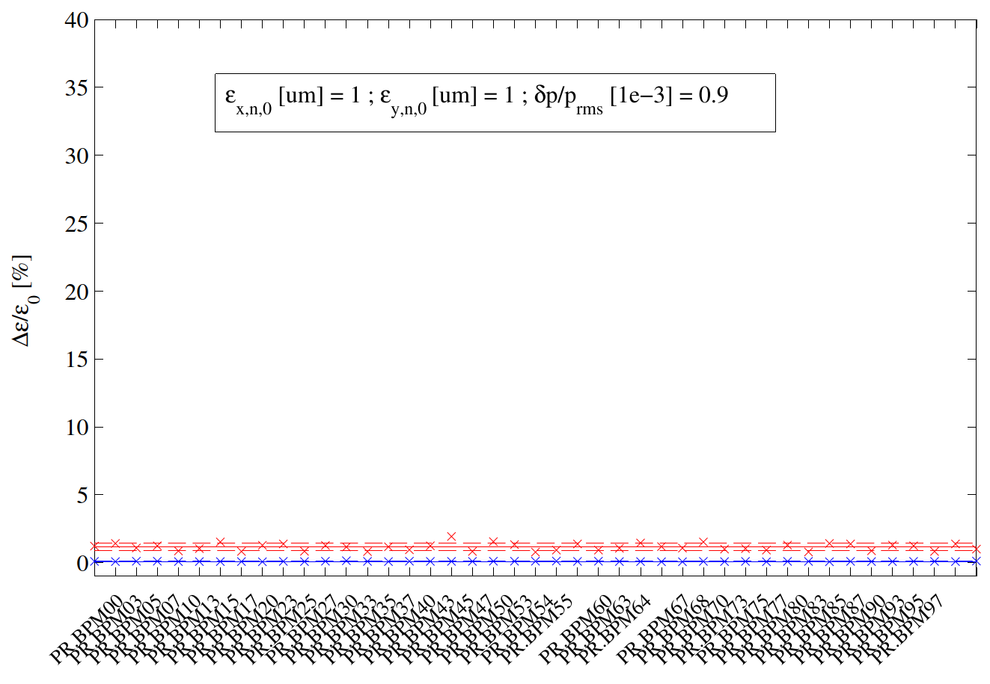
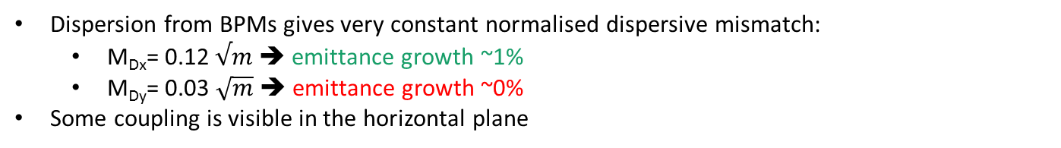
Dispersion at BPMs
PPM-rematched optics
Dispersion from BPMs gives very constant normalised dispersive mismatch:
  M_{Dx}= 0.12 $√m$ ➔ emittance growth ~1%
  M_{Dy}= 0.03 $\sqrt{m}$ ➔ emittance growth ~0%
Some coupling is visible in the horizontal plane
Horizontal
M_{D}
Vertical
Horizontal
Vertical

Slide 29
Operational and (PPM) re-matched optics
PPM optics minimises betatron and dispersive measurements and is suitable for parallel operation, as it moves only BT quads
  V. Forte et al., “Overview Of The CERN PSB-to-PS Transfer Line Optics Matching Studies In View Of The LHC Injectors Upgrade Project”, WEP2P006, HB2018
    Work on transfer line understanding is improving ➔ analysis of quadrupolar gradient error (to be presented)
Horizontal
Vertical

Slide 30
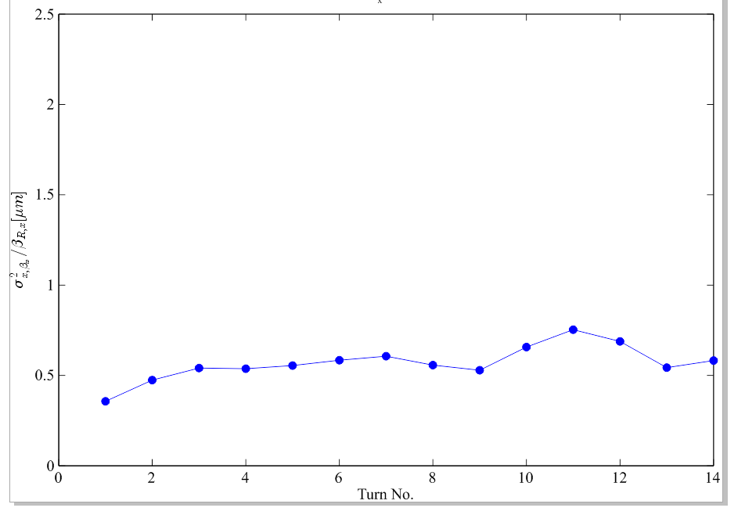
Rematched optics – betatron matching
Excellent betatron matching – basically no oscillation in the first 9 turns

