Slide 1


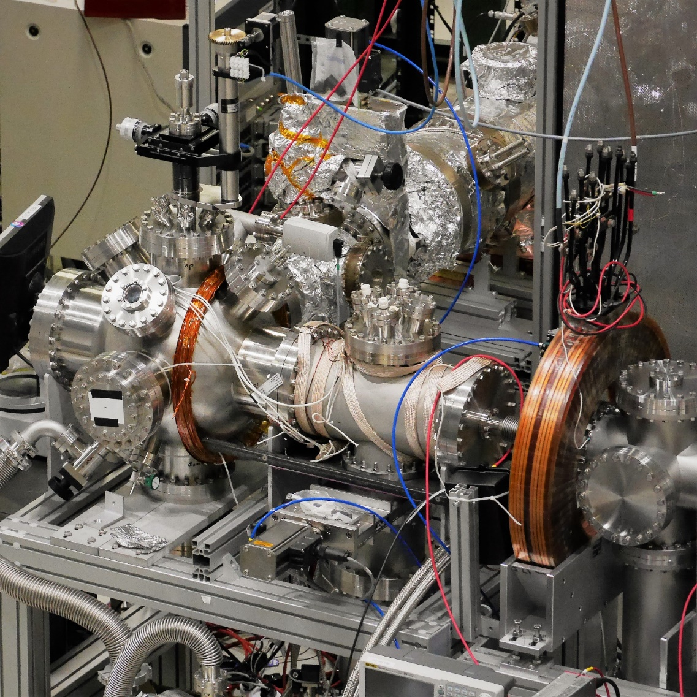
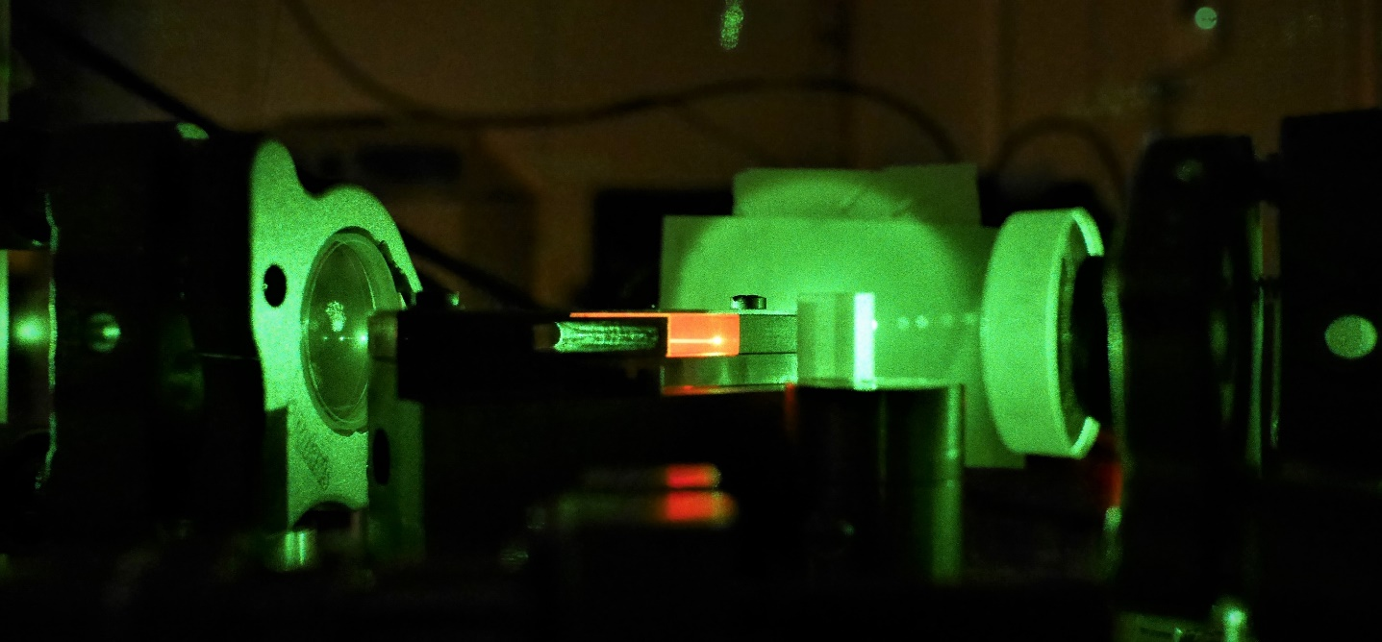
B
Status of the Reaction Chamber and Ps laser
A
r
Pauline Comini,
on behalf of all the persons involved

Slide 2
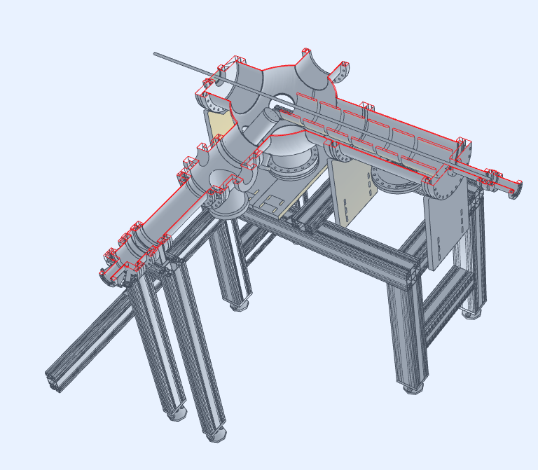
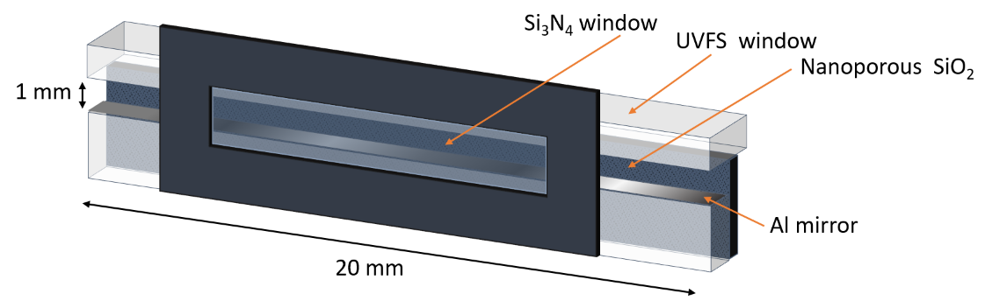
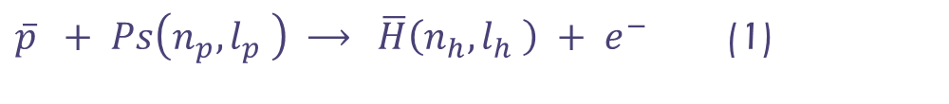



B
Status of the Reaction Chamber and Ps laser
A
r
Reaction chamber
$\overline{p} + Ps\left(n_{p},l_{p} \right) \underset{→}{ } \overline{H}\left(n_{h},l_{h} \right) + e^{−}$ (1)
$\overline{H}\left(n_{h},l_{h} \right) + Ps\left(n_{p},l_{p} \right) \underset{→}{ } {\overline{H}}^{+} + e^{−}$ (2)
From inside:
Ps cell + optics
Ps target and Si target
MCP for positrons
MCP for antiprotons
positron focussing
buncher (accelerating drift tube)
(Anti)proton pulse
Positron focussing
Laser
Target position
Positron pulse
$\overline{p},\overline{H}, {\overline{H}}^{+}$
$$\overline{p}$$
e⁺

Slide 3
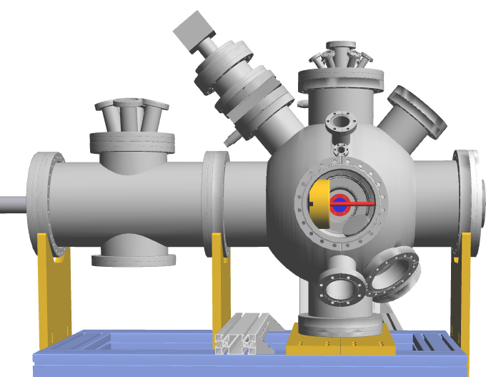
B
Status of the Reaction Chamber and Ps laser
A
r
Reaction chamber
manipulator
Detector well
From outside:
Ps target manipulator (XYZ + rotation around vertical axis with stepper motors)
wells for detectors
laser entrance window
viewports
feedsthroughs
vacuum gauges
pumping
+ scintillator detectors
+ shielding from RIKEN trap magnetic field
Was already designed and installed at CEA
before going to CERN
Laser entrance
e⁺
View from the antiproton line

Slide 4
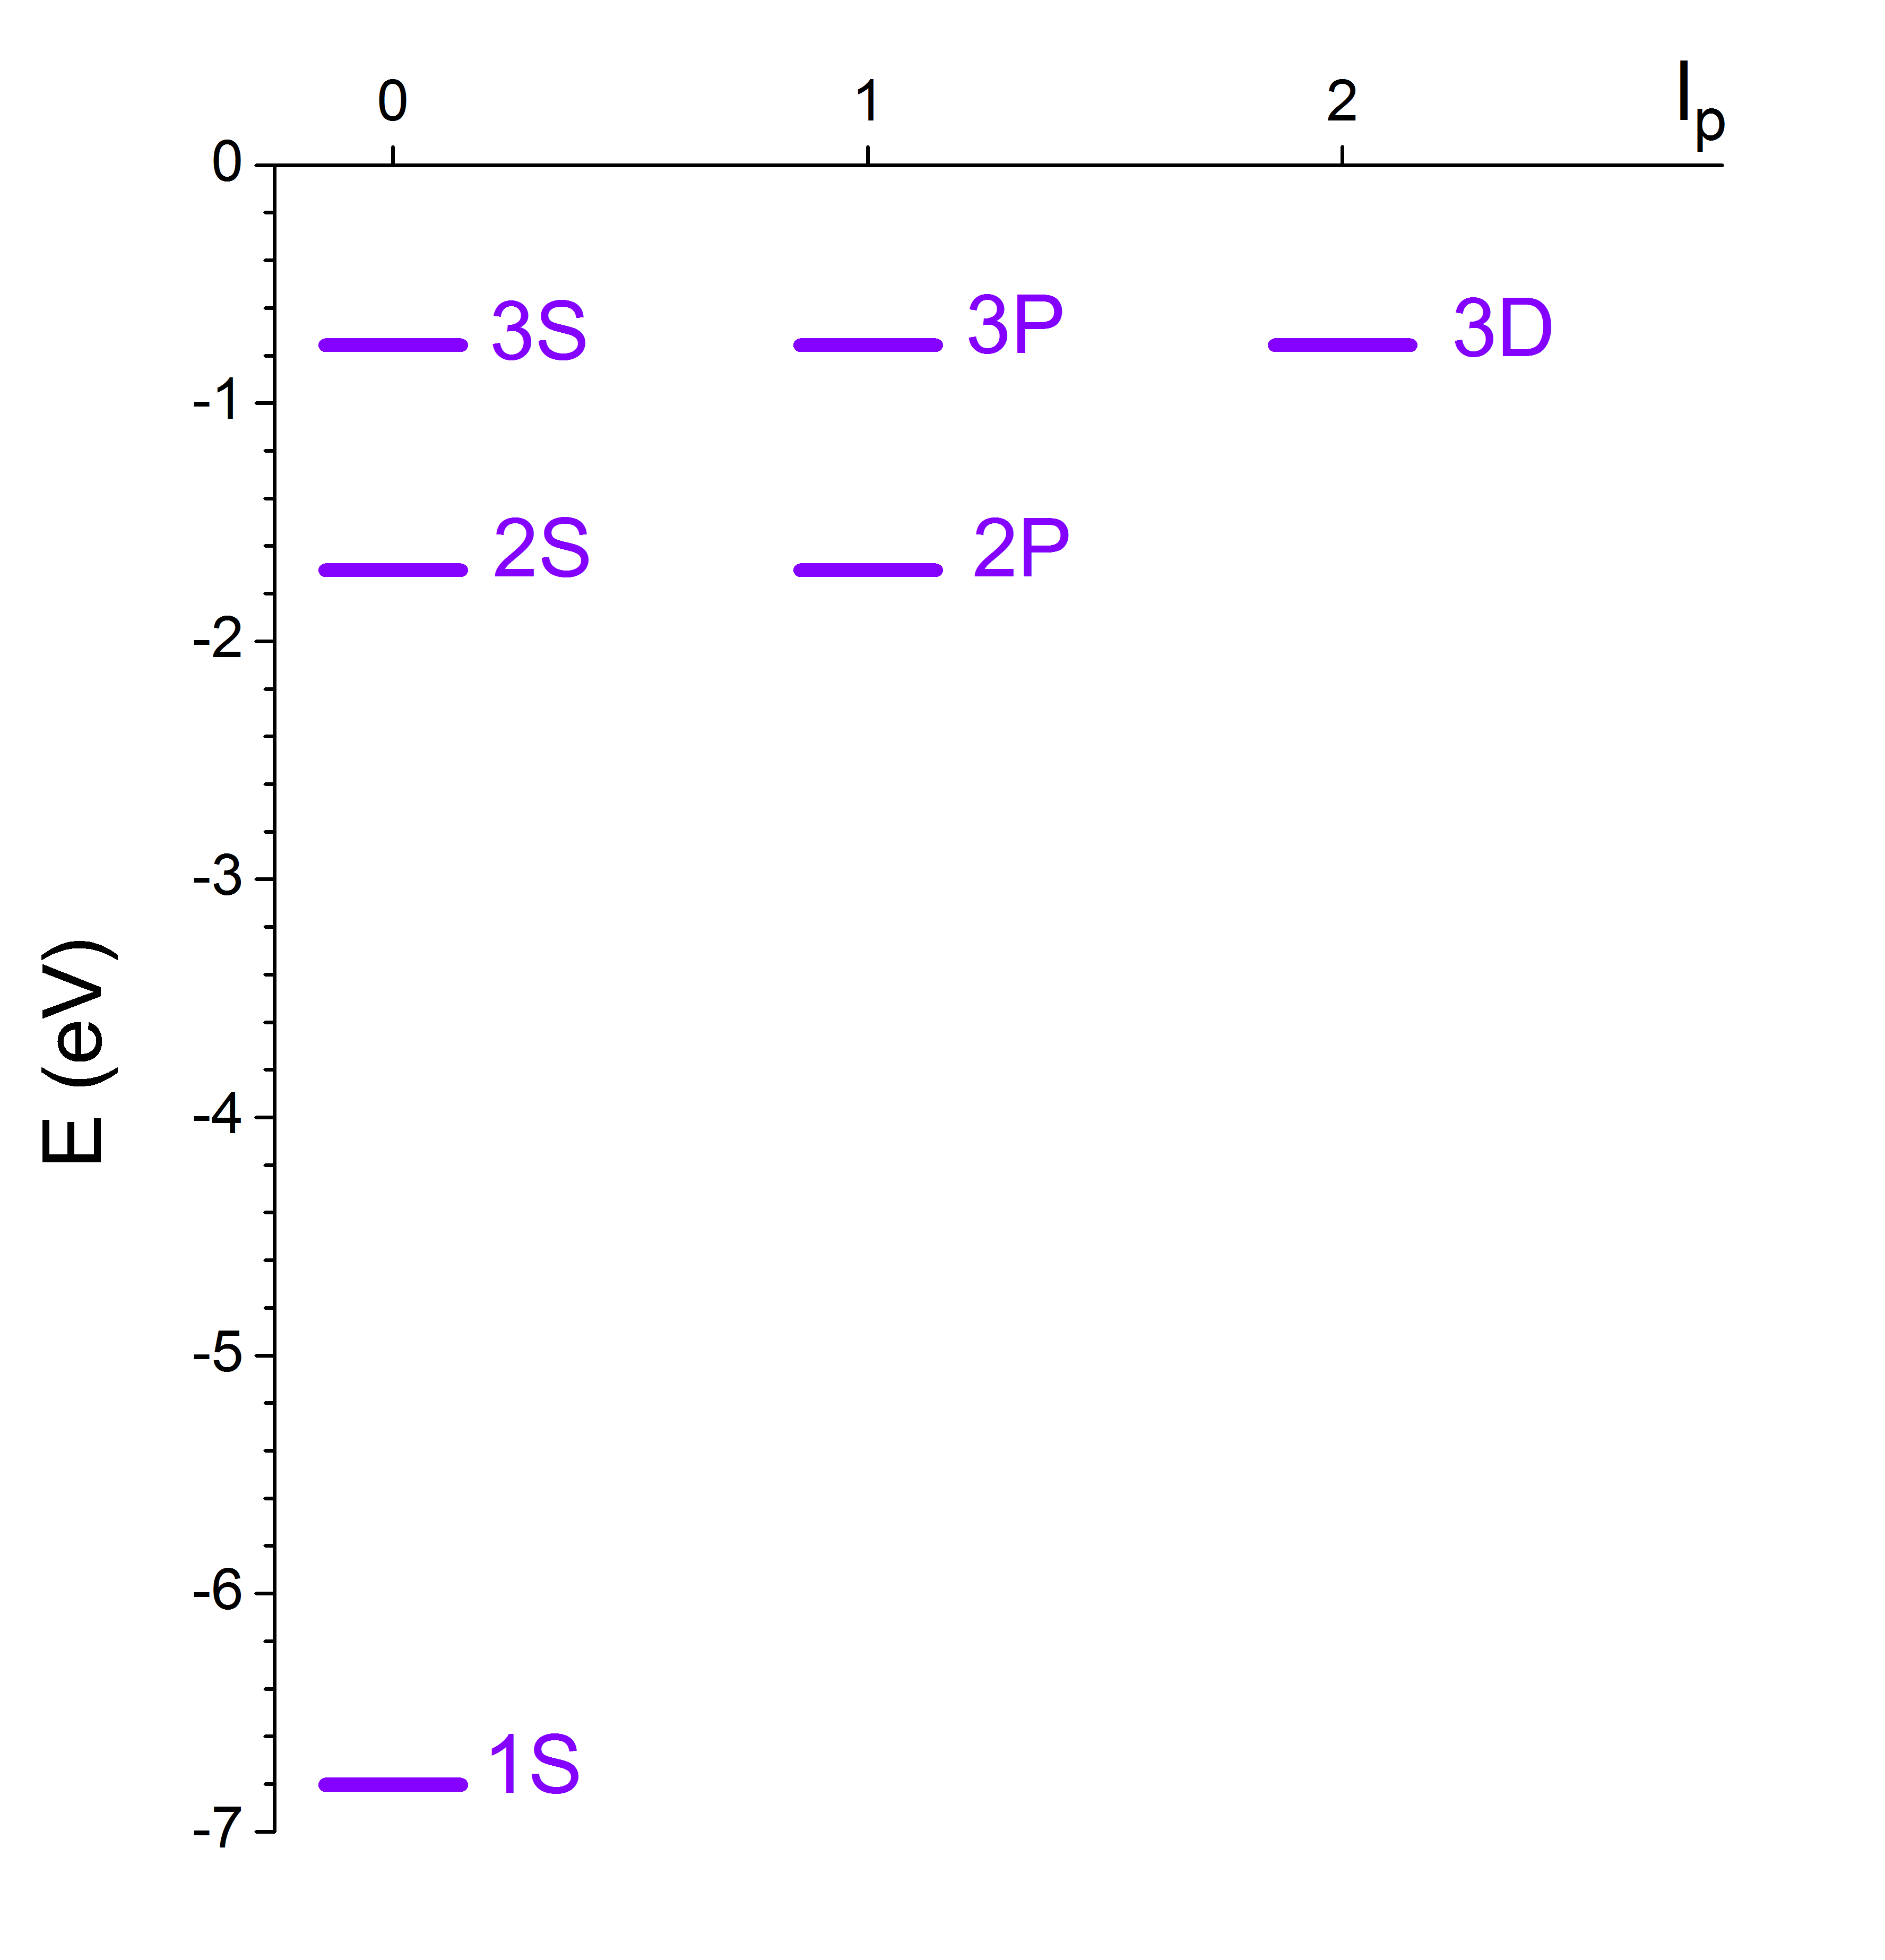
B
Status of the Reaction Chamber and Ps laser
A
r
Laser for Ps excitation
410 nm : 2-photon transition toward 3S or 3D states
~1 mJ / mm², 10 ns : efficient population inversion
However, 3S also fully ionised
(see F. Biraben’s talk on 1st collaboration meeting)
General plan :
Ps(3S) : to probe Ps cloud
Ps(3D) : to produce (anti)hydrogen
maybe also (anti)hydrogen ion
Cross section measurements for 3D
1312 nm
410 nm
243 nm
410 nm
Ps energy levels up to n = 3

Slide 5
B
Status of the Reaction Chamber and Ps laser
A
r
Laser for Ps excitation
410 nm pulsed laser :
frequency doubling of 820 nm pulsed laser
820 nm :
stable TiSa seeder
Short pulses :
Ti:Sa oscillator with pulsed pump laser
410 nm
LBO crystal
820 nm
(Pulsed amplifier)
Was already built at LKB
before going to CERN
CW 532 nm laser
820 nm
532 nm
820 nm
CW Ti:Sa laser
Ti:Sa oscillator
Wavelength meter
Pulsed 532 nm laser
532 nm

Slide 6
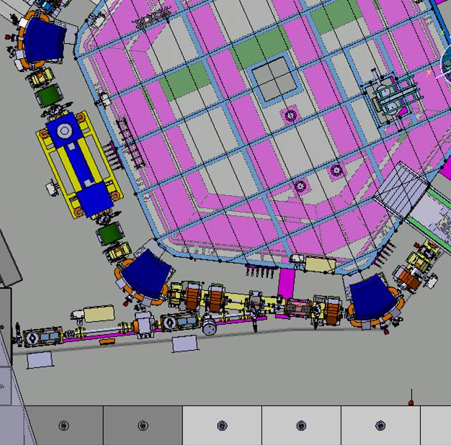
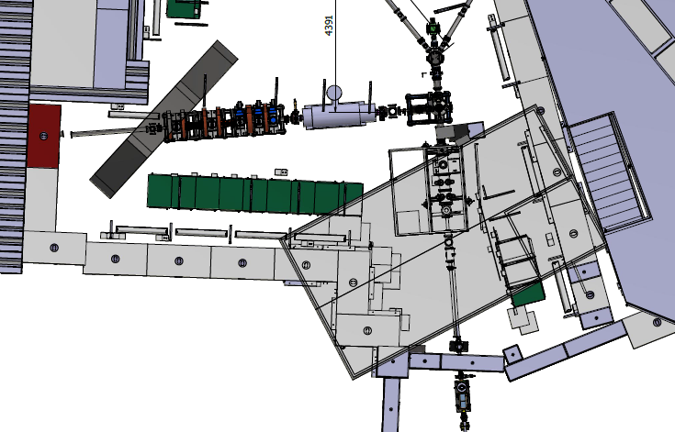
B
Status of the Reaction Chamber and Ps laser
A
r
Installation
TiSa seeder laser
Reaction chamber
Pulsed laser + SHG

Slide 7
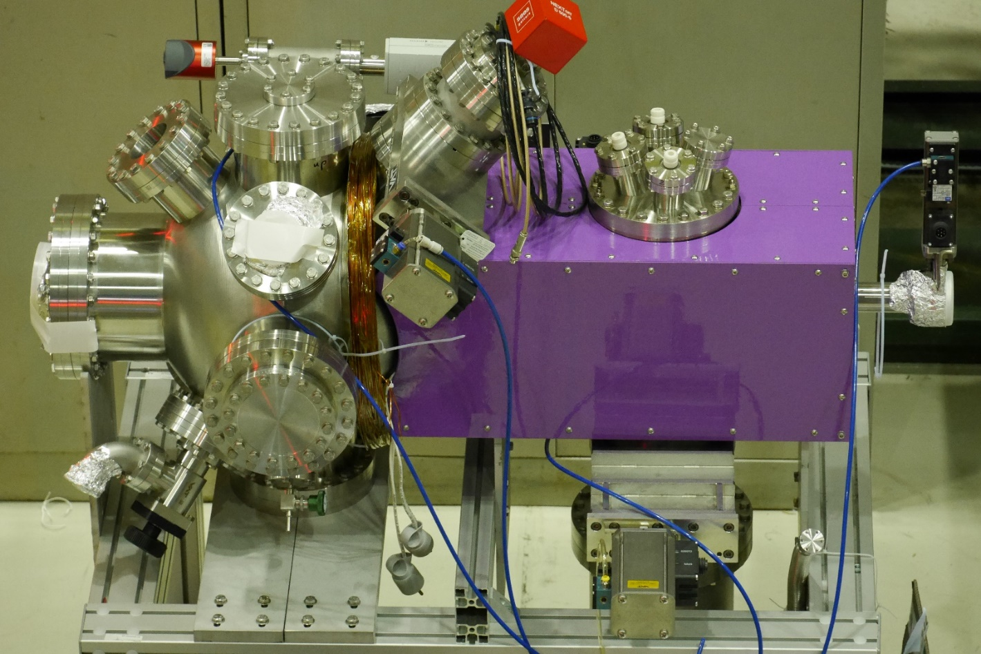
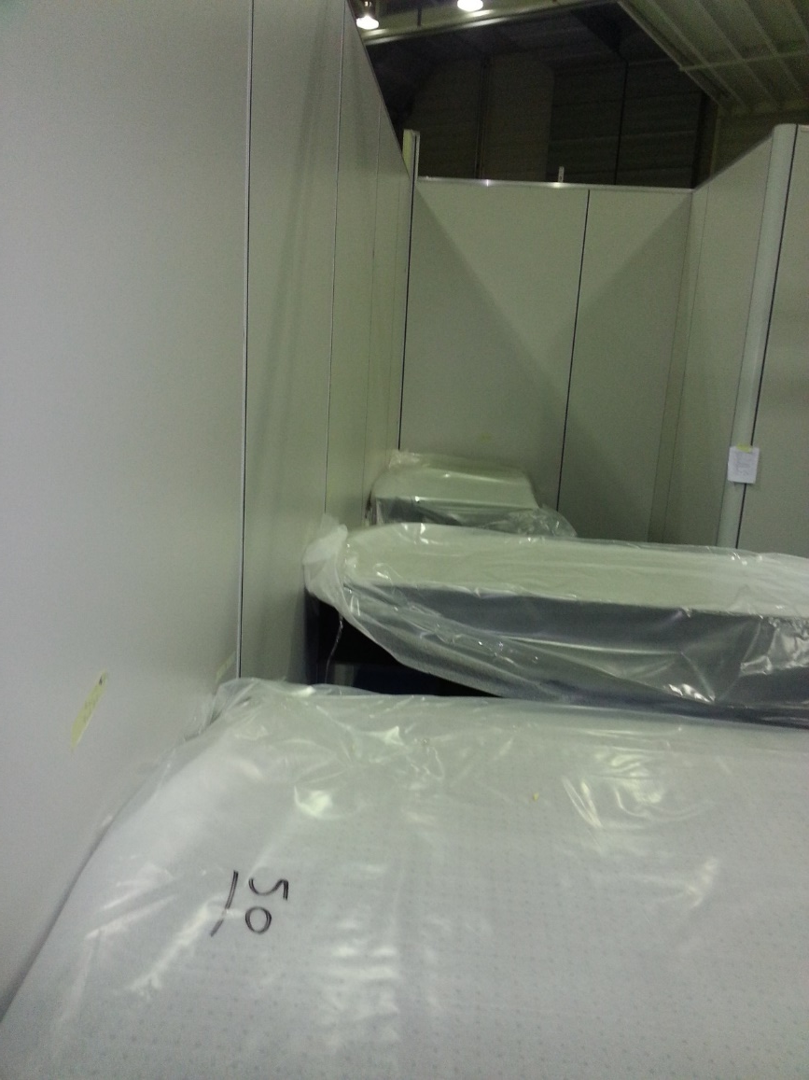
B
Status of the Reaction Chamber and Ps laser
A
r
Installation
November 2017

Slide 8
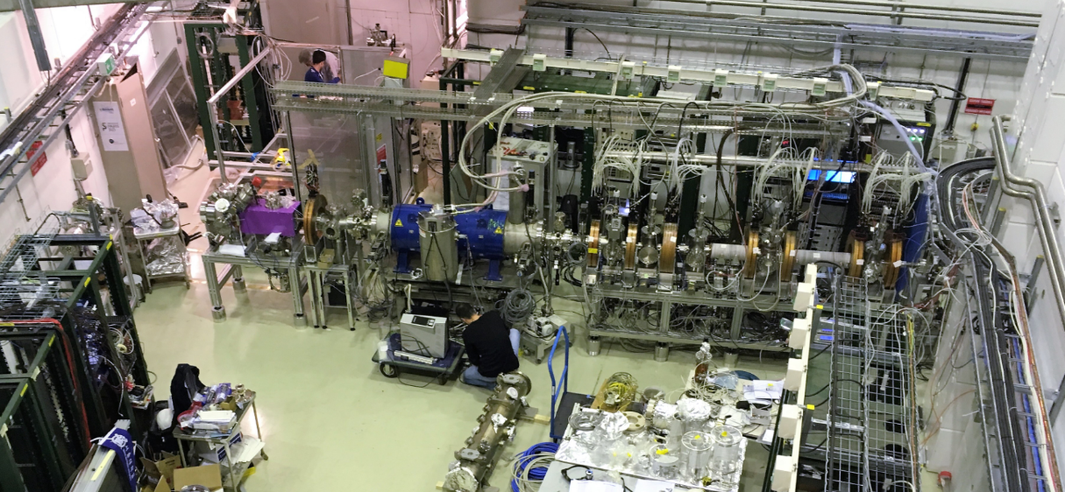
B
Status of the Reaction Chamber and Ps laser
A
r
Installation
April 2018
Reaction chamber at its finale position

Slide 9
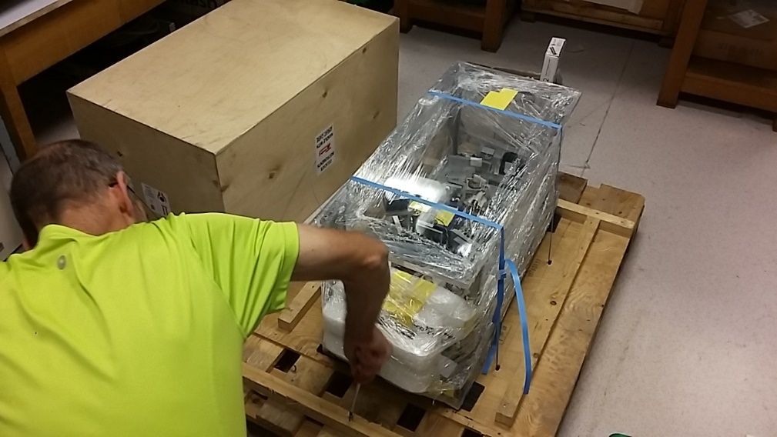
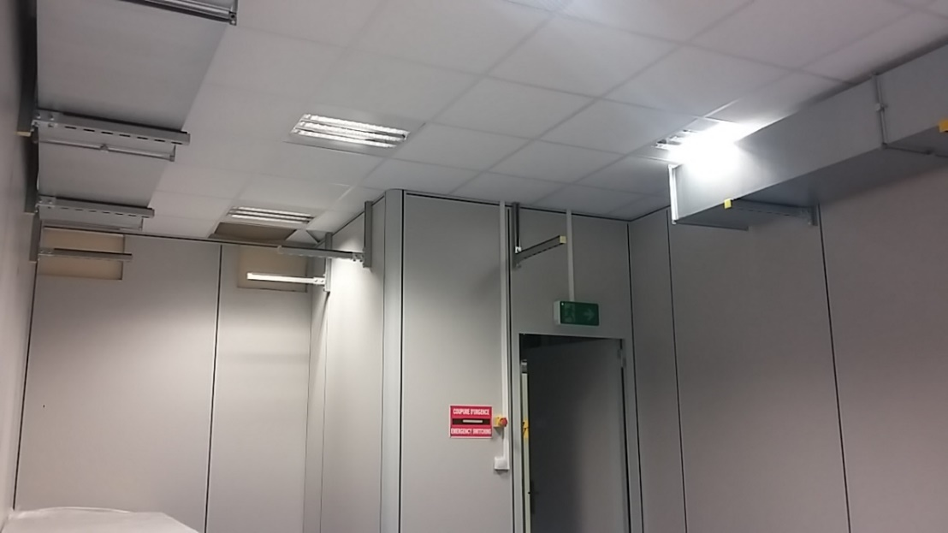
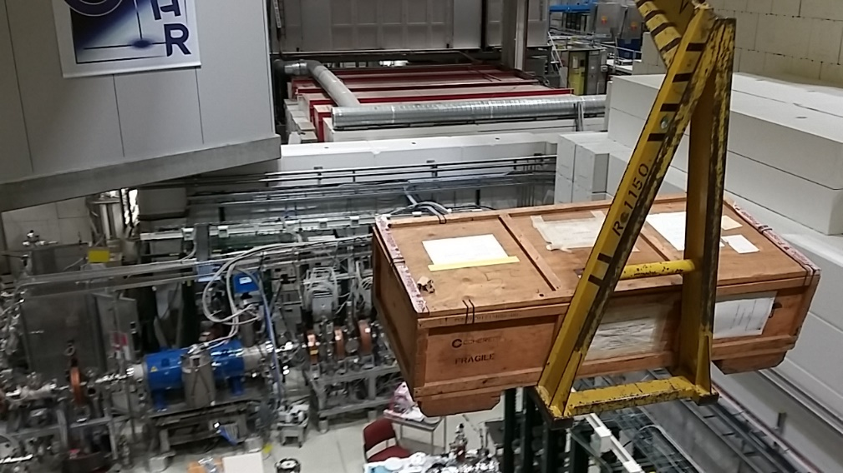
B
Status of the Reaction Chamber and Ps laser
A
r
Installation
May 2018
Installation of the air conditioning
Lasers moved to CERN

Slide 10
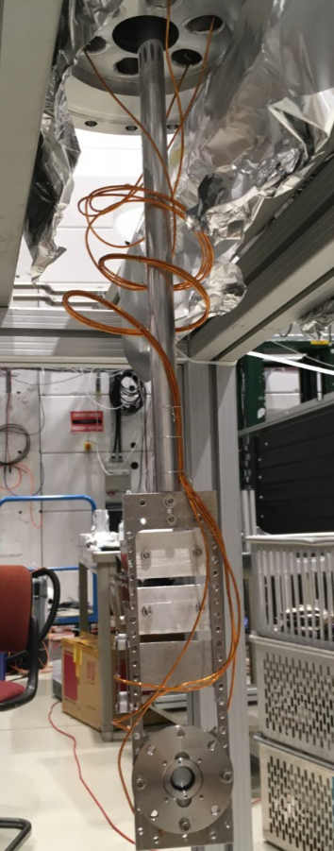
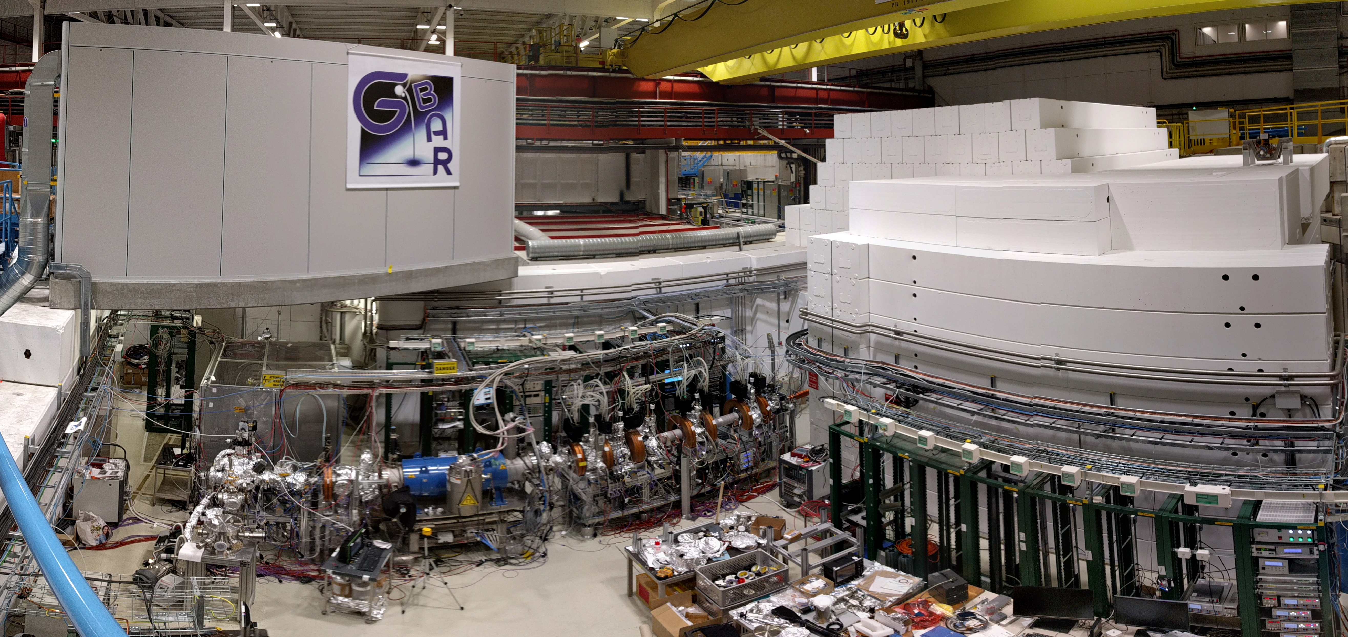
B
Status of the Reaction Chamber and Ps laser
A
r
Installation
Summer 2018
First target holder inserted
Baking
Connection to antiproton line end of August

Slide 11
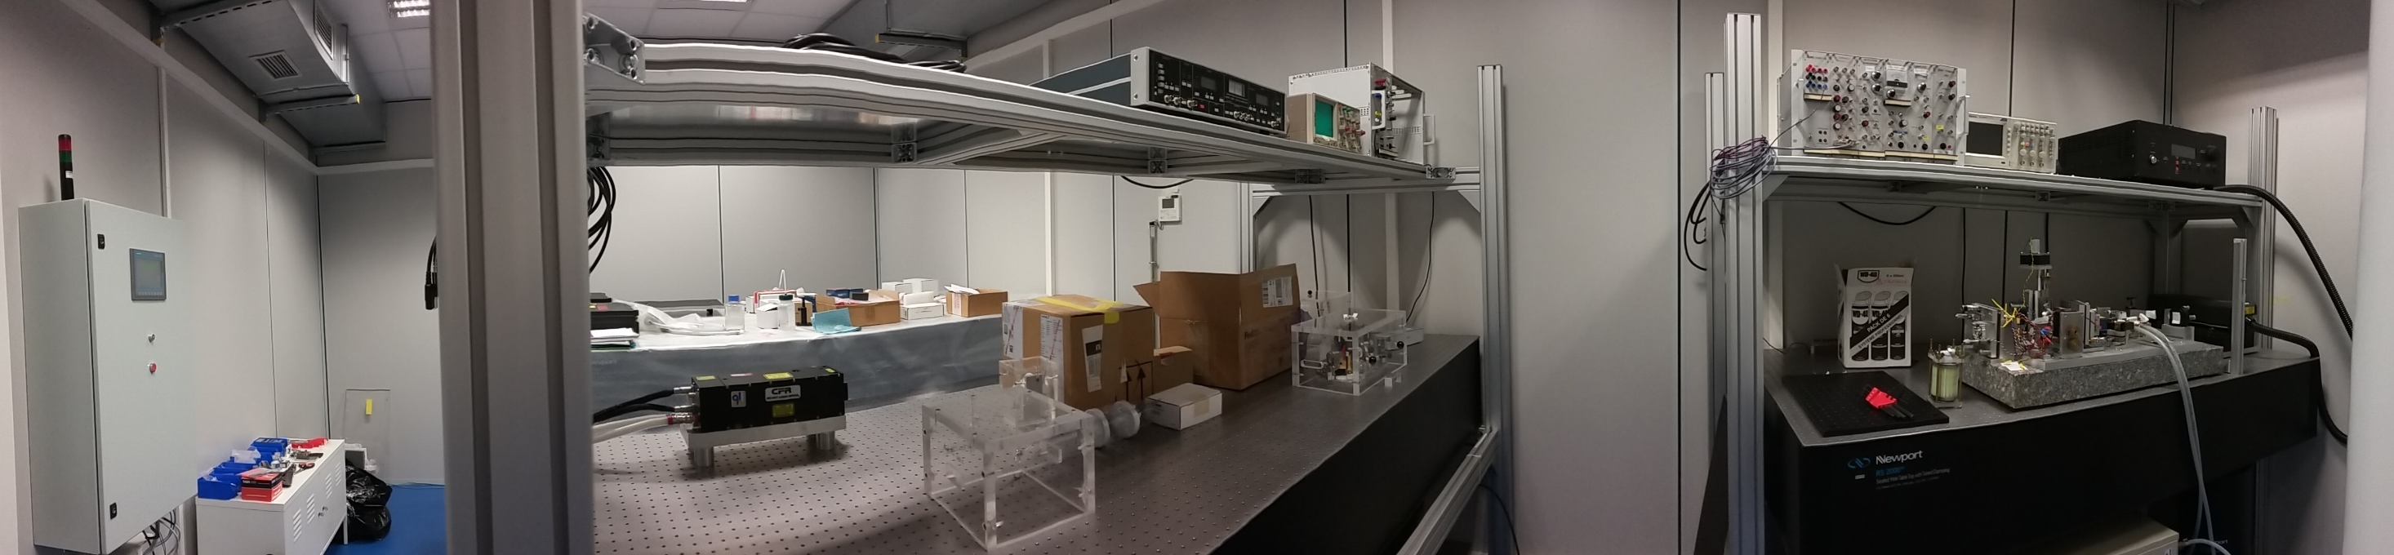
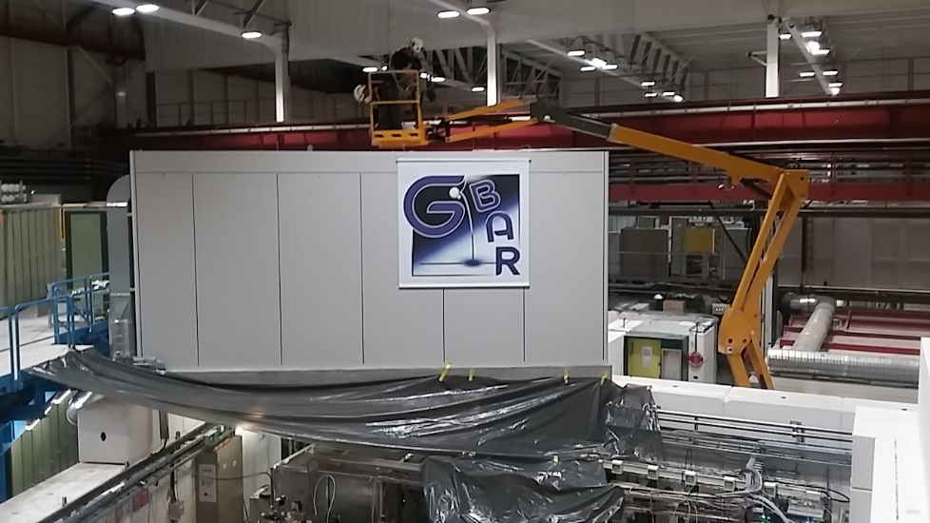
B
Status of the Reaction Chamber and Ps laser
A
r
Installation
Summer 2018
Replacement of the roof insulation
Laser hut equipped with PLC, shelves and … lasers
Authorisation to start lasers despite safety system not operational
Remote monitoring and control implemented

Slide 12
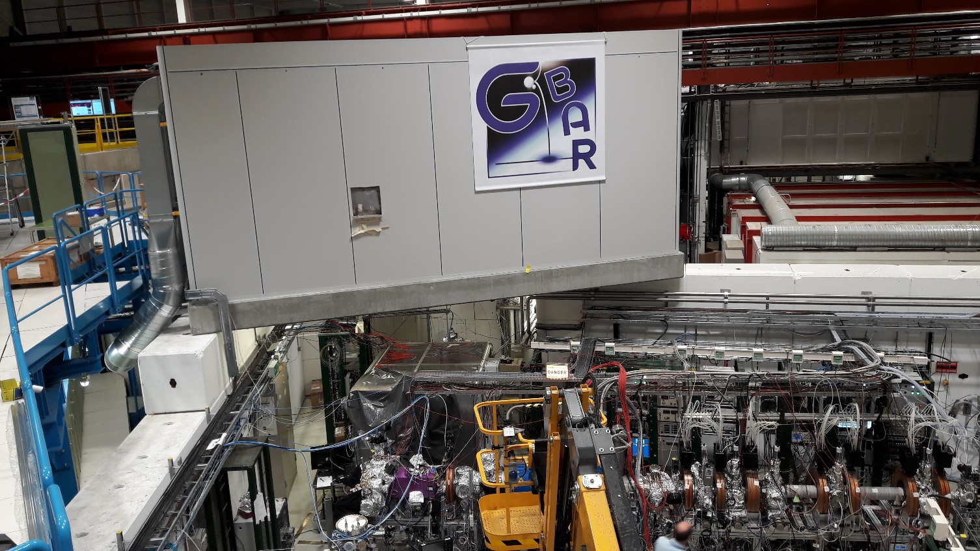
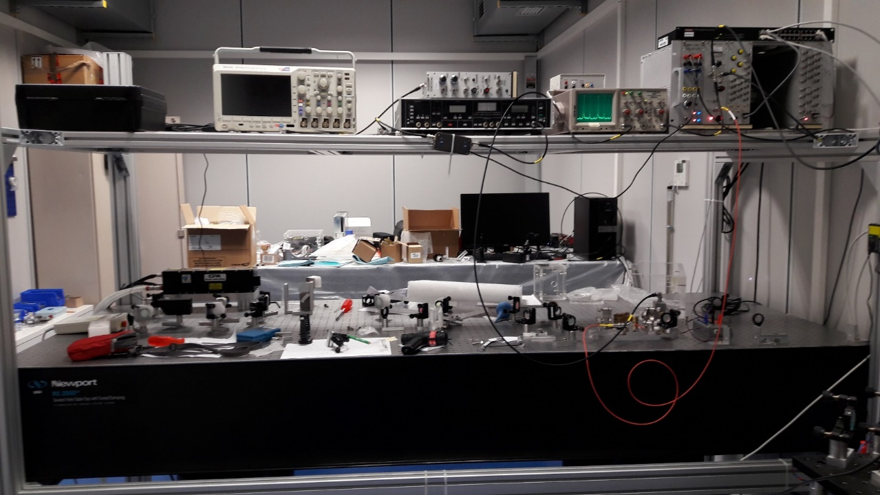
B
Status of the Reaction Chamber and Ps laser
A
r
Installation
September / october 2018
Pulsed laser mounting
Transfer tube installed

Slide 13
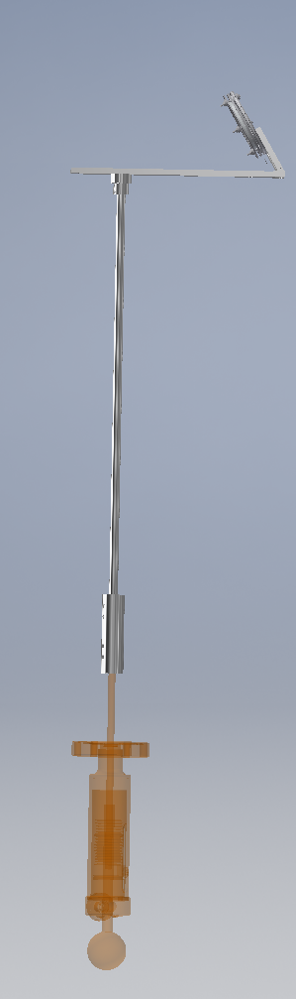
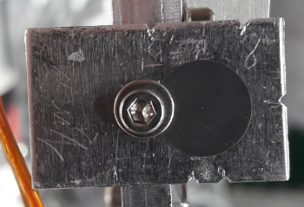
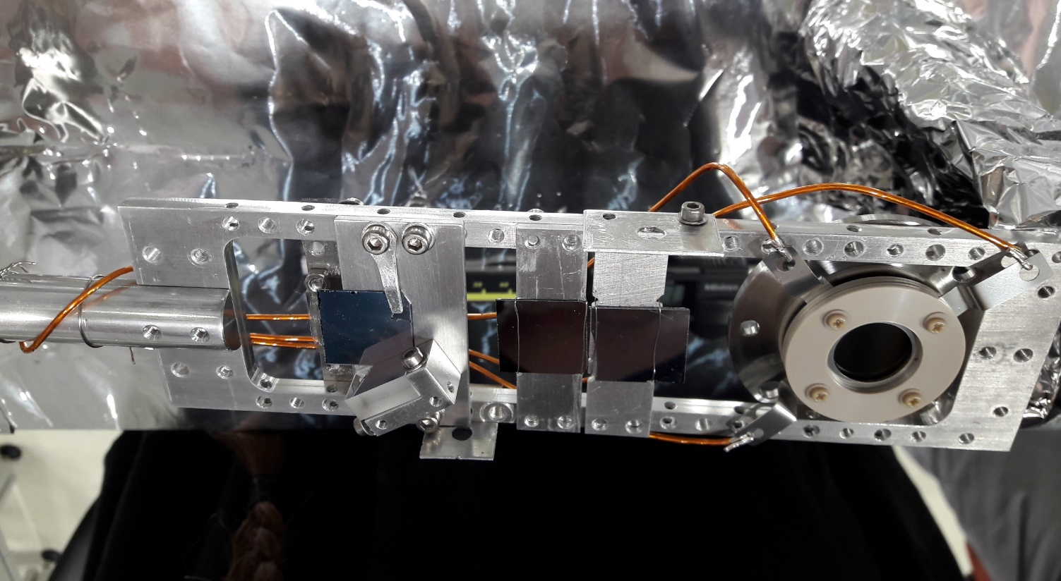
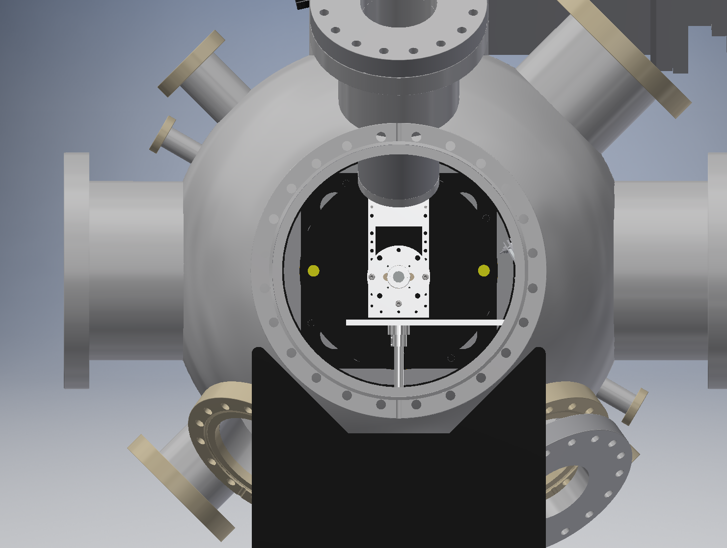

B
Status of the Reaction Chamber and Ps laser
A
r
Installation
October 2018
Latest version of the « Swiss-knife » target
(see also Barbara’s talk)
+ antiproton MCP added
Off-center MCP for antiprotons with possibility
to use positron MCP simultaneously
Nanoporous SiO₂
(not yet tested)
Mirror for the laser
Pinhole
Si target
150 mm
Max. Z
travel
Nanoporous SiO₂
$\overline{p}$ collimator
Positron MCP

Slide 14
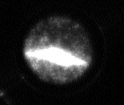
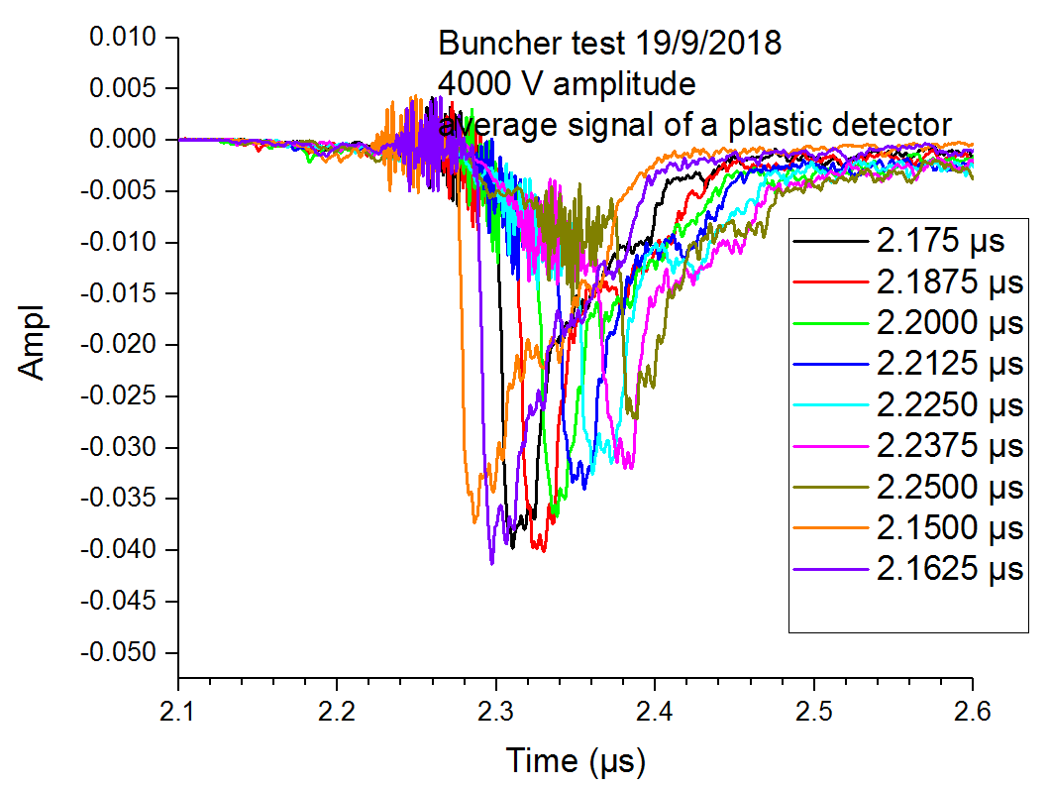
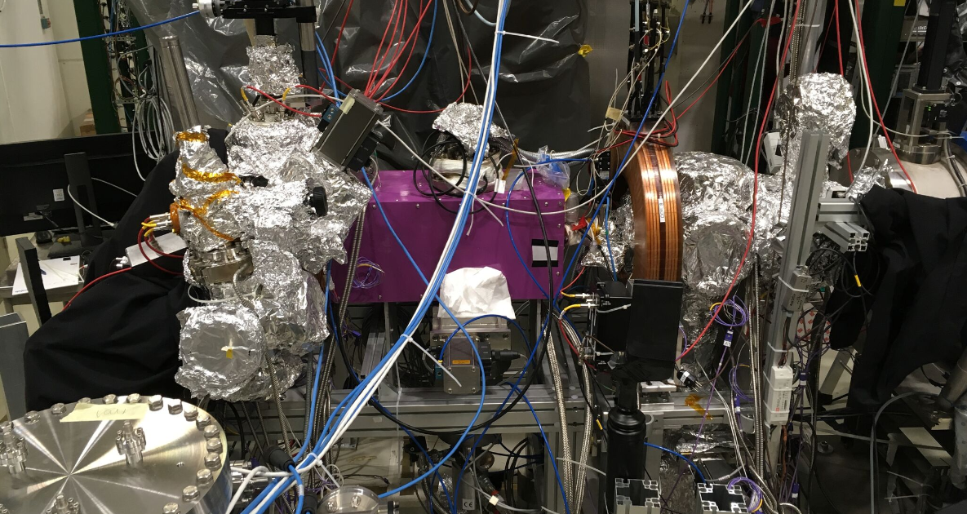
B
Status of the Reaction Chamber and Ps laser
A
r
Tests
Bunching (acceleration) and focussing of the positrons
Tests performed with positrons from BGT 2nd stage
10 mm
MCP
Reaction chamber
Magnetic shield
Gate valve
Buncher
Fast detector
CsI
CsI
e+
Annihilation on the gate valve

Slide 15
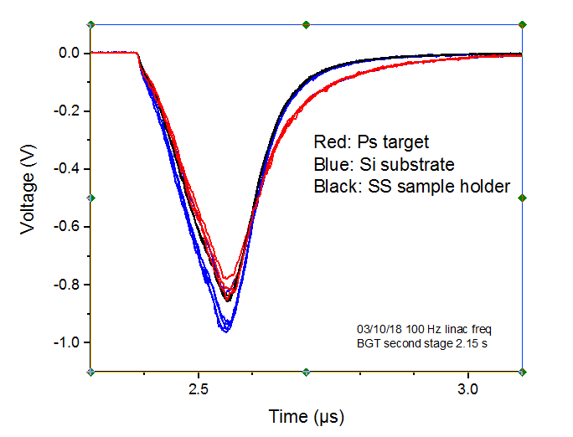
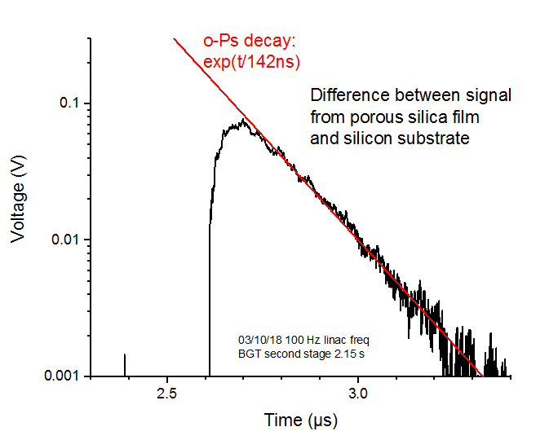
B
Status of the Reaction Chamber and Ps laser
A
r
Tests
1st Positronium sighting in GBAR (oct. 2018)
Also with positrons from BGT 2nd stage
MCP
Reaction chamber
Magnetic shield
Gate valve
Buncher
PbWO₄
Fast detector
CsI
e+

Slide 16
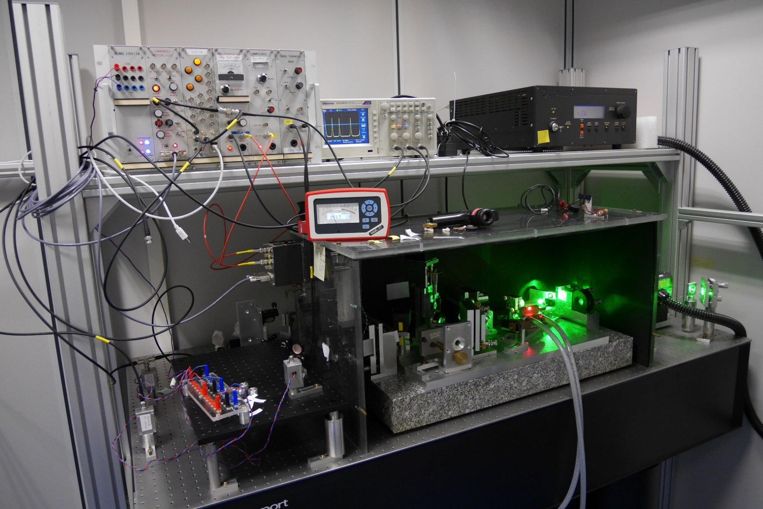
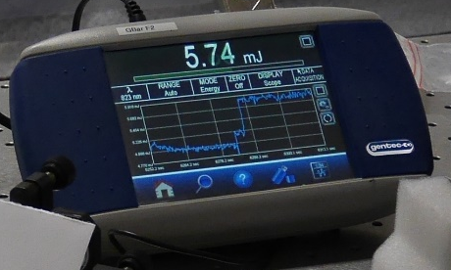
B
Status of the Reaction Chamber and Ps laser
A
r
Tests
Reaction chamber at its finale position and connected to the traps
250 mW at 820 nm
26 mJ, 7 ns at 820 nm
with room for improvement
6 mJ at 410 nm
without optimisation

Slide 17
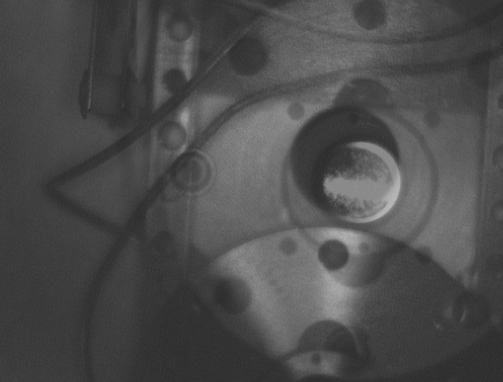
B
Status of the Reaction Chamber and Ps laser
A
r
Things to be solved
Positron beam off-axis
Compensated by correcting coils but alignment between BGT and reaction chamber to be checked
Aperture in last grounded electrode

Slide 18
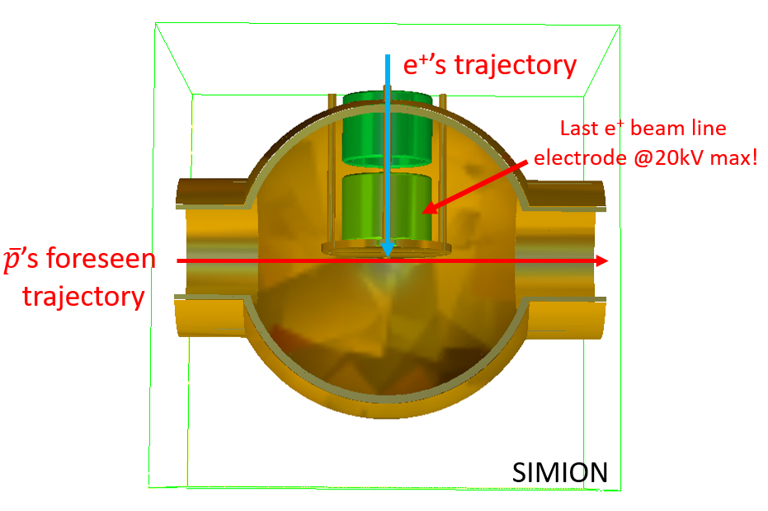
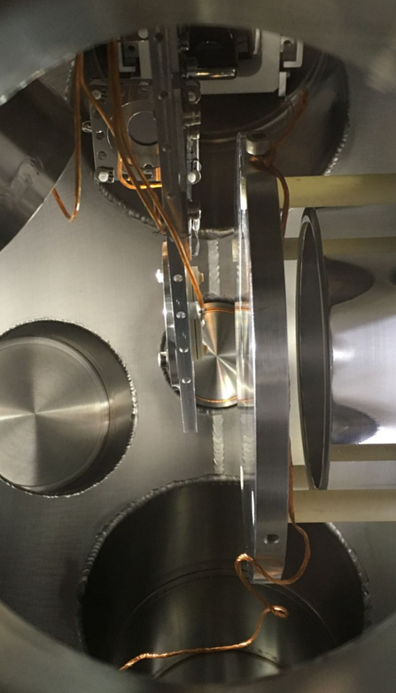
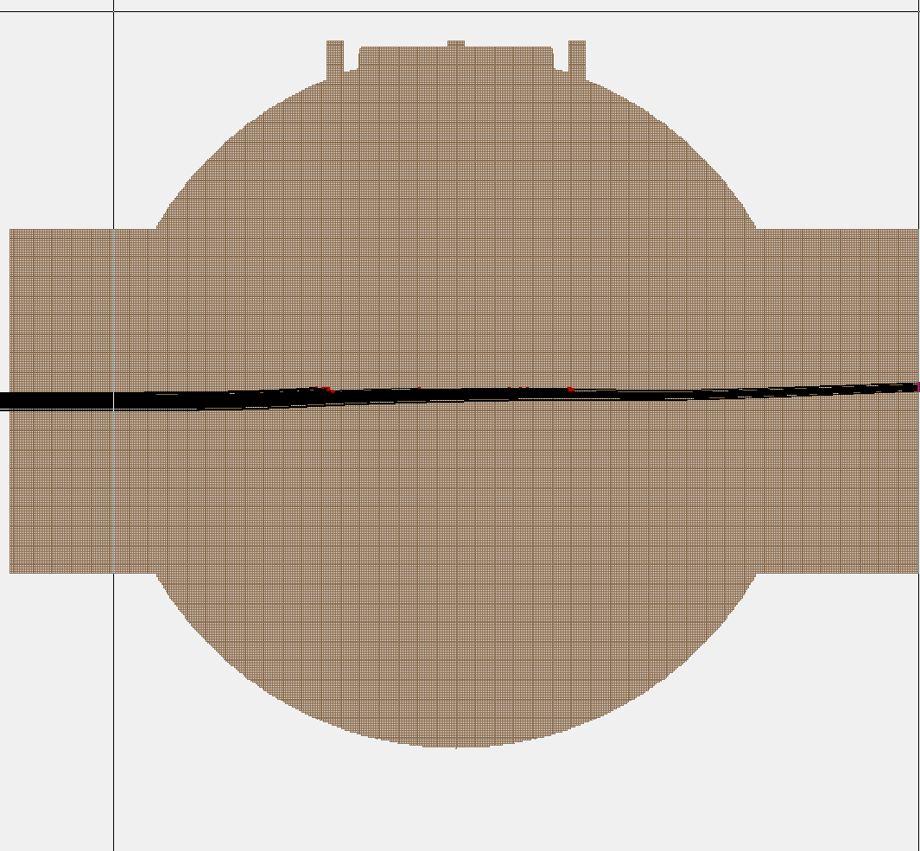
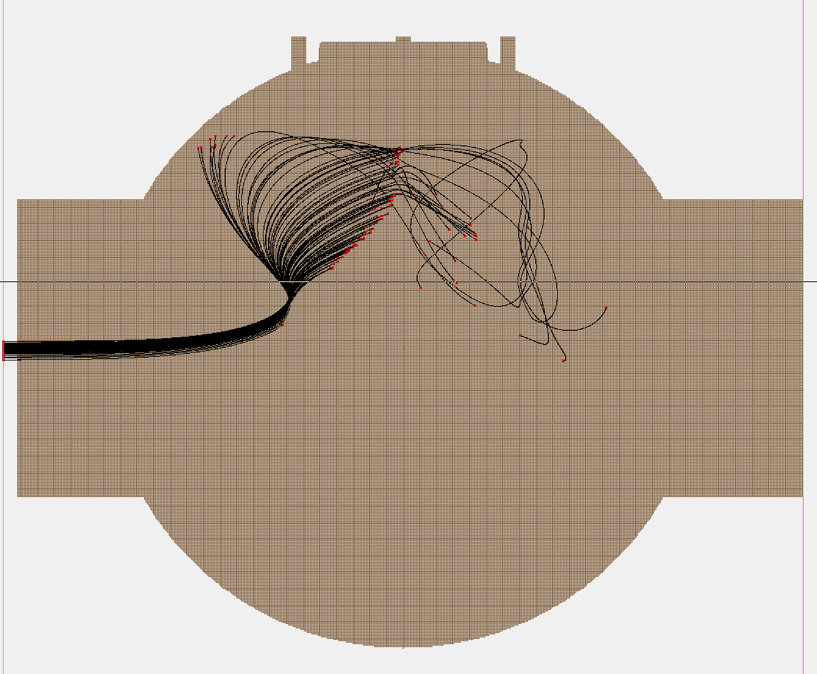


B
Status of the Reaction Chamber and Ps laser
A
r
Things to be solved
Stray electric field :
shielding required !
Also need to foresee new design for the electrode focussing in the Ps cell
Last e⁺ electrode = 20kV (Top view)
e⁺
e⁺
$$\overline{p}$$
$$\overline{p}$$
Beam energy = 10 keV
Beam energy = 1 keV

Slide 19
B
Status of the Reaction Chamber and Ps laser
A
r
Next priorities
Positronium production :
bunching and focussing of positrons from RIKEN trap, after re-alignment
produce Ps in the cavity and measure its density
Ps laser :
finalise laser control (wavelength and pointing stabilisation)
Installation in GBAR area and alignment in reaction chamber
3S in March (Ps density measurement)
3D in April - June
Then cross section measurements (see presentation by Laszlo)

Slide 20

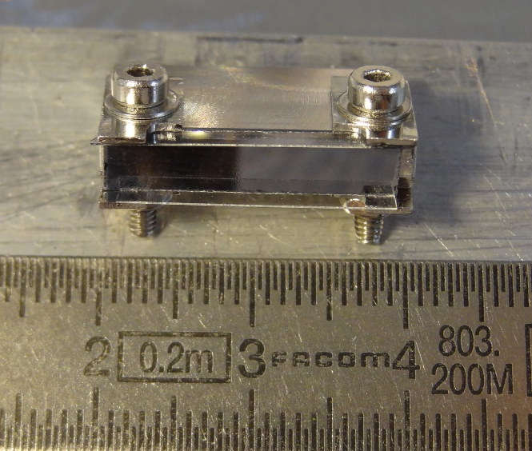
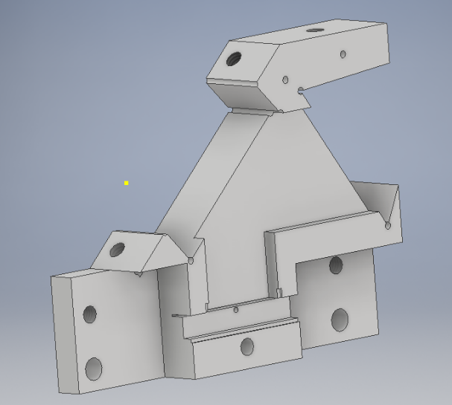

B
Status of the Reaction Chamber and Ps laser
A
r
Toward a dense excited Ps target
HR410 mirror
CaF2 prism
Laser
30°
$$\overline{p}$$
Flat target with Al mirror currently in RC
e⁺
20 mm x 1 mm² design + excitation scheme
20 mm
Larger cavity demonstrator available (unused yet)
Holder design under way

Slide 21
B
Status of the Reaction Chamber and Ps laser
A
r
Summary
1st positrons in RC in August, followed by antiprotons
1st Positronium production in GBAR demonstrated
A « Swiss-knife » target is available for beam characterisation and physics
The laser for Ps excitation is operational
Positron pulse shaping and Ps production to be optimised soon
Laser path to reaction chamber to be finalised
Physics with positronium about to start !
Many thanks to all the persons involved !
Laszlo Liszkay, Barbara Latacz,
BongHo Kim, Andree Welker,
Pierre Cladé, Saïda Guellati,
François Nez, Bérengère Argence,
Pierre-Philippe Crépin, Jean-Yves Roussé
Didier Pierrepont, Jean-Michel Isac (and LKB workshop chocoholics)

Slide 22
B
Status of the Reaction Chamber and Ps laser
A
r

Slide 23
B
Status of the Reaction Chamber and Ps laser
A
r
Laser room organisation
Pulsed laser at 410 nm
10 mJ, 10 ns, max. rep. rate 10 Hz
Whole system:
① Seeder:
1 CW TiSa laser at 820 nm, 400 mW
Pumped by CW 5W laser at 532 nm
Seeder sent to
② Pulsed laser:
1 oscillator + 1 amplifier, 25 mJ at 820 nm
Pumped by 232 mJ at 532 nm
Then frequency doubling 820 to 410 nm
④ 410 nm pulsed laser sent to GBAR experiment
③ Table available for later application
E
E
1.3m
0.9 m
T
PC table + shelf
1.25m
1 m
0.9 m
1 m
1.1 m
②
①
③
④
④

Slide 24





B
Status of the Reaction Chamber and Ps laser
A
r
Extensive laser safety system study
Access control
(clearance required)
E
Emergency stop : full stop
1.3m
0.9 m
Emergency stop : shutters
T
shutter
PC table + shelf
Box + switches
1.25m
Goggle box
1 m
Alignment goggle box
1.1 m
0.9 m
1 m
Laser warning
②
Laser curtain
①
③
PLC
④
④

Slide 25
B
Status of the Reaction Chamber and Ps laser
A
r
Transfer tube
Next steps:
Install the missing laser boxes
Live test of the PPS
Optimise the 410 nm beam
Install the laser area in GBAR zone (breadboard on concrete block and area delimited by laser curtains)
Work on Ps excitation starting from February 2019
Laser breadboard in laser box
Decelerator HV cage
RC
Concrete block

