Slide 1

GBAR Linac
W.Dziewiecki, T. Kosiński, A.Łubian, M.Matusiak, S.Wronka
28.11.2018
@ CERN

Slide 2



Linac for GBAR
Vertically oriented
Standing wave accelerating structure π/2 type;
Microwave source: klystron TH 2157A installed on K2 Scandinova solid state modulator;
Electron source: Altair triode gun 13xx049R;
Focusing based on two-section-solenoid and three quadrupols installed at the beam output;
Electrons energy: 9 - 10MeV;
Output peak current: 300mA, 4μs;
Beam average power : 3,2kW;

Slide 3
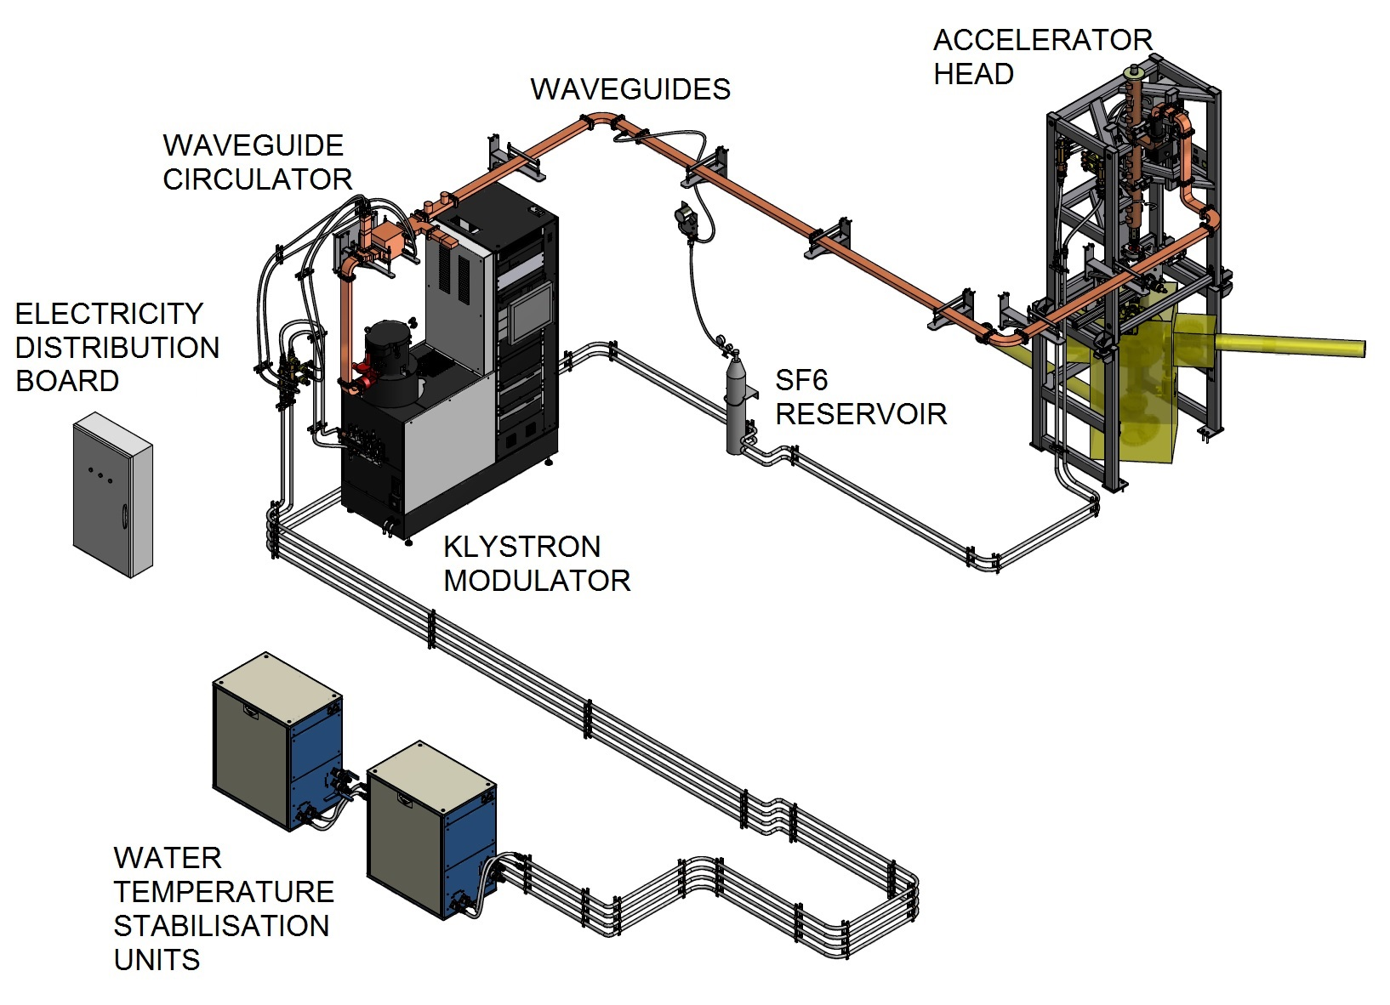

Slide 4
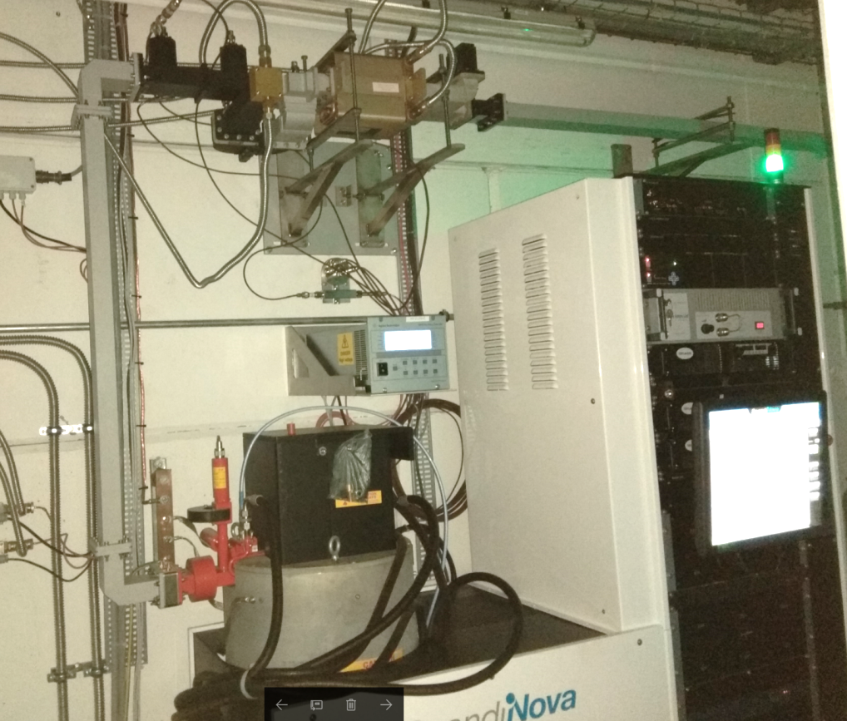
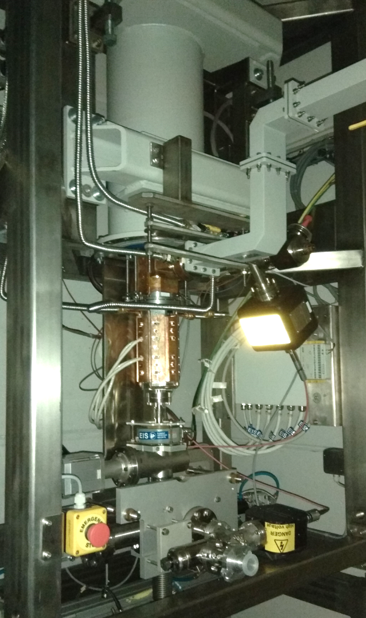
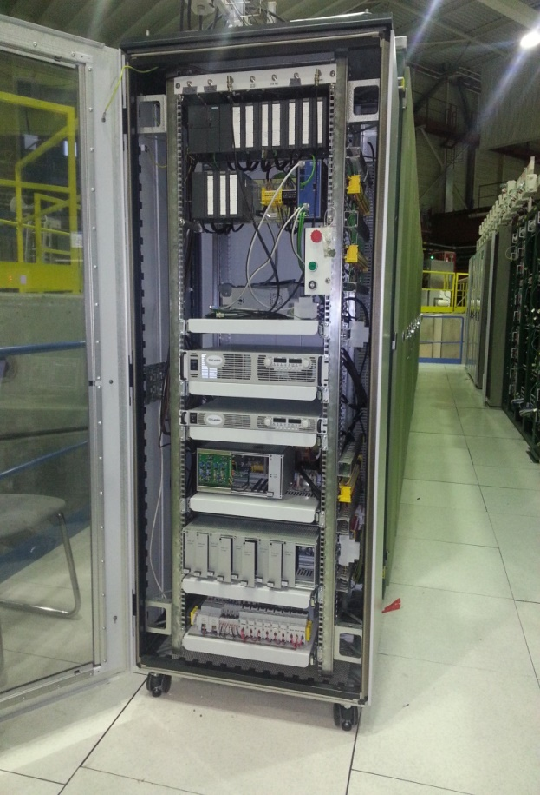
Electronic cabinet

Slide 5
Mesurements

Slide 6
Actions in 2018:
Final structure installation (12.02 - 1.03)
Waveguides failure (22.04 – 22.05*, replacement)
Circulator failure (cont till 13.06, replacement)
Gun modulator failure (15.09 -17.09, repair )
Klystron failure (5.10 - 19.10, replacement)
* mainly waiting time for contamination report

Slide 7
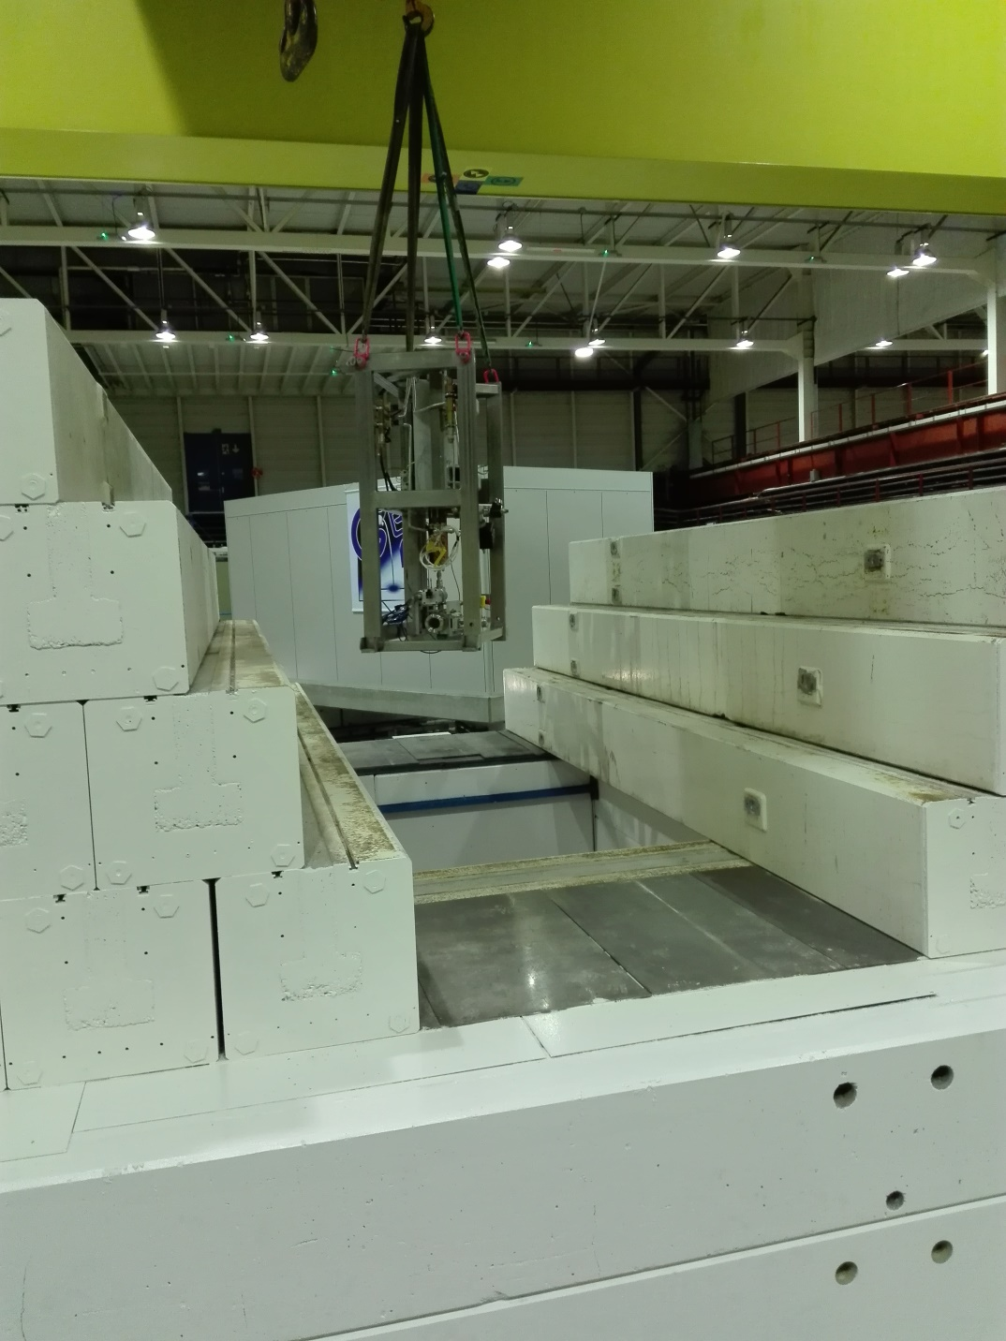

Slide 8
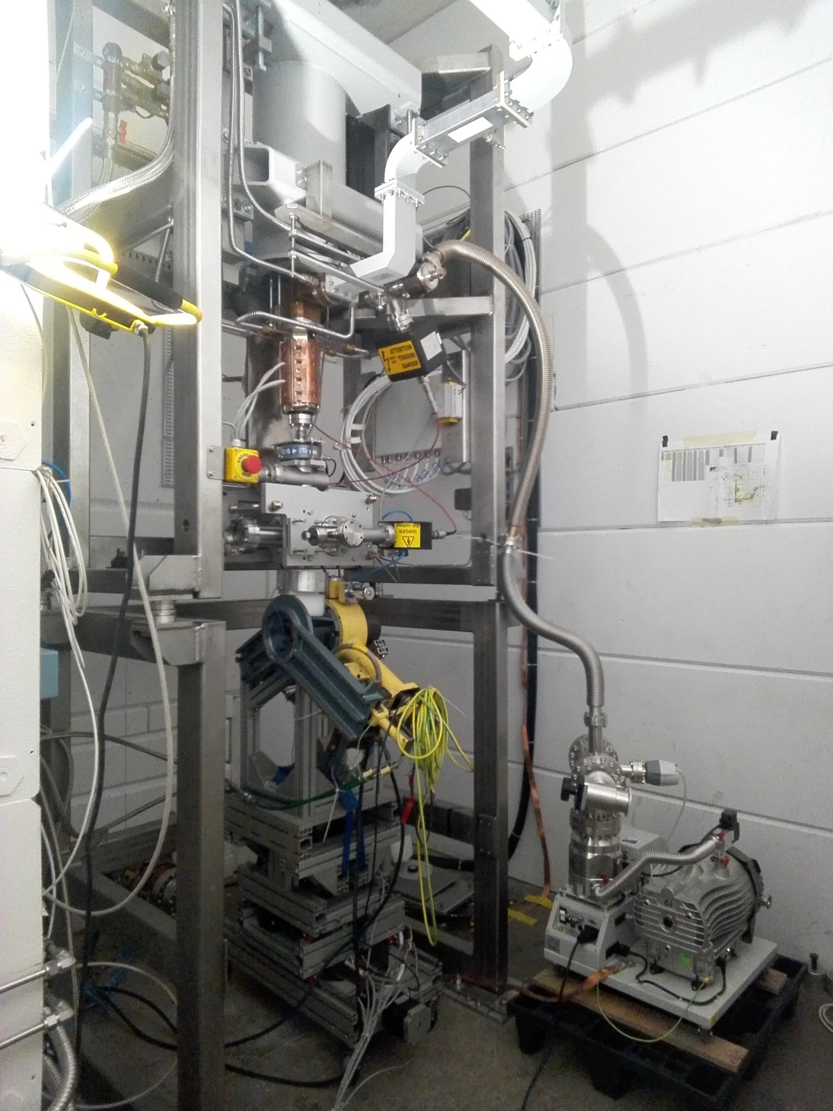
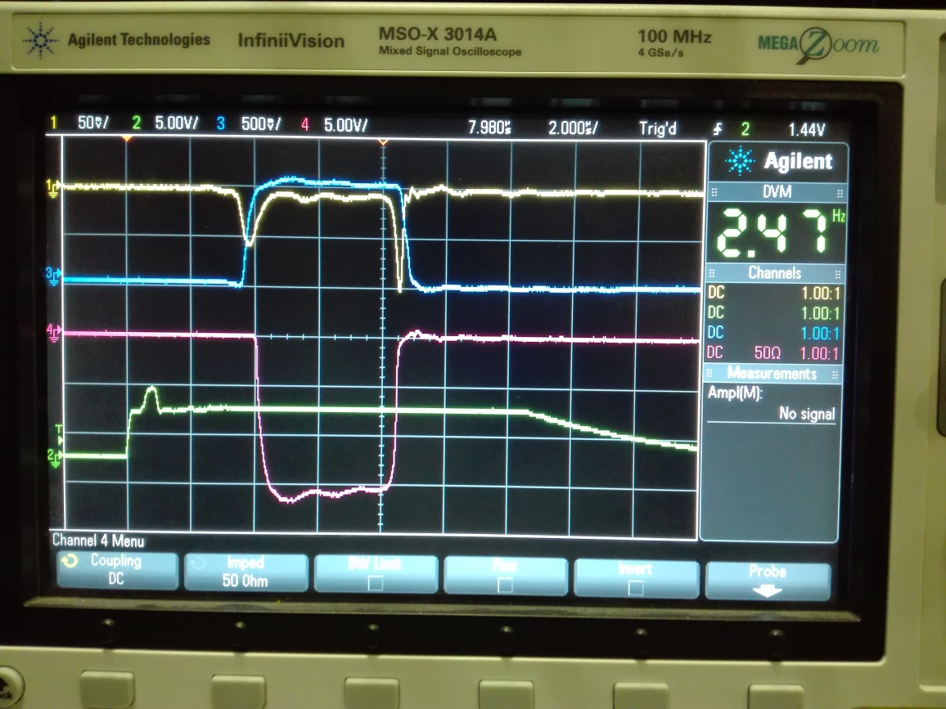

Slide 9
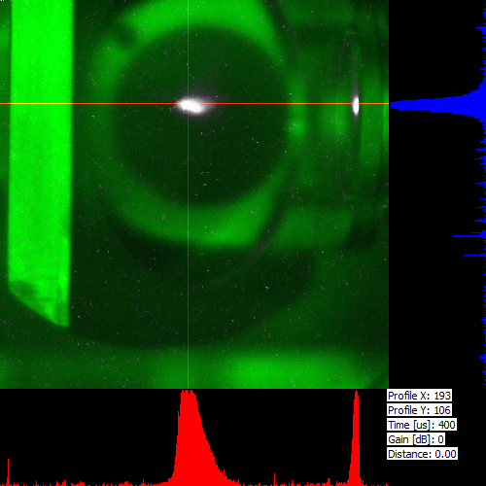
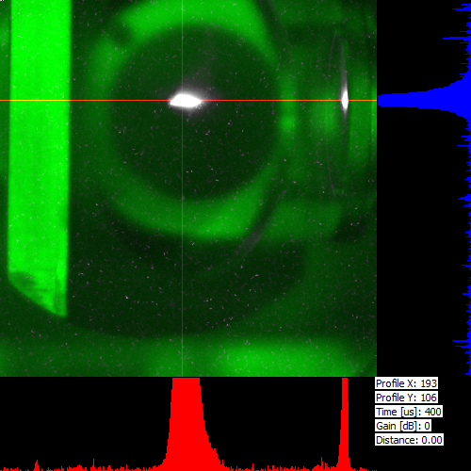

Slide 10
Summary
Linac was succesfully delivering e- beam for GBAR in 2018, although we were unlucky with few main components.
Final commissioning postponed for „after-the-run” time
(i. e. now).
Thank you for your attention!

