Slide 1

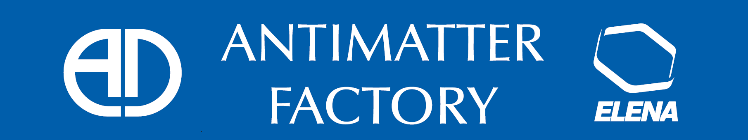
AD-CONS / ELENA Projects
Works in AD during LS2

Slide 2
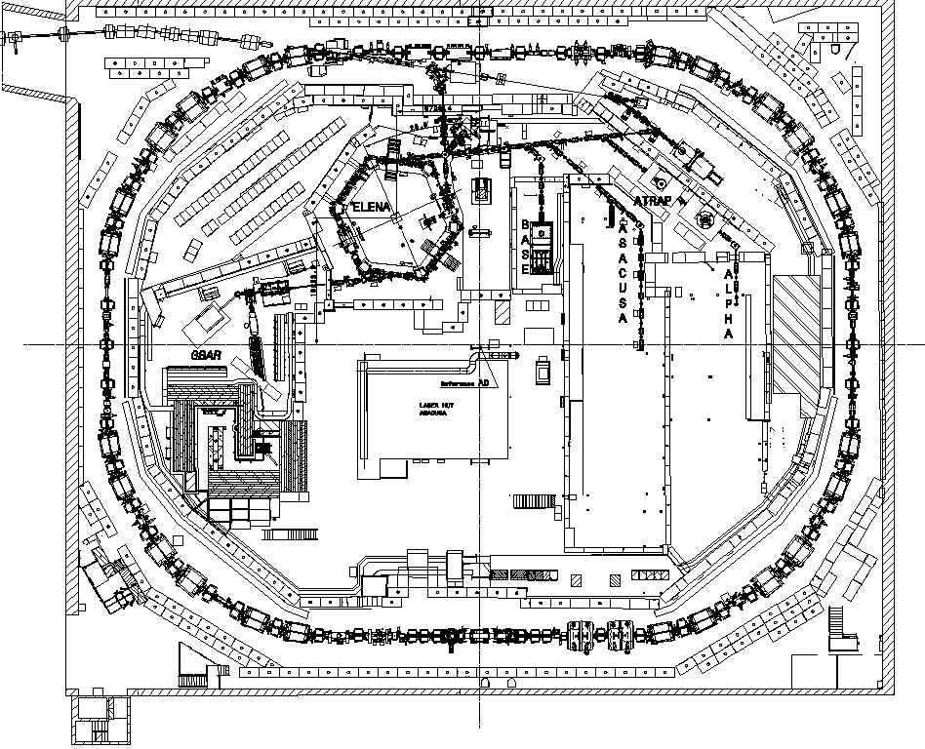
Main works during LS2 in AD hall
Main works :
  Refurbishment of 18 AD ring magnets :
  Nov 2018 – May. 2020
  ELENA transfer lines installation :
  Nov. 2018 – Mar. 2021
  BASE zone extension: Dec 2018 – Jan 2020
  ASACUSA RFQD extraction:
  Nov 2018 – March 2019
  RF C02 cavity replacement March 2019
  Additional pump for exp + ELENA: Feb 2019
  Remove STP6069 and SLV6082: Oct 2019
  ASACUSA laser hut remodeling: Jan – Jul 2019
  AEGIS Relocation (To be confirmed)

Slide 3
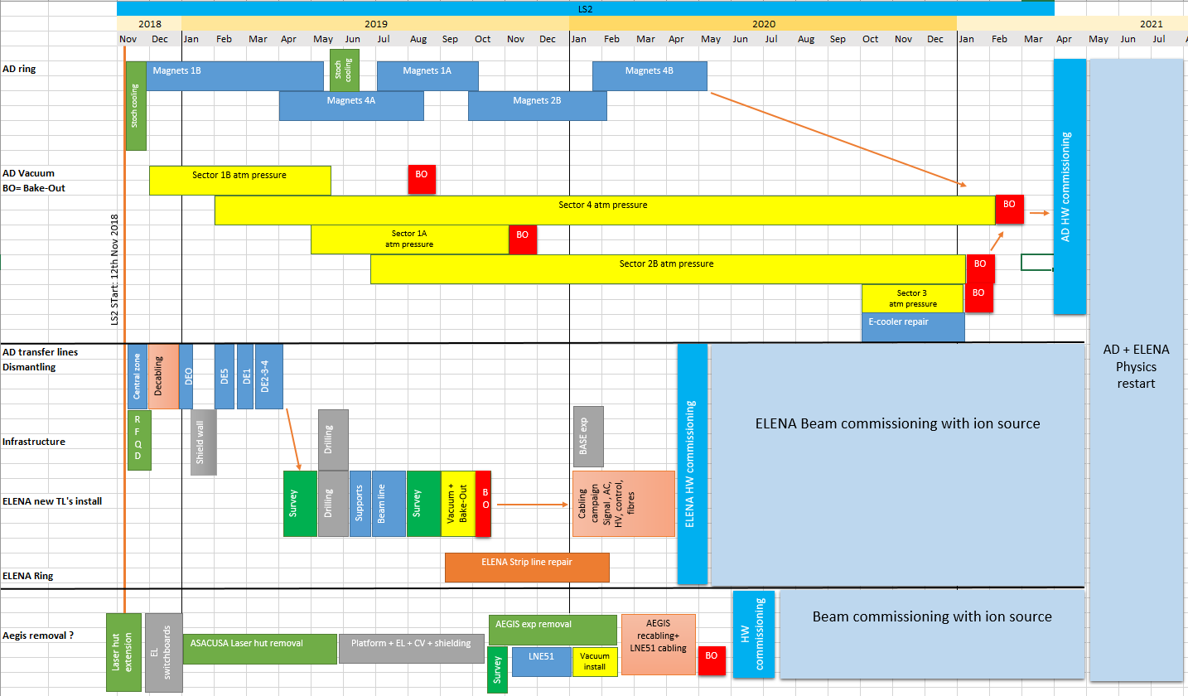
AD works - planning

Slide 4
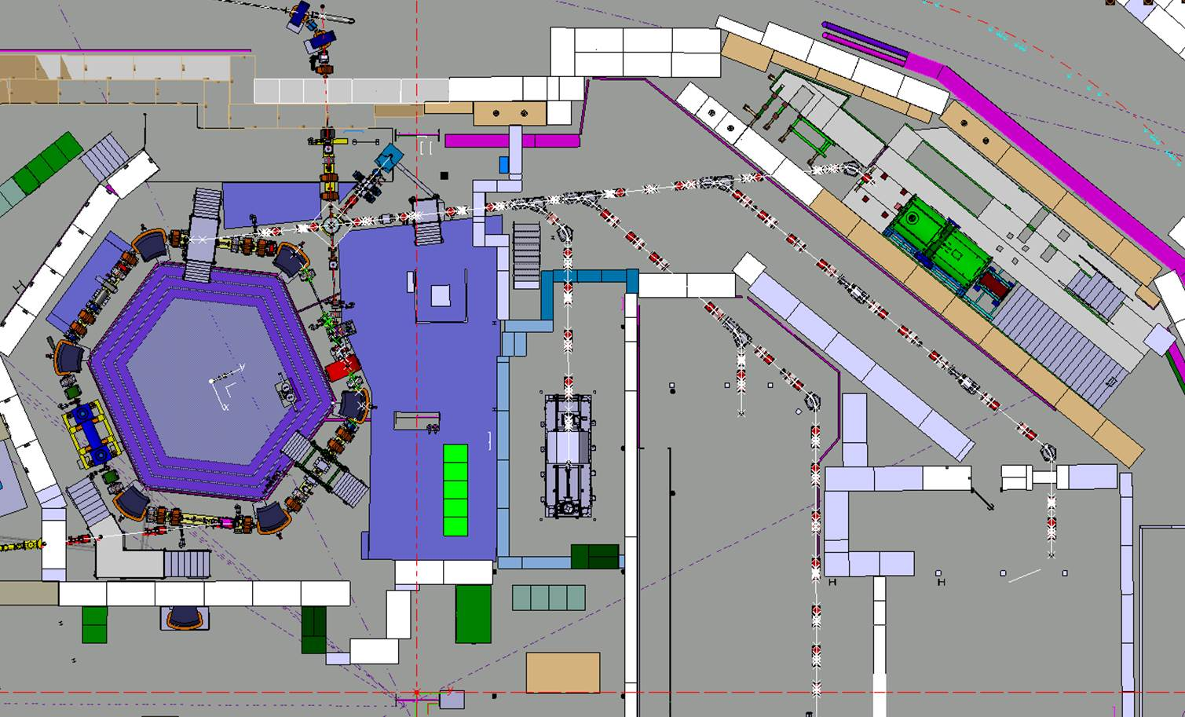
Electrostatic lines to be installed
LNE02
LNE00
LNE01
LNE03
LNE07
LNE06
LNE04
LNE50
LNE05
LNE51
Impact on GBAR: power supply adaptaptions

Slide 5
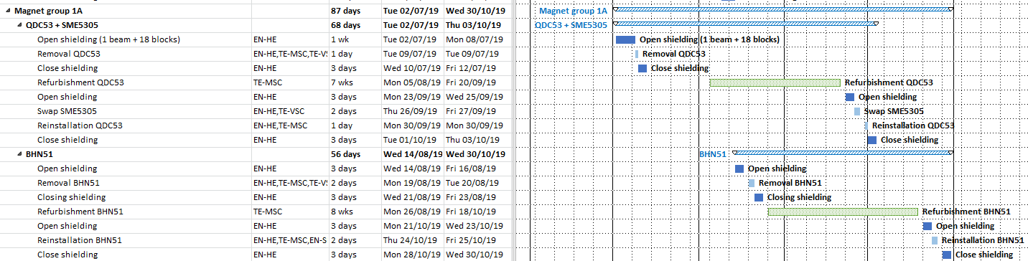
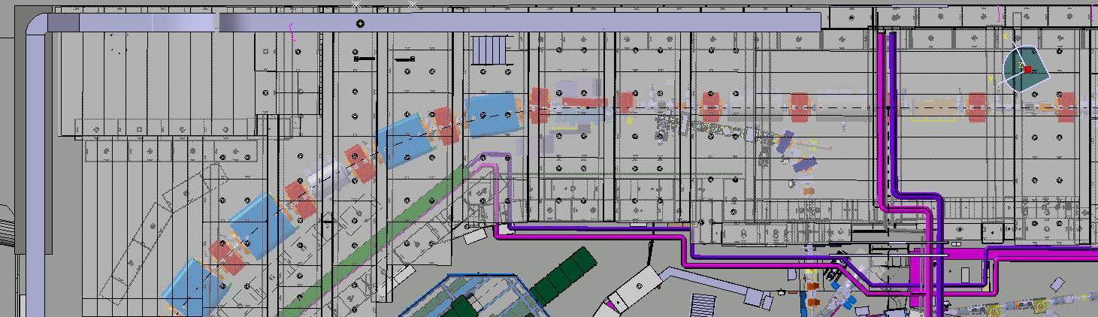
Magnets group 1A
BHN51
QDC53
SME5305
Impact on GBAR: access from bdg 393

Slide 6
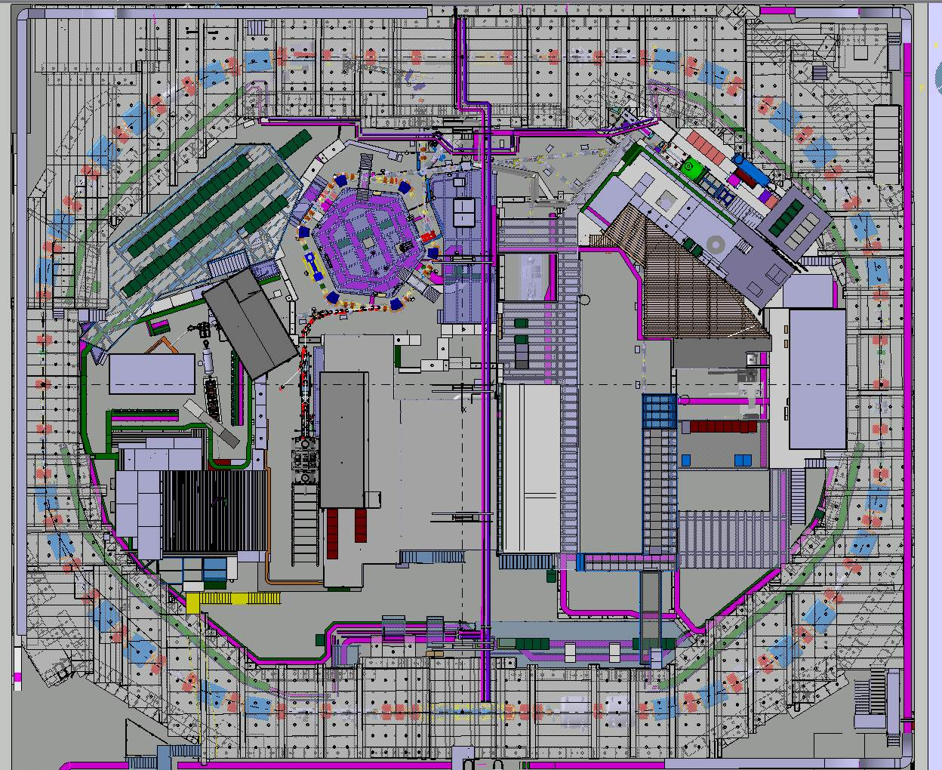
Magnets Group 4B
BHN45
QDN45
QFN44
QDS43
QFN42

Slide 7
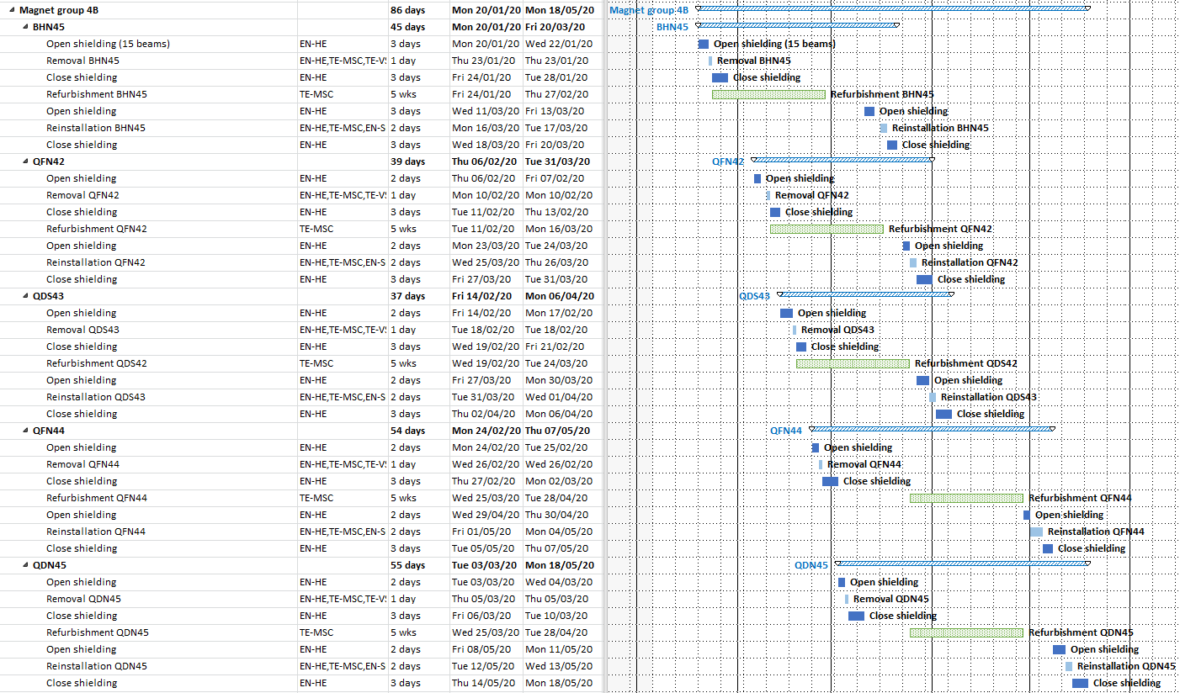
Magnets group 4B
Impact on GBAR: Access to exp area from shielding + handling of blocks nearby

Slide 8
Known Services disruptions
Water cut:
  21/12/2018 – 08/02/2019
  19/12/2019 – 05/02/2020
  17/12/2020 – 03/02/2021
Power cuts:
  19th Dec 2018 from 6h00 to 6h30.
  Test AUG 19 & 20 January 2019
  11th to 15th May 2020
  Test AUG 23 & 24 May 2020

Slide 9
Conclusion
About 18 months of intense activity for ELENA
To be done in parallel with AD machine consolidation / AD hall infrastructure works / BASE exp area extension / AD target renovation / potentially AEGIS relocation…
Will follow-up planning details throuh IIC and ADTC meetings thursdays PM.

