Slide 1
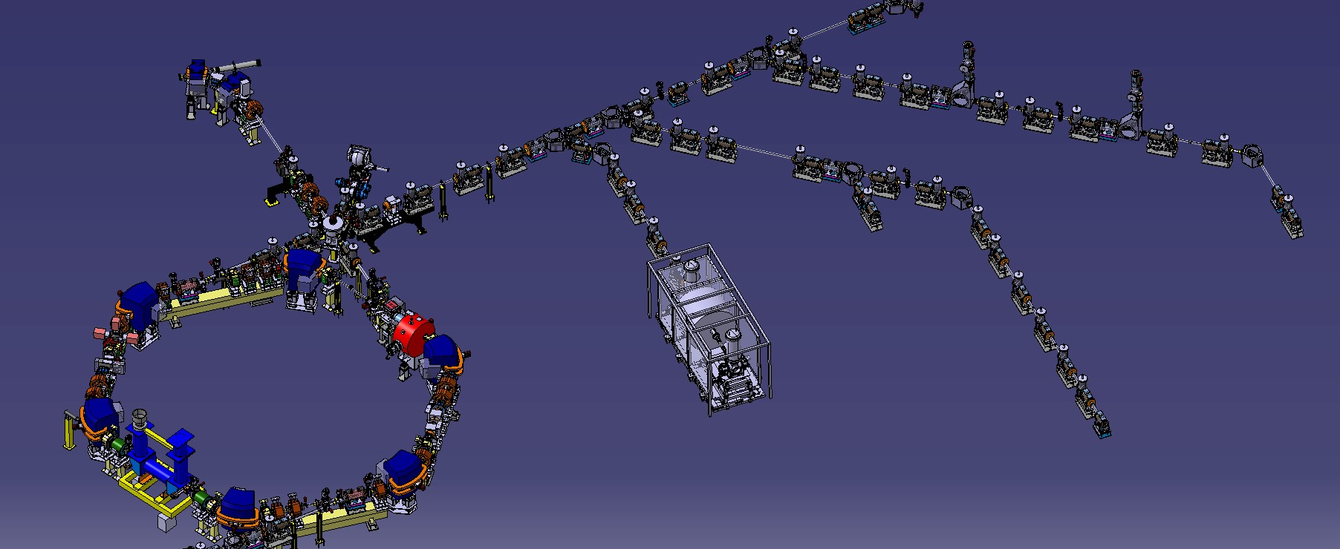
ELENA –
Status and Plans for LS2
C. Carli on behalf of the AD/ELENA team(s) GBAR Meeting, 28th November 2018
Recent Results from Commissioning (selection of a few highlights)
ELENA Commissioning Status
Summary and Outlook

Slide 2
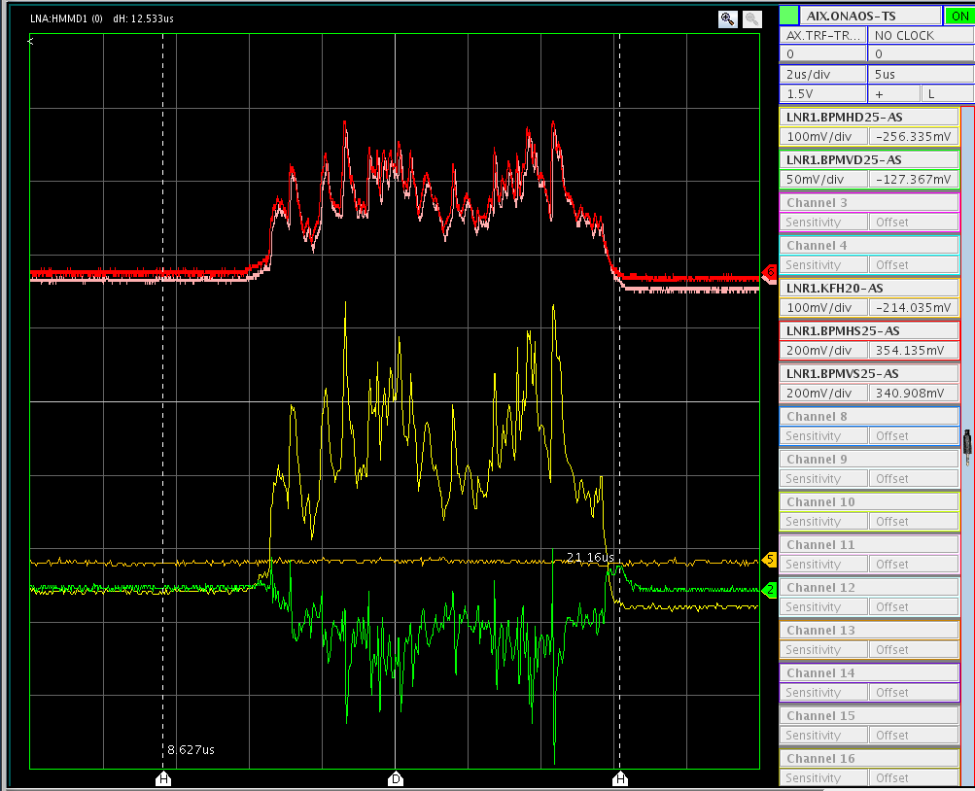
Recent Results from Commissioning
Observation of the beam from the source on a ring pick-up
Observation of beam from source on first pick-up in ring
  Steering without kicker (flat-top shorter than beam
  pulse from source) up to first ring pick-up
  Higher deflection from septum
  and steering upstream
  No beam must hit pick-up plates
  (delicate!)
  Intensity fluctuations depend on
  source settings:
  probably caused by plasma fluctuations
  and may explain poor reproducibility
  observed
  Source optimisation easier with these observations
  Possibly, fluctuations may be reduced with longer rise times of the pulse
Investigations by
D. Gamba
Pick-up sum signals showing (very likely
intensity fluctuations, sometimes saturated)
Pick-up
difference signals

Slide 3
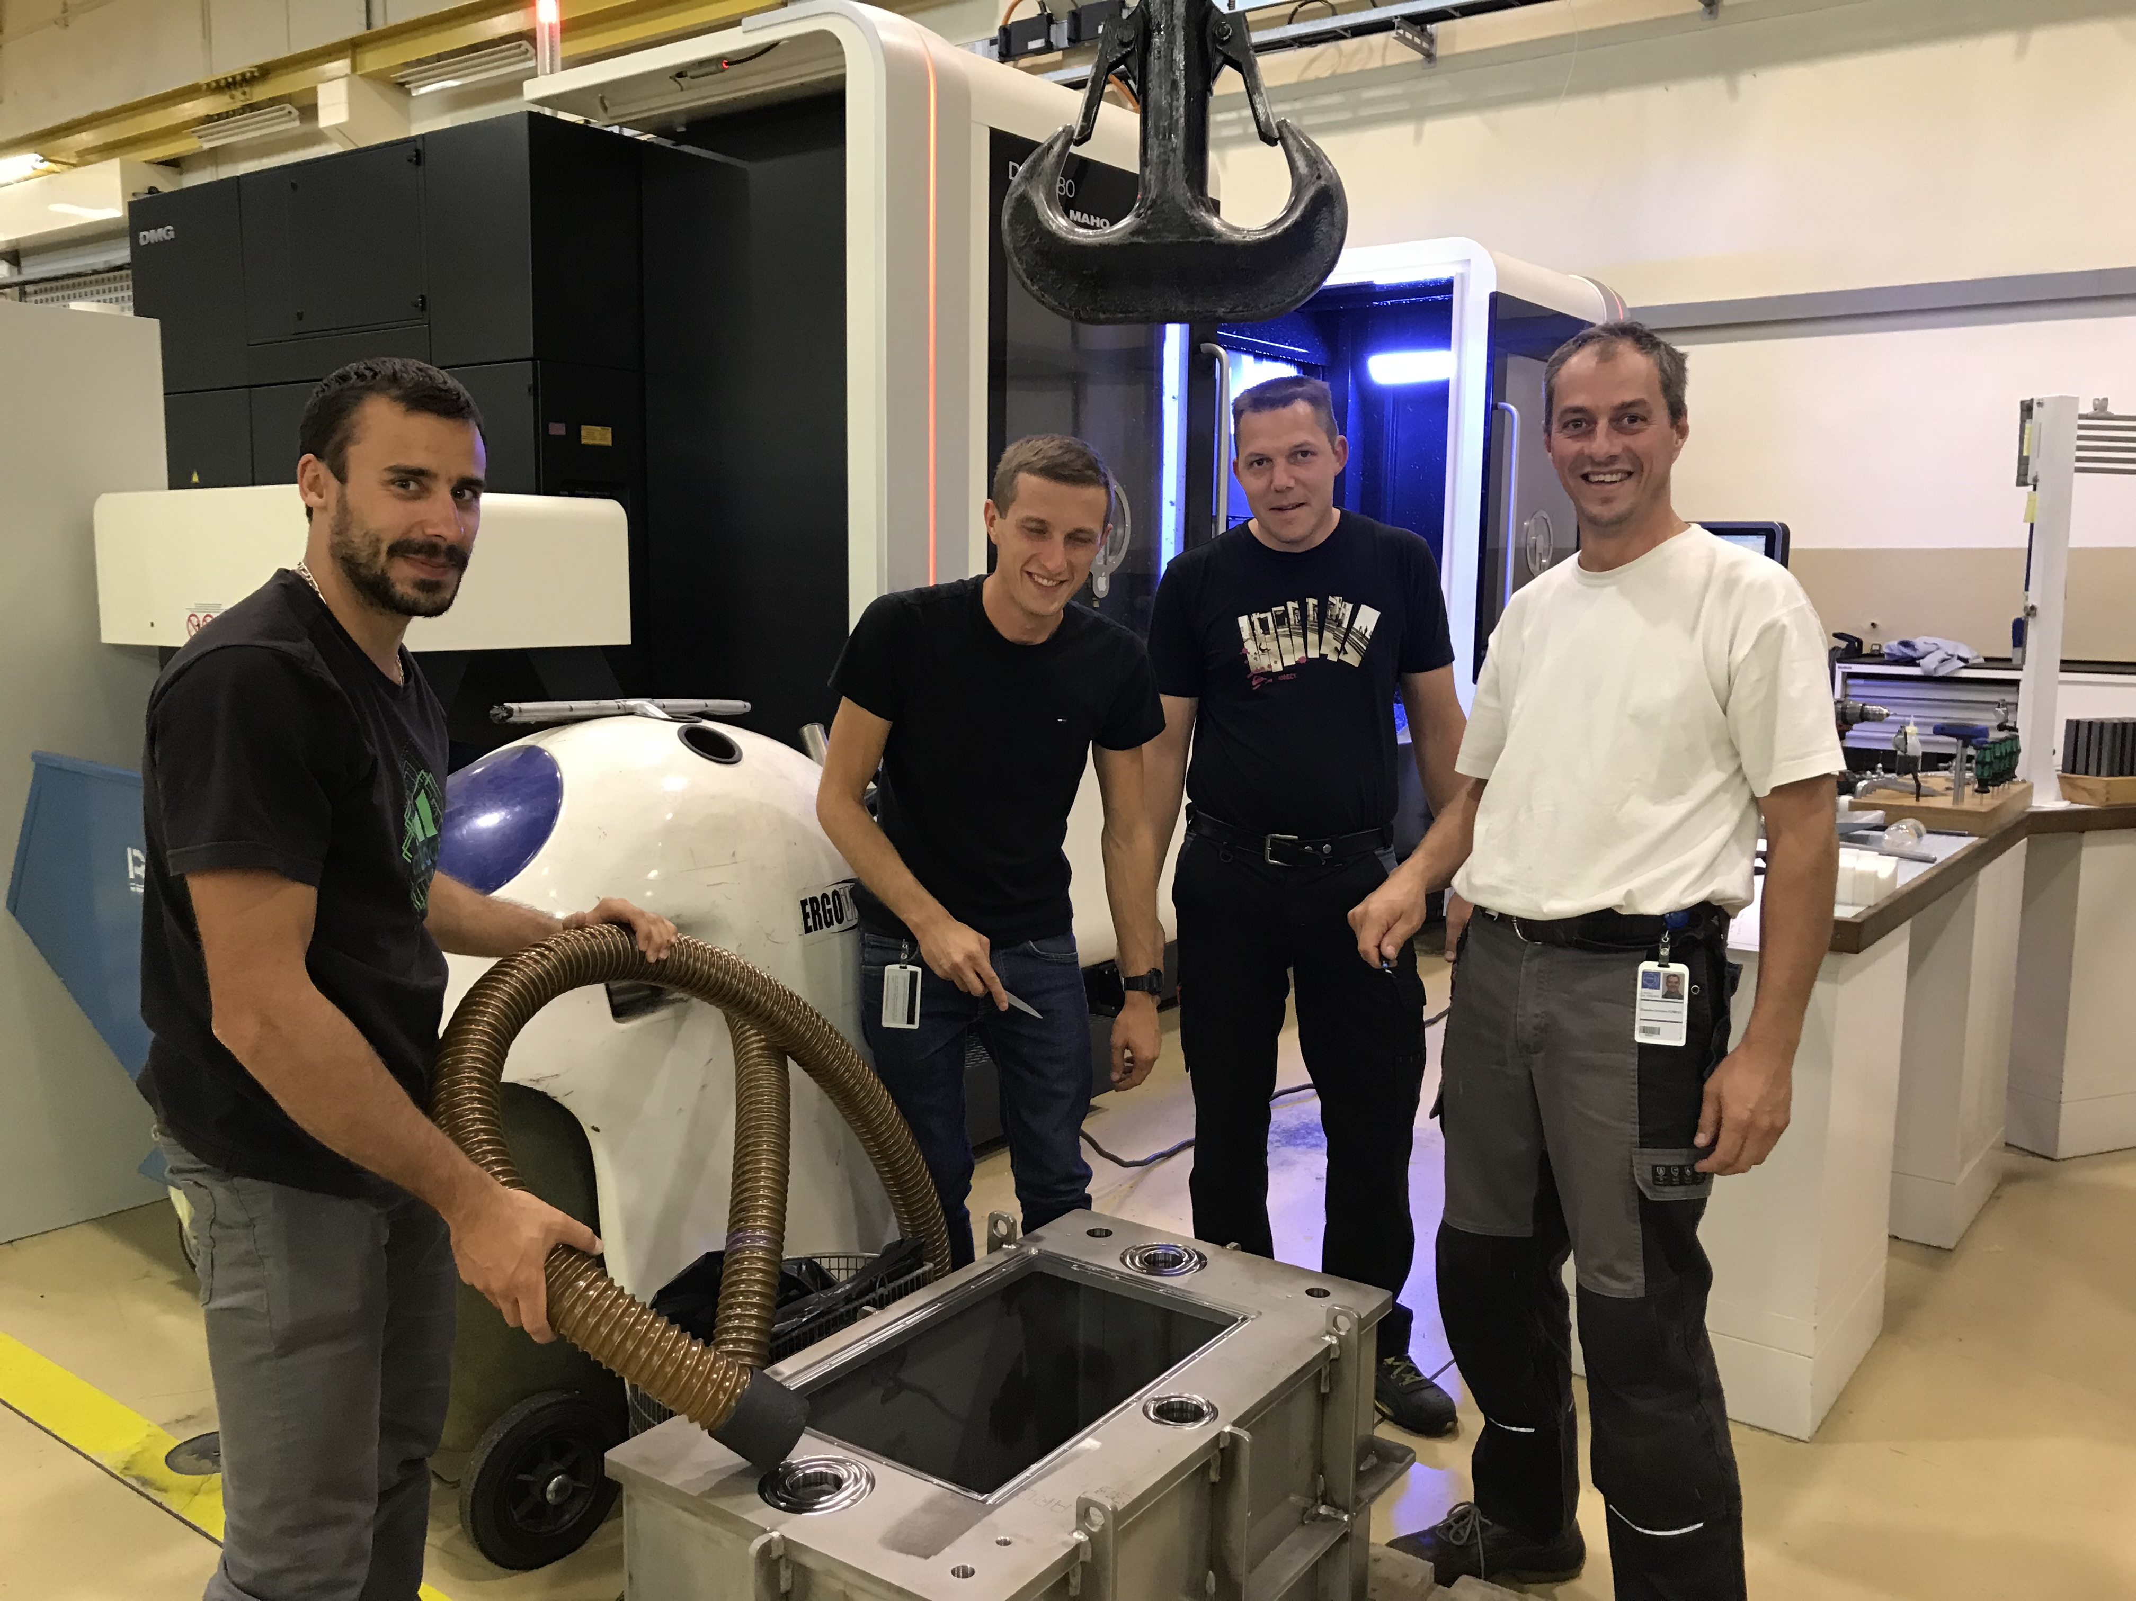
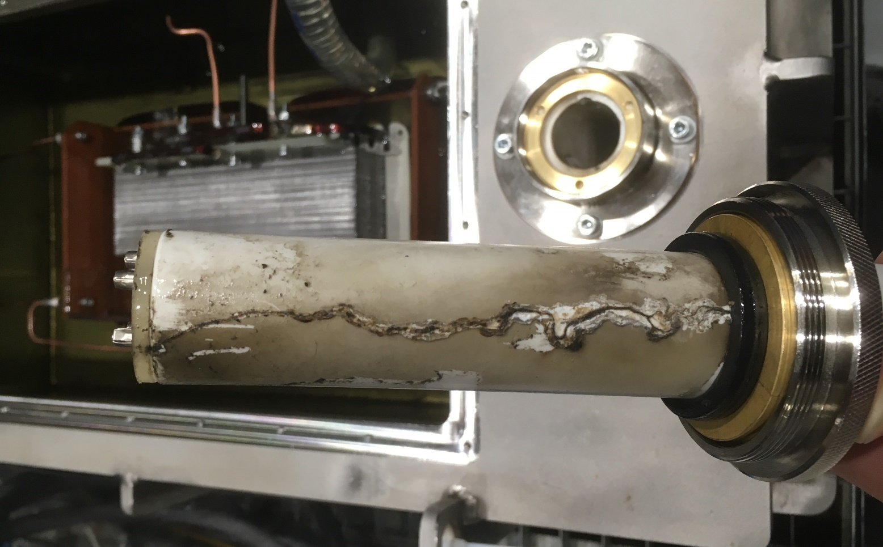
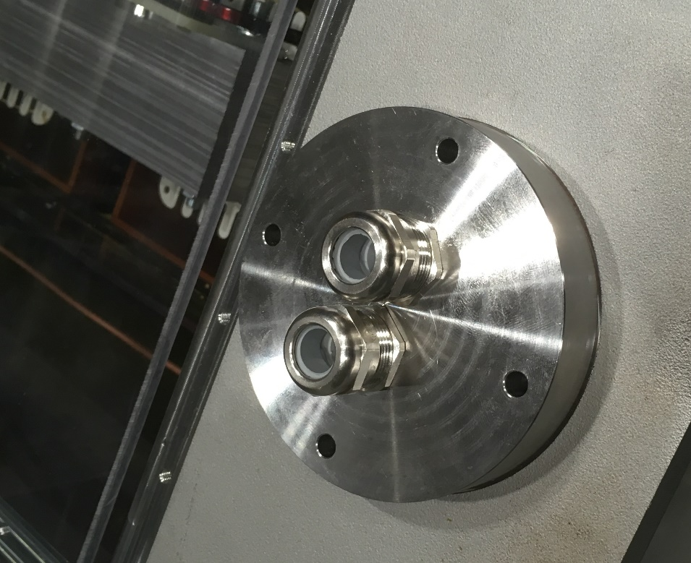
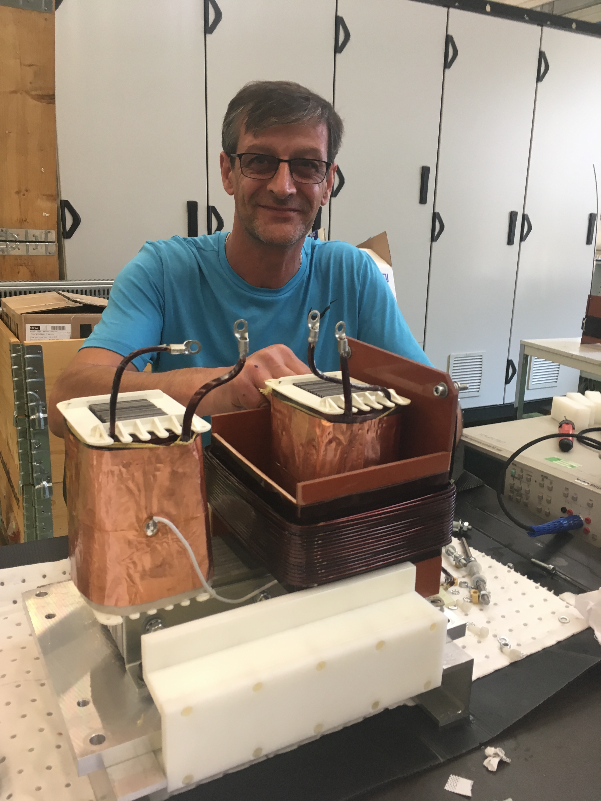
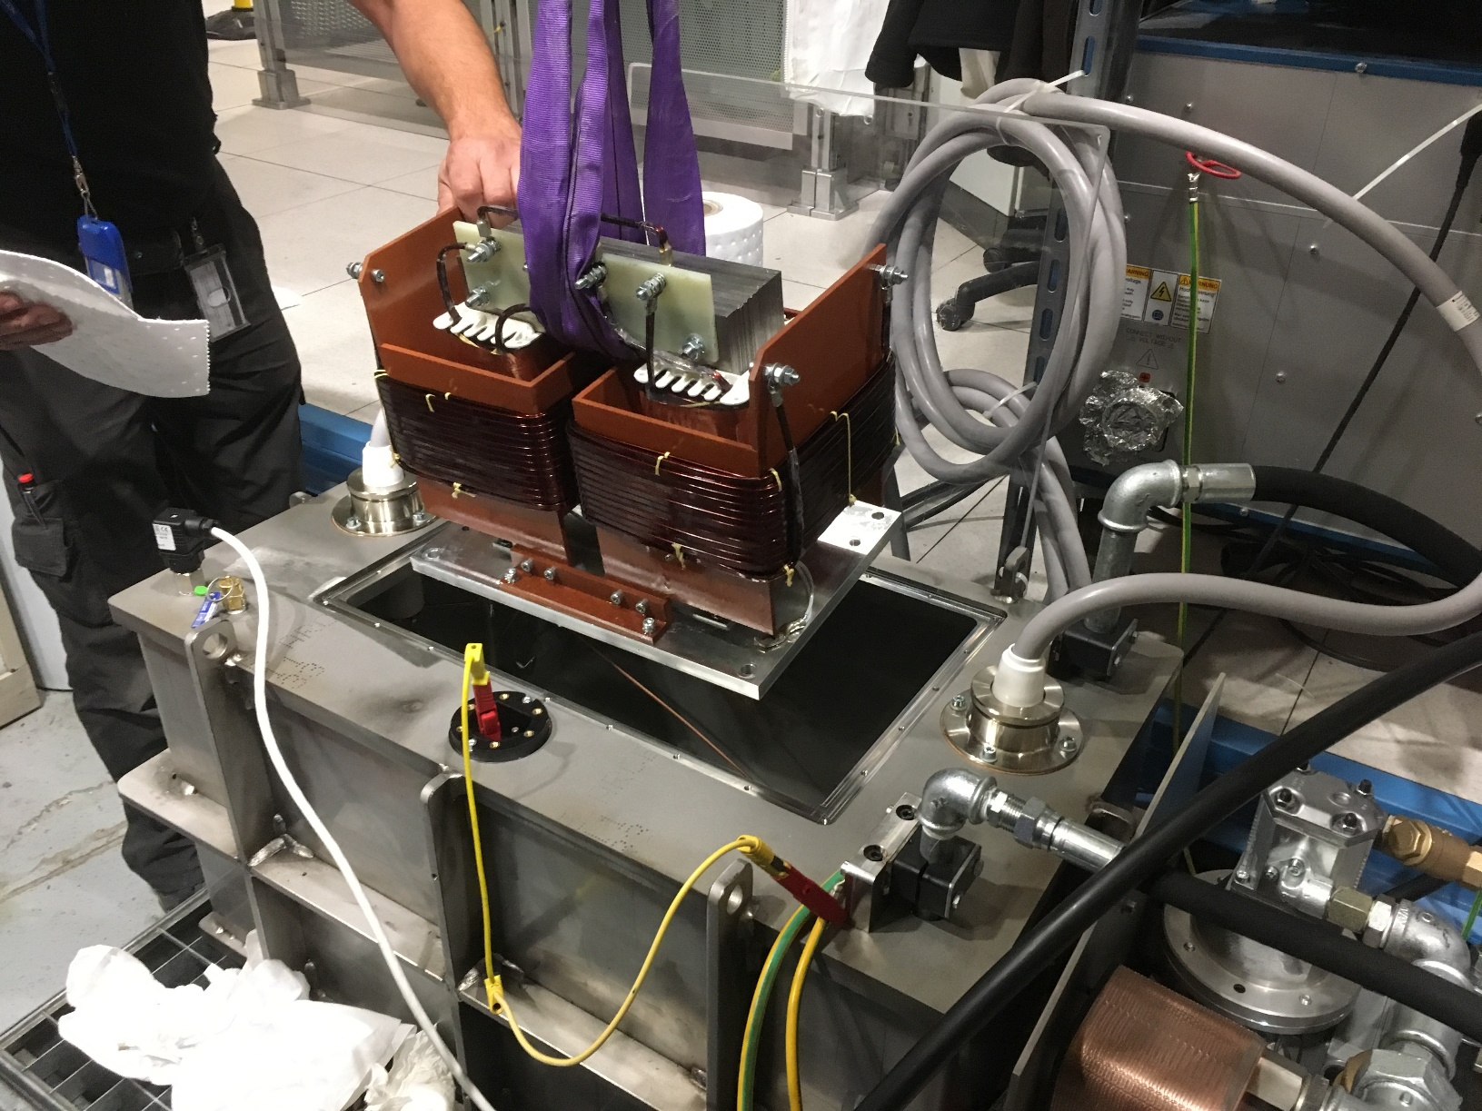
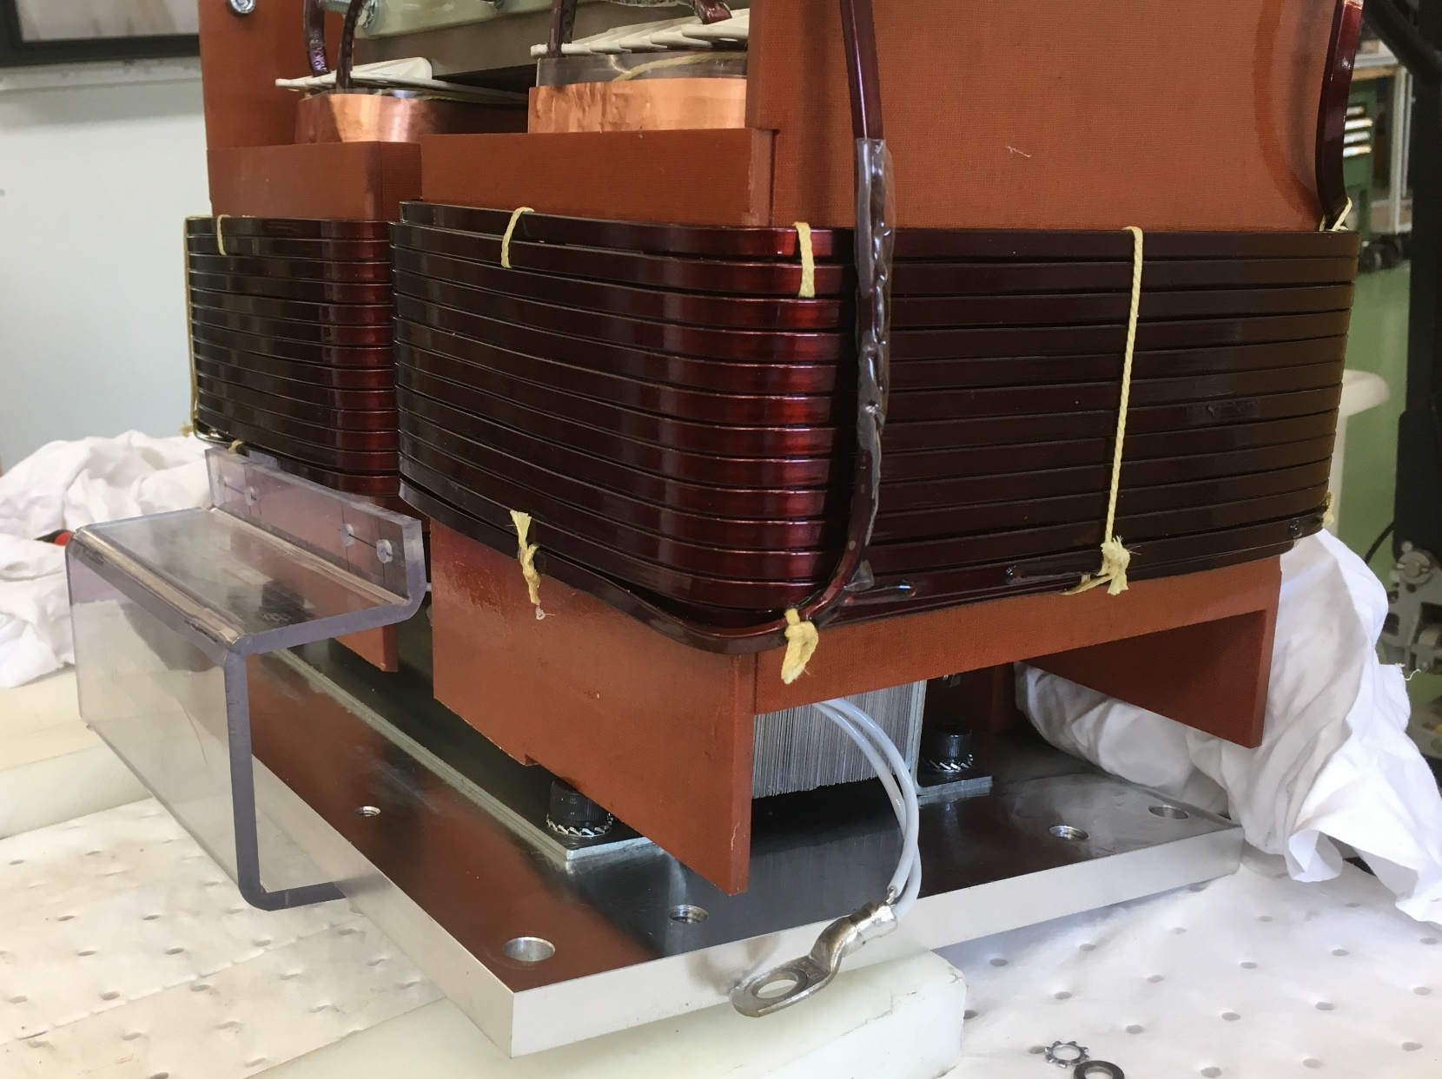
Recent Results from Commissioning
Efforts for a new isolation transformer using oil as insulator
Last (repaired) isolation transfo using solid insulator and operated at 85 kV failed on Friday 21st September
Despite high priority by CERN groups for a transformer using oil, beam available only a few hours since
Broken connector and new HV connection without connector
Oil tank for isolation transformer
completed already on 26th September
Thanks a lot for the high priority
and efforts by several groups
and many people
1st mounting of transformer
New support for secondary coils
Winding new secondary coil

Slide 4
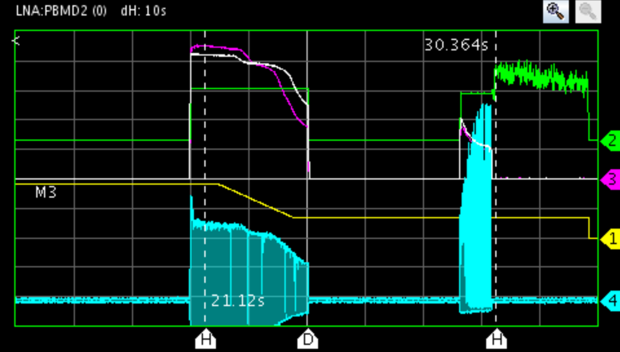
Recent Results from Commissioning
Observation along the cycle – typical situation during last weeks
Intensity estimate from RF electronics
RF voltage
Peak signal of
pick-up sum signal
Some signals along 2nd ramp
and on the 100 keV plateau
(1st ramp not seen!)
Typical situation end of October, beginning
of November
  Only harmonic h=1 available
  Significant loss towards the end of the 2nd ramp
  Many efforts throughout the year resulted in slow improvements
  Clear effect of
2 s/div
Real loss
Bunched beam
electron cooling
(increases pick-up
peak signal)
Probably no loss, but systematic error with short bunches

Slide 5
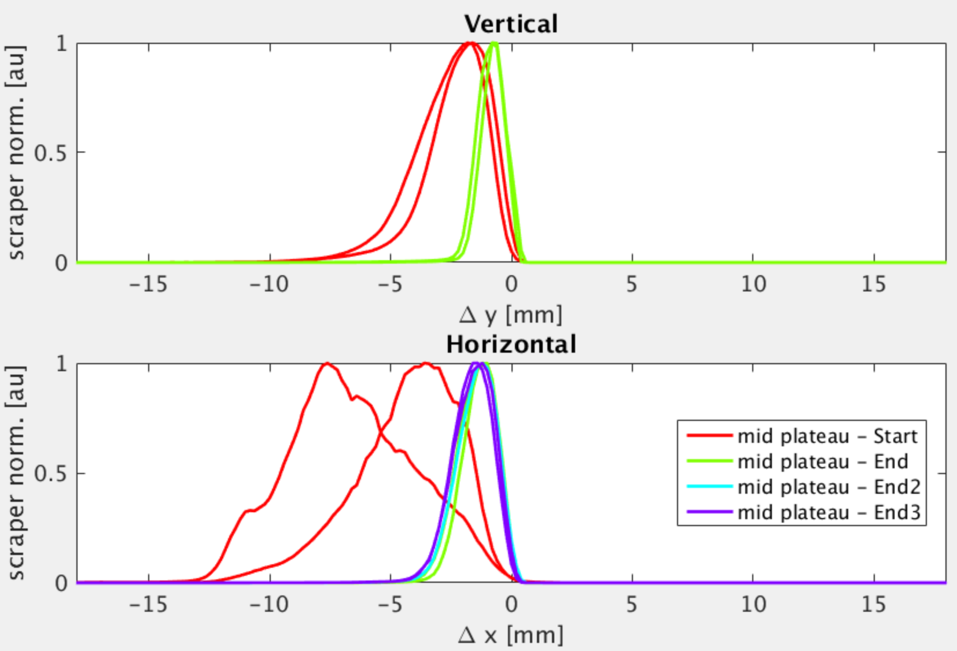
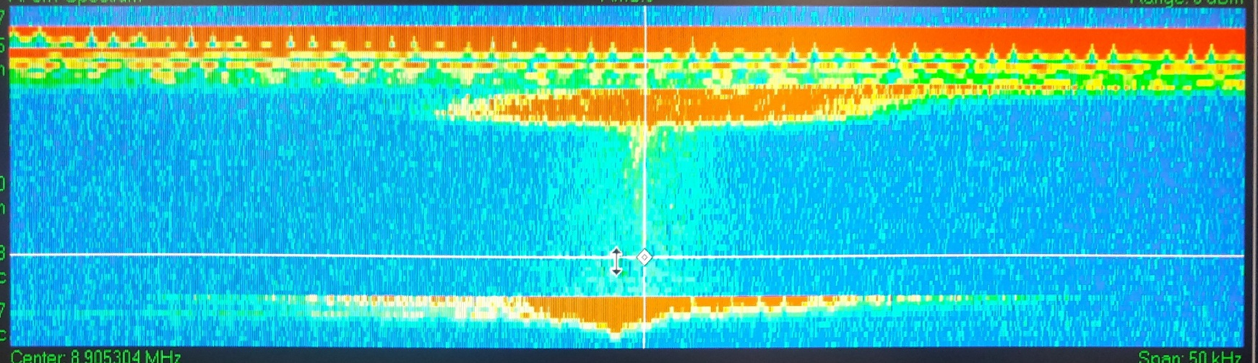
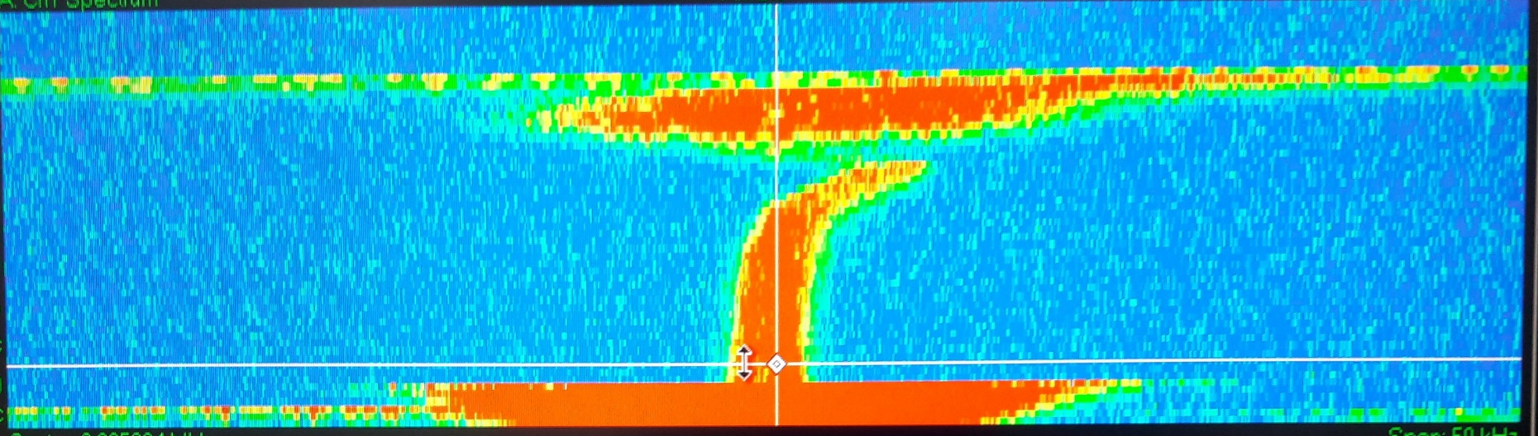
Recent Results from Commissioning
Electron cooling at intermediate 35 MeV/c plateau
Without cooling
Time (15 s)
Bunched
beam
Cooling
Frequency (50 kHz) or rel. momentum offset (7.5 10⁻³ )
- Scraper is an aperture moved into the beam
- Gives information on beam size and
“emittance”
- Measurements with a “scraper” at different
times on the 35 MeV/c plateau
- Clear emittance reduction observed
- Only limited amount of time spent on
systematic optimization of electron cooling
(lack of time)
=> Margin for further improvements?
- RF switched off
- No bunches, but “Schottky noise” generated
by beam acquired by pick-ups
- Spectral noise density (power) proportional
to beam distribution
=> Clear signs of longitudinal electron cooling

Slide 6
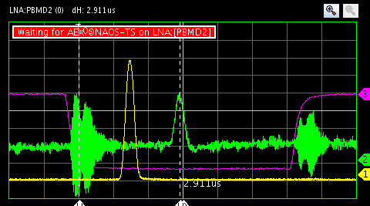
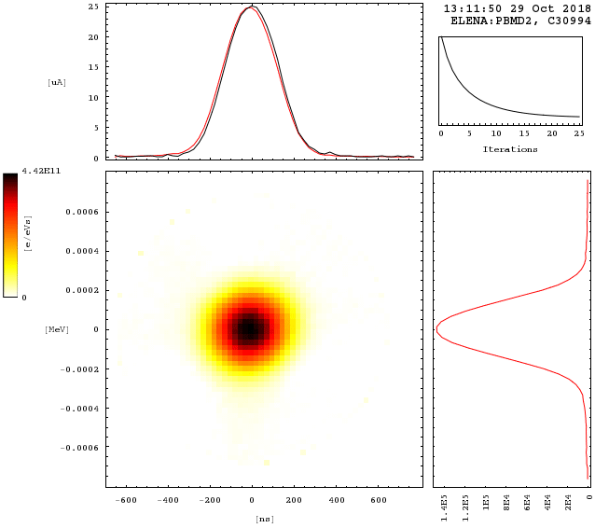
Recent Results from Commissioning
Observation of antiproton beams at extraction with harmonics h=1
Transformer
in LNE 50 line
Last time on a
ring pick-up
Fast deflector
1 us/div
-0.6 0 0.6 keV
Bunches around extraction
  More than .5 10⁷ antiprotons seen
  very reproducibly in ring prior to
  ejection and in line
  Possibly improved with better steering
  thanks to profile acquisitions
  Bunch lengths a bit long with U_{RF} = 32 V
  programmed on harmonics h = 1
  Rms relative momentum spread of 0.68 10⁻³ from reconstruction about nominal
  (and possibly overestimated due to lower than expected RF voltage)
-0.6 0 0.6 ns
Reconstruction (“Tomography”) of longitudinal
phase space density distribution from bunch shapes
acquired during about one synchrotron oscillation

Slide 7
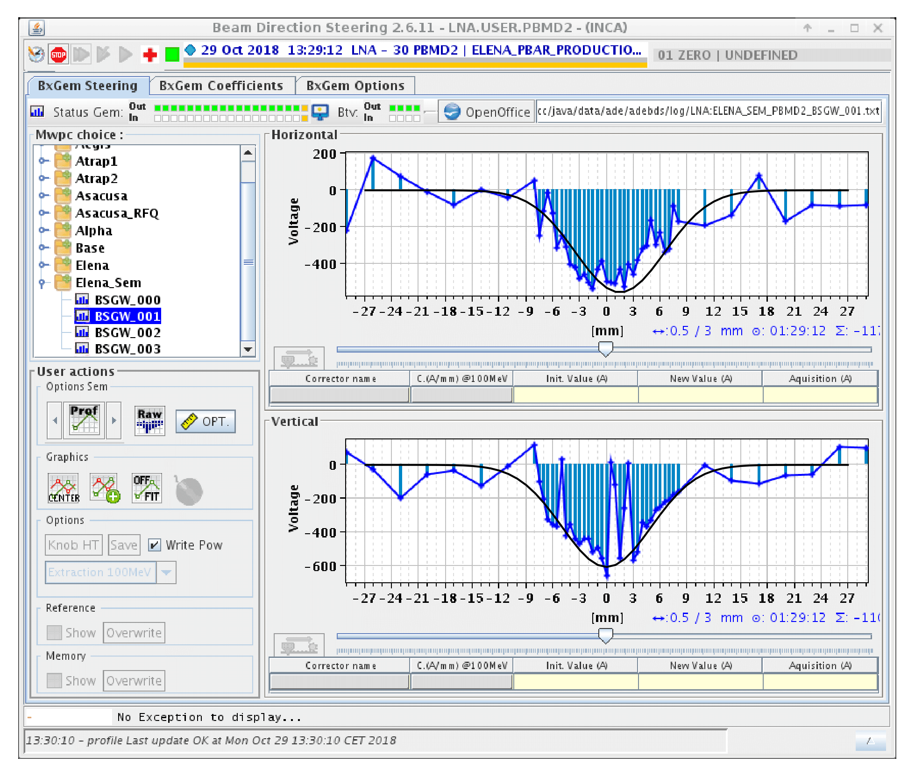
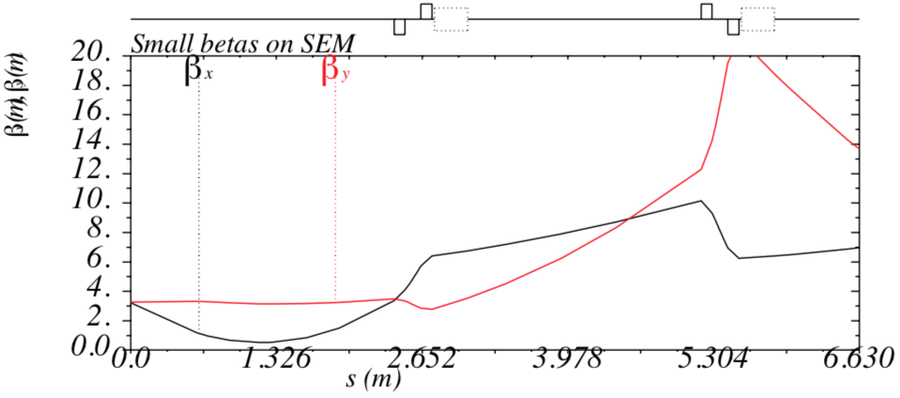
Recent Results from Commissioning
Observation of antiproton beams at extraction with h=1
Profiles in the GBAR line
  Acquisitions with second monitor LNE.BSGWA.5060 in GBAR line
  Beam sizes with voltages of first two
  quads of line set to zero
    β_{H} =6 m gives rms emittance
    ε_{H} = 3.3 um (slightly overestimated without
    taking dispersion into account)
    β_{V} = 20 m gives rms emittance
    ε_{V} = 1.25 um
Gaussian fit by hand with σ_{H} = 4.5 mm
Gaussian fit by hand with σ_{V} = 5 mm
Betatron functions along LNE50 line with settings
to provide beam to GBAR and ring optics updated
to quad settings used in practice

Slide 8
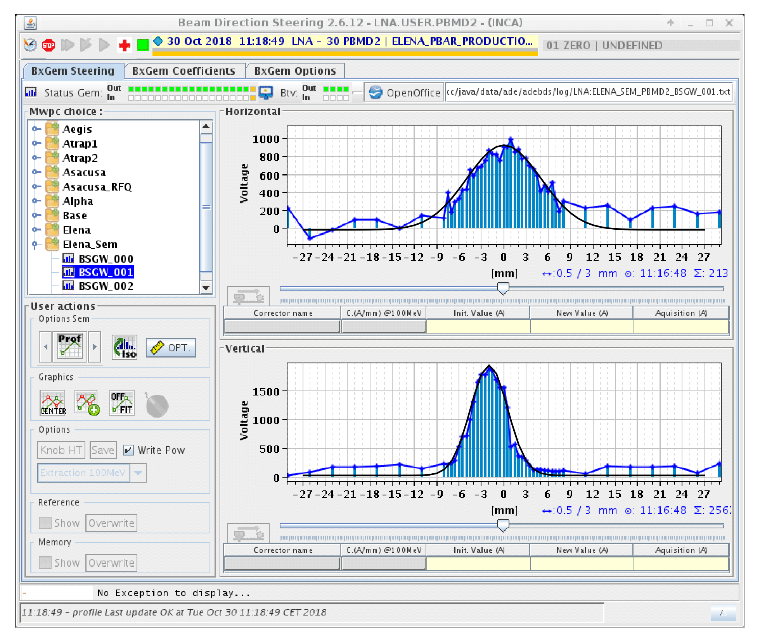
Recent Results from Commissioning
Observation of antiproton beams at extraction with h=1
Profiles in the GBAR line
  Acquisitions with second monitor LNE.BSGWA.5020 in GBAR line
  Beam sizes with voltages of first two
  quads of line set to zero
    β_{H} = 6 m gives rms emittance
    ε_{H} = 4.1 um (slightly overestimated without
    taking dispersion into account)
    β_{V} = 4 m gives rms emittance
    ε_{V} = 1.5 um
Gaussian fit by hand with σ_{H} = 5 mm
Gaussian fit by hand with σ_{V} = 2.5 mm

Slide 9
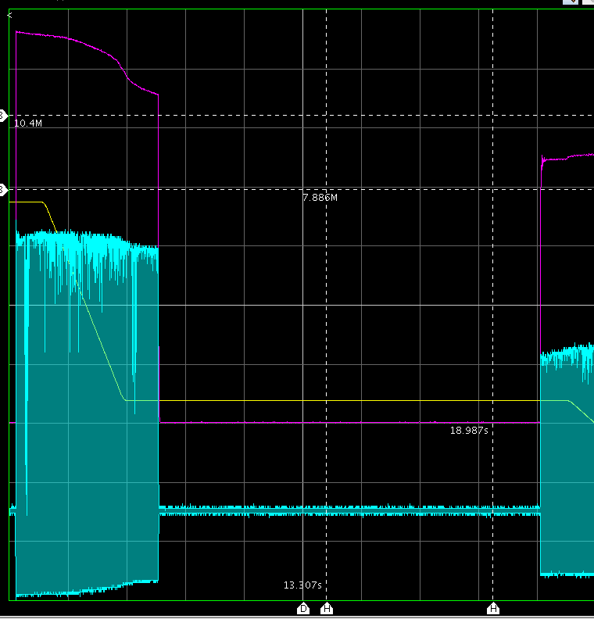
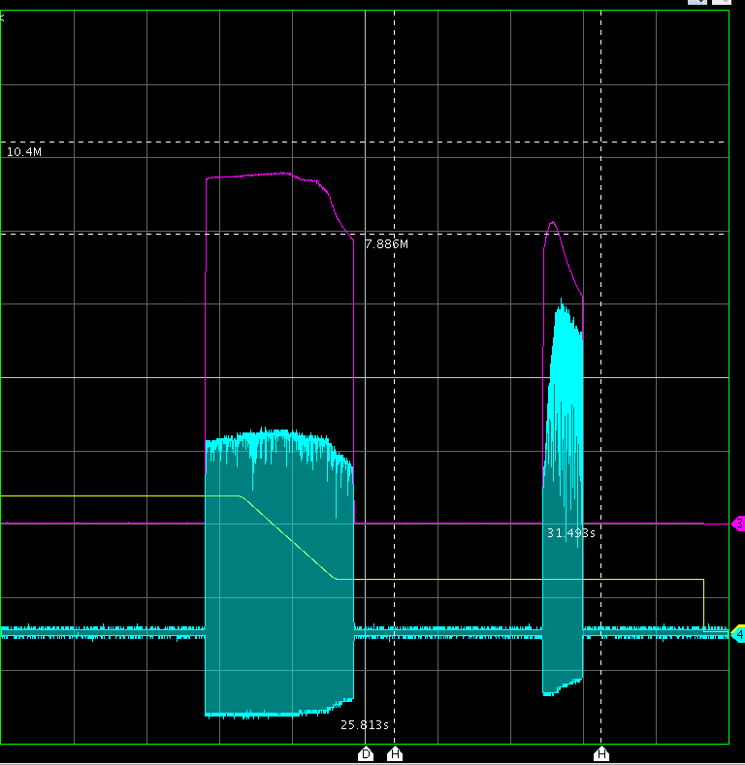
Recent Results from Commissioning
Observation from the very last day with beam in 2018
Higher harmonics h=2 and h=4 finally possible after upgrade of RF control
  Main motivation losses after re-bunching with >1 10⁷ antiprotons with short bunches
  Of interest for observation along 2nd ramp (increased efficiency not expected)
  Whole cycle with beam combining two acquisitions (2nd with slightly higher intensity)
    Improved efficiency (close to 50%)
Probably real loss – 2nd ramp not
priority during last weeks
Bunched beam
electron cooling
(increases pick-up
peak signal)
Cycle
Intensity estimate
from RF electronics
Peak signal of
pick-up sum signal
2 s/div

Slide 10
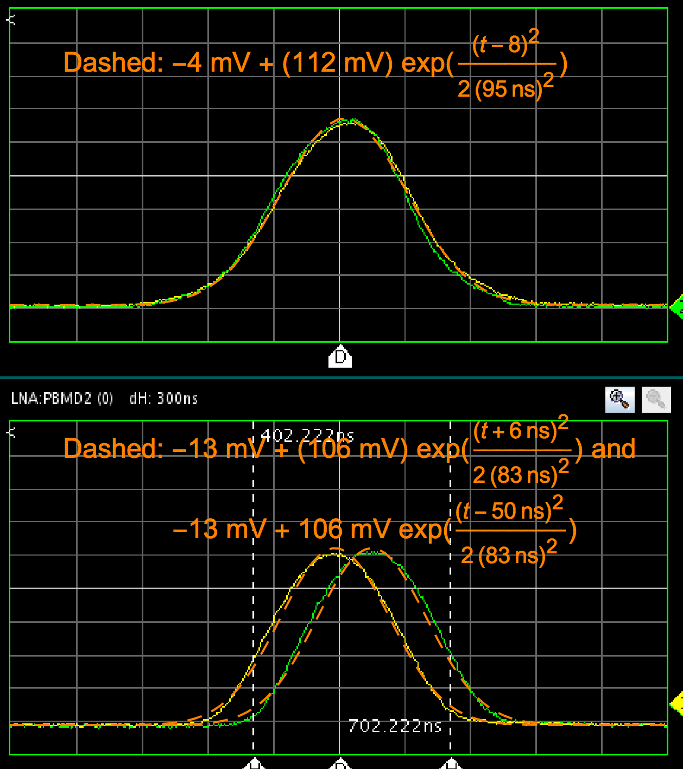
Recent Results from Commissioning
Observation from the very last day with beam in 2018
From sum signal of electro-static pick-ups (10 % uncertainty of calibration)
  3.7 10⁷ antiprotons injected (consistent with data from AD running very well
  Four bunches, each with 0.43 10⁷ antiprotons at extraction
  => Efficiency about 46 %
Total intensity estimated by “beam current transformer” in line about 1 10⁷ antiprotons
  Real loss or acquisition problem?
100 ns/div
20 mV/div
Injected bunch
1 us/div
100 ns/div
20 mV/div
One out of four bunches at extraction
Position pick-up sum signals

Slide 11
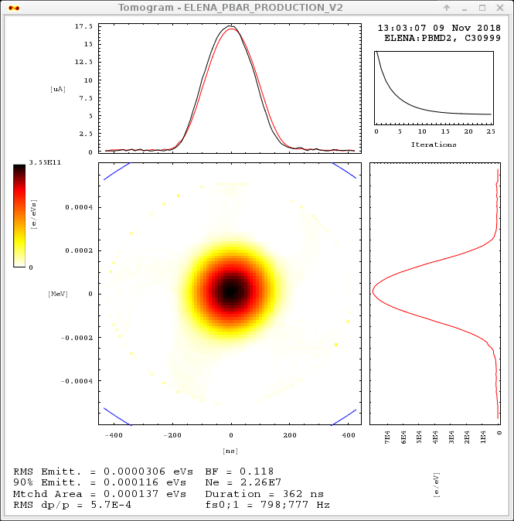
Recent Results from Commissioning
Observation from the very last day with beam in 2018
q_{H}
.40 q .45
500 ms/div
q_{V}
-0.4 0 τ us 0.4
1 us/div
100 ns/div
20 mV/div
-0.4 0 ΔE us 0.4
Measurement of the tunes (working point)
along the second ramp
Some significant variations – better control with
improved procedures to generate functions for
power converters?
Tomoscope acquisition – one of four bunches
just before extraction
about nominal beam characteristics

Slide 12
ELENA Commissioning Status
Aims defined at the beginning of 2018:
  Continuation of Commissioning with electron cooler from April on
  Get Confidence that machine works properly
    Ideally demonstration of operational cycle to deliver 100 keV antiprotons
  First beams for GBAR
Achieved at the end of beam time in 2018:
  Reproducible deceleration of pbars to 100 keV
    Loss along 2nd ramp to 100 keV an issue
    (now >45 % of injected beam at extraction)
    About nominal characteristics in longitudinal phase space (intensities to be confirmed)
    Probably still larger than nominal emittances
  Clear observations of electron cooling (beneficial for deceleration)
  Close to having demonstrated nominal cycle
    Despite long periods without beam and technical problems with source
  Operation for GBAR
    H⁻ and antiproton bunches with about nominal intensities
    Transverse emittance somewhat above nominal (factor <2 in transverse beam size)

Slide 13
ELENA Commissioning Status
Open issues, improvements, next steps
  Efficiency and intensity at 100 keV
    Re-optimization of whole cycle (e.g. first ramp, which was not priority recently, cooling …)
  Injection matching and steering in AD to ELENA lines
    Started before 2nd failure of AD cooler, Potential to reduce losses along 1st ramp
  Profile monitors!
  Upgrades and studies of source
  Cycle generation (procedures and software to generate reference function for power converters) and cycle control
    Improved control of working point and “closed orbit”
    Integration of electron cooler compensation integrated to “closed orbit” manipulations?
  Further thorough studies on electron cooling
    Limited so far due to lack of time
Installation and Commissioning of transfer lines to old experimental area
  Main objective for LS2
  Relies on observation of H⁻ with the profile monitors and availability of all hadware

Slide 14
Summary and Outlook
Significant ELENA Commissioning progress over the year despite various delays
  Delay of restart due a vacuum leak of the cooler, unavailability of AD, issues with the ion source
  In practice, most progress made with antiprotons, only during dedicated AD shifts
  (change of commissioning strategy)
  Confidence that ELENA improves to conditions for all experiments
  Availability of a machine cycle similar to nominal one (intensities and efficiency to be confirmed and slighly large transverse emittances)
  Operation for GBAR with H⁻ and antiproton beams (about nominal intensity for one bunch, but larger emittances)
Plans for LS2
  Installation of the transfer lines to the “old” experimental zone
  Upgrades of the ion source for reliable generation of 100 keV proton and H⁻ beams
  Review of status and possible improvements (ring optics, applications, instrumentation …)
  Possibly test periods in 2019 for tests of the source (already in spring)
  Resume commissioning activities with beam from source in early summer 2020
    Test of ring and electron cooling with protons
    Commissioning of lines with H⁻ (beam intensity and quality of measured profiles?)
100 keV antiprotons for all experiments from 2021 on

