Slide 1
Cooling lasers and ion cooling
Laurent Hilico

Slide 2
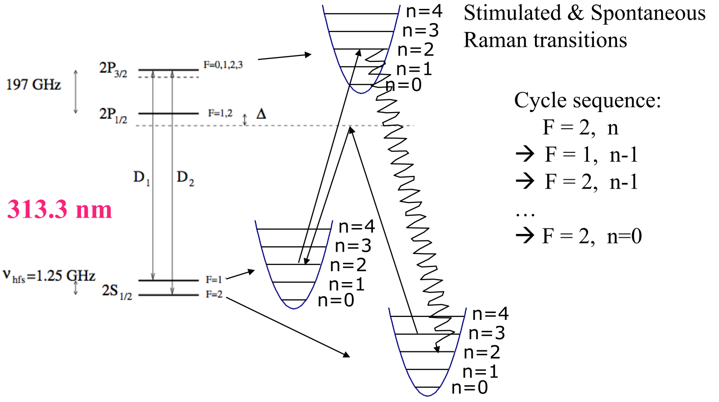
Be⁺ energy levels
313.13 nm
Doppler cooling
2 frequencies separated by 1.25 GHz
1 laser and sidebands produced by an EOM
Raman sideband cooling
2 counter-propagating phase-coherent beams
1 resonant beam
1 « Raman » laser + AOM system
Doppler laser

Slide 3
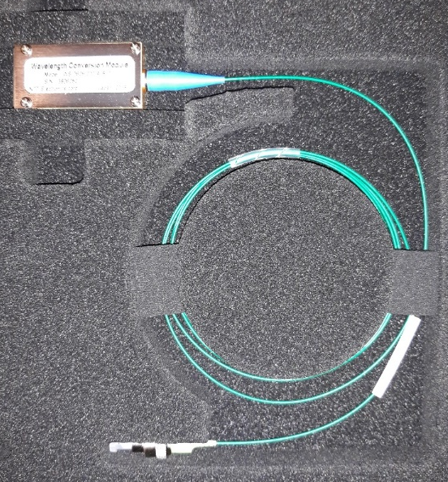
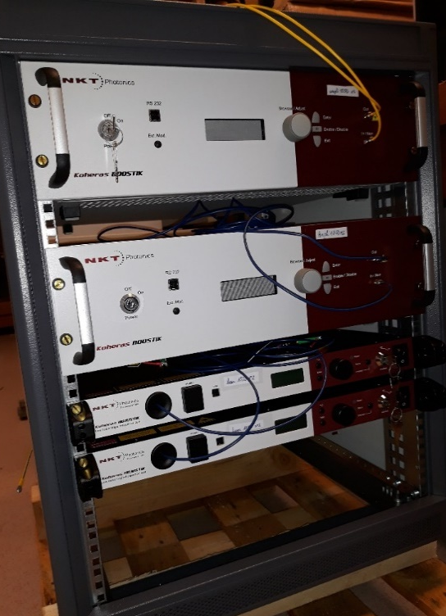
Fiber lasers for 626 nm
5-10 m fiber
626 nm
560 mm
Ridge waveguide PPLN converter
1549 nm
714 mm
1050 nm
2 systems
Raman
1550 (4.5 W) + 1050 (4.5 W) → 626 nm (2 W)
Doppler
1549 (2 W) + 1050 (2 W) -> 626 (400 mW ?)
600 mm
Laser n° 2
13 U 19’’ rack

Slide 4
626 nm DBR laser diode source
F. Braun Institute Berlin, DBR laser diodes, ~50 mW at 626 nm, awfull mode
Injection locking of a Fabry-Perot diode, ~100 mW at 626 nm, nice mode
Comparison
Fiber laser narrow linewidth (< 50 kHz in the UV), easy to frequency control,
remote control, expensive
DBR diode laser cheaper, broader linewidth (1,4 MHz in the UV), to be tightly locked

Slide 5
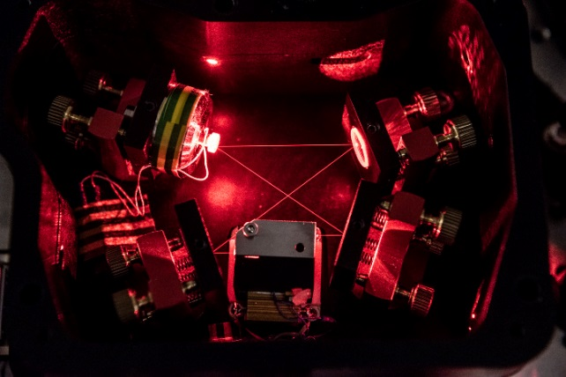
SHG cavities
626 nm
313 nm

Slide 6
Doppler and Raman beams
Precision trap
Doppler
Raman
SHG cavity
EOM
AOM
Capture trap
ON/OFF
Intensity control
Precision trap
SHG cavity
Beam splitter
Double pass
AOM 312,5 MHz
Phase coherent
Raman beams
separated by 1,25 GHz
Double pass
AOM 312,5 MHz

Slide 7
On the to do list
Build a new SHG cavity for the second laser
Implement the double pass AOM systems
Find money for a second fiber laser system
Buy UV optical fibers to couple to the vacuum chamber
We have the optical components
We have the AOM’s and drivers

Slide 8
UV optical fibers, the recipes
NKT LMA-10UV
10 µm
Purchase NKT fibers or Xblue fibers, photonic band gap fibers
Load with H₂ (1-2 weeks under 100-200 Bar)
Collapse the ends
Put in the fridge (-20°… -80°C)
Take the length you need
Cut, polish, collapse the ends
Connectorize
Expose to UV (313 nm)
That’s done
Simple diffusion process of H₂ into SiO₂.
Alphanov in Bordeaux
Buy a patch cord with the desired length (with connectors)
Load with H₂
Put in the fridge
Expose to UV
That’s done
Several companies
AOS Dresden
Lab in Bordeaux
…
H₂ chemically cure the defects that could become colored-center
under UV irradiation and make the fiber absorbing

Slide 9
Optical fibers
~130 dB/km or 0.13 dB/m
Transmission > 70%, losses dominated by insertion losses
Stable in time other months at 313 nm
Method also tested at 280 nm, 235 nm
Collimators to be purged by clean N2, teflon tubes recommanded
On the to do list
Contact Alphanov (Bordeaux) or Glophotonics (Limoges)
Get few fibers
Cure them with our 313 nm and test the result

Slide 10
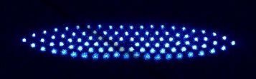
Ion cooling status
Paris LKB Be⁺ Doppler Cooling
Paris LKB Be⁺/H₂⁺ sympathetic Doppler cooling (9/2)
Paris MPQ Sr⁺/Be⁺ sympathetic Doppler cooling (87/9)
Mainz Ca⁺ Doppler Cooling
Mainz single Ca⁺ ground state Raman sideband cooling
Mainz Ca⁺/Be⁺ ion pair ground state Raman sideband cooling
Pulse sequence management using FPGA based electronics

Slide 11
Conclusion
Cooling almost done
We go for optical fibers at 313 nm

Slide 12
1 pixel = 2 µm

