Slide 1


Hydrogen and hydrogen ion production and cross section measurements
L. Liszkay IRFU CEA Saclay, France

Slide 2
Outline
Introduction: reactions, prior results
Positron & proton pulses, positronium cloud
Comparison between matter and antimatter measurement, detectors
First reaction: signal and background
Second reaction
Some technical problems to be solved
Plans

Slide 3
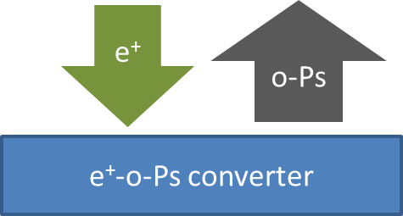

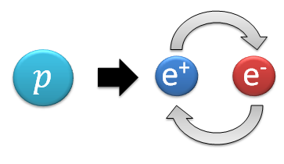
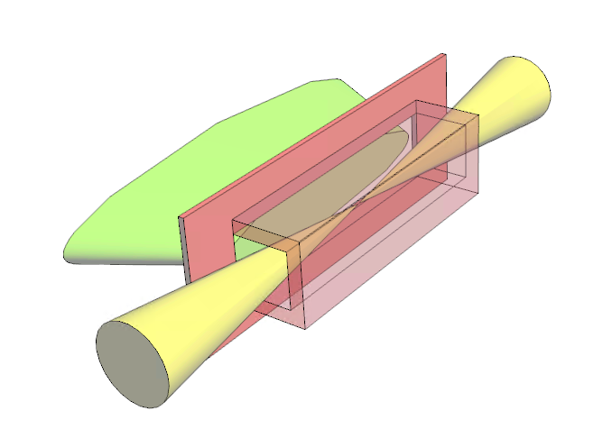
Reactions and target cavity
Reactions in the cloud
Positron-positronium converter (mesoporous SiO₂)
Flat converter or cavity
H
e⁺
With positronium (ortho-Ps) is in the fundamental or 3D state
Proton in the 1-10 keV kinetic energy range
p
Expected signal starts with a few hydrogen atoms per pulse (present status).
The second reaction will give a few ions per pulse at best.

Slide 4
Experimental setup
(B. Latacz)

Slide 5
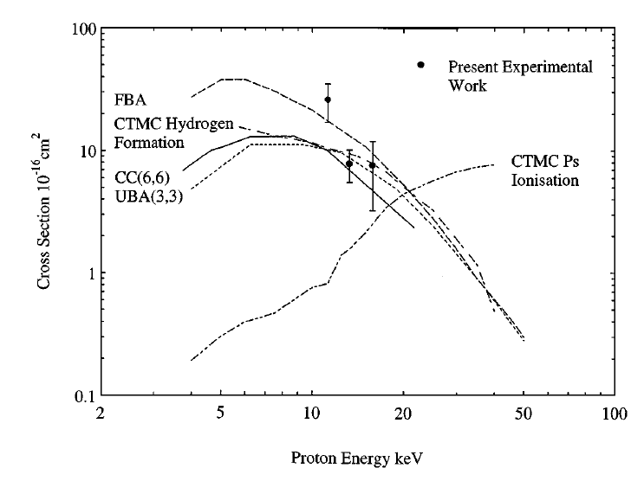
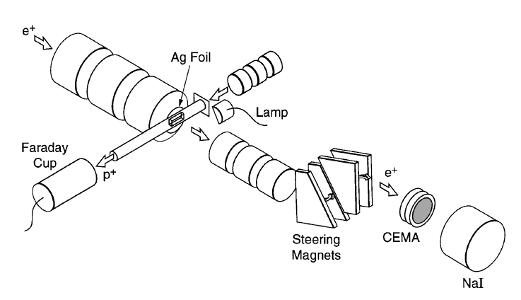
Earlier measurement
Only the first reaction
10-16 keV proton energy
Ground state Ps
Total
211±46 events
Merrison et al, Phys. Rev. Lett. 78, 2828(1997)
Method: positron detection

Slide 6
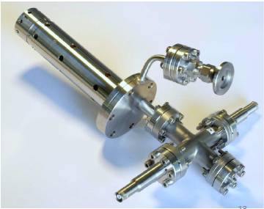
Proton pulse
For details, see the talk of Bongho Kim (Wednesday morning)
larger beam spot is sufficient for the first reaction, best focusing for the ion
A deflection electrode will be used as chopper
pulse length to be determined to optimize signal/background ratio
Nominal performance:
600 µA total current, 5 % of it is proton
5.6x10⁷ protons in 300 ns pulse

Slide 7
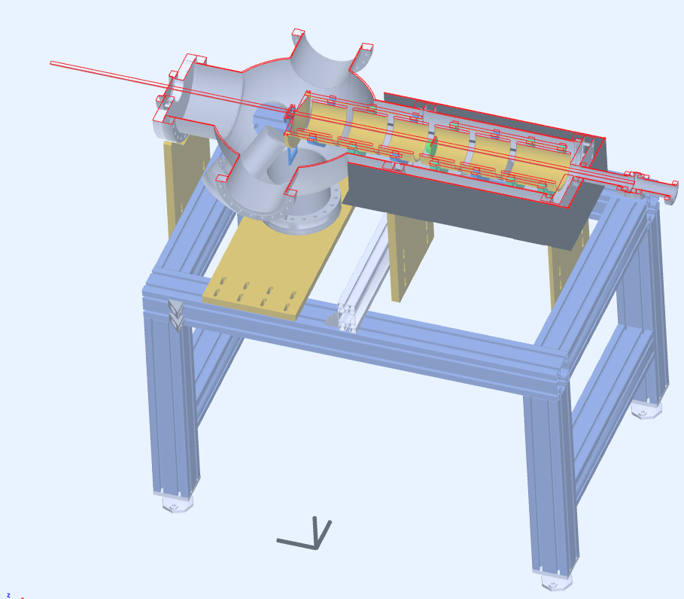
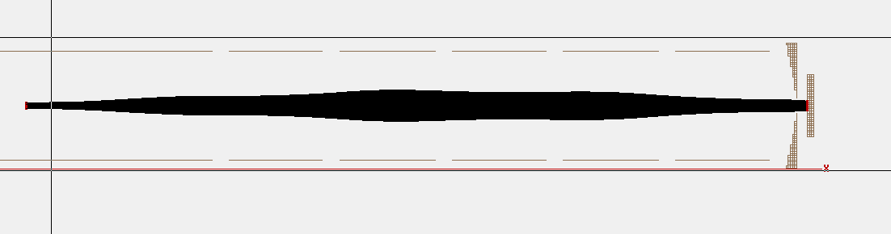
Positron pulse
For details, see the talks of Samuel Niang and Pauline Comini (Wednesday morning)
Pulse from the MRT trap, accelerated to ~4 keV and electrostatically focused in the reaction chamber (see talk of Pauline Comini)
About 10⁸ positron per bunch seems to be in reach at the moment, more later

Slide 8
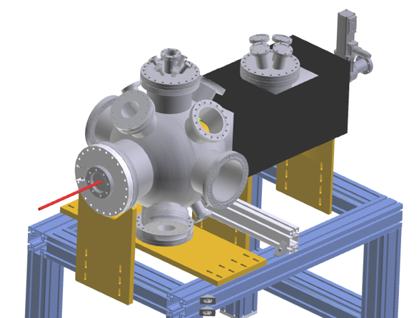
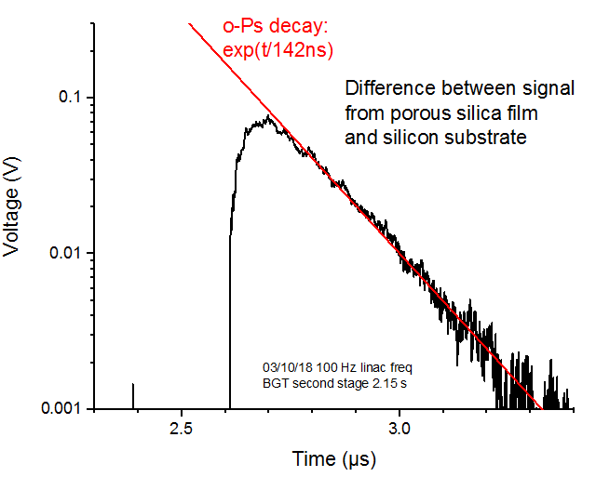
ortho-positronium cloud
No easy method to measure the effective positronium density
We have independent measurements on the positron/positronium conversion efficiency and the kinetic energy of oPs (hopefully, spectrometer will be available in Saclay)
PbWO₄ detector + GEANT4 simulation (work of Bongho Kim) gives information on the quantity of positronium but not direct information on the density
Laser measurements using 3s excitation (see talk of Pauline Comini) is very important for measuring actual density
To reduce incertanities, it is probably better to use the most simple geometry to measure the first reaction (flat target, round beam spot)

Slide 9
Differences between detection of antimatter and matter reaction products
Only MCP can be used to detect the products (hydrogen, hydrogen ion)
The MCP images will be easier to interpret (no annihilation products)
Proton pulse intensity: Faraday cup
No need to keep difference in time of flight to reduce background ➔ (it is a question if we keep the long (anti)proton line for the measurements)
Major background component from the charge exchange reaction H⁺+H₂→H+H₂⁺

Slide 10
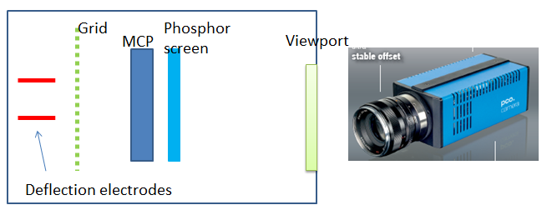
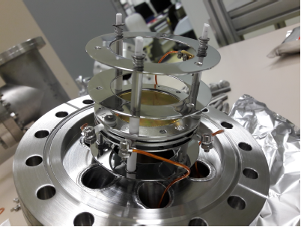
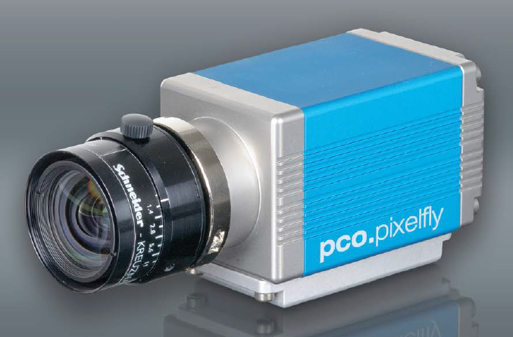
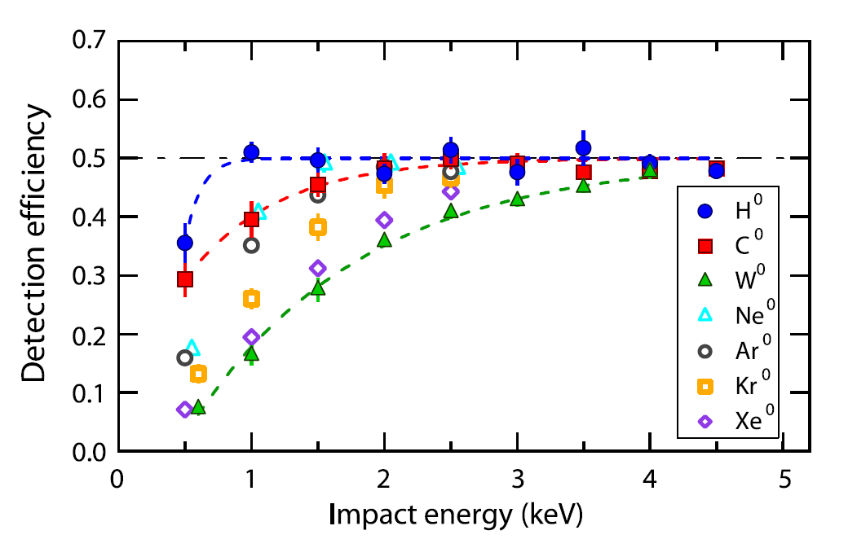
Detection of keV atoms with an MCP
(see talk of Barbara Latacz)
Double MCP (gain > 10⁶)
fast phosphor screen (P46, ~100ns) (→ low background)
fast ( 1 µs) CCD camera
Grid to block charged particles
Detection efficiency corresponds to the sensitive area of the MCP above ~1 keV (hydrogen)

Slide 11
Background components
Positron-electron (e+, para-Ps, ortho-Ps) annihilation in the converter & in the oPs cloud (significant component)
Dark noise of MCP, background radiation, ions (largely suppressed by the short detection window, ~1 µs)
Neutral H generated by charge exchange reaction in the residual gas (major background component)
Sputtered atoms from the interaction zone (converter, collimator) – they will be probably well separated by time-of-flight but they may saturate/damage the MCP

Slide 12
Background from 511 keV annihilation gammas
Para-positronium annihilation and positron annihiliation in the converter material: short lifetime (p-Ps: 125 ps; e+: ~200 ps); no significant contribution after the ~µs hydrogen time-of-flight
Ortho-positronium annihilation: 142 ns decay time, significant even after a few µs; estimated rate for 10 keV proton energy:
~0.3 count for 10⁸ positrons (total surface of MCP)
e⁺
MCP
511 keV gammas
Raction cavity

Slide 13
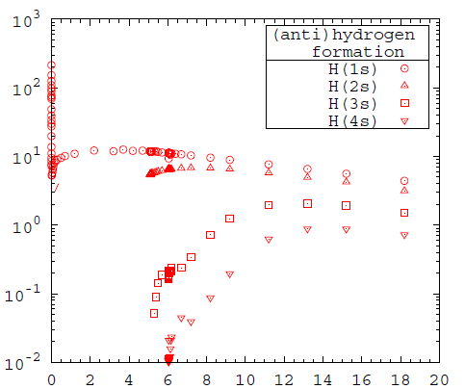
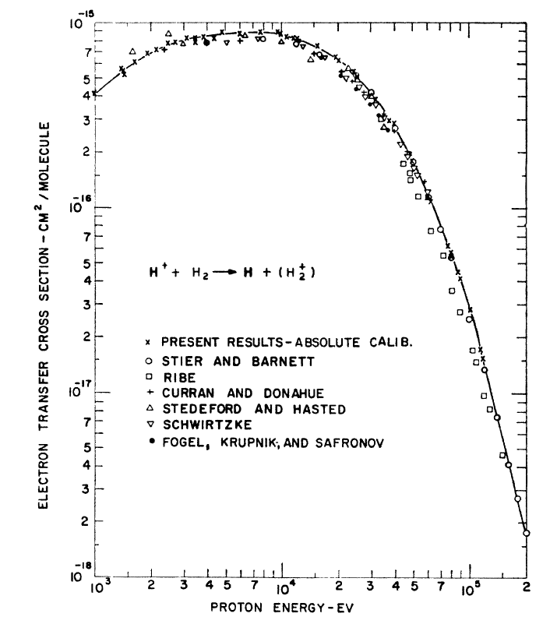
Background from charge exchange reaction: cross sections
H₂
H₂⁺
p
H
Cross section a.u.
Proton energy (keV)
Rawlings et al, Phys. Rev. A 93, 012709(2016)
Cross section is similar to that of the proton-positronium reaction
No information on angular spread of the product
McLure, Phys; Rev 148, 47 (1966)
At 10⁻¹⁰ mbar and 100 cm interaction length this gives a few hydrogen atoms

Slide 14
Background from charge exchange reaction: how to minimize it?
Cross section of the charge exchange reaction is comparable with that of the proton-oPs reaction
The number of H atoms created is comparable even at 1O⁻¹⁰ mbar vacuum
Ways to reduce the relative weight of this background component:
Better vacuum (limited to a few times 10⁻¹⁰ mbar)
More intense positron bunch
Shorter proton path with visibility from the MCP detector (deflection immediately before/after the reaction cavity)
Faraday cup
Positron beam
Deflection
Deflection
Proton beam
Hydrogen
Reaction cavity
MCP
New deflection plates in the reaction chamber?

Slide 15
Measuring cross section of the second reaction
The baseline solution is to measure both reactions in the same Ps cloud (this is relevant for GBAR) and deduce the second cross section using simulations
At present we have no tool (hydrogen beam) to measure the second reaction alone
We can try to use the hydrogen created in charge exchange reactions (see background)
Another possibility is to use the H⁻ beam from ELENA to create an atomic beam
In any case, we need fully commissioned system (linac, traps, focusing, cavity) to get a signal

Slide 16
Second reaction: signal and background
We must reliably detect a rate significantly lower than 1 event / pulse
MCP dark counts & environmental radiation background is low enough
Gamma background from the converter can be reduced by shielding
Background from charge exchange reaction is probably negligible, although we have no data (in the worst case it decreases the same way as the signal)
Possible background from stray ions in the chamber (to be tested; an energy separator or a simple grid may be used if necessary)

Slide 17
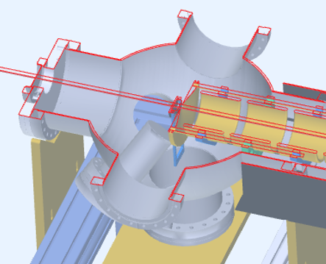
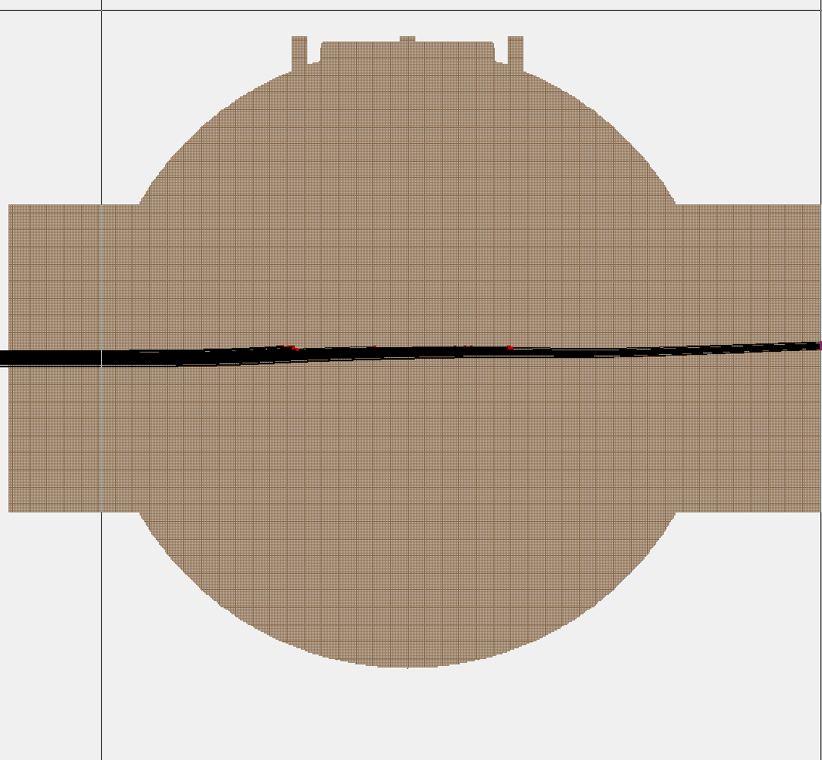
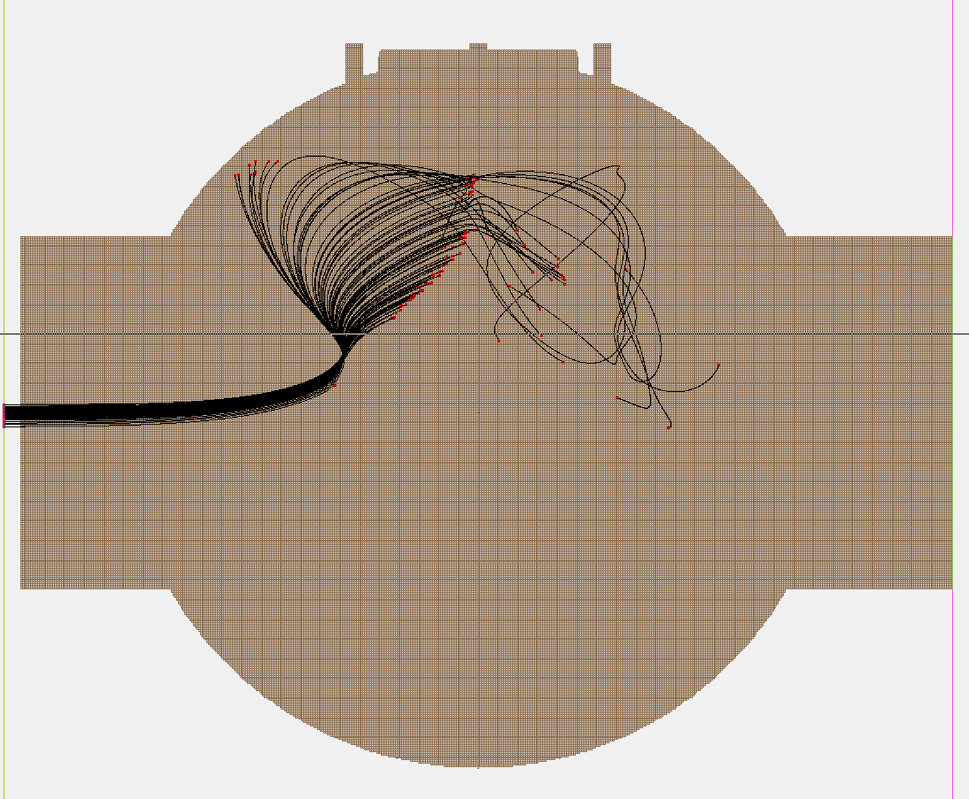


Problem: electrostatic field from the last lens of the positron line
See talk of Pauline Comini on Wednesday
Significant deflection even at 10 keV proton energy, stops beam at low energy
Requires shielding in the reaction chamber (technical problem, easy solution)
Last e⁺ electrode = 20kV (Top view)
e⁺
e⁺
$$\overline{p}$$
$$\overline{p}$$
Beam energy = 10 keV
Beam energy = 1 keV

Slide 18
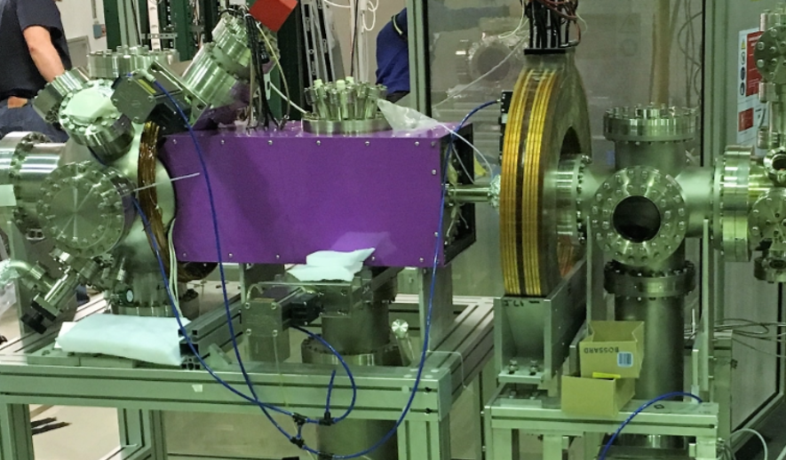
Problem: magnetic field from the positron line deflects protons
Energy dependent deflection
Difficult to shield
May be compensated by steering plates
No easy solution, we are working on a shielding/compensation system with the help of computer simulations

Slide 19
Plans: tasks
To be done before measurement of the first reaction:
Solve problems with the beam transport in the reaction chamber (electrostatic and magnetic field)
Install proton beam and steer it to the reaction target & detectors
Commission switchyard
Install Faraday cup and electronics to measure proton pulse
Set up and tune positron buncher and transport in the reaction chamber
Calibrate positron/positronium detection system
To measure both reactions in the cavity
Fully commission linac & positron traps
Install small converter cavity and focus proton beam
Set up MCP for ion detection (with gamma shielding between the reaction chamber and the MCP)

Slide 20
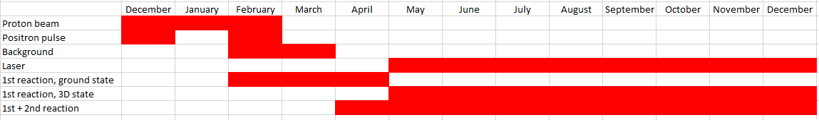
Plans
The time available is limited by the arrival/installation of the antiproton trap (end of 2019?)
Tthese measurements can produce several sets of publishable data
There will be extremely short time for measurements with laser excitation
Can we somehow keep the system running in 2020?
Shifts will be needed to run the measurement 24 or at least 16 hours a day (certainly for the measurement of the second reaction).
To collect more data but also to avoid interruption and instrument failures induced by on/off cycles.

Slide 21
Summary
We can start measurements of the first reaction in ~March 2019
For the second measurement we need fully commissioned system
We can have most results until the end of 2019 but possibility of measurements in 2020 would be very helpful

