Slide 1
Ideas to measure the sign of g
can we simplify the scheme to measure simply the sign?
using the ions
using the atoms

Slide 2
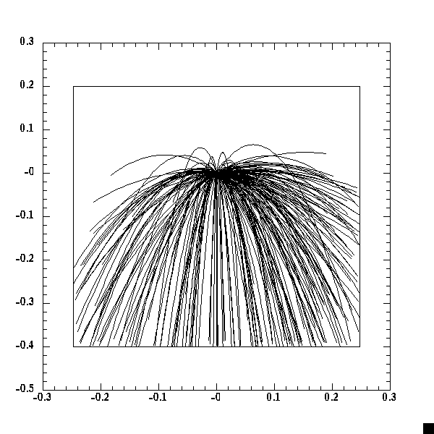
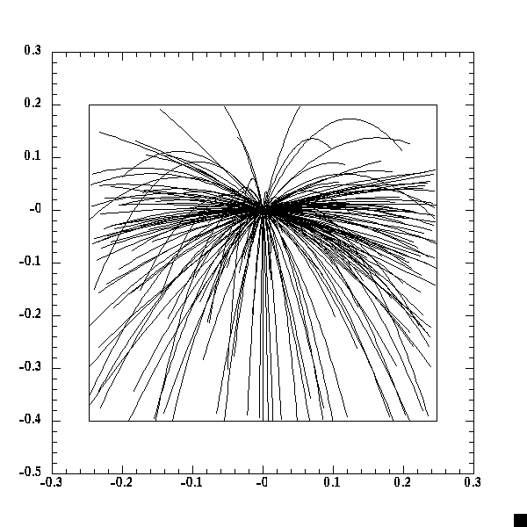
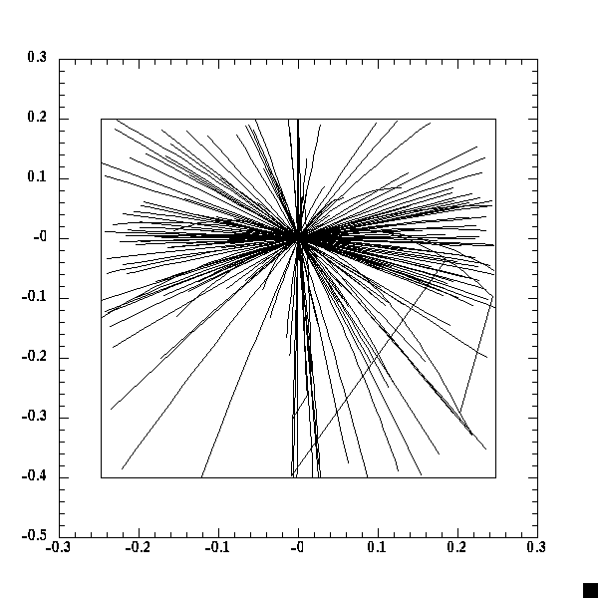
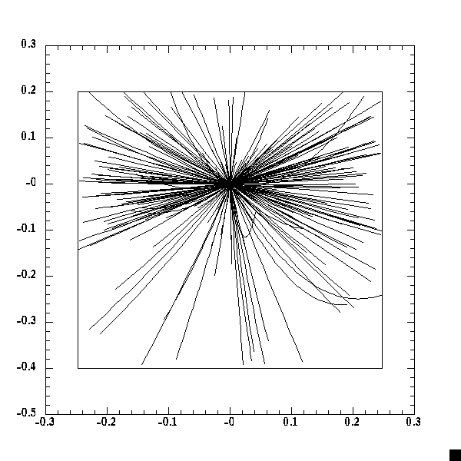
Using ions
T_{horiz} = 3 x T_{vertical} Free fall chamber height = 0.6 m
no B field radius = 0.25 m
10 𝜇K
100 𝜇K
1 mK
10 mK

Slide 3
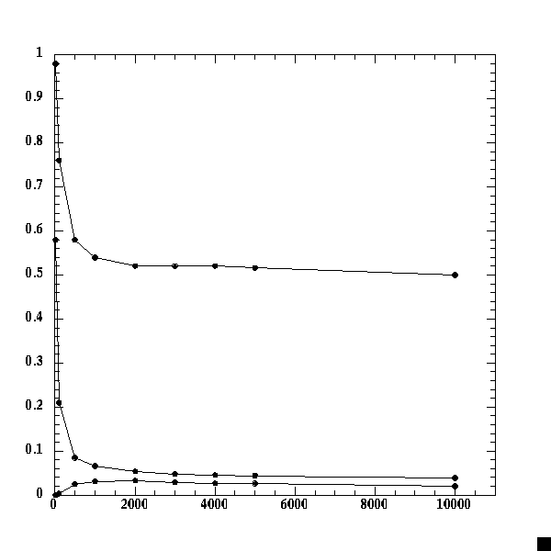
Using ions simulation with 10000 events
T | fraction of events with annihilation below starting point | fraction of events with annihilation at bottom of vessel | fraction of events with annihilation at top of vessel
10 𝜇K | 98 % | 58 % | 0 %
100 𝜇K | 76 % | 21 % | 0.3 %
500 𝜇K | 58 % | 8.5 % | 2.5 %
1 mK | 54 % | 6.6 % | 3.1 %
2 mK | 52 % | 5.4 % | 3.3 %
3 mK | 52 % | 4.8% | 2.9 %
4 mK | 52 % | 4.6 % | 2.7 %
5 mK | 51.6 % | 4.4 % | 2.6 %
10 mK | 50 % | 3.9 % | 2 %
annihilation below launch point
fraction of events
annihilation at bottom plate
annihilation at top plate
Statistical analysis → estimate number of required events
T (𝜇K)

Slide 4
It seems difficult to use ions of a few mK
→ better to aim directly at 𝜇K
any idea to use atoms?

