Slide 1


Recycling antiprotons
pbar working group
(B. Kim, D. Lunney, B. Mansoulié, P. Pérez, A. Welker + …)
GBAR Collaboration Meeting, CERN, 27-11-2018

Slide 2
GBAR2
anti-
proton
dump
Ps
H
antiprotons
e⁺
H⁺
At present, antiprotons not forming antihydrogen are lost.

Slide 3
GBAR2
antiproton trap
Ps
H
antiprotons
e⁺
H⁺
An antiproton trap would allow recirculation
and running without the AD!

Slide 4
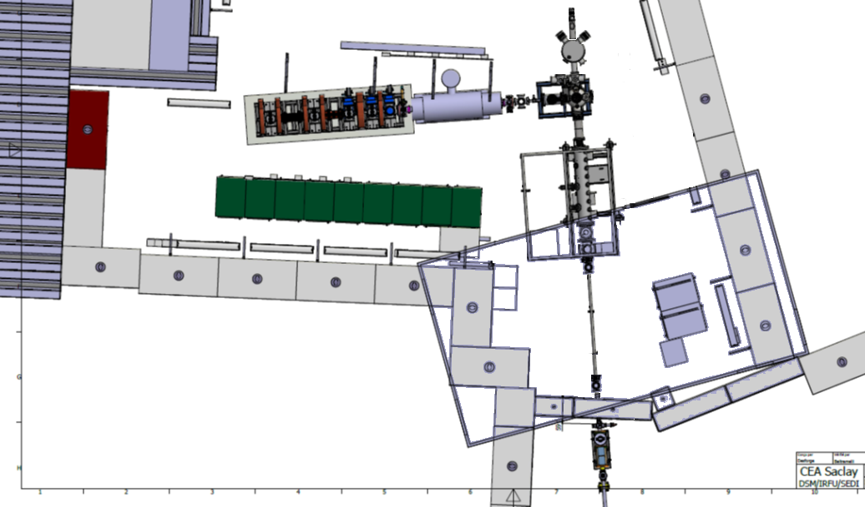
present GBAR layout at CERN
protons

Slide 5
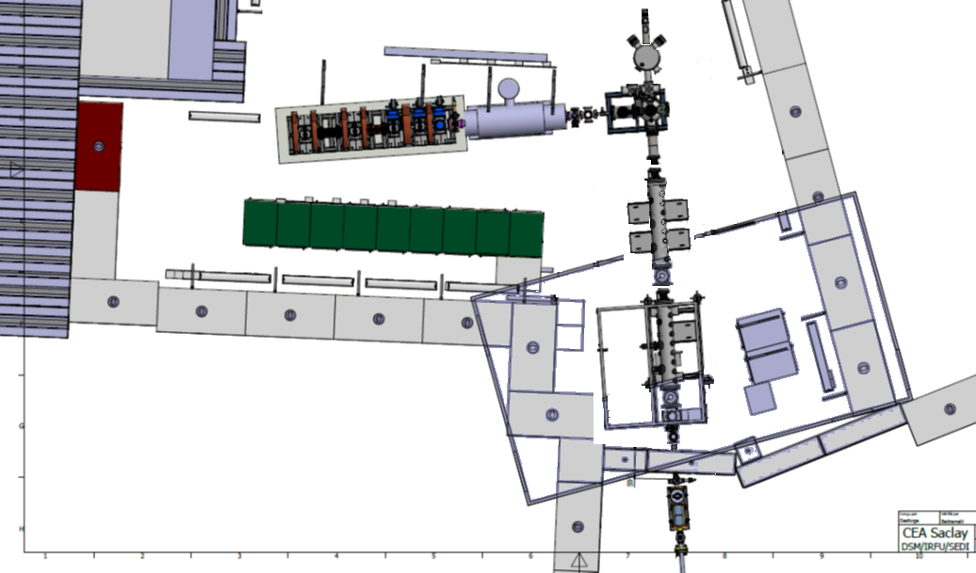
future GBAR layout at CERN
protons

Slide 6
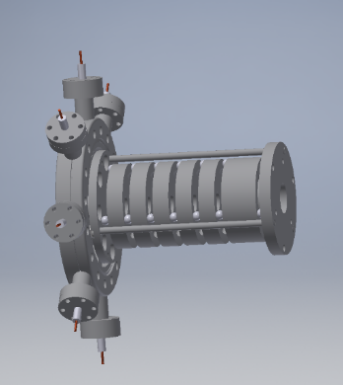
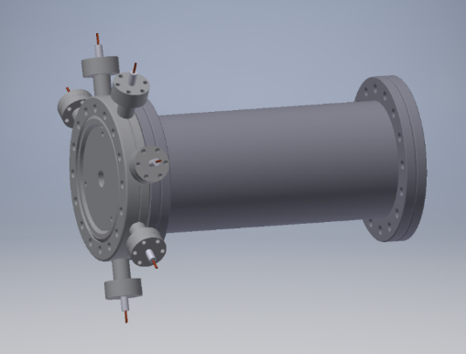

$$\overline{p}ARCEL$$
: an antiproton recycling cell
an idea by Dr. Andree Welker
A recycling cell that prevents the antiprotons from annihilation:
Material costs deduced from existing offers: ~13000 €
1x CF100 with 7 CF16 feedthroughs: 3500 €
6x CF16 20kV feedtrough connectors: 300€
Material electrodes/support: 5000€
CF100 316LNS tube: 600€
Consumables: 400 €
CF100 Valve: 2500€
Dr. Andree Welker, Idea kick off, CERN/Geneva, 24.10.2018
1

Slide 7
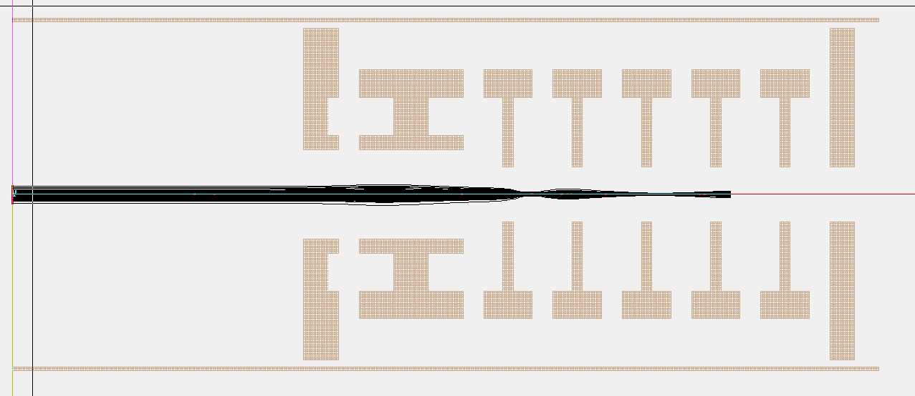
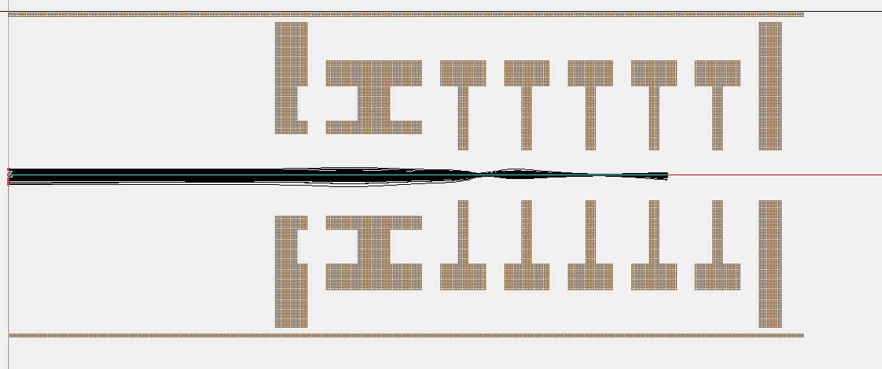


First simulations
1-10 keV deflection possible:
Voltage ranges to be covered by the PS +- (800V – 16 kV)
$\overline{p}$ @ 1 keV
$\overline{p}$ @ 10 keV
Dr. Andree Welker, Idea kick off, CERN/Geneva, 24.10.2018
1

Slide 8
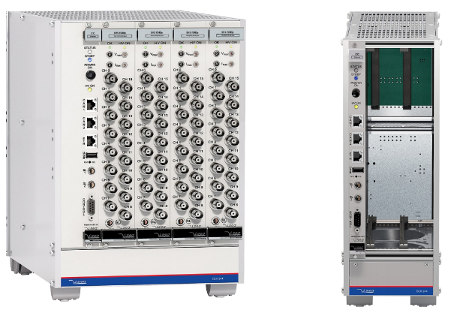
Power supplies
ISEG highly stable PS:
Controlable:
  Standalone Software from ISEG
  via LabView over Ethernet (VI‘s)
  GSI CS/CS++ system
  EPICS
Different module slots
Voltage stability: < 1*10⁻⁵ V (100-3 kV)
        < 5*10⁻⁵ V (100-20kV)
Ripple: (mVpp)>1kHz|10Hz-1kHz|0.1-10Hz
  2 | 7 | 30
3 years warrenty
e.g Module ECH24x (bigger exist)
Material costs deduced from existing offers: ~18000 €
1x ECH244 Crate with 4 slots : 1680 €
1x Network Controler: 1090€
2x 100-20kV positive 4Ch PS 1 slot: 3560 €
2x 100-20kV negative 4Ch PS 1 slot: 3560 €
12x 20kV SHV cable and connector: 1000€
Dr. Andree Welker, Idea kick off, CERN/Geneva, 24.10.2018
1

Slide 9
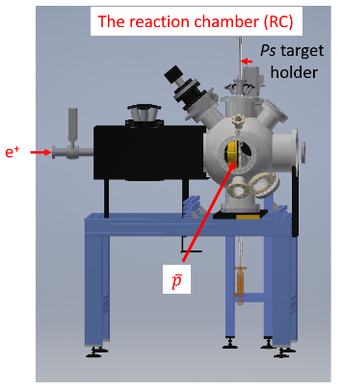
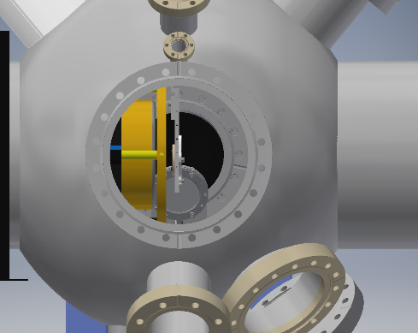
Return through Reaction Chamber
SO₂
Ps
cell
MCP-RC (off beam axis)
Ignore!
Slalom?
Dr. Andree Welker, GBAR group meeting, CERN/Geneva, 18.10.2018

Slide 10
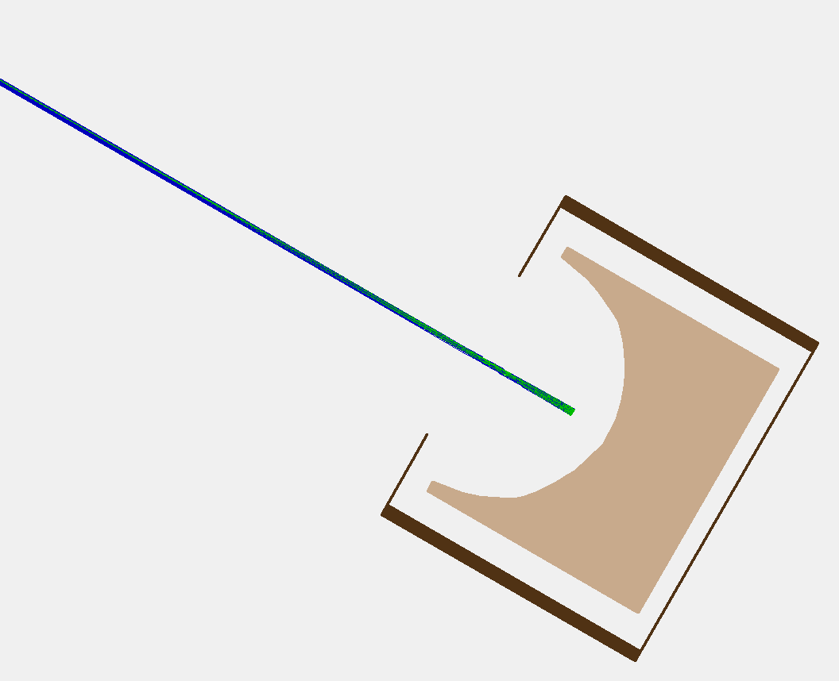
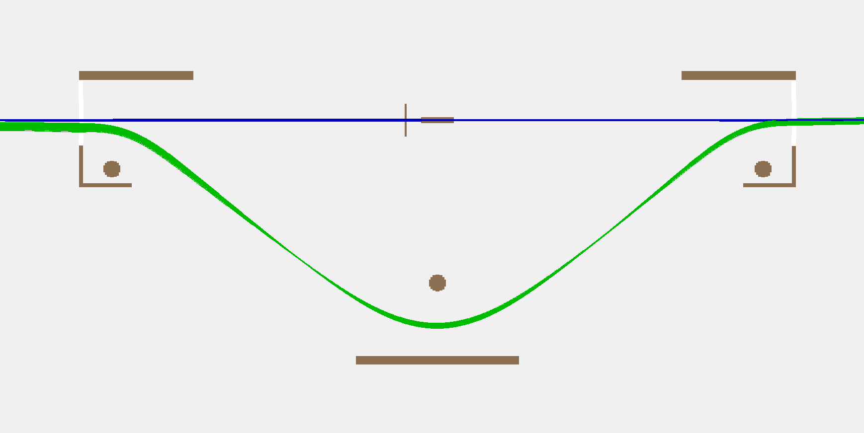
GND
- Several mirror geometries tested
- Best solution → hemispherical geometry
By-pass (if necessary)
Switchyard
-1430V
Ps converter
- Reflection of the pbars on a hemispherical mirror.
- By-pass possible around the Ps converter to avoid high losses.
- Based on electrostatic optics used in Mini-ring.
Mirror

Slide 11
Recycling antiprotons: accumulation & decoupling
Background (trap becomes beam dump?)
Time line: could precede trap installation
Concerning decelerator versus foil: combination difficult… ☹
pbar working group – join us!
GBAR Collaboration Meeting, CERN, 27-11-2018

