Slide 1
Producing Antihydrogen
Molecular Ions in GBAR?
Jean-Philippe Karr
(LKB)
on behalf of
Edmund G. Myers
(Thallahassee, Florida)
e⁻
e⁺
p
p
−
−
p
p
−
H₂⁺
H₂⁻
GBAR meeting – CERN, 29 November 2018

Slide 2
Motivations
−
H₂⁻ is the simplest antimatter ion on which
spectroscopy can be performed.
(reminder: H⁺ has only one bound state)
A single ion can be stored for months in a Penning trap
(cf. BASE experiment: antiproton g-factor)
Spectroscopy of H₂⁻/H₂⁺ allows for improved CPT tests
−
−
Type of transition | Probed symmetry
electron / positron spin-flip
Hyperfine-Zeeman | p / p g-factor
Hyperfine-Zeeman | p / p magnetization distrib.
rovibrational
−
RF/
microwave
−
−
laser
−

Slide 3
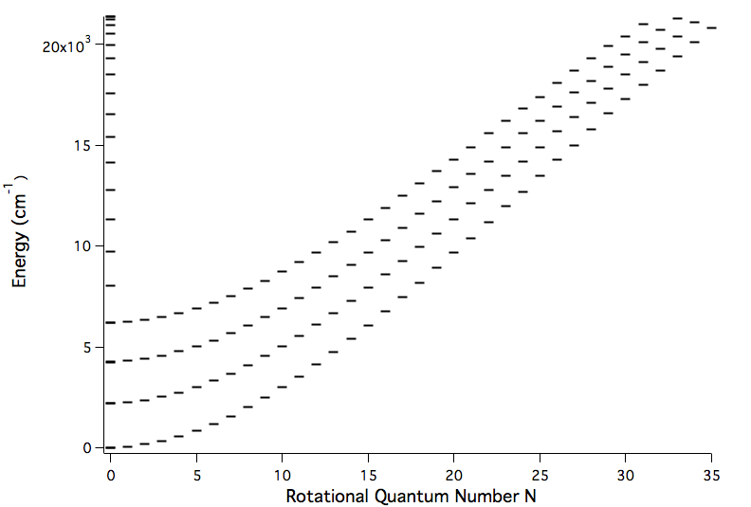
H₂⁺ rovibrational levels
423 bound rovibrational levels (v,N)
supported by the ground (1sσ_{g}) electronic state
(not all levels shown)
Graph: courtesy of Edmund Myers (LEAP 2018, Paris)

Slide 4
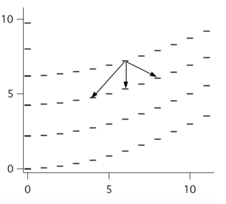
H₂⁺ rovibrational transitions
Homonuclear molecule ⇒ rovibrational transitions are dipole (E1)-forbidden
⇒ quadrupole (E2) transitions, ΔN = 0, ±2
v
3
2
Energy
(10³ cm⁻¹)
1
0
N
Graph: courtesy of Edmund Myers (LEAP 2018, Paris)

Slide 5
H₂⁺ : theory and experiments
Precise theoretical predictions
Rovibrational transition frequencies:
Hyperfine structure: 10⁻⁶
Zeeman effect
V.I. Korobov, L. Hilico, J.-Ph. Karr, PRL 118, 233001 (2017)
V.I. Korobov, J.C.J. Koelemeij, L. Hilico, J.-Ph. Karr, PRL 116, 053003 (2016)
J.-Ph. Karr, L. Hilico, V.I. Korobov, PRA 77, 062507 (2008)
No precise experimental data yet! (excepted for hfs)
Experiment in progress at LKB
  Doppler-free two-photon (2E1) transition (v,N) = (0,2) → (1,2)
  Goal precision ~ 10⁻¹²
  Improved determination of fundamental constants, especially

Slide 6


Curse and blessing of H₂⁺
Vibrational levels decay by E2 transitions
Mean lifetimes are ~week, or longer!
Many, very narrow (<μHz width) transitions
But no fluorescence, how to detect?
How to initialize the state?
For H₂⁺ : - production in selected (v,N) using multiphoton ionization (REMPI) of H₂
- (destructive) detection of v using photodissociation
For the anti-ion, we need nondestructive techniques !
Edmund Myers, LEAP 2018 Paris, edited for Jean-Philippe Karr for presentation to GBAR Nov 2018
Notes:
For H2+, easy to make, can use destructive techniques of state-selective ionization, and ion detection.

Slide 7
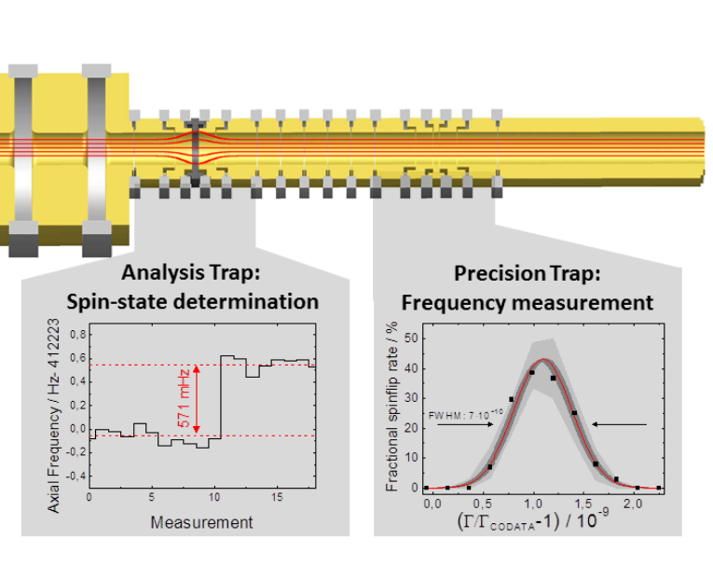
Continuous Stern-Gerlach effect to detect electron spin-flips
Double Penning trap apparatus developed for high-
precision g-factor measurements (Heidelberg/Mainz)
Identifies
e⁻ spin-state M_{S}
Analysis trap
Inhomogeneous B
Precision trap
Uniform B
S. Sturm et al, Nature 2014,
g_{e}(¹²C⁵⁺) to 3×10⁻¹¹
Edmund Myers, LEAP 2018 Paris, edited for Jean-Philippe Karr for presentation to GBAR Nov 2018
Notes:
Magnetic moment of an electron or positron is 650 times larger than that of proton/antiproton: Larger axial frequency shift, easier to get high precision, don’t need a highly inhomogeneous field to detect.

Slide 8
Continuous Stern-Gerlach effect to detect electron spin-flips
Double Penning trap apparatus developed for high-
precision g-factor measurements (Heidelberg/Mainz)
Identifies
e± spin-state M_{S}
Analysis trap
Inhomogeneous B
Precision trap
Uniform B
Will work for
H₂⁺ and H₂⁻
−
S. Sturm et al, Nature 2014,
g_{e}(¹²C⁵⁺) to 3 10⁻¹¹
Edmund Myers, LEAP 2018 Paris, edited for Jean-Philippe Karr for presentation to GBAR Nov 2018
Notes:
Magnetic moment of an electron or positron is 650 times larger than that of proton/antiproton: Larger axial frequency shift, easier to get high precision, don’t need a highly inhomogeneous field to detect.

Slide 9
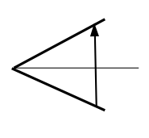
Zeeman/hyperfine spectrum
Case 1 N = 0 : no hyperfine structure
M_{s}
1/2
B
−1/2
dependence of on v (*) large enough to be detected ⇒ identifies v !
(*) R.A. Hegström, PRA 19, 17 (1979)

Slide 10
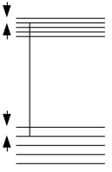
Zeeman/hyperfine spectrum
Case 2 even N ≠ 0 (“para-H₂⁺”) : total nuclear spin I = 0
e.g. N =2, B = 5 T :
M_{S}
M_{N}
14 MHz
+2
−2
+1/2
140 GHz
Identifies M_{N} , v and N !
56 MHz
+2
+1
0
−1
−2
-1/2
transition :
Electron spin – rotation constant

Slide 11
Zeeman/hyperfine spectrum
Case 3 odd N (“ortho-H₂⁺”) : total nuclear spin I = 1
3 times more states…
but same principle:
transition :
Spin-spin Fermi
contact interaction
Identifies M_{N} , M_{I}, v and N !

Slide 12
CPT test #1
N = 0: ratio of spin-flip to cyclotron frequency
Assuming
[ verified to ±2×10⁻¹² for free e⁺/e⁻ : R. van Dyck et al., PRL 1987 ] ,
tests equality of and potential accuracy ~ 3×10⁻¹¹
State of art: ±6.9×10⁻¹¹ (S. Ulmer et al. (BASE), Nature 2015)
±2×10⁻⁹ (M. Fee et al., PRL 1993)
±8×10⁻¹⁰ (M. Hori et al. (ASACUSA) Science 2016)

Slide 13
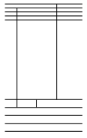
CPT test #2
M_{S}
M_{N}
or transitions
“triple resonance” technique,
using e± spin-flip to identify initial
and final states.
Combination of transitions
extract and electron-proton
hyperfine interaction
+1/2
+2
−2
1
3
initialize
detect
2
+2
+1
0
−1
−2
−1/2
~56 MHz
v=0, N=2
Edmund Myers, LEAP 2018 Paris, edited for Jean-Philippe Karr for presentation to GBAR Nov 2018

Slide 14
CPT test #2
Advantage w.r.t. to measuring on bare antiprotons:
much faster detection of antiproton spin flips, through positron spin flips instead of continuous Stern- Gerlach effect on antiprotons ( )
“Magical” B-field values for which some transition frequencies are independent of B to first order
⇒ potential accuracy < 10⁻¹³ (cf. Be⁺ RF clock, J. Bollinger et al. PRL 1985)
State of art: ±1.5×10⁻⁹ (C. Smorra et al. (BASE), Nature 2017)
hfs of : ±4×10⁻⁴ (M. Ahmadi et al. (ALPHA), Nature 2017)
+ prospects for 10⁻⁶ (M. Diermaier et al. (ASACUSA), Nature Commun. 2017)

Slide 15
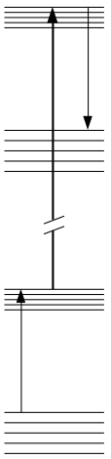
CPT test #3
Ro-vibrational transitions
M_{S}
M_{N}
+2
Change in e± spin-flip frequency
signals vibrational transition
Ion cooling to reach Lamb-Dicke regime
(Image current cooling + dilution
refrigerator → T = 20 mK ;
Electrical coupling to laser-cooled
ion in other trap;
Sympathetic cooling with laser-
cooled anions)
1/2
v=1,
N=2
detect
140 GHz
−1/2
Mid-IR Laser
E2
λ = 4.58 μm
1/2
+2
v=0,
N=2
140 GHz
initialize
−1/2

Slide 16
CPT test #3
Estimated potential accuracy ∼10⁻¹⁵ i.e. ∼ 2× 10⁻¹⁵ on
and
Could reach ∼ 10⁻¹⁷ using quantum-logic spectroscopy
in an RF trap (similar to the GBAR precision trap)
estimates for H₂⁺ : S. Schiller et al, PRL 2014 ; J.-Ph. Karr, J. Mol. Spectrosc. 2014
H₂⁻/H₂⁺ spectroscopy is ∼10³ times more sensitive than
H / H to the mass ratios
State of art: 1S-2S transition
in H ±2×10⁻¹² (M. Ahmadi et al. (ALPHA), Nature 2018)
in H ±4×10⁻¹⁵ (C. Parthey et al., PRL 2011)
−
−
−
−

Slide 17
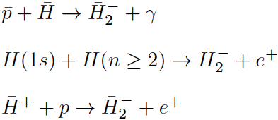
How to produce H₂⁻ ?
−
Edmund Myers, LEAP 2018 Paris, edited for Jean-Philippe Karr for presentation to GBAR Nov 2018

Slide 18


H₂⁻ production: estimates
−
σ = 6 x 10⁻¹⁵ cm² at 0.01 eV
X. Urbain et al. J. Phys B (1986)
But also:
σ = 1.1 x 10⁻¹² cm² at 0.01 eV
M. Stenrup et al. PRA (2009)
−
−
Inject H⁺ into p plasma, n = 10⁶ cm⁻³, T = 100K:
Total reaction rate R = 0.25 s⁻¹,
with 1/180 branching ratio for making H₂⁻
⇒ Expect 1 H₂⁻ for every 180 H⁺
−
−
−
−
−
Dec 2017 meeting: ∼ 1 H⁺/hour ⇒ ∼ 1 H₂⁻/week !
Edmund Myers, LEAP 2018 Paris, edited for Jean-Philippe Karr for presentation to GBAR Nov 2018

Slide 19
State initialization ?
Energetically allowed states:
v ≤ 8, N ≤ 27
with low v, high N favored
Edmund Myers, LEAP 2018 Paris, edited for Jean-Philippe Karr for presentation to GBAR Nov 2018

Slide 20
State initialization ?
E2 Lifetimes: v≥1 states ∼ 10 days
(v=0,N<8) > 1 year !
Solution: Stark quenching
- Put the ion in a cyclotron orbit of large radius r_{c}
motional electric field: ⇒
- This electric field polarizes the ion,
making E1 decay allowed.
Calculation of field-induced decay rates ( )
J.-Ph. Karr, arXiv:1810.04884, to appear in PRA

Slide 21
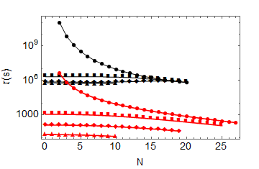
Stark quenching
Results for B = 10 T, r_{c} = 20 mm
(requires separate “quenching” trap)
v=0
v=1
v=4
Spontaneous
lifetimes
v=8
Field-induced
lifetimes
Quenching from high N down to N = 1 or 2 in ∼ 1 week

Slide 22
Molecular Antihydrogen Experiment (MAX)
Demonstrate state identification and Zeeman spectroscopy
on H₂⁺ (ALPHATRAP at MPIK Heidelberg)
2) Develop precise vibrational spectroscopy in a Penning trap*
  Develop ion cooling (to 20 mK?)
  Develop ultra-stable lasers and frequency metrology
−
3) Demonstrate feasibility of H₂⁻ production
4) Develop system for H₂⁻ production
−
5) Design and build whole experiment
6) Install and run at CERN!
_
*Or develop QLS on H₂⁻ in an RF trap, with transfer from
a Stark-quenching Penning trap…
Edmund Myers, LEAP 2018 Paris, edited for Jean-Philippe Karr for presentation to GBAR Nov 2018

Slide 23
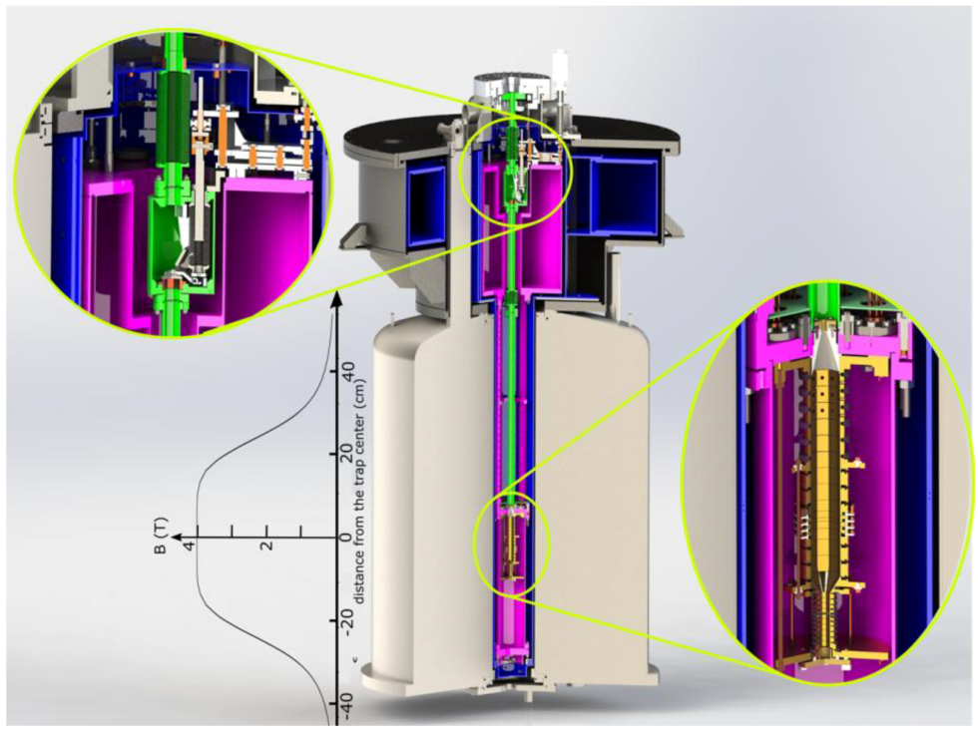
Implementation
−
GBAR produces H⁺
Combine H⁺ with p in (or from) p accumulator trap to make H₂⁻
(H⁺ loss and H₂⁻ formation monitored non-destructively by image current detection)
Inject H₂⁻ into a special 10 Tesla Penning trap for Stark quenching to v=0, N=1 or 2
4) Inject H₂⁻ into an ALPHATRAP-like apparatus for RF/microwave/laser spectroscopy
−
−
−
−
−
−
−
−
ALPHATRAP

Slide 24
Things to do - Theory
Stark quenching rates ✔
Zeeman structure at B ~ 5 T
H₂⁻ making: Calculate reaction rates?
Simulate formation from
H⁺ + p in a Penning trap
_
_
_
Edmund Myers, LEAP 2018 Paris, edited for Jean-Philippe Karr for presentation to GBAR Nov 2018

Slide 25
Thanks for your attention !
For more details:
E.G. Myers, “CPT tests with the antihydrogen molecular ion”,
arXiv:1802.01514
or PRA 98, 010101(R) (2018)

