Slide 1
Antiproton Trap

Slide 2
Current decelerator setup

Slide 3
Current decelerator setup

Slide 4
L1(1705)+Tchamber(345)+L2(338+24+22=384)=2435 mm
+One tube upstream ~ 2700 mm
+DN160~ 2800 mm
+ Q. Triplt dimension could be adjusted

Slide 5
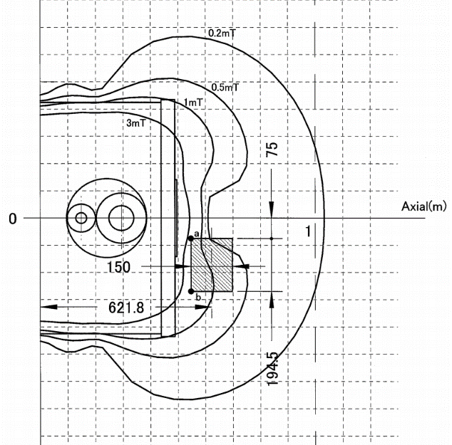
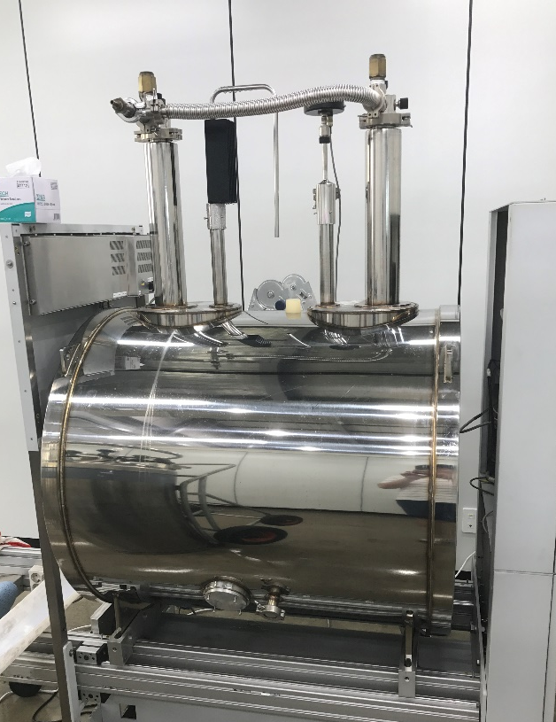
Superconducting solenoid
2 gauss
For central field = 7 T
We will use 3 T
1 m

