Slide 1
Free fall experiment: final steps
Implantation
  Inputs: ions (ovens? lasers?) , H⁺ guiding to an inside FF
  Lasers
  Pumps
  Magnetic shielding
Intermediate steps
  Ion cooling experiments
  Using other ions?

Slide 2
Vacuum
Meeting with Paolo Chiggiato, CERN top vacuum expert.
  E(-12) probably feasible, with lots of care
    Analyze all sources of gas: input lines, ion injection…
    Pre-treatment of vessel (stainless steel) : firing
    Cryopump OK if bakeable (vibrations?), or ion pump + getter
    Vacuum gauge(s): CERN special OK
    Cryo for chamber: necessary to go below E(-12); whole chamber, screen only would be useless.
  Proposes help for P<E(-11) (eitherwise “trivial”)
    Can measure feed-thrus => URGENT!
    Can measure all pieces for outgassing => please send us samples!
    Review design

Slide 3
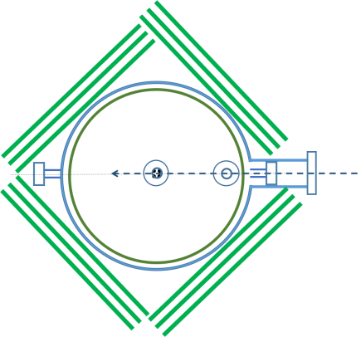
Front
Side
Top
Not included:
Photodetachment laser
Magnetic shielding (???)
Supporting the FF from the floor
Where?
Vibrations?

Slide 4
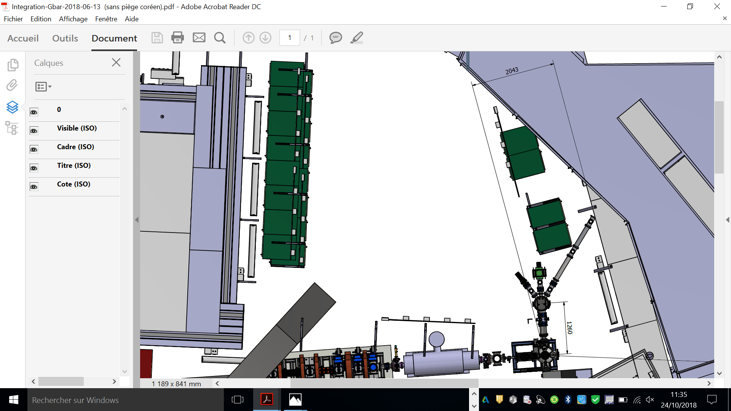

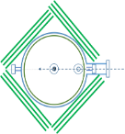
Laser hut on ground floor of the GBAR area?
No need for structure (non-magnetic…)
Easier transport of lasers beams
Better view for visitors (?)
No access with e⁺ beam
(except very low rate)
No access with pbar beam
Access to FF chamber from this end more difficult.
Access from the sides?
(removing TOF side walls?)
3500
2x600x450
1500x900
1800x900
900x600
1:40
2,5 cm = 1 m

Slide 5
Intermediate steps
Laser cooling of ion(s)
The ion injection/cooling(/ photodetach?) experiment should be first made in a lab. It cannot be developed in GBAR!
  Which steps?
    Which cooling experiments in LKB and Mainz?
  How to prove/calibrate efficiency for H⁺
    Protons? In the lab / from GBAR
What can be done with other ions?
  H⁻ from ELENA
  Protons from ELENA
  Protons from our source
How far can we design/build the FF chamber without feedback/iteration from the intermediate steps? Examples:
    first trap at 1kV? 500 V? Trap power supplies at the HV?
    materials used? Cables etc. ? => select and test!

Slide 6
Additional slides

Slide 7
Vacuum
Patrice (Dec 2016) : <10⁻¹¹ mbar => difficult in a large, complex object like this
Needs cryogenics => increases complexity.
time in each step?
  slowing down from keV to meV in the capture trap : 1 ms ?
  cooling to 1 mK : 1 ms?
  cooling to 10 microK: 1 ms?
  free fall of the neutral atom : 200 ms
collisions (Svante Jonsell, Pauline,…)
  inelastic : Hbarp / H₂ or He unknown. Svante’s best guess: sigma.v ~ 8 10⁻¹⁰ cm³/s for H2, 4 10⁻¹⁰ for He; if 10⁻⁹ mbar => τ = [(sigma.v). ρ] = 50 sec
  elastic (heating in traps) : ???
Alpha paper on storing Hbar:
  vacuum estimated from pbar lifetime 5 10⁻¹⁰ m⁻³ = 7 10⁻¹⁴ mbar
  Hbar lifetime 10⁴ – 10⁵ sec, and “loss by heating by collisions dominate if T>100K”
How to? : Bake-out? Outgassing of materials inside ?
  list all materials
    samples were sent from Mainz to CERN => ?

Slide 8
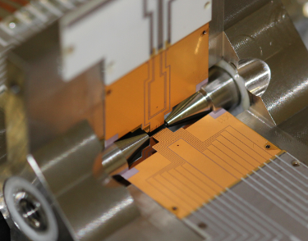
N.B. The trap is rotated by 45° (around z) with respect to the laser beams
Raman beam R2
(σ⁺ / σ⁻)
coil
E
z
B
45°
x
coil
45°
Doppler beams
(σ^{+/-})
E
Raman beam R1
(π)
Beam arrangement 0:

