Slide 1
Update on DFH splices
J. Fleiter

Slide 2
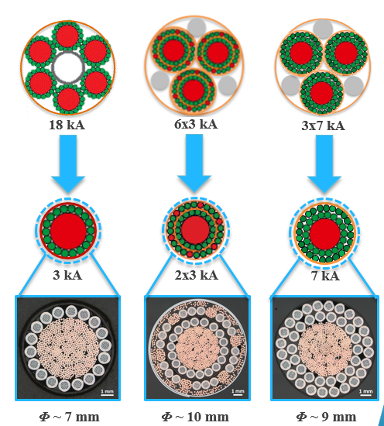
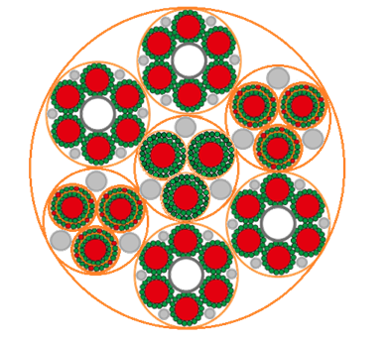
Splice dimensions
In this slide the first estimate of the splice dimensions for the different circuits of DSHx are given:
  18 kA (per splice): 70 x 60 x 300 mm
  2 kA coaxial cable 20 x 30 x 650 mm
  7 kA (per splice) 20 x 45 x 300 mm
The splice will be performed in situ:
  Space around the splice must be available for the splicing process (mold, heaters, handling)
The volume dedicated to the splice should include a provisional length of MgB₂ cable (equivalent to splice length) in case it is damaged due to incident (e.g. heavy part falling down on the MgB₂ during the splicing process…)

Slide 3
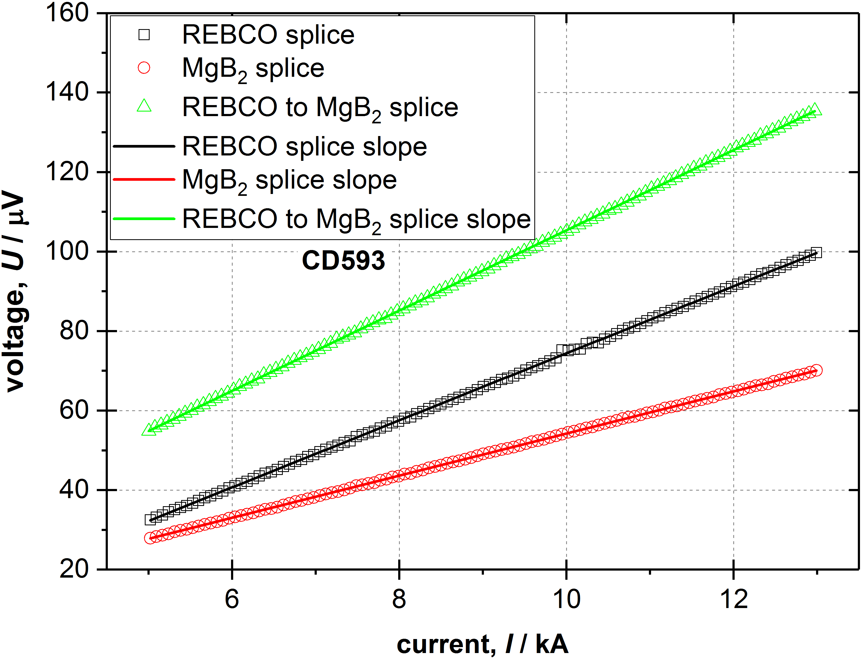
Splice resistance
Measured splice resistance
  3 kA sub cable HTS to MgB₂
    200 mm long splices
    Measured at 4 K up to 14 kA
    10.1 nΩover full current range
    Splice resistance expected to be the same (within 5%) at 20 K
Expected splice resistance for the DFH (including margin)
  18 kA : 2.5 nΩ (810 mW)
  13 kA 2.5 nΩ (422 mW)
  2 kA : 15 nΩ (60 mW)
  2 kA trim : 7.5 nΩ (30 mW in DC)
Measurement performed by C. Barth and G. Peiro

