Slide 1
DFM – Concepts & pre-design
Meeting objective : get feedback on conceptual approach, pre-design
Y.Leclercq, A. Kolehmainen

Slide 2
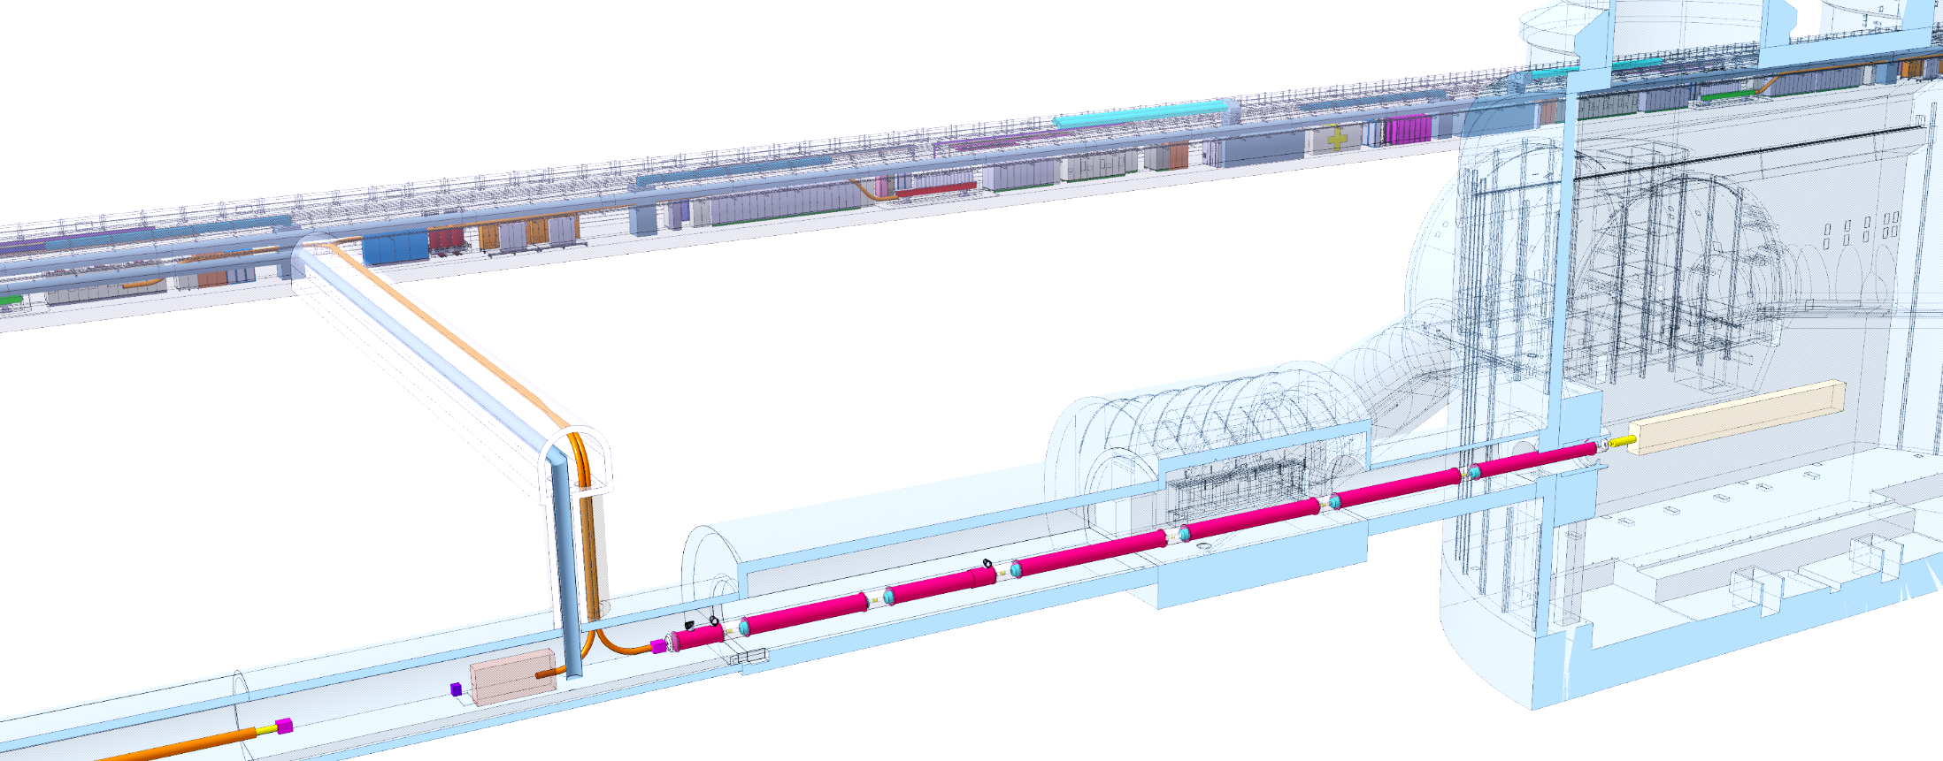


Context
DFHx1
DFHx2
Each IP1 and IP5 sides equipped with 2 cold powering chains of cryostats
Triplet insertion : DFHx – SC Link (DSH) – DFX
Matching sections : DFHm – SC Link - DFM
DFM basic functions:
Electrical interface between SC Link and D2 (MBRD – 13 kA + 4 Correctors MCBRD)
Supply cryogenics to the DSHm SCLink
DFHM
Power converters
Service tunnel
DSHx
Transverse tunnel
DSHm
Q1
IP
≈50m
≈8m
Q2b
Q2a
CP
Q3
≈45m
DFX
D1
≈80m
LHC tunnel
DFM
D2
2 x 13 kA
8 x 0.6 kA
2 x 18 kA
2 x 13 kA
3 x 7 kA
12 x 2 kA
HTS
DFHm
DFHx1
PT
DFHx2
Superfluid @ 1.9K
Liquid He @ 4.5 K
Gaseous He
Heater
Vacuum barrier
HTS
MgB2
NbTi
Warm cable
Splice
PT
⬅ $\dot{m}=2 g/s$
➔ $\dot{m}=5 g/s$
PT
Ghe <17K
Ghe <17K
MgB₂
UR: Service tunnel
UL: Transverse tunnel
MgB₂
LHC tunnel
PT
Jumper DFM
PT
DSHm
Jumper DFX
DFM
PT
NbTi
SFHe @1.9K
Ghe @4.5K
DSHx
PT
DFX
Splice
Jumper D2
Lhe @4.5K
Ghe @4.5K
Jumper D1
D2
Lhe @4.5K
SFHe @1.9K
MBCRD
MBRD
Beam
D1
MBXF

Slide 3
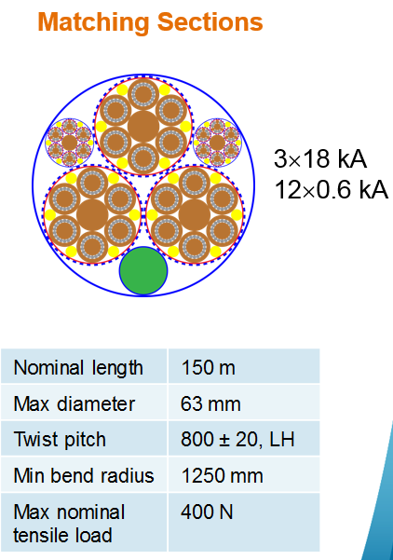
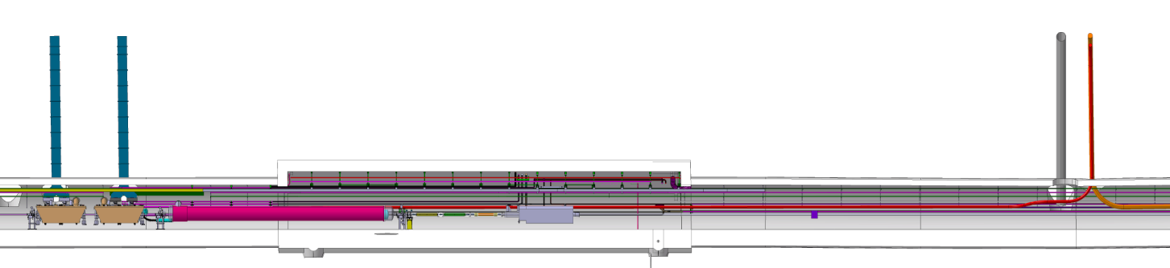
Conceptual specifications
Saturated liquid bath
@ 1.3 bara
CS : LHE inlet
From C
Plug
EhEh’2
SD : GHE return
To D
WP6a meeting : 28 August 2018
Cryogenic layout
Ghe mass flow
Superfluid helium @1.9K
DFM
Integration: & installation
  DFM located in the LHC tunnel about 45m from the shaft: fixed
Electrical layout :
  Number and material of leads : fixed (extra cables & NbTi leads geometry to clarify)
  D2-DFM Splices location : fixed
Cryogenic layout
  Common helium volume with SCLink / splices immersed: fixed
  Generated mass flow from liquid helium vaporisation: fixed
  Thermal contractions approach for DFM: in progress
Vacuum layout EDMS2048016
  Separated insulation vacuum with SCLink & D2-DFM link: fixed
D2
Cold mass
NbTi
NbTi/NbTi splices
NbTi/MgB2 splices
NbTi D2 leads
MgB2
Courtesy Amalia, 8th HL-LHC col.
R≈1.9 m
≈45 m
≈1.5 m
DSHm
CC
CC
DFM
D2
≈140m
93.25m
From IP

Slide 4
DFM functional specifications
DFM
Electrical
  Ensure continuity between DSHm and D2 leads 10 leads ? (15 leads) ?
  Ensure integrity of cables (transport, installation, thermal cycles) Rmin=1.25m / Fmax=400N
  Provide volume, access and protection for splices NbTi-NbTi TBC
  Ensure instrumentation acquisition (V-taps) TBC
Cryogenic
  Ensure max splices temperature < 5.5 K / Max Rsplice
  Ensure immersion of splices nominal ≈100 mm over splices +/-50 mm TBC
  Ensure GHE supply to SCLink : Nominal 2 g/s / design 3g/s
  Adapt to cryogenic layout One jumper, 1 inlet CS, 1 outlet Sd, 1 TS E’hFh2
  Ensure instrumentation acquisition TBC
  Ensure no condensation on external surfaces TBDesigned
  Budget static heat loads 20 W
  Budget dynamic heat loads 1.5 W
  Integrate thermal contractions layout scenario TBD
  Ensure circuits leak tightness 1.10⁻⁹ mbar.l.s⁻¹ tbc
  For saturated LHe volume, a constant increasing slope shall be granted between coldest point and liquid-gas interface
  Autonomy nominal supply 5 minutes
Mechanical
  Design pressure for the vacuum vessels PS=1.49 bara
  Design pressure for the DFH helium vessels PS= PS(DSHx) + 0.5 bar
  Allowable accesses to splices (cut-open) 4 TBC
  Cables fixed points characteristics @ splice level / F max ??? TBC
Insulation vacuum
  Independent insulation vacuum with SCLink see Indico733790
  Share insulation vacuum with Current leads 1.10⁻⁵mbar
  Present pumping and instrumentation interfaces //
Integration
  Fit in LHC tunnel
  Interface with SCLink (cryostat & cables), current leads (mechanical & HTS): Dimensions TBC
Installation
  Compatible with SCLink transport configuration after testing TBD
  Interface with SCLink geometry (cryostat & cables distribution and orientation) Pitch: 0.8m
  Compatible with allowed manufacturing processes Welding
  Compatible with D2-DFM link TBD
Maintenance
  Allow required access to NbTi-NbTi splices TBD
  Allow access for inspections and replacement Safety devices, instrumentation
Safety & rules
  Strategy toward DFM liquid Protect SCLink+DFM
  Design, manufacture and test to Norms PED 2014-68-EU & CERN rules
  Design safe scenario for pressure relief devices ISO 21013-3

Slide 5
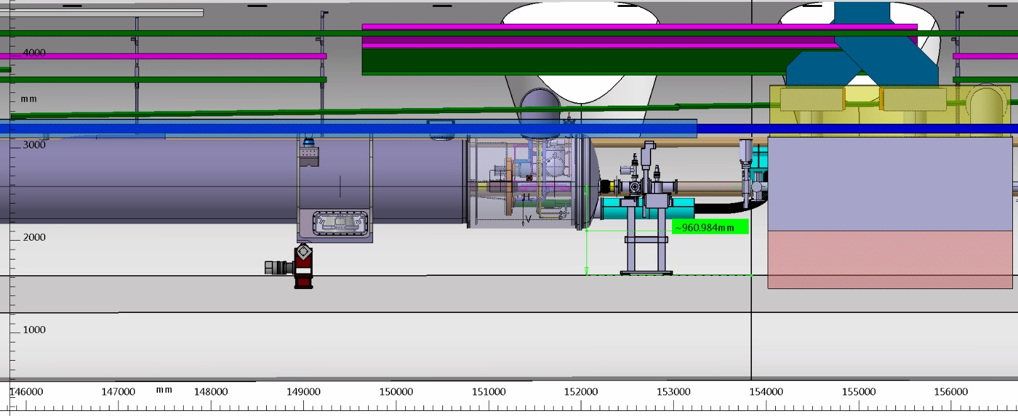
Design guidelines
Ensure DFM installation & integration
Ensure MgB2 & NbTi cables integrity
Ensure splices immersion and gaseous mass flow to SCLink
Ensure increasing slope in saturated bath
Ensure instrumentation routing
Ensure safety aspects
Ensure maintenance

Slide 6
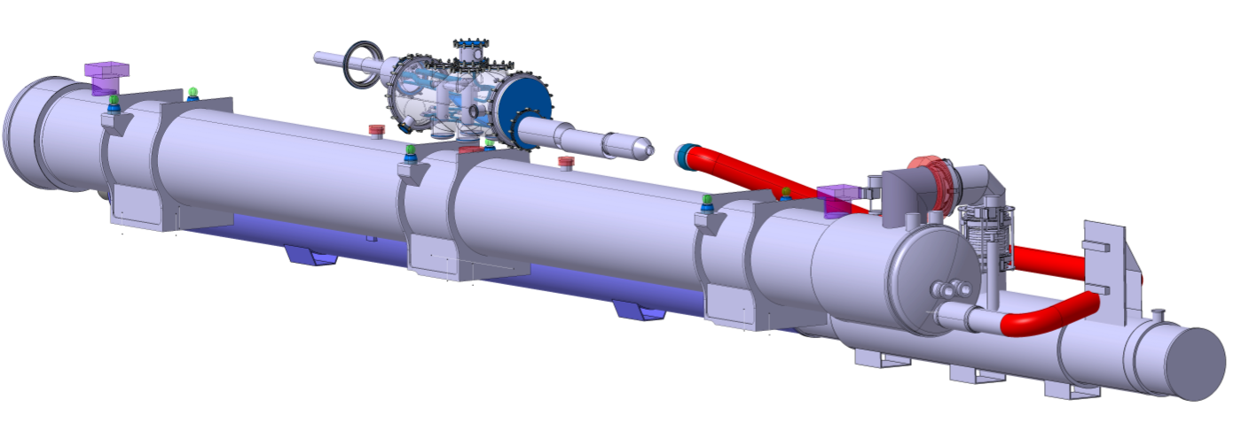

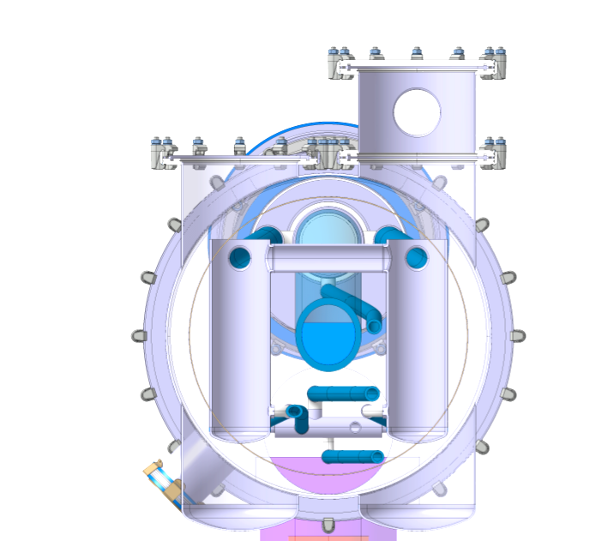
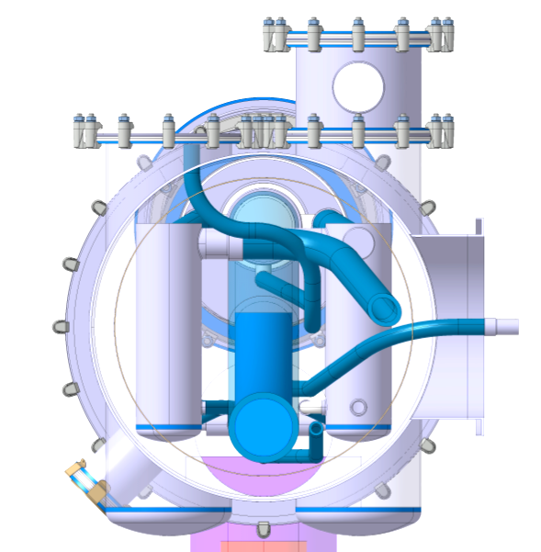
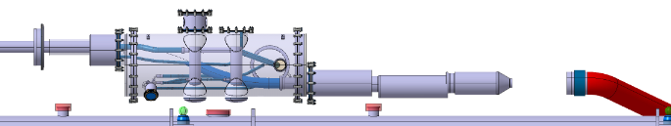
Preliminary design (functional)
DSHm
DFM
Insulation vacuum layout
Electrical layout
Cryogenic layout
  Cryogenic lines/jumper
  Cryogenic services (heater, gauges, instrumentation)
D2-DFM link
D2 jumper
D2
B-B
P relief device
QXL
A-A
Instru. wire
Level gauge
SD
CS
Heater
E’_{H}F_{H2}
B-B
A-A
DFM
Superfluid @ 1.9K
Liquid He @ 4.5 K
Gaseous He
Heater
Vacuum barrier
HTS
MgB2
NbTi
Warm cable
Splice
DSHm
SD
CS
E’_{H}F_{H2}
Plug
D2-DFM link

Slide 7
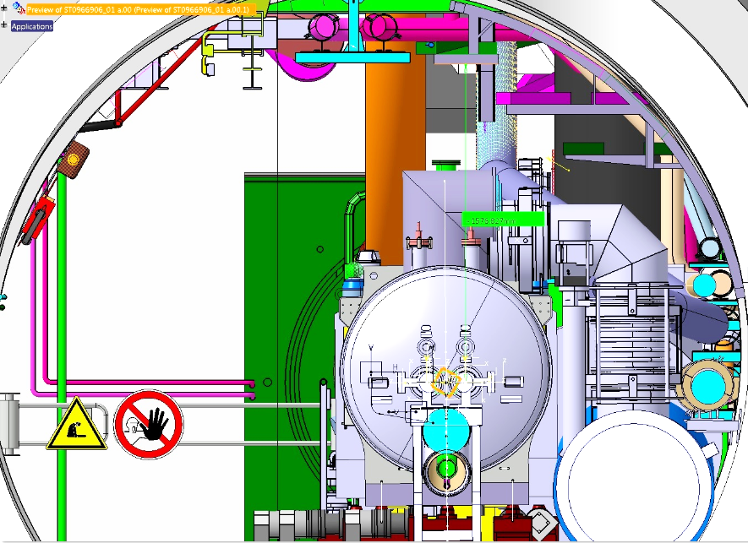
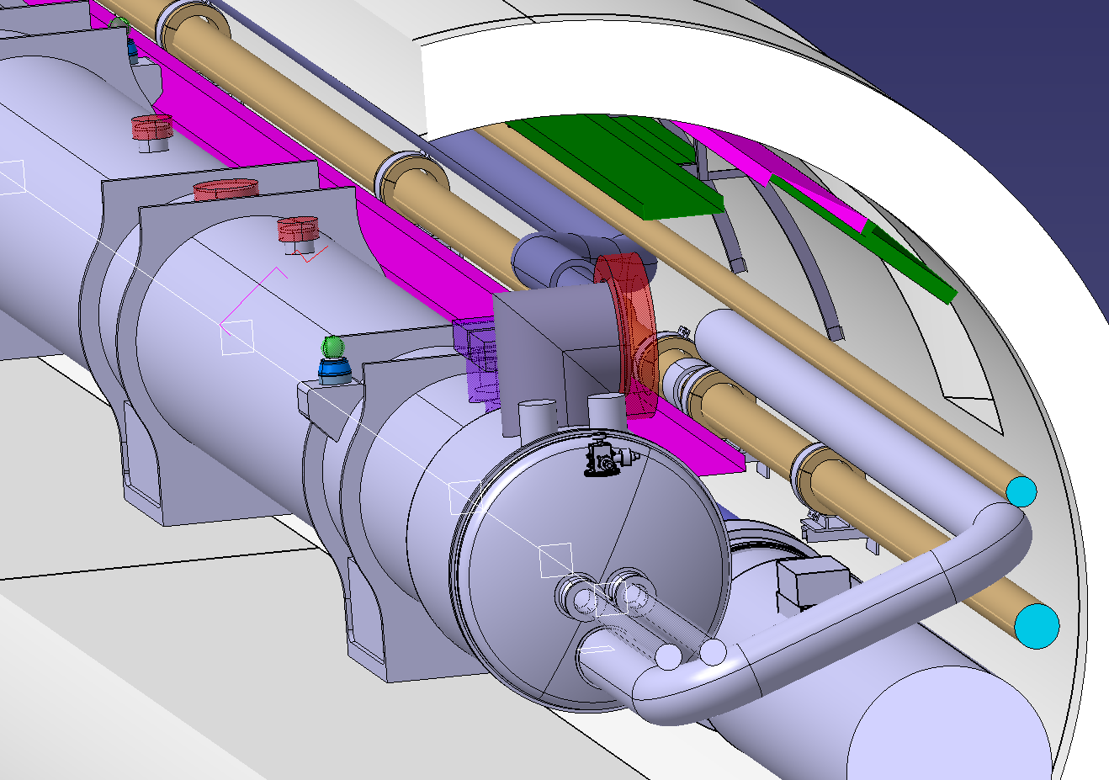
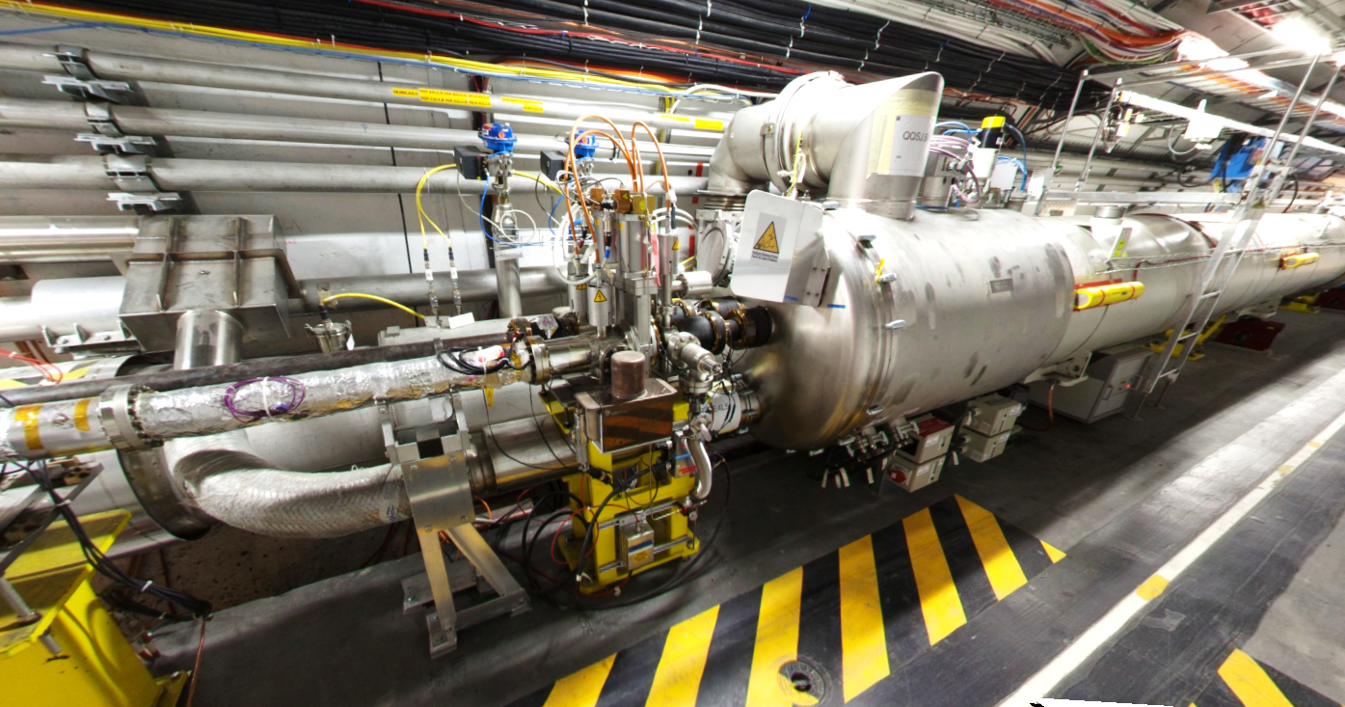
Preliminary design
R=1.9m
≈ 1m
Transport area
Integration
  D2-DFM link: LHC stand alone type
  Physical position:
    Respect transport area
    Access for splices ➔ above D2
Mechanical layout
  DFM fixed to D2
  DSHm fixed to DFM ?
  NbTi-NbTi splices fixed to he vessel
  Future discussions:
    SCLink interface: Inner pipe fixed to outer pipe ?
D2 &
beam
Cryo-lines
D2DFM link routed along the wall
Courtesy E.Chaudet
Superfluid @ 1.9K
Liquid He @ 4.5 K
Gaseous He
Heater
Vacuum barrier
HTS
MgB2
NbTi
Warm cable
Splice
DFM
DSHm
Plug
D2-DFM link
DSHm Weight
20 bar

Slide 8
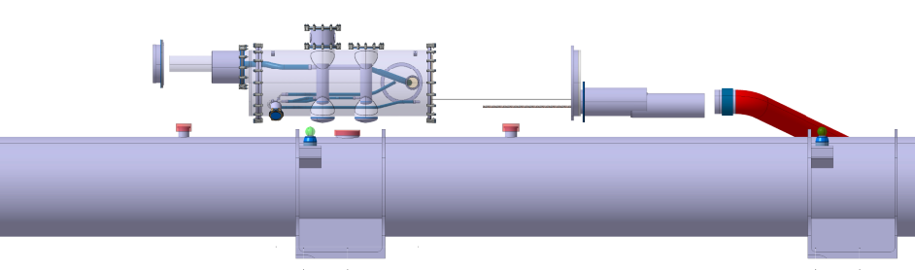


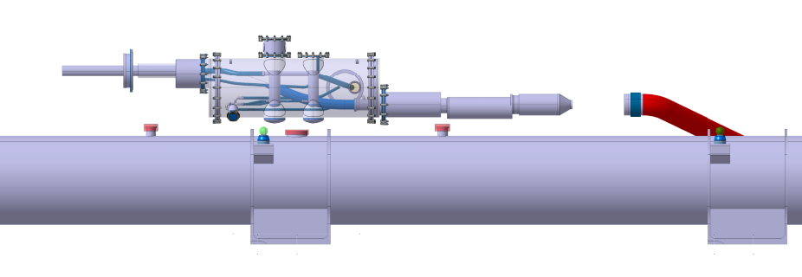
Proposal Assembly sequence
Initial configuration:
  D2 installed
  D2-DFM link installed
  Plug toward D2-DFM link connected
SCLink installation
  Same configuration as DFX:
    MgB2-NbTi splices are located in a rigid protective sleeve
    Only NbTi leads are apparent
  Insertion straight
  Lower protective sleeve
  Close vacuum vessel
  Splice NbTi-NbTi
  Slide sleeve back & weld
SCLink outer jacket
Rigid protective sleeve
Rigid
Flexible
NbTi leads
MgB2 leads
MgB2-NbTi leads

