Slide 1
DFH-DFM meetings
Conceptual specifications
7 Nov. #1: Conceptual Specifications
14 Nov. #2: DFHx : Layout & Splices
21 Nov. #3: Thermo-mechanical engineering
        Thermal Contraction Strategy
        Convective Heat Transfer : Fluid↔Splice
28 Nov. #4: DFM concept & pre-design
5 Dec. #5: DFHx assembly : choices and consequences
Topics:
Conceptual sketches
Technical specifications
DFH concept
DFH design
Specification drawings
Manufacture
Assembly & QA test
Installation
Operation
Maintenance

Slide 2
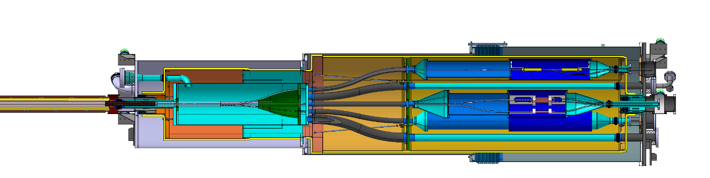
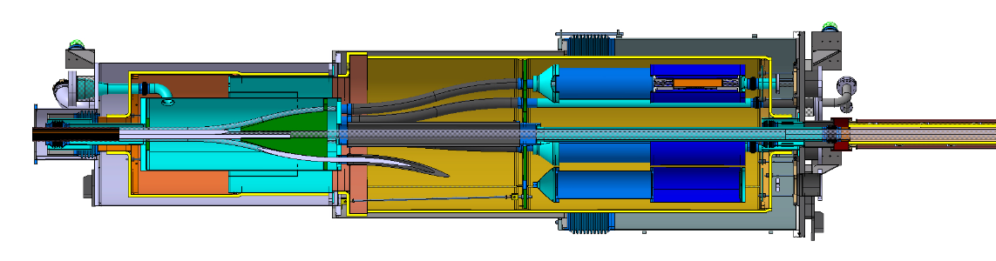


Proposed conceptual installed configuration
Guidelines for the assembly:
  MgB2 cable protected at all times
  MgB2-HTS splices fixed to He vessel
  Orientate angularly the MgB2 leads to the corresponding HTS leads
DFHx layout for analysis
2 x 18 kA
2 x 13 kA
3 x 7 kA
12 x 2 kA
Superfluid @ 1.9K
Liquid He @ 4.5 K
Gaseous He
Heater
Vacuum barrier
HTS
MgB2
NbTi
Warm cable
Splice
$$T_{CL}$$
$$T_{CL}$$
DFHx1
DFHx2
DFHx 3D pre-design for illustration
DSHx

Slide 3

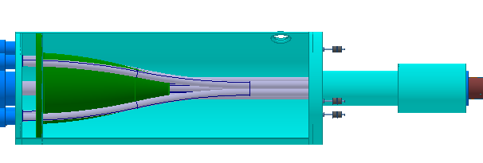

Proposal installation sequence
DFHx1
Protected MgB2 ends
DFHx2
SCLink end preparation for SM18 test
  He vessels pre-mounted once for all before SM18 test
  Only MGB2 ends (temporary protected are visible)
  Only final welds around splices will be further performed
SM18 test installation (DFH proto)
  90% of He vessels are done
  Insertion DFHx1 VV
  Insertion of Interlink
  Insertion of DFHx2
  Opening of flexibles + angular orientation
  Splicing + Current leads
Transport configuration
  Procedure backward
  2 x 1m rigid section
SCLink installation (same as SM18)
MgB2 cables in flexibles
Cable opening in rigid structure
DFHx1
DFHx2

Slide 4
Key influencing parameters
10 m
The pre-opening of the MgB2 cables directly influences:
  The rigid boxes 10m distant to be installed in the turret for transport
  The SCLink vacuum jacket interface flange diameter
  The openings in the vacuum vessels
    ➔ increase radial distance to splices ➔ length of DFH due to bending radius of MgB2
  The interlink vacuum jacket ID (could use it for waving only inner pipe)
Today orders of magnitudes:
  DFHx length ≈ 4m (bending radius 1.5m)
  DFHx Vacuum vessels OD ≈ up to 1.5m
  Interlink OD ≈ 400mm
Ø
Ø
DFHx layout for analysis
2 x 18 kA
2 x 13 kA
3 x 7 kA
12 x 2 kA
Superfluid @ 1.9K
Liquid He @ 4.5 K
Gaseous He
Heater
Vacuum barrier
HTS
MgB2
NbTi
Warm cable
Splice
$$T_{CL}$$
$$T_{CL}$$
Ø
DFHx1
Ø
DFHx2
DFHx 3D pre-design for illustration
DSHx

Slide 5
Spare slides

Slide 6
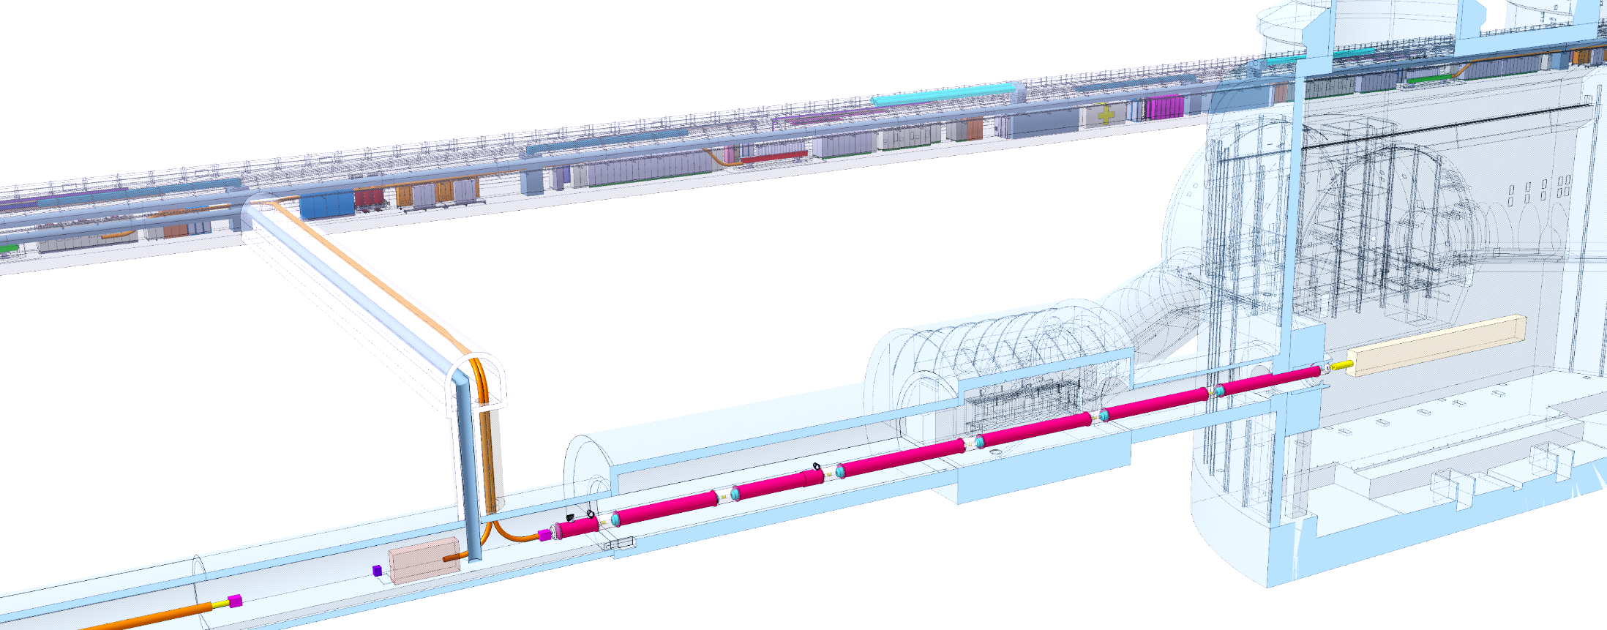


Overview
DFHx1
DFHx2
DFHM
Power converters
Each IP1 and IP5 sides equipped with 2 cold powering chains of cryostats
Triplet insertion : DFHx – SC Link (DSH) – DFX
Matching sections : DFHm – SC Link - DFM
DFX/DFM basic functions:
Electrical interface between SC Link and superconducting magnets
Supply cryogenics to the SCLink
Service tunnel
DSHx
Transverse tunnel
DSHm
Q1
IP
≈50m
≈8m
Q2b
Q2a
CP
Q3
≈45m
DFX
D1
≈80m
LHC tunnel
DFM
D2
2 x 13 kA
8 x 0.6 kA
2 x 18 kA
2 x 13 kA
3 x 7 kA
12 x 2 kA
HTS
DFHm
DFHx1
PT
DFHx2
Superfluid @ 1.9K
Liquid He @ 4.5 K
Gaseous He
Heater
Vacuum barrier
HTS
MgB2
NbTi
Warm cable
Splice
PT
⬅ $\dot{m}=2 g/s$
➔ $\dot{m}=5 g/s$
PT
Ghe <17K
Ghe <17K
MgB₂
UR: Service tunnel
UL: Transverse tunnel
MgB₂
LHC tunnel
PT
Jumper DFM
PT
DSHm
Jumper DFX
DFM
PT
NbTi
SFHe @1.9K
Ghe @4.5K
DSHx
PT
DFX
Splice
Jumper D2
Lhe @4.5K
Ghe @4.5K
Jumper D1
D2
Lhe @4.5K
SFHe @1.9K
MBCRD
MBRD
Beam
D1
MBXF

