Slide 1

Landau damping in the transverse plane
Nicolas Mounet, CERN/BE-ABP-HSC
Acknowledgements: Sergey Arsenyev, Xavier Buffat, Giovanni Iadarola, Kevin Li, Elias Métral, Adrian Oeftiger, Giovanni Rumolo

Slide 2
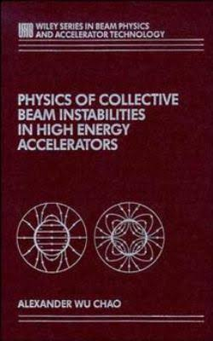
Landau damping in transverse
Alex W. Chao: “[…] there are a large number of collective instability mechanisms acting on a high intensity beam in an accelerator […]. Yet the beam as a whole seems basically stable, as evidenced by the existence of a wide variety of working accelerators[…]. One of the reasons for this fortunate outcome is Landau damping, which provides a natural stabilizing mechanism against collective instabilities if particles in the beam have a small spread in their natural […] frequencies.”

Slide 3
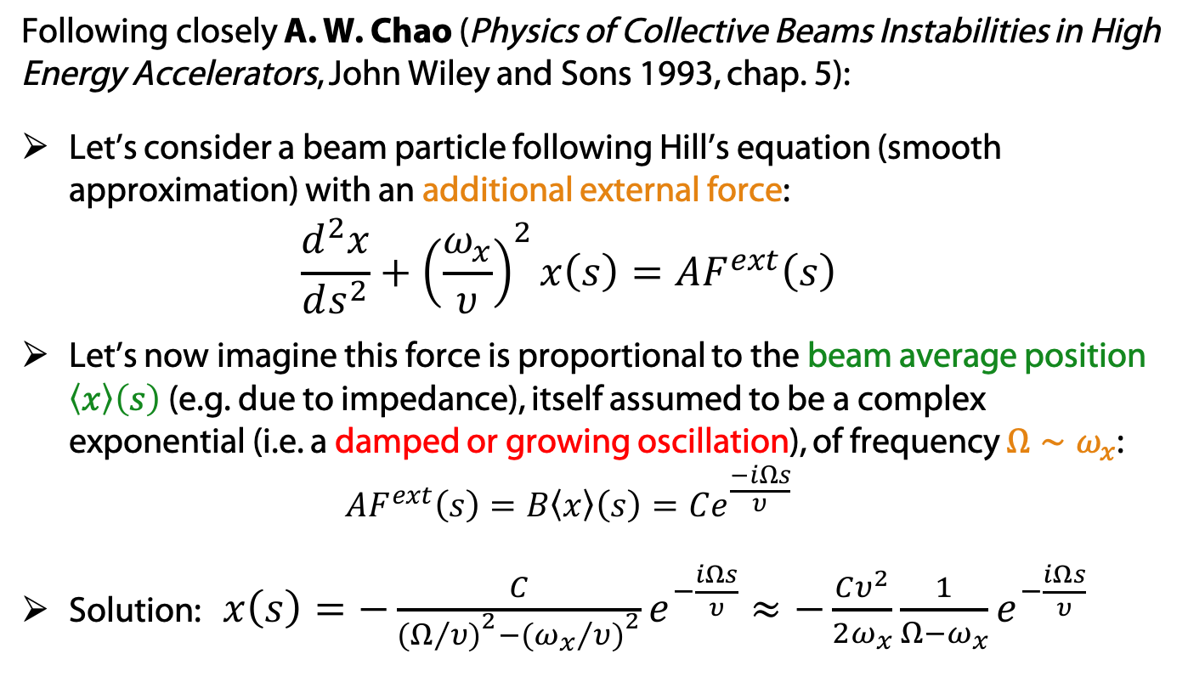
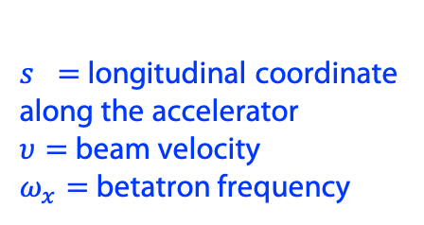
Landau damping from frequency spread: a first sketch
Following closely A. W. Chao (Physics of Collective Beams Instabilities in High Energy Accelerators, John Wiley and Sons 1993, chap. 5):
Let’s consider a beam particle following Hill’s equation (smooth approximation) with an additional external force:
$\begin{aligned}\frac{d^{2}x}{ds^{2}}+{\left(\frac{ω_{x}}{υ}\right)}^{2}x\left(s\right)={AF}^{ext}\left(s\right)\end{aligned}$
Let’s now imagine this force is proportional to the beam average position $\left\langle x\right\rangle \left(s\right)$ (e.g. due to impedance), itself assumed to be a complex exponential (i.e. a damped or growing oscillation), of frequency $Ω∼ω_{x}$:
${AF}^{ext}\left(s\right)=B\left\langle x\right\rangle \left(s\right)=Ce^{\frac{−iΩs}{υ}}$
Solution: $x\left(s\right)=−\frac{C}{{(Ω/{υ)}}^{2}−{({ω_{x}}/{υ)}}^{2}}e^{−\frac{iΩs}{υ}}≈−\frac{Cυ^{2}}{2ω_{x}}\frac{1}{Ω−ω_{x}}e^{−\frac{iΩs}{υ}}$
$s =$ longitudinal coordinate along the accelerator
$υ=$ beam velocity
$ω_{x}=$ betatron frequency

Slide 4
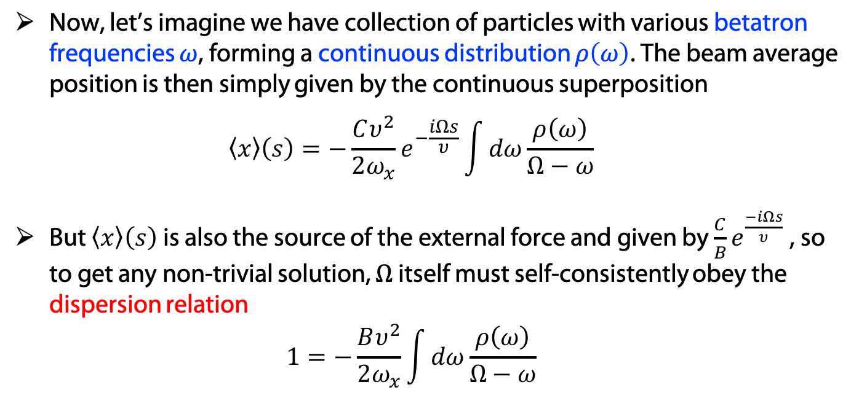
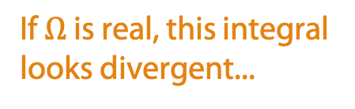
Landau damping from frequency spread: a first sketch
Now, let’s imagine we have collection of particles with various betatron frequencies $ω$, forming a continuous distribution $ρ\left(ω\right)$. The beam average position is then simply given by the continuous superposition
$\left\langle x\right\rangle \left(s\right)=−\frac{Cυ^{2}}{2ω_{x}}e^{−\frac{iΩs}{υ}}\int{dω\frac{ρ\left(ω\right)}{Ω−ω}}$
But $\left\langle x\right\rangle \left(s\right)$ is also the source of the external force and given by $\frac{C}{B}e^{\frac{−iΩs}{υ}}$ , so to get any non-trivial solution, $Ω$ itself must self-consistently obey the dispersion relation
$1=−\frac{Bυ^{2}}{2ω_{x}}\int{dω\frac{ρ\left(ω\right)}{Ω−ω}}$
If $Ω$ is real, this integral looks divergent...

Slide 5
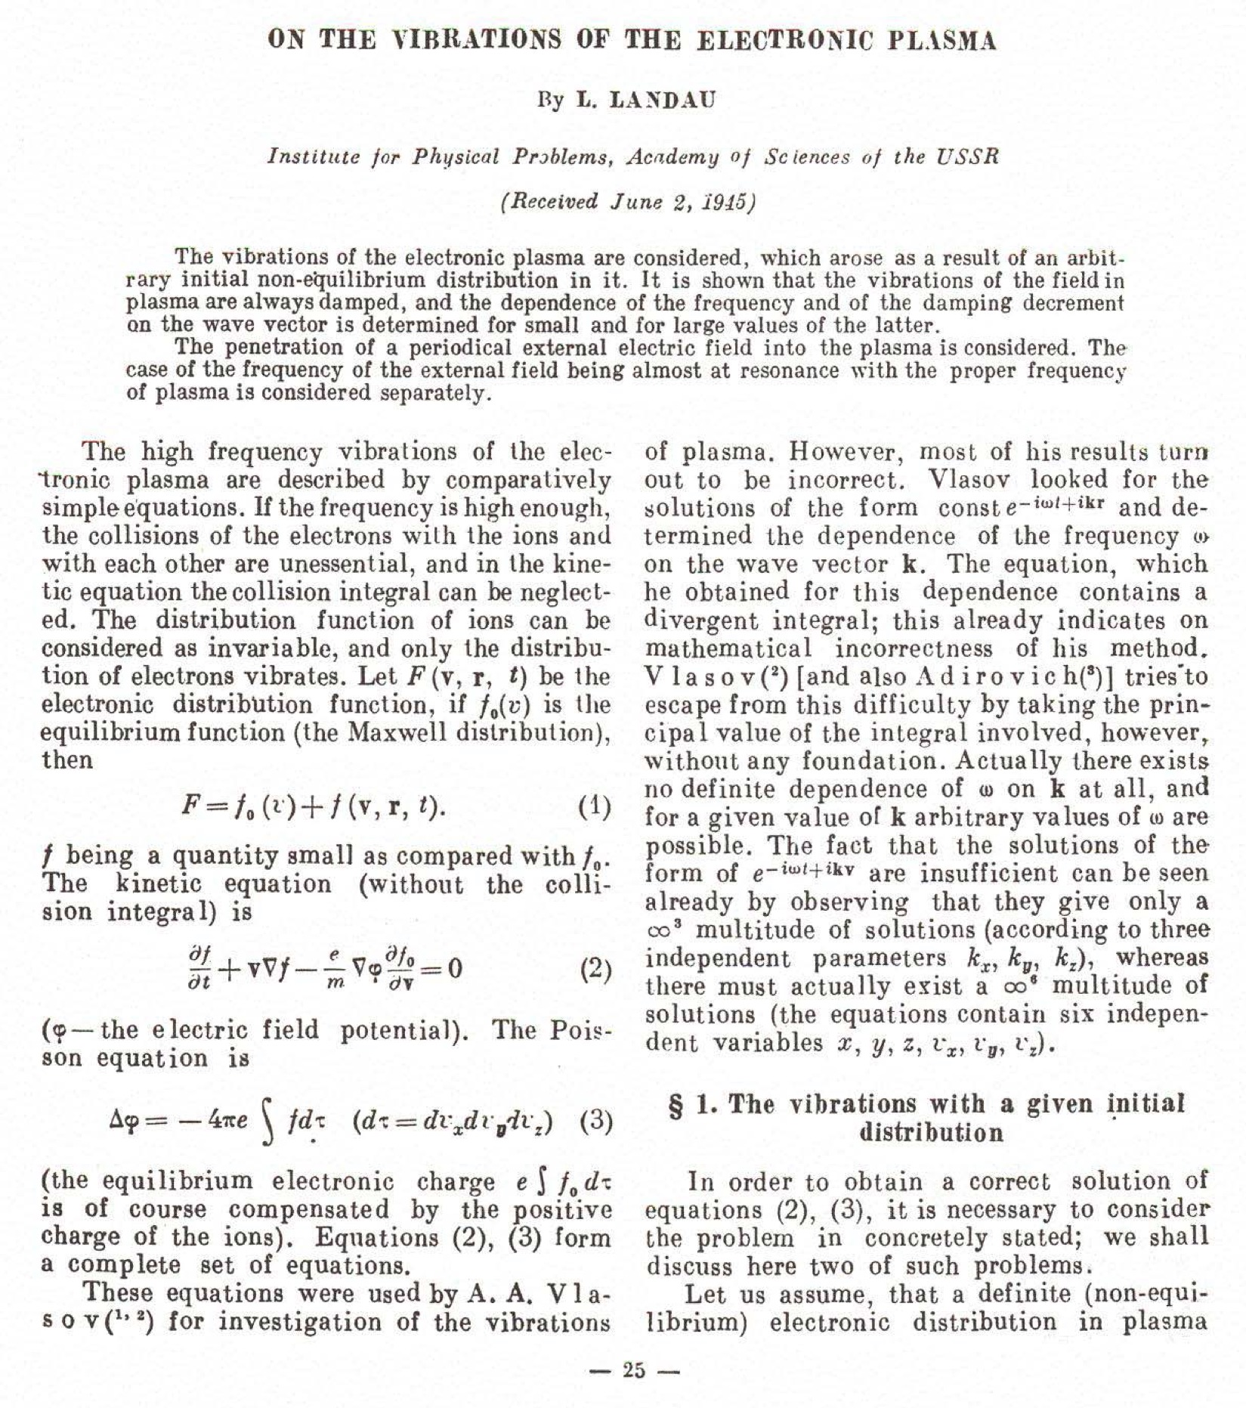
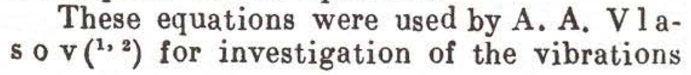
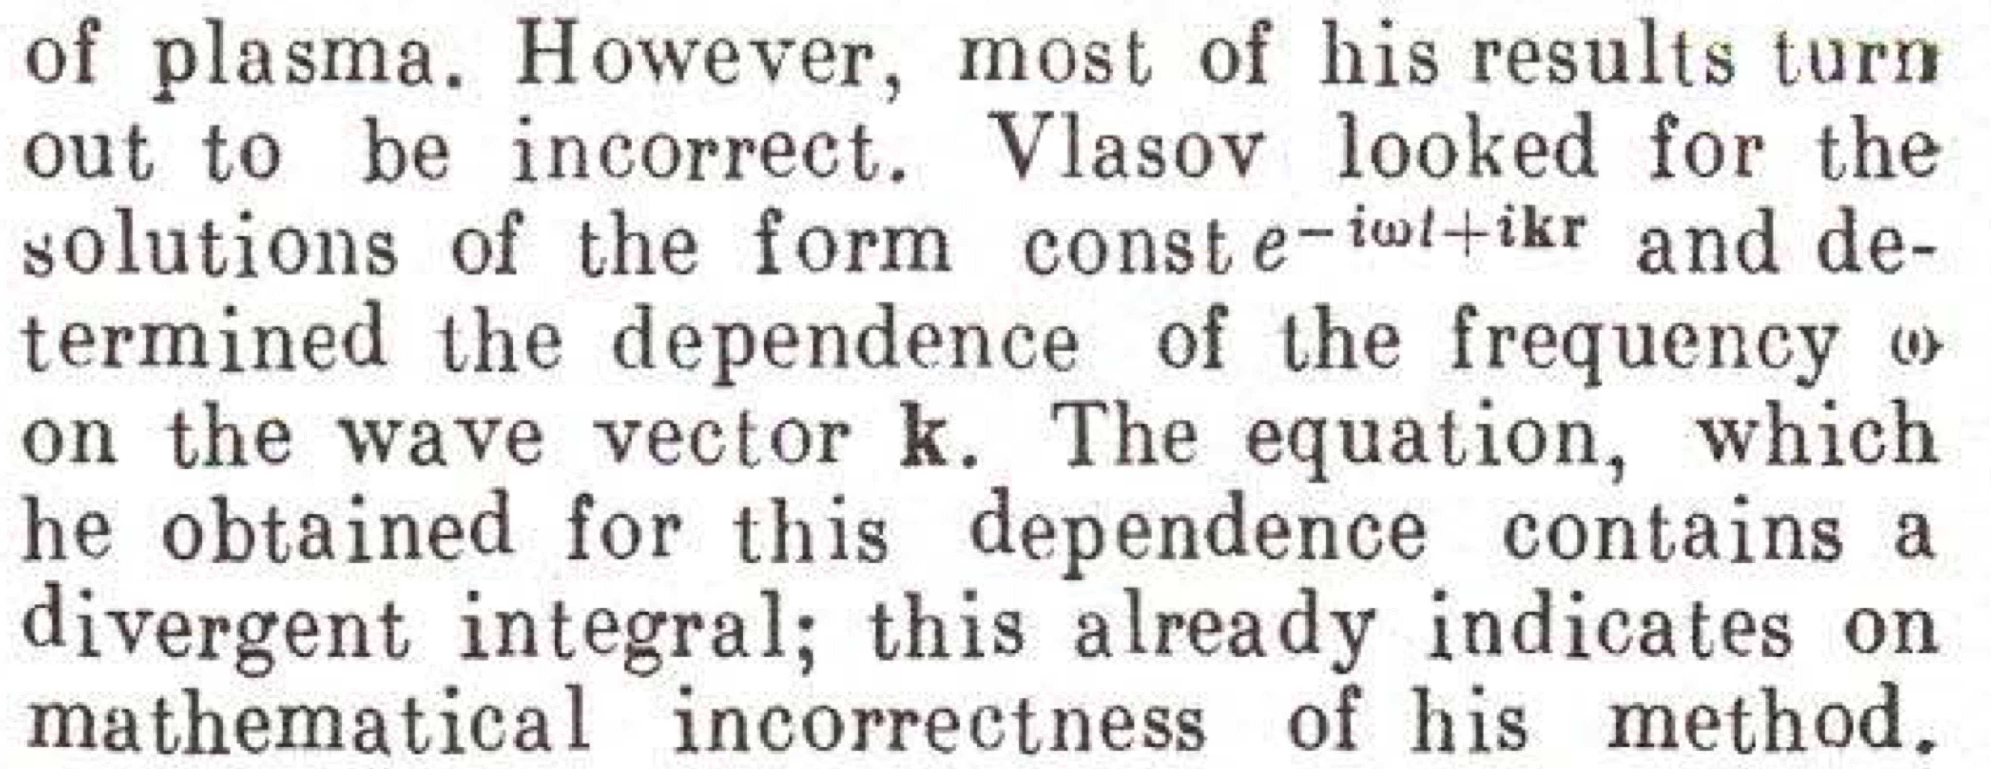
A detour through plasma physics
When a similar integral was found first by Vlasov in the context of plasma waves [A. A. Vlasov, Russ. Phys. J. 9, 1 (1945) 25], Vlasov took its principal value to solve the problem.
Then Landau found a mathematically robust way to compute the integral.
L. D. Landau, J. Phys. USSR 10, 25 (1946)

Slide 6
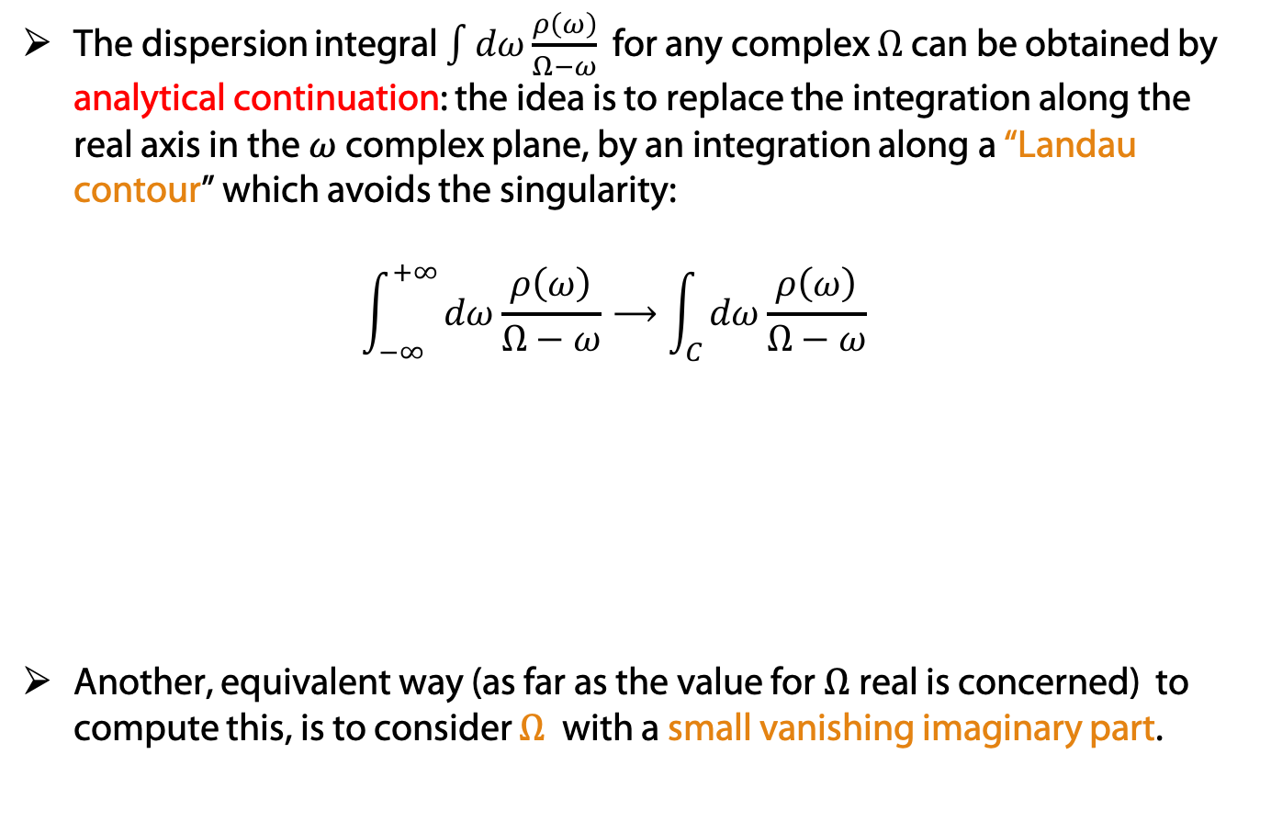
Dispersion integral: Landau’s approach
The dispersion integral $\int{dω\frac{ρ\left(ω\right)}{Ω−ω}}$ for any complex $Ω$ can be obtained by analytical continuation: the idea is to replace the integration along the real axis in the $ω$complex plane, by an integration along a “Landau contour” which avoids the singularity:
$\int_{−∞}^{+∞}{dω\frac{ρ\left(ω\right)}{Ω−ω}}⟶\int_{C}{dω\frac{ρ\left(ω\right)}{Ω−ω}}$
Another, equivalent way (as far as the value for $Ω$real is concerned) to compute this, is to consider $Ω$ with a small vanishing imaginary part.
Courtesy A. W. Chao, Physics of Collective Beams Instabilities in High Energy Accelerators, John Wiley and Sons (1993), chap. 5

Slide 7
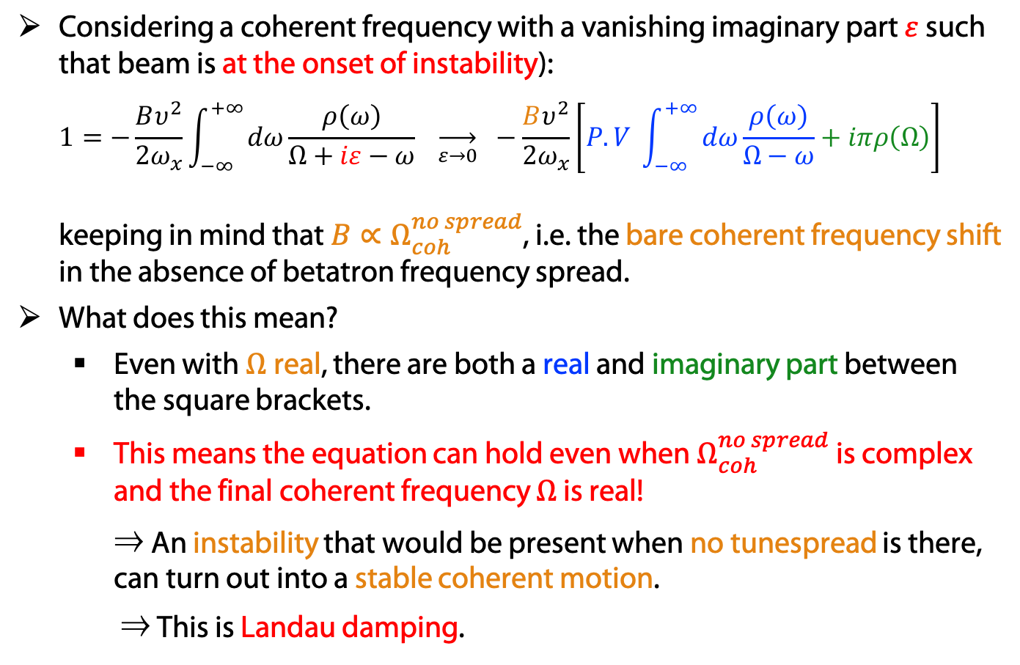
From the dispersion relation to Landau damping
  Considering a coherent frequency with a vanishing imaginary part $ε$ such that beam is at the onset of instability):
  $1=−\frac{Bυ^{2}}{2ω_{x}}\int_{−∞}^{+∞}{dω\frac{ρ\left(ω\right)}{Ω+iε−ω}} \overset{→}{ε→0} −\frac{Bυ^{2}}{2ω_{x}}\left[P.V \int_{−∞}^{+∞}{dω\frac{ρ\left(ω\right)}{Ω−ω}}+iπρ\left(Ω\right)\right]$
  keeping in mind that $B∝Ω_{coh}^{no spread}$, i.e. the bare coherent frequency shift in the absence of betatron frequency spread.
What does this mean?
  Even with $Ω$real, there are both a real and imaginary part between the square brackets.
  This means the equation can hold even when $Ω_{coh}^{no spread}$ is complex and the final coherent frequency $Ω$ is real!
  ⇒ An instability that would be present when no tunespread is there, can turn out into a stable coherent motion.
  ⇒ This is Landau damping.

Slide 8
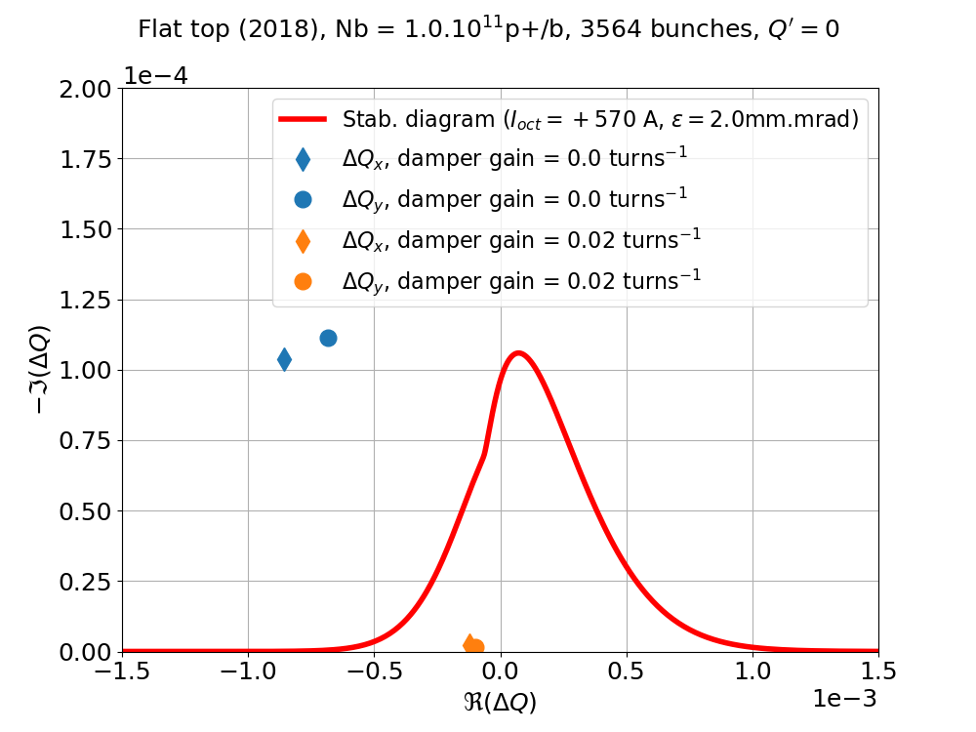
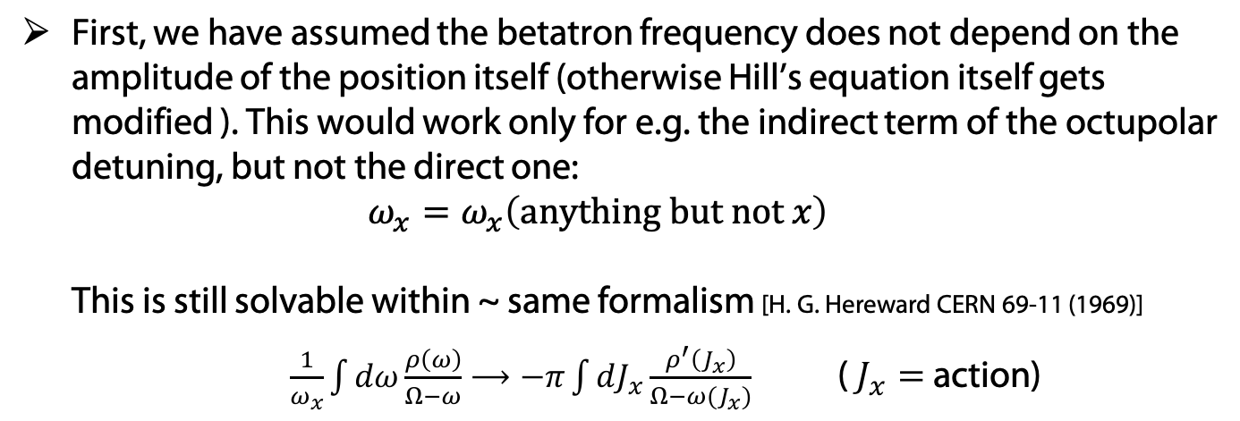
Is this theory general enough?
First, we have assumed the betatron frequency does not depend on the amplitude of the position itself (otherwise Hill’s equation itself gets modified ). This would work only for e.g. the indirect term of the octupolar detuning, but not the direct one:
$ω_{x}=ω_{x}\left(anything but not x\right)$
This is still solvable within ~ same formalism [H. G. Hereward CERN 69-11 (1969)]
$\frac{1}{ω_{x}}\int{dω\frac{ρ\left(ω\right)}{Ω−ω}}⟶−π\int{dJ_{x}\frac{ρ^{′}\left(J_{x}\right)}{Ω−ω(J_{x})}}$ ( $J_{x}=$ action)
Nevertheless, there are still open questions, in particular, does it make sense that the coherent frequency without spread is computed completely separately and without taking into account frequency spread?
Stability diagrams
⇒ modes with a tuneshift inside the diagram are stable (here an LHC example)

Slide 9
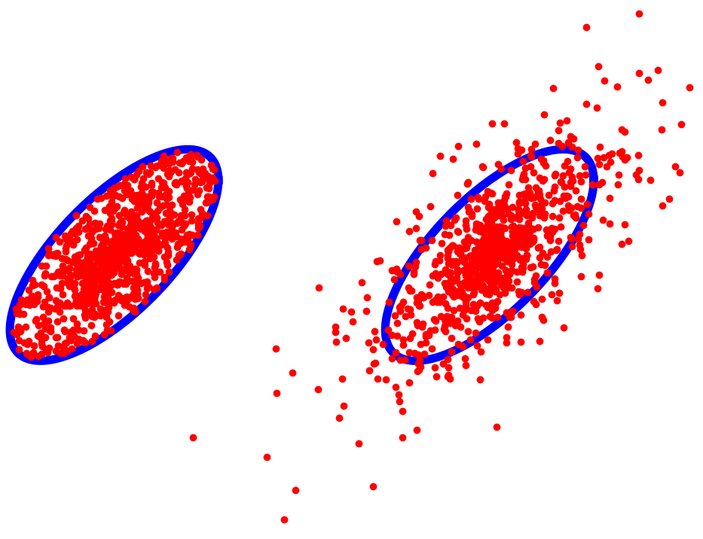
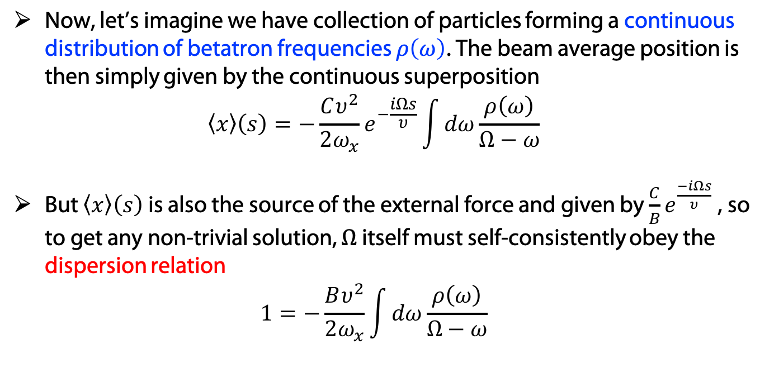
Distribution of particles in phase space
In a classical (i.e. not quantum-mechanical) picture, each beam particles has a certain position and momentum for each of the three coordinates (x, y, z).
For a 2D distribution, in e.g. vertical, such a distribution of particles can be easily pictured in phase space (y,p_{y} ):
p_{y}
y
⇒ the distribution function $ψ$ represents the density of particles in phase space
Uniform density
Gaussian fall-off
Total number of particles $N=\iiint_{position}{\iiint_{momenta}{ψ(x,p_{x},y,p_{y},z,p_{z};t)ⅆxⅆp_{x}ⅆyⅆp_{y}ⅆzⅆp_{z}}}$

Slide 10
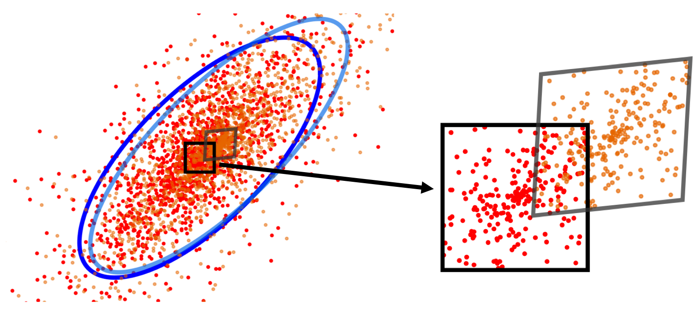
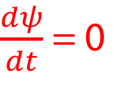
Liouville theorem
Vlasov equation is based on Liouville theorem (or equivalently, on the collisionless Boltzmann transport equation), which expresses that the local phase space density does not change when one follows the flow (i.e. the trajectory) of particles.
In other words: local phase space area is conserved in time:
$\frac{dψ}{dt}$= 0
Red particles at time t become the orange ones at time t + dt, and the black square becomes the grey parallelogram which contains the same number of particles.

Slide 11
Vlasov equation [A. A. Vlasov, J. Phys. USSR 9, 25 (1945)]
Vlasov equation was first written in the context of plasma physics. The idea is to integrate the collective, self-interaction EM fields into the Hamiltonian, instead of writing them as a collision term.
Assumptions:
  conservative & deterministic system (governed by Hamiltonian) – no damping or diffusion from external sources (no synchrotron radiation),
  particles are interacting only through the collective EM fields (no short-range collision),
  there is no creation nor annihilation of particles.
The inclusion of amplitude detuning into a Vlasov theory of coherent modes was performed first by Y. Chin, CERN/SPS/85-09 (1985).
We consider here detuning only from the same plane as the instability. (easy to extend to detuning from the other transverse plane, but much more difficult to include detuning from longitudinal plane – see M. Schenk et al, PRAB 21, 084402 – 2018 ).

Slide 12
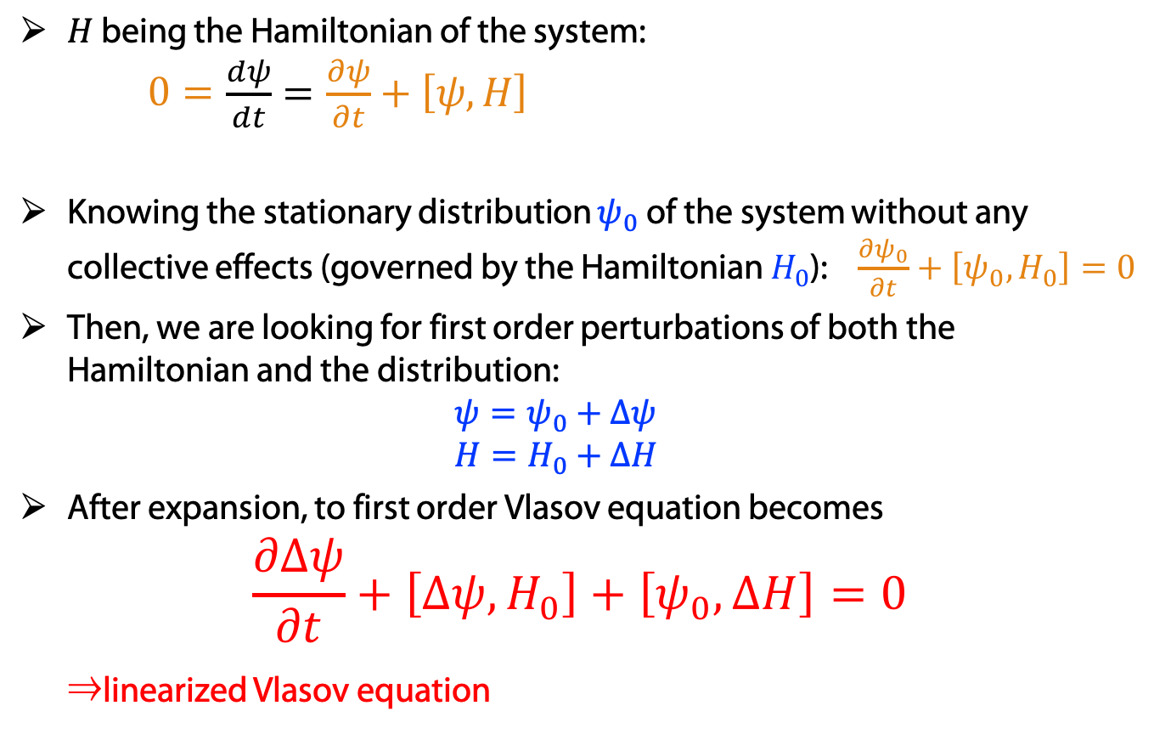

Vlasov equation with Hamiltonians and Poisson brackets
$H$ being the Hamiltonian of the system:
$0=\begin{aligned}\frac{dψ}{dt}&=\frac{∂ψ}{∂t}+\left[ψ,H\right]\end{aligned}$
Knowing the stationary distribution $ψ_{0}$ of the system without any collective effects (governed by the Hamiltonian $H_{0}$): $\frac{∂ψ_{0}}{∂t}+\left[ψ_{0},H_{0}\right]=0$
Then, we are looking for first order perturbations of both the Hamiltonian and the distribution:
$ψ=ψ_{0}+Δψ$
$H=H_{0}+ΔH$
After expansion, to first order Vlasov equation becomes
$\frac{∂Δψ}{∂t}+\left[Δψ,H_{0}\right]+\left[ψ_{0},ΔH\right]=0$
⇒linearized Vlasov equation
Poisson brackets ($x_{i}=$ positions, $p_{i}=$ momenta):
$$[f,g]=\sum_{i}{\frac{∂f}{∂x_{i}}\frac{∂g}{∂p_{i}}−\frac{∂f}{∂p_{i}}\frac{∂g}{∂x_{i}}}$$
Many thanks to Kevin Li

Slide 13
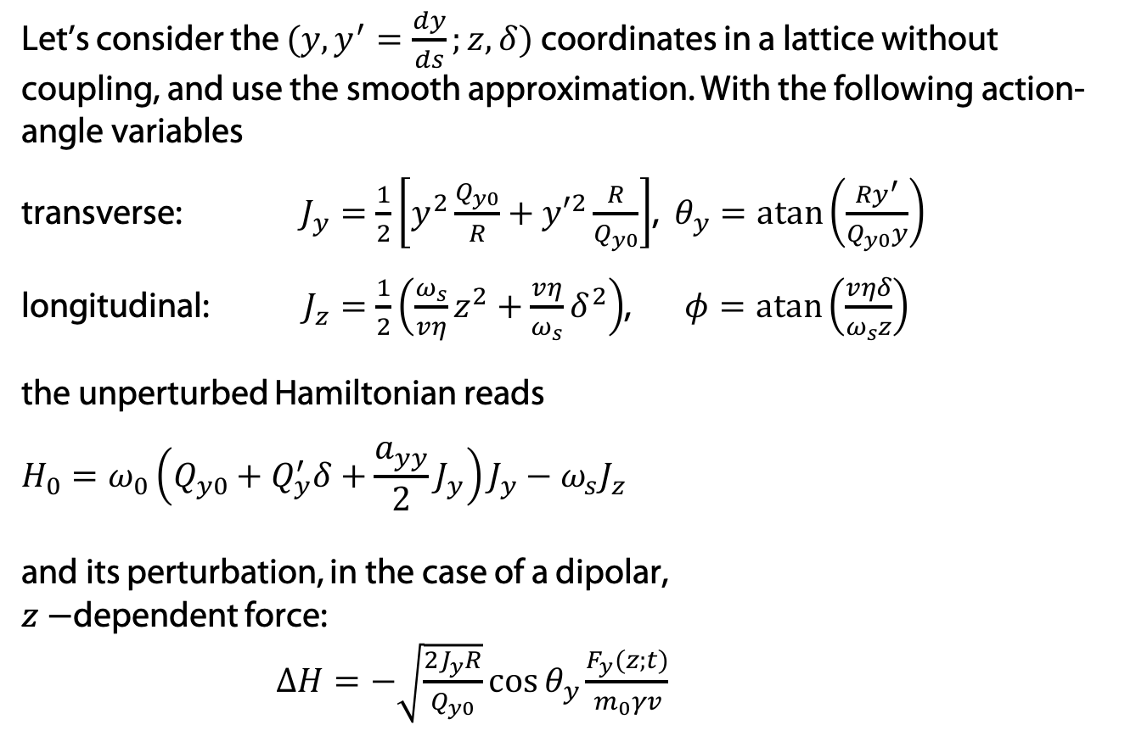


Hamiltonian
Let’s consider the $(y,y^{′}=\frac{dy}{ds};z,δ)$ coordinates in a lattice without coupling, and use the smooth approximation. With the following action-angle variables
transverse: $J_{y}=\frac{1}{2}\left[y^{2}\frac{Q_{y0}}{R}+{y′}^{2}\frac{R}{Q_{y0}}\right]$, $θ_{y}=\operatorname{atan}\left(\frac{Ry^{′}}{Q_{y0}y}\right)$
longitudinal: $J_{z}=\frac{1}{2}\left({\frac{ω_{s}}{vη}z}^{2}+{\frac{vη}{ω_{s}}δ}^{2}\right)$, $φ=\operatorname{atan}\left(\frac{vηδ}{ω_{s}z}\right)$
the unperturbed Hamiltonian reads
$$\begin{aligned}H_{0}&=ω_{0}\left(Q_{y0}+Q_{y}^{′}δ+\frac{a_{yy}}{2}J_{y}\right)J_{y}−ω_{s}J_{z}\end{aligned}$$
and its perturbation, in the case of a dipolar,
$z−$dependent force:
$ΔH=−\sqrt{\frac{2J_{y}R}{Q_{y0}}}\cos{θ_{y}}\frac{F_{y}(z;t)}{m_{0}γv}$
$η$: slippage factor,
$R$: machine radius,
$Q_{y0}$: unperturbed transverse tune,
$ω_{0}$: angular revolution frequency,
${ω_{s}=ω_{0}Q}_{s}$: synchrotron frequency,
$υ$: beam velocity,
$γ$: relativistic mass factor
$m_{0}$: particle rest mass
$Q_{y}^{′}$: chromaticity,
$a_{yy}$: detuning coefficient
$$y$$

Slide 14
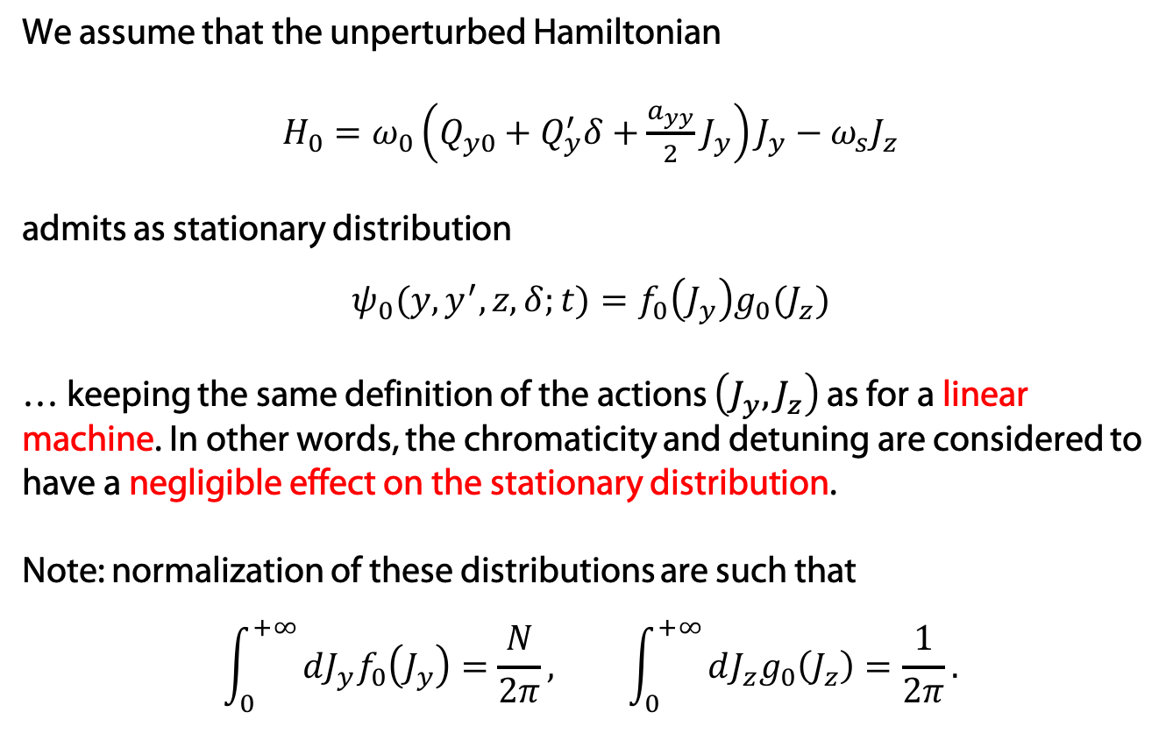
Stationary distribution
We assume that the unperturbed Hamiltonian
$H_{0}=ω_{0}\left(Q_{y0}+Q_{y}^{′}δ+\frac{a_{yy}}{2}J_{y}\right)J_{y}−ω_{s}J_{z}$
admits as stationary distribution
$$ψ_{0}(y,y^{′},z,δ;t)=f_{0}\left(J_{y}\right)g_{0}(J_{z})$$
… keeping the same definition of the actions $\left(J_{y}, J_{z}\right)$ as for a linear machine. In other words, the chromaticity and detuning are considered to have a negligible effect on the stationary distribution.
Note: normalization of these distributions are such that
$$\int_{0}^{+∞}{dJ_{y}f_{0}\left(J_{y}\right)=\frac{N}{2π}}, \int_{0}^{+∞}{dJ_{z}g_{0}\left(J_{z}\right)=\frac{1}{2π}}.$$

Slide 15
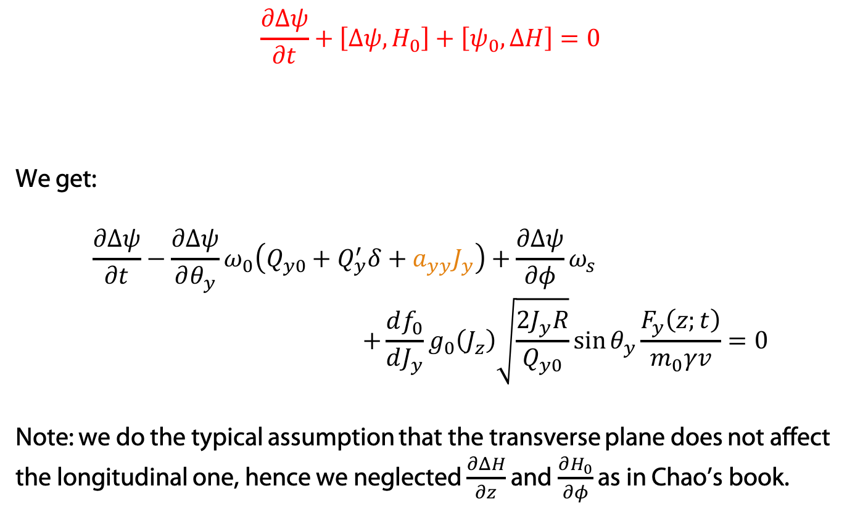
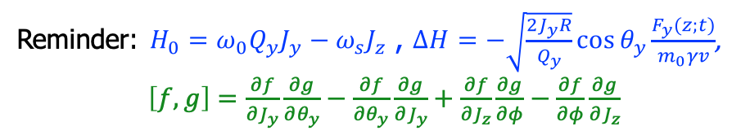
Linearized Vlasov equation
$$\frac{∂Δψ}{∂t}+\left[Δψ,H_{0}\right]+\left[ψ_{0},ΔH\right]=0$$
We get:
$$\frac{∂Δψ}{∂t}−\frac{∂Δψ}{∂θ_{y}}ω_{0}\left(Q_{y0}+Q_{y}^{′}δ+a_{yy}J_{y}\right)+\frac{∂Δψ}{∂φ}ω_{s} \\ +\frac{df_{0}}{dJ_{y}}g_{0}\left(J_{z}\right)\sqrt{\frac{2J_{y}R}{Q_{y0}}}\sin{θ_{y}}\frac{F_{y}\left(z;t\right)}{m_{0}γv}=0$$
Note: we do the typical assumption that the transverse plane does not affect the longitudinal one, hence we neglected $\frac{∂ΔH}{∂z}$ and $\frac{∂H_{0}}{∂φ}$ as in Chao’s book.
Reminder: $H_{0}=ω_{0}Q_{y}J_{y}−ω_{s}J_{z}$ , $ΔH=−\sqrt{\frac{2J_{y}R}{Q_{y}}}\cos{θ_{y}}\frac{F_{y}(z;t)}{m_{0}γv}$,
$\left[f,g\right]=\frac{∂f}{∂J_{y}}\frac{∂g}{∂θ_{y}}−\frac{∂f}{∂θ_{y}}\frac{∂g}{∂J_{y}}+\frac{∂f}{∂J_{z}}\frac{∂g}{∂φ}−\frac{∂f}{∂φ}\frac{∂g}{∂J_{z}}$

Slide 16
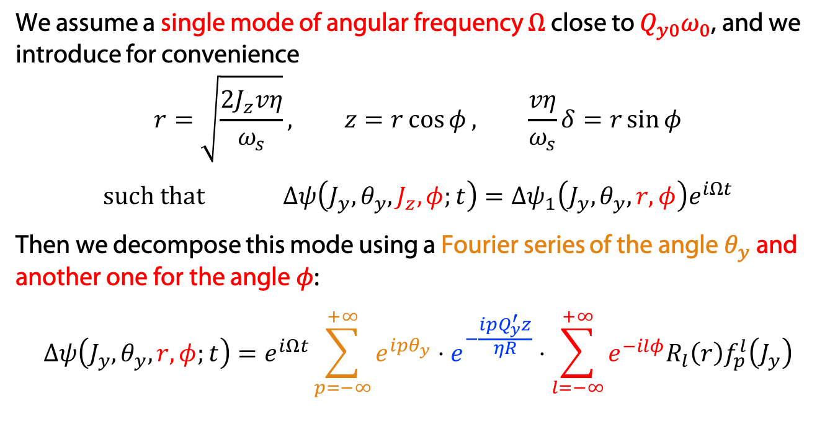
Writing the perturbation
We assume a single mode of angular frequency $Ω$ close to $Q_{y0}ω_{0}$, and we introduce for convenience
$$r=\sqrt{\frac{2J_{z}vη}{ω_{s}}}, z=r\cos{φ}, \frac{vη}{ω_{s}}δ=r\sin{φ}$$
$$such that Δψ\left(J_{y},θ_{y},J_{z},φ;t\right)=Δψ_{1}\left(J_{y},θ_{y},r,φ\right)e^{iΩt}$$
Then we decompose this mode using a Fourier series of the angle $θ_{y}$ and another one for the angle $φ$:
$$Δψ\left(J_{y},θ_{y},r,φ;t\right)=e^{iΩt}\sum_{p=−∞}^{+∞}{e^{ipθ_{y}}}⋅e^{−\frac{i{pQ}_{y}^{′}z}{ηR}}⋅\sum_{l=−∞}^{+∞}{e^{−ilφ}R_{l}\left(r\right)f_{p}^{l}\left(J_{y}\right)}$$
Additional phase factor (that we put here without loss of generality)
→ headtail phase factor

Slide 17
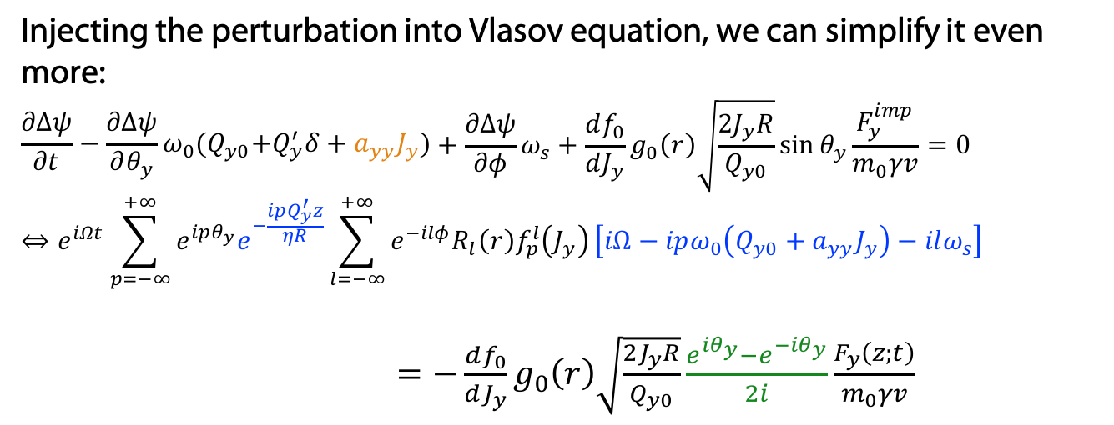
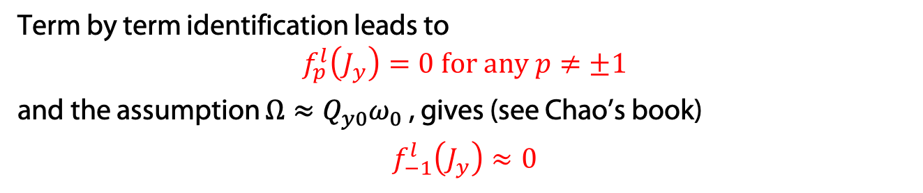
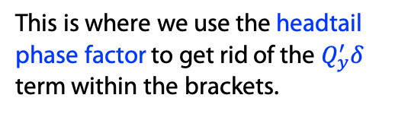
Getting the perturbed distribution
Injecting the perturbation into Vlasov equation, we can simplify it even more:
$$\begin{aligned}\frac{∂Δψ}{∂t}−\frac{∂Δψ}{∂θ_{y}}ω_{0}{(Q}_{y0}+Q_{y}^{′}δ+a_{yy}J_{y})\end{aligned}+\frac{∂Δψ}{∂φ}ω_{s}+\frac{df_{0}}{dJ_{y}}g_{0}\left(r\right)\sqrt{\frac{2J_{y}R}{Q_{y0}}}\sin{θ_{y}}\frac{F_{y}^{imp}}{m_{0}γv}=0 \\ ⇔e^{iΩt}\sum_{p=−∞}^{+∞}{e^{ipθ_{y}}e^{−\frac{ipQ_{y}^{′}z}{ηR}}\sum_{l=−∞}^{+∞}{e^{−ilφ}R_{l}\left(r\right)f_{p}^{l}\left(J_{y}\right)}\left[iΩ−ipω_{0}\left(Q_{y0}+a_{yy}J_{y}\right)−ilω_{s}\right]}$$
$=−\frac{df_{0}}{dJ_{y}}g_{0}\left(r\right)\sqrt{\frac{2J_{y}R}{Q_{y0}}}\frac{e^{iθ_{y}}−e^{−iθ_{y}}}{2i}\frac{F_{y}\left(z;t\right)}{m_{0}γv}$
This is where we use the headtail phase factor to get rid of the $Q_{y}^{′}δ$ term within the brackets.
Term by term identification leads to
$$f_{p}^{l}\left(J_{y}\right)=0 \text{for} \text{any} p≠±1$$
and the assumption $Ω≈Q_{y0}ω_{0}$ , gives (see Chao’s book)
$$f_{−1}^{l}\left(J_{y}\right)≈0$$

Slide 18
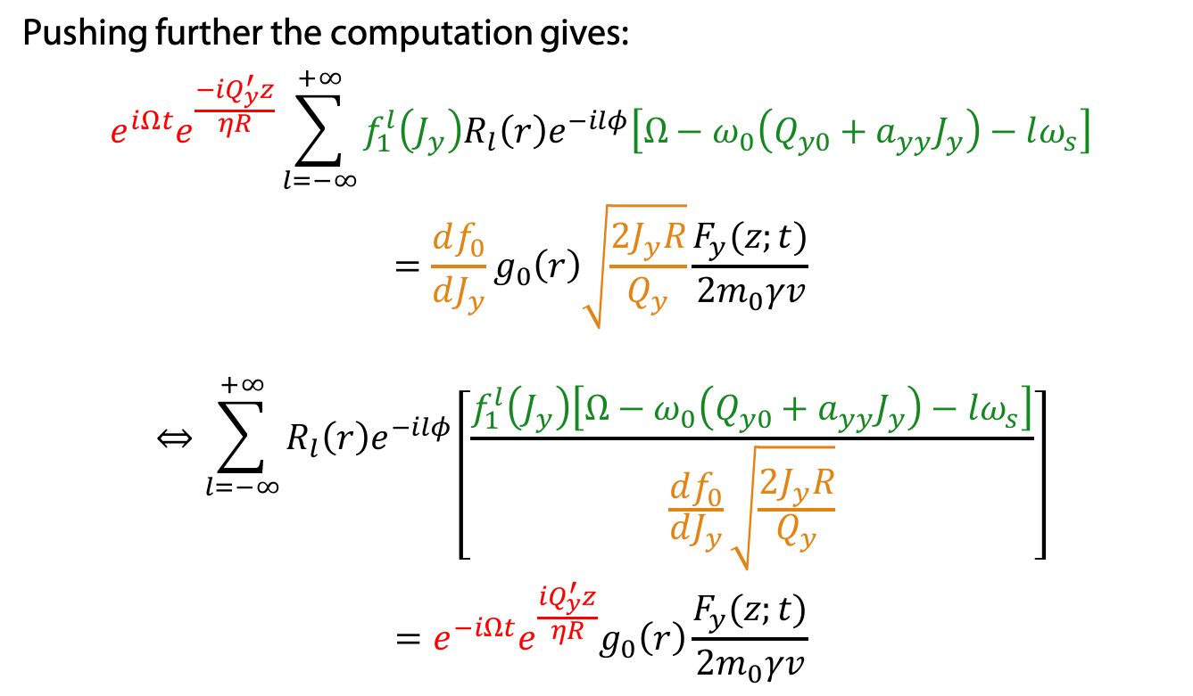
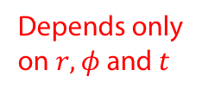

Getting the perturbed distribution
Pushing further the computation gives:
$$\begin{aligned}{e^{iΩt}e}^{\frac{−iQ_{y}^{′}z}{ηR}}\sum_{l=−∞}^{+∞}{{f_{1}^{l}\left(J_{y}\right)R}_{l}\left(r\right)e^{−ilφ}\left[Ω−ω_{0}\left(Q_{y0}+a_{yy}J_{y}\right)−lω_{s}\right]} \\ =\frac{df_{0}}{dJ_{y}}g_{0}\left(r\right)\sqrt{\frac{2J_{y}R}{Q_{y}}}\frac{F_{y}(z;t)}{{2m}_{0}γv}\end{aligned}$$
$$\begin{aligned}⇔\sum_{l=−∞}^{+∞}{R_{l}\left(r\right)e^{−ilφ}}\left[\frac{f_{1}^{l}\left(J_{y}\right)\left[Ω−ω_{0}\left(Q_{y0}+a_{yy}J_{y}\right)−lω_{s}\right]}{\frac{df_{0}}{dJ_{y}}\sqrt{\frac{2J_{y}R}{Q_{y}}}}\right] \\ ={e^{−iΩt}e^{\frac{iQ_{y}^{′}z}{ηR}}g}_{0}\left(r\right)\frac{F_{y}(z;t)}{{2m}_{0}γv}\end{aligned}$$
Depends only on $J_{y}$ and $θ_{y}$
$⇒$ the ratio must be a constant.
Depends only on $r, φ$ and $t$

Slide 19
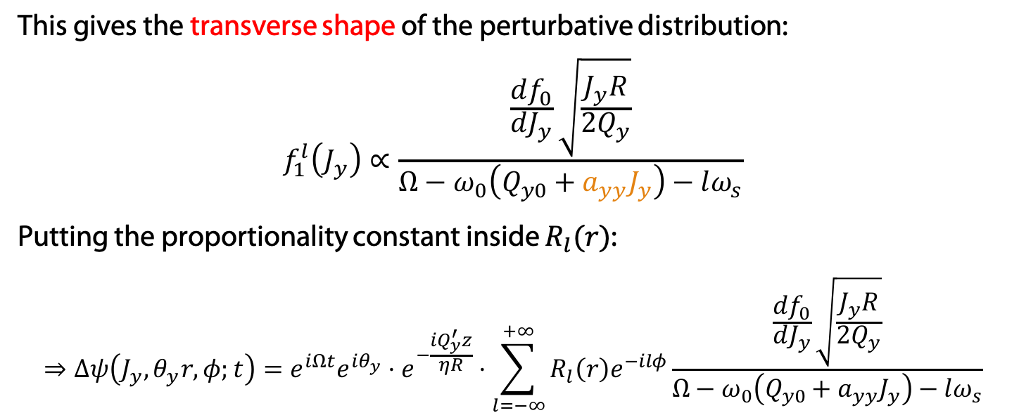
Getting the perturbed distribution
This gives the transverse shape of the perturbative distribution:
$$f_{1}^{l}\left(J_{y}\right)∝\frac{\frac{df_{0}}{dJ_{y}}\sqrt{\frac{J_{y}R}{2Q_{y}}}}{Ω−ω_{0}\left(Q_{y0}+a_{yy}J_{y}\right)−lω_{s}}$$
Putting the proportionality constant inside $R_{l}(r)$:
$$⇒Δψ\left(J_{y},θ_{y}r,φ;t\right)=e^{iΩt}e^{iθ_{y}}⋅e^{−\frac{iQ_{y}^{′}z}{ηR}}⋅\sum_{l=−∞}^{+∞}{R_{l}\left(r\right)e^{−ilφ}\frac{\frac{df_{0}}{dJ_{y}}\sqrt{\frac{J_{y}R}{{2Q}_{y}}}}{Ω−ω_{0}\left(Q_{y0}+a_{yy}J_{y}\right)−lω_{s}}}$$

Slide 20






Force from impedance
The collective force due to a dipolar impedance is obtained as a 4D integral over the perturbed distribution, convoluted with the multiturn wake:
$$\begin{aligned}F_{y}\left(z;t\right)=\frac{e^{2}}{2πR}\sum_{k=−∞}^{+∞}{\iint{{d\tilde{z} dδ W}_{y}\left(\tilde{z}+2πkR−z\right)}} \\ & ×\iint{dJ_{y} dθ_{y} Δψ\left(J_{y},θ_{y},r,φ;t−k\frac{2πR}{v}\right)\sqrt{\frac{2J_{y}R}{Q_{y0}}}\cos{θ_{y}}} \\ \begin{aligned} =&{−e}^{iΩt}\frac{{iω_{0}ω_{s}e}^{2}}{2π^{2}{vηQ}_{y0}}\sum_{k=−∞}^{+∞}{Z_{y}\left({Ω+kω}_{0}\right)e^{\frac{−i\left(Ω+kω_{0}\right)z}{υ}}} \\ ×\int_{0}^{2π}{dθ_{y}e^{iθ_{y}}cosθ_{y}}\sum_{l^{′}=−∞}^{+∞}{\int_{0}^{+∞ }{\frac{dJ_{y}⋅J_{y}⋅\frac{df_{0}}{dJ_{y}}}{Ω−ω_{0}\left(Q_{y0}+a_{yy}J_{y}\right)−l{′ω}_{s}}}} \\ & ×\int_{0}^{+∞}{\tilde{r}d\tilde{r}R_{l^{′}}\left(\tilde{r}\right)}\int_{0}^{2π}{{dφe}^{−ilφ}e^{\frac{i\tilde{r}cosφ}{υ}\left(Ω+kω_{0}−\frac{Q_{y}^{′}ω_{0}}{η}\right)}}\end{aligned}\end{aligned}$$
The collective force due to a dipolar impedance is obtained as a 4D integral over the perturbed distribution, convoluted with the multiturn wake:
$$\begin{aligned}F_{y}\left(z;t\right)=\frac{e^{2}}{2πR}\sum_{k=−∞}^{+∞}{\iint{{d\tilde{z} dδ W}_{y}\left(\tilde{z}+2πkR−z\right)}} \\ & ×\iint{dJ_{y} dθ_{y} Δψ\left(J_{y},θ_{y},r,φ;t−k\frac{2πR}{v}\right)\sqrt{\frac{2J_{y}R}{Q_{y0}}}\cos{θ_{y}}} \\ \begin{aligned} =&{−e}^{iΩt}\frac{{iω_{0}ω_{s}e}^{2}}{2π^{2}{vηQ}_{y0}}\sum_{k=−∞}^{+∞}{Z_{y}\left({Ω+kω}_{0}\right)e^{\frac{−i\left(Ω+kω_{0}\right)z}{υ}}} \\ ×\sum_{l^{′}=−∞}^{+∞}{\int_{0}^{+∞ }{\frac{dJ_{y}⋅J_{y}⋅\frac{df_{0}}{dJ_{y}}}{Ω−ω_{0}\left(Q_{y0}+a_{yy}J_{y}\right)−l{′ω}_{s}}}}\int_{0}^{2π}{dθ_{y}e^{iθ_{y}}cosθ_{y}} \\ & ×\int_{0}^{+∞}{\tilde{r}d\tilde{r}R_{l^{′}}\left(\tilde{r}\right)}\int_{0}^{2π}{{dφe}^{−il^{′}φ}e^{\frac{i\tilde{r}cosφ}{υ}\left(Ω+kω_{0}−\frac{Q_{y}^{′}ω_{0}}{η}\right)}} \end{aligned}\end{aligned}$$
$$y$$
Disp. integral $I\left(Ω−l^{′}ω_{s}\right)$
$$2πi^{l^{′}}J_{l^{′}}\left[\left(Ω+kω_{0}−\frac{Q_{y}^{′}ω_{0}}{η}\right)\frac{\tilde{r}}{υ}\right]$$
$$π$$

Slide 21
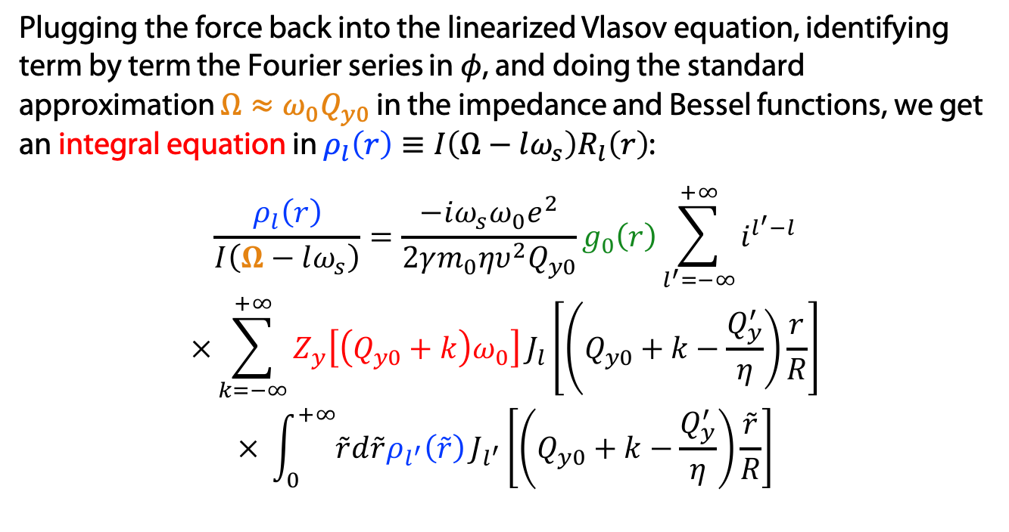
Sacherer equation equation with detuning
Plugging the force back into the linearized Vlasov equation, identifying term by term the Fourier series in $φ$, and doing the standard approximation $Ω≈{ω_{0}Q}_{y0}$ in the impedance and Bessel functions, we get an integral equation in $ρ_{l}\left(r\right)≡{I\left(Ω−lω_{s}\right)R}_{l}\left(r\right)$:
$$\begin{aligned}\frac{ρ_{l}\left(r\right)}{I\left(Ω−lω_{s}\right)}&=\frac{−iω_{s}{ω_{0}e}^{2}}{2γm_{0}ηυ^{2}Q_{y0}}g_{0}\left(r\right)\sum_{l^{′}=−∞}^{+∞}{i^{l^{′}−l}} \\ \begin{aligned}×\sum_{k=−∞}^{+∞}{Z_{y}\left[{\left(Q_{y0}+k\right)ω}_{0}\right]}J_{l}\left[\left(\left.Q_{y0}+k−\frac{Q_{y}^{′}}{η}\right)\frac{r}{R}\right.\right] \\ × \int_{0}^{+∞}{\tilde{r}d\tilde{r}ρ_{l^{′}}\left(\tilde{r}\right)}J_{l^{′}}\left[\left(Q_{y0}+k−\frac{Q_{y}^{′}}{η}\right)\frac{\tilde{r}}{R}\right]\end{aligned}\end{aligned}$$
Equation obtained first by Y. Chin, CERN/SPS/85-09 (1985).

Slide 22
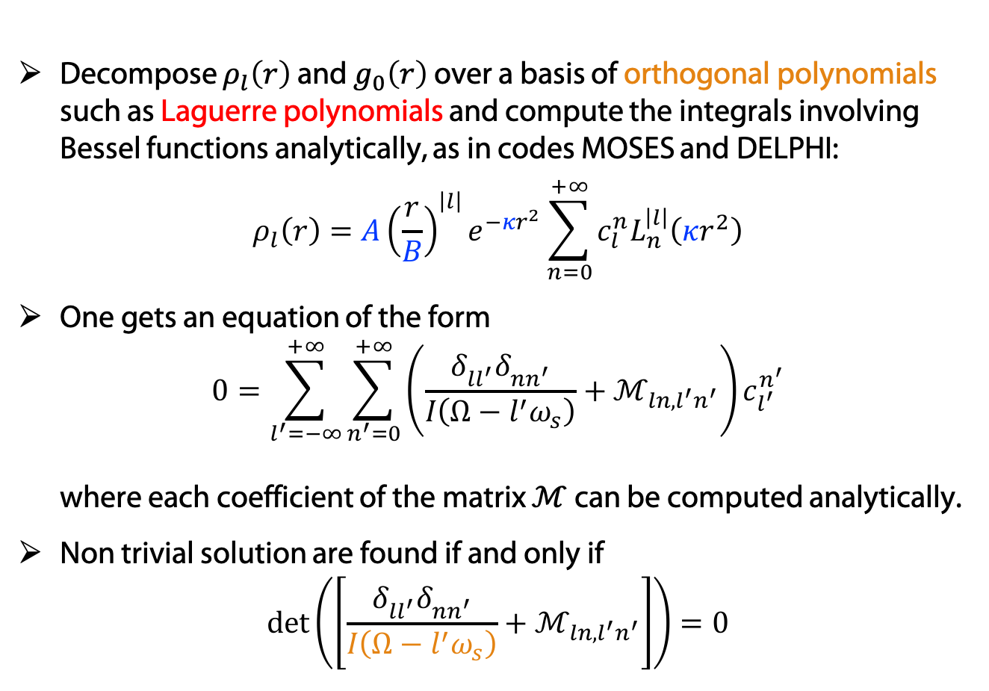
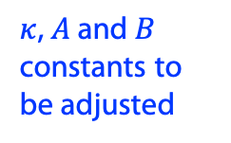
Strategy to solve the equation
Decompose $ρ_{l}\left(r\right)$ and $g_{0}\left(r\right)$over a basis of orthogonal polynomials such as Laguerre polynomials and compute the integrals involving Bessel functions analytically, as in codes MOSES and DELPHI:
$$ρ_{l}\left(r\right)={A\left(\frac{r}{B}\right)}^{\left|l\right|}e^{−κr^{2}}\sum_{n=0}^{+∞}{c_{l}^{n}L_{n}^{\left|l\right|}\left(κr^{2}\right)}$$
One gets an equation of the form
$0=\sum_{l^{′}=−∞}^{+∞}{\sum_{n^{′}=0}^{+∞}{{\left(\frac{δ_{ll^{′}}^{}δ_{nn^{′}}^{}}{I\left(Ω−l^{′}ω_{s}\right)}+ℳ_{ln,l^{′}n^{′}}\right)c}_{l^{′}}^{n^{′}}}}$
where each coefficient of the matrix $ℳ$ can be computed analytically.
Non trivial solution are found if and only if
$\det\left(\left[\frac{δ_{ll^{′}}^{}δ_{nn^{′}}^{}}{I\left(Ω−l^{′}ω_{s}\right)}+ℳ_{ln,l^{′}n^{′}}\right]\right)=0$
$κ$, $A$ and $B$ constants to be adjusted
Dispersion integral
Y. Chin, CERN/SPS/85-09 (1985).

Slide 23
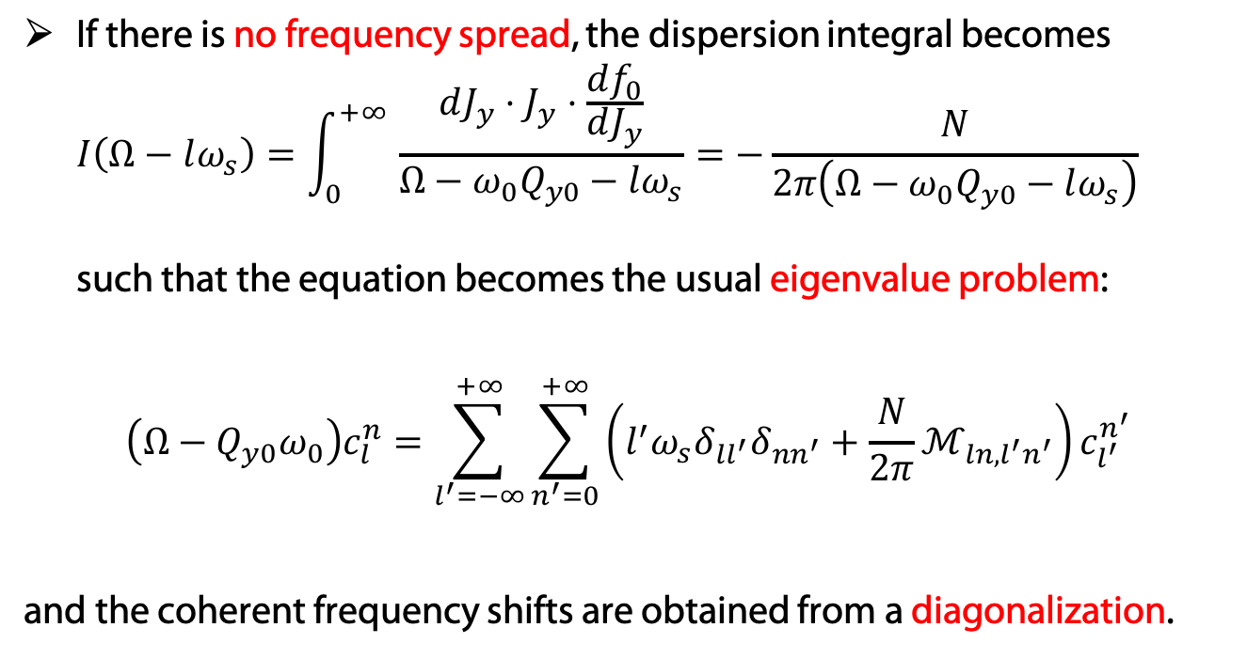
Limiting cases of the determinant equation
If there is no frequency spread, the dispersion integral becomes
$I\left(Ω−lω_{s}\right)=\int_{0}^{+∞ }{\frac{dJ_{y}⋅J_{y}⋅\frac{df_{0}}{dJ_{y}}}{Ω−ω_{0}Q_{y0}−lω_{s}}}=−\frac{N}{2π\left(Ω−ω_{0}Q_{y0}−lω_{s}\right)}$
such that the equation becomes the usual eigenvalue problem:
$${\left(Ω−Q_{y0}ω_{0}\right)c}_{l}^{n}=\sum_{l^{′}=−∞}^{+∞}{\sum_{n^{′}=0}^{+∞}{\left({l^{′}ω_{s}δ}_{ll^{′}}δ_{nn^{′}}+\frac{N}{2π}ℳ_{ln,l^{′}n^{′}}\right)c_{l^{′}}^{n^{′}}}}$$
and the coherent frequency shifts are obtained from a diagonalization.

Slide 24
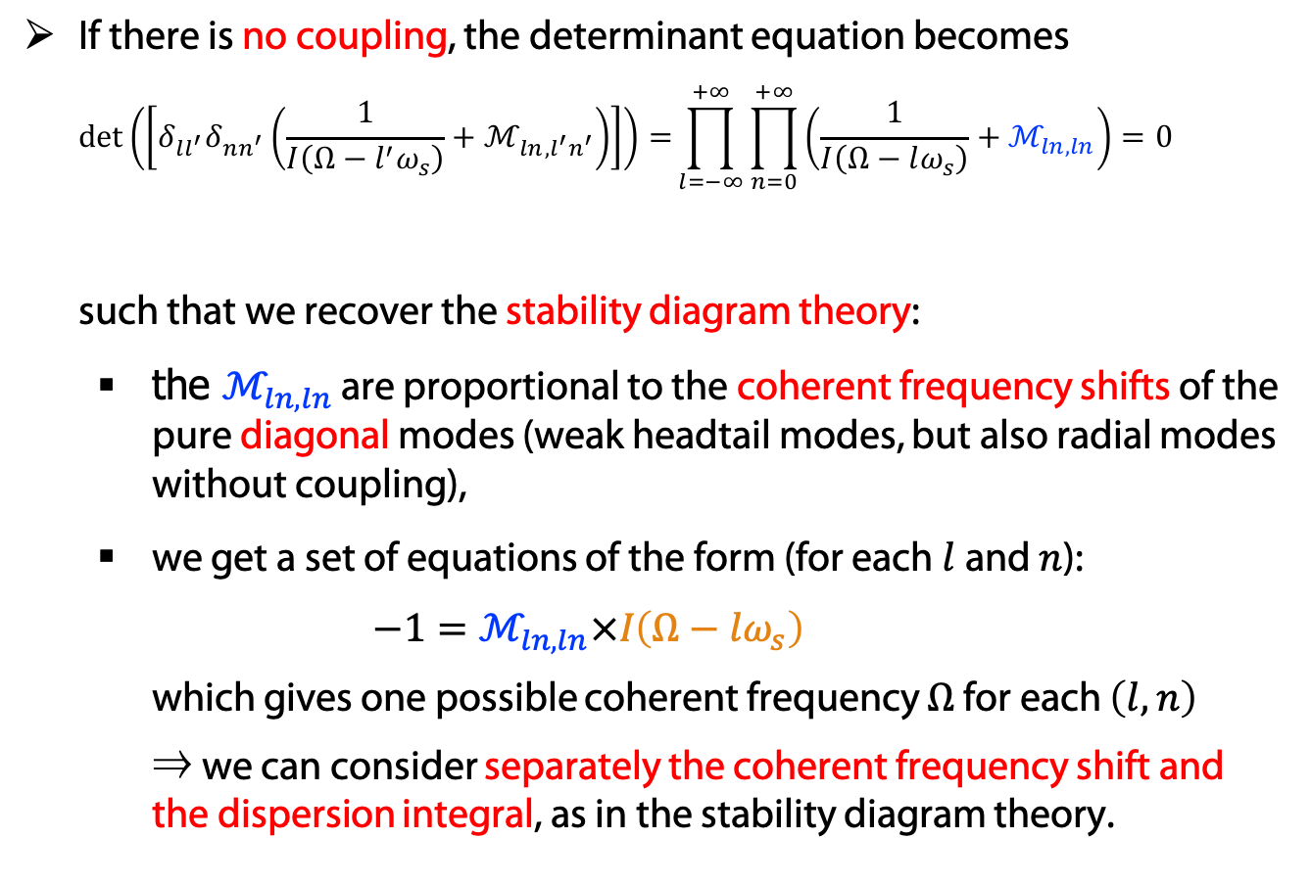
Limiting cases of the determinant equation
If there is no coupling, the determinant equation becomes
$\det\left(\left[δ_{ll^{′}}δ_{nn^{′}}\left(\frac{1}{I\left(Ω−l^{′}ω_{s}\right)}+ℳ_{ln,l^{′}n^{′}}\right)\right]\right)=\prod_{l=−∞}^{+∞}{\prod_{n=0}^{+∞}{\left(\frac{1}{I\left(Ω−lω_{s}\right)}+ℳ_{ln,ln}\right)=0}}$
such that we recover the stability diagram theory:
  the $ℳ_{ln,ln}$ are proportional to the coherent frequency shifts of the pure diagonal modes (weak headtail modes, but also radial modes without coupling),
  we get a set of equations of the form (for each $l$ and $n$):
  $−1=ℳ_{ln,ln}×I\left(Ω−lω_{s}\right)$
  which gives one possible coherent frequency $Ω$ for each $\left(l,n\right)$
  ⇒ we can consider separately the coherent frequency shift and the dispersion integral, as in the stability diagram theory.
Only diagonal terms of the matrix
Dispersion integral

Slide 25
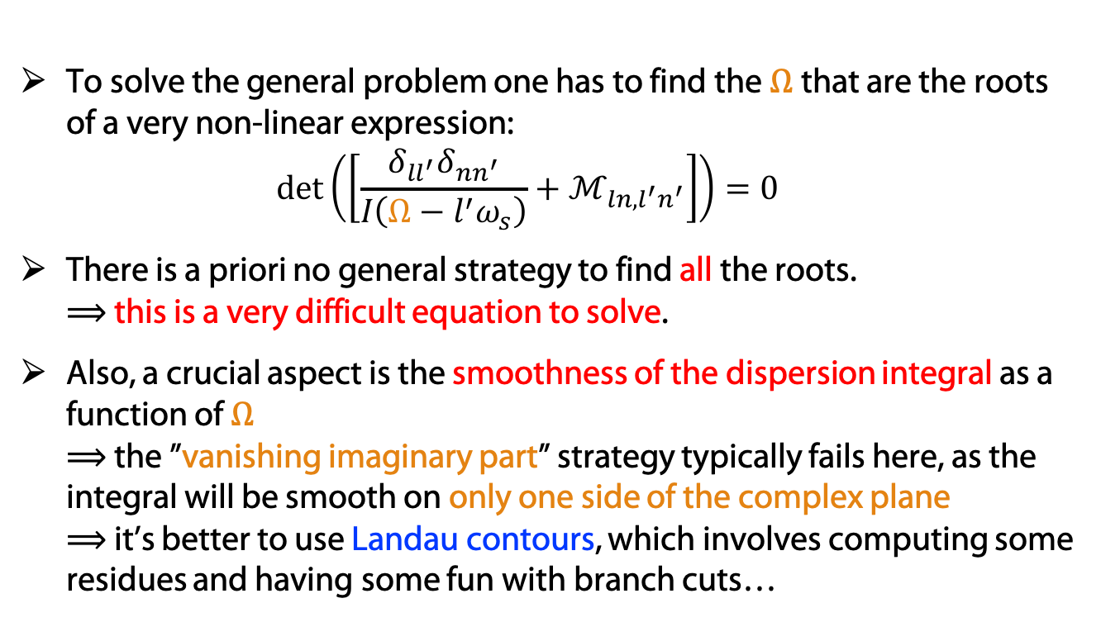
The determinant equation
To solve the general problem one has to find the $Ω$that are the roots of a very non-linear expression:
$\det\left(\left[\frac{δ_{ll^{′}}δ_{nn^{′}}}{I\left(Ω−l^{′}ω_{s}\right)}+ℳ_{ln,l^{′}n^{′}}\right]\right)=0$
There is a priori no general strategy to find all the roots.
⟹ this is a very difficult equation to solve.
Also, a crucial aspect is the smoothness of the dispersion integral as a function of $Ω$
⟹ the ”vanishing imaginary part” strategy typically fails here, as the integral will be smooth on only one side of the complex plane
⟹ it’s better to use Landau contours, which involves computing some residues and having some fun with branch cuts…

Slide 26
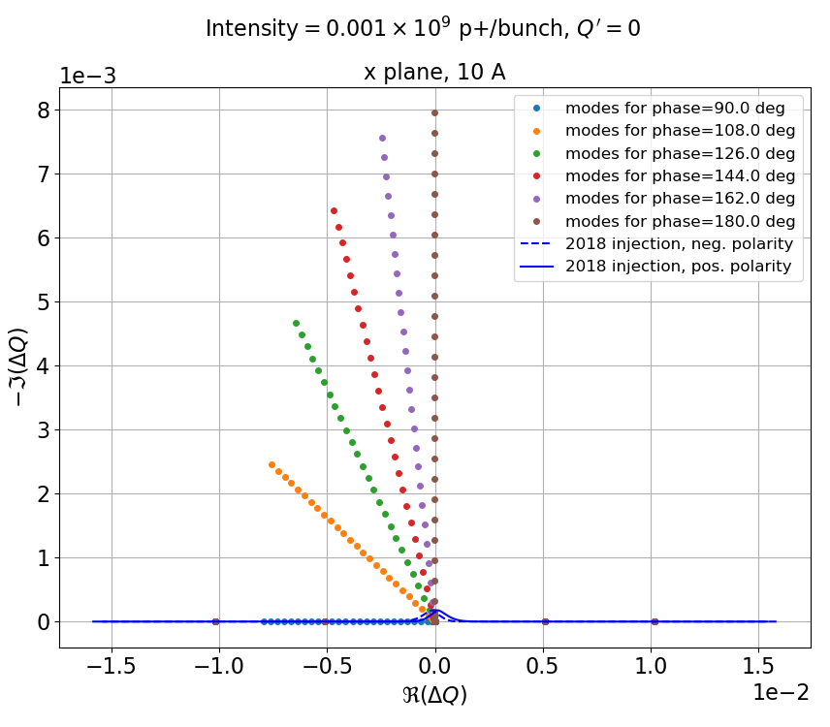
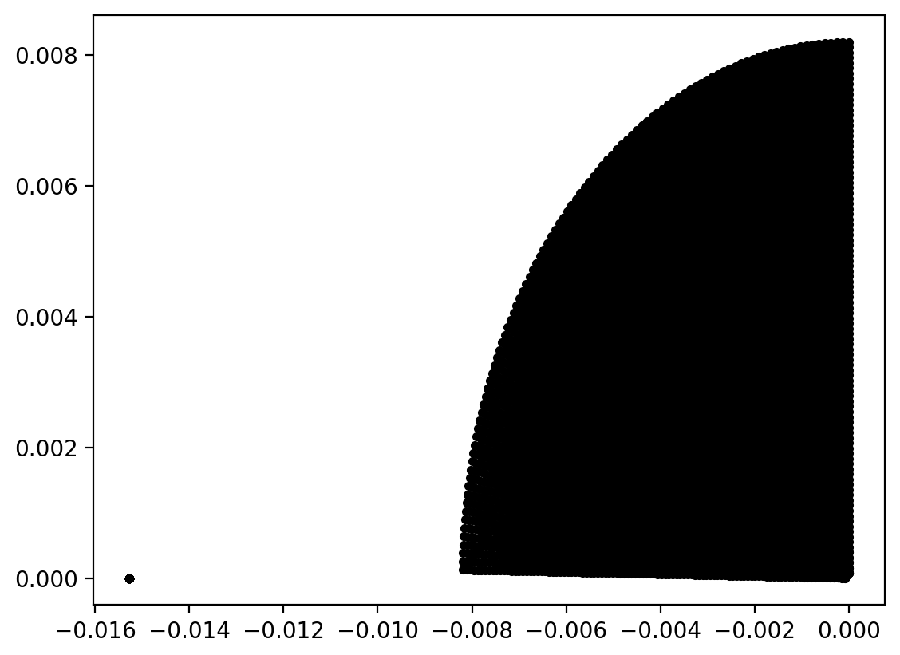
Is there a stability diagram still in the general case?
We can try to map the complex plane of unperturbed tuneshifts, thanks a broad scan of the phases and gains of a damper (inspired by the experimental study by S. Antipov et al, CERN-ACC-NOTE-2019-0034) – without impedance
Making a fine mesh of phases and gains, we can cover a large area in the complex plane:
Case Q’=0

Slide 27
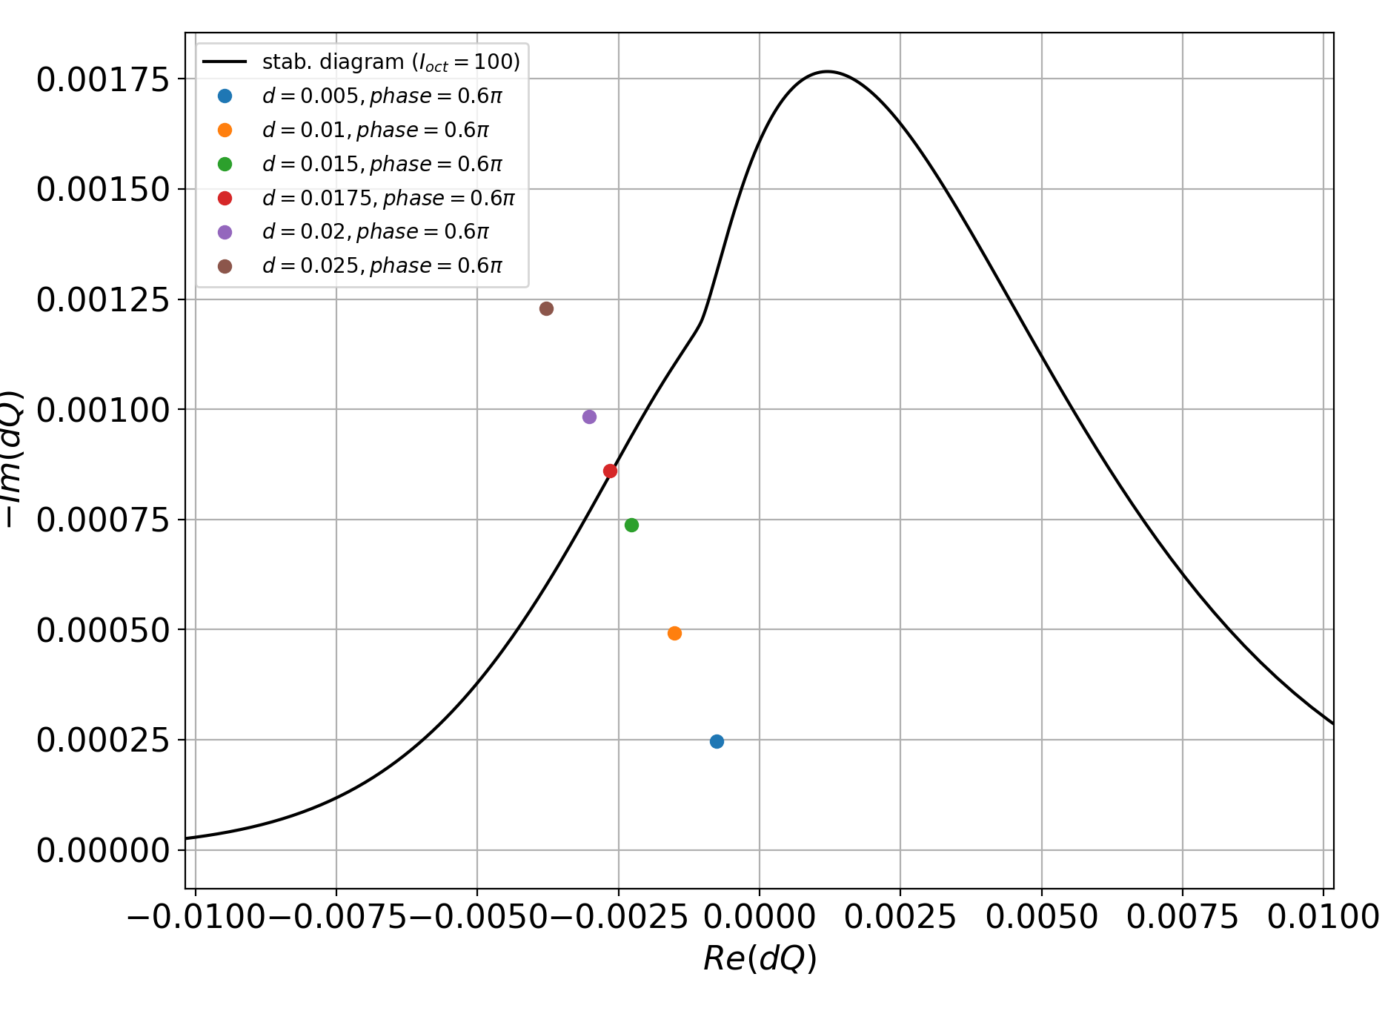
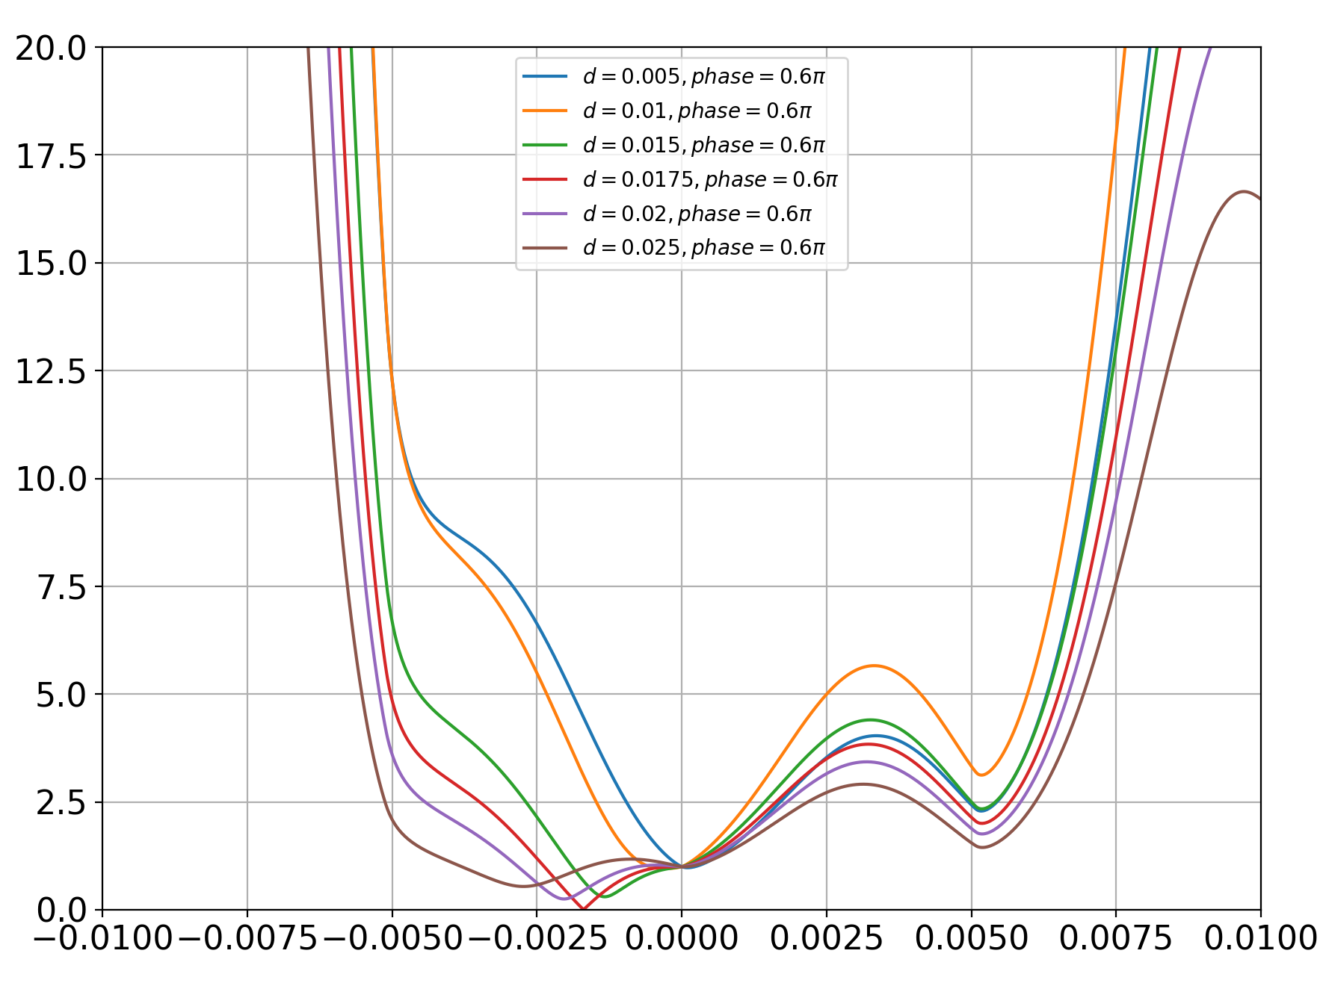
Can we recover the stability diagram theory?
Strategy: for each gain/phase of the damper, we compute the determinant along the real tune shifts→ when it touches the stability diagram, the minimum of this 1D curve should go to zero
Case Q’=0

Slide 28
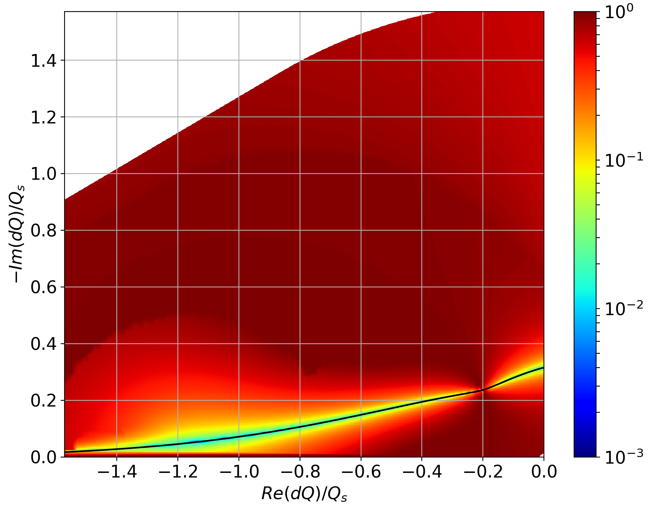
Generalized stability diagrams
The color represents the minimum of the previous 1D curves:
“Usual” stability diagram
Case Q’=0

Slide 29
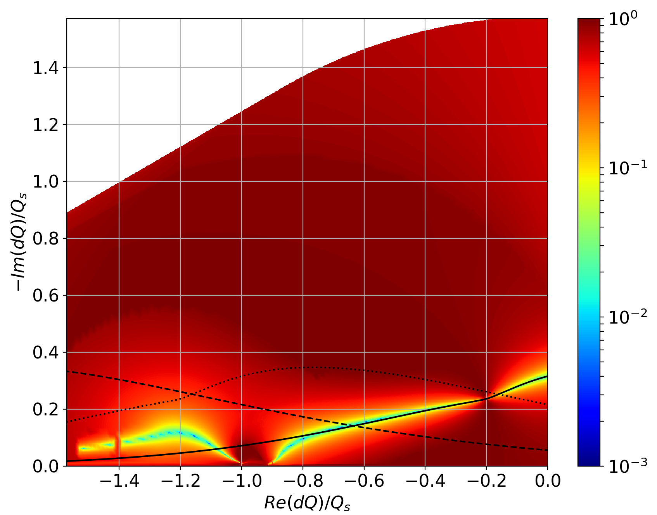
Effect of chromaticity
The color represents again the minimum of the 1D curves:
Usual stability diagrams around 0, -Q_{s} and -2Q_{s}
Case Q’=5

Slide 30
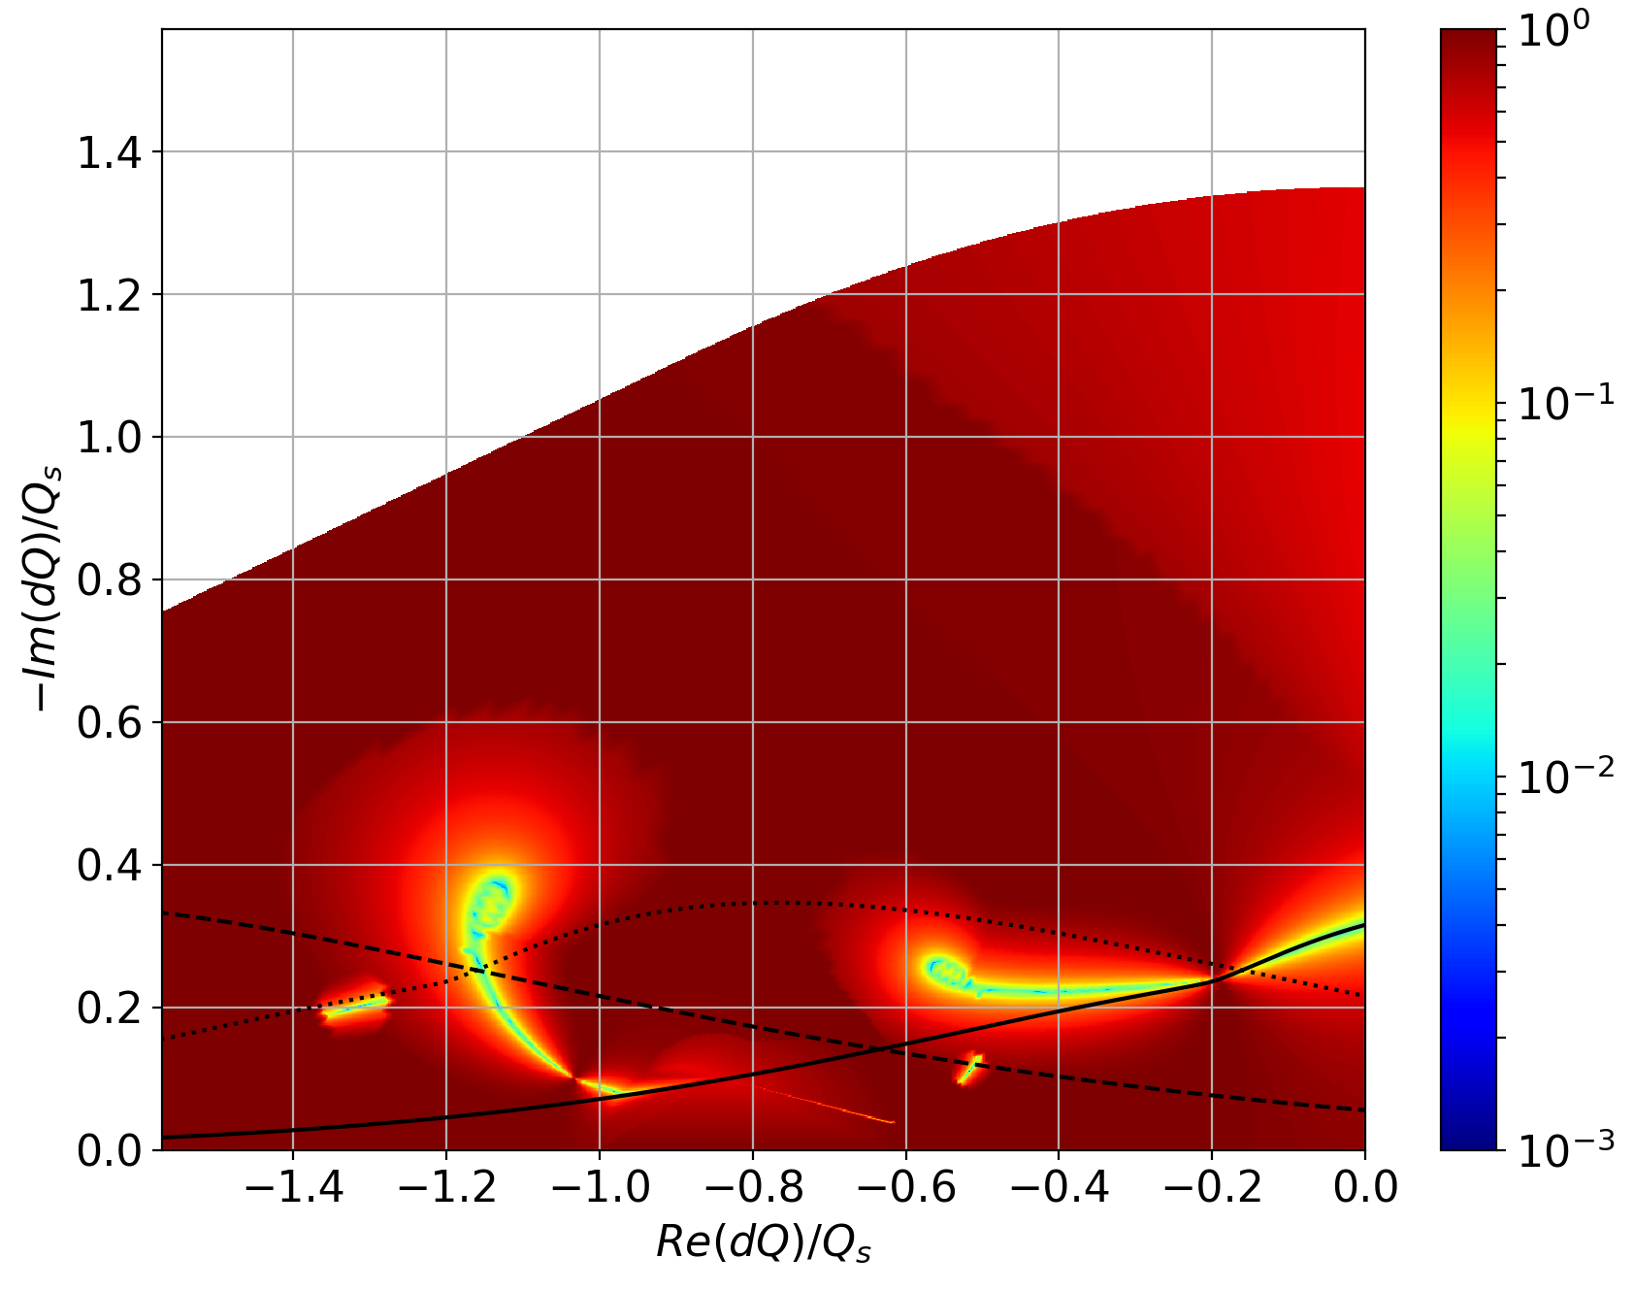
Effect of chromaticity
The color represents again the minimum of the 1D curves:
Usual stability diagrams around 0, -Q_{s} and -2Q_{s}
Case Q’=15
→ Generalized stability diagrams, different from the “usual” ones and chromaticity dependent.

Slide 31
Transverse Landau damping - Summary
Landau damping is one of the main mitigation of all kinds of instabilities in the transverse plane.
We have sketched the standard approach to Landau damping, leading to the stability diagram theory.
We have reviewed a generalization of the approach using the Vlasov formalism, from which we can find the stability diagram theory as a limiting case.
⇒ but the resulting non-linear determinant equation is extremely difficult to solve.
Generalized, chromaticity-dependent, stability diagrams could be obtained using the general formalism were presented (still preliminary).

