Slide 1
Landau damping in the longitudinal plane
ICFA mini-Workshop on "Mitigation of Coherent Beam Instabilities in particle accelerators" MCBI 2019,
Zermatt, Switzerland
T. Argyropoulos, I. Karpov, E. Shaposhnikova (CERN)
24.09.2019
With input from T. Bohl, H. Damerau, J. E. Muller, J. Repond, M. Schwarz. H. Timko

Slide 2
Outline
Introduction
Single bunch
  Sacherer and Hofmann-Pedersen approaches
  Loss of Landau Damping in LHC
  Van-Kampen modes
  Lebedev’ equation
Landau damping in double RF system
Multi-bunch beam
  Stability diagrams in single and double RF
  Bunch-by-bunch Landau damping
Conclusion

Slide 3
Introduction
Landau damping is lost when coherent bunch frequency moves outside incoherent frequency band modified by beam-induced voltage
In longitudinal plane, Landau damping of coherent modes is achieved by synchrotron frequency spread ∆ω_{s}, which can be increased by
  increasing bucket filling factor
  → minimum RF voltage for a given emittance (limited by particle losses)
  increasing bunch emittance
    → controlled emittance blow-up, limited by available RF voltage (H. Timko’ talk)
  applying higher harmonic RF system (active or passive)
    (see also talks by M. Venturini and N. Yamamoto this afternoon)

Slide 4



Sacherer’ formalism
General equation (F. Sacherer, 1971) for perturbation
  Coherent frequencies ω_{c} are obtained for spread ∆ω_{s} = 0 using effective impedance Z_{eff}
Stability diagrams obtained for “synthetic kernel” assuming rigid bunch motion and replacing wake field by local interaction.
  → No LD for distribution function with μ ≤ 1 for η ImZ/n < 0 (space charge above transition)
The stability limit for μ =2 is replaced by semi-circle with radius ∆ω_{c}/ ∆ω_{s} = 0.25 (pessimistic)
  → Popular criterion for loss of Landau damping:
  dependence on particle distribution is removed
  (sinusoidal modes used for calculation of ∆ω_{c} )
Analytical solutions for ∆ω_{c} exist for some distribution functions (Gaussian, binominal with μ = 1/2, 1) → consistent approach when used together with the exact [∆ω_{c}/ ∆ω_{s}]_{stab}

Slide 5
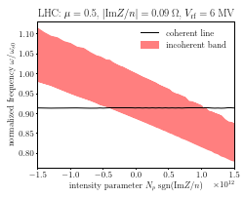

Hofmann-Pedersen formalism
Self-consistent analytical solution for ω_{sc} and ∆ω_{s} in case of μ = 1/2 (“parabolic” line density) and ImZ/n=const
  rigid bunch motion (also)
  coherent frequency calculation: spread ∆ω_{s} is included
  → non-zero threshold for η ImZ/n <0
Threshold for loss of LD
with F = π⁴/30 for short bunches agrees with Sacherer’ criterion for m=1 and μ = 1/2 with [∆ω_{c}/ ∆ω_{s}]_{stab} = 2/3 → F = π²/4 (~ 30% higher)

Slide 6
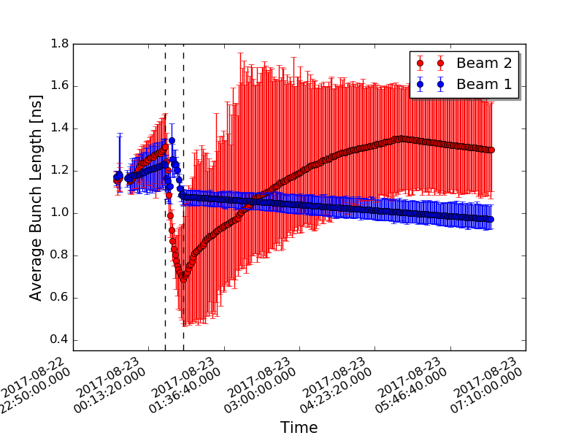
Longitudinal beam stability in CERN LHC
Measured average bunch length during cycle
D. Boussard, D. Brandt and L. Vos (1999) “Is a longitudinal feedback system required for LHC?
From Sacherer criterion ∆ω_{c} < ∆ω_{s} /4 (shift < spread/4)
at 7 TeV with ImZ/n = 0.28 Ohm, 4σ =1 ns, V=16 MV:
N_{th} = 2.4x10¹¹ → no dedicated wideband feedback,
natural Landau damping is sufficient
To avoid LLD during ramp, emittance ε ~ E^{1/2}
→ controlled emittance blow-up keeps τ = const
Significantly lower single-bunch stability threshold was measured: scaled to 7 TeV for 4σ =1 ns, V=16 MV,
N_{th} = 2.0x10¹¹ for 3 times smaller ImZ/n = 0.09 Ohm
ramp
Beam 1: controlled blow-up: ε ~ E^{1/2}
Beam 2: emittance blow-up didn’t work
→ instability during acceleration ramp

Slide 7
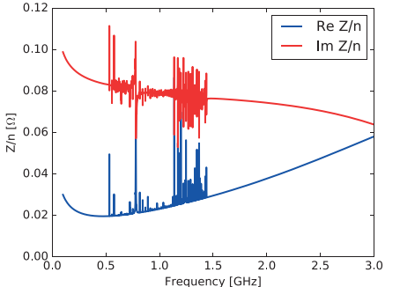
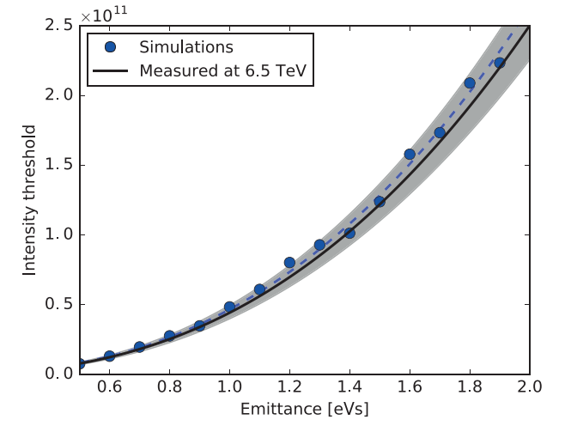
Landau damping in LHC
Fit of measured profiles with μ = 2
Measured & simulated
LHC threshold intensity
λ(t) = λ₀(1 - 4t²/τ²)^{2.5}
LHC impedance model
450 GeV
N_{th} ~ ε^{5/2}
12 MV
6.5 TeV
(ImZ/n) = 0.09 Ohm
Similar results in simulations
for full Z
BLonD simulations using full LHC impedance model and μ = 2 agree with measurements
(PhD thesis J. E. Muller, 2016)
For μ =2: F=1/3 (instead of 1/2)

Slide 8
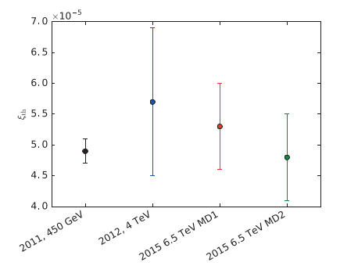

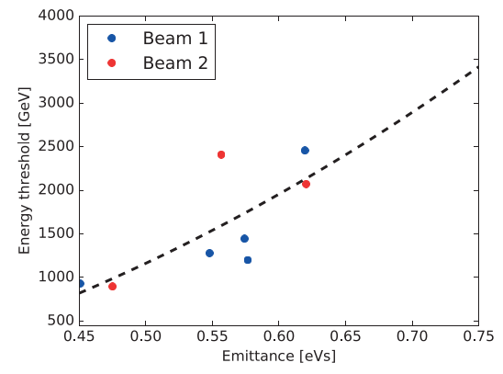
Landau damping in LHC
Measurements in LHC
→ Expected scaling with energy, voltage and bunch length works in LHC with
ξ_{th} = (5.0±0.5)10⁻⁵ (ns)⁵V
on flat bottom, flat top and during cycle
= ξ
ε ~ E^{1/2}
(PhD thesis J. E. Muller, 2016)

Slide 9
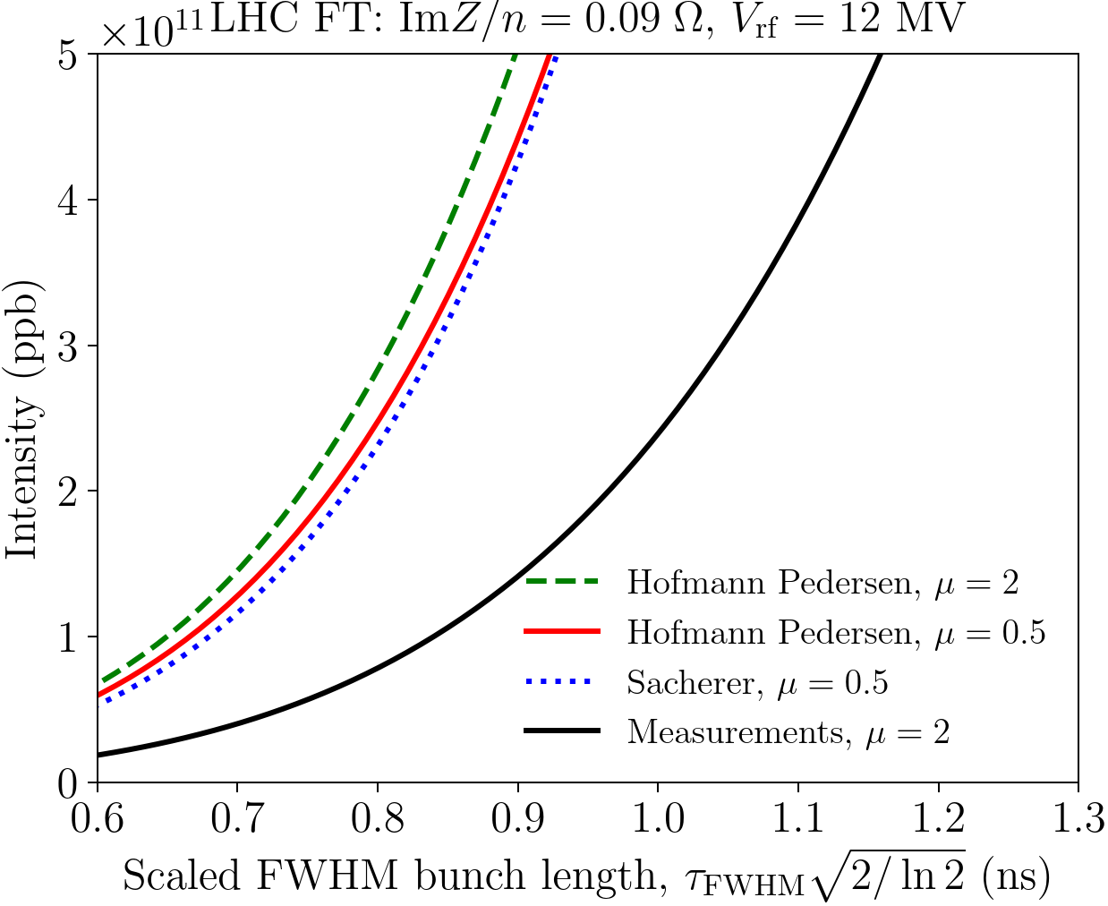
Comparison of loss of LD thresholds for LHC
Expected from Sacherer’ criterion scaling with energy, voltage and bunch length seems to work, but
→ The thresholds predicted from Sacherer’ stability diagrams (and Hofmann-Pedersen approach) are 3 – 4 times higher than measured/simulated thresholds.
The discrepancy cannot be explained either by
by different particle distribution: thresholds for different distributions are similar for the same FWHM bunch length (semi-analytical calculations of I. Karpov using Hofmann-Pedersen approach, also seen in simulations by J. E. Muller)
by “missing “ impedance due to good agreement between measurements and simulations

Slide 10
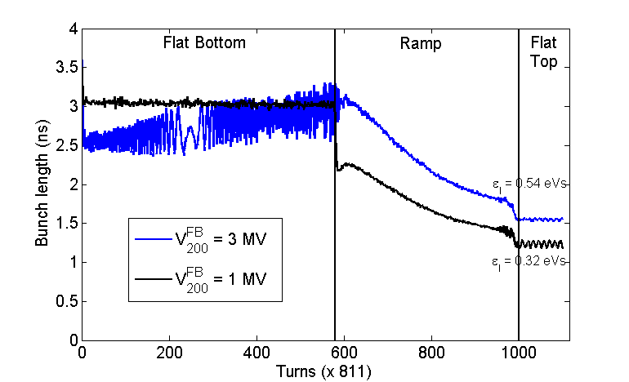
Loss of Landau damping in the CERN SPS
Sacherer’ criterion for ImZ/n = const
predicts a factor 10 higher impedance thresholds at injection (26 GeV/c, 2 MV) than on flat top (450 GeV/c)
Measurements: similar thresholds ~1x10¹¹
(optics Q26)
→ Due to initial particle distribution (rotated bunches) and/or change of effective impedance during the ramp
(factor two reduction in bunch length)?
Good agreement between measurements and simulations (with rotated bunches and full SPS impedance model).
Calculations
Measurements of a single bunch in single RF system
Cycle time [s]

Slide 11
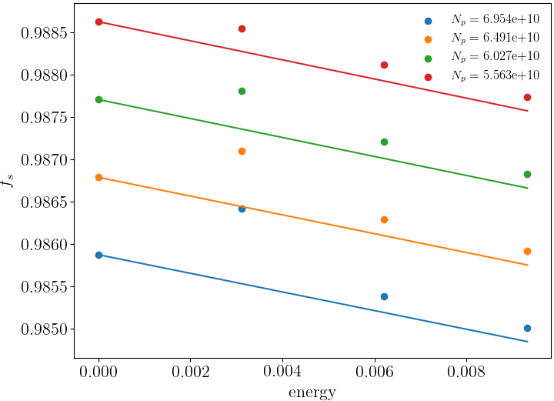


Landau damping: Van-Kampen modes
Trivial solution J=0
Mode below threshold
Method (A. Burov, 2010): find Van-Kampen modes solving Vlasov equation for perturbation f(J,ψ,t) of stationary distribution function F(J) expanded (Oide & Yokoya, 1990) as
Without mode coupling the matrix equation (in action J) is
2
where
Loss of LD
and
Incoherent frequencies
Continuous spectrum - singular modes from incoherent band. Discrete modes - coherent solutions described by regular eigenfunctions → their existence outside incoherent band serve as criterion for loss of LD
The effect of PWD is relatively small (< 10%)

Slide 12








Lebedev’ approach
Matrix equation (A. N. Lebedev, 1967) in variables with
where and normalisation
Finally,
where is a solution of equation
where

Slide 13





Sacherer’ stability diagram as a low-frequency limit
In a single RF, for short bunches
For Bessel function J_{m} can be replaced by
or
Then, for uncoupled modes m, eigenfunction Is solution of
Lebedev’ equation for mode m → Sacherer’ stability diagram with synthetic kernel used for m > 0
This equation is valid for low frequency impedances with f < 1/(π𝜏) (𝜏 - bunch length)
with effective impedance
Consistent coherent frequency can be obtained neglecting synchrotron frequency spread

Slide 14
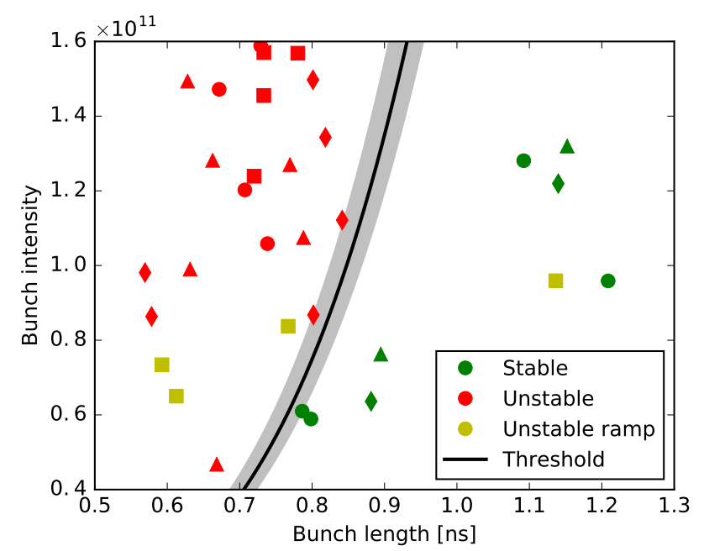
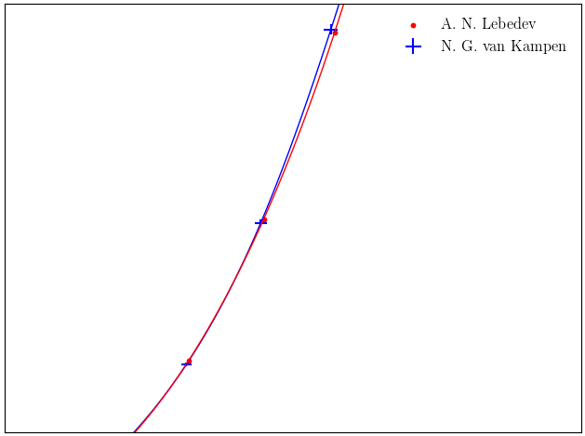
Van-Kampen modes vs Lebedev’ approach
Loss of Landau damping in LHC: comparison of calculations and measurements
A. N. Lebedev
N. G. van Kampen
Solution for ImZ/n = const doesn’t converge → physical impedance model should be used.
For LHC, the results strongly depend on cut-off frequency for ImZ/n = const or resonant frequency of the broad-band impedance model- study ongoing.
Good agreement with measurements for μ=2 and b-b impedance: f_{res}= 5 GHz, Q = 1, ImZ/n = 0.076 Ohm, f_{cut} = 20 GHz
→ Numerical code solving Lebedev’ matrix equation (I. Karpov, 2019) gives the same thresholds as Van-Kampen modes (slightly longer computation time) for the same impedance model (with or not PWD).

Slide 15
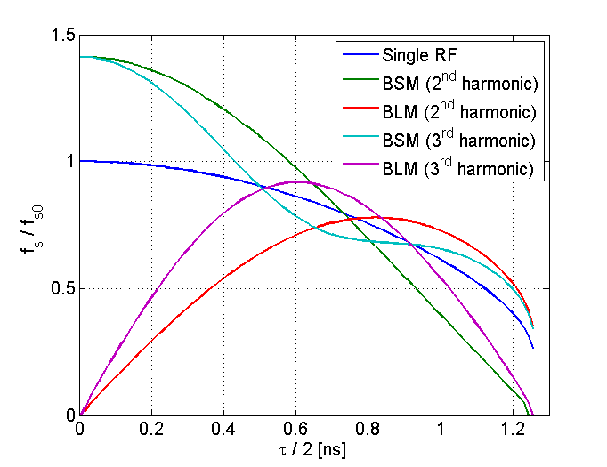
Landau damping in double RF system
Synchrotron frequency distribution
400
Voltage in 2 RF systems: V = V₁sinφ +V₂ sin(nφ + Φ₂)
with nV₂/V₁ < 1
For maximum change in ω_{s}(0): Φ₂ = φ₂ – n φ_{s}
Above transition:
φ₂ = 0 - BLM (Bunch-Lengthening Mode)
φ₂ = π - BSM (Bunch-Shortening Mode)
BLM: “flat” bunches, increased bucket size, larger spread for the same V1/V2 = n, but region with ω’_{s}(J) =0 for any ratio V₂ /V₁ (V. Balbekov, S. Ivanov, 1987)
and high sensitivity to error in Φ₂
→ only BSM works for LHC beam in the CERN SPS (n=4)
The same (BSM) from studies in PS (H. Damerau et al.)
Lower is n, point ω’_{s}(J) = 0 is further away from bunch center
400 MHz RF
→ For short bunches, ∆ω_{s} is significantly increased
(by ~ 10/φ_{b}²) with optimum n ~ 5/φ (φ_{b} = h ω₀ 𝜏/2)

Slide 16
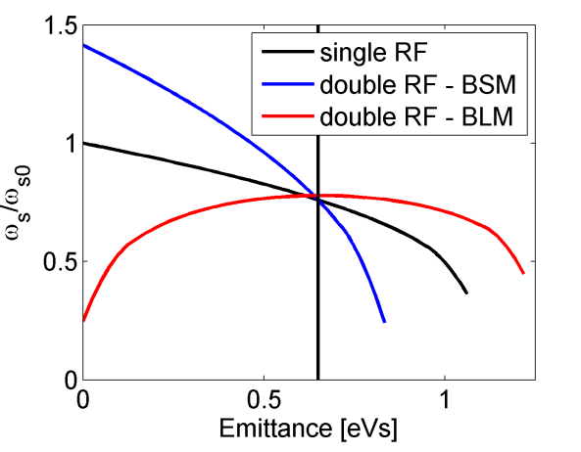
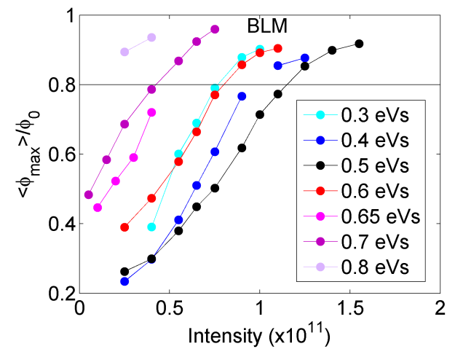
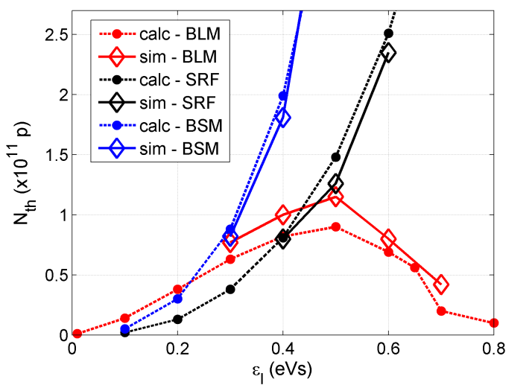
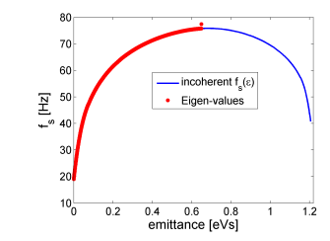
Double RF system: single bunch stability
Oscillation amplitude normalised to the kick amplitude
Thresholds from Van-Kampen modes
and simulations for ImZ/n = const
(inductive impedance above transition)
In simulations the criterion for LLD needs to be chosen (0.8)
This was also the case for Van Kampen modes
→ For n=2, long bunches are more stable in BSM.
Different behaviour below transition (simulations O. Boine - Frankenheim, T. Shukla, PRST AB, 2005)?
T. Argyropoulous, PhD thesis, 2015

Slide 17
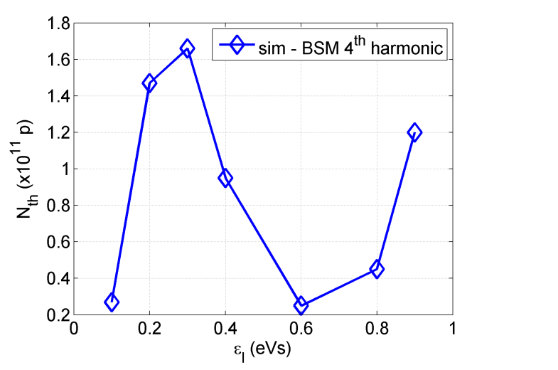
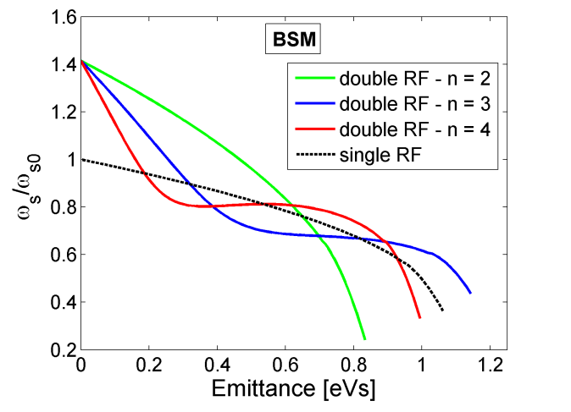
Landau damping in BS-mode for n > 2
Synchrotron frequency distribution
in BS-mode for various n
Threshold from particle simulations
(T. Argyropoulos, PhD thesis, 2015)
→ Flat portion in ω’_{s}(J) appears for n>2
Stability in BSM can be improved by phase shift, also in BLM (T. Argyropoulos, A. Burov, E.S., IPAC’12)
BS-mode with n=4 and V2/V1=n,
V1=0.6 MV @100 MHz , SPS @26 GeV/c

Slide 18

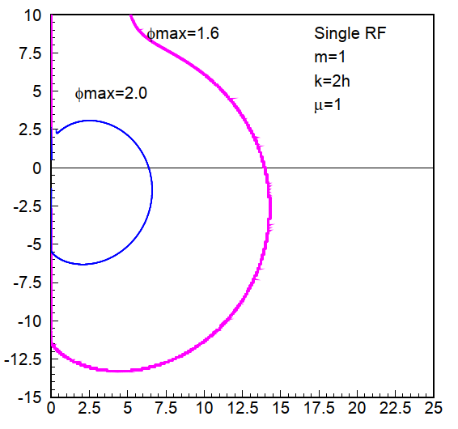




Landau damping for multi-bunch beam
Stability diagram for
For narrow band impedance with ω_{r}, only one resonant harmonic k_{r} = ω_{r} /ω₀ = lM + n can be kept (M - number of equidistant bunches) in Lebedev’ equation:
From stability diagram
(V. Balbekov, S. Ivanov, 1987):
unstable
stable
with
→ Beam is stable if vertical line 1/R_{sh} is inside stability region

Slide 19
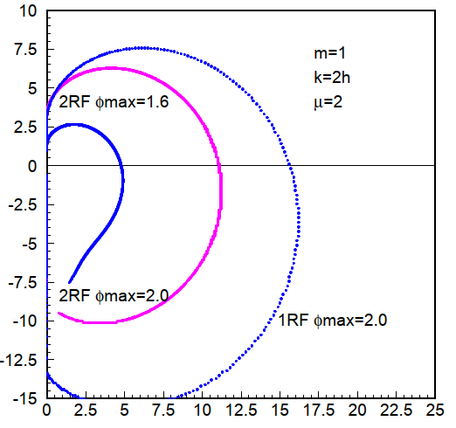
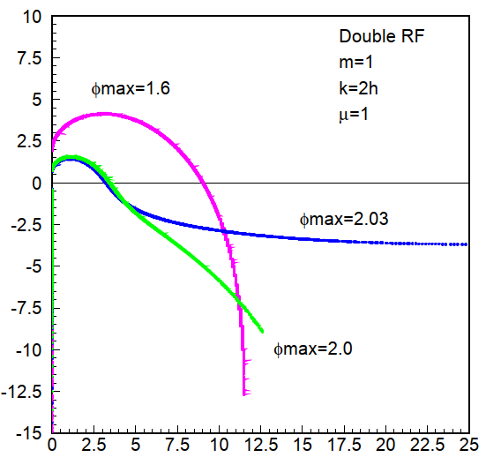

Landau damping for multi-bunch beam: stability diagrams in single and double RF
Stability diagrams (m=1) for μ =1,2 in 1RF & 2RF (BLM) for various φ_{max}
The instability threshold
→ Strong depends on ω’_{s}/F’
Distributions with non-zero function F’
at the edge are more unstable (μ < 1)
Note that all modes m are excited simultaneously in the BL-mode (not in BS-mode) since
μ= 2: R_{th} in double RF system (BLM) is higher than in single RF
μ= 1: R_{th} in double RF system is decreasing with emittance

Slide 20
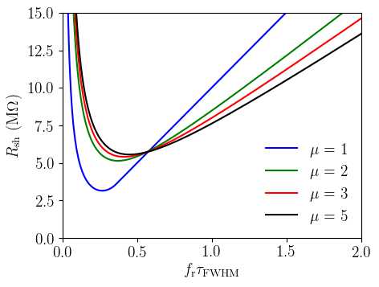

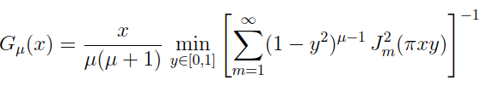
Multi-bunch threshold
In single RF system the threshold (no acceleration)
The FWHM bunch length is important
Lebedev’ equation allows analysis of beam stability with both narrow and broad-band impedances
This approach was used for narrow-band resonator and ImZ/n = const (M. Blaskiewicz, “Landau damping with high frequency impedance”, 2009)
where
Threshold R_{sh} for coupled-bunch instabilities in FCC-hh at 50 TeV for nominal intensity N_{b}=10¹¹, V = 38 MV, γ_{t} =99.3 (I. Karpov, E.S., IPAC’19)

Slide 21
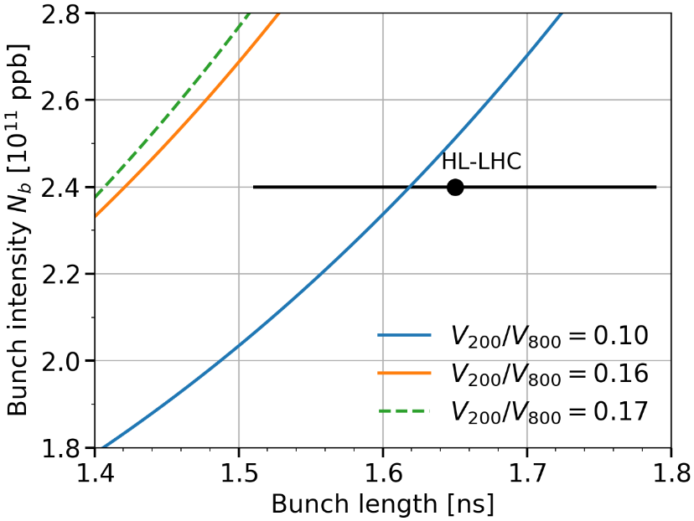
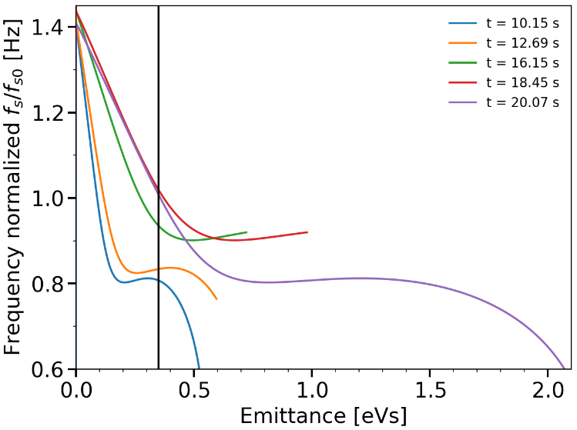
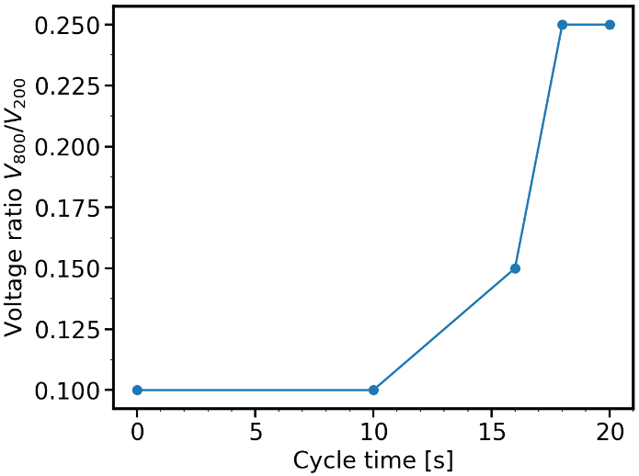
Stabilisation of LHC proton beam in CERN SPS
The LHC beam in SPS is stabilised by the 4th harmonic RF system (~ factor 4 in N_{th}). → Extra stability margin for the LHC beam by optimising the 800 MHz voltage program (J. Repond, PhD thesis, 2019). Ratio V₄/V₁ = 0.1 was used in the past for the whole cycle.
V₈₀₀ = 0.25 V₂₀₀
Optimum V₈₀₀/V₂₀₀
ratio during SPS cycle
SPS @450 GeV
Increasing V₈₀₀ helps to improve beam stability thresholds, …
but only towards the end of the ramp,
where the threshold is minimum
→ higher bunch intensities were stabilized at the end of 2018

Slide 22
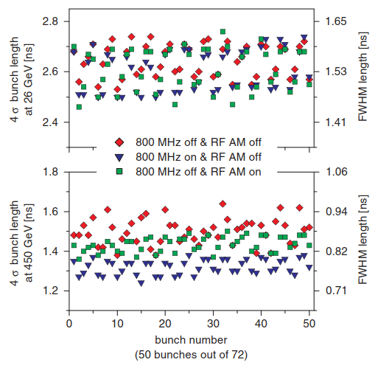
Bunch-by-bunch synchrotron frequency spread
Effect of main RF Amplitude Modulation
Coupled-bunch instability can also be stabilisied by bunch-by-bunch spread ∆ω_{s} > shift ∆ω_{c}:
spread in bunch population
{∆N/N}_{rms} > Im{∆ω_{c}}/Re{∆ω_{c}}
low-frequency voltage-modulation
ω_{s0} ~ V^{1/2}
from RF cavities at (h+1) or residual beam loading (from fractional ring filling) – ESRF storage ring (O. Naumann, J. Jacob, 1997)
CERN SPS simulations: LHC beam is globally more stable with fundamental impedance reduced (by feedback) than removed (J. Repond, M. Schwarz)
SPS, Q26, N_{b} = 3x10¹⁰ ppb, 16% RF AM
E. Vogel, T. Bohl and U. Wehrle, PRST 8 (2005)

Slide 23
Summary
In longitudinal plane, the simplified analytical criteria are often used for scaling of the loss of Landau damping threshold with beam and machine parameters.
Sacherer stability diagram in longitudinal plane is justified only for low-frequency impedances and in other cases should be used with caution.
More complete formalisms (Van-Kampen modes and Lebedev equation) together with particle simulations are available for accurate threshold estimations, also based on realistic impedance model.
Dependence of thresholds on particle distribution can be reduced by using the FWHM bunch lengths.
Landau damping can be significantly increased by additional, higher harmonic RF system, but its limitations in BLM and, for n > 2, in BSM should be taken into account for the choice of the beam and RF parameters.

Slide 24
Summary
In longitudinal plane, the simplified analytical criteria are often used for scaling of the loss of Landau damping threshold with beam and machine parameters.
Sacherer stability diagram in longitudinal plane is justified only for low-frequency impedances and in other cases should be used with caution.
More complete formalisms (Van-Kampen modes and Lebedev equation) together with particle simulations are available for accurate threshold estimations, also based on realistic impedance model.
Dependence of thresholds on particle distribution can be reduced by using the FWHM bunch lengths.
Landau damping can be significantly increased by additional, higher harmonic RF system, but its limitations in BLM and, for n > 2, in BSM should be taken into account for the choice of the beam and RF parameters.
Thank you for your attention!

Slide 25
Spare slides

Slide 26
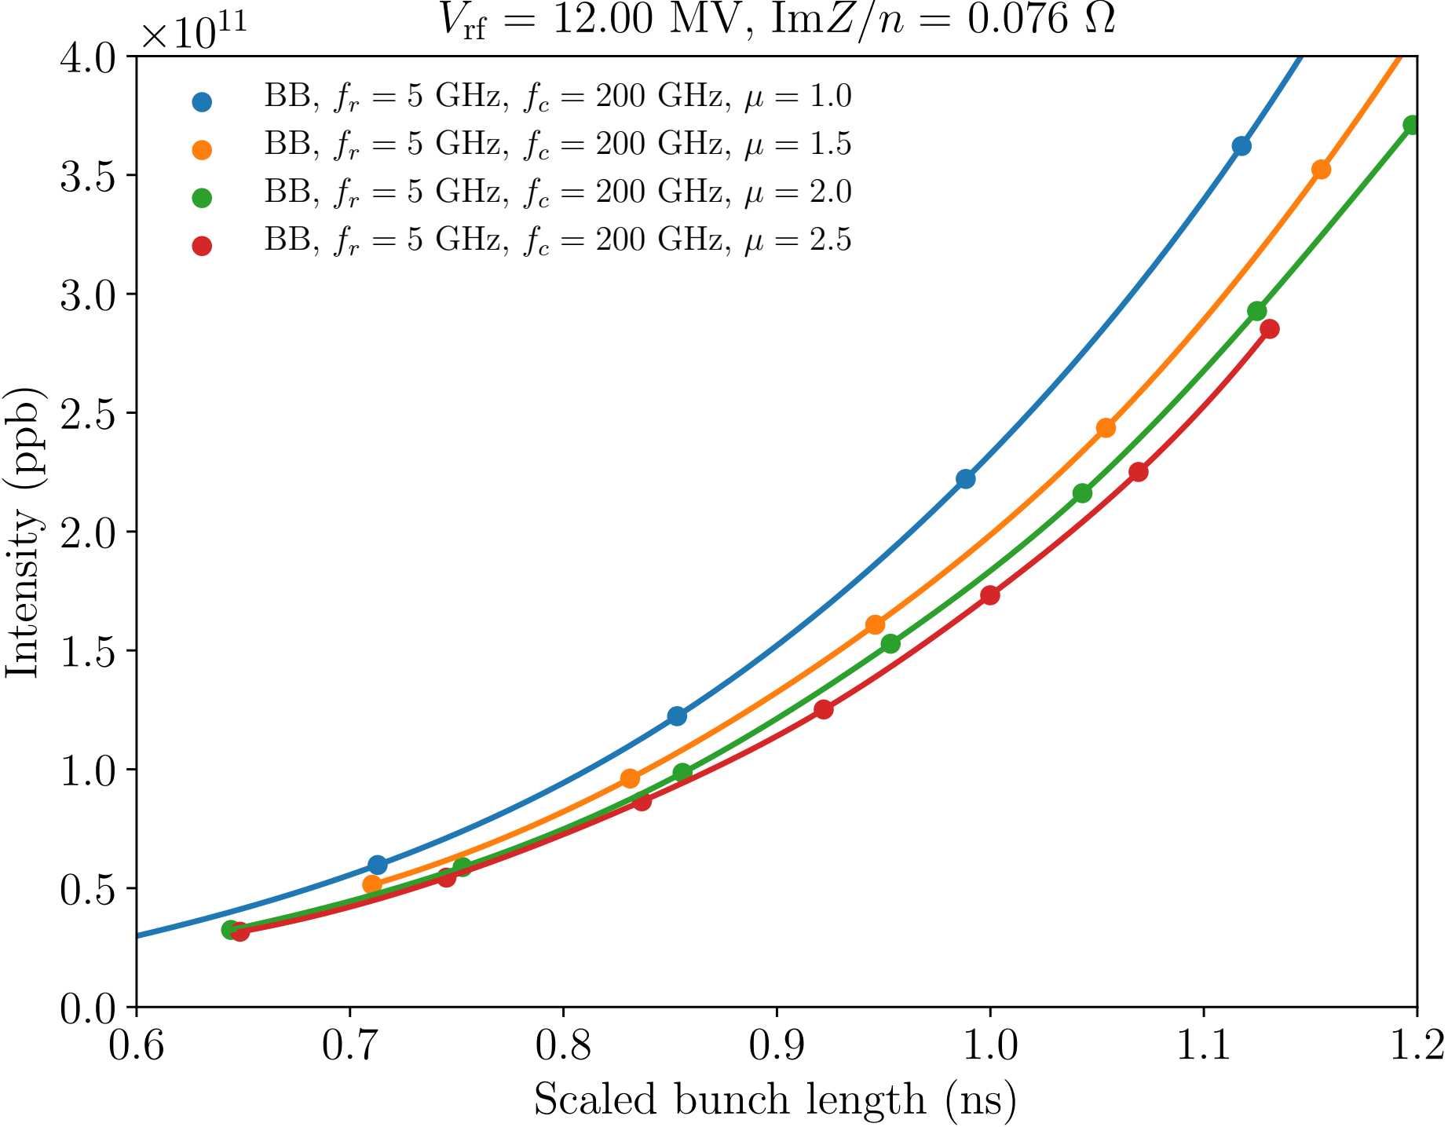

Thresholds for different distribution functions
Distribution function
$$ℱ\left(ℰ\right)={ℱ_{0}\left(ℰ_{max}−ℰ\right)}^{μ}$$
The same full-width half-maximum bunch length
I. Karpov
Again full-width half-maximum bunch length is a good parameter for stability evaluation

Slide 27
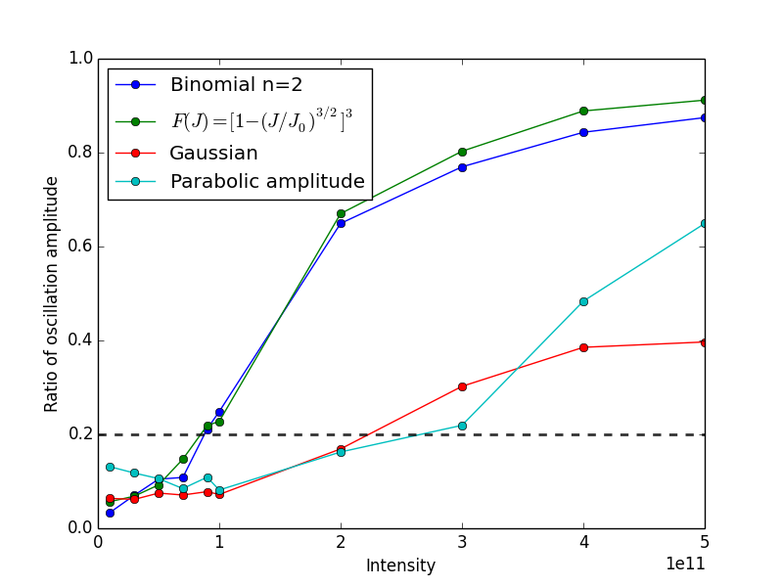
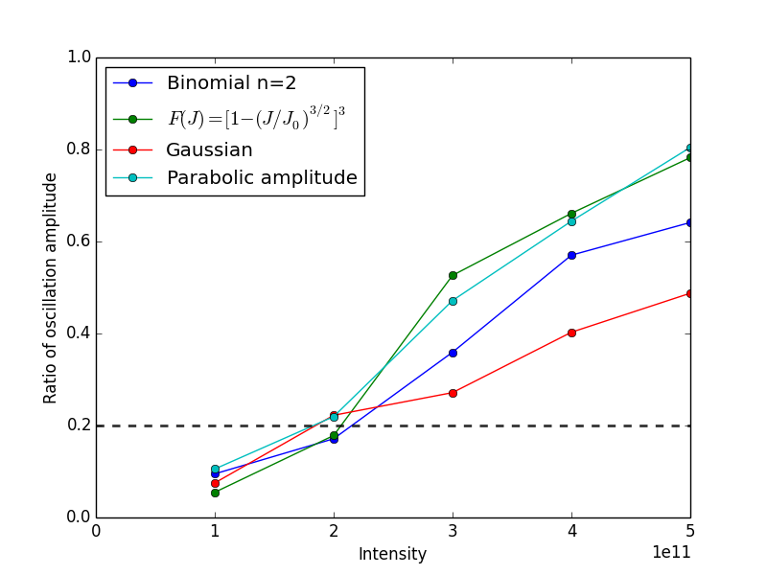
Threshold of loss of Landau damping for different particle distributions
J. E. Muller
Threshold of LLD for different particle distributions with 1 eVs emittance @4.0 TeV
Threshold of LLD for different particle distributions with 0.8 ns FWHM @4.0 TeV

Slide 28
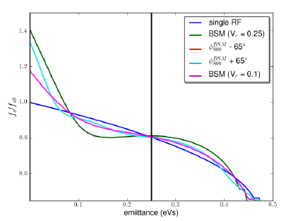
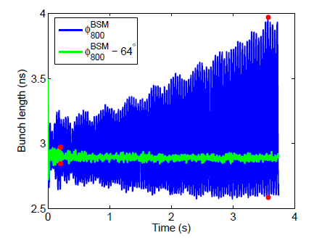
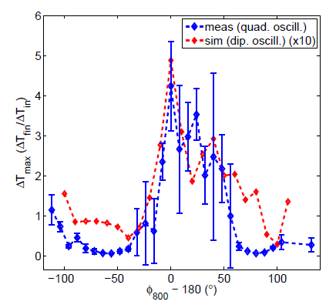
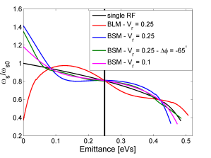
Synchrotron frequency distribution and phase between 2 RF systems in BS-mode
Very good agreement between measurements and simulations (with SPS impedance model):
single bunches are unstable in BS-mode with V2/V1=4
can be stabilised by significant phase shift of 800 MHz RF system
(T. Argyropoulos et al., IPAC’12)

Slide 29
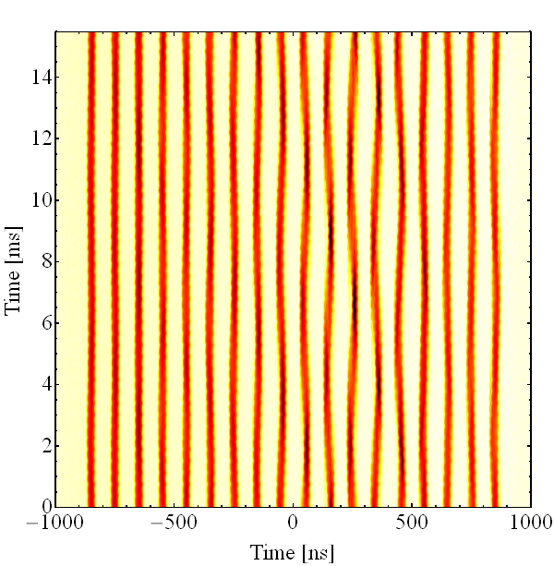
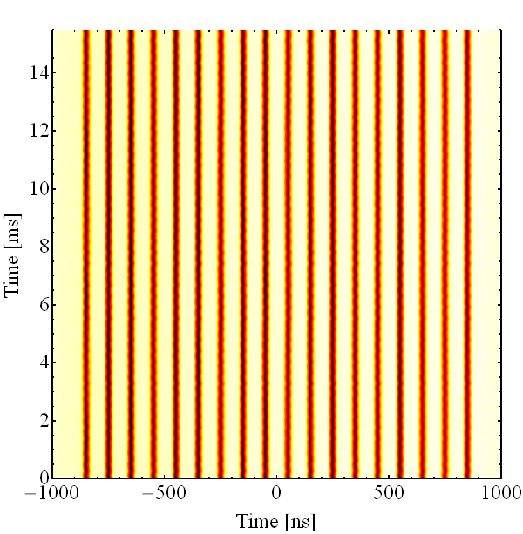
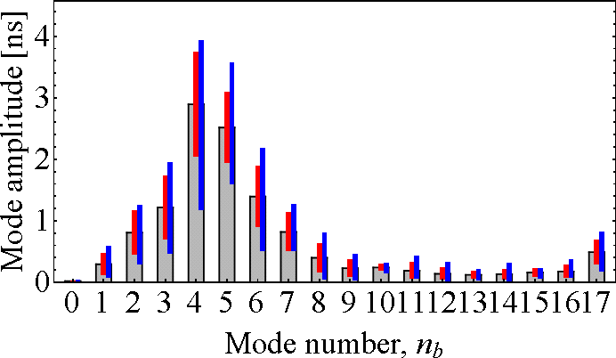
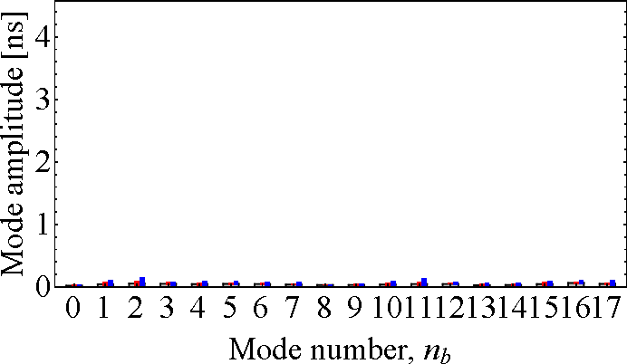
Damping of coupled-bunch instability with higher harmonic RF system in CERN PS
10 & 40 MHz in BL-mode
10 & 40 MHz in BS-mode
Bunch mode spectrum
First successful tests at flat top energy in CERN PS, (H. Damerau et al., 2017)

Slide 30
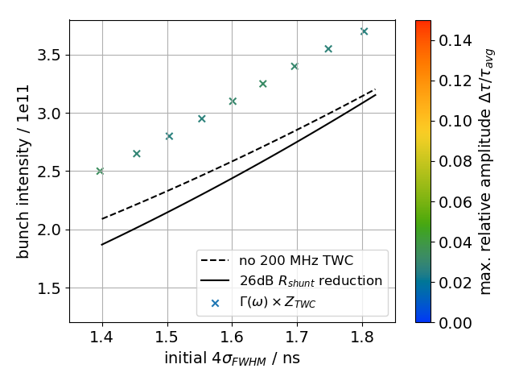
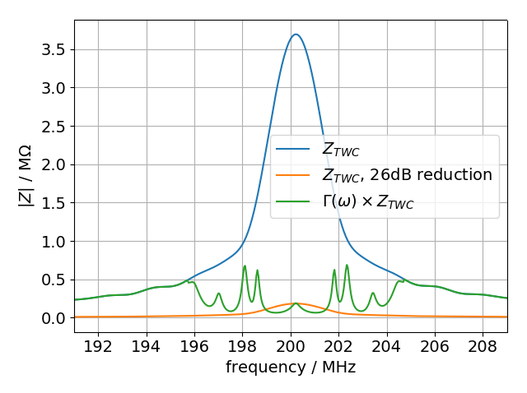
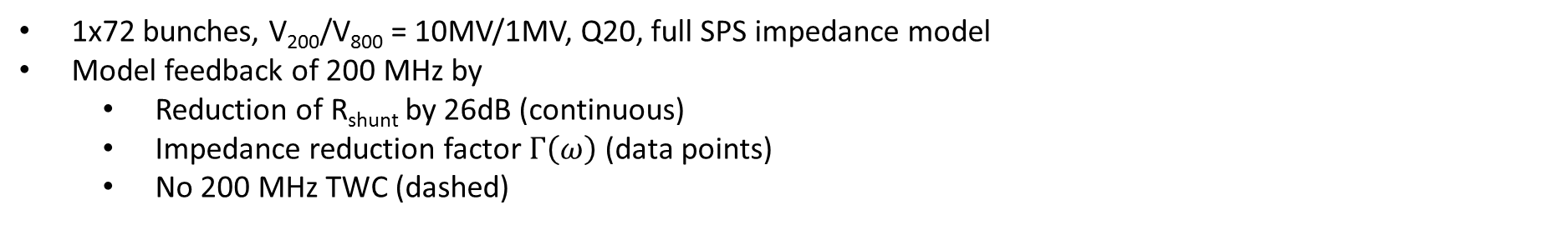
Thresholds for different feedback models
1x72 bunches, V₂₀₀/V₈₀₀ = 10MV/1MV, Q20, full SPS impedance model
Model feedback of 200 MHz by
  Reduction of R_{shunt} by 26dB (continuous)
  Impedance reduction factor $Γ\left(ω\right)$ (data points)
  No 200 MHz TWC (dashed)
Reducing the shunt impedance yields similar threshold as without the 200 MHz TWCs
No threshold was found when using the impedance reduction factor $Γ\left(ω\right)$, even though it has more ‘residual’ impedance around 200 MHz
M. Schwarz, 2019

