Slide 1
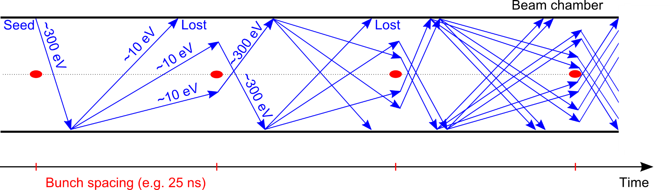
Surface effects for electron cloud
R. Cimino LNF-INFN
Thanks to F. Ruggiero

Slide 2
OUTLINE
Introduction:
E-cloud mitigation methods in a global scenario: compatibility with impedance, vacuum, etc.
The seed of e⁻cloud: number of photoelectrons (PY) and their effect to the surface.
How surface sensitive is SEY?
- Role of Temperature, overlayer thickness, etc
Conclusions

Slide 3
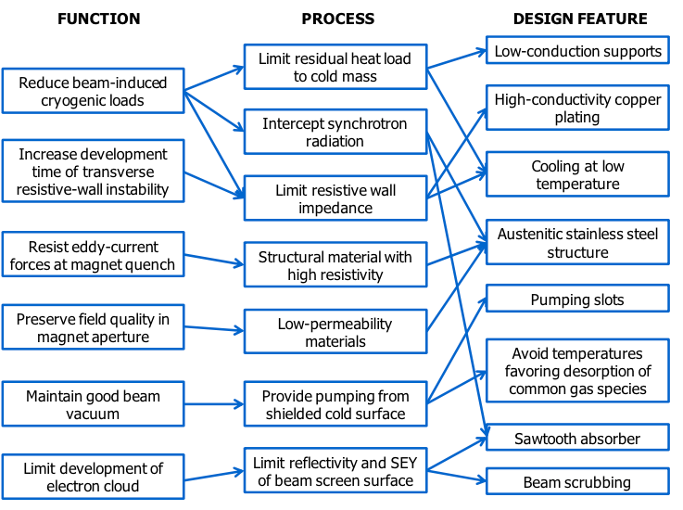
The global scenario: e⁻ cloud methods must be compliant with all BS features.
For LHC:
Cu layer
Pumping slots
shields
Cooling tubes
“Saw teeth”
Pumping slots
V. Baglin et al. CERN-ATS-2013-006

Slide 4
The global scenario: e cloud methods must be compliant with all BS features.
For LHC:
Cu layer
Pumping slots
shields
Cooling tubes
“Saw teeth”
Pumping slots
V. Baglin et al. CERN-ATS-2013-006
Alternative solution: Laser treated materials (see: Oleg Talk)

Slide 5
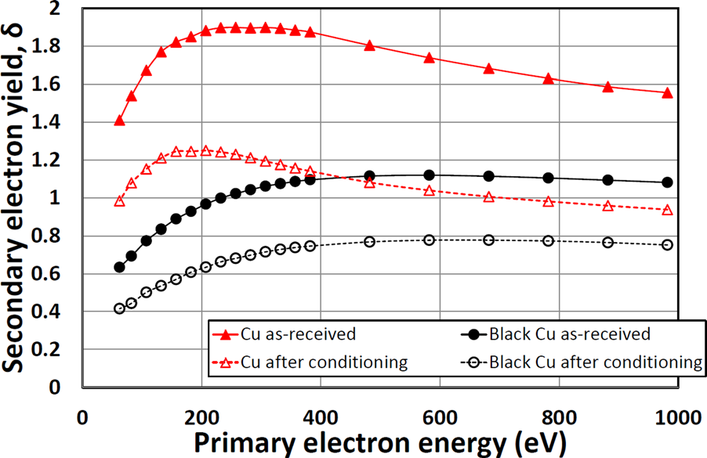
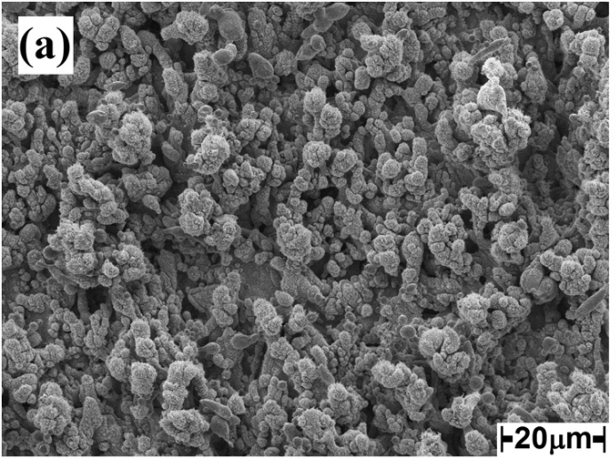
Limiting SEY with LASE-Cu
surface morphology of LASE
R. Valizadeh et al. , Appl. Phys. Lett. (2014)
Very low SEY
R. Valizadeh et al. , Appl. Surf. Sci. (2017)
R. Valizadeh, et al. Appl. Phys. Lett. 105, 231605 (2014)
See Oleg Talk
Is it compliant with all BS functionalities?

Slide 6
The global scenario: e cloud methods must be compliant with all BS features.
For LHC:
Cu layer
Pumping slots
shields
Cooling tubes
“Saw teeth”
Pumping slots
V. Baglin et al. CERN-ATS-2013-006

Slide 7
The global scenario: e cloud methods must be compliant with all BS features.
For LHC:
Cu layer
Pumping slots
shields
Cooling tubes
“Saw teeth”
Pumping slots
V. Baglin et al. CERN-ATS-2013-006
Impedance issues?

Slide 8
The global scenario: e cloud methods must be compliant with all BS features.
For LHC:
Cu layer
Pumping slots
shields
Oleg will answer to this!
Cooling tubes
“Saw teeth”
Pumping slots
V. Baglin et al. CERN-ATS-2013-006
Impedance issues?

Slide 9
The global scenario: e cloud methods must be compliant with all BS features.
For LHC:
Cu layer
Pumping slots
shields
and temperature fluctuations
Cooling tubes
“Saw teeth”
Pumping slots
V. Baglin et al. CERN-ATS-2013-006
Vacuum issues?

Slide 10
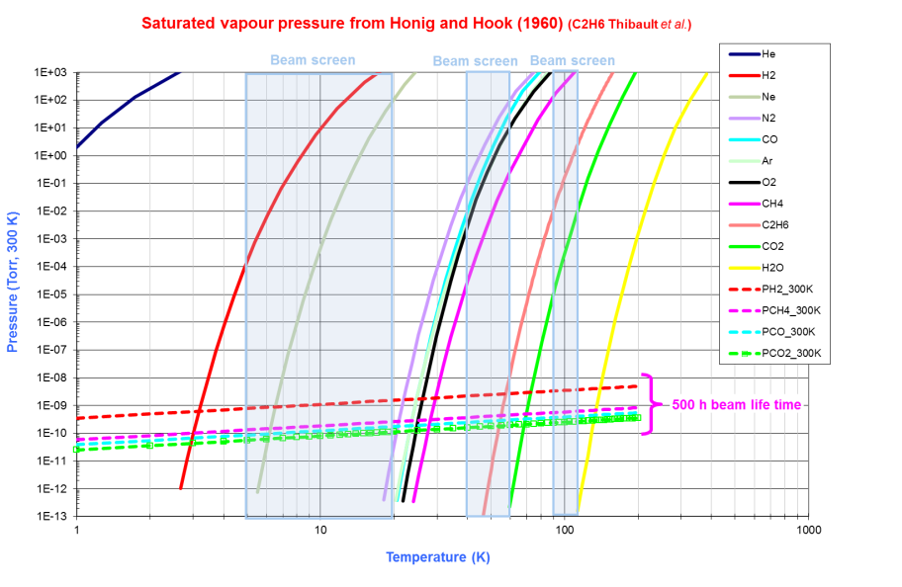
When Operating at Low Temperature
LHC
Synchrotron Radiation Power = 0.13 W/m
FCC
Synchrotron Radiation Power = 40 W/m
Working Pressure
(<10⁻¹¹ mbar)
Beam screen Temperature Range
Independently on the substrate treatment, the thermal stability against small BS T fluctuation has to be guaranteed

Slide 11
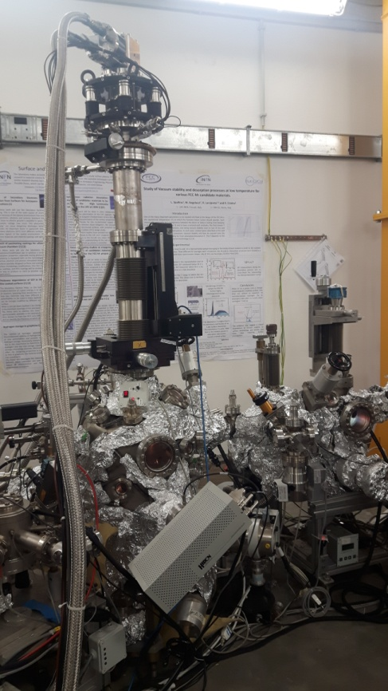
We studied thermal stability @ LNF within EuroCirCol collaboration
Ultra high vacuum systems
Secondary Electron Yield (SEY) measurements
Equipment : Electron gun, Faraday cup
preparation
chamber
main chamber
fast-entry lock
LNF-cryogenic manipulator
Sample at 15-300 K
Temperature Programmed Desorption (TPD) and Mass Spectrometry measurements
Equipment : QMS (Hiden HAL 101 Pic)

Slide 12
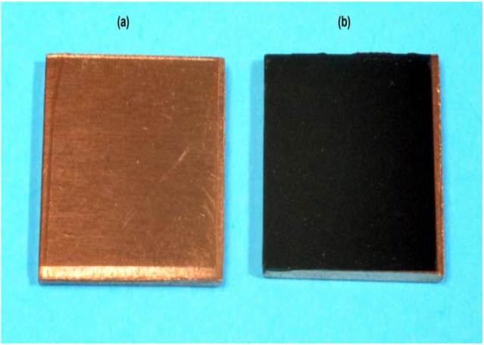
TPD from unbaked lase-Cu for temperature induced vacuum transients study
poly-Cu
Comparative study of TPD from flat poly-Cu and LASE-Cu unbaked samples using different gases
(Ar, CH₄, CO and H₂ )
Representative of Laser treated Cu

Slide 13
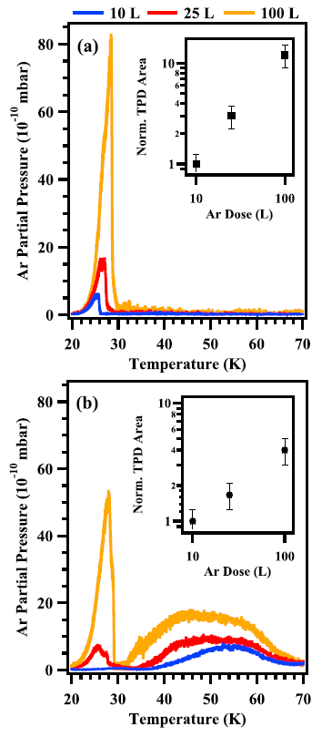
TPD from unbaked lase-Cu for temperature induced vacuum transients study: Ar
Single TPD peak at ~30 K corresponding to the desorption of a condensed thick Ar layer
Desorption temperature determined by the weak Ar-Ar van der Waals interaction energies
Ar on poly-Cu
L. Spallino, M. Angelucci, R. Larciprete, R. Cimino,
Appl. Phys. Lett. 114, 153103 (2019)

Slide 14
TPD from unbaked lase-Cu for temperature induced vacuum transients study: Ar
Single TPD peak at ~30 K corresponding to the desorption of a condensed thick Ar layer
Desorption temperature determined by the weak Ar-Ar van der Waals interaction energies
Ar on poly-Cu
L. Spallino, M. Angelucci, R. Larciprete, R. Cimino,
Appl. Phys. Lett. 114, 153103 (2019)
Ar on LASE-Cu
TPD peak at ~30 K corresponding to the desorption of a condensed thick Ar layer together with a broad TPD profiles, whose peak temperatures and widths depend on the Ar dose

Slide 15
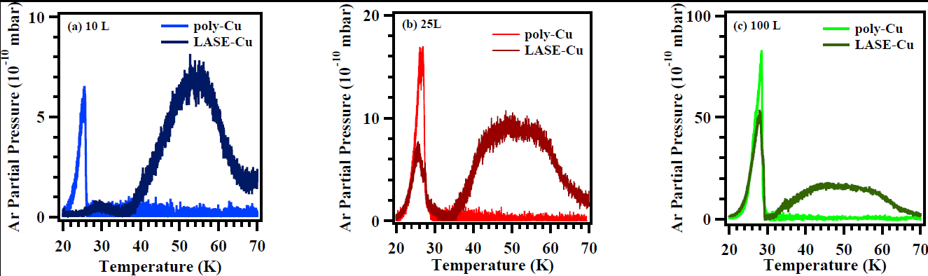
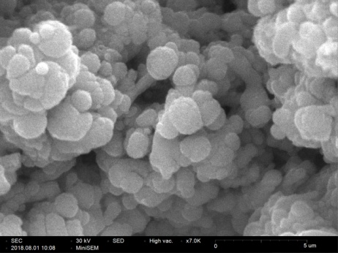
TPD from unbaked lase-Cu for temperature induced vacuum transients study: Ar
TPD characteristics determined by the sponge-like structural features of LASE-Cu
5 mm

Slide 16
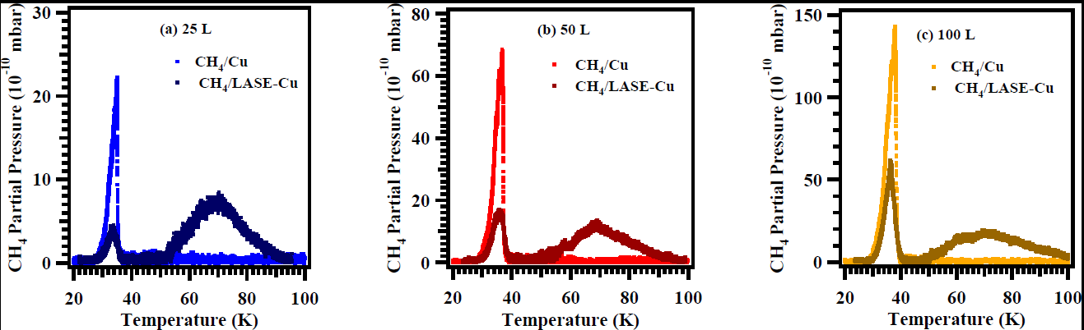
TPD from unbaked lase-Cu for temperature induced vacuum transients study: CH₄
Conceptually identical results have been obtained with CH₄
L. Spallino, M. Angelucci and R. Cimino, to be published

Slide 17
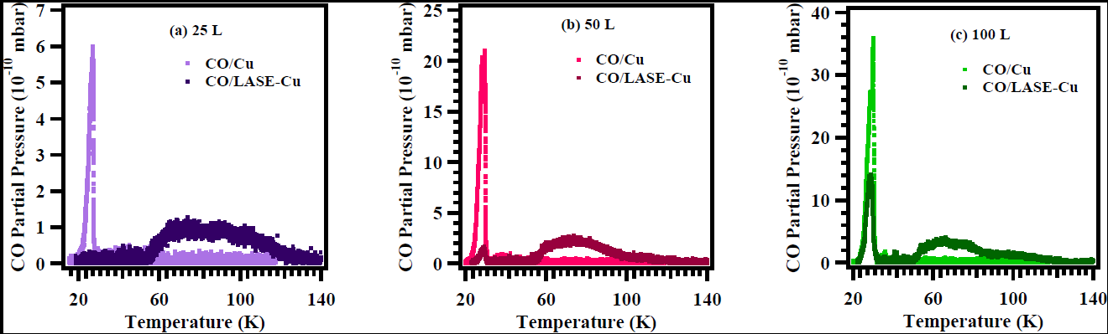
TPD from unbaked lase-Cu for temperature induced vacuum transients study: CO
Conceptually identical results have been obtained with CO
L. Spallino, M. Angelucci and R. Cimino, to be published

Slide 18
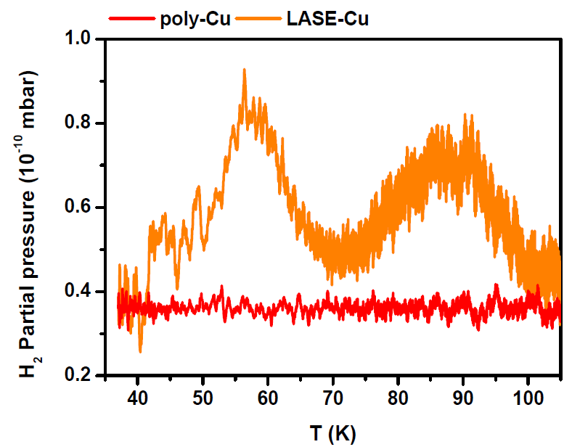
TPD from unbaked lase-Cu for temperature induced vacuum transients study: H₂
TPD of 100 L H₂ dosed on poly-Cu and LASE-Cu samples held at T~15-18 K
No TPD signal should be observed by considering the H₂ vapor suture pressure curve!!!
The wide distribution of high energy adsorption sites within the inner pore is responsible for the H₂ TPD signal from LASE-Cu sample
L. Spallino, M. Angelucci and R. Cimino, to be published

Slide 19
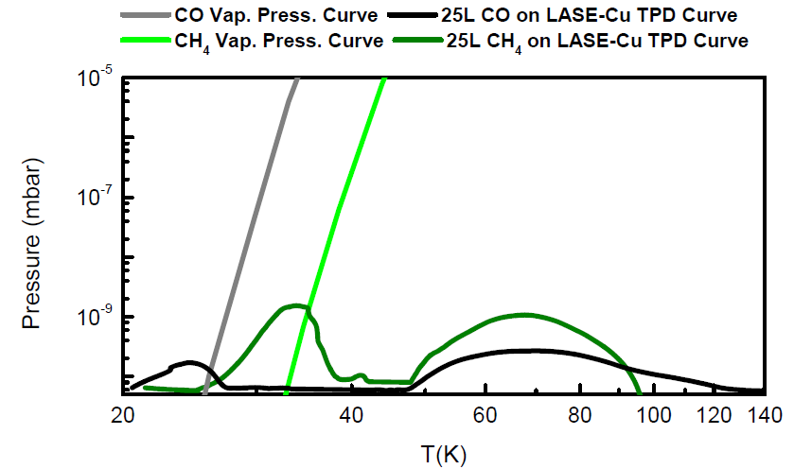
TPD from unbaked lase-Cu for temperature induced vacuum transients study
Saturated vapour pressure from Honig and Hook (1960)
L. Spallino, M. Angelucci and R. Cimino, to be published
Further studies and electron/photon stimulated desorption are necessary to validate/optimize LASE-Cu at low T.
Low SEY AND Low impedance AND Vacuum compatibility, etc. must be granted!

Slide 20
OUTLINE
Introduction:
E-cloud mitigation methods in a global scenario: compatibility with impedance, vacuum, etc.
The seed of e⁻cloud (and of single bunch inst.): number of photoelectrons (PY) and their effect to the surface.
How surface sensitive is SEY?
- Role of Temperature, overlayer thickness, etc
Conclusions

Slide 21
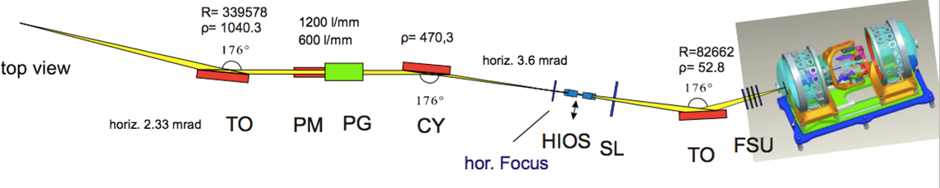
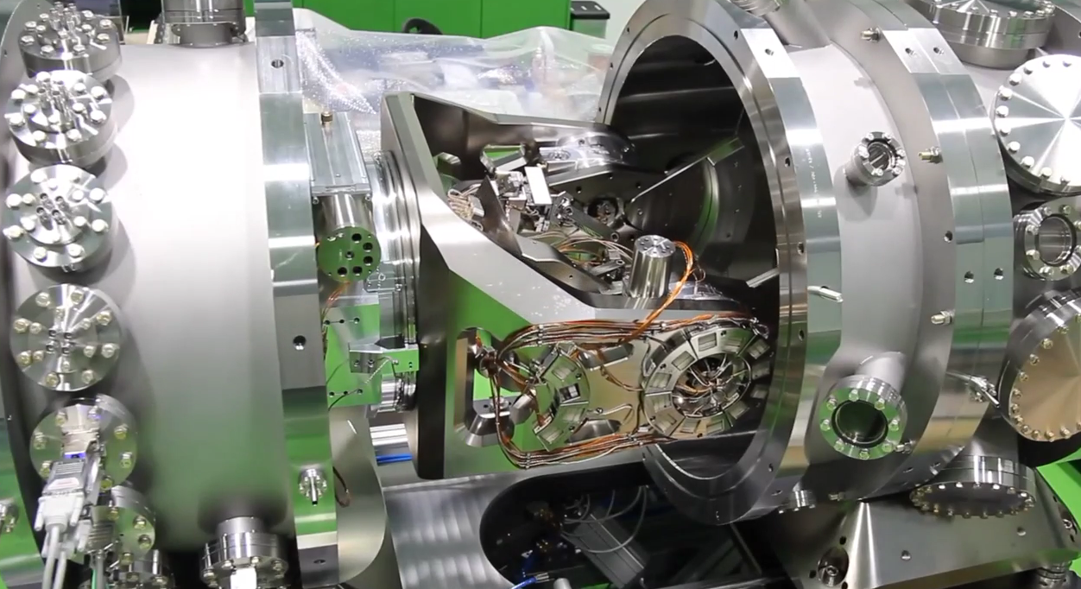
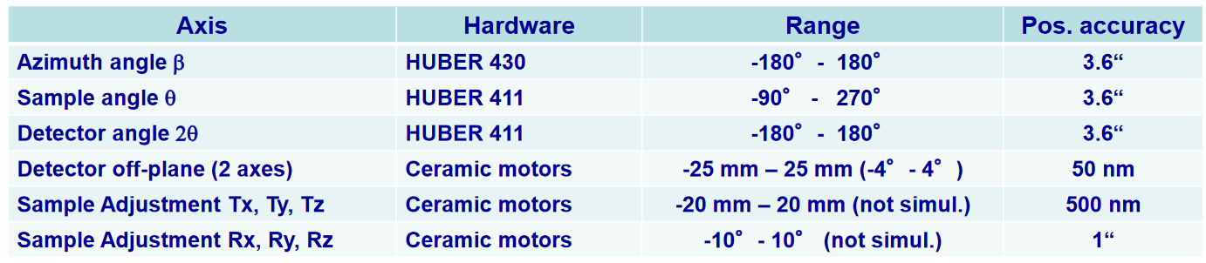
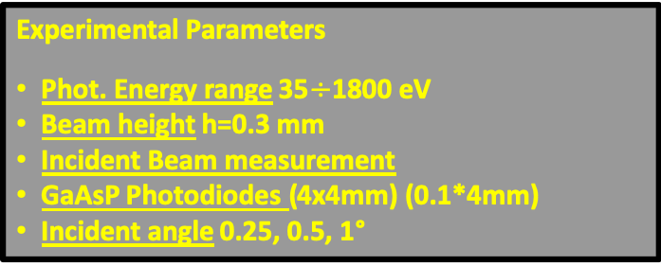
We can measure PY and R in operational conditions
Experimental Parameters
Phot. Energy range 35$÷$1800 eV
Beam height h=0.3 mm
Incident Beam measurement
GaAsP Photodiodes (4x4mm) (0.1*4mm)
Incident angle 0.25, 0.5, 1°
The Beamline
A. Sokolov, et al., Journal of Synchrotron Radiation 25, 100 (2018).
The Reflectometer
A.A.Sokolov,et al,Proc.of SPIE92060J-1-13(2014)

Slide 22
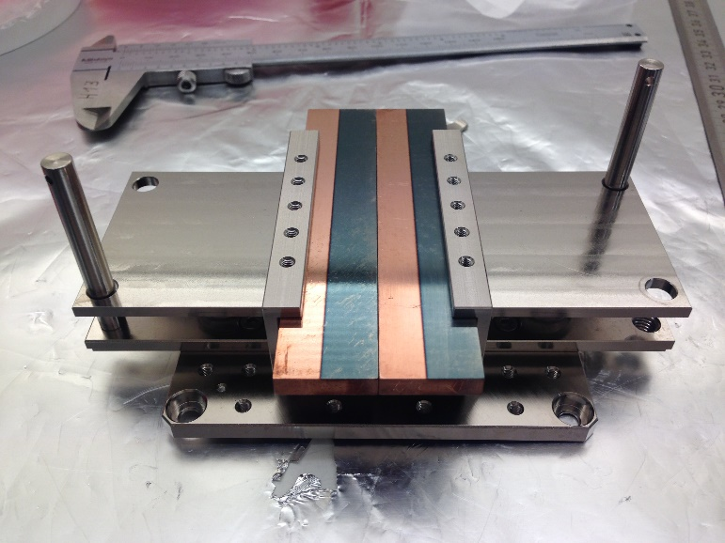
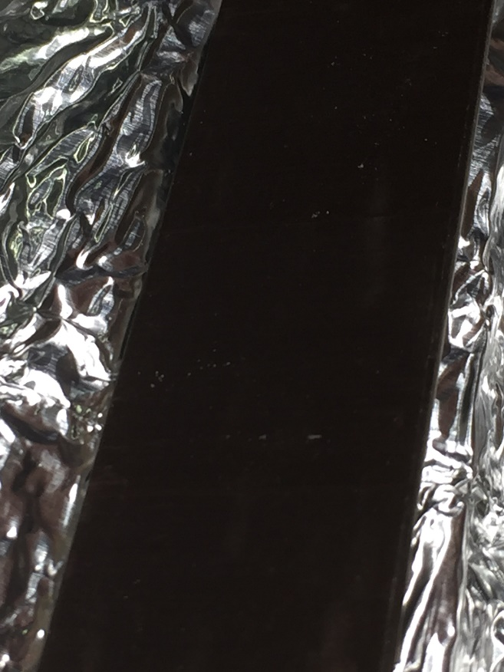
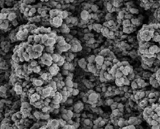
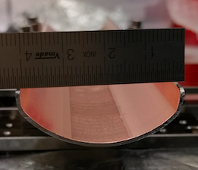
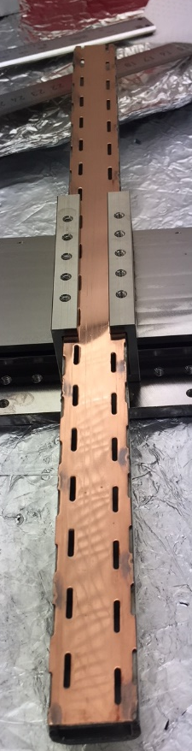
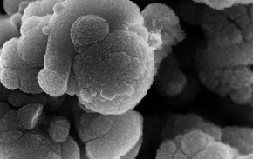
The sample studied:
Cu (different Roughness)
LHC - Saw Tooth
LASE
Cu+ amorphous Carbon Thin Film
And: NEG, Stainless Steel, ...
50 mm
LHC Saw Tooth
5 mm
LASE Cu
Cu LHC

Slide 23
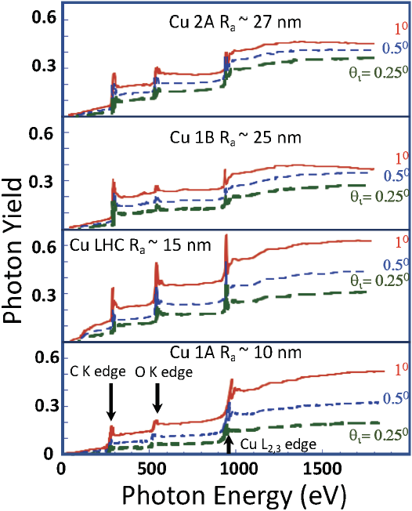
Selected results: Photo Yield
In all cases, PY is higher at higher photon energies.
The PY dependence on θ_{i} is consistently dimmed and finally washed out when surface Ra is increasing.
In all cases, the Cu-L2-3 absorption edge at 930-950 eV is visible and cause an increase in the measured PY.
In all spectra we measure a significant effect due to the C K-edge at 280 eV and O K-edge at 530 eV (surf. Contaminants)
Roughness does influence the PY. The lower is Ra, the highest is the measured PY.
E. La Francesca et al: submitted to PR ST

Slide 24
Photon interaction studies (RT) @ DAΦNE-L
Photo Stimulated
Desorption
Preliminary results on PSD
from small samples @ DAΦNE
Pressure Evolution
Surface Chemistry Changes
(Conditioning)
Photon / Electron Scrubbing comparison

Slide 25
Photon interaction studies (RT) @ DAΦNE-L
Preliminary results
from small samples
Studied on the same surface
Photon Scrubbing
Surface Modifications
Photo Yield
SEY
Strong variation of surface conditions at “low dose”
Slow variations at
“high doses”
Finale State SEY=1.3

Slide 26
Photon interaction studies (RT) @ DAΦNE-L
XPS
Preliminary results
Surface Modifications
XPS Map
Modification of Carbon C-1s
From sp³ to sp²
Same chemical process of Electron Scrubbing
Scrubbing Area
Spot Dimension
But SEY_{Max} Decreases to 1.3
as for low energy electrons
Still in progress!

Slide 27
OUTLINE
Introduction:
E-cloud mitigation methods in a global scenario: compatibility with impedance, vacuum, etc.
The seed of e⁻cloud: number of photoelectrons (PY) and their effect to the surface.
How surface sensitive is SEY?
- Role of Temperature, overlayer thickness, etc
Conclusions

Slide 28
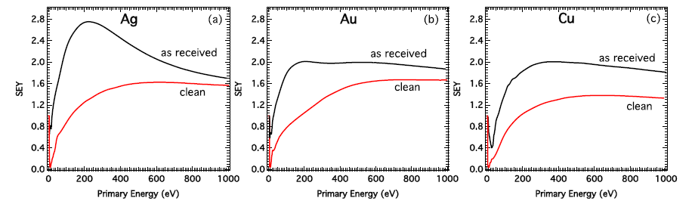
SEY behavior is strongly influenced by the chemical state of the surface
L. A. Gonzalez et al., AIP Adv. (2017)
Contaminants from atmosphere ~ 5 - 20 nm

Slide 29
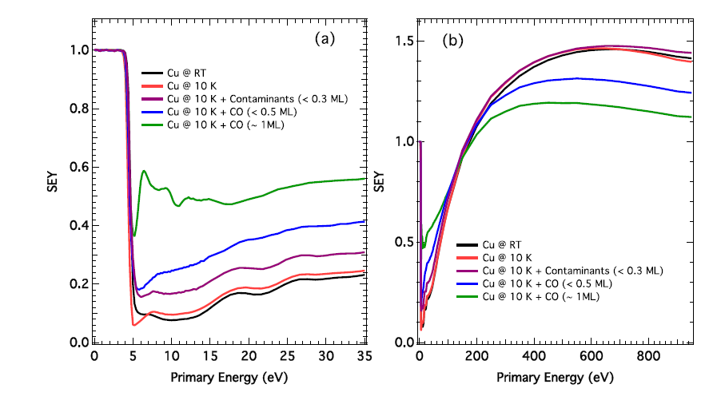
SEY at LT (20 K) ~ SEY at RT but...
L. A. Gonzalez et al., AIP Adv. (2017)
SEY is highly sensitive to the presence of adsorbates, even at sub-monolayer coverages
SEY of cold surfaces influenced by gas physisorption

Slide 30
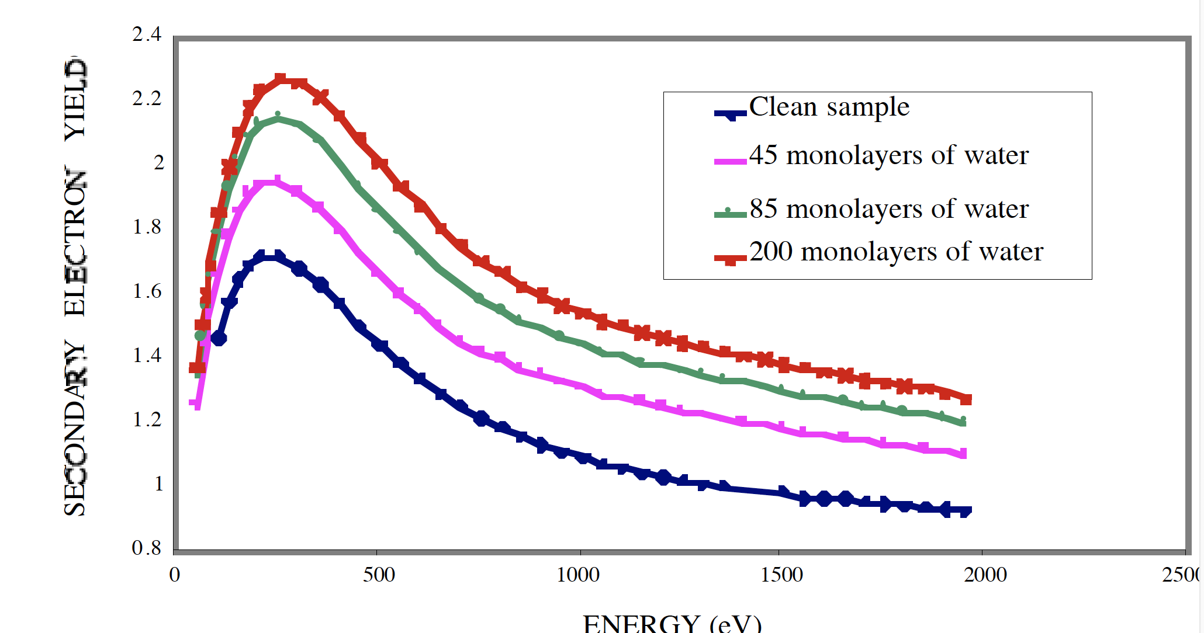
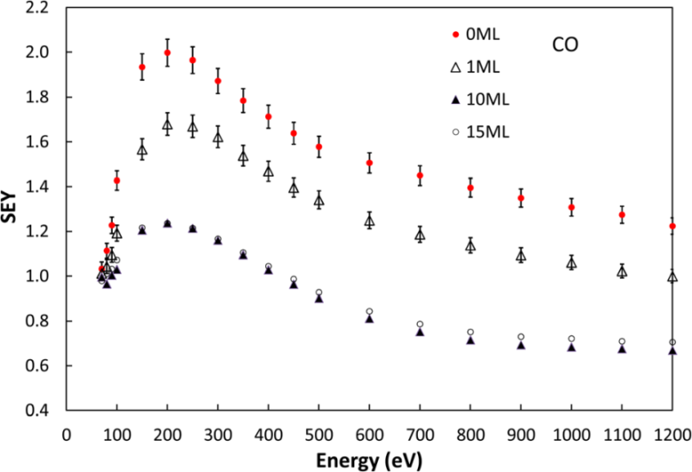
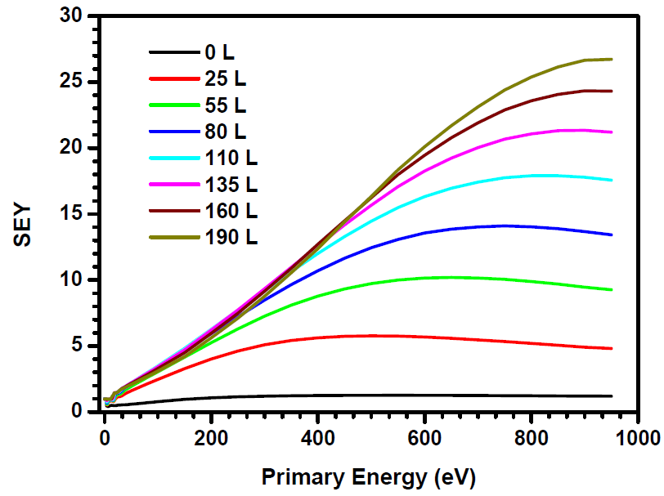
SEY Surface sensitivity: gases on LT Cu
CO thick layer coverage
Ar thick layer coverage
H₂O thick layer coverage
Kuzucan et al., J. Vac. Sci. Technol. A (2012)
L. Spallino, M. Angelucci and R. Cimino, to be published
V . Baglin, et al Proceedings of EPAC 2000, Vienna, Austria
SEY is an intrinsic material property strongly sensitive to the surface composition and chemical state
Element and coverage specific

Slide 31
How a Coating modify SEY?
(the case of a-C on Cu)
-Preliminary-
We followed the growth of thin a-C layers on Cu with XPS to measure its thickness
a-C thermal evaporator
XPS
Increasing C
Graphite road
A. Novelli et al., in preparation

Slide 32
How a Coating modify SEY?
(the case of a-C on Cu)
-Preliminary-
We followed the growth of thin a-C layers on Cu with XPS to measure its thickness
a-C thermal evaporator
Cu 2p
C 1s
Increasing C
Graphite road
A. Novelli et al., in preparation

Slide 33


How a Coating modify SEY?
(the case of a-C on Cu)
-Preliminary-
We followed the growth of thin a-C layers on Cu with XPS to measure its thickness
In XPS:
where d is the unknown thickness and λ is the inelastic mean free path.
Cu 2p
C 1s
Increasing C
A. Novelli et al., in preparation

Slide 34
How a Coating modify SEY?
(the case of a-C on Cu)
-Preliminary-
We followed the growth of thin a-C layers on Cu with XPS to measure its thickness
In XPS:
where d is the unknown thickness and λ is the inelastic mean free path.
Cu 2p
C 1s
Increasing C
We also calibrate the 1ML Carbon signal with the one emitted from Gr/Cu (1 Ml)
A. Novelli et al., in preparation

Slide 35
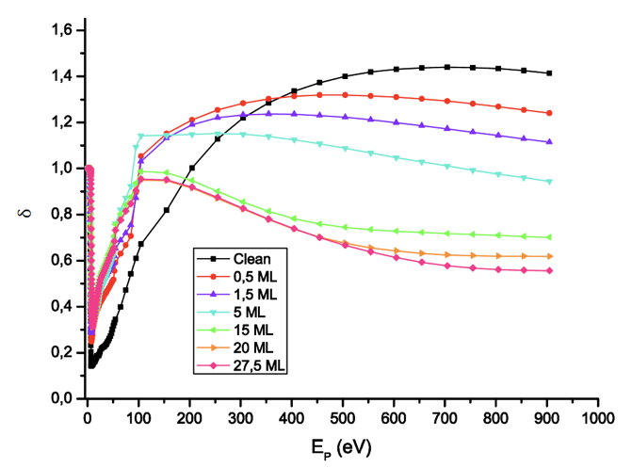
How a Coating modify SEY?
(the case of a-C on Cu)
-Preliminary-
By simultaneously follow SEY changes with a- C thickness we can measure SEY dependence on actual a-C coverage.
δ_{max}, E_{max} sets to their (a-C) final values quite soon, while minor changes still occurs at higher doses in the very low (< ~ 20 eV) and quite high primary energy (> ~400 eV) part.
Increasing C
A. Novelli et al., in preparation

Slide 36
How a Coating modify SEY?
(the case of a-C on Cu)
-Preliminary-
By simultaneously follow SEY changes with a- C thickness we can measure SEY dependence on actual a-C coveradge.
Increasing C
A. Novelli et al., in preparation

Slide 37
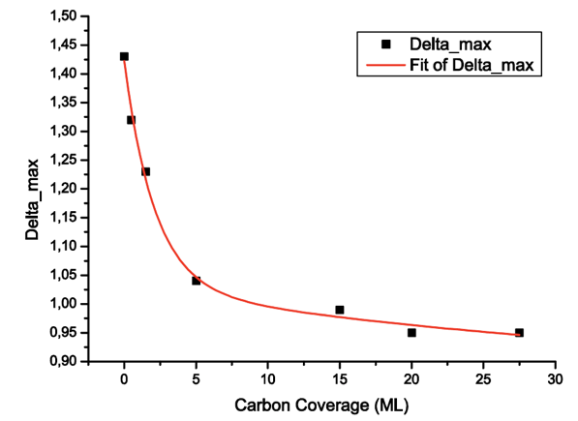
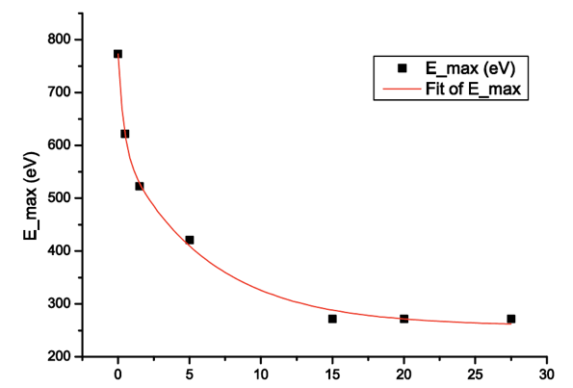
How a Coating modify SEY?
(the case of C on Cu)
E_{max}
δ_{max}
In Graphite:
1 ML ~ 3.4 Å
Carbon Coverage (ML)
Carbon Coverage (ML)
Could follow d_{max} vs C coverages
Could follow E_{max} vs C coverages
➔ 15-20 Ml (~ 5-6 nm) of a-C determines SEY properties.
A. Novelli et al., in preparation

Slide 38
Do we learn something on Scrubbing?
To have a fully scrubbed Surface, we need more than 5-6 nm of (low SEY) a- C covering our surface.
Original Contaminant thickness depends on the material and material cleaning. (can be between 4 to 20 nm)
During irradiation (ph and e⁻) both desorption and substrate chemical modifications occurs.
Are we always sure that we are left with the minimum C coverage to reduce SEY below 1.1 ?
Why photons and low energy electrons (below 50 eV) behaves differently than high energy electrons (above 50 eV up to 3keV)?

Slide 39
Conclusions
All new materials should be validated in all aspects in a global approach.
Laboratory experiments have been and must be refined.
Material studies in conditions as close as possible to operating ones (preparation, Low Temperature & geometry) is mandatory.
There are still open aspects in the scrubbing process.
Very thin coatings (about 6 nm for a-Carbon) are enough to completely reduce clean poly - Cu SEY to the one of a-C.

Slide 40
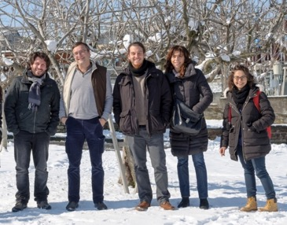





Thank you for your attention
Thanks to the low temperature team at LNF:
M. Angelucci, A. Liedl, R. Larciprete e L. Spallino.
Tanks to the technical support of DAФNE-L Team:
A. Grilli, M. Pietropaoli, A. Raco, V. Tullio, V. Sciarra and G. Viviani
Thanks to EuroCirCol project and to its scientific community
Thanks to MICA supporting project funded by INFN-SNC5
Thanks to CERN-INFN bilateral agreement K E 3 7 2 4 / T E / H L - L H C - Addendum N o. 4 to Agreement TKN3083

