Slide 1
ADTObsBox to Catch Instabilities
M. Söderén for the ADT team
Notes:
The development of the ADT, how it is currently being used(OP and ABP) and what upgrades are planned for the future

Slide 2
Agenda
What is the ADTObsBox
How the ADTObsBox has been used to catch instabilities
LS2 upgrades to increase its hunting capabilities
How the ADTObsBox will be used to catch instabilities

Slide 3
What is ADTObsBox
An acquisition system that takes advantage of the bunch-by-bunch turn-by-turn submicrometer transverse position data available from the transverse feedback system in the LHC and makes it available for a range of analysis tools

Slide 4
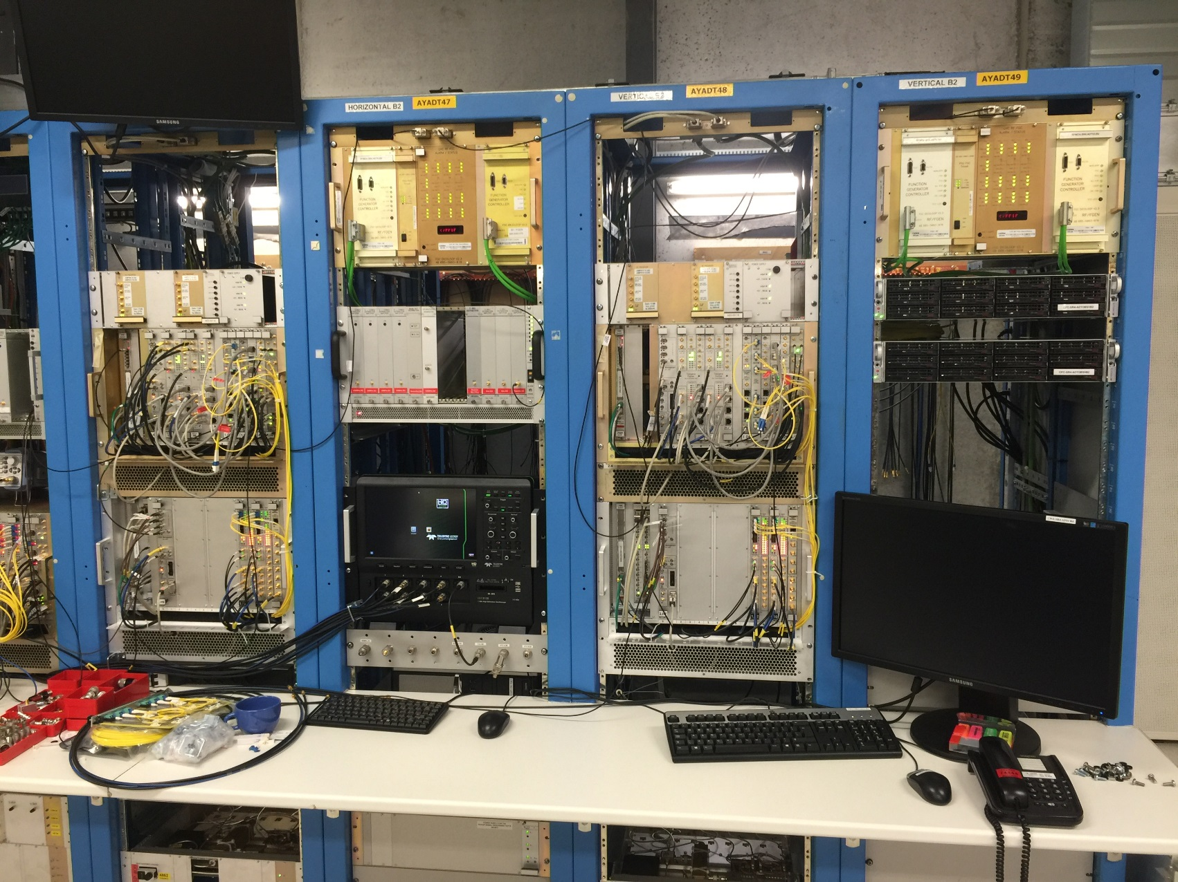
What is ADTObsBox
ADTObsBox
Beam Position monitor
SPLITTER
1 Gbps fiber
mDPSU
One system per plane per beam so four in total
Four pickups per system so 16 in total

Slide 5
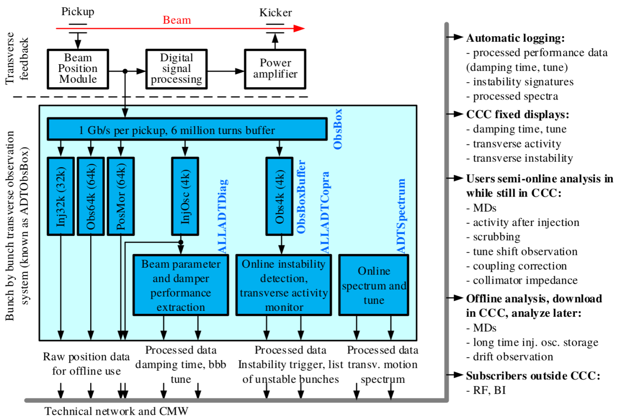
What is ADTObsBox

Slide 6
Data
4.6 TB of data stored since late 2017 in our nfs-server
  336 GB/221368 files: Every injection, all bunches, 4k turns
    Triggered by BeamIN
  474 GB/9754 files: Post mortem data, all bunches, 64k turns
    Triggered by BeamOut
  3700 GB/179793 files: Instability data, all bunches, 64k turns
    Triggered by internal beam instability detection
  72 GB/41269 files: Other data (e.g. dedicated MDs)
Since fill 6030, stored to a dedicated server (unlimited storage time) with backup to CASTOR. Owned by us and maintained by CO.
ADTObsBox™ data used for: Injection drift observation, Post-mortem analysis, Instability cause analysis, MDs, Generating cool animated plots for meetings and papers
ABP has automatic scripts that goes through the data after every fill to search for interesting event
Notes:
Explain how instability trigger system works
More on injection and post-mortem
ADTObsBox is trademarked

Slide 7
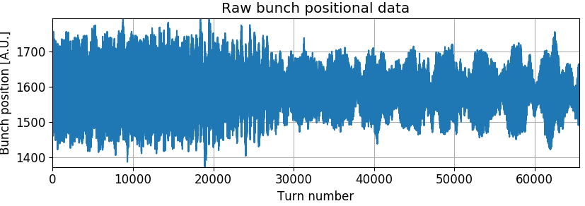
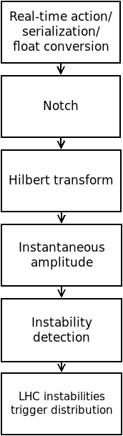
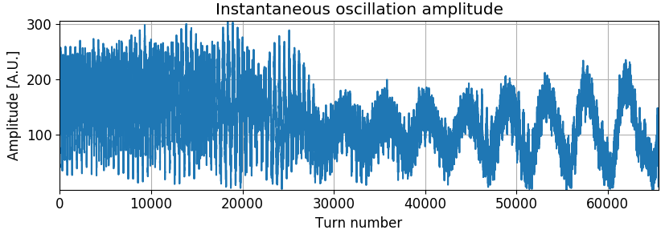
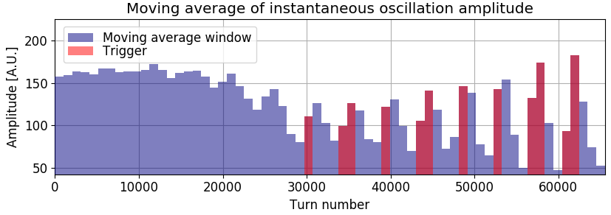

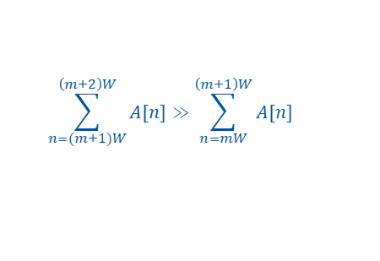

How
$$x[n]$$
$$x_{n}\left[n\right]=x\left[n\right]−x[n−1]$$
$$x_{h}\left[n\right]=−0.0906x_{n}\left[n\right]−0.0198x_{n}\left[n−1\right]−0.5941x_{n}\left[n−2\right]$$
$$+0.5941x_{n}\left[n−4\right]+0.0198x_{n}\left[n−5\right]+0.0906x_{n}[n−6]$$
$$A\left[n\right]=\sqrt{{{(x}_{h}[n])}^{2}+{{(x}_{n}[n−3])}^{2}}$$
$$\sum_{n=(m+1)W}^{\left(m+2\right)W}{A[n]}≫\sum_{n=mW}^{\left(m+1\right)W}{A[n]}$$
$$w=window size$$
*[1] for all details
Notes:
Adt used as an exciter and as an acquisition system, the tasks for the different MDs varies
4147:
Explore source of 50Hz perturbation and investigate possible cause of beam degreation

Slide 8
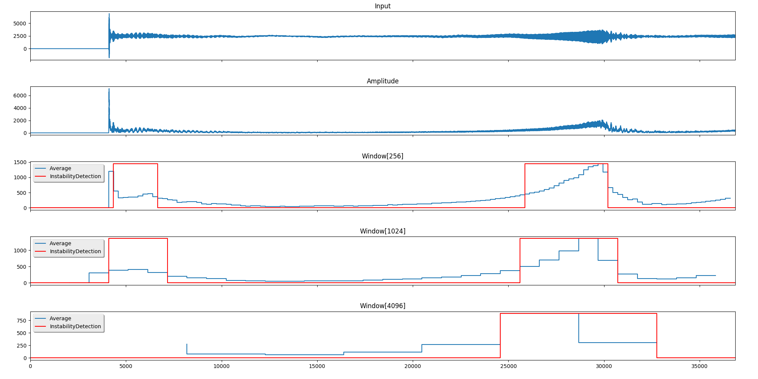
How
Three windows of length 256, 1024 and 4096 turns
The maximum instantaneous amplitude for every 4096 turns and the output from the longest window is sent to the ADT activity monitor and TIMBER
*[2] for complete implementation details
Notes:
Adt used as an exciter and as an acquisition system, the tasks for the different MDs varies
4147:
Explore source of 50Hz perturbation and investigate possible cause of beam degreation

Slide 9
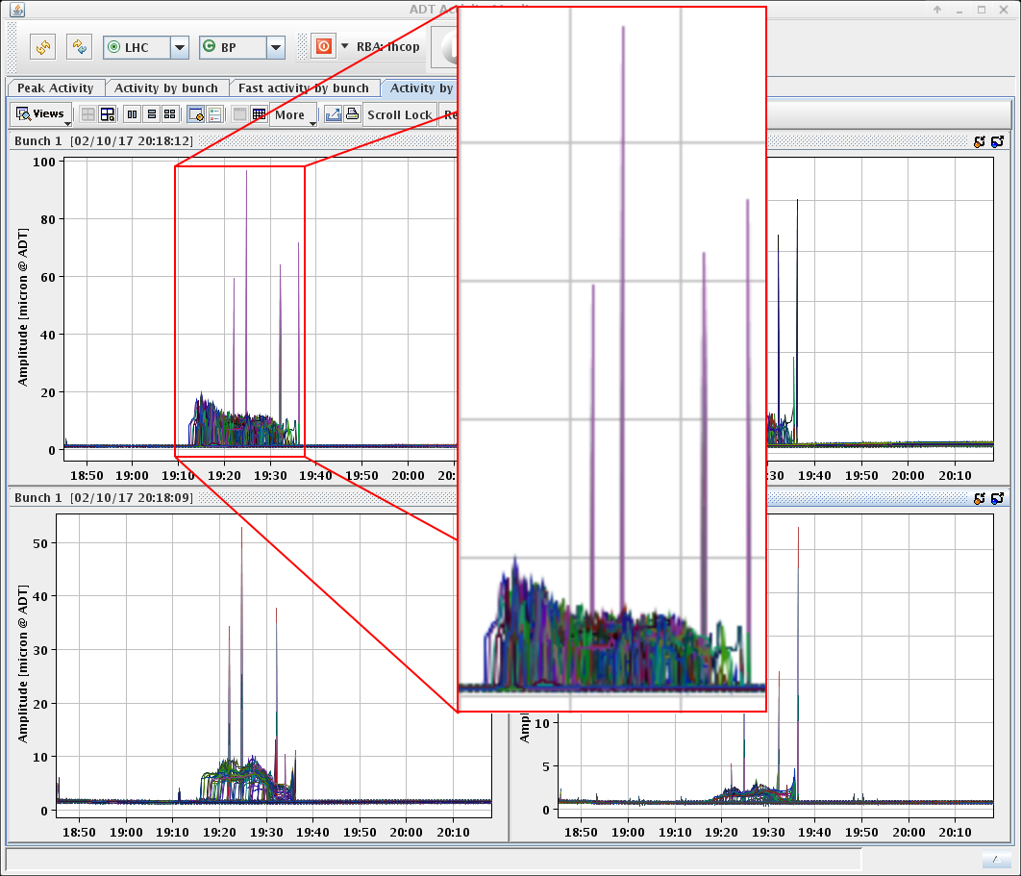
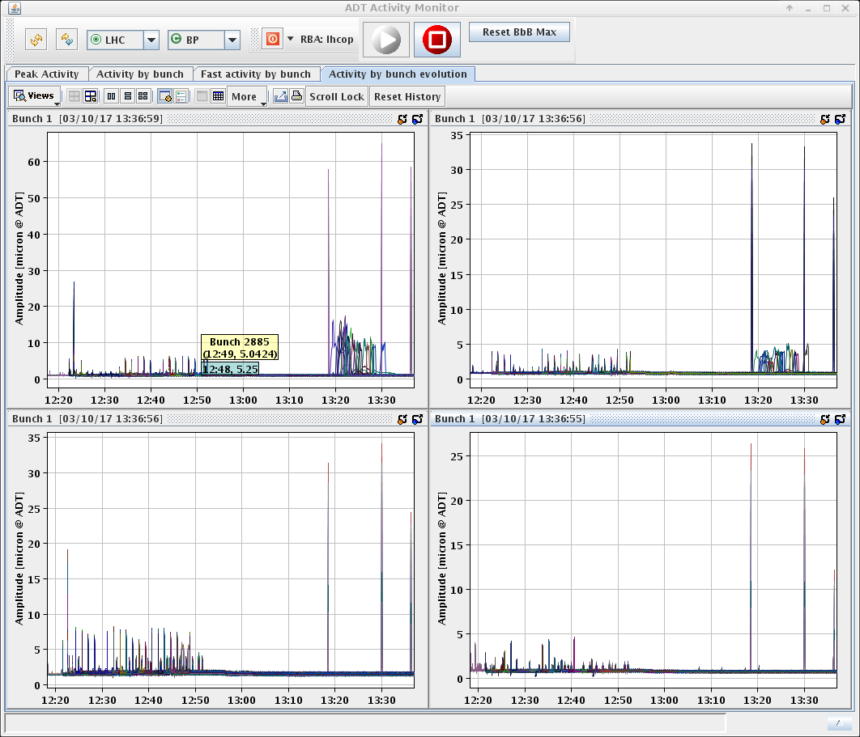
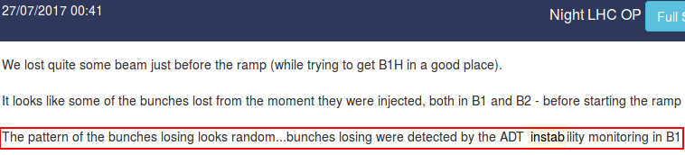
As a bonus: ADT activity monitor
Notes:
Adt used as an exciter and as an acquisition system, the tasks for the different MDs varies
4147:
Explore source of 50Hz perturbation and investigate possible cause of beam degreation

Slide 10
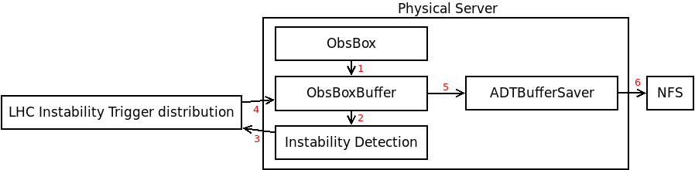
Limitations/issues
Long delay from fiber to trigger (~1s)
Limited computational resources when it was implemented
False triggers caused by glitches in the data-stream, complex to detect
Done through software
Notes:
Explain how instability trigger system works
More on injection and post-mortem
ADTObsBox is trademarked

Slide 11
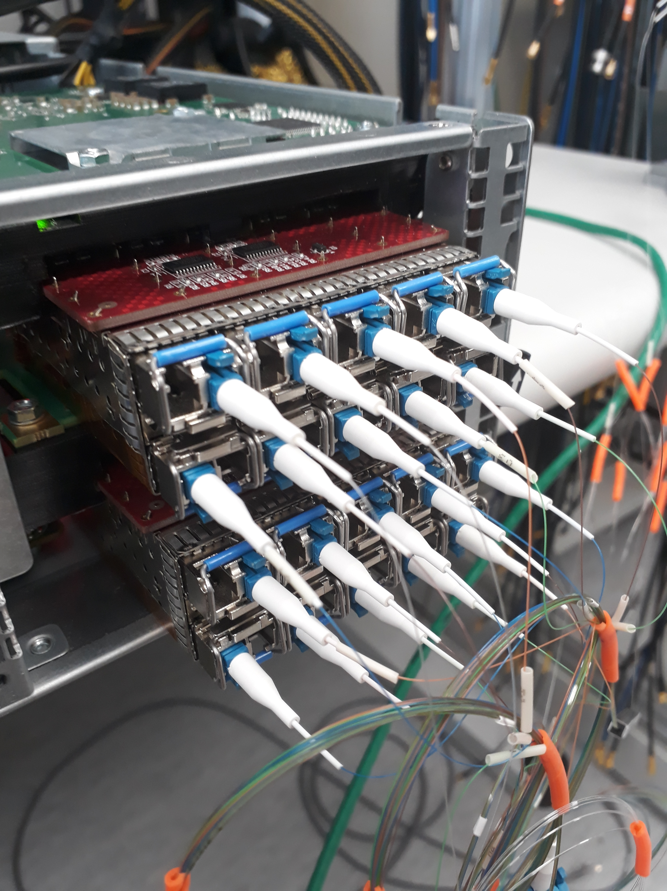
ADTObsBox in LS2
Substantial amount of work is put into the upgrade of the system
Substantial investment for the upgrade of the system(105000 CHF from RF budget)
New acquisition cards and drivers have been developed that allows for one-turn delay from fiber to analysis(was 4096 turns)
Each new server will receive all 16 channels which will allow for cross-plane cross-beam analysis
Computational resources required just to receive data is reduced by a factor ~100
Multi-threaded driver. Many readers, not only FESA class

Slide 12
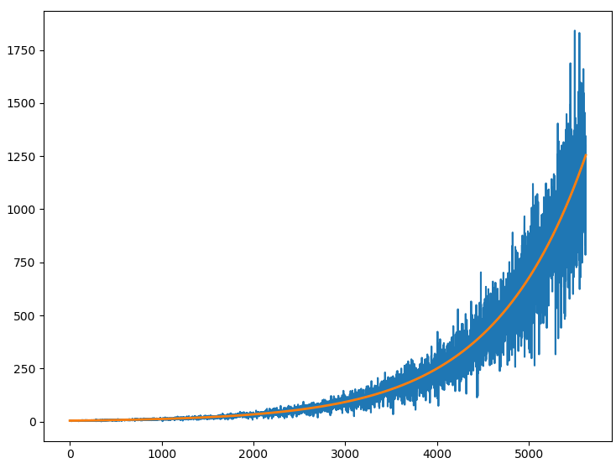
ADTObsBox in LS2
Introduction of a 24h buffer for data from all 16 pickups
  Uses 144TB of local hard-drives
4 triggers limit removed to synchronize acquisition with more instruments
Possible to implement more sophisticated instability analysis with new servers
Receive triggers from LHC instability trigger distribution
Exponential curve-fitting using least-square method

Slide 13
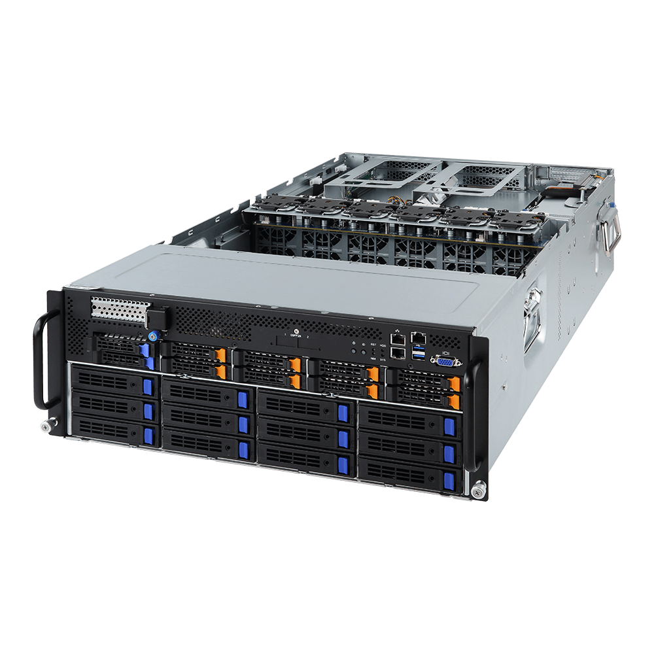
ADTObsBox in LS2
Three new servers
One new server has the same performance as all four of the old ones
Real-time server:
  GPUs for ?
  Instability analysis
  Passive tune extraction
  …..
Buffer server:
    Same functionality as current system
    144TB local storage (24h full machine buffer)
Development server:
  Possibility to run unorthodox experiments

Slide 14
ADTObsBox features in RUN 3
Possible applications:
  Finalize the real time, passive, bunch by bunch tune measurement from the ADT pickup data
  Finalize the on demand Tune measurement system (with excitation)
  Automated high precision tune extraction with excitation and data from all pickups (used in MDs)
  Post mortem data analysis immediately after dump?
  saving certain internal signals from the Digital signal processing (expert use)
  Excitation feedback control
    Send signals from ADTObsBox to mDSPU such as increase gain or stop excitation
Notes:
When the system was introduced, the users wanted all the data but they could not handle it

Slide 15
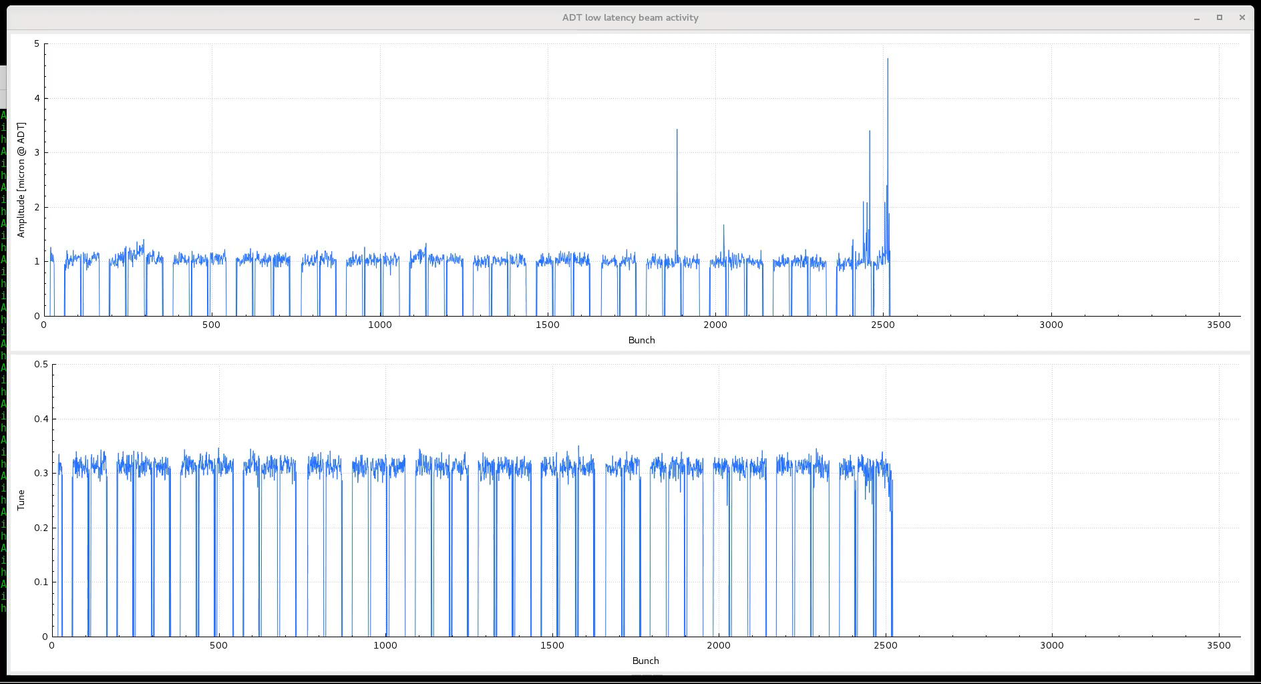

ADTObsBox features in RUN 3
  Request from ABP and OP to implement a passive, bunch by bunch tune measurement using the ADT pickup data. The goal is ${10}^{−4}$@ 1Hz
Combining data from all 4 pickups using a NUDFT-III on a GPU is being tested
Amplitude (μm@ADT)
Testing passive tune extraction with data from one pickup during one of the last fills of run 2
Tune (frev)
≈0.4*${10}^{−2}$@ 300Hz
Notes:
When the system was introduced, the users wanted all the data but they could not handle it

Slide 16
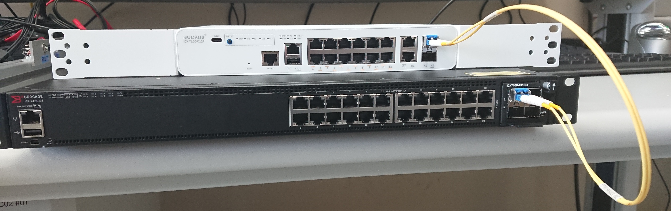
Scenarios for ADTObsBox in RUN 3
“We want it to detect instabilities automatically and reliable”
  Can be done but we have limited resources. Input and help from ABP would be appreciated
“We saw something interesting a few hours ago”
  Download the data from the 24h buffer
“We want to test [x] and analyse all the data in real-time”
  Can be done on the development machine in your favourite programming language
“We want to save all the data for one MD”
  100 bunches for 8h ≈1TB(compressed)
“We want to freeze all the buffers every s and save it to your nfs server”
  The new dedicated fibers should allow for this
TODO: replace with 10km cables
Notes:
Working progress, have been tested. Low priority during LS2

Slide 17
Thank you for your attention

Slide 18
References
[1] G. Kotzian, “Transverse feedback parameter extraction from excitation data”, presented at IPAC’17, Copenhagen, Denmark, May 2017
https://cds.cern.ch/record/2631483
[2] M. Soderen, “Online Transverse Beam Instability Detection in the LHC: High-Throughput Real-Time Parallel Data Analysis”, Master thesis, 2017
https://cds.cern.ch/record/2289132

