Slide 1

Longitudinal beam quality monitoring
T. Argyropoulos, CERN, BE-OP
ICFA Mini-Workshop on
“Mitigation of Coherent Beam Instabilities in particle accelerators”
Zermatt, 25/09/2019
With inputs from: H. Damerau, I. Karpov, A. Lasheen, J. E. Muller, G. Papotti, E. Shaposhnikova, H. Timko,

Slide 2
Why to monitor longitudinal beam quality?
Reliable monitoring of the longitudinal beam quality is very important in machine operation.
Ensures machine safety and efficiency
Quick observation of beam degradation → efficient reaction in case of problems (controlled beam dump, preventing beam extraction, etc.)
Identify unwanted particle population in circular accelerators (satellite bunches, particles in abort-gap region, etc.)
Longitudinal beam parameters can be used as feedback to other beam manipulations (controlled emittance blow-up in the LHC)
Quickly spot hardware problems (RF cavities trips, errors in the phase of successive LINAC modules, errors in the LLRF loops, problems in RF manipulations etc.)
Especially crucial during machine commissioning and machine studies
…

Slide 3
What is longitudinal beam quality
The criteria of longitudinal beam quality vary from one machine to the other, depending on:
The beam pattern → Single- or multi- bunch beams
The type of accelerated particles → Hadrons or electrons
Large variability on the RF frequencies (up to tens of GHz) → large variation in bunch lengths (down to fs level)
Specific needs of each machine on what should be monitored → define requirements in resolution and frequency of the measurement:
  Bunch instabilities → fast acquisitions of the beam but smaller resolution (depending on the single-bunch mode)
  Bunch distribution → higher resolution but less frequent acquisitions, special mean to resolve the bunch tails
  Long term evolution of the beam parameters → smaller resolution and acquisition rate

Slide 4
Longitudinal beam parameter diagnostics
The variability of the beam parameters for the different types of accelerators define the measurement approach.
accurate and reliable measurement of the longitudinal bunch parameters
(bunch shape, length, position, emittance)
Large variety of diagnostics:
  pick-ups, wall-current monitors (WCM), RF zero-phasing, transverse deflecting cavities,
  beam shape monitors , etc.
  or by using the synchrotron radiation to reconstruct the bunch distribution, streak camera, coherent radiation etc.
Big development in this domain.
  → Measurements of bunches with length of a few fs have been achieved!

Slide 5
Outline
This talk will be mainly focused on CERN accelerators (mainly SPS and LHC)
  Bunch size of the order of a few ns → bunch profiles measured by wall-current monitors (bandwidth up to several GHz) together with fast-sampling oscilloscopes.
Monitoring of single bunches
  Intra-bunch motion
  Bunch evolution during cycle
Multi-bunches
The Beam Quality Monitor in the CERN SPS and LHC
Observation of bunch phases in the LHC
Summary

Slide 6
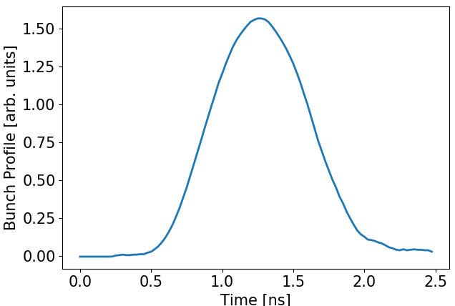
Monitoring of single bunches
Need of reliable and accurate longitudinal diagnostics:
  Most of the times: bunch position and length are enough (for beam instabilities)
  But often a detailed knowledge of the longitudinal bunch profile is needed (higher mode of instabilities, RF manipulations, luminosity calculations, etc.)
Example of bunch profile measurement in LHC
High resolution bunch profile measurement at the moment of injection into the LHC
Measured by a WCM of bandwidth
~3GHz and scope sampling rate at
40 GS/s.
Bunch length τ_{4σ}=1.37 ns

Slide 7
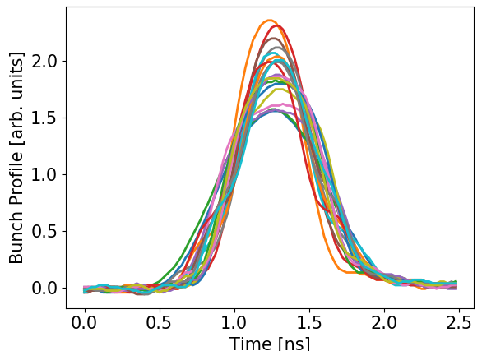
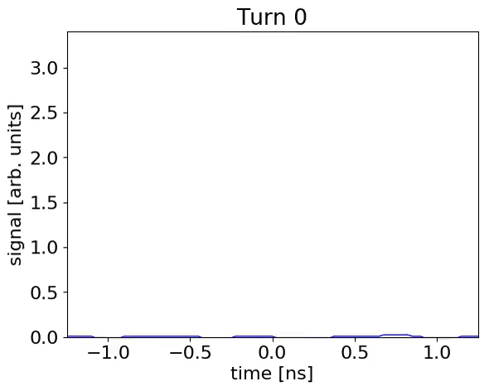
Intra-bunch motion - instabilities
Measurements to resolve well the synchrotron frequency (or a few f_{s} periods):
depending on the mode of instability and the synchrotron frequency, a few thousands of acquisitions can be needed → easily achieved for single bunches
Example of non-rigid dipole oscillations in the LHC
Static plot of the acquired profiles
I. Karpov

Slide 8
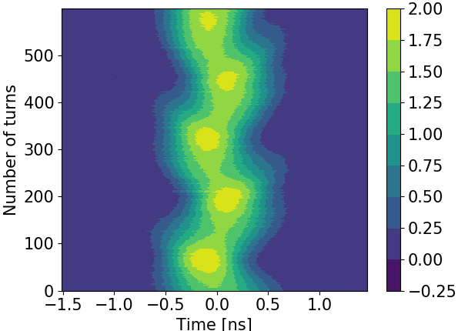
Intra-bunch motion
Other means to illustrate the measurements can be easier for the users to understand
Waterfall plot: dipole oscillations at injection in the LHC
Apart from better visualisation of the bunch motion it can be used to quickly detect phase and energy errors.

Slide 9
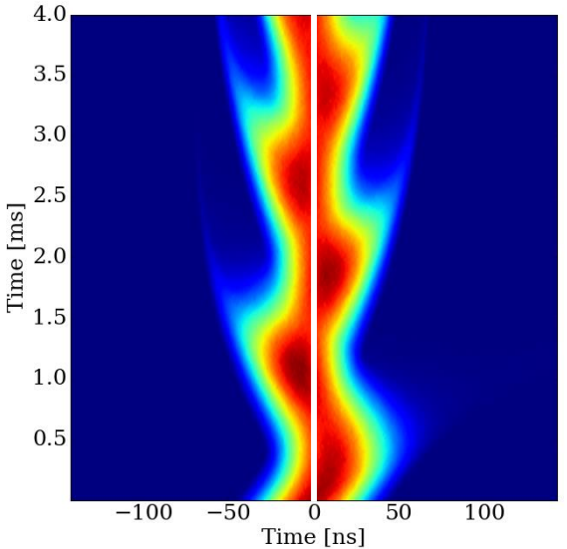
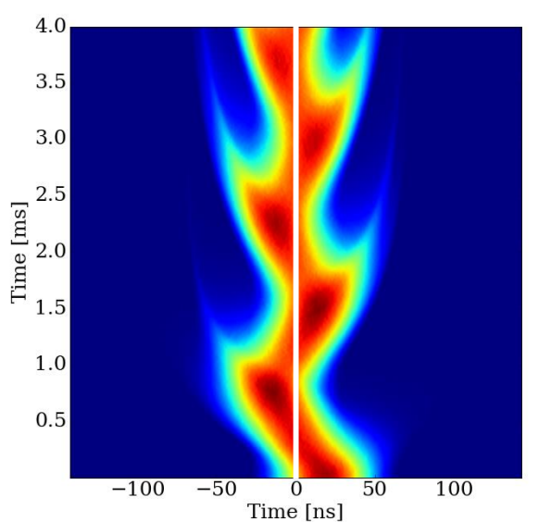
Intra-bunch motion
Other means to illustrate the measurements can be easier for the users to understand
Equivalent dipole oscillations at injection initiated by energy and phase errors
Energy error at injection
Phase error at injection
H. Damerau

Slide 10
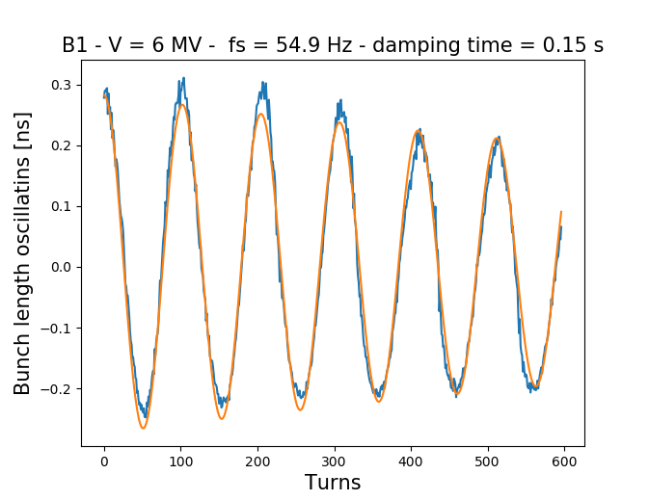
Intra-bunch motion – data analysis
Fitting the acquired bunch profiles provides information on the bunch lengths, positions → can be further analysed to extract other information (bunch intensities, frequencies of oscillations etc.)
Bunch length oscillations at LHC injection
Fitting the bunch oscillations at injection (RF voltage mismatch) can provide information about the synchrotron frequency → Detect problems in the RF Voltage amplitude

Slide 11
Intra-bunch motion - Tomography
Reconstruction of the longitudinal phase space distribution by performing longitudinal tomography
  Visualizing a bunch in the longitudinal plane.
  Knowledge of the particle distribution → calculation of longitudinal emittance and momentum spread, with a much better precision than is possible from the observation of a bunch profile.
  Very important in analytical calculations and macro-particle simulations of beam instabilities!
Originally developed at CERN PS → investigate the complex RF manipulations (bunch splitting, merging, rotation, etc.)
Based on measurements of bunch profiles (at least half synchrotron frequency period) → high quality bunch profile signal is needed → correction for the transfer function of the system is essential
Takes as input several machine parameters (magnetic bending field, RF voltage, etc.) → should be accurately known
Well-established operational tool in all machines of the CERN PS Complex

Slide 12
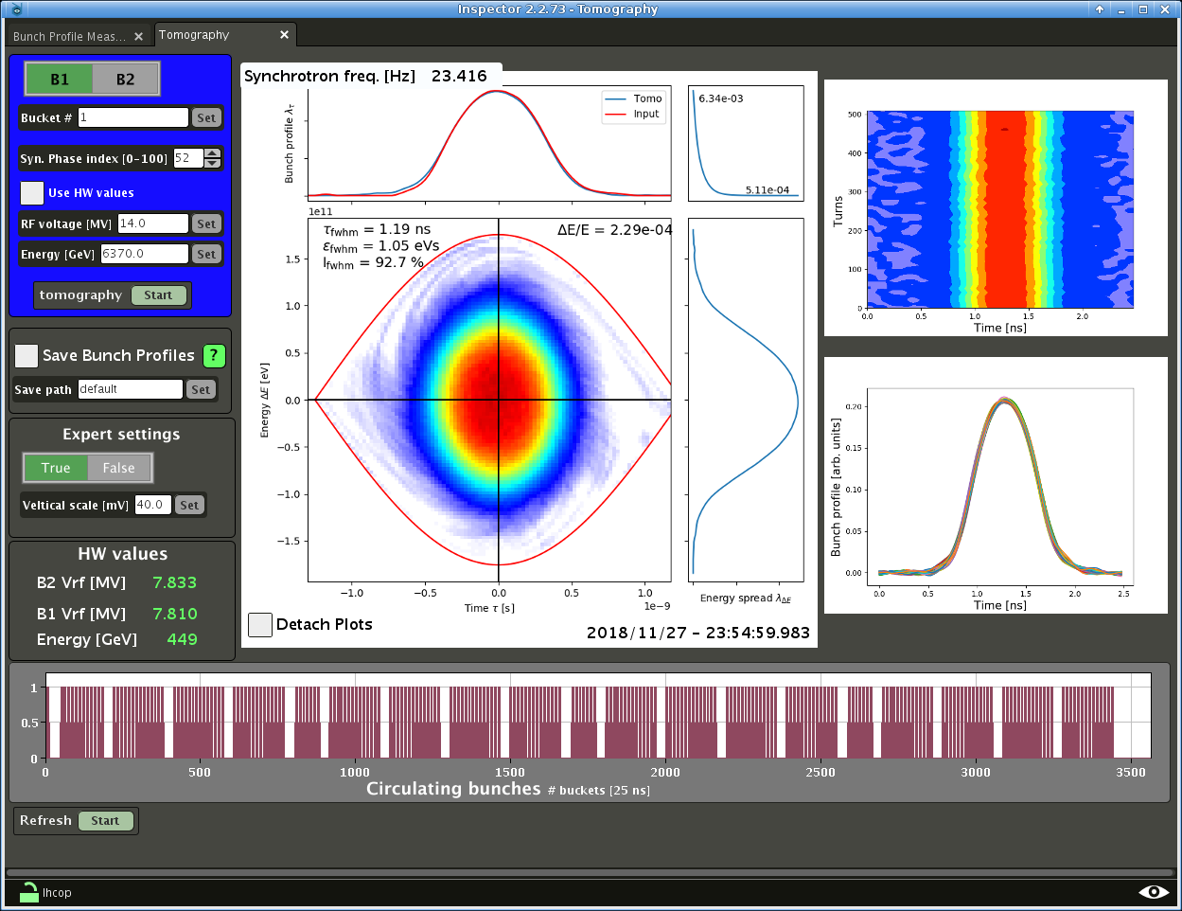
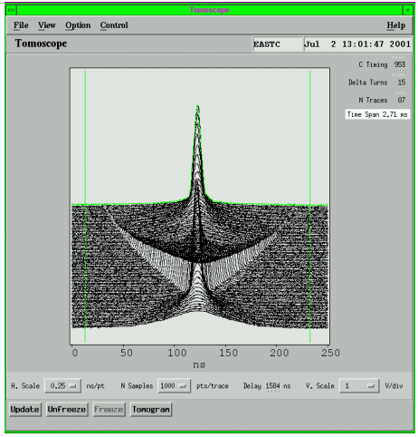
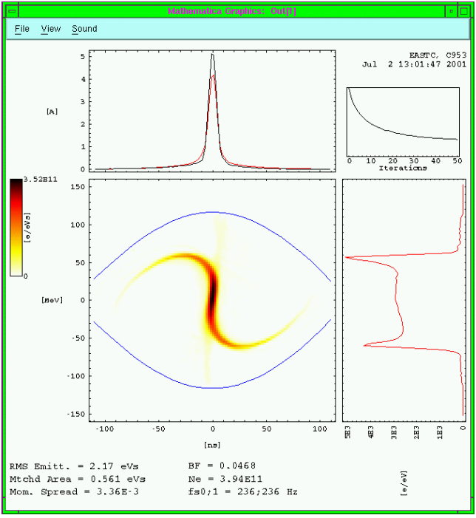
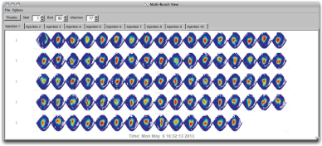
Intra-bunch motion – Tomography examples
Bunch rotation in the CERN PS
LHC Tomography 2018 - Pb ion bunch
Bunch profile meas. (WCM)
Reconstructed longitudinal phase-space
S. Hancock, J. Sanchez Alvarez,
PS/RF/Note 2001-010
Fermilab Recycler ring –
Slip stacked beam
Tomography very important at certain times in the cycle → beam injection, extraction, RF manipulations (bunch splitting, rotation, slip-stacking recapture etc.)

Slide 13
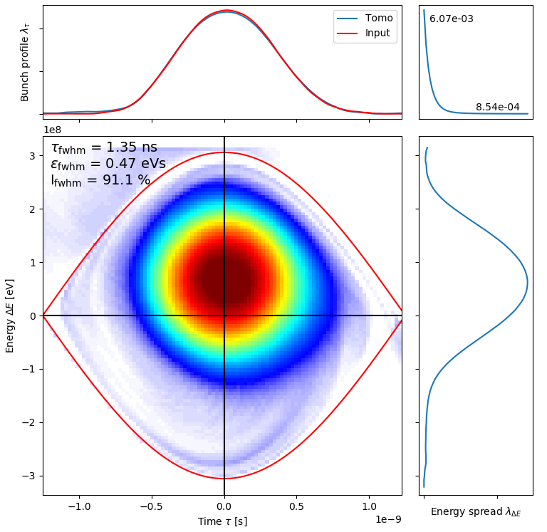
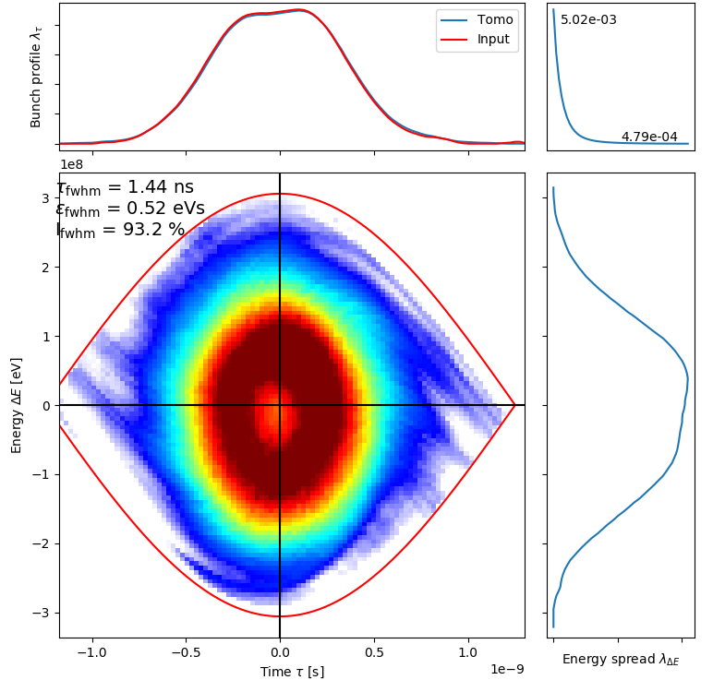
Intra-bunch motion – Tomography examples
LHC bunch injection with large energy error
Hollow bunch in LHC after large energy error
After filamentation and issues with the phase-loop
Generation of hole in the bunch distribution → preserved until the beginning of the ramp (~30 min later)
A general, common operational tool for bunch tomography is going to be implemented in all CERN machines after the start-up

Slide 14
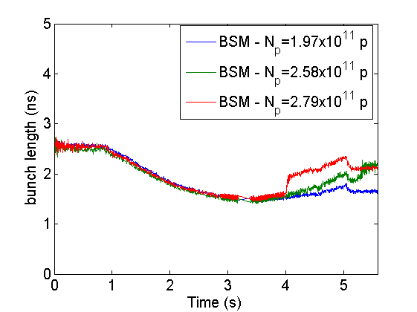
Bunch evolution along the cycle
Cycle times can vary from a few seconds to many hours (LHC case) → acquisition should be less frequent
Visualization is based on the evolution of beam parameters (bunch lengths, positions) → fast fitting algorithms needed in operation → Full Width Half-Maximum (FWHM) is mainly used at CERN (also beam stability is defined by the bunch core)
No possible to measure instability growth rates but can be used to check global beam stability and instability thresholds
SPS bunch length evolution along the cycle
Bunch length evolution at CERN SPS in double harmonic operation (Bunch Shortening Mode) for different intensities
Stable bunch
Slow instability → slow emittance blow-up during the ramp, bunches unstable at flat top
Fast instability → fast emittance blow-up (microwave) and bunches stable at flat top
Fast blow-up
Unstable at flat-top
Slow growth
Stable

Slide 15
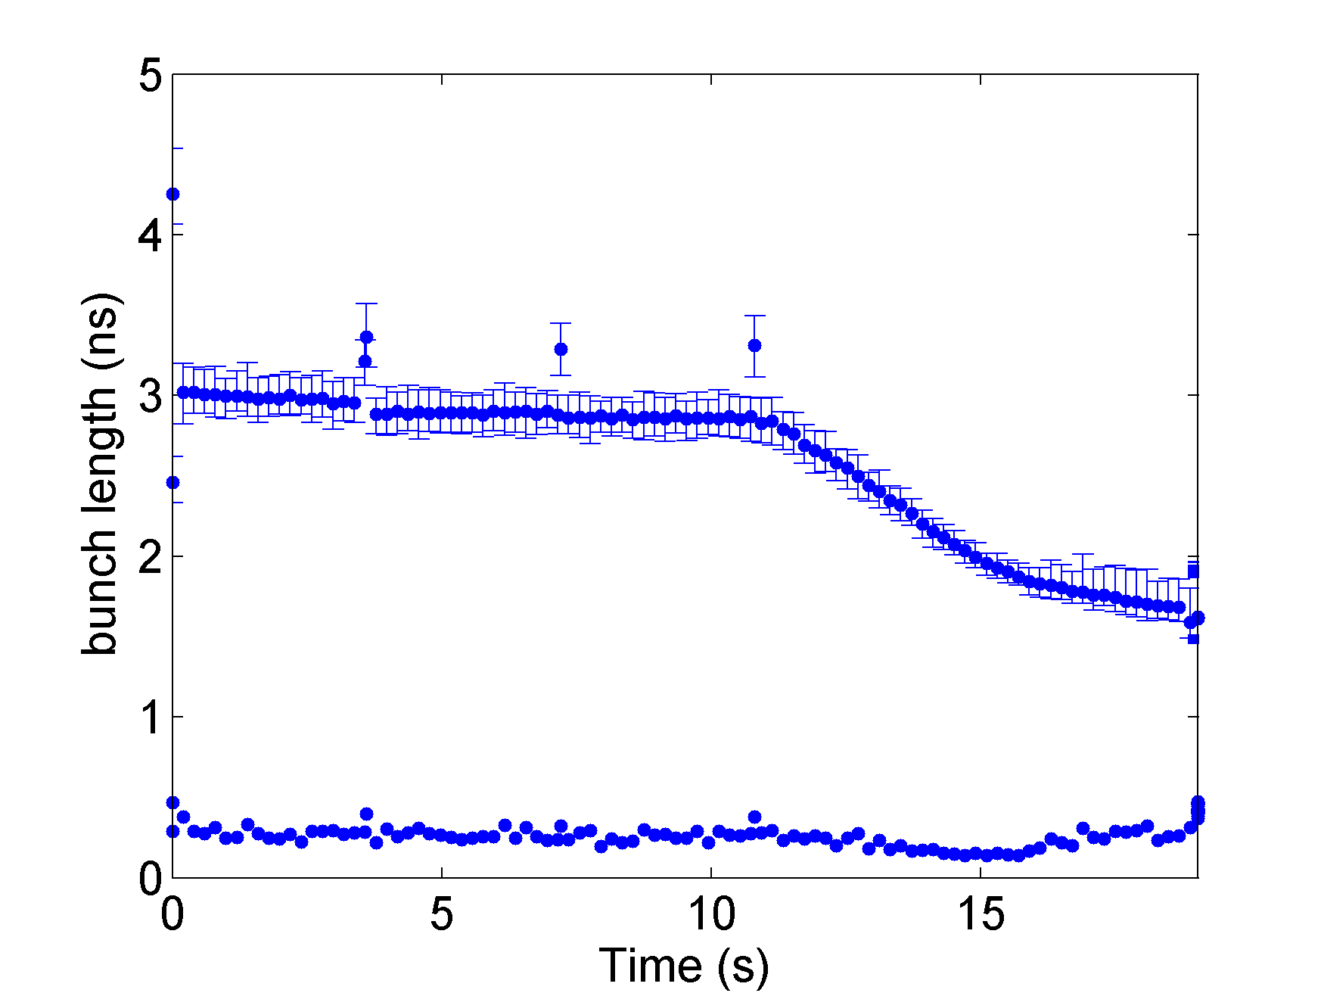
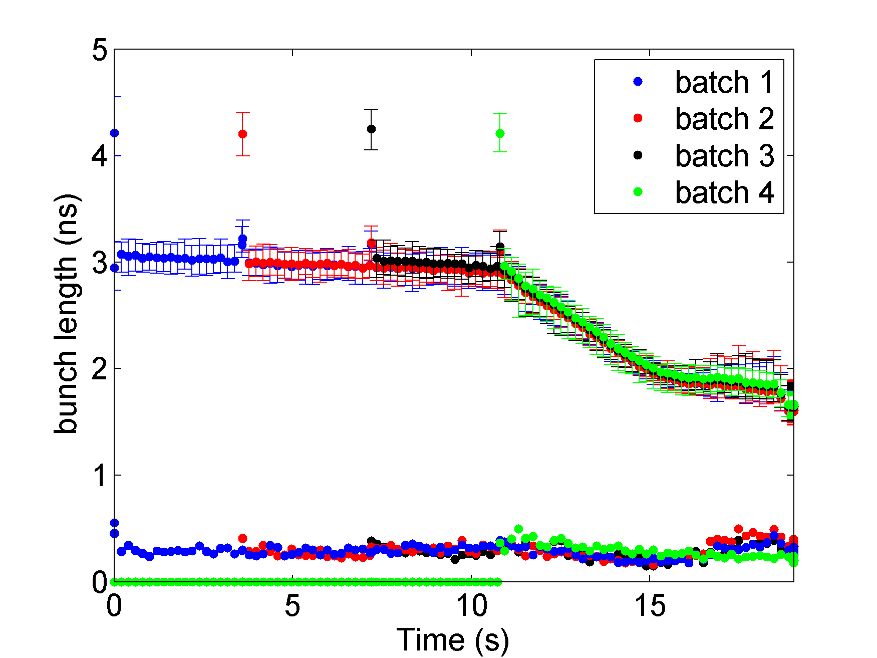
Multi-bunch case
Similar plots can be used to visualize the longitudinal beam quality in the case of multi-bunched beams
  Only mean bunch length with an error bar indicating the spread inside the bunch.
Fast analysis of the acquired bunch profiles
  Even less frequent acquisitions and sometimes need to reduce the time resolution!
SPS bunch length evolution along the cycle
1 batch (72 bunches)
Onset of
instability
4 batches

Slide 16
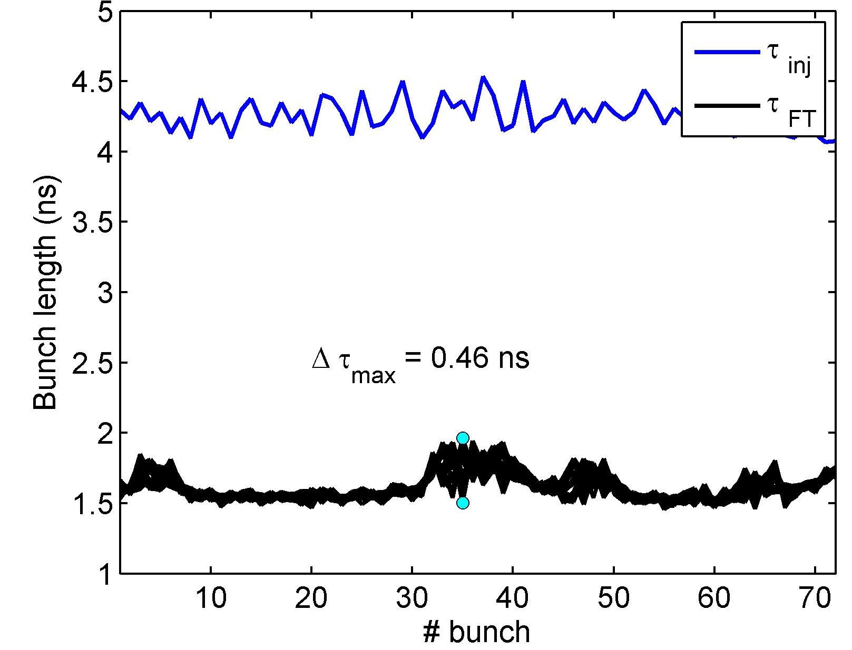
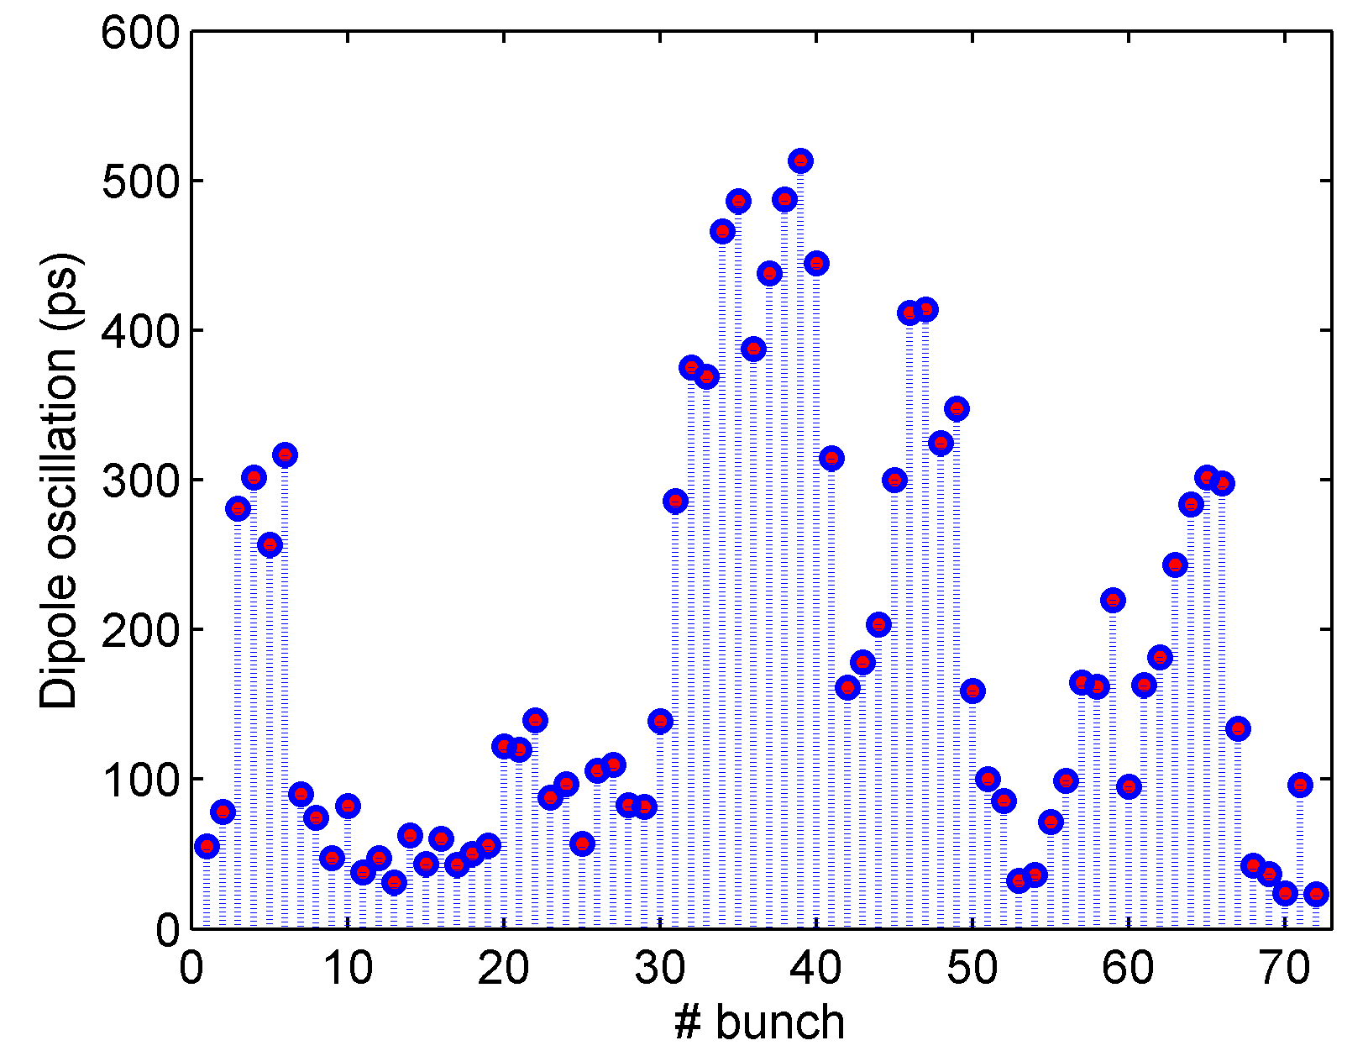
Multi-bunch case
Similar plots can be used to visualize the longitudinal beam quality in the case of multi-bunched beams
  Only mean bunch length with an error bar indicating the spread inside the bunch.
Fast analysis of the acquired bunch profiles
  Even less frequent acquisitions and sometimes need to reduce the time resolution!
SPS bunch length evolution along the cycle
We can always zoom into special instances during the cycle to look into more details the intra-bunch motion
  Frequent acquisitions (resolve f_{s} period) of high resolution
  Similar plots as before
1 batch (72 bunches)
Dipole and quadrupole oscillations at the SPS before extraction to the LHC
Onset of
instability
4 batches
Bunches unstable →
Should be prevented from entering LHC

Slide 17
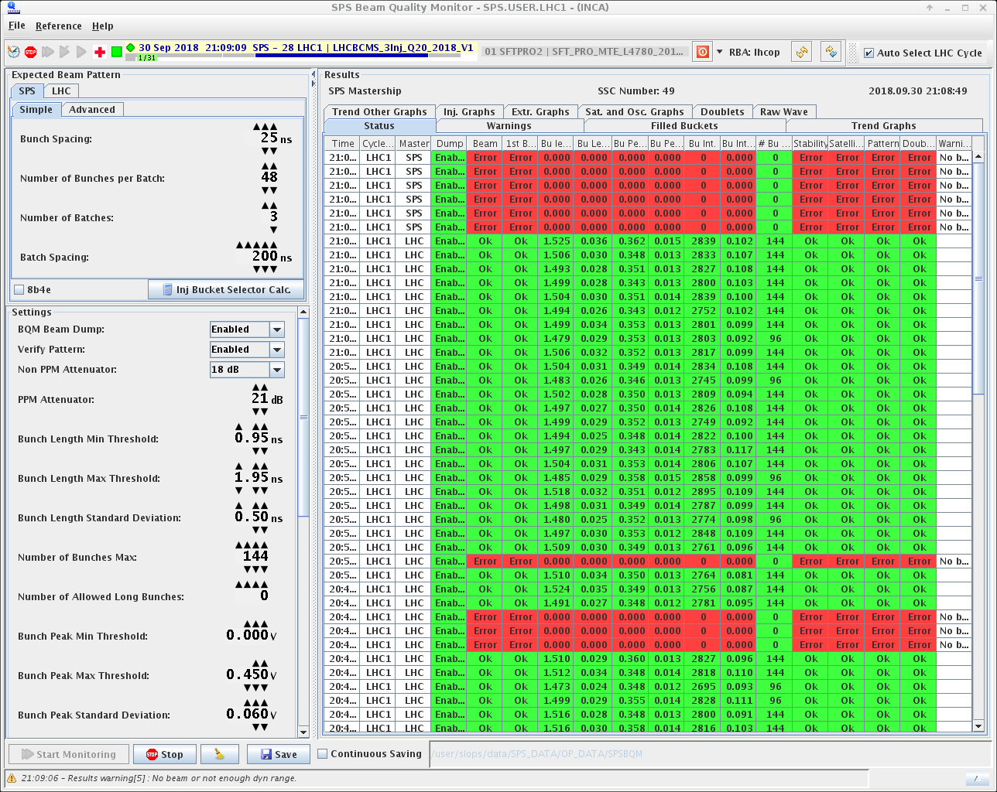
The Beam Quality monitor
The importance of monitoring the longitudinal beam quality led to the implementation of the Beam Quality Monitor (BQM) in the SPS and LHC operation (G. Papotti, IPAC2011).
The BQM monitors longitudinal beam parameters (beam pattern, bunch lengths, bunch positions, intensities) on a cycle-by-cycle basis (bunch profiles measurements by WCM) → Fast algorithms for online analysis (FWHM)
In the SPS: ensures the beam quality at extraction to meet the LHC needs → beam stability (dipole, quadrupole oscillations), requested beam pattern, bunch uniformity, no satellite bunches, no bunches in the abort gap region.
Triggers the SPS emergency beam dump in case any of the checks is not passed.
Screenshot of the SPS BQM GUI
Beam
pattern
Each line shows analysis for a cycle. Any failure (red box) prevents extraction
Settings: can be modified by the operators
Crucial for machine safety and efficiency

Slide 18
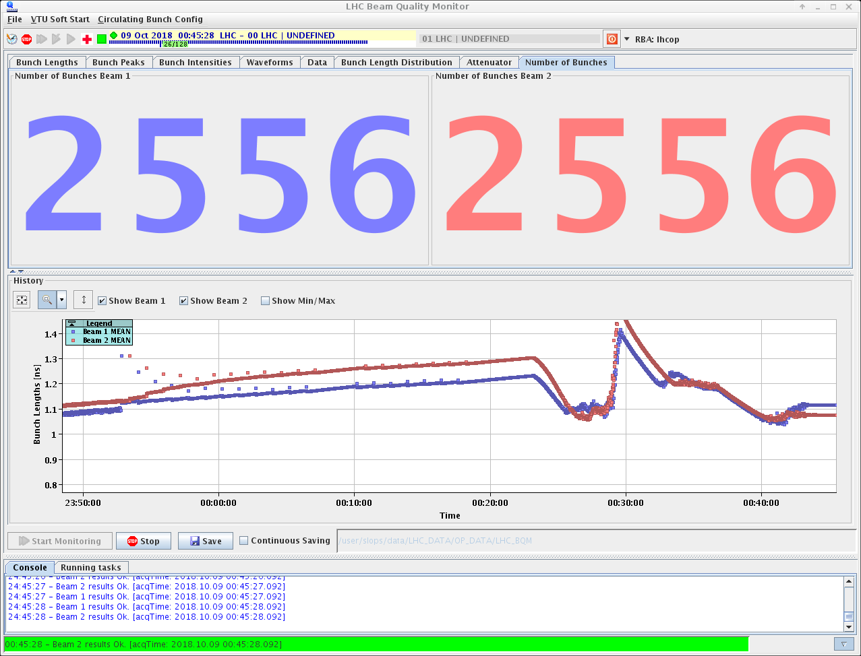
The LHC BQM
Similarly, the LHC BQM provides information of the longitudinal beam parameters along the cycle:
  Average, maximum and minimum bunch lengths (FWHM)
  Filling pattern of the circulating beam
  → prevents injections where beam is present
  → verifies it with respect to the one in configuration database
Less frequent measurement (every 1s) → no dipole or quadrupole oscillations measured (no stability check)
But the average bunch length measurement is used for feedback in the controlled longitudinal emittance blow-up → vital to avoid longitudinal instabilities due to loss of Landau damping (see talk of H. Timko)
Screenshot of the LHC BQM GUI
Beam 1
Beam 2
Number
of bunches
Average bunch lengths
Flat-bottom, injection
Ramp, controlled
emittance blow-up

Slide 19
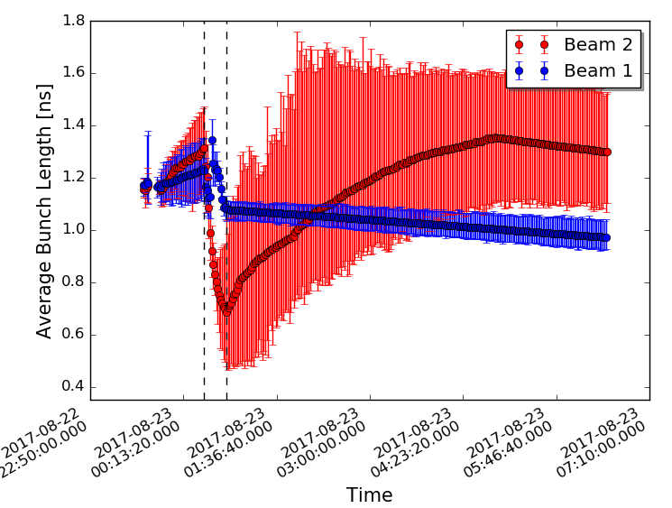
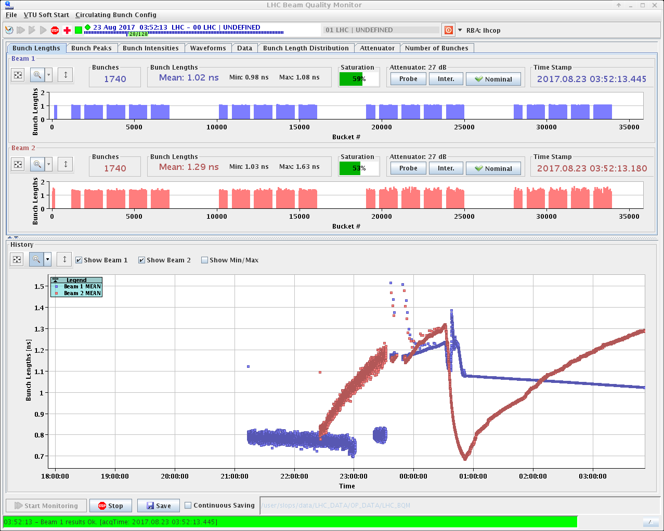
The LHC BQM
All raw and analyzed data (for all bunches) are logged for offline analysis
Screenshot of the LHC BQM GUI – No phase loop and controlled emittance blow-up for Beam 2
Data retrieved from the database
No beam dump is triggered by the LHC BQM

Slide 20
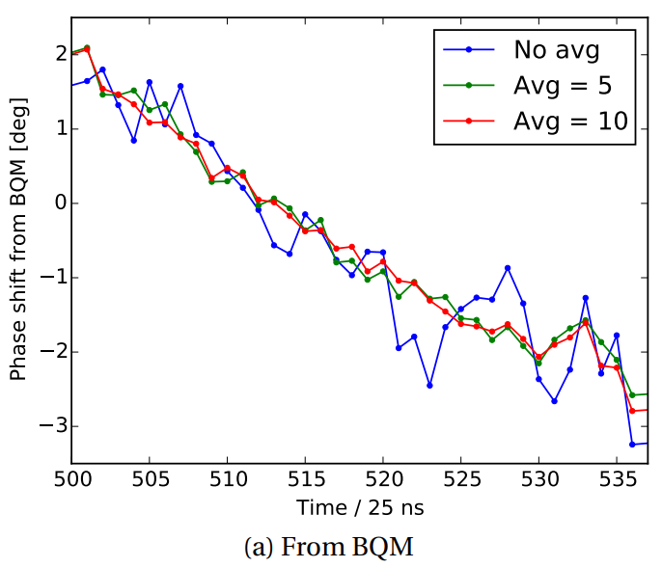

Observation of bunch phases in the LHC
Knowledge of the bunch phases is very important → resistive impedance measurements, e-cloud monitoring
Can be extracted from bunch profiles acquisition in BQM:
  Linear fit to the bunch positions, assuming constant
  distance between the buckets (2.5 ns)
  Averaging over a few measurements also reduces
  noise
  But phase shift due to transient beam loading is also
  included → larger than the phase shift due to other
  effects of interest
  (impedance: ~0.01 deg., e-cloud: ~0.1 deg.)
Bunch-by-bunch phase shift for 1 LHC batch
$Δφ\sim 5$ deg.
one-turn feedback off

Slide 21
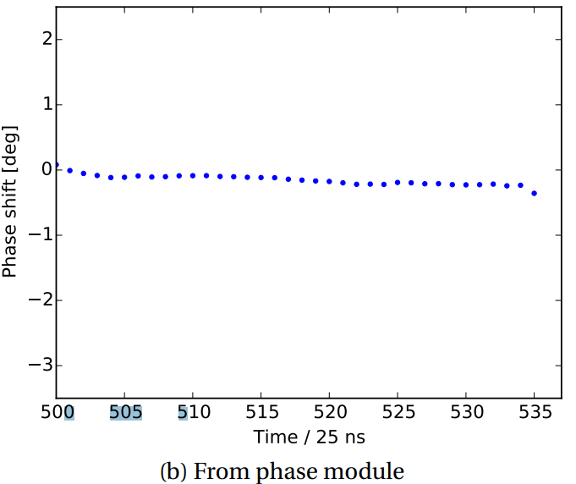

Observation of bunch phases in the LHC
Beam phase module (PM) are installed for bunch phase measurements in the LHC (J. E. Muller, Thesis 2016)
(similar to the one used for the phase-loop)
PM determines the bunch phase as the difference between the beam phase measured from the WCM and the RF voltage phase → beam loading is excluded
PM designed accuracy ~1 deg. (~ 0.01 required) → corrections
of systematics were implemented and after a bit of data
processing the required accuracy was achieved!
PM data are transferred to a high-performance server
known as ObsBox (see talk of M. Soderen) → no memory limit
Bunch-by-bunch synchronous phase is measured
turn-by-turn → dipole oscillations can be reliably
monitored
Bunch-by-bunch phase shift for 1 LHC batch
Beam pattern due to e-cloud
$Δφ≪1$ deg.
one-turn feedback off

Slide 22
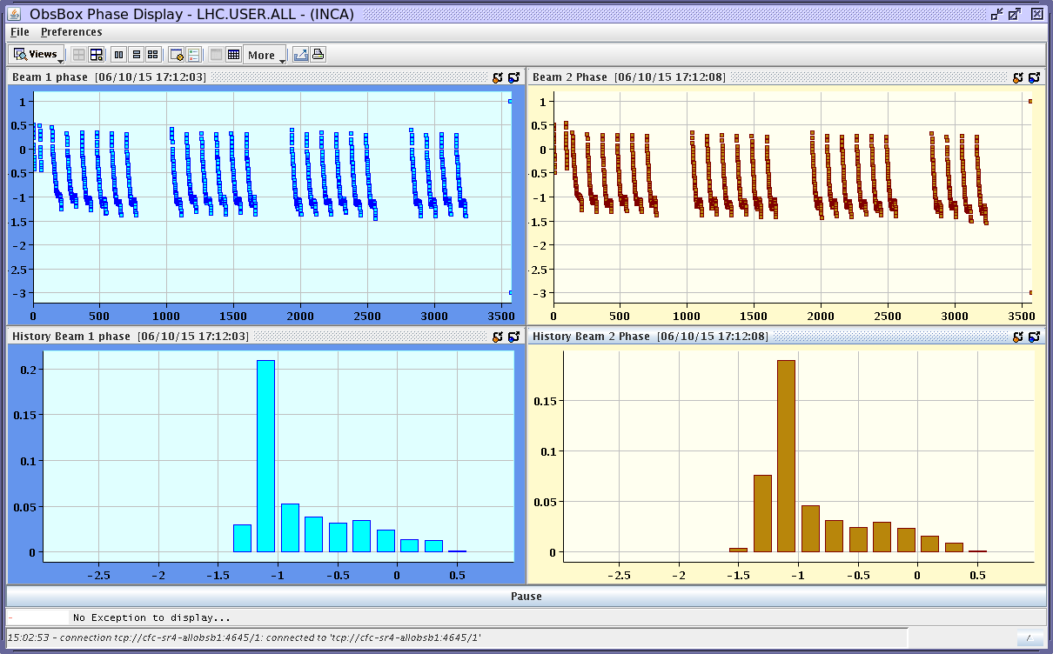
Observation of bunch phases in the LHC
Bunch phases from PM as well as the RF voltage phase and amplitude are stored in the CERN logging database for any offline analysis
Diagnostic tool implemented in the LHC control
room to monitor the e-cloud activity, during
scrubbing runs and in operation during the
intensity ramp-up.
Screenshot of the LHC bunch-by-bunch phase fixed display
e-cloud signature
along the
bunch trains

Slide 23
Summary
Longitudinal beam quality monitoring is one of the main key components for the safe, reliable and efficient operation of the particle accelerators.
What needs to be monitored depends strongly on the needs, issues and beam parameters of each individual accelerator.
For the CERN accelerator complex an accurate knowledge of the bunch profile is crucial both in the daily operation and during the various machine studies → generally measured with high bandwidth WCM.
Single- and multi- bunch plots of the beam signal and the longitudinal parameters obtained, can be used to quickly identify instabilities or hardware problems → increase the reaction time.
Other methods of measuring and monitoring the longitudinal beam quality are also used (not discussed here)
  Beam Synchrotron Light Monitor Longitudinal (BSRL): LHC density monitor based on single-photon counting system measuring synchrotron light (A. Jeff et al.) → high dynamic range for satellite bunch detection and abort gap population monitoring.
  Peak-detected Schottky spectrum: obtain the particle distribution in synchrotron frequencies (for stationary conditions) or to observe coherent bunch oscillations (E. Shaposhnikova et al.) → synchrotron frequency distribution inside the bunch important for beam stability (see talk E. Shaposhnikova)

