Slide 2

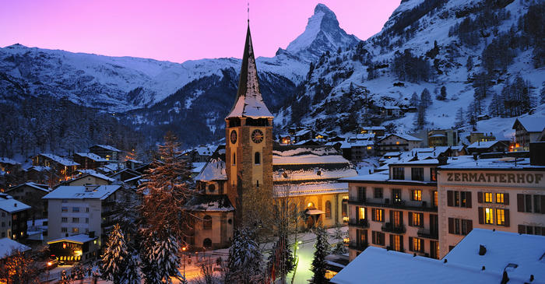
MCBI for CERN LHC Injectors Upgrade (LIU) and High Luminosity LHC (HL-LHC)
Giovanni Rumolo, CERN, Genève, Switzerland
ICFA Mini-Workshop on Mitigation of Coherent Beam Instabilities in Particle Accelerators – MCBI 2019
23 – 27 September 2019, Zermatt (Switzerland)
Acknowledgements: D. Amorim, S. Antipov, G. Arduini, M. Barnes, H. Bartosik, M. Beck, N. Biancacci, R. Bruce, O. Brüning, X. Buffat, M. Carlà, P. Costa Pinto, H. Damerau, R. Di Maria, B. Goddard, A. Huschauer, V. Kain, E. Koukovini-Platia, G. Iadarola, A. Lasheen, K. Li, M. Meddahi, L. Mether, E. Métral, B. Mikulec, N. Nasresfahani, Y. Papaphilippou, T. Pieloni, S. Redaelli, J. Repond, A. Romano, L. Rossi, B. Salvant, M. Schenk, E. Shaposhnikova, M. Taborelli, H. Timkó, R. Tomás, C. Vollinger, C. Zannini

Slide 3
Why upgrades and what are the upgrades for LHC and its injector chain?
Present intensity limitations and future performance of the LHC injectors
  Where do we need mitigation of coherent beam instabilities?
  How far we can go with the upgrades
Mitigation of beam instabilities for HL-LHC

Slide 4
Why upgrades and what are the upgrades for LHC and its injector chain?
Present intensity limitations and future performance of the LHC injectors
  Where do we need mitigation of coherent beam instabilities?
  How far we can go with the upgrades
Mitigation of beam instabilities for HL-LHC

Slide 5
Goals of upgrades in a nutshell (HL-LHC)
The High Luminosity LHC (HL-LHC) upgrade
Aims at 3000 (4000) fb⁻¹ total integrated luminosity over HL-LHC run (2026 – 2037)
Based on operation at levelled luminosity of 5 (7.5) x10³⁴ cm⁻²s⁻¹ by lowering β*
Beam properties @LHC injection
 | N_{b} (x 10¹¹ p/b) | ε_{x,y,} (μm) | Bunch spacing | Bunches
HL-LHC beam | 2.3 | 2.1 | 25 ns | 4x72 per injection
Notes:
Both the consideration of energy deposition by collision debris in the interaction region magnets, and the necessity to limit the peak pile-up in the experimental detector, impose an a priori limitation upon peak luminosity. The consequence is that HL-LHC operation will have to rely on luminosity levelling.

Slide 6
Goals of upgrades in a nutshell (LIU)
The High Luminosity LHC (HL-LHC) upgrade
Aims at 3000 (4000) fb⁻¹ total integrated luminosity over HL-LHC run (2026 – 2037)
Based on operation at levelled luminosity of 5 (7.5) x10³⁴ cm⁻²s⁻¹ by lowering β*
The LHC Injectors Upgrade (LIU)
Aims at matching the beam parameters at LHC injection with HL-LHC target
Needs to deploy means to overcome performance limitations in all injectors!
Beam properties @LHC injection
 | N_{b} (x 10¹¹ p/b) | ε_{x,y,} (μm) | Bunch spacing | Bunches
HL-LHC target | 2.3 | 2.1 | 25 ns | 4x72 per injection
Present | 1.3 | 2.7 | 25 ns | 4x72 per injection
Notes:
Invest on improved shielding, ventilation, etc to make accesses possible when needed

Slide 7
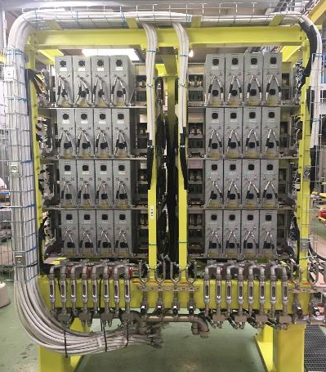
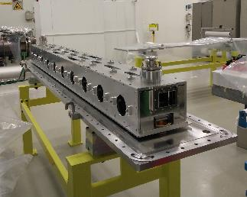
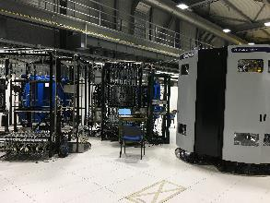
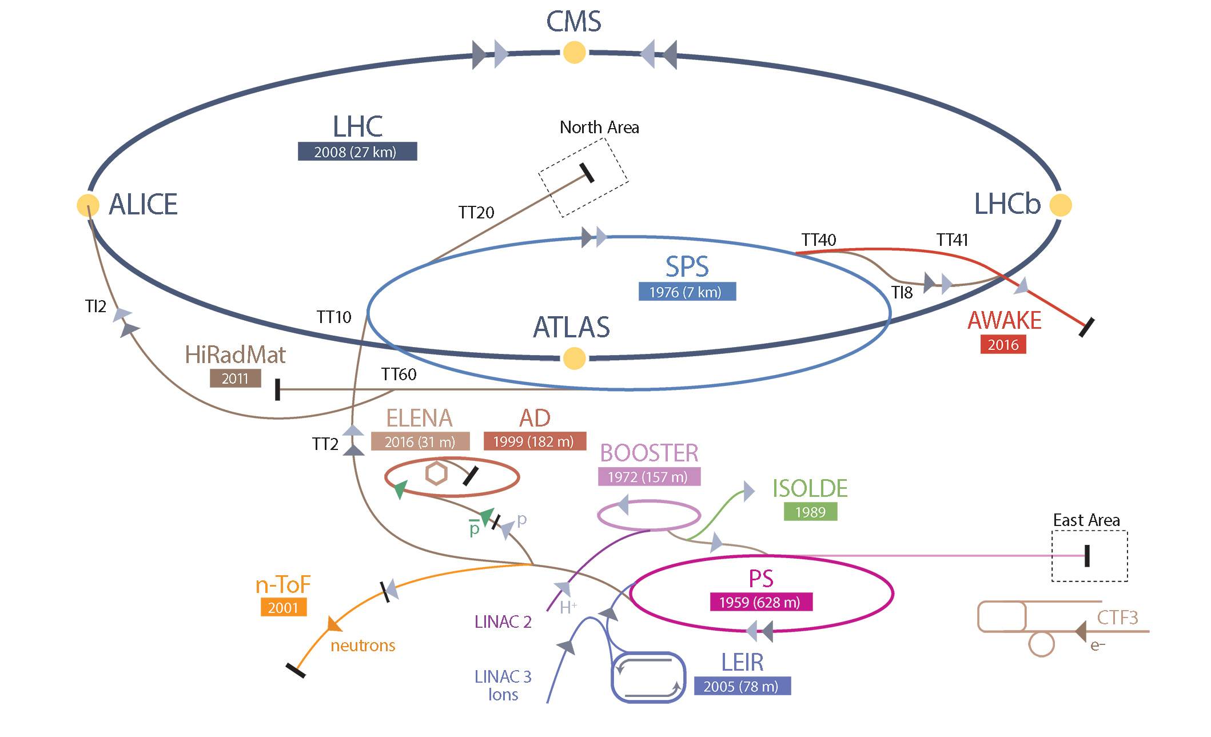
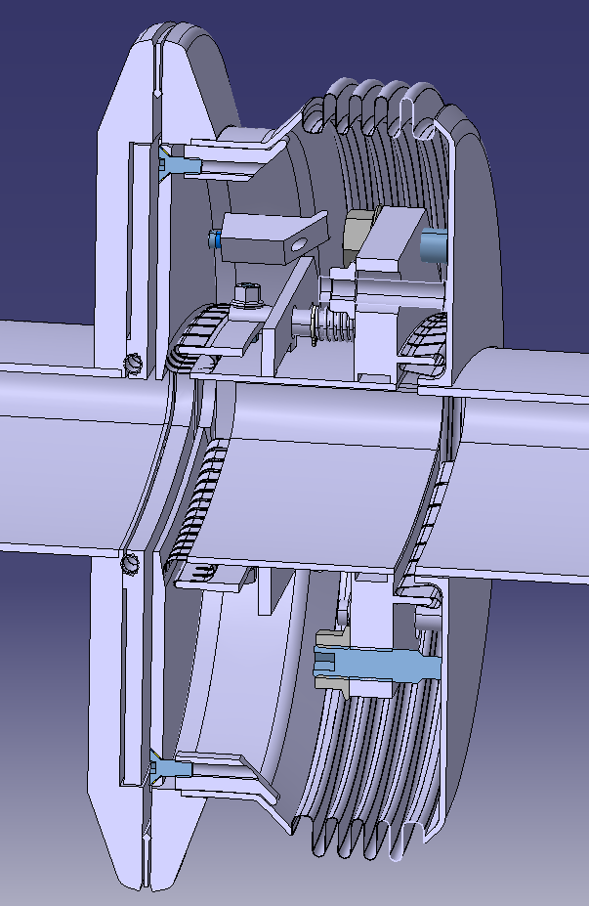
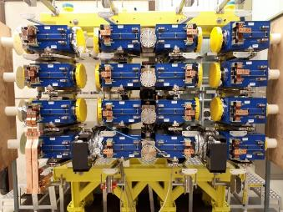
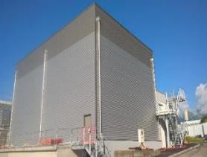
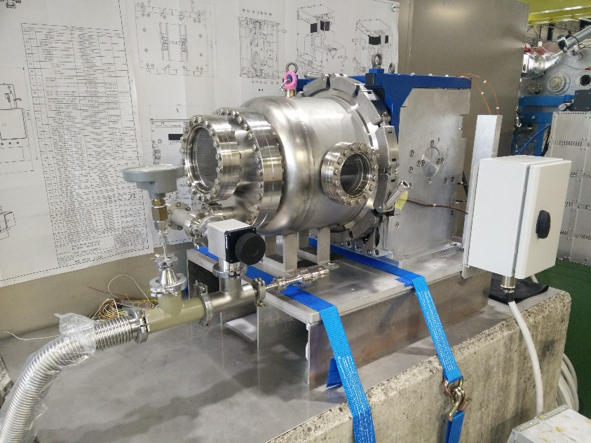
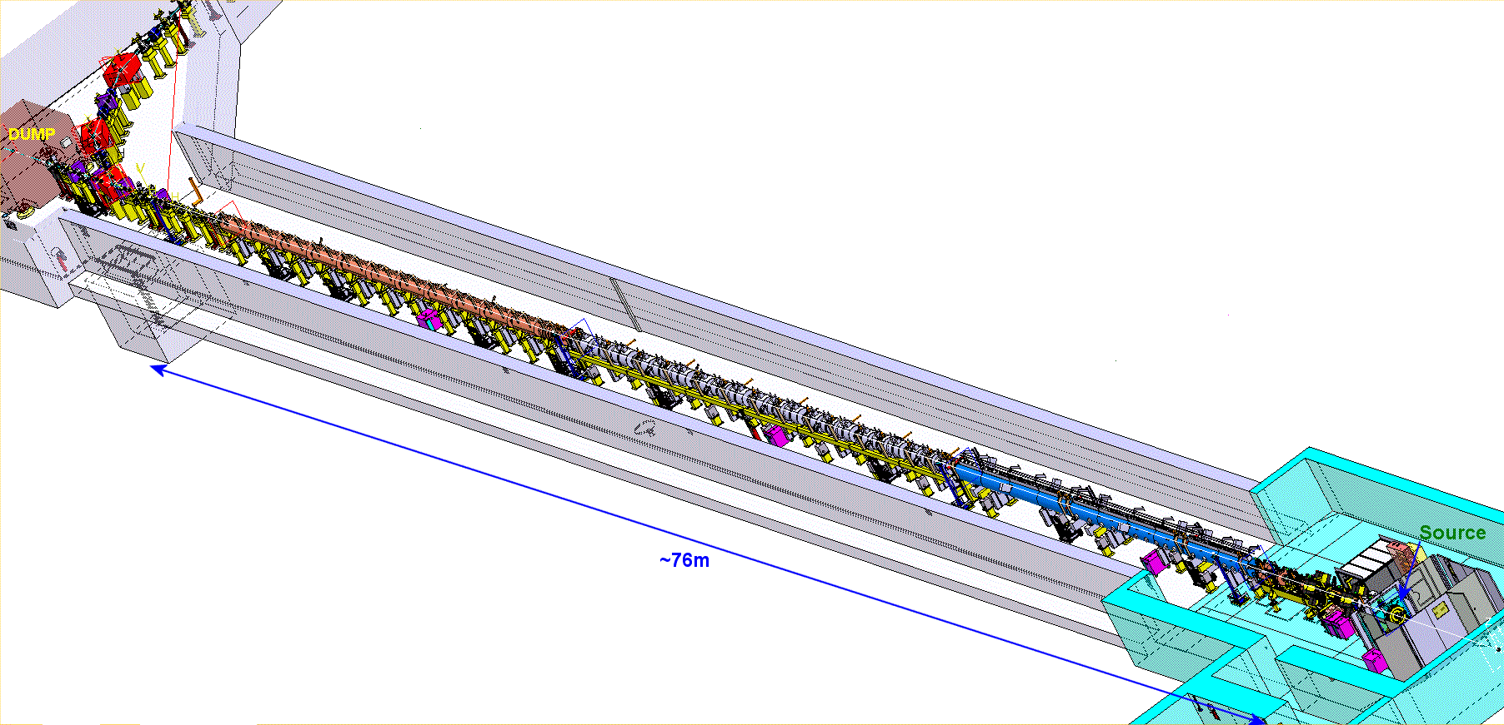
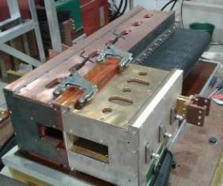

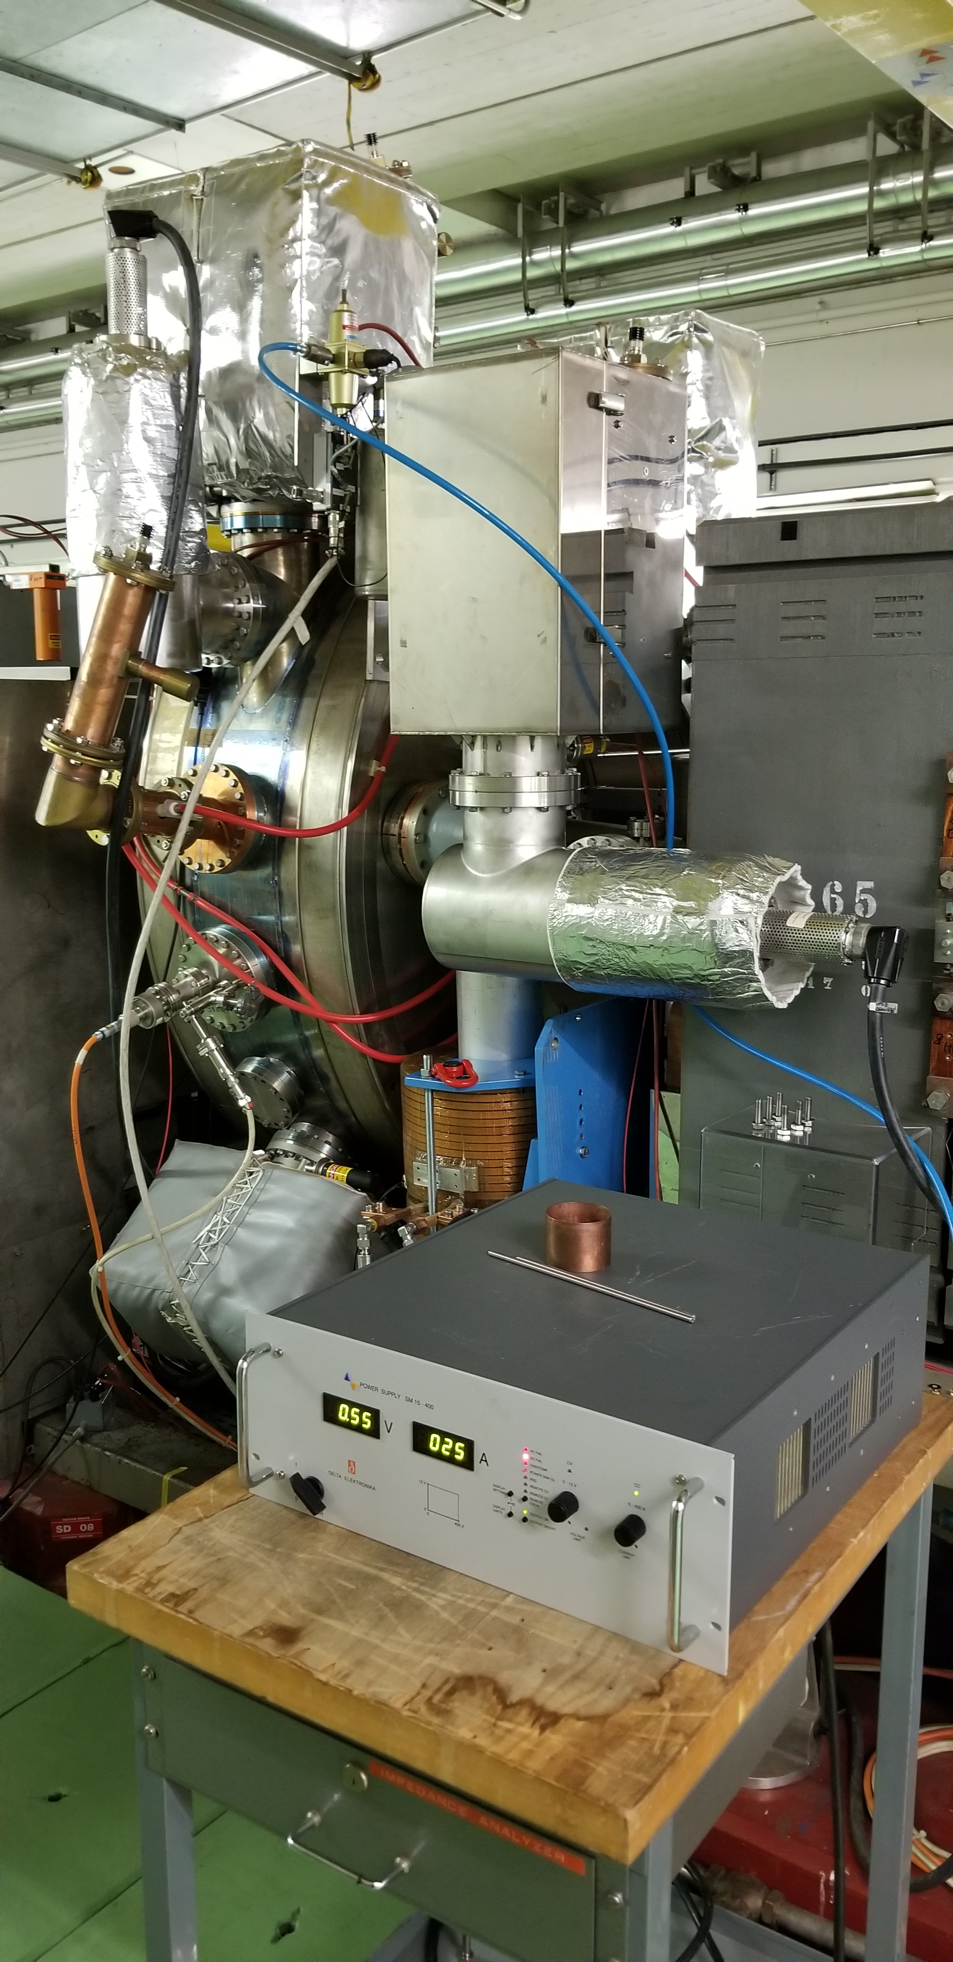
A view on LHC Injectors and LIU
Main RF system (200 MHz) upgrade
Longitudinal impedance reduction & anti-ecloud coating
New beam dump and protection devices
160 MeV H⁻ charge exchange injection
Acceleration to 2 GeV with new main power supply and new RF systems
2 GeV injection
New RF equipment including broad-band feedback
Linac4
Acceleration of H⁻ to 160 MeV
Nominal 40 mA within 0.4 μm
Notes:
PSB
Connection to Linac4 → New H⁻ charge exchange injection at 160 MeV from Linac4 to double brightness of LHC beams
Acceleration to 2 GeV
New main power supply POPS-B
Replacement of C02-C04-C16 RF systems by Finemet based RF system
PS
New injection at 2 GeV for protons to mitigate space charge
RF improvements to improve beam quality and increase longitudinal coupled bunch instability threshold
Impedance reduction of the RF systems
Installation of new Finemet RF system as longitudinal feedback
Operational deployment of transverse feedback system
SPS
200 MHz RF system upgrade
Rearrangement of cavities and power upgrade
New LLRF including slip stacking capability
Electron cloud mitigation and impedance reduction to increase intensity reach
a-C coating of QFs + one full arc
QF-type flange shielding and HOM damping in 200 MHz cavities
New beam dump system in LSS5 and new design of protection devices to comply with the target HL-LHC beam parameter values

Slide 8
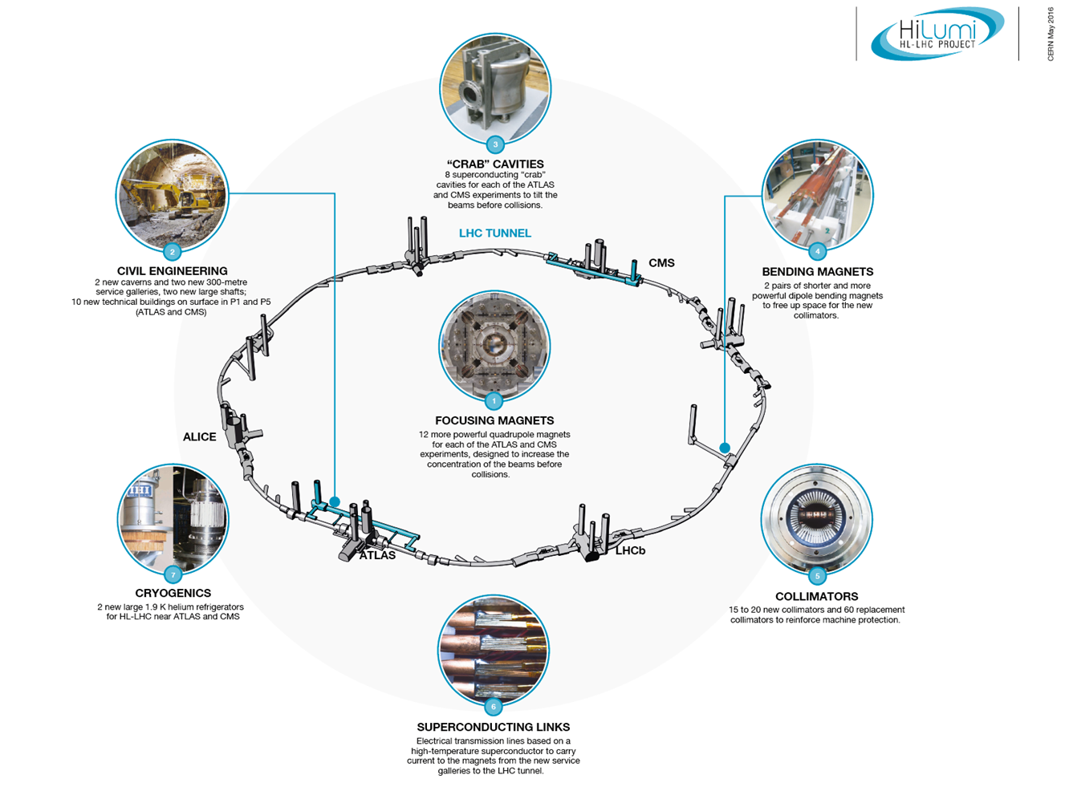
A view on LHC and HL-LHC

Slide 9
Why upgrades and what are the upgrades for LHC and its injector chain?
Present intensity limitations and future performance of the LHC injectors
  Where do we need mitigation of coherent beam instabilities?
  How far we can go with the upgrades
Mitigation of beam instabilities for HL-LHC

Slide 10
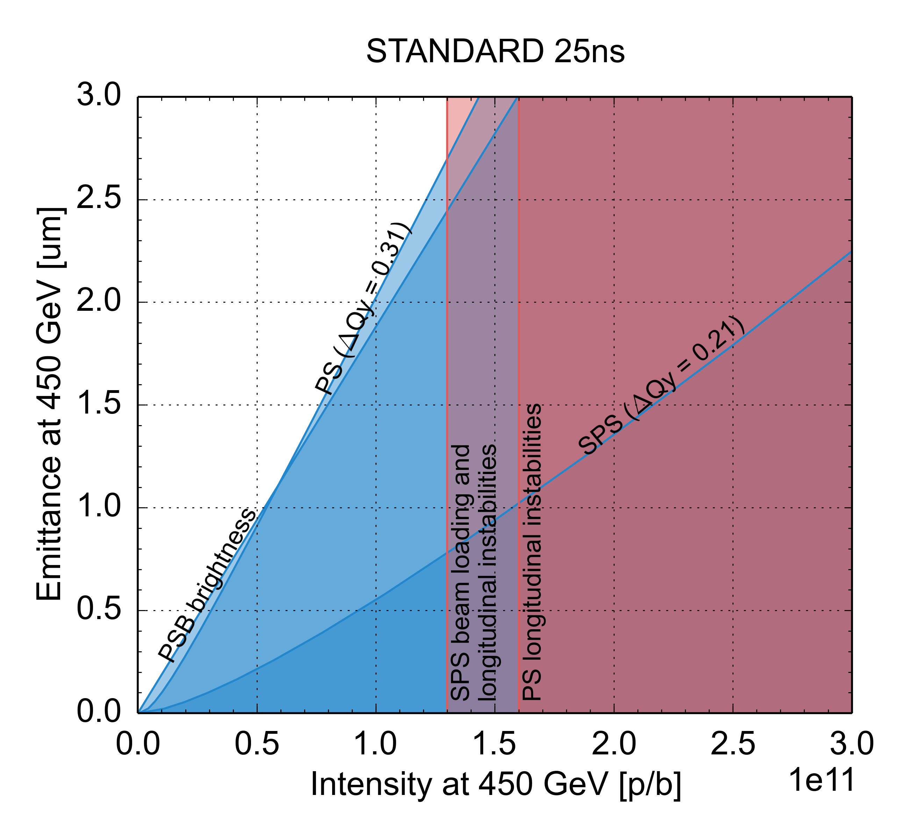
Present performance limitations
 | N_{b} (x 10¹¹ p/b) | ε_{x,y,} (μm)
HL-LHC target | 2.3 | 2.1
Present | 1.3 | 2.7
PSB injection: Brightness limited by efficiency of multi-turn injection process and space charge effects
PS and SPS injection: Brightness limited by space charge – ΔQ<0.31 (PS) and 0.21 (SPS), to limit beam degradation
PS cycle: Bunch intensity limited by longitudinal coupled bunch dipolar instability
SPS cycle: Bunch intensity limited by RF power, longitudinal coupled bunch instability

Slide 11
Present performance limitations
 | N_{b} (x 10¹¹ p/b) | ε_{x,y,} (μm)
HL-LHC target | 2.3 | 2.1
Present | 1.3 | 2.7
PSB injection: Brightness limited by efficiency of multi-turn injection process and space charge effects
PS and SPS injection: Brightness limited by space charge – ΔQ<0.31 (PS) and 0.21 (SPS), to limit beam degradation
PS cycle: Bunch intensity limited by longitudinal coupled bunch dipolar instability
SPS cycle: Bunch intensity limited by RF power, longitudinal coupled bunch instability

Slide 12
Lifting the brightness limitations
Halve the slope of the PSB brightness line
  160 MeV H⁻ charge exchange injection from Linac4 replacing 50 MeV multiturn injection from Linac2 (demonstrated in simulations)
Reduce space charge at PS injection to accommodate same tune spread as current LHC beam (ΔQ_{y}=-0.31)
  Increase of PS injection energy from 1.4 GeV to 2 GeV
  Increase of longitudinal emittance (compatibly with other constraints) at transfer in order to gain from decreasing λ_{max} and increasing δ=(δp/p₀)
Concerning beam stability:
  PSB H instability due to extraction kicker not expected to be an issue → Eirini’s talk
  Larger longitudinal emittance beneficial to beam stability

Slide 13
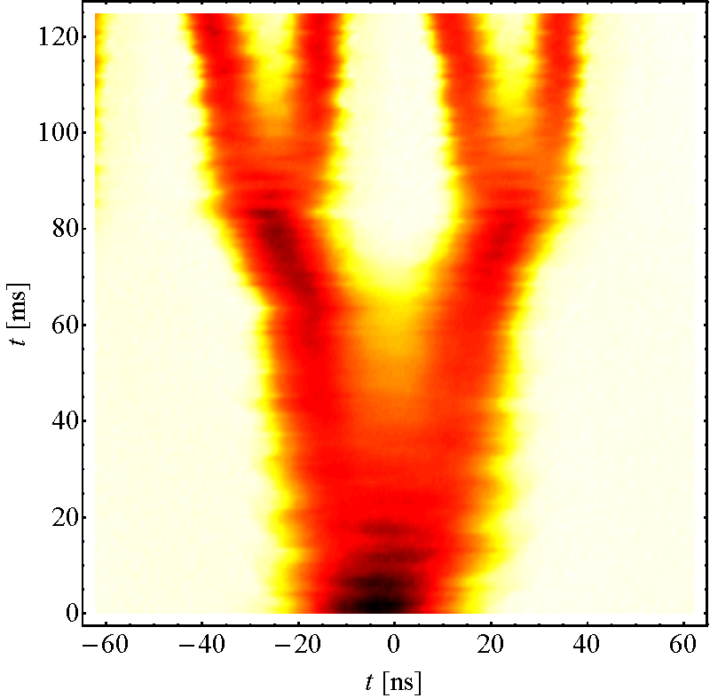
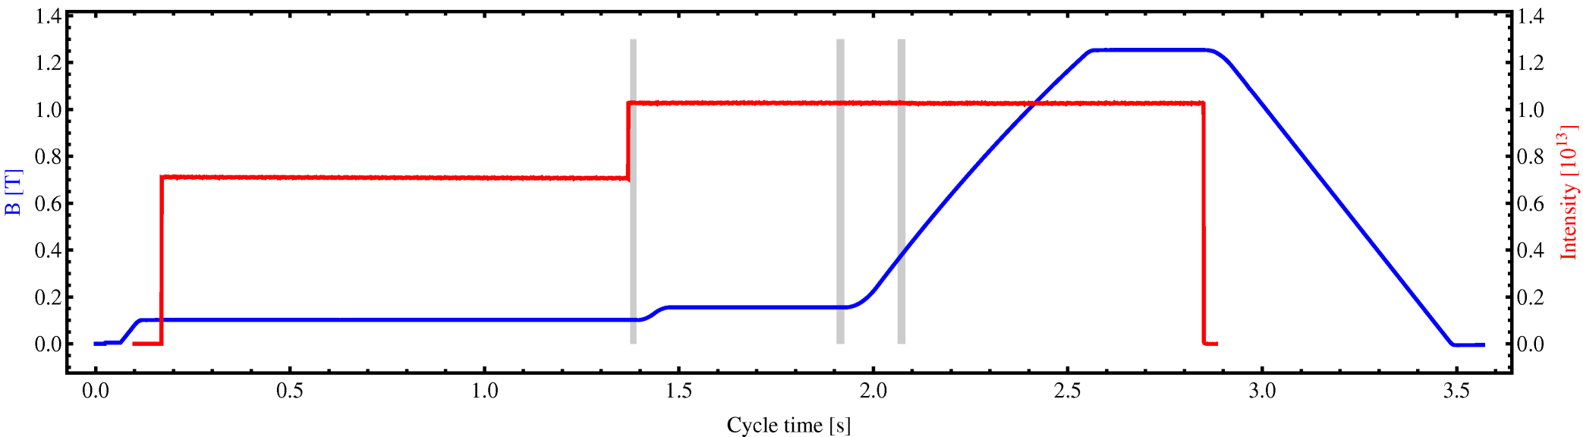
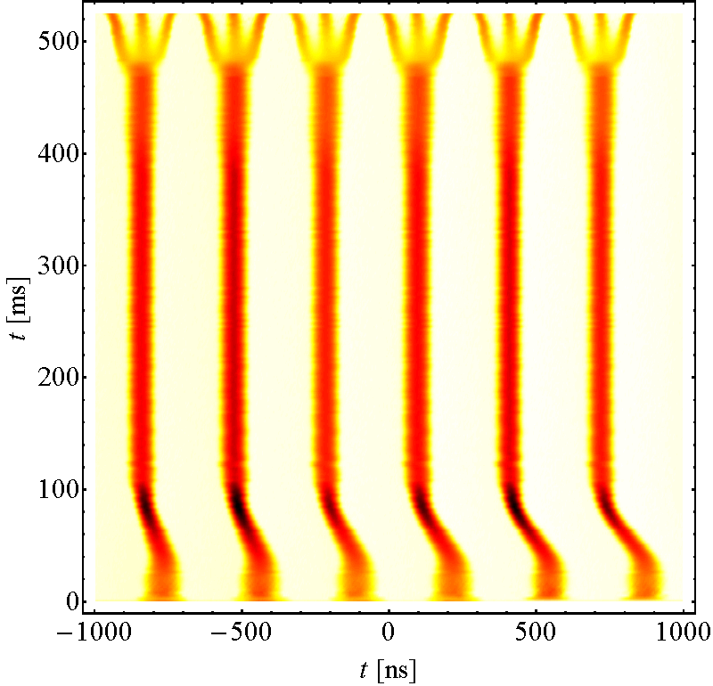
Lifting the PS intensity limitation
Instability
Bunch current limited around 1.6e11 p/b at extraction
Above 1.6e11 p/b longitudinal coupled bunch instabilities appear on the ramp and at flat top for nominal longitudinal emittance
  Dipolar oscillation, caused by 10 MHz RF system impedance (as found also in simulations)

Slide 14
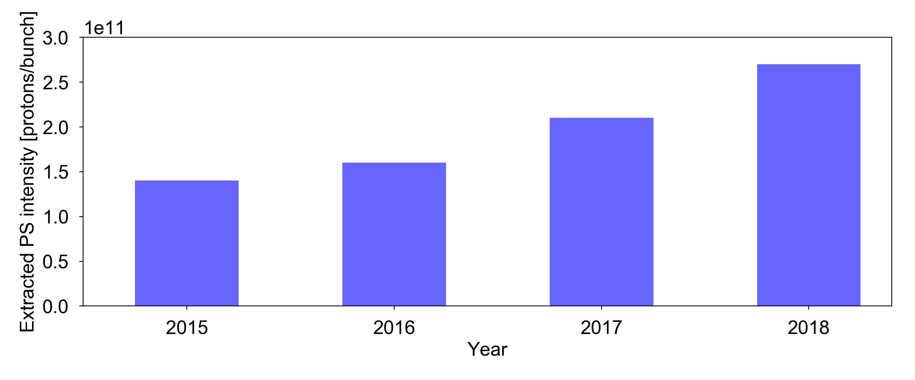
Mitigation of the PS longitudinal instability
Longitudinal feedback based on broad-band Finemet cavity as kicker installed and deployed over Run 2 (2015 – 2018) → Heiko’s talk
New power converters for 40/80 MHz and broadband cavities + multi-harmonic feedbacks and 40 MHz as Landau system + transverse optimisation
Commissioning of coupled bunch feedback with broadband cavity and operational optimization

Slide 15
Mitigation of the PS longitudinal instability
Longitudinal feedback based on broad-band Finemet cavity as kicker installed and deployed over Run 2 (2015 – 2018) → Heiko’s talk
Goal in terms of intensity out of the PS reached!
  However, we may need to seek further stabilization in order to decrease the longitudinal emittance into the SPS (requirement to minimize capture losses)
  In this case, the option of installing a Landau cavity in the PS with the right tuning range to cover ramp + flat top remains viable as a post-LIU action

Slide 16
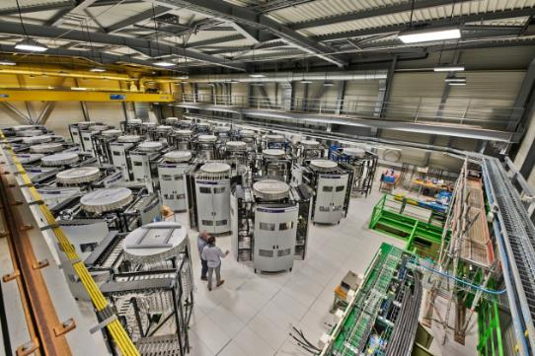
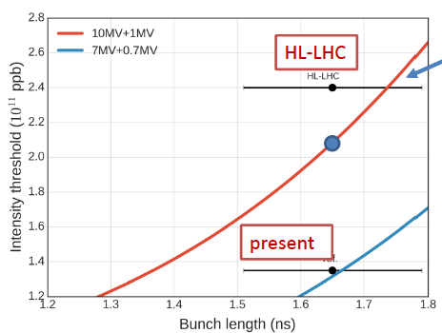
Lifting the SPS intensity limitation
Beam loading in the present 200 MHz TW RF system – intensity limited to about 1.3e11 p/b
Longitudinal instabilities during ramp with very low threshold cured by
  800 MHz RF system in bunch shortening mode
  Controlled emittance blow-up (with constraint of 1.7 ns bunch length at extraction) – not needed in Q20
Bunch length spread
Still lagging 20% below target …
Only RF power upgrade
Notes:
(2x4 & 2x5 section cavities)
Bunch length variation due to controlled emittance blow-up in presence of beam loading
More 800 MHz voltage is available but it is kept at 10% level of 200 MHz voltage to avoid region with ω’(J)=0 during ramp

Slide 17
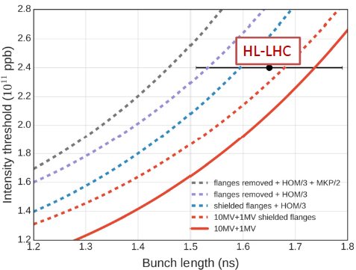
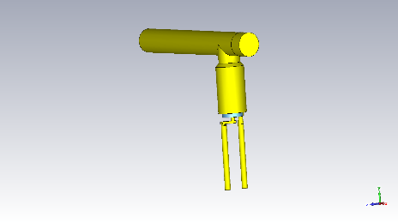
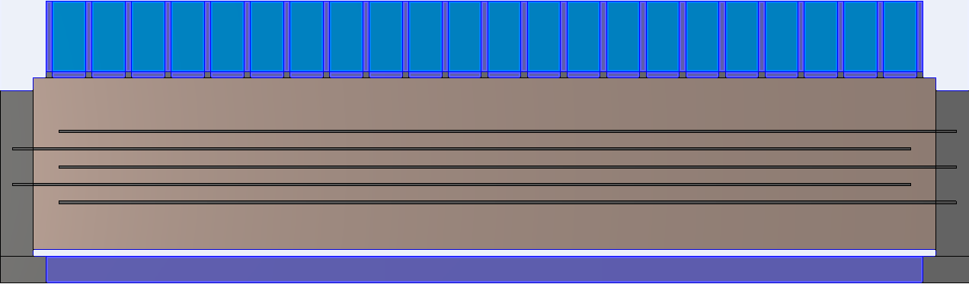
Mitigation of the SPS longitudinal instability
Impedance reduction needed in addition
  Shielding of a subset of vacuum flanges
  Enhanced damping of HOMs of 200 MHz (factor 3 desired) → baseline for LIU
  Serigraphy on the injection kickers MKP
new HOM coupler

Slide 18
Mitigation of the SPS transverse instability
Transverse Mode Coupling Instability (TMCI) threshold was raised from 1.6e11 p/b to 4e11 p/b when switching to a low gamma transition (γ_{t}) optics → See Yannis’ talk
original SPS optics
low γ_{t} SPS optics
4.0e11
x2.5
1.6e11
measurements confirm 2.5 times higher threshold!

Slide 19
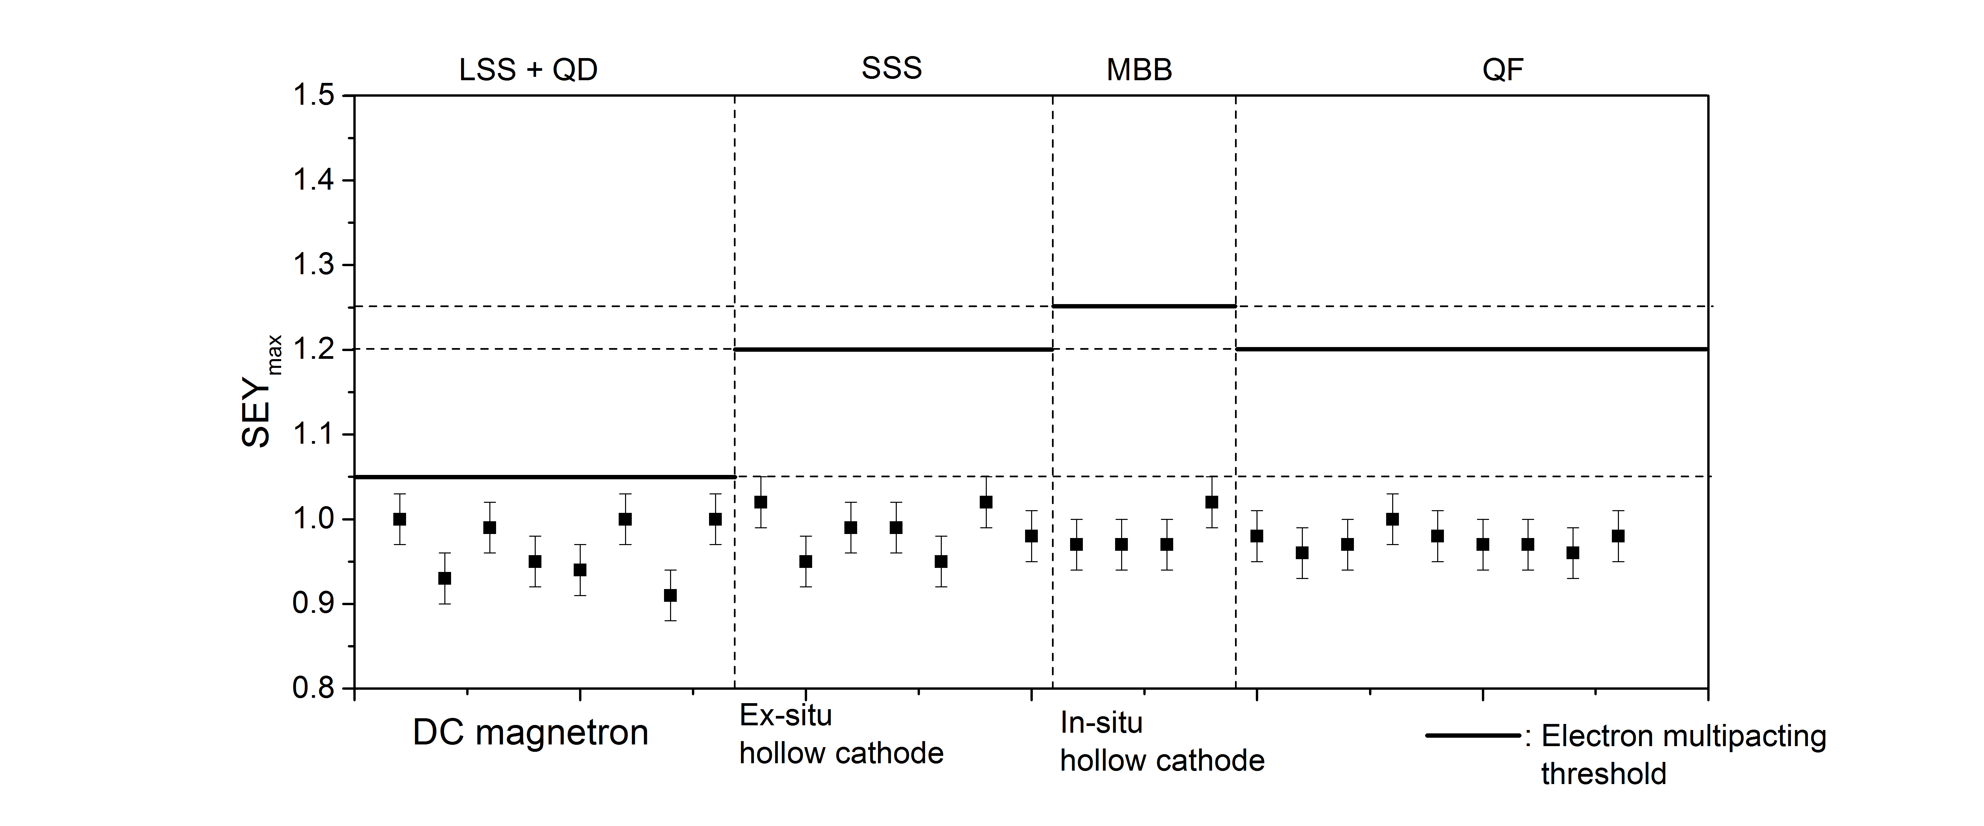
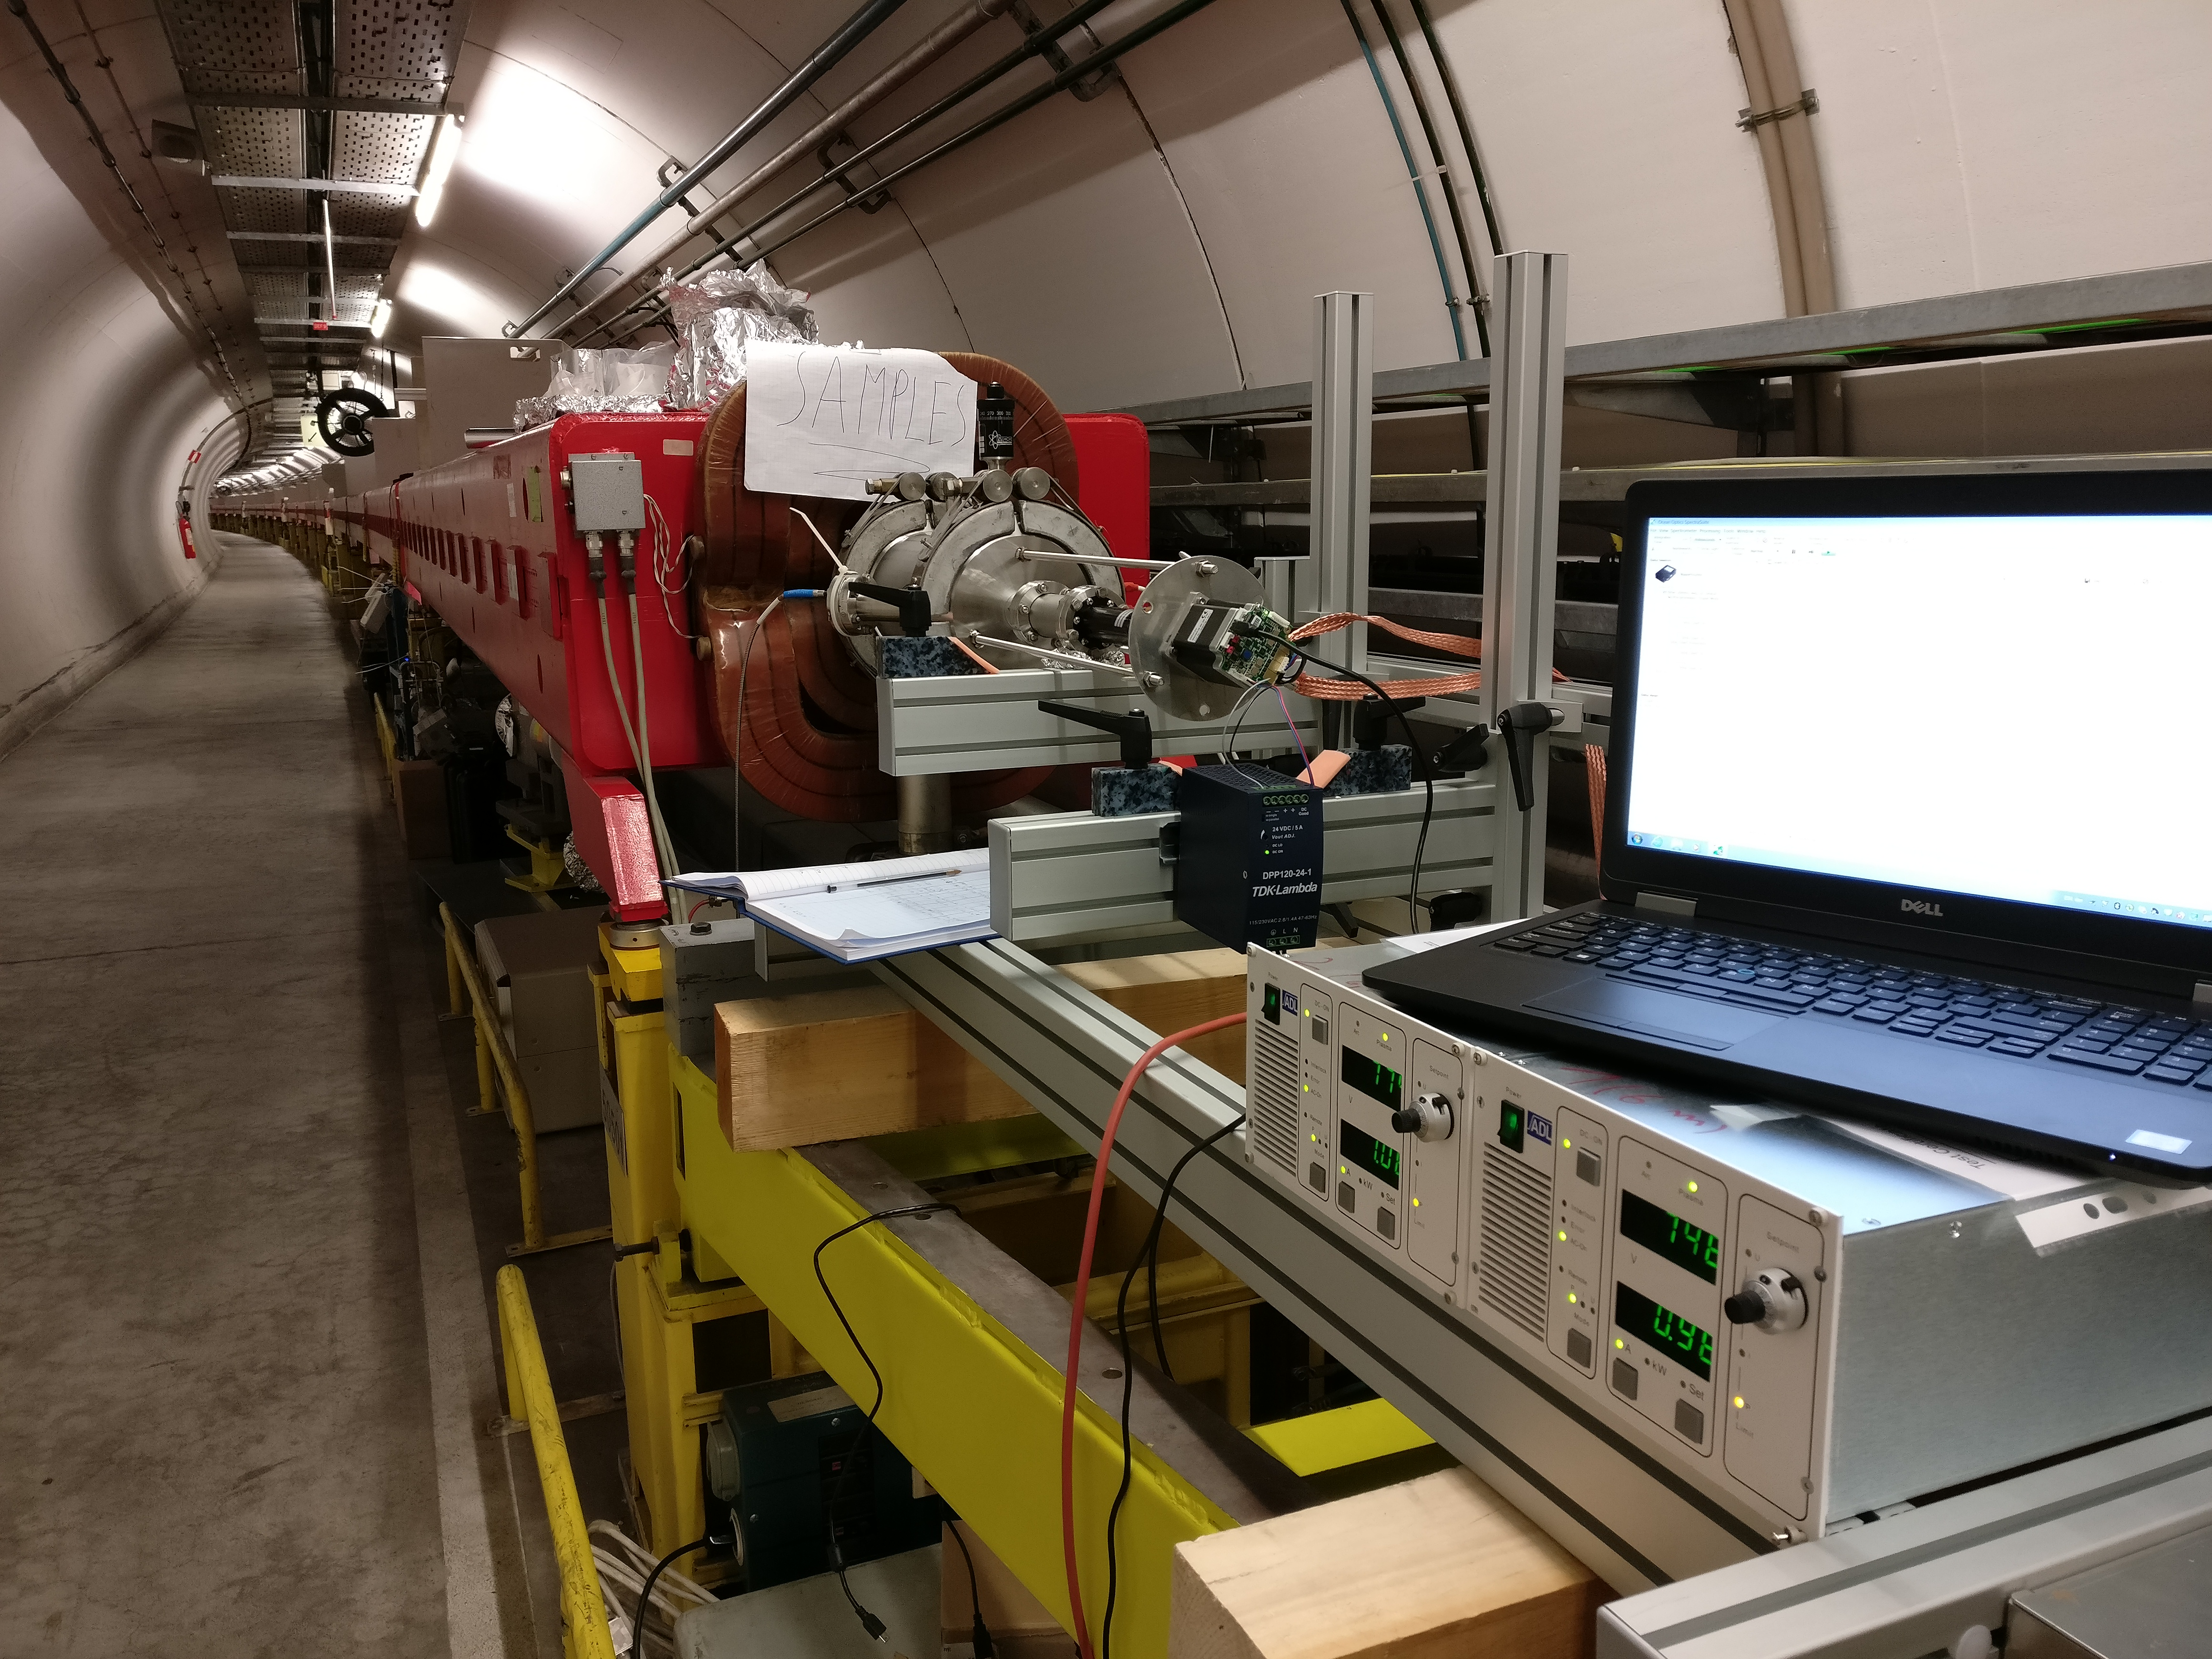
Mitigation of the SPS transverse instability
Electron cloud responsible for instabilities, can be mitigated by
  Beam induced scrubbing (it worked, it still works!)
  Coating with a-C the chambers of the focusing quadrupoles and adjacent drift chambers

Slide 20
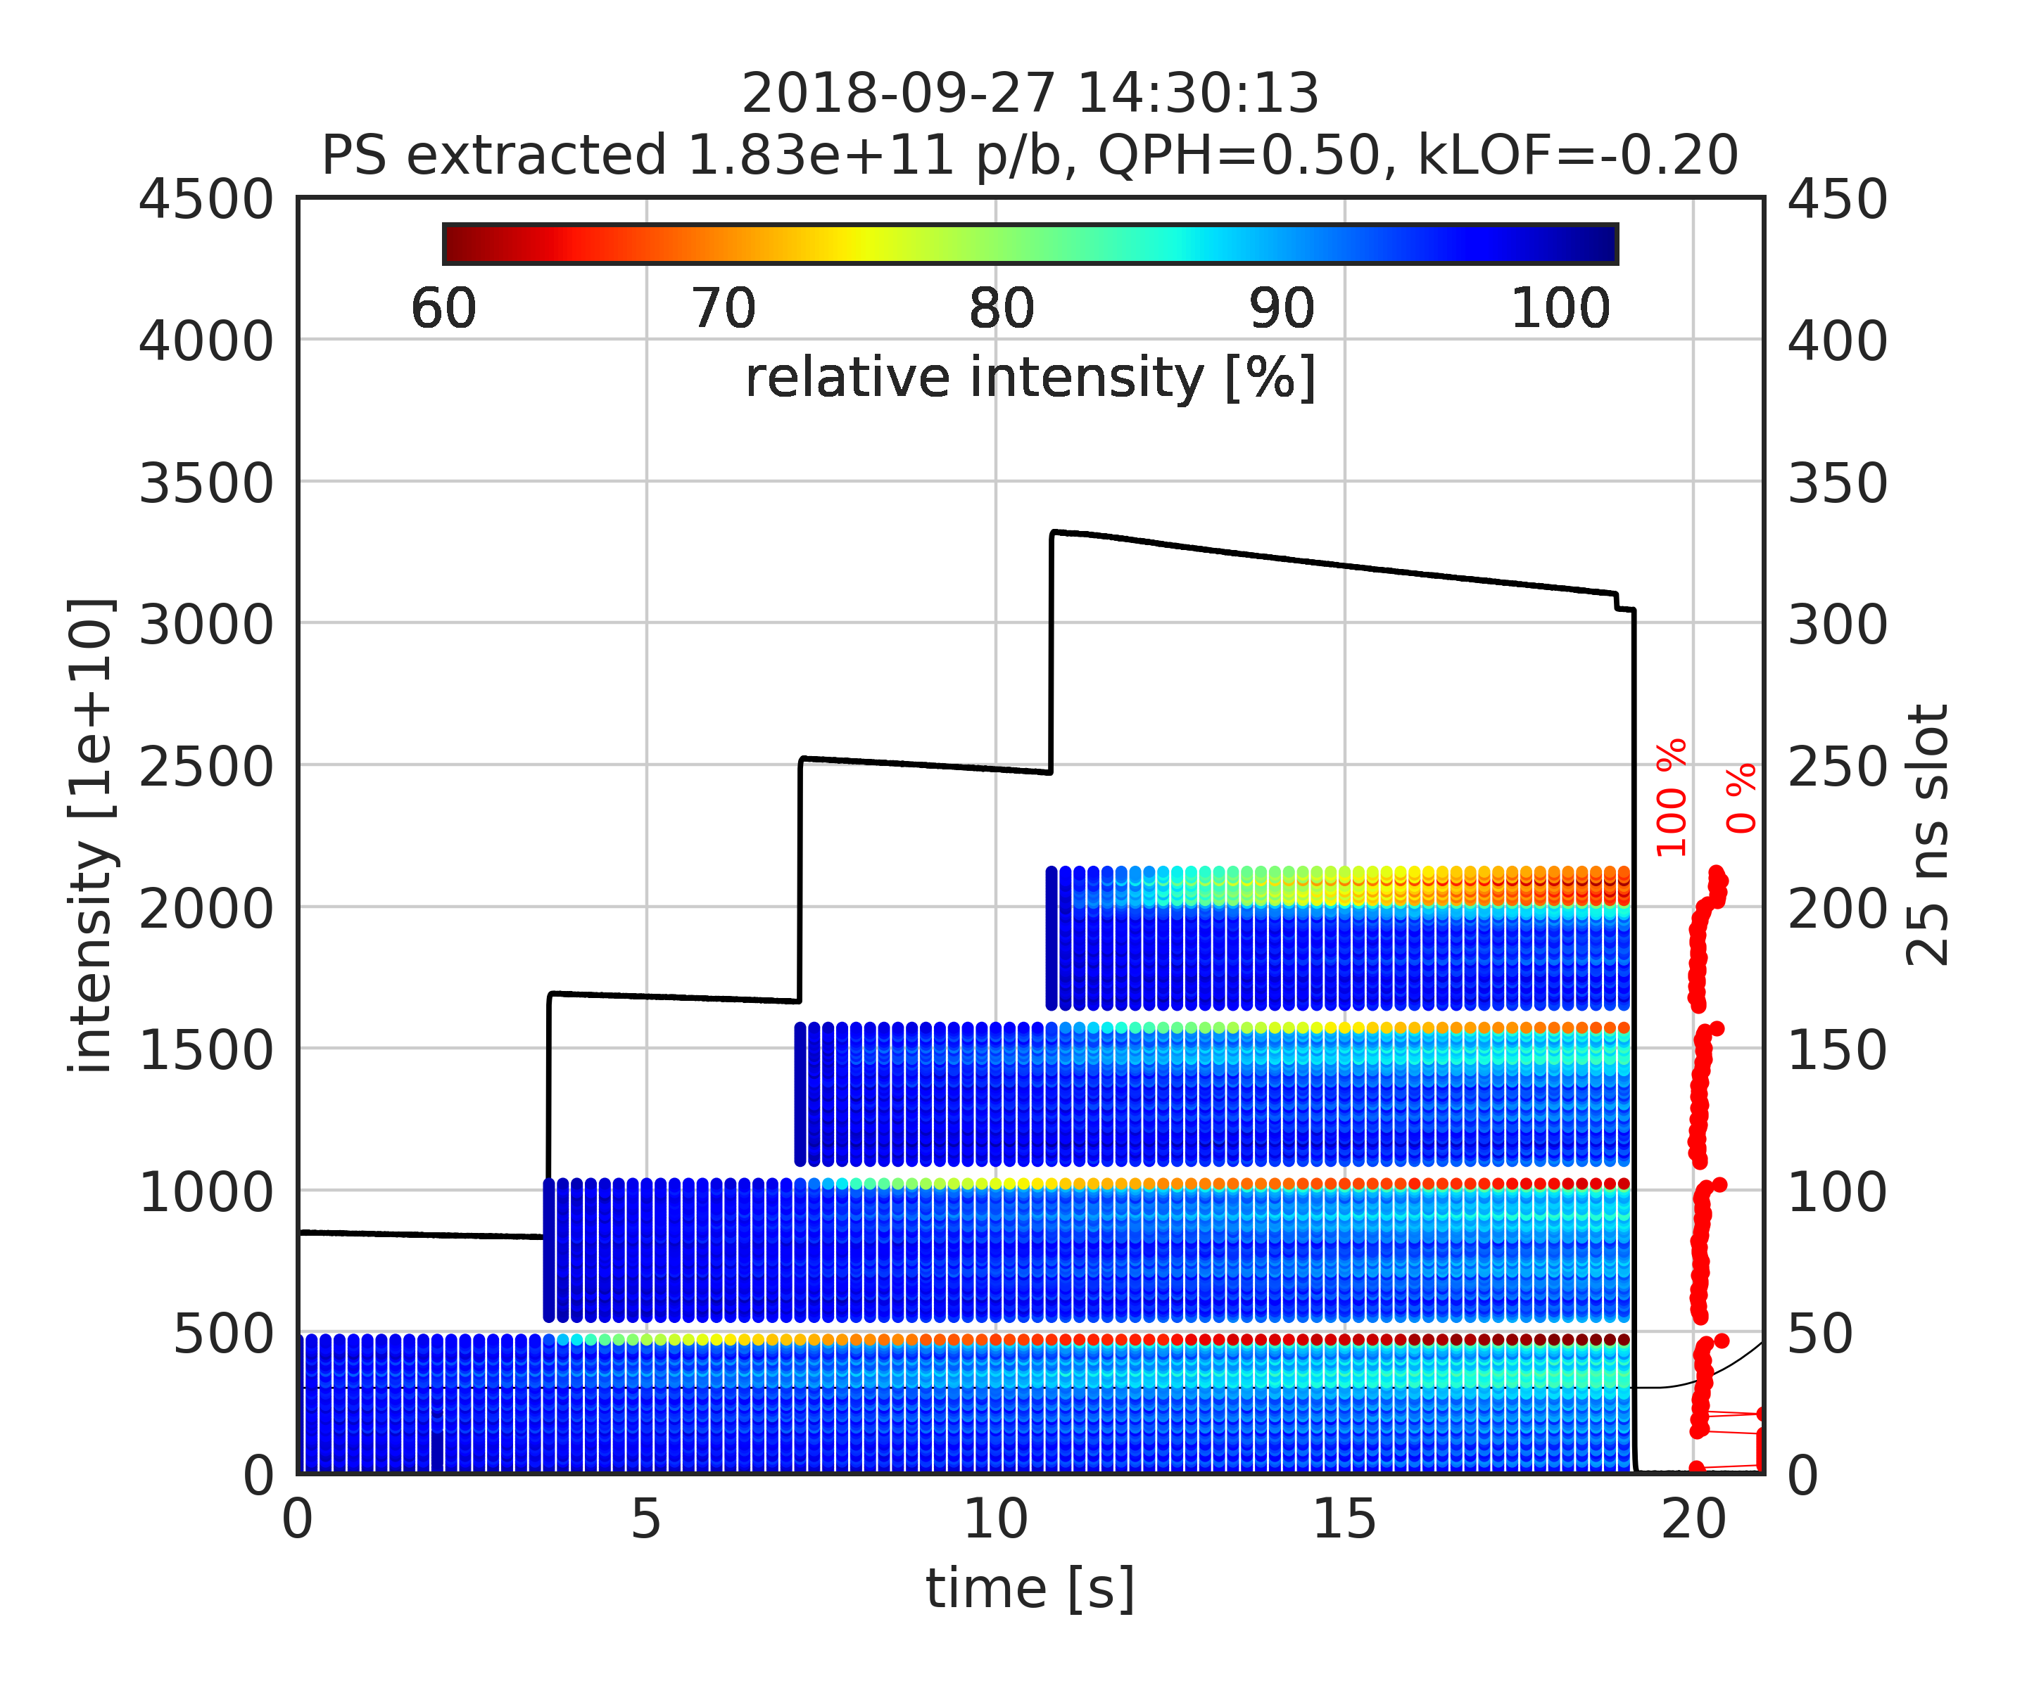
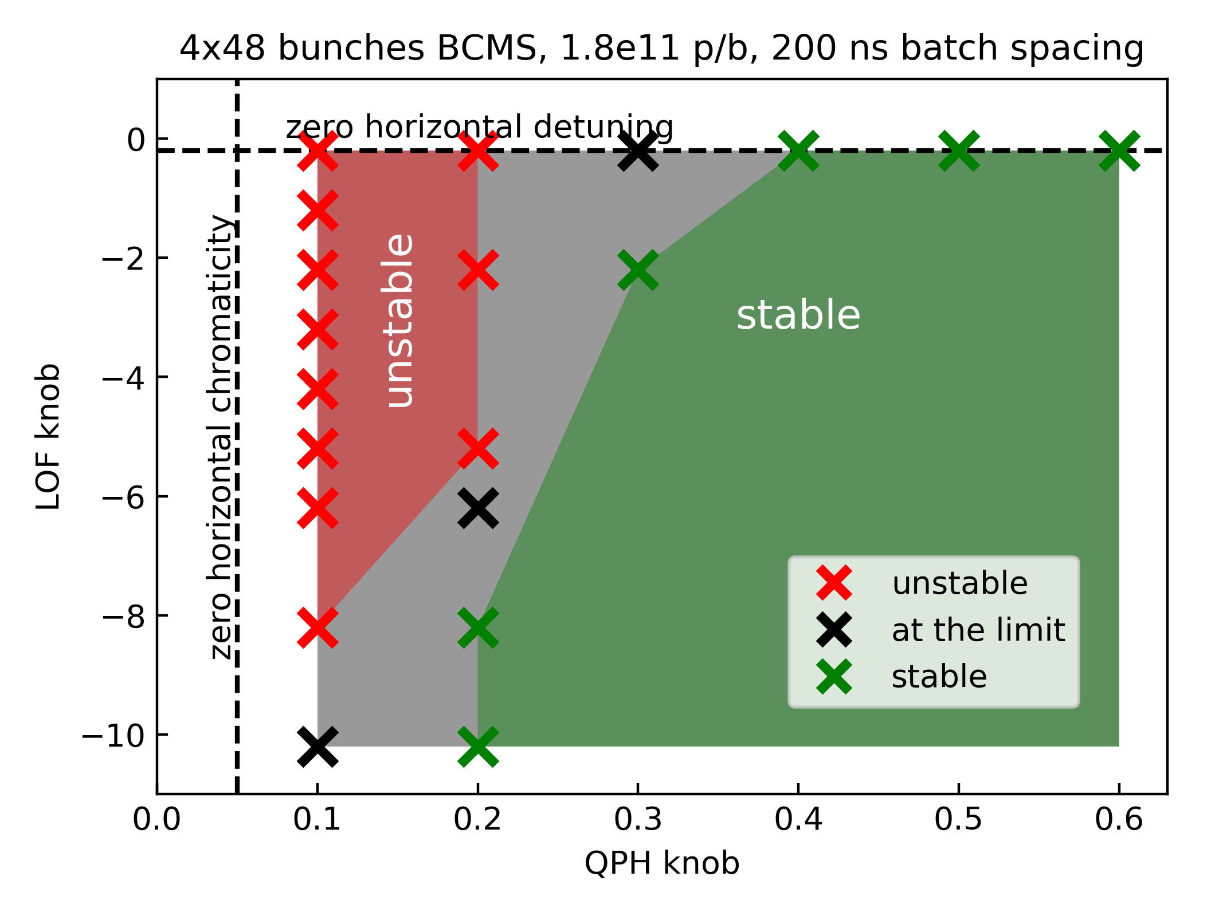
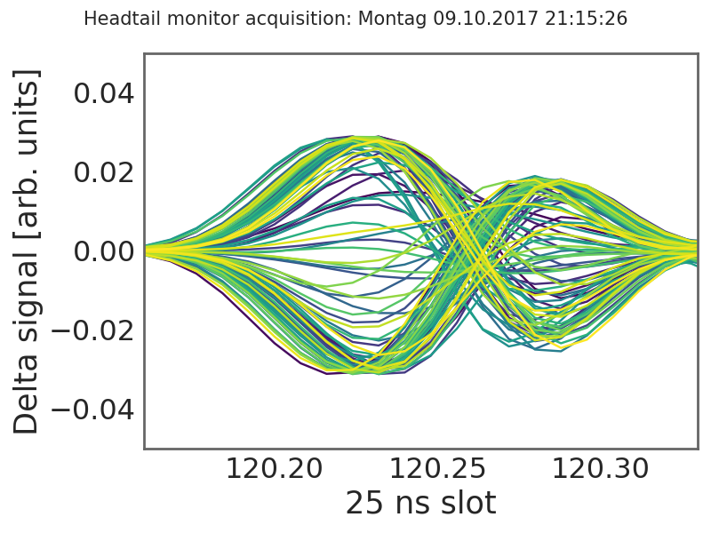
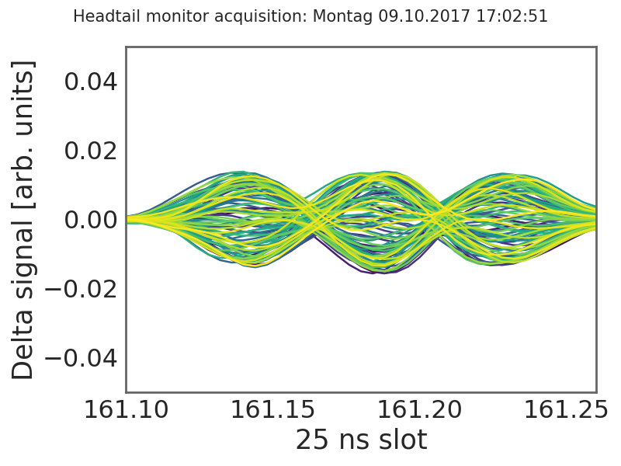
Mitigation of the SPS transverse instability
Horizontal coupled bunch instability
  Observed in 2017-18 for intensities above 1.8 x 10¹¹ p/b
  Driven by resistive wall and narrow band horizontal impedances, but also destabilizing effect of impedance reduction → Carlo’s talk
  Needs to be operationally stabilized for future operation – tradeoff with beam lifetime
ξ_{H}~0.1–0.2
ξ_{H}~0.3–0.5

Slide 21
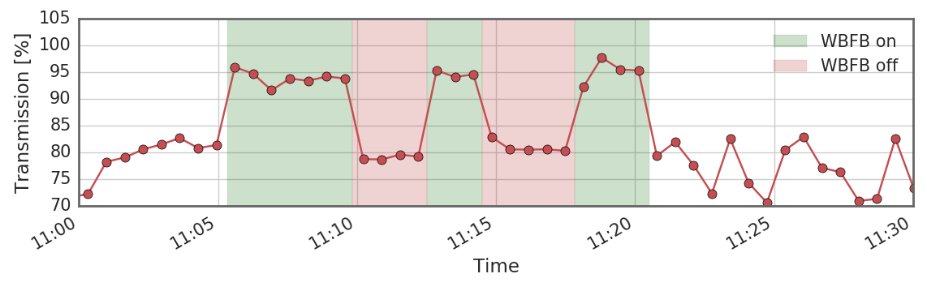
A possible weapon for the unexpected …
Prototype of vertical (V) wideband feedback system deployed at SPS
  Using stripline pick-ups + two stripline kickers and a slotline kicker, bandwidth up to 1 GHz, power > 1 kW
Damping of Transverse Mode Coupling Instability (TMCI) with single bunch demonstrated in machine experiments in 2017-18

Slide 22
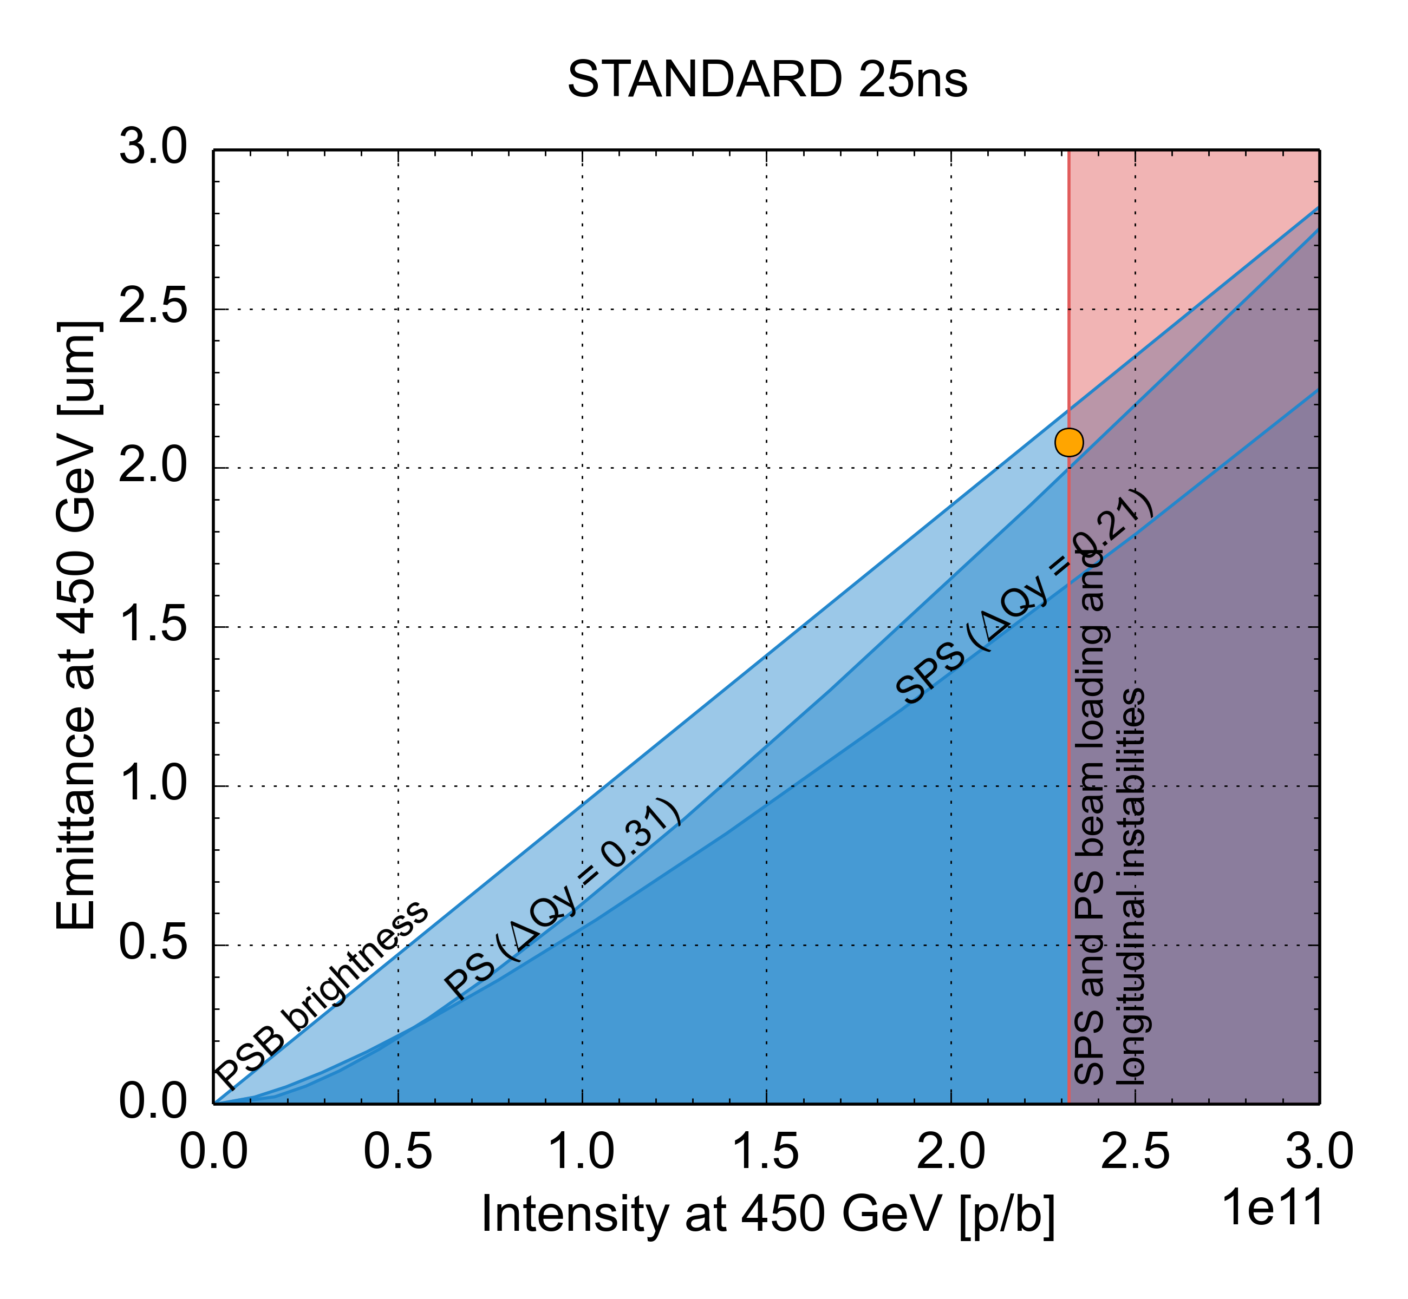
Summary: Future LIU performance
 | N_{b} (x 10¹¹ p/b) | ε_{x,y,} (μm)
HL-LHC target | 2.3 | 2.1
Present | 1.3 | 2.7
LIU matches HL-LHC
PSB injection: from Linac4
PS injection: 2 GeV, larger longitudinal emittance
PS cycle: Longitudinal coupled bunch feedback system, impedance reduction
SPS cycle: RF power upgrade, longitudinal impedance reduction, beam scrubbing & partial a-C coating, low γ_{t} optics

Slide 23
Why upgrades and what are the upgrades for LHC and its injector chain?
Present intensity limitations and future performance of the LHC injectors
  Where do we need mitigation of coherent beam instabilities?
  How far we can go with the upgrades
Mitigation of beam instabilities in the LHC

Slide 24
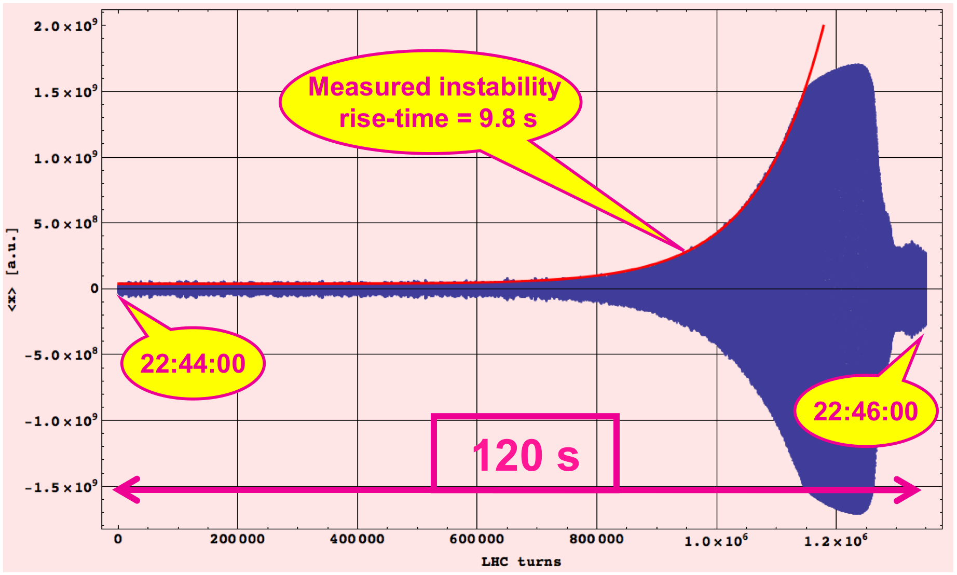
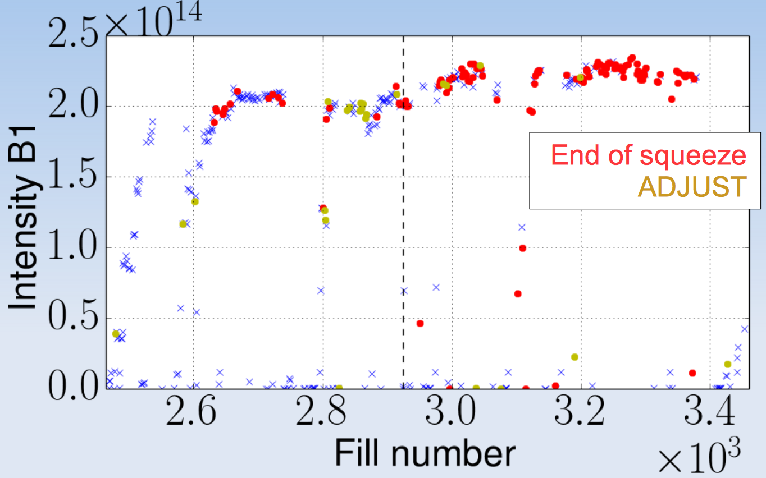
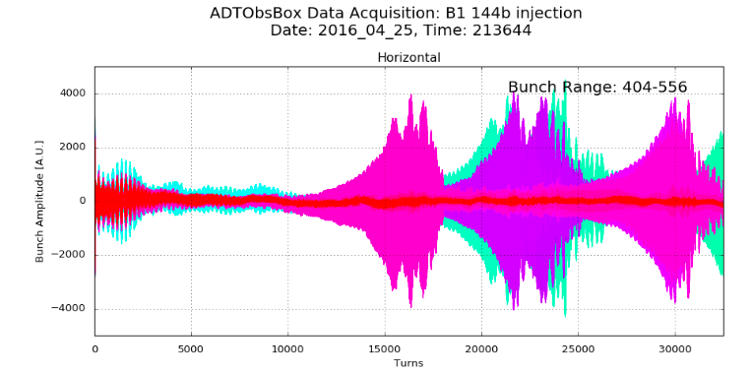
LHC beam stability
LHC transverse beam instabilities observed with different types of beams and at different stages of the LHC cycle (see Xavier’s talk)
2010, single bunch
during the ramp
2011-12, 50 ns beam
during β* squeeze or while adjusting the beams to collide
2015-18, 25 ns beam
at injection

Slide 25
LHC beam stability
LHC transverse beam instabilities observed with different types of beams and at different stages of the LHC cycle (see Xavier’s talk)
Sources are mainly
  Transverse impedance (dominated by collimators, especially when closed at top energy) through loss of Landau damping due to beam-beam, electron cloud, linear coupling, cut tails, noise induced modifications of distribution
  Electron cloud, at least with 25 ns beams
Controlled through “extreme” machine settings, e.g. at 6.5 TeV Q’=+15-20, octupole strength close to maximum, maximum damper gain and bandwidth
Need to gain some margin with stabilisation knobs for operation with HL-HLC beam parameters (double intensity, double brightness) → Impedance reduction, electron cloud understanding and partial mitigation

Slide 26
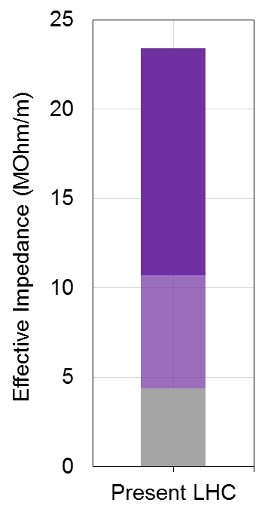
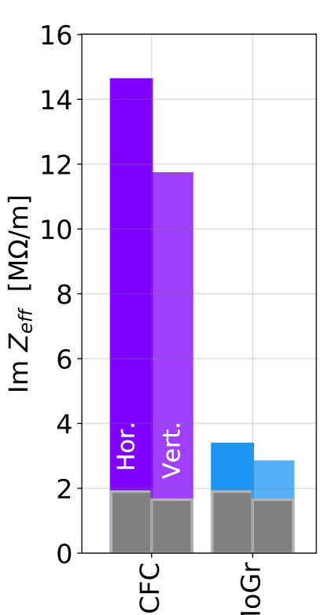
LHC beam stability
Due to the small gaps, at 6.5 TeV the most critical impedance contributor (80%) is collimators
Within HL-LHC primary and secondary collimators replaced by new ones with Mo-Gr jaws having same robustness and higher conductivity (with Mo coating on secondaries) → Alessio’s talk
Impedance reduction
secondary collimators
Secondary
collimators in IR-7
Primary
collimators
Resistive wall
Everything
else
Geometric
Present
Upgrade

Slide 27
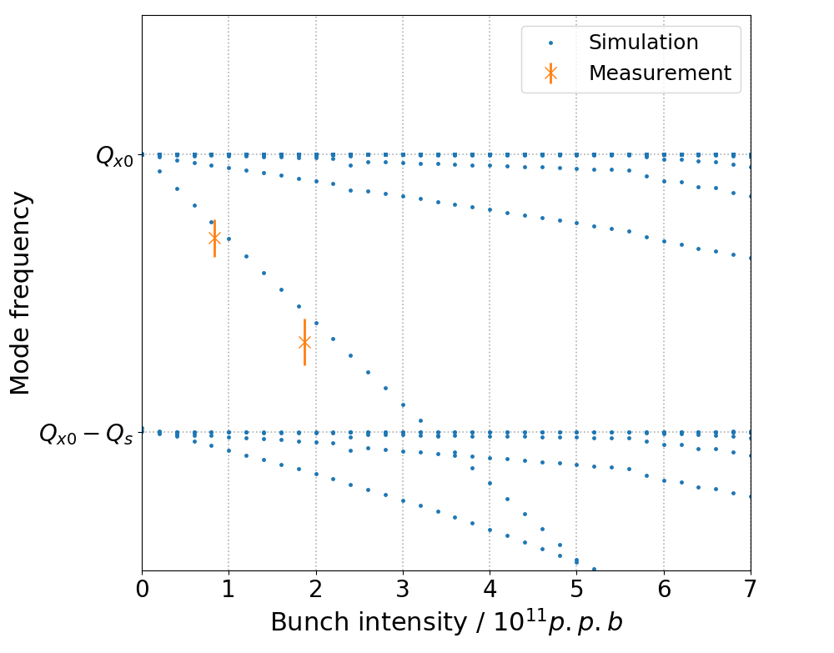
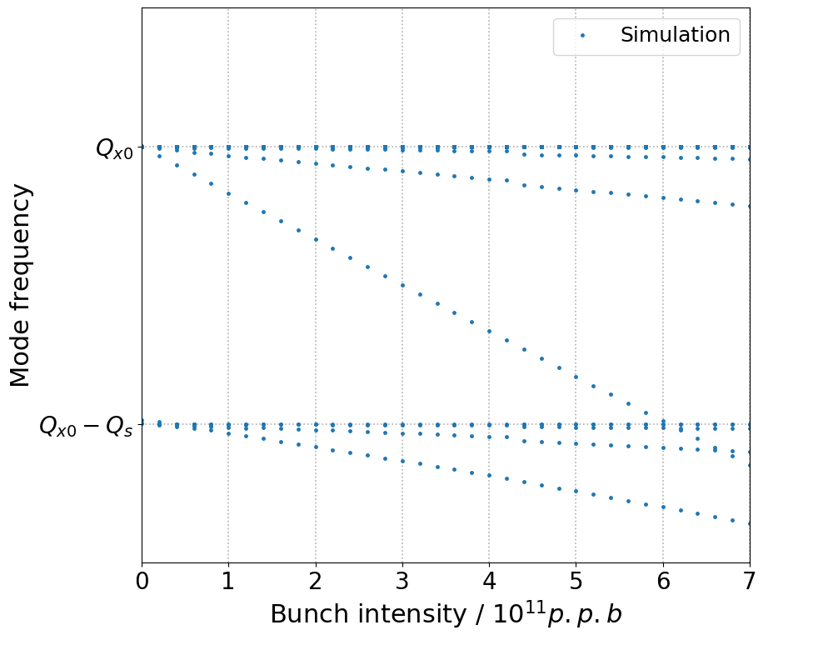
LHC beam stability
Example: Effect of impedance reduction on TMCI threshold
HL-LHC impedance
(after collimator impedance reduction)
Present LHC impedance model
Instability
Instability

Slide 28
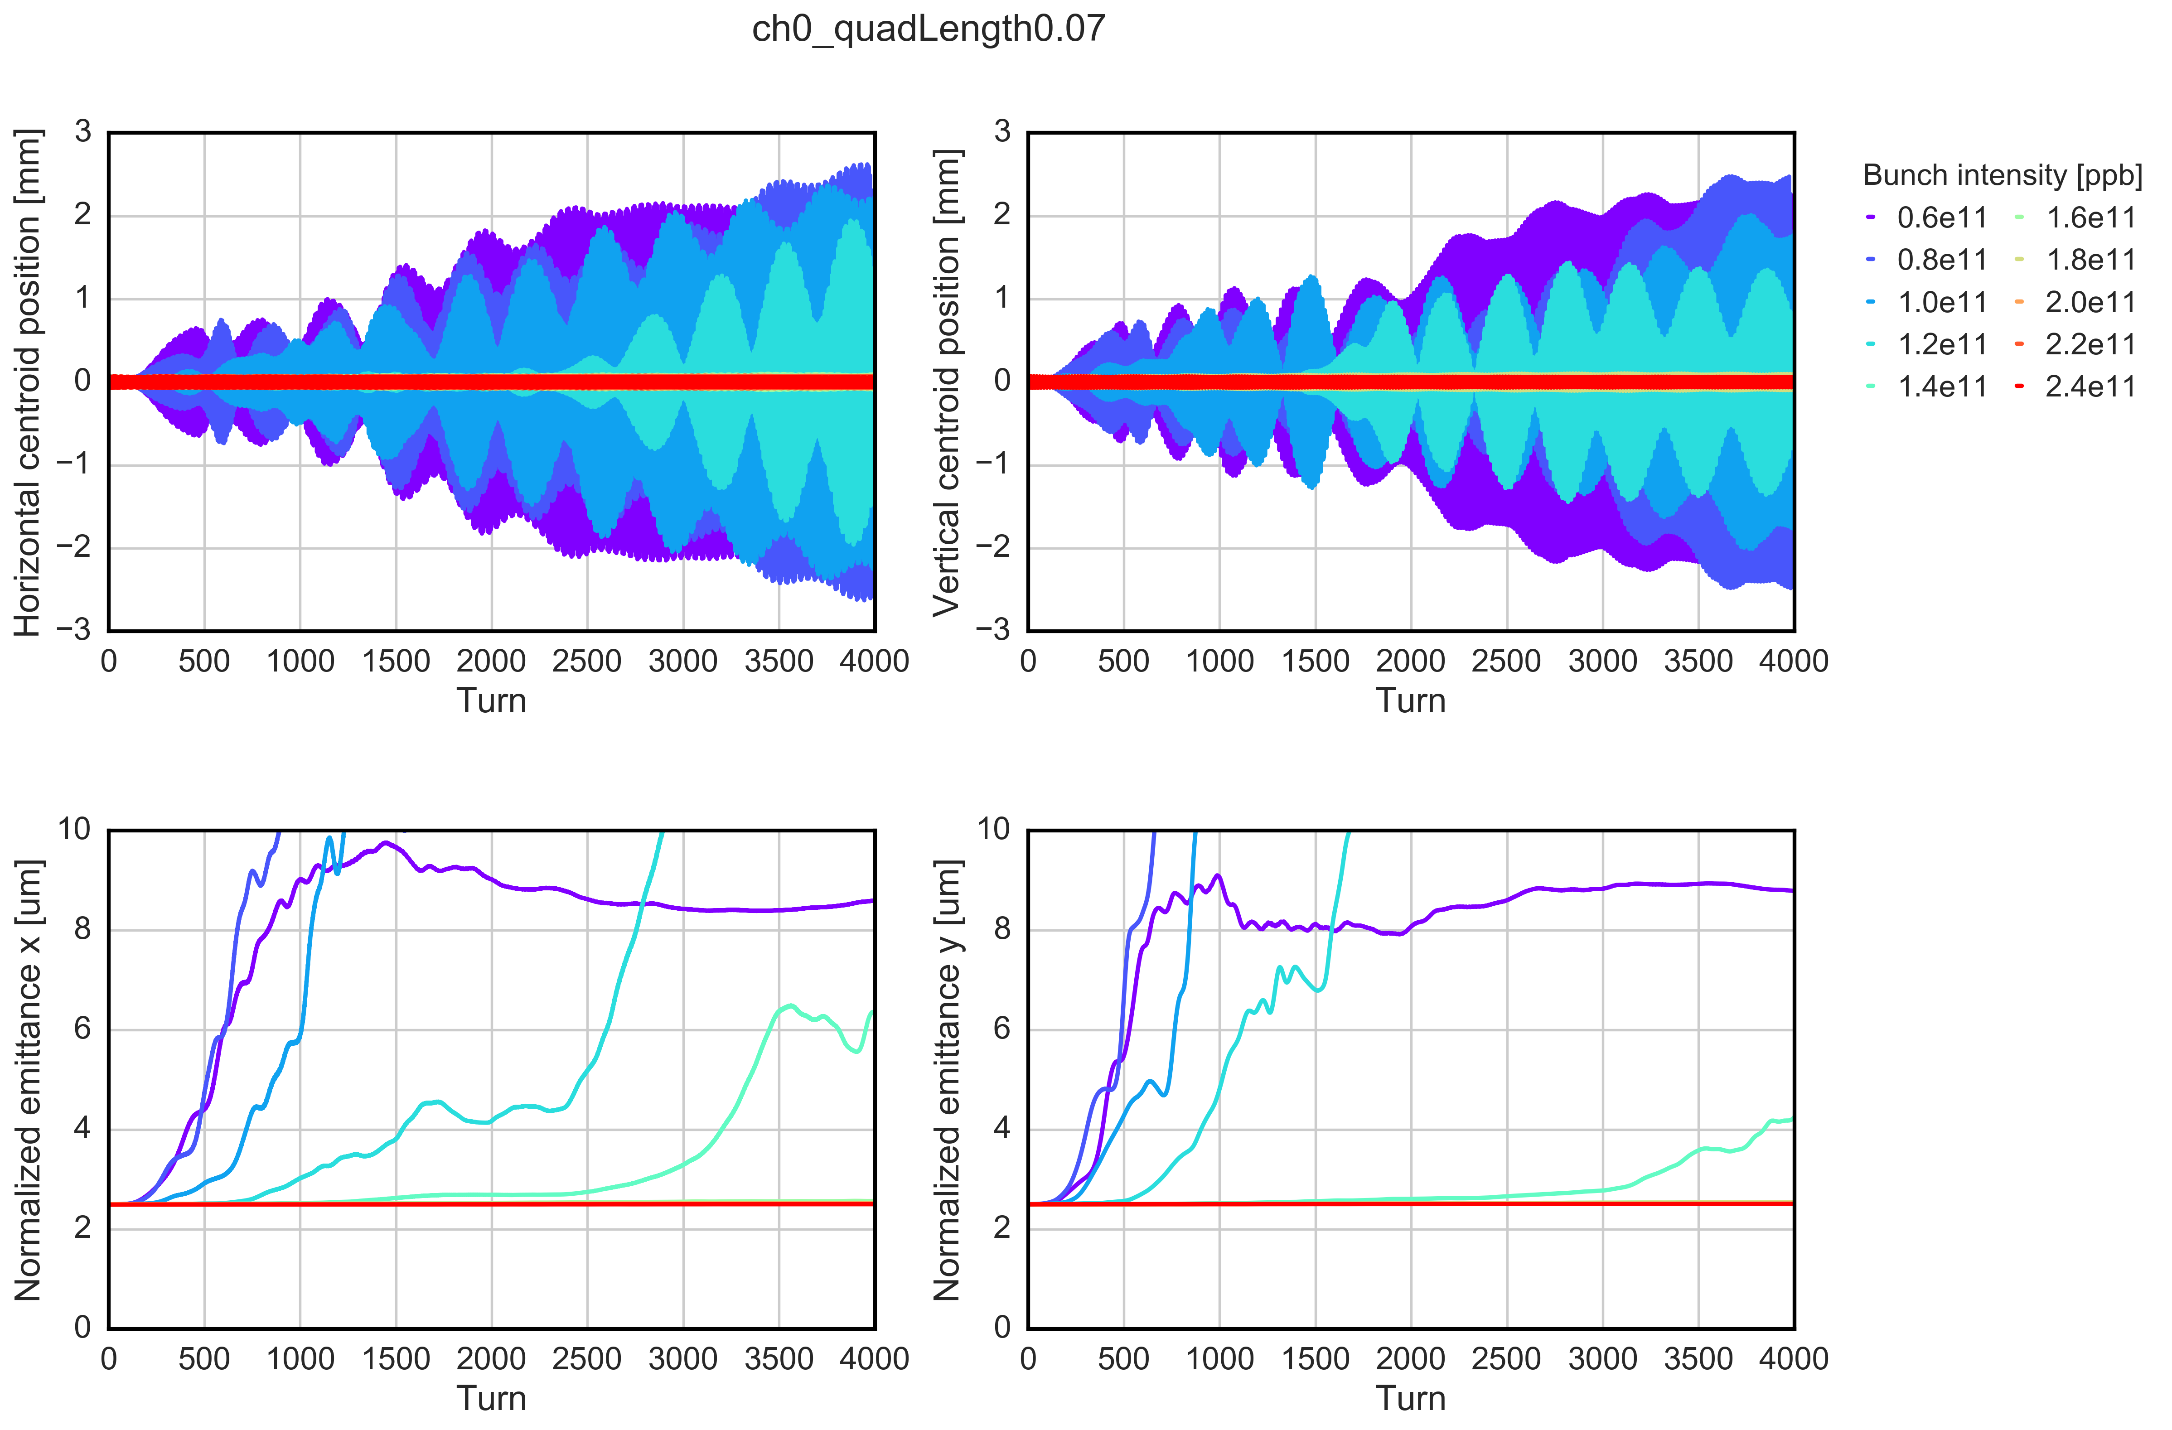
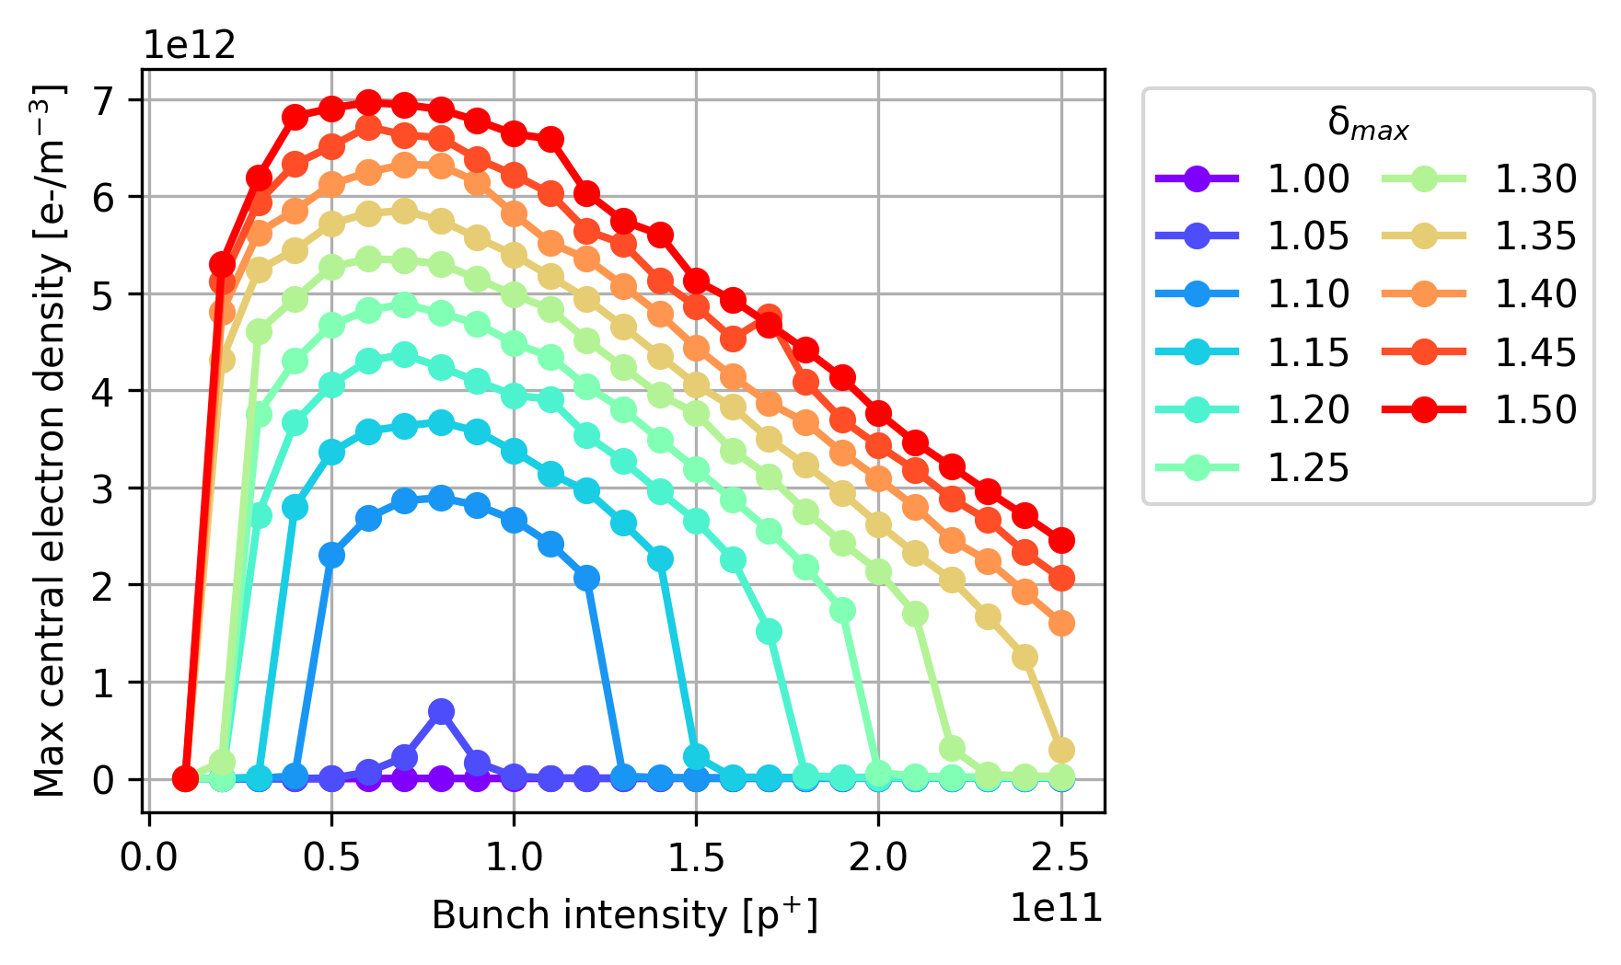
LHC beam stability
Strong instabilities observed at 450 GeV with 25 ns beams, in both x and y
  Stabilized with high chroma (Q’=20), high octupole strength (ΔQ=1.5e-3)
  Caused mainly by electron cloud in quadrupoles
Simulations predict more stability for HL-LHC (thanks to lower electron cloud)
Instability simulations (450 GeV)
(e-cloud in the arc quadrupoles - SEY 1.3)
e-cloud buildup simulations
arc quadrupoles

Slide 29
LHC beam stability
Strong instabilities observed at 450 GeV with 25 ns beams, in both x and y
  Stabilized with high chroma (Q’=20), high octupole strength (ΔQ=1.5e-3)
  Caused mainly by electron cloud in quadrupoles
Simulations predict more stability for HL-LHC (thanks to lower electron cloud)
More electron cloud instabilities have been observed e.g. at flat top induced by decaying intensity and onset of central stripe in dipoles

Slide 30
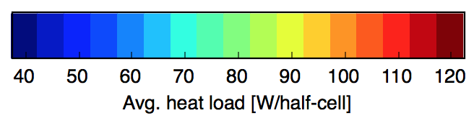
Electron cloud mitigation
S45
S56
In general, low SEY after scrubbing is crucial to cure e-cloud instabilities
Heat load measurements show that SEY may remain as high as 1.35 (in average) in some cells
  Reason for high remaining SEY under close scrutiny to improve opening procedures in the future
Critical sections like the new triplets will be a-C coated
S34
S67
SEY = 1.15 – 1.25
SEY = 1.30 – 1.35
S23
S78
ALICE
LHCb
S12
S81
ATLAS

Slide 31
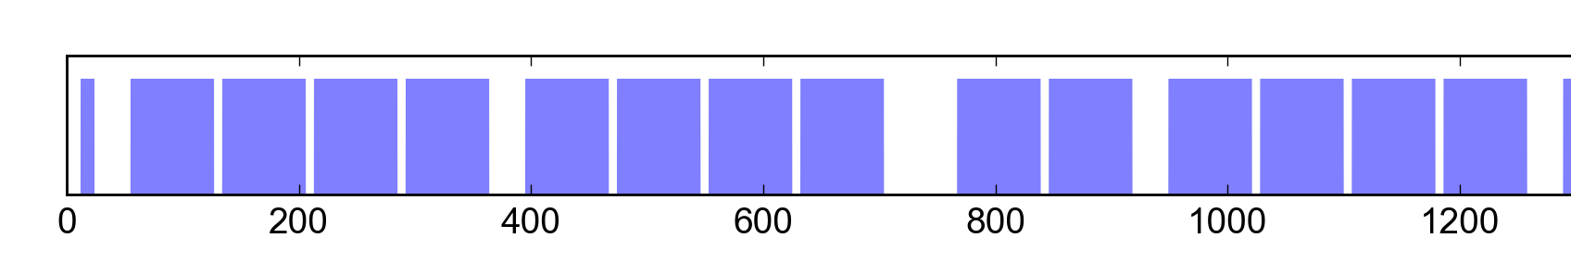
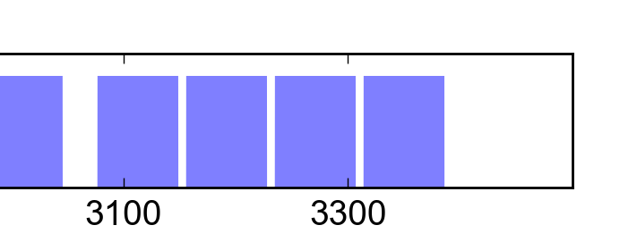
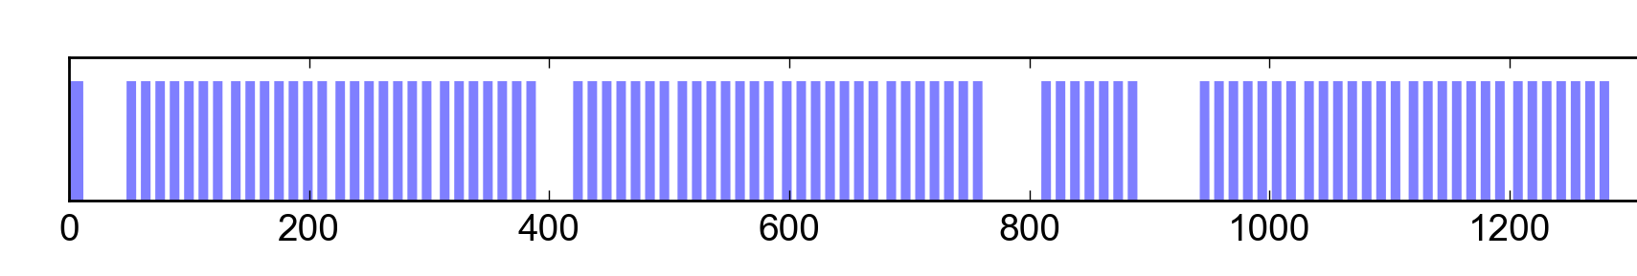
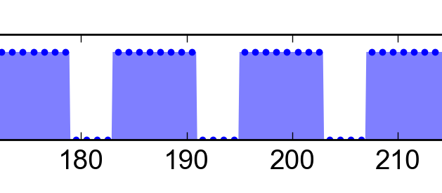
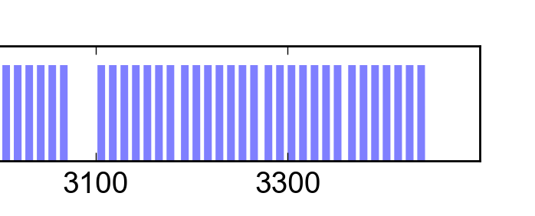
Electron cloud mitigation
If electron cloud remains a problem with HL-LHC operation, a last resort safety net is the filling scheme …
25 ns (2760b)
72b
25 ns slot
8b+4e (1972b)
8b
4e
8b
4e
8b
4e
8b
25 ns slot
→ Pure 25 ns and 8b+4e can be combined to reach the maximum heat load

Slide 32
LHC beam stability: longitudinal
Instabilities at injection → Theodoros’ talk
  Persistent oscillation, and even instability, from injection errors
  Improved injection matching (voltage, energy)
Controlled longitudinal emittance blow up during the ramp (target bunch length 1.1-1.2 ns) to avoid onset of instabilities → Helga’s talk
Possible instabilities at flat top if bunch length decreases below 0.9 ns

Slide 33
To wrap up and conclude
LHC and its injectors set to major upgrades: LIU, HL-LHC
  Injectors upgraded in 2019-2020, LIU beam commissioning in 2021-2024
  LHC upgraded in 2024-2025 and HL-LHC era >2026
Mitigation of beam instabilities is key to goal performance in the LHC injectors
  PSB, PS → Mainly rely on active feedback systems
  SPS → Impedance reduction, electron cloud suppression, longitudinal emittance blow up, enhanced Landau damping, optics change
Preservation of beam stability in LHC → Avoid loss of Landau damping, operational scenarios, impedance reduction, electron cloud build up & instability scaling, low electron cloud filling pattern

Slide 34
THANK YOU FOR YOUR ATTENTION

Slide 35
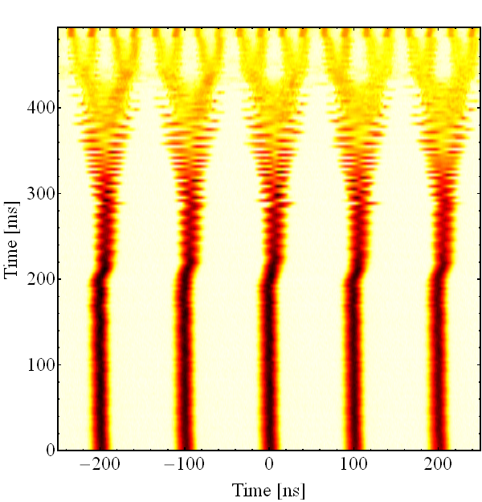
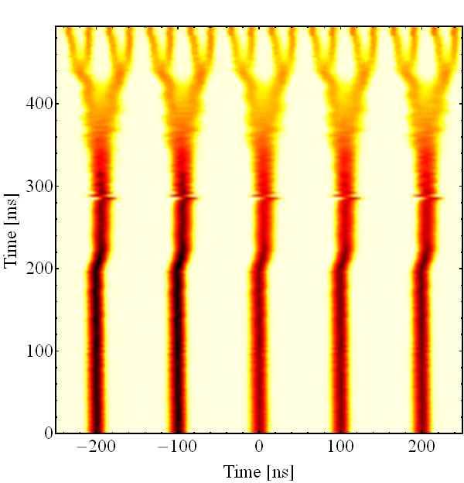
Mitigation of the PS longitudinal instability
Longitudinal feedback based on broad-band Finemet cavity as kicker installed and deployed over Run 2 (2015 – 2018)
Feedback off (N_{b} = 1.8 · 10¹¹ ppb)
Feedback on (N_{b} = 1.8 · 10¹¹ ppb)

Slide 36
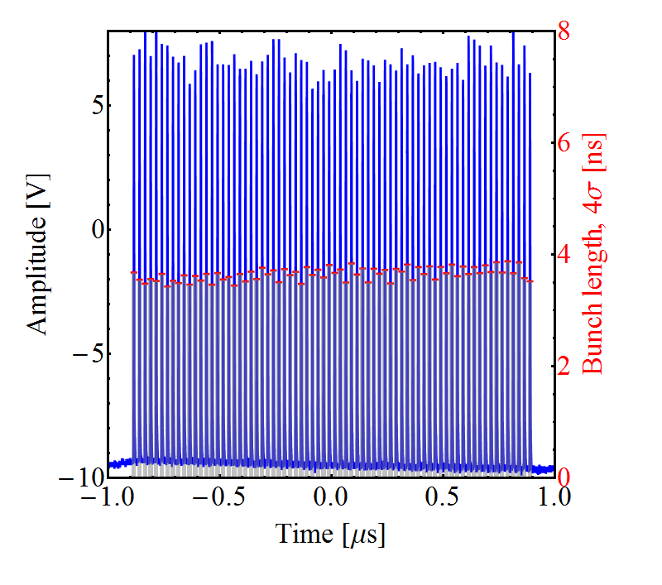
Mitigation of the PS longitudinal instability
Longitudinal feedback based on broad-band Finemet cavity as kicker installed and deployed over the last three years
With transverse optimisation, beam is now stable up to 2.6e11 p/b
N_{b} = 2.6 ∙ 10¹¹ ppb, ΔN/N < 5%

Slide 37
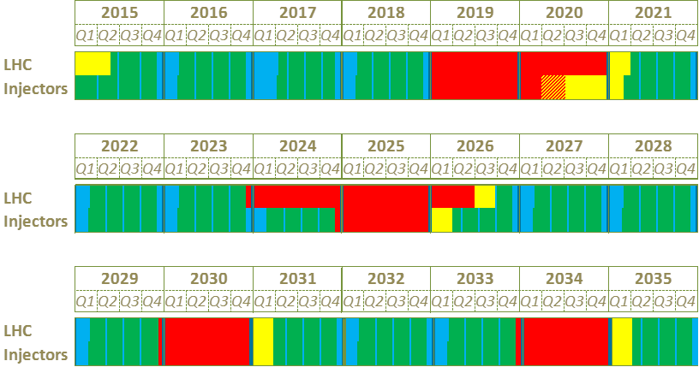
Timeline of the projects
Proton Runs
Technical Stops
Long Shutdowns
Beam Commissioning
We are here
LS2
Run 2
Mainly LIU work
LS3
Run 3: LIU beam commissioning through the injector chain
Run 3
Mainly HL-LHC work
Run 4: HL-LHC run with a period of ‘luminosity learning’
Run 4

Slide 38

Lifting the PS intensity limitation
Longitudinal feedback based on broad-band Finemet cavity as kicker installed and deployed over the last three years
With transverse optimisation, beam is now stable up to 2.6e11 p/b
Goal in terms of intensity out of the PS reached!
Brightness still pending Linac4 and space charge mitigation in PS
2.6e11 p/b, 5 μm

Slide 39
HL-LHC single particle dynamics
Simulated evolution of an HL-LHC physics fill with baseline parameters
Strong effect of linear and nonlinear errors in IRs due to large β → Low Dynamic Aperture in absence of correction
Pre-computed corrections from magnetic measurements needed even for basic optics measurements
β∗ levelling will require commissioning of a large number of optical configurations → Challenge for efficiency of the optics measurement and correction tools
Notes:
needed to fulfil the tight tolerances coming from DA or coherent stability constraints

Slide 40

Luminosity projection

Slide 41
LHC beam stability
Strong instabilities observed at 450 GeV with 25 ns beams, in both x and y
  Stabilized with high chroma (Q’=20), high octupole strength (ΔQ=1.5e-3)
  Caused mainly by electron cloud in quadrupoles
Simulations predict more stability for HL-LHC (thanks to lower electron cloud)
Instability simulations (450 GeV)
(e-cloud in the arc quadrupoles - SEY 1.3)
e-cloud buildup simulations
arc quadrupoles

Slide 42

Beam induced heat load in LHC
High heat load on beam screen in cold regions (cryo limit 160 W/hc in the arcs)
  With 25 ns beams
  Much higher than calculation from impedance + synchrotron radiation
  Different among arcs
Most observations compatible with electron cloud, probably localised in some magnets (or even some parts of magnets)
  Coating with a-C for triplet quadrupoles to decrease SEY
8 Aug 2017
Heat load
per half cell
Notes:
Only 25 ns, scaling with bunch intensity (linear, threshold at just below 4e10 p/b), power loss localised in last bunches of trains from RF measurements of stable phase, at least partly scrubbable, behaviour in dipoles and quadrupoles

Slide 43


E-cloud build up with intensity
Underlying mechanism:
When the SEY decreases the energy window for multipacting becomes narrower
For high bunch intensity the e- spectrum drifts to higher energies and can move outside the most efficient region

Slide 44


Inferring the average SEY
Simulations
Measurements
6.5 TeV
450 GeV
6.5 TeV
High-load
Low-load

Slide 45

Inferring the average SEY
Simulations
Measurements
450 GeV
450 GeV
6.5 TeV
High-load
Low-load

Slide 46


Beam induced heat load in LHC
Two fold issue for HL-LHC
  Less margin for cryostat with HL-LHC parameters (three-fold contribution from impedance and synchrotron radiation)
  How does the additional load scale with bunch intensity? → We can make a prediction only if we assume it is caused by electron cloud
Maximum allowed by cryogenics
Margin
~7 kW
Margin
~4 kW
e-cloud S12
(2017)
~6 kW
e-cloud S34
(2017)
~2kW
2556b
1.15e11 p/bunch
6.5 TeV
2760b
2.2e11 p/bunch
7 TeV

Slide 47
Some other challenges in LHC
Beam-beam interaction
  Head-on beam-beam tune shift limit (based on past experience) currently surpassed
  Effect of the long-range → 6σ DA comfortably achieved during the whole levelling process, even including the chromaticity and octupole settings necessary for beam stability
Incoherent emittance growth along the cycle
  Larger than expected from Intra Beam Scattering (with margin), but impact de-facto mitigated by β* levelling
  Influence of noise → minimise sources by careful design of power converters, crab cavity controls, transverse damper upgrade (it might also benefit coherent instabilities)
Beam halo active control for machine protection
  Potentially large halo generation with HL-LHC beams, especially during commissioning
  Cleaning techniques under study, option for Hollow Electron Lens
Notes:
→ adjust crossing angle during levelling process to reduce the pile-up density and the radiation on the inner triplets

Slide 48
Some other challenges in LHC
Beam-beam interaction
  Head-on and long range (dynamic aperture during leveling), compensation techniques
Incoherent emittance growth along the cycle
  Sources to be understood, influence of noise
Large beam halo generation with future beams
  Halo active control for machine protection, cleaning techniques under consideration
RF power and longitudinal stability
  Power consumption for future injection voltage, transient beam loading, instabilities at flat bottom, longitudinal emittance blow up
Notes:
→ adjust crossing angle during levelling process to reduce the pile-up density and the radiation on the inner triplets

