Slide 1



Identification of the horizontal instability mechanism at the CERN PSB
ICFA mini-Workshop on “Mitigation of Coherent
Beam Instabilities in particle accelerators” MCBI
23-27 Sept. 2019, Zermatt, Switzerland
Eirini Koukovini Platia, H. Bartosik, G. Rumolo, C. Zannini
Acknowledgements
M. Barnes, G. Kotzian, K. Li, E. Métral, N. Mounet, A. Oeftiger, M. Schenk, L. Sermeus, BE-OP-PSB

Slide 2
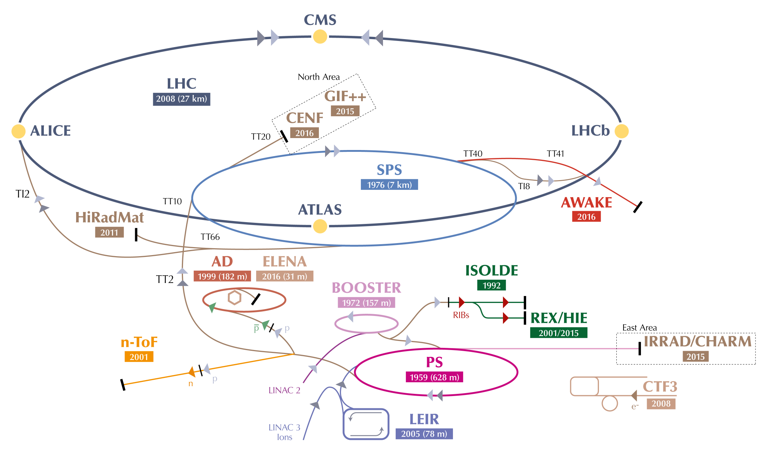
Proton Synchrotron Booster (PSB)
In operation since 1972
1.4 GeV
50 MeV
See R. Steerenberg’s talk
1 of 16 E. Koukovini-Platia
25/9/2019

Slide 3
LHC Injectors Upgrade (LIU)
Currently in a long shutdown
Major upgrades ongoing to double the intensity and brightness of the beam for the HL-LHC era
Linac2 is replaced by Linac4, a normal conducting 160 MeV H⁻ accelerator
Higher intensity beams in the future (ex. ISOLDE) in the framework of Physics Beyond Colliders [1]
2 GeV
160 MeV
LINAC 4
2 of 16 E. Koukovini-Platia
25/9/2019

Slide 4
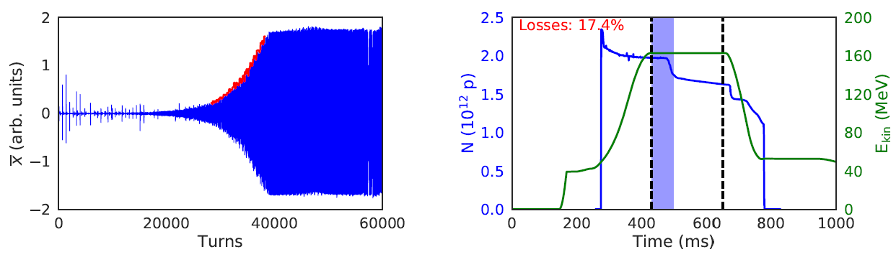
Machine Observables
Without the transverse feedback, we observe exponential growth of the beam centroid in the horizontal plane and beam losses:
Beam losses
Beam centroid growth
3 of 16 E. Koukovini-Platia
25/9/2019

Slide 5
Relevant Facts
Reports of the horizontal head-tail instability in the PSB date back to the ‘70s
Studies in the past [2-5] suspected the resistive wall impedance and a ripple in the power supply of the focusing quadrupoles as the instability source
The external circuit of the extraction kicker (i.e. including cables connecting the kicker to the generator) was first considered as possible driving source of the instability in [6] and later in [7-8]
In routine operation, the transverse feedback (TFB) fully suppresses the instability
What motivated the studies in 2018?
4 of 16 E. Koukovini-Platia
25/9/2019

Slide 6
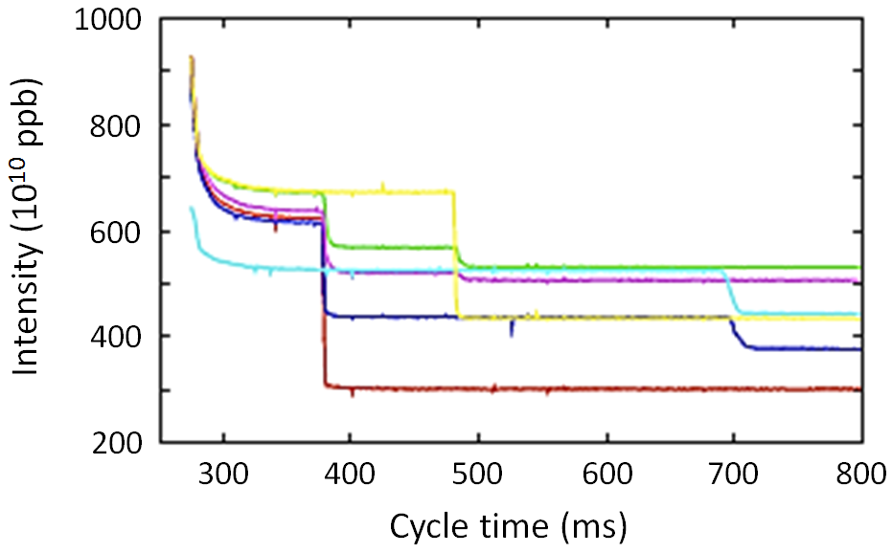
Motivation
Instabilities are observed at different times in the PSB magnetic cycle:
are they all caused by the same impedance source?
c = 370 ms
~160 MeV
c = 478 ms
~330 MeV
c = 690 ms
~1.25 GeV
Courtesy D. Quatraro
New injection energy at 160 MeV after the second long shutdown (LS2)
  What are the instability characteristics at this energy?
  Will the transverse feedback be able to suppress it?
Higher extraction energy at 2 GeV: will there be another critical energy?
Improve our understanding for the underlying mechanism and suggest possible mitigation measures
5 of 16 E. Koukovini-Platia
25/9/2019

Slide 7
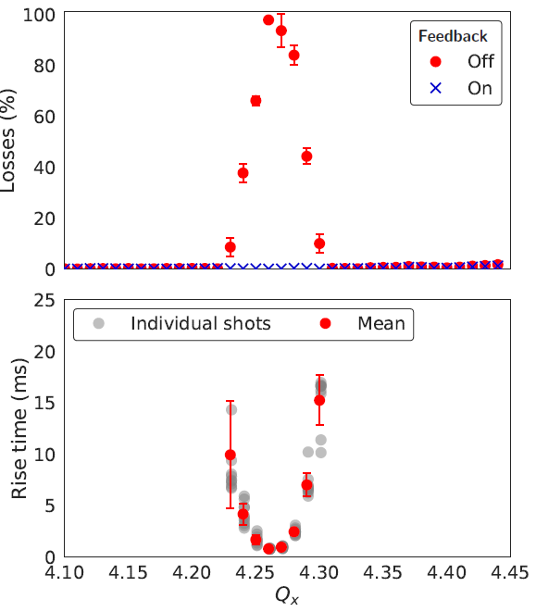
Measurements at 160 MeV
2 x 10¹² ppb, single bunch, single RF and natural chromaticity
Measurements to characterize the instability at 160 MeV mimicking the future injection energy with Linac4
At 160 MeV, the instability is triggered for a range of horizontal tunes
With Linac4, may be limited in intensity reach and choice of working point
Losses up to 100% for certain tunes
0.3 ms rise time or ~300 turns
(T_{s} = 590 turns)
6 of 16 E. Koukovini-Platia
25/9/2019

Slide 8
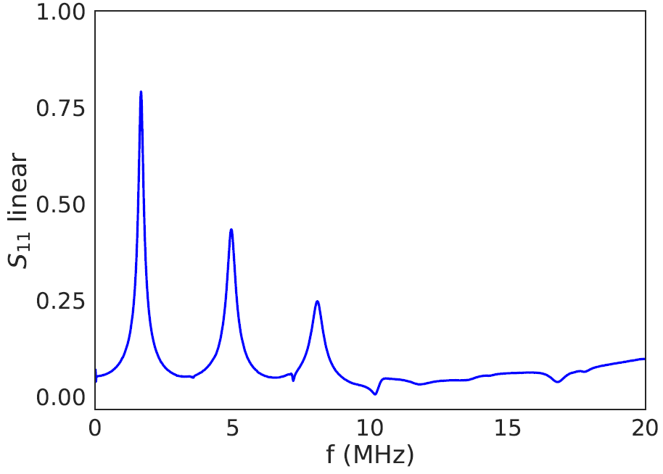
Narrow-Band Resonator as Suspect
Measurements of S₁₁ to identify the frequency of the resonances due to coupling of extraction kicker with external circuit (M. Chanel & C. Carli)
1.65 MHz
Lowest resonance suspected to be associated to the unmatched terminations of the PSB extraction kicker
7 of 16 E. Koukovini-Platia
25/9/2019

Slide 9
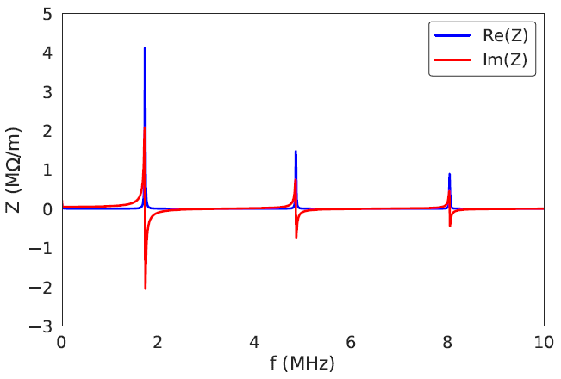
Impedance Model of Extraction Kicker
Horizontal impedance model of the PSB
extraction kicker due to coupling with cables
(using transmission line theory)
First resonance at 1.72 MHz
Narrow-band resonances with a high Q value in the order of 100 (due to very low attenuation constant of the cables)
Shunt impedance in the order of MΩ/m
Courtesy C. Zannini
See C. Zannini’s talk this afternoon
8 of 16 E. Koukovini-Platia
25/9/2019

Slide 10
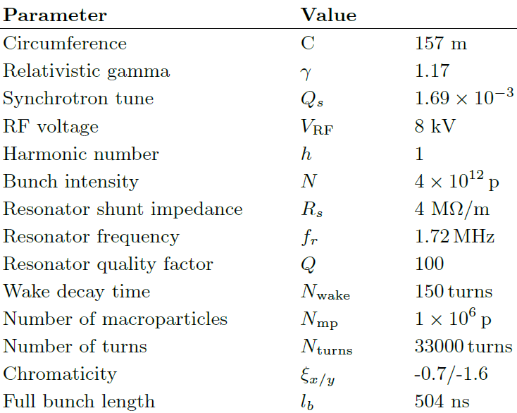
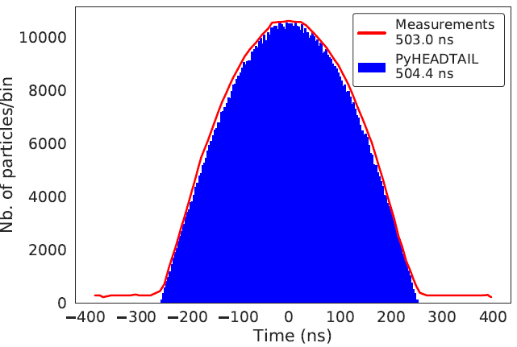
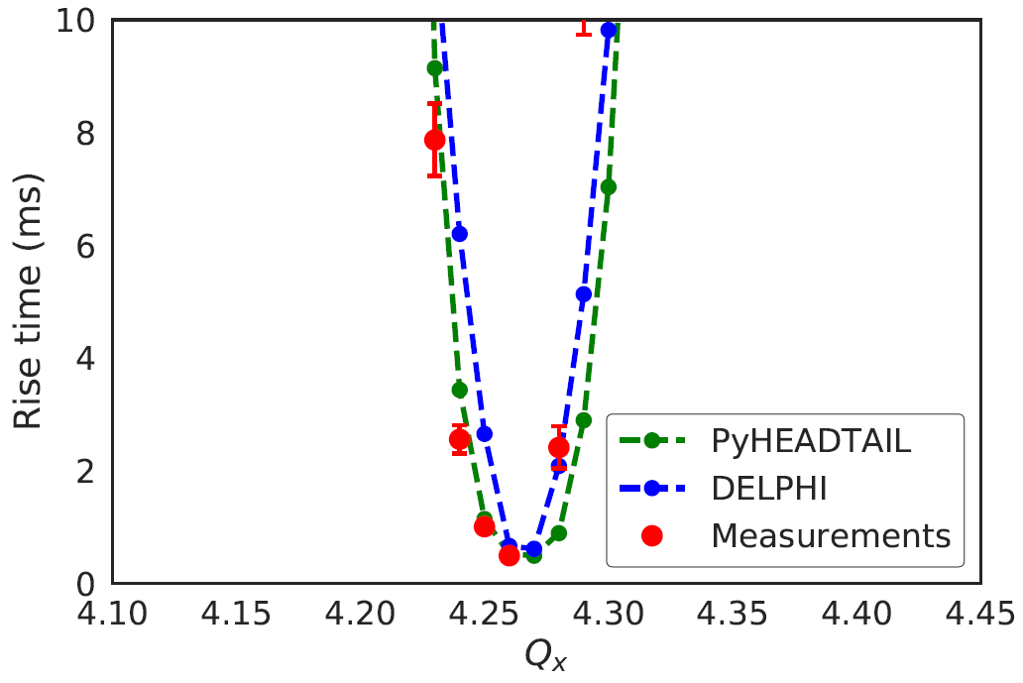
Simulations with Narrow-Band Resonator
PyHEADTAIL [9] simulations
Non-linear synchrotron motion, parabolic matched bunch distribution
9 of 16 E. Koukovini-Platia
25/9/2019

Slide 11
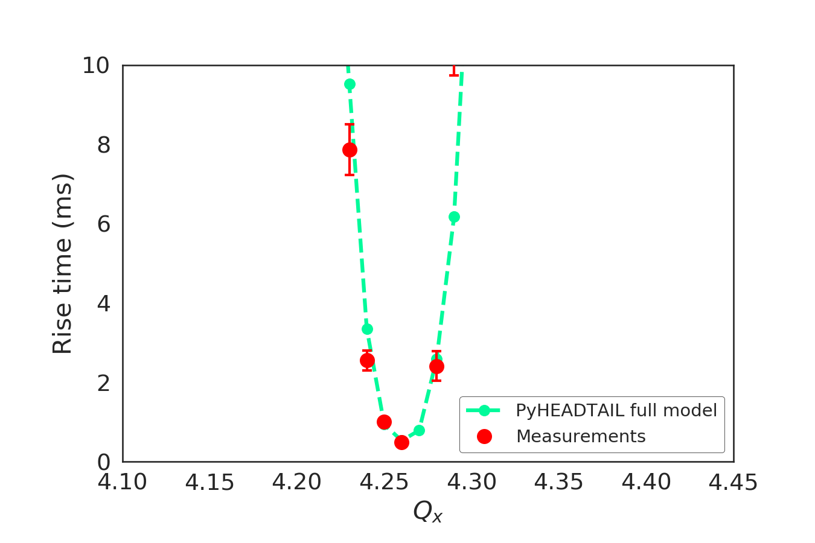
Simulations with Full PSB Impedance Model
What about a more realistic impedance model including
resistive wall, indirect space charge, flanges, step transitions, injections kickers, extraction kicker with cables
Very good agreement between PyHEADTAIL using the full PSB impedance model and measurements
10 of 16 E. Koukovini-Platia
25/9/2019

Slide 12
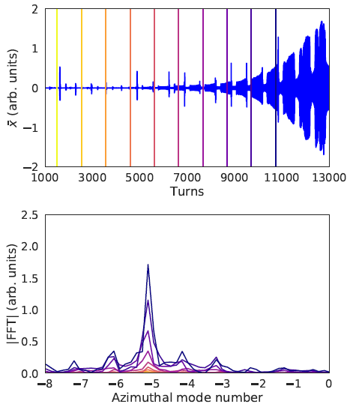
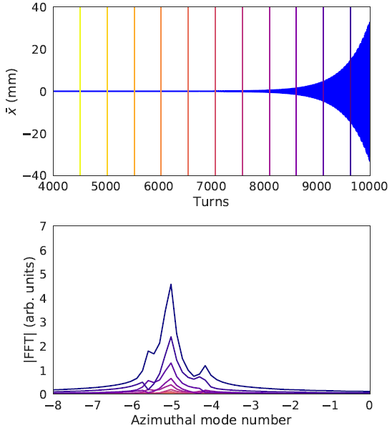
Azimuthal Mode Number of the Instability
Measurements
PyHEADTAIL (full imp. model)
The FFT from the measured data indicates that the instability is of azimuthal
mode number -5, in very good agreement with PyHEADTAIL
11 of 16 E. Koukovini-Platia
25/9/2019

Slide 13
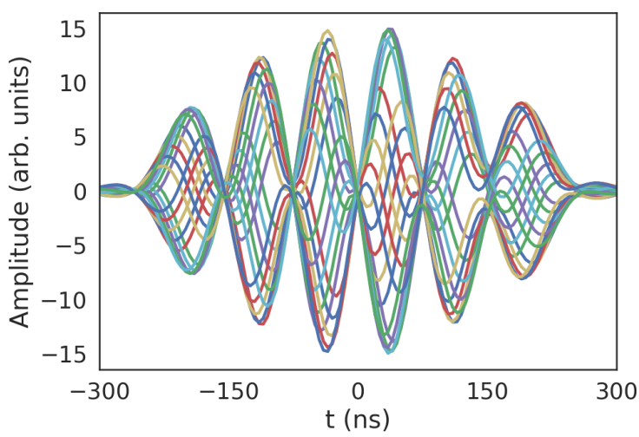
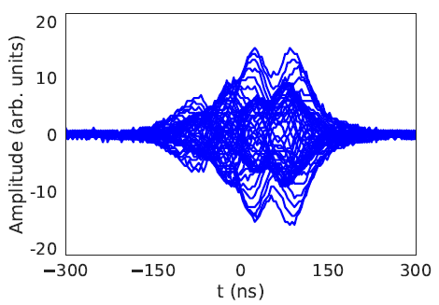
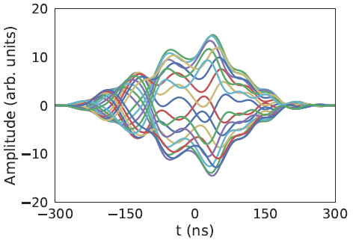
Radial Mode Number of the Instability
DELPHI simulations
Measured head-tail
modes with pick-up
Head
Tail
Head
Tail
Without indirect space charge
Head
Tail
With indirect
space charge
Single bunch, Q_{x} = 4.26, N = 4 x 10¹² p
The effect of direct space charge has also been included in PyHEADTAIL simulations. Although results are preliminary, we do not observe a significant effect on the instability.
The radial head-tail modes agree well for a tune of 4.26 when indirect space charge is included in simulations. However, over the whole range of explored tunes the number of nodes might differ by few units. Something missing?
12 of 16 E. Koukovini-Platia
25/9/2019

Slide 14
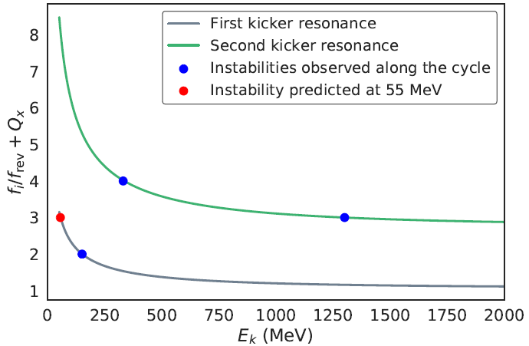
Analytical Studies
The impedance model can be used to predict the expected energies at which the instability will occur. Condition to drive an instability [10]:
          f_{i}/f_{rev} + Q_{x} = n
Any integer
Resonant frequency of the impedance
Revolution frequency
Horizontal tune
All observed instabilities in the PSB at specific energies are now explained
No further instability is predicted above 1.25 GeV and up to 2 GeV
Instability predicted at ~55 MeV
~330 MeV
~55 MeV
~1.25 GeV
~160 MeV
13 of 16 E. Koukovini-Platia
25/9/2019

Slide 15
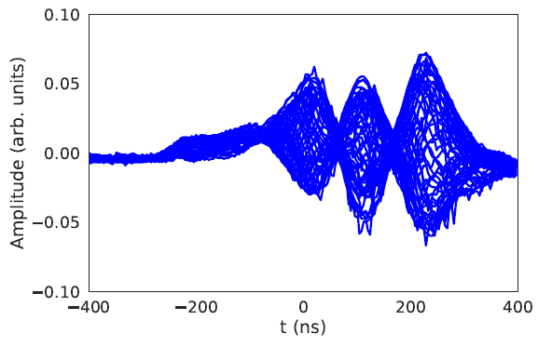
Instability at 55 MeV
The theoretical analysis predicts a horizontal instability at ~55 MeV which was never reported in the past
Dedicated measurements using the horizontal pick-up were done
A head-tail instability
is detected at ~55 MeV
Theory and machine measurements are in excellent agreement
A single impedance source, i.e. the resonances due to the extraction kicker system with cables, can explain all observations
14 of 16 E. Koukovini-Platia
25/9/2019

Slide 16
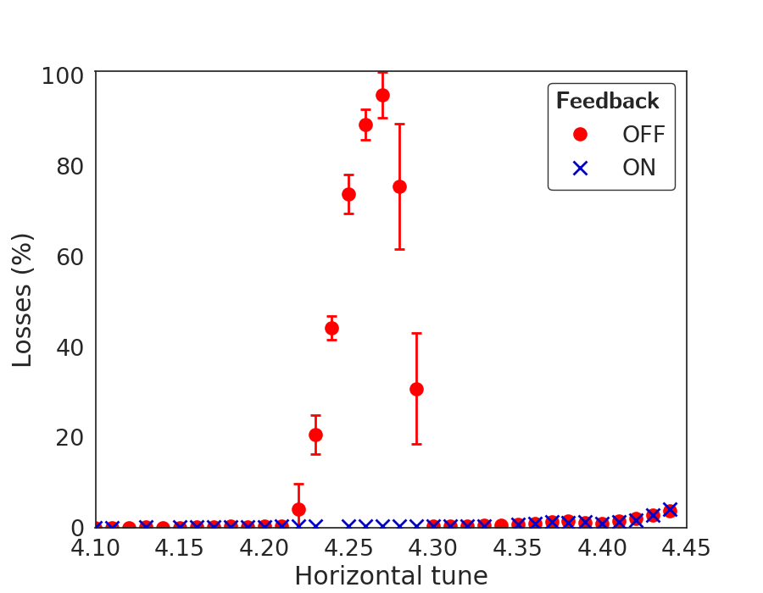
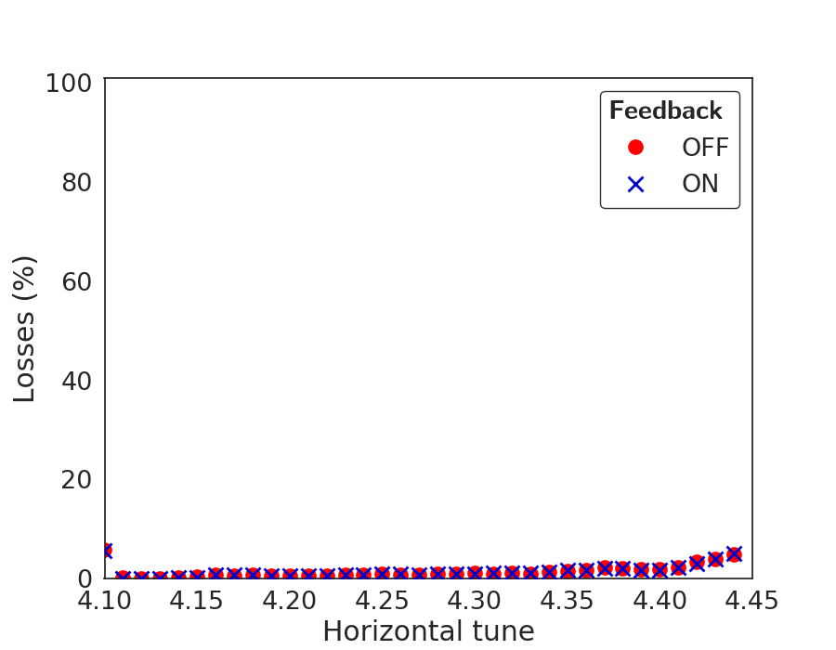
Source of Instability
Kicker intervention to modify temporarily (i.e. not usable in operation), one of the filter networks at the main switch end of the transmission cables (many thanks to M. Barnes and L. Sermeus)
Kicker in nominal configuration
Modified kicker termination for MD
No sign of instability!
The resonances introduced by the cables of the PSB extraction kicker system are
the impedance source responsible for all observed instabilities
15 of 16 E. Koukovini-Platia
25/9/2019

Slide 17
Conclusions
The long-standing unknown source of the horizontal PSB instability has been found: the resonances introduced by the cables of the PSB extraction kicker system are responsible for all observed instabilities
Similar experience at J-PARC [11]
Will the TFB be able to cope with the instability after LS2?
  Updated hardware of the TFB (installed in 2018 for the LIU) is expected to cope with the instability [12]
  Possible permanent solutions are being investigated
Another critical energy up to 2 GeV?
  Analytical studies do not predict another instability
Simulations
  The measured rise time vs. tune can be well reproduced using a
    single narrow-band resonator
    the full PSB impedance model
  The azimuthal mode number also agrees very well with the measurements when the full PSB model is used
  Some issues reproducing the radial modes for all tunes: suggests that some additional ingredient might be missing in the model
16 of 16 E. Koukovini-Platia
25/9/2019

Slide 18
References
[1] E. Koukovini Platia et al., Protons Beyond the LHC Injectors Upgrade Project, CERN-PBC-REPORT-2019-004, (2019).
[2] J. Gareyte and F. Sacherer, in Proc. of HEACC’74, Stanford, California, US, 2-7 May, 1974.
[3] D. Quatraro, A. Findlay, B. Mikulec, and G. Rumolo, in Proc. of IPAC’10, Kyoto, Japan, 23-28 May, 2010.
[4] V. Kornilov, S. Aumon, A. Findlay, B. Mikulec, and G. Rumolo, MD on Head-Tail Instability in the PS Booster, Tech. Rep., CERN, 2013.
[5] M. McAteer, C. Carli, V. Forte, G. Rumolo, and R. Tomás, in Proc. of IPAC’14, Dresden, Germany, 16-20 June, 2014.
[6] G. Nassibian and F. J. Sacherer, Nuclear Instruments and Methods 159, 21 (1979).
[7] D. Quatraro, A. Blas, M. Chanel, A. Findlay, B. Mikulec, and G. Rumolo, in Proc. of PAC’09, Vancouver, BC, Canada, 4-8 May, 2009.
[8] C. Zannini, Electromagnetic simulation of CERN accelerator components and experimental applications, Ph.D. thesis, EPFL (2013).
[9] E. Métral et al., IEEE Transactions on Nuclear Science 63, 1001 (2016).
[10] J. Gareyte and F. Sacherer, in Proc. of 9th International Conference on High Energy Accelerators (HEACC'74), Stanford, California, US, 2-7 May (1974).
[11] P. K. Saha et al., Phys. Rev. Accel. and Beams 21, 024203 (2018).
[12] A. Blas and G. Kotzian, in Proc. of HB2018, Daejeon, Korea, 18-22 June, 2018.

