Slide 1





Mitigation of Coherent Beam Instabilities in FCC-ee
M.Zobov, E.Belli, M.Migliorati
ICFA mini-Workshop MCBI-2019
Zermatt, 23-27 September 2019

Slide 2
OUTLINE
Future Lepton Circular Collider: brief introduction and parameters
FCC-ee wake fields and coupling impedance
Impedance-related beam instabilities
Two stream instabilities: ion instabilities and e-cloud effects
Other effects
Summary

Slide 3
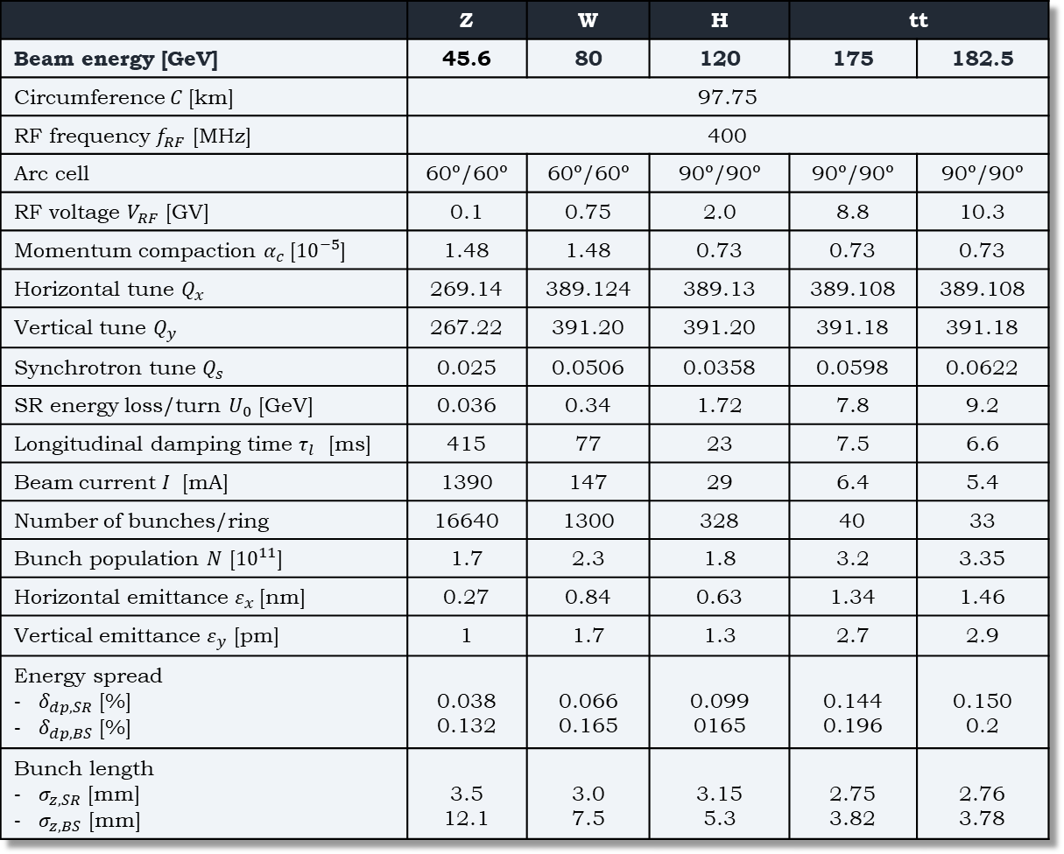
FCC-ee parameters
1364 contributors
from 351 institutes
Lower beam energy, longer damping times, higher beam intensities and highest number of bunches

Slide 4
FCC-ee is a particle factory with an unprecedented luminosity
LEP FCC-ee
Main ingredients
Two separate rings allow colliding many bunches
Crab waist collision concept (low emittance, low beta, high beam-beam parameter)
Longer perimeter allows storing higher intensity beams with the same synchrotron radiation losses

Slide 5
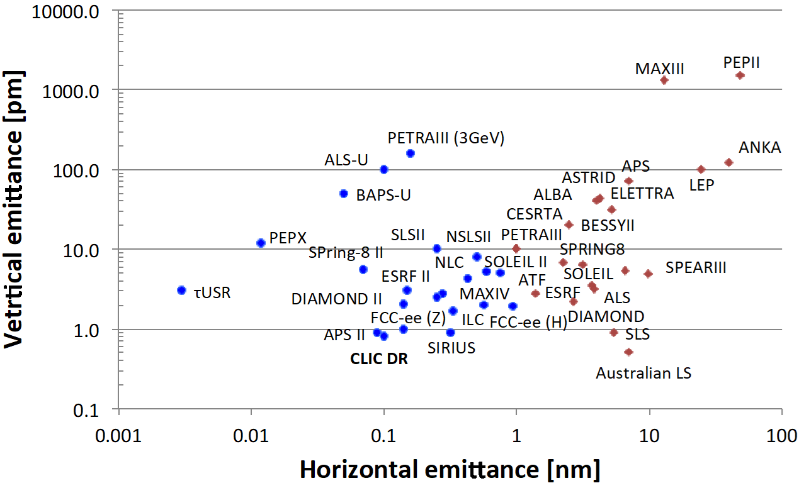
FCC-ee emittance is comparable with emittances of modern diffraction limited synchrotron light sources
Courtesy Yannis Papaphilippou

Slide 6
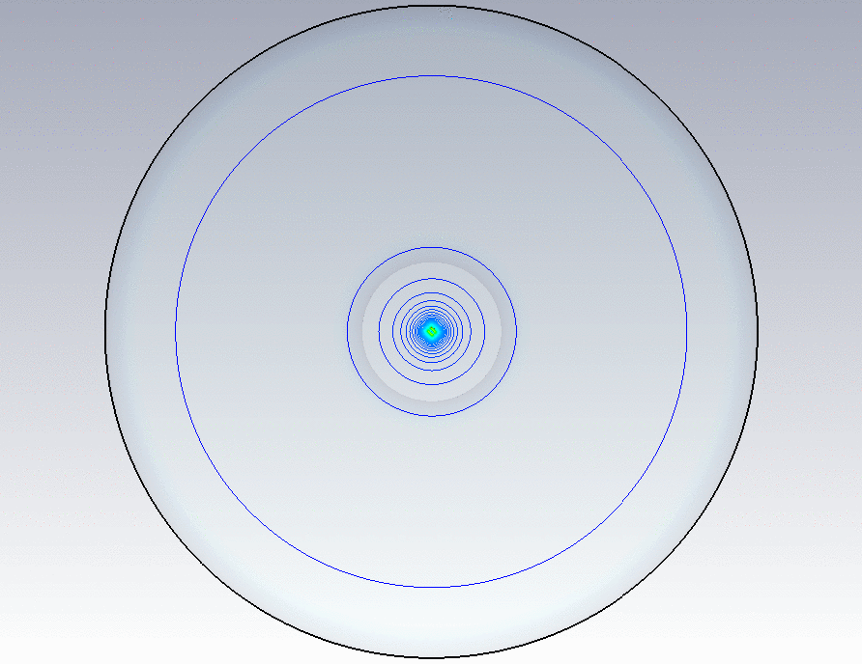
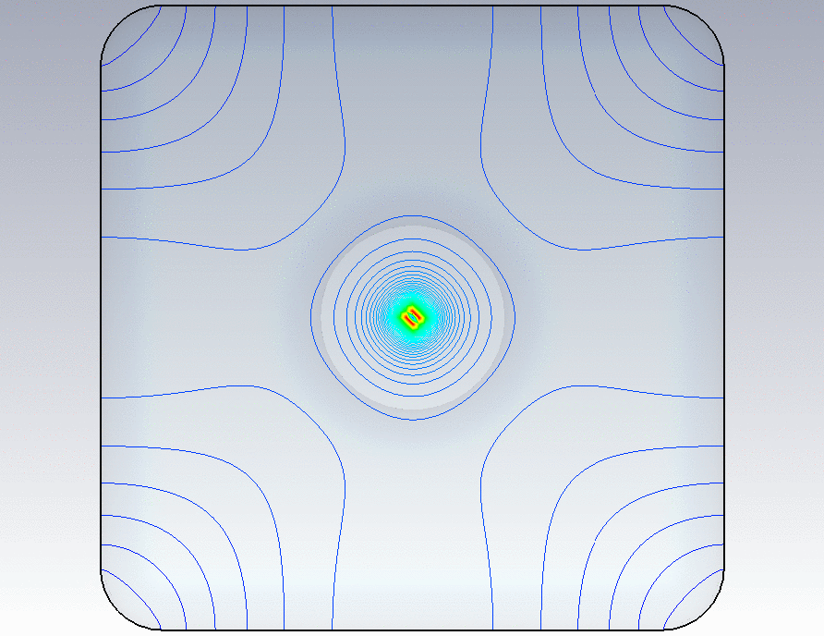
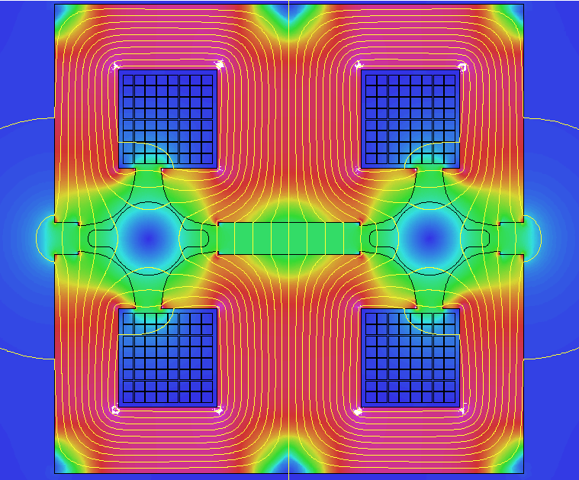
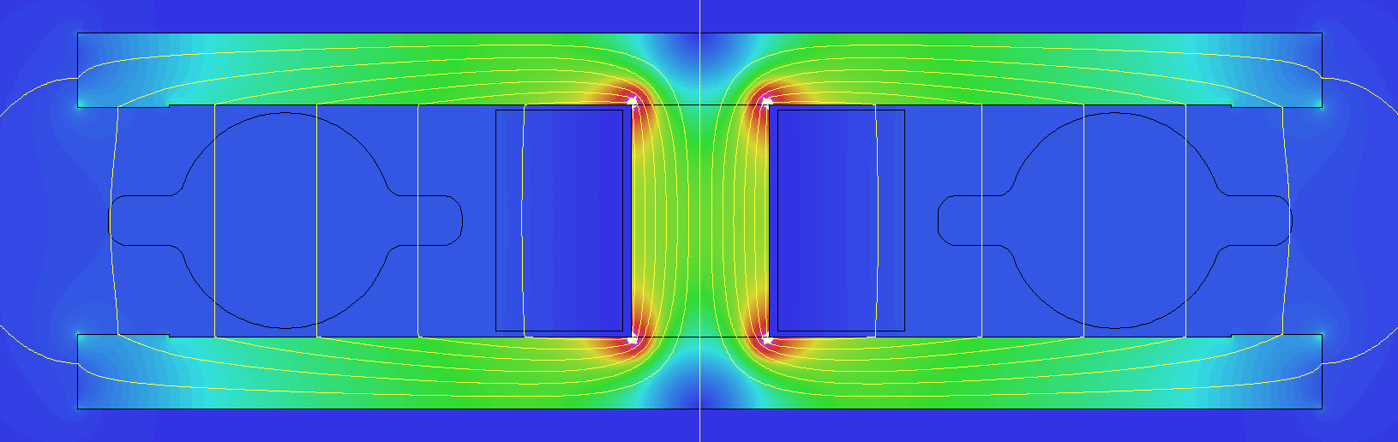
Beam Pipe Cross Section
The round cross section has been chosen in order to avoid the betatron tune shift with multibunch beam current due to quadrupolar resistive wall wake fields
Additional antechambers are foreseen for pumping purposes and installation of synchrotron radiation absorbers
Twin dipole magnet
Quadrupole magnet
From Milanese’s talk during FCC-ee Week, 2017

Slide 7
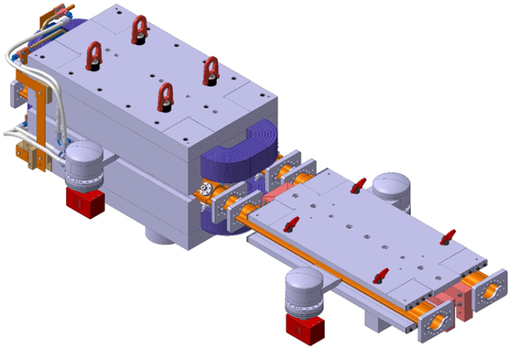
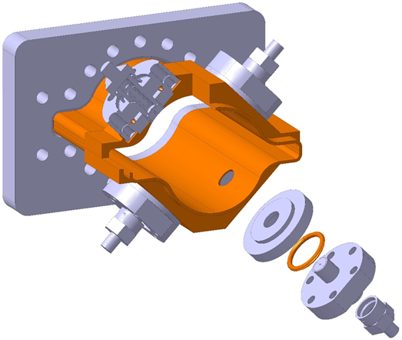
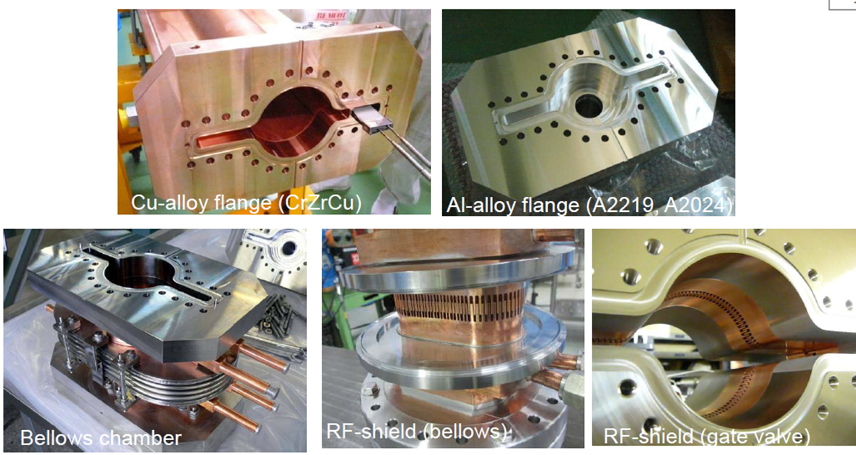
Beam pipes of other vacuum chamber components should possibly have similar shape
CERN design
Machined BPM block
KEK design
From R.Kersevan and C.C.Garion talk during FCC Week 2019

Slide 8
Impedance of a coated beam pipe
A coating is required to suppress the e-cloud (beam induced multipacting) in the positron ring and/or for pumping purposes in both rings: NEG, TiN, AC
Longitudinal impedance
Transverse impedance

Slide 9
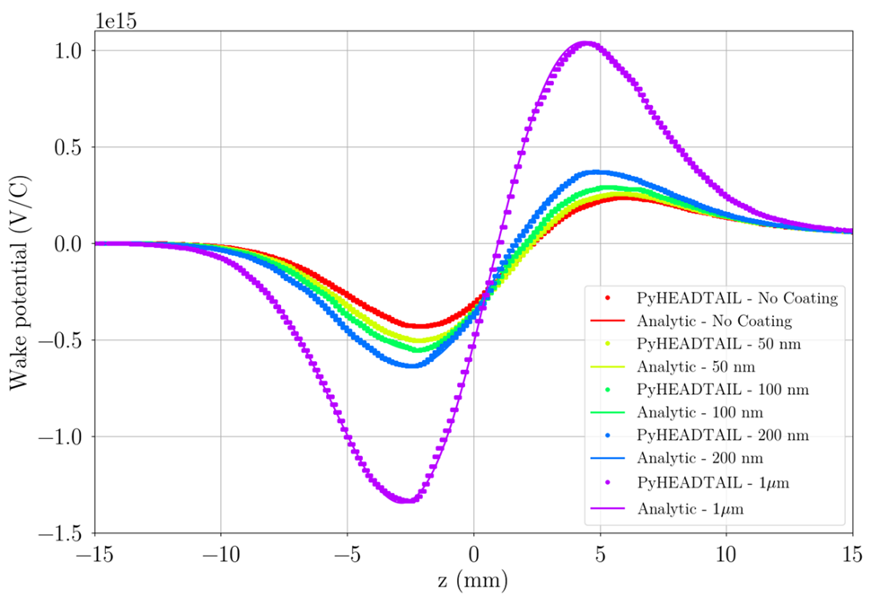
For thin resistive coatings
The real part of the impedance does not depend on both the coating thickness and coating conductivity.
The imaginary part has an additional term depending on the coating thickness, while the dependence on the conductivity is very weak.
Bunch length = 3.5 mm, coating conductivity = 2x10⁶ S/m
1 micron coating
No coating
M.Migliorati, E.Belli and M.Zobov, Phys.Rev.Accel.Beams 21 (2018) 041001

Slide 10
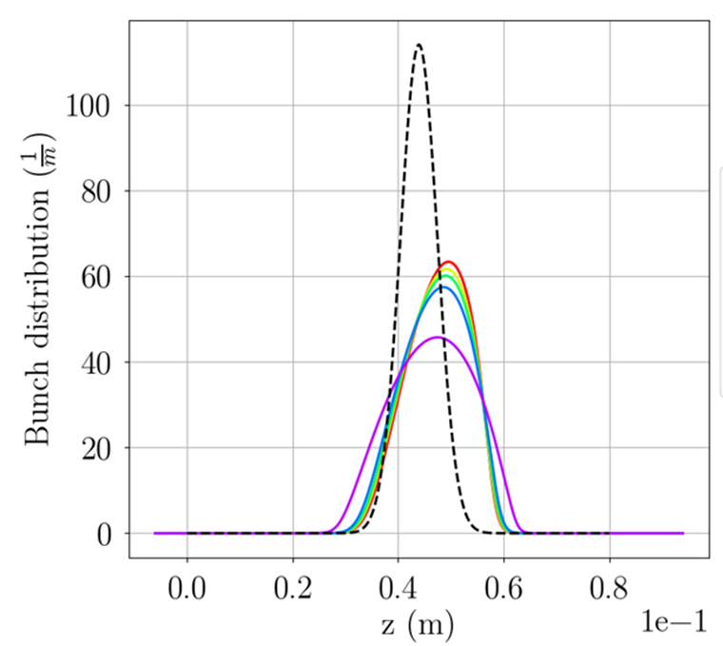
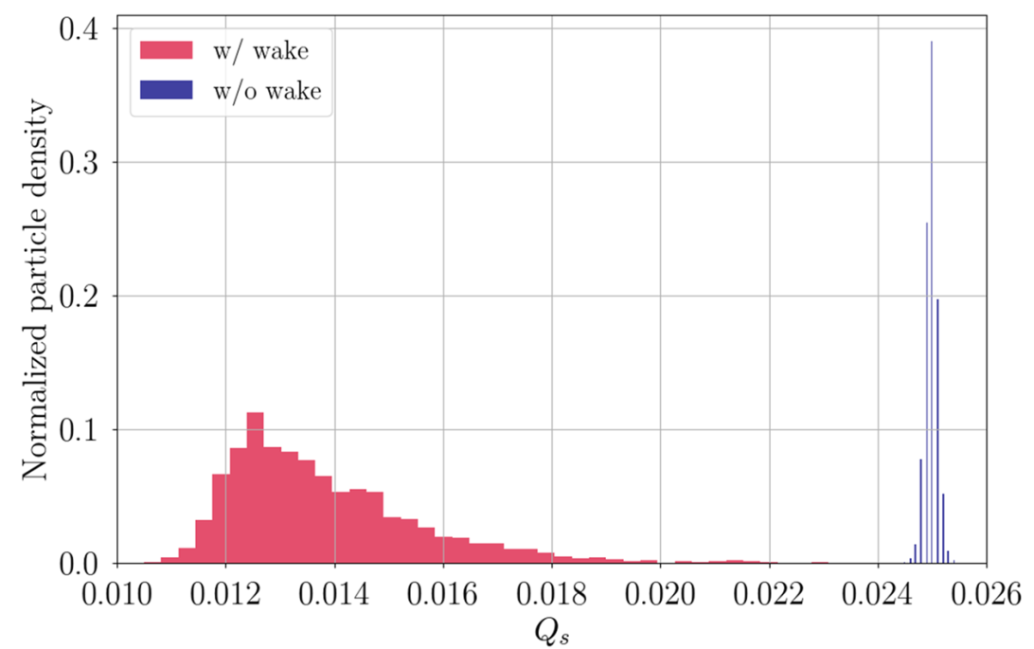
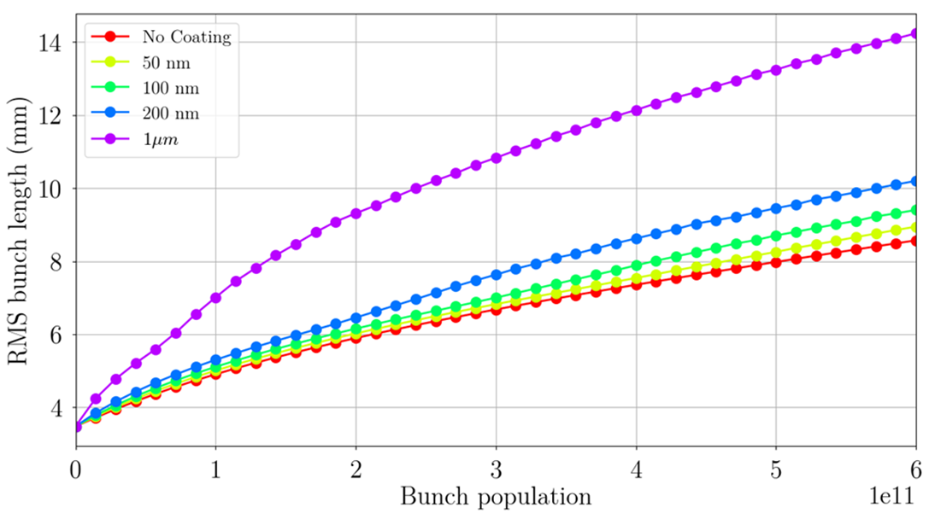
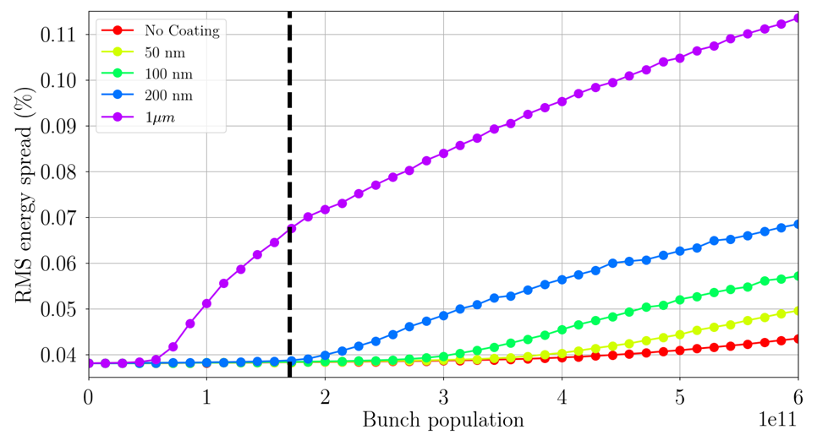
Single bunch longitudinal dynamics
Bunch shape distortion
Synchrotron tune shift and spread
Bunch lengthening
Energy spread growth
M.Migliorati, E.Belli and M.Zobov, Phys.Rev.Accel.Beams 21 (2018) 041001

Slide 11
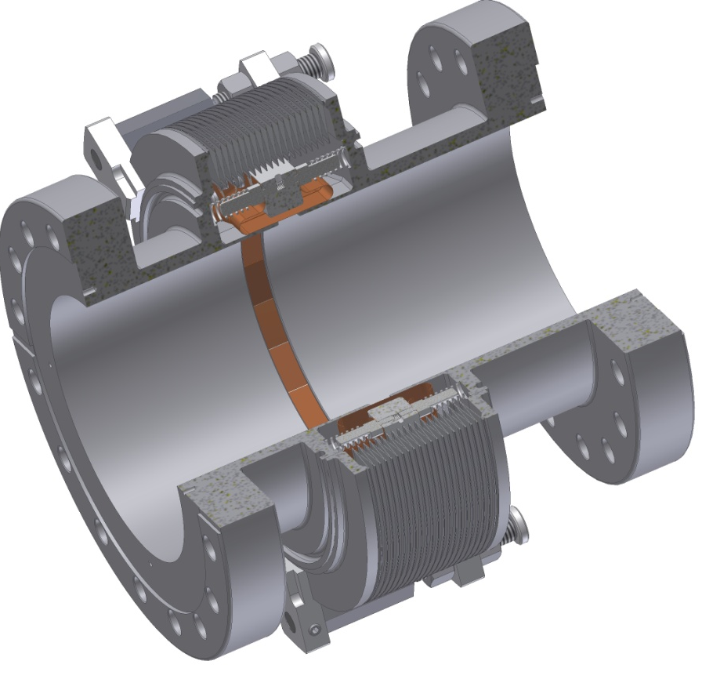
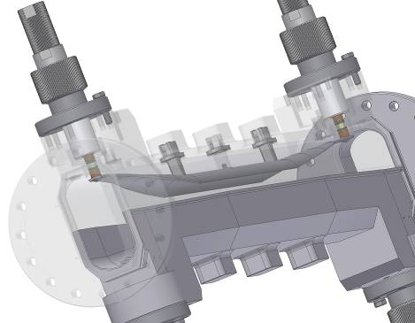
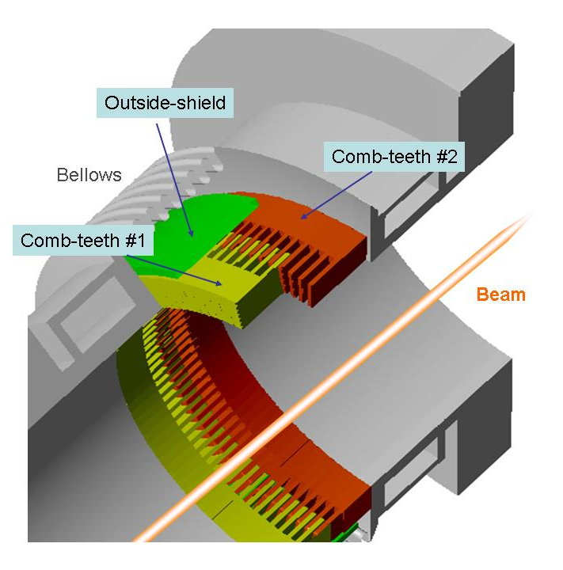
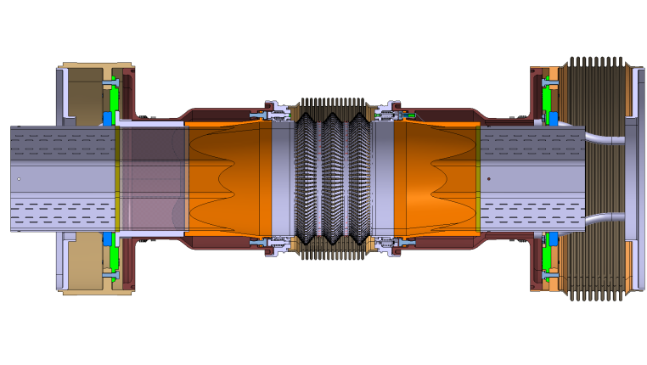
Best design solutions of vacuum chamber elements used in modern syncrotron sources and particle factories are considered for implementation in FCC-ee
Some Examples
DAΦNE bellows
DAΦNEinjection kicker
KEKB bellows
DAΦNE long. feedback kicker
SuperKEKB collimator
SuperKEKB gate valve
CERN bellows
Sirius BPM

Slide 12
HOM absorbers in the IR
A.Novokhatski, E.Belli et al, PRAB, 20, 111005
IR geometry optimisation is underway
From the talk of A.Novokhatski during FCC Week 2019

Slide 13
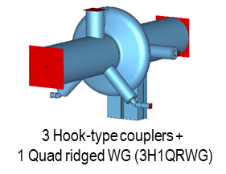
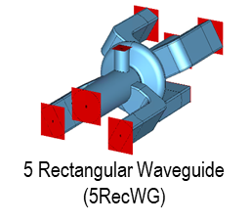
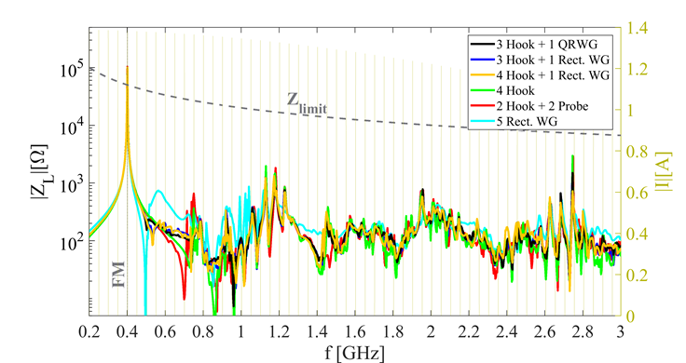
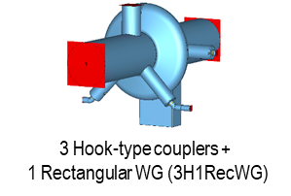
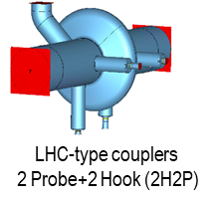
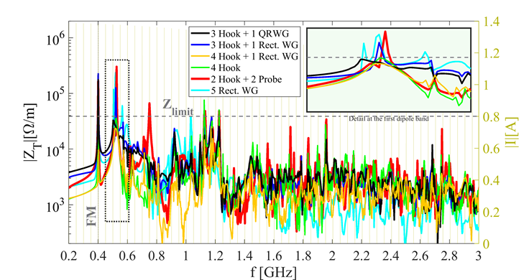
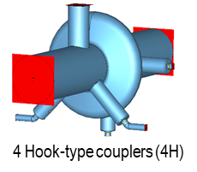
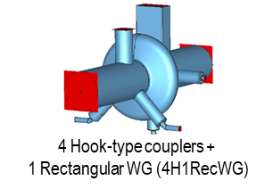
Different HOM damping techniques are considered for RF cavities
From the talk of Shahnam Gorgi Zadeh during FCC Week 2019

Slide 14
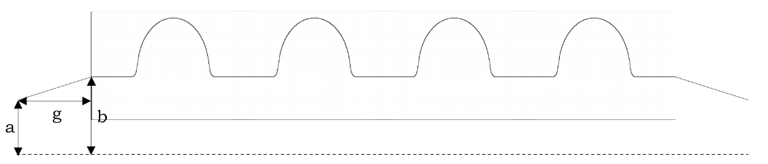
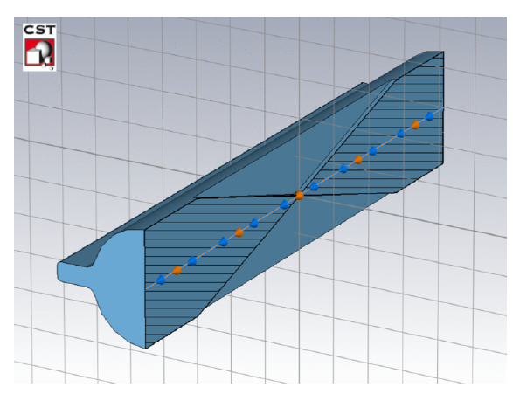
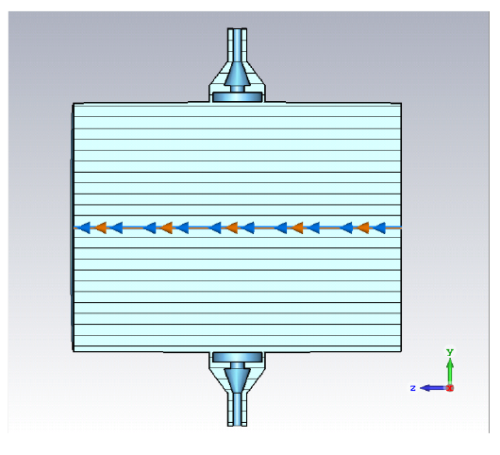
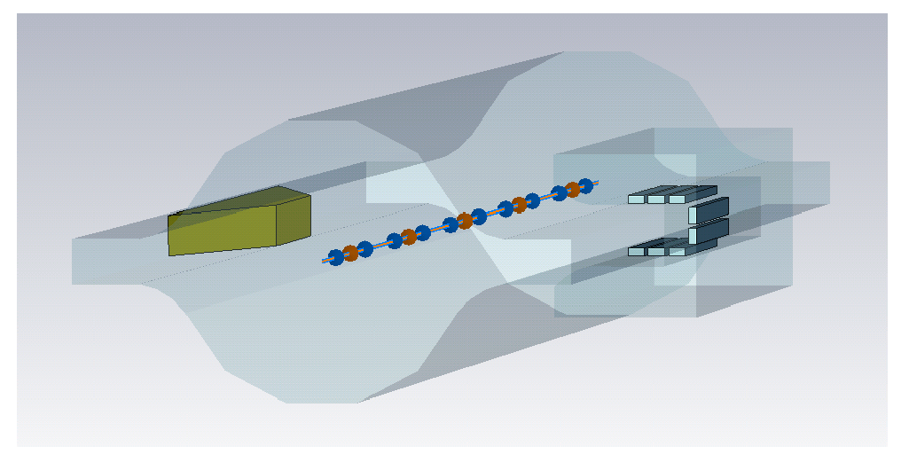
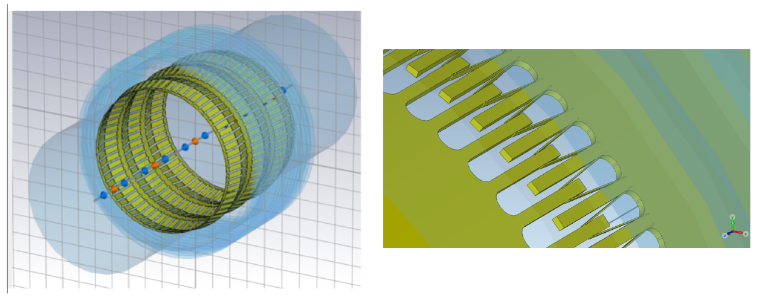
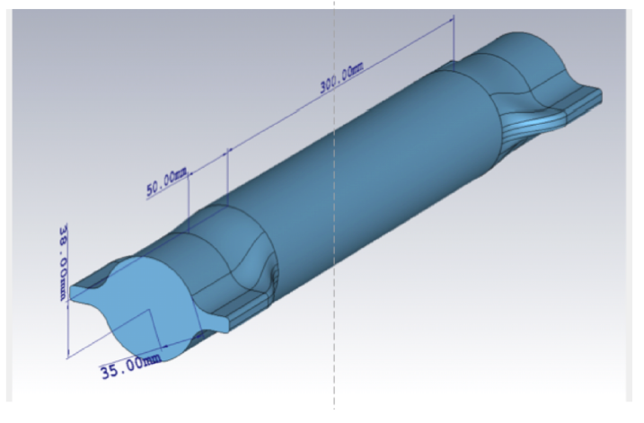
The wake fields and impedance have been evaluated for several most important vacuum chamber components

Slide 15
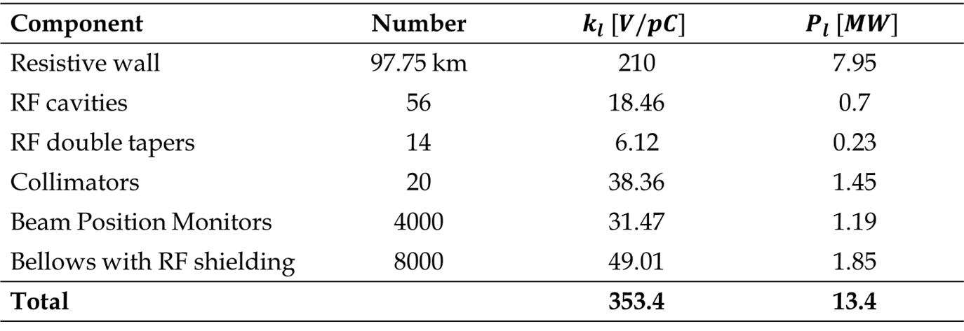
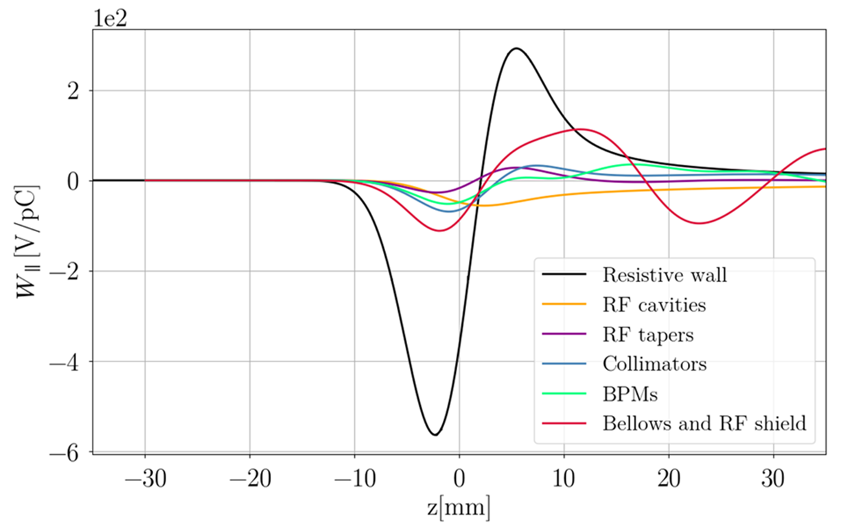
Longitudinal Impedance Budget
*100 nm NEG coating is considered

Slide 16
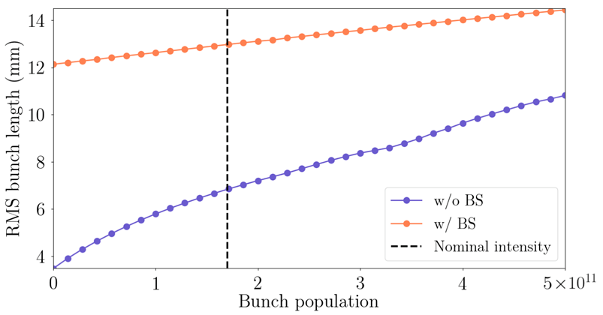
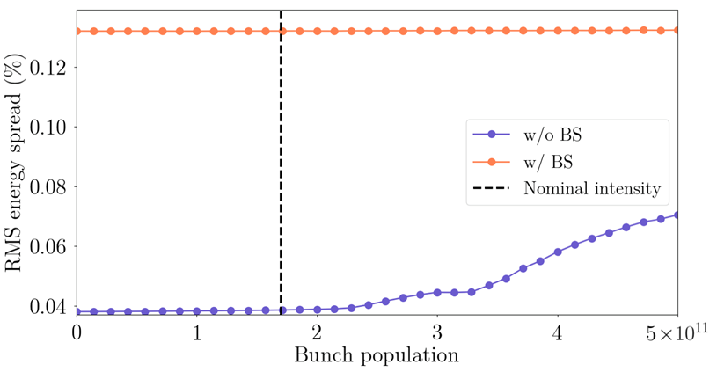
Bunch length and energy spread versus bunch intensity

Slide 17
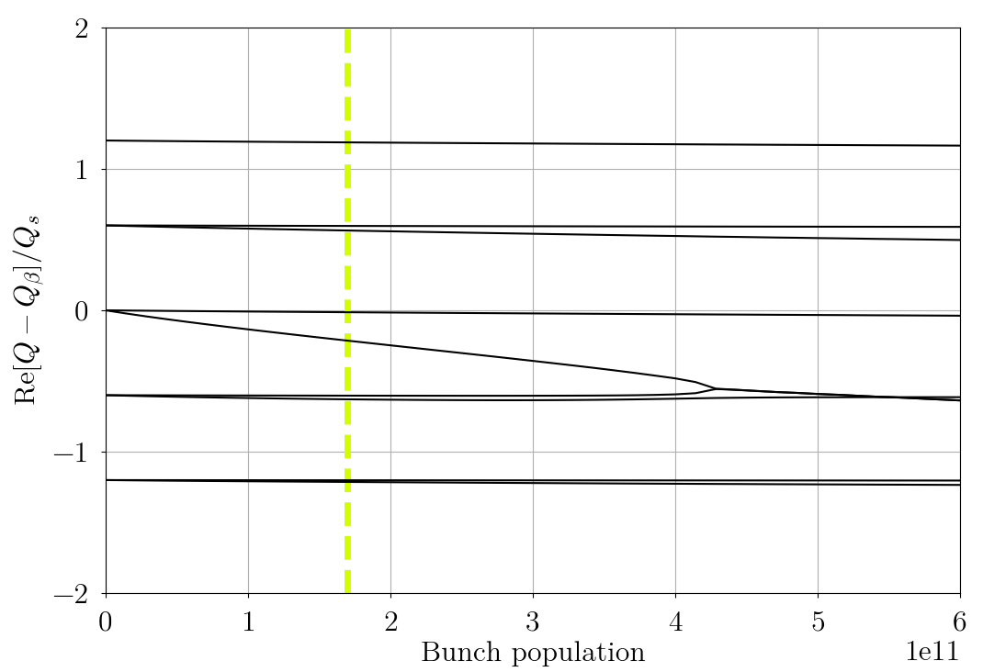
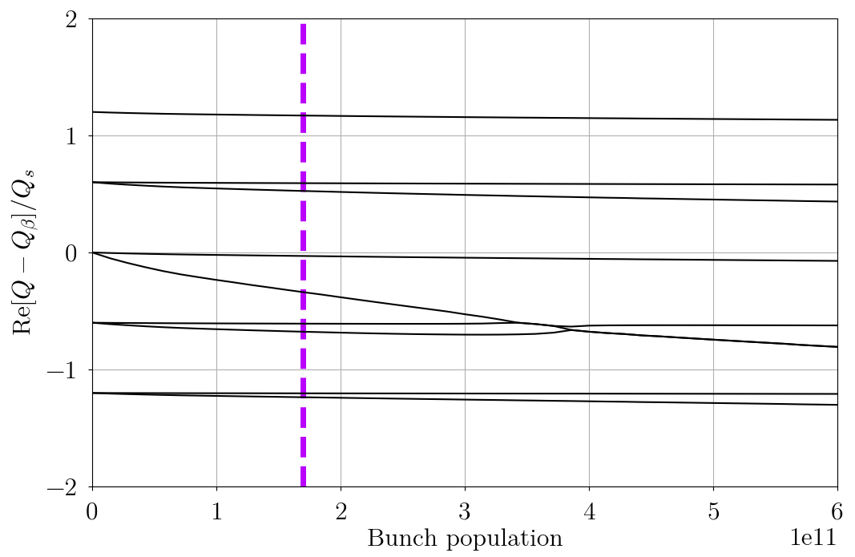
Transverse mode coupling instability (TMCI)
Differently from the longitudinal microwave instability TMCI is destructive.
It takes place when frequencies of different modes of transverse internal bunch oscillations merge
50 nm coating
1μm coating
Instability threshold
Nominal bunch current

Slide 18
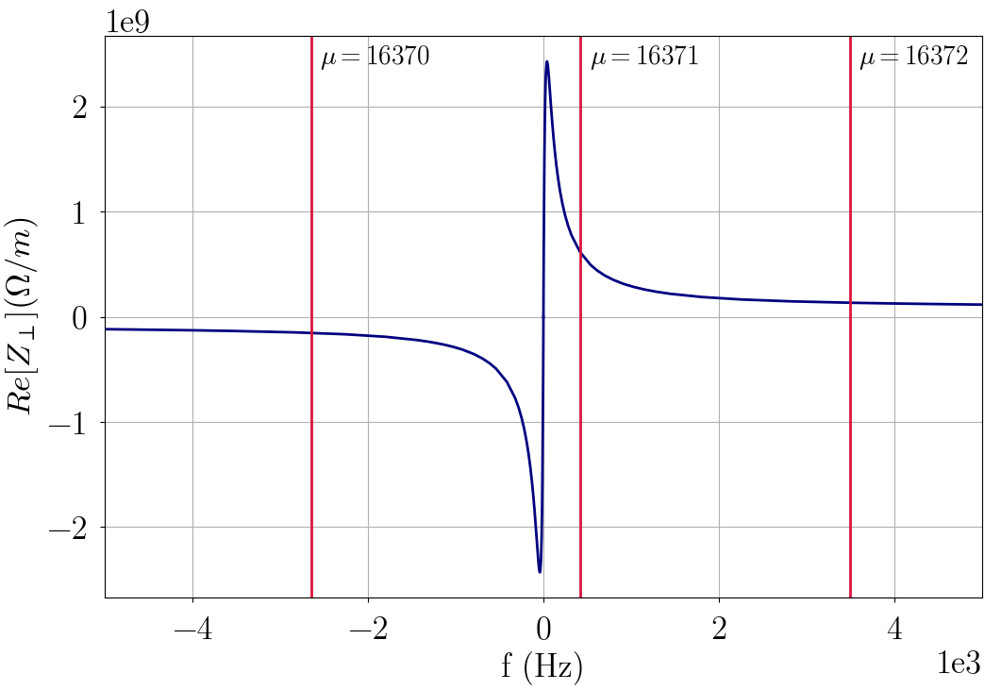
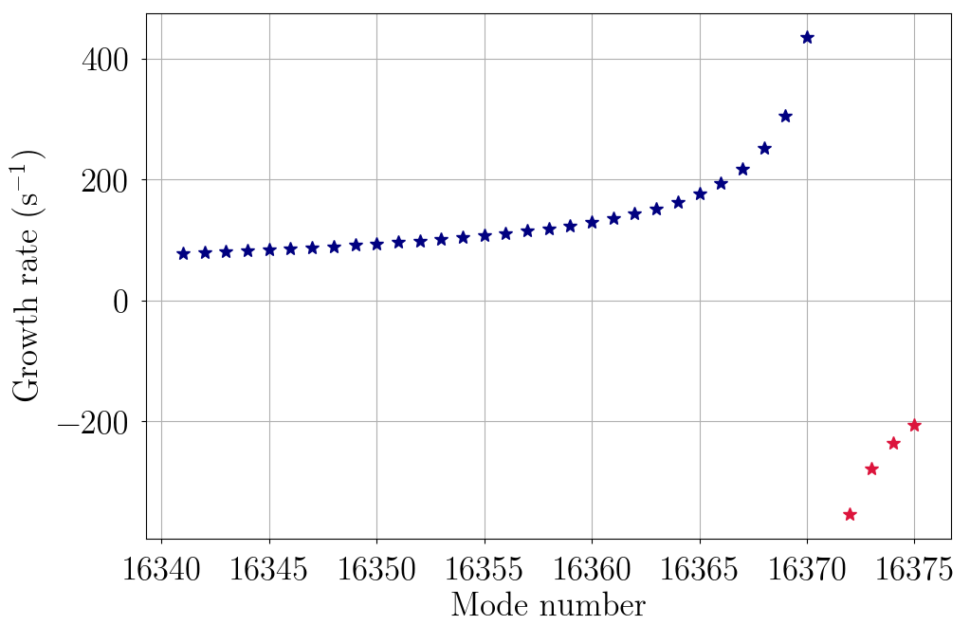
Transverse Coupled Bunch Instability
stable region
unstable region
The most dangerous mode
Its growth time is about 7 revolution turns
A robust feedback is required for the instability suppression!

Slide 19
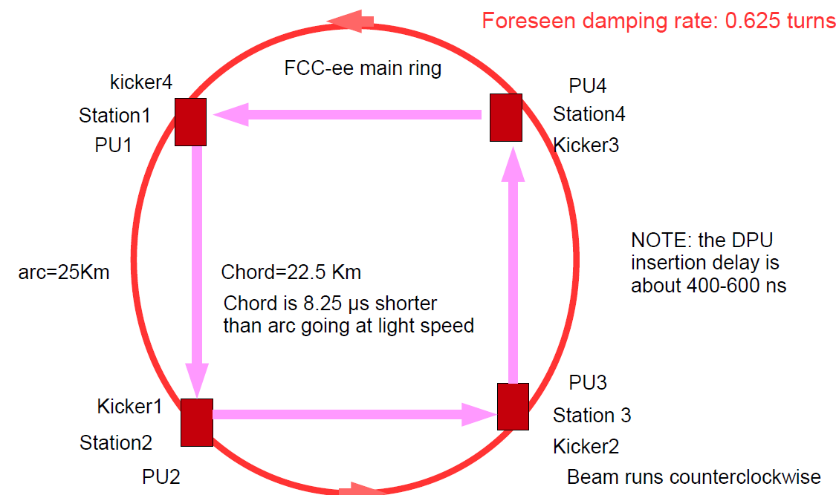
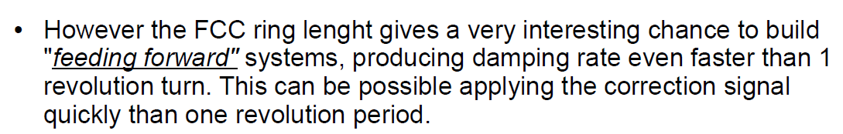
Distributed feedback system
From A.Drago talk at ICFA mini-Workshop on Impedances and Beam instabilities, Benevento, 19-22 September 2017

Slide 20
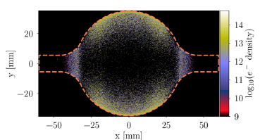
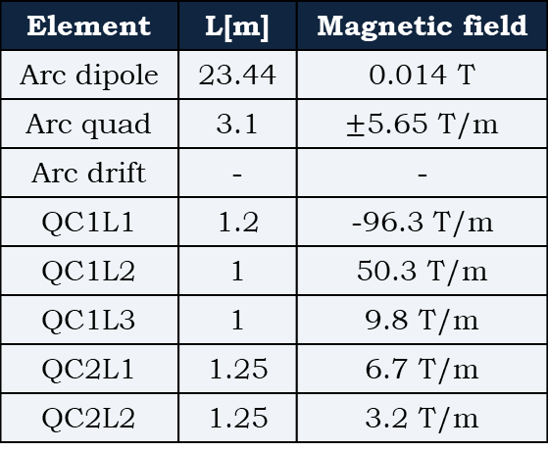
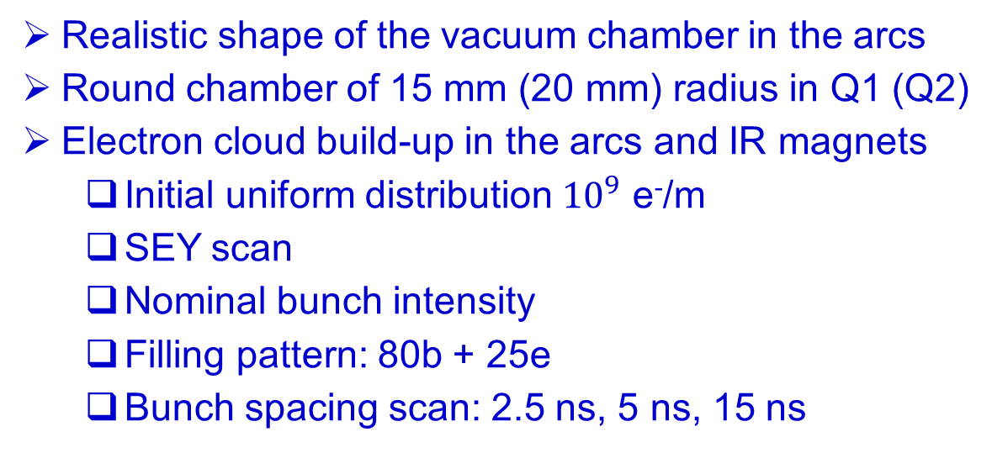
Electron cloud buildup at 45.6 GeV
Element | L[m] | Magnetic field
Arc dipole | 23.44 | 0.014 T
Arc quad | 3.1 | $±$5.65 T/m
Arc drift | - | -
QC1L1 | 1.2 | -96.3 T/m
QC1L2 | 1 | 50.3 T/m
QC1L3 | 1 | 9.8 T/m
QC2L1 | 1.25 | 6.7 T/m
QC2L2 | 1.25 | 3.2 T/m
Realistic shape of the vacuum chamber in the arcs
Round chamber of 15 mm (20 mm) radius in Q1 (Q2)
Electron cloud build-up in the arcs and IR magnets
  Initial uniform distribution ${10}^{9}$ e⁻/m
  SEY scan
  Nominal bunch intensity
  Filling pattern: 80b + 25e
  Bunch spacing scan: 2.5 ns, 5 ns, 15 ns
E.Belli’s PhD thesis

Slide 21
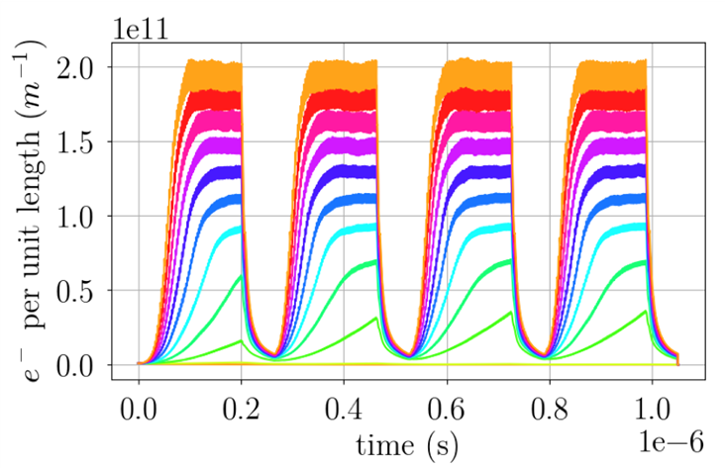
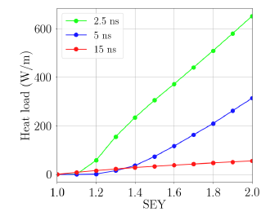
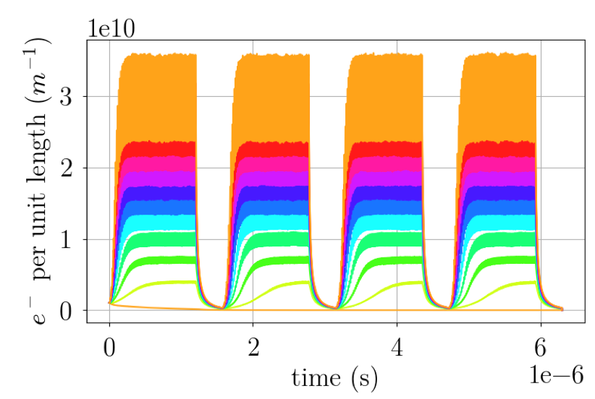
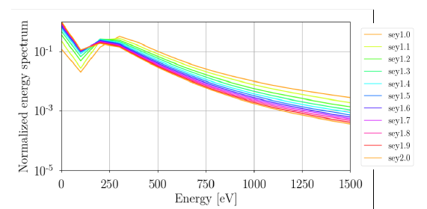
e-cloud buildup and heat load in the arc dipoles
2.5 ns
15 ns

Slide 22
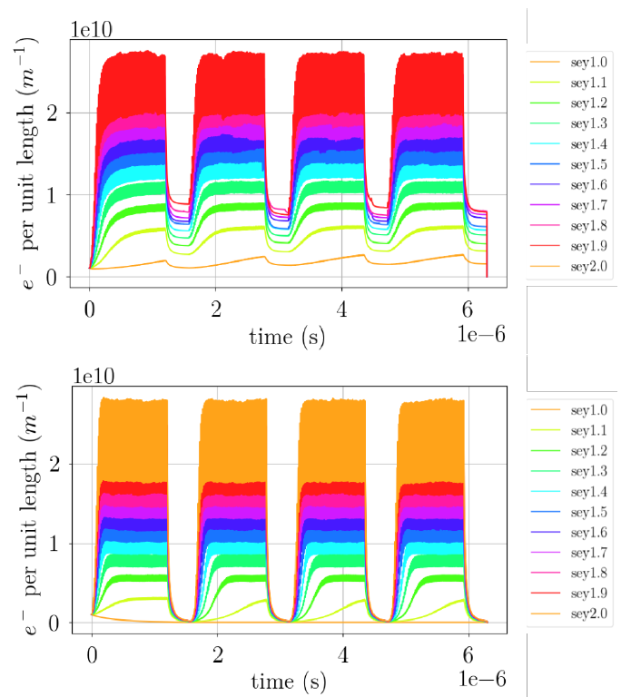


e-cloud buildup and heat load in the arc quadrupoles (top) and drifts (bottom)
15 ns

Slide 23




e-cloud heat load in the IR quadrupols
2.5 ns
5 ns
15 ns
Threshold SEY for IR quadrupoles

Slide 24


e-cloud single bunch instability threshold
Electron density threshold
K.Ohmi and F.Zimmermann, Phys.Rev.Lett.85 (2000) 3821
To be compared with the average density of 1.64x10¹⁰ m⁻³ near the central area estimated by Ohmi-san for FCC-ee Z (Int.J.Mod.Phys. A34 (2019) 1940001): nominal intensity, 20 ns, no antechamber

Slide 25




An extensive measurement campaign was performed at CERN to characterize TiZrV films with thickness below 250 nm
After 4th activation cycle of 4 hours
After 4th activation cycle of 24 hours
E.Belli et al., Phys.Rev.Accel.Beams 21 (2018) no.11, 111002

Slide 26






Ion instabilities in FCC-ee
(Courtesy L.Mether, A.Oeftiger and G.Rumolo)
 | Mass number, A | Ionization cross-section, σ [Mbarn]
H₂ | 2 | 0.5
N₂ | 28 | 2.0
CO | 28 | 2.0
CO₂ | 44 | 2.0

Slide 27
Partial pressure thresholds for residual gas species are probably tighter than vacuum specifications allow
 | H₂ | N₂, CO | CO₂
Arcs | – | 0.1 nTorr | 50 pTorr
Straight sections | 0.5 nTorr | 5 pTorr | 5 pTorr
Mitigation is required
Length of bunch train
Efficient only for heavier species in the straight sections, in the arcs would have to go to less than 10-20 bunches for an effect
Bunch spacing
A larger bunch spacing could increase thresholds in arcs and straight sections
  Test for CO₂ in the arcs with 7.5 ns bunch spacing shows significant improvement
  pressure threshold increased at least by a factor of 20
Feedback
Generally efficient at suppressing coupled bunch instabilities
A damping time of ~10 turns → realistically achievable pressure thresholds
However, emittance growth may still occur
From the talk of L.Mether, A.Oeftiger and G.Rumolo at FCC Week 2018

Slide 28

Coherent beam-beam instability with a crossing angle
45.6 GeV
From D.Shatilov’s talk at EPS-HEP Conference 2019
References
K.Ohmi et al., Phys.Rev.Lett. 119 (2017) no.13, 134801
D.Shatilov, ICFA Beam Dyn.Newslett. 72 (2017) 30-41

Slide 29
Interplay of different effects
Instabilities in a real lattice: tune, chromaticity, betatron functions, coupling, nonlinear detuning etc. (several talks at this Workshop)
Beam-beam interaction and impedance, both transverse and longitudinal. For example:
a) beamstrahlung helps to suppress the microwave instability in FCC-ee (this talk)
b) collisions with a crossing angle can provide Landau damping of the longitudinal
multibunch instabilities (A.Drago’s talk)
c) damping of transverse instabilities in beam-beam collisions (known experience)
Beam-beam interaction and ion related instabilities (see, for example, Beam-beam damping of the ion instability, M. Blaskiewicz, TUPLM11, NAPAC2019)
e-Cloud effects and beam-beam interaction (observations at several colliders)
Space charge and beam-beam interaction (should be important for SuperKEKB)
Other effects

Slide 30
Summary of mitigation techniques
1. Impedance and impedance-related instabilities
choice of the vacuum chamber shape to eliminate the quadrupolar wakes
the vacuum chamber pipe should have the same cross-section almost everywhere in order to reduce the geometric impedance
thin coating to reduce the RW impedance
vacuum chamber component design using the experience from other high current colliders and synchrotron radiation sources
novel designs: IR HOM absorbers, HOM suppressors in the RF cavities, other
distributed feedback systems
special bunch patterns to reduce lost HOM power
2. e-Cloud effects
choice of the bunch patterns and bunch separation
coating with low SEY to reduce the heat load and stay under the instability threshold
antechambers
fast feedback systems
3. Ion related instabilities: lower pressure, dedicated beam patterns, lattice parameters, feedbacks
4. Interplay between different effects/instabilities can be important and should be studied in detail

