Slide 1

Elucidating the structure of surface sites using sensitivity enhanced NMR methods

Slide 2
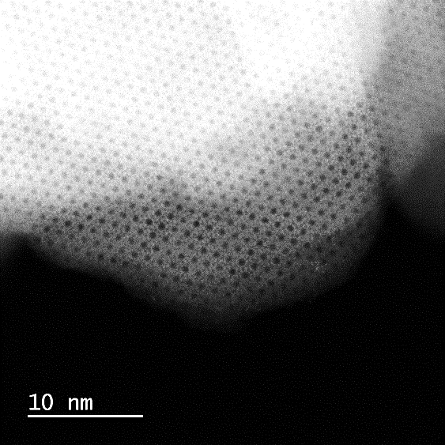
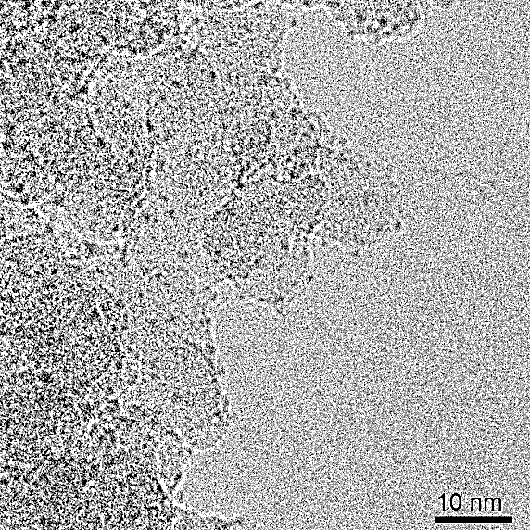
Heterogeneous Catalysts
Supported
metal oxides
Zeolites
Supported
metal nanoparticles
Involved in numerous industrial catalytic processes
  - Metathesis - Epoxidation
  - Dehydrogenation - Hydrogenation
  - Polymerization ……….

Slide 3
Heterogeneous Catalysts
Supported
metal oxides
Zeolites
Supported
metal nanoparticles
Main goal:
Can we further improve these industrial catalytic processes?

Slide 4
Heterogeneous Catalysts
Supported
metal oxides
Zeolites
Supported
metal nanoparticles
What is the structure of the active sites?
What are the roles of: supports, interfaces, additives, promoters, size and composition?
How do these properties affect: Structure, Activity, Selectivity and Stability?
Main goal:
Can we further improve these industrial catalytic processes?

Slide 5
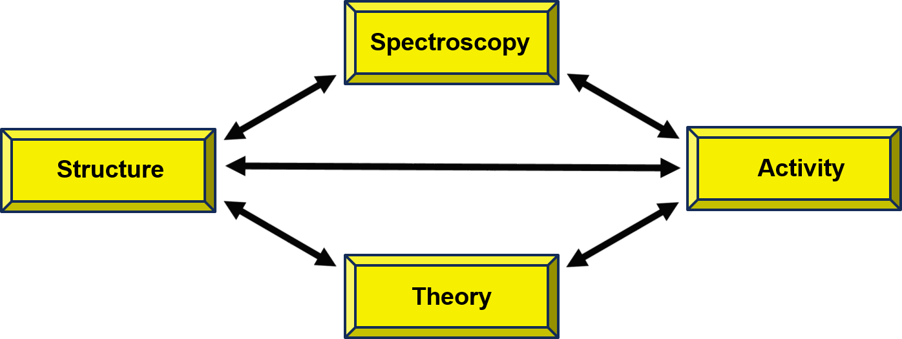
Major aspects within the group
Controlling the grafting of tailored
molecular precursor (SOMC)
Detailed characterization of surface species
(spectroscopy and computational chem.)
Catalyst evaluation and further development

Slide 6
Major aspects within the group
Controlling the grafting of tailored
molecular precursor (SOMC)
Detailed characterization of surface species
(spectroscopy and computational chem.)
Catalyst evaluation and further development
Today’s challenges and directions:
Bridging the gap between industrial and well-defined heterogeneous catalysts
Bridging the gap between single-sites and nanoparticle-based catalysts
Detailed and efficient structural characterization of surface species by NMR

Slide 7
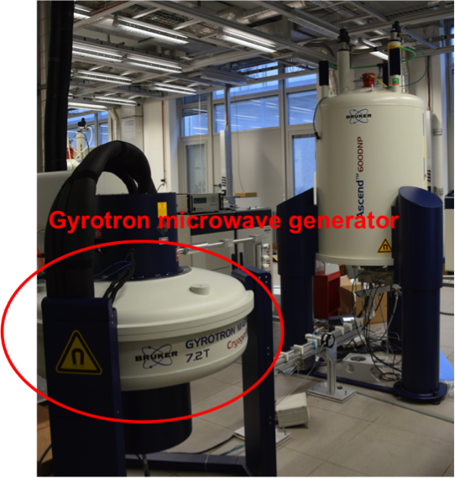
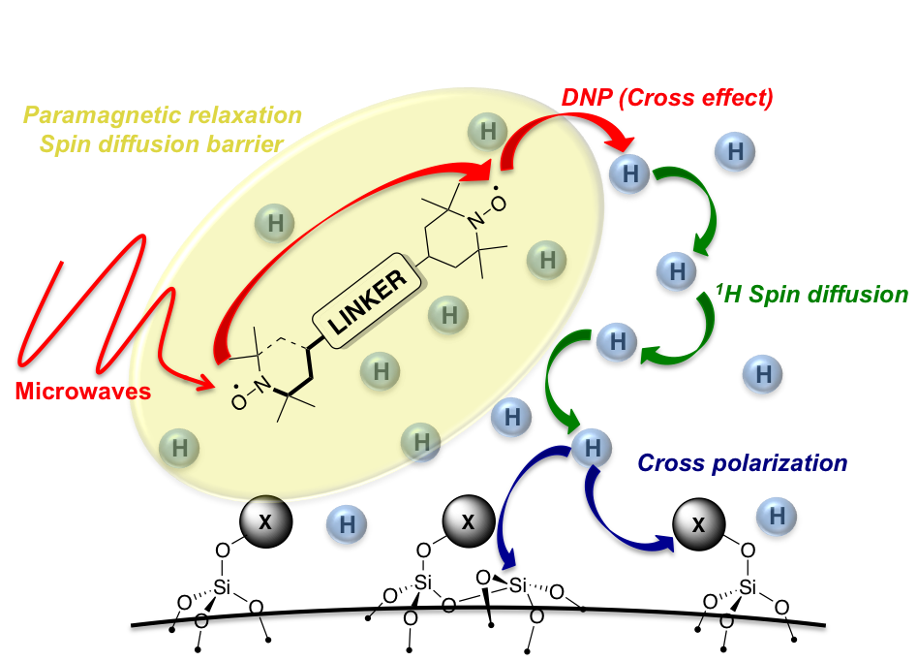
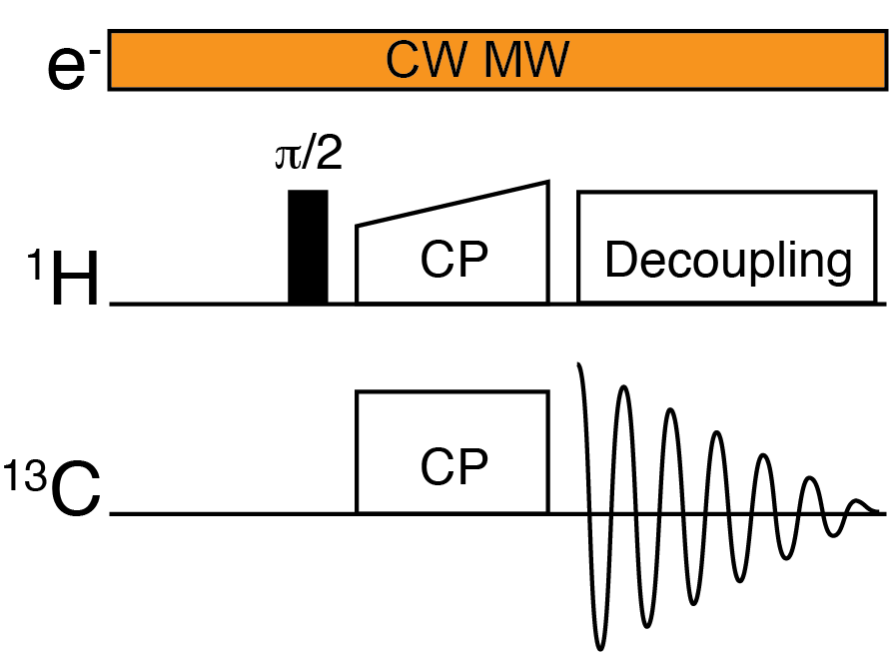
Dynamic Nuclear Polarization
Sample preparation – solid sample is impregnated with biradical solution, i.e. polarizing agent.
Potential to enhance the signals by a factor of 660

Slide 8
Dynamic Nuclear Polarization
DNP has been crucial to characterize
low abundant surface species
Lesage et al. JACS 2010, 132, 15459. Rossini et al. ACR 2013, 46, 1942.
Zagdoon et al. JACS 2012, 134, 2284. Liao et al. Curr. Op. Coll. Interf. Sci. 2018, 33, 63.
Gajan et al. JACS, 2013, 135, 15459. Cavailles et al. ACIE 2018, 57, 7453.
Gajan et al. PNAS 2014, 111, 14693.
Copéret et al. JACS 2017, 139, 10588. Gordon et al. PNAS 2018, 115, E5867.
Gordon et al. ACS Cent. Sci. 2017, 3, 759. Gordon et al. Acc. Chem. Res. 2019, 52, 2278.

Slide 9
Dynamic Nuclear Polarization
DNP has been crucial to characterize
low abundant surface species
Performance tends to be unpredictable
Radical or solvent might interact with the
catalyst
Lesage et al. JACS 2010, 132, 15459. Rossini et al. ACR 2013, 46, 1942.
Zagdoon et al. JACS 2012, 134, 2284. Liao et al. Curr. Op. Coll. Interf. Sci. 2018, 33, 63.
Gajan et al. JACS, 2013, 135, 15459. Cavailles et al. ACIE 2018, 57, 7453.
Gajan et al. PNAS 2014, 111, 14693.
Copéret et al. JACS 2017, 139, 10588. Gordon et al. PNAS 2018, 115, E5867.
Gordon et al. ACS Cent. Sci. 2017, 3, 759. Gordon et al. Acc. Chem. Res. 2019, 52, 2278.

Slide 10
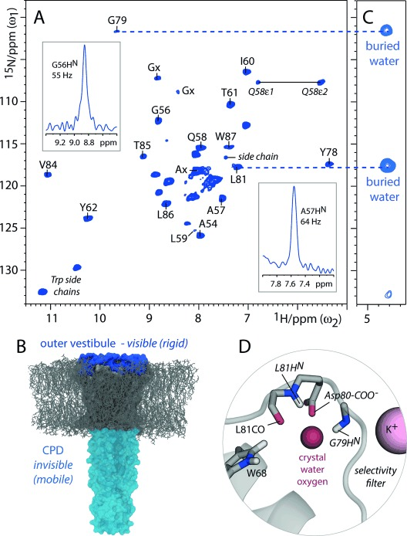
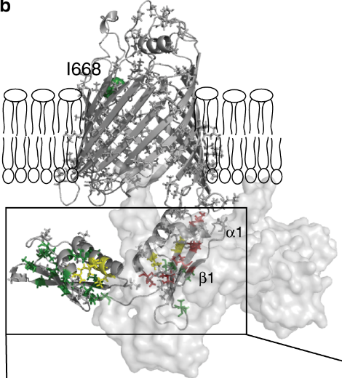
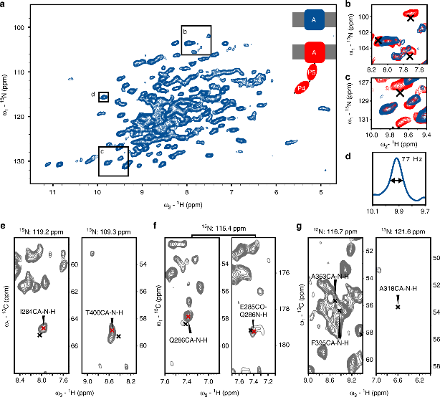
1H Detection in combination with fast MAS
KcsA
BamA
Mance, D.; Sinnige, T.; Kaplan, M.; Narasimhan, S.; Daniëls, M.;
Houben, K.; Baldus, M.; Weingarth, M,
Angew. Chemie - Int. Ed. 2015, 54 (52), 15799–15803
Pinto, C.; Mance, D.; Sinnige, T.; Daniëls, M.; Weingarth, M,;
Baldus, M.,
Nat Commun 9, 4135 (2018)

Slide 11
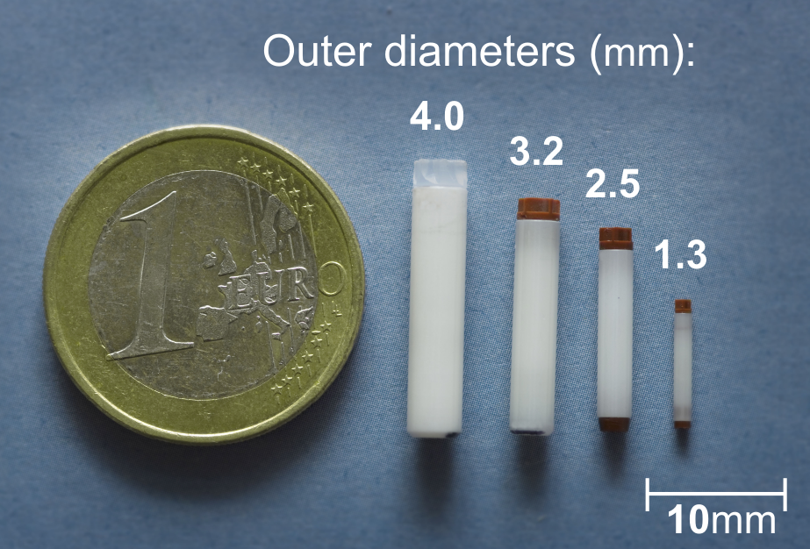
1H Detection in combination with fast MAS
Use of 1H detected experiments to overcome sensitivity issues
Small quantity of sample required
No modification of sample required

Slide 12
1H Detection in combination with fast MAS
Use of 1H detected experiments to overcome sensitivity issues
Small quantity of sample required
No modification of sample required
Demonstrate performance on a unlabelled system (Vanadium Oxide Catalyst)

Slide 13
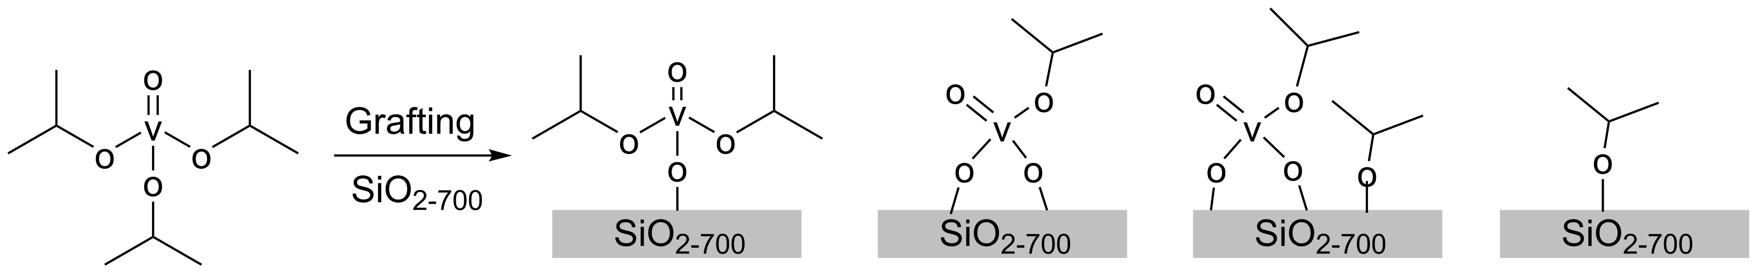
1H Detection in combination with fast MAS
Preparation of Vanadium Oxide Catalyst through SOMC approach
?
Mance*, D.; Comas-Vives, A.; Copéret*, C., J. Phys. Chem. Lett. 2019, 10 (24), 7898–7904.

Slide 14
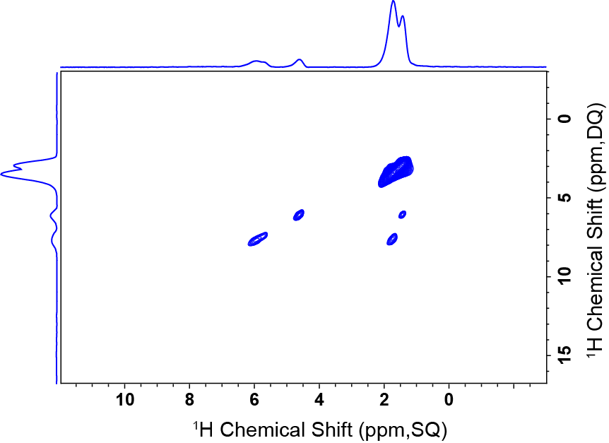
1H Detection in combination with fast MAS
1H-1H DQ-SQ, 700MHz at 50 kHz MAS
Mance*, D.; Comas-Vives, A.; Copéret*, C., J. Phys. Chem. Lett. 2019, 10 (24), 7898–7904.

Slide 15
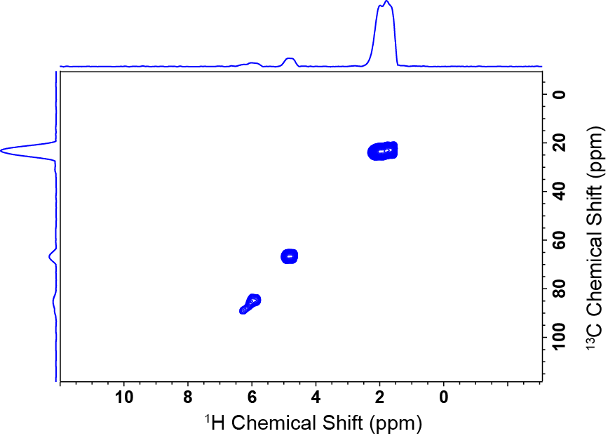
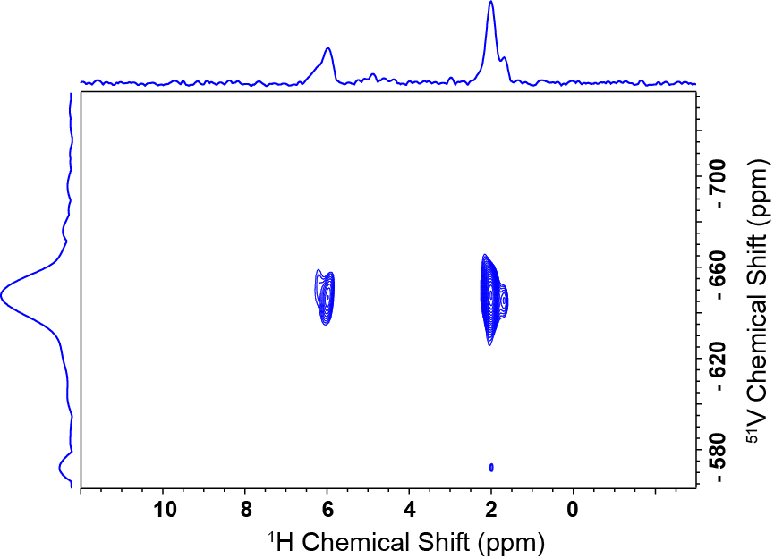
1H Detection in combination with fast MAS
1H-Detected D-HMQC, 700MHz at 50 kHz MAS
Approx. 1 day per spectra
Mance*, D.; Comas-Vives, A.; Copéret*, C., J. Phys. Chem. Lett. 2019, 10 (24), 7898–7904.

Slide 16
1H Detection in combination with fast MAS
1H-Detected D-HMQC, 700MHz at 50 kHz MAS
Approx. 1 day per spectra
?
Mance*, D.; Comas-Vives, A.; Copéret*, C., J. Phys. Chem. Lett. 2019, 10 (24), 7898–7904.

Slide 17
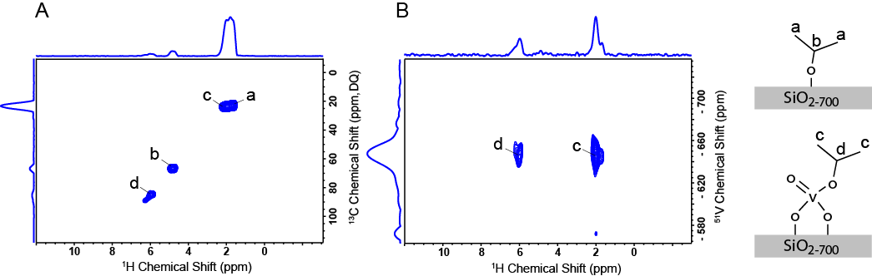
1H Detection in combination with fast MAS
1H-Detected D-HMQC, 700MHz at 50 kHz MAS
Approx. 1 day per spectra
Mance*, D.; Comas-Vives, A.; Copéret*, C., J. Phys. Chem. Lett. 2019, 10 (24), 7898–7904.

Slide 18
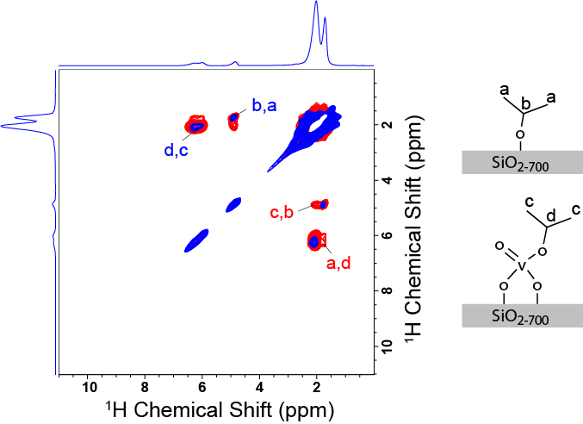
1H Detection in combination with fast MAS
1H-1H RFDR, 700MHz at 50 kHz MAS
0.5 ms RFDR recoupling
5.0 ms RFDR recoupling
Mance*, D.; Comas-Vives, A.; Copéret*, C., J. Phys. Chem. Lett. 2019, 10 (24), 7898–7904.

Slide 19
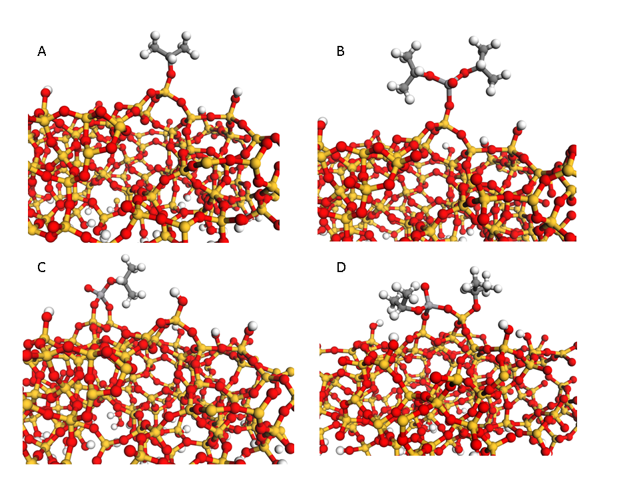
1H Detection in combination with fast MAS
1H-1H RFDR, 700MHz at 50 kHz MAS
Validating assignments by Computational Chemistry/NMR calculations
0.5 ms RFDR recoupling
5.0 ms RFDR recoupling
Mance*, D.; Comas-Vives, A.; Copéret*, C., J. Phys. Chem. Lett. 2019, 10 (24), 7898–7904.

Slide 20
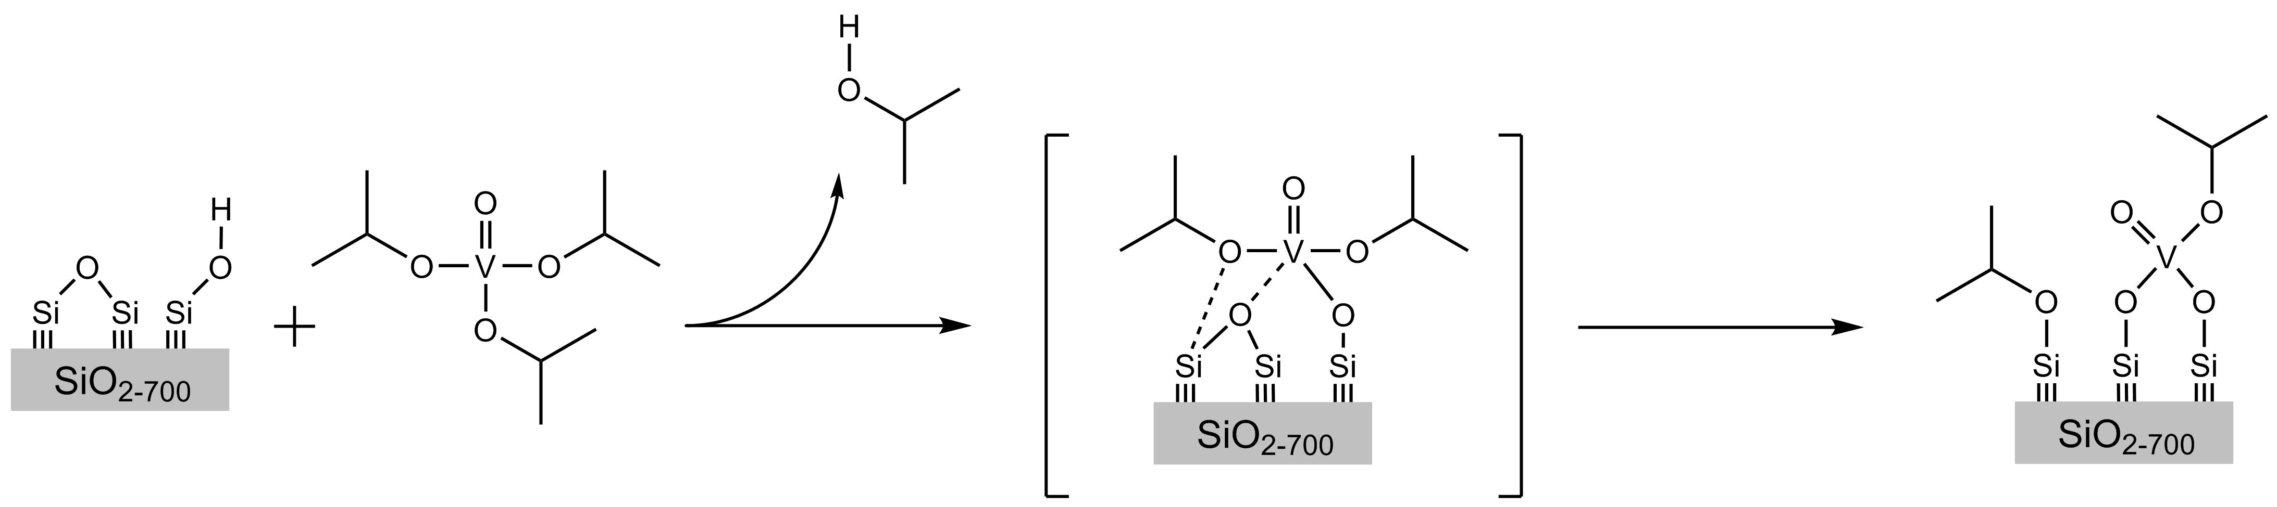
1H Detection in combination with fast MAS
Proposed grafting mechanism
Mance*, D.; Comas-Vives, A.; Copéret*, C., J. Phys. Chem. Lett. 2019, 10 (24), 7898–7904.

Slide 21
Summary
Sensitivity enhanced methods are an effective method for characterization of Catalysts
NMR provides us a unique tool in correlating NMR parameters with catalytic performance
The small quantities required make isotope enrichment more practical

Slide 22
Summary
Sensitivity enhanced methods are an effective method for characterization of Catalysts
NMR provides us a unique tool in correlating NMR parameters with catalytic performance
The small quantities required make isotope enrichment more practical
Outlook:
Development of more dedicated experiments
Focus on characterizing Catalysts pre- and post- reaction in order to understand reaction-mechanism’s, deactivation mechanism, etc.

Slide 23
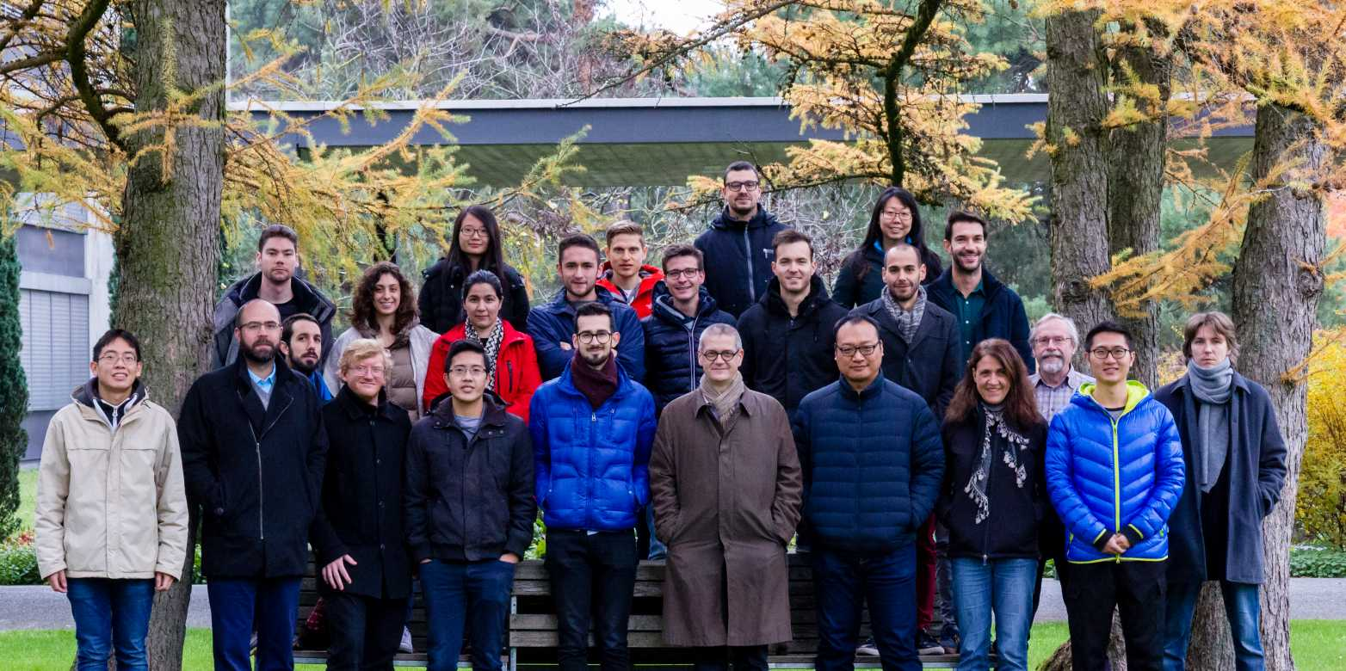
Acknowledgement
Copéret Group, 2019

