Slide 1
PBC Conventional Beams working group meeting
CERN 03/11/2018
New QCD Facility at M2 / COMPASS++
Status
Oleg Denisov for LoI group

Slide 2
Outline
LoI status
Short summary for ESPP
Timelines

Slide 3
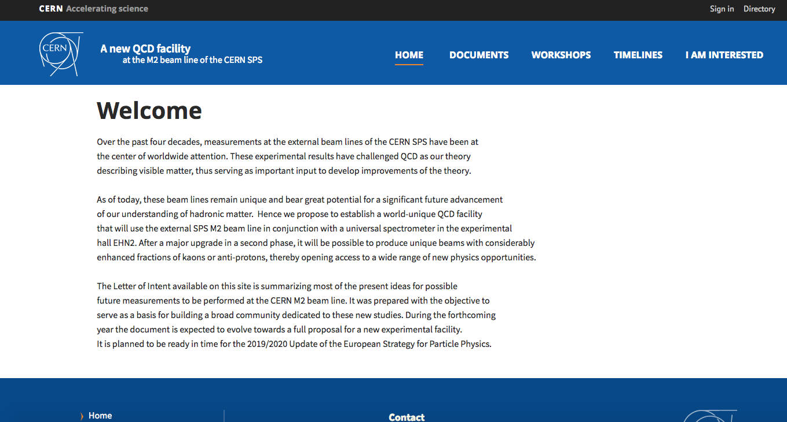
Current status of NQF initiative
A New QCD facility at the M2 beam line
WEB Page: https://nqf-m2.web.cern.ch/

Slide 4
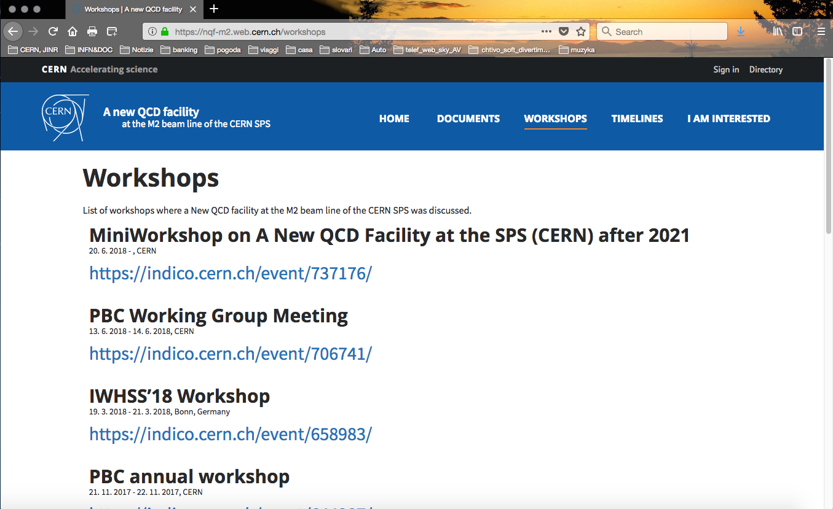
A New QCD facility at the M2 beam line
WEB Page: https://nqf-m2.web.cern.ch/

Slide 5
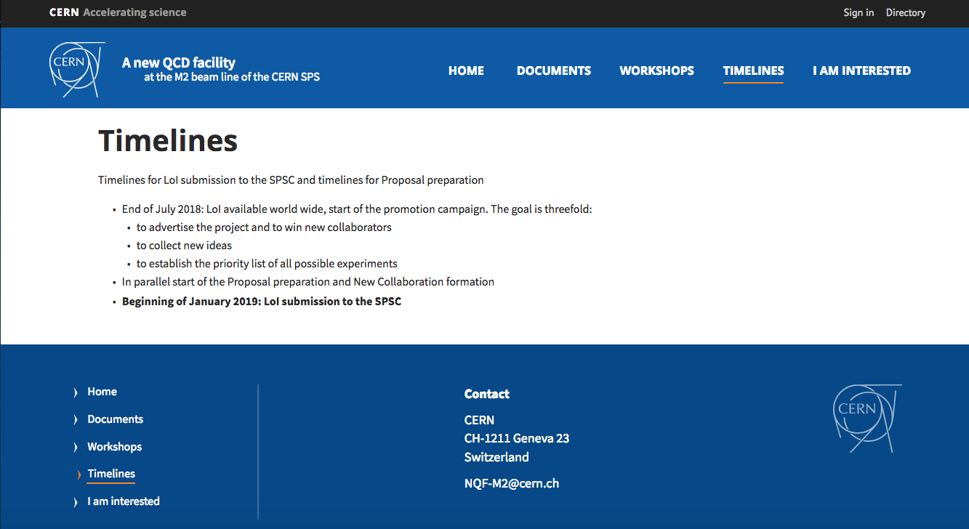
A New QCD facility at the M2 beam line
WEB Page: https://nqf-m2.web.cern.ch/

Slide 6
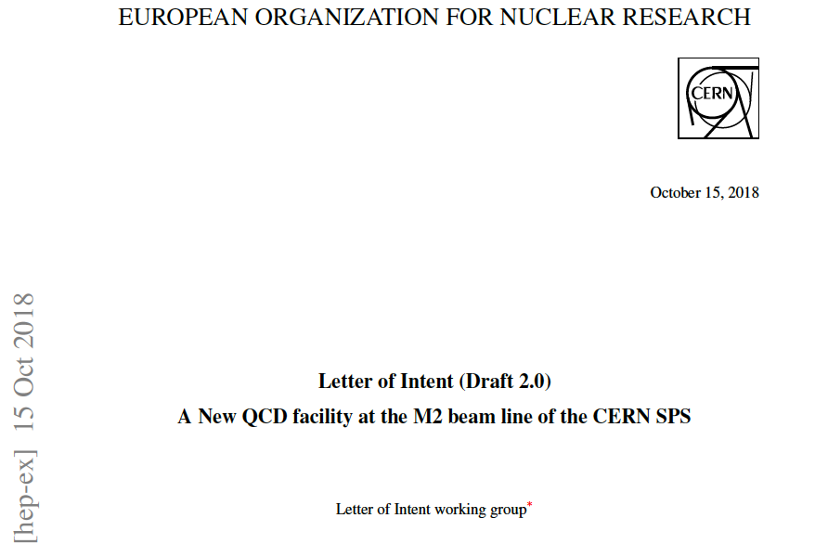
A NQF@M2 beam line of the SPS CERN
A New QCD Facility at M2 beam line LoI is under preparation now. The goal is to bring together new Collaboration enthusiastic about opportunities of doing physics at CERN with conventional and newly designed RF separated kaon and antiproton beams. The total duration of the program reaches 10 years of running with hadron and muon beams.
http://arxiv.org/abs/1808.00848

Slide 7
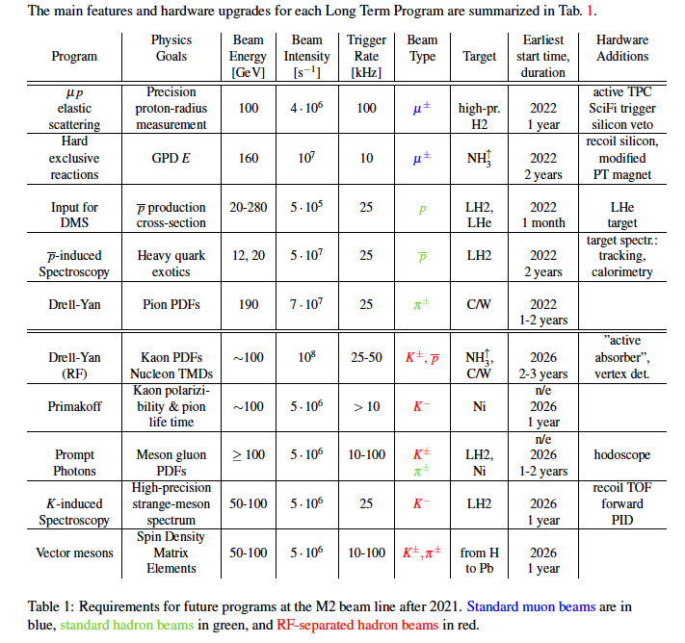
Summary table – beam requirements

Slide 8
Short (<10 pages) summary document will be submitted to ESPP
Content:
- Executive summary of the LoI for “New QCD facility”
- Cover letter
We expect 10 to 15 new groups to join the NQF initiative,
First version of the authors list will be ready in ~ 10 days from now.

