Slide 1
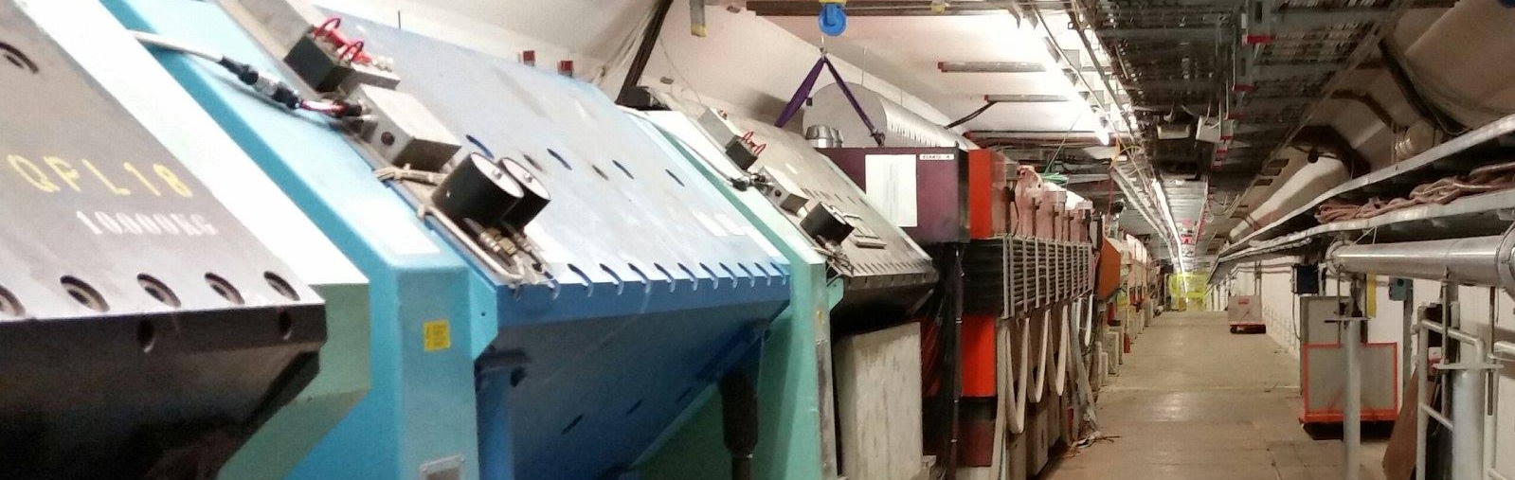


CBWG Meeting – EHN2 Studies
Impressions of the M2 beam line - 2016
Dipanwita BANERJEE , Eva MONTBARBON, Johannes BERNHARD (EN-EA) 03.12.2018

Slide 2


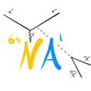
EHN2 Working Group
Work Breakdown Structure
  WP1: Muon beams post 2020
  WP2: Hadron and Electron beams post 2020
  WP3: RF-separated beams
  WP4: Beam Instrumentation (dedicated meetings)
User presentations for technical details and plans completed
Started with 1 meeting / month, then continued with ad-hoc user requirements discussions as soon as studies were more detailed
Integration + costing launched

Slide 3
WP1: Muon beams
Clearly a priority due to the interest to start directly in 2021
COMPASS transversity running in 2021 taken out of PBC, already approved by Research Board
Studies for 2018 test beams, proton radius measurement, NA64µ phases 1 and 2, MuonE
Downstream location equipped with electrical infrastructure, gas supply and networking, can be re-used for 2021+ tests
Test beams of MuonE and proton radius successfully completed

Slide 4
Proton Radius Measurements
+ +
Fulfilment of beam requirement is quite straight-forward for location of high-pressure TPC at the COMPASS target position + use of the COMPASS spectrometer, compatible with current operations mode (only lower intensity)
Integration studies to be done for 2 x 4 m vacuum/He tube and low-scattering windows (if required)
Need to be clarified for high-precision mount for silicon trackers, scintillating fibre detectors and TPC

Slide 5
NA64µ studies
Phase 1
  Location identified in PPE211
  Calculated optics that fulfil user requirements
  Checked for compatibility with downstream experiments
    Dedicated physics data taking
    Beam downstream good enough for commissioning and tests, but not for physics data taking

Slide 6
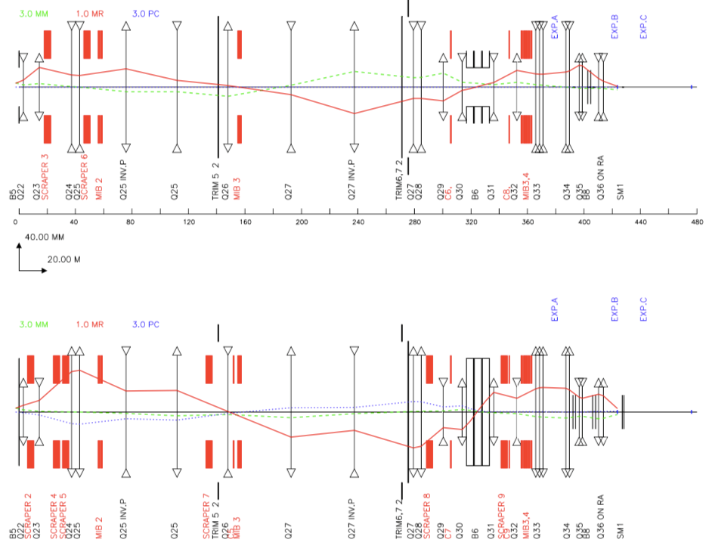
NA64µ studies
Additional needs:
  Use of BMS + additional magnetic spectrometers
  2 new MBPL magnets + cabling (reuse Bend7 for MS1 and power converters of Quad34 + spares for MS2)
  Remove Quad34
  Control room, gas supply
Very moderate costs < 100kCHF
Could profit from common detector platform (extra cost)

Slide 7
NA64µ studies
Phase 2
  Location inside of SM2 spectrometer magnet
  Checked for compatibility with upstream experiments
    Dedicated physics data taking
    Beam upstream not possible due to additional magnetic spectrometer (MS) requirements
PPE211
PPE221

Slide 8
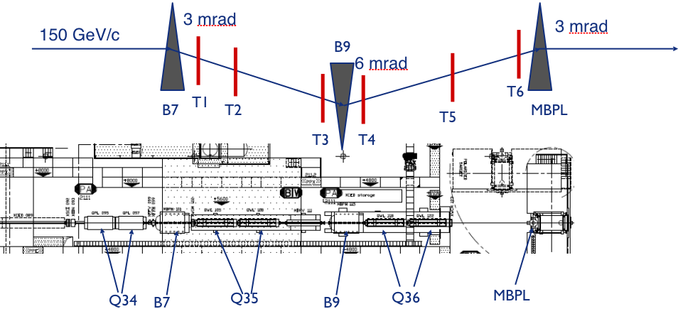
NA64µ studies
Phase 2
  Location inside of SM2 spectrometer magnet
    Proposal to use magnetic chicane + additional MBPL at Compass target location as magnetic spectrometer
    Would need gas supply depending on tracker (T1-6) technology

Slide 9
MuonE
Studies completed for 30 m upstream option, beam similar to NA64µ phase 1 + minor changes in Scraper settings
Space requirements increased to 40 m
  Would need to free space from Quad32 up to Bend8
  Added absorber for muon ID and downstream calorimeter, significant amount of material
    Possibly mitigate by low-Z material, e.g. Carbon, but set-up becomes significantly longer
    Make calorimeter and muon ID absorber easily removable, e.g. mount on rails
    Contamination of downstream beam studied with FLUKA and GEANT4, found < 10 ppm hadrons and < 1 % photons and electrons. Can be removed by converter and sweeping with Bend 8 or Bend 9 if necessary

Slide 10
MuonE
Infrastructure requirements depend on final choice for detectors
  Gas supply in case of CO₂ or N₂ cooling
  Cooling water in case of conventional cooling
High precision measurement at 10⁻⁵ accuracy, i.e. requires very stable conditions
  Study for thermal conditions in upstream location to be done
  Study might be required for high precision mount / common platform, possibly water-cooled
High data rates expected due to triggerless readout, need room for ~ 10 servers
Counting room
Moderate investments in the order of 150 – 400 kCHF necessary, very much depending on final infrastructure

Slide 11
WP2: Hadron and Electron beams
Low-energy antiproton beam production study done including vacuum revision, start now study for dedicated low-energy optics (better momentum selection, higher acceptance)
High-energy hadron beams
  Shielding study done for high intensities, validated with RP measurements in the 2018 DY configuration, will be continued by Master student S. Cholak

Slide 12
WP2: Hadron and Electron beams
Special thanks to M. van Dijk and S. Cholak
High-energy hadron beams
  Differential absorption study done with FLUKA + GEANT4, not promising: 2 m polyethylene increase pion content at 190 GeV/c from 25% to only 29.5% at the cost of 86% lost beam and considerable degradation of divergence at CEDAR location
Electron beams not further studied as there was no further interest

Slide 13
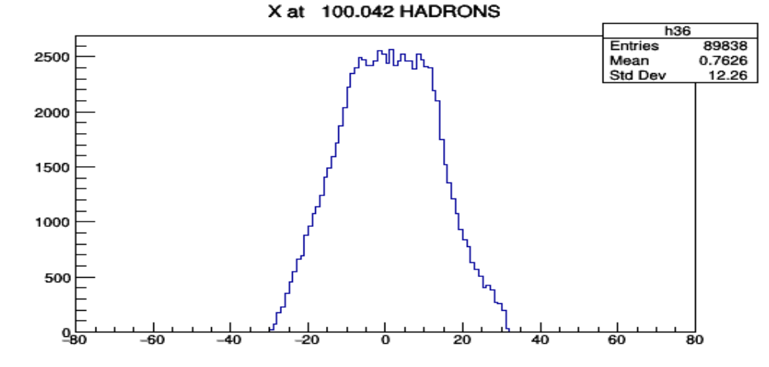
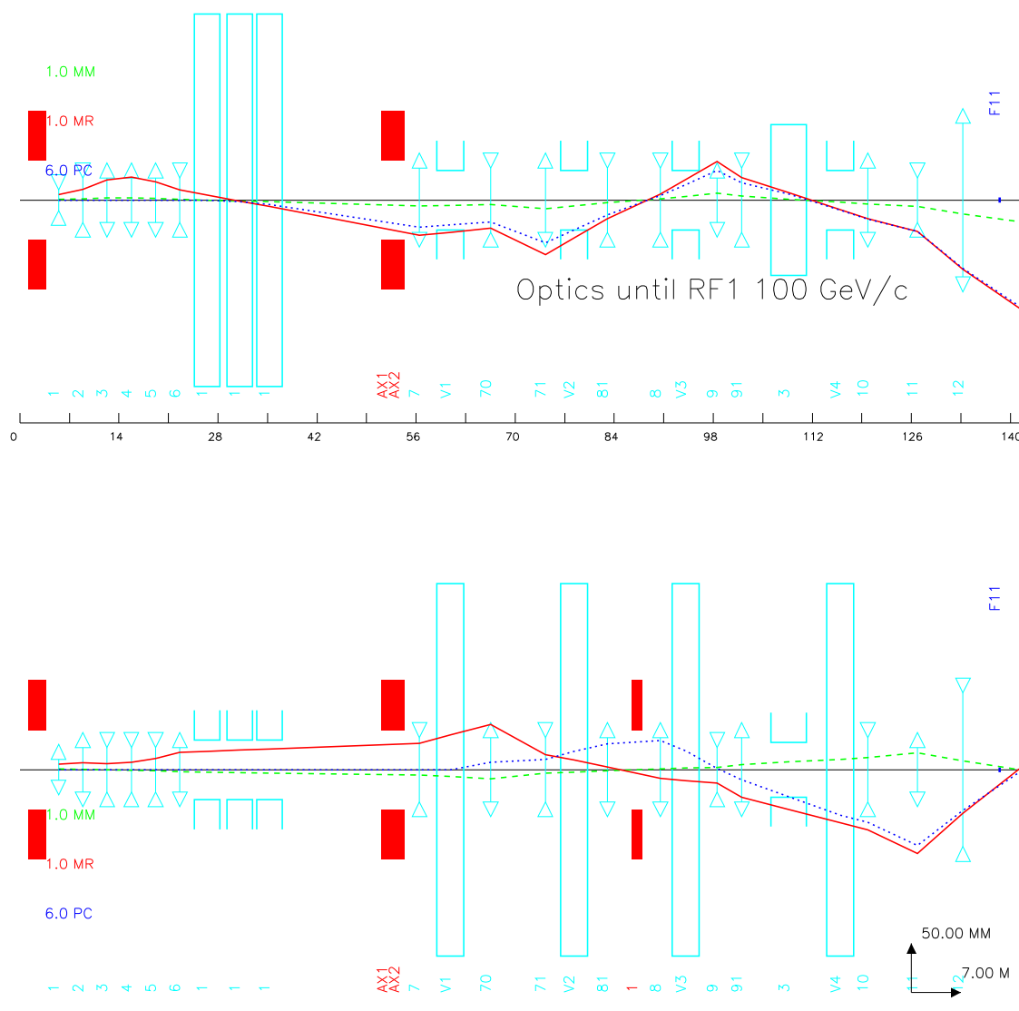
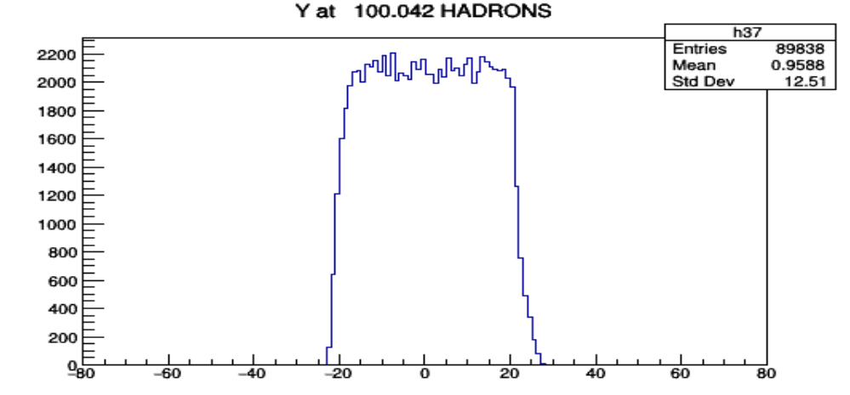
WP3: RF-separated beams
Progress with frontend for momentum selection, achieved higher momentum resolution as required by adding a vertical achromat
Studies for production yield complemented with loss studies for the frontend
Launched work for detailed 3D drawings for part of TCC2, M2 tunnel and experimental area, necessary for integration of new RF infrastructure and beam dumps
Draft optics within next weeks

Slide 14
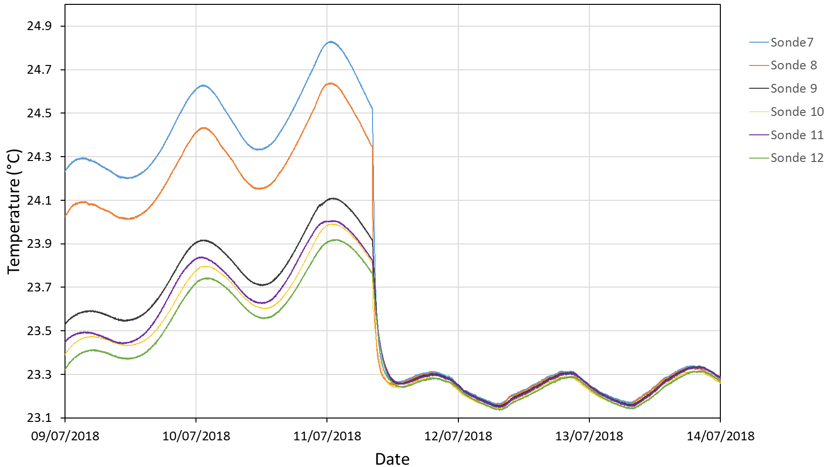
WP4: Beam instrumentation
Upgrade of thermal housing of COMPASS Cedars (S. Mathot)
  New CEDAR active thermal housing running very stably without interruptions, temperature control at 0.1ºC level
Upgrade of electronics by COMPASS
  Commissioning done, took first data for the last few weeks of beam
Delta T = 0.03 °C
with chiller on
CEDAR1 thermal map

Slide 15
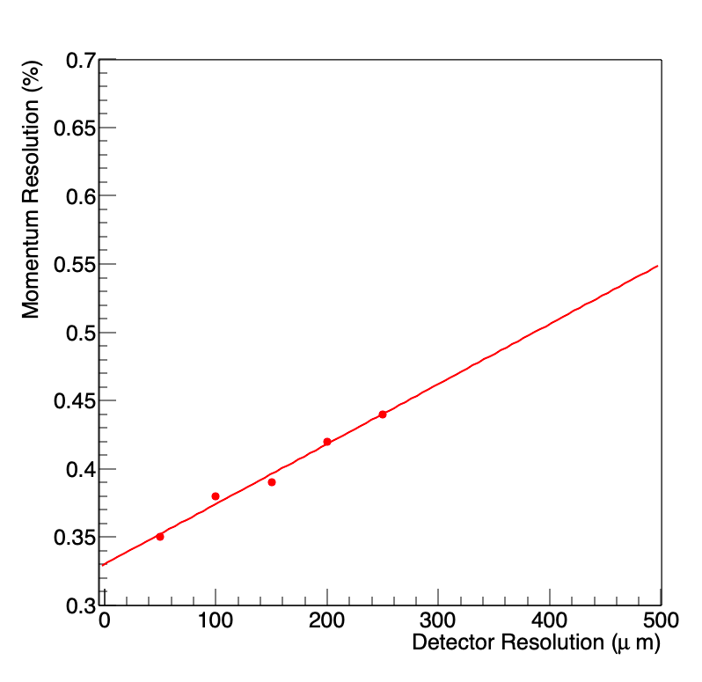
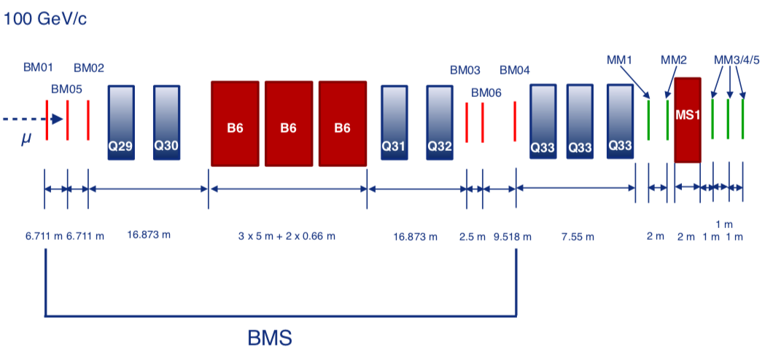
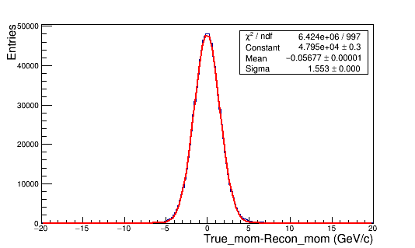
WP4: Beam instrumentation
Study of possible upgrade for beam momentum measurements
  Current BMS with scintillator hodoscopes H1-6
  Detector resolutions: H1-4 ~1.3mm, H5 ~0.7mm, H6 ~0.4mm
  Current overall momentum resolution ~ 1 %
  Possibility to improve momentum resolution with an upgrade of BMS stations: Momentum resolution checked as a function of detector resolution using TMVA analysis of ROOT
Further upgrade needs for beam line instrumentation to be discussed within the EABI working group, e.g. threshold Cherenkovs
e.g., 50% improvement
For det.res ~ 400 µm
Current Resolution
1%

Slide 16
Thank you!

