Slide 1
SPS proton sharing in the future
G. Arduini, H. Bartosik, K. Cornelis, M. Fraser,
B. Goddard, V. Kain, E. Koukovini-Platia,

Slide 2
Protons on target in previous years
WANF:
CHORUS and NOMAD
(half-integer ext.)
Year
NA
(third-integer ext.)
M. Fraser

Slide 3
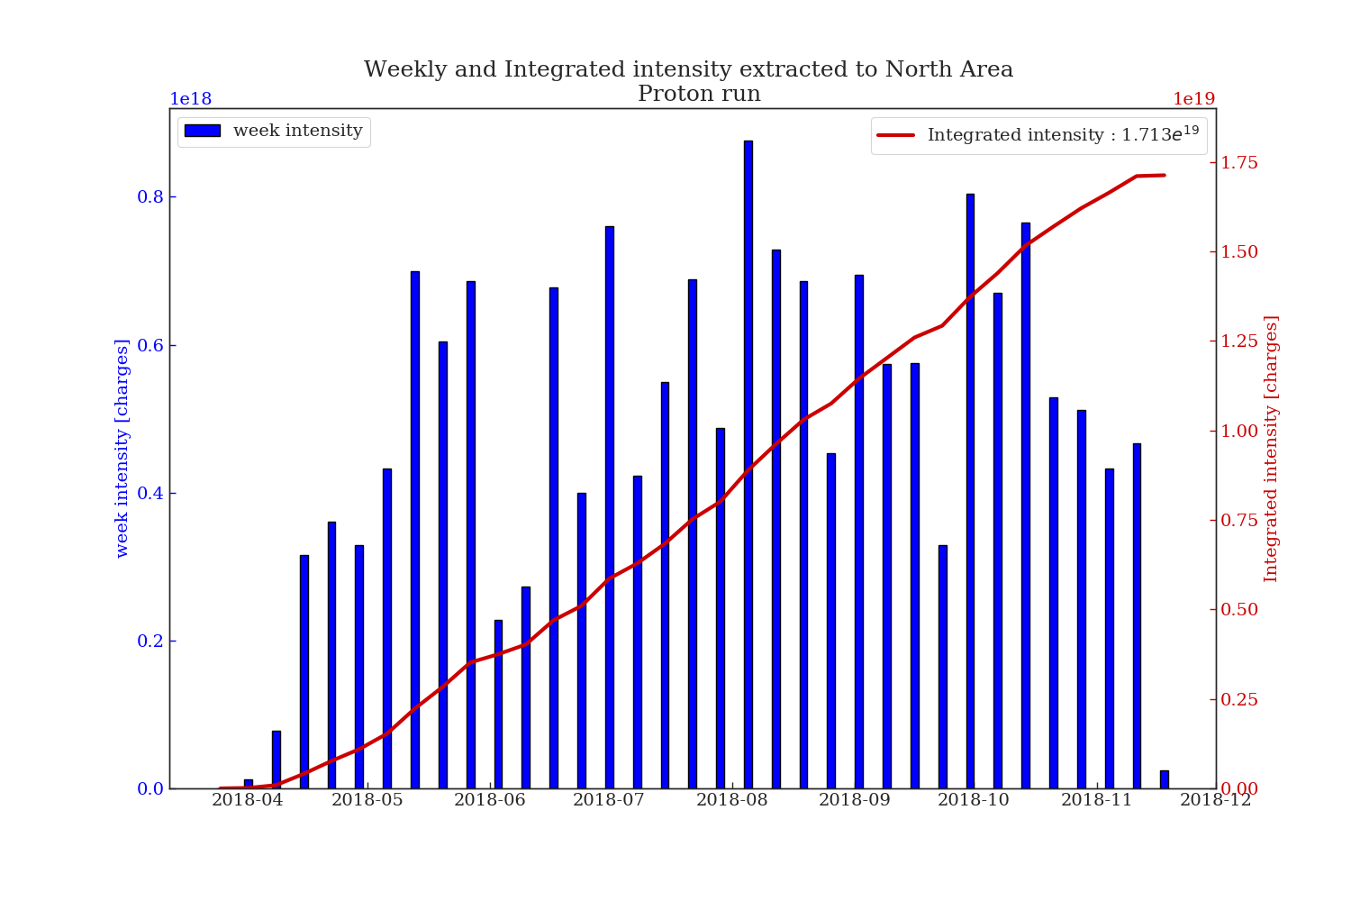
Intensity to North Area 2018
Experiment | Extracted Intensity | T2 | T4 | T6 | T10
North Area | 1.713e19 | 2.038e18 | 2.765e18 | 7.469e18 | 1.366e18
Sum on all targets (not T10) = 1.23e19
J. Della Costa

Slide 4
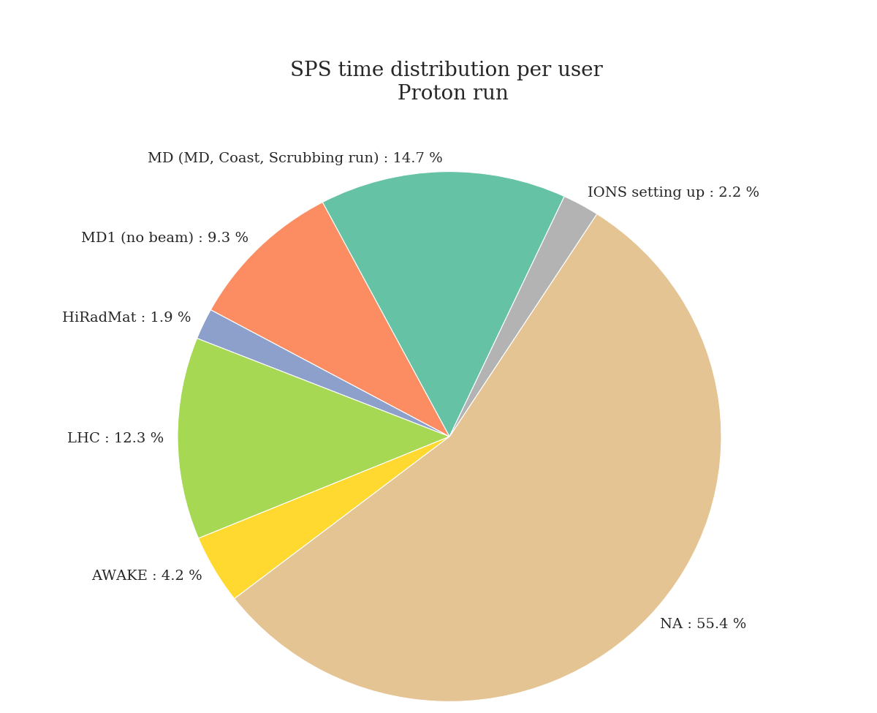
SPS time sharing in 2018
J. Della Costa

Slide 5
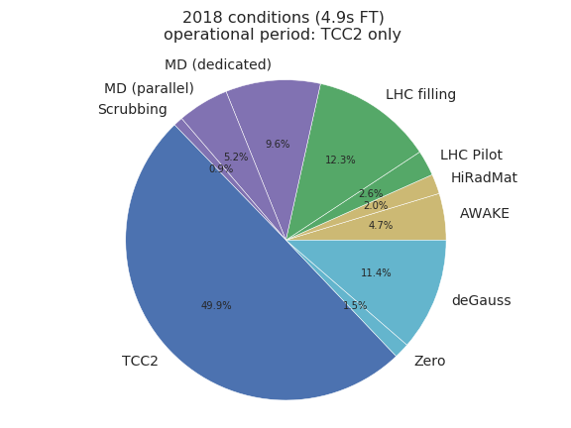
SPS time sharing in 2018 – in simulation

Slide 6
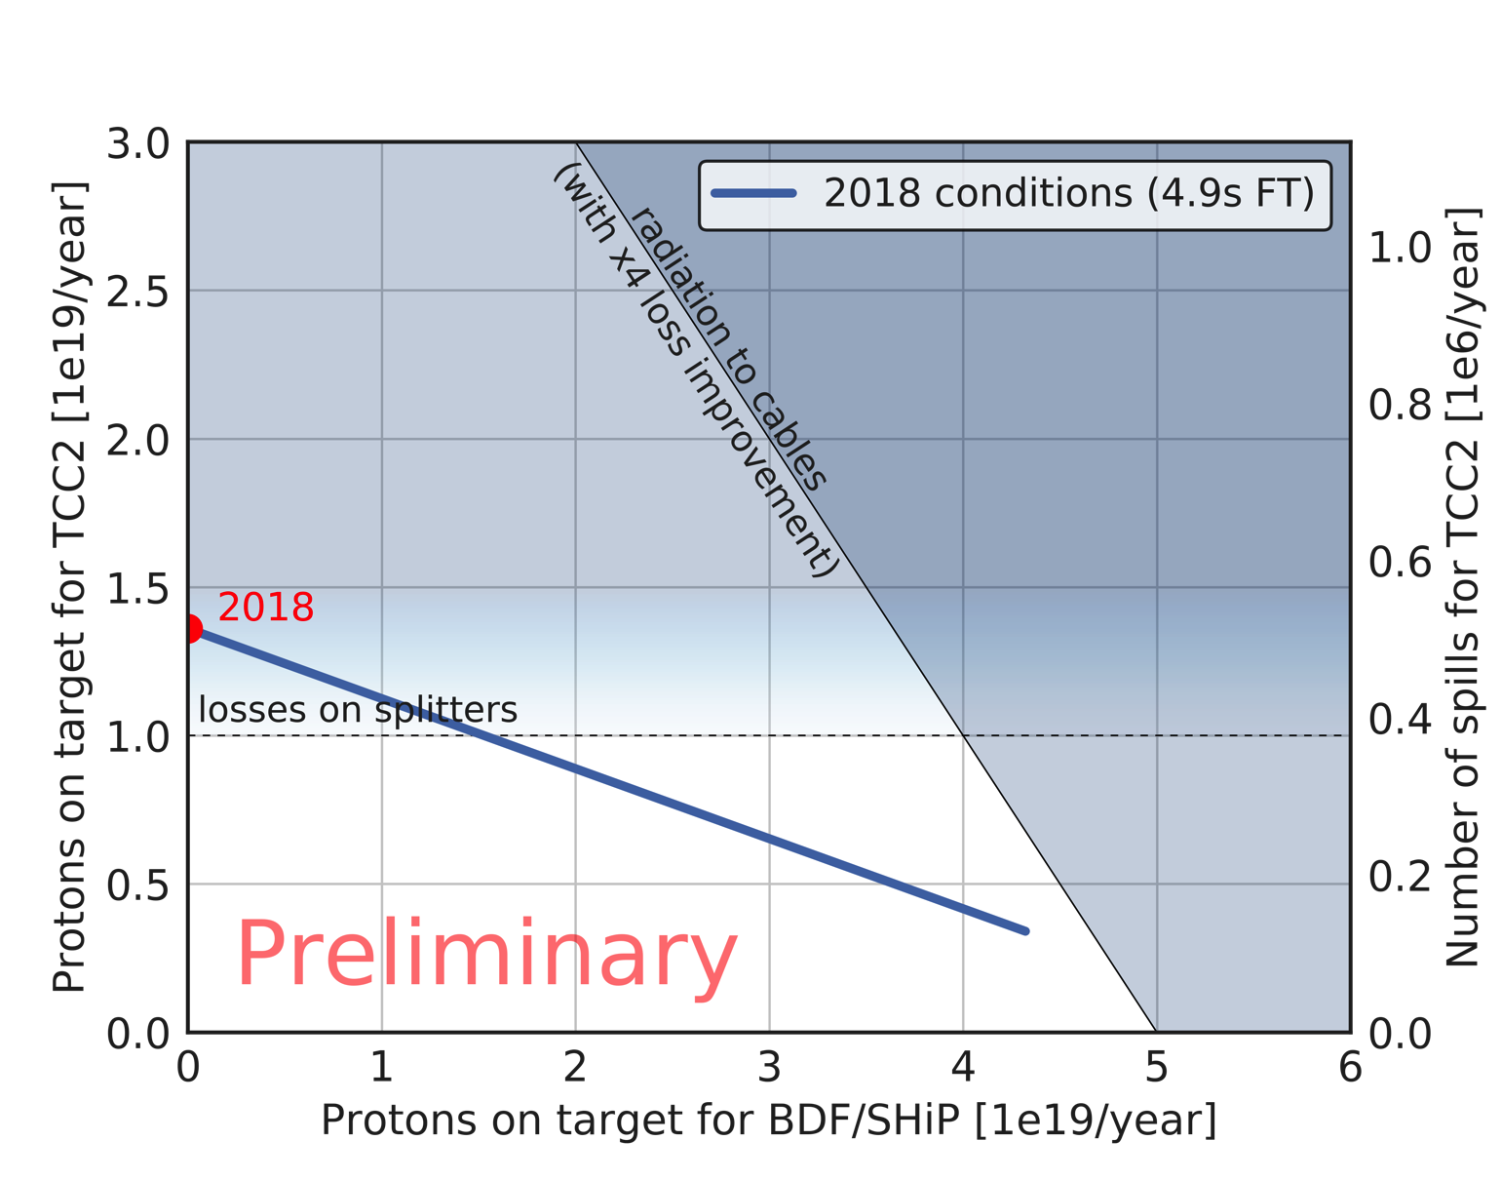
Proton sharing based on 2018
Operational period of 217 days with protons
HiRadMat and AWAKE included
Average intensity per spill for TCC2 at 0.75*2.6e13

Slide 7
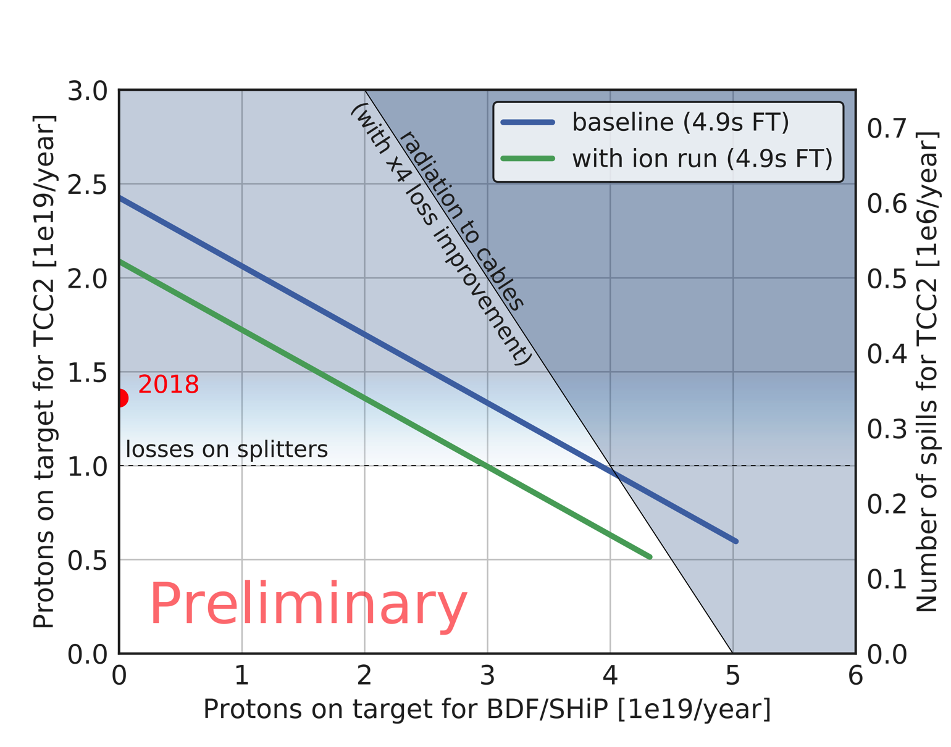
Proton sharing in SHiP era
Operational period of 217 / 245 days with protons
HiRadMat and AWAKE included
Average intensity per spill for TCC2 at 0.75*4e13

Slide 8
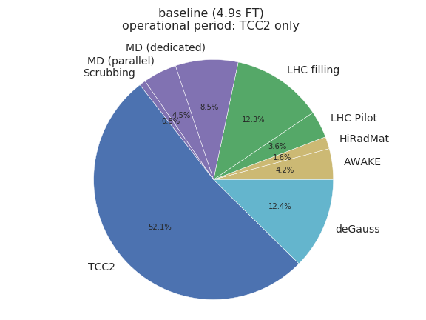
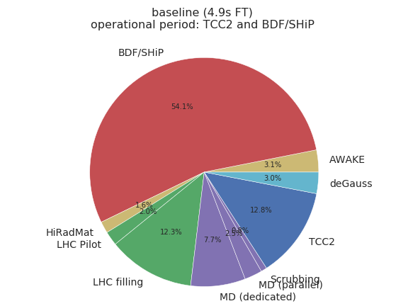
SPS time sharing future scenario

Slide 9
Summary
Model of future proton sharing based on 2018 operational year
  Assuming same number of operational days / year
  Same number of MDs and time sharing with AWAKE and HiRadMat users
  2018 was an exceptional year in terms of number of spills and number of protons to TCC2 targets
SHiP pot / year goal of 4e19 within reach even with AWAKE and HiRadMat
  Assuming pure proton operation
  With a reduced number of spills to TCC2 targets (about half compared to 2018)
Study being finalized this week and summarized in internal note

Slide 10
BACKUP

Slide 11
Proton sharing scenarios (preliminary)
Here still without AWAKE or HiRadMat users!
Radiation to cables
4 x 10¹⁹ pot/year in SHiP →
1 x 10¹⁹ pot/year in TCC2
(baseline in 2015 analysis)
Limit from losses on splitter

Slide 12
Cycle duration and power consumption for the possible SPS cycles during the operation for SHiP
 | Cycle | 2018 Cycle dur. [s] | 2011 Cycle dur. [s] | 2018 Power [MW] | 2011 Power [MW]
 | SHiP (1.2 s flat-top) – 400 GeV/c | 7.2 | 7.2 | 32.5 | 32.5
 | FT (9.7 s flat-top) – 400 GeV/c | 15.6 | 15.6 | 63.6 | 63.6
 | LHC nominal – 450 GeV/c | 22.8 | 21.6 | 16.8 | 16.7
 | LHC pilot – 450 GeV/c | 12 | 7.2 | 31.7 | 41.3
 | MD – 26 GeV/c | 7.2 | 4.8 | 2.9 | 0.3
 | ZERO – 14 GeV/c | 1.2 | 1.2 | 0.1 | 0.1
 | FT 2015 (4.9 s flat-top) | 10.8 | 10.8 | 52.2 | 52.2
Updating the parameters from EDMS 2015
Changes marked in blue (slower ramp for LHC →longer cycle duration and longer
MD cycle necessary for the demagnetization)

Slide 13
Considered SPS super-cycles with 9.7s flat top for TCC2 targets compatible with 39 MW limit
Fixed target operation for TCC2 only - 2018
 | SuperCycle | # LHC pilot | # LHC nominal | # SHIP nominal | # FT | # MD | # ZERO | SuperCycle duration [s] | Power [MW]
 | LHC set-up day | 1 | 0 | 0 | 1 | 1 | 1 | 36 | 38.7
 | LHC set-up night | 1 | 0 | 0 | 1 | 0 | 7 | 36 | 38.1
 | LHC filling day | 0 | 1 | 0 | 1 | 0 | 0 | 38.4 | 35.8
 | LHC filling night | 0 | 1 | 0 | 1 | 0 | 0 | 38.4 | 35.8
 | Fixed target TCC2 day | 0 | 0 | 0 | 1 | 1 | 3 | 26.4 | 38.4
 | Fixed target TCC2 night | 0 | 0 | 0 | 1 | 0 | 9 | 26.4 | 37.6
Fixed target operation for TCC2 only - 2011
 | SuperCycle | # LHC pilot | # LHC nominal | # SHIP nominal | # FT | # MD | # ZERO | SuperCycle duration [s] | Power [MW]
 | LHC set-up day | 1 | 0 | 0 | 1 | 1 | 5 | 33.6 | 38.4
 | LHC set-up night | 1 | 0 | 0 | 1 | 0 | 9 | 33.6 | 38.4
 | LHC filling day | 0 | 1 | 0 | 1 | 1 | 0 | 42 | 35.8
 | LHC filling night | 0 | 1 | 0 | 1 | 0 | 0 | 37.2 | 35.8
 | Fixed target TCC2 day | 0 | 0 | 0 | 1 | 1 | 5 | 26.4 | 38.4
 | Fixed target TCC2 night | 0 | 0 | 0 | 1 | 0 | 9 | 26.4 | 37.6

Slide 14
Assumptions on SHiP running scenario
  Analysis from 2015 (based on 2011 schedule)
  Updated analysis without protons during ion run (based on 2018 schedule)
  Updated analysis with protons instead of ion run (based on 2018 schedule)
2018
2018
2011

Slide 15
Assumptions on SHiP running scenario
  Analysis from 2015 (based on 2011 schedule)
  Updated analysis without protons during ion run (based on 2018 schedule)
  Updated analysis with protons instead of ion run (based on 2018 schedule)
2018
2018
2011
75% transmission efficiency to TCC2 targets contains:
Extraction transmission: 99%
TT20 transmission: 96%
Splitting transmission: 80% (100% for BDF beam)

Slide 16
Ongoing Work (to be finalized in coming weeks)
For realistic estimation of pot, still to be considered:
  Take physics users other than LHC, MDs, TCC2 targets and SHiP into account (e.g. AWAKE, HiRadMat)
  Take into account the limitations from activation of slow extraction equipment (input from ABT, see presentation of M. Fraser)
  Estimate the impact of increased cool-down time (due to enhanced activation)
  Limitations from losses around the machine due to high proton flux
Provide figures for pot/year for SHiP for same pot for TCC2 experiments
  As a function of other physics users in parallel (AWAKE, HiRadMat, ...)

Slide 17
Summary
  SPS has several physics users to serve
  Developing SHiP operational scenarios in parallel to TCC2 targets based on CNGS experience
    Updated the detailed analysis done in 2015 with new boundary conditions (duration of operational cycles, changes in 2018 schedule)
    Other constraints related to high proton flux (such as cool-down periods) still to be considered
    The work is ongoing and will be finalized in the coming weeks
  Obviously the pot/year reach for SHiP depends on how much beam will be given to other users (AWAKE, HiRadMat, …) – in other words: reaching 4e19 pot/year in SHiP significantly penalizes other users
    Different scenarios will be provided

