Slide 1

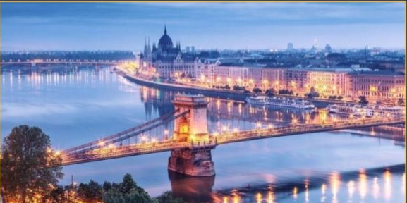
Fifth Workshop on
Accelerator Magnets in HTS
WAMHTS-5
Lucio Rossi CERN – ARIES task 14.5 Coordinator
Budapest , Hotel Mercure Korona, 11-12 April 2019

Slide 2

Scope
Discuss progress in HTS magnets for accelerator magnets
Review progress of previuous Eucard2 program (2 magnets still to be tested!)
Review progress in understanding effects of cabling and current redistribution.
To discuss simulation and design of N.I. coils (or other ideas)
Exchange experience between various communities and reinforce collaboration
No proceedings (papers) but slides available to community as usual (in case form Industry we may publish «revised slides»)
Thanks to Soren Prestemon (LBNL), Gijs de Rijk and Luca Bottura (CERN) for helping in the Program Committee (as well as other colleagues for inputs!).
And please apologise to whom we have not asked.

Slide 3
Thanks
This workshop acknowledege the support ot the ARIES Project
Thanks to Valerie Brunner, CERN assistant for Aries and future accelerator EU projects, for the organization.
Do not miss: dinner this evening:
Meeting at 19.15 in the hotel lobby (dinner at 19.30)

