Slide 1
Advances in HTS Modeling
WAMHTS-5, Budapest, April 11th 2019
Marco Breschi
University of Bologna, Italy
Acknowledgement: L. Cavallucci, F. Grilli, P. L. Ribani

Slide 2
Outline
Introduction
HTS tape modeling
From tapes to cables
  Twisted Stacked Tape Cable
  Roebel cables
Scaling up: coils and magnet systems
Discussion

Slide 3
Outline
Introduction
HTS tape modeling
From tapes to cables
  Twisted Stacked Tape Cable
  Roebel cables
Scaling up: coils and magnet systems
Discussion

Slide 4
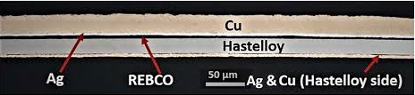
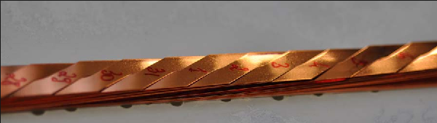
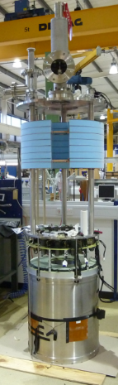
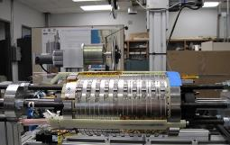
Main issues and problem scales…
REBCO tape
Scale
Layer/filament
Tape
Cable
Coil
Magnet systems
Roebel Cable
Issues
High aspect ratio
Anisotropy
Strong non-linearity
Inhomogeneity of critical current
Interface properties
Problem dimensions (3D)
Multiphysics
Hybrid 32 T NHMFL magnet

Slide 5
…and modeling solutions
Modeling techniques
Field models (FEM, FEM-BEM, variational methods..)
  Homogenization
  Multi-scale
  Change of coordinates
  Reduced dimensionality
  Statistical approach (for I_{c} longitudinal variations)
Circuit models
  Lumped parameters
  Distributed parameters
Hybrid models (field model + circuit model)

Slide 6
Outline
Introduction
HTS tape modeling
From tapes to cables
  CORC
  Twisted Stacked Tape Cable
  Roebel cables
Scaling up: coil and magnet systems
  Insulated coils
  Non insulated coils
Discussion

Slide 7
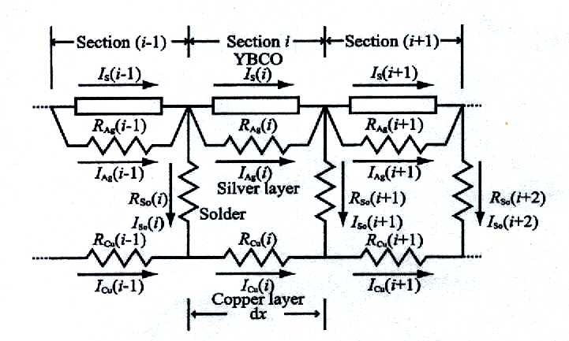
HTS tape modeling: circuit models
Lumped or distributed parameter circuit models
[1] Y. Fu, O. Tsukamoto, M. Furuse, IEEE Trans. Appl. Supercond., Vol. 13, pp. 1780 – 1783, 2003.
[2] M. Breschi, P. L. Ribani, X. Wang, J. Schwartz, Supercond. Sci. Technol., Vol. 20, L9 – L11, 2007.
[3] D. Colangelo, B. Dutoit, Supercond. Sci. Technol., Vol. 27, 124005, 2014
Marco Breschi, WAMHTS-5, Budapest, April 11th 2019
Notes:
3

Slide 8
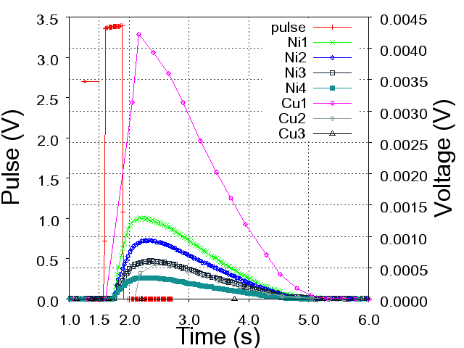
HTS tape modeling: circuit models
Lumped or distributed parameters circuit models
Cu
0
1
2
3
4
Ni
0
1
2
3
4
Resistive heater pulses applied on the copper side of the tape
[2] X. Wang, A. Caruso, M. Breschi, G. Zhang, U. Trociewitz, H. Weijers, J. Schwartz, IEEE Trans. Appli. Supercond., Vol. 15, n. 2, pp. 2586 – 2589, 2005.
Measured at 77 K, I_{t} = 58 A (40% I_{c}), pulse height = 3.42 V
Nickel substrate and copper not equipotential
Different voltages measured on the two sides of the tape
Marco Breschi, WAMHTS-5, Budapest, April 11th 2019
Notes:
3

Slide 9
HTS tape modeling: circuit models
Current redistribution during quench
The resistance of the buffer layer is greater than the transverse resistances between YBCO and Ag layers
Current redistribution length (4 cm – 10 cm) towards the substrate greater than towards the Ag and Cu layers (1 cm - 2 cm)
Tuning the contact resistances can affect the quench propagation velocity
[2] M. Breschi, P. L. Ribani, X. Wang, J. Schwartz, Supercond. Sci. Technol. 20 L9 – L11, 2007.
Marco Breschi, WAMHTS-5, Budapest, April 11th 2019
Notes:
3

Slide 10
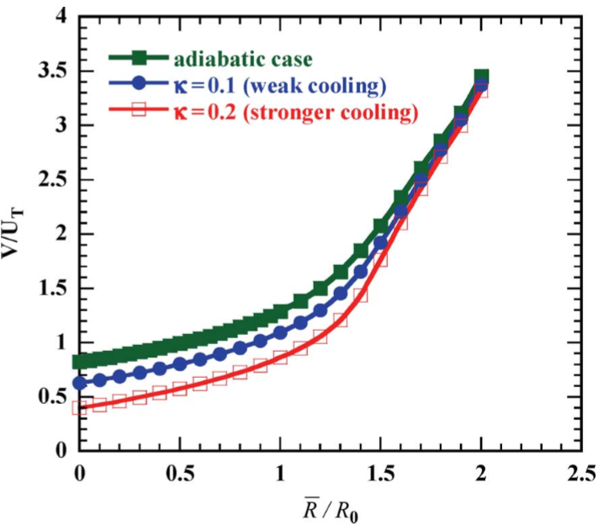
HTS tape modeling: different architectures
New tape architectures with higher NZPV
Understanding the crucial role of transverse resistances in the quench development led to alternative tape architectures
Increasing NZPV with increasing interfacial resistance
Current flow diverter
[4] Levin GA, Barnes PN, Rodriguez JP, Connors JA, Bulmer JS., IEEE Trans. Appl. Supercond., Vol. 19, 2009
[5] C. Lacroix, F. Sirois, Supercond. Sci. Technol., 035003, 2014.
Marco Breschi, WAMHTS-5, Budapest, April 11th 2019
Notes:
3

Slide 11
HTS tape modeling: field models
3D model and mixed dimensional method (2D – 3D)
Copper stabilizers and substrate meshed in 3-D, YBCO layer meshed as a 2-D shell.
[6] W. K. Chan, P. J. Masson, C. Luongo., IEEE Trans. Appl. Supercond., Vol. 20, pp. 2370 - 2380, 2010
Marco Breschi, WAMHTS-5, Budapest, April 11th 2019
Notes:
3

Slide 12
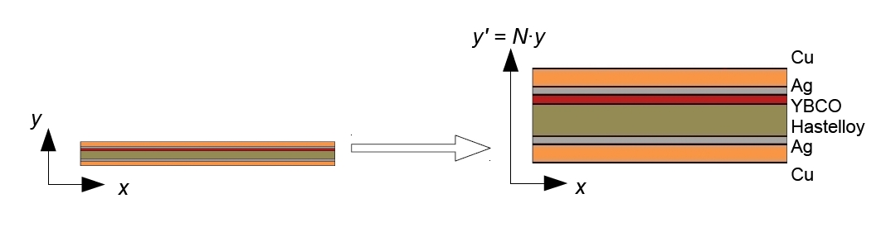
HTS tape modeling: field models
2D model with change of coordinates
To cope with the high aspect ratio, the tape thickness is multiplied by a constant parameter N
Triangular mesh
[7] M. Casali, M. Breschi, P. L. Ribani, IEEE Trans. Appl. Supercondu., vol. 25, n. 1, 6862876, 2015
Marco Breschi, WAMHTS-5, Budapest, April 11th 2019
Notes:
3

Slide 13
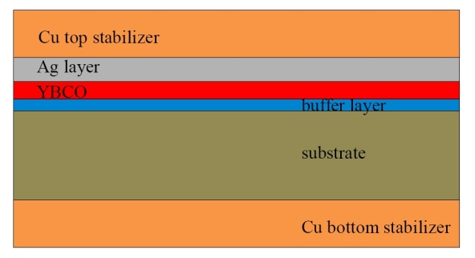
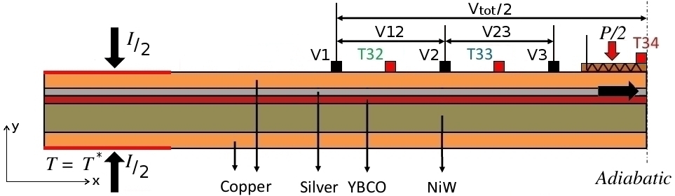
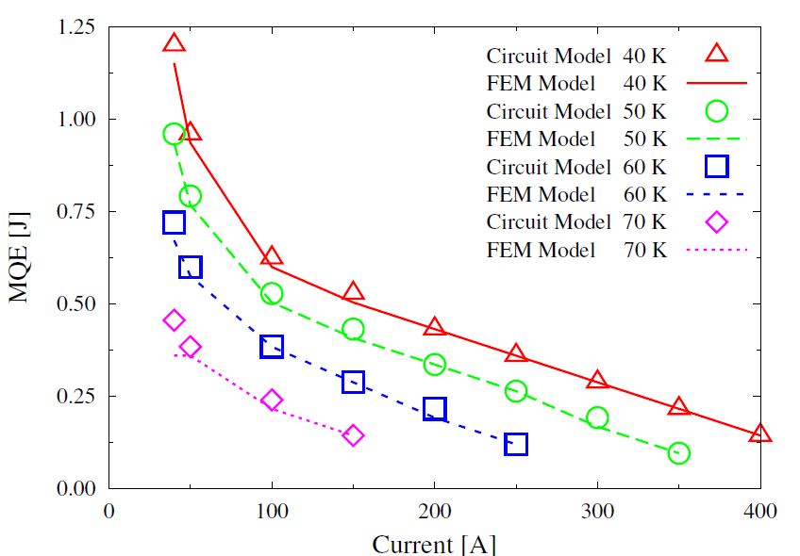
HTS tape modeling: field vs circuit model
Significant reduction of computation time with circuit model relative to field model
Computation time [s] | RECOVERY | QUENCH
Circuit | 188 | 89
FEM | 6329 | 1371
Marco Breschi, WAMHTS-5, Budapest, April 11th 2019
Notes:
3

Slide 14
Outline
Introduction
HTS tape modeling
From tapes to cables
  Twisted Stacked Tape Cable
  Roebel cables
Scaling up: coils and magnet systems
Discussion

Slide 15
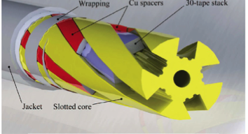
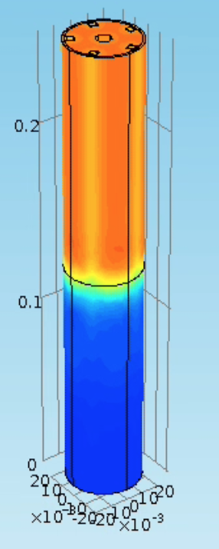
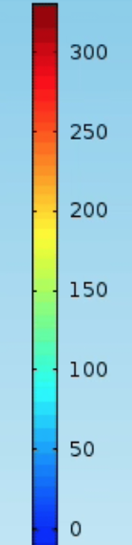
From tapes to cables: twisted stacked tape cable (slotted core)
Twisted stacked cable (ENEA Frascati)
Electro-thermal field model based on homogenization technique
[8] M. Breschi, et al., IEEE Trans. Appl. Supercondu., vol. 25, n. 3, 4800505, 2015
Marco Breschi, WAMHTS-5, Budapest, April 11th 2019
Notes:
3

Slide 16
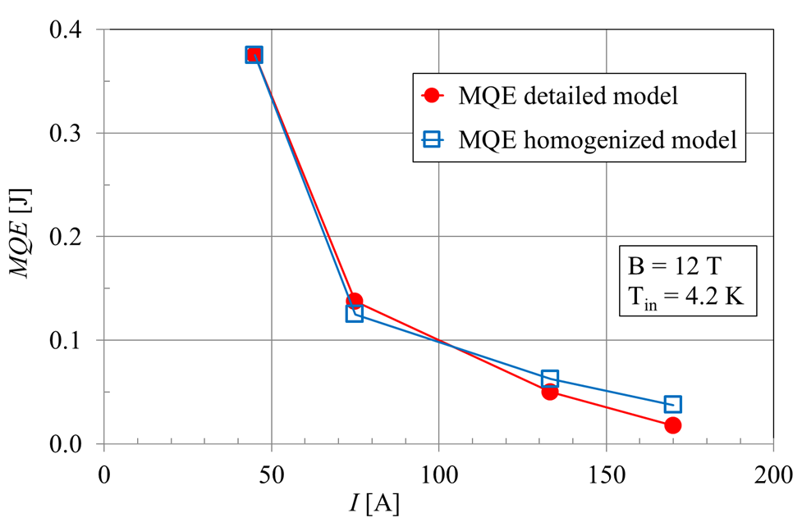
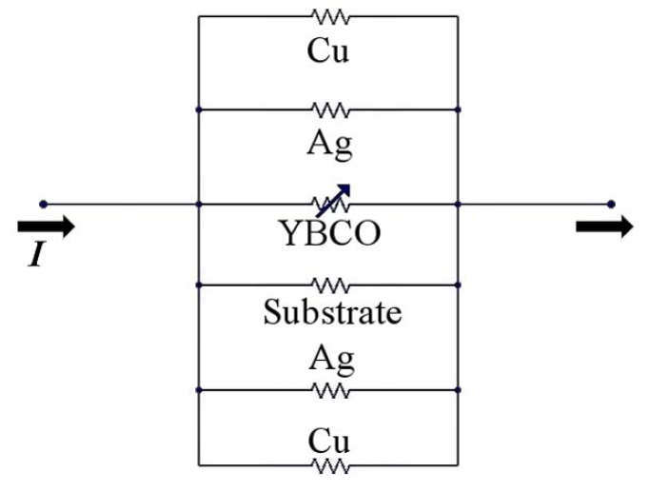
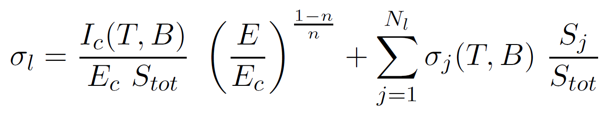
From tapes to cables: homogenization
Increasing the number of degrees of freedom, modeling stacks requires homogenization techniques
Resistances are taken in parallel for the longitudinal flow, and in series for the transverse flow, obtaining anisotropic properties
Transverse current flow
Longitudinal current flow
The error on MQE due to homogenization can reach 30 %
[8] M. Breschi, et al., IEEE Trans. Appl. Supercondu., vol. 25, n. 3, 4800505, 2015
Notes:
3

Slide 17
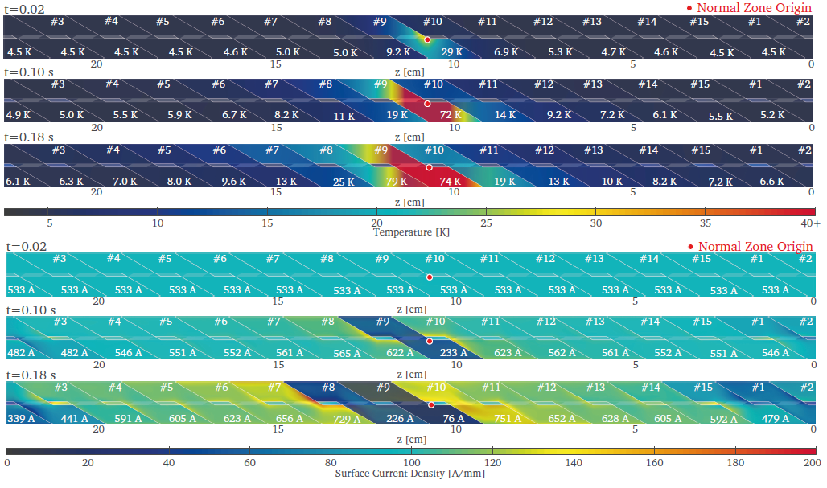
From tapes to cables: 3D - thin strip
Electromagnetic and thermal network model for quench analysis, AC loss and field quality
Computation of current and temperature distribution during quench.
[9] J. Van Nugteren., «High Temperature Superconductors Accelerator Magnets», Ph.D. dissertation, University of Twente, 2016

Slide 18
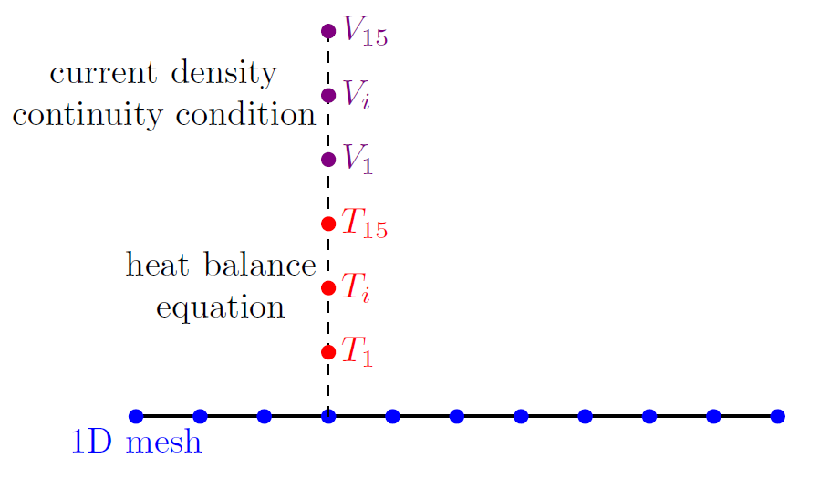
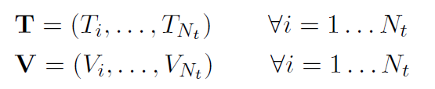
From tapes to cables: Roebel cable reduced dimensionality approach
Electrothermal model for quench calculation
The Roebel cable is described by means of a 1D FEM model.
At each mesh point, the model unknowns are the temperatures T_{i} and voltages V_{i} of each tape
The heat diffusion equation can be written for the i-th tape as
thermal conduction between the i-th and j-th tapes in contact
[10] L. Cavallucci, M. Breschi, P. L. Ribani and Y. Yang, IEEE Trans. Appl. Supercond., vol. 28, no. 4, Jun. 2018.
Joule power due to the current exchange between the i-th and j-th tapes in contact
heater thermal disturbance

Slide 19
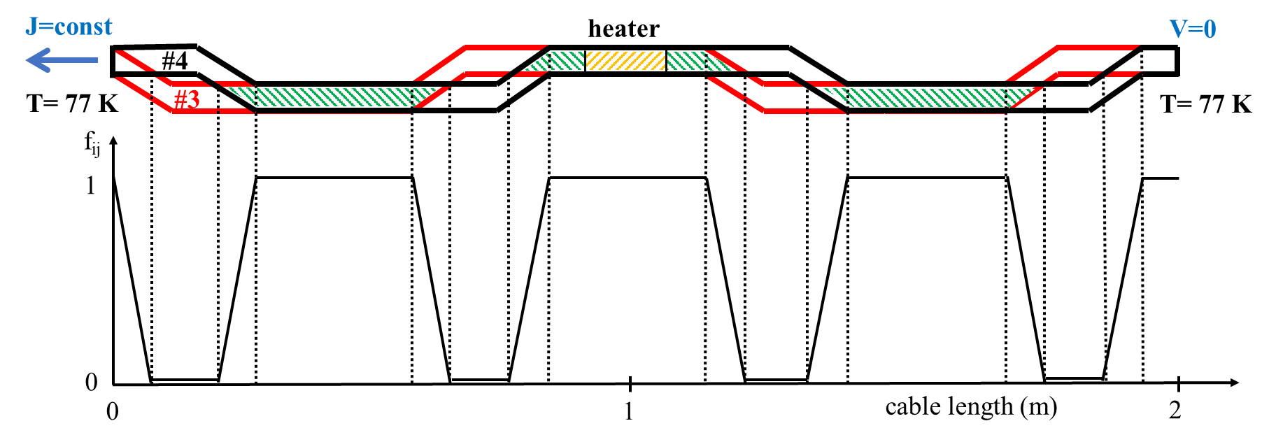
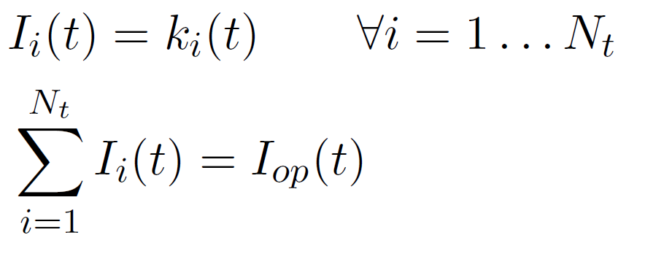
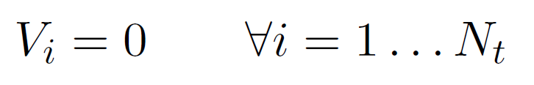
From tapes to cables: Roebel cable reduced dimensionality approach
The contact between different tapes is described through non-uniform conductances
The current distribution is set on each tape at the other terminal
The electric potential at the reference terminal of the cable is set to 0
Coupling with the thermal model

Slide 20
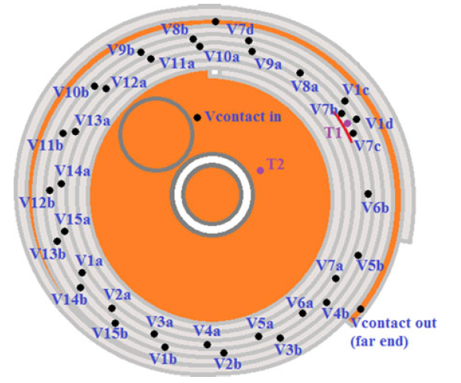
From tapes to cables: Roebel cable reduced dimensionality approach
Experiment at the University of Southampton
A 2 m long Roebel cable with 15 strands YBCO tapes (Bruker EST) was wound into a pancake coil of 7 turns with 72 mm inner diameter.
A length of fiberglass ribbon was co-wound as electrical insulation layer; the coil was then impregnated with epoxy resin.
At the 4th turn of the coil, a miniature heater was attached to tape #7 at the inner face of the turn
Quench experiments were performed at 77 K, 450 A transport current
[11] Q. Zhang, et. al., IEEE Trans. Appl. Supercond., vol. 28, no. 4, Jun. 2018.

Slide 21
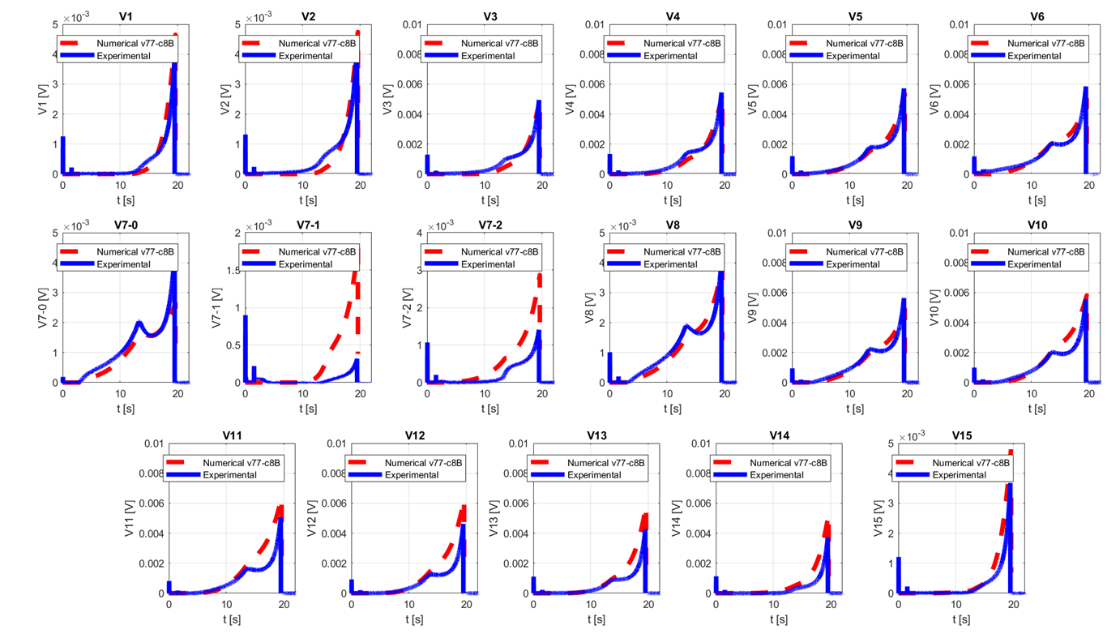
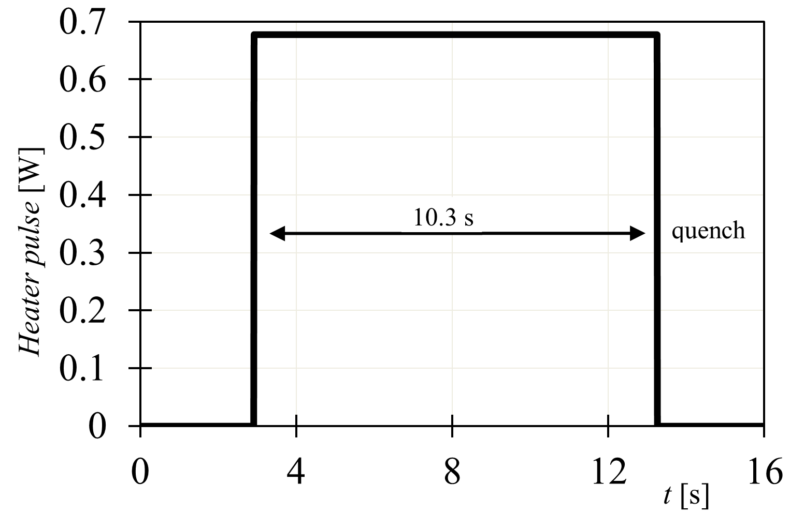
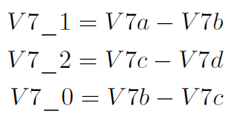

From tapes to cables: Roebel cable reduced dimensionality approach
Model vs experiment
A good agreement was found between the experimental and numerical results

Slide 22
From tapes to cables: Roebel cable reduced dimensionality approach
Quench propagation in the longitudinal and radial direction
The temperature distribution at the end of the heater pulse shows the effects of the heat transverse between tapes of the cable and from turn to turn
For some tapes, the heat redistribution between turns is faster than within the same turn

Slide 23
Outline
Introduction
HTS tape modeling
From tapes to cables
  Twisted Stacked Tape Cable
  Roebel cables
Scaling up: coils and magnet systems
Discussion

Slide 24
Scaling up: full coil models
Coil represented in some parts as a homogenous mixture of cable and insulation, in other parts as structures including cable and insulation layers
[13] E. Härö and A. Stenvall, IEEE Trans. Appl. Supercond., vol. 24, no. 3, 4900705, 2014.
Multiscale coil model composed of a homogenized coil and a localized embedded multilayer tape module (inset)
[12] W. K. Chan, J. Schwartz, IEEE Trans. Appl. Supercond., vol. 22, no. 5, 4706010, 2012.
[9] J. Van Nugteren., Ph.D. dissertation, University of Twente, 2016

Slide 25
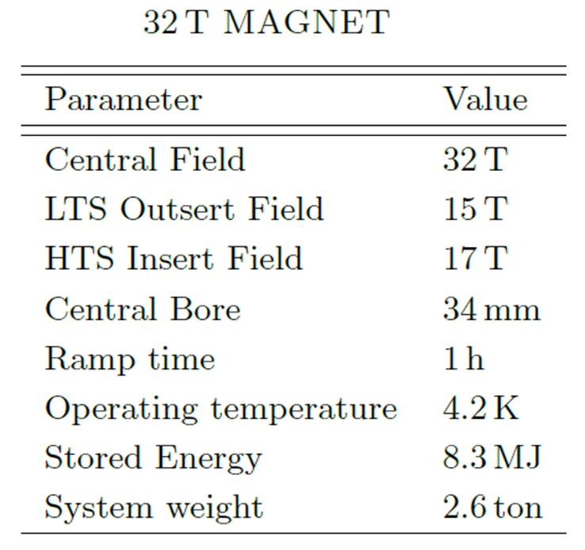
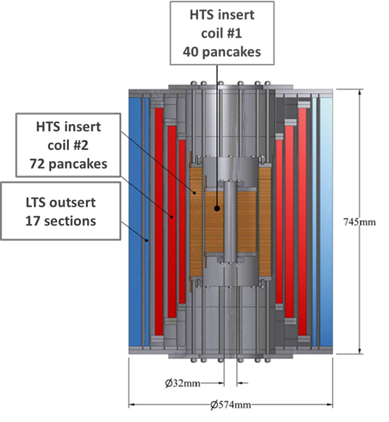
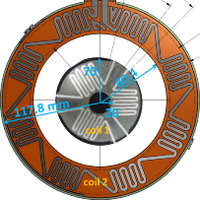
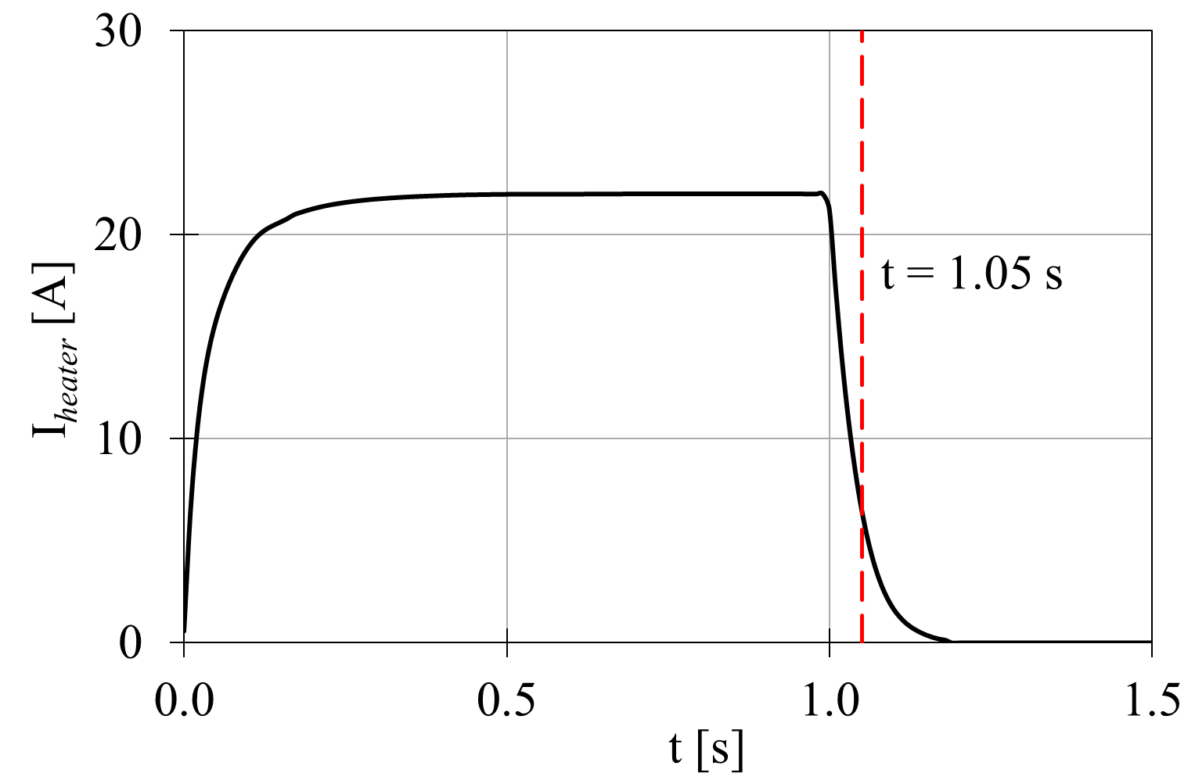
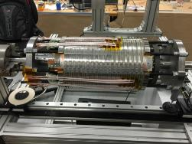
Scaling up: 32 T NHMFL magnet model
HTS insert coil #1 (10.7 T)
HTS insert coil #2 (6.3 T)
[14] H. W. Weijers et al., IEEE Trans. Appl. Supercond., vol. 24, no. 3, Jun. 2014, Art. ID. 4301805.

Slide 26
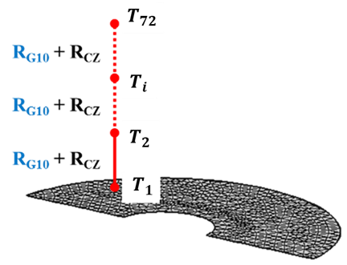
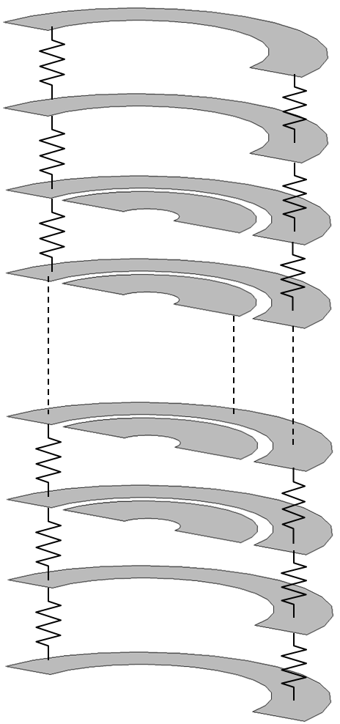
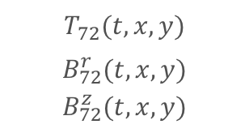
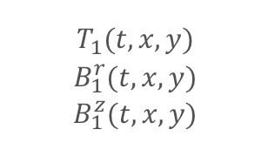

Scaling up: 32 T NHMFL magnet model
Only one 2D pancake is discretized with a mesh. At each mesh point, a set of heat balance equations is written for an array of temperatures
$$T_{72}(t,x,y)$$
$$B_{72}^{r}(t,x,y)$$
$$B_{72}^{z}(t,x,y)$$
R_{G10}, R_{CZ} DISTRIBUTED THERMAL RESISTANCES
$$T_{i}(t,x,y)$$
$$B_{i}^{r}(t,x,y)$$
$$B_{i}^{z}(t,x,y)$$
$$T_{1}(t,x,y)$$
$$B_{1}^{r}(t,x,y)$$
$$B_{1}^{z}(t,x,y)$$
Axial heat flux between pancakes
[15] M Breschi, L Cavallucci, P. L. Ribani, A. V. Gavrilin, and H. W. Weijers, Supercond. Sci. Technol., vol. 29, 2016, Art. no. 055002.

Slide 27
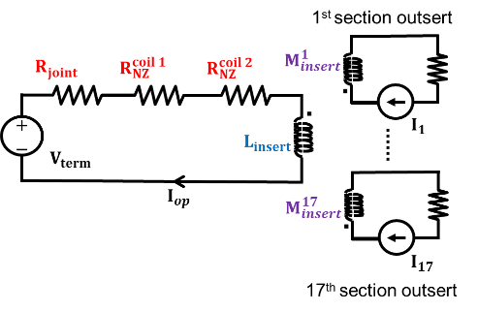
Scaling up: 32 T NHMFL magnet model
Coil constitutive law
Lumped parameter circuit describing the mutual induction coupling between the insert and the 17-sections outsert
The resistances of coil 1 and coil 2 can be computed from the power dissipated in all pancakes

Slide 28
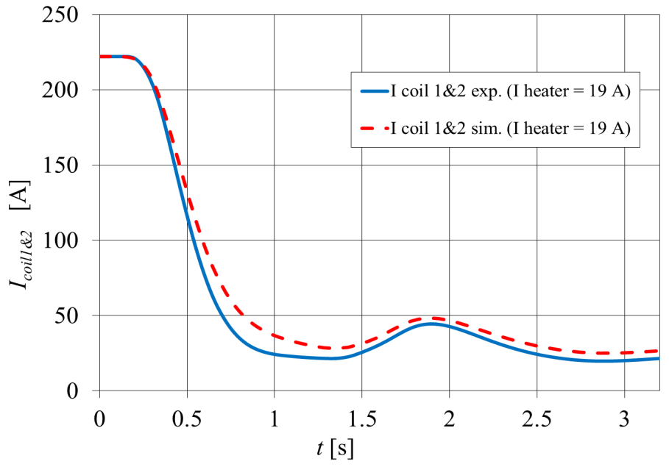
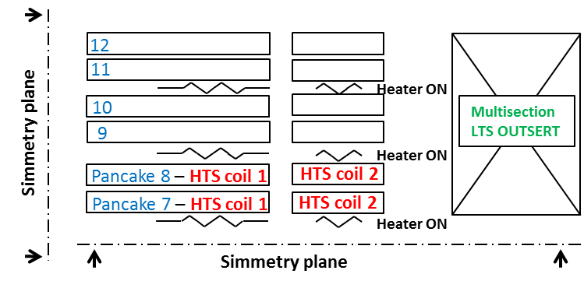
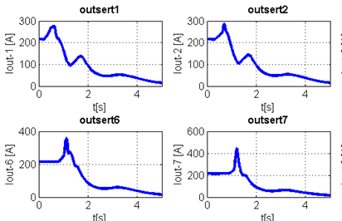
Scaling up: 32 T NHMFL magnet model
The model was first validated versus the tests of prototype coils made of 12 pancakes
A local peak of the insert transport current during the discharge is due to the inductive coupling between the insert and the outsert
Outsert currents during quench

Slide 29
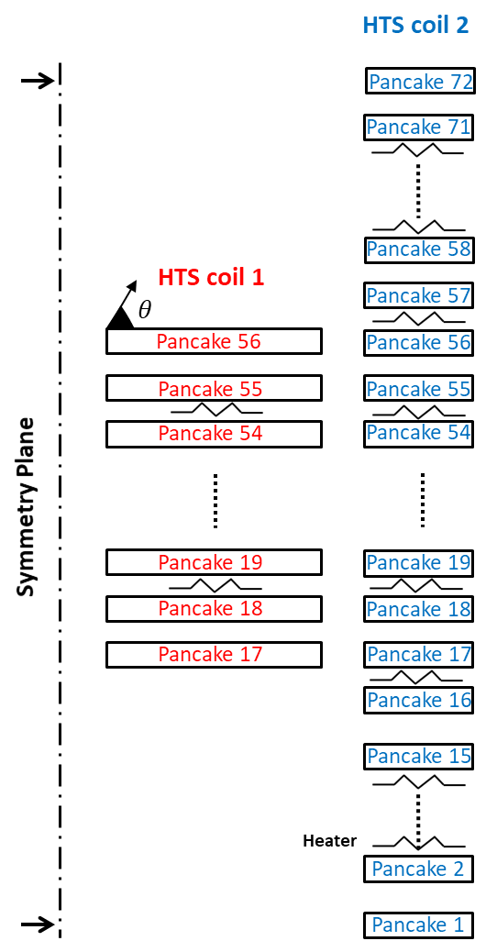
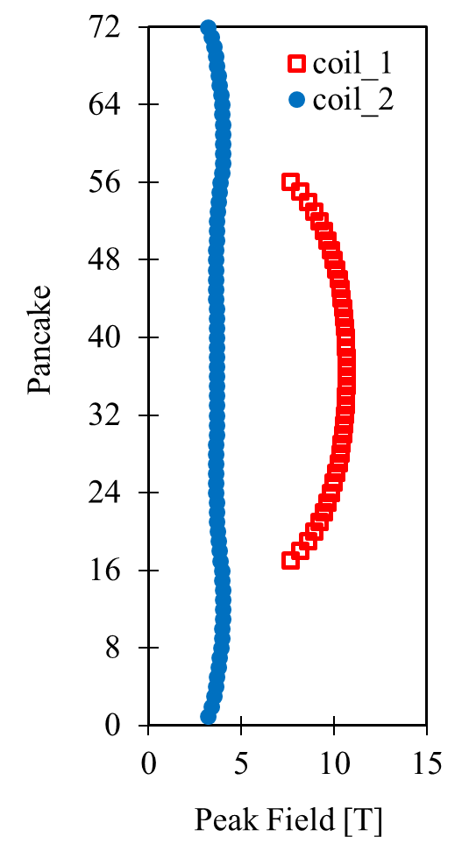
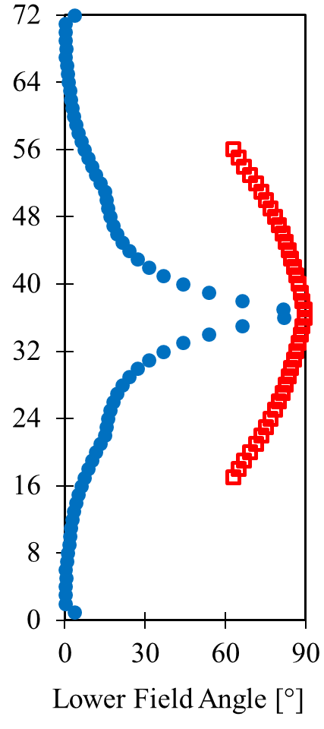
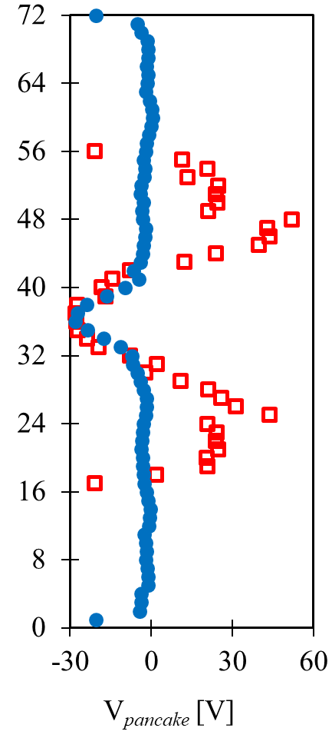
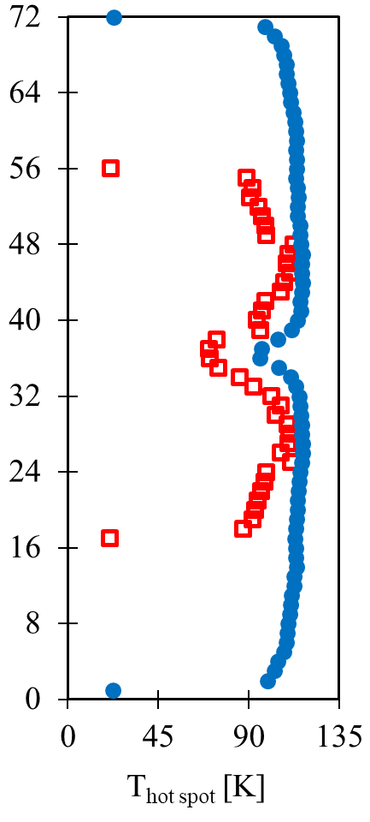
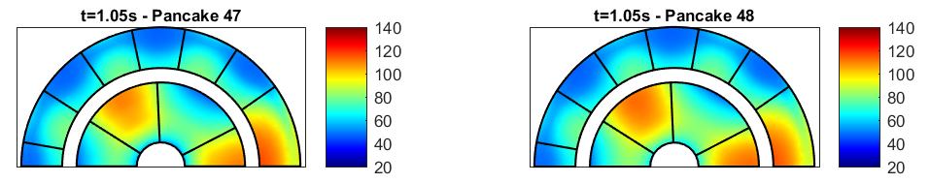
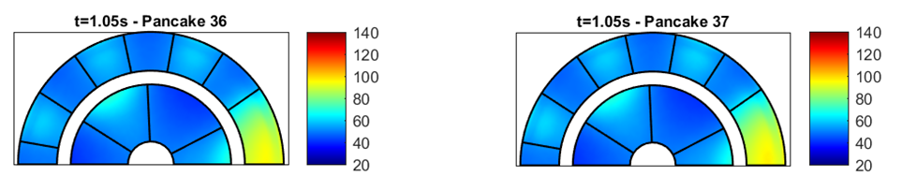
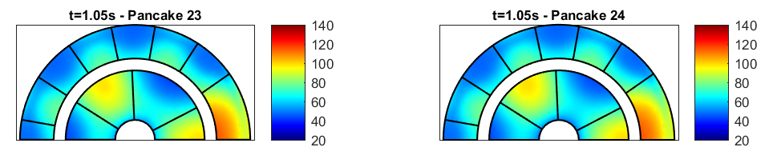
Scaling up: 32 T NHMFL magnet model
The model was then applied to analyze the self field quench test of the 32 T magnet (no current in the outsert)
Lower Field Angle θ
at t = 1.05 s
Pancake Terminal Voltages
at t = 1.05 s
Hot Spot Temperature
at t = 1.05 s
Peak Field
at t = 1.05 s
The most dangerous hot spot locations derive from a trade-off between magnetic field and field angle impacting J_{c}

Slide 30
Outline
Introduction
HTS tape modeling
From tapes to cables
  Twisted Stacked Tape Cable
  Roebel cables
Scaling up: coils and magnet systems
Discussion

Slide 31
Discussion: simulations
Impressive advances have been made in the last 15 years in the modeling of HTS devices, from single tape to full coils
The crucial techniques adopted are homogenization, reduced dimensionality and multi-scale approach
To improve the models as predictive tools, we could benefit from:
Shared material properties and parameterizations of the critical surface for wide ranges of temperature, field
Interface properties (electrical and thermal contact resistances)
Improvement of computation speed (parallel computing)
Predictive analysis and comparison between models and dedicated experiments

Slide 32
Discussion: design
Concerning quench and current distribution, much more analytical work was performed for LTS than for HTS (different times of the theory development ?)
Results available for the LTS can be extended to HTS, but not always (NI coils, Roebel cables, etc)
Analytical formulae for the calculation of current distribution time constants and lengths, quench energy, propagation velocity, would be useful for the design of HTS based magnets

Slide 33
Thank you for your attention
M. Breschi

