Slide 1



BNL Experience with NI Coils
R. Gupta, M. Allen, K. Amm, M. Anerella,
J. Cozzolino, P. Joshi, S. Joshi and W. Sampson

Slide 2
High Field, Large Aperture HTS NI Solenoid for Axion Search at CAPP/IBS
Center for Axion and Precision Physics Research (CAPP),, Institute for Basic Science (IBS),. Daejeon, South Korea
Axion dark matter is partially converted to a very weak flickering Electric (E) field in the presence of a strong magnetic field (B)
Scanning
Rate:
High field, large volume : key to targeted breakthrough
  High field solenoid magnets: B (B⁴)
  High volume magnets/cavities: V (V²)

Slide 3
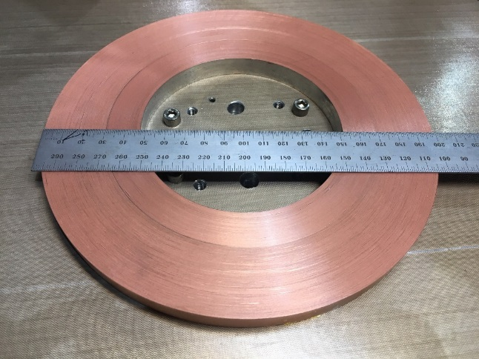
Design Requirements of IBS Solenoid
High Field : 25 T (must use HTS; it’s all HTS)
Large Volume: 100 mm bore, +/-100 mm long
      Stresses: J X B X R
Field quality: ~10%
Ramp-up time: up to 1 day
Relaxed field quality and slow ramp rate allows the use of No-Insulation windings to (a) tolerate defect in HTS tapes, and (b) expected to offer a more reliable quench protection

Slide 4
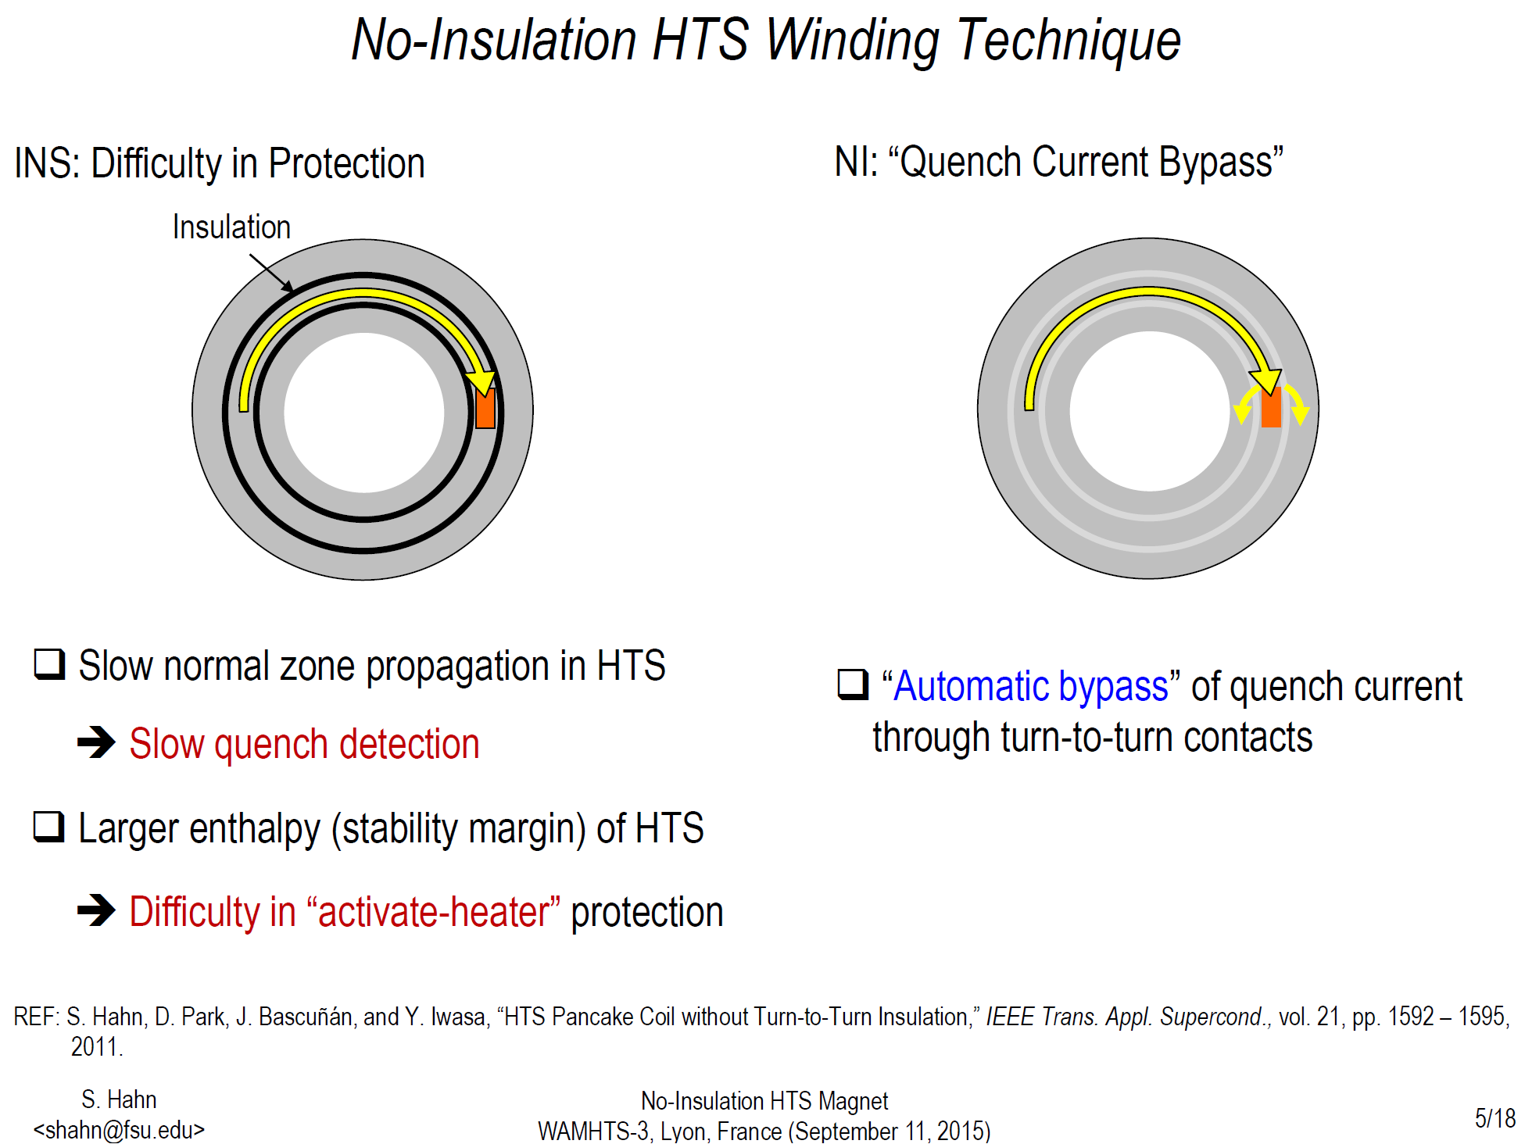
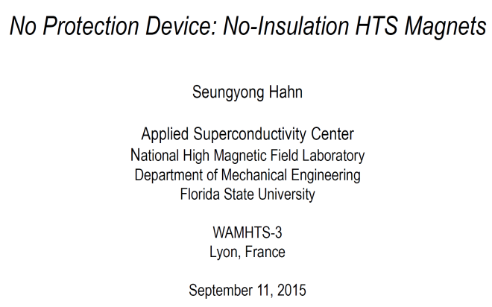
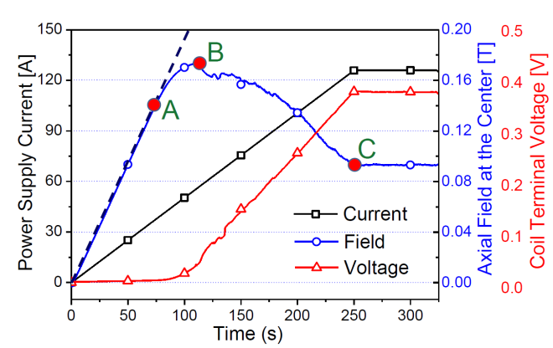
No Insulation Approach to Magnet Protection
(slides courtesy S. Hahn)
A decrease in field implies that more and more turns are getting shorted
Successfully demonstrated to work in small coils, but not yet in big coils at 4K

Slide 5
Major Design Decisions (1)
No-insulation winding
  Better tolerance to defects (it’s still an R&D conductor) and hopefully better quench protection
Single layer coil design
  To avoid unbalanced Lorentz forces
12 mm wide tape
  To (a) reduce impact of hairline defects, (b) help in quench protection and fewer coils (cost reduction)
  Piece length > 100 m (not =100m) for cost reduction (each pancake needs ~300 m)

Slide 6
Major Design Decisions (2)
Electrical margin > 50% (Note: NOT =)
  Tight spec on I_{c} is a “mirage” as there is a large variation in I_{c} margin within HTS coil even for a 100% uniform conductor
Low spec on minimum I_{c}
  Design is limited by the mechanical properties
Mechanical margin > 50%
  50 μm Hastelloy and 20 (10+10) μm Cu chosen
No multi-width coils
  Smaller width increases J_{c} and J X B stresses

Slide 7
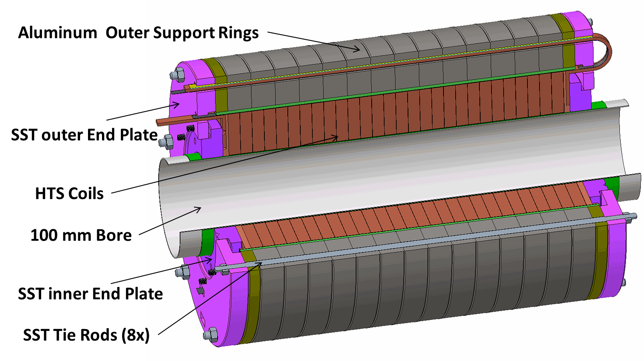
IBS HTS Solenoid Design Summary
Design Field: 25 T
Operating Temperature: ~4 K
Cold Bore: 100 mm
Coil i.d.: ~105 mm
Coil o.d.: ~200 mm
Single Layer
Conductor: 12 mm wide ReBCO (50 μm Hastelloy, 20 μm Cu)
Conductor per Pancake: ~300 m
Number of Pancakes: 28
Current: ~450 A
Coil Current Density: ~500 A/mm²
Stored Energy: ~1.3 MJ
Inductance: ~13 Henry
Maximum Hoop Stress: ~480 MPa
Maximum Axial Stress: ~180 MPa
Outer Support Ring: High Strength Aluminum Rings

Slide 8
Orthogonal Coil Stresses (@4 K, 25 T)
~480 MPa Max Stress
-114 MPa Max Stress
-170 MPa Max Stress
Azimuthal
Radial
+
Axial
+

Slide 9
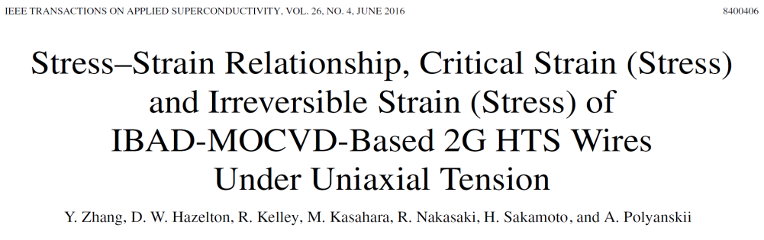
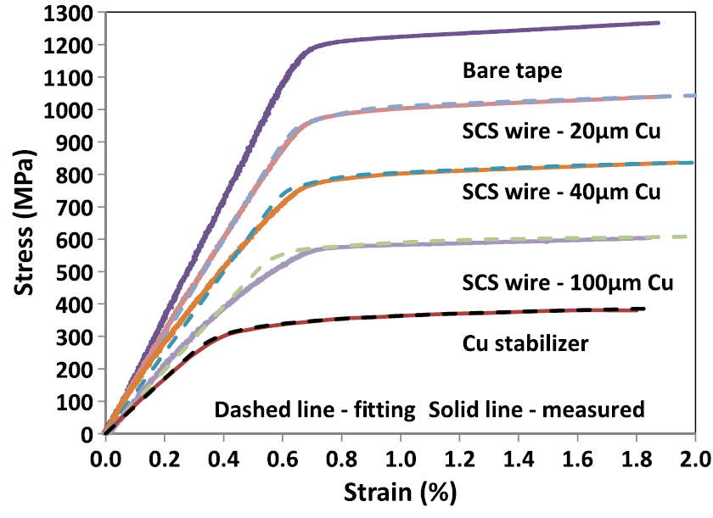
Mechanical Properties of the Conductor
Requirement of Azimuthal stresses of ~500 MPa is met with 2G Tape having
50 micron Hastelloy
and 20 micron Copper
Meeting requirement of ~200 MPa on the narrow side of the tape needs to be checked as no such data is available
Courtesy: SuperPower

Slide 10
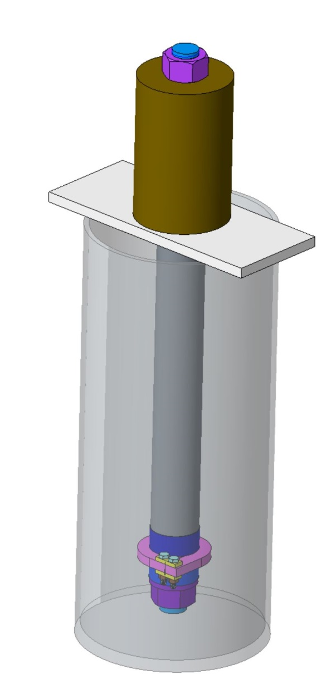
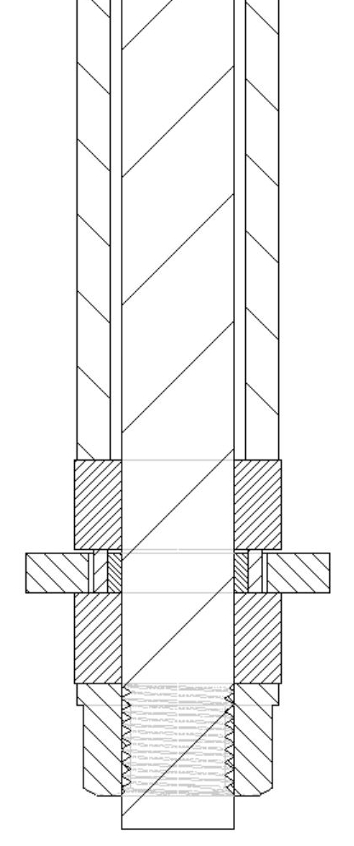

Apparatus to Apply up to 300 MPa Load on the Narrow Side (design needs 170 MPa)
Hydraulic Cylinder
32 mm dia. actuator rod
LN₂ Dewar
Press Plates
HTS Test Sample
Sample O.D. Support
Sample Bobbin
Source of Load on Narrow Side: B_{r}

Slide 11
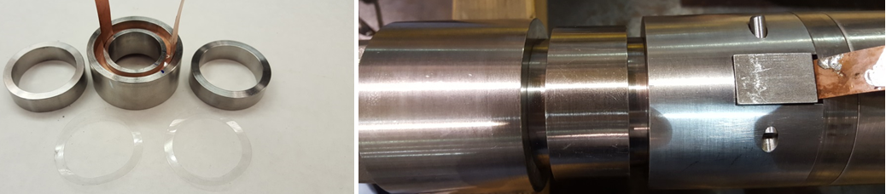
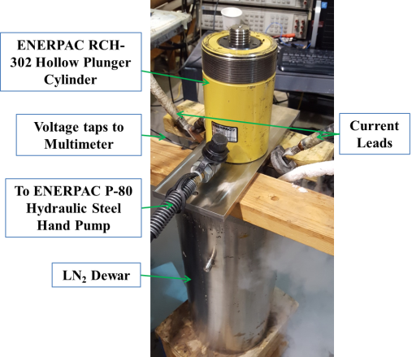
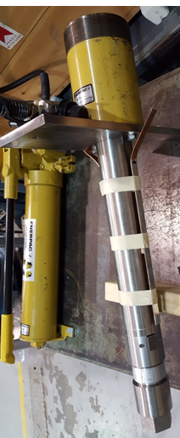
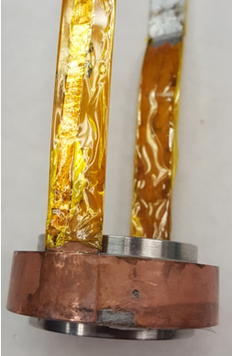
Test Setup to Vary Load on the Narrow Edge During the 77 K Test
Load varied while testing
11

Slide 12
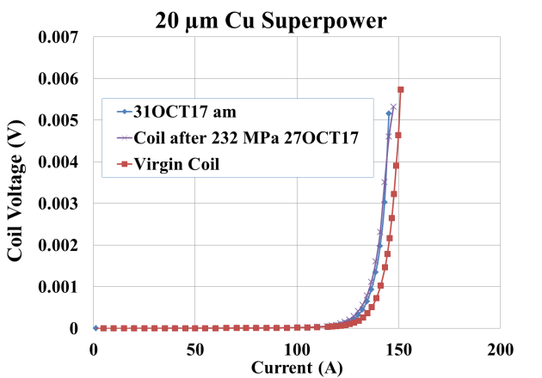
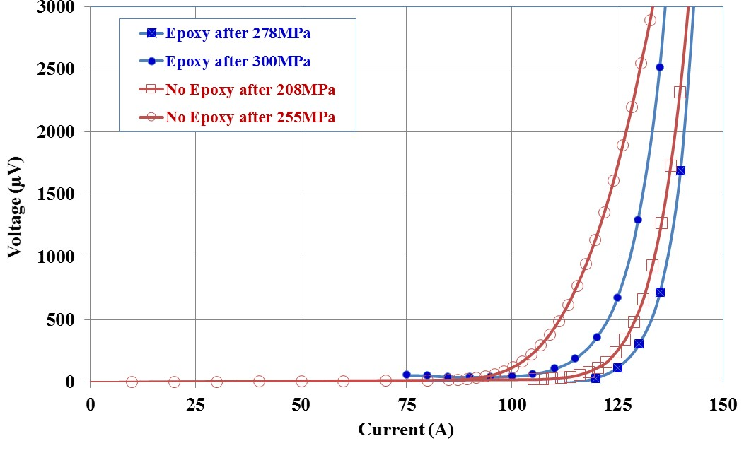
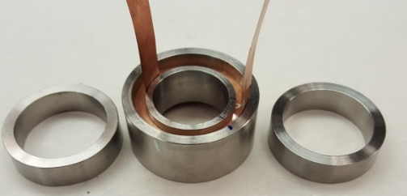
Experimental Results of the Load on the Narrow Edge (need >170 MPa)
Studies show that painting the surface of the coil with epoxy helps
It reduces the point/local load on an individual tape
We have >50% margin
Meets the requirements of 170 MPa on the narrow side
Cyclic studies performed
Tapes with 40 and 65 microns copper and also from the other vendors were tested as well
Load should be distributed over the coil surface and not accumulate on the narrow side of one tape

Slide 13
Coil Construction and Test Results

Slide 14
BNL Experience with HTS Magnets
BNL has been working on HTS coil and HTS magnet technology almost from the beginning (about two decades)
BNL has made coils with all type of HTS (Bi2212, Bi2223, ReBCO MgB₂) in a variety of forms (wire, tape, cable)
BNL has experience in making coils with over 60 km of HTS (4mm tape equivalent)
BNL has made over 100 HTS coils and over 20 HTS magnets in a variety of geometry – dipole, quadrupole, solenoid, curved coils
BNL has made coils with a variety of insulations - inorganic, stainless steel and no-insulation

Slide 15
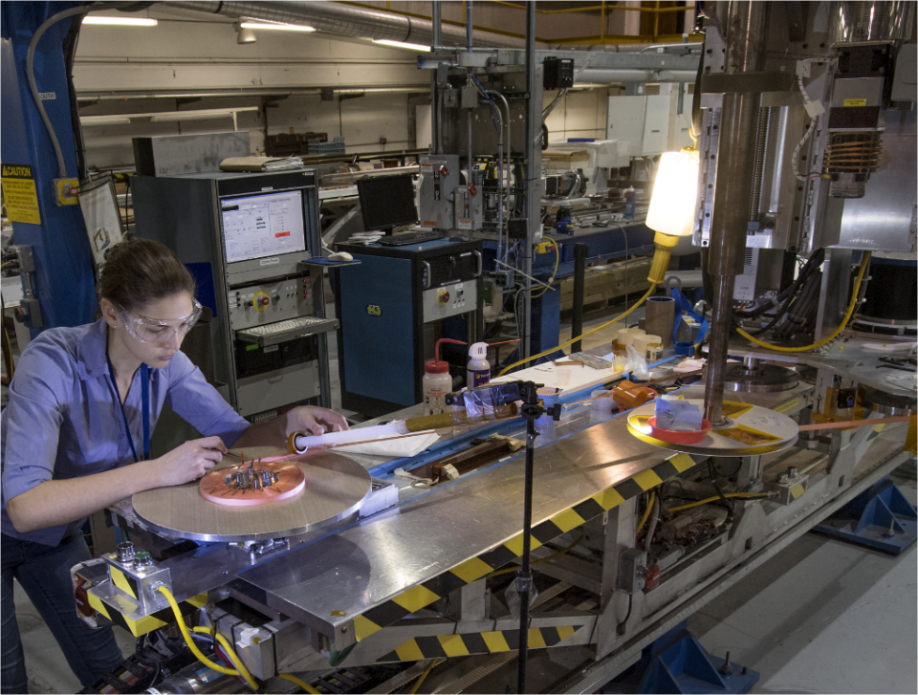
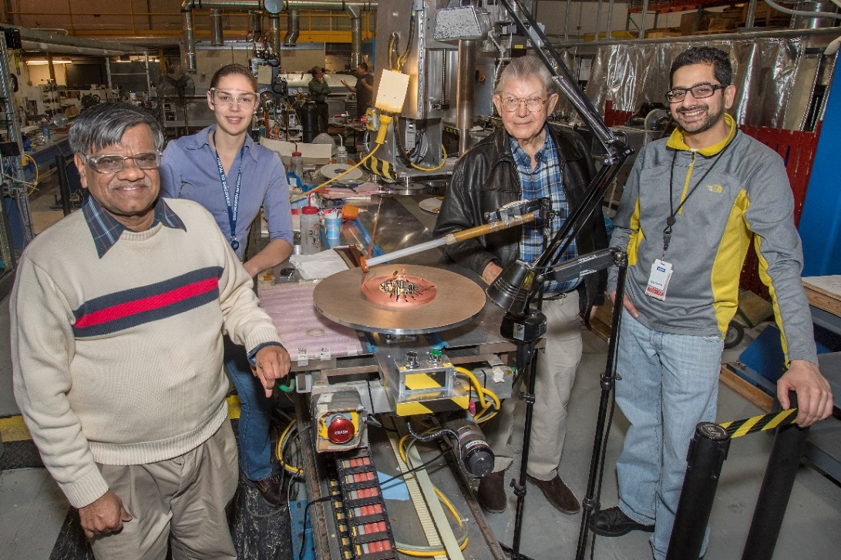
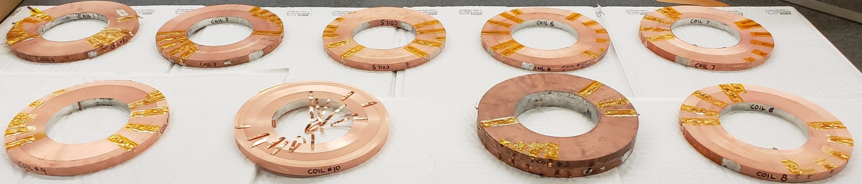
Winding of IBS NI HTS Coils with BNL Universal Coil Winder
16 coils wound
~5 km of 12 mm tape used

Slide 16
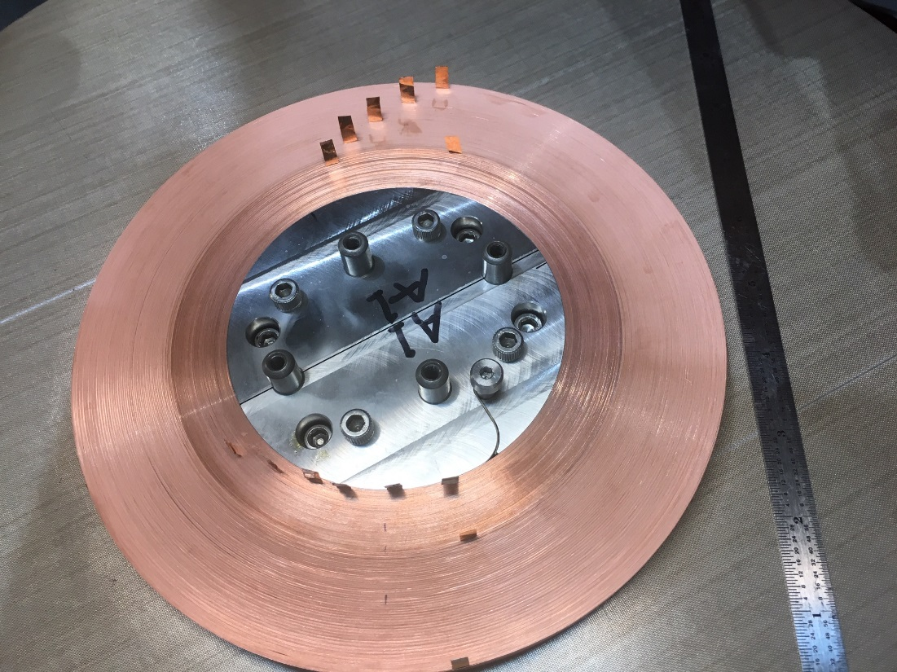


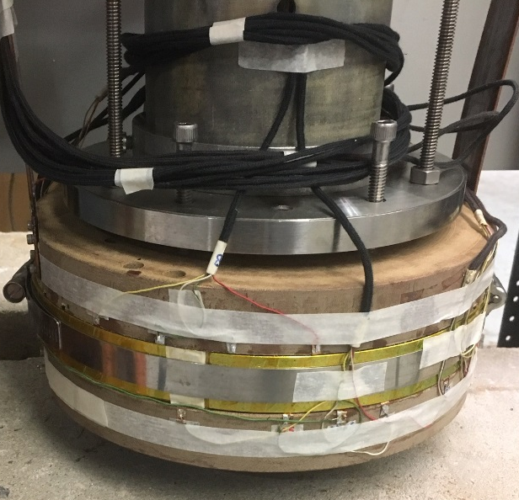
IBS Coil - Well Instrumented
(two single pancakes spliced to a double pancake)
Major parameters:
i.d. : 105 mm
o.d. : 200 mm
Turns: ~1250 (DP)
600 meters of tape
A large number of v-taps are key to our detailed investigations during the test and how the performance of the conductor within the coil changes after certain event and to decide if more measurements needed then
(12 mm wide)

Slide 17
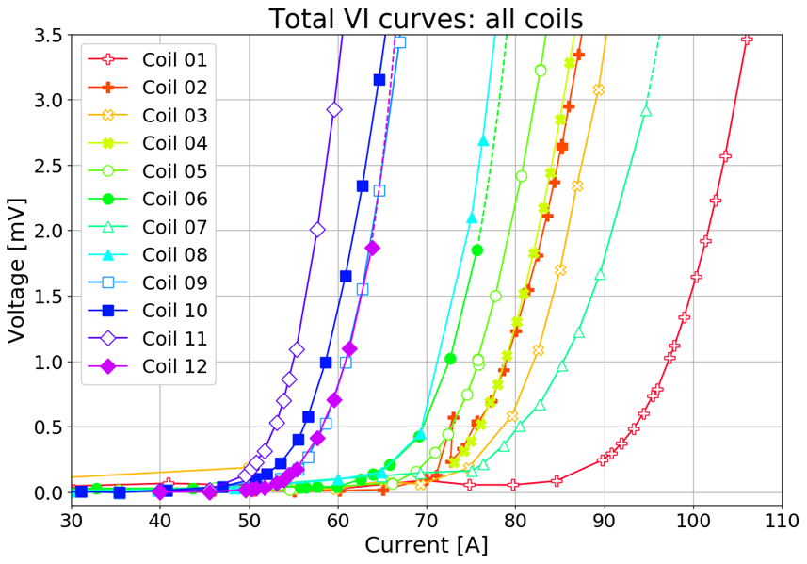
77 K (LN2) Test of 12 Pancake coils
(coils 1-6 tested as single pancakes and 7-12 as double pancakes)
A significant variation between coil to coil
50 A in single pancake creates ~0.5 T and in double pancake ~1 T
@3mV
(0.1 μV/cm)

Slide 18
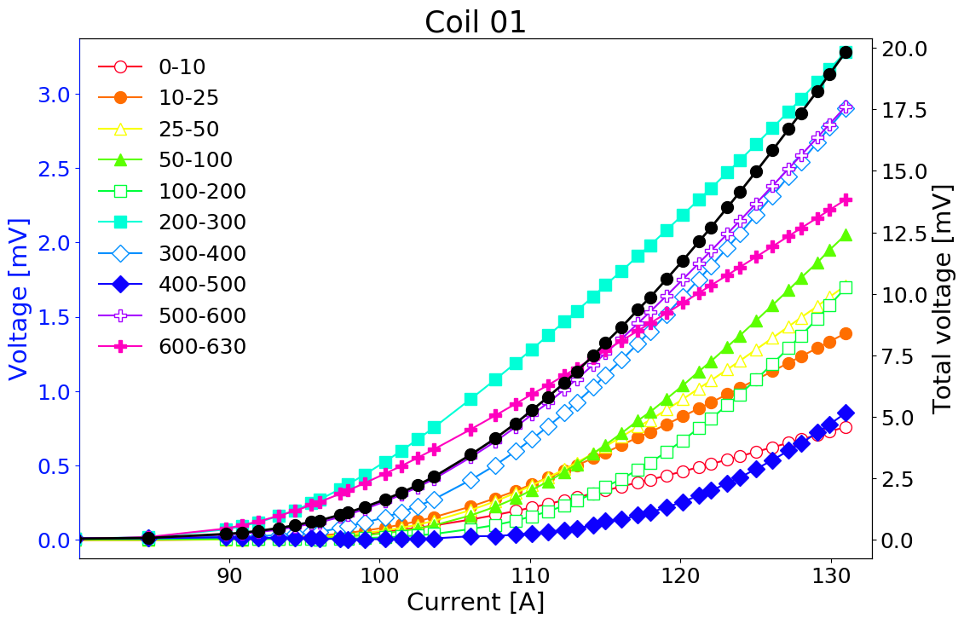
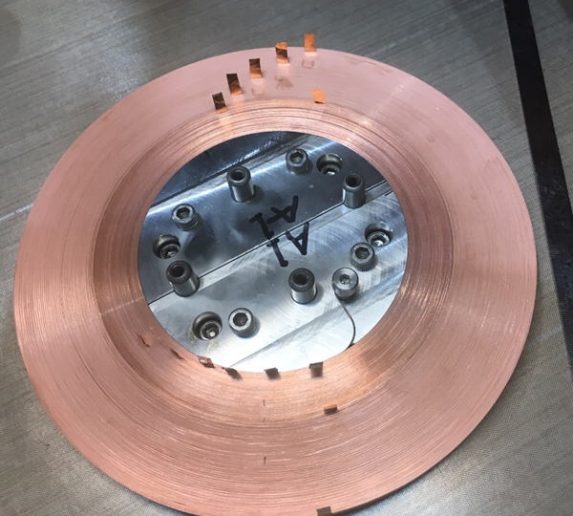
Details of the 77 K Test Results
(Sectional Voltage in Coil #1)
@3mV
(0.1 μV/cm)

Slide 19
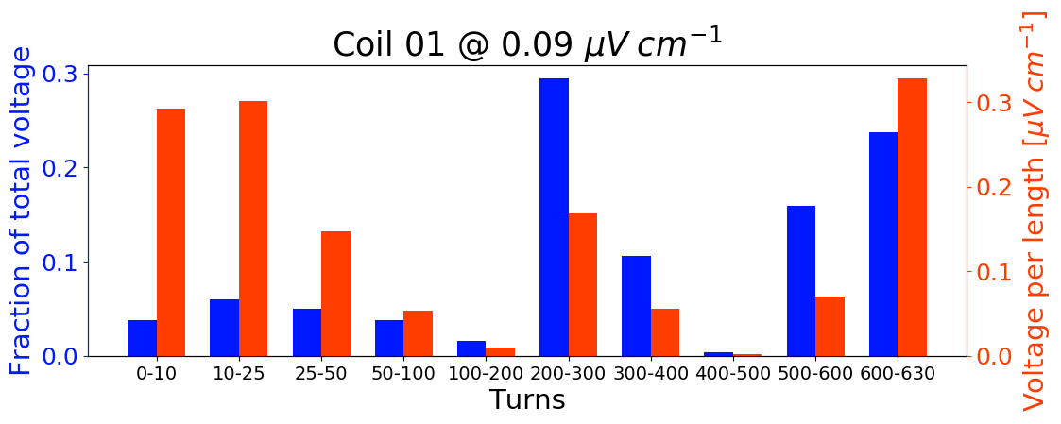
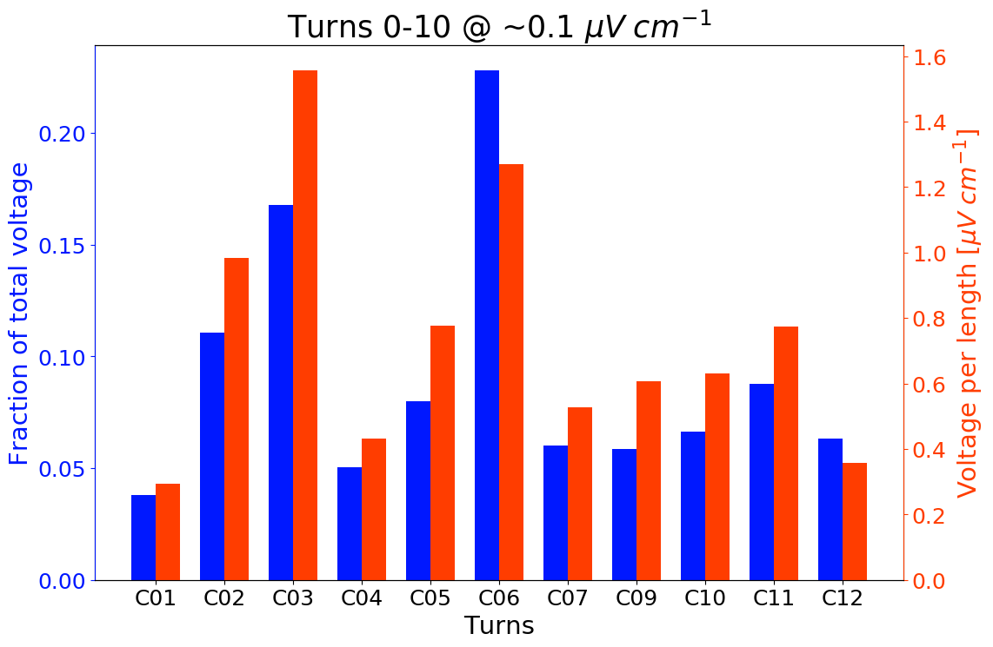
Details of the 77 K Test Results
(Sectional Voltage in Coils)
Backup slides for a detailed analysis of 77 K test results for twelve coils

Slide 20
Coil Tests in Helium

Slide 21
IBS Double Pancake Coil Runs with Helium
Two sets of runs of R&D coils (including defect simulation with heaters) were carried out in 2017 (not presented here)
Two sets of runs of the IBS double pancake “production coil” were carried out from 9/10 to 9/14 and from 10/16 to 10/18. First test run was extensive and discussed here:
  Many test runs over the design current of 450 Amps
  Several test runs at the stress level of 25 T solenoid
  A large number of shut-offs at various currents
  Many high current quenches or runaways
  Sudden over-current tests
  Helium runout tests
Attempt to create a series of fault scenarios

Slide 22
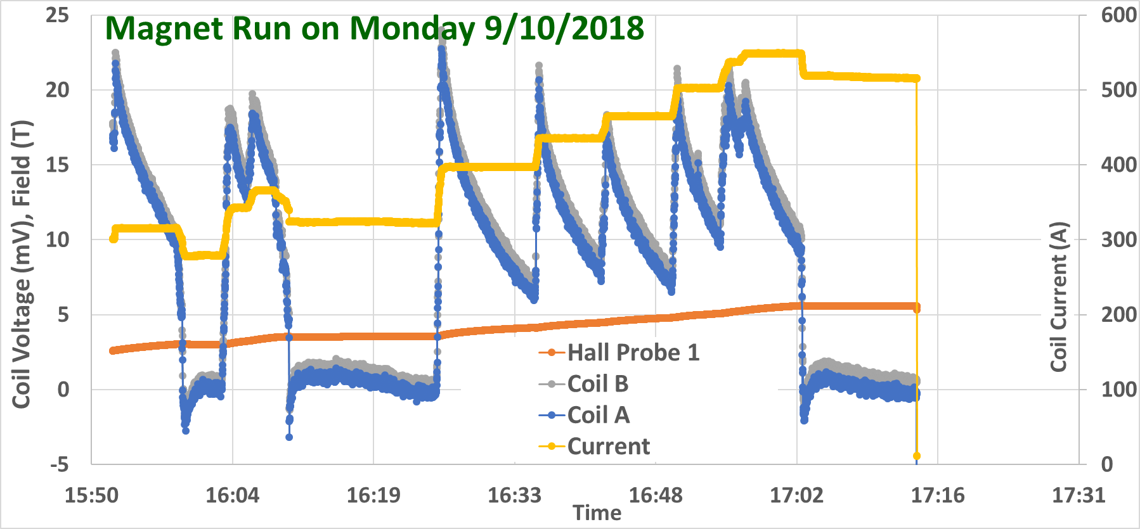
Monday Run Summary
Current
Shut-off @500+A
Field
Shut-off may cause an eventual thermal runaway (quench)
As a part of the study a large number of shut-off (over 30) performed. This gives an early indication, depending on whether coil runs away or not, on how close we are to the limit (more discussion in the next slide)
    Do these shot-offs create excessive shielding currents?

Slide 23
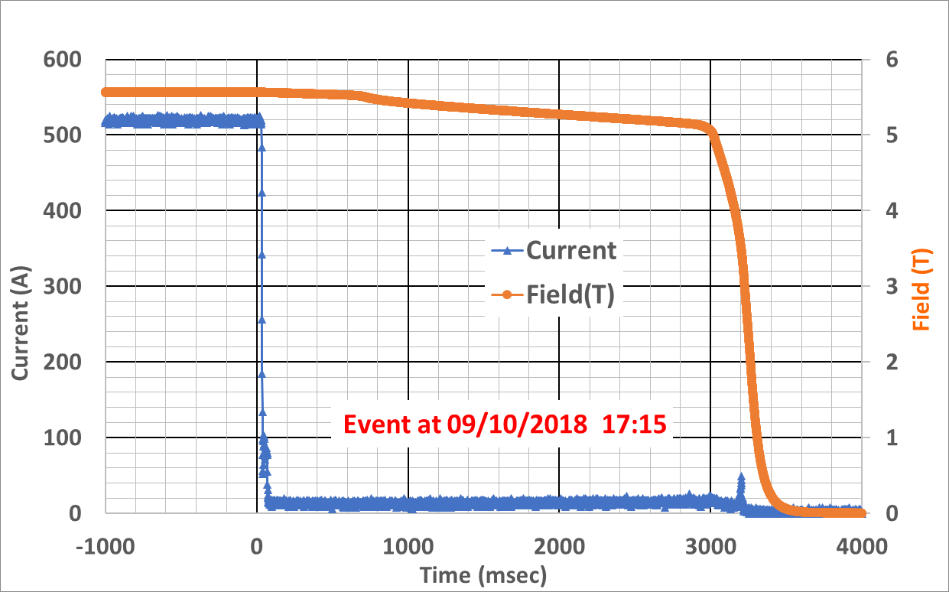
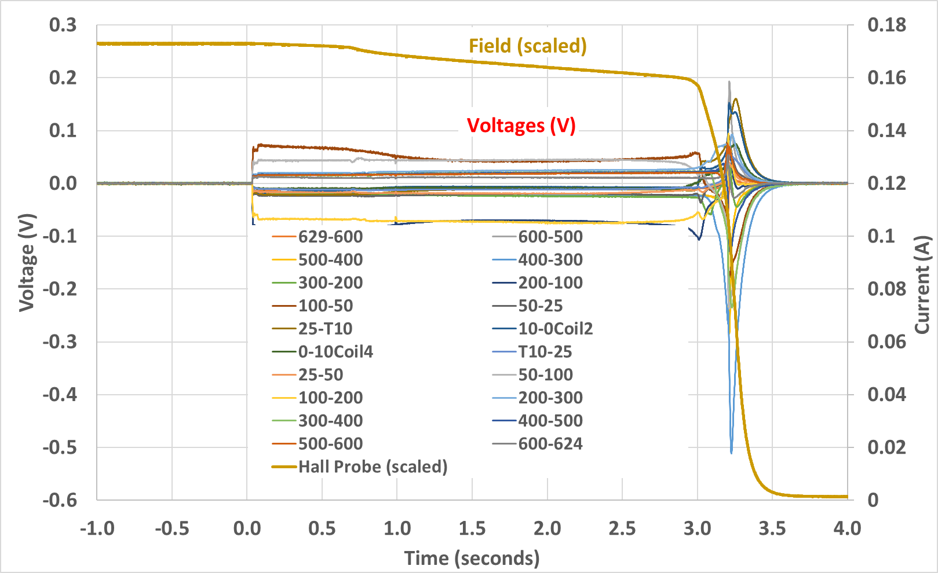
Discussion on Shut-off @550 Amp
(a large number of shut off tests at different currents)
In No-insulation coils, in addition to the circulating current, the current may flow across the turns (sideways), providing an extra protection
These sideways current keep flowing even after the power supply shut-off and decay slowly in No insulation coils
These sideways current heat-up the coil and depending on the contact resistance and on how close one is to the critical surface, may or may not quench the coil (thermal runaway)
In our case, we found that it runs away at 450 Amps or more
At high currents it runs away within a few hundred milli-seconds
At 550 A, it took about 3 seconds
During this period resistive voltage kept increasing the temperature

Slide 24
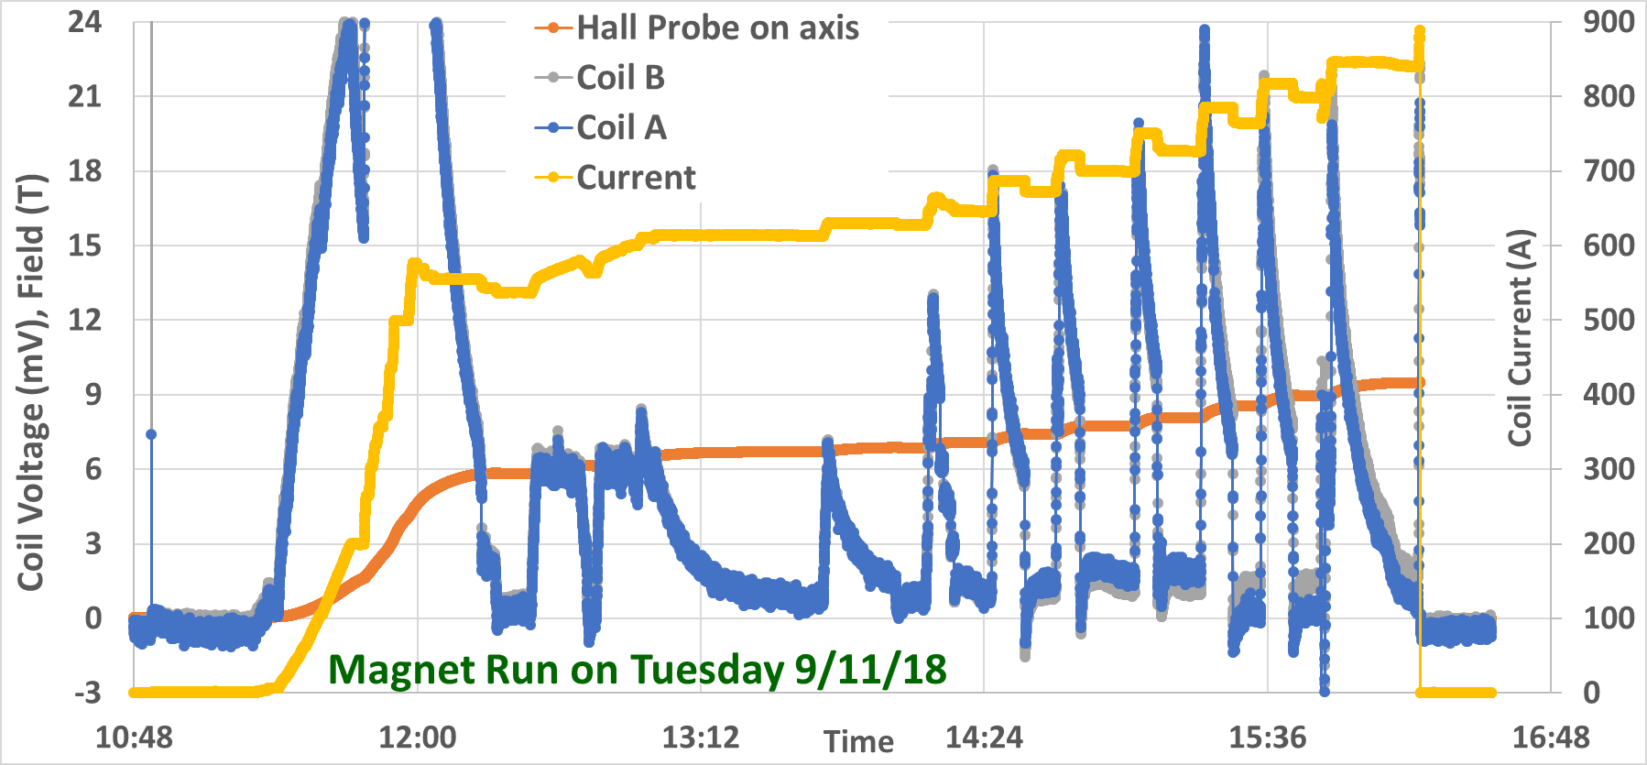
Tuesday Run Summary
Keep increasing current to see how high it could go (as in LTS)
Quenched in going from 850 A to 900 A (design: ~450 A)
Bore field ~9 T, Peak field ~17 T (high peak stresses: B x I)
850 Amp in a double pancake creates similar peak stresses and similar stored energy per pancake as in the 25T IBS solenoid
Quench discussed in more details in the next slide

Slide 25
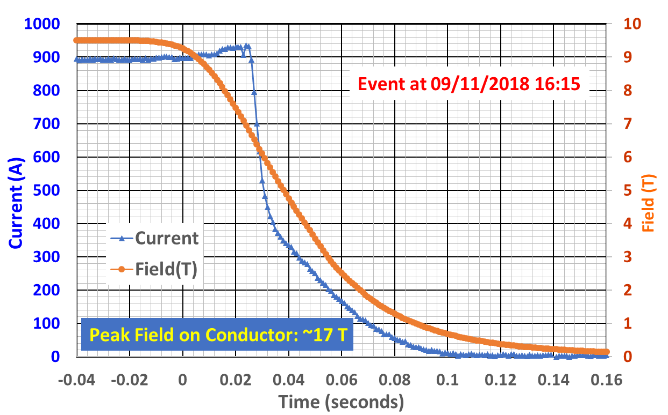
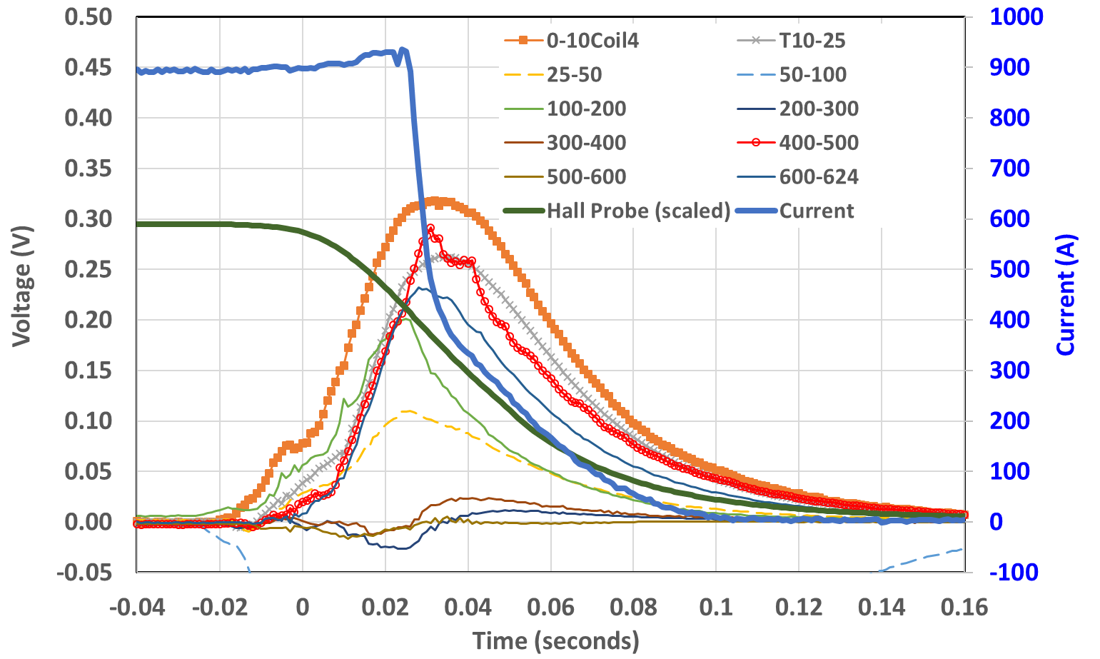
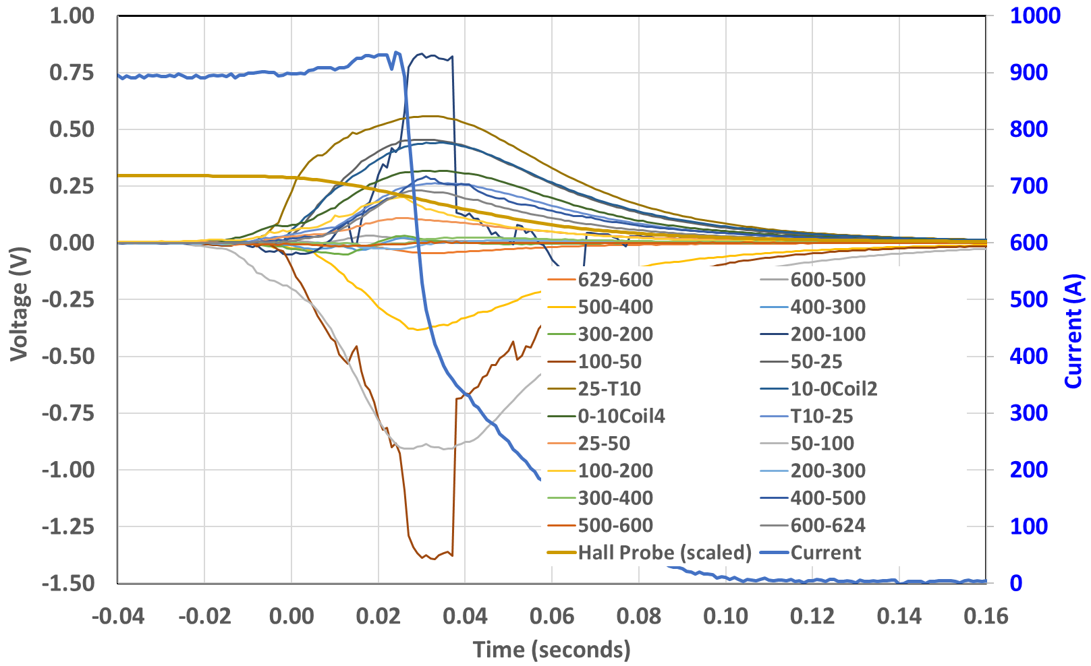
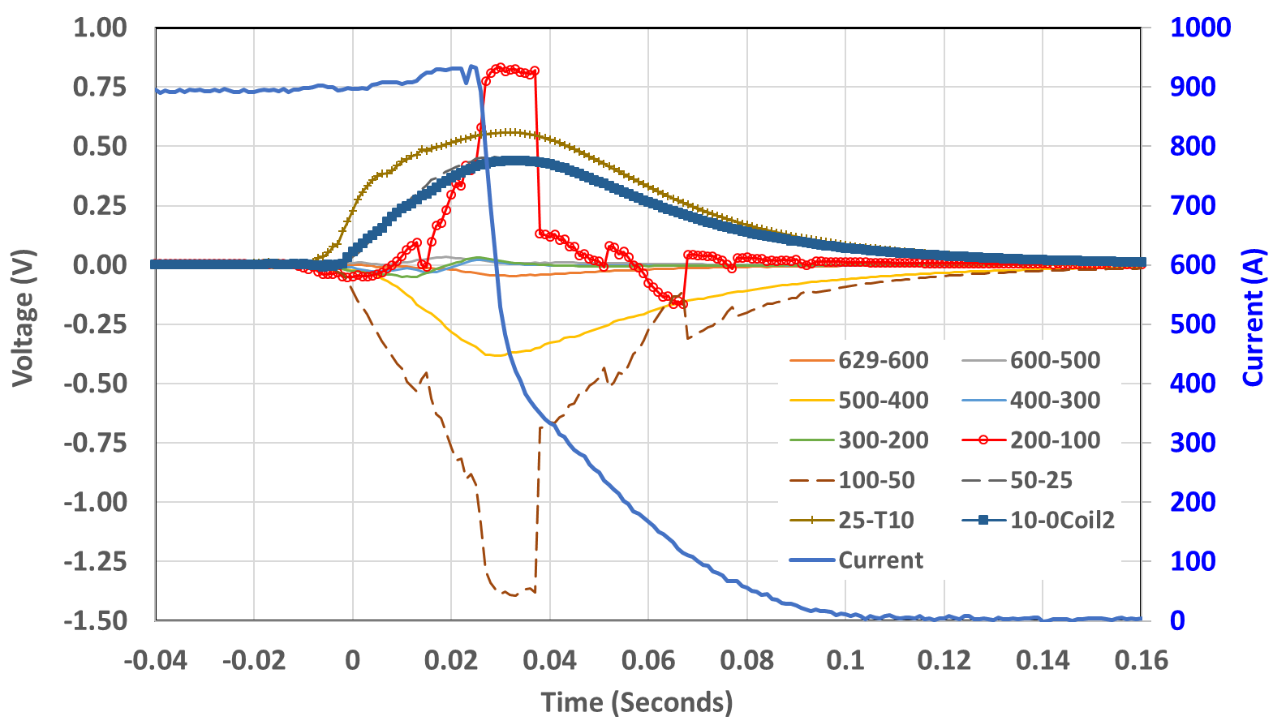
Discussion on Quench at High Current
(Tuesday Run: v-taps help in analysis)
Stored Energy ~90 kJ
NO slow quench propagation.
All done in <200 msec
Starter coil
Follower coil
Both coils

Slide 26
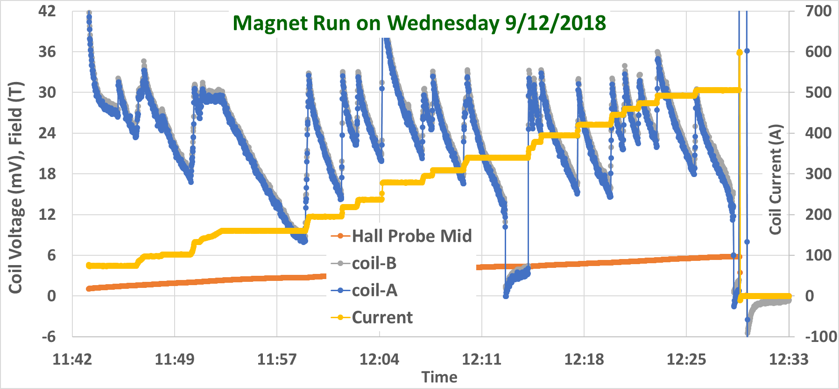
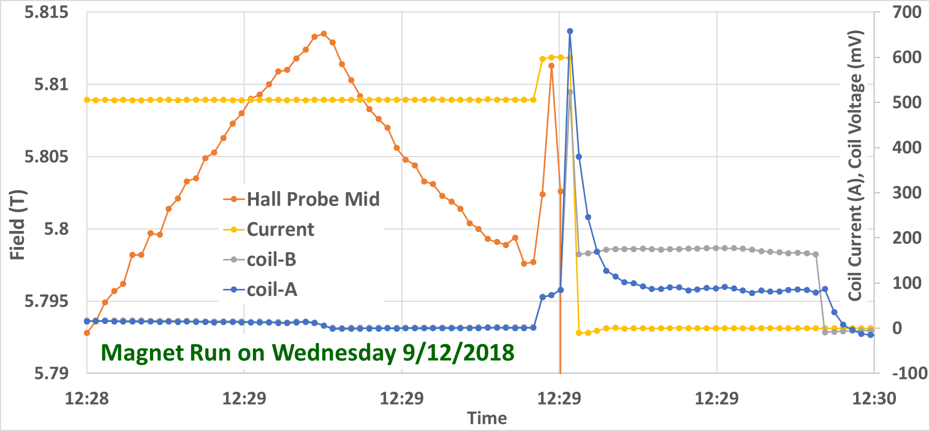
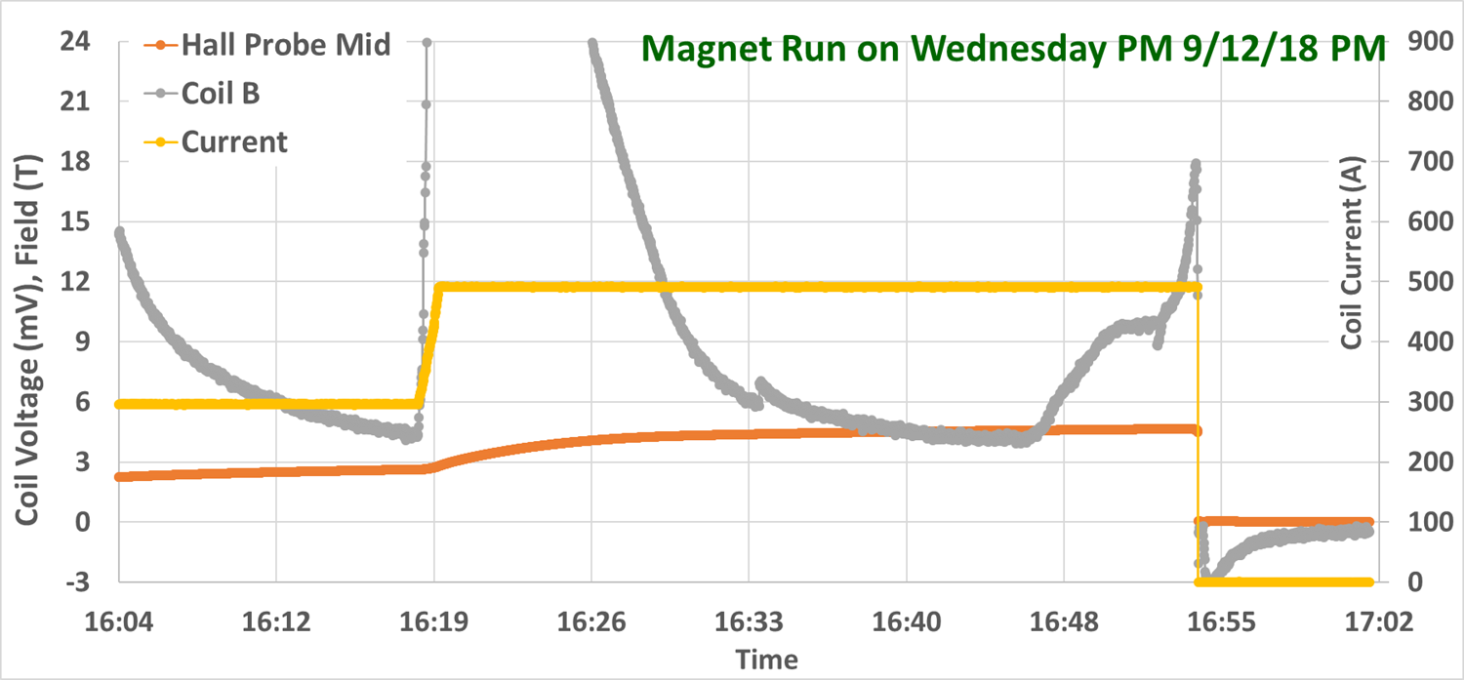
Wednesday Run Summary
(unusual events – not expected during normal operation)
Sudden increase in current due to coupling of two power supplies
Running out of Helium at the end of the day

Slide 27
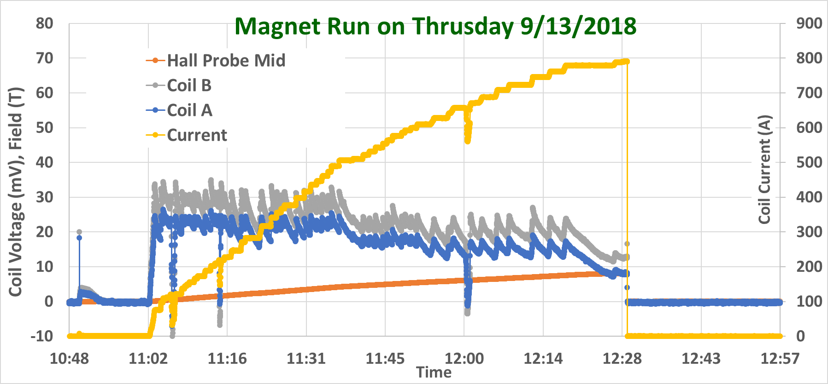
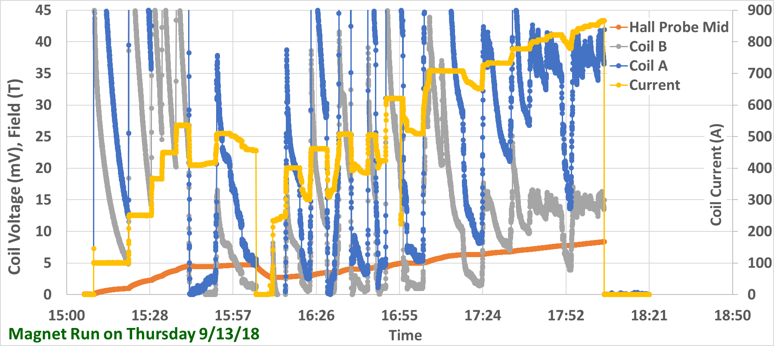
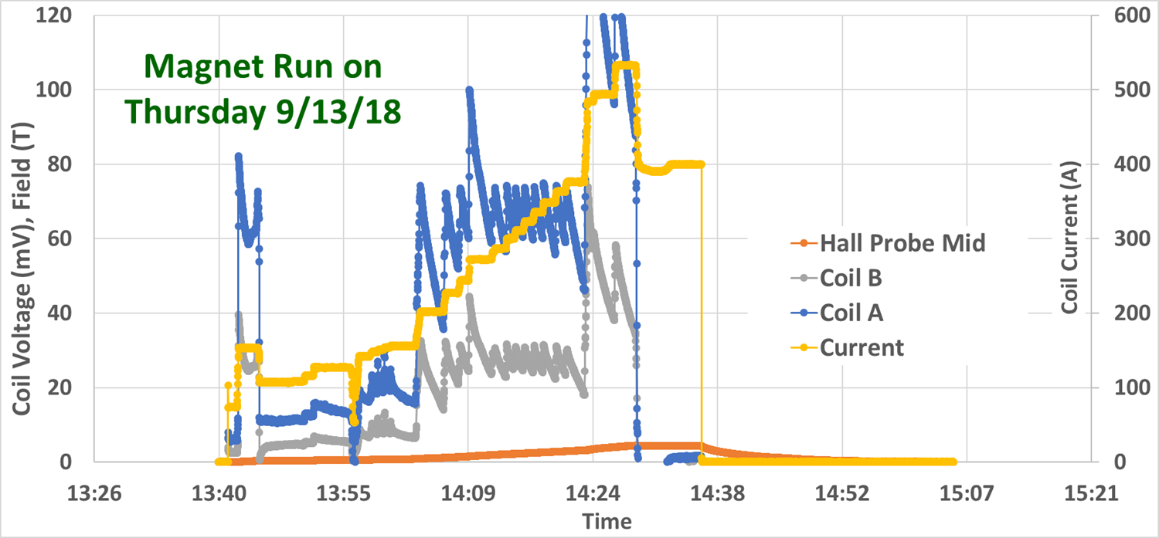
Thursday Run Summary
Two more quenches at 800-850 A (design: ~450 A)
..and a shut-off near design current

Slide 28
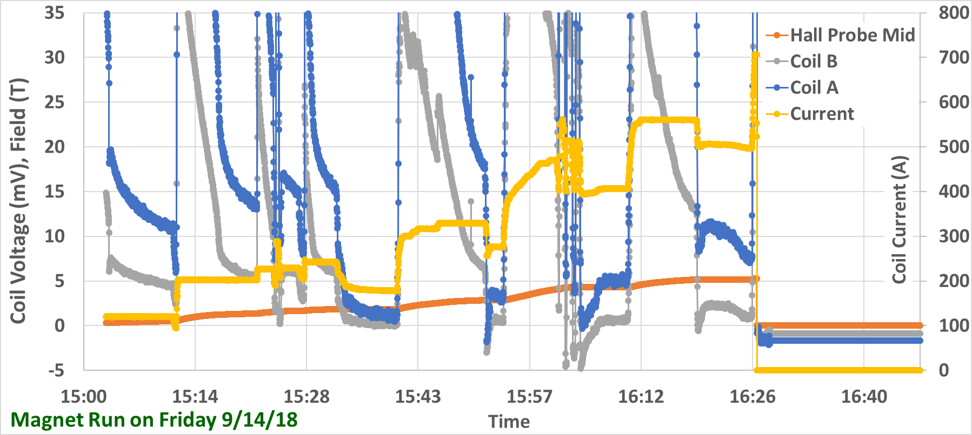
Friday Run Summary
Higher temperature operation mostly in Helium gas environment

Slide 29
Overall Summary of four Series of Tests of two Large NI Coils at 4 K
Two large coils survived many quenches/thermal runaway at 4 K, 17 T peak field (i.d. 105 mm, o.d. 200 mm, ~600 m of 12 mm wide tape used in each)
Coil survived simulation of a variety of accidents
Maximum current density in coil: ~950 A/mm² (design needs ~500 A/mm²)
Hoop stresses (JXB) over 400 MPa
A large number of v-taps helps understanding of the quench propagation within coil and coil-to-coil

Slide 30
Key Takeaway from the Quench Studies in Large NI HTS Coils
Conventional HTS thinking: Slow quench propagation velocities in HTS. This implies energy getting deposited in a small area for long enough to possibly degrade and even permanently damage the conductor locally.
Conventional Approach: Fast acting heaters. Challenge in HTS magnets to make it work - large and varying thermal margin across the magnet.
Recent results in the “No-Insulation Windings” point to a very different scenario ➔ quench propagation is fast within a pancake between the adjacent turns (as indicated by the large number of v-taps) and also the propagation is fast to the adjacent pancakes.
BNL 4 K results in large aperture, high field/high stress double pancake coils are so far encouraging.
We need to properly understand the other results/concern with more diagnostics (v-taps) and demonstrate a working solution.

Slide 31
High Field Solenoids for Neutron Scattering
PBL Collaborators:
Bob Weggel, Ron Scanlan, Erich Willen, Steve Kahn, Del Larson and Jim Kolonko

Slide 32
HTS Solenoid for Neutron Scattering
(PBL/BNL SBIR, Phase I funded)
Ultimate requirements of the experiment:
A high field (25 T) magnet with wide opening (both horizontally and vertically) to maximize the range of angles for incoming neutrons and minimize the blockage of scattered neutrons (angular opening)
Stated Goals of PBL/BNL SBIR:
Develop innovative designs and technologies with large opening angles that could revolutionize the capabilities of neutron diffraction
Specifically exploit the concept of the open-midplane design (developed under HEP for Muon collider and LHC luminosity upgrade)
Also HTS coils conical angle to maximize the reach of experiment. A NI HTS conical coil to be built and tested at 77 K in Phase I
Proof-of-principle magnet to be demonstrated in Phase II, if funded

Slide 33
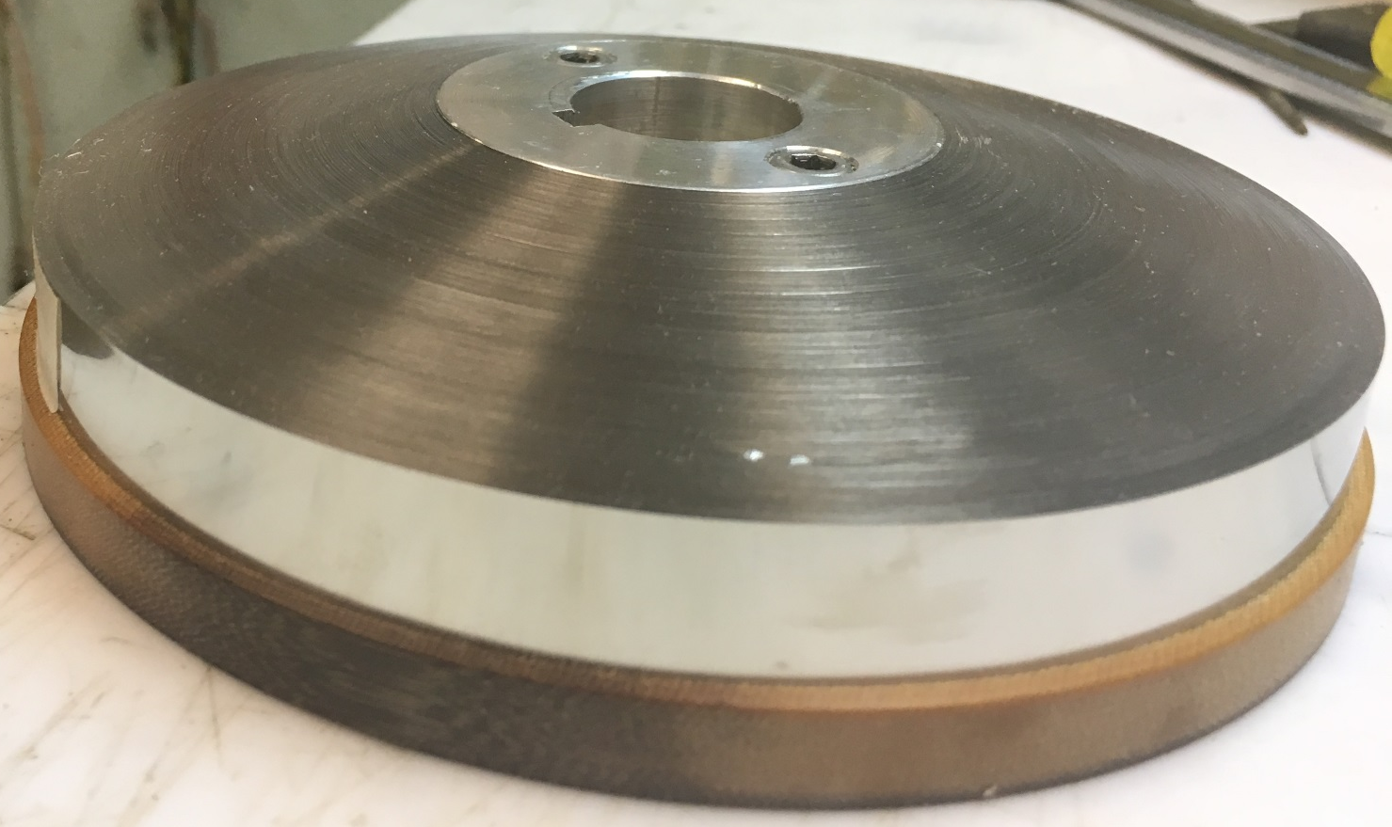
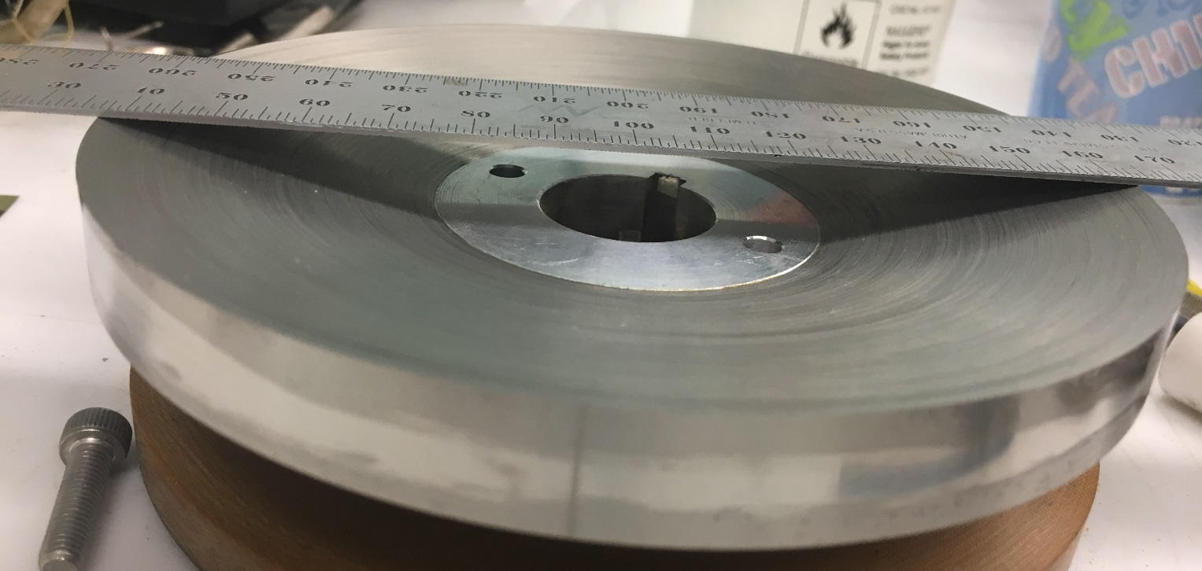
Practice Winding of Conical Shape Coil
(made with Stainless Steel tape)

Slide 34
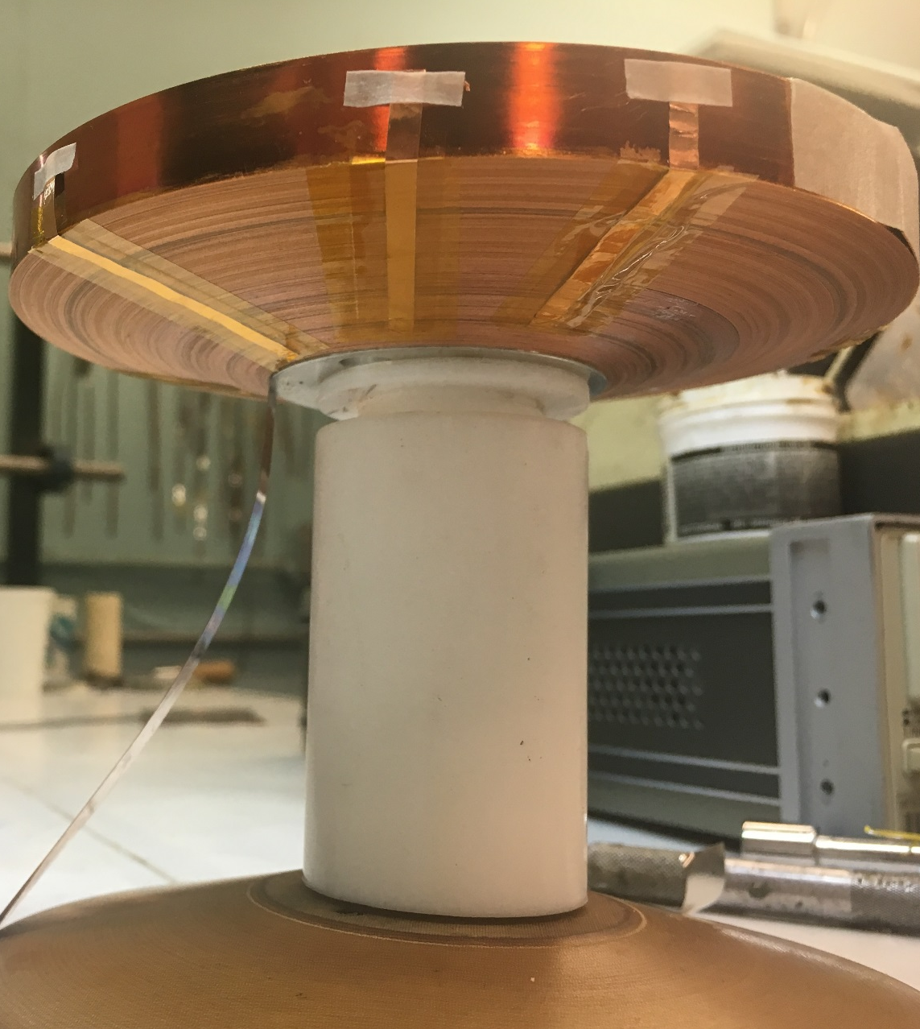
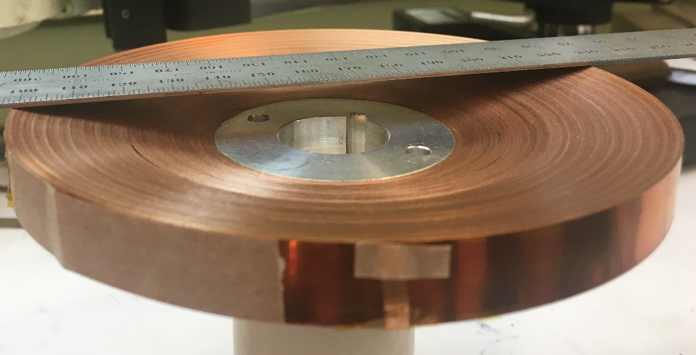
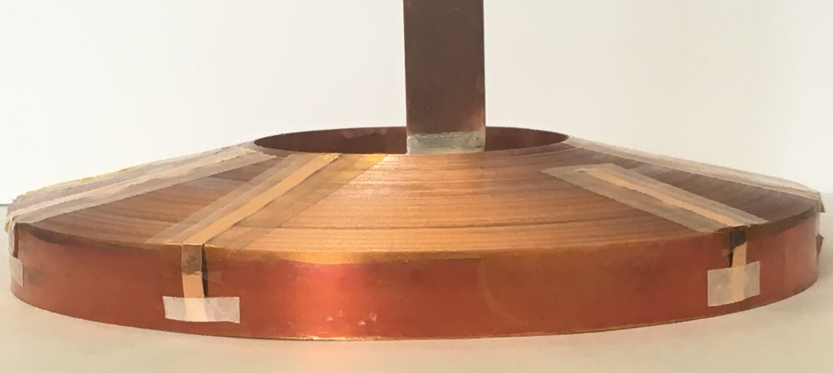
Conical Shape NI HTS Coil
Cone angle = ±15 degrees
315 turns with 12 mm wide tape
Inner diameter = 2” (50.8 mm)
Outer dimeter = 5” (127 mm)

Slide 35
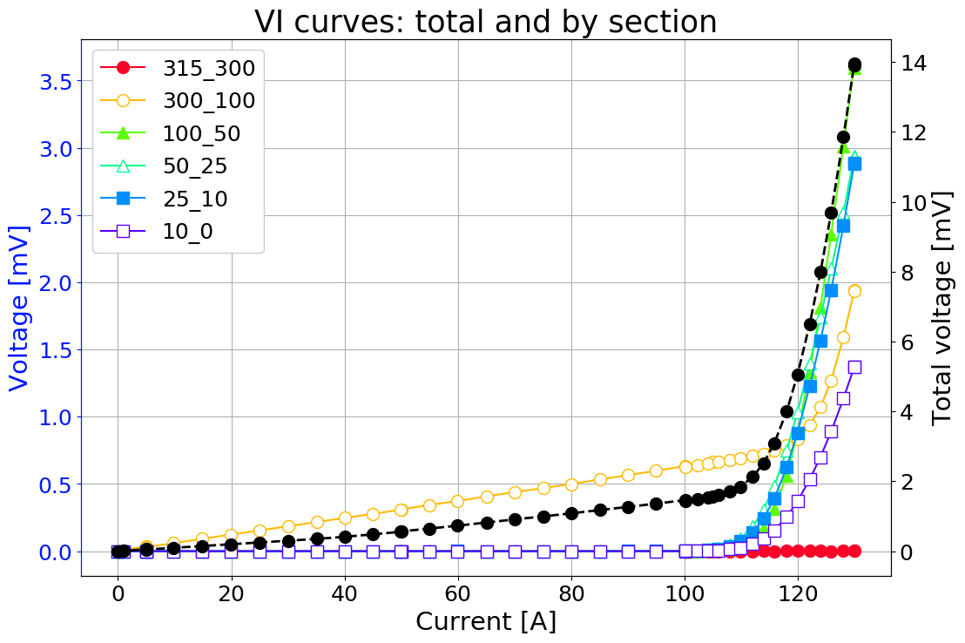
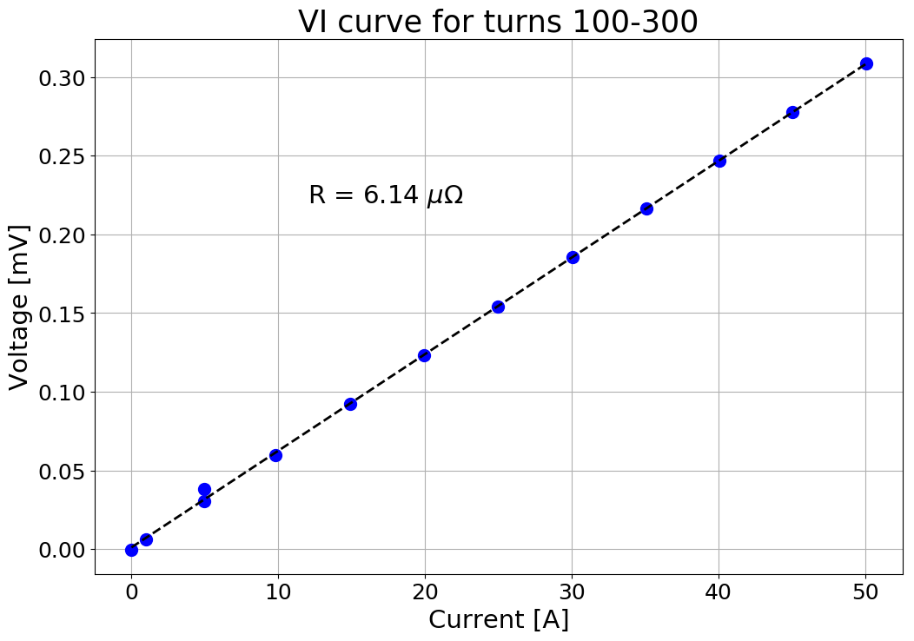
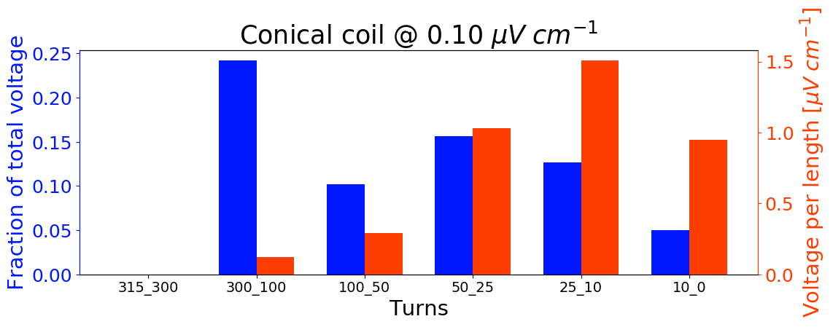
77 K Test Results (just received)
Local resistive component
Starts from the beginning, source needs to be examined (is it real?)
Perhaps wind another coil
Apart from this, the winding experience went well

Slide 36
BNL Participation in USMDP
BNL has recently joined the US Magnet Development Program
Specific tasks this year uses BNL’s common coil dipole to perform R&D for high field accelerator magnets based on HTS
  Quench studies on CORC cable in dipole field
  Magnetization studies on HTS tape coils with dipole field primarily parallel to wide face and hybrid field over 10 T
Plans underway to make this magnet available for a wider use. It will operate in an independent test stand providing a background field of 10 T and current for cable/coil up to 30 kA (100 kA option)

Slide 37
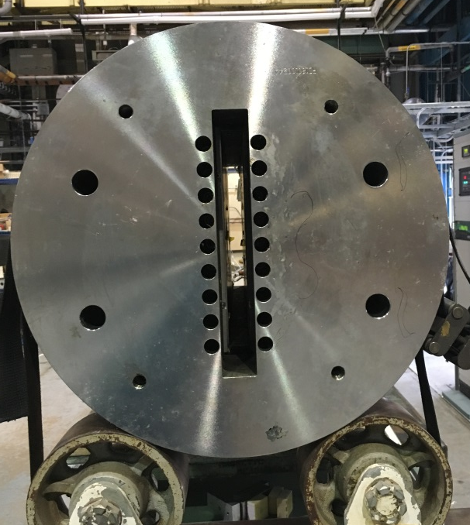


A Unique Facility for Magnet R&D
BNL Common coil dipole offers a large open space for inserting and testing “coils” at high fields without requiring any disassembly
New racetrack coils come in direct contact with the existing Nb₃Sn coils, just as in any other coils in magnets
A coil test becomes a magnet test with a rapid around and lower cost
Insert coils in Empty space
BNL Nb₃Sn common coil dipole DCC017 without insert coils
New HTS coils with the existing Nb₃Sn coils and become part of the magnet
HTS coils inside Nb₃Sn dipole - early experience of HTS/LTS hybrid dipole

Slide 38


Parameters of BNL Dipole DCC017
31 mm
Two layer, 2-in-1 common coil design
10.2 T bore field, 10.7 T peak field at 10.8 kA short sample current
31 mm horizontal aperture
335 mm vertical aperture
    A unique feature for insert coil or cable testing
0.8 mm, 30 strand Rutherford cable
70 mm minimum bend radius
85 mm coil height
614 mm coil length
One spacer in body and one in ends
Iron over ends
Iron bobbin
Stored Energy@Quench ~0.2 MJ
335 mm
304.8 mm
310.4 mm
614.3 mm

Slide 39
Summary
Slow ramp rate and relaxed field quality in IBS 25 T, 100 mm bore HTS solenoid allows the use of No-insulation (NI) winding (courtesy S. Hahn)
Four sets of 4 K test runs with many voltage taps in two sets of coils. A large number of v-taps provide useful information for extensive analysis
IBS double pancake coils were subjected to several quenches/runaway. The test run also included simulation of various accidents. The coil was able to reach high field in the next run, implying no major degradation
The quench propagation in this large no-insulation coil is fast, both within pancake and pancake-to-pancake. Our understanding of the process is that it should be scalable to longer magnet many pancakes

Slide 40
Extra Slides

Slide 41


Observed Change in Contact Resistance
Large coil (100 mm id, 220 mm od, using >500 m 12 mm tape)
No epoxy painted on the surface
Coil was rewound at higher (3X) tension
Better situation with higher tension.
Higher tension used in production coils.

Slide 42
Detailed Analysis of 77 K Test Results

Slide 43
77 K (LN2) Test of 10 Pancake coils
(coils 1-6 tested as single pancakes and 7-12 as double pancakes)
A significant variation between coil to coil
50 A in single pancake creates ~0.5 T and in double pancake ~1 T
@3mV
(0.1 μV/cm)

Slide 44
Details of the 77 K Test Results
(Sectional Voltage in Coil #1)
@3mV
(0.1 μV/cm)

Slide 45






Distribution of Voltage @77K within Pancakes Coils #1 to Coil #6 (tested as single pancakes)
*** Note: A significant coil to coil variation ***

Slide 46






Distribution of Voltage @77K within Pancakes Coils #7 to Coil #12 (tested as double pancakes)
*** Note: A significant coil to coil variation ***

Slide 47




Variation in the Voltage @77K within a set of turns of different Coils (1)
@3mV
(0.1 μV/cm)
Note: A significant coil to coil variation
Turns: 0-10, 10-25, 25-50 & 50-100

Slide 48







Variation in the Voltage @77K within a set of turns of different Coils (2)
Note: A significant coil to coil variation

Slide 49

Correlation between Coil I_{c} (@77K) and Wire Transport I_{c} (77K, self-field, averaged)
(Single Pancake)
(Double Pancake)
Because of a higher field, a lower current expected in DPC as compared to in SPC

Slide 50

Correlation between Coil I_{c} (@77K) and Wire Tapestar I_{c} (77K, self-field, averaged)
Because of a higher field, a lower current expected in DPC as compared to in SPC

Slide 51

Correlation between Coil I_{c} (@77K) and Wire I_{c} (30 K, 2 T, ends only)
As a part of contract, SuperPower also measured and provided Ic (30K, 2T) measurements from the samples cut at the two ends.
Ic (30K, 2T) has been found to have a good correlation with Ic(high field 4K).
However, often a significant variation was found when comparing the enhancement at the two ends.
Poorer correlation between coil
I_{c} (77, self-field) and conductor
I_{c} (30K, 2T) from two ends

Slide 52



Quench Propagation in the Second Series of Double Pancake Tests
Select turns of both coils
Starter pancake (coil)
Follower pancake (coil)
R&D Coil
Quench propagation from the inner turns to the outer turns
Quench propagation from one pancake (coil) to another pancake (coil) after ~1/2 sec

Slide 53
Conductor Requirements
I_{c}(8T,4K) >675A (50% margin)
    50 micron Hastelloy, 20 micron Copper
    Design and conductor specs are governed by the mechanical properties (50% margin) and not by the electrical properties
Need a significant quantity of 2G HTS (ReBCO) tape
  9 km, 12 mm wide
SuperPower has delivered 5 km of 12 mm wide tape (easily exceeding I_{c} margin)

Slide 54
Orthogonal Coil Strains @4K, 25 T

Slide 55

2-d Magnetic Model of DCC017

