Slide 1
Transposition in superconducting cables: are there differences between LTS and HTS?
D. Uglietti
EPFL, Swiss Plasma Center (SPC), CH-5232 Villigen PSI, Switzerland
OUTLOOK
Transposition 7
Rutherford or Roebel 1
Bi2212 coated conductor 1
Non-insulated coils 3
Loosely based on:
https://dx.doi.org/10.1088/1361-6668/ab06a2

Slide 2
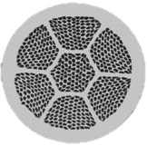

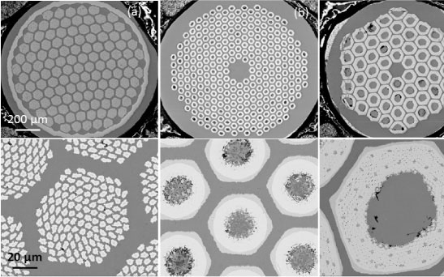

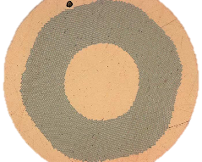
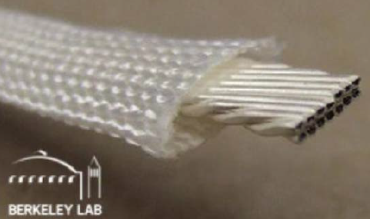
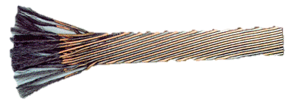
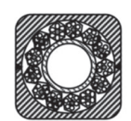
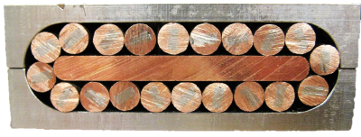

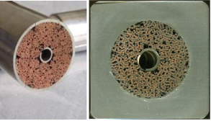
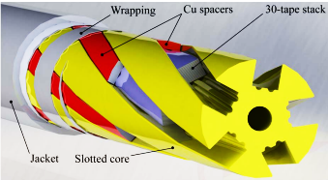
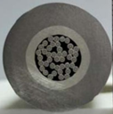
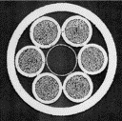
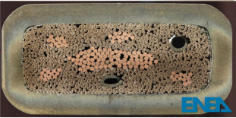

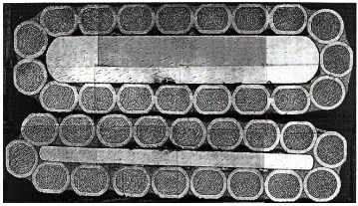
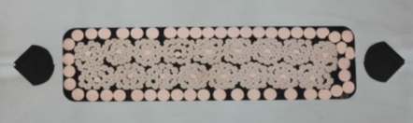

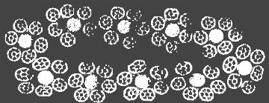


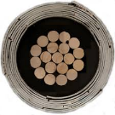
From strand to cables
X
1990-2010 HTS strands
1950-60 LTS strands
microstructure driven by stability
RRR=30
RRR>100
microstructure driven by critical current
Nb₃Sn ribbons were prone to flux jumps. REBCO c.c. are not…
X
1970-90 LTS cables
1990-2019 HTS cables
Imitating/copying from LTS.
Instead of being driven by fundamental properties.

Slide 3

Flux jumping
LTS HTS
…identify the (NbTi) filament size to cure the flux jump quenches. Flux jumps also an issue for the wide Nb₃Sn tapes … where the field component perpendicular is large.
Bruzzone P 2006 https://doi.org/10.1109/TASC.2006.873342
Coupling between the filaments … causes flux jumping. The characteristic distance become the composite radius rather than the filament radius.
Wires with fully coupled filaments are prone to flux-jump instabilities and hysteretic loss instabilities.
Wilson, 1984, Superconducting Magnets Oxford Science Publications:
The extension of this concept to the multi-strand conductors led in the early seventies to the design of twisted, flat cables (Rutherford cables).
Bruzzone P 2006 https://doi.org/10.1109/TASC.2006.873342
$$d<\sqrt{\frac{3γC(T_{c}−T)}{μ_{0}J_{c}^{2}}}$$
Wilson, 1984, Superconducting Magnets, p.134
Filament size
HTS do not need fine filaments because T_{c} is large
But HTS wires, tapes (and cables) with coupled filaments are stable against flux jump and hysteretic loss, because of the much larger minimum quench energy.
Coupling currents do not cause quenches in strand, maybe they don’t in cables either?
AC losses will be discussed next time…

Slide 4
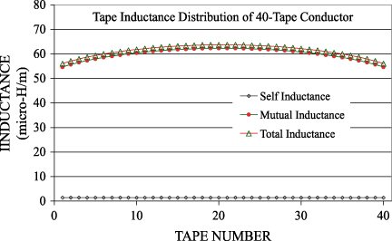
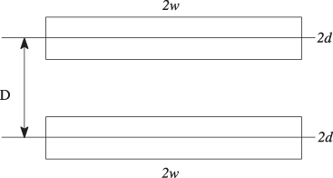

Inductance
$$L_{i}=L_{self}+\sum_{j=1}^{N}{M_{ij}}$$
M. Takayasu calculated the inductance mismatch in the twisted tape stack:
Takayasu 2012 Supercond. Sci. Technol. 25 014011 http://dx.doi.org/10.1088/0953-2048/25/1/014011
formula for two parallel wires, replace the distance with the geometric mean distance
1946 W. Grover, Inductance Calculations: Working Formulas and Tables. Research Triangle Park: Instrum. Soc. Amer
1908 E B Rosa The self and mutual-inductances of linear conductors Bulletin of the Bureau of Standards
<7% (H/m)
small enough
Why is 7% small enough? It should depends on:
Ramp rate
Transverse resistance
Temperature margin
…
Actually, in the calculations the tapes are considered parallel, and the total inductance of each tape is only a function of the tape length and the inter-tape distance: the mismatch decreases with the tape length…

Slide 5
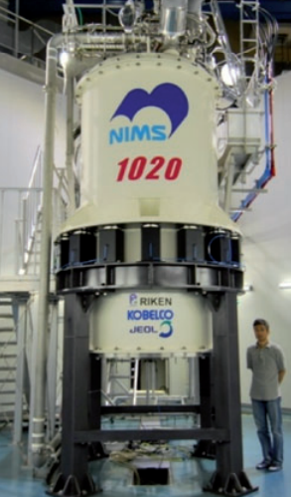
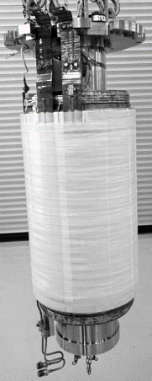
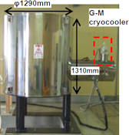
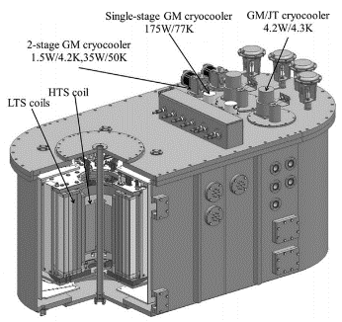
Non-transposed strands in magnets?
Could MRI and NMR magnets be wound with multifilamentary, non-transposed LTS wires?
10 T insert for 25 T cryogen-free magnet
3 T MRI
3.6 T insert for 24 T NMR
https://onlinelibrary.wiley.com/doi/pdf/10.1002/9780470034590.emrstm1492
https://doi.org/10.1109/TASC.2016.2524466
https://doi.org/10.1109/TASC.2017.2657689
https://doi.org/10.1088/1361-6668/aa6676
https://doi.org/10.1109/TASC.2013.2239342
Non-transposed multifil. Bi-2223 tapes are good enough for MRI and NMR magnets.
A Bi-2223 tape is similar to a non-transposed stack of REBCO tapes: parallel, non-twisted superconducting paths in a conductive matrix.
Why a non transposed stack is not considered for magnets?

Slide 6
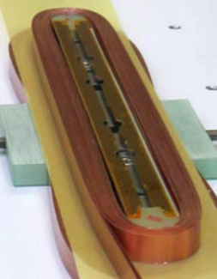
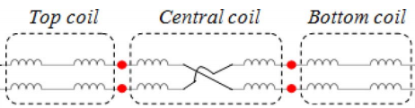
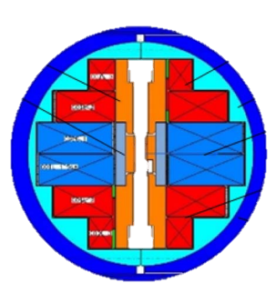
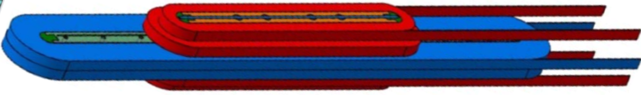
CEA non-transposed cable
CEA dipole, 2016
IMP Quadrupoles, 1971
https://doi.org/10.1109/TASC.2018.2796063
https://doi.org/10.1109/TASC.2018.2809780
https://doi.org/10.1109/TNS.1971.4326352
steel tape
CuBe tape
Cu tape
General Electric Nb₃Sn ribbon
2’600 A at 13 T
Nb₃Sn
Nb, 25 μm
Hastelloy substrate
Cu tape, 50 μm
solder
REBCO
800 A at 5 T
steel tape, 25 μm
Copper tape, 60 μm
solder
Quench by flux jumps. Stabilised with 150 μm Al ribbon (RRR=2000).
Hastelloy substrate, 50 μm
CuBe tape, 100 μm
0.5” = 12.7 mm
12 mm
350 mm
35 turns
61 turns
73 turns
700 mm
Effect of coupling currents is more evident at 4.2 K than at 77 K.
Screenings currents are an important issue (magnetization > 10% of the total field).

Slide 7
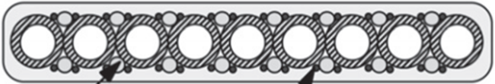
Non-transposed strands/conductors
https://doi.org/10.1109/TASC.2006.873342
Flux jump and coupling curr.
T-7, NbTi, 5’600 A at 3.5 T. Design: 6’000 A
Coupling curr.
LIN-5, NbZr, 1’000 A at 5.8 T
IMP mirror coils 380 A
15 strands NbTi in Cu, non-twisted https://www.bnl.gov/magnets/Staff/Gupta/Summer1968/1968-summer-study.pdf
Princeton D coil test program 200 A
Nb₃Sn ribbon
IMP quadrupole 800 A
Nb₃Sn ribbon
Flux jump, needed extra Cu
“The mirrors were successfully charged”
Flux jump, needed extra Al
10 mm
1968 https://doi.org/10.1063/1.1656640
In coils currents of about 10% to 50% of short-sample values.
AC machines
NMR and MRI magnets
dipole
Bi-2223 400 A, 15 T
CEA double stack 2’500 A
Bi2223 Roebel (Siemens, Mitsubishi)
HTS non-transposed conductors may be viable because of:
smaller size (less coupling currents and smaller inductance mismatch)
much larger stability margin
10 x12 mm tapes 10 kA at 15 T
(20 kA ±10°)
>50’000 A at 15 T
Transposed stack of non-transposed tapes

Slide 8
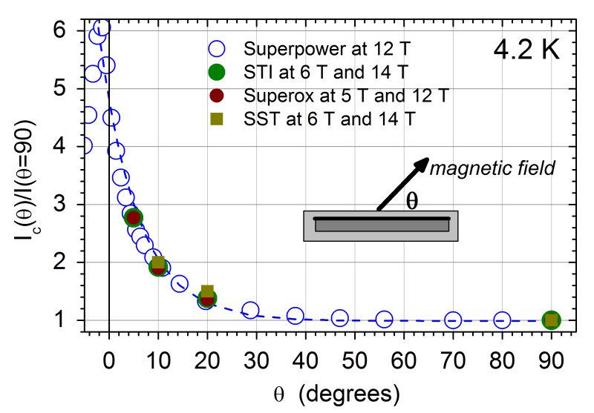
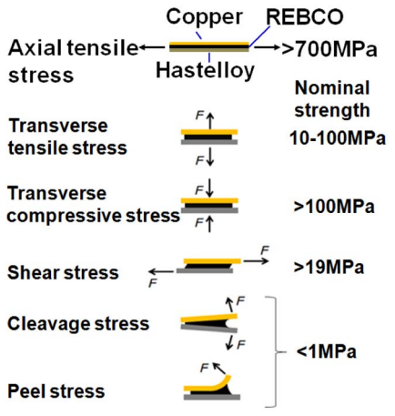
Benefit of lower (no) transposition
Critical current in NbTi and Nb₃Sn is isotropic, transposition by twisting does not change I_{c}.
σ_{c} ε_{c}
0.4%–0.6%
<0.05%
<0.01%
https://doi.org/10.1109/TASC.2016.2526661
https://doi.org/10.1016/j.phpro.2014.09.029
https://doi.org/10.1109/TASC.2018.2791514
https://doi.org/10.1088/1361-6668/aa604e
>400 MPa
H. Maeda et al., TAS 24 (2014) 4602412
https://doi.org/10.1109/TASC.2013.2287707
Anisotropy in critical current ∼5 Anisotropy in σ and ε is 10–100
OPPORTUNITY: gain in I_{c} if the cable/magnet design exploits the anisotropy
OPPORTUNITY: very high tensile strength
CHALLENGE: avoid at all cost transv. tensile, shear, cleavage stresses in cables/magnets
Copying LTS cables is not a good idea
I_{c}
σ_{c}
ε_{c}
Twisted soldered stack
Non-twisted, non-soldered stack
If transposition is needed, better get it without twisting.

Slide 9
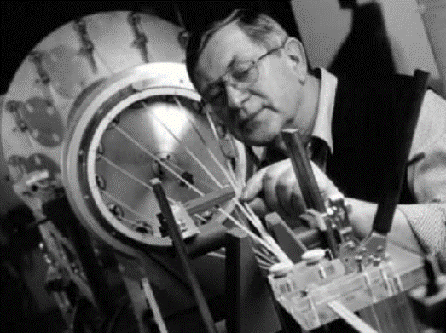
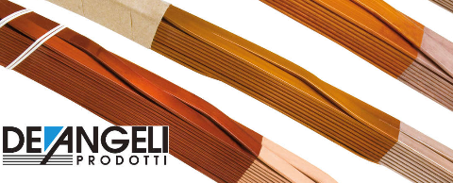
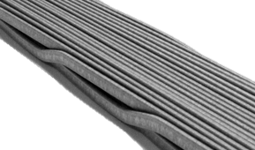
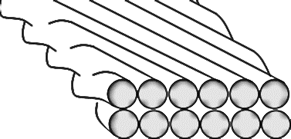
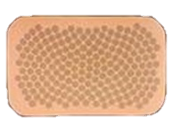
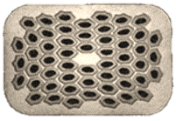
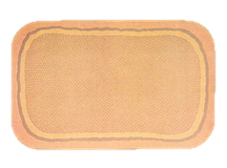
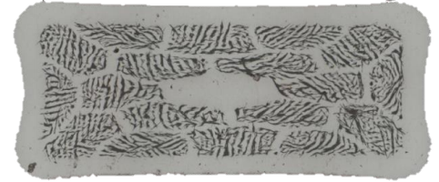
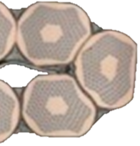
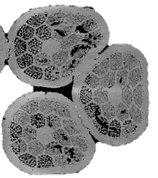

Rutherford or Roebel?
1996-2002 Bi2223 Roebel bars for SMES and transformers:
https://ieeexplore.ieee.org/stamp/stamp.jsp?tp=&arnumber=783449
https://doi.org/10.1016/S0921-4534(02)01102-4
1972 - Rutherford cable is a modified Roebel for round wires.
https://doi.org/10.1109/77.783250 pag.116
1999 Wilson proposed to revive Roebel cables (HTS tapes) for accelerators https://doi.org/10.1109/77.783250
1914 - copper Roebel cables for AC machines.
In commercial NMR magnets, high field coil sections are wound with rectangular NbTi and Nb₃Sn wires.
Unreacted Nb₃Sn and Bi2212 strands do not tolerate very heavy compaction. https://doi.org/10.1109/TASC.2016.2532324
http://www.kobelco.co.jp/english/ktr/pdf/ktr_34/072-077.pdf
http://www.jastec-inc.com/e_products_wire/list.html
https://doi.org/10.1088/1757-899x/279/1/012022
Rutherford Roebel
Heavy deformation at the cable edges
No deformation
Void fraction
NbTi 8%–12% https://doi.org/10.1088/0953-2048/17/5/024
Bi2212 >15% https://doi.org/10.1088/0953-2048/12/2/006
<5% if n° strands >20

Slide 10
Bi2212 coated tapes
Before the introduction of OP HT, PIT wires had low J_{c} in the ceramic. Higher values were obtained by other techniques tape casting, dip-coating, spray coating …
1992 http://cds.cern.ch/record/256832/files/P00019776.pdf
1997 https://doi.org/10.1109/77.621033
1997 https://doi.org/10.1109/77.614587
2004 https://doi.org/10.1063/1.1774620
ADVANTAGES
Continuous heat treatment
Lengths: 10 m to 100 m
Ag or Ni substrate
5 to 30 μm thick ceramic
Double side deposition
No textured buffer layer
Wesche R 1998 High-temperature Superconductors: Materials, Properties and Applications Kluver Academic Publisher https://www.springer.com/de/book/9780792383864
R&D on Bi2212 coated tapes was stopped probably for two reasons:
in the 90’s
Electro-technical applications were the main target.
Magnet builders asked round, twisted multifilamentary wires.
Today
High field magnets (dipoles, solenoids, toroids) need HTS.
REBCO c.c. tapes are OK.
In general round twisted multifilamentary wires are not the preferred strand for magnets.
After 30 years, Bi2212 round twisted multifilamentary wires have no commercial application.
After 10 years, coated conductors are going to be integrated in commercial NMR magnets.

Slide 11
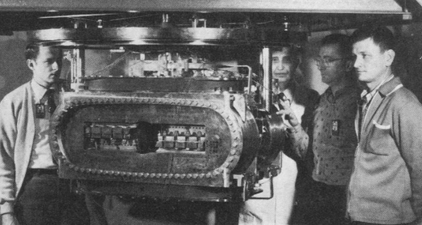
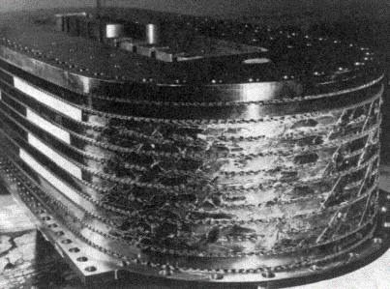
Non-Insulated coils
1963 Geballe T H Insulated Superconducting Wire US Patent number: 3109963
… to form the insulating coating (Au, Ag or Cu) on the superconducting wire before the final cold-drawing step.
… insulating coating is a better conductor than the superconducting materials in their normal state
1966 The IMP Superconducting Coil System https://doi.org/10.1109/TNS.1971.4326352
Nb₃Sn ribbon. Initial design was non-insulated pancakes. But the test pancakes generate too much heat during charging (large LHe consumption). Then painted with colloidal graphite /Al₂O₃.
Also insulated solenoids wound with Nb₃Sn ribbons had large LHe evaporation rates (hysteretic losses)
1986 Gömöry F, et al Small superconducting solenoid wound from non-insulated unstabilized multifilamentary Nb3Sn conductor Proc. IIR Conf, Recent achievements in cryoengineering, Cryoprague 86 197–202

Slide 12
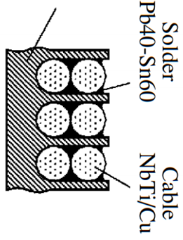
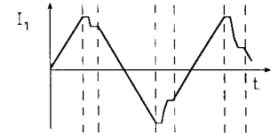
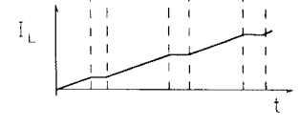

Non-Insulated coils
1999 Barkov et al Superconducting magnet system of the CMD-2 detector IEEE Trans. Appl. Supercond. 9 4644-47 https://doi.org/10.1109/77.819332 https://doi.org/10.1134/S0020441206060066
Coils for detector should be transparent to particles (Al stabiliser).
“Solenoid can be protected by various methods without Al stabilized superconductors”.
The (dump) resistance is distributed uniformly along the whole winding allowing the stored energy is dissipate uniformly over the coil.
∅ 0.7 m
0.9 m
Former
Solder
Pb40Sn60
NbTi/Cu
AC power supply (40 A) connected to a fluxpump (cryotrons + sc transformer) providing 1500 A to the solenoid. https://doi.org/10.1109/77.791914
Charging time 20 h.
Turn/turn resistance is determined by the 0.3 mm steel wall and is equal to 1.4 10⁻⁸ Ω at 4.2 K.

Slide 13
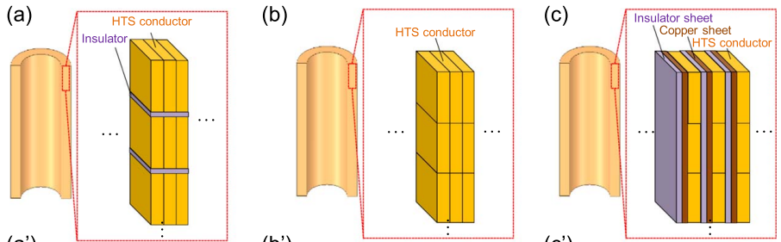
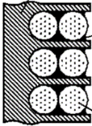
Non-Insulated coils
2010 Hahn S et al HTS Pancake Coils Without Turn-to-Turn Insulation IEEE Trans. Appl. Supercond. 21 1592-95 https://doi.org/10.1109/TASC.2010.2093492
2019 Suetomi Y et al. A novel winding method for a no-insulation layer-wound REBCO coil to provide a short magnetic field delay and self-protect characteristics Supercond. Sci. Technol. 32 045003
https://doi.org/10.1088/1361-6668/ab016e
Double pancake NI
Layer-wound NI
intra-Layer no-insulation (LNI)
High turn-to-turn resistance
Low layer-to-layer resistance
Turn-to-turn copper shunt: self-protection and short tau.
Transverse resistance
3–12∙10⁻⁸ Ω/cm² REBCO tapes soldered face to face
6∙10⁻⁷ Ω/cm²
1–10∙10⁻⁵ Ω/cm² In various non-insulated REBCO coils
X 100
Experiments on NI coils have demonstrated that even if tapes are not soldered together, current can easily redistribute during quench (overcurrent).
Non-insulated coils were re-invented five times.
Better spend more time on bibliographic searches…

Slide 14
Conclusions
HTS excellent stability and small cross sections open the opportunity to low or non-transposed cables. Advantages should be weighted against disadvantages (higher losses).
Rutherford cables are well suited for round NbTi. But Roebel cables (made with rectangular wires) may be better suited for Nb₃Sn or Bi-2212 strands.
In general a twisted multifilamentary structure is not necessary for HTS magnet strands. Other features (J_{e}, strength, cost, …) could play a more important role.
Too late to revive Bi2212 coated tapes? Conjugate the advantages of Bi2212 (no textured buffer) and REBCO (no Ag matrix, high J_{c}).
Non-insulated coils can have various configurations (partial insulation). In general they are very robust against over-current (quench), even if the tapes are not soldered together.

