Slide 1
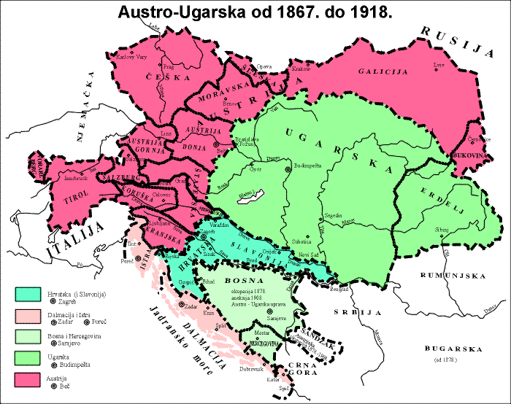
Intriguing similarities at large pt in pp and PbPb collisions
Guy Paić
Instituto de Ciencias Nucleares
UNAM, Mexico
Guy Paić
Instituto de Ciencias Nucleares
UNAM, Mexico
arXiv:1805.04572

Slide 2
Motivation
In the last 5-6 years a body of experimental and phenomenological results have established clear existence of “collective” effects in the lightest collisions i.e. pp considering the low <4 GeV/c region of the spectra (radial and azimuthal flow etc)
The similarities grow with the multiplicity of the events.
  A question was left untouched:
  arXiv:1805.04572 A. Mishra, A. Ortiz, G.Paic4572
  investigate the similarities since the pp spectra are used as the benchmark for parton energy loss?

Slide 3
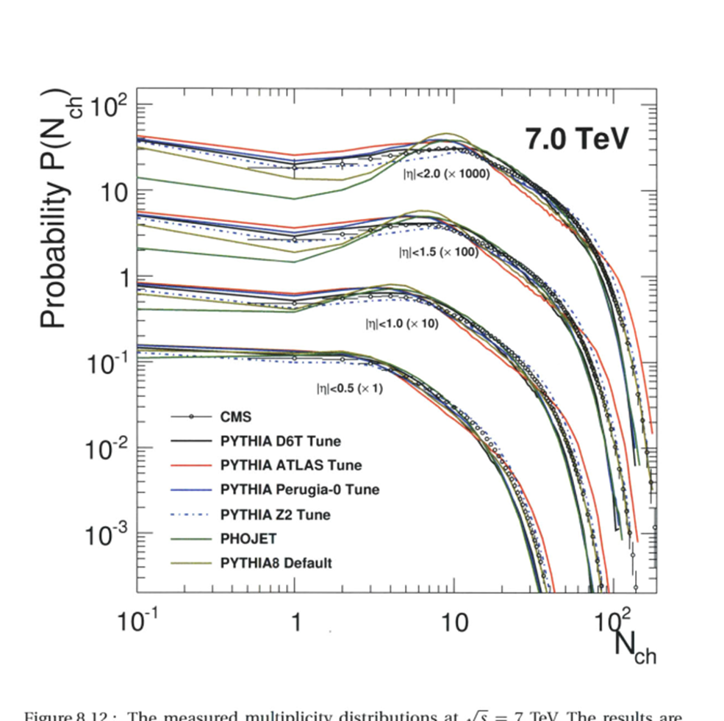
The surprise when we measure in function of multiplicity
web.mit.edu/mithig/theses/Yen-Jie-Lee-thesis.pdf

Slide 4
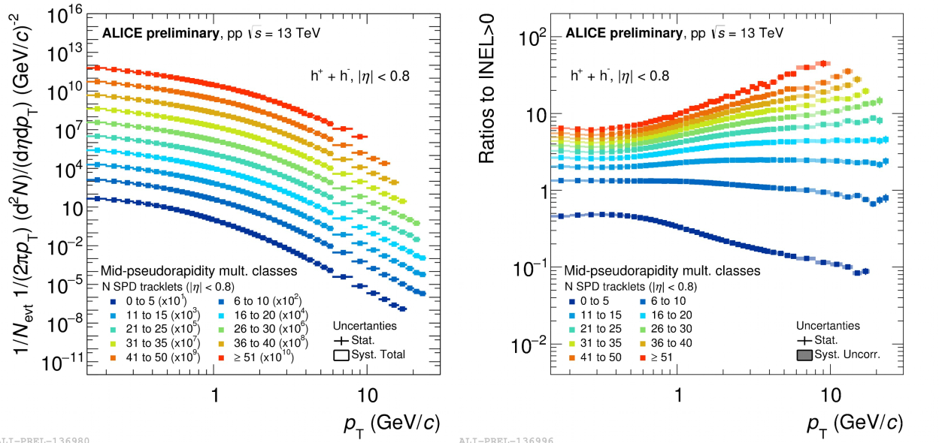
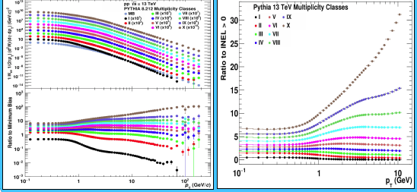
P_{t} distribution in function of multiplicity in pp collisions at 13 TeV
i
Mind you of the log scale!!
Rather perturbing evolution with multiplicity!? Nonlinear!
arXiv:1805.04572

Slide 5

How to characterise the transverse momentum spectra in a model independent way
We believe the best (unbiased) way is to extract the shape of the spectra using the power law exponent where the transverse momentum probability is given to be
Above a certain value of transverse momentum. (in our case 6 GeV/c)
BUT
it is obvious that the pt spectra cannot be represented by a single exponent in a large pt range so we determined a tangent at every point of the spectra

Slide 6
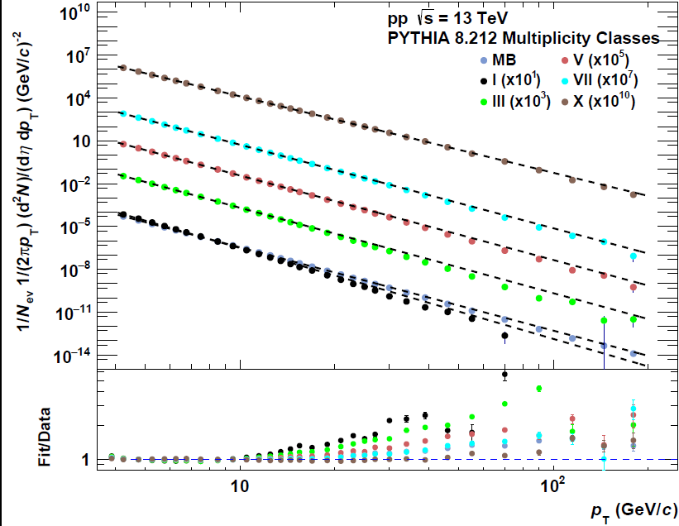
The spectra cannot be fitted with a single exponent !
Transverse momentum distributions of charged particles for different multiplicity classes in pp 13 TeV (simulated with PYTHIA 8.212)
Although usually not perceptible on log scale the differences are manifest
multiplicity
Mult
Mult

Slide 7
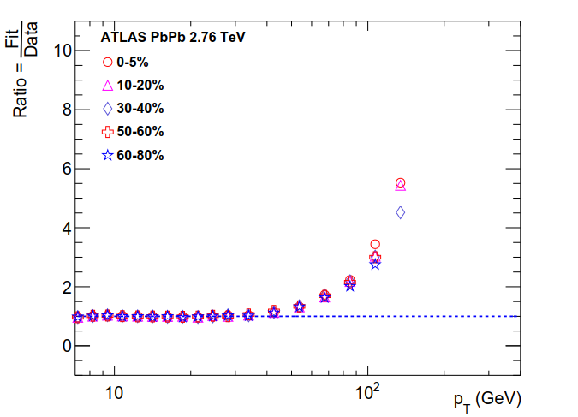
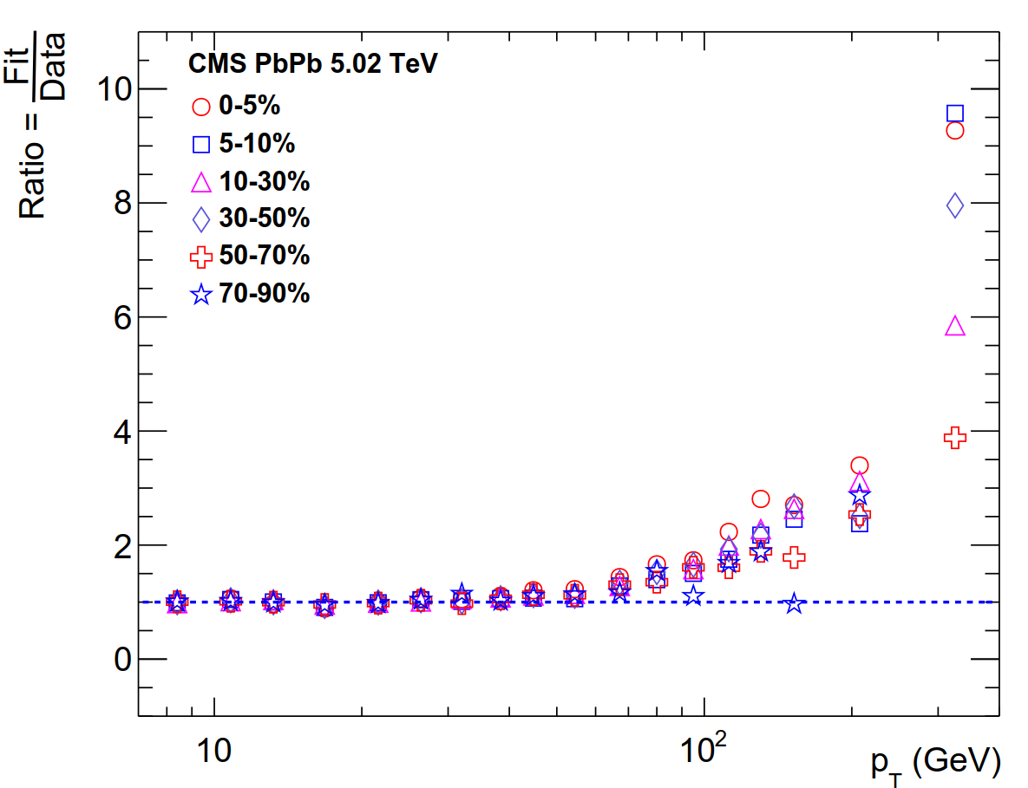
All the centralities have the same way of departure from the low pt fit.

Slide 8
Use a sliding tangent in pt bins to extract the exponent

Slide 9

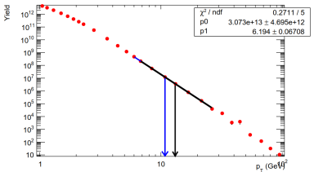
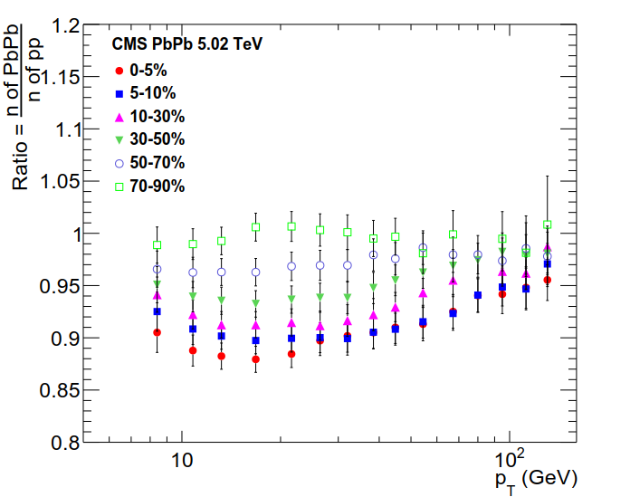
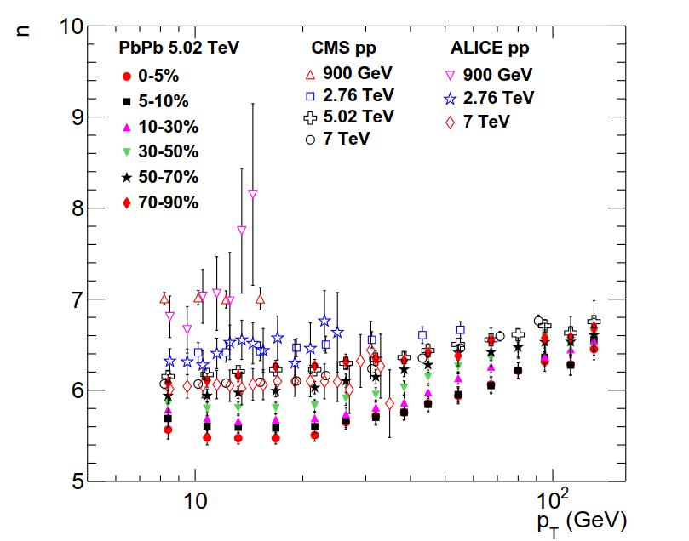
the exponent is not constant: changes with p_{t} – it is different for different energies
There is a clear evolution - but at the highest transverse momenta ALL the centralities exhibit the same exponent.!?

Slide 10
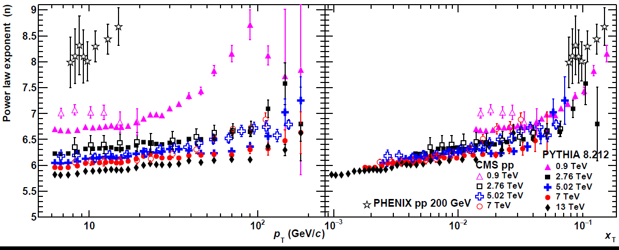
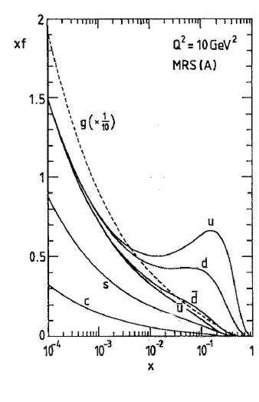
Resulting exponents for different collision energies from 200 GeV – 13TeV in minimum bias pp collisions
X_{t}=2p_{t}/sqrts
Parton distribution function
Scaling behavior observed when scaled vs x_{t}!

Slide 11
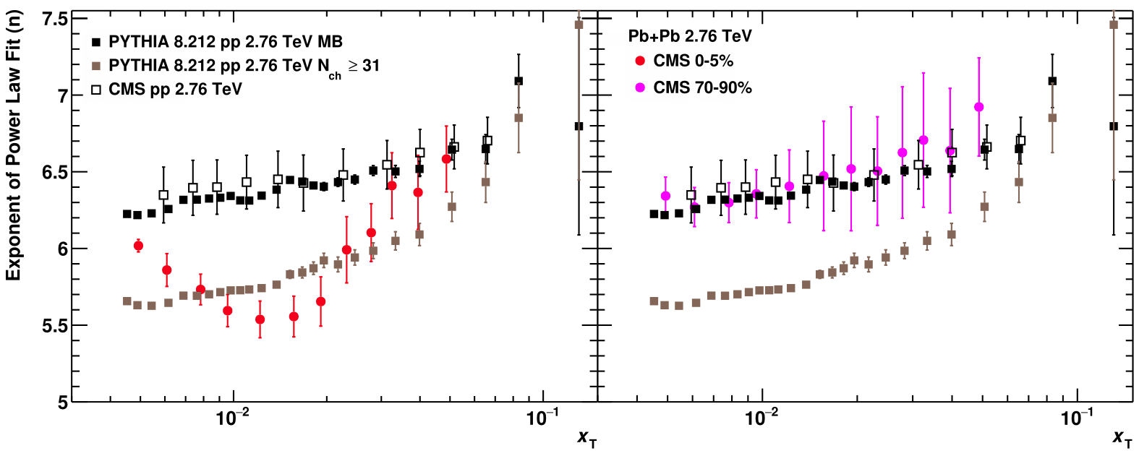
Behavior of the PbPb spectra with centrality and of the pp spectra with multiplicity at high collision energies
Both the pp spectra and the PbPb spectra have a drastic evolution with multiplicity/centrality

Slide 12
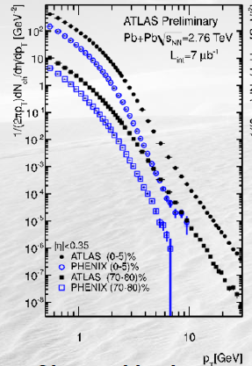
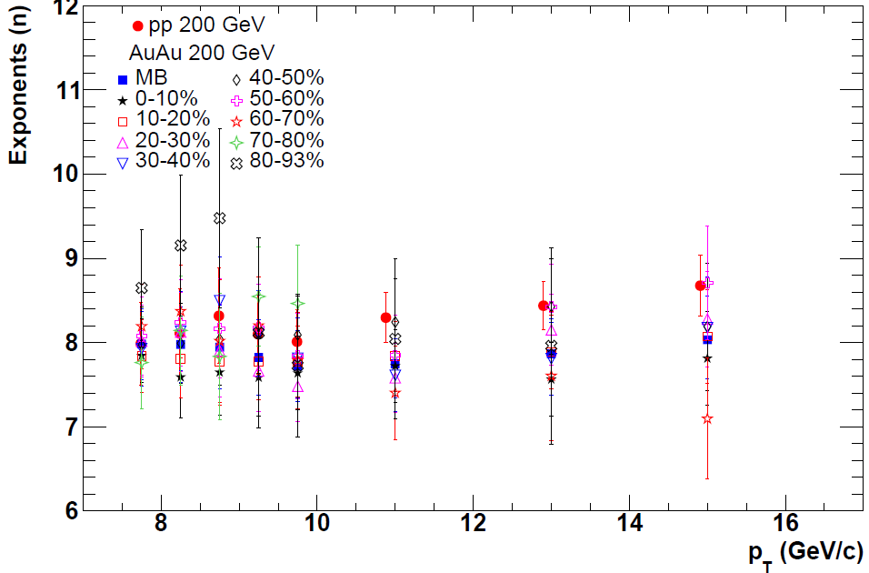
at 200 GeV) there is no major difference in exponents of pp and AuAu collisions centralities with pt !
A clear evolution of the momentum spectra

Slide 13
Conclusion I
The slopes of the transverse momentum spectra have a marked dependence on the multiplicity and energy in pp collisions and on the centrality in heavy ion collisions when considering the high collision energies.
For every centrality one may find a pp spectrum which has a the same exponent
The exponents vs momentum exhibit a scaling behavior with xt
The question is whether this a coincidence or is connected to common characteristics

Slide 14

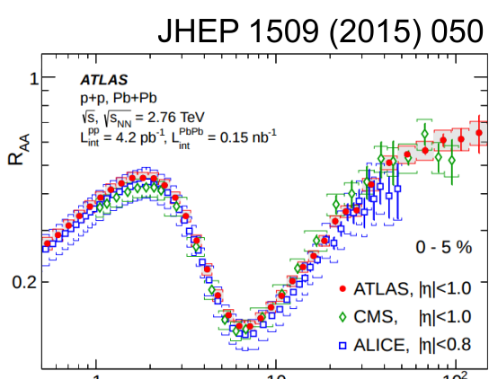
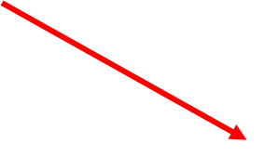
consequences
One of the basis of our paradigm : one can obtain information on the energy loss in the plasma dividing the spectra of heavy ion collisions by the spectra of minimum bias pp collisions where “supposedly “ nothing happens.
The Surprising Transparency of the sQGP at LHC
W.Horowitz and M. Gyualassy arXiv:1104.4958 [hep-ph]
“The plasma produced at LHC is indeed less opaque to jets than predicted by constrained extrapolations from RHIC.”

Slide 15
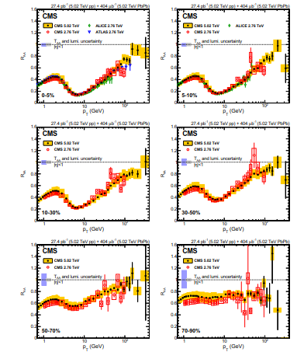
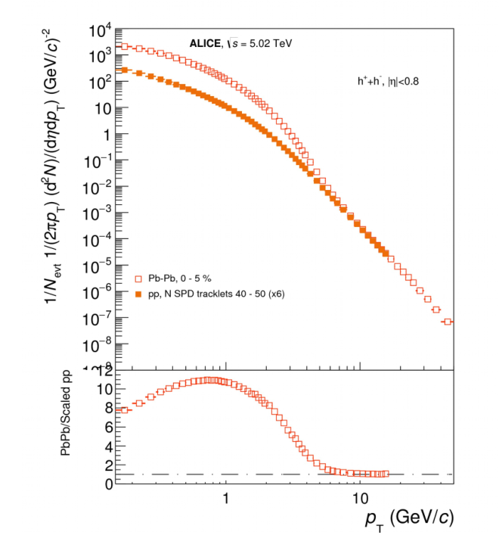
The slope of the nuclear modification factor exhibit at high momenta exactly the same behavior observed for pp high energy divided by the pp Minimum bias
Superposition of a pp spectrum to a PbPb spectrum of the same exponents
Pythia 40-50
Pythia M=40-50
Pythi
Somehow contraintuitive ! As the collisions grow mas peripheral the high momenta have trouble getting out!

Slide 16
Conclusion II
The effect of the rise of the RAA at high momenta is not due to an increased transparency of the hot system. The behavior of the rise is solely due to the evolution of the pt spectra. Rather then working with the ratio of two spectra we should carefully analyse the spectra of each collision system.
The main question is: what is causing the hardening of the spectra in all cases?
Since the multiplicities are very different we propose that the energy density which is growing with multiplicity in pp collisions and reaches values rather similar to the heavy ions ones taking into account the different geometries is at the origin of the observation .

Slide 17
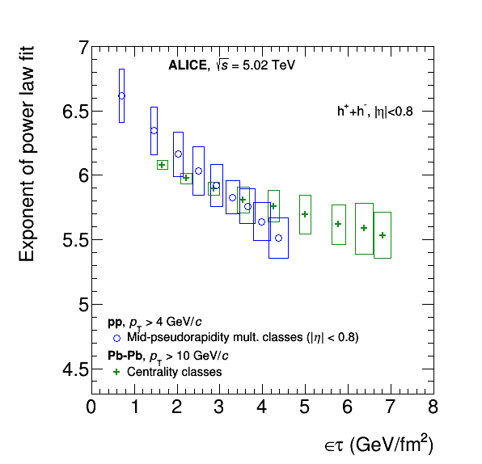

the energy densities?
Note: the proton radii are taken from HBT analysis.probably have a large error
Reasonable scaling given the errors in the estimates of radii

Slide 18
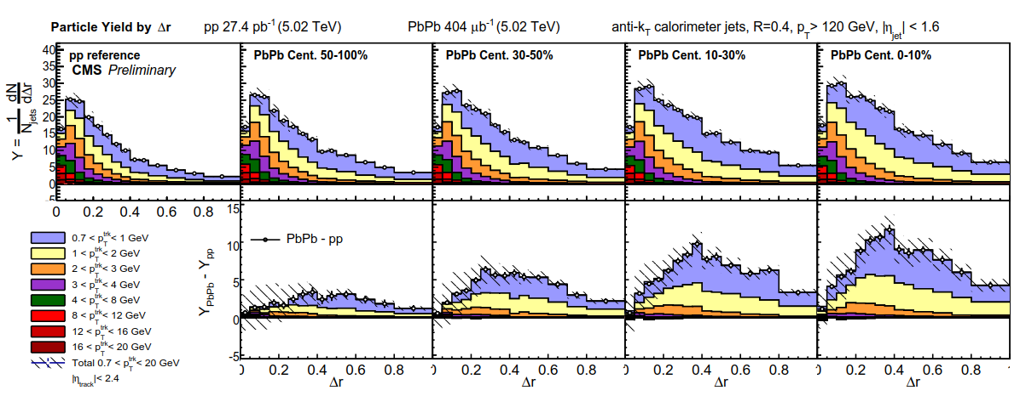
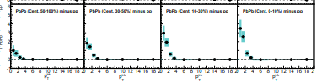
CMS data;CMS-PAS-HIN-16-020
assocT
We observe in the low momenta all the debris of the jets – even those that we do not measure!

Slide 19
where do we see jet quenching
Yes there is jet quenching and we clearly see
the debris of the jets, but is different from what is observed
in the regular R_{AA} treatment in amount and momentum range!!!

Slide 20
Final conclusions
the RAA as it is computed today does have serious flaws since the pp reference has a (before) unexpected pt dependence on the multiplicity
The rise of the “R_{AA}” is trivially explained by the spectra of pp and PbPb and NOT by “jet quenching”
It has been demonstrated that the characterization of the spectra in function of x_{t} and of the power law exponent offers interesting observation
The similarity of the exponents and the scaling with multiplicity indicate that the energy density is an important factor to reckon with

Slide 21
Köszönöm!

Slide 22
backup

Slide 23
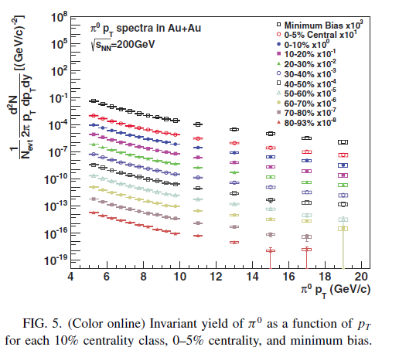
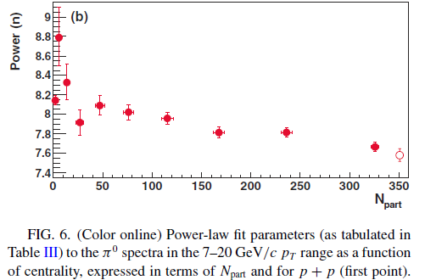
Phenix
Very small variation of n~~+/-5%

Slide 24

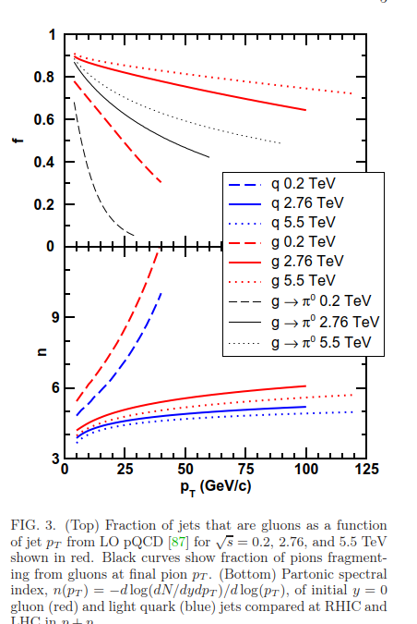
Horowitz, Gyulassy

Slide 25
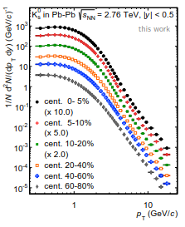
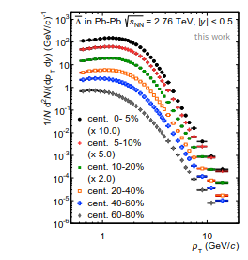
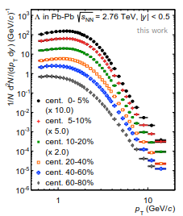

Slide 26
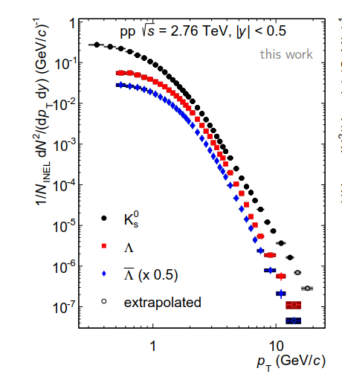
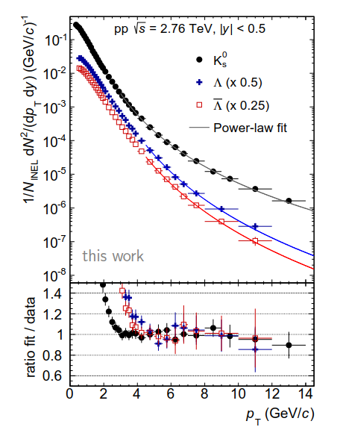
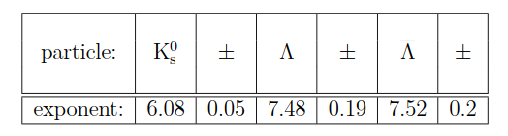
CERN-THESIS-2015-209
Title Modification of K0s
and Λ(Λ¯¯¯¯) transverse momentum spectra in Pb-Pb collisions at sNN−−−−√
= 2.76 TeV with ALICE
Author(s) Schuchmann, Simone (Frankfurt U.) ; Appelshaeuser, Harald (dir.) (Frankfurt U.)

Slide 27
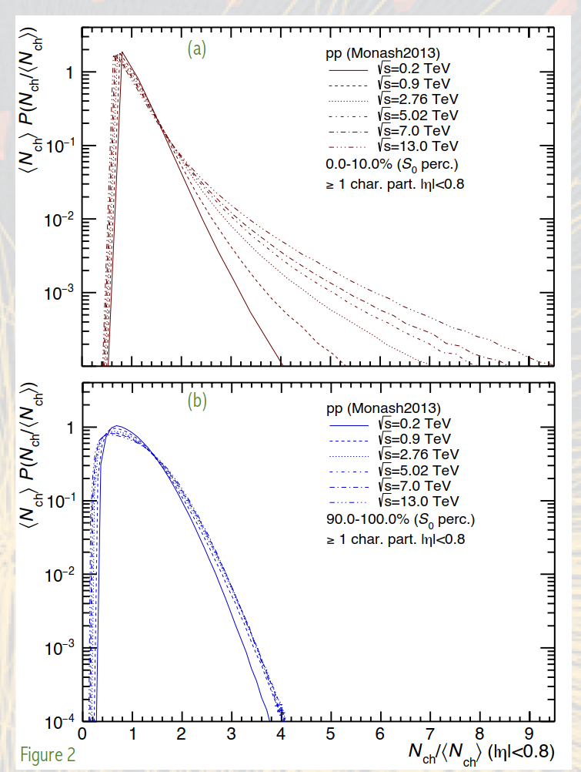

G. bencedi, A. Ortiz, G. Paic
Poster at Initial stages 2017

Slide 28
Λ and K0S production in Pb-Pb and pp collisions with ALICE at the LHC
www.ep.ph.bham.ac.uk/publications/thesis/ldh_thesis.pdf
CERN-THESIS-2015-209
Title Modification of K0s
and Λ(Λ¯¯¯¯) transverse momentum spectra in Pb-Pb collisions at sNN−−−−√
= 2.76 TeV with ALICE
Author(s) Schuchmann, Simone (Frankfurt U.) ; Appelshaeuser, Harald (dir.) (Frankfurt U.)

Slide 29
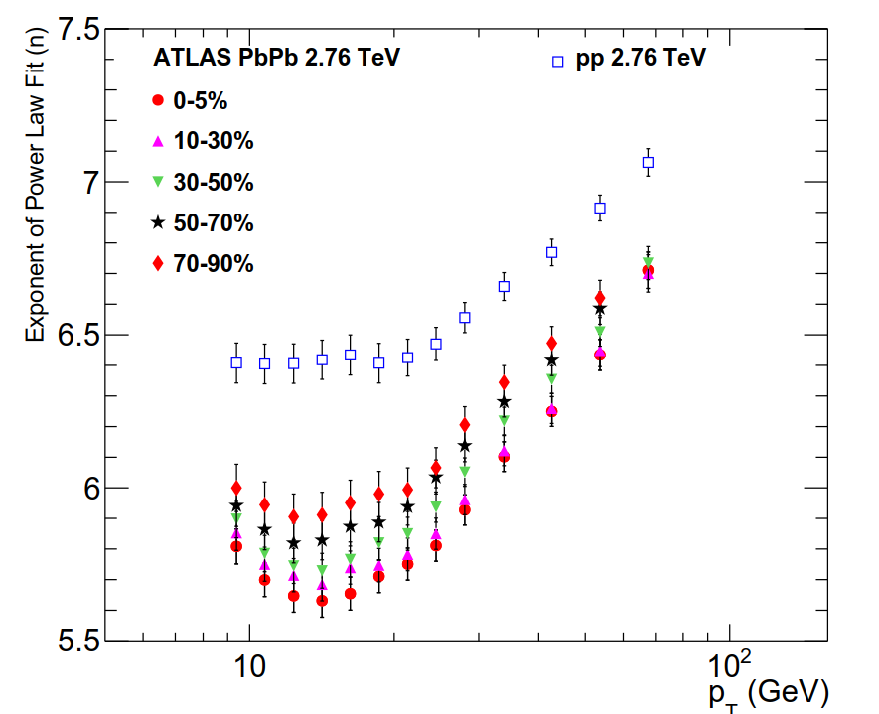

Slide 30
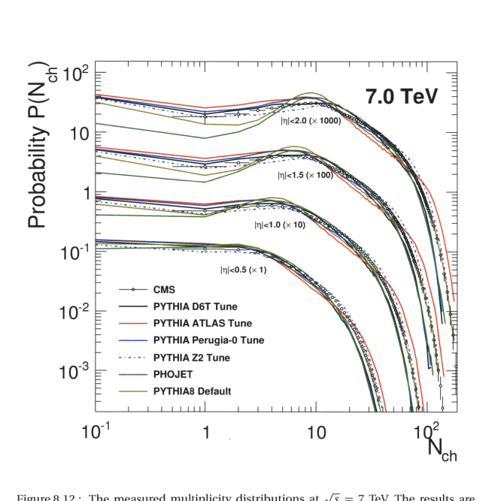
[PDF]Measurement of the Charged-Hadron Multiplicity in Proton ... - MIT
web.mit.edu/mithig/theses/Yen-Jie-Lee-thesis.pdf
Jul 6, 2010 - Yen-Jie Lee. M.S., National Taiwan University (2004). Submitted to the Department of Physics in partial fulfillment of the requirements for the degree of. Doctor of Philosophy at the ..... generators and analytical models. In this thesis, two studies of the particle production in p+p collisions with the Com-.

