Slide 1


Study of $pp$ and $p\overline{p}$ scattering at LHC energies using an extended Bialas-Bzdak model
T. Csörgő^{1,2} and I. Szanyi^{1,3}
¹Wigner RCP, Budapest, Hungary
²EKE KRC, Gyöngyös, Hungary
³ELTE, Budapest, Hungary
18th Zimányi School, Budapest, Hungary

Slide 2

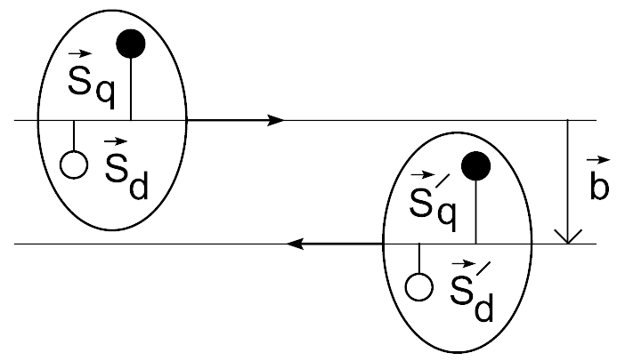
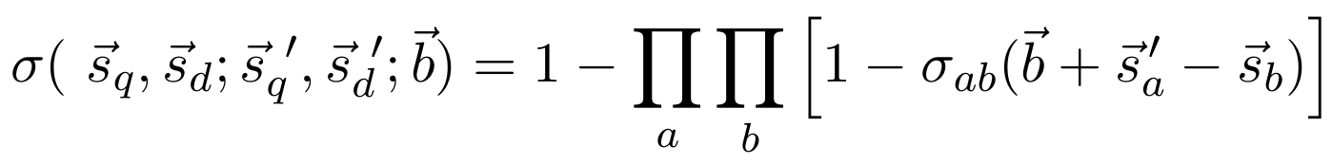
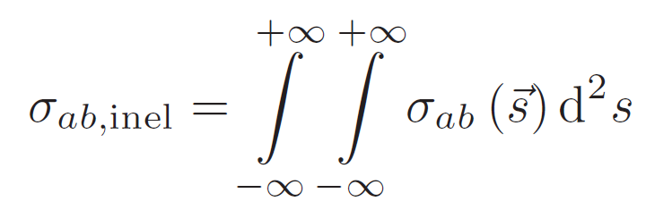
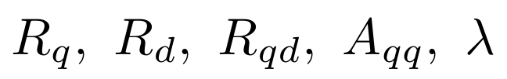
Inelastic cross section in Bialas-Bzdak p=(q,d) model
Quark-diquark distribution inside the proton:
Interaction probability of the constituents:
Inelastic cross-sections of quark, diquark scatterings:
                Free parameters:
A. Bialas, A. Bzdak Acta Phys.Polon. B 38, 159-168 (2007)
arXiv:0612038
Proton-proton scattering in the quark-diquark model.

Slide 3



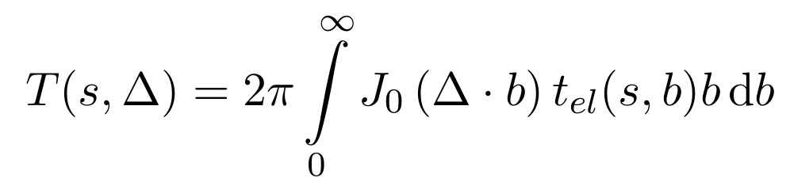
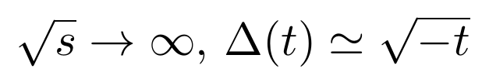

Unitarily extended Bialas-Bzdak model (reBB)
Elastic amplitude in the impact parameter space:
The opacity or eikonal function:
Elastic amplitude in the momentum space:
Elastic differential cross section:
arXiv:1505.01415
F. Nemes, T. Csörgő, M. Csanád, Int. J. Mod. Phys. A Vol. 30 (2015) 1550076

Slide 4

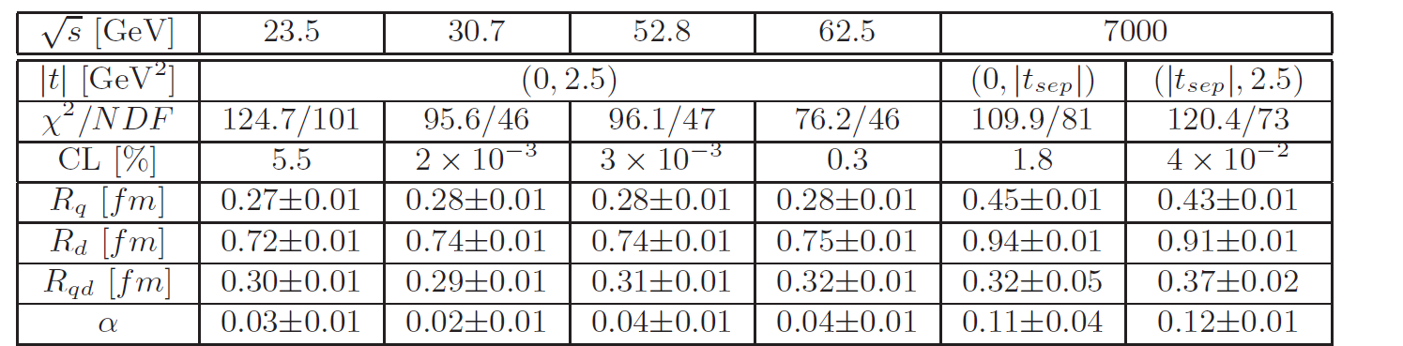

Earlier results
F. Nemes, T. Csörgő, M. Csanád, Int. J. Mod. Phys. A Vol. 30 (2015) 1550076

Slide 5


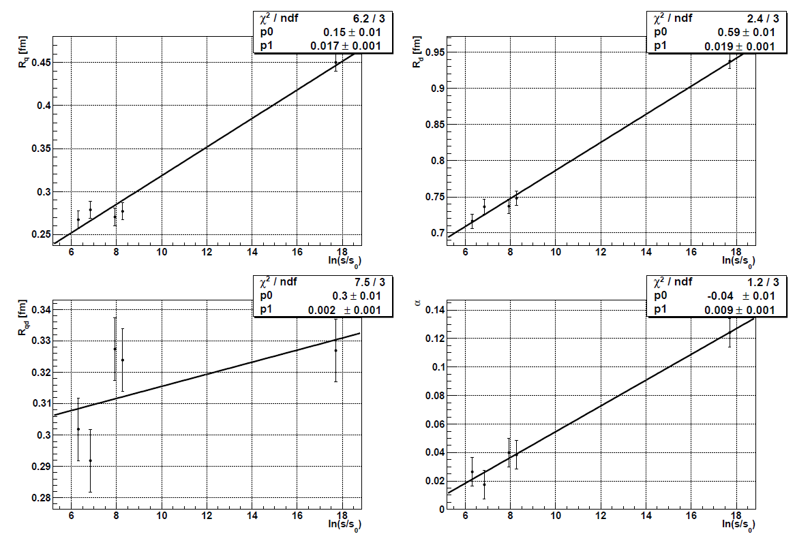

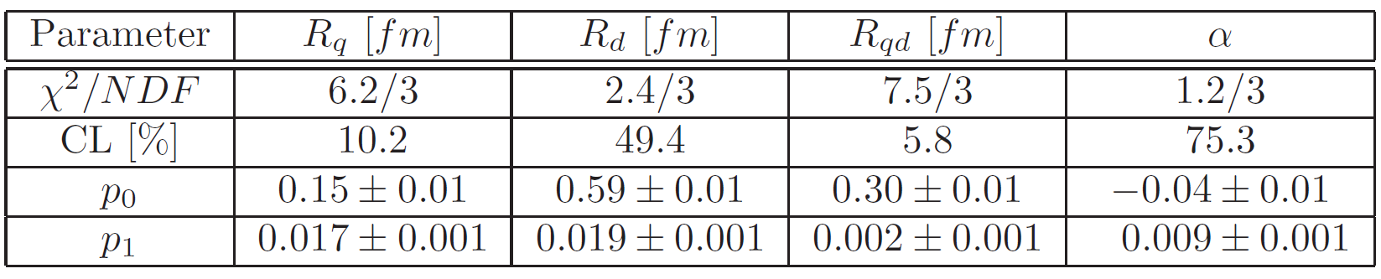





Energy dependence of the parameters for $pp$
$α(s)$
arXiv:1505.01415
$R_{d}(s)$
$$R_{qd}(s)$$
$$R_{q}(s)$$

Slide 6
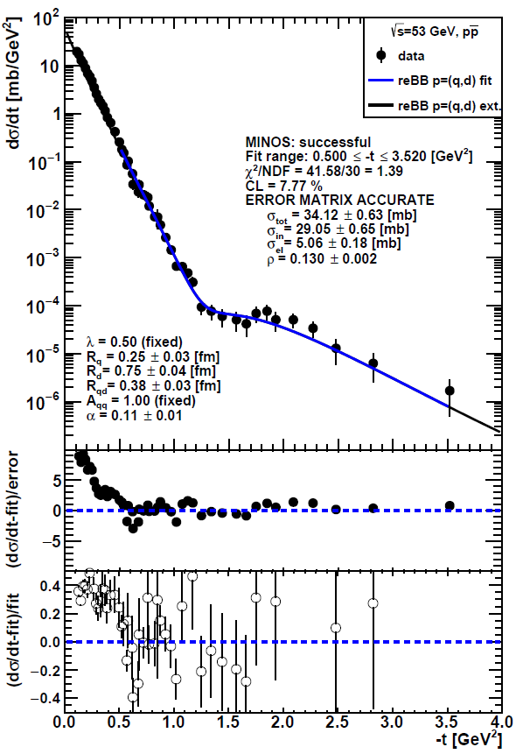
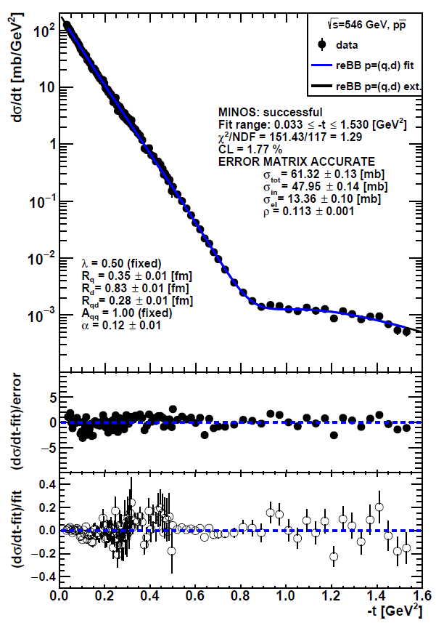
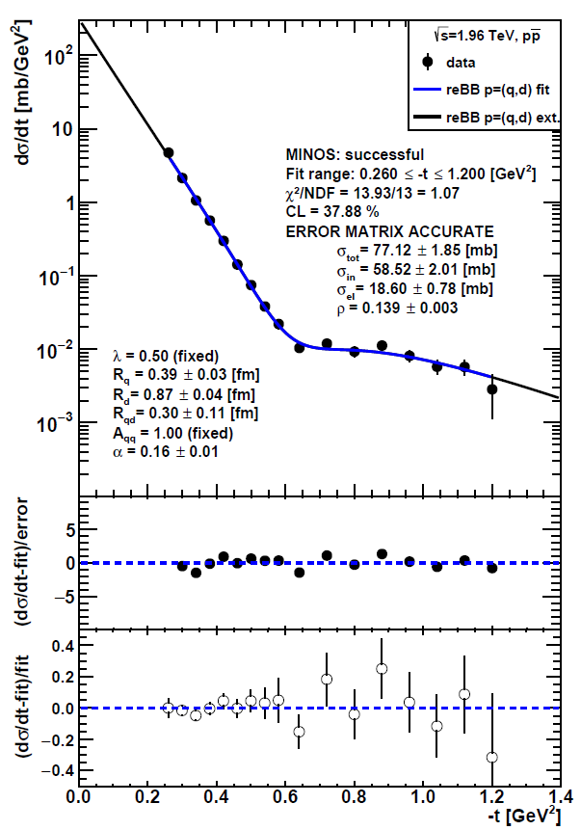




New results: ReBB fits to $p\overline{p}$ dσ/dt data
$$\sqrt{s}=53 GeV$$
$$\sqrt{s}=546 GeV$$
$$\sqrt{s}=1.96 TeV$$

Slide 7
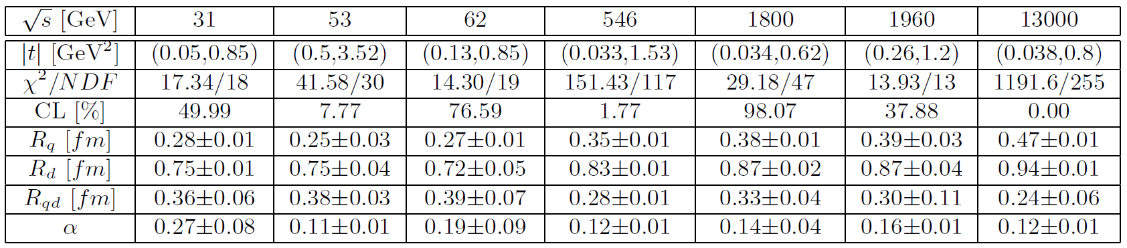
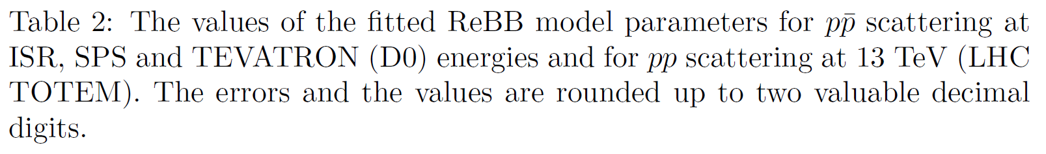
New results

Slide 8
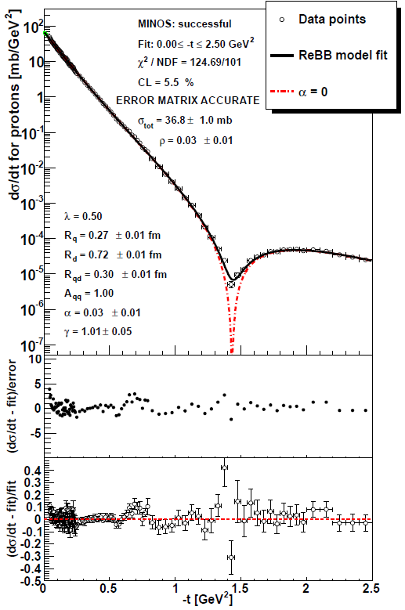
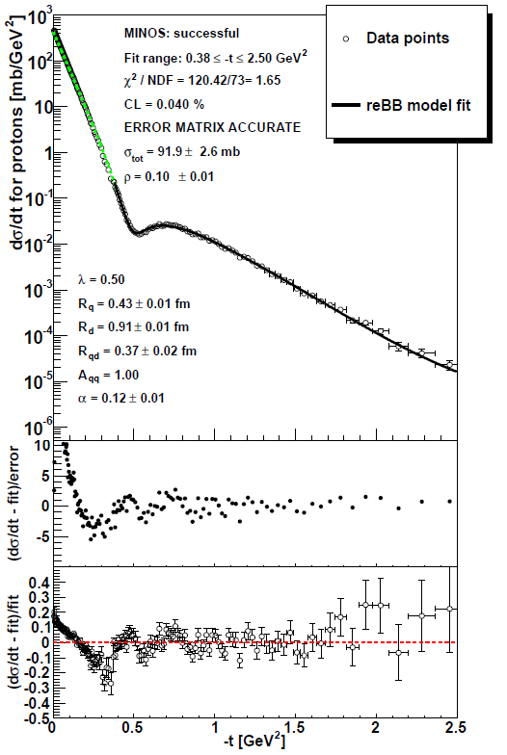
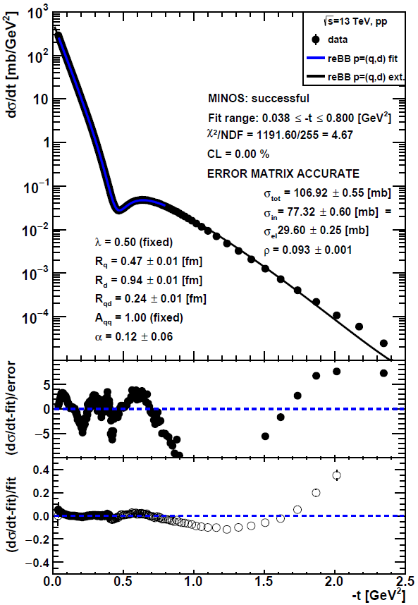




ReBB fits to $pp$ dσ/dt data at several energies
$$\sqrt{s}=13 TeV$$
TOTEM preliminary
$$\sqrt{s}=23.5 GeV$$
$$\sqrt{s}=7 TeV$$
arXiv:1505.01415
arXiv:1505.01415

Slide 9
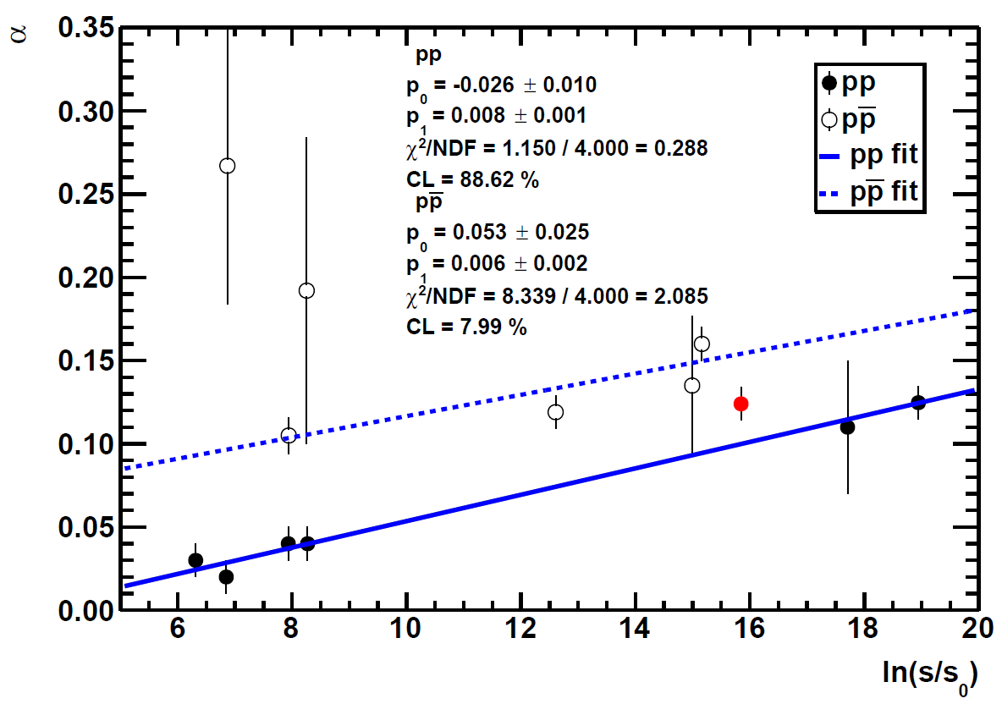
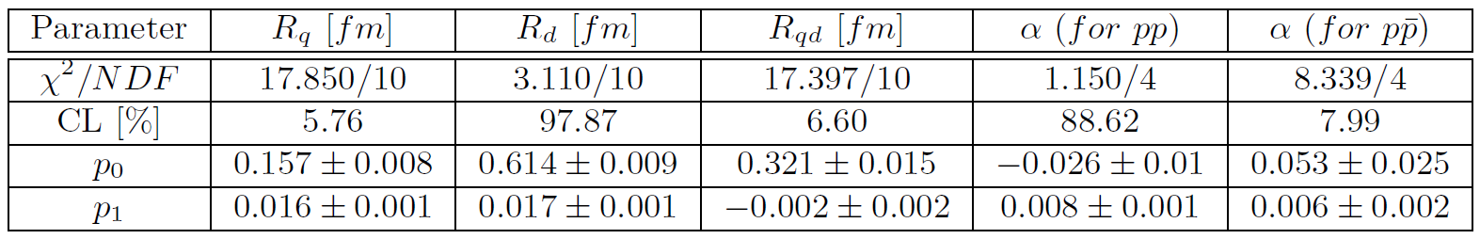
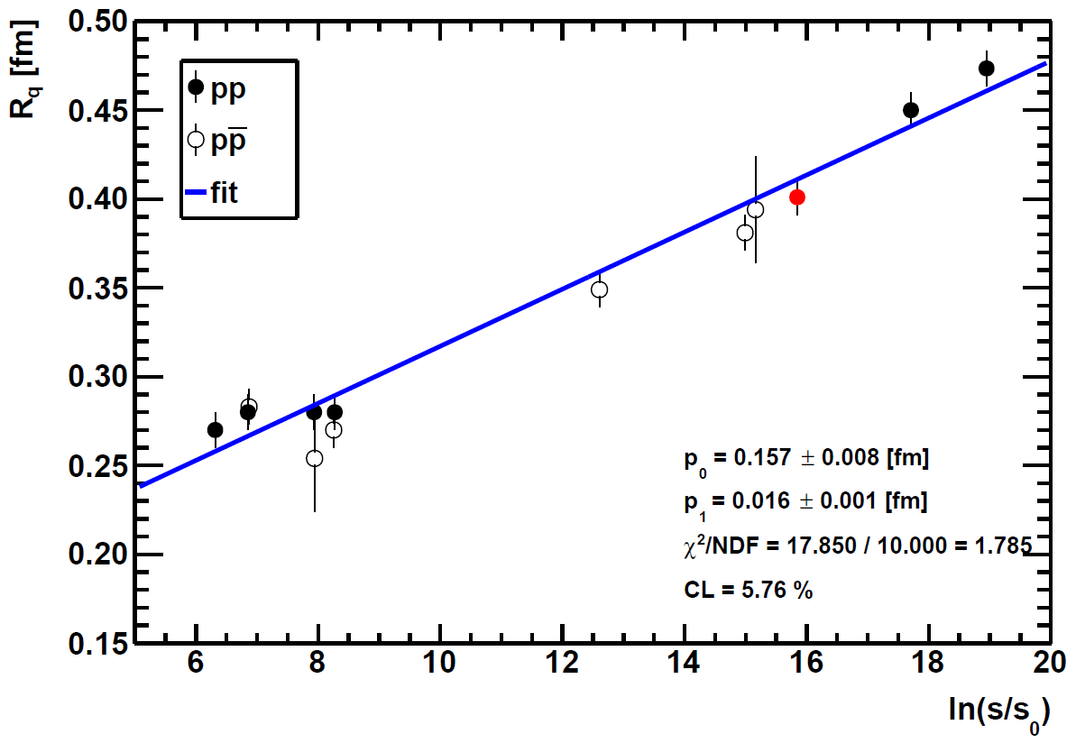
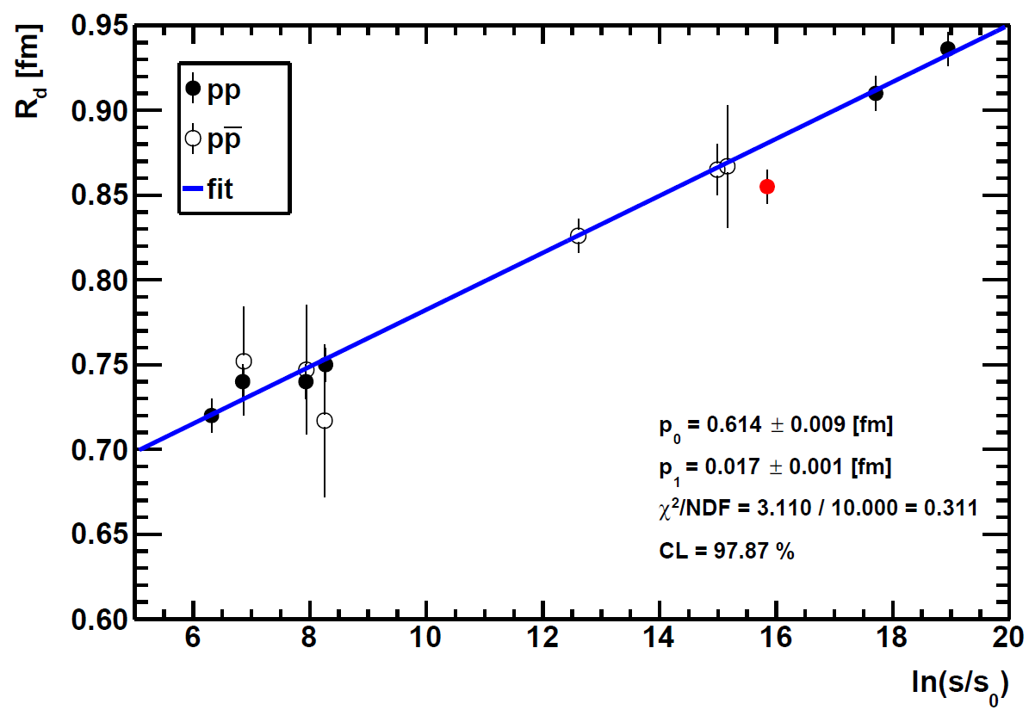
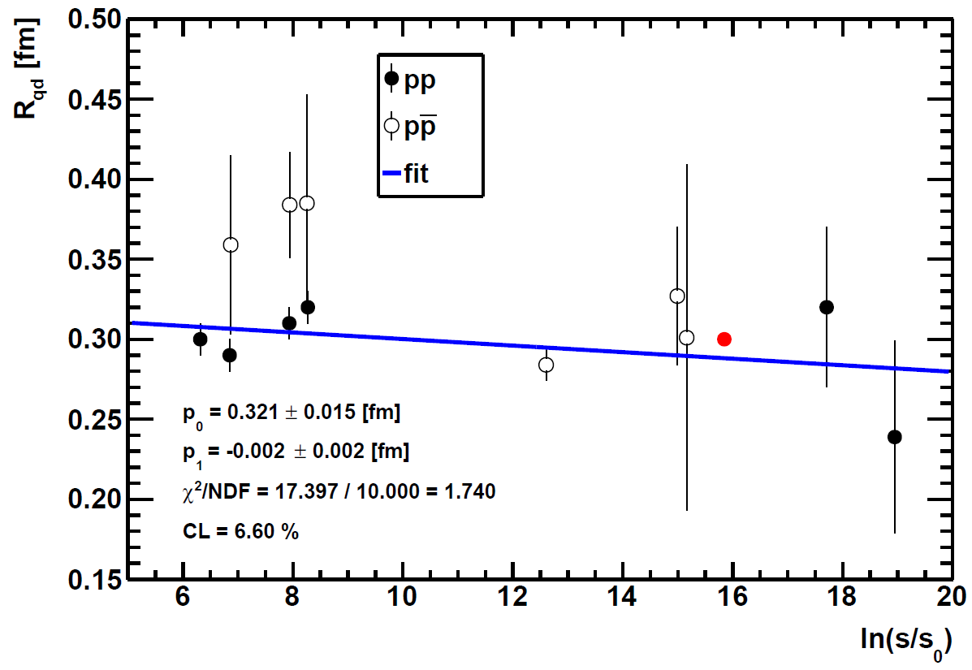





Energy dependence of the parameters for $pp$ & $p\overline{p}$
$α(s)$
$$R_{q}(s)$$
$R_{d}(s)$
$$R_{qd}(s)$$

Slide 10
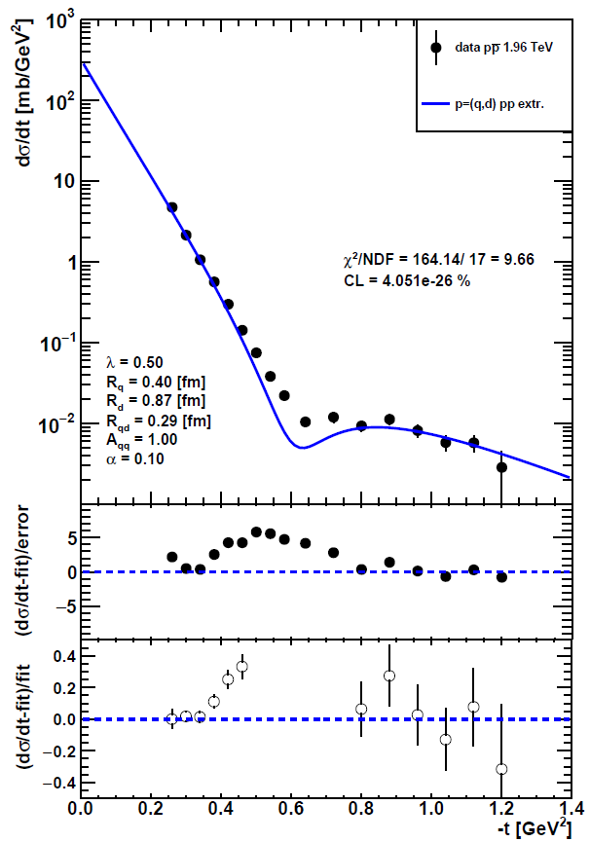
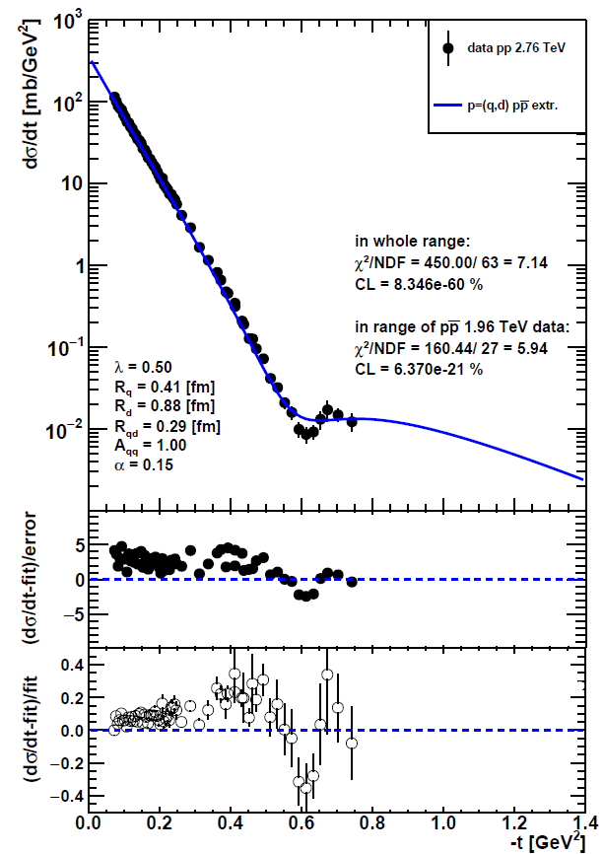



Extrapolation for $pp$ @ 1.96 TeV & $p\overline{p}$ at 2.76 TeV
$$\sqrt{s}=1.96 TeV$$
$$\sqrt{s}=2.76 TeV$$
significant odderon effect
significant odderon effect
TOTEM preliminary

Slide 11
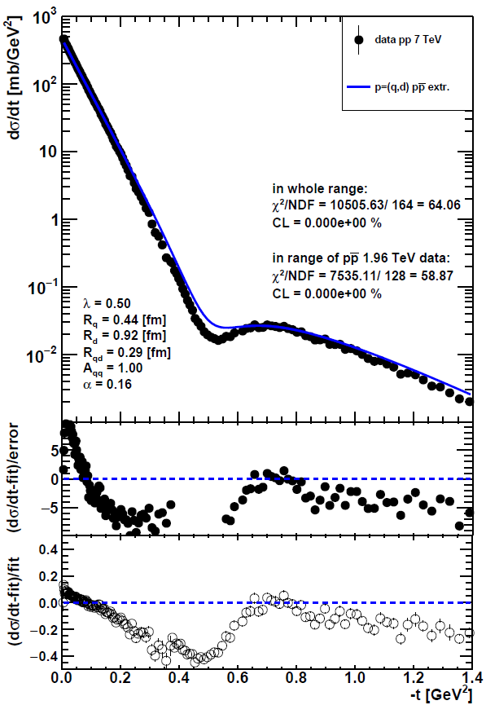
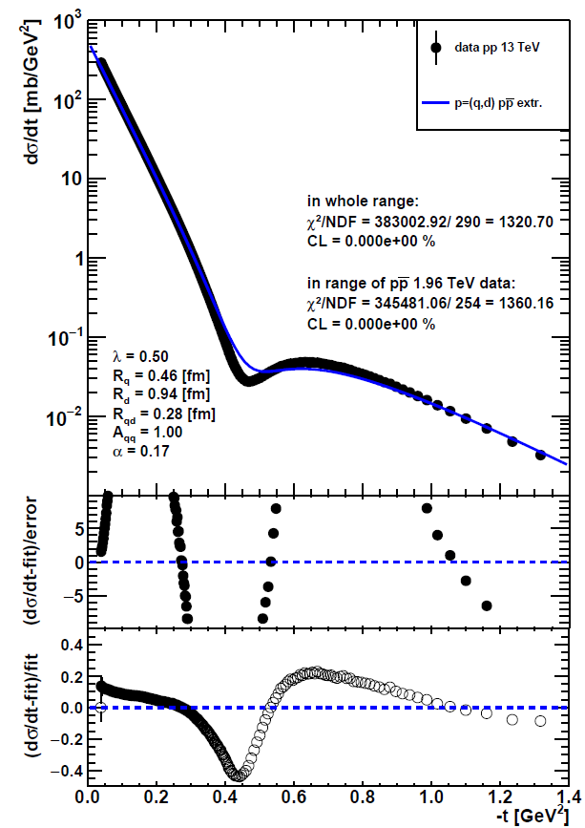



Extrapolation for $p\overline{p}$ at 7 & 13 TeV
$$\sqrt{s}=7 TeV$$
$$\sqrt{s}=13 TeV$$
significant odderon effect
significant odderon effect
TOTEM preliminary

Slide 12
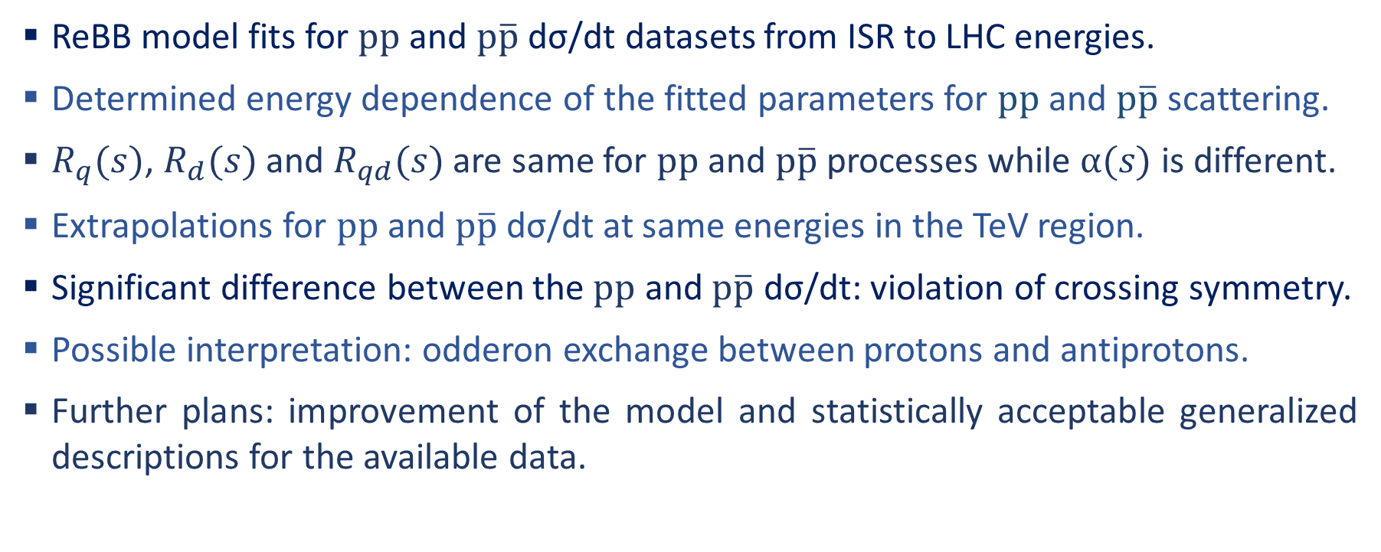
Summary and conclusions
ReBB model fits for $pp$ and $p\overline{p}$ dσ/dt datasets from ISR to LHC energies.
Determined energy dependence of the fitted parameters for $pp$ and $p\overline{p}$ scattering.
$R_{q}(s)$, $R_{d}(s)$ and $R_{qd}(s)$ are same for $pp$ and $p\overline{p}$ processes while $α(s)$ is different.
Extrapolations for $pp$ and $p\overline{p}$ dσ/dt at same energies in the TeV region.
Significant difference between the $pp$ and $p\overline{p}$ dσ/dt: violation of crossing symmetry.
Possible interpretation: odderon exchange between protons and antiprotons.
Further plans: improvement of the model and statistically acceptable generalized descriptions for the available data.

Slide 13
Thank you for your attention!
Partially supported by:
ÚNKP-18-2 New National Excellence Program of the Ministry of Human Capacities
National Research, Development and Innovation Office (NKFIH/NRDI) grants FK 123842 and FK 123959
Exchange programme of the Hungarian and the Ukrainian Academy of Sciences, NKM-86/2016 and NKM-92/2017
The Hungarian project EFOP 3.6.1-16-2016-00001
Circles of Knowledge Club, Hungary

