Slide 1
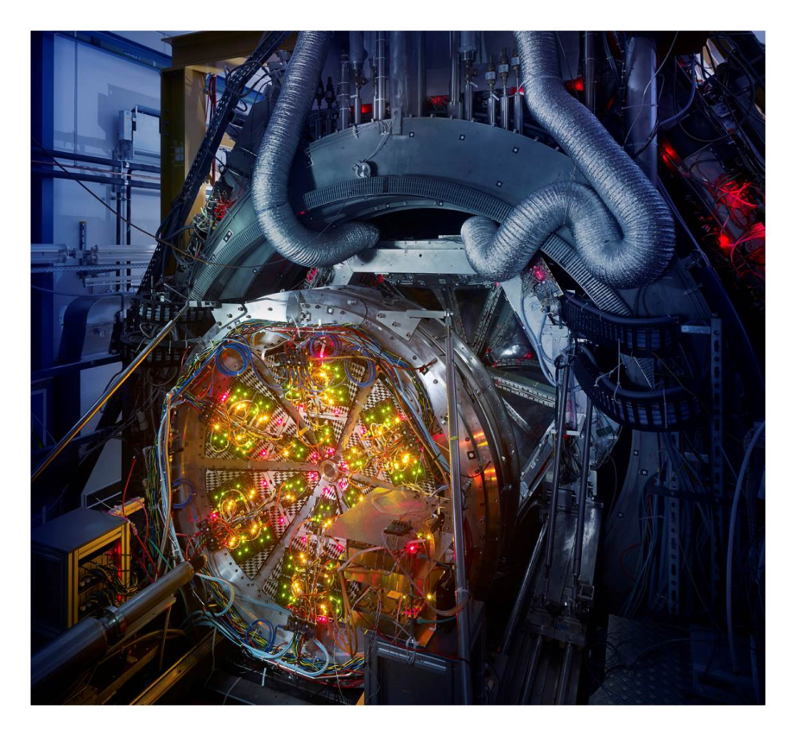
Resonances in vacuum and dense matter studied by HADES@SIS18
Szymon Harabasz for the HADES Collaboration
Introduction
Sub-NN-threshold hadron production
Electromagnetic radiation in vacuum and medium
Collectivity
Summary

Slide 2
Introduction

Slide 3
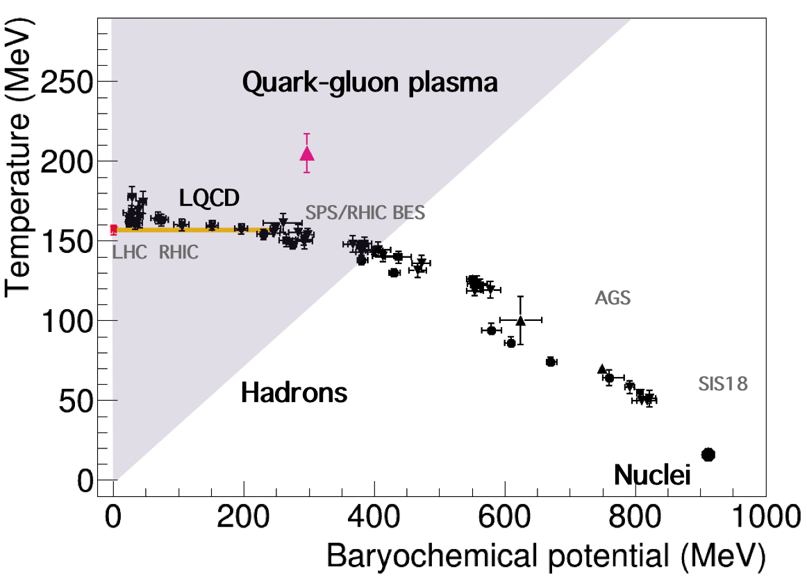
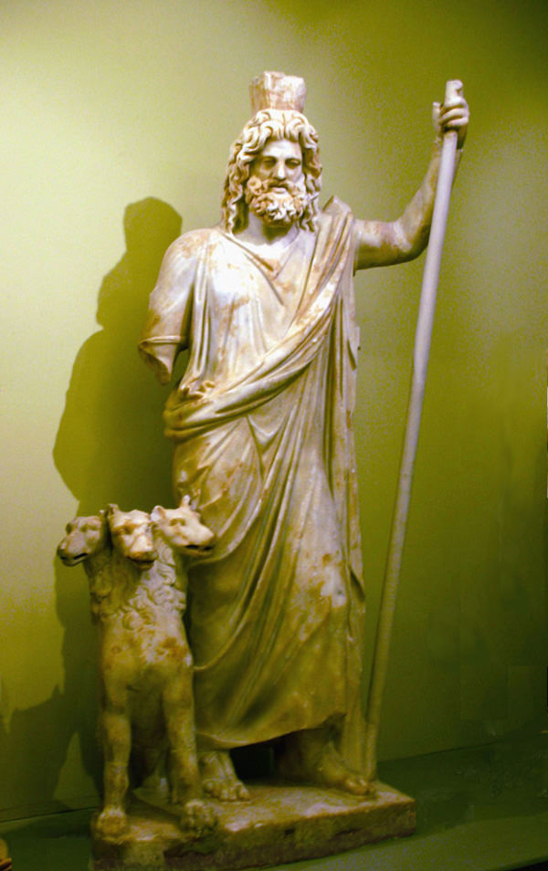
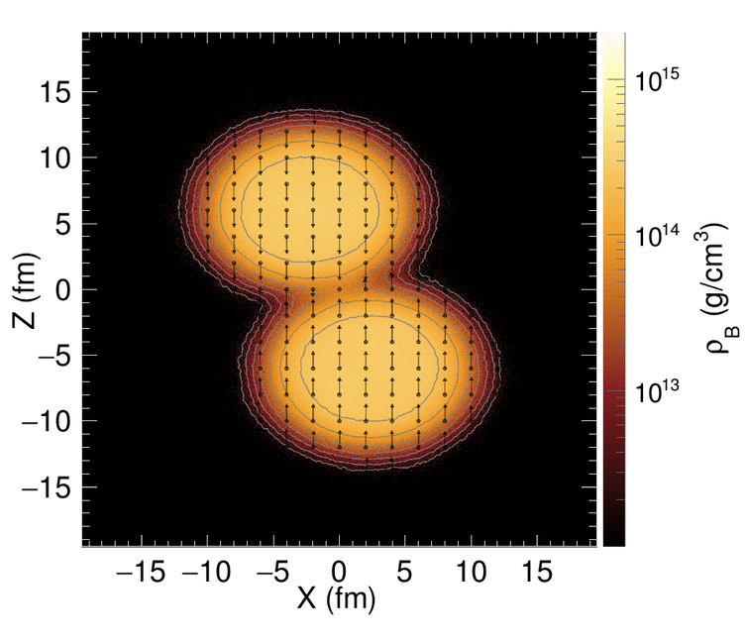
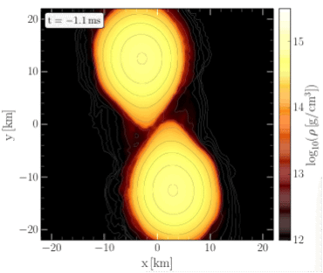

The HADES physics case
Pion and nucleon beams:
  Reference measurements (vacuum, cold QCD matter)
  Electromagnetic structure of baryons and hyperons
  in the region of 0 < q² < 4m_{p}²
Heavy ion collisions:
  Properties of matter occuring in neutron star mergers
[T. Galatyuk, PoS INPC2016 (2017) 354; NPA QM18]
Au+Au, $\sqrt{s_{NN}}=2.4$ GeV
NS mergers
HADES
High μ_{B} region of QCD phase diagram
Main focus on rare and penetrating probes
Various aspects of baryon-meson coupling
T < 70 MeV, ρ≈3ρ₀ in both cases

Slide 4
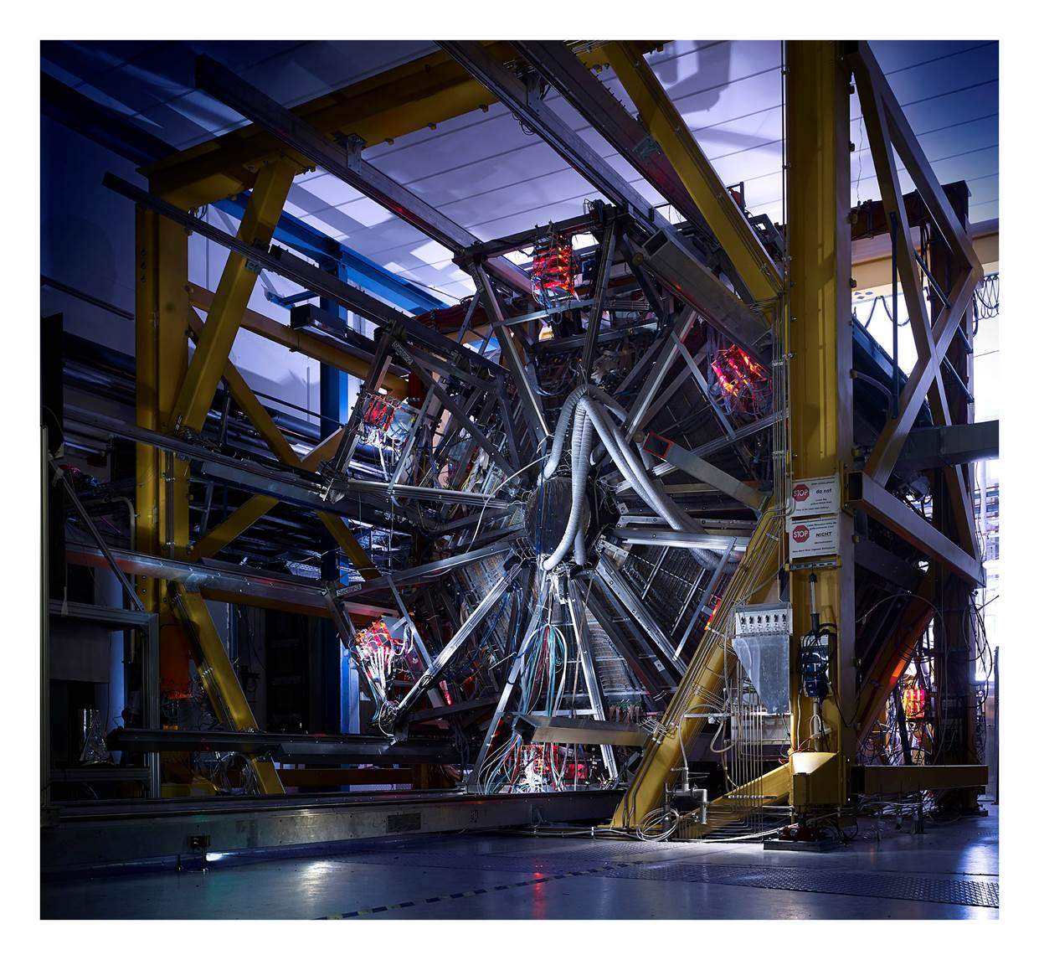
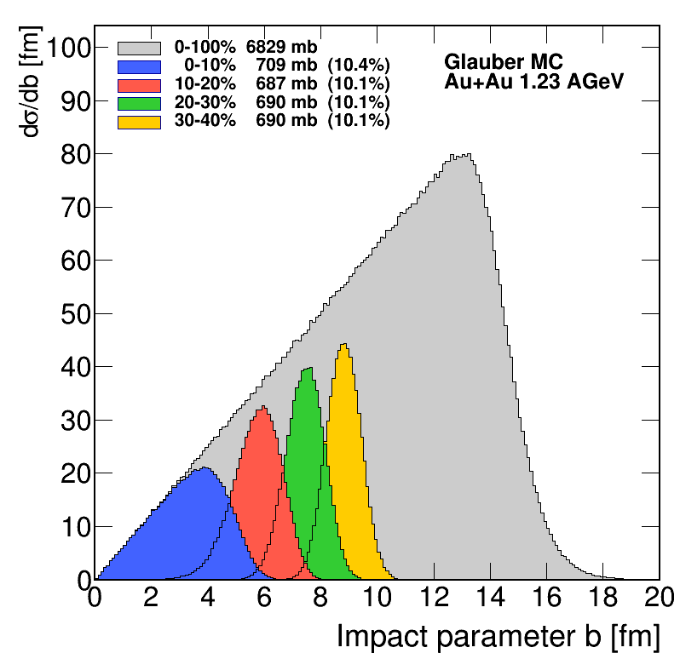
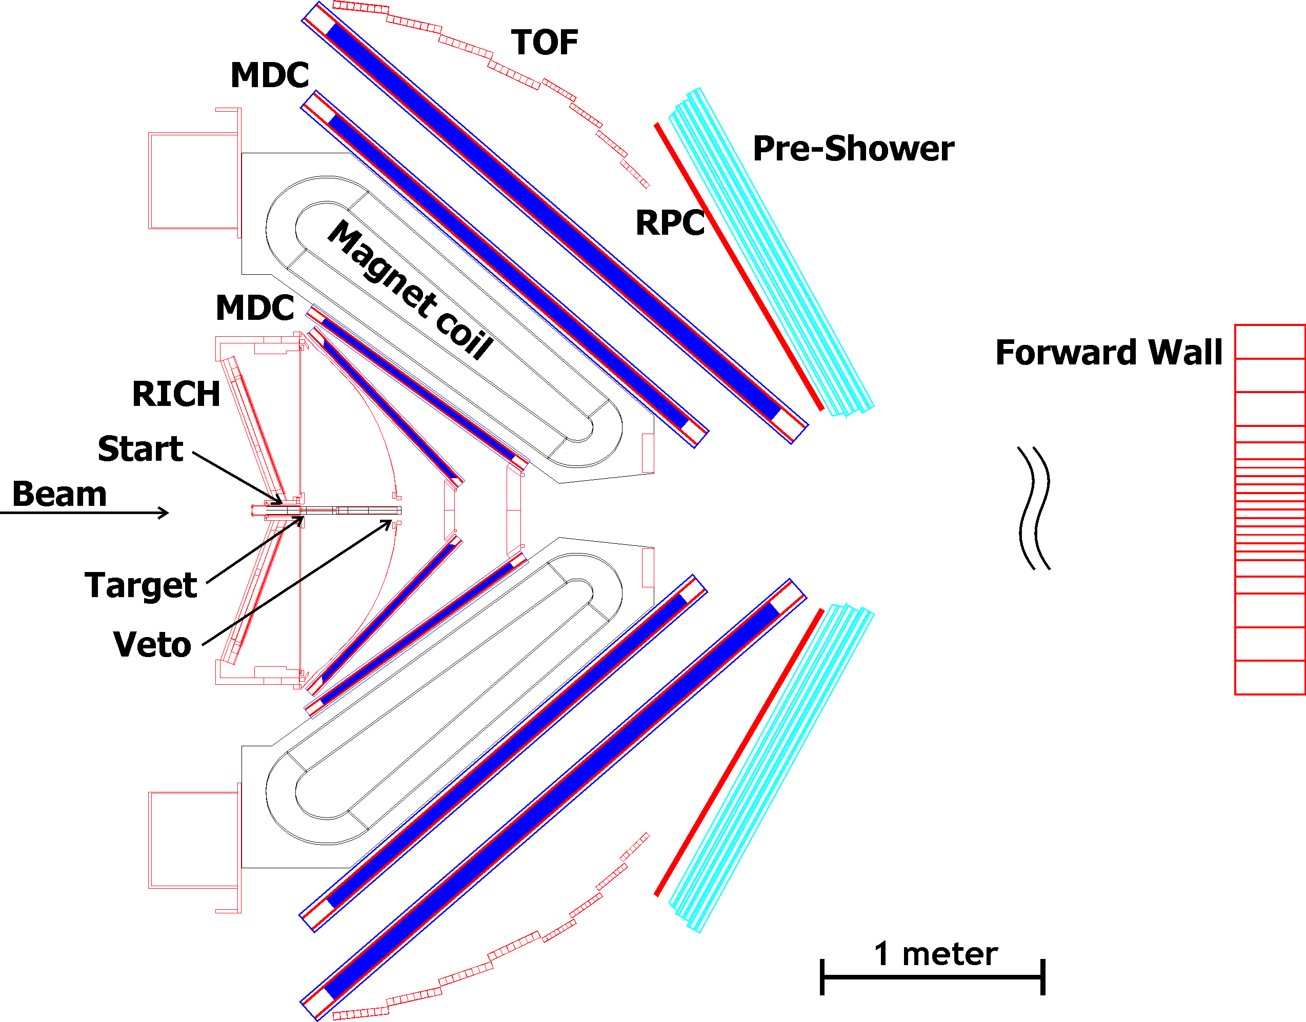


Meet the HADES
(High Acceptance Di-Electron Spectrometer)
[HADES Coll., Eur.Phys.J. A54 (2018) 85]
Photo: Jan Michael Hosan/HA Hessen Agentur GmbH
4.3⨯10⁹ of 40% most central Au+Au events recorded
Beams from SIS18: protons, nuclei, secondary pion beams, E_{kin}=1-2 GeV/u
Fast detector → interaction rate: 8 kHz in AuAu, 200 kHz at SIS100
Large acceptance → full azimuth, polar from 18º to 85º
Mass resolution → of the order of few %
Good particle identification
Efficient track reconstruction
Search for rare and penetrating probes
Di-lepton production suppressed by the factor α²
Sub-threshold production of strangeness and vector mesons
Notes:
e+e- use upper case for + and –
Text restructured

Slide 5
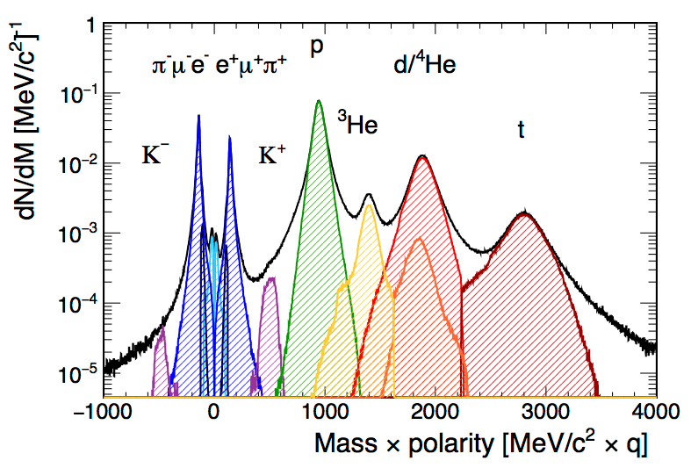
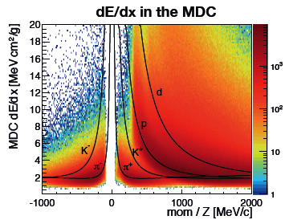
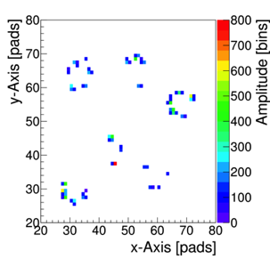
Particle identification performance
By means of:
Velocity and momentum
dE/dx in TOF and MDC
RICH information and PreShower

Slide 6
Sub-NN-Threshold hadron Production

Slide 7
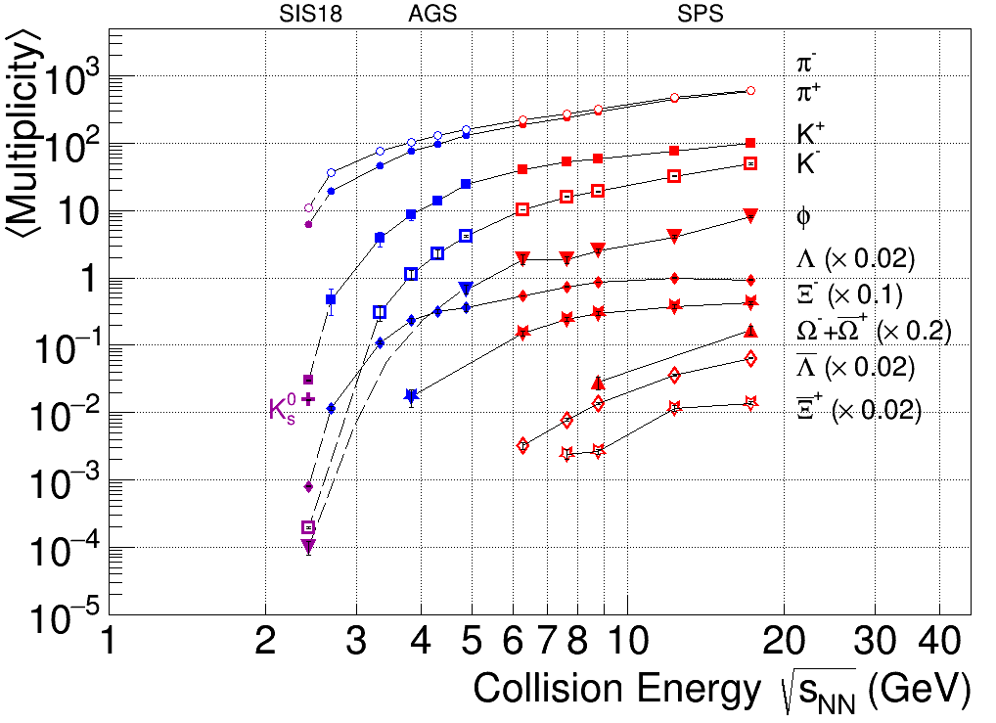
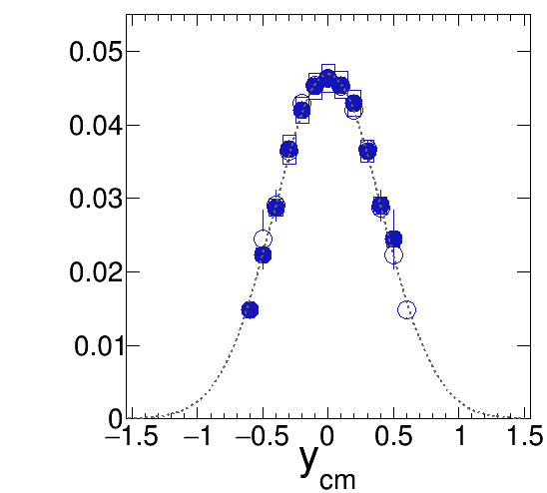

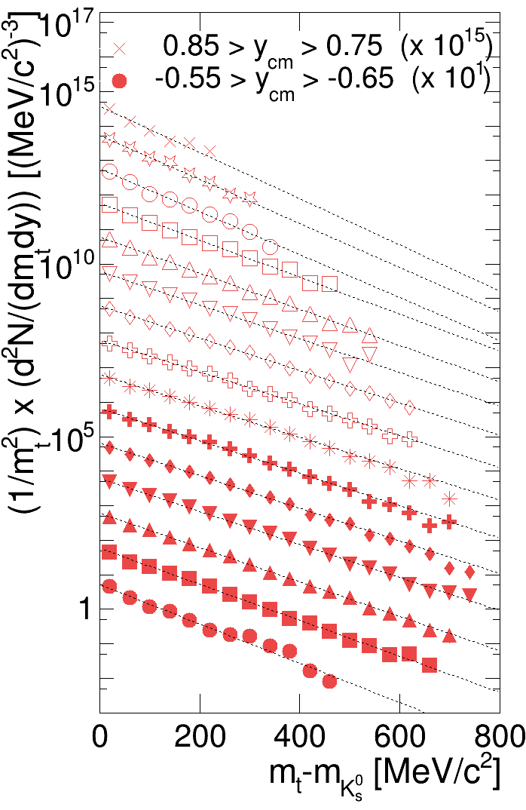
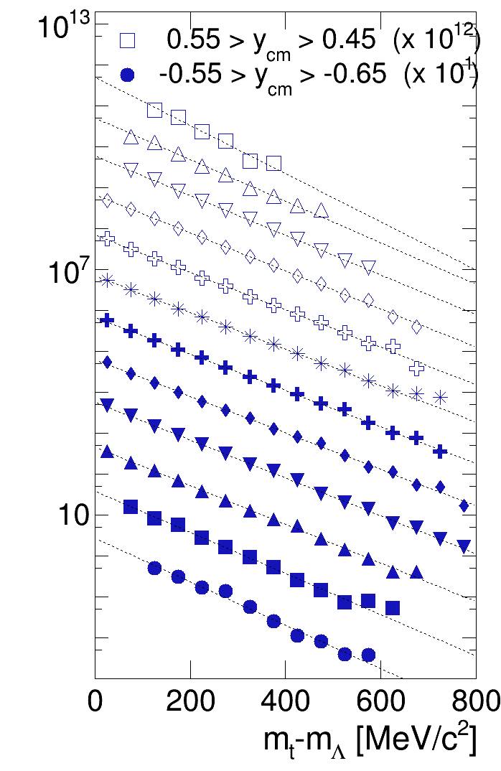
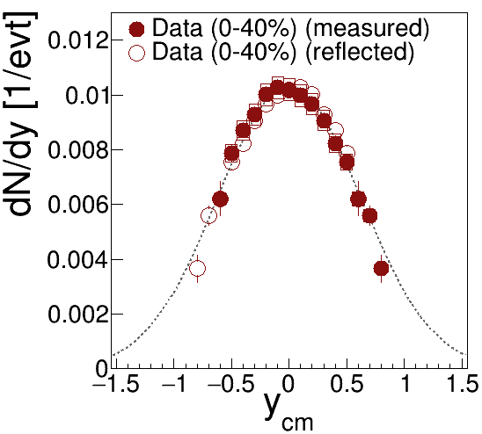

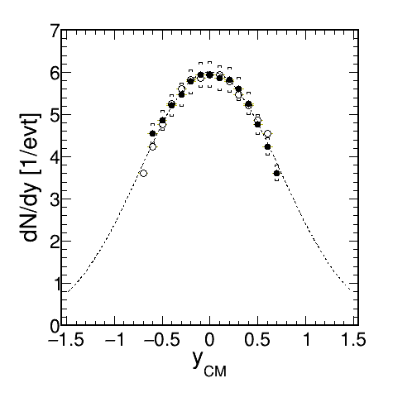
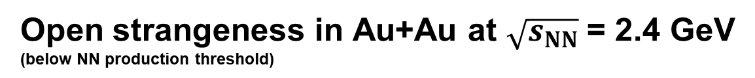
Open strangeness in Au+Au at $\sqrt{s_{NN}}$ = 2.4 GeV (below NN production threshold)
[C. Blune, C. Markert, PPNP 66 (2011);
update T. Galatyuk, QM 2018]
Constraint strangeness production and propagation mechanism
Narrower dN/dy for heavier particle is consistent with a thermal source
$$π^{−}$$

Slide 8


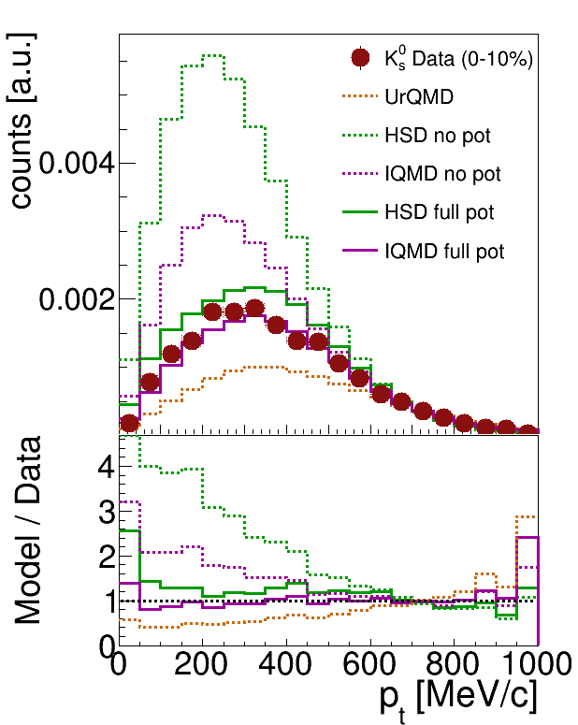
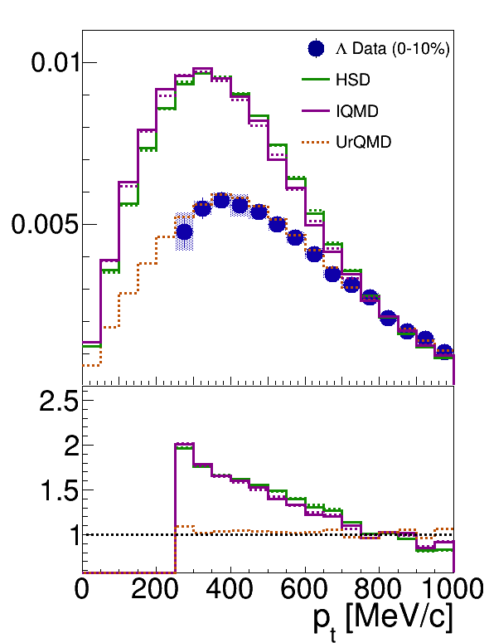
Comparison to microscopic transport
Kaon potential relevant to describe K⁰ distribution, but doesn’t improve Λ
Hyperon described by UrQMD, which has no potential, but it has feed-down from higher resonances
None of the codes describe K⁰ and Λ simultaneously

Slide 9

Hadron yields as function of system size
All strange hadrons produced below the
free NN threshold:
  K⁺Λ: -160 MeV
  K⁺K⁻: -470 MeV
Universal scaling with participant number
Not expected if subtreshold production driven by resonance decays

Slide 10
Strangeness in cold nuclear matter
Pion beam with p = 1.7 GeV/c
  Targets: ¹²C or ¹⁸⁴W
K⁺ shifted to backward rapidity
  Rescattering
  Absorption due to charge exchange is negligible for K⁺ but dominating for K⁻
Significant φ production
  φ/K⁻ ratio ~ 0.5

Slide 11
VaCuum and Medium
Electromagnetic radiation

Slide 12
Exclusive analysis of pp→ppe⁺e⁻
Exclusive analysis of pp→ppe⁺e⁻
[PRC 95, 065205 (2017)]
QED: point like γ∗NR, Heavy Ion Phys. 17, 27 (2003)
I&W: two component quark model, PRC 69, 055204 (2004)
R&P: covariant constituent quark model, PRD 93, 033004 (2016)
S&M brems.: PRC 82, 062201 (2010)
PDG 2018
First measurement of
BR( Δ→pe⁺e⁻ ) = 4.19 ± 0.42(model) ± 0.46(syst.) ± 0.34(stat.)

Slide 13
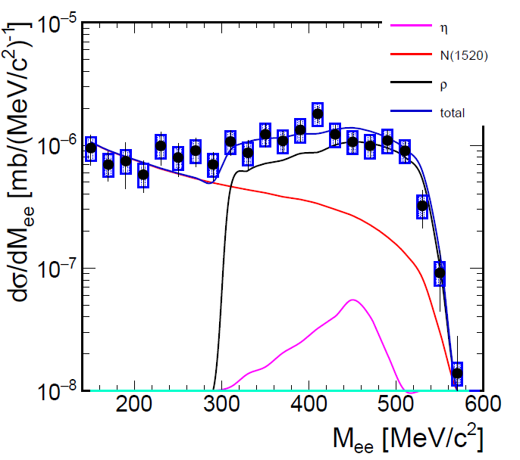

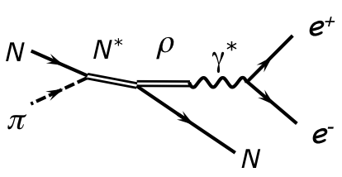

Role of the ρ meson
Exclusive np→npe⁺e⁻,$\sqrt{s}$ = 2,4 GeV
Exclusive π⁻ + p → ne⁺e⁻, $\sqrt{s}=$ 1.49 GeV
HADES, EPJA 53, 149 (2017)
Total
η→e⁺e⁻γ
N(1520)→ne⁺e⁻
0.9 < M^{miss}_{ee} < 1.03 GeV/c²
Model A [EPJA 50, 107 (2014)], e.g.:
Model B [PRC 82, 062201 (2010)], e.g.:

Slide 14


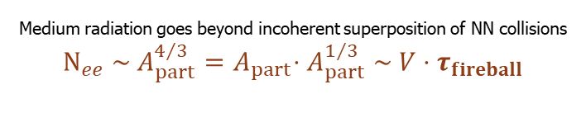
Dilepton excess yield
QM 2017
Coarse Graining (CG): ρ in-medium spectral function with thermodynamic parameters from transport
CG FRA: Phys. Rev. C 92, 014911 (2015)
CG GSI-Texas A&M: Eur. Phys. J. A, 52 5 (2016) 131
CG SMASH: arXiv:1711.10297 [nucl-th]
HSD: Phys. Rev. C 87, 064907 (2013)
Medium radiation goes beyond incoherent superposition of NN collisions
$$N_{ee} \sim A_{part}^{4/3}{=A}_{part}⋅A_{part}^{1/3} \sim V⋅τ_{fireball}$$

Slide 15
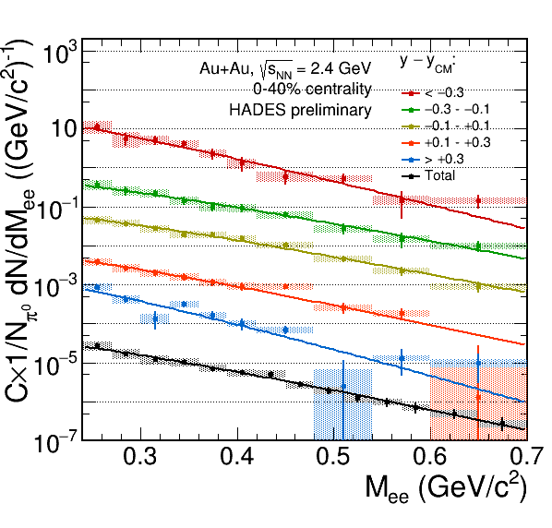
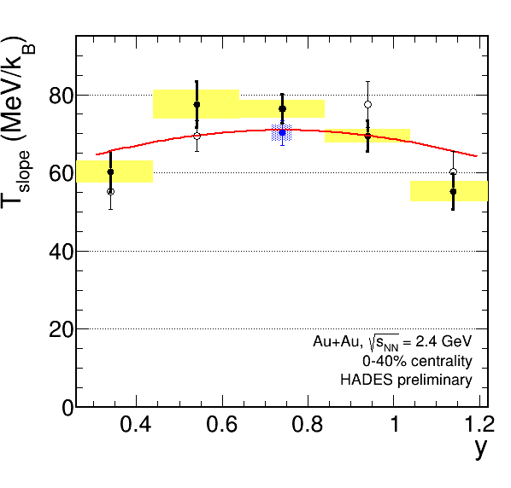
Fit to invariant mass as a function of rapidity
Total e+e− yield
Integrated over y
const/cosh(y-y_{CM})
Consistent with thermal ansatz
T_{slope} ∝ 1/cosh(y-y_{CM})

Slide 16
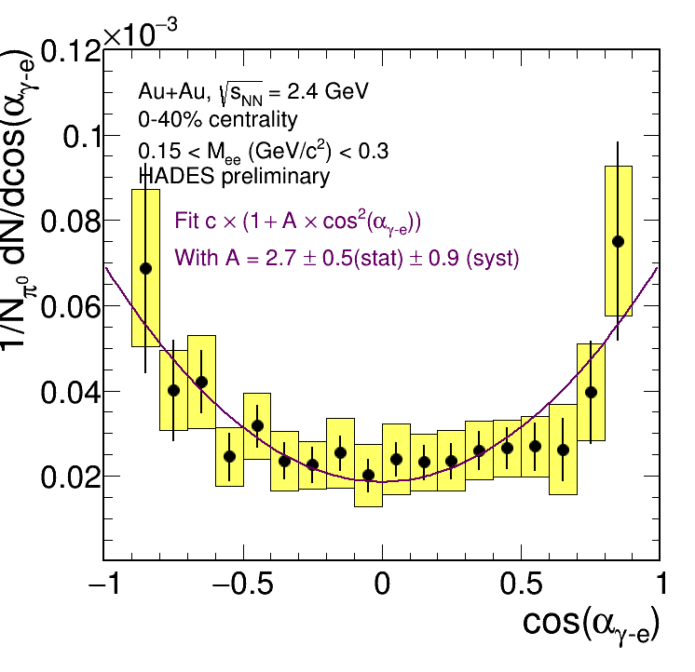
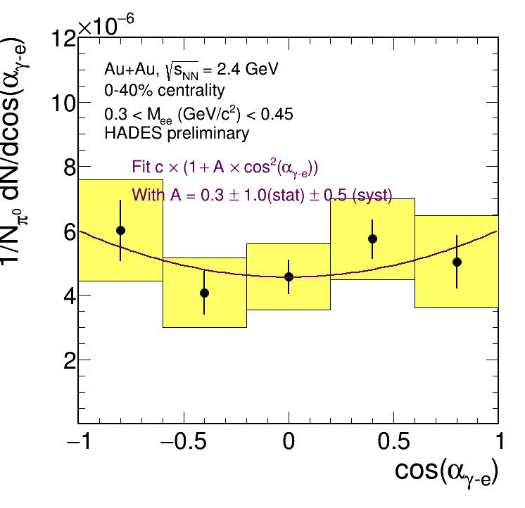
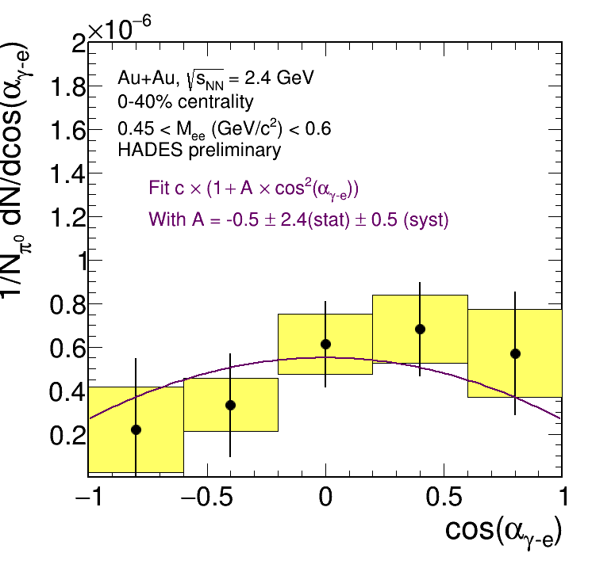
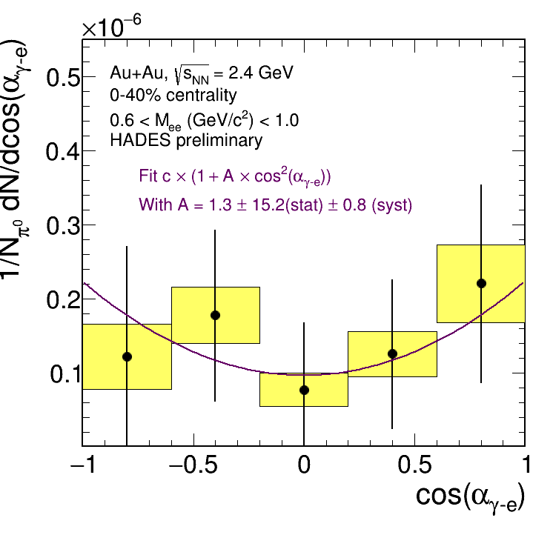

Angular distributions
Total e+e− yield
0.14 < M_{ee} (GeV/c²) < 0.28
0.28 < M_{ee} (GeV/c²)
"Helicity" angle, between e^{+/−} in γ∗ frame and γ∗ in the frame of its source
Meaning of the observable [PLB 348 283 (1995)]:
  Dalitz decays of pseudoscalar mesons: A = +1
  Δ→Ne⁺e⁻: A = +1
  Bremsstrahlung in soft photon approximation: A small
  ρ from ππ annihilation: A = -1 (with respect to the direction of one of π)
In HIC thermalization may wash out the anisotropy (?)
Exclusive np→npe⁺e⁻ $\sqrt{s}=2.4$ GeV
HADES, EPJA 53, 149 (2017)
0.15 < M_{ee} (GeV/c²) < 0.3
0.3 < M_{ee} (GeV/c²) < 0.45
0.45 < M_{ee} (GeV/c²) < 0.6
0.6 < M_{ee} (GeV/c²) < 1.0

Slide 17
Pion-proton resonances in medium
Novel method of iterative background estimation [arXiv:1808.05466]
First precise data on in-medium πp resonances
Δ⁺⁺
Δ⁰
Sensitive to the Coulomb force?
→ useful to extract space-time evolution of the fireball

Slide 18
CollectiVity

Slide 19

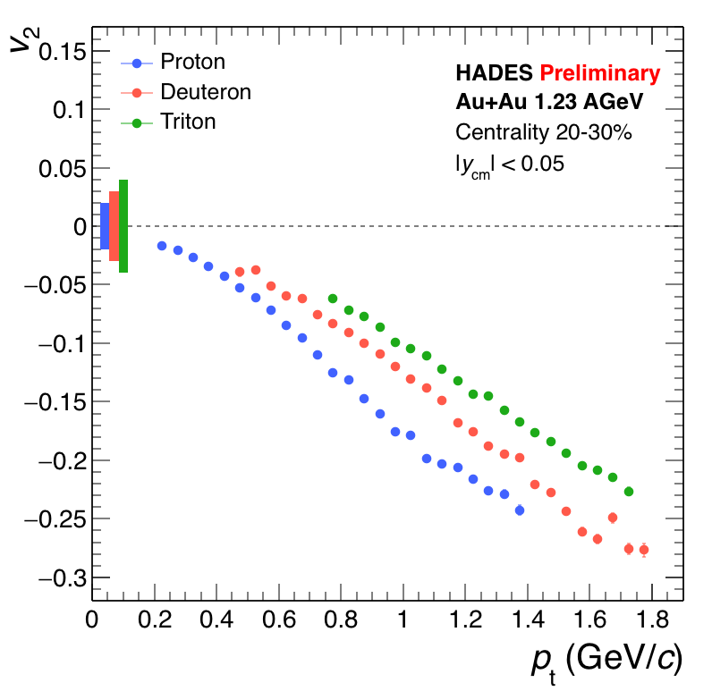
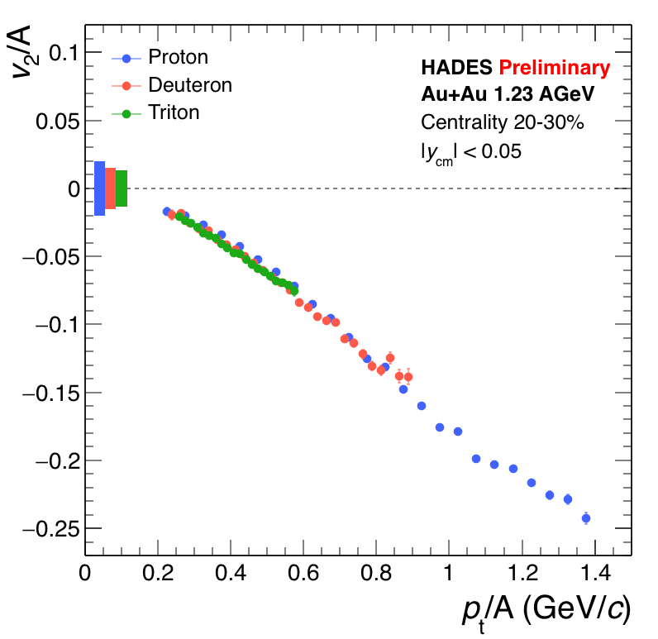
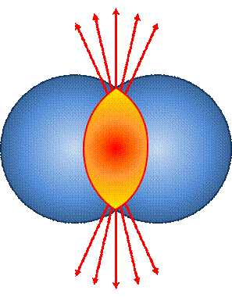
Elliptic (v₂) azimuthal anisotropy
Protons, deuterons, tritons
Comparison of v₂ of p, d, t
at mid-rapidity
At our energies v₂ < 0
  "Squeeze-out" rather than "flow"
Scaling of v₂ and p_{t} with number of nucleons A
  Consistent with nucleon coalescence

Slide 20
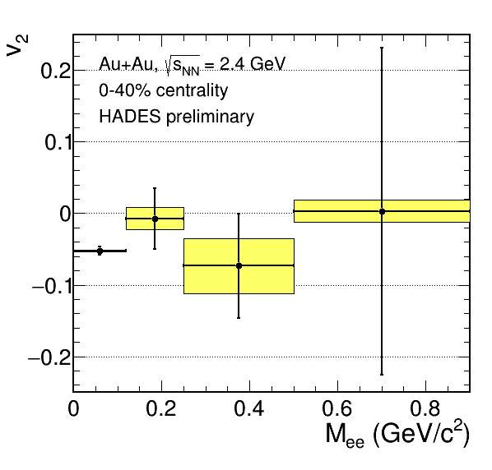
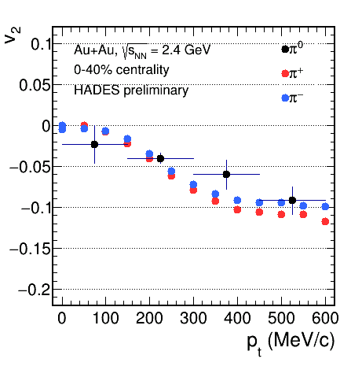
Dilepton azimuthal anisotropy
π⁰ – dileptons with M_{ee} < 0.12 GeVc²
HADES is capable of extracting v₂ of dileptons
For more conclusive results larger statistics is needed

Slide 21

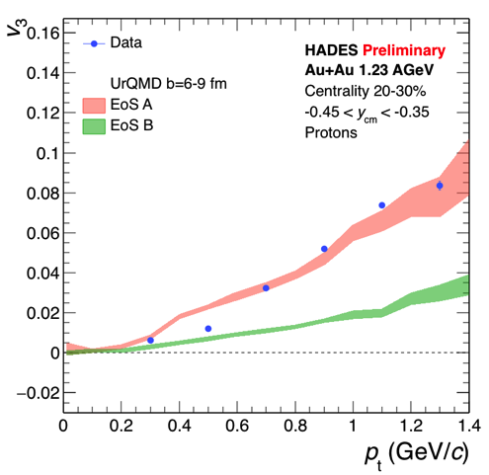
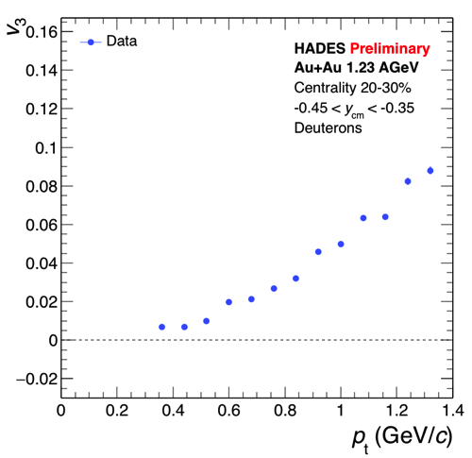
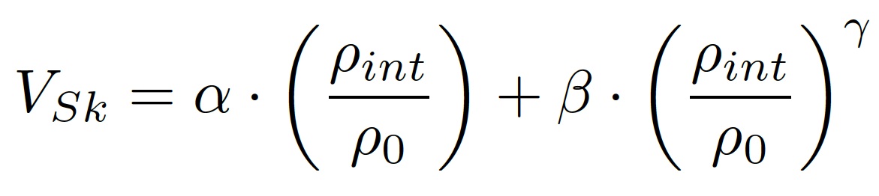
Triangular anisotropy v₃{Ψ_{RP}}
α (MeV) | -124 | -356
β (MeV) | 71 | 303
γ | 2 | 1.17
Sensitivity to the equation of state

Slide 22
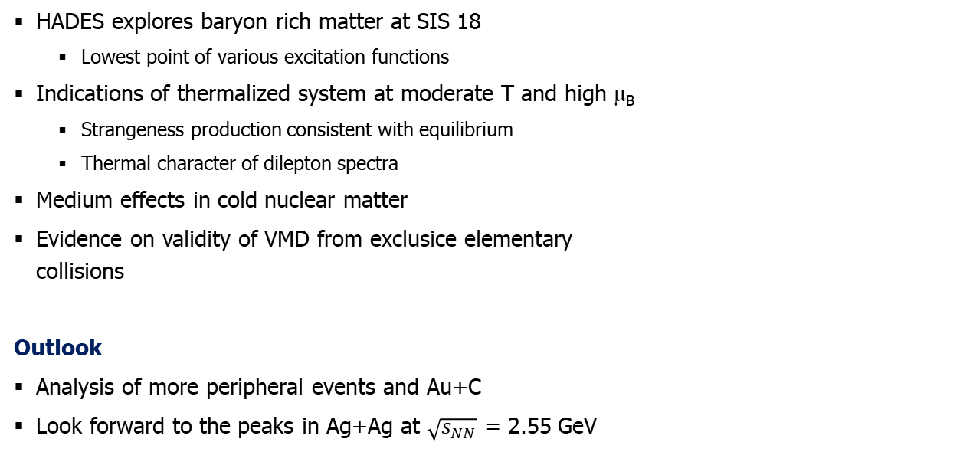
Summary and Perspectives
  HADES explores baryon rich matter at SIS 18
    Lowest point of various excitation functions
  Indications of thermalized system at moderate T and high μ_{B}
    Strangeness production consistent with equilibrium
    Thermal character of dilepton spectra
  Medium effects in cold nuclear matter
  Evidence on validity of VMD from exclusice elementary
  collisions
  Outlook
  Analysis of more peripheral events and Au+C
  Look forward to the peaks in Ag+Ag at $\sqrt{s_{NN}}$ = 2.55 GeV
See the talk by M. Zétényi
4 weeks of data taking

Slide 23
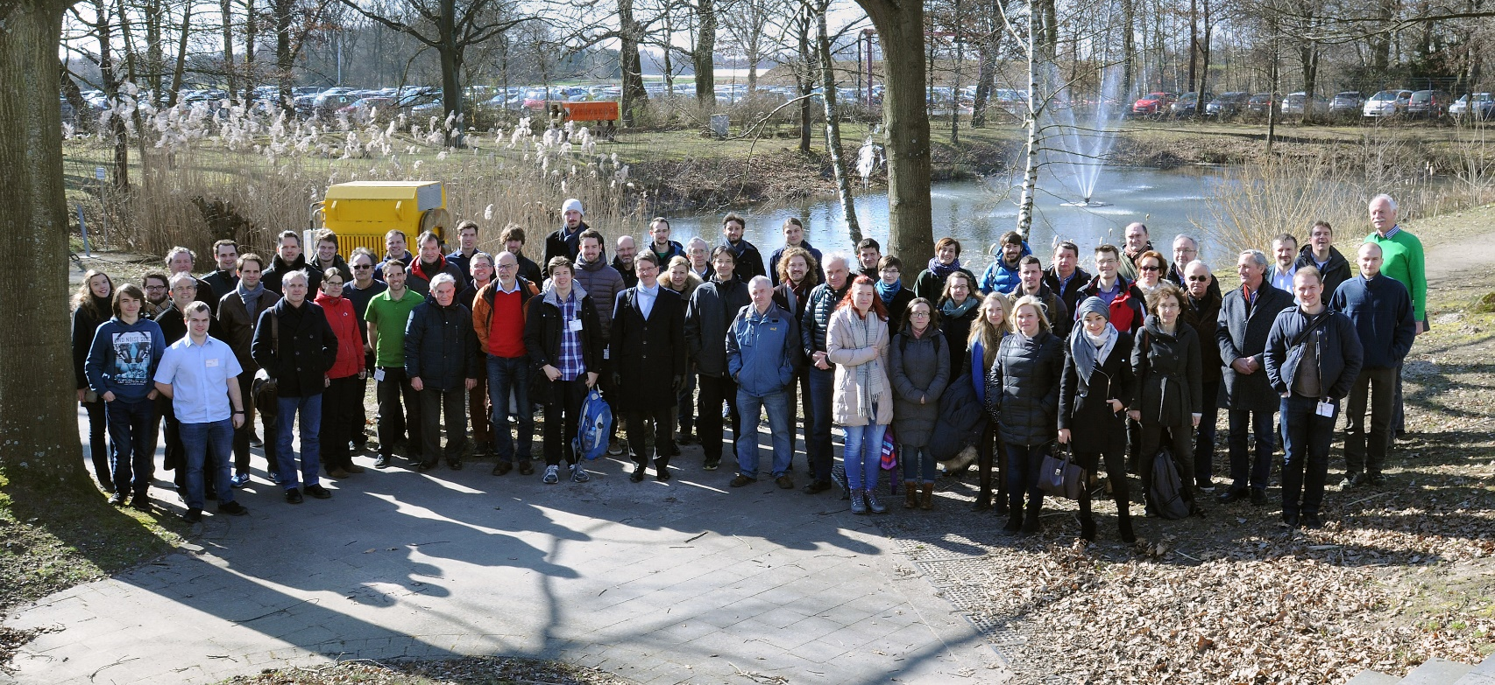
Thank you for you attention
9 countries, 16 institutions, 150 collaborators
HADES Collaboration, Feb 22nd 20018

Slide 24
Extra slides

Slide 25
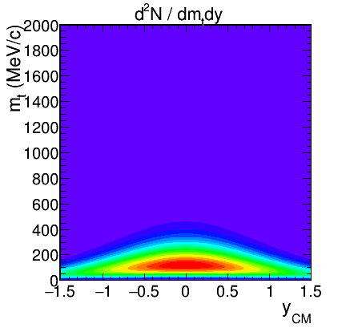
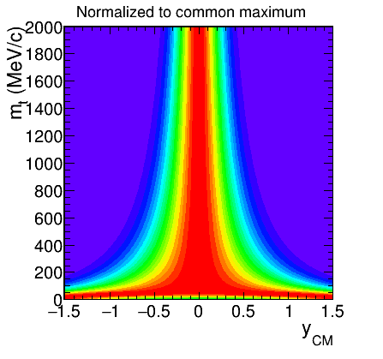
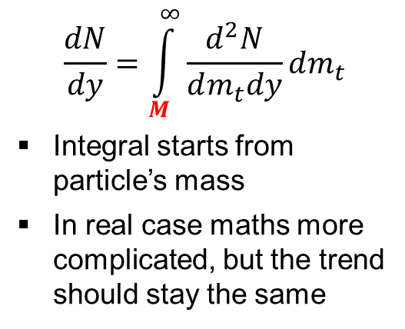
Rapidity width
Static, purely thermal source:
$$\frac{dN}{dy}=\int_{M}^{∞}{\frac{d^{2}N}{dm_{t}dy}dm_{t}}$$
Integral starts from particle’s mass
In real case maths more complicated, but the trend should stay the same

Slide 26
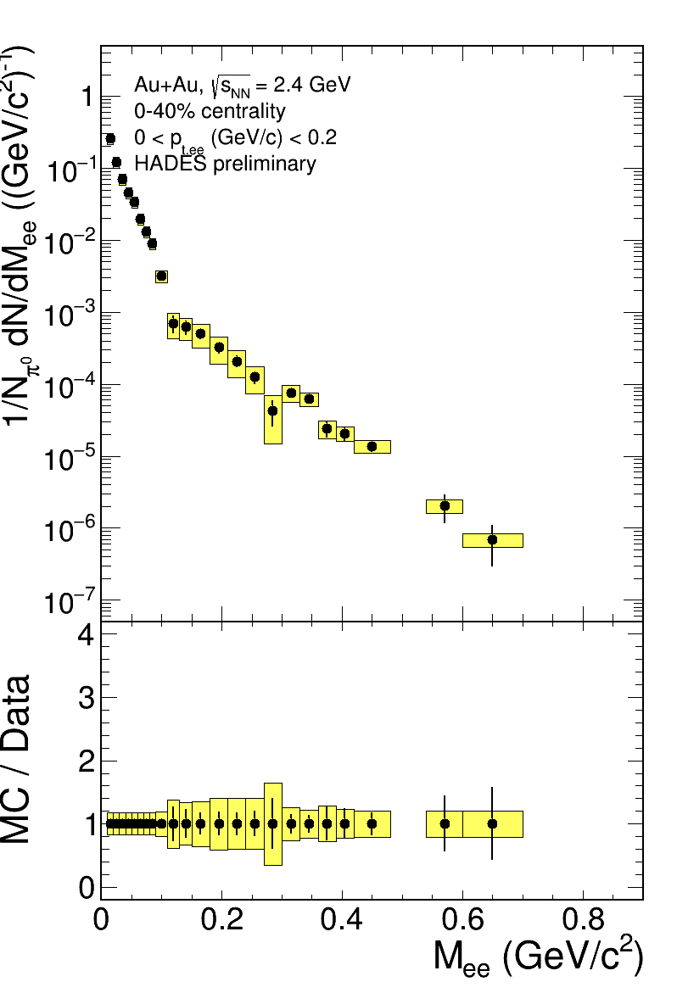
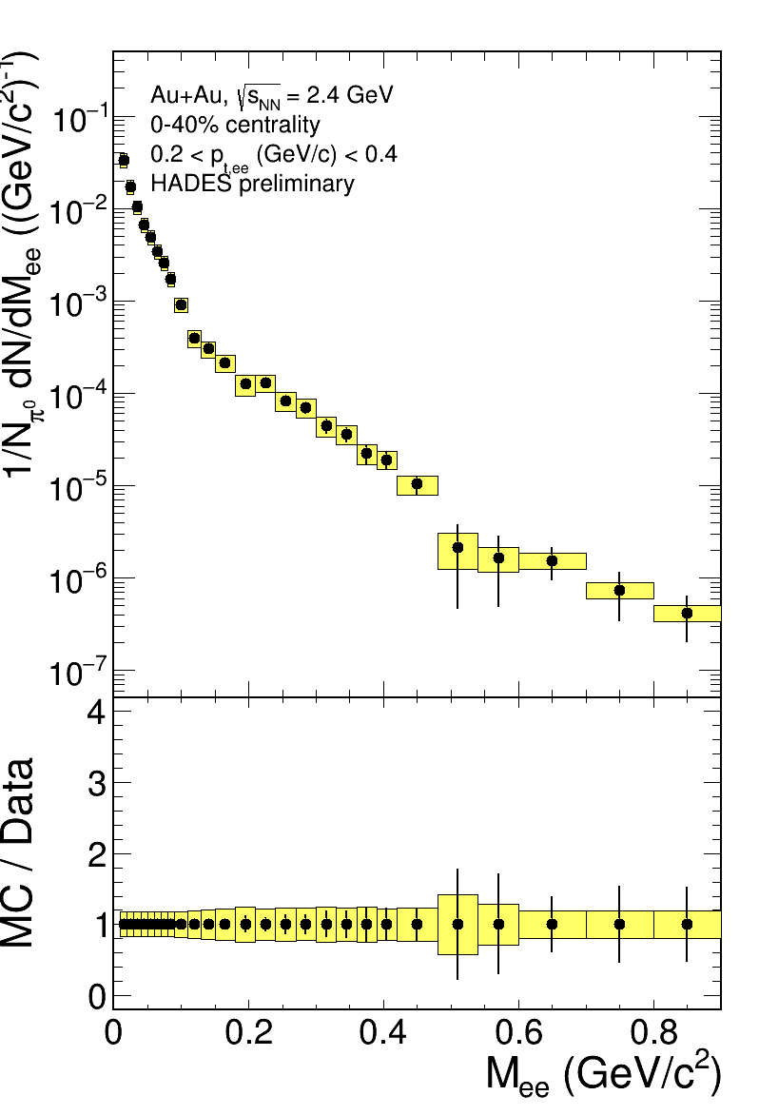
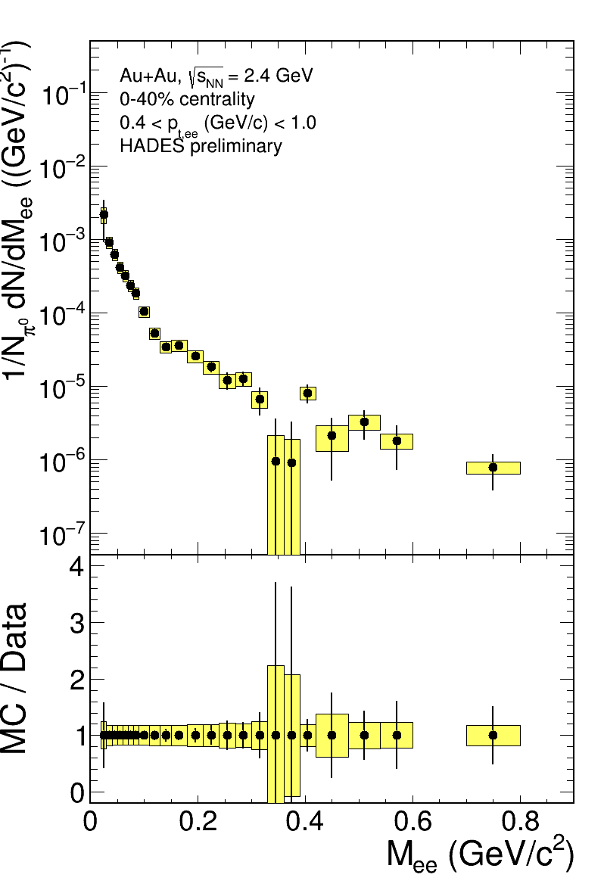
Invariant mass p_{t}-dependent
0 < p_{t,ee} (GeV/c) < 0.2
0.2 < p_{t,ee} (GeV/c) < 0.4
0.4 < p_{t,ee} (GeV/c) < 1.0
Invariant mass spectra – not affected
by the blue shift
Less steep at higher p_{t}
Similar observation
as for IMR dimuons
at SPS NA60
[S. Damjanowic, Trento 2010]

Slide 27
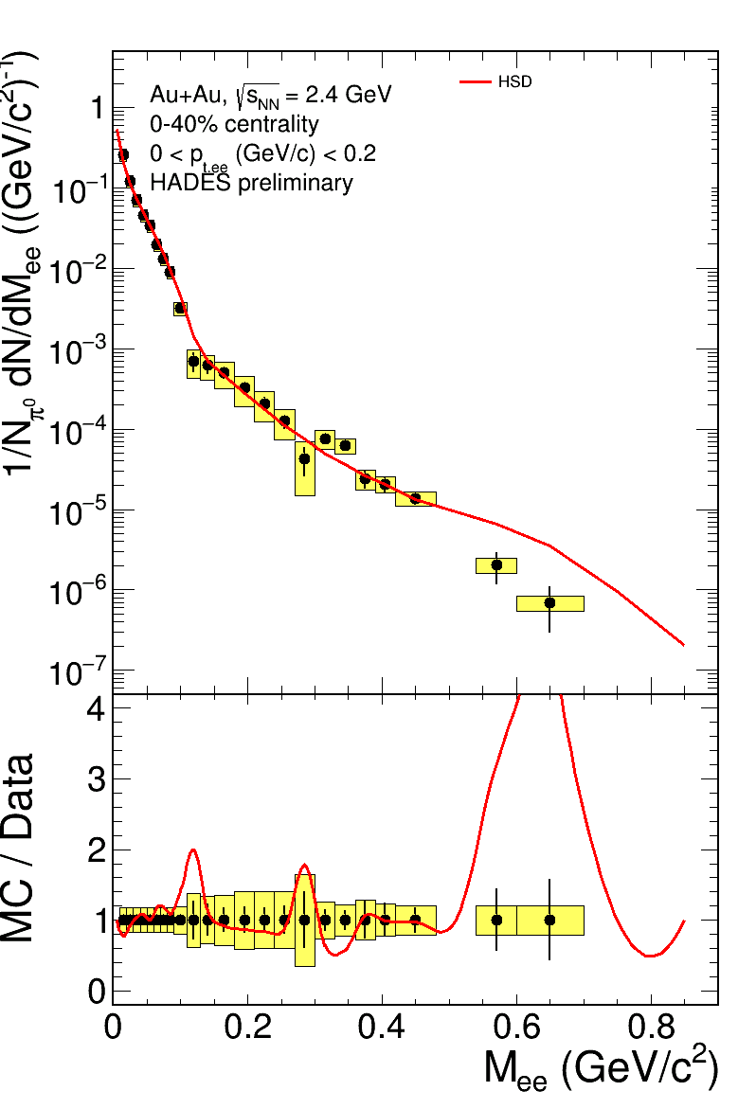
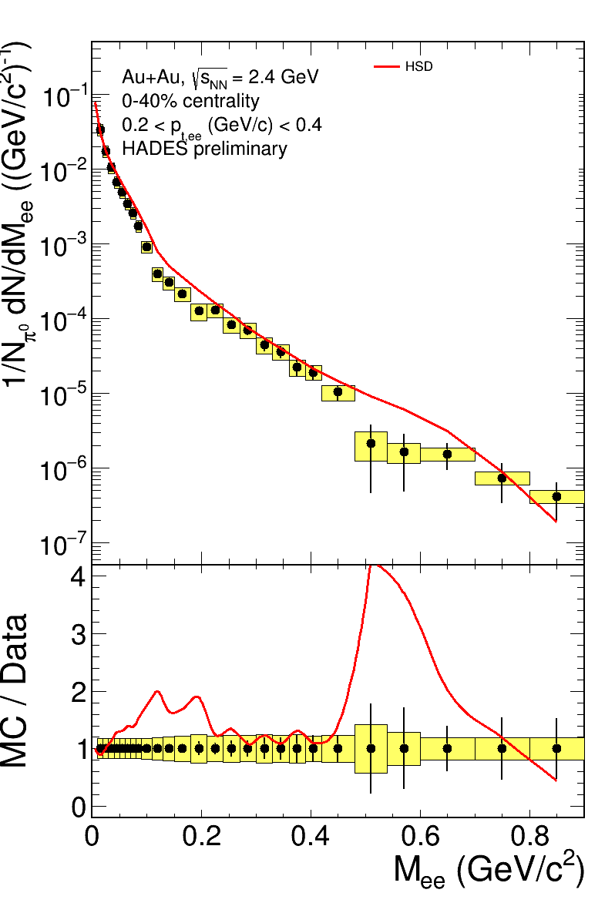
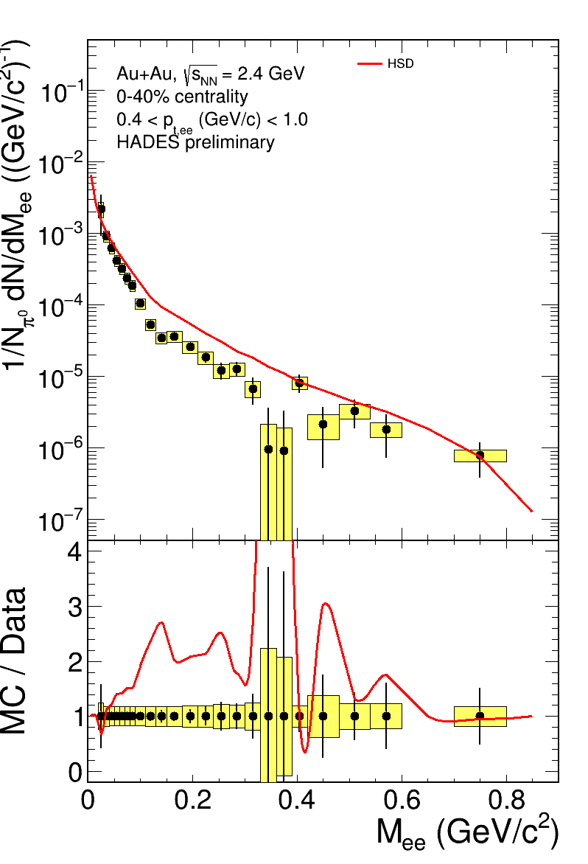
Invariant mass p_{t}-dependent
0 < p_{t,ee} (GeV/c) < 0.2
0.2 < p_{t,ee} (GeV/c) < 0.4
0.4 < p_{t,ee} (GeV/c) < 1.0

Slide 28
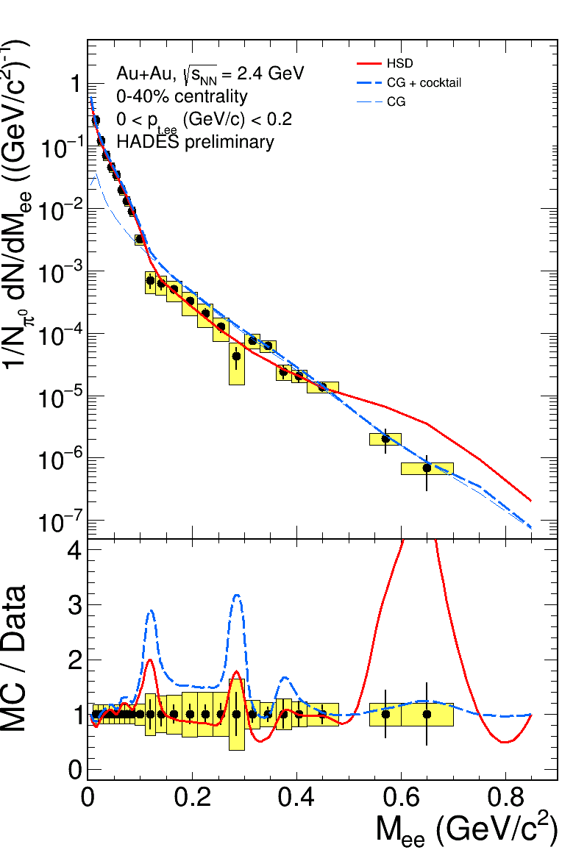
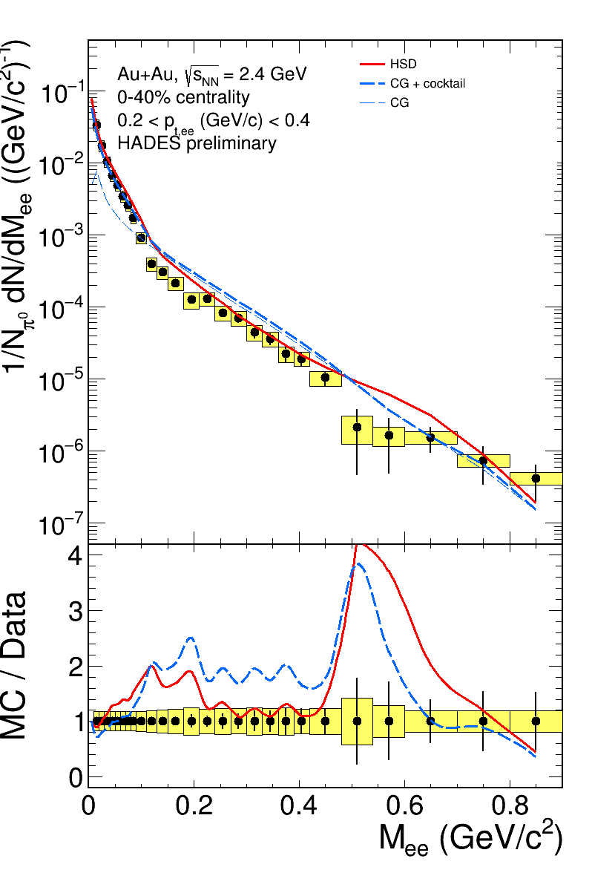

Invariant mass p_{t}-dependent
0 < p_{t,ee} (GeV/c) < 0.2
0.2 < p_{t,ee} (GeV/c) < 0.4
0.4 < p_{t,ee} (GeV/c) < 1.0
Cocktail:
π⁰ from charged pions multiplicity, cross-checked with the conversion method
η from the γ conversion
φ from the K⁺K⁻ channel
ω from the m_{t} scaling
Coarse-Graining (CG):
GSI-Texas A&M

Slide 29



Invariant mass p_{t}-dependent
0 < p_{t,ee} (GeV/c) < 0.2
0.2 < p_{t,ee} (GeV/c) < 0.4
0.4 < p_{t,ee} (GeV/c) < 1.0
Cocktail:
π⁰ from charged pions multiplicity, cross-checked with the conversion method
η from the γ conversion
φ from the K⁺K⁻ channel
ω from the m_{t} scaling
Pluto thermal ρ:
Breit-Wigner + Boltzmann
Weighted with 1/M³ factor (from VMD)
No 2m_{π} cutoff

Slide 30



Invariant mass p_{t}-dependent
0 < p_{t,ee} (GeV/c) < 0.2
0.2 < p_{t,ee} (GeV/c) < 0.4
0.4 < p_{t,ee} (GeV/c) < 1.0
Cocktail:
π⁰ from charged pions multiplicity, cross-checked with the conversion method
η from the γ conversion
φ from the K⁺K⁻ channel
ω from the m_{t} scaling
Coarse-Graining (CG):
GSI-Texas A&M
Pluto thermal ρ:
Breit-Wigner + Boltzmann
Weighted with 1/M³ factor (from VMD)
No 2m_{π} cutoff

Slide 31




Invariant mass p_{t}-dependent
0 < p_{t,ee} (GeV/c) < 0.2
0.2 < p_{t,ee} (GeV/c) < 0.4
0.4 < p_{t,ee} (GeV/c) < 1.0
$\frac{1}{2}$(pp + np) – dileptons from elementary collisions at the same energy as Au+Au
Respective η contribution subtracted
"Reference spectra"

Slide 32







Transverse momentum with fits
Total e+e− yield
$$\frac{1}{p_{t}}\frac{dN}{dp_{t}}∝m_{t}K_{1}\left(\frac{m_{t}c^{2}}{k_{B}T}\right)$$
$$k_{B}T_{slope}={k_{B}T}_{kin}+\frac{1}{2}M_{ee}c^{2}{\left\langle β\right\rangle }^{2}$$
Assumes pure Boltzmann nature of the source:
$$\frac{d^{3}N}{d\vec{p}}∝\exp\left(−\frac{E}{k_{B}T}\right)$$
Fit to the model points:
  CG: $T_{kin}=65 {MeV}/{k_{B}}, \left\langle β\right\rangle =0.19$
  HSD:$T_{kin}=74 {MeV}/{k_{B}}, \left\langle β\right\rangle =0.05$

Slide 33

Azimuthal anisotropy at intermediate energies
Recall, at SIS18 energies:
Long passing times
Moderate temperatures
Negative v₂: preferred emission of hadrons perpendicular to reaction plane
Shadowing by spectators

Slide 34









Elliptic (v₂) azimuthal anisotropy
Protons, deuterons, tritons

