Slide 1





Machine-Learning based Identification of highly collimated Electron pairs from boosted Z-Boson decays
CERN Project weeks - final presentation: 18.10.2019
Sophia Veneris, Rhabanus-maurus-gymnasium St. ottilien
Supervisor: Dr. Dominik Duda, Mpp München

Slide 2

introduction
Many bsm-theories (= beyond the standard model –theories) predict the existence of high-mass particles
which decay dominantely in strongly boosted W-, Z- and/or Higgs-bosons.
unknown particle with mass in TeV range
boosted boson
(e. g. Z-boson)
e+
e-
boosted boson/
(Higgs/W/Z)
quarks/ leptons
- standard ATLAS techniques only available for hadronic boson decays, but not for decays into electrons

Slide 3
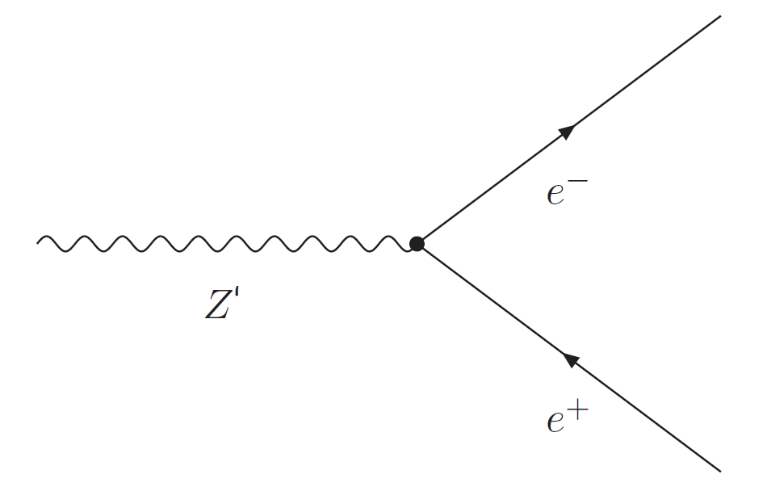
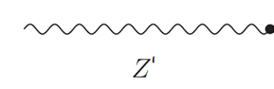




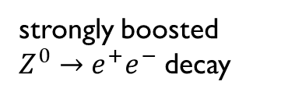

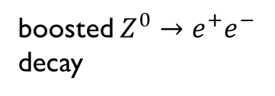
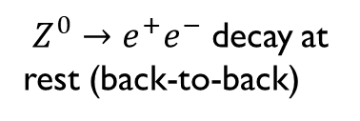
basics decay of high pt Z-bosons
energy and momentum conservation law: energy and momentum cannot be lost
pT = transverse momentum
why are high pT Z-bosons so interesting to us?
Key to searches for new physics
Unique signature in the detector
Highly collimated : parallel and very close to each other
$$e^{+}$$
$$e^{+}$$
$$e^{−}$$
$$Z^{0}$$
$$e^{−}$$
$Z^{0}→e^{+}e^{−}$ decay at rest (back-to-back)
strongly boosted $Z^{0}→e^{+}e^{−}$ decay
boosted $Z^{0}→e^{+}e^{−}$ decay

Slide 4
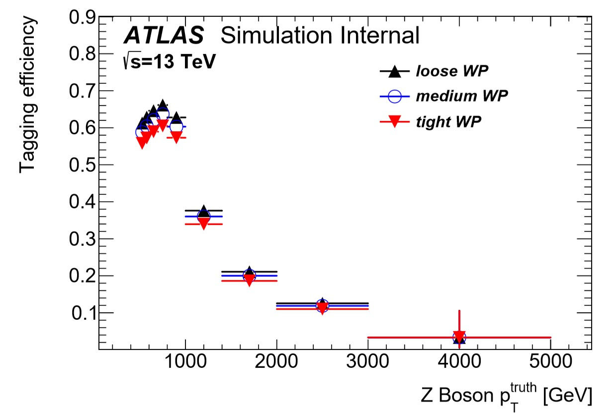
Basics highly collimated Electron pairs
Efficiency to find both electrons with standard ATLAS reconstruction/identification techniques is strongly degraded for Z-bosons with a pT beyond 1 TeV

Slide 5
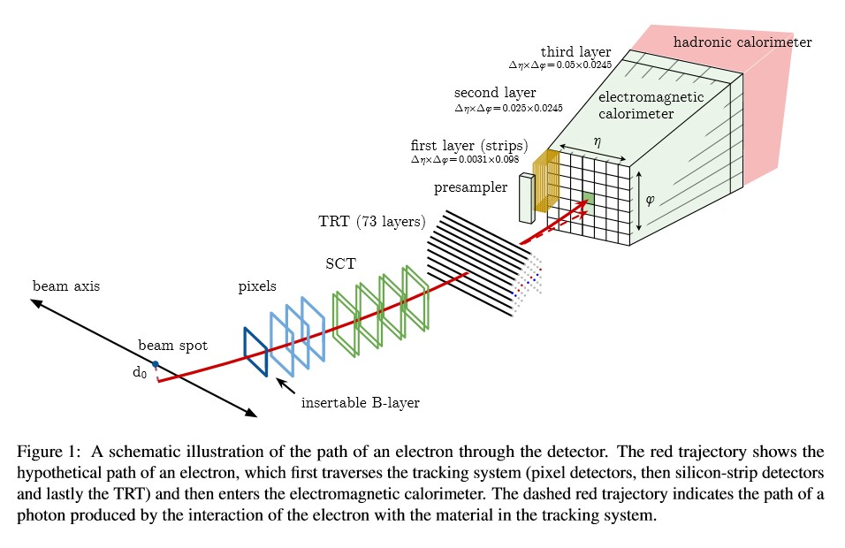
Basics the ATLAS-Experiment
multi-purpose particle detector
for our analysis relevant:
the tracking system
Pixel detector
Silicon-strip detectors
TRT = transition radiation tracker
the electromagnetic calorimeter

Slide 6
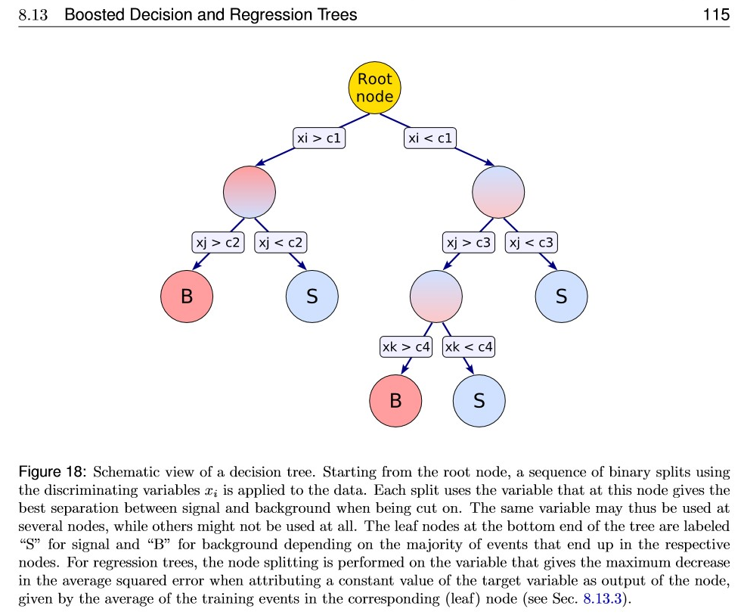
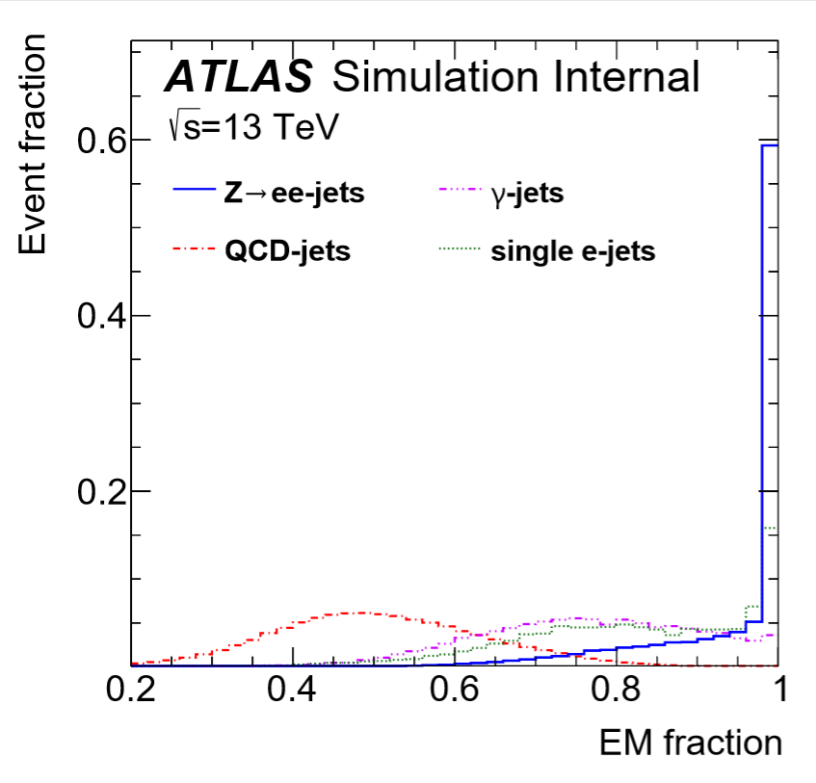
Basics machine-learning
BDT = Boosted Decision Tree
=>decision tree that weighs incorrect classifications in the next tree-modeling higher in order to improve the separation efficiency

Slide 7
Strategy Training with TMVA
TMVA (short for: Toolkit for Multivariate Data Analysis with ROOT)
Training with two simulated data samples (Monte Carlo Simulation):
Monte Carlo simulation: based on the „law of large numbers“
Same amount of each, signal or background, in training and test sample
(1.) the program trains with the training sample to find the best cuts for separating signal from background
(2.) the test sample is used to probe for possible overtraining
Input sample
Background
Training sample
Test sample
Signal
Training sample
Test sample
11 819 074
events
10 566 000
events
5 283 000
events
5 283 000
events
1 253 074
events
626537 events
626537 events

Slide 8
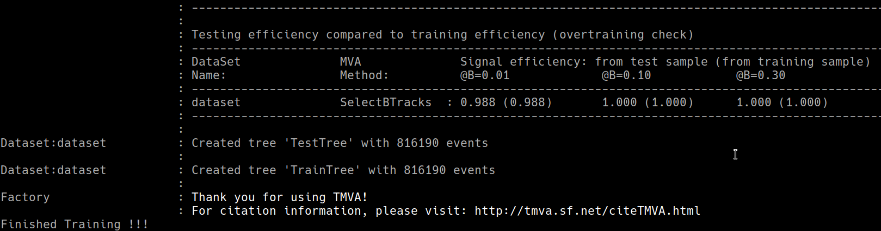
= ?
eff. test sample = (eff. training sample)
(nearly) no overtraining
eff. test sample ≠ (eff. training sample)
indicates statistical fluctuations
overtraining
more input needed

Slide 9
EM Fraction Fat Electrons
Electron jets:
how much of the jets total energy was located in the electromagnetic calorimeter?
very good discrimination betweeen signal and background possible
Fat Electron = dielectron candidate jet

Slide 10
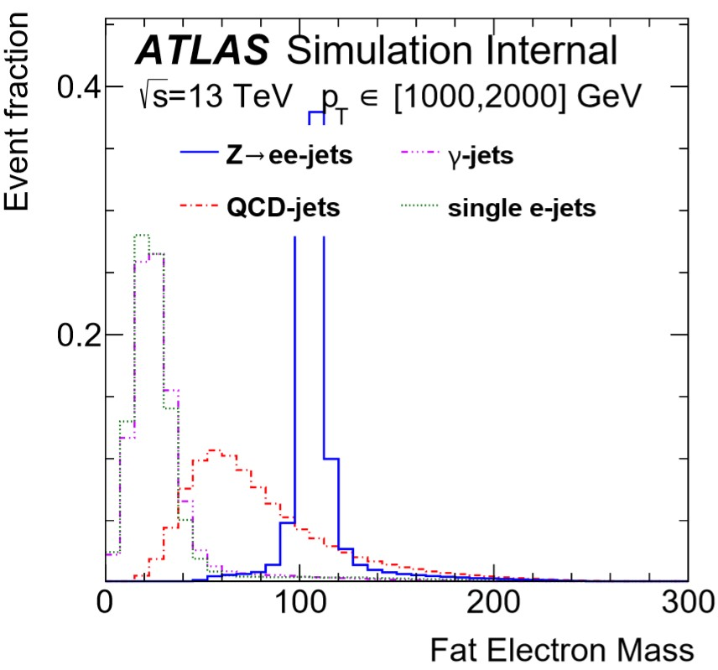
Fat Electron Mass:
as measured by the electromgnetic calorimeter system
Fat Electron = dielectron candidate jet

Slide 11
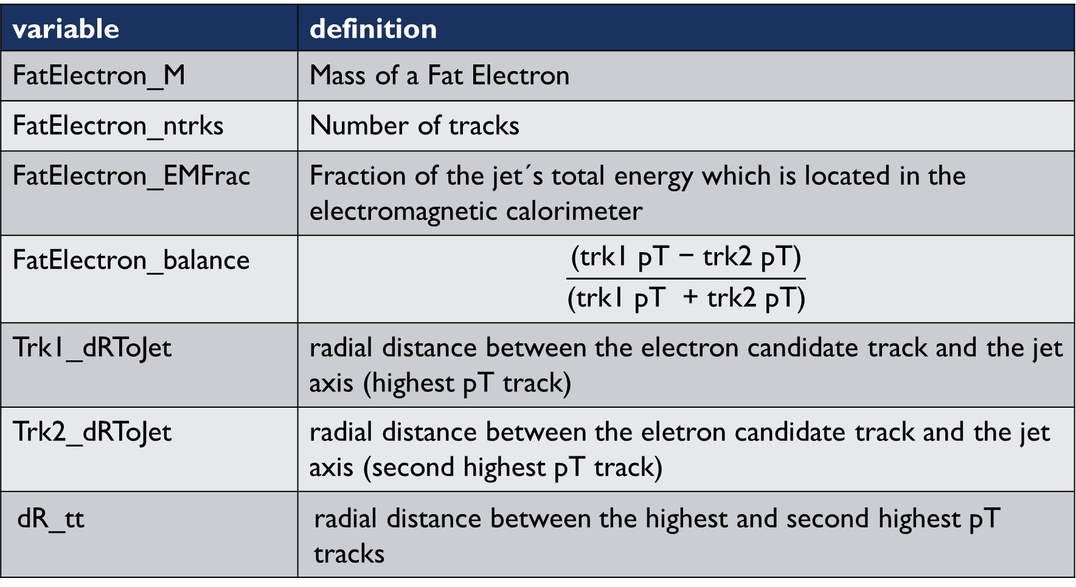
variable | definition
FatElectron_M | Mass of a Fat Electron
FatElectron_ntrks | Number of tracks
FatElectron_EMFrac | Fraction of the jet´s total energy which is located in the electromagnetic calorimeter
FatElectron_balance | $$\frac{\text{(}\text{trk}\text{1 }\text{p}\text{T}\text{ − }\text{trk}\text{2 }\text{p}\text{T}\text{)}}{\text{(}\text{trk}\text{1 }\text{p}\text{T}\text{ + }\text{trk}\text{2 }\text{p}\text{T}\text{)}}$$
Trk1_dRToJet | radial distance between the electron candidate track and the jet axis (highest pT track)
Trk2_dRToJet | radial distance between the eletron candidate track and the jet axis (second highest pT track)
dR_tt | radial distance between the highest and second highest pT tracks

Slide 12
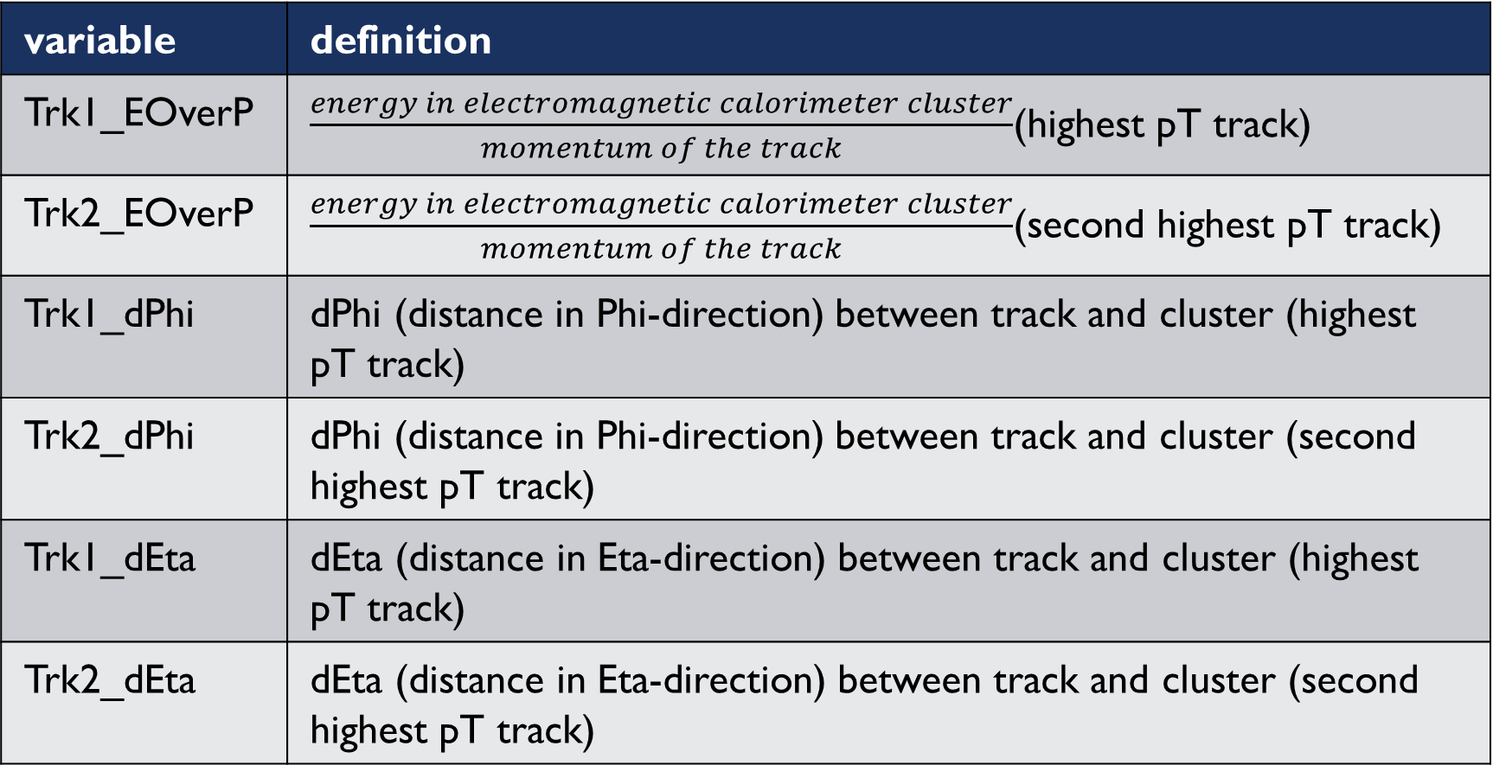
variable | definition
Trk1_EOverP | $\frac{energy in electromagnetic calorimeter cluster}{momentum of the track}$(highest pT track)
Trk2_EOverP | $\frac{energy in electromagnetic calorimeter cluster}{momentum of the track}$(second highest pT track)
Trk1_dPhi | dPhi (distance in Phi-direction) between track and cluster (highest pT track)
Trk2_dPhi | dPhi (distance in Phi-direction) between track and cluster (second highest pT track)
Trk1_dEta | dEta (distance in Eta-direction) between track and cluster (highest pT track)
Trk2_dEta | dEta (distance in Eta-direction) between track and cluster (second highest pT track)

Slide 13
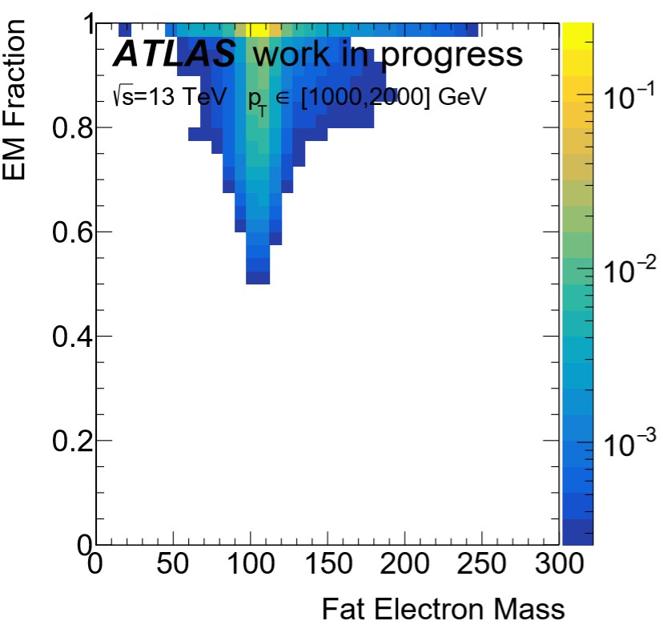
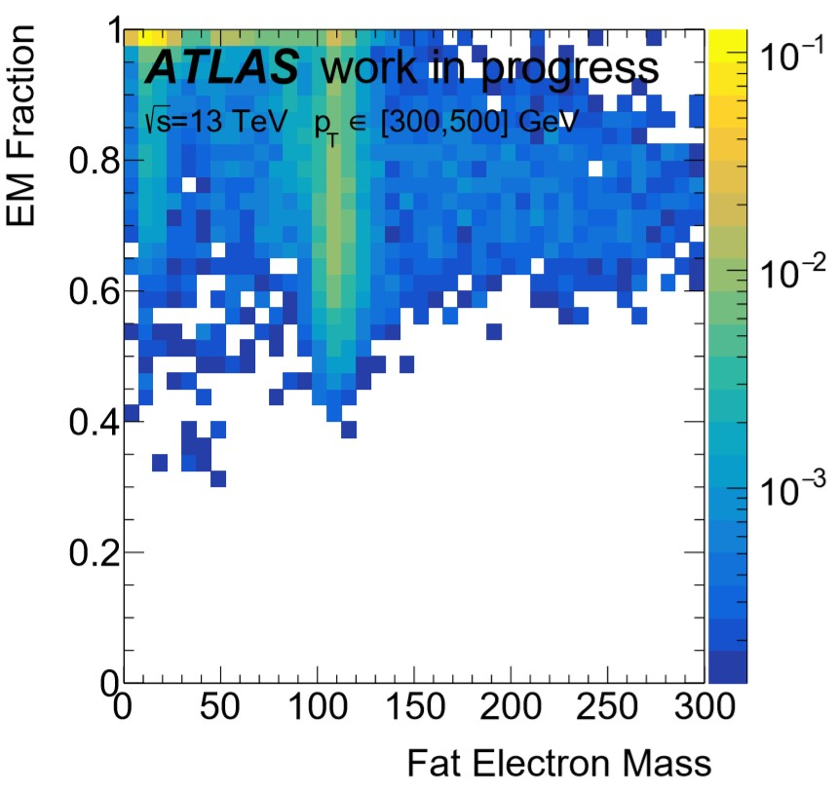
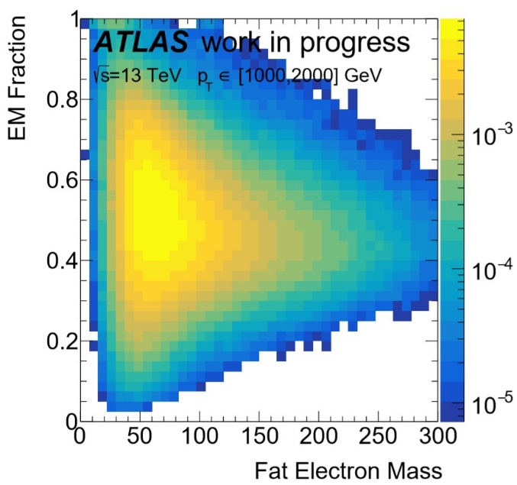
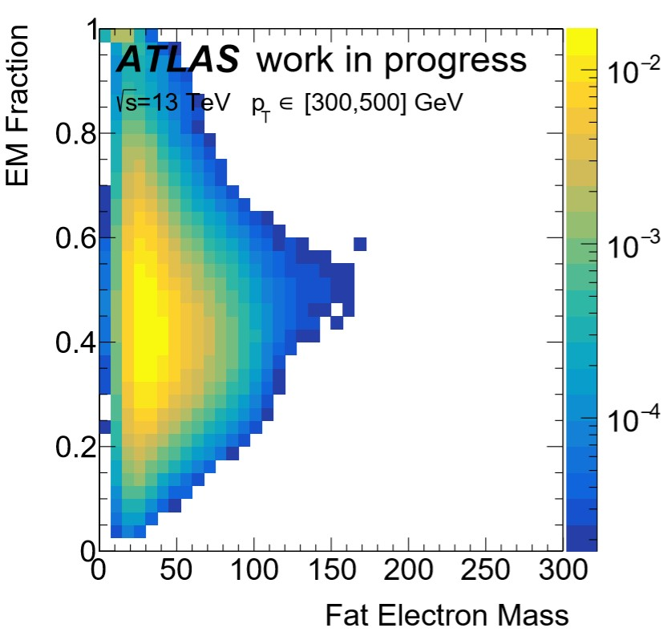
2DComparison FatElectron_M vs. FatElectron_EMFrac
QCDjets
QCDjets
Zee
Zee

Slide 14
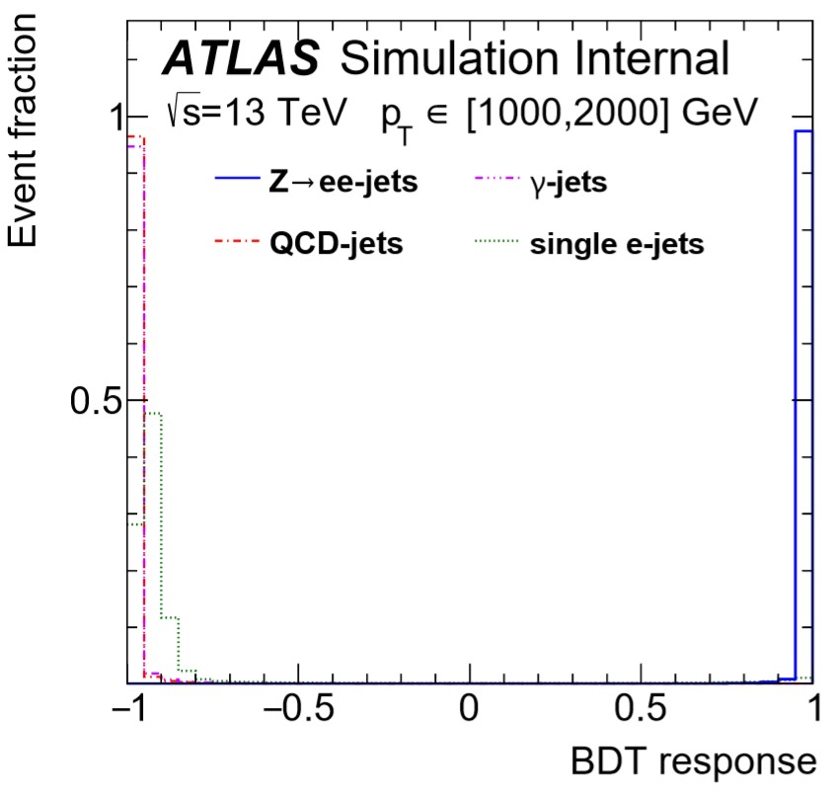
BDT response
Working points:
Loose: 99% efficient
Medium: 95% efficient
Tight: 90% efficient

Slide 15
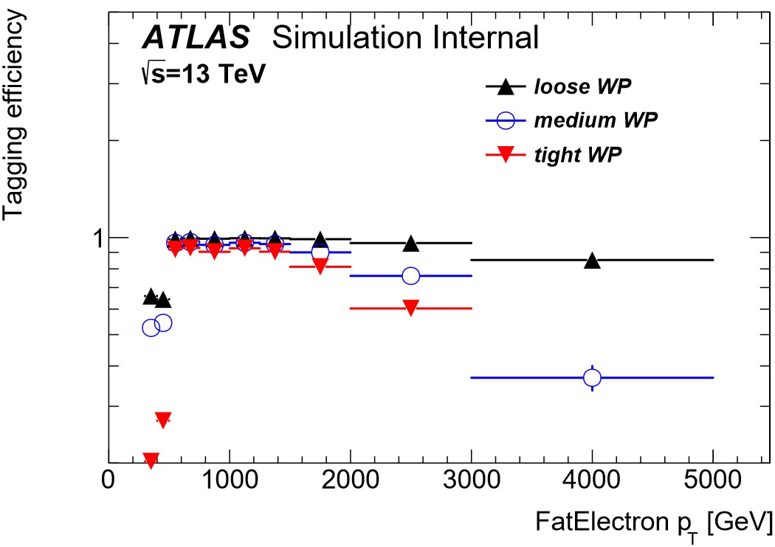
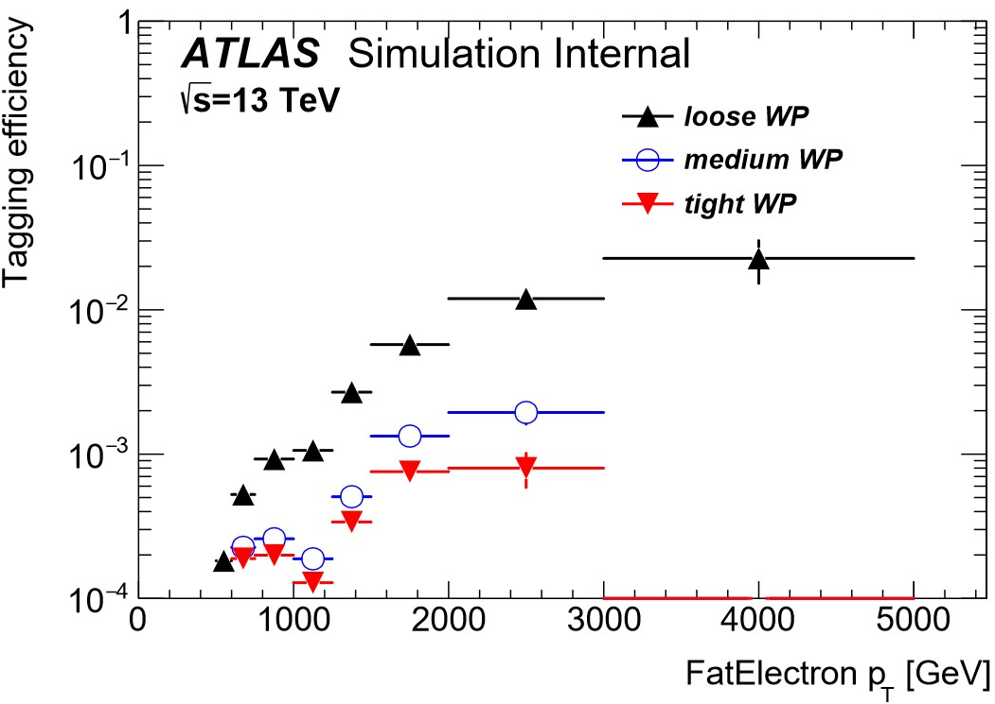
Results
Zee QCDjets
Efficiency = $\frac{number of objects with required properties}{number of total objects}$

Slide 16
3. Conclusion and outlook
Studied several quantities for their ability to separate signal from background
the results improve the identification of Z -> ee substantially
Outstanding tasks:
Test, if decorrelation with mass is needed
pT- and Eta- dependence must be taken into account during the training
=> Aiming to establish this technique eventually as a common tool in ATLAS

Slide 17
Thank You!
to
my supervisor: Dr. Dominik Duda (Max-Planck-Institut für Physik, München)
the organizer: Sebastian Fabianski (Netzwerk Teilchenwelt)
Prof. Dr. Siegfried Bethke (Max-Planck-Institut für Physik, München)
Prof. Dr. Andrzej Buras (TU München)
Dr. Sandra Kortner (Max-Planck-Institut für Physik, München)
Barbara Wankerl (Netzwerk Teilchenwelt / Max-Planck-Institut für Physik, München)
Dr. Pater Timotheus Bosch OSB (Rhabanus-Maurus-Gymnasium St. Ottilien)
Markus Schnell (Rhabanus-Maurus-Gymnasium St. Ottilien)
my school´s headmasters (Michael Häußinger, Werner Hörmann : Rhabanus-Maurus-Gymnasium St. Ottilien)
… and to all other scientists, teachers, classmates and friends who supported me in and during this project!

Slide 18
4. references
Graphics:
https://home.cern/sites/home.web.cern.ch/files/logo/cern-logo.png
http://atlasexperiment.org/photos/logos-2015-png.html
https://www.mpp.mpg.de/fileadmin/config/themes/mpp/images/mpp-mpg-logo.png
http://www.physik.uni-regensburg.de/service/schulen/nwt_logo.jpg
https://atlas.physicsmasterclasses.org/zpath_files/img/highslide/feynman/Zprime_ElectronPositron.png
Content:
http://tmva.sourceforge.net/
https://arxiv.org/pdf/1902.04655.pdf
https://root.cern.ch/download/doc/tmva/TMVAUsersGuide.pdf

Slide 19

Backup slides

Slide 20
histograms
plot making with python
1-component histograms:
A variable along the x-axis
the probability distribution is displayed on the y-axis
2-component histograms:
A variable along the x-axis
Another variable along the y-axis
The probability distribution is shown by different colours (colour range)

Slide 21
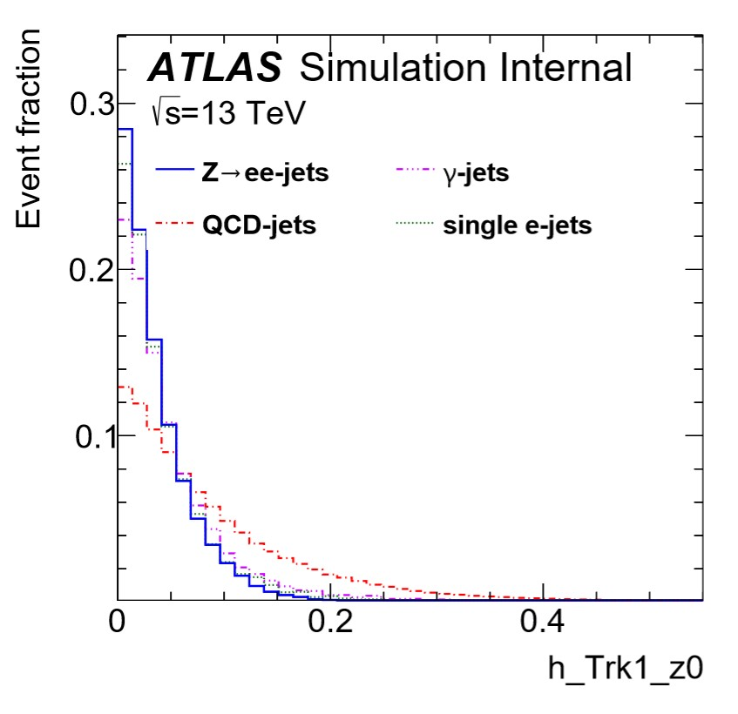
h_Trk1_z0:

Slide 22
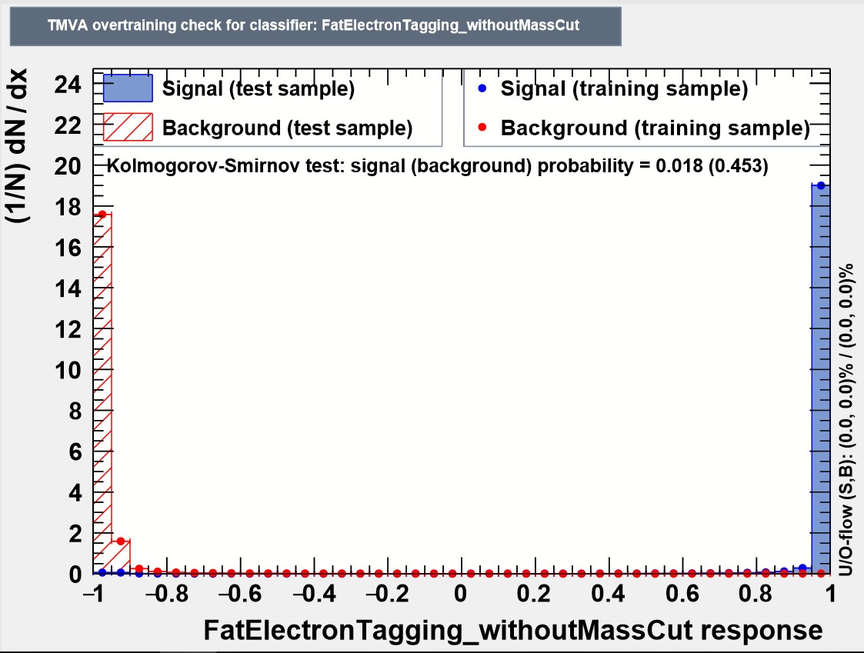
Overtraining Check

Slide 23
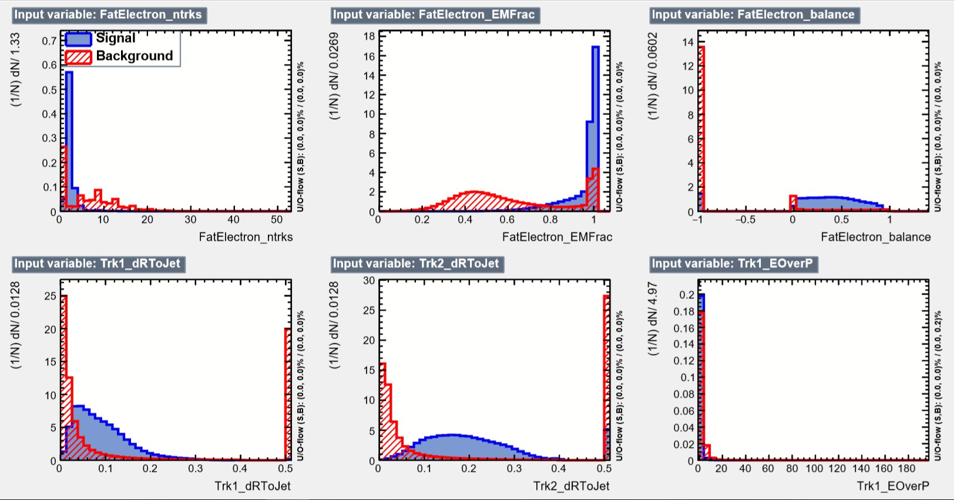

Slide 24
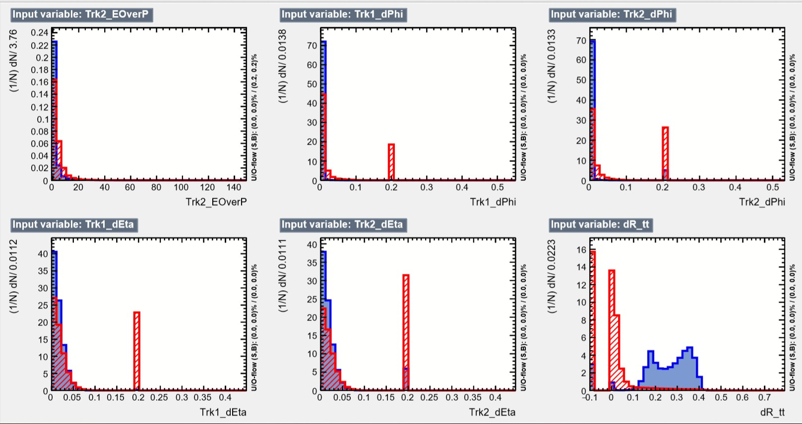

Slide 25
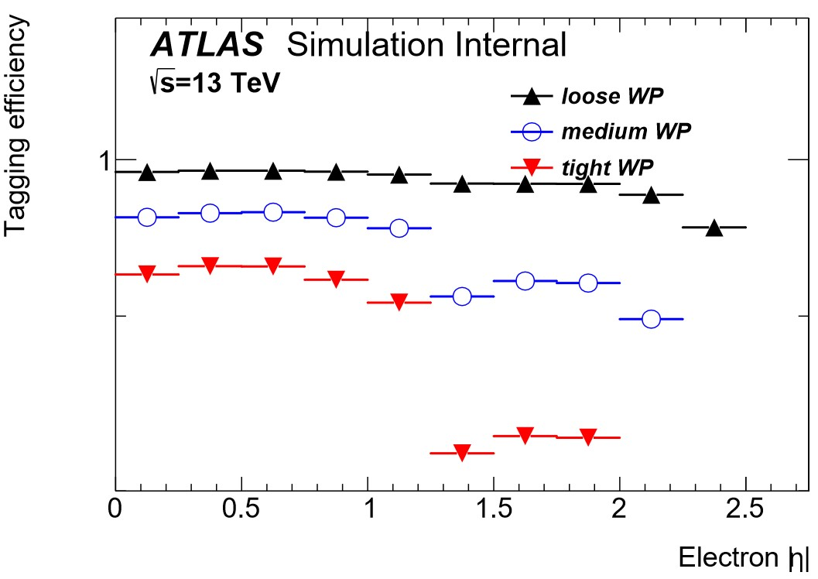
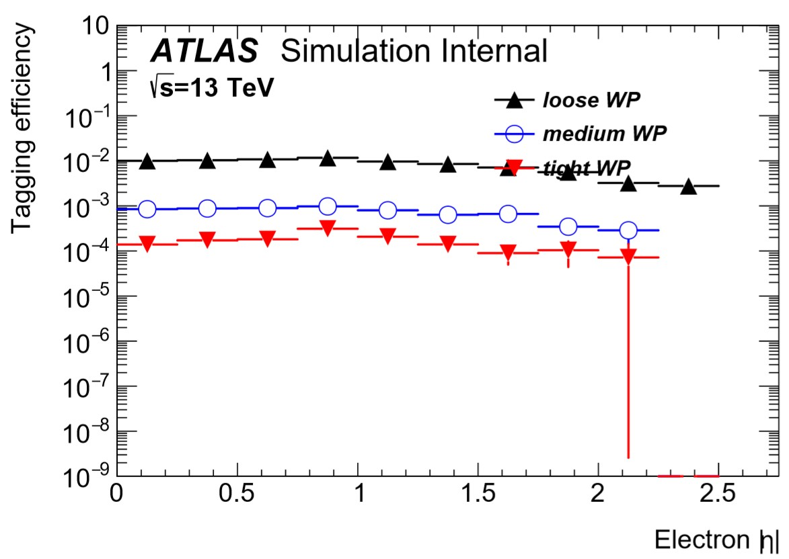
T-efficiency plots: Eta
Zee single ejets

